Slide 1
Journey to ONE UNC Health
Strategically and Structurally Aligning Around the Patient
Notes:
UNC Health Care has developed a transformation strategy to ensure our success well into the future. Like many health systems across the country, we’re facing an urgency to change and make a significant shift due to the rise of consumerism, digital technologies, price transparency, and competition from high-tech companies such as Amazon, Google and Microsoft. The market is changing, and we need to change along with it to ensure we can continue to provide the best care and services into the future.
Our new direction will strategically and structurally keep the patient at the center of everything we do, and create a more responsive, integrated system that will allow us to grow and be THE health system of choice.
In order to execute the strategy, we are developing a new operating model, leadership and governance structures. The goal is to move away from siloed structure that’s creating friction toward a more responsive, patient-focused integrated system.

Slide 2

The ‘Why’
Transform
Notes:
Due to the rise of consumerism, digital technologies and the need to make care more affordable, we have a new set of competitors, such as tech giants Amazon and Google, and big retailers such as CVS and Walgreens. These companies are now in the healthcare space.
Today’s customers have higher-than-ever expectations related to technology, convenience, quality and value, and their options are many. We need to go where they are, offer what they want, and deliver what they need.

Slide 3
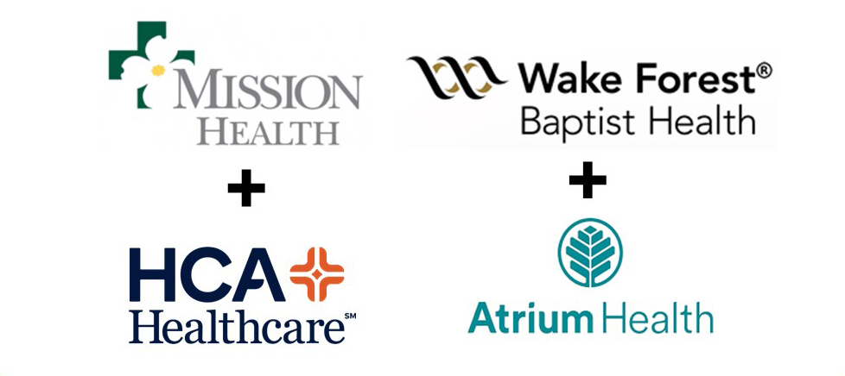



The ‘Why’
Notes:
In addition, more competition is occurring locally, with health system mergers and acquisitions from outside of NC, physician practices aligning with systems and insurance companies forming more narrow (healthy-based) networks.
Finally, payors want to change how they pay and how much, moving from fee-for-service to value-based contracts.

Slide 4












Strategic Vision
We have aligned around strategic aspirations that inform a set of choices
We will reinvent what it means to be North Carolina’s Health System and improve the health and well-being of our patients
As a System, we will:
Organize regionally
Organize regionally
Act as
a system
Integrate
clinically
Compete on value & experience
Advance our academic missions
Integrate
clinically
Act as
a system
Integrate
clinically
Compete on value & experience
Advance our academic missions
Integrate
clinically
Pursue Dual Transformation
Pursue Dual Transformation
Outperform in the central region
Develop
regional models
Enhance culture
& talent
Invest in
new businesses
Outperform in the central region
Develop
regional models
Enhance culture
& talent
Invest in
new businesses
Enable cultural transformation
Enable cultural transformation
4
4
Notes:
The new strategy maps out what we need to do to today and in the future.
Advance Our Academic Mission: We are an academic health system. It’s the heart of what we do. Through the SOM strategic plan, we are increasing strategic research investments, and we hope that better system integration will lead to clinical research opportunities across the state.
Outperform in the Triangle: For this strategy to be successful, we have to ‘win’ in the Triangle.
Culture and Talent: We are committed to recruiting and retaining the very best talent, and equipping them with the skills to thrive and lead.
Four Tenants:
These are the key tenants for achieving our strategic vision
Defining Dual Transformation: Enhancing what we already do well, while also creating new business and growth opportunities.

Slide 5
Our Journey to ONE UNC Health
Unified Strategy
Unified Operating Model
Unified Culture
Notes:
Everything is coming together as a complete effort: strategy; governance; leadership; how we operate and a cohesive culture
The new strategy maps out what we need to do to today and in the future.
The operating model is a blueprint of how we will operate to meet our strategic goals.
The leadership and committee structures for how we’re organized to lead and make decisions will be modernized, too, to make us more nimble and focus our decision-making.
UNC Health Care will focus on culture as well. We will capitalize on elements of our existing culture that are strong and sustainable, and develop new elements that will provide us with the foundation of how we will do our work.

Slide 6
Leadership Structure
Dr. Wesley Burks
CEO of UNCHCS /
Dean of UNC School of Medicine
Dr. Cristy Page
Executive Dean, School
of Medicine
Amy Higgins
Chief Transformation & Experience Officer (CTEO)
John Lewis
Chief Business Integration Officer (CBIO)
Andy Willis
Chief External Affairs Officer (CEAO)
Gary Park
Chief Operating Officer
(COO)
Dr. Matt Ewend
Chief Clinical Officer
(CCO)
Dr. Cristy Page
Dr. Matt Ewend
Gary Park
John Lewis
Amy Higgins
Andy Willis
Jeri Williams
Chief Audit & Compliance Officer (CACO)
Glenn George
Chief Legal Officer
(CLO)
Katie Eimers
Chief System Initiatives Officer (CSIO)
Scott Doak
Chief Human Resources Officer (CHRO)
Jeri Williams
Glenn George
Scott Doak
Katie Eimers
Notes:
The Leadership Structure has been redesigned to align with the UNC Health Care strategy and operating model.
Leadership structure was designed for the future, to help us meet all of the aspirations we just described
Also focused on one person, one role!
Important alignment of the model with an evolution of support services, academic enterprise and physicians.

Slide 7
Governance
DECISION-MAKING
RECOM-MENDING
INFORM-ING
KEY
 | BOARD OF DIRECTORS
 | Executive Council (EC)
Decision- making body | Academic Council (AC) Cristy Page Small team of SOM leaders who set strategy, allocate capital/resources, and oversee the SOM operations |  |  |  |  |  | Care Delivery Council (CDC) Wesley Burks Small team of HCS leaders who set strategy, allocate capital/resources, and oversee the operations of care delivery |  |  |  |  | System Leadership Team (SLT) Wesley Burks Inform only; 40-50 leaders (L2 and select L3 and L4s
Recom-mending Body | Department Chairs Leadership Committees Oversees Clinical & Basic science departments to support the tripartite mission | Education Leadership Committee Oversees education efforts across UME,GME, pipeline programs, IPE, Allied Health, and CME | Research Leadership Committee Oversees research efforts across the SOM and HCS spectrum, including basic science, translational, and clinical research | Diversity and FALD Leadership Committee Oversees strategic operational efforts for diversity, equity, and inclusion, faculty affairs and leadership development | Dean’s Advisory Committee Facilitates the alignment of Clinical, Basic Science, Centers, and health system goals, advising the Dean on SOM administrative matters | Faculty Physicians Executive Committee Oversees Faculty Physicians clinical and financial operations to support the tripartite mission | System Physician Executive Committee (SPEC) FP, PN, REX, Population Value Care leaders oversee clinical care delivery and physicians | Triangle Operating Committee (TOC) Oversees care delivery operations | State Operating Committee (SOC) Oversees care delivery operations | Quality Improve-ment Oversight Committee (QIOC) Oversees quality improvement efforts | Business Develop-ment Committee (BDC) Facilitates strategic business development (e.g., M&A, partnerships, New Transform.)
Academic Mission
Care Delivery Mission
Notes:
Realignment of committees and decision-making is something that has come through loud and clear during focus groups and many meetings. The purpose of focusing on governance committee structure is to assist in making decisive, efficient and effective decisions. This is critical for deploying our new strategy and becoming a more nimble organization.
One key change will be moving away from our current Senior Executive Team (SET) structure: SET’s portfolio of governance was too vast, and our academic and care delivery missions require more focused meetings. SET is being split into two bodies – the Care Delivery Council (CDC) and the Academic Council (AC). This will allow more focused governance bodies on the health care delivery and academic missions, respectively. Dr. Burks will be the chair of the CDC and Dr. Page will be the chair of the AC. Both the CDC and AC will sit atop ‘recommending bodies’ to support clear funneling/cascading of decisions.
Much of today’s discussion centers on the Health Care System, the left side of this chart makes clear that the same level of thought has been paid to academics.
SPEC: These governance changes will empower physicians. SPEC, the Triangle Operating Committee, and State Operating Committee, work alongside Quality Improvement, reporting up to Dr. Burks and the CDC. Positioning physicians next to operations and quality improvement is a good thing!

Slide 8
Operating Model
OUR REGIONAL OPERATING MODELS WILL:
Establish a Regional Leader who is accountable for clinical operations
Organize hospitals into sub-regions to strengthen ties in local markets
Better integrate support services in support of transformation
Organize outpatient sites across the region into one Ambulatory unit
Notes:
Each market will be led by an executive (Steve Burriss – Triangle / Chris Ellington – Statewide) who will report to Gary Park, COO.
Ernie Bovio will lead Triangle East (including UNC REX) and Janet Hadar will lead Triangle West (including UNC Medical Center) and report to Steve.
Ian Buchanan will oversee ambulatory services and Cathy Madigan will be Chief Nursing Officer for the system.

Slide 9
Clinical Operating Model
Chief Executive Officer
UNC Health Care
Wesley Burks
Chief Operating Officer
UNC Health Care
Gary Park
Triangle
Steve Burriss
Statewide
Chris Ellington
Triangle West
Janet Hadar
Triangle East
Ernie Bovio
Ambulatory
& Post- Acute
Ian Buchanan
Chief Nursing Officer
Cathy Madigan
Statewide Hospital Presidents (x7)
System Affiliations & Integration
Notes:
Each market will be led by an executive (Steve Burriss – Triangle / Chris Ellington – Statewide) who will report to Gary Park, COO.
Ernie Bovio will lead Triangle East (including UNC REX) and Janet Hadar will lead Triangle West (including UNC Medical Center) and report to Steve.
Ian Buchanan will oversee ambulatory services and Cathy Madigan will be Chief Nursing Officer for the system.

Slide 10

ORGANIZE REGIONALLY starting with the Triangle Region
Triangle Region
Steve Burriss
Janet Hadar
President, UNC Hospitals
Ernie Bovio
President, UNC REX
UNC REX
Johnston Health - Smithfield & Clayton
UNC Holly Springs
Ian Buchanan
President, Ambulatory and Post-Acute Care
Post-Acute Care Services
Ambulatory Centers
UNC Hospitals
Chatham Hospital
Hillsborough
Wakebrook
Notes:
In the Triangle Region, Janet will serve as President of UNC Medical Center, also overseeing Chatham Hospital and Wakebrook.
Ernie Bovio will serve as President of UNC REX, also overseeing Johnston Health Smithfield and Clayton, as well as the UNC Holly Spring facility when that is complete.

Slide 11
UNC Physicians
UNC Physicians
UNC Faculty Physicians
UNC REX Physicians
UNC Physicians Network
UNC Health Alliance
SYSTEM PHYSICIAN EXECUTIVE COMMITTEE
Executive committee ensuring alignment across physician entities and one physician voice to the system
Notes:
System Physician Executive Committee:
UNC Physicians’ Executive Committee
Oversee individual physician entities
Participate in forming specialty programs
Dr. Matt Ewend, Chief Clinical Officer, will oversee UNC Physicians and lead the System Physician Executive Committee
Large physician entities will be more closely integrated:
Faculty Physicians
Rex Physicians
UNC Physicians Network
Caldwell and Pardee Physicians

Slide 12


Next steps
Communications Timeline:
  Week of Sept. 23: Rollout to Leaders across UNC Health Care and School of Medicine
  Monday, Sept. 30: Message from Dr. Burks to managers and above
  Tuesday, Oct. 1: Message from Dr. Burks to all co-workers
  Mid-October (Dates/Times TBD): Town Halls and Co-Worker Forums
  October 30 – ONE UNC Health Leadership Conference
Questions:
  Please submit any questions you have to ONEUNCHealth@unchealth.unc.edu.
12
Notes:
We will communicate any changes as a result of this transformation with timeliness and respect. In the meantime, we’re asking you to stay focused on providing the excellent service that our customers expect and deserve.
If you or your team have questions, they can be submitted to ONEUNCHealth@unchealth.unc.edu and responses will be provided as quickly as possible.

Slide 13

We Need Your Support
Notes:
I know this is a lot to take in. The focus of today has been on the clinical organization and leadership. More information will be shared in the coming weeks related to our physician, academic, and administrative leadership structures.
As leaders, you determine the success of our strategy, structure and culture, which means your collective engagement and support will be critical to having colleagues embrace this transformation. Our team members will look to you for guidance, reassurance and inspiration.
Change is never easy. But it is exciting and will be achievable, as long as we pull together. We need you ‘All-In’
We will communicate any changes as a result of this transformation with timeliness and respect. In the meantime, we’re asking you to stay focused on providing the excellent service that our customers expect and deserve.
If you or your team have questions, they can be submitted to ONEUNCHealth@unchealth.unc.edu and responses will be provided as quickly as possible.

