Slide 1
Total wellbeing
2021
Jessica Pyjas, MPH, CCWS
Work/Life & Wellness
Program Manager

Slide 2
Today’s Objectives:
Recognize how GuidanceResource® can assist you
Understand Work/Life & Wellness resources available to you
Begin saving with Perks & Discounts
Learn about available tuition and educational resources

Slide 3
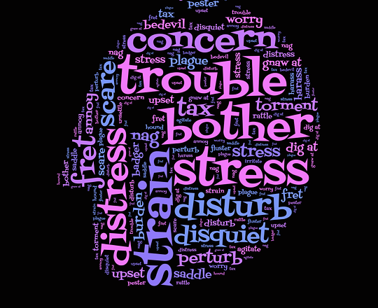
How have you been feeling Lately?

Slide 4
GuidanceResources® for Employees

Slide 5


GuidanceResources®
Free, confidential services for the following:
Counseling
Legal Guidance
Financial Guidance
Help with Work-Life Balance
Online Resources
24 hours a day, 7 days a week:
877-314-5841
guidanceresources.com
Web ID: TARHEELS
Notes:
Counseling for parenting, relationships, work stress and more!

Slide 6

Confidentiality
The program is strictly confidential
Records are maintained by ComPsych®
Summary reports do NOT identify individuals

Slide 7

Confidential Counseling
Short-term Counseling (3)
Address issues early
No cost
Voluntary
Long-term Counseling
Continuing treatment for long-standing issues
Refer to insurance or community resources
Notes:
Available to anyone in your home.
70/30 plan MH copay: $45
80/20 plan MH copay: $25

Slide 8

Legal Guidance
Expert legal information from licensed ComPsych staff attorneys
  Unlimited access:
Family Law
Wills
Bankruptcy
Estate Planning
Real Estate
ID Theft
  Local, quality referrals:
30-minute in-person consultation
Discounted legal fees

Slide 9

Financial Guidance
Confidential and objective information from ComPsych® staff financial experts
  Unlimited access:
Budgeting
Income Tax
Credit
Real Estate
Debt
Retirement planning

Slide 10

Work-Life Balance
What would you do with an extra hour in your day?
Addressing work-life balance issues by providing practical information and referrals:
Child and elder care
Educational options
Community information
Event planning
Home improvement
Buying/selling a home or relocating
Assistance with locating and shopping for items

Slide 11
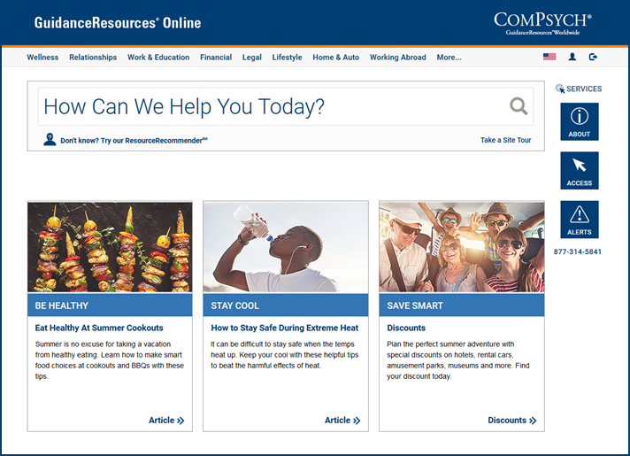
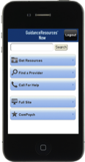

GuidanceResources® Now
Online resources available 24/7
Access from anywhere, anytime
Click to Chat with a GuidanceConsultantSM
HelpSheetsSM on thousands of topics vital to employees
Localized online resources
Training programs
Free Annual Credit Report
  www.GuidanceResources.com
  Company Web ID: TARHEELS
  Free Mobile App:
  GuidanceResources® Now

Slide 12

Available 24/7
Call anytime: 877-314-5841
TDD: 800-697-0353
Or Visit Online: www.GuidanceResources.com
Company Web ID: TARHEELS
Free Mobile App: GuidanceResources® Now
For you AND your family members
Notes:
GuidanceResources is your single source for confidential support, expert information and valuable resources, when you need it most.

Slide 13

Notes:
-Established in February 2018
-Replaces Work Well, Live Well
-Total WellBeing reflects a holistic approach to employee wellness

Slide 14

Wellness Resources During COVID-19
Supporting Yourself & Others:
911, GuidanceResources, Domestic Violence hotline
Adjusting to Life Change:
Pre-recorded webinars and quick reads working from home and more!
Finding Peace in Uncertainty:
Quick reads on self-care, mental health, and SOM supports
Eat Well to Be Well:
Nutrition tips, counseling, produce delivery, discounts off meal delivery, prevent diabetes program and more!
Staying Busy Indoors:
UNC Department of Music, musicals, comedy, & tunes
Keeping Kids Busy:
Tutors, tigers, Disney, cooking, coloring, videos, games, & activities

Slide 15


Wellness Resources During COVID-19
Making Time for Mindfulness:
30-Minute Mindfulness Meditation Self-Compassion Sessions
  Mondays at 12:15 p.m.
  Tuesdays & Thursdays at 4:00 p.m.
Contact Jennifer Tauber at Jennifer_Tauber@med.unc.edu for WebEx information
Staying Active Outside a Gym:
Gentle Yoga with Gilling Culture of Health
  Mondays & Wednesdays 12:00-12:30 p.m.
Campus Recreation Resources
  Free On-Demand Fitness Classes
    Core & Strength, Cardio & HIIT, Yoga, Barre & more!
  Group Fitness Semester Pass
    Unlimited group classes for only $30 a semester
    Contact: lbrookey@email.unc.edu to sign up!

Slide 16
Learn more
Visit:
go.unc.edu/wellness-during-covid-19

Slide 17


Wellness Wednesday Webinars
Emotional Intelligence
Feb. 24
Healthy Food Choices on the Go
March 3
Sleep: An Essential Component of Health & Well-Being
March 17
Letting Go of the Things that Hold You Back
April 7
10 Strategies for Improving Your Finances
April 14
Understanding Depression
May 5
Full Class List at: hr.unc.edu/benefits/work-life/
Enroll in Carolina Talent at: connectcarolina.unc.edu
Notes:
-1-5 WLW classes offered each month
-Webinars & Classes are 45-60 minutes
-Can participate in webinars from your smart phone using the GoToWebinar App!
Upcoming classes shown.
Most Popular Past Webinars & In-Person Classes:
Improving Your Memory
Laughter, Humor and Play to Reduce Stress
Balancing Work & Life
Eating Healthy on a Budget

Slide 18
Total WellBeing
Wellness Week 2021
SAVE THE DATE:
March 8-12
Wellness Webinars
Cooking Demos
Fitness Sessions
Mindfulness Sessions
On-Demand Sessions
Prizes!
Notes:
Promoted: Email (61%) -WorkWell Newsletter (25%) -Word of Mouth (13%)

Slide 19

Eat Smart, Move More, Weigh LEss Online
Program Features:
15 weekly live online sessions
Support by a Registered Dietitian Nutritionist (RDN)
Evidence Based
Positive Outcomes in just 15-weeks!
Average weight loss 7.5 lbs.
95% of participants became more mindful of what and how much they eat
90% of participants were more mindful of being physically active every day
71% of those who complete the program maintain or lose additional weight six-months after the end of the program
Sessions begin the week of March 15
esmmweighless.com
*FREE for BCBSNC members
Voucher code:
GNC2021
*Through June 30, 2021
Notes:
Free to BCBSNC members (State Health Plan) through June 30, 2021
Afternoon 12p.m. and evening classes 7, 8, & 8:30 p.m. classes

Slide 20
PerksConnect
Carolina’s Newest Perks Program
#UNCjobperks

Slide 21



New PerksConnect Discounts
200,000+ national deals Online cash back incentives
Up to 70% off Travel
Up to 50% off Event Tickets Up to 13% off Gift Cards

Slide 22

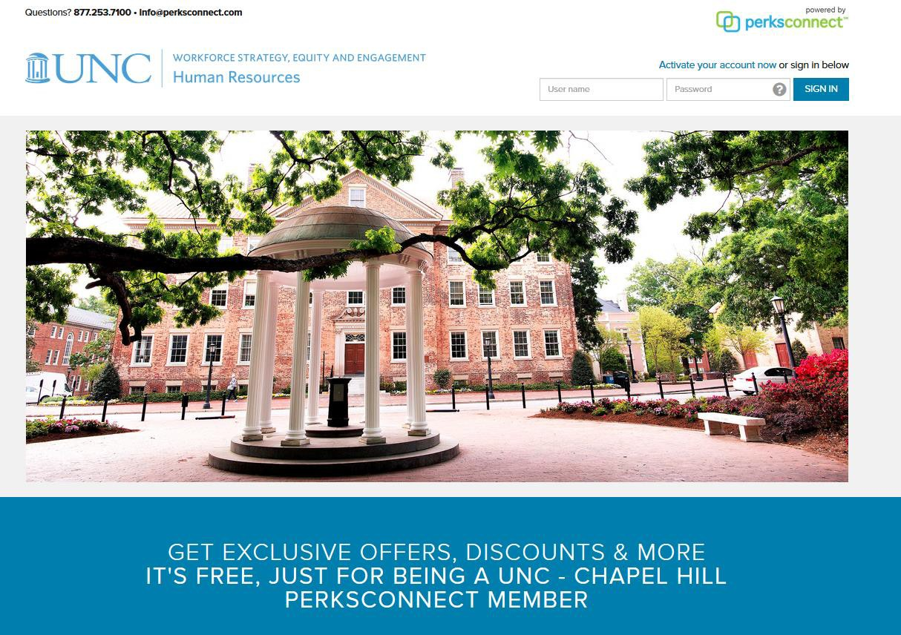
Perks Connect:
UNC.PerksConnection.com Group Code: Goheels

Slide 23
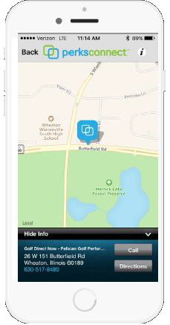
Stay Connected: PerksConnect Plus
One touch search using GPS
Filter results by category and distance
Save favorites
Map location & directions

Slide 24



$ Other Savings Programs $
www.workingadvantage.com
Company Code: 653475624
www.blue365deals.com
Shop.wesave.com

Slide 25

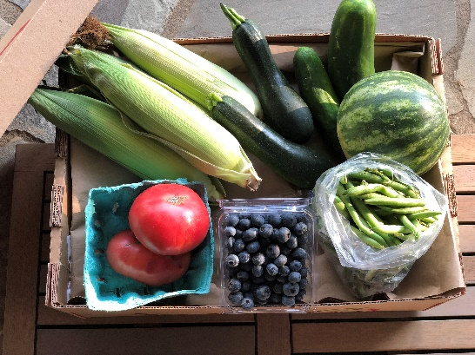
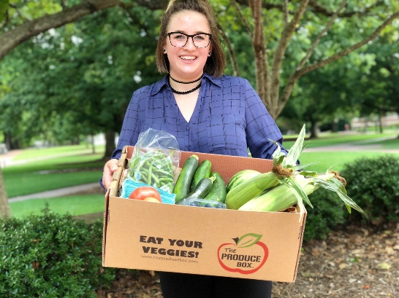

Eat Healthy with The Produce Box
The Produce Box
Fresh fruits and veggies hand-delivered to your workplace or home
10+ boxes to choose from, including a customized box just for you!
Weekly deliveries – skip when you want
13 delivery locations across UNC
  Learn more at: go.unc.edu/theproducebox
  Receive a free 12-month membership and $10 off your first order with code: BLUE365
  ($30 savings)
Notes:
Supporting local farmers since 2007!
Year round produce delivery program.
More than fruits and veggies, now features meats, dairy, breads and more!

Slide 26
Tuition & Educational Resources

Slide 27
Educational Programs
Application Fee Waiver
Allows employees to waive the admission fees to an undergrad/grad degree program at UNC Chapel Hill
In-State Residency Tuition Program
Waives the 12-month NC residency requirement for spouse and dependents
Are eligible for in-state tuition for coursework at any UNC System institution

Slide 28
Educational Programs
UNC Faculty/Staff Tuition Waiver Program
Eligible to waive tuition costs for up to three courses per academic year at any UNC System Institution
Employees studying at UNC Chapel Hill may apply one of the three tuition waivers to a summer session course
Educational Assistance Program
Reimbursement for coursework considered beneficial to both employee and University
Courses may be taken at any accredited university, college, or community/technical college
For more information contact benefits@unc.edu

Slide 29


Stay in the Know
WorkWell monthly newsletter
Follow us on social media, @unc_hr
Resources, interactive quizzes and handouts available at:
hr.unc.edu/totalwellbeing
go.unc.edu/wellness-during-covid-19
Wellness Calendar at: go.unc.edu/totalwellbeing-calendar
Notes:
WorkWell comes to everyone monthly from UNC Human Resources. Check your email!

Slide 30
Questions?

Slide 31
Resources for Parents
Child Care Scholarships & Referral Services
  Child care subsidies available for eligible students and employees (waitlist)
  Free child care center referrals to 4 and 5-star facilities that meet your needs
  Details at hr.unc.edu/benefits/work-life/child-care/
Helping Heels
  Part-time child care, pet care, or senior care offered by Carolina affiliates on a voluntary or pay for service basis
  Visit hr.unc.edu/helping-heels-list/
Juggle
  Safer, smarter, and simpler child and pet care provided by recent graduates
  Waive your first booking fee with referral code: UNC-CH
  Details at hr.unc.edu/juggle/
KinderCare Education Child Care Tuition
  Save 10% through WorkingAdvantage with code: 653475624
  Visit www.workingadvantage.com
YMCA Scholastic Support Centers
  Offers K-8 students space to participate in online school or virtual Academy classes
  Available Monday-Friday 7:30 a.m.-3:30 p.m.
  Extended day option until 6 p.m. at some locations
  Details at www.ymcatriangle.org/programs/school-programs/scholastic-support-centers

