Slide 1
Division Leader & Team Captain Virtual Training September 22, 2021

Slide 2
AGENDA
Welcome & Introductions – Sherene Jenkins
Message from our Campaign Chair – Linc Butler
History of CCCS at Carolina – Sherene Jenkins
Website/Communications – Ari Ball
Campaign Training – Laura Baker, SECC

Slide 3
Ice Breaker
Share 3 words that describe yourself in the chat box

Slide 4
Message from our Campaign Chair
Linc Butler
Associate Vice Chancellor, Human Resources and Equal Opportunity and Compliance

Slide 5
2021 Campaign Coordinators
Sherene Jenkins
Human Resource and Equal Opportunity and Compliance
Ari Ball
Human Resource and Equal Opportunity and Compliance

Slide 6
UNC-CH Giving History
Since 2002, UNC-Chapel Hill has raised a total of $14,250,765

Slide 7
Campaign Administration
Weekly Newsletter - 11 updates (Campaign Update, Make An Impact, Why I Give, Weekly Winners)
Average Click Rate – 47.16%
Of the 23,872 recipients, 939 employees pledged to CCCS
Paperless campaign saves ~$3K yearly in administrative costs

Slide 8
2020 School/Department Totals
$104,448 School of Medicine
$75,172 College of Arts & Sciences
$42,917 Gillings School Global Pub Health
$36,263 VC for Research
$19,808 School of Dentistry
$19,126 Information Technology Services
$16,765 Finance & Operations
$13,982 Kenan-Flagler School of Business
$9,869 University Libraries
$8,900 Eshelman School of Pharmacy
$8,668 Athletics
$8,365 UNC CH - Retiree
$8,134 School of Nursing
$7,550 School of Government
$6,708 University Development
$6,660 School of Law
$5,456 VC Student Affairs
$5,217 Office of the Provost
$3,910 School of Info & Library Science
$3,477 UNC General Alumni Association
$3,376 HR & EOC
$3,290 Graduate School
$3,253 University Communications
$3,150 Misc. Credit Cards - UNC CH
$2,750 University Counsel
$1,770 Innov, Entrepreneur, Econ Dev
$1,659 School of Media and Journalism
$1,646 Office of the Chancellor
$1,352 School of Education
$1,074 School of Social Work

Slide 9
UNC System Top Contributors

Slide 10
SECC Overall Top Contributors

Slide 11
2020 Top 10 Charities
UNC-Chapel Hill gave to 445 charities in 2020
Charity Name Amount Donated
Food Bank of Central & Eastern NC $29,948.38
Planned Parenthood Fed. - America $28,223.00
Inter-Faith Council for Social Service $16,931.00
United Way - Greater Triangle $ 8,273.00
Doctors Without Borders, USA $ 7,887.00
Durham Rescue Mission $ 7,857.50
Habitat for Humanity - Orange $ 7,556.00
2nd Chance Pet Adoptions $ 5,955.00
SECU Family House - UNC Hospitals $ 5,757.35
Ronald McDonald House - Chapel Hill $ 5,701.00

Slide 12
2020 Impact/Service Areas

Slide 13
Website & Communication
https://carolinacares.unc.edu/
Weekly Communication
Campaign Update
Charity Feature Story
Why I Give Stories
Weekly gift card winners
Social Media
Thank You Cards *NEW*

Slide 14
CCCS Campaign Goals
Increase our 2020 contributions of $481,738 to
$1,000,000
Spread the word & increase participation
Encourage employees to use ePledge
Have fun

Slide 15
Volunteer Workshops
Laura Baker, Director
State Employee Combined Campaign
Making A Difference Together

Slide 16
Campaign Overview
SECC History
2020 Campaign Statistics https://portal.ncsecc.org/servlet/eAndar.article/19/Campaign-Stats
2021 Campaign Overview – Oct 1 – Dec 17
Campaign Roles

Slide 17
Campaign Overview
Established by Governor Jim Hunt in 1984. Our 2021 State Co-Chairs are Douglas Holbrook & Jon Minshew.
Campaign established to offer state employees a convenient, efficient, and trusted way to support local, national, and international charities. Charities apply annually from Nov. – March & meet stringent eligibility criteria.
Designations based campaign - Donors choose where their gift goes through designating to the causes they care about. Over $2.6 million raised in 2020.
The state of NC is required to contract with a nonprofit organization to manage administrative needs of the SECC; this allows gifts to be tax deductible. EarthShare NC is the administrator of the campaign. www.earthsharenc.org

Slide 18
What Is a Division Leader?
Recruiting or facilitating the appointment of SECC team captains for each division/location of the agency.
Meeting with team captains prior to the start of the Campaign.
Communicating weekly with team captains on campaign progress.
Working with team captains to ensure every employee in their division/location has been personally asked.
(100% ask, not 100% participation).
Answering team captains questions and challenges during the campaign.
Ensuring team captains tally and send forms and summary reports to the SECC office weekly.
Thanking all of your agency’s volunteers who helped to make the Campaign a success.

Slide 19
What is a Team Captain?
As a Team Captain, you are the “go-to” person for educating, motivating, and inspiring your fellow employees.
Working with your Division Leader to conduct a positive & informative campaign; including a kickoff and timeline, charity fairs, employee meetings, and other events.
Don’t do it alone! Recruit coworkers who care about the community and are excited about the campaign.
Obtaining support from management & senior leadership.
Creating a thank you plan for donors.
Ensuring each employee is given the opportunity to make an informed decision regarding their individual pledge. (100% ask, not 100% participation)
Addressing questions and challenges during the campaign, with the help of your Division Leader.
Reporting campaign results by calculating & sending pledge and report forms weekly to the SECC office.

Slide 20
2021 Statewide Video
September 15, 2021, Video Release
Making A Difference Together
Depts/Agencies chose their own campaign timeframe
SECC Video Sneak Peek! NC SECC Campaign Video 2021 - YouTube

Slide 21
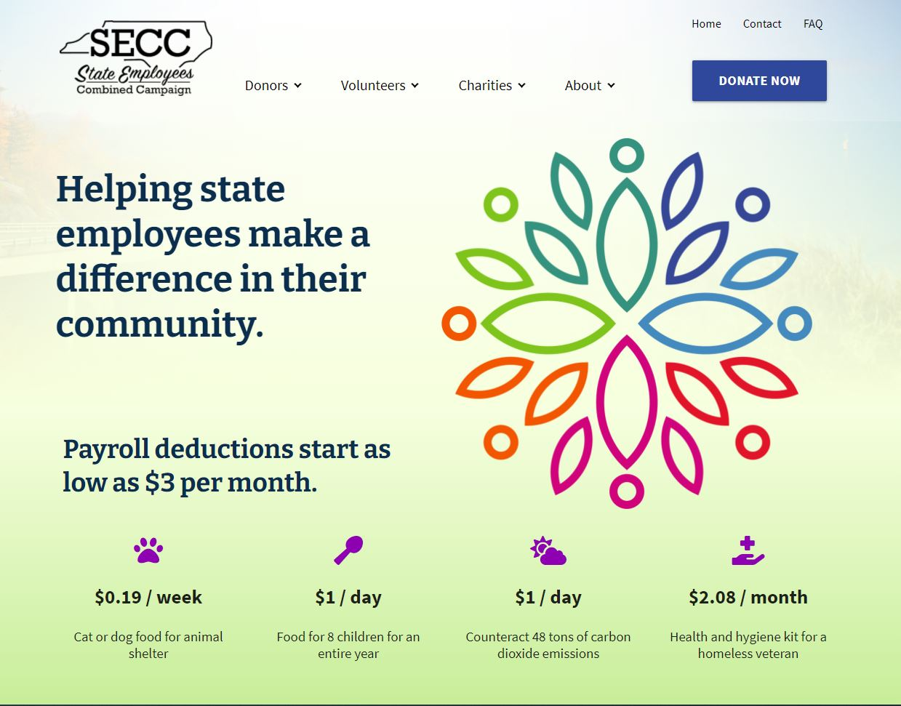
Campaign Resources
Website www.ncsecc.org
Charity Search Engine *UPDATED
Donation Impact Calculator *NEW
Volunteer Resources
Ways to Give in 2021
ePledge
PDF Fillable Forms
Events – Venmo Platform *NEW
Credit Card Donations
Facebook: facebook.com/ncsecc
Instagram: Instagram.com/ncsecc

Slide 22
ePledge
ePledge is an online giving platform that provides a way for employees to donate online. It tracks your campaign pledges in real-time, so the online responses are always up to date.
ePledge is a great option to reach employees but communication from division leaders and team captains is vital
ePledge is NOT the Adobe Digital PDF Pledge Form & is NOT the credit card Donate Now option on the SECC website

Slide 23
Campaign Forms
Campaign materials have not been sent yet
Pledge Form Types
Adobe Digital PDF, Printed, ePledge
Report Forms
Combined, Payroll Only, Cash/Check/Credit Card
Event Form
Venmo for event payments

Slide 24
Campaign Materials
2019 UNC-Chapel Hill converted CCCS to a paperless campaign – saving approximately $3000 a year in the administration of the campaign.
2021 SECC will continue our almost 100% electronic model from 2020. Encourage the use of our ePledge (electronic giving) model and will continue to offer the Adobe Digital PDF pledge form for those wishing to use that online method of giving.

Slide 25
Campaign Events & Charity Fairs
What events worked virtually in 2020?
Bingo, Silent Auctions, Trivia Games, Scavenger Hunts
Looking Ahead
Events, Charity Fairs – Virtual Fairs

Slide 26
Campaign Incentives
Weekly winners will pick from 2 prizes instead of having one chosen for them
$25 or $50 Amazon Gift Card or Charity Designation of their choice
Thanksgiving $50 Harris Teeter Gift Card – 1 per Dept/Agency

Slide 27
Questions & Conversation

Slide 28
Thank You!
Please email your program coordinator with any questions.
melissakeeney@ncsecc.org
laurabaker@ncsecc.org
Follow us on Facebook & Instagram @ncsecc
www.ncsecc.org

