Slide 1
ONE UNC Health: Teammate Connect #1
You and Our Mission and Vision
AGENDA:
Unifying
Mission and Vision
Actions
Notes:
1 minute
(MEETING LEADER) SAY:
Let’s turn our attention to ONE UNC Health. ONE UNC Health is our shared culture and strategy across UNC Health and with the UNC School of Medicine.
Recently, Dr. Burks shared a video with four stories about how we've unified over the last couple years as ONE UNC Health.
Making the most of being ONE system is a multi-year transformation journey.
The purpose of these Teammate Connects is to have a team discussion about our journey as ONE UNC Health. These are done by everyone across the system.
Today, we’ll reflect on and connect your unique contributions to our Mission and Vision. We will also talk about next steps to take together.
(MEETING LEADER) DO: Go to the next slide.

Slide 2
Unifying as : Our Story of Challenge and Growth
Working as ONE
example areas:
However
Finally
With a clearer path ahead for our Mission for all North Carolinians, we’re reinventing what it means to be North Carolina’s health system. Our journey to drive affordable care. Our journey to create an unrivaled experience. Our journey to build healthier communities through a world-class workplace. Our journey – with you – as ONE UNC Health.
COVID-19
Health Equity
Diversity, Equity and Inclusion
Well-Being
Care Pathways
Virtual Health
Research
Clinical Trials
Rural Health
Education
Partnerships and New Capability
Our world transformed. The pandemic shifted everyone’s expectations, sped up healthcare trends and brought systemic challenges, including racism and healthcare disparities, into clearer view. It has left us strained and battered.
But throughout it all, you responded as ONE UNC Health. Through our shared Values of Carolina Care, Leading the Way, It Starts With Me and One Great Team, you brought excellence and empathy…
Therefore
Once
We now begin to heal together, and we transition to our next chapter as ONE UNC Health – starting with our people-first foundation. We’re committing to your well-being and total benefits. We’re committing to transparency and accountability for a more unifying, inclusive and equitable culture.
We’re reimagining excellence in patient care, research and education in our core focus of treating patients when they’re sick, and we’re transforming our capability in keeping people healthy close to home in more equitable and affordable ways.
To live our Mission, we ignited a journey in 2019 as ONE UNC Health. It was a journey to unify through a shared culture and strategy. We had a lot of good things going in coming together as a system with our shared Values, brand and ways of organizing…
2
Notes:
6 minutes
SAY:
Although we’ve been challenged time and again during the last few years, we’ve come a long way with our shared culture and strategy.
Let’s look at a short story that recaps our journey and what’s ahead for us as ONE UNC Health.
ASK: Can I have two volunteers: one person to read the first two parts of the story and another person to read the last two parts?
DO: Identify the two volunteers.
DO: Have the first volunteer read the first two parts of the story: Once and However.
DO: Have the second volunteer read the final two parts of the story: Therefore and Finally.
SAY: Together, we have been challenged in many ways the last few years. And we have grown. A few of the ways we're working more as ONE are listed here.
DO: Highlight a specific example of working together as ONE that relates to the group having this discussion.
You are to prepare one or two examples.
In addition, you can mention any of the four examples in the recent ONE UNC Health video from Dr. Burks, which include:
The UNC Health Caldwell COVID-19 field hospital
Our COVID-19 testing and sequencing research
Patient treatment and monitoring at home through the Advanced Care at Home program
The clinical collaboration between UNC Hospitals and UNC Health Rockingham
DO: Select one question from the following list for the group to discuss. Have one or two teammates respond.
Recommended option: “How have you been challenged professionally over the last two years? And how have you grown?”
Option 2: “Consider our work as a team or group specifically. If we made a video about our efforts over the last two years in support of ONE UNC Health, what would be in it?"
Option 3: “What are the challenges and the bright spots in coming together more across UNC Health?”
DO: Go to the next slide.

Slide 3
ONE UNC Health is our shared culture and strategy.
Notes:
7 minutes
SAY: Our Mission and Vision require us to unite in our work for North Carolinians. In silence, read our Mission and Vision.
SAY: Our Mission and Vision are the heart of ONE UNC Health. ONE UNC Health is our shared culture and strategy.
DO: Select one question from the following list for the group to discuss. Have one or two teammates respond.
Recommended option: “Given our Mission and Vision, why is it crucial that we come together as ONE UNC Health? Consider what is possible if we do, and what is likely if we don’t.”
Option 2: “In what ways do we feel connected to our Mission and Vision on a personal or team level?”
Option 3: “How can a shared culture and strategy support our Mission and Vision?”
DO: Highlight one or two current priorities for the group having this discussion in support of our shared culture and strategy.
You are to develop talking points about these current priorities.
DO: Go to the next slide.

Slide 4
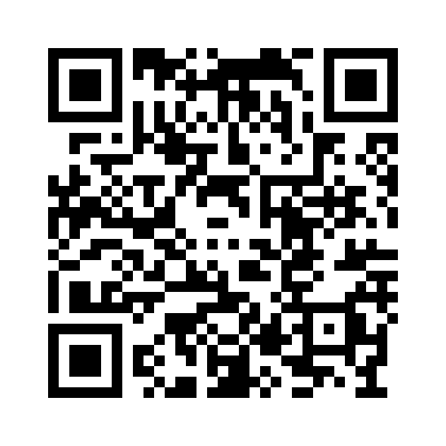
Actions
Our Journey, Our Story
Teammate Playbook Highlights Infographic
Resources and Involvement
… and a follow-up connect in six weeks on our shared culture and people priorities
Notes:
1 minute
SAY:
As next steps, there are a few actions that we will take together.
In a few weeks in May, you will receive the first chapter of the ONE UNC Health Teammate Playbook. It builds on today’s discussion, and is an online, individually experienced module. There's also an infographic coming on your screensavers and monitors that will celebrate some of our early successes of this shared journey.
Like all teams, we’ll have a follow-up connect in a few weeks. It will focus on our people priorities and how we will continue growing our shared culture. ​
We have many resources and approaches for connecting, supporting and getting involved. Some are listed here. Scan the QR code, and after the discussion check the resources out and share them.
And as you go about your day, think of how you can support our shared culture and strategy as ONE UNC Health.
SAY:
I appreciate the difference you’re making and your resilience, but I want you to seek support anytime you need it.
The health and well-being of those we serve and ourselves is our Mission.

Slide 5
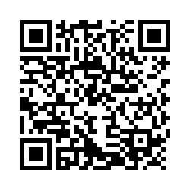
Feedback
Notes:
SAY: One last thing: Please share your feedback on ONE UNC Health using the QR code.
DO: Give the group a moment to access the QR code on their phones.
SAY: Please take care of yourself and one another.
DO: End the meeting.

