Slide 1
[Department/Unit] Learnings for SHARE Your Voice, Your Experience

Slide 2
UNC School of Medicine Overall

Slide 3
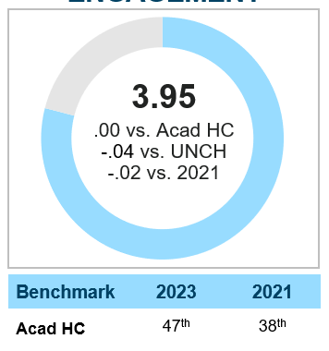
SHARE Learnings
The Engagement Indicator, with a scale of 1-5, is a composite metric of 6 items that measure an employee’s degree of pride in the organization, intent to stay, willingness to recommend, and overall workplace satisfaction
Engagement
How many participated?
Survey June 2023
N=2,191
61% Response Rate
(2021: 61%)
New:
Data captured faculty /
EHRA-NF / SHRA; Hybrid/virtual/onsite
Not participating:
Credentialed MD faculty
Post Docs
Residents
Temporary employees
Employees hired after April 7
Working at the organization, department, and team level, we work to address ways to improve the employee experience and improve recruitment and retention.

Slide 4
Summary
STRENGTHS
OPPORTUNITIES
Respect
For employees from manager
For manager’s abilities
Teamwork
Managers encourage teamwork
Within work unit
Employee involvement in decision making
Resilience-Decompression
Ability to disconnect from work
Freeing mind from work
Caring about quality improvement and providing high-quality service
Perceptions around organizational culture

Slide 5
Our Department/Unit Overall
[Department/Unit Name]

Slide 6
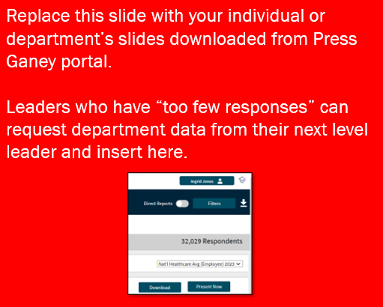
Engagement Indicator
The Engagement Indicator is a composite metric of six (6) items that measure employees' degree of pride in the organization, intent to stay, willingness to recommend, and overall workplace satisfaction.
3.95
-0.04 vs. Overall Organization
-0.06 vs. Nat'l Healthcare Avg (Employee) 2023
Historical Performance
'21 | 3.97

Slide 7
Resilience
Resilience
Decompression
3.47
Decompression items focus on employees' ability to disconnect from work.
3.9
-0.34 vs. Overall Organization
-0.23 vs. Nat'l Healthcare Avg (Employee) 2023
Historical Performance
'21 | 3.77

Slide 8
Resilience
Resilience
Activation
4.38
Activation items focus on finding meaning in the work and focusing on patients/clients as individuals.
3.9
-0.34 vs. Overall Organization
-0.23 vs. Nat'l Healthcare Avg (Employee) 2023
Historical Performance
'21 | 3.77

Slide 9
Strengths
Strengths are identified through the application of an algorithm that considers performance score, Percent (%) Favorable, and positive difference from a designated national benchmark.
 |  | Score | vs. Nat'l Healthcare Avg (Employee) 2023 | Responses
1 | I respect the abilities of the person to whom I report. | 4.47 | +0.14 | 2,181
2 | The person I report to treats me with respect. | 4.56 | +0.11 | 2,180
3 | My work unit works well together. | 4.36 | +0.15 | 2,178
4 | The person I report to encourages teamwork. | 4.42 | +0.15 | 2,180
5 | The person I report to encourages people to learn from their mistakes. | 4.27 | +0.11 | 2,138
6 | This organization treats teammates with respect. | 4.08 | +0.16 | 2,163
7 | My leader would support and protect me if I were to speak up and escalate a safety concern. | 4.30 | - | 2,113
8 | I am involved in decisions that affect my work. | 3.94 | +0.27 | 2,175
9 | The person I report to cares about my job satisfaction. | 4.28 | +0.07 | 2,183
10 | In my work unit, teammates are treated respectfully regardless of their differences. | 4.24 | - | 2,166
Note: the questions reflected here are automated and do not reflect the adjustments made in the SHARE SOM version of the survey. To make adjustments before presenting, use this key: https://www.med.unc.edu/intranet/wp-content/uploads/sites/578/2023/09/Key-to-SHARE-Driver-Results.pdf .

Slide 10
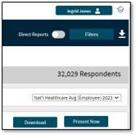
Concerns
Concerns are identified through the application of an algorithm that considers performance score, Percent (%) Unfavorable, and negative difference from a designated National Benchmark.
 |  | Score | vs. Nat'l Healthcare Avg (Employee) 2023 | Responses
1 | I am able to free my mind from work when I am away from it. | 3.33 | -0.37 | 2,181
2 | I am able to disconnect from work communications during my free time (emails/phone etc.). | 3.47 | -0.33 | 2,182
3 | I rarely lose sleep over work issues. | 3.46 | -0.26 | 2,177
4 | I can enjoy my personal time without focusing on work matters. | 3.60 | -0.19 | 2,183
5 | My pay is fair compared to other healthcare employers in this area. | 3.14 | -0.09 | 2,142
6 | I feel like I belong in this organization. | 3.85 | -0.19 | 2,174
7 | Mistakes have led to positive changes here. | 3.79 | -0.18 | 1,891
8 | In this organization, people have equal employment opportunities regardless of their differences. | 3.79 | -0.17 | 2,118
9 | I am mentally and emotionally healthy. | 3.94 | -0.16 | 2,163
10 | This organization cares about quality improvement. | 3.95 | -0.10 | 2,126
Replace this slide with your individual or department’s slides downloaded from Press Ganey portal.
Leaders who have “too few responses” can request department data from their next level leader and insert here.
Note: the questions reflected here are automated and do not reflect the adjustments made in the SHARE SOM version of the survey. To make adjustments before presenting, use this key: https://www.med.unc.edu/intranet/wp-content/uploads/sites/578/2023/09/Key-to-SHARE-Driver-Results.pdf .

Slide 11
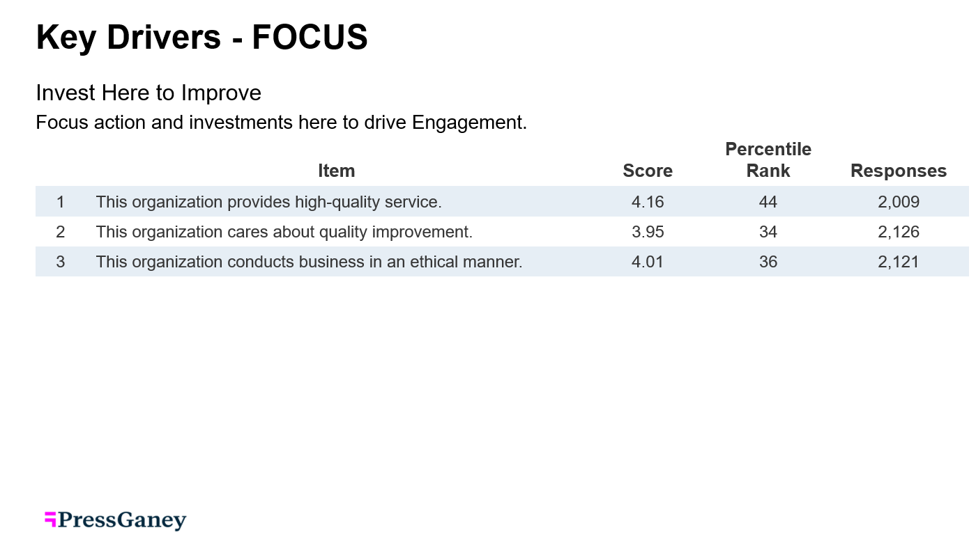
Key Drivers
Instructions only (delete this slide when presenting)
To receive Key Drivers specific to your work unit, you must have 30 or more respondents.
If your unit has less than 30 respondents:
You will view Key Drivers for your department.
You will see Key Drivers for your next level leader (provided there are 30 or more respondents).
You may choose not to use Key Drivers.
If you choose to use key drivers for your discussion, enter Slides 8-9 from “Present Now” in place of this slide.
Note: the questions reflected here are automated and do not reflect the adjustments made in the SHARE SOM version of the survey. To make adjustments before presenting, use this key: https://www.med.unc.edu/intranet/wp-content/uploads/sites/578/2023/09/Key-to-SHARE-Driver-Results.pdf .

Slide 12
Discussion: What do we want to focus on first?
From our data, what surprises you?
What do you see as our team’s strengths?
What should we focus on?
What ideas or suggestions do you have for improving or maximizing (engagement, trust, team strength, well-being) in our team?

Slide 13
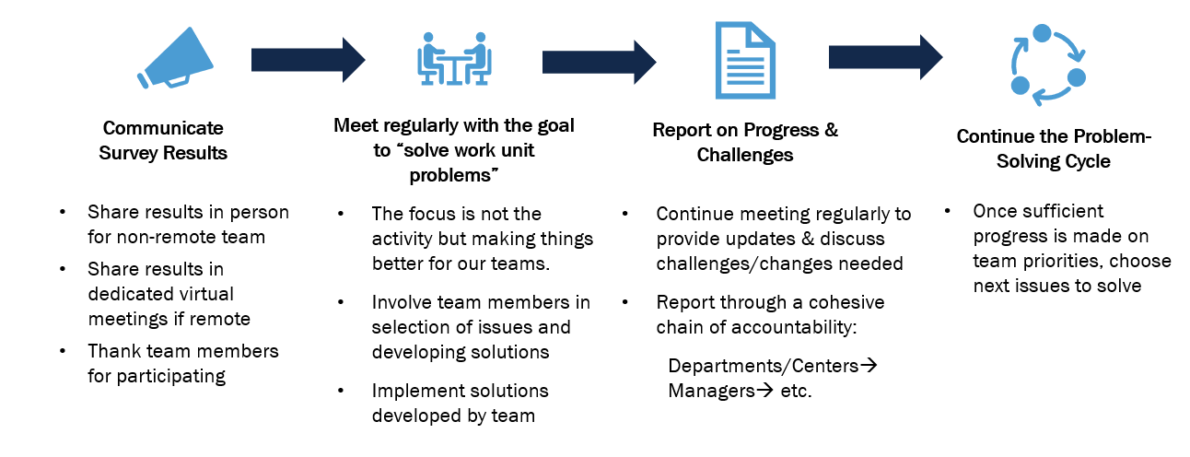
Key Improvements for Success

Slide 14
Thank you!

Slide 15
Upcoming Key Dates (for information only)

Slide 16
Support for Leaders (for information only)
Recordings of trainings and other resource materials can be found on the
“SHARE Resources for Managers” page on the SOM intranet: https://www.med.unc.edu/intranet/share-resources-for-managers/

