Slide 1

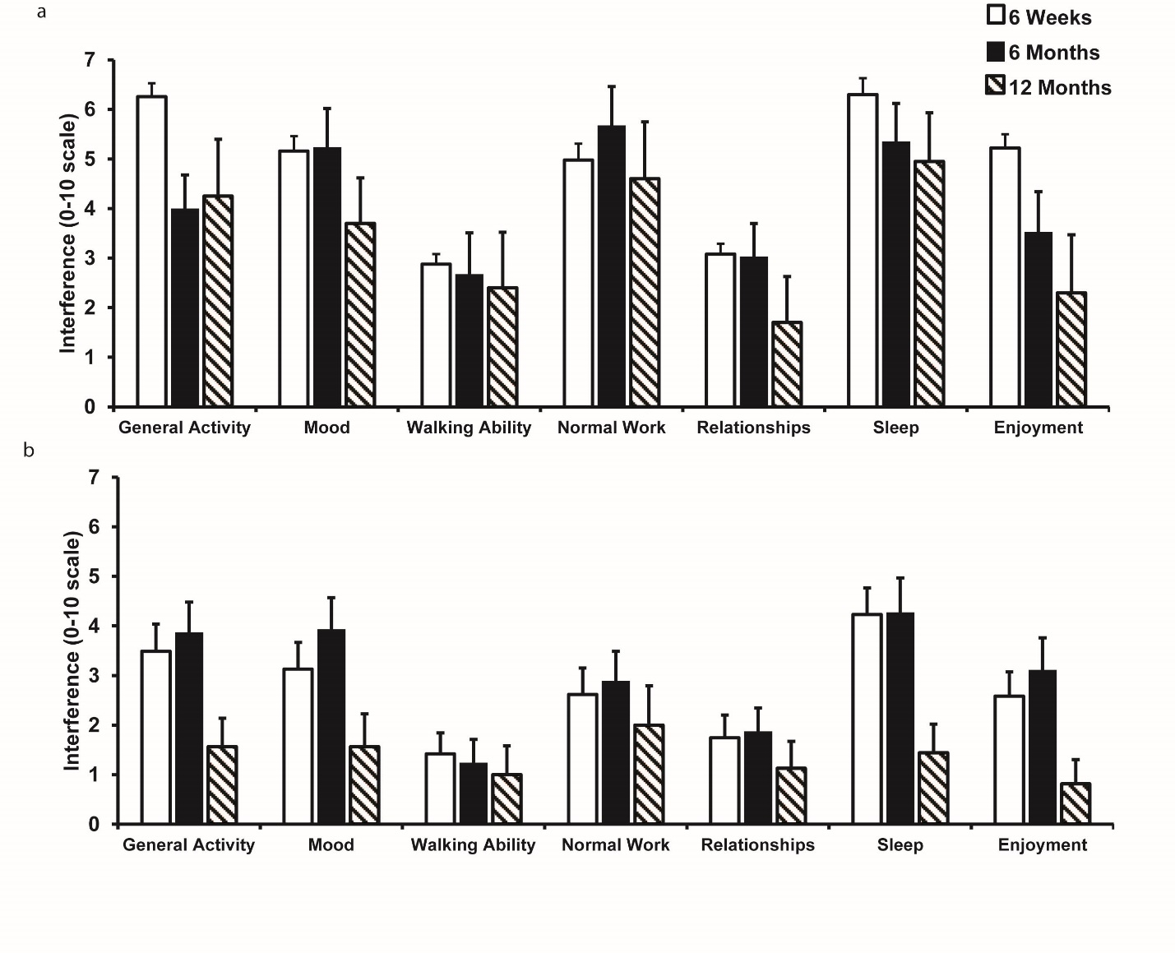
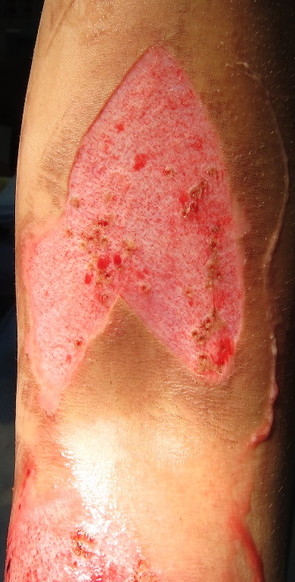
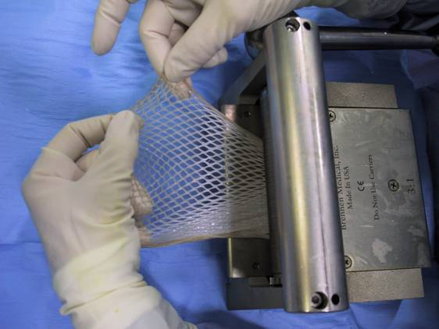
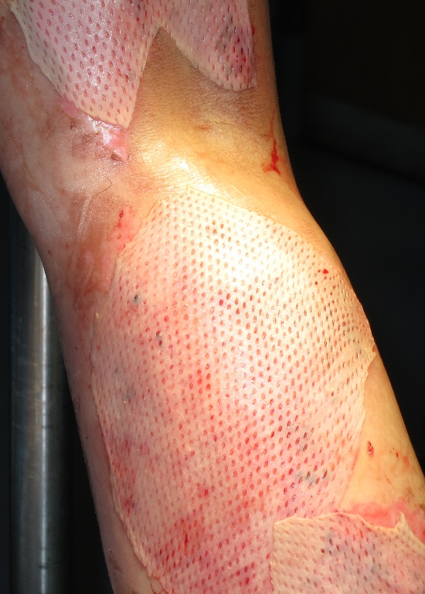
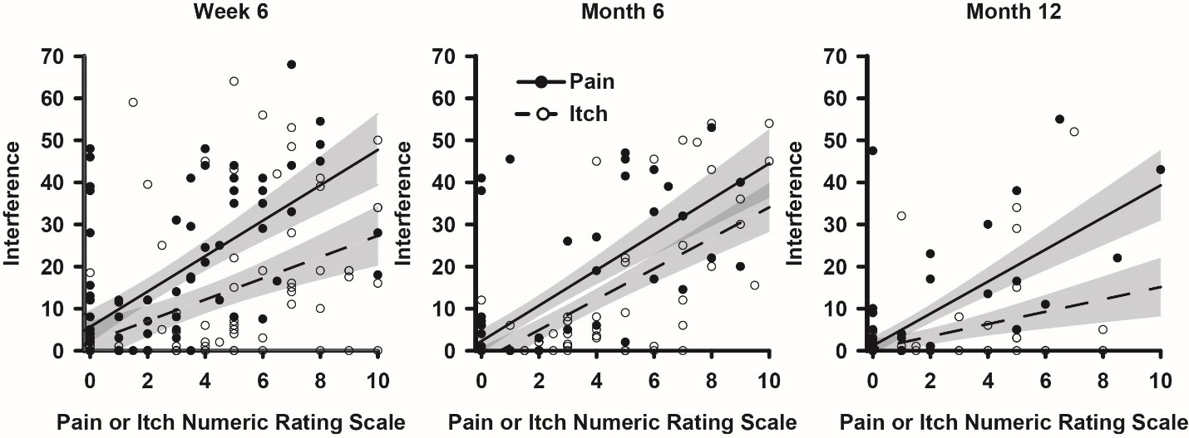
Functional consequences of graft site pain and itch in survivors of major thermal burn injury.
^{1,2}Mauck MC, ^{1,2}Doshi N, ^{1,2}Bien M, ^{1,2}Jia E, ^{1,2}Jallah, ⁸Shupp JW, ⁵Karlnoski R, ⁵Smith DJ, Cairns BA, ^{1,2,4}McLean SA.
From the ¹TRYUMPH Research Program, ²Department of Anesthesiology, ³Department of Surgery, and ⁴Department of Emergency Medicine, University of North Carolina, Chapel Hill, NC; ⁵Florida Gulf-to-Bay Anesthesiology, Tampa, FL; ⁶Department of Plastic Surgery, University of South Florida, Tampa, FL; ⁷Department of Anesthesiology, Duke University, Durham, NC; ⁸MedStar Health Research Institute, Washington, DC
Table 1. Characteristics of study participants (n=96)
Age, mean (SD), y | 38 (13)
Males, n (%) | 72 (75)
Income level n (%)
$0-19,999 | 13 (17)
$20,000-39,999 | 24 (31)
$40,000-59,999 | 17 (22)
$60,000 or higher | 24 (31)
Burn Total Body Surface Area (%, SD) | 5 (3)
Length of Hospital Stay in days (SD) | 10 (3)
y, year; NRS, numeric rating scale; SD, standard deviation
Pain
RESULTS
Study participant characteristics are shown in Table 1.
Figure 2 shows that pain results in more interference relative to itch, but both significantly interfere significantly with function.
Based on the slope of the regression lines (Figure 2) averaged over 6 week, 6 month and 12 month time points, a NRS of 3.7 and a NRS of 6.8 were required to produce clinically significant interference with pain and itch respectively (change in interference score of 15 or greater).
Pain and itch cause significant interference across 7 domains of life function over time after major burn injury (Figure 3).
Following major thermal burn injury, there is a decline in physical and mental health in all participants, however those with moderate or severe graft site pain and itch generally have lower mental and physical health (Table 2).
At 6 weeks, 6 months, and 12 months, major thermal burn injury survivors with moderate or severe graft site pain reported a clinically important reduction in physical and mental health function (Table 2).
CONCLUSIONS
Pain and itch interfere significantly with life function in the aftermath of burn injury.
Future studies aimed at understanding pain and itch pathogenesis in the aftermath of burn injury are urgently needed to address the significant decline in function after burn injury.
REFERENCES
LaBorde P. Burn epidemiology: the patient, the nation, the statistics, and the data resources. Crit Care Nurs Clin North Am 2004;16(1):13-25.
Malenfant A, Forget R, Papillon J, Amsel R, Frigon JY, Choiniere M. Prevalence and characteristics of chronic sensory problems in burn patients. Pain 1996;67(2-3):493-500.
Summer GJ, Puntillo KA, Miaskowski C, Green PG, Levine JD. Burn injury pain: the continuing challenge. J Pain 2007;8(7):533-548.
Research reported here was funded by the University of North Carolina Department of Anesthesiology and the Jaycee Burn Center.
INTRODUCTION
Burn injuries affect 11 million people annually worldwide.
Hospitalized burn patients commonly receive a tissue autograft to treat their burn injury, in which skin is removed from a healthy “donor” site and transferred to a burn injury site (the “graft” site).
Pain and itch are common, morbid sequelae of burn injury that requires tissue autografting
Chronic pain and chronic itch at the graft site are major causes of patient suffering and disability in this population.
Clinical experience suggests that chronic pain and itch at the graft site are major causes of patient suffering and disability.
Despite this fact, to our knowledge no studies have been performed that evaluate the impact of graft site pain and itch on functional outcomes among survivors of MThBI.
METHODS
This prospective, multicenter, longitudinal cohort study enrolled adult European Americans and African Americans who presented to the hospital within 72 hours of major thermal burn injury.
Only individuals with total body surface area (TBSA) burned ≤30% also receiving tissue autograft were enrolled.
Pain and itch severity (numeric rating scale (NRS) 0-10) were prospectively assessed during the year after MThBI via structured in-person and telephone interviews (daily during hospitalization, weekly post-discharge through study day 21, and then monthly through 12 months).
Demographics, burn characteristics, and hospital length of stay were obtained by abstraction of the medical record.
Moderate to severe pain and itch was defined as NRS≥4.
The impact of pain and itch severity on function was explored using the Brief Pain Inventory (modified for itch) and SF-12 administered at intervals following burn injury.
Brief Pain Inventory interference subscale examined interference over 7 important domains of life function.
Itch
a
b
c
Figure 3: Influence of pain (a) or itch (b) on 7 domains from the Brief Pain Inventory and a modified version of the Brief Pain Inventory for itch. Patients were asked the degree to which pain interfered with general activity, mood, walking ability, normal work, relationships, sleep and enjoyment of life on a 0-10 numeric rating scale. Open bars represent interference measured at 6 weeks after burn injury, solid bars represents 6 months, and striped bars represent 12 months. Error bars represent the standard error of the mean.
Table 2. Physical and mental health outcomes over time among survivors of major thermal burn injury receiving a tissue autograft according to pain and itch outcome group.
Physical health‡ (SF-12 PCS) by outcome
Timepoint | No moderate or severe pain or itch | Moderate or severe pain | Moderate or severe itch
Pre-burn (SD) | 57.1 (3.0) | 53.2 (8.2) | 51.2 (10.7)
6 weeks | 49.6 (7.8) | †*37.9 (10.5) | *43.3 (10.5)
6 months | 52.7 (6.9) | *43.6 (11.8) | *47.1 (10.3)
12 months | 53.0 (7.0) | *47.0 (11.1) | 49.0 (9.6)
Mental health‡ (SF-12 MCS) by outcome
Timepoint | No moderate or severe pain or itch | Moderate or severe pain | Moderate or severe itch
Pre-burn (SD) | 55.6 (9.2) | 51.7(10.9) | 48.1 (15.3)
6 weeks | 51.8 (12.7) | *43.7(12.7) | 47.8 (13.5)
6 months | 52.2 (12.0) | 46.2(13.8) | *43.1 (15.5)
12 months | 52.8 (10.8) | *41.4(11.2) | 47.0 (12.1)
‡Physical (PCS) and mental (MCS) component scores were calculated from administration of the SF-12 pre-burn (4 weeks prior to burn) or at the 6 week, 6 month and 12 month timepoint after autograft surgery. SD=standard deviation. Moderate to severe pain and itch were defined as NRS score ≥4. *Significant differences (p<0.05) in mean SF-12 component score between patients with pain or itch NRS≥4 and those without both pain and itch (NRS < 4). †Significant differences (p<0.05) in the mean SF-12 component score between pain and itch.
http://who.int/buruli/photos/Mesher2_Zilliox_large.jpg
Figure 1: Skin graft procedure for coverage of burn injury site. Figure 1a shows the burn injury site after debridement. Figure 1b shows the process in which harvested from a donor site is meshed with a microtome to provide more extensive coverage of the burn injury site. Figure 1c shows an example burn injury site covered with meshed tissue autograft.
Figure 2: Relationship between pain and itch severity and pain and itch-related functional interference over time among survivors of major thermal burn injury receiving a tissue autograft. Pain and itch severity evaluated via 0-10 NRS score. Interference scale was calculated by summing 0-10 NRS interference scores for general activity, mood, walking ability, normal work, relationships, sleep, and enjoyment for pain (black circles) and itch (open circles) at Week 6 (a), Month 6 (b), and Month 12 (c). Linear regression line is plotted for pain (solid line) and itch (dashed line) in each graph. 95% confidence bands for the regression lines are shaded grey.

