Slide 1
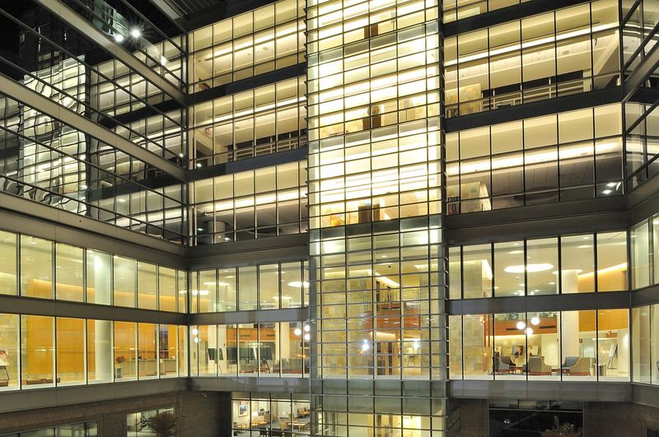
Welcome to UNC
Hematology/Oncology!

Slide 2
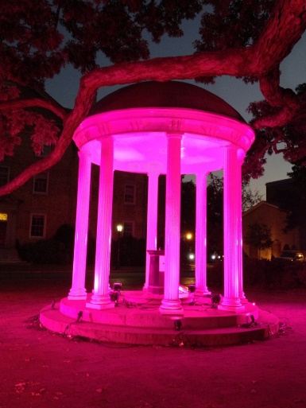

UNC and Chapel Hill
UNC
Oldest public university in the US
NCI-ranked “Exceptional” Comprehensive Cancer Center
Gillings School of Public Health (#2 in U.S.)
Eshelman School of Pharmacy (#1 in U.S.)
UNC Top 10 in NIH Funding
Chapel Hill
Classic university town
Triangle (+ Durham and Raleigh)
Great culture:
  “Foodiest” small town (CH) and small city (Durham) in America
  Wonderful arts scene

Slide 3
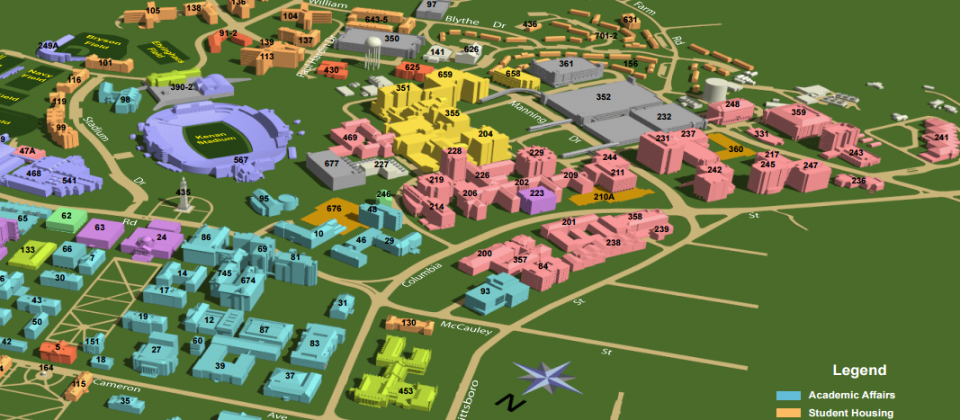
Geography
NC Cancer Hospital
POB
UNC Lineberger
Chapel
Hill
Carrboro
School of Nursing
Eshelman School of Pharmacy
Gillings School of Global Public Health
Dental School
Notes:
13:35

Slide 4
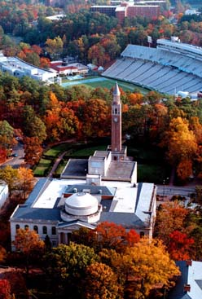
UNC Hematology / Oncology
55-60 faculty, 19-21 fellows
  Oncologic subspecialties
  Classical Hematology
UNC Lineberger
  350 members from multiple schools, esp:
    Schools of Medicine, Public Health, Pharmacy
    Largest research entity at UNC
McAllister Heart Institute
  Thrombosis/hemostasis/vascular research
  International leadership

Slide 5
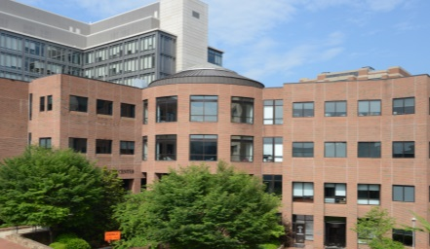
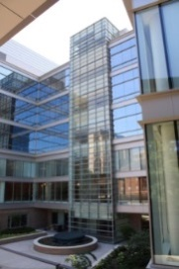
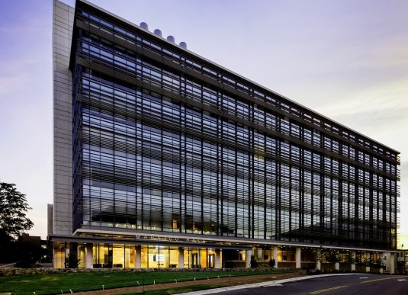
UNC Hematology / Oncology
Create and Apply Knowledge
Research
>300 publications per year
(50% first or last author)
Clinical care
135,000 Patient visits
5000 New patients / year
+ 2,700 at Rex affiliate
650 on treatment trials
NIH Direct Cost funding to Division members

Slide 6
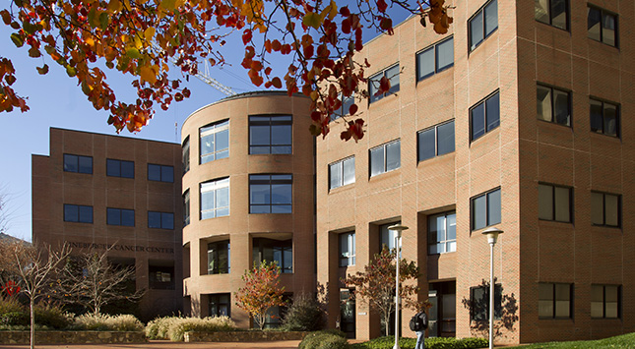
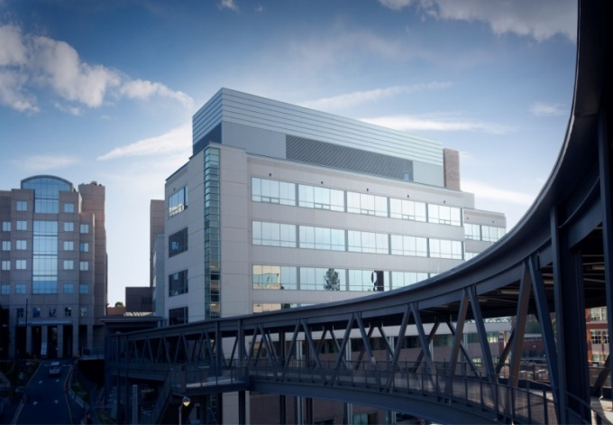
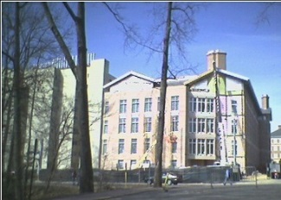
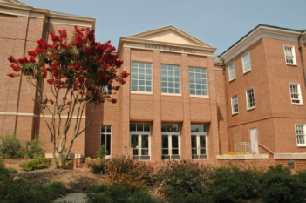
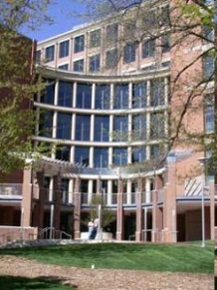
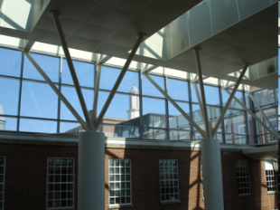
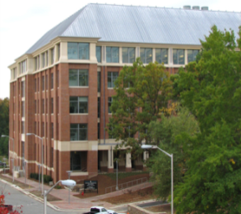
Questions?
Notes:
31:00

Slide 7
Missions of the UNC Hematology/Oncology Fellowship Program
To provide outstanding clinical training
To provide outstanding research opportunities
  Basic Science
  Translational
  Clinical
  Health Services
For fellows to have successful careers in hematology/oncology

Slide 8
Fellowship Program Structure
Fellowship education committee*
Fellowship Director
Alice Ma
UNC graduate medical education
Associate Program Director: Billy Kim
Associate Program Director: Frances Collichio
*Consists of 2 members from each class, program directors, Lisa Carey, Tom Shea, Nigel Key, Bill Wood, Autumn McRee, Chad Pecot, Matt Milowsky, Brandi Reeves, Marcie Riches and Matt Foster

Slide 9
American Board of Internal Medicine Requirements
Board | Months in Training | Clinical Months | Continuity clinic ^{A} | Procedures
Oncology | 24 | 12^{B} | 24 months | BM Bx Chemotherapy CVC
Hematology | 24 | 12 | 24 months | BM Bx Chemotherapy CVC Peripheral blood smear, apheresis
Both | 36 | 18 ^{C} | 36 months
A: ½ day per week
B: 50% of the time outpatient months
C: 12 months neoplastic dz and 6 months non-neoplastic heme

Slide 10
ABIM Alternate Pathways
Geriatrics and Medical Oncology
Pediatric Hematology/Oncology and Adult Hematology or Oncology
Infectious Diseases and Medical Oncology
ABIM research pathway

Slide 11
First year
Clinical and inpatient focus
Inpatient |  | Consult |  | Clinic |  | Elective
Malignant Heme | BMT | Coag | Solid Tumors | Benign Heme | Solid Tumor | Elective/Selective
1-2 | 1-2 | Total 2-3 |  | 1-2 | 1-2 | 3
Electives: solid tumor clinics, transfusion medicine, hematopathology,
inpatient solid tumor oncology, outpatient BMT,
palliative care (required 2 weeks) etc
Vacation: 4 weeks

Slide 12
Fellowship tracks
Fellows select career pathway
in late first, early second year
Basic Science Research track
Clinical and translational research track
Health outcomes research track
Clinical track

Slide 13
Outpatient
Year | Continuity clinic
1St year | 6-month rotating blocks (GI, breast)
2nd year | Four 6 month rotating blocks (malignant heme, benign heme, lung and GU)
3rd year research track | 0.5 day in clinic of interest
2nd or 3rd year clinical track ^{B} | 5 month blocks of outpatient clinics per year
A : Rotations defined as : thoracic, breast, GU, GI, melanoma, head and neck
B: Clinical track fellows will have 0.5 day in one clinic of interest (e.g. GI) and then rotate
through the areas (breast, thoracic, etc) for more prolonged exposure

Slide 14
Research Training
NC TraCS (North Carolina Translational and Clinical Sciences Institute)
  MSCR (Masters of Science in Clinical Research)
    2 year degree program training individuals to be principal investigators and collaborators in clinical/translational research
  TCRC (Translational and Clinical Research Curriculum)
    2 year non-degree program providing training in biostatistics, epidemiology and career development skills.
    https://tracs.unc.edu/index.php/services/education/translational-and-clinical-research-curriculum
K12 programs
  For senior trainees and junior faculty in basic or translational research in hematology or oncology

Slide 15
Research Support
Early Grants
  Hematology T32 (coagulation, sickle cell)
  New Immunotherapy T32
  New Geriatric Oncology T32
  Other Institutional T32 awards (Pharmacology, Nursing)
  Health Behavior/Health Outcomes
  T32-like Institutional Funding for well-qualified research track fellow
Later Grants
  K12 for senior fellows/junior faculty
  KL2
  BIRCWH
Other
  Foundational Grants (ASCO, ASH, etc)
  NIH Loan Repayment

Slide 16
Planning the Path to Research Independence….
 | 1 | 2 | 3 | 4 | 5 | 6 | 7 | 8 | 9 | 10
Fellowship Faculty | X | X | X | (X) (X) | X | X | X | X | X | X
T32/NRSA |  | X | X | (X)
K12 (Institutional) |  |  |  | (X) | X | X
K08 or K23 or R21 (Individual—Mentored and mobile) |  |  |  |  | (X) | X | X | X | X
RO1 or other (Individual) |  |  |  |  |  |  |  |  | X | X

Slide 17
Fellow’s career choices
 | Academic | Private | Industry | Gov | Unknown
1995-2009 | 22 | 23 | 2 | 1 | 1
2010-18 | 30 | 22

Slide 18
“Benign” or “Classical” Hematology at UNC

Slide 19

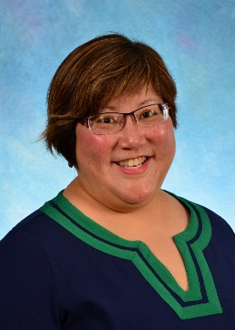
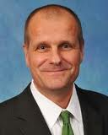
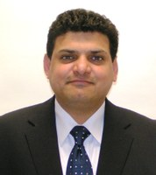

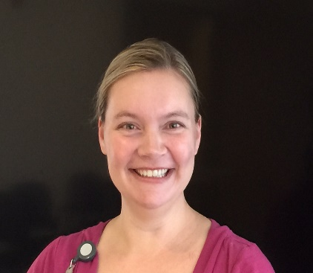
The Hemostasis and Thrombosis Program
Comprehensive Hemophilia Treatment Center (est. 1977)
6 physicians, 3 clinical nurses, 1 research nurse, 3 research coordinators, 1 social worker, 1 pharmacist
Currently follows ≈250 adults, ≈100 children with hemophilia, several hundred vWD
≈25 new thrombosis patients/week
Multi-disciplinary HHT Clinic

Slide 20
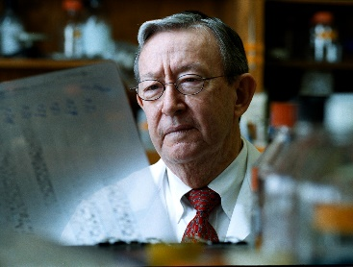
Hematology ‘Firsts’ at UNC
1947: Hemophilia dog colony founded by Kenneth
Brinkhous MD
1952: Invention of the APTT
1956: Discovery of factor X (‘Stuart Prower factor’)
1962: Development of the first FVIII concentrate
1972: Separation of plasma FVIII from VWF
1978: Center for Thrombosis and Hemostasis founded
  by Harold Roberts, MD
1987: First human trial of recombinant clotting factor (rFVIII)
1989: First administration of rFVIIa in the US
1991: Isolation of vitamin K carboxylase
1994: Elucidation of the mechanism of action of rFVIIa
1997: First mouse model of hemophilia B
2004: Identification of the gene for Vitamin K epoxide reductase

Slide 21
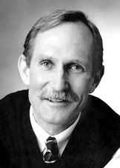
Hematology T32 Training Grant
Continuously funded since 1975
An estimated 95 previous T32 scholars, (including 1 Nobel Laureate!)
Clinical or bench research in benign
hematology – 5 slots

Slide 22
Previous Benign Hematology Trainees
2016
  Joan Beckman—U Minnesota, Asst Professor
  Damon Houghton—Mayo Clinic, Asst Professor
2015
  Karlyn Martin—Northwestern—Asst Professor
2014
  Ming Lim—University of Utah—Asst Professor
2013
  Brandi Reeves -- UNC
2011
  Marshall Mazepa—U Wisconsin
  Payal Desai – Ohio State
  Micah Mooberry -- UNC

Slide 23

Clinical / Translational
Research at UNC:
Opportunities for Fellows

Slide 24
Clinical / Translational Research Training @ UNC
Guiding principles:
Complete a portfolio of work within fellowship timeframe
Develop relationship with > 1 mentor
Create an individual, coherent body of work
Have fun ☺….
Clinical and Translational
Research Program
Tissue-based genomic/transcriptomic/proteomic profiling
Animal models
Investigator-initiated treatment and nontreatment trials
Global Heme/Oncology
BENCH
Tissue-based research
BEDSIDE
Therapeutic applications

Slide 25
UNC Infrastructure
Highly integrated, well-funded institution
Opportunities
  > 30 Division faculty with track record
  6 PhD members with collaborative roles
  > 400 UNC faculty working in Heme/Onc
Longstanding emphasis and focus on team science
  Multiple joint appointments with Schools of Public Health and Pharmacy
  Training grant opportunities across this landscape
  Divisional commitment to supporting research years

Slide 26
General Approach for Heme/Onc Fellows
Experienced
  Mentor relationship built at the outset
  Resources, trajectory, oversight planning before arrival
  Work can start as early as 1st year
Inexperienced but bright and enthusiastic
  Exposure to breadth of research early 1st year
  Designated faculty guidance
  Find mentor, start working within that umbrella 2nd yr+
Training: Alphabet soup programs - MSCR, MPH, TraCS…

Slide 27
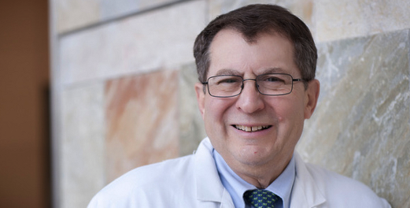
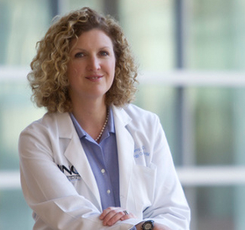
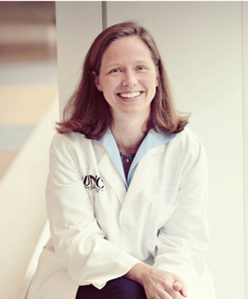
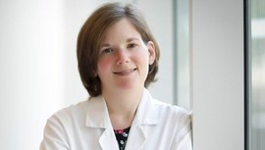
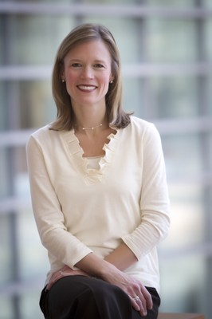
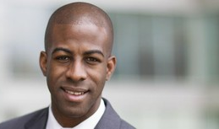
BREAST CANCER
Hy Muss
Geriatric Oncology
Lisa Carey
Biomarkers,
clinical trials
Claire Dees
Drug Development
Phase I
Katie Reeder-Hayes
Health Services
& Outcomes
Carey Anders
Brain metastases,
Clinical trials
Trevor Jolly
Geriatric Oncology

Slide 28
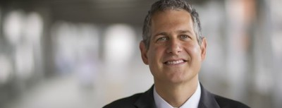
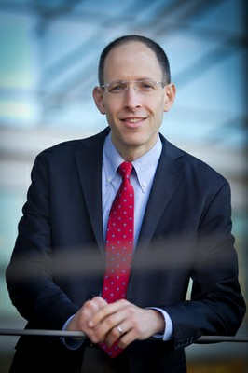
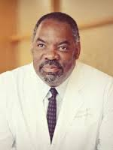
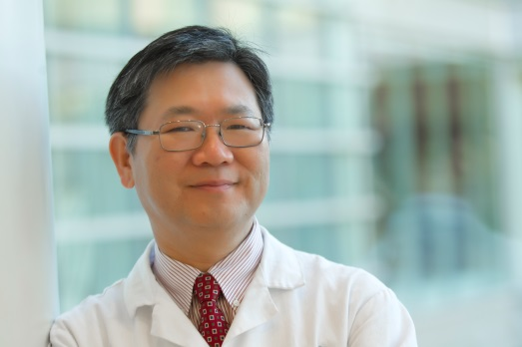
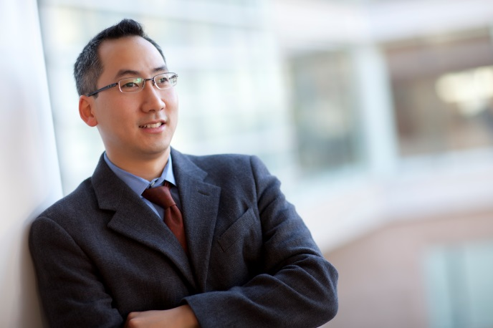
Example: GU CANCER
Ethan Basch
Health Services & Outcomes
Matt Milowsky
Bladder Cancer
GU Clinical Trials
Tracy Rose
GU Cancer
Clinical Trials and outcomes
Young Whang
Prostate Cancer
Paul Godley
Prostate Cancer
Disparities, Outcomes
Billy Kim
Translational Research

Slide 29
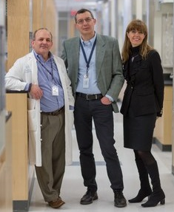
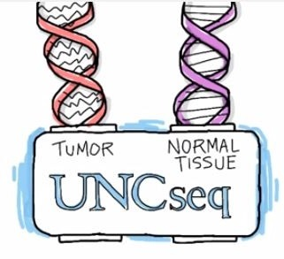
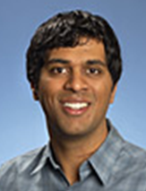

Preparation Meets Opportunity
New cGMP facility for cellular Rx
CAR T trials
$3m correlative immunooncology
Mouse Phase I Unit
32 funded grant proposals: $25M
Success: Cell, Nature, Cancer Cell, Cancer Disc
5,000 cages
Small animal imaging (PET/CT, MRI, U/S)
PK/PD monitoring
Multiple Labs
CPO, LCCC, Marsico, Genetics, MBRB
100% funding for PhD faculty
305 total publications in FY16
8 only authored
61 first authored
75 last authored

Slide 30
Finding Your Research Niche
Clinical
trials
Translational
research
Health
Services
research
Learning the ropes
1st year – conferences, seminars, discussions with faculty
1st-2nd year – Ongoing talks with Drs. Ma and Kim
Facilitated discussions with relevant faculty
Recommendations for specific training program
Getting attached and funded
3rd (?4th) year - MAGIC

Slide 31
Summary
UNC provides a rich resource for “clinical” research
  Large Division, most do funded research
  Clinical / Translational / Health services research
  Myriad training grants and support
Goals for fellows training in clinical research:
  Develop a portfolio
  Differentiate yourself
  Develop the skills to run your own program

Slide 32
Research Orientation to the Lineberger Comprehensive Cancer Center
William Y. Kim, MD
Rush S. Dickson Associate professor of medicine and genetics
Associate director for research, Hematology/Oncology fellowship
Jonathan S. Serody, MD
Elizabeth Thomas Professor of Medicine, Microbiology and Immunology
Associate Director Translational Science Lineberger Cancer Center
Associate Chief Division of Hematology and Oncology
Notes:
I was at a career cross roads a few years ago.
I had been offered job running oncologic drug discovery at one of the world’s largest pharmaceutical companies.
While considering that option, I realized that I was most passionate about Cancer Rsch in this Univ in this state, and thefore there was no better job for me than running this center.
The epiphany exaclty co-incided with the succession planning described by Bill Roper, and I happily started as Ca Ctr director in 2014.

Slide 33
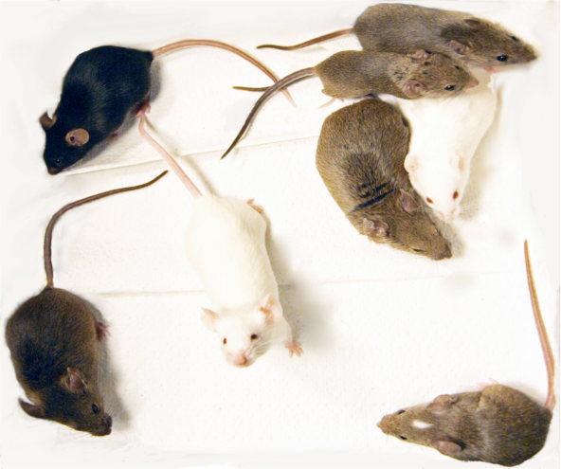
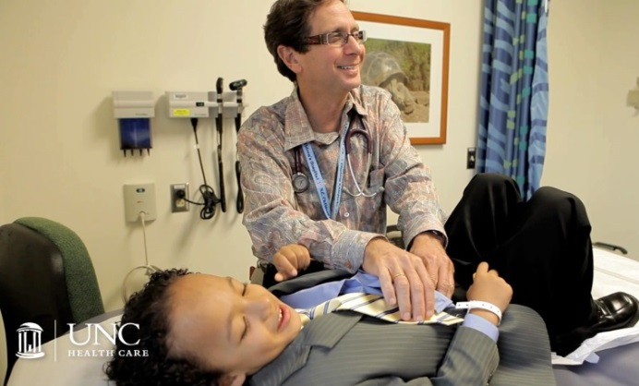
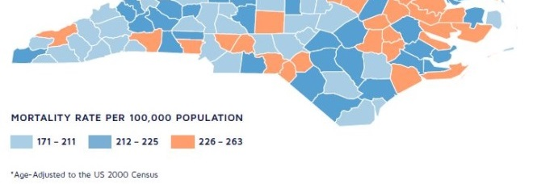
UNC Lineberger:
NC’S PUBLIC COMPREHENSIVE CANCER CENTER.
MATRIX CANCER CENTER EMBEDDED IN UNC-CH.
AREAS OF FOCUS
    Population Sciences Research
    Dissemination and outreach in NC
    Economic Development
    Clinical Excellence
    Basic Research
    Clinical and Translational Research
Notes:
NC’s public comprehensive ca ctr.
We are a Matrix Ca Ctr embedded within UNC, an outstanding public university
Here are areas of focus, similar to other com ca ctr. We think we are exceptional in all of these areas as you will hear today.
We go from model organisms to patients to populations in the state and the nation

Slide 34

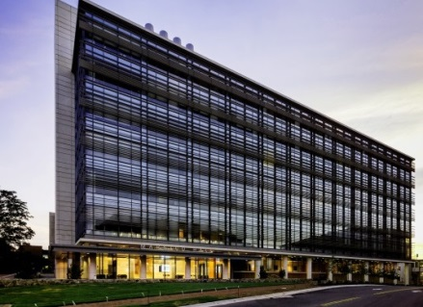
Facilities
Lineberger Bldg: 79,000 nsf
  NC Cancer Hospital
  Clinical space increased 3-fold
  Research space: clinical trials unit,
  Protocol office, PK/PD Lab
  53 Inpatient Beds
  BMT Unit in Neuropsychiatry Hospital with additional 24 beds
Marsico Hall: 22,000 nsf
(Opened 2014)
Notes:
14:10

Slide 35
NCI Funding Over The Past 8 Years
2016 NCI FUNDING:
Michigan $60.2M
Stanford $56.1M
UNC $54.4M
Wash U $42.3M
Duke $39.1M
Emory $24.4M
(9th among matrix cancer centers)
http://report.nih.gov/award/index
Notes:
25

Slide 36
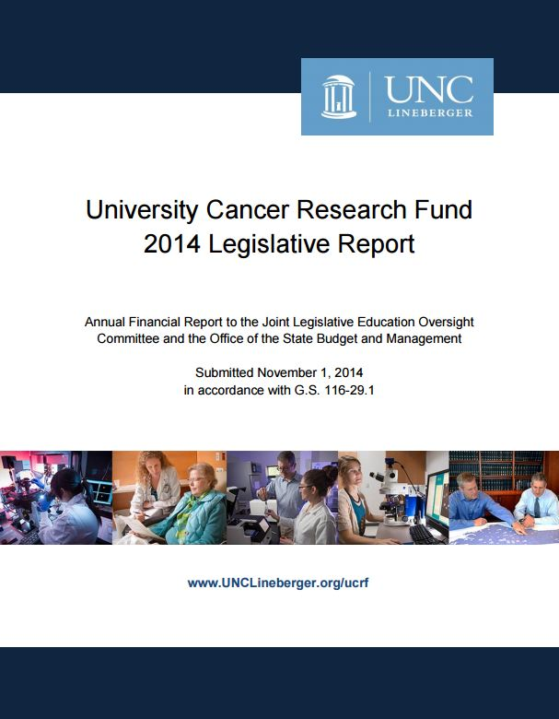
University Cancer Research Fund
Funded $395M for cancer research through 2008-2015 (with $46.4M in FY2016).
Institutional impact:
  Recruitment/Retention >180 faculty
  Major investment – genomics, NGS and bioinformatics, cellular immunotherapy program
  Built population and hospital cohorts
  Created informatics and big data infrastructure
  Developed therapeutics, devices and diagnostics
  Statewide outreach and network support
https://unclineberger.org/ucrf/ucrf-annual-reports/UCRFLegislativeReport2014FINAL.pdf
  In 2014, the UCRF funding created 2,250 NC jobs and generated $333M in economic impact
Notes:
27:10

Slide 37

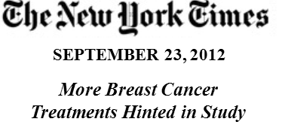
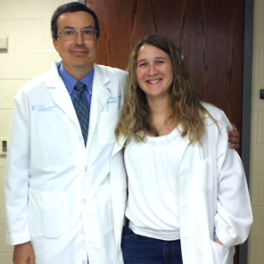
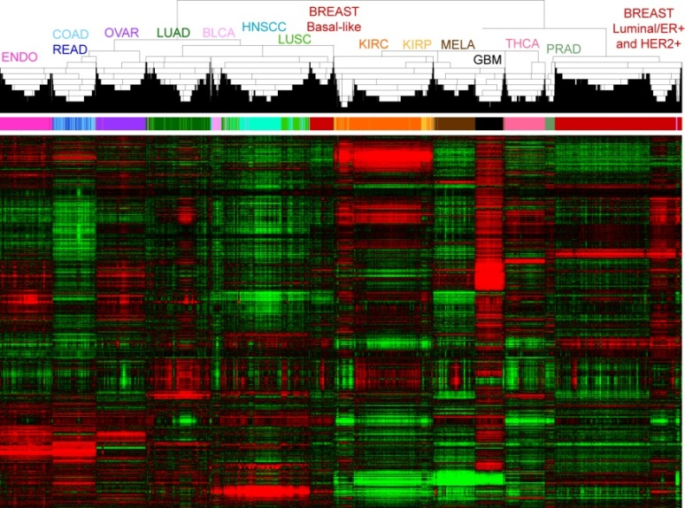
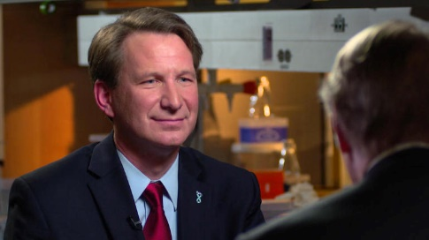
Cancer Genomics: National Leadership
CHUCK PEROU, KATIE HOADLEY
LCCC 1108 –UNCseq
Over 2,900 patients consented
28 tumor types
10,000 samples
>100 trillion bases
60 Minutes piece on IBM Watson
--Hoadley, Cell, 2014
https://www.youtube.com/watch?v=Y9HumO20GKc
Notes:
Provided samples, sequencing capacity and analysis for the TCGA
Work has led to more than 20 high-profile papers that were led by LCCC members
Also, we have translated the knowledge of somatic tumor sequencing into patient care, with LCCC 1108 (or UNCseq).

Slide 38
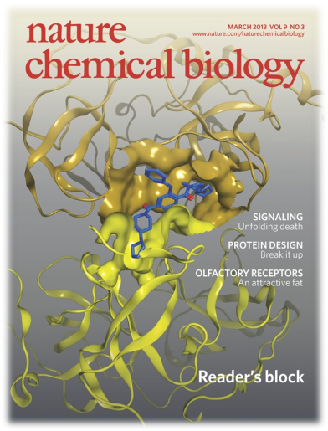
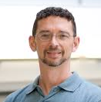
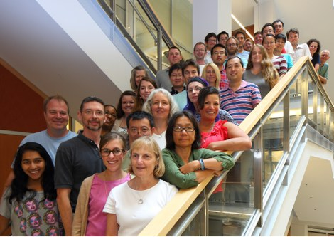
Discovering Cancer Drugs
CENTER FOR INTEGRATIVE CHEMICAL BIOLOGY AND DRUG DISCOVERY (CICBDD)
Many Cancer Projects:
Mer Inhibitors for Pediatric Leukemia
IDH1 Inhibitors for Glioma, Leukemia
>$14M in funded proposals
Science Focus:
Chemical Biology of Chromatin Regulation
55+ publications: Nature Chemical Biology, PNAS, Cell, Science
2 Oncology start-ups with LCCC founders
Ongoing Expansion:
New recruitment: Jeff Aubé (U of K), Tim Willson (GSK)
Leveraging $100M gift to Eshelman School of Pharmacy
STEPHEN FRYE (MT)
CICBDD DIRECTOR

Slide 39

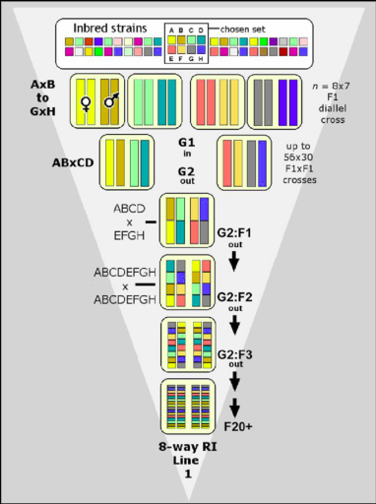
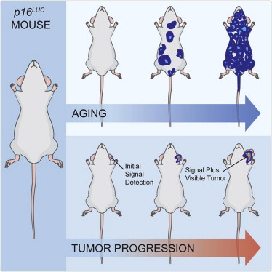
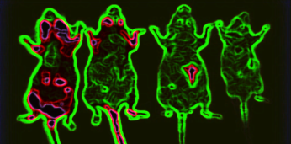
Studying Cancer in the Mouse
MOUSE PHASE I UNIT
50+ partners in academia and industry
40+ publications (e.g. Cell, Nature, Cancer Cell, Cancer Disco.)
32 funded grant proposals: $25M
5,000 cages for serial housing
Small animal imaging (PET/CT, Optical, MRI, U/S)
Pharmacokinetics and Pharmacodynamic Monitoring
COLLABORATIVE CROSS
80+ publications since 2011
Example:
Pardo-Manuel de Villena et al., Nature Genetics, 2015
Sharpless et al., Cell 2013

Slide 40
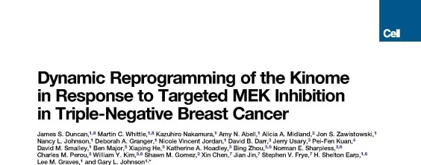




Kinoming
In progress trials in melanoma, lung, lymphoma and breast cancer
FUNDING: NCI R01, Komen, MRA, LLS, V Foundation, Lustgarten
Ben Major
GARY JOHNSON
STERGIOS MOSCHOS
2014 CANCER CLINICAL INVESTIGATOR TEAM LEADERSHIP AWARDEE
Notes:
23:40

Slide 41






Cellular Immunotherapy Program
    Developed the sixth CAR-T cell program in the United States
    cGMP facility built and functioning off HWY 54 on Quadrangle Boulevard
    Two CAR-T cell trials currently open at UNC
    CD30-CAR therapy after autologous SCT for patients with relapsed/refractory Hodgkin and anaplastic large cell lymphoma
    CD30-CAR therapy for R/R patients not undergoing autograft
Developing novel murine CAR approaches to understanding efficacy in solid tumors
Identification of neoantigens from SNV, translocations and spliced variants
Biomarker discovery of response to checkpoint inhibitors
Plans for CAR therapy with suicide gene for ALL and
CAR therapy for myeloma in 2018
Support NCI RO1 x 3, NHLBI RO1, LLS, NCI SPORE, NCI T32, UCRF & industry

Slide 42

LCCC Entrepreneurship
Notes:
24:15

Slide 43
Division of Hematology/Oncology Members
There are six divisional members who have space and or resource commitment for laboratory work in the Lineberger Cancer Center
  Also a much larger number of PhD investigators in the Cancer Center who have trained MD/MD PhD fellows
There are four divisional investigators with laboratory-based research in the Carolina Cardiovascular Biology Center

Slide 44




Jonathan Serody, MD
Evaluations of the role of innate lymphoid cells in treating GI tract GVHD
Interactions of immune and stromal cells and their roles in tumor growth
Biomarker Response to Checkpoint Inhibitor Therapy
Th17-mediated lung inflammation and GVHD
12 Manuscripts with Ben Vincent including publications in Nature Nanotechnology, JNCI, JCI x 3
Oncology Fellow

Slide 45




William Kim, MD
Oncology Fellow
CLINICAL/TRANSLATIONAL RESEARCH
Cancer genomics (TCGA)
Discovery of luminal and basal molecular subtypes of bladder cancer
Genetic models of cancer using mice
Immunotherapy/immunogenomics

Slide 46

Chad Pecot, MD
Lung tumor models of metastasis and angiogenesis
Regulation of anti-tumor activity mediated by micro RNA

Slide 47

Ben Vincent MD
Immunogenomic evaluations in cancer and infectious complications of cancer
Neoantigen vaccination for cancer treatment
Novel approaches to interrogate immune activity from sequencing data

Slide 48


Nigel Mackman, PhD
Laboratory focuses on the role of tissue factor, coagulation proteases and protease activated receptors in hemostasis, thrombosis and inflammation.
They have generated a variety of novel mouse lines and study mechanisms of thrombosis in cancer, the role of the clotting cascade in viral infections and in cardiac injury.
Hematology Fellow

Slide 49
CDAs in basic or translational research obtained by fellows
Individual | CDA
Eben Lichtman | ASCO YIA
Ben Vincent | Komen, K12
Tracy Rose | BCAN YIA, K12
Jay Coghill | K08
Joan Beckman | Hemostasis and Thrombosis Research Society Mentored Research Award, K12
Hank van Deventer | K08
David Chism | LCCC Developmental Research Award
Autumn McRee | K12, LCCC Developmental Research Award
Note: this represents only basic and translational CDAs

Slide 50
Faculty Who Have Mentored MD Fellows in the Basic Sciences in the Cancer Center
Individual | Mentor
Shannon Penland/Jessica Fu/**Patrick Dillon/**Hanna Sanoff | Ned Sharpless
**Ben Vincent, **Jay Coghill/**Hank van Deventer/Judy Ng-Cashin | Jon Serody
**David Chism, **Autumn McRee, **Tracy Rose, Mingqing Li, | Billy Kim
Jeremiah Boles | Nigel Mackman
**Brandi Reeves | Rafal Pawlinski
Eben Lichtman*, Raghuveer Ranganathan* | Gianpietro Dotti
Yvonne Chao* | Chad Pecot
Mark Woodcock* | Benjamin Vincent
*Current fellows
**Academic Faculty Members

Slide 51
LCCC Core Facilities
Animal models, Animal experiments and protocols, and Histopathology
Genomics and Bioinformatics
  Human and mouse microarrays, expression data from RNA from any source, custom arrays
  Massive parallel sequencing (4 platforms on campus; Illumina, 454, PacBio and Ion Torrent)
Immunogenomics Facility
    Neoantigen identification, adaptive immune receptor repertoire evaluation, mRNA-sequencing, flow cytometry and IHC from tumor samples
Flow Cytometry
Proteomics/Mass Spec
Tissue Procurement

Slide 52
Why MD Fellows:
Fellows are better at making the work clinically relevant.
Fellows are easier to fund.
Fellows are good at bureaucracy needed for human studies.
LCCC scientists will be enthusiastic about working with you!

Slide 53

Questions?
William Kim
wykim@med.unc.edu
Jon Serody
jonathan_serody@med.unc.edu
Notes:
31:00

Slide 54
Opportunities for Training in
Population Research
UNC Hematology/Oncology Training Program
Bill Wood, MD, MPH
Hanna Sanoff, MD MPH
Ethan Basch, MD MSc
Katherine Reeder-Hayes, MD MBA MSc

Slide 55
WHY UNC?
Training
Access to resources
Access to mentorship

Slide 56
WHO CAN TRAIN AS A POPULATION SCIENTIST?
Fellows with prior research training or experience (MPH, biostats or epidemiology)
Fellows with strong interest in population health and desire for academic career development
Fellows who would like to know more and are willing to extend/work hard during fellowship

Slide 57
Elements of Population Science Training During Fellowship
Advanced Methods Training
Post-doctoral research fellowships
Didactic/degree opportunities
Gaining Research Experience
Mentoring from division members
Partnerships with the School of Public Health

Slide 58



UNC Cancer Research Training Programs
Cancer Control Education Program
NRSA Training Program
in
Health Services Research
Cancer Care
Quality
Training Program

Slide 59
Overview: CCQTP
Home: Department of Health Policy
Leader: Stephanie Wheeler, PhD, Associate Professor of Health Policy
Aim: Train clinician and non-clinician scientists to work in multidisciplinary research teams to improve the cancer care quality across the cancer care continuum
Participants: pre/post doc, MD + PhD
Elements: coursework (some specified), journal club, seminars, network in SPH

Slide 60
Overview: NRSA
Home: Sheps Center for Health Svcs Research
Leader: Tim Carey, MD+ Morris Weinberger, PhD
Aim: Trainees will gain experience in applying research methods to the systematic analysis and evaluation of health care services and health policy issues (focuses include disparities, comparative effectiveness, dissemination/implementation, not limited to cancer research)
Participants: pre/post doc, MD + PhD
Elements: coursework ($$ support, degree oriented, not specific classes), weekly seminar, network across campus

Slide 61
Overview: CCEP
Home: Lineberger Comp Cancer Center
Leader: Jo Anne L. Earp, Sc.D
Aim: trains pre- and postdoctoral fellows for careers as independent investigators in interdisciplinary and collaborative cancer prevention and control research.
Participants: pre/post doc, MD + PhD
Elements: diverse faculty mentoring, core courses and individualized training program

Slide 62
Didactic/Degree Programs
Master of Public Health (School of Public Health)
Master of Science in Clinical Research (Dept of Epidemiology)
NCTraCS Translational and Clinical Research Curriculum certificate program
https://tracs.unc.edu/index.php/services/education/translational-and-clinical-research-curriculum
Odum Institute for Research in Social Science short courses

Slide 63
What Can I do as a Population Science-Focused Fellow at UNC?

Slide 64




Personalized home-based interval exercise training may improve cardiorespiratory fitness in cancer patients preparing to undergo hematopoietic cell transplantation
Bone Marrow Transplant. 2016 Jul;51(7):967-72
William Wood, MD
Fig 2. Overview of exercise intervention.
Ethan Basch, MD

Slide 65


Neoadjuvant chemotherapy administration and time to cystectomy for muscle-invasive bladder cancer: An evaluation of transitions between academic and community settings.
Urol Oncol. 2015 Sep;33(9):386.e1-6
Highlights
• We analyze bladder cancer patients referred to an academic center for cystectomy
• We compare neoadjuvant chemotherapy in the community and in an academic center
• Receipt of chemotherapy in the community was associated with a delay in cystectomy
• Those treated in the community get the same chemotherapy and have similar outcomes
Tracy Rose, MD
Fig 1.
Overall survival in patients who received NAC in AMC and in the community
Ethan Basch, MD

Slide 66




Young Men With Cancer Experience Low Referral Rates for Fertility Counseling and Sperm Banking
J Oncol Pract. 2016 May;12(5):465-71.
Purpose: With improved cancer survival rates and the current trend of delaying parenthood, fertility is a growing issue among cancer patients. The purpose of this study was to evaluate the incidence of fertility counseling and sperm banking in reproductive-age male cancer patients and to assess factors that influence counseling and banking.
Natalie Grover, MD
Statewide geographic variation in outcomes for adults with acute myeloid leukemia in North Carolina.
William Wood, MD
Cancer. 2016 Jun 28.
Hazard ratios (HRs) with 95% confidence intervals are illustrated from a survival analyses according to Area Health Education Centers region for adults with acute myeloid leukemia in North Carolina who received inpatient chemotherapy from 2003 to 2009 (n = 553). Cities with populations > 100,000 are noted.
Ashley Freeman, MD

Slide 67




Katherine Reeder-Hayes, MD, MBA, MSc
This study found significant disparities in the receipt of SLNB, an innovative and morbidity-sparing procedure for early-stage breast cancer, among vulnerable populations including African-American women, those of low socioeconomic status, and the elderly. These disparities appear to persist over time, with only slight attenuation after controlling for geographic and institutional factors.
Paul Godley, MD PhD
Fig 1. Estimated SLNB rates by race 2000–2002. *Adjusted for age, marital status, medicaid eligibility, comorbidity score, educational attainment, tumor grade and stage, ER status, institutional coop group affiliation, SEER region

Slide 68


Race, response to chemotherapy, and outcome within clinical breast cancer subtypes.
Breast Cancer Res Treat. 2015 Apr;150(3):667-74.
Jill Tichy, MD
Katie Reeder-Hayes, MD, MBA, MSc
Fig 1.
a Time to recurrence, b overall survival

Slide 69




Hanna Sanoff, MD
Fig 2. Percentage of elderly patients with stage III colon cancer treated with chemotherapy.

Slide 70



Grant Williams, MD
“If positive, findings from this pilot study would suggest the potential for improving the care of older persons with CRC undergoing adjuvant chemotherapy through a home-based physical activity intervention to manage fatigue, HRQOL, and physical function.”
Contemp Clin Trials. 2015 May;42:90-7.
Hanna Sanoff, MD
Fig. 1. Study design.

Slide 71



Tyler Buckner, MD, MSc
African-Americans have a higher rate of proximal deep vein thrombosis at presentation.
Thromb Res. 2010 Sep;126(3):e246-7

Slide 72
Domains of Population Research: Heme Onc Faculty
Patient Reported Outcomes
Quality of Care
Comparative Effectiveness
Cost
Race and Age Disparities
Provider and System-Level Factors
Qualitative and Survey Methods
Dissemination/Implementation
Behavioral Interventions
Physical Activity Interventions
Supportive Care Interventions

Slide 73
Lineberger Resources:
Cancer Outcomes Research Program
Weekly breakfast meeting
Listserv/social media networking
Monthly Grand Rounds

Slide 74
Lineberger Resources: CIPHR
Carolina Information and Population Health Resource
a data resource: NC Central Cancer Registry linked to multiple payer claims (commercial, Medicare, Medicaid)—80% of NC cancer cases
a facility: office and meeting space
a team: Big Data analysts/ programmers, secure data storage, IT infrastructure and support, multi-disciplinary investigators

Slide 75

UNC Project-Malawi
Current Heme-Onc Activities

Slide 76


Malawi country profile
Population ~15.3 million
(NC ~9.7)
Surface area ~45,700 square miles
(NC ~48,600)
Life expectancy 56 years
(US 78 years)
Annual GDP per capita 318 USD
(US 47,199)
Human Development Index rank 171 out of 187 countries
(US 4)
HIV prevalence 11% in 2009
Severely limited cancer facilities
  No RT
  4 pathologists
  2 clinical oncologists
  2 hematologists
  1 medical oncologist
MALAWI
United Nations
UN Development Program
UNAIDS
Notes:
Malawi, ‘the warm heart of Africa’, is a small country in southern Africa, slightly smaller than North Carolina, with roughly 1.5 times our state’s population.
Life expectancy, average annual GDP per capita, and Human Development Index rank are all shown with comparison to the US.
11% of Malawians were HIV-infected in 2009, with more than 40% of those needing ART receiving it.
Cancer services are sparse, and cancer is the leading indication for referral outside Malawi for patients able to travel to neighboring countries or India.

Slide 77


UNC Project-Malawi
>20-year collaboration between UNC and Malawi Ministry of Health, established in 1991
Based in the capital Lilongwe at Kamuzu Central Hospital (KCH)
1000-bed public tertiary care hospital
1 of 2 national teaching hospitals serving a catchment area of 4-5 million people
>350 employees, 40,000 square-feet, extensive community engagement
Longstanding involvement of UNC IGHID, Lineberger, Surgery, Women’s Health, Gillings School of Global Public Health
Training site for Fogarty AIDS International Training and Research Program
Clinical trial site for protocols implemented through numerous multinational NIH-sponsored networks (ACTG, HPTN, IMPAACT, CHAVI, AMC)
Notes:
Our program dates originally to 1991, and is a formal collaboration with the Malawi Ministry of Health.
We are based in the capital, Lilongwe, right in the middle of the country, at Kamuzu Central Hospital, 1 of 2 national teaching hospitals.
One of our great strengths is the infrastructure we have on the ground, led by Dr. Francis Martinson, our country director, and Innocent Mofolo, who’ve personally helped me with everything from finding a house and schools for my daughters, to filling our gas tank during one of our many petrol shortages.
Our second major strength is the engagement of departments and divisions across UNC, including not only our ID division which launched the program, but our Cancer Center, Departments of Surgery and Ob-Gyn, as well as our renowned School of Public Health.
The strength and breadth of these roots in Malawi, and also in Chapel Hill, have led us to be an obvious site for inclusion in nearly all NIH-sponsored networks conducting studies in sub-Saharan Africa.

Slide 78




Malawi National Cancer Registry (n = 18,946; 2007-2010)
Men
Women
Msyamboza et al, BMC Res Notes 2012
Notes:
The nice thing for us in Malawi is that we can compare hospital data from our pathology lab with population data from our national cancer registry, which is based in Blantyre and to which we contribute.
As I showed you earlier in Uganda, overall cancer incidence has also increased markedly in Malawi among both men and women in recent years.

Slide 79

KCH Pathology Laboratory
UNC Project-Malawi and KCH collaboration
200,000 USD renovations and installation of new equipment
Aperio virtual microscopy system installed for long-distance virtual consultation
Operational since July 2011
Specimen review provided by Prof. George Liomba
Immunohistochemical staining implemented
>10,000 specimens reviewed to date
Gopal et al, Lancet Oncol 2013; Gopal et al, PLOS ONE 2013; Montgomery et al, USCAP 2015
Notes:
In Lilongwe, we established a pathology laboratory the year before I arrived, largely through NIH funding to support two phase III clinical trials for KS which are cosponsored by Corey’s KS Working Group of the AIDS Malignancy Consortium and also the AIDS Clinical Trials Group. Before this, diagnostic pathology was only available in Blantyre, Malawi’s second largest city.

Slide 80


KCH Pathology Laboratory
Jul 2011-Feb 2013
Gopal et al, Lancet Oncol 2013; Gopal et al, PLOS ONE 2013; Montgomery et al, USCAP 2015
Notes:
I’m not aware that the de novo creation of a pathology laboratory in a city of one million people in sub-Saharan Africa had ever been previously described, and so we recently described our early experience. One third of all specimens submitted to the lab were invasive cancer. This always impresses visiting expat pathologists when they work in our lab, who are used to looking at a lot more benign slides. KS is significantly underrepresented as it is often not biopsied in routine care settings. HIV status was only known for about 10% of cancer cases overall, but there’s wide variation in prevalence across cancer types as expected, and each decade increase in patient age increased the odds of a submitted specimen being malignant by 33%.

