Slide 1
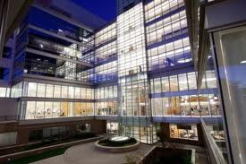
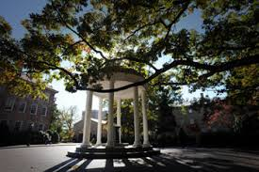
An Advertisement from the Program Director
Alice Ma, MD
alice_ma@med.unc.edu

Slide 2
Why come to Carolina?
Unique Programs
Strength
Growth
Flexibility
Leadership
Lifestyle

Slide 3
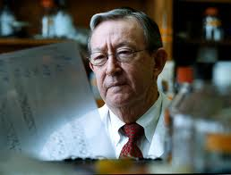
Benign Hematology
Harold R. Roberts
Historical strength of the program
Continued success in research
Depth and breadth in clinical services
6 coagulationists, 2 sickle cell specialists
We’ve trained national and international leaders in hemophilia
We invented the aPTT!!
And gave the first factor VIII concentrate, and have the longest running animal model of hemophilia, discovered FX and figured out the mechanism of rFVIIa action, etc. . .
We’re doing gene therapy for Hemophilia A and B!

Slide 4
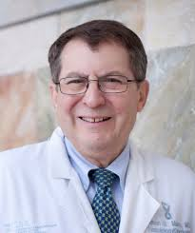
Geriatric Oncology
Dr. Hy Muss
Multidisciplinary Clinical Care for older patients with cancer
Research programs run from basic, translational, clinical, health services
We offer the combined ABIM fellowship track
Education for patients and providers
Run by Dr. Hy Muss, a national and international leader

Slide 5
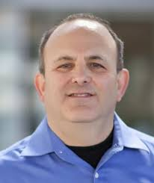
Immunotherapy Initiative
Jon Serody
Longstanding history in tumor and BMT immunobiology
GMP facility up and running to make our own CAR-T—one of 6 in the USA
Chimeric Antigen Receptor therapy for oncology patients
Fellow-level opportunities to participate at many levels in ground-breaking work
Other areas include neoantigen discovery, GVHD therapies, tumor vaccines
Initiative in Bioinformatics

Slide 6
Cancer Genomics
Billy Kim
The Cancer Genome Atlas
UNC is the home of RNA sequencing for the national TCGA
UNCSeq™
Focuses on ~260 actionable genes that are mutated in cancer
Mutations thought to be actionable reported back to patient record after clinical validation
Lots of data—we need fellows to write it up!!

Slide 7
UNC Project Malawi
Satish Gopal
Started in 1991, based in Lilongwe, at Kumuzo Central Hospital (KCH)
>350 staff, ID, women’s health, surgery, Heme Onc
Clinical trial site for protocols implemented through numerous multinational NIH-sponsored networks
Fellows may rotate for clinical or research activities, travel grants available
Wealth of clinical experiences and data

Slide 8
Growth
Research Funding
Clinical Volume
BMT/malignant hematology
Inpatient and outpatient volume
Support for programs
Mentoring program

Slide 9
UCRF (University Cancer Research Fund)
Line Item in the North Carolina State Budget to support cancer research at UNC--$40-50 million/yr
Has allowed for equipment and infrastructure
Pilot grants (fellows have gotten these!)
New investment into cancer-specific programs

Slide 10
Flexibility
Single or double board in hematology and/or oncology
ABIM alternate pathways
Onc/ID
Geriatrics/Onc
Peds HemeOnc/Medical Heme or Onc
ABIM research pathway
Clinical Practice Pathway

Slide 11
Get a Masters
The following training programs have funding for Masters degrees:
Hematology T32
Sheps Center in Health Sciences Research
Cancer Care Quality Program
Via the Preventive Medicine Residency
The heme onc division will also fund a masters degree for a well-qualified fellow (competitive)

Slide 12
Mentorship
Starts early in fellowship
Formative feedback given to trainee and fellowship program
Continues through junior faculty years

Slide 13
Leadership in Education
Dr. Alice Ma (Fellowship director) and Dr. Fran Collichio (Associate Fellowship Director for Education) are active in ASH and ASCO Education initiatives
This ties to fellows being nominated for positions within ASH and ASCO

Slide 14
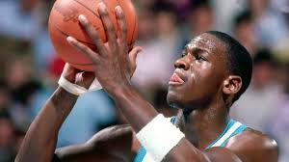
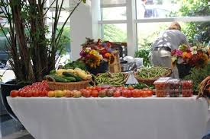
Livability
Small university town feel
Great climate
Arts and entertainment
College Basketball
Bon Appetite magazine named us the “foodiest small town in America”
There’s a farmer’s market in the hospital lobby. Really.

