Slide 1
Joanna Herath Service Line Administrator
New Fellow Orientation
Division of Gastroenterology and Hepatology

Slide 2
So you’re like Cuddy on “House”?
I am not the blood sucking business person I’m made out to be.

Slide 3
Purpose of An Administrator
Help you make money
Make the environment a good place to work
Make sure you have what you need to do your job every day
Be your advocate and representative to internal and external parties
Maintain Standards of Care
Do what’s best for the business

Slide 4
Program Overview
Pay the bills
Grow the business
Compensate/hire/ retain/ talented people
Function efficiently and effectively
Give good care
Go home at night
Don’t break the law
40 faculty members
150 employees
Educational Business
11 fellows
Clinical Business
15,000 clinic visits
13,000+ endoscopic procedures
Research business
$15M + research dollars

Slide 5
Book of Business I - Clinical Care
1) Clinic
1st floor NC Memorial
4th floor NC Memorial
3rd floor Meadowmont
Hospital Based Services
Operations are managed by the hospital
Hospital pays expenses associated with provision of care
Division pays faculty and other clinicians
Patients get 2 bills
Professional fee (clinician)
Technical/Facility fee (hospital)
2) Infusions
1st floor NC Memorial
3) GI Procedure Units
Basement NC Memorial
3rd floor Meadowmont
4) Motility
Basement NC Memorial
5) Inpatient Consult Services
GI
Hepatology

Slide 6
Clinical Volume Trends – FY 05 through FY 10

Slide 7
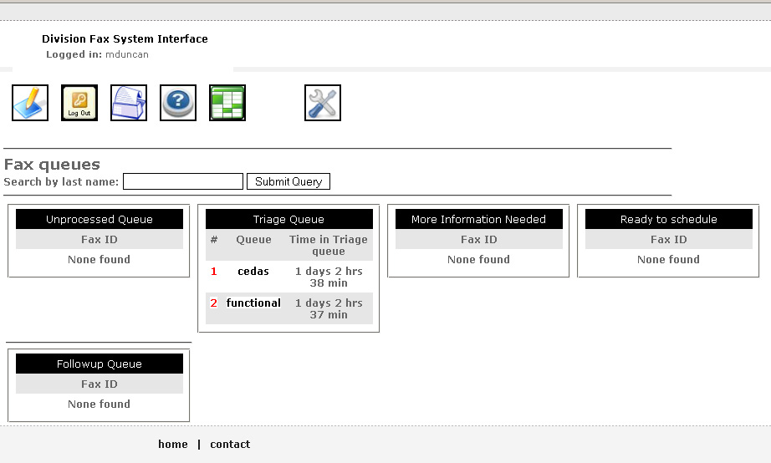
Referral portal

Slide 8
Margin Statement
Actual FYTD 10 - Apr
Budget FYTD10 - Apr
Variance
 | Rev | Exp | Margin |  | Rev | Exp | Margin |  | Rev | Exp | Margin
Revenue | 6,582,636 |  |  |  | 6,678,250 |  |  |  | (95,614)
Personnel |  | 3,171,508 |  |  |  | 3,117,503 |  |  |  | 54,005
Benefits |  | 993.762 |  |  |  | 928,328 |  |  |  | 65,434
HCS |  | 239.836 |  |  |  | 588,746 |  |  |  | 348,910
Supplies |  | 37.786 |  |  |  | 33,333 |  |  |  | 4,453
Travel |  | 12.624 |  |  |  | 12,500 |  |  |  | 124
Comm. |  | 42,127 |  |  |  | 33,333 |  |  |  | 8,794
Print |  | 6.010 |  |  |  | 4,167 |  |  |  | 1,843
Rep/Maint |  | 17.184 |  |  |  | 2,583 |  |  |  | 14,601
Advertising |  | 1.820 |  |  |  | 4,167 |  |  |  | (2,347)
Comp Svc |  | 8.798 |  |  |  | 7,500 |  |  |  | 1,298
Misc |  | 27.442 |  |  |  | 20,900 |  |  |  | 6,542
Fixed Costs |  | 4.608 |  |  |  | 4,167 |  |  |  | 441
Taxes |  | 1.983.797 |  |  |  | 2,011,399 |  |  |  | (27,602)
Clinic |  | -22 |  |  |  | 0
Total | 6,582,636 | 6,547,281 | 35,355 |  | 6,678,250 | 6,768,626 | (90,376) |  | (95,614) | (221,345) | 125,731
Adj |  | 69,736
Adj. Bal | 6,582,636 | 6,477,545 | 105,091 |  |  |  |  |  | (95,614) | 291,081 | 1954,67
Notes:
8

Slide 9
No Margin. No Mission.

Slide 10
Book of Business II - Education
Average Cost of a Clinical Fellow
$60,000-70,000
Salary +Benefits+ Medical Malpractice
How are expenses covered?
Clinical care
State funds
Donations/Fundraising

Slide 11
Book of Business III - Research
Federal Grants/ Clinical Trials / Foundation Grants
Central Staff
Center Administrator
Accounting Manager 2 technicians
Pre Award Manager
Clinical Trials Manager

Slide 12
Research Funding - 2009
Expenditures (millions) by units FY09 Award
60
$13,584,696
Source: OSR FY09 Annual Report

Slide 13
Research Rankings
Awards, Expenditures and Proposals, FY09
Awards | Expenditures | Proposals
Lineberger | Lineberger | Lineberger
Medicine | Medicine | CGIBD
Psychiatry | Psychiatry | Biochemistry
Pathology | Cystic Fibrosis | Psychiatry
Cystic Fibrosis | CGIBD | Pathology
CGIBD | Genetics | Genetics
Source: OSR F09 Annual Report

Slide 14
Program Overview
Pay the bills
Grow the business
Compensate/hire/ retain/ talented people
Function efficiently and effectively
Give good care
Go home at night
Don’t break the law
40 faculty members
150 employees
Educational Business
11 fellows
Clinical Business
15,000 clinic visits
13,000+ endoscopic procedures
Research business
$15M + research dollars

Slide 15
Summary
The GI Division is a leader in research, patient care, education based on objective measures
More research grants than most departments and center
Innovation in clinic management with outstanding metrics (no show, time to third appointment, satisfaction)
Referral portal that is envy of health care system
Online mentorship program for fellows and faculty

