Slide 1
Meaningful Use and Value-Based Care
Meaningful Use 2013
GI Resident Business Module
10/9/13
Maryanne Berry

Slide 2
What is Meaningful Use?
Part of American Reinvestment and Recovery Act of 2009, administered by CMS
It is an initiative that will not go away
We are in Stage 1 of 3
Data has to be in structured form
UNC qualifies for two separate programs, “Eligible Professionals” and “Eligible Hospitals”
Meaningful Use is one of several regulatory programs affecting the Electronic Medical Record (EMR) and Value-Based Purchasing
Starts with incentives, ends with penalties.
MU is driving the technology and functionality of the EMR, facilitating improvements in processes, and standardizing metrics.
Notes:
Use of a certified EHR in a meaningful manner
Electronic exchange of health information
EP for outpatient and EH for inpatient

Slide 3
Programs and Incentives
Providers who bill in their own name are able to earn incentives for their organization from CMS.
Medicare
Physicians only
Up to $44,000 over 5 years
Penalties for non-compliance start in 2015, based on 2013 data.
Medicaid
Physicians and Nurse Practitioners
Up to $63,750 over six years
While Residents cannot earn incentive and are not eligible alone, their performance impacts the rates of their Attending Physicians
Not only does MU prepare us for future quality programs, the incentive is helping pay for Epic and other costs.

Slide 4
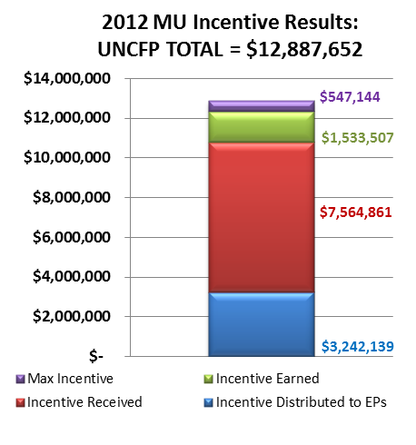
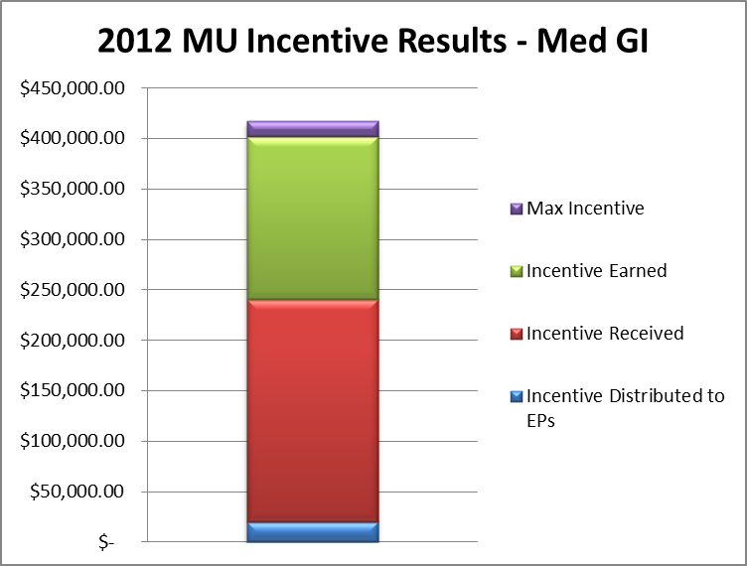
2012 Incentive Results
 | UNCFP | MED GI
Gross Max Incentive | $ 12,887,652 | $ 417,204
Gross Incentive Earned | $ 12,340,507 | $ 401,706
Gross Incentive Received | $ 10,807,000 | $ 240,500
Incentive Distributed to EPs | $ 3,242,139 | $ 20,277
UNC Health Care MU EP 2012 Gross Incentive
Notes:
MU is strategically important because it prepares us for many other quality and value-based purchasing programs. Structured data is the building block for all value-based purchasing. However, the incentive pay is also useful.
UNC Faculty Physicians earned $12.8M gross last year. Will earn less this year because of falling incentives but will still be significant.
Chart on right shows GI earned $417,204 gross.

Slide 5
MU Stage 1 at a Glance
8 Key MU Measures
Why are we doing this?
Measure | Goal
Problems | 80%
Allergies | 80%
Meds | 80%
eRx | 40%
HT/WT/BP | 50%
Smoking Status | 50%
Patient Clinical Summary | 50%
Patient Ed | 10%
The healthcare landscape will be different
Take advantage of incentives
Avoid penalties
Perhaps more importantly, MU is an initiative that is:
Strategic
Transformative
Directive, guiding
A component of the package to fulfill our vision of providing high quality care
MU Stage 1 has 26 measures. These 8 measures are the only ones that impact you in clinic for 2013.
Notes:
Explain each measure. Mention the badge cards. Problems, meds, and allergies must be active, coded, verified. Schedule II drugs are exempt from ePrescribing. Ht, Wt, BP must be recorded if patient is 3 or older. Smoking must be documented in 12 y/o and older. Patient clinical Summary must be printed or emailed. Patient education can be accomplished in 4 ways (Smoking Cessation, Problems, Meds, and Labs).

Slide 6
MU in 2013
Measures and goals stay the same
Reporting period extended to 12 Months, starting Jan 1st and ending Dec 31st
Most providers are in MU Stage 1, program year 2 in 2013
Patient Clinical Summary is critical to success – summaries must be provided to patients for more than 50% of office visits all year long
Failing to achieve MU in 2013 will lead to reimbursement penalties in 2015. Penalties follow the provider
2013 incentives decrease

Slide 7
MU in 2013
WebCIS will be here all of 2013, this is the EHR we have to use to demonstrate MU
Structured data matters, will be in the Data Warehouse, possibly in Epic
Coded problems, meds, allergies, etc, will be easier to migrate, report, and archive
Workflows that incorporate collection of coded data, spread among providers and staff may ease transition to Epic

Slide 8
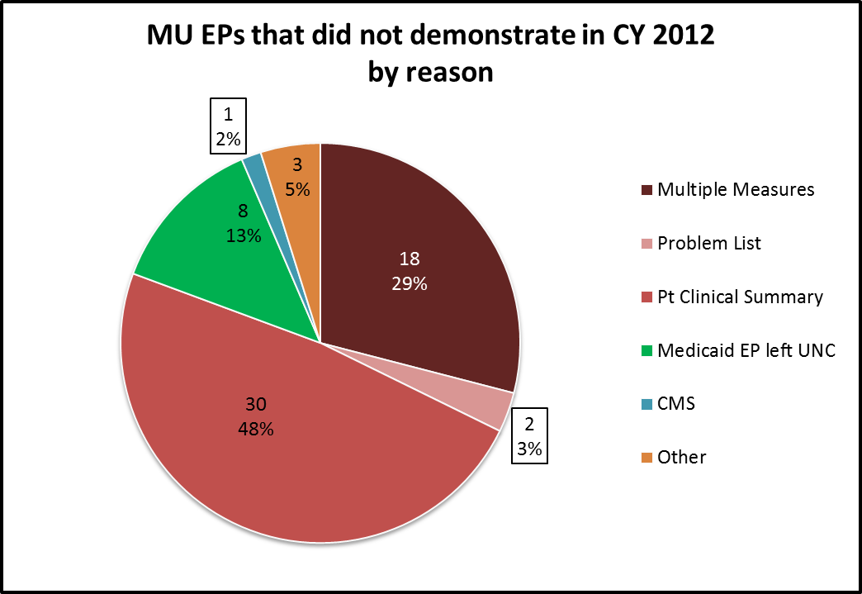
Patient Clinical Summary (PCS): Most challenging measure
A must-pass element; 50% of visits, ≤ 3 business days
Defined as an “after-visit summary” for patient engagement.
Should contain at least problems, medications, allergies
Must be printed and handed to the patient, mailed, or emailed.
If patient opts out, must document
Cannot generate and toss, we will not attest
Nurses can generate the PCS but info is physician-driven (e.g. problems)
The PCS is the most significant contributing factor for EPs that fail

Slide 9
2014 will be a big year!: MU Stage 2
Providers progress through stages as individuals
2014 will be earliest our providers will enter Stage 2
Will be done in Epic, not WebCIS
In stage 2, some thresholds change
Measures dependent on actions by others
Menu items in Stage 1 are Core (req’d) in Stage 2
More emphasis on exchange
Quality reporting alignment across CMS programs
MU2 demonstration to occur on a new EMR!

Slide 10
MU2 Threshold Changes
Measure | Stage 1 | Stage 2
Problems | 80%
Allergies | 80%
Meds | 80%
eRx | 40% | 50%
Vitals & Demographics | 50% | 80%
Smoking Status | 50% | 80%
Patient Clinical Summary | 50% within 3 business days | 50% within 1 business day
Patient Ed | 10%
Some of the Stage 2 changes to the current measures for 2014.
Notes:
Explain each measure. Mention the badge cards. Problems, meds, and allergies must be active, coded, verified. Schedule II drugs are exempt from ePrescribing. Ht, Wt, BP must be recorded if patient is 3 or older. Smoking must be documented in 12 y/o and older. Patient clinical Summary must be printed or emailed. Patient education can be accomplished in 3 ways.

Slide 11
MU2 Menu to Core Measure Changes
Lab Results +/- or numerical recorded as structured data (threshold raised from 40% to 55%)
Patient Lists (Generate at least one report listing patients of the EP with a specific condition)
Preventive/Follow-up Reminders (Use EHR to identify and provide reminders for > 10% of patients with 2 or more office visits in the last 2 years)
Medication Reconciliation (for > 50% of transitions of care)
Summary of Care record provided for each transition of care or referral (Problems, Meds, Allergies rolled into this measure)

Slide 12
Other MU2 Changes
Greater Focus on Patient Engagement
50% of patients must be invited to join the Patient Portal
5% of patients must use the Patient Portal at least once
5% of patients must use secure messaging
Focus on Transitions of Care
50% of care transitions must include a Summary of Care
Summary of the patient to be sent with referral
Medication Reconciliation required
Computer Physician Order Entry in ambulatory (aCPOE)
>60% of medication orders must be created electronically
>30% of lab and radiology orders must be created electronically
MU2 demonstration to occur on a new EMR!

Slide 13
PQI’s MU work: How we’ll help
Policy analysis
Administrative management
Eligibility review
Eligibility assessed annually, based on the prior year’s charges
New providers
Performance monitoring
Data shifts from rolling 90-day period to overall year-to-date
Improvement efforts within your practice
Support
Sustaining MU1 and Preparing for MU2, Epic, ICD-10
www. unchealthcare.org/mu – MeaningfulUse@unch.unc.org – (919) 966-7260

Slide 14
2014 will be a big year!: Epic
Software will not solve everything, it is a piece of the equation, not the solution
Go live at UNC: April 4, 2013

Slide 15
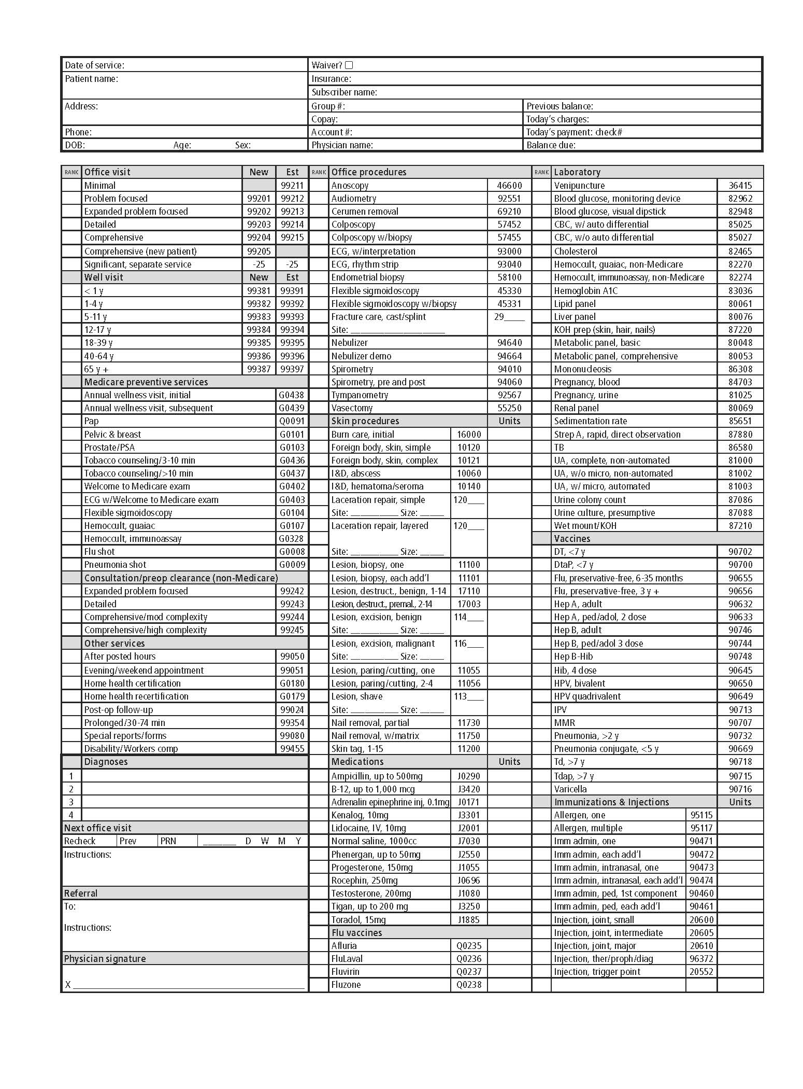
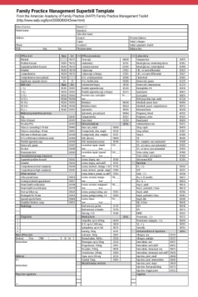
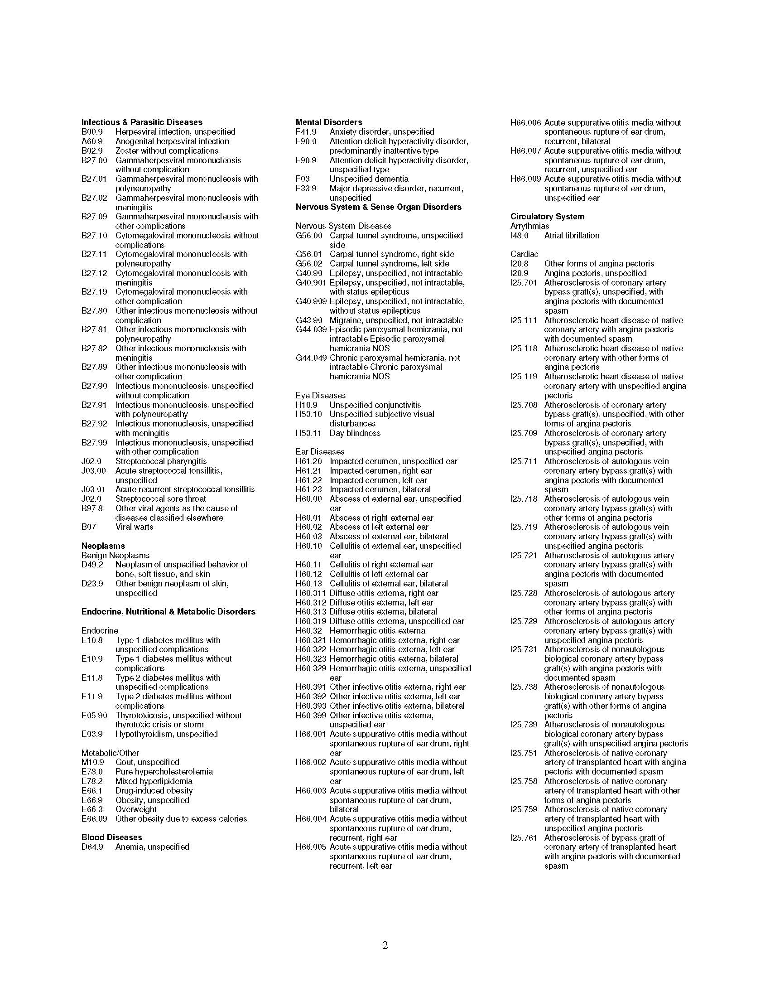
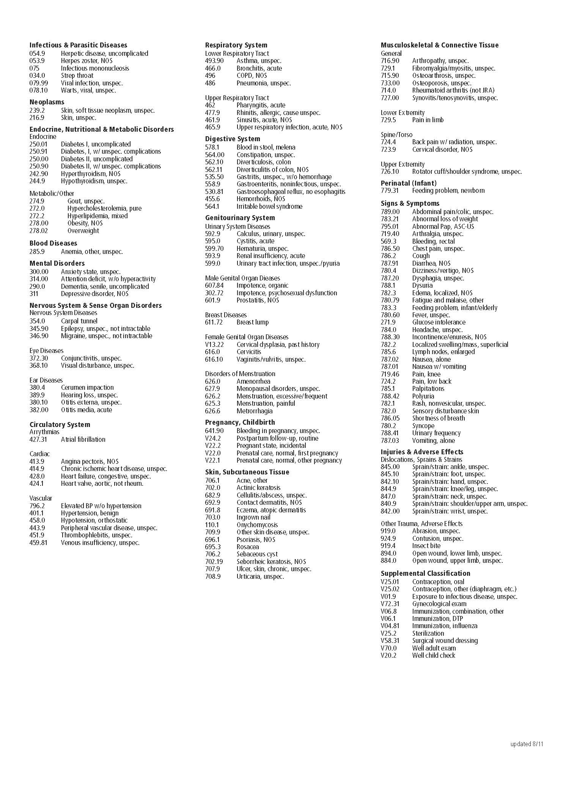
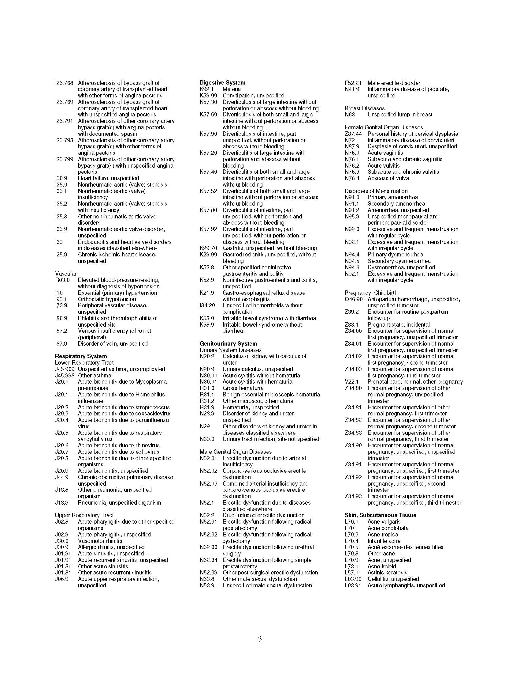
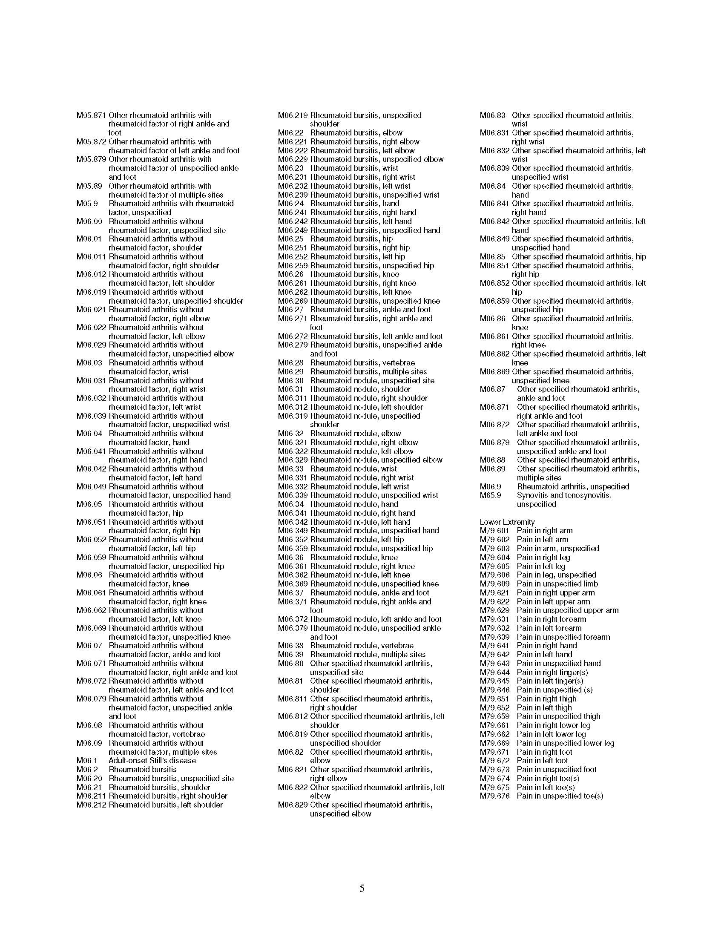
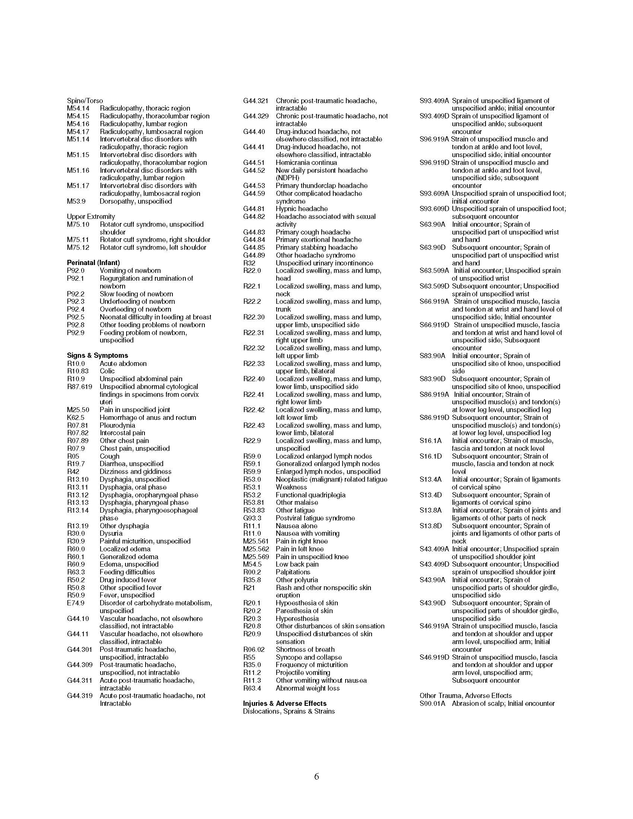
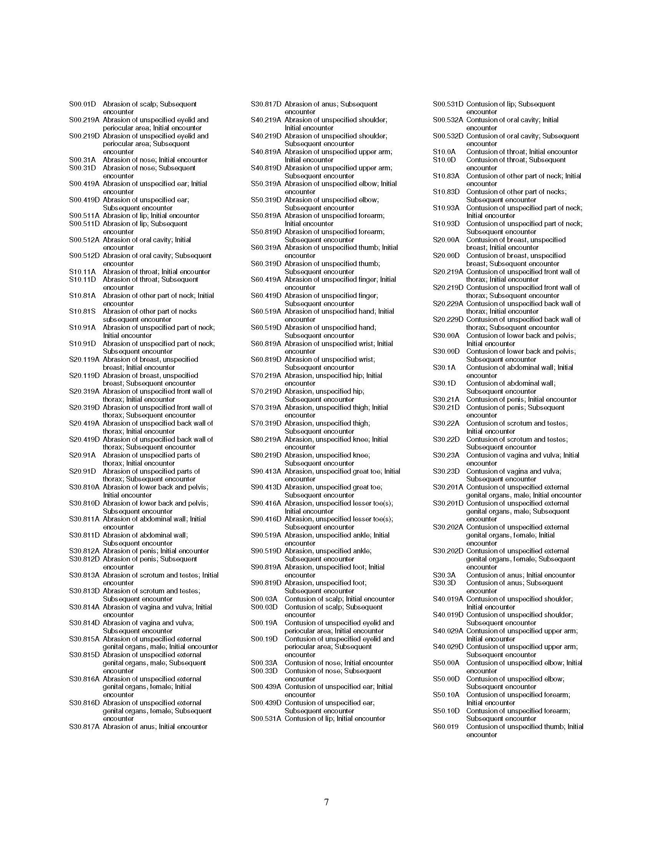
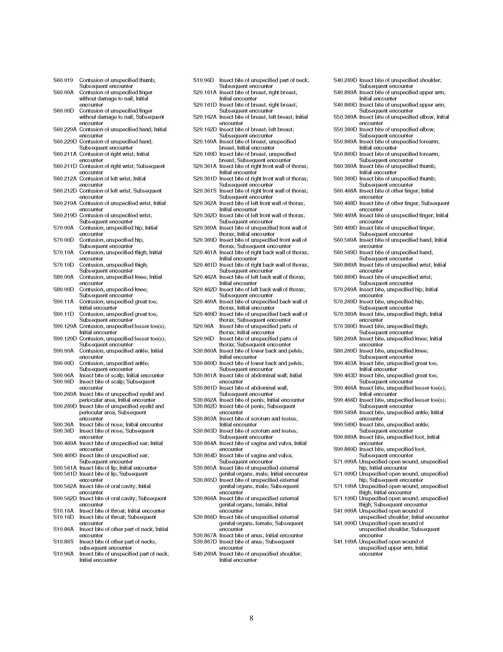
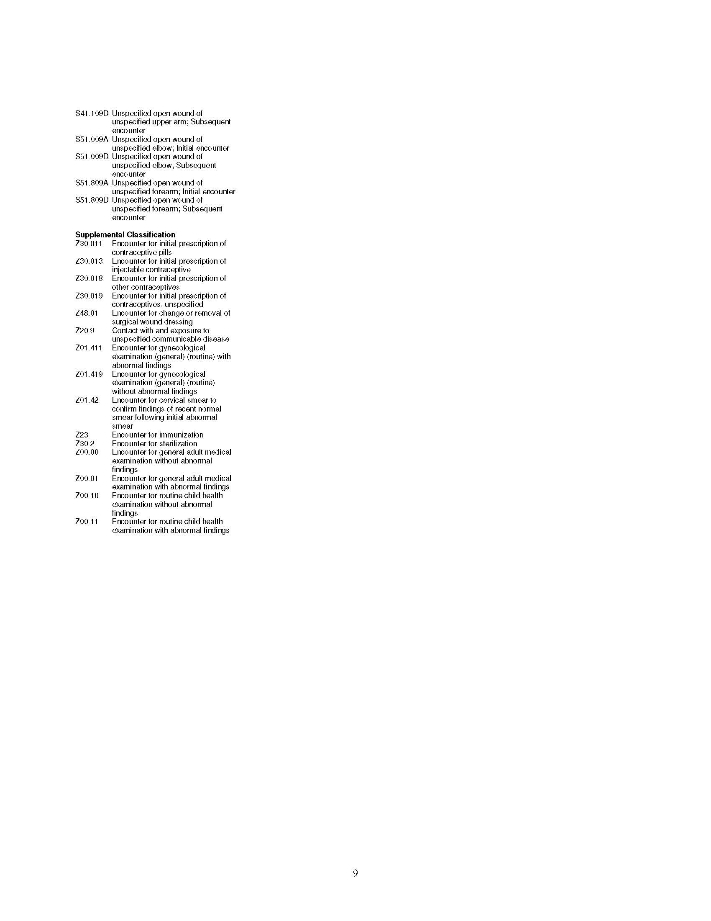
2014 will be a big year!: ICD-10
A change you will see and feel in encounter forms
What’s the major difference?
13,000 codes grow to 68,000
Includes laterality
More specific
What’s the date?
October 1, 2014
Today= 2 pages
Tomorrow= 9
ICD 9-CM Code Format
ICD 10-CM Code Format
X
X
X
.
X
X
X
X
X
.
X
X
X
X

Slide 16
Physician Quality Reporting System (PQRS)
System for measuring and reporting quality data to Medicare
Individual or group participation
Group reporting option focuses on primary care measures: diabetes, heart failure, coronary artery disease, preventive care
1.5% penalty beginning in 2015
Focus on Preventive Care (Breast Cancer and CRC Screenings)

Slide 17
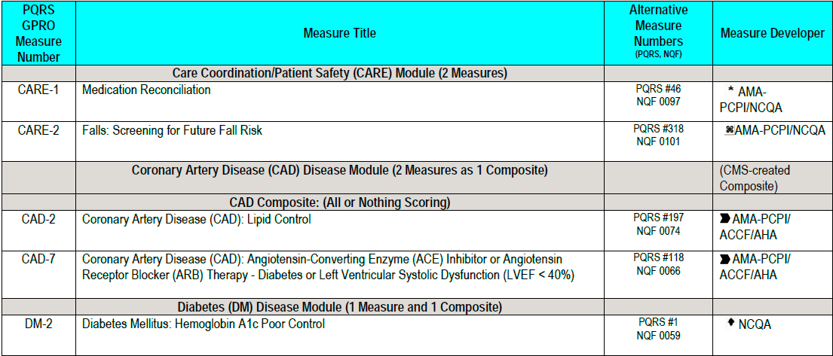
2013 PQRS GPRO Measures

Slide 18
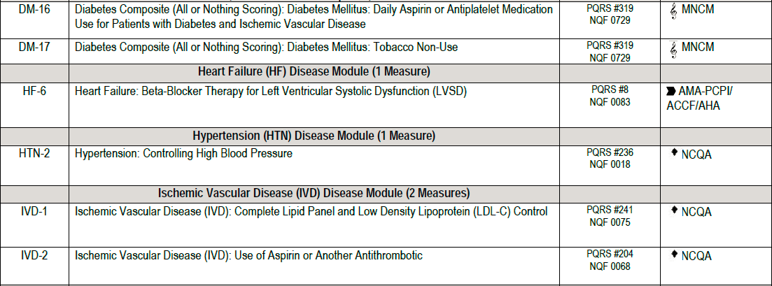
2013 PQRS GPRO Measures

Slide 19
2013 PQRS GPRO Measures

Slide 20
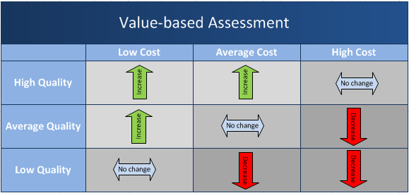
Value-based modifier is the initial transition from volume to value: 2015 Fee Schedule defines value as low cost/high quality
Revenue neutral program, there will be winners, losers, and a lot in between

Slide 21
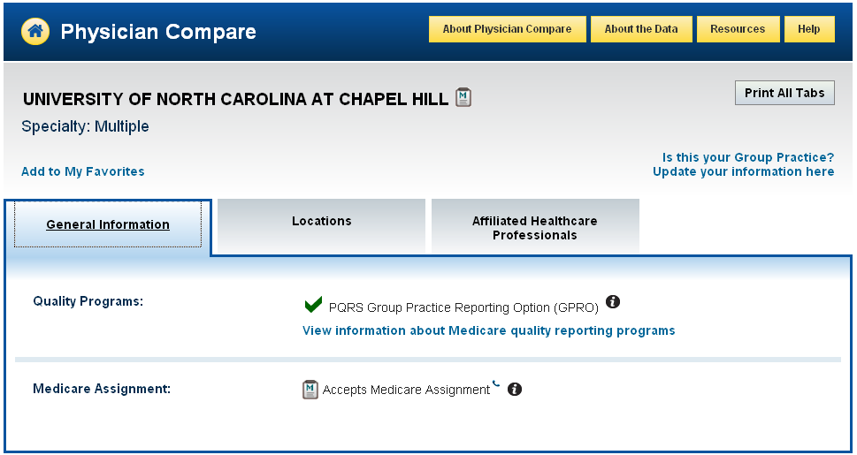
Physician Compare
http://www.medicare.gov/physiciancompare/search.html

Slide 22
Speed bumps on the road to Value
Incentives & Competing Priorities
Clinical, Financial, Administrative Processes
Data Quality & Integrity
Patient Engagement
Health Information Exchange

Slide 23
Benefits on the road to Value
Opportunities to align incentives
Opportunities for process improvement
Information about quality & outcomes
Enhanced Patient Engagement
Enabled Health Information Exchange

Slide 24
Your Quality Coach
Maryanne Berry, MSES, PMP
919.618.1319
Mberry@unch.unc.edu
Available to come to clinic

