Slide 1
Moderate Sedation: Principles and UNC Policy
Lisa M. Gangarosa MD
GI Core Curriculum

Slide 2
Sedation is a balancing act

Slide 3
What is moderate sedation?
A drug-induced depression of consciousness during which patients respond purposefully to verbal commands, either alone or accompanied by light tactile stimulation.
No interventions are required to maintain a patent airway, and spontaneous ventilation is adequate.
Cardiovascular function is usually
maintained.
UNC Moderate Sedation (Adult) Policy/Guidelines for Non-Anesthesiologists

Slide 4
Goals of Moderate Sedation
Patient comfortable and cooperative
Provide anxiolysis, analgesia, and amnesia
Minimize procedural risk
Rapid recovery

Slide 5
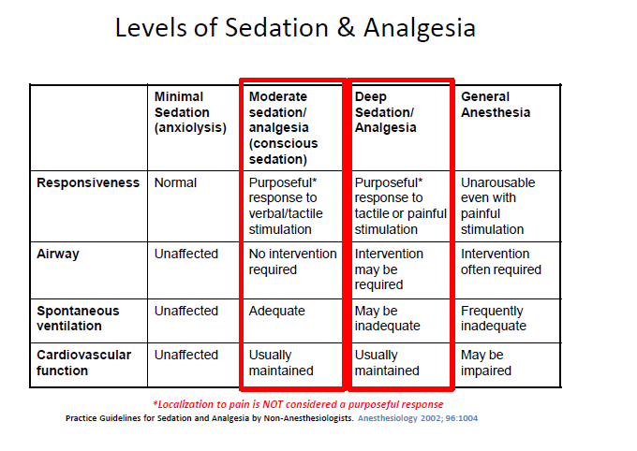
Sedation is Continuum

Slide 6
Pre Procedure: Consent
Consent
Explanation of the risks, benefits, and alternatives to sedation must be provided to patient.
The general consent for treatment encompasses moderate sedation when no other procedure is performed.
When a procedure is being performed in conjunction with the sedation, written consent for procedural sedation must be included with the procedural consent.

Slide 7
Pre Procedure: History
History
Medical Conditions: (for example) cardiac, pulmonary, renal, hepatic, endocrine, head trauma, prior intubation, stridor, snoring, sleep apnea
Past medication history, including previous adverse reactions to anesthesia/sedation
Prior surgeries and/or airway issues
Present medication regimen, especially medications taken within the last 48 hours
Allergies
Pregnancy status, when applicable
Tobacco, alcohol, or substance use/abuse
Last oral intake, which includes tube feedings
Exposure to infectious disease and the need for isolation procedures

Slide 8
Pre Procedure: Physical Exam
1. Cardiac
2. Pulmonary
3. Airway (Complicated airway examples include, but are not limited to):
a. Habitus
b. Head and Neck
c. Mouth
d. Jaw
4. Examination specific to the procedure proposed
5. Ability to lie in required position for the procedure

Slide 9
Physical Exam
Assessment and documentation of the airway should be done prior to any sedation performed. There are certain objective measurements that can predict the degree of difficulty of both mask ventilation and intubation. However, a normal airway exam does NOT rule out the possibility of an unanticipated difficult airway.

Slide 10
The airway exam is designed to help identify those patients who may be a difficult face mask ventilation and/or difficult intubation using standard techniques. This airway assessment will NOT predict every difficult airway.

Slide 11
According to the American Society of Anesthesiologists (ASA):
Difficult Airway is the existence of clinical factors that complicate either ventilation administered by face mask or intubation performed by experienced and skilled clinicians.
Difficult mask ventilation describes the situation in which it may be difficult or impossible to oxygenate and ventilate a patient using a bag mask technique.
-Difficult tracheal intubation describes a situation in which it may be difficult or impossible to correctly place an endotracheal tube into the patient’s airway.
It has also been defined by the need for more than three intubation attempts or attempts at intubation that last > 10 min.

Slide 12
Ease of Mask Ventilation
Grade I- Mask ventilated easily
Grade II- Mask ventilated with an adjunct (oral airway or nasal trumpet)
Grade III- Difficult to mask ventilate even with airway adjunct
Grade IV- Unable to mask ventilate

Slide 13
Indicators of Potential Difficult Intubation
Significant Obesity
Head and Neck
Short thyromental distance
Limited neck range of motion
Facial or neck trauma, tumor, edema, abscess or hematoma
Tracheal deviation
Large neck circumference
Dysmorphic facial features
Excessive Facial Hair
Mouth
Small mouth opening
Macroglossia
Protruding incisors
Small interincisor distance
Edentulous
Inability to prognath
Tonsillar hypertrophy
High arched palate
Jaw
Micrognathia
Retrognathia
Trismus

Slide 14
Morbid Obesity
Patients who are morbidly obese are often difficult to mask ventilate secondary to difficulty getting a mask seal, as well as the force needed to move the chest wall

Slide 15
Head and Neck Exam

Slide 16
Thyromental Distance
Measured with the head maximally extended
From thyroid notch to tip of mentum
Length of ≥ 6 cm (3 finger breadths) predicts easy intubation

Slide 17
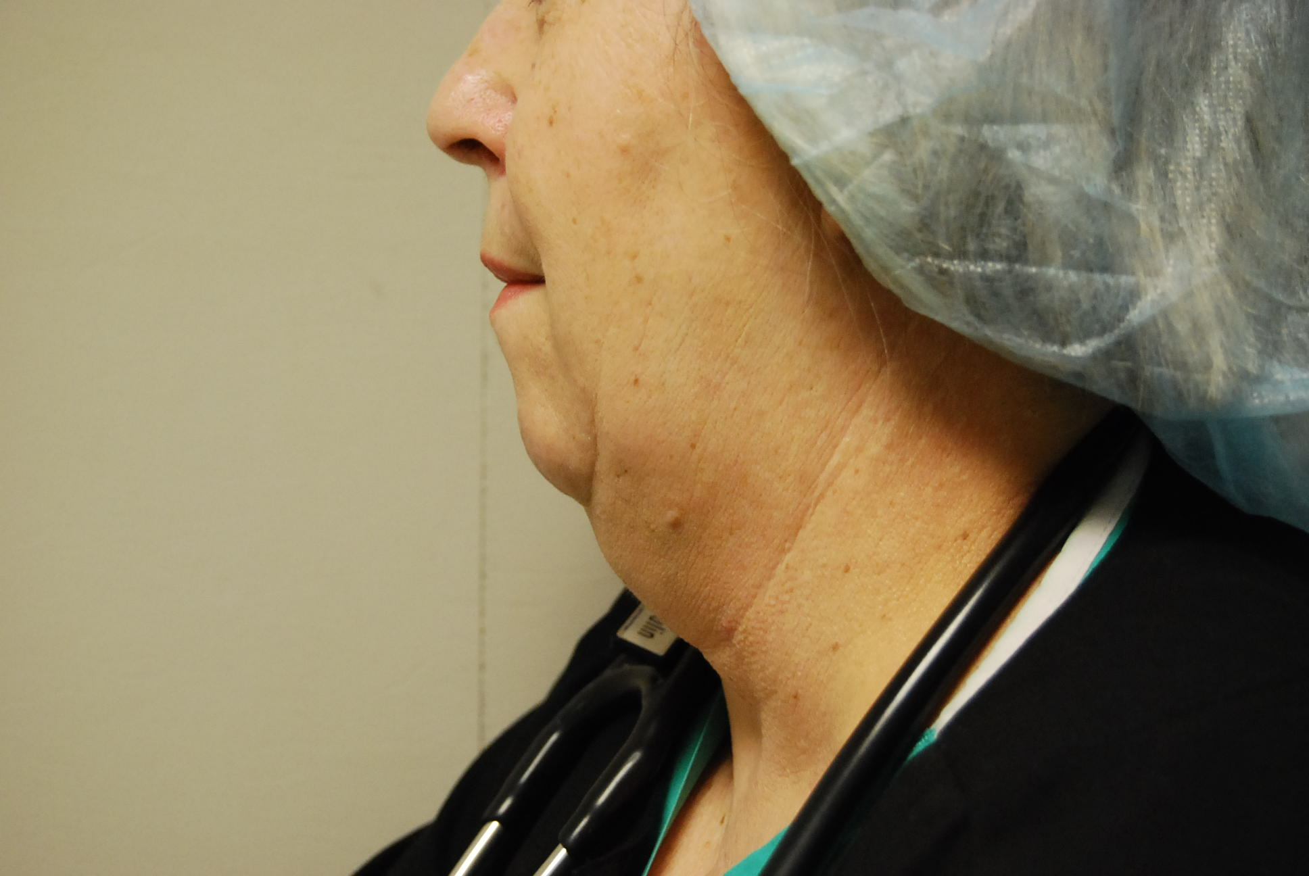
Short Thyromental Distance
Notes:
Pat Van Culin CRNA

Slide 18
Short Thyromental Distance

Slide 19
Cervical Spine Mobility/Neck Anatomy
Certain disease processes may inhibit normal ROM
Ankylosing Spondylitis
Rheumatoid or Osteoarthritis
Trauma (C-spine collar)
Obesity (large fat pad on the back of the neck)
Radiation, burn or surgery to neck, prior tracheostomy

Slide 20
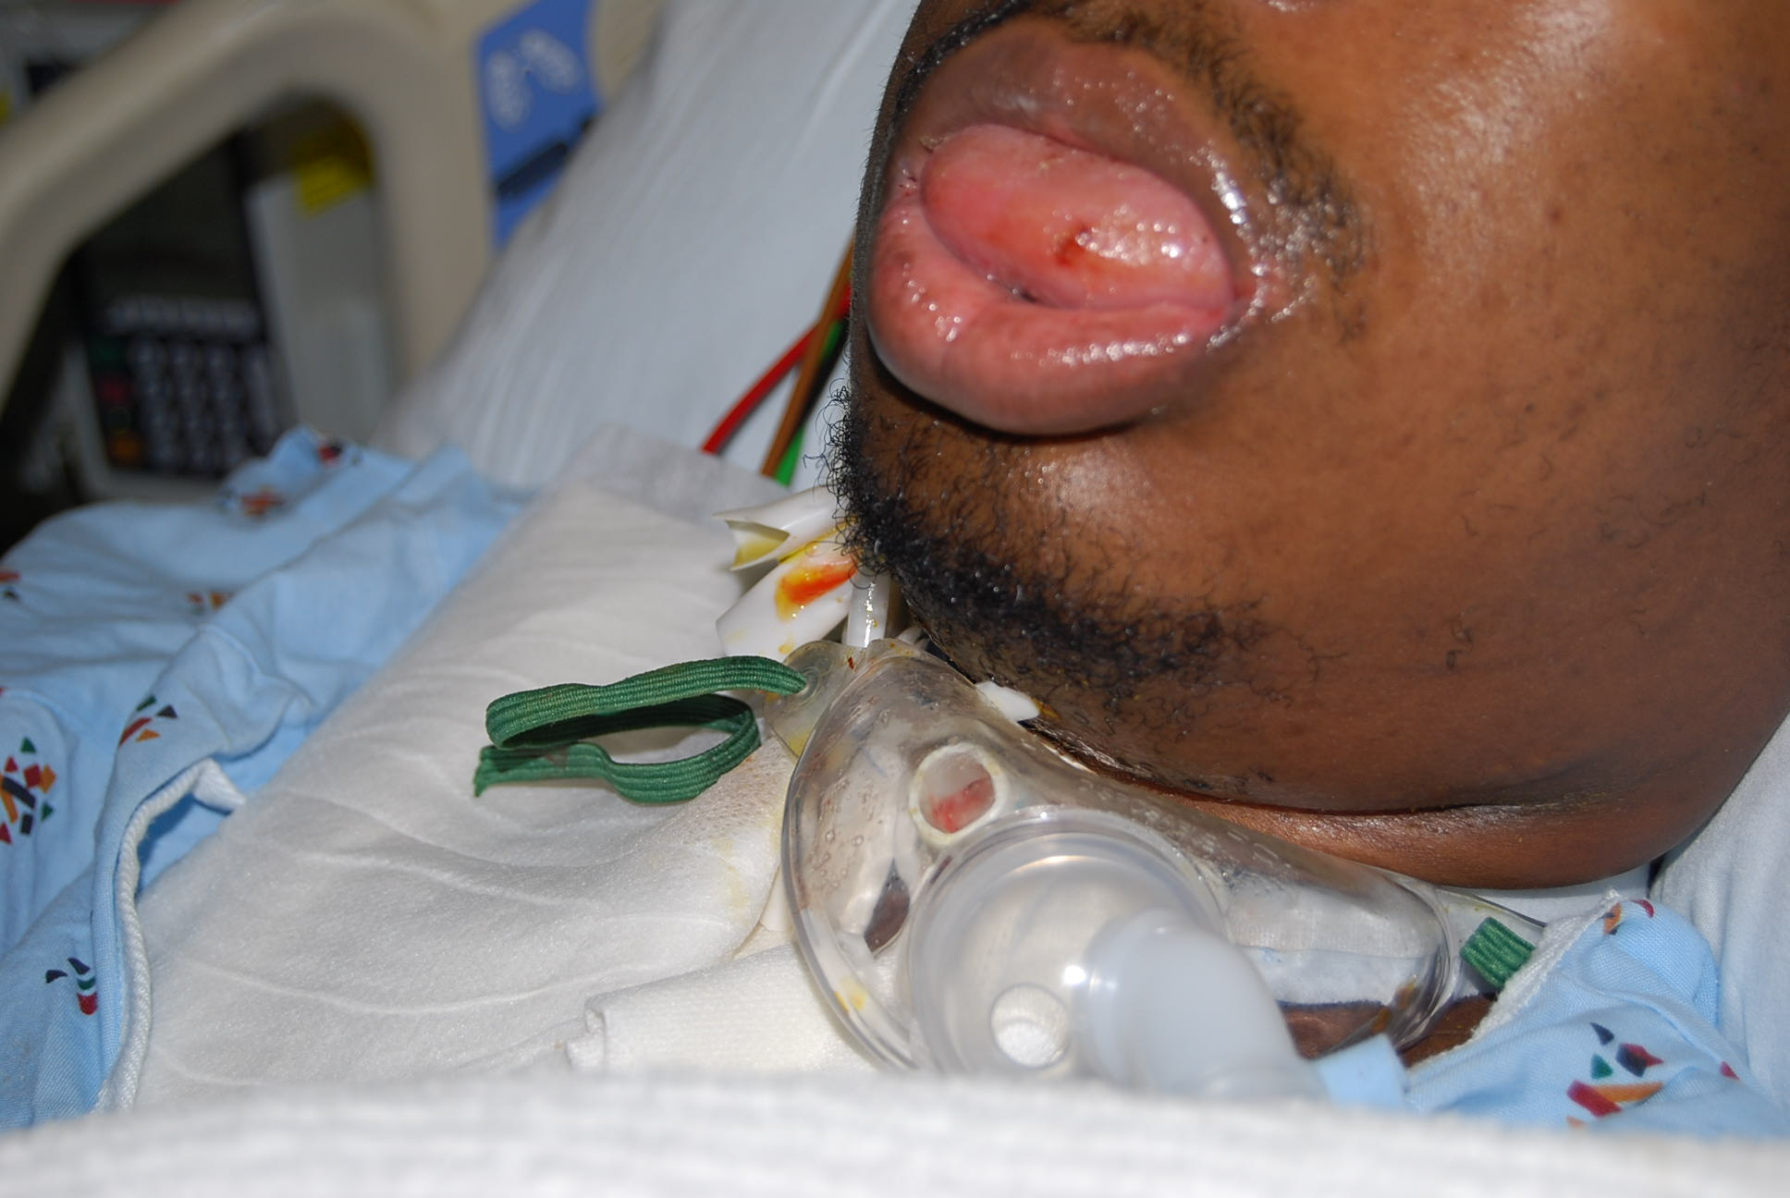
Facial/Tongue Edema

Slide 21
Rigid Submandibular Space
Submandibular rigidity can occur following radiation to the neck, a burn, or surgery
This prevents normal neck extension and possibly normal mouth opening
These patients are likely to be a difficult airway

Slide 22
Tracheal Deviation
This may be determined by palpating the trachea to make sure it is midline and easily mobile
The presence of tracheal deviation may also be noted on CXR

Slide 23
Neck Circumference
>17 inches in men and >16 inches in women predicts an increased incidence of both OSA and difficulty with mask ventilation

Slide 24
Mouth Exam

Slide 25
Mallampati Classification
Approximates the size of the tongue relative to the size of oral cavity. One should examine the airway with the patient in a seated position. The patient should open his/her mouth as wide as possible and protrude their tongue without phonation. The visualization of certain oropharyngeal structures is used to predict the degree of difficulty with intubation.

Slide 27
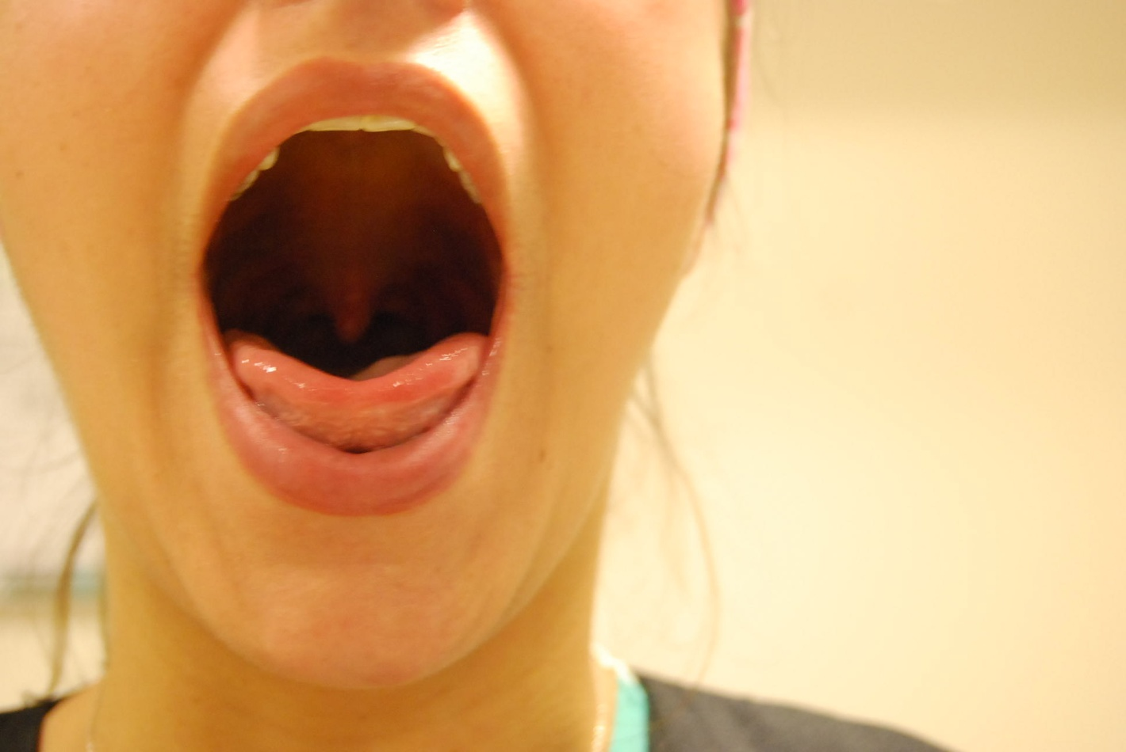
Mallampati Class I
Notes:
Katie Hogan CRNA

Slide 28
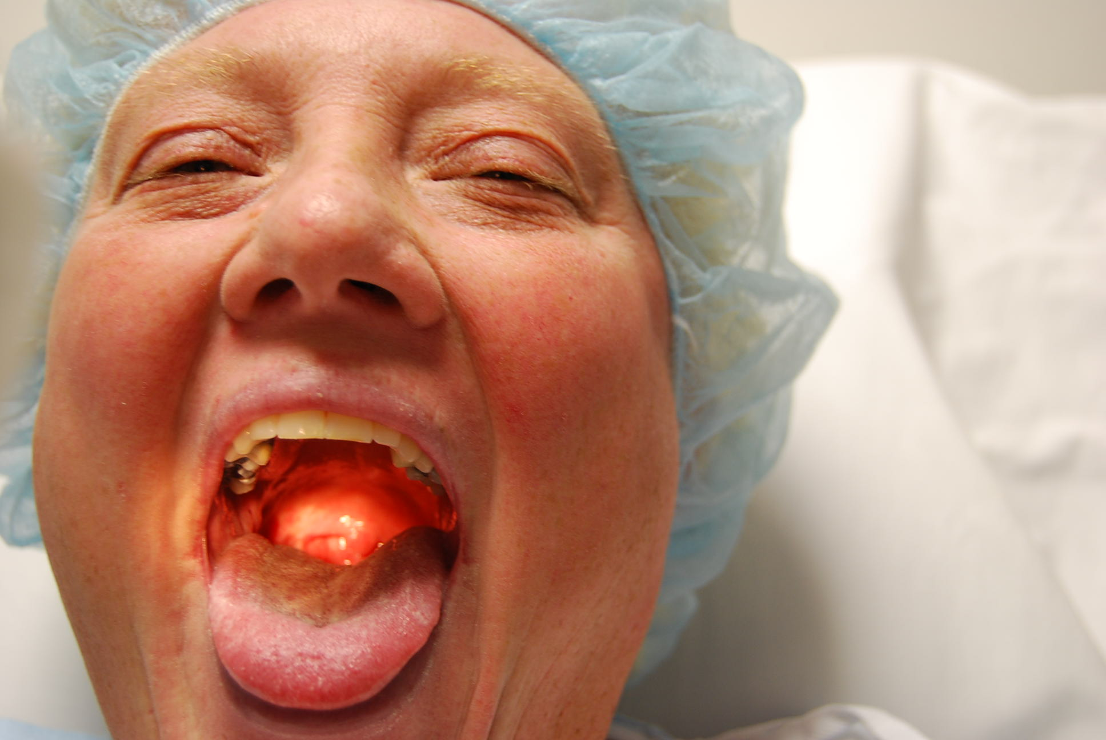
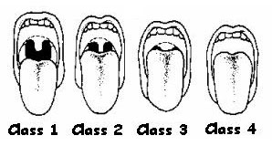
Mallampati Class II

Slide 29
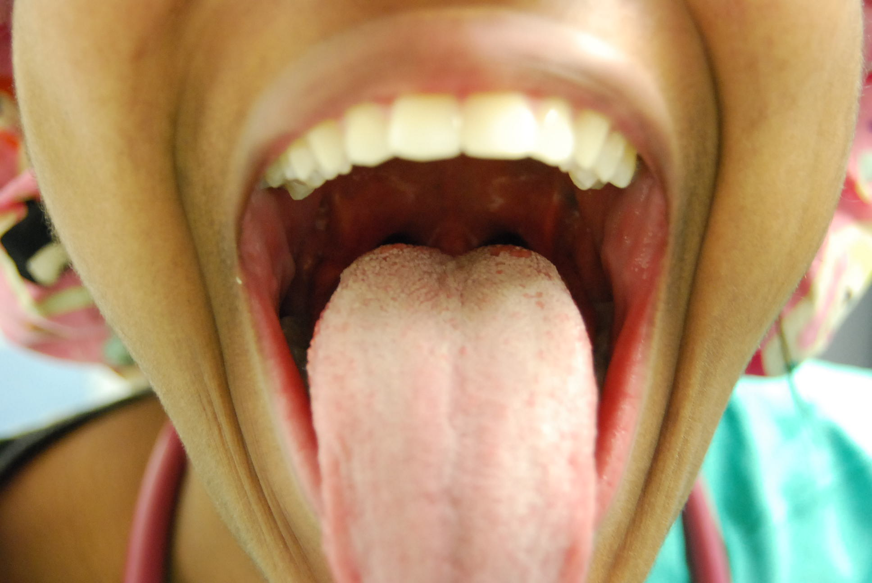
Mallampati Class III
Notes:
Shawna Davis CRNA

Slide 30
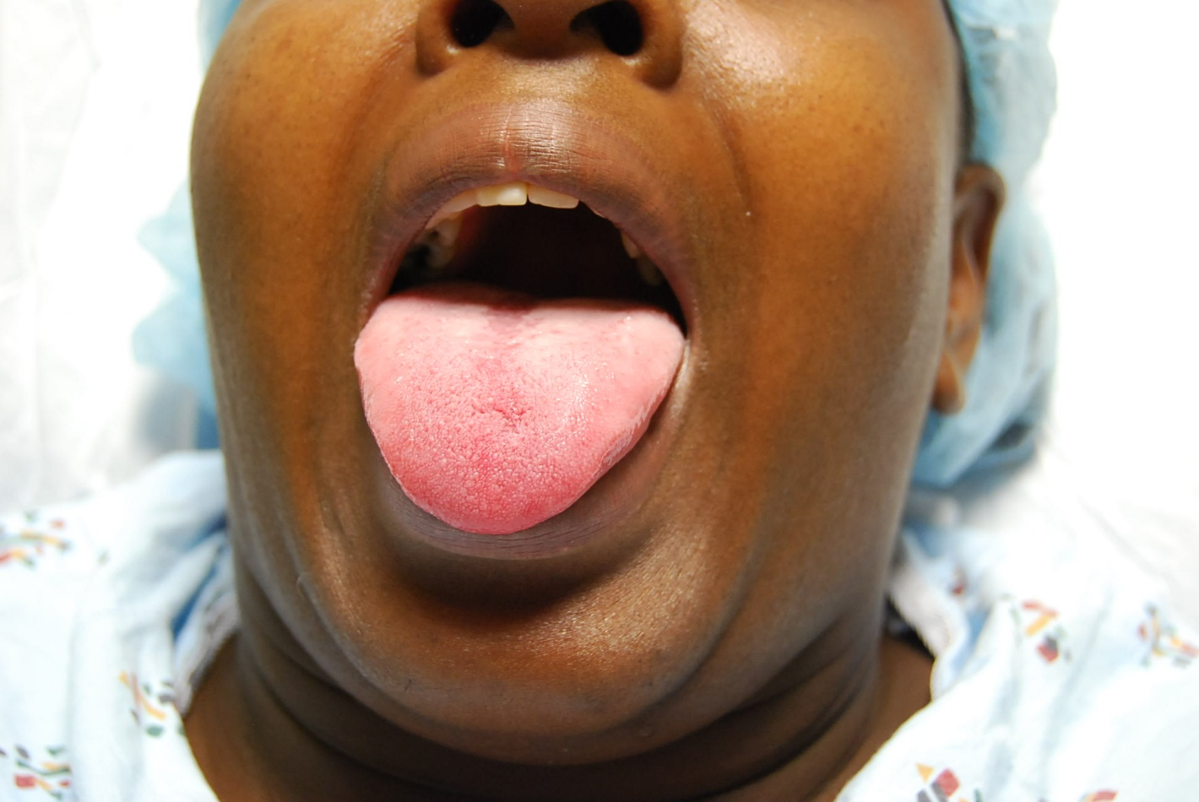
Mallampati Class IV

Slide 31
High Mallampati
Mallampati class 3 or 4 correlates with difficult direct laryngoscopy
A high Mallampati score is particularly predictive of a difficult intubation when combined with short thyromental distance

Slide 32
Protruding Incisors
Large upper incisors or “buck teeth” may indicate difficult airway
Inability to prognath (bring lower incisors in front of upper incisors) may predict difficulty with intubation

Slide 33
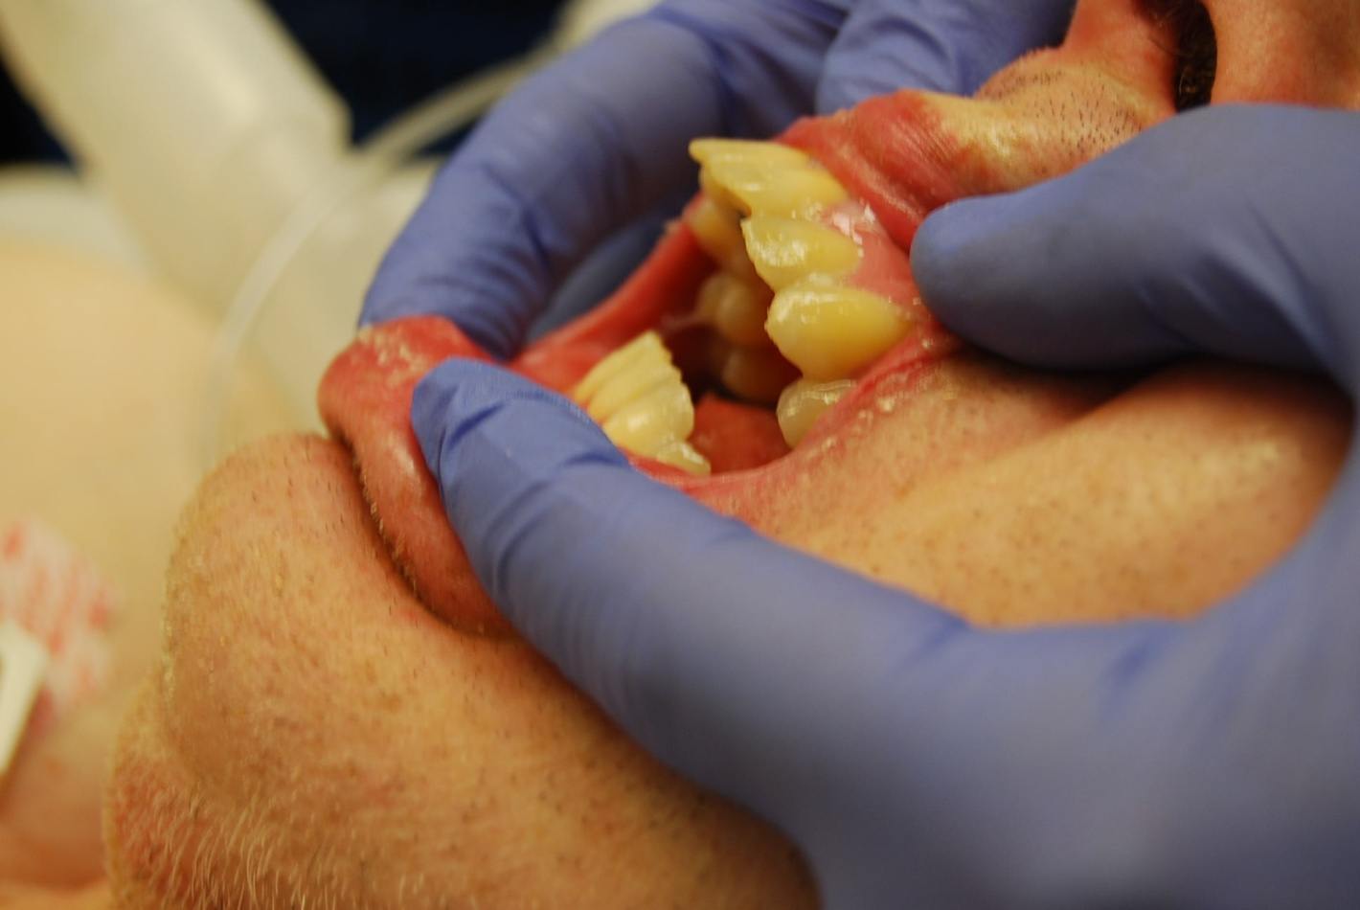
Protruding Incisors

Slide 34
Interincisor Distance
Distance between top and bottom teeth is at least 3 finger breadths
If the patient is edentulous, measure the intergum distance

Slide 35
Edentulous
Lack of teeth allows soft tissues to collapse following sedation
This may result in airway obstruction
These patients often require an oral airway for adequate mask ventilation

Slide 36
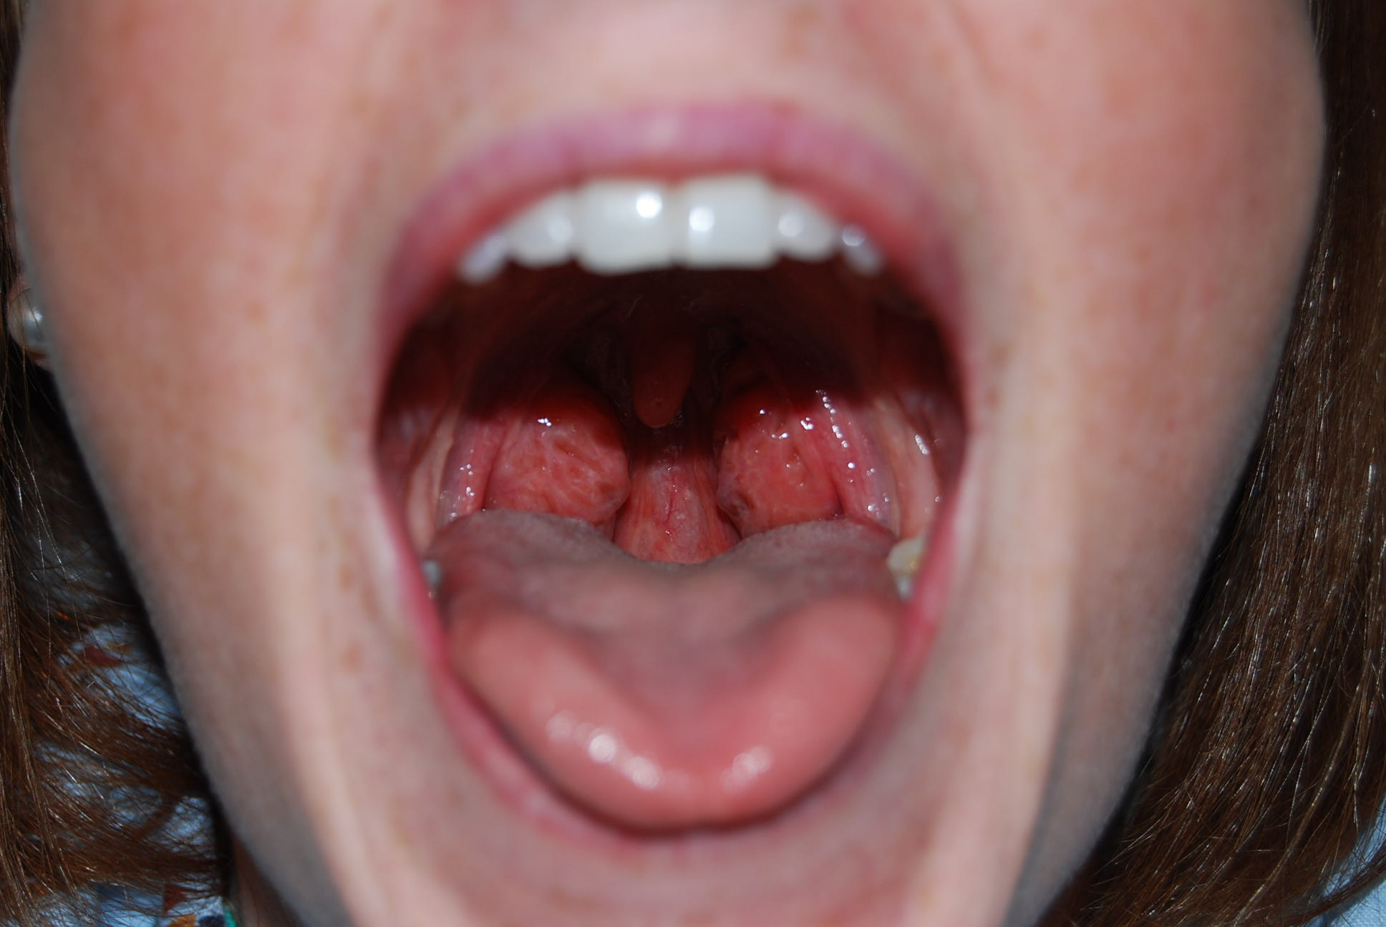
Tonsillar Hypertrophy

Slide 37
Jaw Abnormalities

Slide 38
Micrognathia
Patients who have a small mandible are likely to be a difficult airway

Slide 39
Retrognathia
People with a recessed jaw are often difficult to intubate, because their larynx does not line up with their oropharynx making visualization of the vocal cord difficult

Slide 40
Trismus
Trismus is the inability to open the mouth appropriately
This may be caused by TMJ, facial fracture, edema or mass effect

Slide 41
Pre Procedure: Additional Evaluation
1. The patient’s physiological status must be re-evaluated immediately before administering moderate sedation and documented in the medical record.
2. American Society of Anesthesiologists (ASA) physical status classification documented.
3. Review of appropriate diagnostic/laboratory data and determination of need for and availability of blood/blood products.
4. Interpretation of cardiac rhythm if other than regular rate and rhythm.
5. Presence of satisfactory intravenous access.
6. For elective procedures:
a. The patient should be NPO (nothing by mouth) prior to sedation for a duration that is appropriate for the procedure being performed and for the patient population being served.
b. The general requirement is: no solid foods for at least six hours prior to the procedure; may have clear liquids up to two hours prior to procedure.
c. Note: this requirement does not apply for urgent/emergent procedures.
7. Presence of a responsible adult to accompany the discharged patient is required for outpatients.

Slide 42
FYI-Anesthesia’s Fasting Guidelines
Preoperative Fasting Guidelines
UNC Anesthesiology
You are scheduled for a procedure at UNC hospitals requiring either sedation or general anesthesia. We ask that you follow a few guidelines the night before and day of your procedure. These guidelines are for your safety, and not following them could result in your case being cancelled or postponed.
Please do not eat anything after midnight before your procedure.
You may drink clear liquids up to 2 hours before your scheduled arrival time at the hospital
Clear liquids ALLOWED: Water, Black Coffee (no milk), Apple Juice, Pedialyte, Sodas (eg. Sprite)
Liquids NOT ALLOWED: Orange juice, Juices with pulp, milk, chicken broth, jello, thickened liquids, alcohol

Slide 44
When to consider anesthesia consult
A consultation is suggested in elective procedures if a patient :
Is known to have significant respiratory compromise or hemodynamic instability
Presents with significant co morbid conditions or sleep apnea that are outside the provider’s scope of practice
Has an ASA physical status of 4 or 5
Has a high-risk airway
Patients with a history of airway problems during sedation/analgesia or general anesthesia
Patients with a history of adverse reaction to sedation/analgesia or general anesthesia

Slide 45
Intraprocedure Monitoring
Personnel
Requires 2 people present
One performing the procedure
One monitoring the patient
Both must be credentialed/trained
Verbal and visual contact

Slide 46
Intraprocedure Monitoring
A level of surveillance of the patient that is continuous without any interruption at any time, and during which the nurse, LIP, or other health care provider is in constant attendance is required. Evaluation of the patient’s response to the drugs is the primary responsibility of the individual administering the drugs and monitoring the patient. This individual must NOT be the person performing the procedure.
KEY POINT: Monitoring staff are empowered to stop the sedation process at any time during the procedure, including refusing to initiate sedation.

Slide 47
Intraprocedure Monitoring
1. The following parameters are monitored continuously and recorded every 5 minutes:
o Arousal score
o Cardiac rhythm
o Blood pressure (BP) (continuously if an intra-arterial catheter is in use, otherwise every 5 minutes)
o Pulse rate
o Respiratory rate
o Oxygen saturation
o Monitoring of end-tidal carbon dioxide (ETCO2), while not required, should be considered when personnel are physically separated from the patient and/or unable to visualize respiratory efforts continuously, such as during magnetic resonance imaging (MRI) or radiation therapy procedures.
2. Pain will be recorded
o pre-procedure
o post-procedure
o every hour
o whenever redosing of analgesics is required

Slide 48
Medication Use for Moderate Sedation
Medication use for moderate sedation almost always includes a combination of a short-acting opioid and short-acting benzodiazepine
Fentanyl and Midazolam are the preferred agents

Slide 49
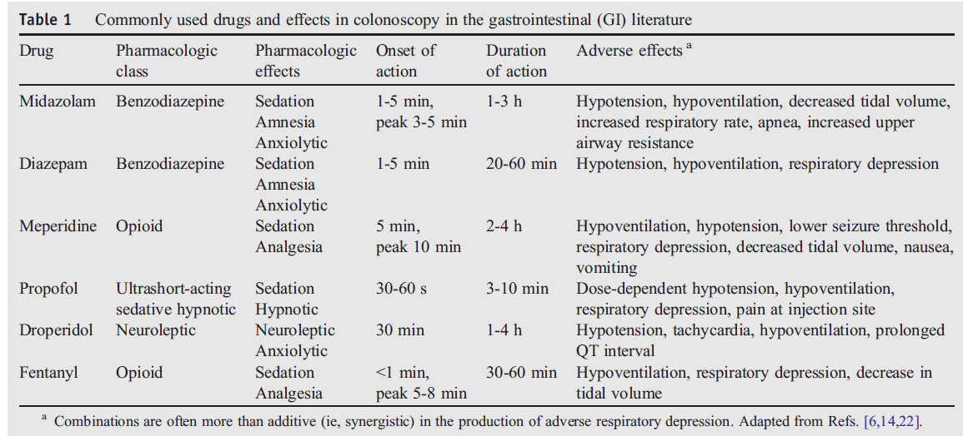
Drugs used in moderate sedation
J Clin Anesth. 19(5):397-404, 2007

Slide 50
Fentanyl
Classification: Opiate Agonist
Indications: Pain relief, sedation
Side Effects: Respiratory depression, nausea, vomiting, bradycardia, hypotension, skeletal and thoracic muscle rigidity especially following rapid IV administration
Contraindications: Increased ICP, severe respiratory depression
Onset of Analgesia: 1-2 min
Peak: 3-5 min
Duration: 30 minutes – 1 hour; respiratory depression may last longer than analgesia

Slide 51
Fentanyl
Dose:
Adults:
IV: 0.5 – 1 mcg/kg
Range: single dose of 50- 100 mcgs – May repeat 25 to 50 mcg every 5 minutes up to ~250 mcgs
Clcr 10-50ml/minute: Administer 75% of usual dose
Clcr< 10 ml/minute: Administer 50% of usual dose
Nursing Considerations:
Administer drug over 1 – 2 minutes
Apnea may precede sedation
Antagonist: Naloxone

Slide 52
Morphine
Classification: Opiate Agonist
Indications: Management of moderate to severe pain, sedation
Side Effects: Respiratory depression, nausea, vomiting, bradycardia, hypotension, peripheral vasodilatation, histamine release, pruritis, increased ICP
Contraindications: Increased ICP, severe respiratory depression
Onset:
IV: 5 min
IM or SC: 10-30min
PR: 20-30 min
PO: 60 min
Peak Analgesia:
IV: 20 minutes
Oral: 60 minutes
Suppository: 20 – 60 minutes
Subcutaneous: 50 – 90 minutes
IM: 30 – 60 minutes
Duration: 3 – 5 hours

Slide 53
Morphine
Dose:
Adults: (teenagers > 50 kg and adults)
IV: 2-4mg per dose
Repeat in 1-2 mg increments
Usual 8-10mg, maximum dose: 20 mg
Clcr 10-50ml/minute: Administer 75% of usual dose
Clcr< 10 ml/minute: Administer 50% of usual dose
Nursing Consideration:
Administer drug over 2 – 3 minutes

Slide 54
Midazolam (Versed)
Classification: Benzodiazepine
Indications: Sedation, amnesia
Side Effects: Bradycardia, hypotension, respiratory depression, apnea, cardiac arrest, laryngospasm.
Contraindications: CNS depression, respiratory depression, severe uncontrolled pain, severe hypotension, acute angle closure glaucoma
Onset of Action:
IV: 1 – 5 minutes
IM: 15 minutes
Intranasal: 10-15 minutes
Oral: 10-20 minutes
Duration: 2-6 hours
Note: FDA black box warning for ritonavir and oral midazolam; efavirenz also listed as having significant interactions with benzo’s

Slide 55
Midazolam (Versed)
Dose:
Adults:
Under age 60:
IV: 1 – 2.5 mg push over 2 minutes
Repeat dose every 2 minutes, as needed
Additional doses to maintain desired level of sedation may be given in increments of 25% of dose used to achieve sedation endpoint
Age 60 and older:
IV: 1.5mg or less over at least 2 minutes. If additional titration is needed give at a rate not exceeding 1mg over 2 minutes. Total doses >3.5mg are not usually necessary
Antagonist: Flumazenil

Slide 56
Happy 50th? Sedation for Colonoscopy in HIV-Infected Patients
We asked experts about their approaches to sedation in HIV-infected patients receiving ritonavir
Response 3
— M. Brian Fennerty, MD
In my practice, we sedate our HIV-infected endoscopy patients the same as we do all our endoscopy patients: We titrate midazolam for effect. In my mind, there is little reason to view midazolam as "contraindicated" with ritonavir. Use of the two drugs together does significantly increase blood levels of midazolam, but this effect should lead to adequate sedation at lower doses without the potential for oversedation, assuming the midazolam is used appropriately — that is, infused at a low dose with a reassessment of effect and level of sedation before additional doses are given. I have performed hundreds of endoscopies using midazolam in patients on ritonavir or efavirenz (another antiretroviral contraindicated with midazolam) and have never witnessed a significant adverse effect. Until interaction between these sedatives and antiretrovirals is proven to be clinically relevant (versus pharmacologic or theoretical, as it is now), deviating from a safe and time-tested sedation strategy does not seem justified.
http://aids-clinical-care.jwatch.org/cgi/content/full/2009/406/1

Slide 57
Diazepam
Classification: Benzodiazepine
Indications: Sedation, amnesia
Side Effects: Bradycardia, hypotension, respiratory depression, apnea, cardiac arrest, laryngospasm, phlebitis, pain with injection
Contraindications: CNS depression, respiratory depression, severe uncontrolled pain, severe hypotension
Onset of Action:
IV: 1 –5 minutes
Oral: 30 minutes
Duration:
IV: 15-60 min
PO: 3-8 hours

Slide 58
Diazepam
Dose:
Adults:
IV: Initial dose 5-10mg administered slowly over 2-3 minutes. Usually less than 10mg required, but up to 20mg may be used.
Oral: 2-10 mg
When given with opiates decrease opiate dose by one-third
Nursing Considerations:
Flush IV before and after with normal saline
Administer IV doses slowly, not to exceed 5 mg/minute
Do not dilute
Administer oral dose 15 to 30 minutes prior to the procedure
Obese patients may require higher doses
Antagonist: Flumazenil

Slide 59
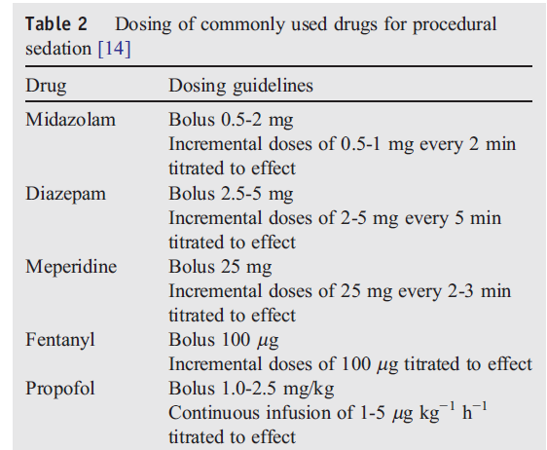
Dosing
J Clin Anesth. 19(5):397-404, 2007

Slide 60
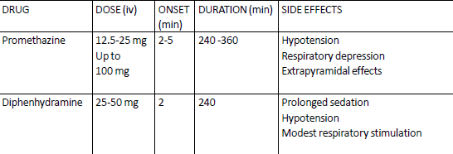
Adjuvant Agents

Slide 65
Potential Complications of Moderate Sedation In Endoscopy
How often?
How to manage?

Slide 66
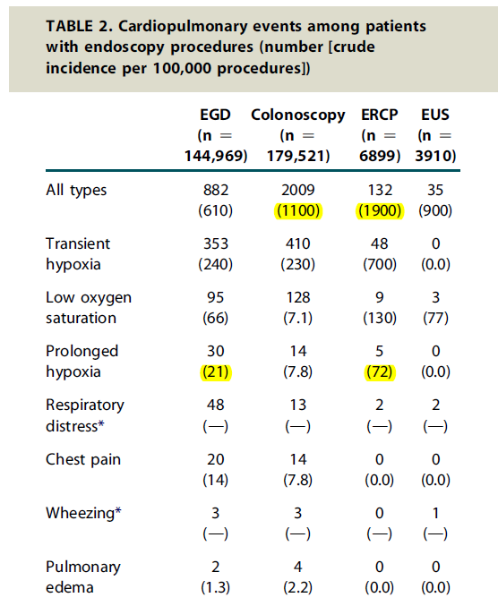
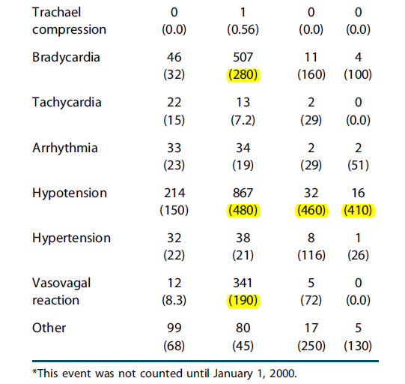
How often do unplanned cardiopulmonary complications occur in endoscopy?
Total rate 1.4%
GIE 66: 27-34, 2007

Slide 67
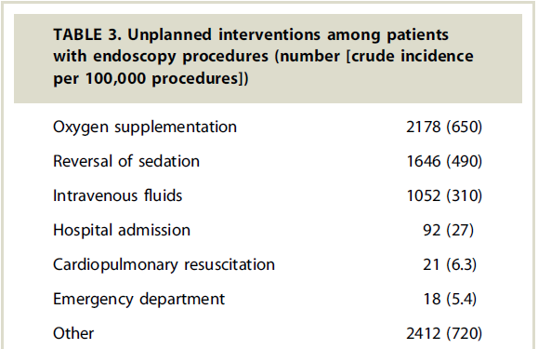
Types of Unplanned Interventions
GIE 66: 27-34, 2007

Slide 68
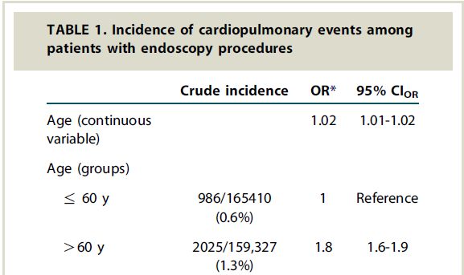
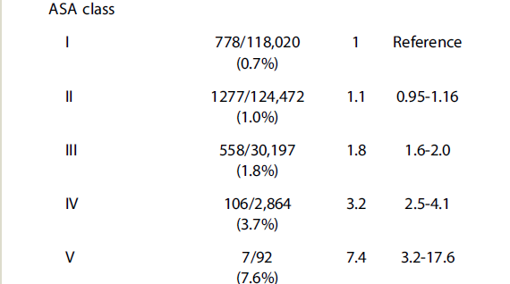
Risk Factors
GIE 66: 27-34, 2007

Slide 69
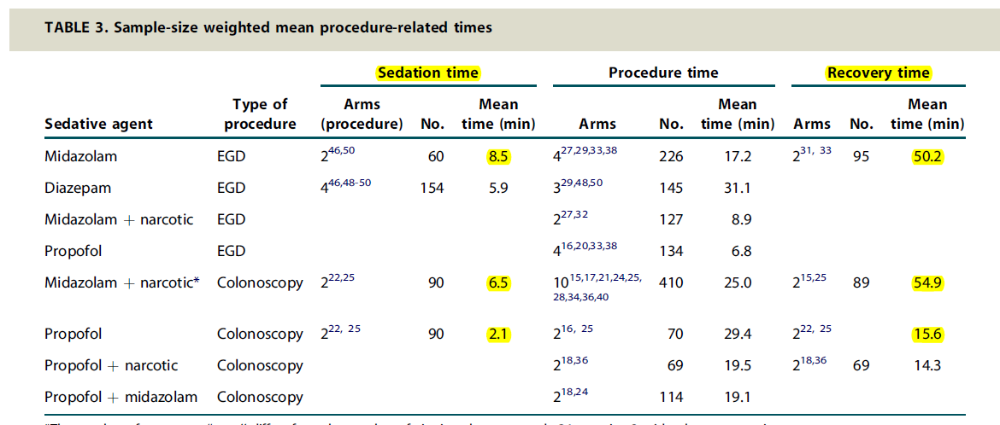
GIE 67: 910-23, 2008

Slide 73
Caution When Using Supplemental Oxygen
**Supplemental oxygen will delay recognition of apnea secondary to increased oxygen reserve in the body

Slide 77
Goals of Airway Management
Oxygenation-delivering oxygen to tissues
Ventilation- removing carbon dioxide (CO₂)
Airway protection from aspiration

Slide 78
Airway Obstruction
Can occur during any form of sedation
May be relieved with chin thrust/jaw lift
In some cases requires placement of airway devices
Nasal Trumpet
Oral Airway

Slide 79
Airway Obstruction-Jaw Thrust
Place thumbs or fingers behind the posterior portion of the mandible
Push upward to displace mandible forward
This maneuver should pull mandible and tongue forward, preventing tongue from occluding airway

Slide 80
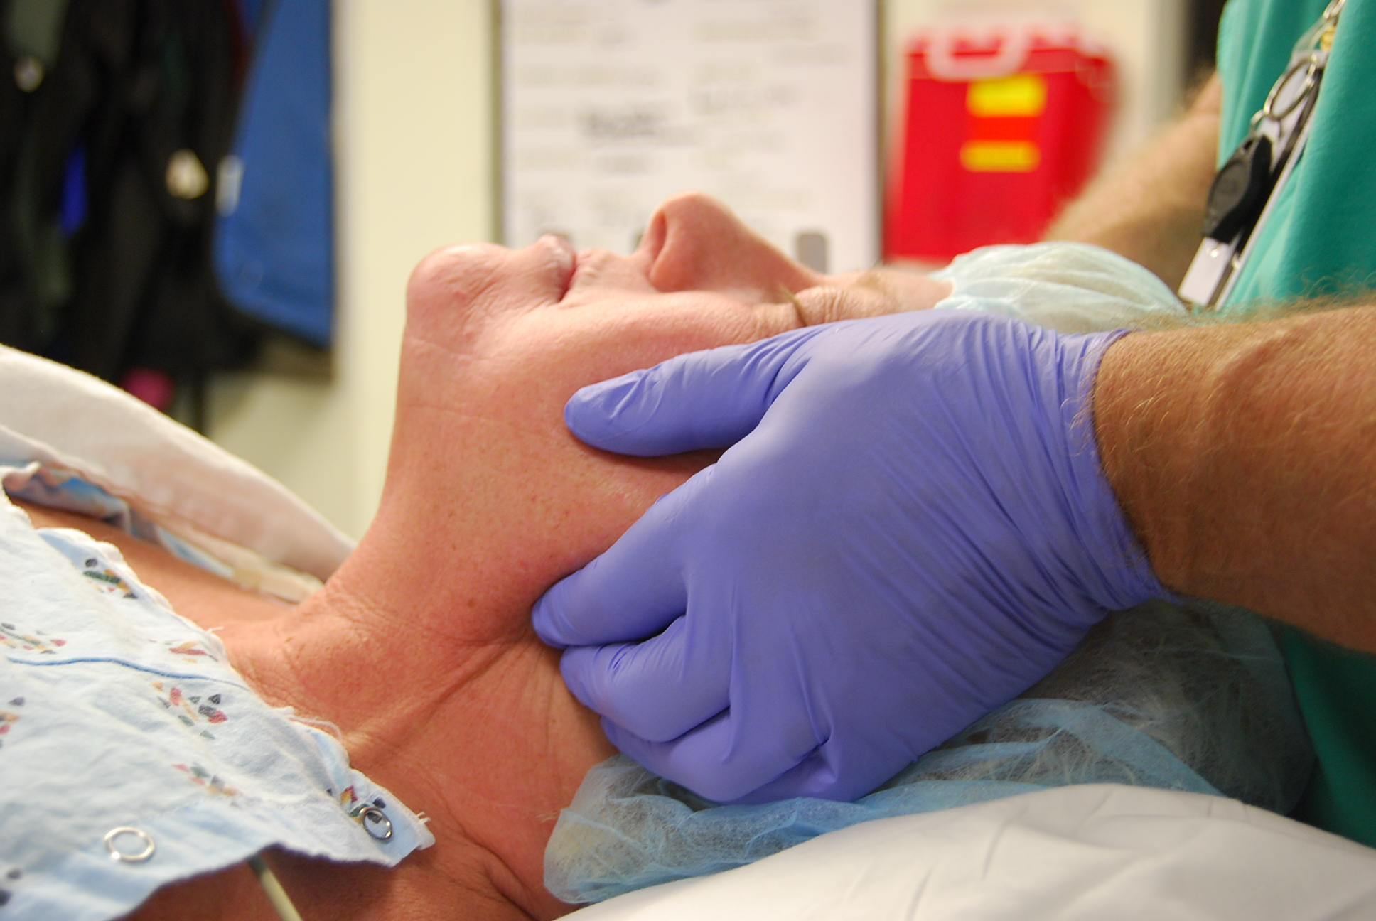
Airway Obstruction-Jaw Thrust

Slide 82
Airway Obstruction- Nasal Trumpet
Also called nasopharyngeal airway
Flexible rubber device that is inserted into one nostril to allow air passage
Comes in many sizes
Estimate length of trumpet needed by measuring from the nares to the meatus of the ear
Lubricate well
Gently advance at an angle perpendicular to the face
This device can cause epistaxis and should be avoided in the anticoagulated patient

Slide 83
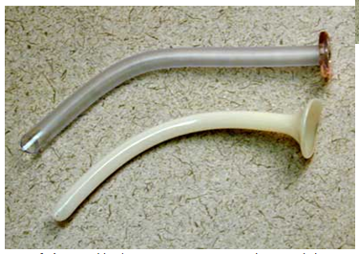
Types of Nasal Trumpets

Slide 84
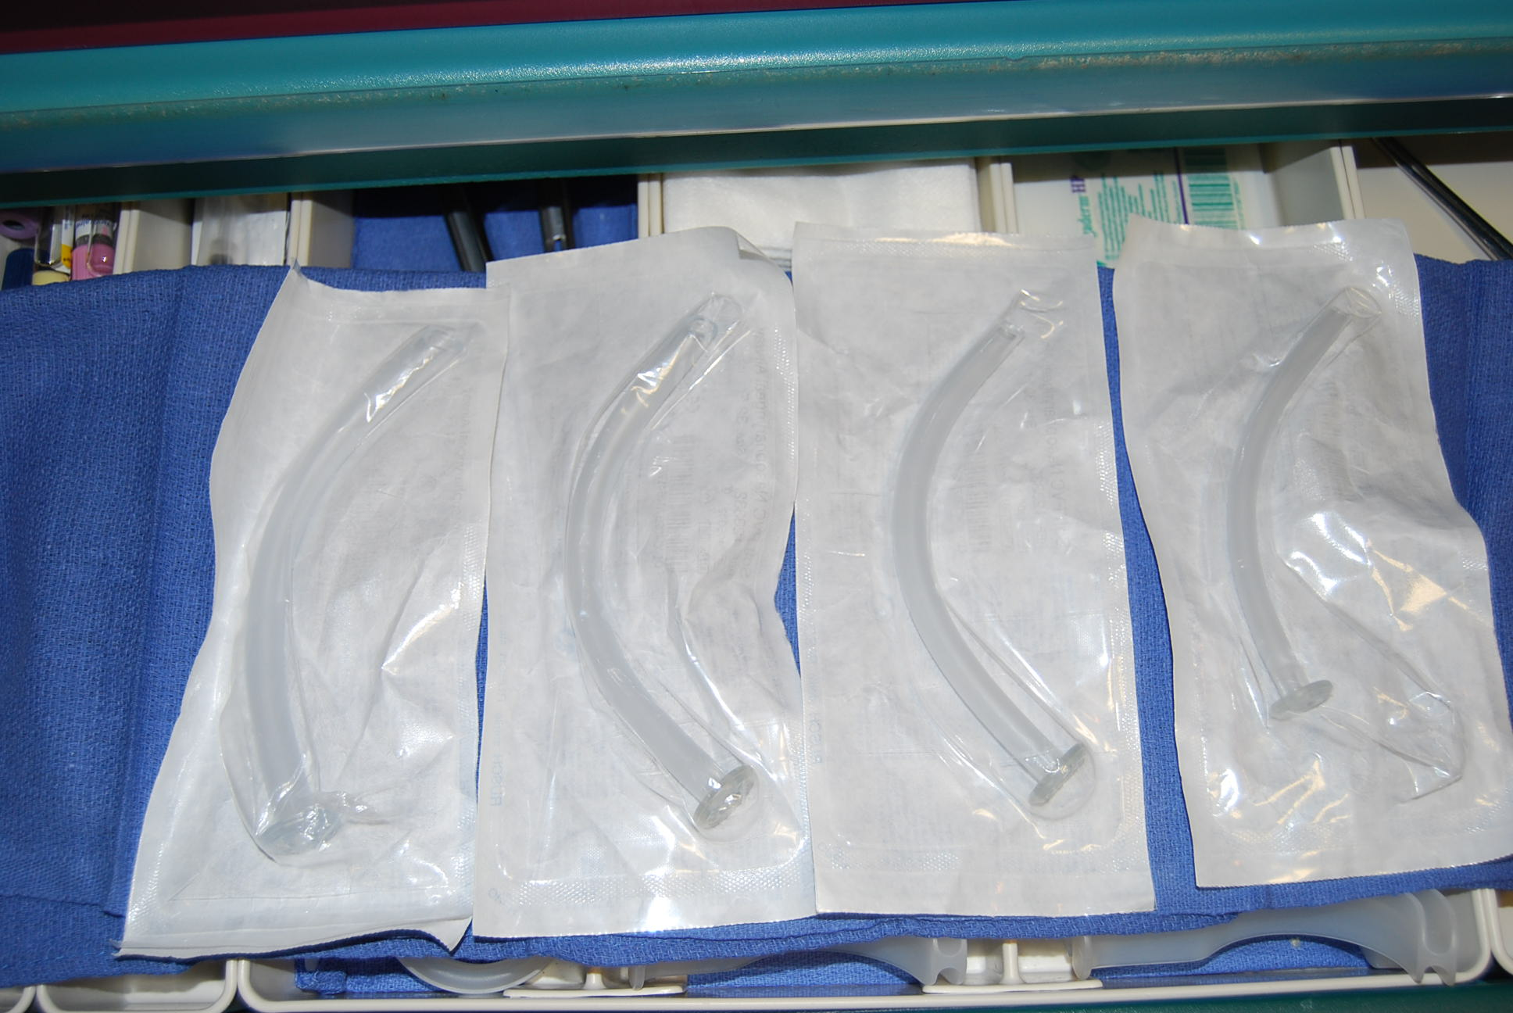
Nasal Trumpets

Slide 85
Airway Obstruction- Oral Airway
Also called oropharyngeal airway
Curved plastic device that is inserted into the mouth over the tongue to pull the tongue forward
Estimate correct size by measuring from the mouth to meatus of the ear
Use a tongue blade to depress the tongue and open the mouth, then insert airway
Use caution when inserting to not push the tongue posteriorly, worsening the obstruction
May cause gagging/vomiting in a conscious patient

Slide 86
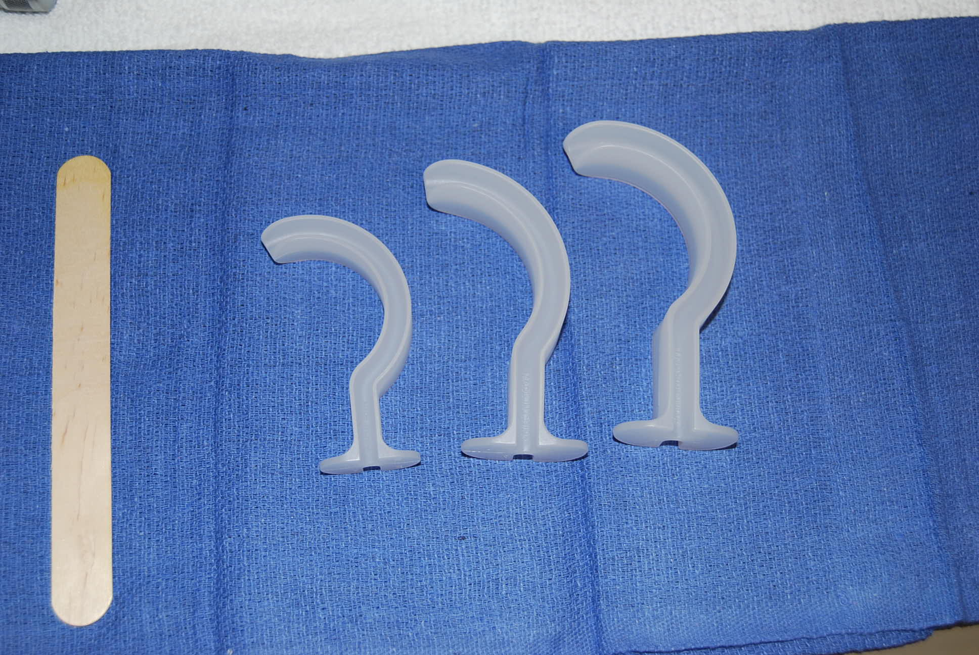
Oral Airways

Slide 87
Hypoventilation and Apnea
Simply relieving obstruction may not be enough
Some patients may require rescue with bag-valve-mask ventilation
Do not rely solely on the pulse oximeter to for detection of inadequate ventilation
Watch for chest rise and feel over the nose and mouth for air movement
A bag-valve-mask and oxygen source should be readily available in the room

Slide 88
Hypoventilation and Apnea
Place the bag-mask over the patient’s nose and mouth
Create a “C” shape on the mask with your thumb and pointer finger
Use your other 3 fingers to lift the mandible up towards the mask
Ensure proper connection with oxygen source
Squeeze the bag and watch for chest rise
CALL FOR HELP as soon as a problem is recognized; seconds matter

Slide 89
Bag-Valve-Mask

Slide 90
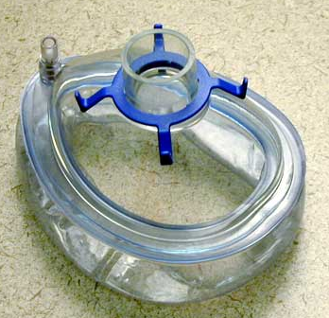
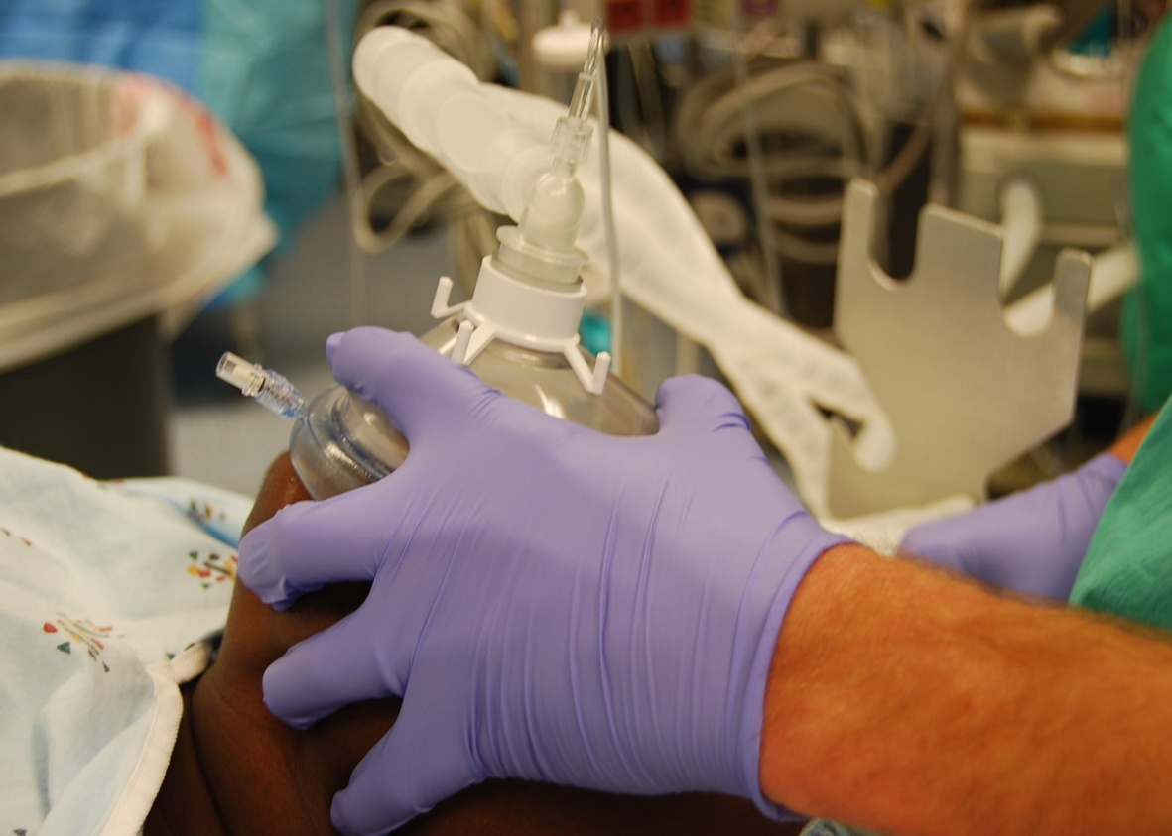
Bag-Valve-Mask

Slide 91
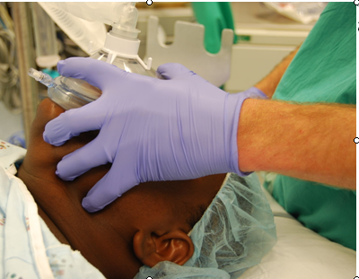
Bag-Valve-Mask
Hold your thumb and pointer finger in a “C” shape over the mask
Use your other fingers to lift the mandible towards you
Do not press down on the patient’s face with the mask
If air is leaking around the mask, hold the mask with both hands and have an assistant squeeze the bag
CALL FOR HELP

Slide 92
Bag-Valve-Mask
If you do not see chest rise, place an oral airway or nasal trumpet and then resume mask ventilation

Slide 93
Signs of Successful Bag-Valve-Mask
Fog in the mask
Chest rise with each breath
Breath sounds on ascultation
Return of CO₂ if a detector is in use

Slide 94
Advanced Airway Management
In some situations, it may be difficult to bag-valve-mask a patient despite an oral airway and a 2-person technique
In this case, the Laryngeal Mask Airway (LMA) may be a life saving device

Slide 95
Laryngeal Mask Airway (LMA)
This device can be inserted into the mouth past the tongue
It sits just above the opening to the airway (glottic opening)
It does not protect the patient from aspiration
Positive pressure ventilation can be delivered through the LMA

Slide 96
LMA Insertion
Choose the appropriate size based on the weight recommendations on the outside of the package
Lubricate the cuff of the LMA
Tilt the head back to open the airway
Scissor open the mouth and push the LMA back with your finger until it stops
Inflate the cuff with air
Connect to your bag and oxygen source and squeeze the bag

Slide 97
Laryngeal Mask Airway

Slide 98
Other Predictors of Potentially Difficult Airway
Excessive facial hair
Dysmorphic facial features
High arched palate

Slide 101
Reversal Agents – Flumazenil (Romazicon®)
Classification: Benzodiazepine antagonist
Indications: Reverse sedative effect of Benzodiazepines
Side Effects: Arrhythmias, nausea, vomiting, pain at injection site, blurred vision, seizures, vaso-vagal episodes, headache, tremor, dyspnea
Contraindications: Benzodiazepine dependence
Onset: 1-3 min
Peak: 6-10 min
Half-life: 1 hr
Adult
Initial: 0.2 mg IV over 15 seconds. May repeat dose every 1-minute up to a 1mg cumulative dose. Most patients respond to 0.6-1mg of drug.
If resedation occurs dose may be repeated after 20 minutes, but no more than 1mg at one time, and patients should not receive more than 3mg in one hour
Nursing Considerations:
Give through a large vein to minimize pain at injection site
Do not use to reverse sedation from Benzodiazepines given for seizures
Availability: (Always check package label for concentration)
Injection: 0.1 mg/ml (5 ml)

Slide 102
Reversal Agents – Naloxone (Narcan)
Classification: Opiate Antagonist
Indications: Reverses respiratory and CNS depression secondary to receiving a narcotic
Side Effects: Nausea, vomiting, hypertension, hypotension, tachycardia, ventricular arrhythmias, sweating, unmasking of pain
Contraindications: Use with caution in patients with cardiovascular disease , opiate addiction and infants born to drug addicted mothers
Onset of Action:
IV: within 1 - 2 minutes
ETT, IM, SC: within 2 – 5 minutes
Peak: 5-15 minutes
Duration: 20 – 60 minutes – this is shorter than that of most opioids, therefore repeated doses may be needed
Dose:
Adults:
IV:
For oversedation : 0.1- 0.2mg IV q2-3 min and titrate as needed for effect
For arrest: 0.4 – 2 mg every 2 – 3 minutes ( max 10mg)
Availability: Injection: 0.4 mg/1 ml vial; 2mg/2ml syringe

Slide 104
Discharge Guidelines
Patients should be alert and oriented. Patients whose mental status was altered pre-procedure should have returned to baseline.
Patients discharged to home or other non-monitored area (e.g. lobby) should achieve pre-procedure baseline levels of oxygenation when removed from supplemental oxygen for a five-minute period.
The Aldrete Scoring System (ranging from "10" for complete recovery to "0" in comatose patients) may be used without obtaining physician/dentist order to determine readiness of discharge.
1. The Aldrete score should be documented on discharge/transfer.
2. Patients may be discharged without physician/dentist intervention with of score of "8" or above, provided that activity, respiration, and color on the scale are scored as "2" and circulation and consciousness are scored at "1" or "2.”
A responsible adult will be provided with written instructions regarding post procedure diet, medications, activities, and a phone number to use in case of emergency.
Outpatients should be discharged to a responsible adult who assumes responsibility for transport and who has been educated to post-procedure complications and the appropriate reporting mechanism.

Slide 105
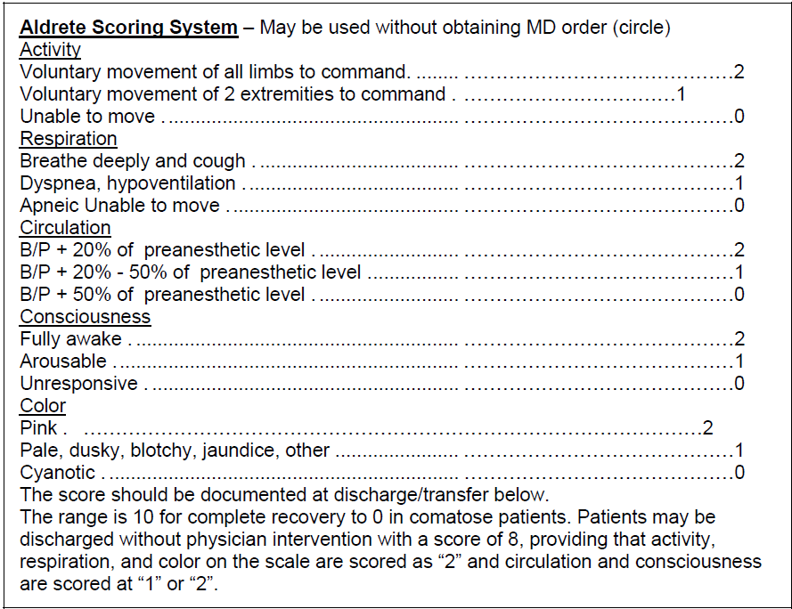

Slide 106
UNC Policy for MD’s to get Adult Moderate Sedation Privileges
Required Resuscitation Competence
Advanced cardiac (cardiopulmonary) life support (ACLS) is required if the code team is not available. These requirements are waived if the LIP is board certified in an exempted specialty .
Required Airway Assessment and Management Competence
Completion of in-house airway assessment and management module is required unless the provider has ACLS or is board certified in a specialty that encompasses airway assessment & management as a core competency of specialty certification
Required Pharmacology and Sedation Policy Competence
For initial request for certification by LIPs who have not been previously credentialed to perform moderate sedation, LIPs must complete the Adult Moderate Sedation for LIPs module and pass an exam.

Slide 107
References
Moderate Sedation: An Anesthesiologist’s Perspective, Cheryl Jones MD, Duke Dept of Anesthesia
UNC Adult Moderate Sedation Policy: http://intranet.unchealthcare.org/policies/unc-hcs-policies-pdf-new-format/ADMIN0160%20pdf.pdf
Airway Assessment for Procedural Sedation by Non-Anesthesiologists by Kathleen Smith MD, UNC Anesthesiology

