Slide 1
New Fellows Orientation to GI Procedures
Presented b y
Kristine Barman RN, BSN, CGRN
CN III

Slide 2
Welcome
On behalf of the staff of GI Procedures, I would like to welcome you to UNC Health Care and the School of Medicine. You have the distinct privilege of working with some of the best Gastroenterologist and nursing staff in the country. You will be challenged to go deeper, look closer and GET TO THE CECUM! We have no doubt, you will get there. We are excited to have you on board and look forward to working with you.
Marvetta M. Walker RN, MHA

Slide 3
Collaborative Team
Marvetta Walker
Manager, GIP
Susan Phillips
VP, Surgical Services
Dr. Sid Levinson Medical Director, Meadowmont
Dr. Robert Sandler
Chief, Gastroenterology and Hepatology
Dr. Ian Grimm
Medical Dir, Memorial
Pediatric Endoscopy / Bronchoscopy

Slide 4
Departmental Organizational Structure
Marvetta Walker
Manager, GI Procedures
Nadine Shivers
CNIV, Memorial
Bonnie Streeter
CN IV, Meadowmont
Kathy Abode
Director, Pediatric Bronchoscopy
GI Motility
Mary Scholz
Biofeedback
Jill Williams
Manometry
Sheila Crawford
Manometry
Elaine White
(GI Contract RN)
Pamela Harris
(GI Contract RN)
Debra Groves
CNIII
Clinical Nurses CNII
(8 = 88.8%)
Endoscopy Tech
(5-100%)
Kris Barman
CNIII
Clinical Nurse II
(10/12 = 83.3%)
Endoscopy Tech
(5/8 = 63%)
Patient Business Associates
2
Medical Services Assistant II
3
Notes:
Help them to understand managerial responsibilities
Budget, purchasing, strategic planning, operational efficiency, blah blah

Slide 5
Staff
We have exceptional staff
Highly skilled
Compassionate
Willing to assist
FUN!
Highly skilled with more than 100-years experience in GI
High speed, low drag technicians
Eager to learn
Willing to teach
Diverse Group

Slide 6
GI Procedures Community Agreement
We will direct all of our efforts to support a GOOD patient experience
We will work to the same standard and level of consistency when caring for patients
We will clearly communicate roles and expectations - of and between team members
We will be considerate of others and honor our scheduled time commitments
We will be motivated and take pride in our work
We will seek assistance when necessary (Don’t go it alone)
We will do our part
We will be clear about our expectations of self and others
We will acknowledge our strengths & weaknesses, as well as the strength & weaknesses of others
We will Lead by example: Each One - Teach One
We will celebrate each other through encouragement, praise and recognition
We will be honest and gentle in sharing our truth
We will remember the “Golden Rule” – Treat others the way you want to be treated
We will appreciate differences of others (i.e., opinions, styles)
We will care for each other
We will thank each other
We will exercise teamwork – Recognize what needs to be done/Do it/Share in responsibility
We will listen before we answer
We will “Let it go!”
We will know when and how to say “no” and support each other in saying “no”

Slide 7
General Overview
First case start at 8:00 am (staff has patient ready)
Hours of operation: 8:00 am to 6:30 pm (last inpatient down by 3:00 pm (unless emergent)
RN and Technician reports at 7:30
Core staff report from 8:00 am – 4:30 pm
Late staff report from 9:30 am – 6:30 pm
1 RN and 1 Endoscopy Tech per room
Charge Nurse of Day runs the board
Nadine Shivers is the Supervisor for Memorial
In orientation
Marvetta will assist you in the mean time
Concerns that cannot be resolved by the Charge Nurse or Supervisor will be as gladly addressed by Marvetta

Slide 8
Overview
Consulting providers should provide inpatient list at or prior to 8:00 am to prevent delays and allow for on time departure

Slide 9
A Day in GI Memorial
Number of Procedures: 30 (21 – 49)
Inpatients: 7
Outpatients: 24
Busiest Days: Monday & Friday
A rapidly changing environment
Must be present and engaged to ensure overall efficiency and quality care

Slide 10
FY 10 Procedures - Memorial

Slide 11
Inpatient vs. Outpatient

Slide 12
Procedural Rules
This is a great place to learn; if you’re unsure please ask. We are here to ensure your overall success
In an effort to prevent major delays
The nurse may provide a 20-minute time check to the Attending.
This will serve as a warning that we are running behind schedule
At this time the Attending may complete the procedure

Slide 13
Quality Initiatives
First case start: Patient should be in room prepared for procedure no later than 8:05 am
Inpatient Wait Time: Less than 45 minutes from arrival to procedure
Decrease recovery time
Minimum = 30 minutes
Maximum = 40 minutes for conscious sedation
Increase patient satisfaction.

Slide 14
Renovations Projects
Physician Workroom
Increased from 3 to 6 computer workstations
50% of computer available
Remaining equipment installation within 2-weeks
PAX Station
Will be stationed outside Procedure Room 4
View of radiology images using high resolution
Expansion of recovery bays
To improve overall efficiency
No change in physical space required

Slide 15
New Technologies
Electronic GI Schedule
50” Plasma monitor to replace white board
Controlled by Charge Nurse from desk
Fluroscopy Table
EU-ME1 Endoscopic Ultrasound - universal processor for mechanical and electronic scanning
Titan ultrasound machine to perform liver biopsy

Slide 16
Upcoming Trial
Propofol Trial
Performed on Friday – full day (# of weeks TBD)
Use of 2 Rooms
Designated staff
Sorry, but Fellows will not serve as part of this trial
We hope you are still in the early phase of your fellowship when it is adopted as our standard practice
Goal is to improve overall efficiency and increase patient satisfactory in the department
Decrease sedation time
Decrease recovery times
Increasing patient satisfaction
Come on par with our competitors by providing options for patients

Slide 17
Top 10 Things Fellows Should Know
We’re like the government; we’re here to help you
We are not reimbursed for Capsules on inpatients
Inpatients should not come to suite for procedures that can be performed on an outpatient basis
Take it away Kris…

Slide 18
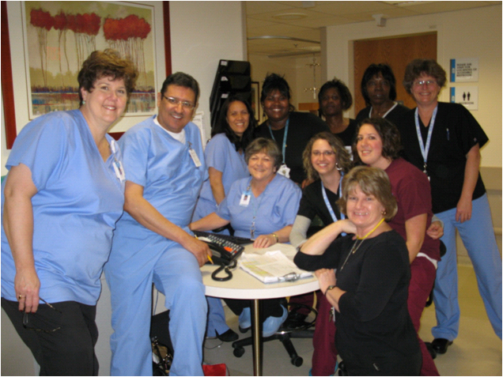
Questions

