Slide 1
David Sun Lecture Helping Your Patient by Helping Yourself: How to Improve the Patient Physician Relationship
Douglas A. Drossman, MD, MACG
Center for the Education and Practice of Biopsychosocial Care
DrossmanGastroenterology PLLC
Adjunct Professor of Medicine and Psychiatry
University of North Carolina

Slide 2
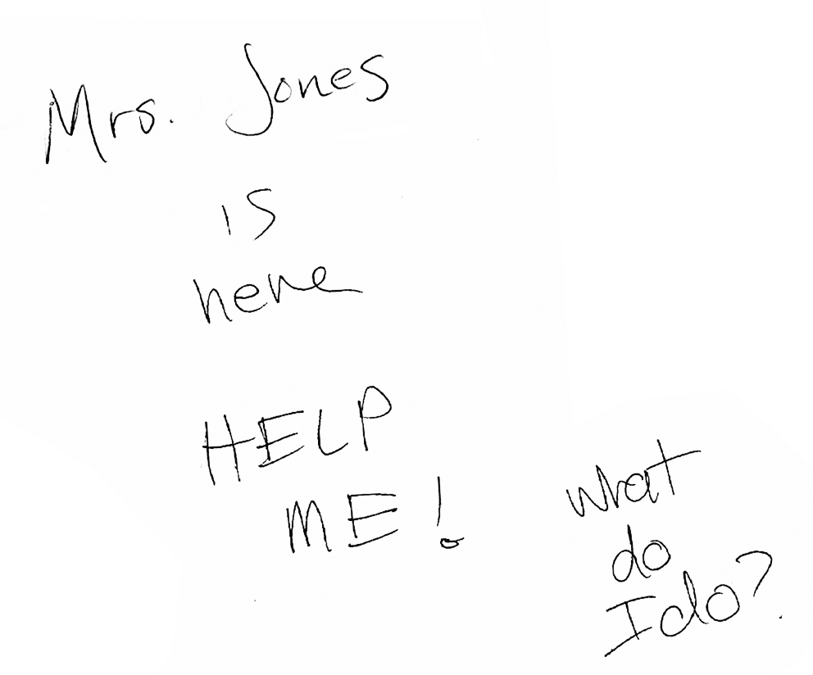
Notes:
Thank you. Today I want to talk about something that is very close to me as a physician; our skills in understanding and properly caring for patients
SLIDE Here is a note from one of my fellows left on my desk after seeing one of the patients in my clinic.
Now admittedly I see patients with very complex and difficult to treat functional GI disorders such S and like those with severe FM, CFS these disorders are not readily understood from what we learn in medical school.
So today I want to explore why that may be so and try to improve upon that.

Slide 3
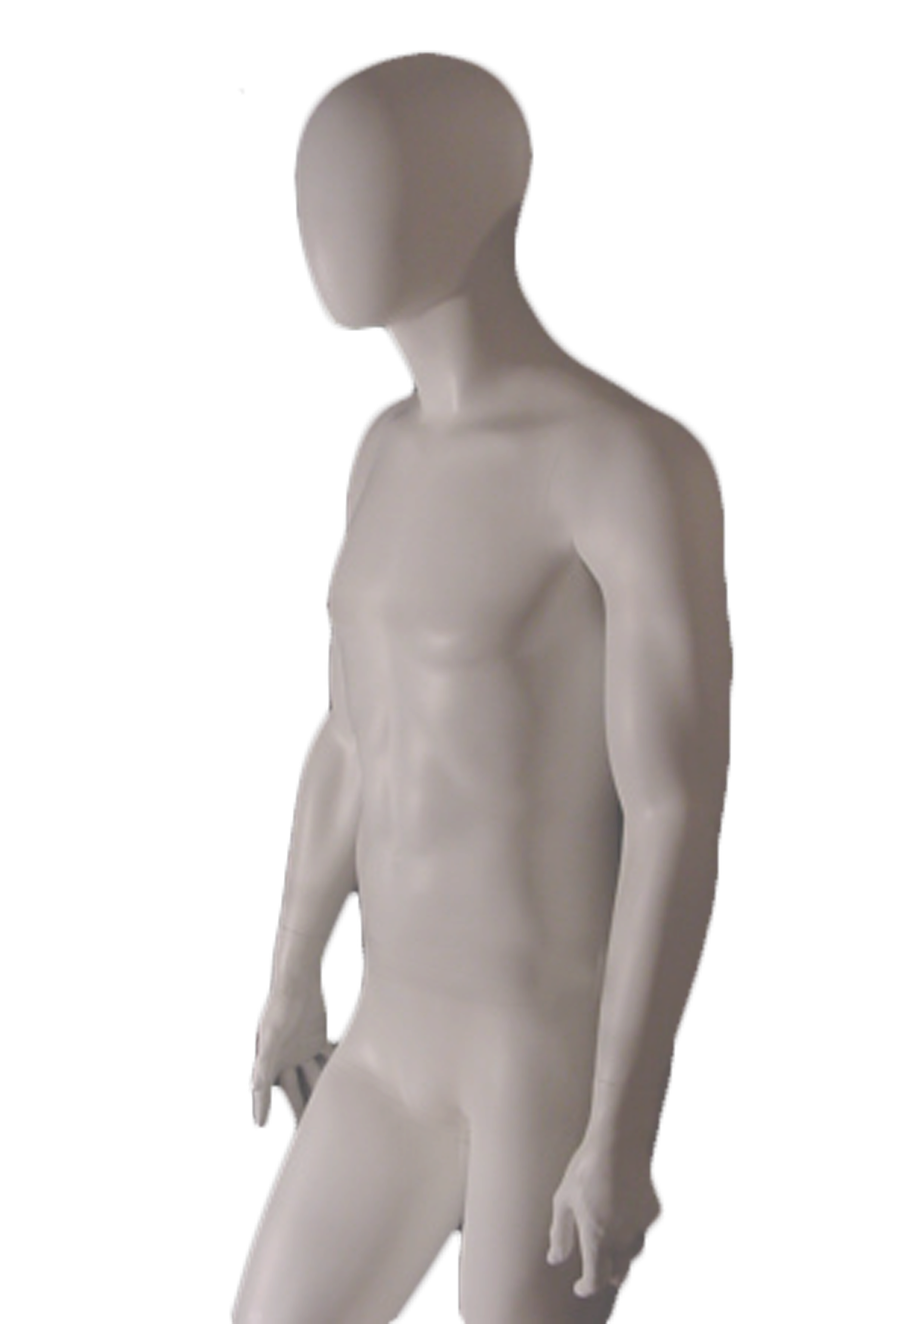
“The concept of the separation of mind and body is dominant and pervasive in Western thinking. This has had profound negative effects on research, patient care and the patient-physician relationship.”
Notes:
I believe it has a lot to do with our persistent belief in the folk model of separation of mind and body.
Now it wasn’t always this way.

Slide 4
The greatest mistake in the treatment of diseases is that there are physicians for the body and physicians for the soul, although the two cannot be separated.
Plato
400 BC
Notes:
In fact, over 2 centuries ago Plato and later Aristotle and Hippocrates taught about holism, that mind and body are integrated. and physicians must take into account the whole person rather than just the diseased part.
But in the 17th century this was supplanted by the concept mind body separation
Why did this occur? Malcolm Gladwell writes in his books that paradigm shifts or major changes in societal beliefs take hold when the society is prepared for and conceptually supports those changes. Bill Gates’ and Steve Jobs’ remarkable success with computers occurred at the time when the technology for home computers was emerging, [and the growth of the garment industry in NYC in the early 20th century occurred because the jewish immigrant tailor’s brought their skills to a place where the new technology was more efficiently producing garments for sale]

Slide 5
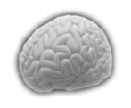
Res Extensa
Res Cogitans
Descartes
1637 CE
Notes:
- In the 1600’s the evolving sociopolitical movement toward separation of church and state
- And then in 1637 Rene Descartes published his letter “Meditations on First Philosophy” and introduced the idea of dualism: that the material body – res extensa was separate and distinct from the thinking mind res cogitans and this concept has permeated our thinking up until the present day
- - Now up until the 17th century, physicians were not permitted to dissect the human body because the spirit or sole was there. So knowledge of anatomy was primitive.
- But now with Descartes’ idea taking hold, the mind and spirit could be separated from the mortal body and this led to human dissection at the medical universities
- Now they could see the images of disease and with this came pathological classification and later refinements including histopathology and radiological imaging.
But the consequence was that the things you didn’t see like symptoms without structure and mental illness was isolated from such investigation.
And since the mind harbored the spiritual sole mental illness and abberant behaviors were considered spiritual possession or insanity and these persons were relegated to the asylums.
- In fact, it wasn’t until the beginning of the 20th century in the US that Benjamen Rush brought the study of mental health into the medical schools.

Slide 6
Disease
Illness
Perception
Verifiable
“Functional”
“Organic”
Notes:
So over time disease being verifiable was real and later was called organic, while illness, the personal experience of ill health was as a perception more subjective and later was called “functional”.
Chronic Pain is a good example of an illness you can’t see or measure. Certainly our patients believe it to be real. Elaine Scarry in her book The Body in Pain said: “To have pain is to have certainty; To hear about pain is to have doubt”

Slide 7
Biomedical Model: Cartesian Reductionism
Environmental
Exposures
“Psychologic
Overlay”
Disease
Biological
Predisposition
Clinical
Outcomes
Illness
?
?
?
Notes:
How does all of this relate to clinical medicine? The cartesian model is reductionistic – there is a linear unidirectional path where biological predispositions (e.g., altered host immunity - nod 2 gene alteration) coupled with the environmental exposures (e.g., enteric infection) produces disease (IBD) and the clinical outcome.
Illness is fully explained by the degree of disease.
Now, there are at least two problems here:
1) this assumes a single predisposition, an altered gene for example. But that can’t explain the heterogeneous and multidetermined nature of diseases like diabetes or IBD or cancer.
2) Because disease (structural abnormalities) is supposed to fully explain the illness (patient perception) the model leaves no room for variability in illness expression or even the possibility of illness without disease. A patient with a peptic ulcer may have severe pain and only slight mucosal disruption, while another having no history of pain at all presents to the emergency room with a GI bleed or even a perforation.
Let’s look at how this model plays out in real life when patients bring their illnesses to doctors

Slide 8
Illness Perception
Disease Verifiable
fatigue
chest pain
dizziness
headache
edema
back pain
dysphagia
insomnia
abdominal pain
numbness
Kroenke, et. al., AJM, 1989
Notes:
Here is a study looking at the 10 most common symptoms occurring in a primary care ambulatory clinic. The blue bars show the proportion where a specific disease was diagnosed.
So we may search for an underlying disease, more often than not it won’t be found.
This is a dilemma. And the feelings and behaviors that are generated from it are captured by the media in the form of humor

Slide 9
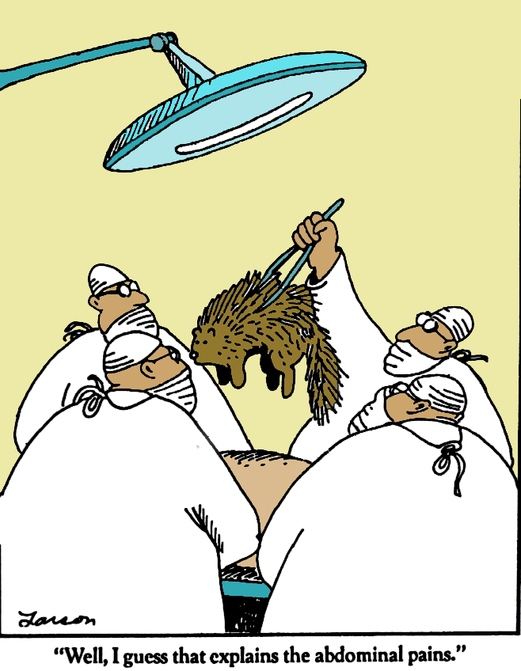
“Well, I guess that explains the abdominal pains.”
Notes:
It’s so important to make a diagnosis
Discuss NYU conference – patient with pain
Specialist can deal with uncertainty better

Slide 10
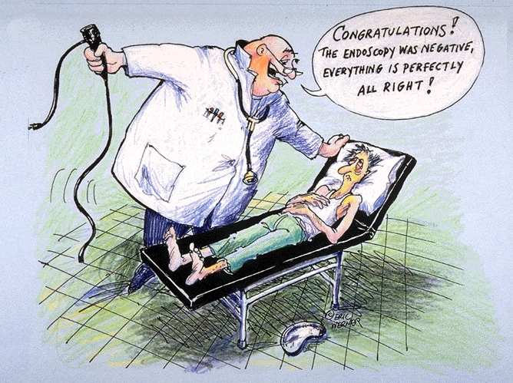
The pain still
bothers me!
Maybe he
Missed it
Does he
believe me?
Does this mean
It’s in my head?
I can not eat or
drink – how will
I manage?
My whole life is
affected
Notes:
And as specialists (like this gastroenterologist), we can feel satisfied that we’ve done our job even when the tests are negative
But the patient is left with the illness.
One of my former GI fellows told me that when she joined her practice she was told that a patient visit is a means to getting them to a procedure.

Slide 11
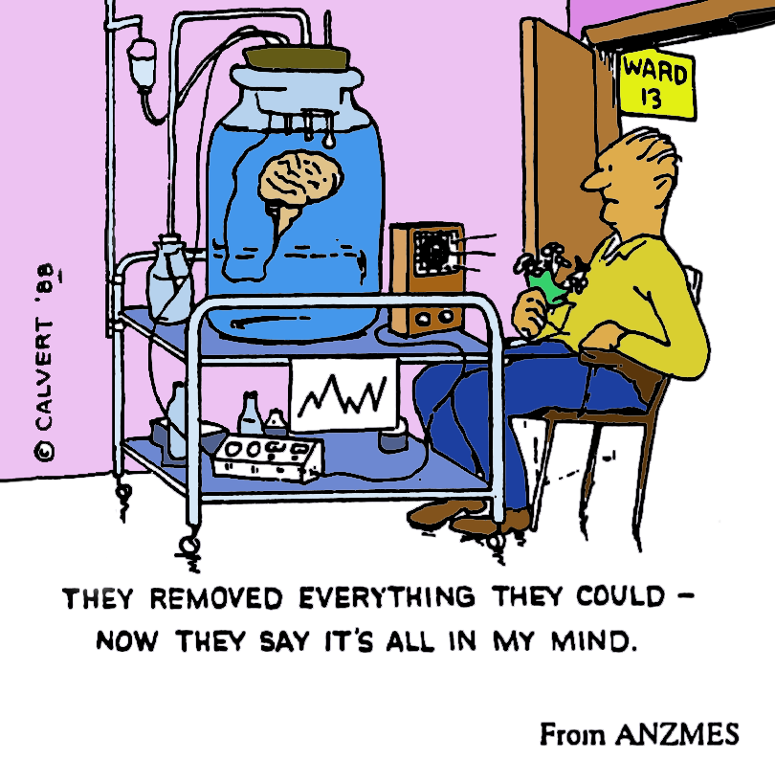
Notes:
And there could be no ending when looking for structural disease, and this is enabled because you get reimbursed for the tests, not the diagnosis and Osler said 90% of dx…
The cartoon that without a disease – it can only be in the mind.

Slide 12
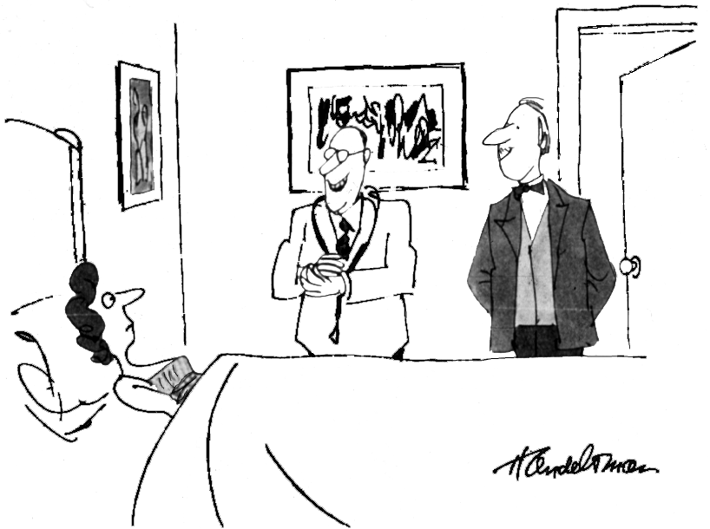
“Well, the old body checks out. Now let’s see what Doc Atkins here makes of the old mind.”
Notes:
With a negative w/u medical physicians can shift the responsibility to the psychiatrist.
So see the joy of the internist in transferring the patient and the patient’s surprise and non acceptance
But we really don’t know there is a psychiatric issue; all that’s hapenned is that we didn’t make a structural diagnosis

Slide 13
COPING
RIGHTFUL
SUFFERING
Asymptomatic ulcer
AIDS
COPD
Hypertension
Cancer
DISEASE
Motility Disorders
Chronic
back pain
Chronic fatigue
Chronic abdominal pain
FGIDs
FUNCTIONAL
(PSYCHOSOMATIC)
HEALTH
ILLNESS
Notes:
But there’s more
When there is Illness without disease the patient may become stigmatized.
Let’s look at this grid where we compare illness and disease and I’ve put some examples on the grid.
(Describe)

Slide 14
MD Perceptions of Patients: Organic vs. Functional
Seriousness of the problem
Functional
Organic
Disability of the patient
Reasonableness of request
Helpfulness of doctor
Satisfied with recommendation
Likeability of doctor/patient
0
20
40
60
80
% Positively endorsed
Dalton, Drossman, Clin Gastro and Hepatol, 2004; 2:121-126
Notes:
[Discuss study as example]
And we see this as stigmatization in the media as well

Slide 15
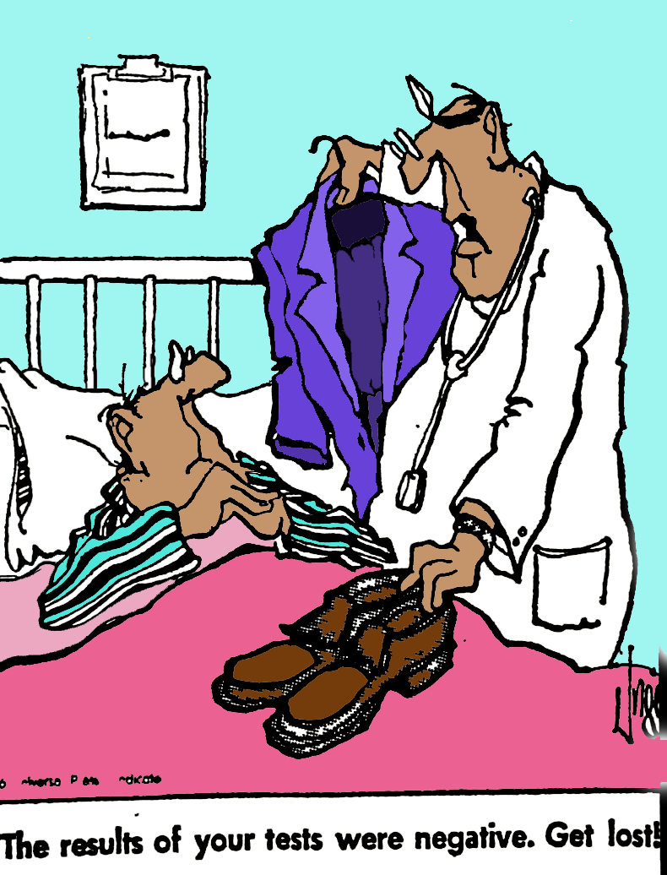
“The results of your test were negative. Get lost!”
Notes:
You may feel you’ve failed and project it back to the patient.

Slide 16
Cost-Effective Psychological Treatment?
Notes:
Even the psychiatrist may feel ill equipped to help
These cartoons make us laugh because we can identify with the frustration of this shared experience.
So how do we change this?

Slide 17
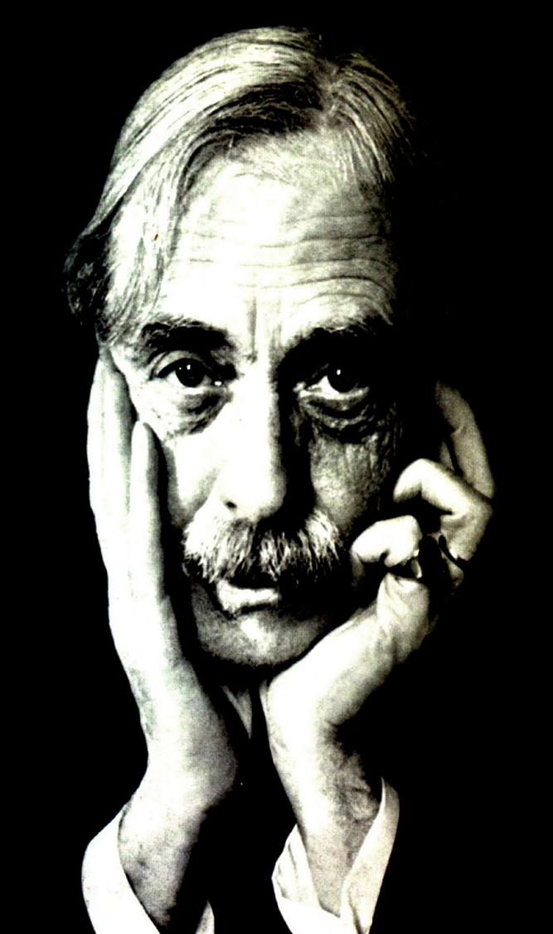
“To see is to forget
the name of the
thing one sees.”
Paul Valéry
Notes:
Paul Valery made this statement about art; to see a pure experience we should not be influenced by prior labels or concepts
So shouldn’t we apply this to our patients when we label them as functional?

Slide 18
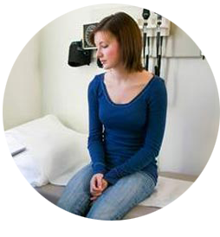
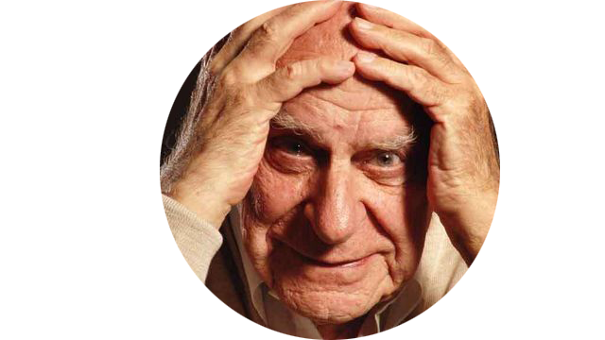
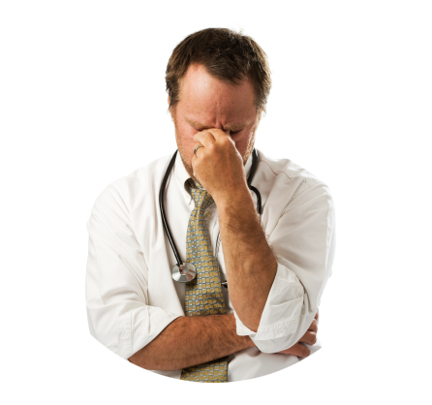
Notes:
- Next we need to realize that we are stuck in a vicious cycle that needs to stop
- The solution here is not trying harder to diagnose disease, but in abandoning the effort to do so (“Don’t just do something, stand there”)
I propose that we can stop this vicious cycle –
by accepting the illness as real
committing to work with the patient in his illness
and learning to listen, understand and communicate.

Slide 19
Acupuncture for IBS: 6 Weeks
Follow-up After Treatment
IBS-SSS (symptoms)
IBS-Quality Of Life
140
25
120
20
100
Mean
Change
(+SE) from
Baseline
15
80
60
10
40
5
20
35
53
108
7.5
7.4
16.9
0
0
Waitlist
n=77
Sham Acupuncture
Waitlist
n=77
Sham Acupuncture
Limited
n=34
Augmented
n=41
Limited
n=34
Augmented
n=41
Kaptchuk TJ, et al., BMJ 2008;336:999
Notes:
- Here’s some evidence [Discuss study]
What was the augmentation? [DISCUSS]
Several investigators including Mack Lipkin, Dennis Novack, Debra Roter at Hopkins, Tony Suchman at Rochester, and Wendy Levinson in Portland have made a career on finding the elements that lead to good communication and positive results.
Next slide
So now let’s look at the elements that lead to such a good treatment response.
There are some ineffective things that we say in good faith but it doesn’t work because we are not considering the patient:
“Don’t worry; it’s nothing serious.”
“I’d like to order a few tests to be sure there’s no problem . . . But I believe they’ll be normal.”
“Your problem is due to stress.”

Slide 20
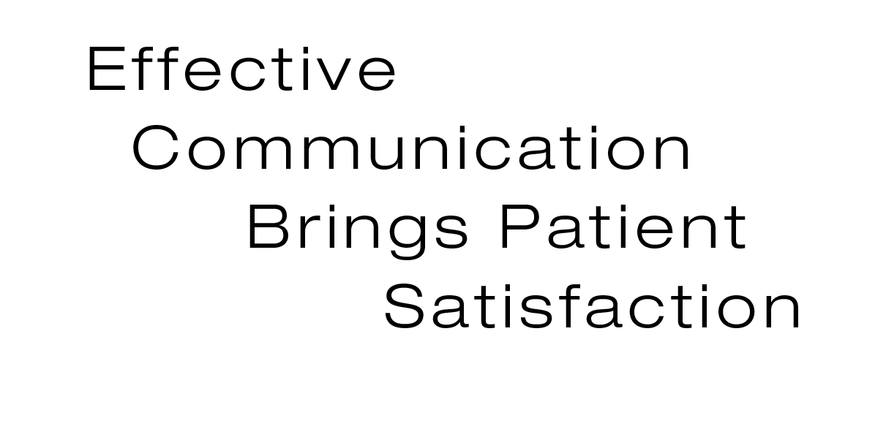
Notes:
Patient satisfaction relates to:
the doctor’s Humaneness,
technical competence,
interest in psychosocial factors,
and the provision of medical information,
but if there is too much focus on biomedical issues, it has a negative effect

Slide 21
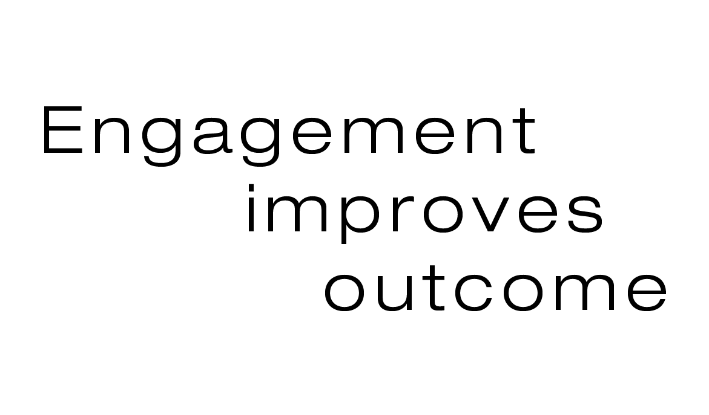
Notes:
Certain communication methods engage the patient and improve clinical outcome:
- good eye contact,
- affirmative nods/gestures,
- partner like relationship,
- closer interpersonal distance,
- gentle tone of voice

Slide 22
Notes:
Furthermore physicians with good communications skills like their patients and enjoy their work more and the patients are more satisfied
- Ineffective communication skills increases malpractice claims [Wendy Levinson]

Slide 23
listen actively
identify agenda(s)
empathize
validate feelings
set realistic goals
educate
reassure
negotiate
“be there”
Notes:
Let me take you through a few suggestions
Listen Actively – cocktail party

Slide 24
listen actively
identify agenda(s)
empathize
validate feelings
set realistic goals
educate
reassure
negotiate
“be there”
Patient’s Agenda
My symptoms
I’m under
more stress
Do I have
cancer?
Am I crazy?
Why am I
not getting
better?
What brought you here today?
What do you think you have?
What worries or concerns do you have?
What do you feel I can do to help?
Notes:
Patient’s have reasons for coming and some may be easy to elicit.
At other times it takes thoughtful questions to truly understant the reasons (read four questions)

Slide 25
listen actively
identify agenda(s)
empathize
validate feelings
set realistic goals
educate
reassure
negotiate
“be there”
“I can see how difficult it has been to manage with your pain.”
Notes:
Acknowledge the pain – empathize
- Demonstrates an understanding of patient’s pain and distress, and
- Maintains an objective and observant stance
e.g.: “I can see how difficult it has been to manage with your pain”

Slide 26
listen actively
identify agenda(s)
empathize
validate feelings
set realistic goals
educate
reassure
negotiate
“be there”
“I can see you are frustrated when people say this is due to stress and you know it’s real.”
Notes:
Validating feelings creates a bridge between you and the patient.
“It must be frustrating when people say this is due to stress when you know it’s real” – put on slide after a click
This opens the door to further dialog about how stress can play a role.
Avoided responding to patient’s “either-or” question– “You don’t think it’s in my head do you?”
- Dr. asked why patient is asking - to get more data
- Reflected back on patient concerns and validated them: “So you’re wondering by my question if I think it’s a psychiatric problem?”
- Distinguished the stigmatizing term “psychiatric problem” from “stress” a common influence on symptoms
- THEN validated patient feeling that it’s not a psychiatric problem while maintaining the plausibility of stress as a factor

Slide 27
listen actively
identify agenda(s)
empathize
validate feelings
set realistic goals
educate
reassure
negotiate
“be there”
Video 1
Notes:
- Avoided responding to patient’s “either-or” question– “You don’t think it’s in my head do you?”
- Dr. asked why patient is asking - to get more data
- Reflected back on patient concerns and validated them: “So you’re wondering by my question if I think it’s a psychiatric problem?”
- Distinguished the stigmatizing term “psychiatric problem” from “stress” a common influence on symptoms
- THEN validated patient feeling that it’s not a psychiatric problem while maintaining the plausibility of stress as a factor

Slide 28
Validating Patient Feelings Relating to Stress
Avoided responding to patient’s “either-or” question– “You don’t think it’s in my head do you?”
Dr. asked why patient is asking - to get more data
Reflected back on patient concerns and validated them: “So you’re wondering by my question if I think it’s a psychiatric problem?”
Distinguished the stigmatizing term “psychiatric problem” from “stress” a common influence on symptoms
THEN validated patient feeling that it’s not a psychiatric problem while maintaining the plausibility of stress as a factor

Slide 29
listen actively
identify agenda(s)
empathize
validate feelings
set realistic goals
educate
reassure
negotiate
“be there”
Set up an initial mutual understanding.
Notes:
We need to set realistic goals at the very beginning of the interaction.
Patients may come the to doctor with expectations for a rapid diagnosis and cure while the physician sees this as a chronic problem that needs symptom management. So often this is not articulated and months later the patient is frustrated that her needs have not been met.
Asking the patient from the outset can lead into a dialogue where there is a mutual understanding of expectations.
- Avoided responding defensively to challenge – “Is there something you can do?”
- Asks about patient expectations
- Acknowledges that mutual realistic goals not established on first visit
- Does not respond to nonverbal and verbal pain behaviors “I have to live with this, forever?”
- Acknowledged concerns without need to do something (“Don’t just do something, stand there”)
- Offers a realistic goal for improvement

Slide 30
listen actively
identify agenda(s)
empathize
validate feelings
set realistic goals
educate
reassure
negotiate
“be there”
Video 2
Notes:
- Avoided responding defensively to challenge – “Is there something you can do?”
- Asks about patient expectations
- Acknowledges that mutual realistic goals not established on first visit
- Does not respond to nonverbal and verbal pain behaviors “I have to live with this, forever?”
- Acknowledged concerns without need to do something (“Don’t just do something, stand there”)
- Offers a realistic goal for improvement

Slide 31
Patient Dissatisfaction with Care – Establishing Realistic Expectations
Avoided responding defensively to challenge – “Is there something you can do?”
Asks about patient expectations
Acknowledges that mutual realistic goals not established on first visit
Does not respond to nonverbal and verbal pain behaviors “I have to live with this, forever?”
Acknowledged concerns without need to do something (“Don’t just do something, stand there”)
Offers a realistic goal for improvement

Slide 32
listen actively
identify agenda(s)
empathize
validate feelings
set realistic goals
educate
reassure
negotiate
“be there”
Elicit patient’s understanding
Address misunderstandings
Provide information consistent with patient’s frame of reference
Check the patient’s understanding of what was discussed

Slide 33
listen actively
identify agenda(s)
empathize
validate feelings
set realistic goals
educate
reassure
negotiate
“be there”
Identify patient’s worries, concerns
Acknowledge (validate) them
Respond to the specific concerns
Avoid “false” reassurances
Notes:
And what do patients want? Patient’s with chronic illness want to be understood, given a sense of hope and not abandoned

Slide 34
listen actively
identify agenda(s)
empathize
validate feelings
set realistic goals
educate
reassure
negotiate
“be there”
Notes:
Help the patient take responsibility
Relationship centered care – not doctor centered

Slide 35
listen actively
identify agenda(s)
empathize
validate feelings
set realistic goals
educate
reassure
negotiate
“be there”
Provide support and a listening ear.
Notes:
Sometimes the patient brings up very difficult issues, a history of abuse, a major loss in the family which may be difficult to discuss. It’s our job to be nonjudmental, to listen and provide support. The patient is not looking for solutions as much as a listening ear.
And I want to thank you for listening and I hope what I’ve said will harmonize and help. If you’d like to do more please join me tomorrow for our workshop
- Clearly this patient is struggling with issues and whether or not to discuss them and she is not certain of their relevance
- I remained nonjudgmental – and used questions and reflections
- Reflected on similarity of current feelings of “helpless” and “out of control” to feelings generated from earlier traumatic events
- Used silence and reflection as a means of support
- Gently acknowledged options for further exploration
Stayed with the patient, and offered availability to discuss further or to refer

Slide 36
listen actively
identify agenda(s)
empathize
validate feelings
set realistic goals
educate
reassure
negotiate
“be there”
Video 3
Notes:
- [Nonjudgmental - Used questions and reflections
- Addressed patient feelings “Helpless”, “Out of control” as related to symptoms
- Reflected on similarity of current feelings to feelings generated from earlier traumatic events
- Used silence and reflection as a means of support
- Gently acknowledged options for further exploration
Stayed with the patient, and offered availability to discuss further or to refer
I want to thank you for listening and I hope this has been of some help to you. If you’d like to do more please join me tomorrow for our workshop

Slide 37
“Be There” for Uncomfortable Issues
Nonjudgmental - Used questions and reflections
Addressed patient feelings “Helpless”, “Out of control” as related to symptoms
Reflected on similarity of current feelings to feelings generated from earlier traumatic events
Used silence and reflection as a means of support
Gently acknowledged options for further exploration
Stayed with the patient, and offered availability to discuss further or to refer

