Slide 1
Confocal Microscopy
Pablo Ariel, Ph.D.
Microscopy Services Laboratory
Department of Pathology and Laboratory Medicine
University of North Carolina, Chapel Hill
June 2020

Slide 2
Why confocal ?
What problem does a confocal solve ?

Slide 3
Widefield fluorescence microscopy
Fluorophores
Sample
Focal plane
Lenses et al
Lamp
Sensitive area detector
This is what a confocal solves
Out of focus objects are blurred
Detection in parallel
Notes:
Highly simplified ray diagrams
Ray tracing: https://ricktu288.github.io/ray-optics/

Slide 4
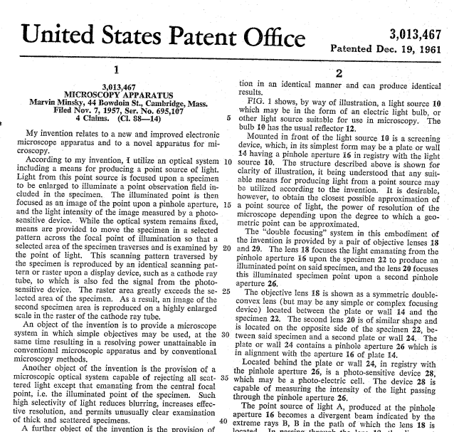
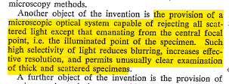
Notes:
https://patents.google.com/patent/US3013467A/en

Slide 5
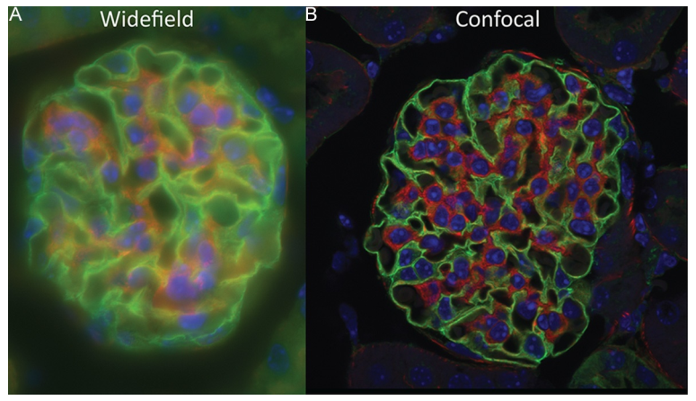
Example: 15um kidney section, 63X/1.4NA objective
How does a confocal do this?
Bonus: Compare for yourself at https://www.olympus-lifescience.com/en/microscope-resource/primer/java/confocalvswidefield/
Notes:
Modified from https://doi.org/10.1016/B978-0-12-420138-5.00007-0

Slide 6
Widefield fluorescence microscopy
Laser scanning confocal microscopy
Fluorophores:
in focal plane
Sample
out of focal plane
Focal plane
Lenses, scanners et al
Lenses et al
Lamp
Laser
Sensitive area detector
Pinhole
(Less) sensitive spot detector
Out of focus objects are blurred
Light from out of focus objects removed
Detection in parallel

Slide 7
Widefield fluorescence microscopy
Laser scanning confocal microscopy
Fluorophores:
in focal plane
Sample
out of focal plane
Focal plane
Lenses, scanners et al
Lenses et al
Lamp
Laser
Sensitive area detector
Pinhole
(Less) sensitive spot detector
Out of focus objects are blurred
Light from out of focus objects removed
Detection in parallel
Detection in series (“scanning”)

Slide 8
Widefield fluorescence microscopy
Laser scanning confocal microscopy
Fluorophores:
in focal plane
Sample
out of focal plane
Focal plane
Lenses, scanners et al
Lenses et al
Lamp
Laser
Sensitive area detector
Pinhole
(Less) sensitive spot detector
Out of focus objects are blurred
Light from out of focus objects removed
Detection in parallel
Detection in series (“scanning”)

Slide 9
Widefield fluorescence microscopy
Laser scanning confocal microscopy
Fluorophores:
in focal plane
Sample
out of focal plane
Focal plane
Lenses, scanners et al
Lenses et al
Lamp
Laser
Sensitive area detector
Pinhole
(Less) sensitive spot detector
Out of focus objects are blurred
Light from out of focus objects removed
Detection in parallel
Detection in series (“scanning”)

Slide 10
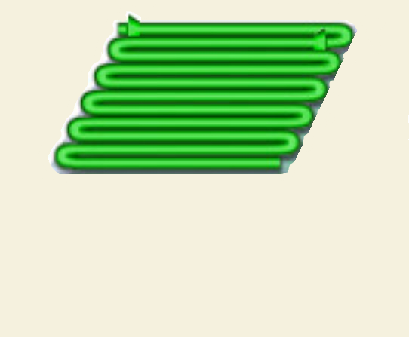
Laser scanning is 2D
Y
X
https://www.olympus-lifescience.com/en/microscope-resource/primer/java/galvanometerscanning/
Notes:
Heavily modified from Figure 4: http://zeiss-campus.magnet.fsu.edu/articles/spinningdisk/introduction.html

Slide 11
Laser scanning confocal microscopy
Fluorophores:
in focal plane
out of focal plane
Lenses, scanners et al
Laser
Pinhole
(Less) sensitive spot detector

Slide 12
Laser scanning confocal microscopy
Fluorophores:
in focal plane
out of focal plane
Lenses, scanners et al
Laser
Critical for removing out of focus light
Pinhole
(Less) sensitive spot detector

Slide 13
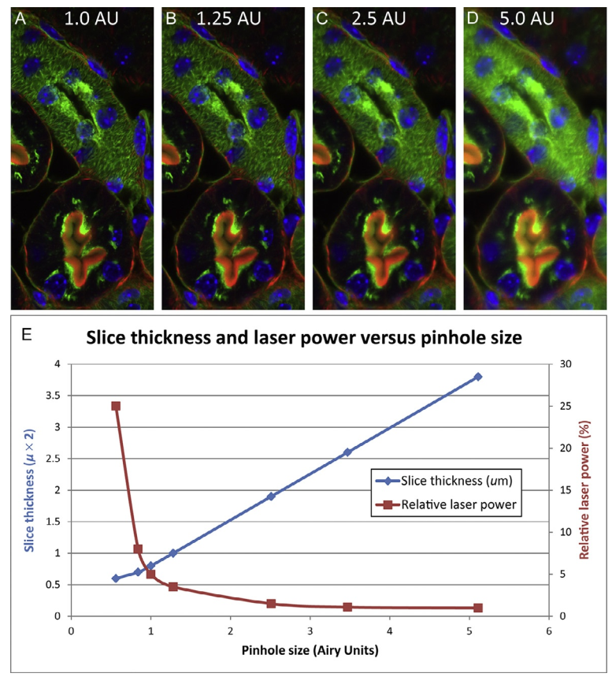
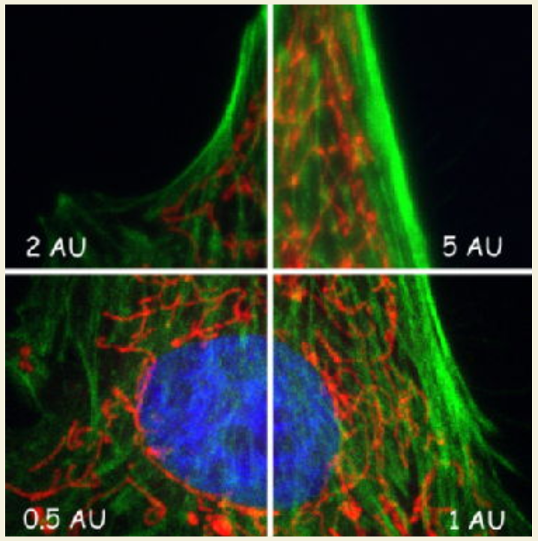
How do we set the pinhole size ?
~1 Airy unit is usually a good compromise
Notes:
Graphics modified from
https://ieeexplore.ieee.org/document/8039195
https://warwick.ac.uk/fac/sci/lifesci/research/facilities/imaging/sp5booking/imaging-pinhole/
https://doi.org/10.1016/B978-0-12-420138-5.00007-0

Slide 14
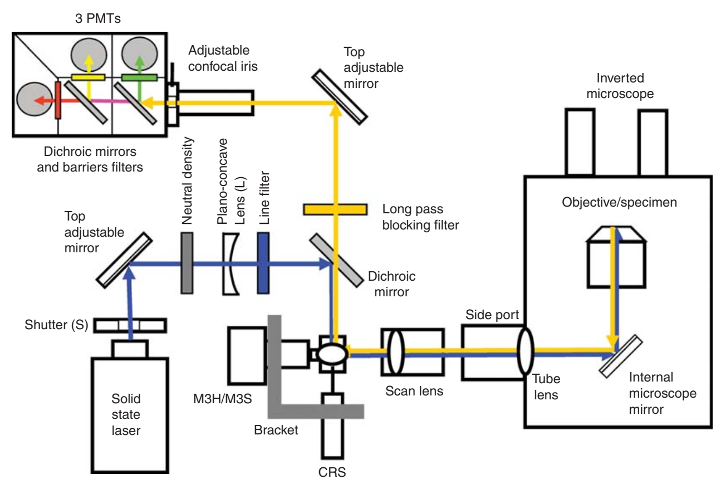
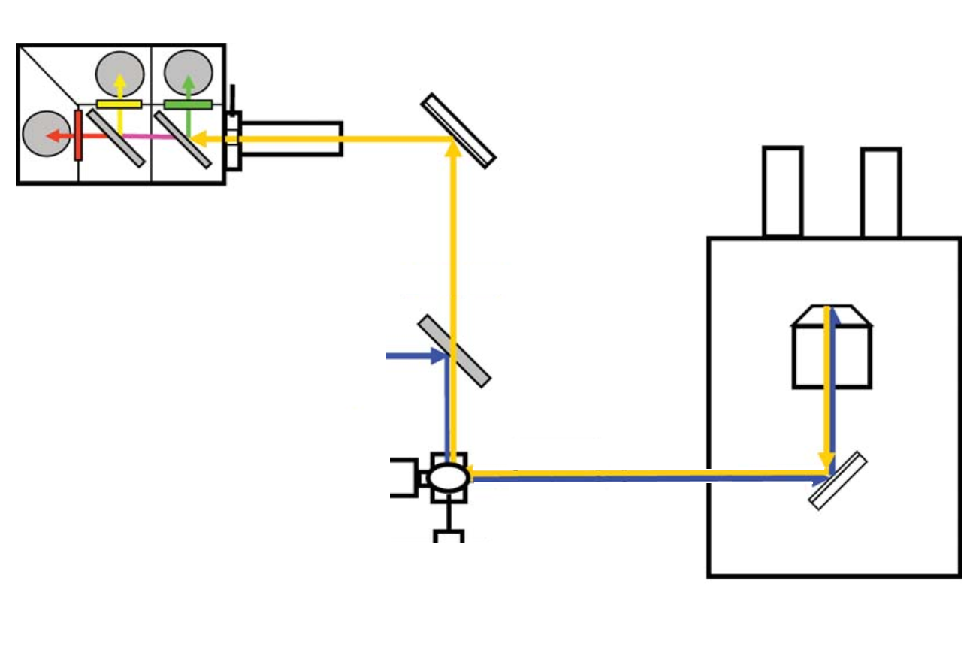
Confocals can image multiple fluorophores
3 PMTs
Pinhole
Dichroics and filters
Objective and sample
Excitation laser
Dichroic
Scanning
mirrors
Notes:
http://cshprotocols.cshlp.org/content/2014/10/pdb.top071795

Slide 15
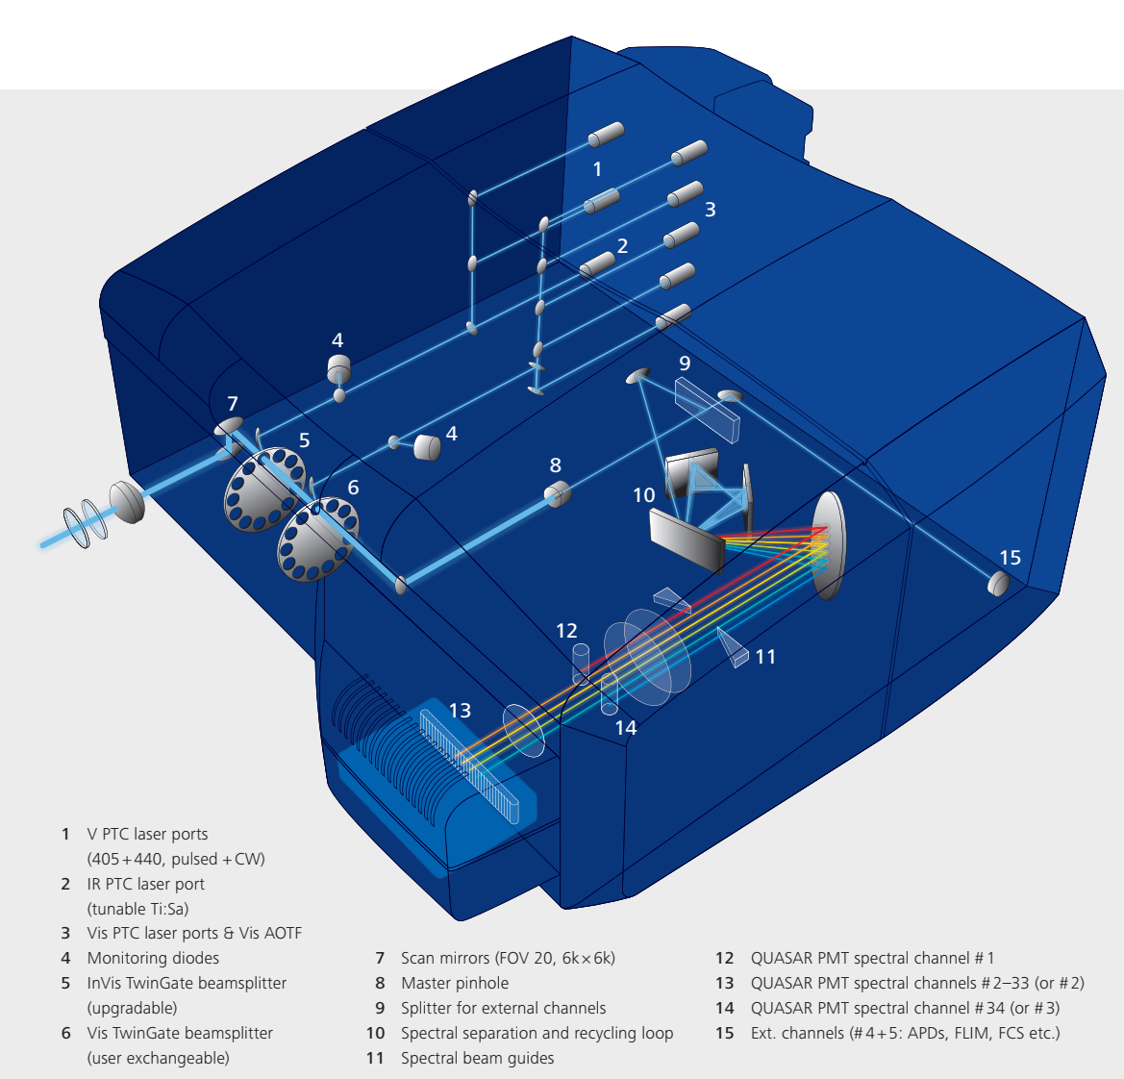
Modern confocals have flexible wavelength detection windows
Example: Zeiss LSM710 light path
(two of these in cores on campus)
Video: Zeiss LSM980 - https://zeiss.wistia.com/medias/4ehx150o5j

Slide 16
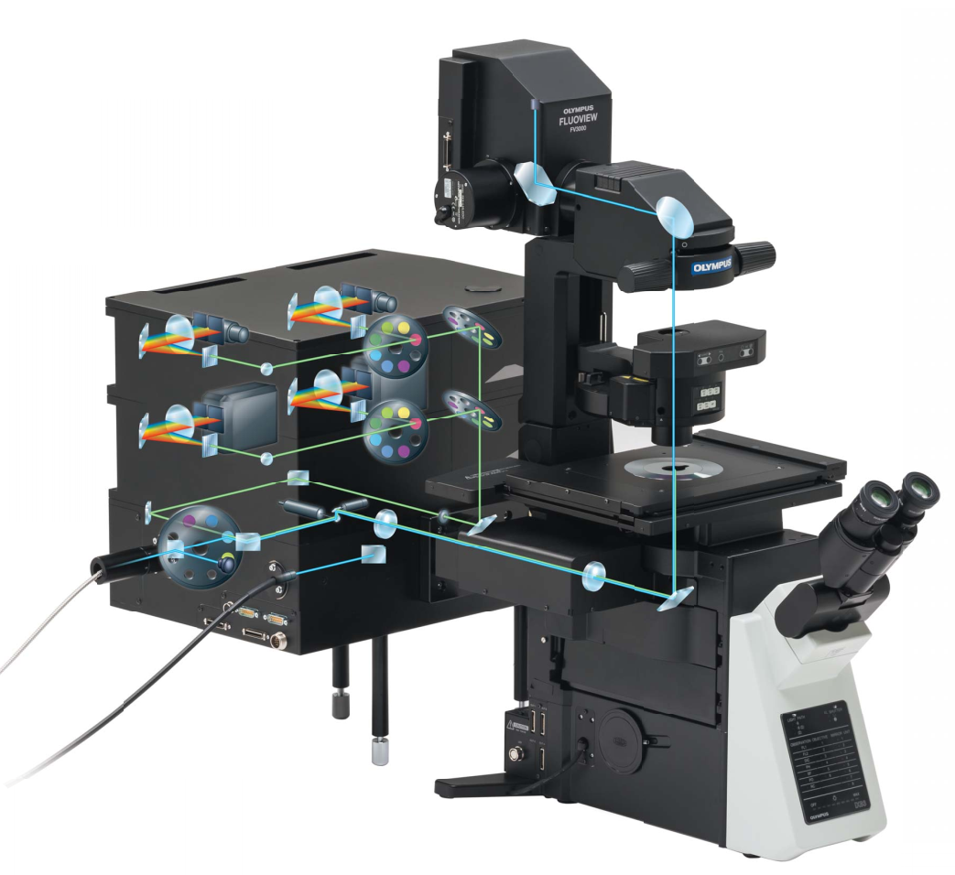
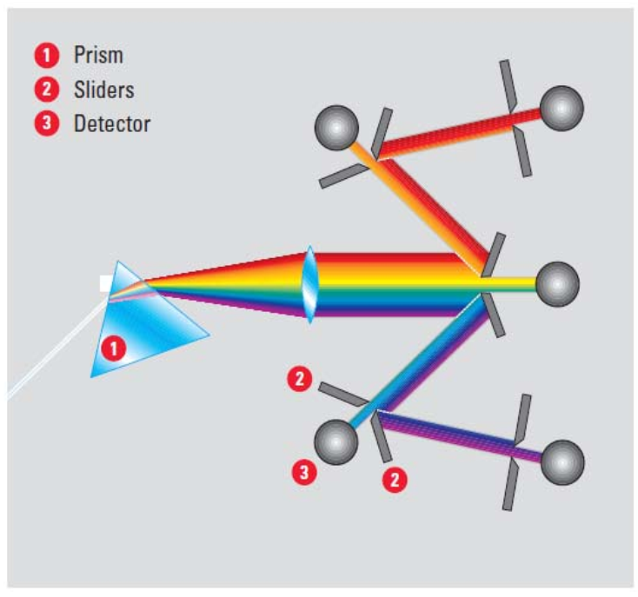
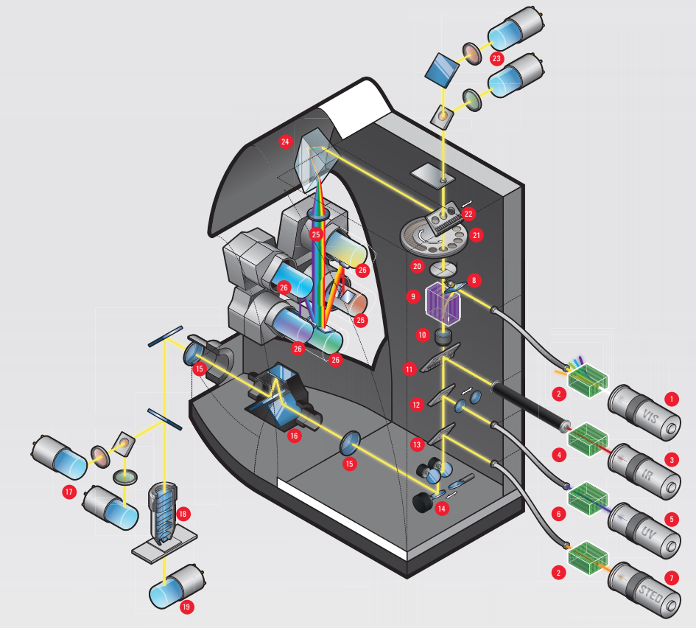
Different companies do this in different ways
Zeiss LSM710 – Diffraction grating
Olympus FV3000 – Volume phase hologram
Leica SP8 - Prism
Nikon A1 – many options
Notes:
https://applications.zeiss.com/C125792900358A3F/0/55FE5FC0794DD7E0C12583C10039E6A3/$FILE/EN_41_011_082_LSM980_rel1-1.pdf
https://www.olympus-lifescience.com/en/.downloads/download/?file=855640653&fl=en_US&inline

Slide 17
Laser scanning confocals can do brightfield at the same time
Leica SP8
This detector gets brightfield image at same time as fluorescence

Slide 18
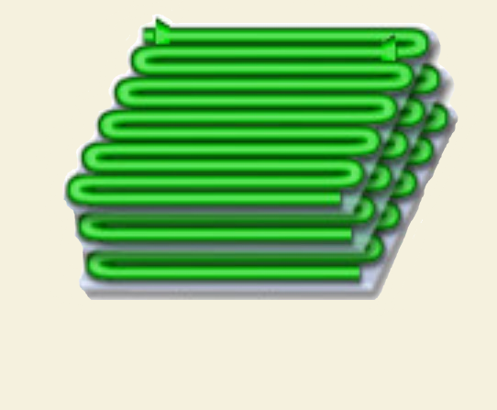
Confocal allows 3D imaging
Recipe:
Scan laser in 2D
Move sample in Z
Repeat
Y
Z
X
Notes:
Modified from Figure 4: http://zeiss-campus.magnet.fsu.edu/articles/spinningdisk/introduction.html

Slide 19
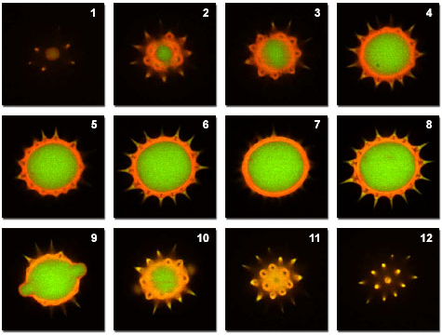
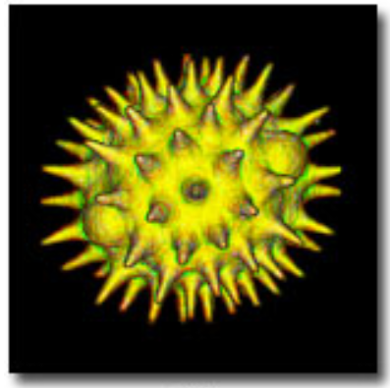
Confocal allows 3D imaging
Recipe:
Scan laser in 2D
Move sample in Z
Repeat
Pollen grain serial optical sections with a confocal
Reconstruct 3D
Notes:
Modified from https://www.olympus-lifescience.com/en/microscope-resource/primer/techniques/confocal/confocalintro/

Slide 20
Problems with laser scanning confocal
Fluorophores:
in focal plane
out of focal plane
Lenses, scanners et al
Laser
Pinhole
(Less) sensitive spot detector

Slide 21
Problems with laser scanning confocal
Fluorophores:
in focal plane
out of focal plane
Lenses, scanners et al
Laser
Pinhole
(Less) sensitive spot detector
Not very sensitive

Slide 22
Problems with laser scanning confocal
Fluorophores:
in focal plane
out of focal plane
Slow
Lenses, scanners et al
Laser
Pinhole
(Less) sensitive spot detector
Not very sensitive

Slide 23
Problems with laser scanning confocal
Fluorophores:
in focal plane
out of focal plane
Slow
Lenses, scanners et al
Laser
Damaging
Pinhole
(Less) sensitive spot detector
Not very sensitive

Slide 24
Increasing sensitivity of laser scanning confocal
Fluorophores:
in focal plane
out of focal plane
Lenses, scanners et al
Laser
Pinhole
(Less) sensitive spot detector
Not very sensitive

Slide 25
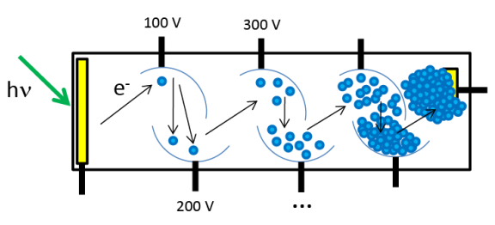
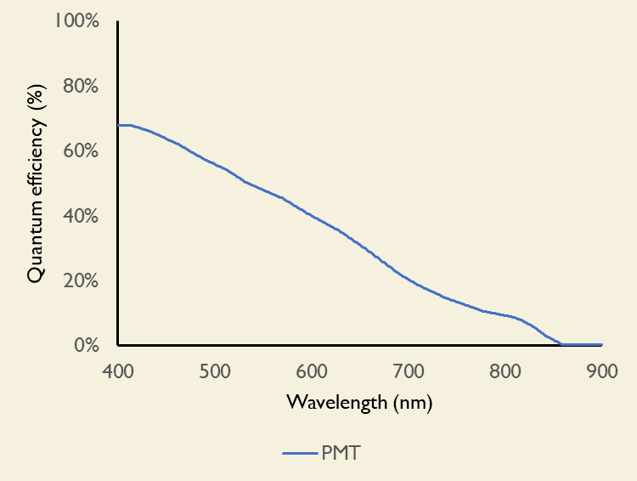
Increasing sensitivity of laser scanning confocal
Problem
Standard photomultiplier tubes are noisy and not very sensitive
Notes:
Information from
Olympus: https://www.olympus-lifescience.com/en/laser-scanning/fv3000/#!cms[focus]=cmsContent6335
Leica: https://downloads.leica-microsystems.com/Leica%20HyD/Dedicated%20Articles/Photoncounting_Technological%20Readings_Jul2015.pdf
https://journals.plos.org/plosone/article?id=10.1371/journal.pone.0214659
Zeiss:

Slide 26
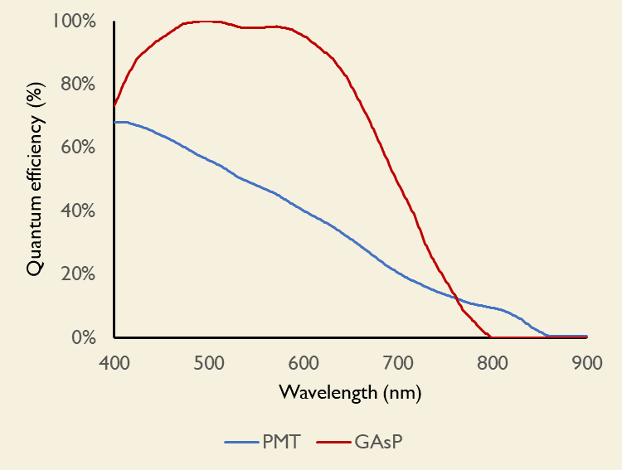
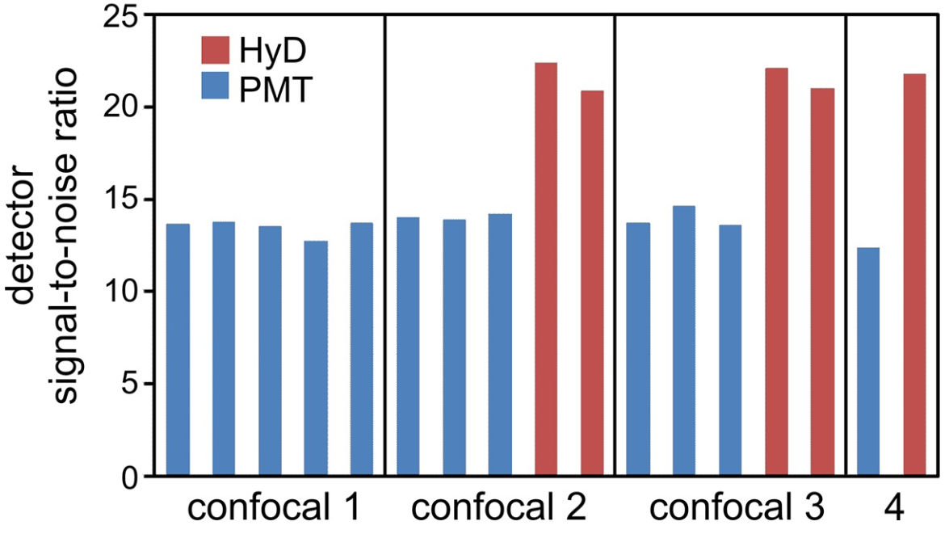
Increasing sensitivity of laser scanning confocal
Problem
Standard photomultiplier tubes are noisy and not very sensitive
Better detectors ($$$)
GaAsP PMTs (many companies)
HyDs (PMT+APD, Leica)
Solution
Notes:
Information from
Olympus: https://www.olympus-lifescience.com/en/laser-scanning/fv3000/#!cms[focus]=cmsContent6335
Leica: https://downloads.leica-microsystems.com/Leica%20HyD/Dedicated%20Articles/Photoncounting_Technological%20Readings_Jul2015.pdf
https://journals.plos.org/plosone/article?id=10.1371/journal.pone.0214659
Zeiss:

Slide 27
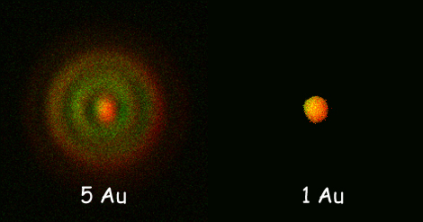
Increasing sensitivity of laser scanning confocal
Problem
Pinhole blocks light
Pinhole
Image of 100nm beads with Zeiss 880 LSM
Notes:
Information from:
https://warwick.ac.uk/fac/sci/lifesci/research/facilities/imaging/sp5booking/imaging-pinhole/

Slide 28
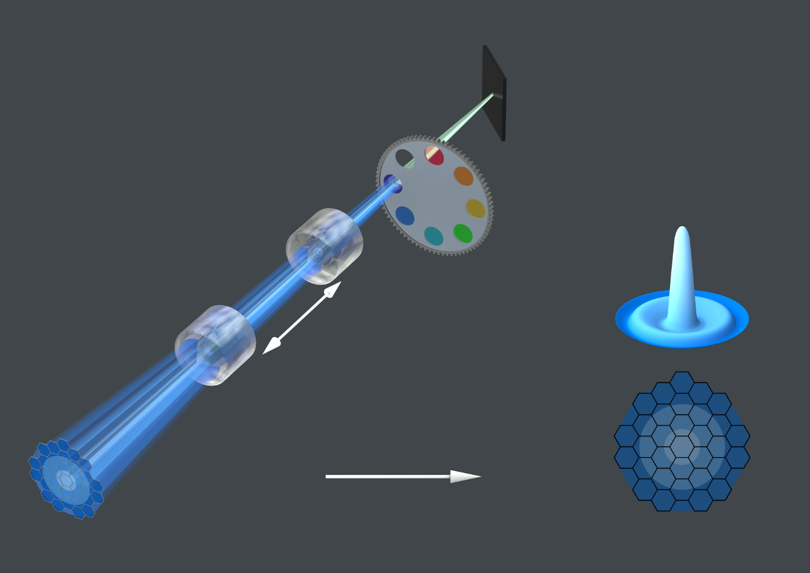
Increasing sensitivity of laser scanning confocal
Problem
Pinhole blocks light
Rethink pinhole and point detection ($$$)
Airyscan (Zeiss)
Solution
Notes:
Information from:
https://www.zeiss.com/microscopy/us/products/confocal-microscopes/confocal-microscope-with-multiplex-mode-lsm-980-airyscan-2.html#airyscan

Slide 29
Increasing speed of laser scanning confocal
Fluorophores:
in focal plane
out of focal plane
Slow
Lenses, scanners et al
Laser
Pinhole
(Less) sensitive spot detector

Slide 30
Increasing speed of laser scanning confocal
Problem
Scanners are slow
( single image can take ~1s)
Increasing sensitivity allows higher speed
(with same signal-to-noise ratio)
Scan less: trade field of view for speed
(cropping, linescans)
Solutions
Scan coarsely: trade resolution for speed
(fewer pixels)
Resonant scanners ($$$, 30 frames/s or higher):
Mirrors that oscillate at a fixed (high) frequency
Less flexibility (rotation, zoom)
Uneven illumination issues
Beware: speed costs photons (fewer from each location)
Notes:
https://www.microscopyu.com/techniques/confocal/resonant-scanning-in-laser-confocal-microscopy

Slide 31
Problems with laser scanning confocal
Fluorophores:
in focal plane
out of focal plane
Lenses, scanners et al
Laser
Damaging
Pinhole
(Less) sensitive spot detector

Slide 32
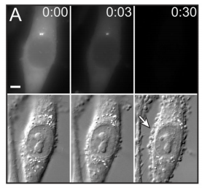
Decreasing damage of laser scanning confocal
Problem
Light damages cells and fluorophores
Fluorophores (“bleaching”)
Live cells (“photodamage”)
Notes:
https://www.ncbi.nlm.nih.gov/pmc/articles/PMC3843244/

Slide 33
Decreasing damage of laser scanning confocal
Problem
Light damages cells and fluorophores
Increasing sensitivity allows less damage
(with same signal-to-noise ratio)
Scan coarsely: trade resolution for less damage
Solutions
Scan faster: trade sensitivity for less damage
Use longer wavelengths (less damaging)
Improve sample:
Live: use brighter, more stable fluorophores
Fixed: use mounting media
Notes:
https://www.microscopyu.com/techniques/confocal/resonant-scanning-in-laser-confocal-microscopy

Slide 34
Pyramid of frustration
Specimen health
?!
Temporal resolution
Spatial resolution
Contrast

Slide 35
Parameters we adjust on a laser scanning confocal
For contrast
For resolution
Laser power
Zoom
PMT Gain
Image size
Scan Speed
Frame size
Averaging
Pixel size

Slide 36
Parameters we adjust on a laser scanning confocal
For contrast
For resolution
Laser power
Zoom
PMT Gain
Image size
Scan Speed
Frame size
Averaging
Pixel size

Slide 37
Optimizing contrast on a laser scanning confocal
Low contrast
Low bleaching
High contrast
High bleaching
Laser power
PMT Gain

Slide 38
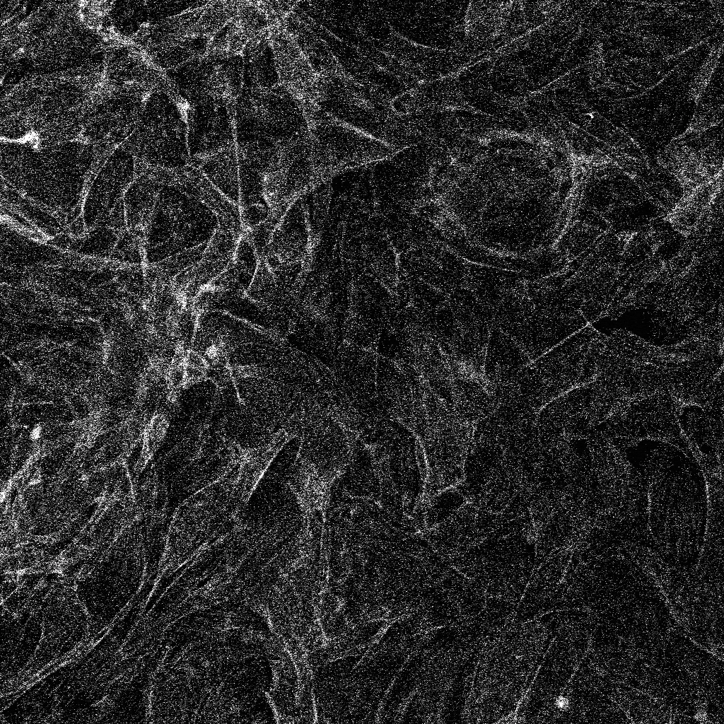
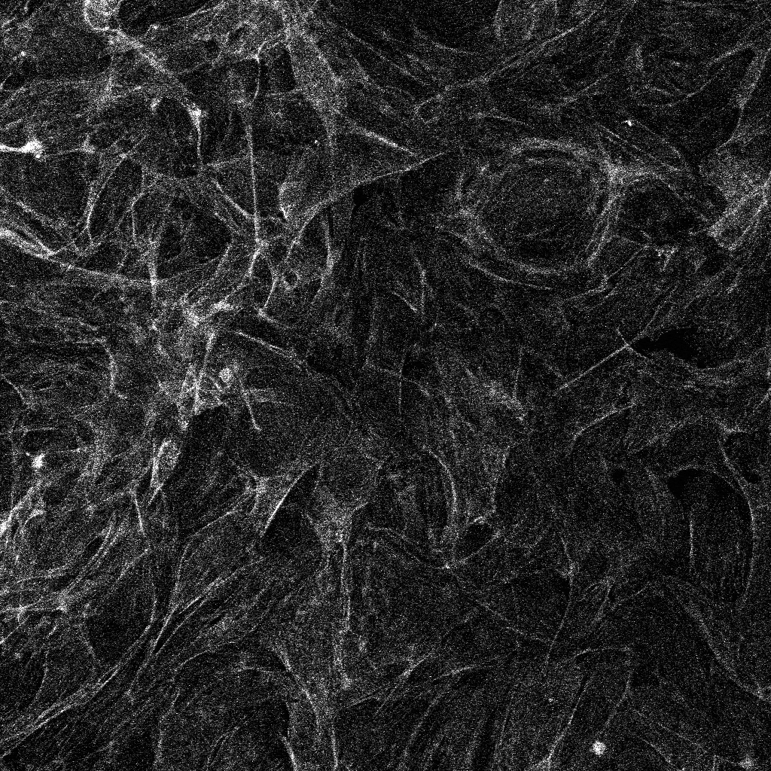
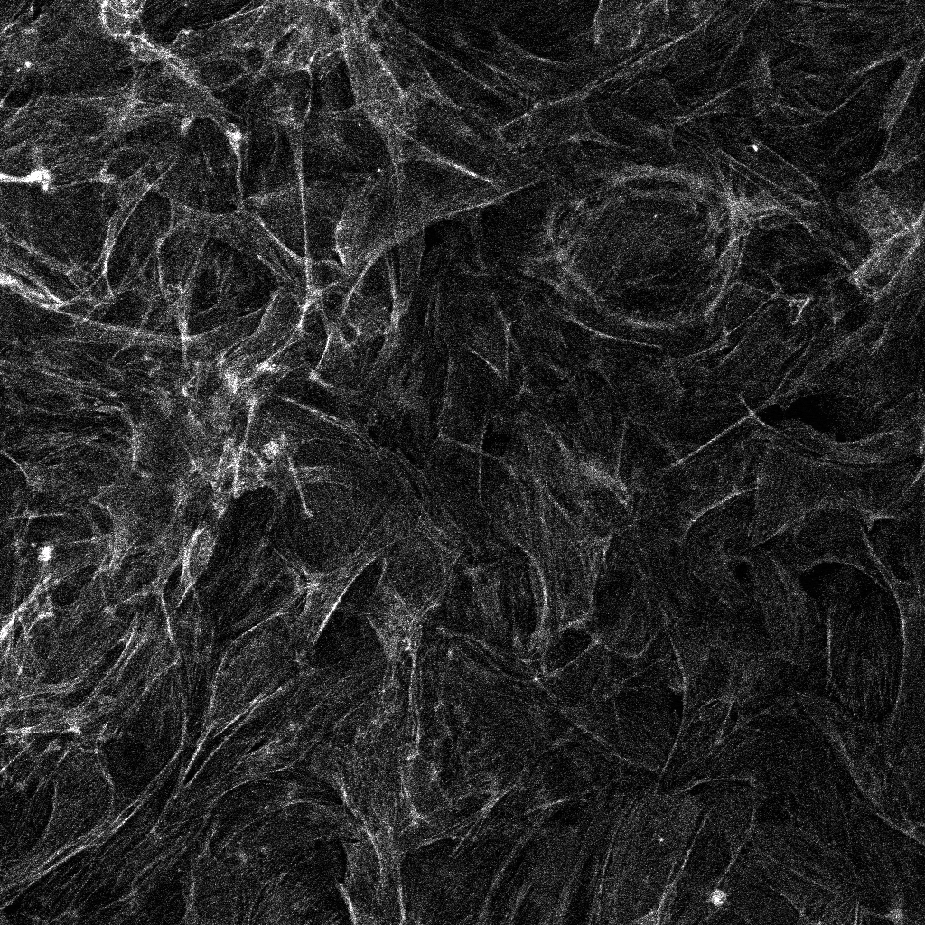
Balancing gain and laser power
Gain: 700
Laser: 0.45%
Gain: 650
Laser: 0.9%
Gain: 600
Laser: 2%
Gain: 550
Laser: 4.5%
Gain: 500
Laser: 11.8%
Gain: 450
Laser: 55%
Notes:
AVG signal levels in the entire field within 2% of each other between settings
Highest laser power not always best option: take into account bleaching and fluorophore saturation

Slide 39
Optimizing contrast on a laser scanning confocal
Low contrast
Low bleaching
High contrast
High bleaching
Laser power
PMT Gain
Low contrast
High speed
High contrast
Low speed
Scan Speed
Averaging

Slide 40
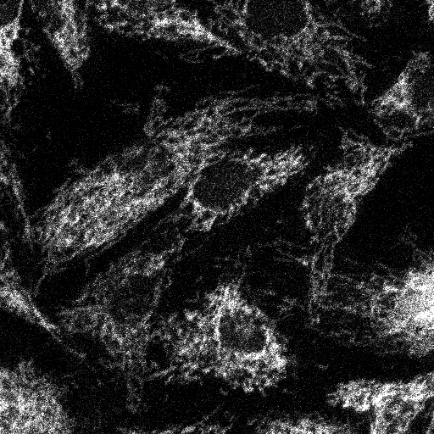
Averaging
No averaging
Average of
2 frames
Average of
4 frames
Average of
8 frames
Average of
16 frames
Notes:
AVG signal levels in the entire field within 2% of each other between settings
Mention that speed has very similar effects

Slide 41
Optimizing contrast on a laser scanning confocal
Low contrast
Low bleaching
High contrast
High bleaching
High(er) bleaching
Laser power
PMT Gain
Low contrast
High speed
High contrast
Low speed
Scan Speed
Low(er) bleaching
Averaging

Slide 42
Beware of signal saturation
Notes:
AVG signal levels in the entire field within 2% of each other between settings

Slide 43
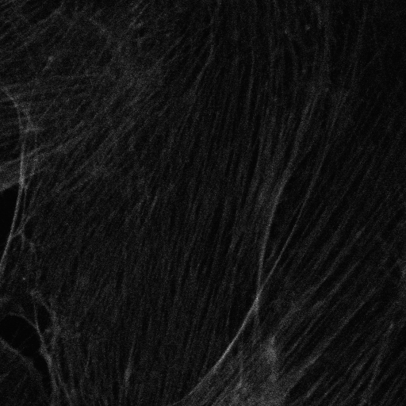
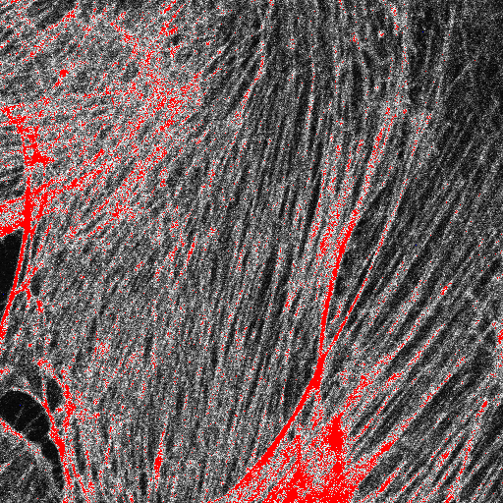
Saturation irreversibly destroys data
Distorts morphology
Compare details here

Slide 44
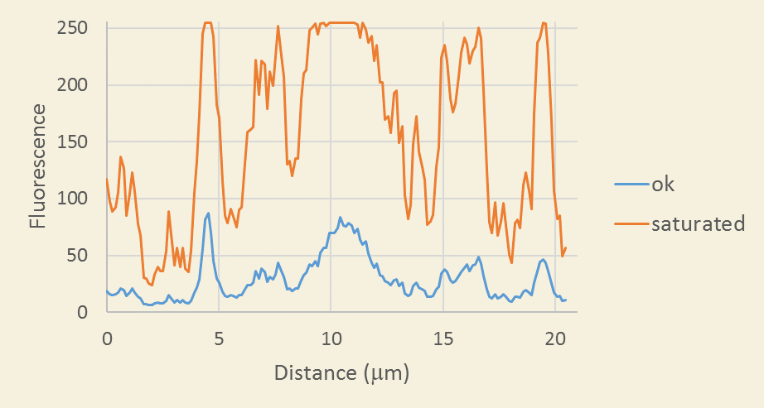
Saturation irreversibly destroys data
Makes quantification imposible
Notes:
AVG signal levels in the entire field within 2% of each other between settings

Slide 45
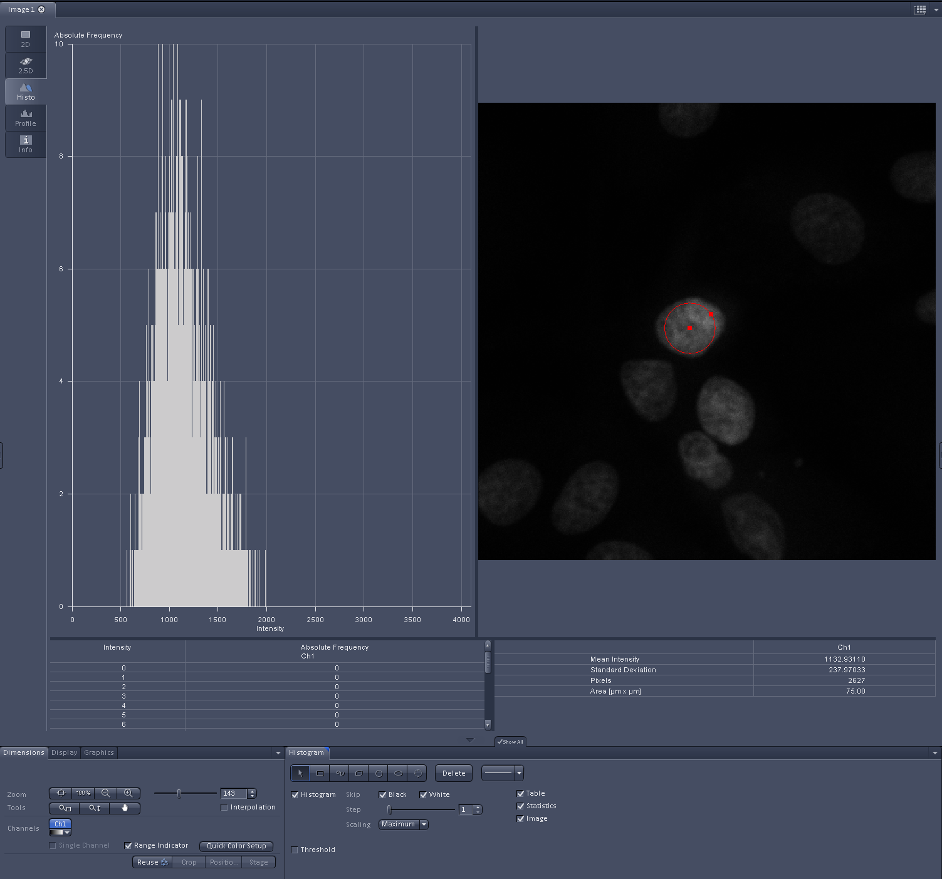
To avoid saturation
Find bright object in brightest experimental condition
Adjust for maximum pixel intensities at half the full range

Slide 46
Optimizing resolution on a laser scanning confocal
What level of biological detail do you need?
Beware:
More is not always the right answer

Slide 47
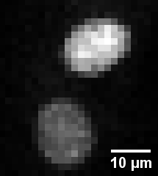
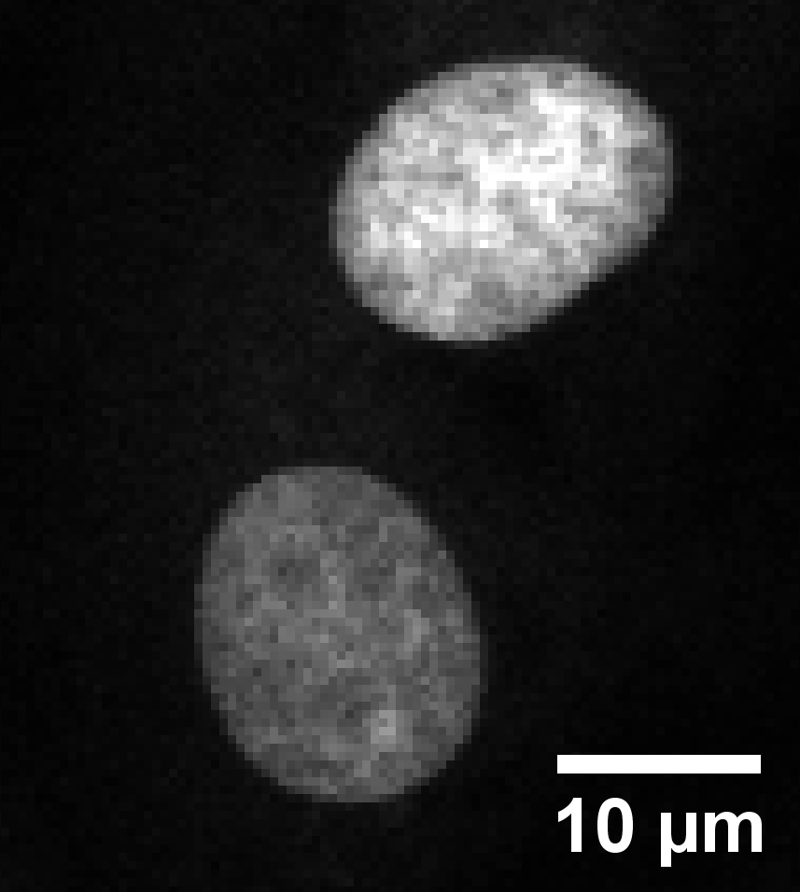
You may not need high resolution…
Good enough for counting nuclei
Overkill

Slide 48
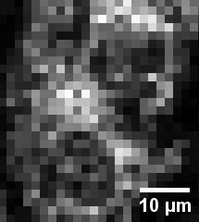
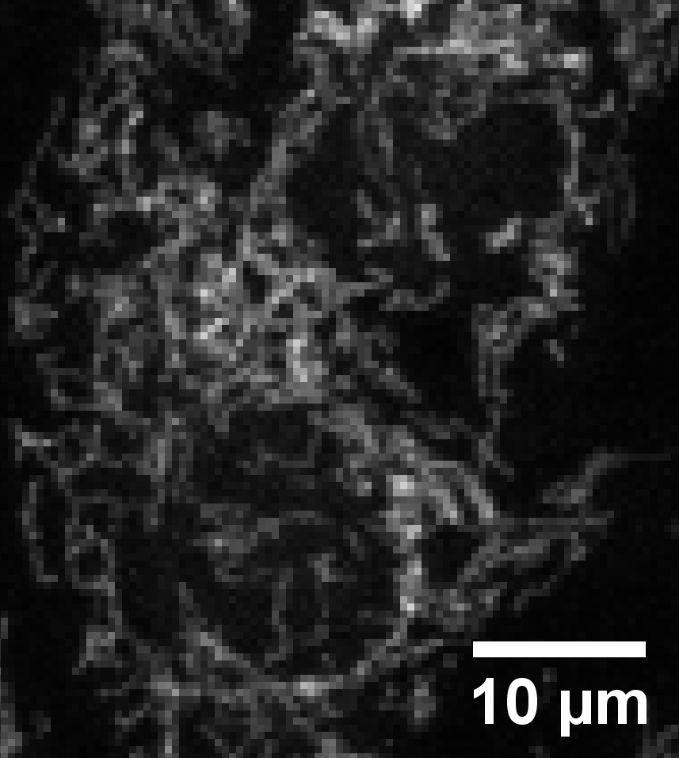
On the other hand…
Not enough detail
Better
Notes:
Images taken on LSM700 on BPAE slide. Zoom of 1 in both cases

Slide 49
Optimizing resolution on a laser scanning confocal
What level of biological detail do you need?
If the answer is as much as possible…

Slide 50
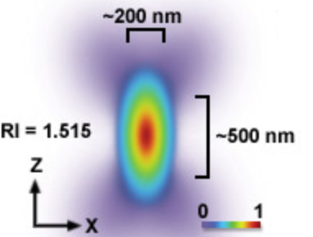
Optimizing resolution on a laser scanning confocal
Key concept #1
Point objects are blurred
Notes:
PSF figure modified from Fig 2 http://zeiss-campus.magnet.fsu.edu/articles/superresolution/introduction.html

Slide 51
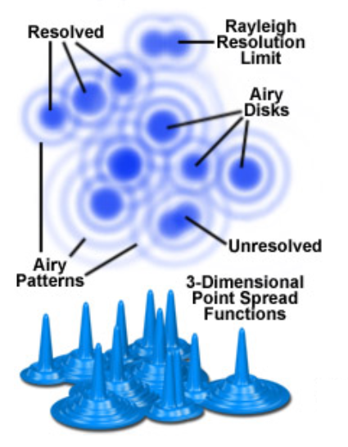
Optimizing resolution on a laser scanning confocal
Key concept #2
Minimal distance to distinguish 2 point objects: Resolution
Resolution in XY
Resolution in Z
Rz
z
Rxy
Rxy and Rz depend on fluorophore λ and objective NA
Notes:
XY Modified from Fig 1 https://www.olympus-lifescience.com/en/microscope-resource/primer/techniques/confocal/resolutionintro/

Slide 52
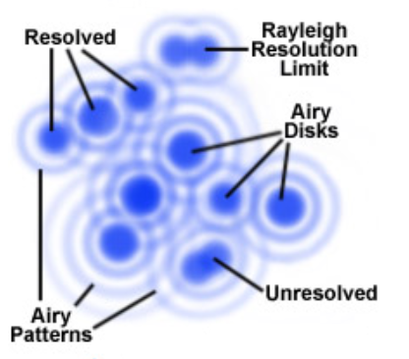
Optimizing resolution on a laser scanning confocal
Key concept #3
Optimal sampling in XY and Z
XY: pixel size
Rxy
Optimal pixel size ~
3
“Nyquist criterion”

Slide 53
Optimizing resolution on a laser scanning confocal
Key concept #3
Optimal sampling in XY and Z
Z: spacing between slices
Rz
Optimal interval spacing ~
3
“Nyquist criterion”

Slide 54
Optimizing resolution on a laser scanning confocal
Must set pixel size correctly !
How?

Slide 55
Parameters we adjust on a laser scanning confocal
For contrast
For resolution
Laser power
Zoom
PMT Gain
Image size
Scan Speed
Frame size
Averaging
Pixel size

Slide 56
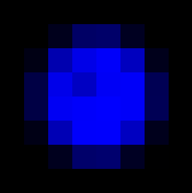
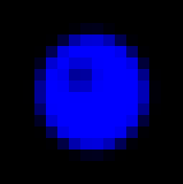
Setting pixel size correctly
Sample
Image
x_{i}
y_{i}
y
N_{y}
x
N_{x}
Image size:
X μm x Y μm
%
Frame size:
N_{x} pixels x N_{y} pixels
Pixel size:
X_{i} μm x Y_{i} μm

Slide 57
Setting pixel size correctly
Sample
Image
Zoom
Scan area of laser
Image size:
X μm x Y μm
%
Frame size:
N_{x} pixels x N_{y} pixels
Pixel size:
X_{i} μm x Y_{i} μm

Slide 58
Setting pixel size correctly
Sample
Image
Zoom
Scan area of laser
Image size:
X μm x Y μm
Directly user-controlled
%
Frame size:
N_{x} pixels x N_{y} pixels
Pixel size:
X_{i} μm x Y_{i} μm

Slide 59
Setting pixel size correctly
Sample
Image
Zoom
Scan area of laser
Increase frame size
Image size:
X μm x Y μm
Smaller pixel size
%
Frame size:
N_{x} pixels x N_{y} pixels
Slower imaging
Pixel size:
X_{i} μm x Y_{i} μm
More bleaching

Slide 60
Setting pixel size correctly
Sample
Image
Zoom
Scan area of laser
Image size:
X μm x Y μm
%
Frame size:
N_{x} pixels x N_{y} pixels
Pixel size:
X_{i} μm x Y_{i} μm

Slide 61
Setting pixel size correctly
Sample
Image
x_{i}
y_{i}
y
x
Zoom
Scan area of laser
Increase zoom
Image size:
X μm x Y μm
Smaller area
%
Frame size:
N_{x} pixels x N_{y} pixels
More bleaching
Pixel size:
X_{i} μm x Y_{i} μm
Smaller pixel size

Slide 62
Recommended workflow
Determine pixel size you need.
Decision based on size and spacing of structures of interest
Determine image size you need.
Decision based on size and spacing of experimental units
(example: tissue structures cells, organelles)
Set the zoom to get the desired image size
Set the frame size to get the desired pixel size
Adjust other parameters to balance:
contrast
bleaching
speed

Slide 63
There is more to confocal than laser scanning
Specimen health
Spinning disk confocal
Laser scanning confocal
Temporal resolution
Spatial resolution
Contrast

Slide 64
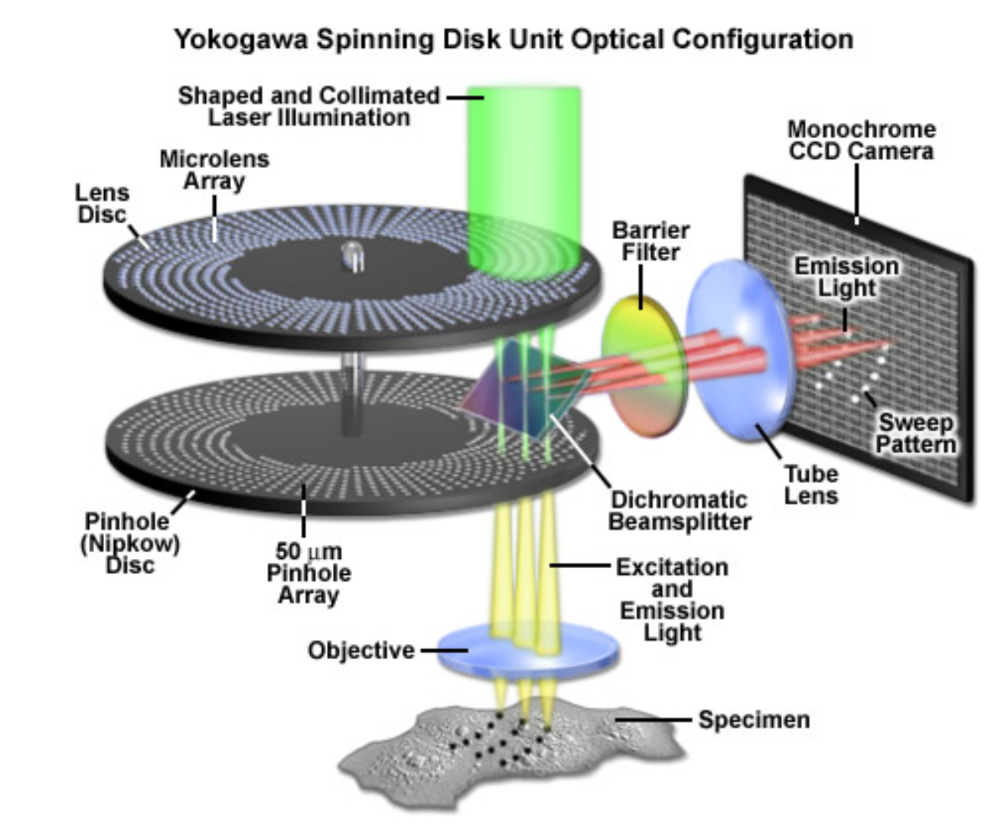
Spinning disk confocal microscope
Video: https://www.youtube.com/watch?v=eue5g6iSmPU
Notes:
http://zeiss-campus.magnet.fsu.edu/articles/spinningdisk/introduction.html
https://www.youtube.com/watch?v=eue5g6iSmPU

Slide 65
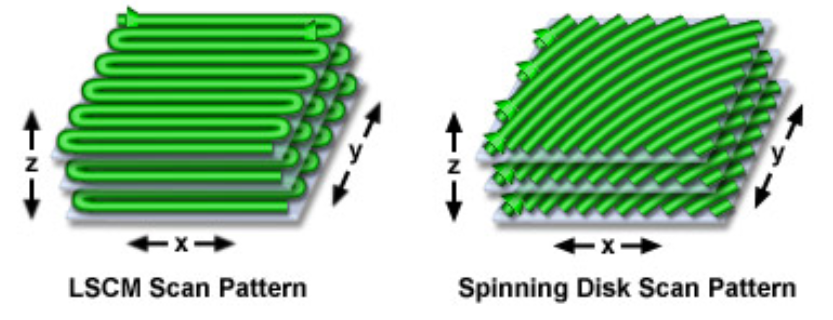
Spinning disk confocal microscope
Notes:
http://zeiss-campus.magnet.fsu.edu/articles/spinningdisk/introduction.html

Slide 66
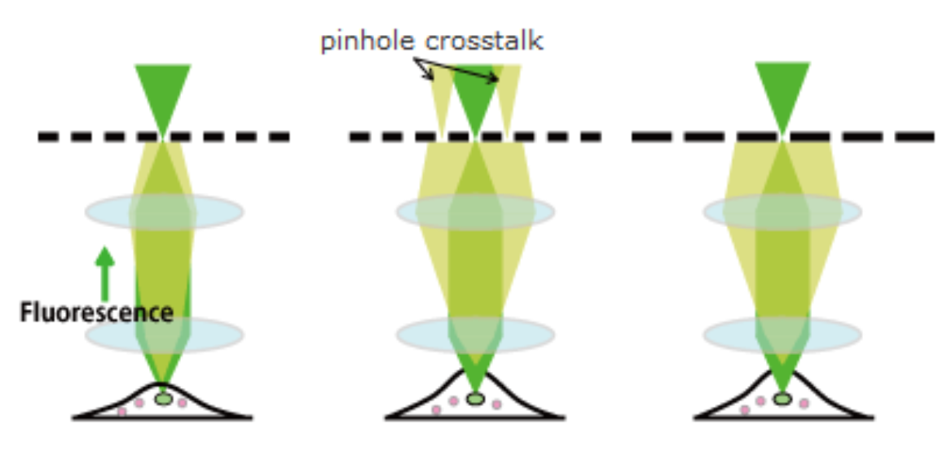
Spinning disk confocal microscope
No free lunch: pinhole cross-talk reduces axial resolution
Pinhole array disk
Lenses:
objective et al
Sample
Thin sample
Thick sample
Notes:
https://www.yokogawa.com/us/solutions/products-platforms/life-science/spinning-disk-confocal/csu-w1-confocal-scanner-unit/

Slide 67
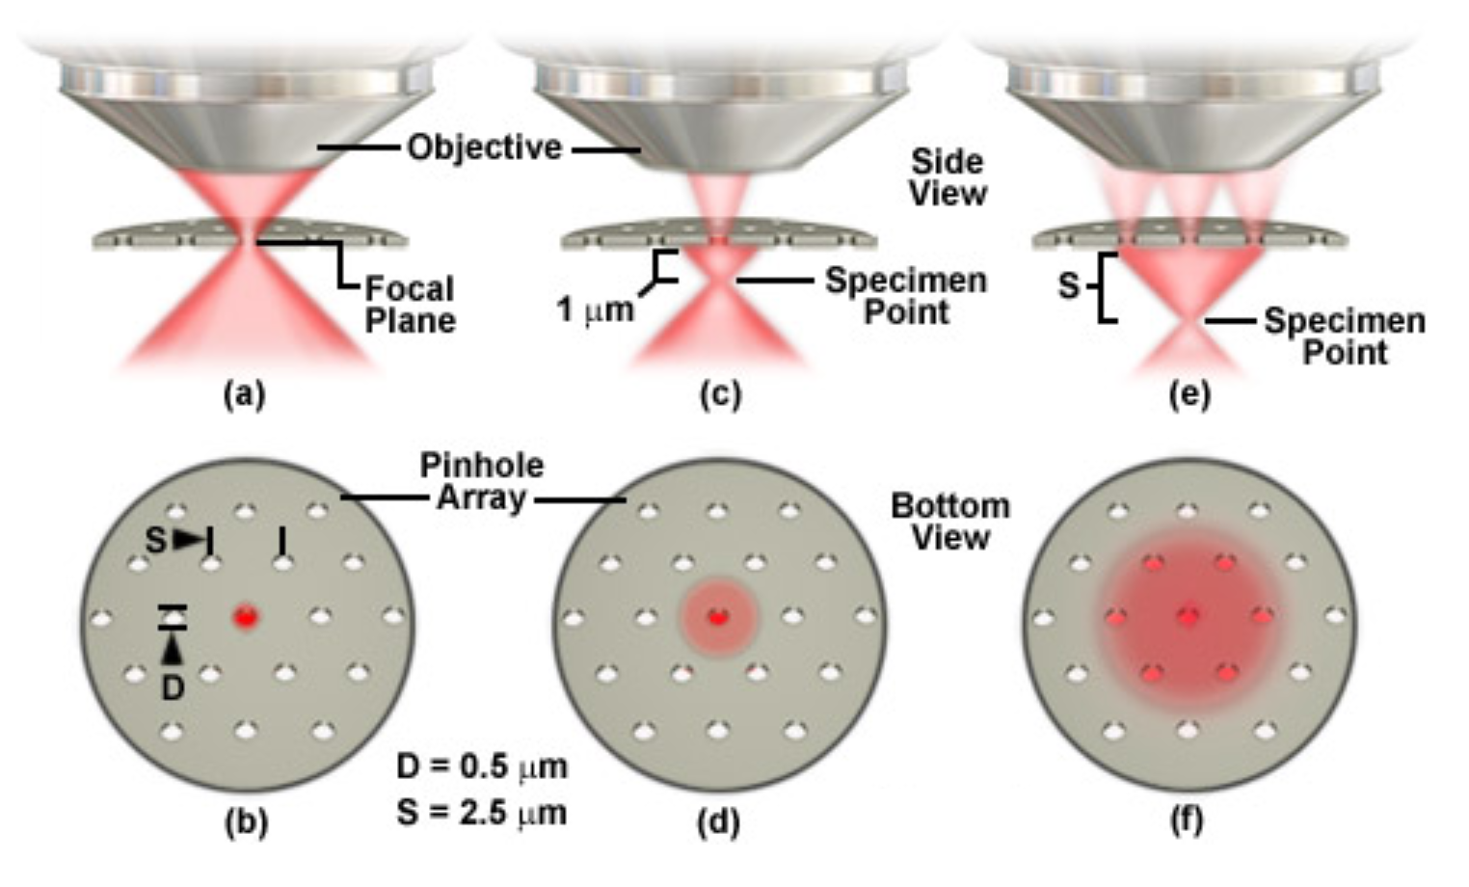
Spinning disk confocal microscope
No free lunch: pinhole cross-talk reduces axial resolution
Notes:
http://zeiss-campus.magnet.fsu.edu/articles/spinningdisk/introduction.html

Slide 68
Spinning disk confocal microscope
No free lunch: pinhole cross-talk reduces axial resolution
Pinhole array disk
Lenses:
objective et al
Sample
Thin sample
Thick sample
Thick sample
Larger distance between pinholes
Notes:
https://www.yokogawa.com/us/solutions/products-platforms/life-science/spinning-disk-confocal/csu-w1-confocal-scanner-unit/

Slide 69
Confocal is great !
But…

Slide 70
Confocal is not the best technique for every application

Slide 71
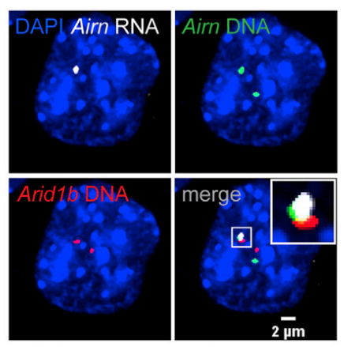
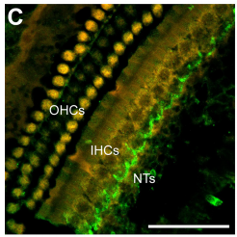
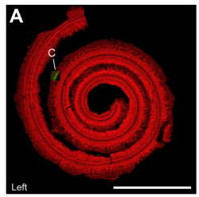
Widefield
Confocal
Fast
Sensitive
Great for thin samples (typically <10um)
Slow
Less sensitive
Great for thick samples (typically >10um)
1mm
50 μm
Estimating 3D distance between DNA loci
Calabrese lab (Schertzer et al, 2019)
Nerve terminals in the cochlea
Fitzpatrick lab (Pappa et al, 2019)
Notes:
Calabrese lab paper - https://doi.org/10.1016/j.molcel.2019.05.028

Slide 72
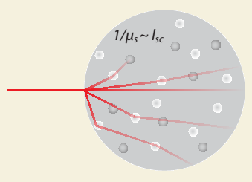
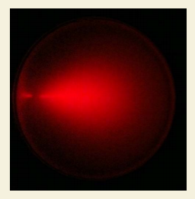
Thick things can be very hard to image
Why?
Light scattering due to heterogeneity in refractive index degrades transparency
Options?
Image thin things:
Cells cultured on surfaces
Slices of thicker things
Image transparent things
Naturally transparent
Chemically cleared
Use infrared light (“multiphoton”)

Slide 73
Other issues when imaging

Slide 74
What does “representative” image mean?
What population are we making inferences about?
Random sampling vs picking areas that “look right”.
Showing something can happen vs how often it happens.
Images as evidence vs images as illustrations.
“Publication quality” vs actual quality.

Slide 75
How many images ?
5, 10, 20 ? Why?
Image more cells in more locations, more dishes, more cultures, more slices, more animals ? Where is the variability? More images within a dish may be a poor use of your time.
Do power analysis:
Variance of what we are measuring
Minimal effect we want to uncover
Statistical test we are going to use
Probability that we will find an effect if there is one

Slide 76
Where can you get help ?
Imaging cores on campus:
Microscopy Services Laboratory (Rigor and Reproducibility section)
Neuroscience Microscopy Core
Hooker Imaging Core
Biology Department Microscopy Core
Online resources:
iBiology lectures on microscopy
Molecular expressions – exploring the world of optics and microscopy
Olympus microscopy resource center
Nikon MicroscopyU
Zeiss microscopy online campus
Good books ($):
Fundamentals of Light Microscopy and Electronic Imaging
Quantitative Imaging in Cell Biology
Great courses ($$$):
Analytical & Quantitative Light Microscopy (Woods Hole, MA)
Optical Microscopy & Imaging in the Biomedical Sciences (Woods Hole, MA)
Quantitative Imaging: From Acquisition to Analysis (Cold Spring Harbor, NY)
Quantitative Fluorescence Microscopy (Bar Harbor, ME)

