Slide 1
Introduction to Fluorescence Light Microscopy
Pablo Ariel, Ph.D.
Microscopy Services Laboratory
Department of Pathology and Laboratory Medicine
University of North Carolina, Chapel Hill
July 2020

Slide 2
Why ?

Slide 3
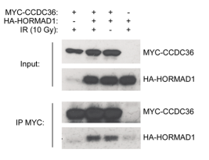
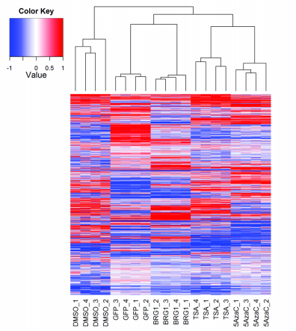
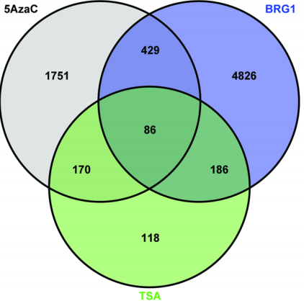
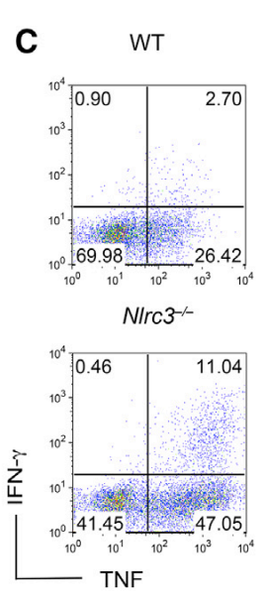
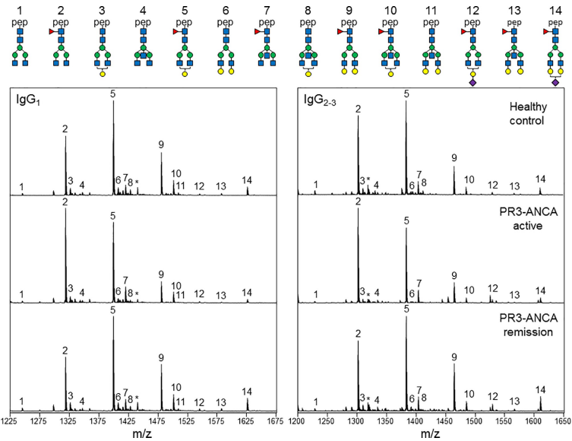
Many other techniques
Notes:
Western blot from Gao et al 2018 (Vaziri lab)
Gene expression array from Song et al 2014 (Weissman lab)
Flow cytometry from Uchimura et al 2018 (Ting lab)
Mass spec from Lardinois et al 2019 (Falk lab)

Slide 4
Key issues
Spatial resolution
Individual cells? Subcellular compartments?
Temporal resolution
seconds, minutes, hours?
Compatibility with live cells

Slide 5
Advantages of light microscopy
Spatial resolution
∼0.25um
A lot of interesting biology happens here
Temporal resolution
<1s
Compatibility with live cells
Yes.
Notes:
Contrast spatial resolution with flow (1 cell), biochemical fractionation (populations). Temporal resolution of other techniques is slower. Other techniques are not compatible with live cells.

Slide 6
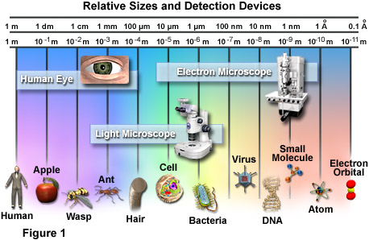
Spatial resolution digression
How big is the stuff we care about in biology?
Scale of the universe: https://scaleofuniverse.com/
https://micro.magnet.fsu.edu/cells/index.html

Slide 7
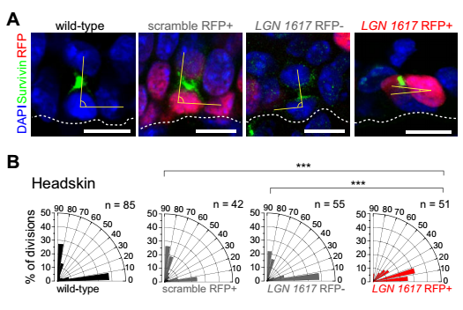
Microscopy example
Orientation of cell divisions in skin
Scott Williams’ lab (Byrd et al, 2016)

Slide 8
How ?

Slide 9
Focus on fluorescence light microscopy

Slide 10
Focus on fluorescence light microscopy

Slide 11
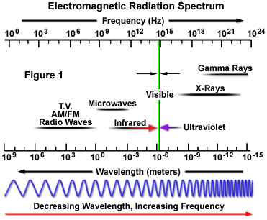
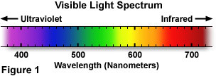
Light is part of the EM spectrum
Key parameter:
λ
( wavelength )
Notes:
https://micro.magnet.fsu.edu/primer/lightandcolor/electromagintro.html
https://micro.magnet.fsu.edu/primer/lightandcolor/lightsourcesintro.html

Slide 12
Focus on fluorescence light microscopy

Slide 13
Fluorescence
Jablonksi Energy Diagram
Excited states
Energy
Vibrational energy levels
S₂
S₁
Excitation (absorption)
Vibrational relaxation
Non radiative relaxation
S₀
Ground state
Notes:
https://www.olympus-lifescience.com/en/microscope-resource/primer/java/jablonski/jabintro/

Slide 14
Fluorescence
Jablonksi Energy Diagram
Excited states
Energy
Vibrational energy levels
S₂
S₁
Excitation (absorption)
Vibrational relaxation
Non radiative relaxation
S₀
Ground state
Notes:
https://www.olympus-lifescience.com/en/microscope-resource/primer/java/jablonski/jabintro/

Slide 15
Fluorescence
Jablonksi Energy Diagram
Excited states
Energy
Vibrational energy levels
S₂
S₁
Excitation (absorption)
Vibrational relaxation
Non radiative relaxation
Fluorescence emission
S₀
Ground state
Notes:
https://www.olympus-lifescience.com/en/microscope-resource/primer/java/jablonski/jabintro/

Slide 16
Fluorescence
Jablonksi Energy Diagram
Excited states
Energy
Vibrational energy levels
S₂
S₁
Excitation (absorption)
Vibrational relaxation
Non radiative relaxation
Fluorescence emission
S₀
Ground state
Notes:
https://www.olympus-lifescience.com/en/microscope-resource/primer/java/jablonski/jabintro/

Slide 17
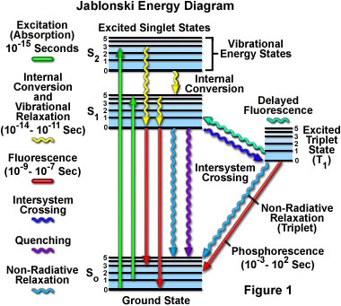
Fluorescence
These diagrams can get way more complicated…
Notes:
https://www.olympus-lifescience.com/en/microscope-resource/primer/java/jablonski/jabintro/

Slide 18
Fluorescence
Wavelength and energy are connected:
$$E=\frac{c. h}{\text{l}}$$
Probability and energy of transitions define fluorescence spectrum
E
Stokes shift
Prob
Excitation
spectrum
Emission
spectrum
λ_{ex}
λ_{em}
λ
Notes:
https://www.olympus-lifescience.com/en/microscope-resource/primer/java/jablonski/jabintro/

Slide 19
Fluorescence
The Stokes shift is the key to getting contrast from fluorescence
How do I make what I am interested in different from the rest of the sample ?
Detectors
Emission filter
Dichroic
Light source
Excitation filter
λ
Cells with GFP localized to the nucleus
Notes:
https://www.thermofisher.com/us/en/home/life-science/cell-analysis/cell-analysis-learning-center/molecular-probes-school-of-fluorescence/fundamentals-of-fluorescence-microscopy/epifluorescence-microscope-basics.html

Slide 20
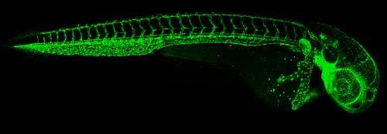
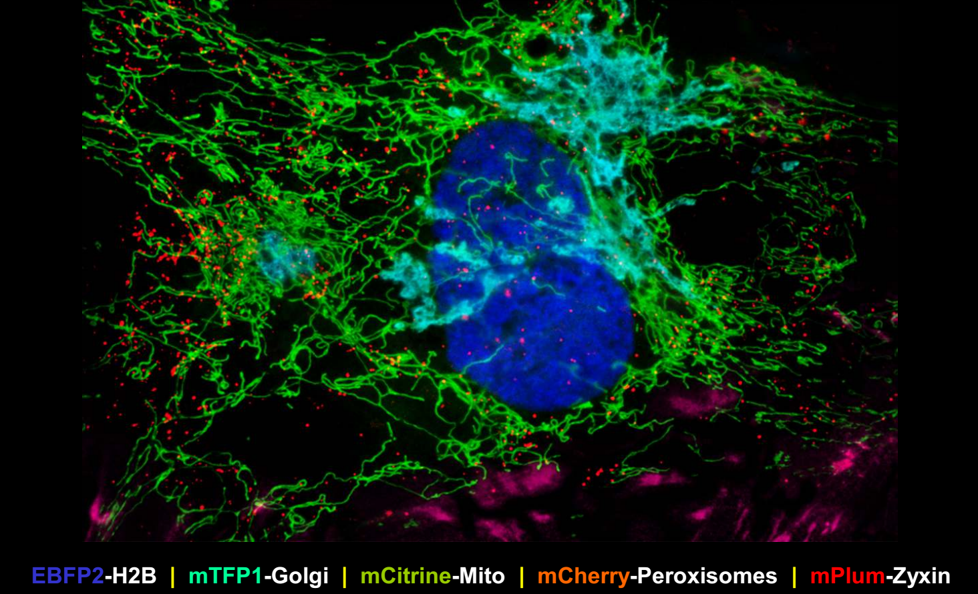
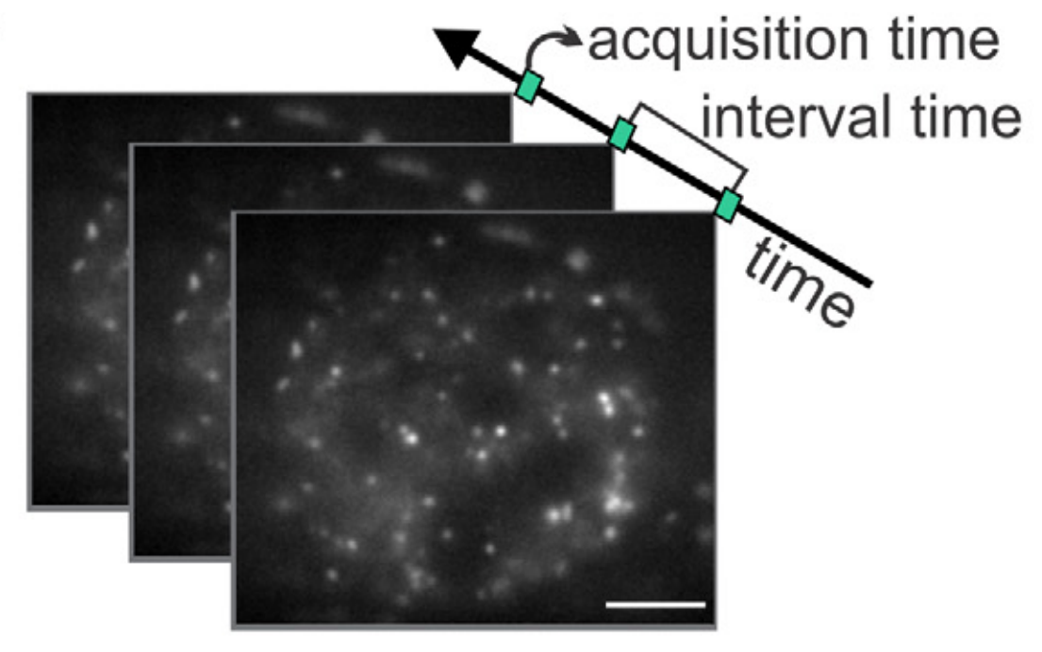
Fluorescence – smart labelling can give:
Tissue specificity
GFP in blood vessels
Cellular specificity
Astrocyte cells in ballistically transfected brain slices
Organelles marked by different fluorophores
Subcellular specificity
Molecular specificity
Transcription factor binding and diffusion at single molecule level
Notes:
https://doi.org/10.1073/pnas.1313753110 ; https://phys.org/news/2013-11-important-clue-circulatory-wired.html
https://doi.org/10.1016/j.jneumeth.2004.05.013
John Allen – Davidson lab
https://doi.org/10.1016/j.ymeth.2017.03.014

Slide 21
There are many ways to get contrast
Fluorescence
Absorption
Polarization
Phase
…

Slide 22
Focus on fluorescence light microscopy
How do we visualize small things ?

Slide 23
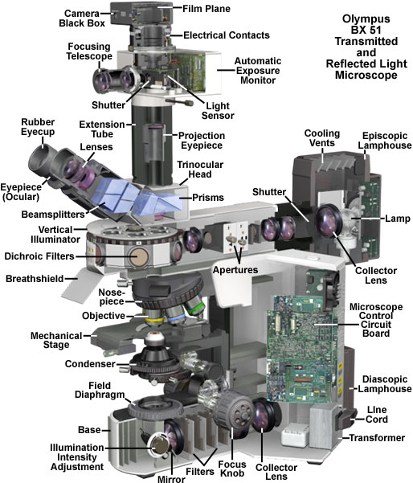
Microscopes can be very complicated
Notes:
https://micro.magnet.fsu.edu/primer/anatomy/bx51cutaway.html

Slide 24
The basics
What ?
How ?
Microscopes generate contrast
Illumination

Slide 25
Contrast and illumination
Detectors
Emission filter
Dichroic
Light source
Excitation filter
λ
Cells with GFP localized to the nucleus

Slide 26
The basics
What ?
How ?
Microscopes generate contrast
Illumination
Microscopes magnify
Lenses
Microscopes resolve details

Slide 27
Lenses
Most important lenses:
Objectives

Slide 28
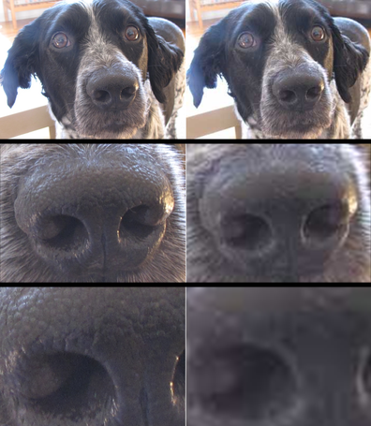
Lenses – resolving vs magnifying
Discerning details
Making bigger images
Jackson’s nose
(an Internet dog)
Notes:
Dog’s name: Jackson
http://sustainable-nano.com/2014/01/06/whats-the-difference-between-magnification-and-resolution-dog-of-science-demonstrates/

Slide 29
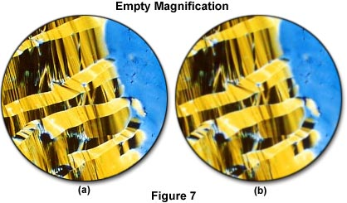
Lenses – resolving vs magnifying
Discerning details
Making bigger images
Liquid crystalline DNA
Notes:
https://micro.magnet.fsu.edu/primer/anatomy/magnification.html

Slide 30
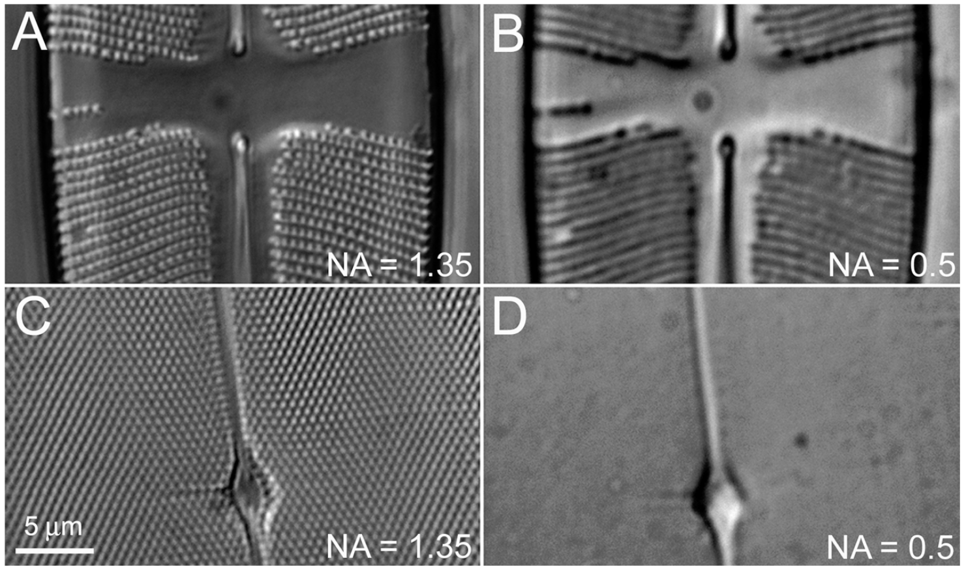
Lenses – resolving vs magnifying
Discerning details
Making bigger images
Diatoms
North 2006, JCB
Notes:
http://jcb.rupress.org/content/172/1/9.long

Slide 31
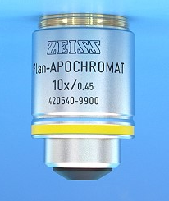
Lenses – resolving vs magnifying
Resolution depends on objective NA, not magnification

Slide 32
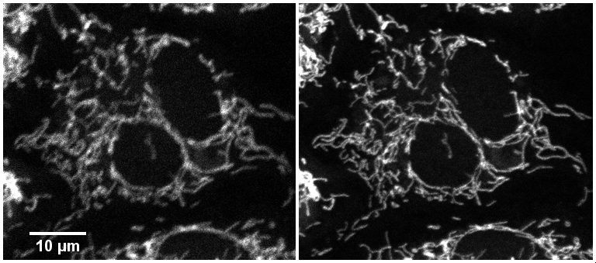
Lenses – resolving vs magnifying
Resolution depends on objective NA, not magnification
40X/0.6
40X/1.3
Higher resolution means more detail
Notes:
Images taken on LSM700 on BPAE slide, mitotracker red. 0.136um pixel size (roughly Nyquist). Conditions to roughly match signal and signal to noise levels in both images

Slide 33
The basics
What ?
How ?
Microscopes generate contrast
Illumination
Microscopes magnify
Lenses
Microscopes resolve details
Microscopes generate images
Detectors

Slide 34
Detectors
Typically:
cameras
photomultiplier tubes

Slide 35
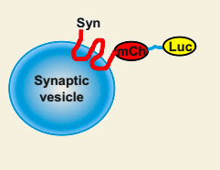
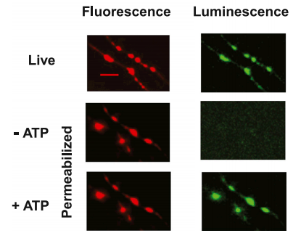
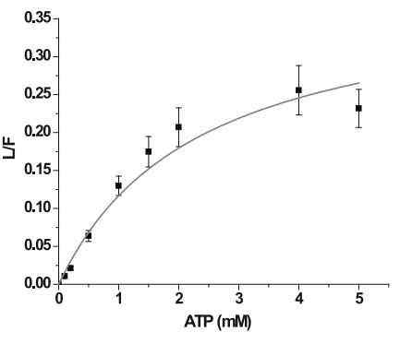
The best microscopy is quantitative
Example: ATP concentration in neurons using images
Luciferin + ATP + O₂
photons
Oxyluciferin + PPi + AMP + CO₂
Calibration curve
Ragnaraju et al, Cell 2014
Notes:
https://doi.org/10.1016/j.cell.2013.12.042
DATA not pretty pictures

Slide 36
Most common forms of fluorescence microscopy:
Widefield
Confocal
Fluorophores
Sample
Focal plane
Lenses et al
Sensitive area detector
Out of focus objects are blurred
Detection in parallel
Notes:
Highly simplified ray diagrams
Ray tracing: https://ricktu288.github.io/ray-optics/

Slide 37
Most common forms of fluorescence microscopy:
Widefield
Confocal
Fluorophores:
in focal plane
Sample
out of focal plane
Focal plane
Lenses, scanners et al
Lenses et al
Sensitive area detector
Pinhole
(Less) sensitive spot detector
Out of focus objects are blurred
Light from out of focus objects removed
Detection in parallel
Notes:
Highly simplified ray diagrams
Ray tracing: https://ricktu288.github.io/ray-optics/

Slide 38
Most common forms of fluorescence microscopy:
Widefield
Confocal
Fluorophores:
in focal plane
Sample
out of focal plane
Focal plane
Lenses, scanners et al
Lenses et al
Sensitive area detector
Pinhole
(Less) sensitive spot detector
Out of focus objects are blurred
Light from out of focus objects removed
Detection in parallel
Detection in series
Notes:
Highly simplified ray diagrams
Ray tracing: https://ricktu288.github.io/ray-optics/

Slide 39
Most common forms of fluorescence microscopy:
Widefield
Confocal
Fluorophores:
in focal plane
Sample
out of focal plane
Focal plane
Lenses, scanners et al
Lenses et al
Sensitive area detector
Pinhole
(Less) sensitive spot detector
Out of focus objects are blurred
Light from out of focus objects removed
Detection in parallel
Detection in series
Notes:
Highly simplified ray diagrams
Ray tracing: https://ricktu288.github.io/ray-optics/

Slide 40
Most common forms of fluorescence microscopy:
Widefield
Confocal
Fluorophores:
in focal plane
Sample
out of focal plane
Focal plane
Lenses, scanners et al
Lenses et al
Sensitive area detector
Pinhole
(Less) sensitive spot detector
Out of focus objects are blurred
Light from out of focus objects removed
Detection in parallel
Detection in series
Notes:
Highly simplified ray diagrams
Ray tracing: https://ricktu288.github.io/ray-optics/

Slide 41
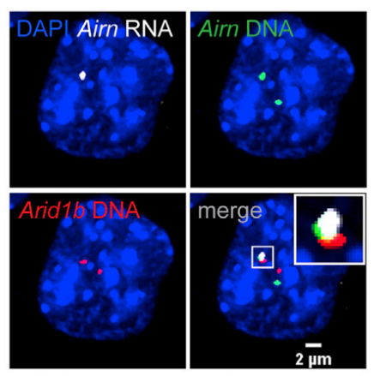
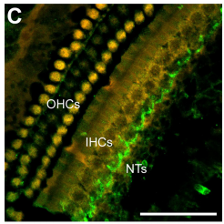
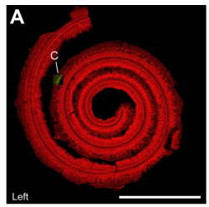
Widefield
Confocal
Fast
Sensitive
Great for thin samples (typically <10um)
Slow
Less sensitive
Great for thick samples (typically >10um)
1mm
50 μm
Estimating 3D distance between DNA loci
Calabrese lab (Schertzer et al, 2019)
Nerve terminals in the cochlea
Fitzpatrick lab (Pappa et al, 2019)
Notes:
Calabrese lab paper - https://doi.org/10.1016/j.molcel.2019.05.028

Slide 42
Imaging is great !
But…

Slide 43
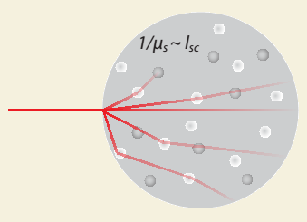
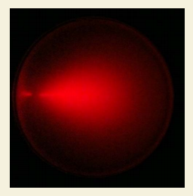
Thick things are hard to image
Why?
Light scattering due to heterogeneity in refractive index degrades transparency
Options?
Image thin things:
Cells cultured on surfaces
Slices of thicker things
Image transparent things
Naturally transparent
Chemically cleared
Use infrared light (“multiphoton”)

Slide 44
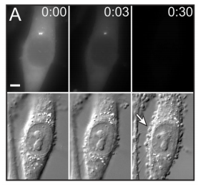
Light damages…
Fluorophores (“bleaching”)
Live cells (“photodamage”)
Notes:
https://www.ncbi.nlm.nih.gov/pmc/articles/PMC3843244/

Slide 45
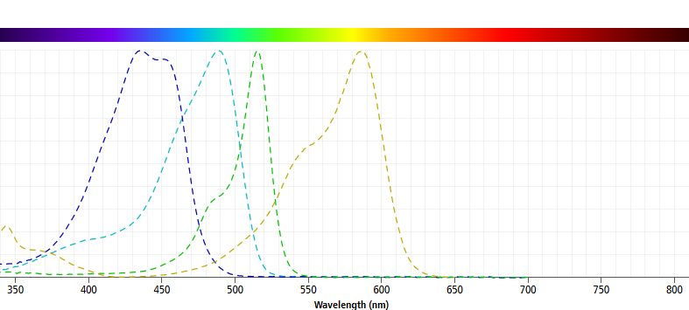
Fluorophores overlap spectrally
Excitation spectra
ECFP
EGFP
EYFP
mCherry
Notes:
http://www.bdbiosciences.com/en-us/applications/research-applications/multicolor-flow-cytometry/product-selection-tools/spectrum-viewer

Slide 46
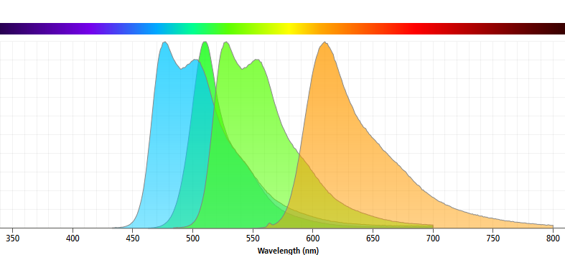
Fluorophores overlap spectrally
Emission spectra
ECFP
EGFP
EYFP
mCherry
Notes:
http://www.bdbiosciences.com/en-us/applications/research-applications/multicolor-flow-cytometry/product-selection-tools/spectrum-viewer

Slide 47
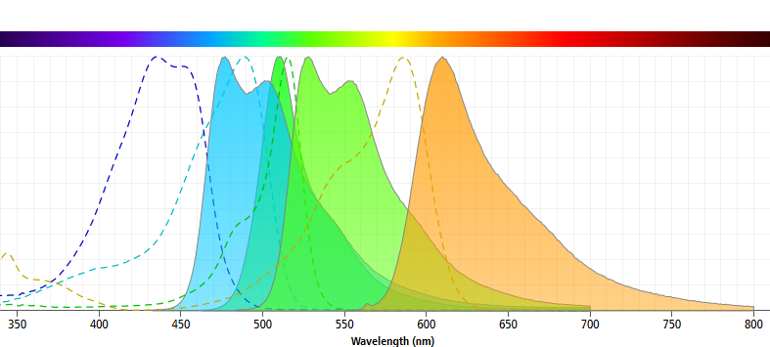
Fluorophores overlap spectrally
Excitation + emission spectra
ECFP
EGFP
EYFP
mCherry
Notes:
http://www.bdbiosciences.com/en-us/applications/research-applications/multicolor-flow-cytometry/product-selection-tools/spectrum-viewer

Slide 48
Autofluorescence can be very high
iDISCO-treated brain
Light-sheet imaging
Ex 488; Em 525/50
Data courtesy of Nicolas Renier (Tessier-Lavigne lab, Rockefeller University; ICM Brain & Spine Institute, Paris)

Slide 49
Colocalization is complicated
“Superres”
microscopy
“Standard”
microscopy
Higher resolution
Yellow is useless: easy to manipulate and hard to interpret
Colocalization does not imply interaction
At the molecular level, there is no such thing as colocalization!
At best: two molecules with a certain distance of each other
Notes:
https://doi.org/10.1111/febs.13652

Slide 50
What does “representative” image mean?
What population are we making inferences about?
Random sampling vs picking areas that “look right”.
Showing something can happen vs how often it happens.
Images as evidence vs images as illustrations.
“Publication quality” vs actual quality.

Slide 51
How many images ?
5, 10, 20 ? Why?
Image more cells in more locations, more dishes, more cultures, more slices, more animals ? Where is the variability? More images within a dish may be a poor use of your time.
Do power analysis:
Variance of what we are measuring
Minimal effect we want to uncover
Statistical test we are going to use
Probability that we will find an effect if there is one

Slide 52
Where can you get help ?
Imaging cores on campus:
Microscopy Services Laboratory (Rigor and Reproducibility section)
Neuroscience Microscopy Core
Hooker Imaging Core
Biology Department Microscopy Core
Online resources:
iBiology lectures on microscopy
Molecular expressions – exploring the world of optics and microscopy
Olympus microscopy resource center
Nikon MicroscopyU
Zeiss microscopy online campus
Good books ($):
Fundamentals of Light Microscopy and Electronic Imaging
Quantitative Imaging in Cell Biology
Great courses ($$$):
Analytical & Quantitative Light Microscopy (Woods Hole, MA)
Optical Microscopy & Imaging in the Biomedical Sciences (Woods Hole, MA)
Quantitative Imaging: From Acquisition to Analysis (Cold Spring Harbor, NY)
Quantitative Fluorescence Microscopy (Bar Harbor, ME)

