Slide 1
Confocal microscopy tips
Pablo Ariel
Microscopy Services Laboratory, UNC-CH
May 25th, 2017

Slide 2
Before imaging
During imaging
After imaging

Slide 3
Before imaging
During imaging
After imaging

Slide 4
Sample prep is critical
Optimize:
Antibody concentrations
Fixation, permeabilization
Incubation times, temperatures

Slide 5
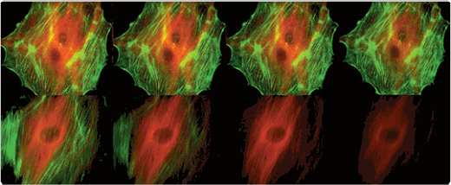
Select proper fluorophores
AF488
AF546
FITC
Cy3
AlexaFluor dyes are bright and photostable
https://www.thermofisher.com/us/en/home/brands/molecular-probes/key-molecular-probes-products/alexa-fluor/alexa-fluor-dyes-excellent-photostability.html
Notes:
Figure 1. Comparison of the photobleaching rates of the Alexa Fluor® 488 and Alexa Fluor® 546 dyes and the well-known fluorescein and Cy3 fluorophores. The cytoskeleton of bovine pulmonary artery endothelial cells (BPAEC) was labeled with (top series) Alexa Fluor® 488 phalloidin and mouse monoclonal anti–a-tubulin antibody in combination with Alexa Fluor® 546 goat anti–mouse IgG antibody or (bottom series) fluorescein phalloidin and the anti–a-tubulin antibody in combination with a commercially available Cy3 goat anti–mouse IgG antibody. The pseudocolored images were taken at 30-second intervals (0, 30, 90, and 210 seconds of exposure). The images were acquired with bandpass filter sets appropriate for fluorescein and rhodamine.

Slide 6
Select compatible mounting media
https://www.thermofisher.com/us/en/home/life-science/cell-analysis/cellular-imaging/fluorescence-microscopy-and-immunofluorescence-if/mounting-medium-antifades/prolong-gold-antifade.html
Notes:
Photobleaching resistance for fluorescent dyes and proteins with ProLong antifade reagents. Photobleaching resistance was quantified on a LSM 710 (Zeiss) confocal microscope. HeLa or U2OS cells were stained and mounted using standard ICC protocols. Five regions within three fields of view were scanned 50x with a 1.58 μs dwell time per pixel. Excitation wavelength and intensity were optimized for the fluorophore being measured.

Slide 7
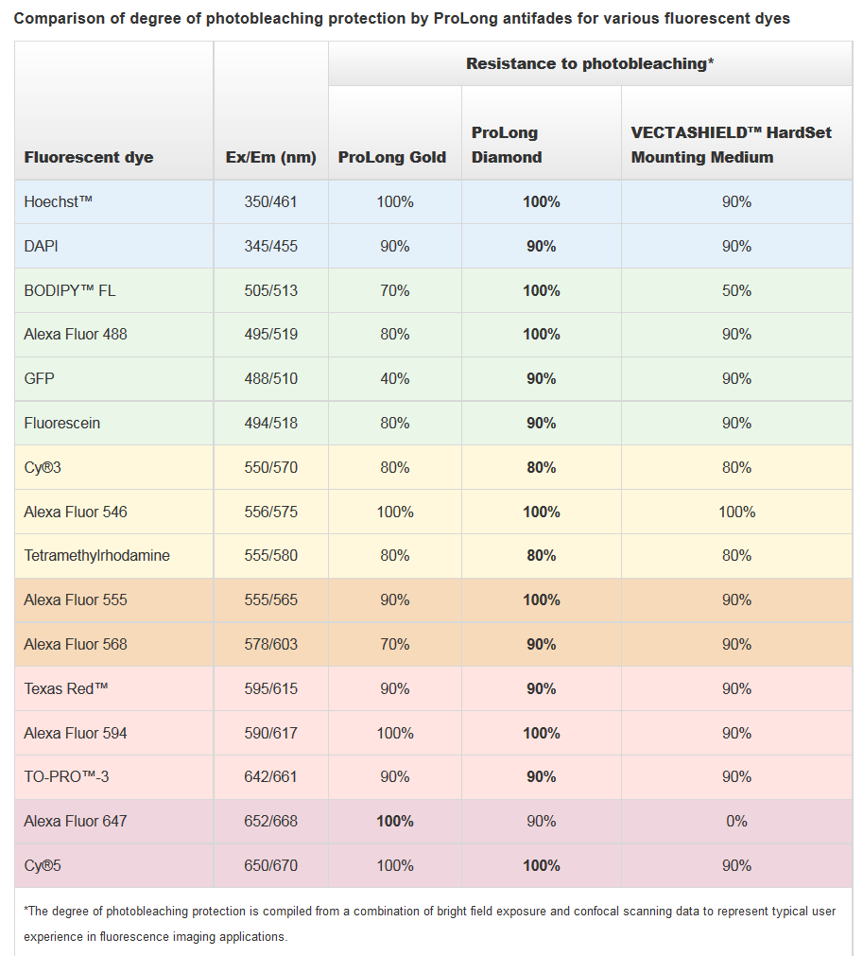
Select compatible mounting media
https://www.thermofisher.com/us/en/home/life-science/cell-analysis/cellular-imaging/fluorescence-microscopy-and-immunofluorescence-if/mounting-medium-antifades/prolong-gold-antifade.html
Notes:
Photobleaching resistance for fluorescent dyes and proteins with ProLong antifade reagents. Photobleaching resistance was quantified on a LSM 710 (Zeiss) confocal microscope. HeLa or U2OS cells were stained and mounted using standard ICC protocols. Five regions within three fields of view were scanned 50x with a 1.58 μs dwell time per pixel. Excitation wavelength and intensity were optimized for the fluorophore being measured.

Slide 8
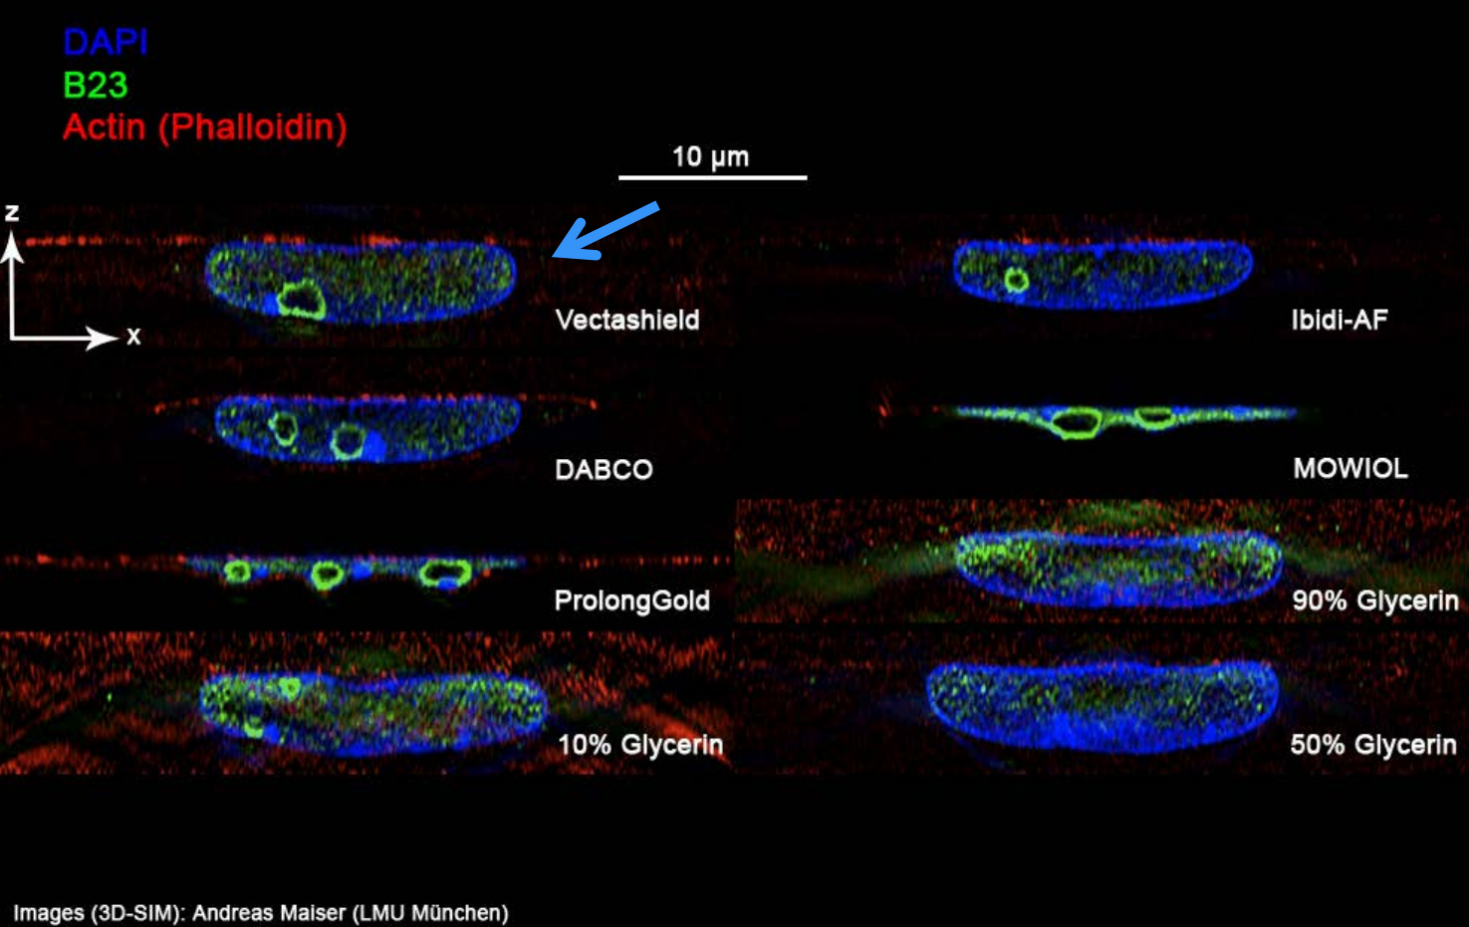
Beware hardening mounting media
Images courtesy of Patrina Pellet (GE Healthcare)

Slide 9
Use a #1.5 coverslip
#1.5
#1

Slide 10
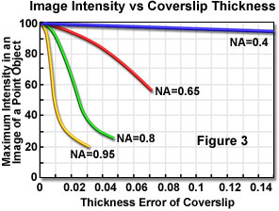
Use a #1.5 coverslip
Average difference between #1 and #1.5 coverslip
http://olympus.magnet.fsu.edu/primer/anatomy/coverslipcorrection.html

Slide 11
Avoid large coverslips
Slide tilt

Slide 12
Include controls
Examples:
No antibody
No primary
No target protein

Slide 13
How will you sample?
What is “representative” ?
Random sampling?
Criteria for excluding cells?
Z stacks vs single planes?

Slide 14
Before imaging
During imaging
After imaging

Slide 15
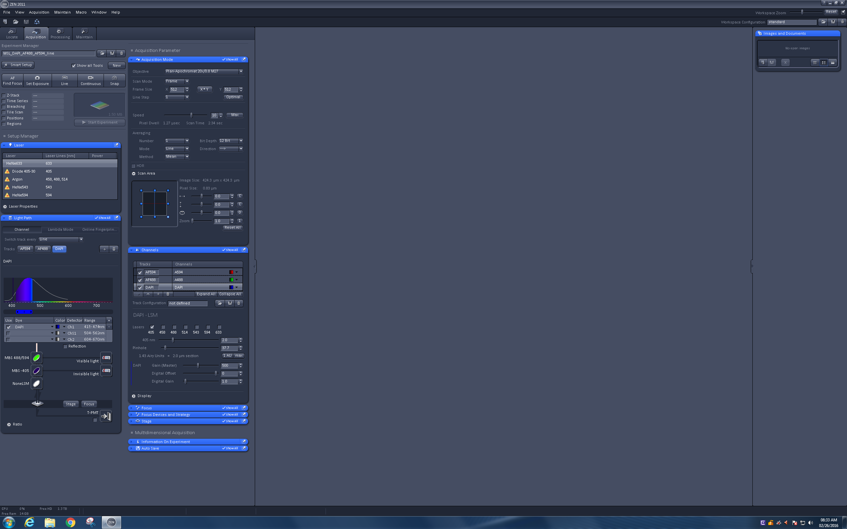
Loading the proper configuration

Slide 16
Loading the proper configuration
Smart Setup is not that smart

Slide 17
Loading the proper configuration
14 seconds
5 seconds
Smart Setup:
DAPI + AF488 + AF594
“Best signal”
MSL_DAPI_AF488_AF594
(filters tweaked to match)
Notes:
All settings are the same except for filters in the initial comparison
Filters modified to be the same in the second comparison.

Slide 18
Selecting an objective

Slide 19
Selecting an objective
Work backwards from the analysis you want to do
Size of objects of interest ?
Number of objects per field ?
Subcellular colocalization?
Consider your sample
Dim?
Bleaches quickly?
Alive?
Very thick?

Slide 20
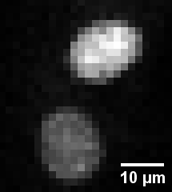
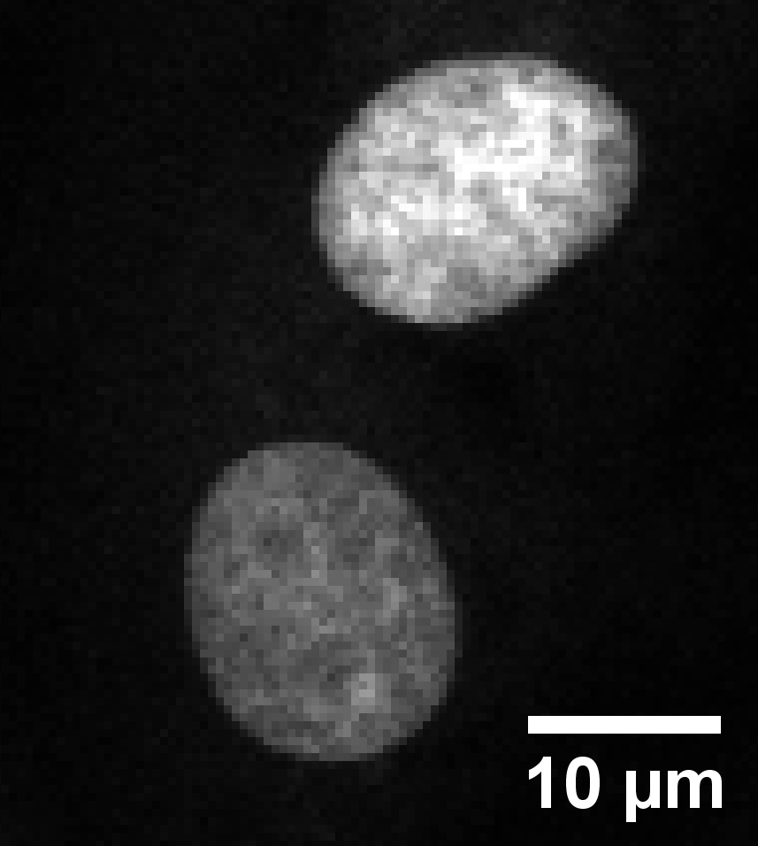
Selecting an objective
Size of objects of interest
Example 1: nuclei
10X/0.45
Zoom 1
40X/0.95
Zoom 1
Good enough for counting nuclei
Overkill
Notes:
Images taken on LSM700 on BPAE slide. Zoom of 1 in both cases

Slide 21
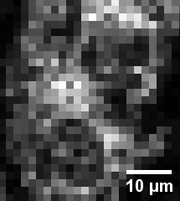
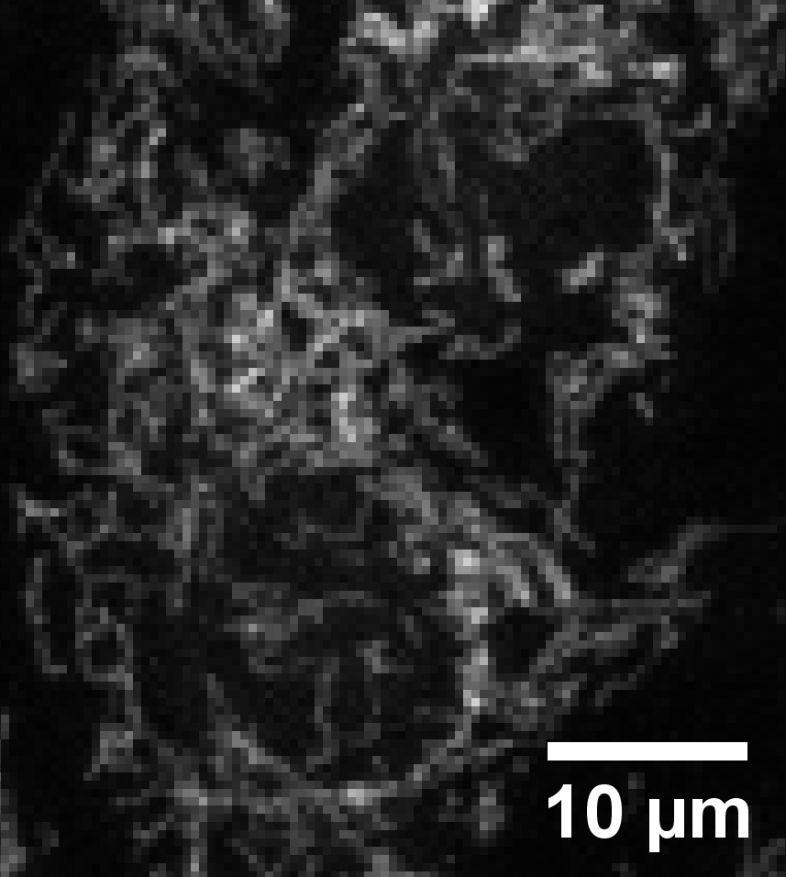
Selecting an objective
Size of objects of interest
Example 2: mitochondria
10X/0.45
Zoom 1
40X/0.95
Zoom 1
Not enough detail
Better
Notes:
Images taken on LSM700 on BPAE slide. Zoom of 1 in both cases

Slide 22
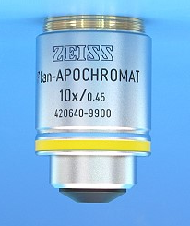
Selecting an objective
Resolution depends on NA, not Mag
Resolution depends on NA, not Mag

Slide 23
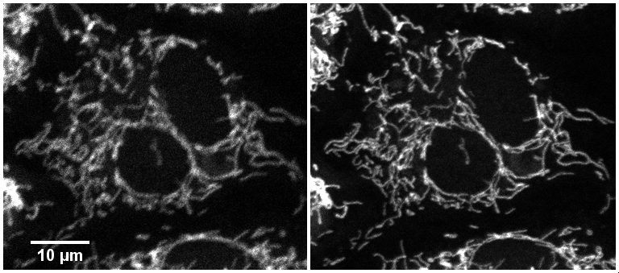
Selecting an objective
Resolution depends on NA, not Mag
40X/0.6
40X/1.3
Higher resolution means more detail
Notes:
Images taken on LSM700 on BPAE slide. 0.136um pixel size (roughly Nyquist). Conditions to roughly match signal and signal to noise levels in both images

Slide 24
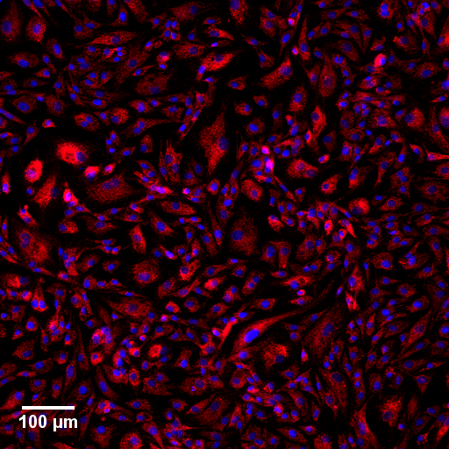
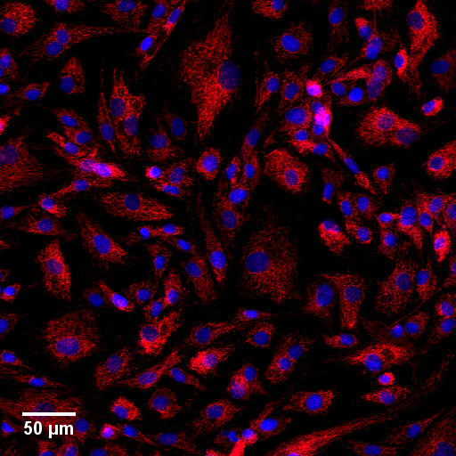
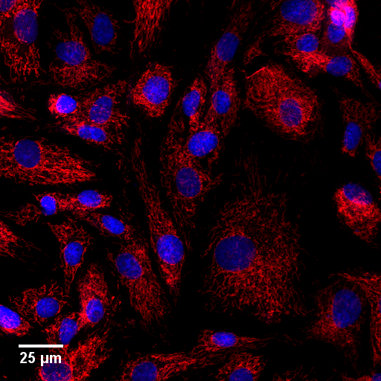
Selecting an objective
Number of objects per field
10X/0.45
20X/0.80
40X/0.95
Tradeoffs between number of cells, detail and time

Slide 25
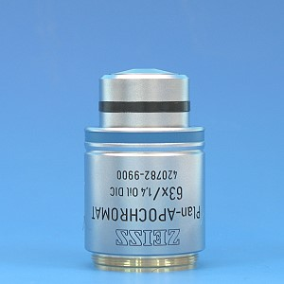
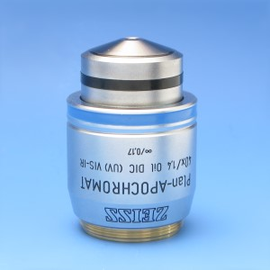
Selecting an objective
For subcellular colocalization
use Plan-Apochromat objectives
63X/1.4
40X/1.4
LSM 700 & 710
LSM 710

Slide 26
Selecting an objective
Dim, photosensitive, live samples
NA⁴
Brightness
∝
Mag²
Notes:
Same settings for acquisition and display, except for:
pinhole size, which was adjusted to 1AU in both. Using the 40X pinhole size in the 63X led to a pinhole size smaller than 1AU and an even dimmer image.
Pixel size which I couldn’t make exactly identical: 0.122um in 40X, 0.120um in 63X
Note that pixel size is slightly below Nyquist

Slide 27
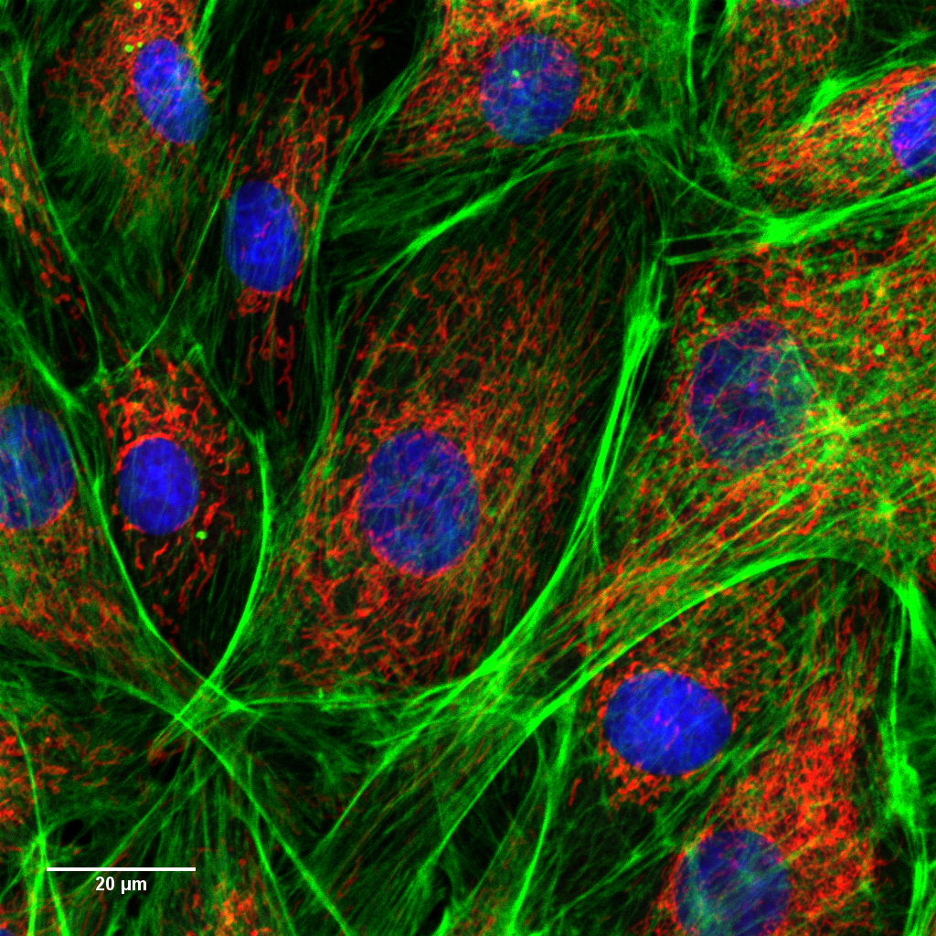
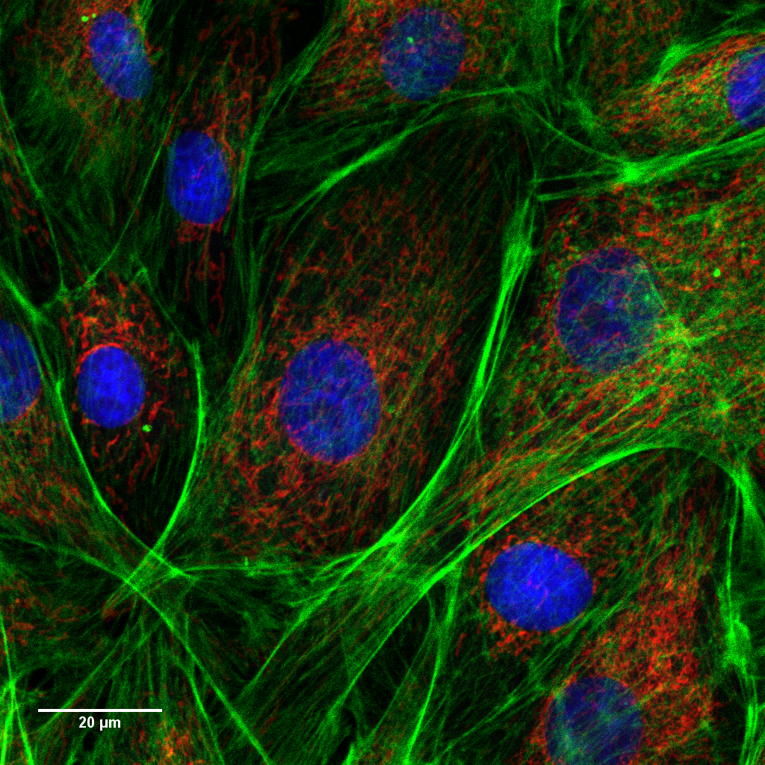
Selecting an objective
Dim, photosensitive, live samples
40X/1.4
63X/1.4
40X/1.4 is the brightest objective
Notes:
Same settings for acquisition and display, except for:
pinhole size, which was adjusted to 1AU in both. Using the 40X pinhole size in the 63X led to a pinhole size smaller than 1AU and an even dimmer image.
Pixel size which I couldn’t make exactly identical: 0.122um in 40X, 0.120um in 63X
Note that pixel size is slightly below Nyquist

Slide 28
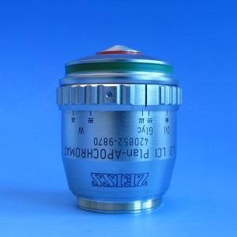
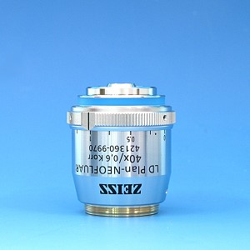
Selecting an objective
Objectives for special applications
Thick, aqueous samples
Plates
25X/0.8
40X/0.6
LSM 710
LSM 700

Slide 29
Selecting an objective
There is a lot to consider
We can help you decide
Notes:
Same settings for acquisition and display, except for:
pinhole size, which was adjusted to 1AU in both. Using the 40X pinhole size in the 63X led to a pinhole size smaller than 1AU and an even dimmer image.
Pixel size which I couldn’t make exactly identical: 0.122um in 40X, 0.120um in 63X
Note that pixel size is slightly below Nyquist

Slide 30
Pinhole

Slide 31
Pinhole
Set to 1 AU for your longest wavelength dye
Keep physical size same for all channels

Slide 32
Setting the correct pixel size

Slide 33
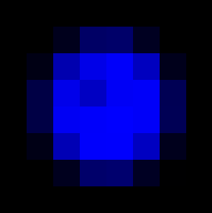
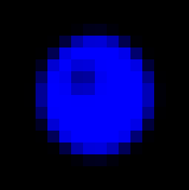
Setting the correct pixel size
Sample
Image
x_{i}
y_{i}
y
N_{y}
x
N_{x}
Image size:
X μm x Y μm
%
Frame size:
N_{x} pixels x N_{y} pixels
Pixel size:
X_{i} μm x Y_{i} μm

Slide 34
Setting the correct pixel size
Sample
Image
Zoom
Scan area of laser
Image size:
X μm x Y μm
%
Frame size:
N_{x} pixels x N_{y} pixels
Pixel size:
X_{i} μm x Y_{i} μm

Slide 35
Setting the correct pixel size
Sample
Image
Zoom
Scan area of laser
Image size:
X μm x Y μm
Directly user-controlled
%
Frame size:
N_{x} pixels x N_{y} pixels
Pixel size:
X_{i} μm x Y_{i} μm

Slide 36
Setting the correct pixel size
Sample
Image
Zoom
Scan area of laser
Increase frame size
Image size:
X μm x Y μm
Smaller pixel size
%
Frame size:
N_{x} pixels x N_{y} pixels
Slower imaging
Pixel size:
X_{i} μm x Y_{i} μm
More bleaching

Slide 37
Setting the correct pixel size
Sample
Image
Zoom
Scan area of laser
Image size:
X μm x Y μm
%
Frame size:
N_{x} pixels x N_{y} pixels
Pixel size:
X_{i} μm x Y_{i} μm

Slide 38
Setting the correct pixel size
Sample
Image
x_{i}
y_{i}
y
x
Zoom
Scan area of laser
Increase zoom
Image size:
X μm x Y μm
Smaller area
%
Frame size:
N_{x} pixels x N_{y} pixels
More bleaching
Pixel size:
X_{i} μm x Y_{i} μm
Smaller pixel size

Slide 39
Setting the correct pixel size
What is the correct size ?

Slide 40
Setting the correct pixel size
Lower limit:
Resolution_{xy}
0.6 λ_{em}
max
Pixel size ≈
≈
2
2 NA_{obj}

Slide 41
Setting the correct pixel size
Example:
40X/1.4
AlexaFluor 488
Lower limit:
Resolution_{xy}
0.6 520nm
Pixel size ≈
≈
2
2 1.4
220nm
Pixel size ≈
≈
0.11μm
2

Slide 42
Setting the correct pixel size
You may not need such small pixels…
Good enough for counting nuclei
Overkill

Slide 43
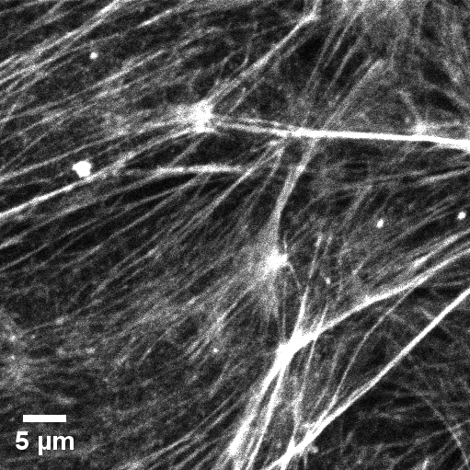
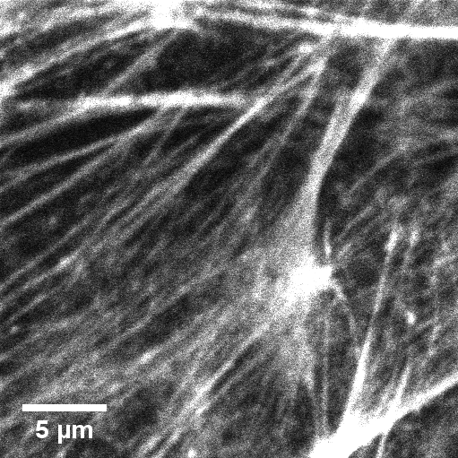
Setting the correct pixel size
Beware of pixel sizes smaller than limit
Smallest recommended pixel size
Zoomed 2X smaller pixel size
Less area
More bleaching

Slide 44
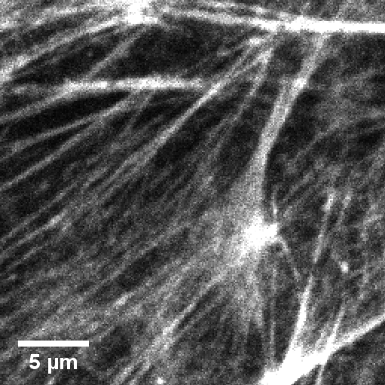
Setting the correct pixel size
Beware of pixel sizes smaller than limit
Digital zoom of original image
Zoomed 2X smaller pixel size
Less area
More bleaching
No extra detail!

Slide 45
Setting gain, laser power & digital offset
Notes:
AVG signal levels in the entire field within 2% of each other between settings

Slide 46
Setting gain, laser power & digital offset
Do not saturate your image
Notes:
AVG signal levels in the entire field within 2% of each other between settings

Slide 47
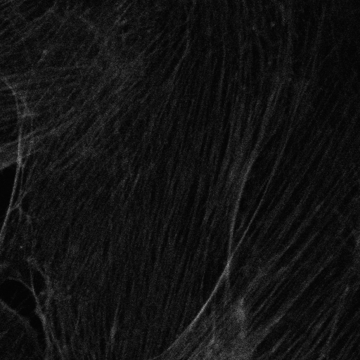
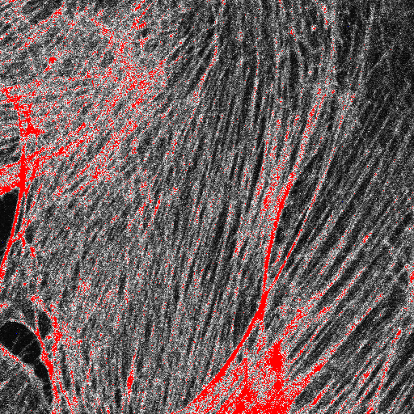
Saturation irreversibly destroys data
Distorts morphology
Compare details here
Notes:
AVG signal levels in the entire field within 2% of each other between settings

Slide 48
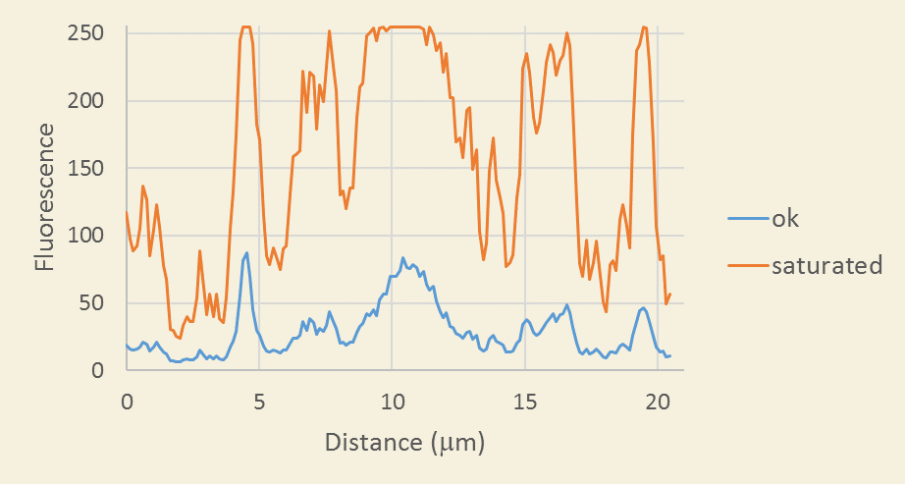
Saturation irreversibly destroys data
Makes quantification imposible
Notes:
AVG signal levels in the entire field within 2% of each other between settings

Slide 49
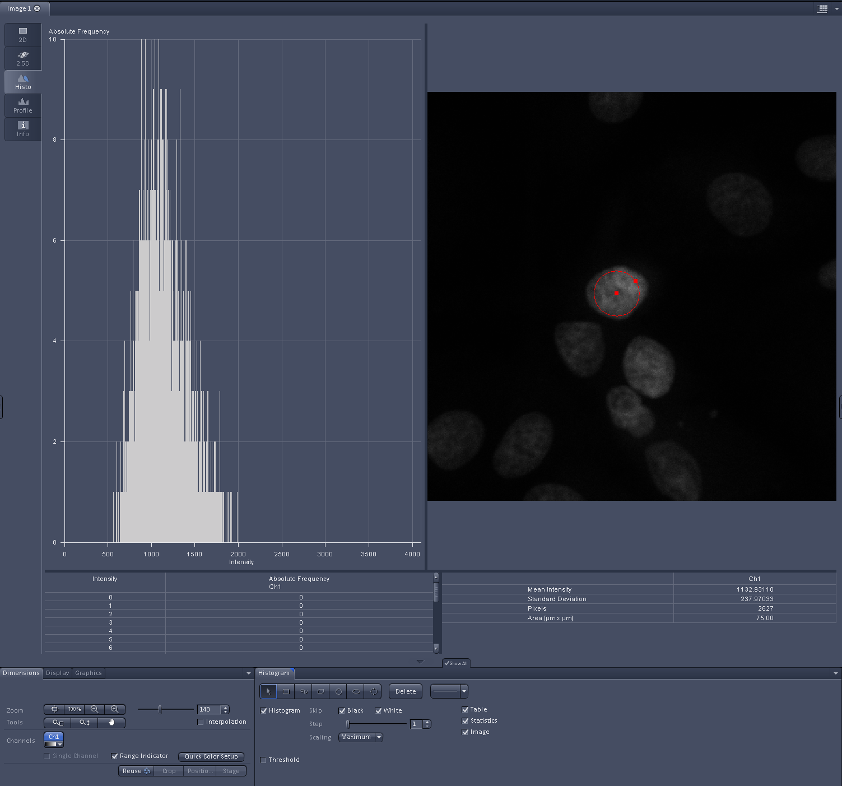
To avoid saturation
Find bright object in brightest experimental condition
Adjust for maximum pixel intensities at half the full range
Notes:
AVG signal levels in the entire field within 2% of each other between settings

Slide 50
Setting gain, laser power & digital offset
What:
How:
No saturated pixels
Range indicator
No pixels at 0
Digital offset
Good StoN
No bleaching
Gain vs laser power
Notes:
AVG signal levels in the entire field within 2% of each other between settings

Slide 51
Setting gain and laser power

Slide 52
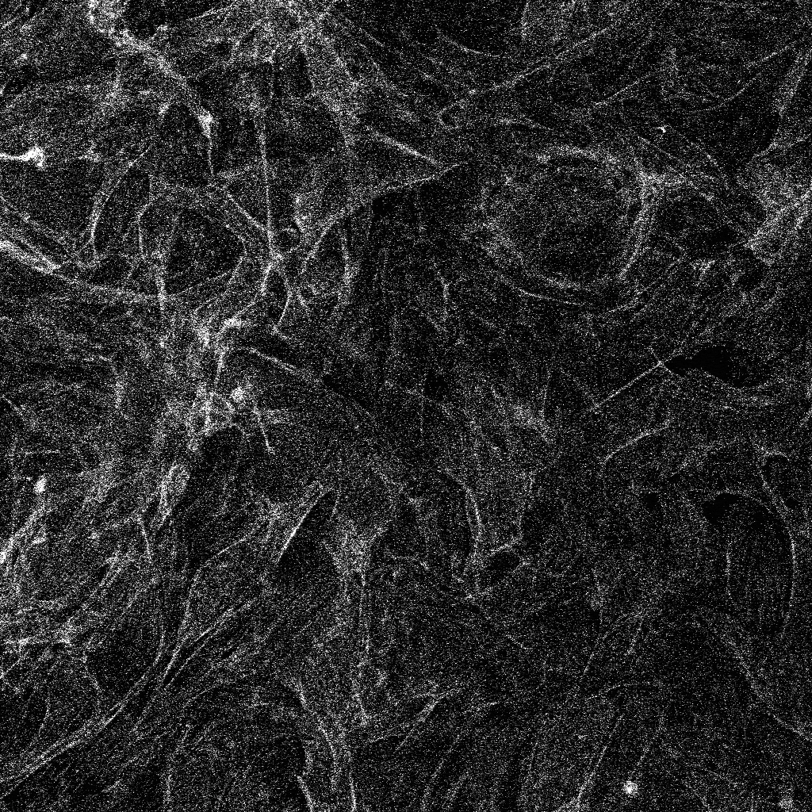
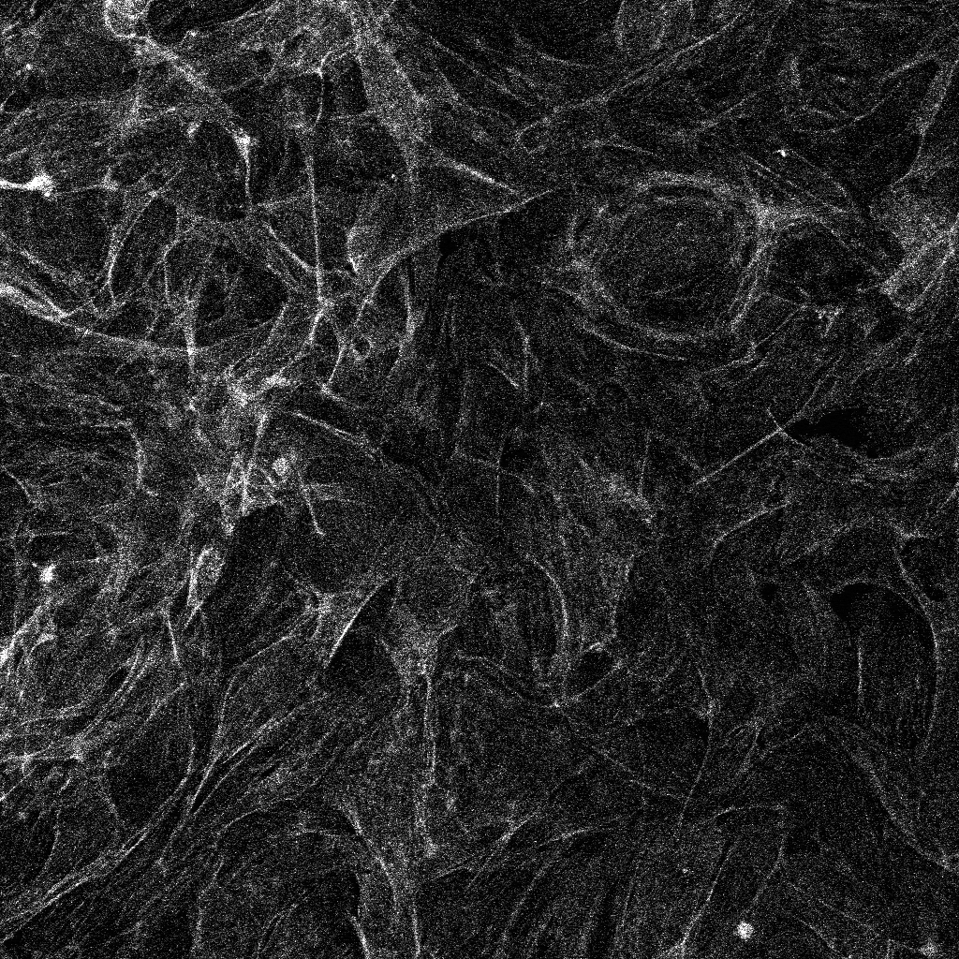
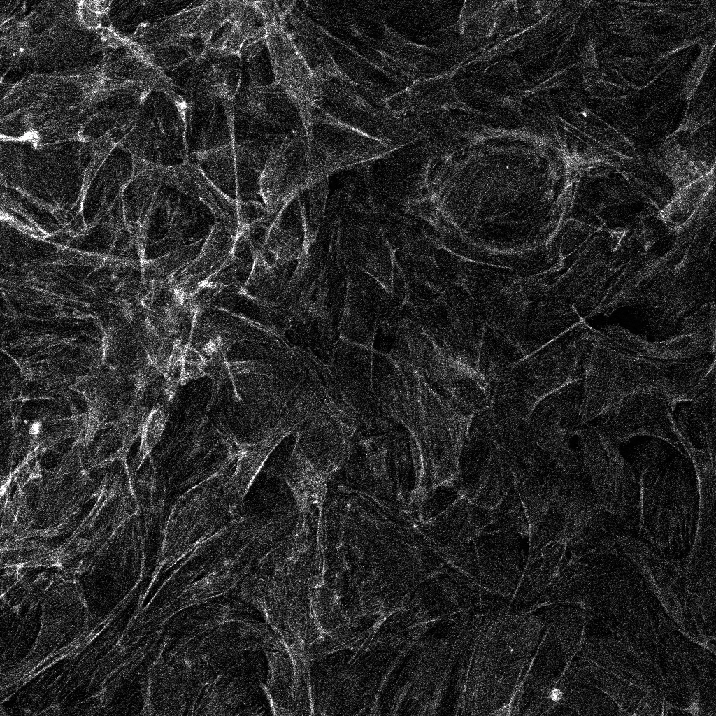
Setting gain and laser power
Gain: 700
Laser: 0.45%
Gain: 650
Laser: 0.9%
Gain: 600
Laser: 2%
Gain: 550
Laser: 4.5%
Gain: 500
Laser: 11.8%
Gain: 450
Laser: 55%
Notes:
AVG signal levels in the entire field within 2% of each other between settings
Highest laser power not always best option: take into account bleaching and fluorophore saturation

Slide 53
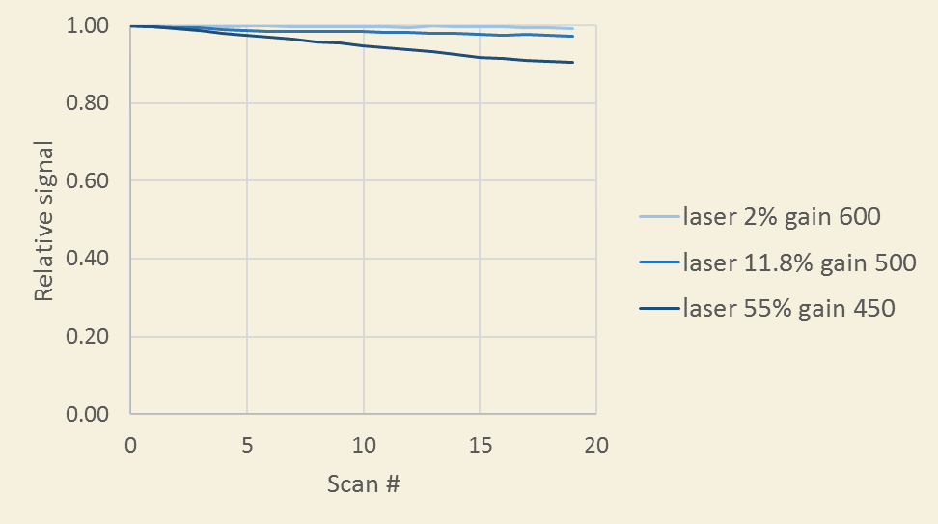
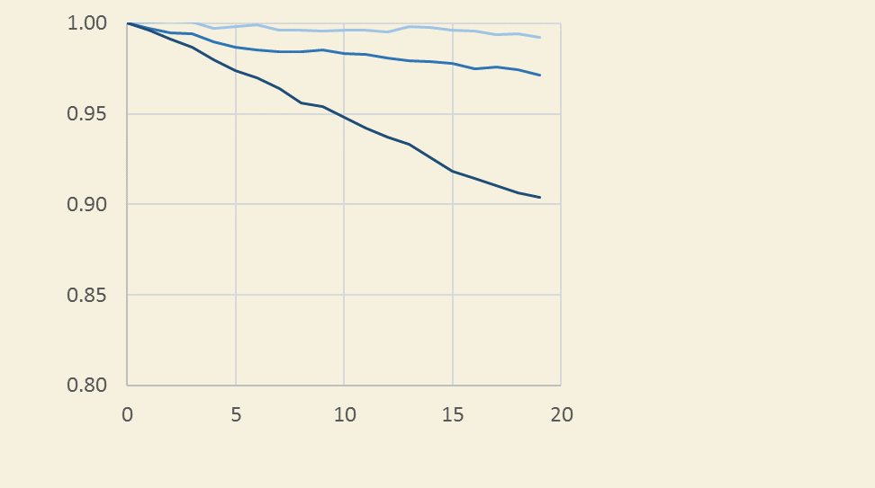
Setting gain and laser power
Beware: high laser powers can cause bleaching
Test bleaching of your fluorophore in your sample
Note: laser powers not the same between LSM700 and LSM710
Notes:
AVG signal levels in the entire field within 2% of each other between settings

Slide 54
Averaging
Notes:
AVG signal levels in the entire field within 2% of each other between settings

Slide 55
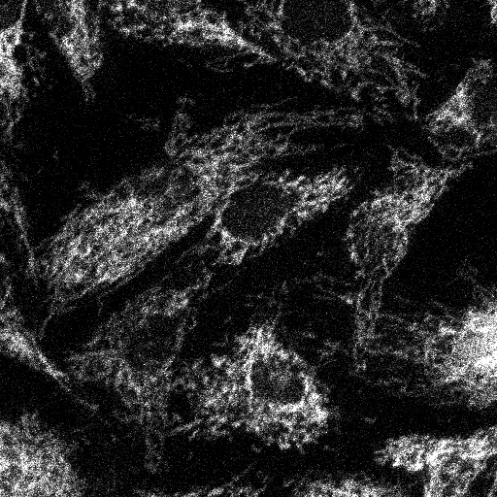
Averaging
No averaging
Average of
2 frames
Average of
4 frames
Average of
8 frames
Average of
16 frames
Notes:
AVG signal levels in the entire field within 2% of each other between settings
Mention that speed has very similar effects

Slide 56
Bidirectional mode: 2X speed boost
Notes:
AVG signal levels in the entire field within 2% of each other between settings

Slide 57
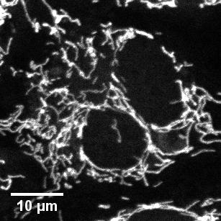
Bidirectional mode: 2X speed boost
Unidirectional
Bidirectional
40X/1.3, zoom=2.3
Check for artifacts
Notes:
AVG signal levels in the entire field within 2% of each other between settings

Slide 58
Setting Z intervals
Size of objects of interest ?
For maximal resolution use software suggestion

Slide 59
Before imaging
During imaging
After imaging

Slide 60
Saving
Use .lsm or .czi
Do not use .tif
Do not export contents of image window

Slide 61
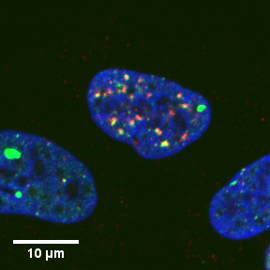
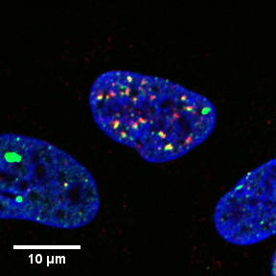
Deconvolution improves contrast
Autoquant
Courtesy of Anastasia Zlatanou
Notes:
AVG signal levels in the entire field within 2% of each other between settings

Slide 62
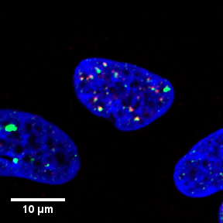
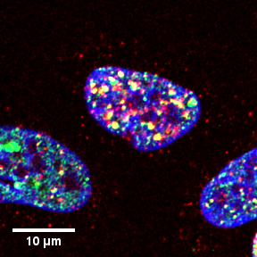
Display adjustments
Make defensible adjustments

Slide 63
Display adjustments
Adjustments MUST be same across images you will compare

Slide 64
3D analysis in Imaris
Raw data, interpolated in 3D
Notes:
AVG signal levels in the entire field within 2% of each other between settings

Slide 65
3D analysis in Imaris
Raw data, interpolated in 3D
Notes:
AVG signal levels in the entire field within 2% of each other between settings

Slide 66
3D analysis in Imaris
Extract surfaces from data
Notes:
AVG signal levels in the entire field within 2% of each other between settings

Slide 67
3D analysis in Imaris
Extract colocalizing volumes from data
Notes:
AVG signal levels in the entire field within 2% of each other between settings

Slide 68
We are here to help YOU with YOUR science
Please ask questions (now or later)
msl@med.unc.edu

