Slide 1
Light-sheet microscopy at MSL: what, why and how?
Pablo Ariel, Ph.D.
Microscopy Services Laboratory
Department of Pathology and Laboratory Medicine
University of North Carolina, Chapel Hill
July 2020

Slide 2
What ?
Why ?
How ?

Slide 3
What ?
Why ?
How ?

Slide 4
Key features of light-sheet microscopy
Objective
z
x
Sample with fluorophores
Laser sheet
Detection orthogonal to sheet

Slide 5
Different scopes for different questions
Fixed
Alive
Big
Lavision Ultramicroscope
Small
Slow
Fast

Slide 6
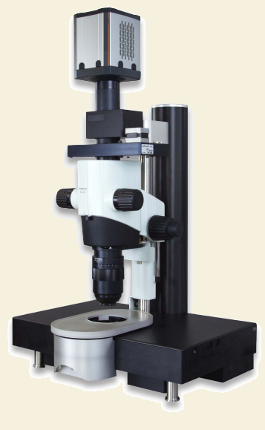
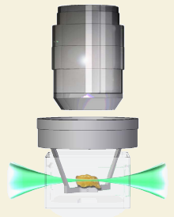
Ultramicroscope
Objective
Sample
Lavision Biotec
UltraMicroscope II

Slide 7
What ?
Why ?
How ?

Slide 8
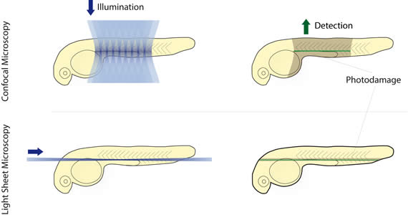
Compared to confocal, light-sheet is
Faster
Less damaging
Modified from Leica Microsystems

Slide 9
What ?
Why ?
How ?

Slide 10
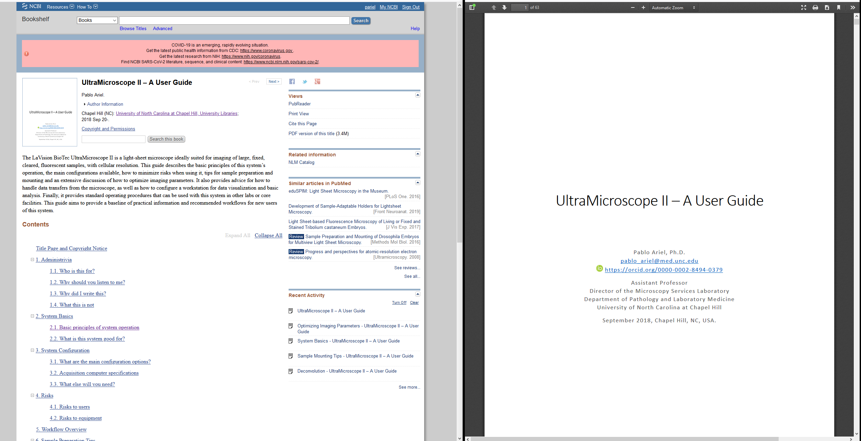
https://www.ncbi.nlm.nih.gov/books/NBK536385/
https://doi.org/10.17615/C69M15

Slide 11
Requirement # 1
Biological question at the right scale

Slide 12
What is the spacing of the objects you study ?
( more important than size of those objects)
Notes:
Resolution 10-1um in XY, 5um in Z (sheet width and Z resolution of 2X/0.5 objective)

Slide 13
Example:
Labeled axons can be visualized (0.2μm)

Slide 14
Example:
Labeled axons can be visualized (0.2μm)
but they look bigger

Slide 15
Problem:
2 objects close together

Slide 16
Problem:
2 objects close together
?

Slide 17
Problem:
2 objects close together
?

Slide 18
Spacing more important than size

Slide 19
Spacing more important than size

Slide 20
Examples of biological questions for the Ultramicroscope
Correct scale:
Locating cells of interest in large pieces of tissue
Analysis of vasculature
Tracing sparsely labeled axons in brain
Incorrect scale:
Discerning subcellular details
Counting all cells in densely packed tissue
Tracing individual axons in densely labeled samples
Notes:
Subcellular details: counting spines, boutons; is subcellular localization of a protein different in different areas of the tissue
Label all axons exiting region, trace all of them.

Slide 21
Requirement # 2
Sample must be transparent

Slide 22
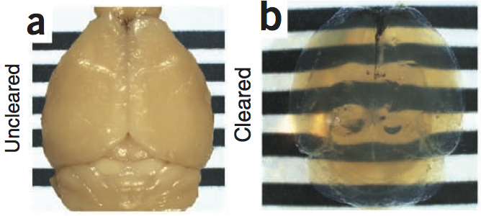
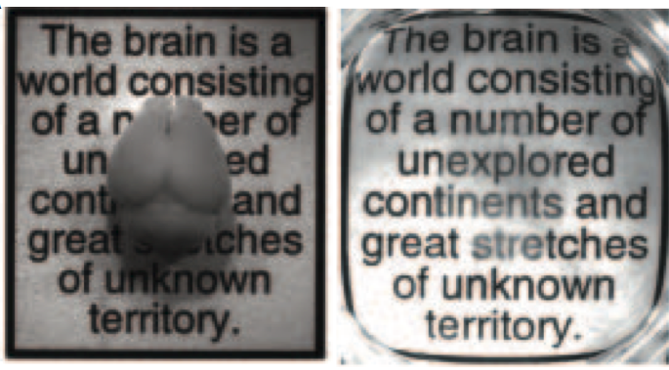
Which clearing method?
Ertürk et al 2012 Nature Protocols
Chung et al 2013 Nature
Tainaka et al 2014 Cell

Slide 23
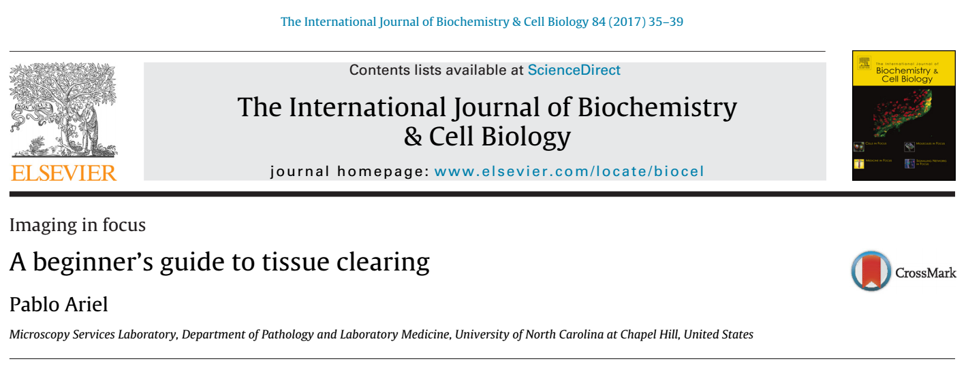
Which clearing method?
Key questions:
How big is your sample?
Do you need to stain lipids?
Do you need immunostaining?

Slide 24
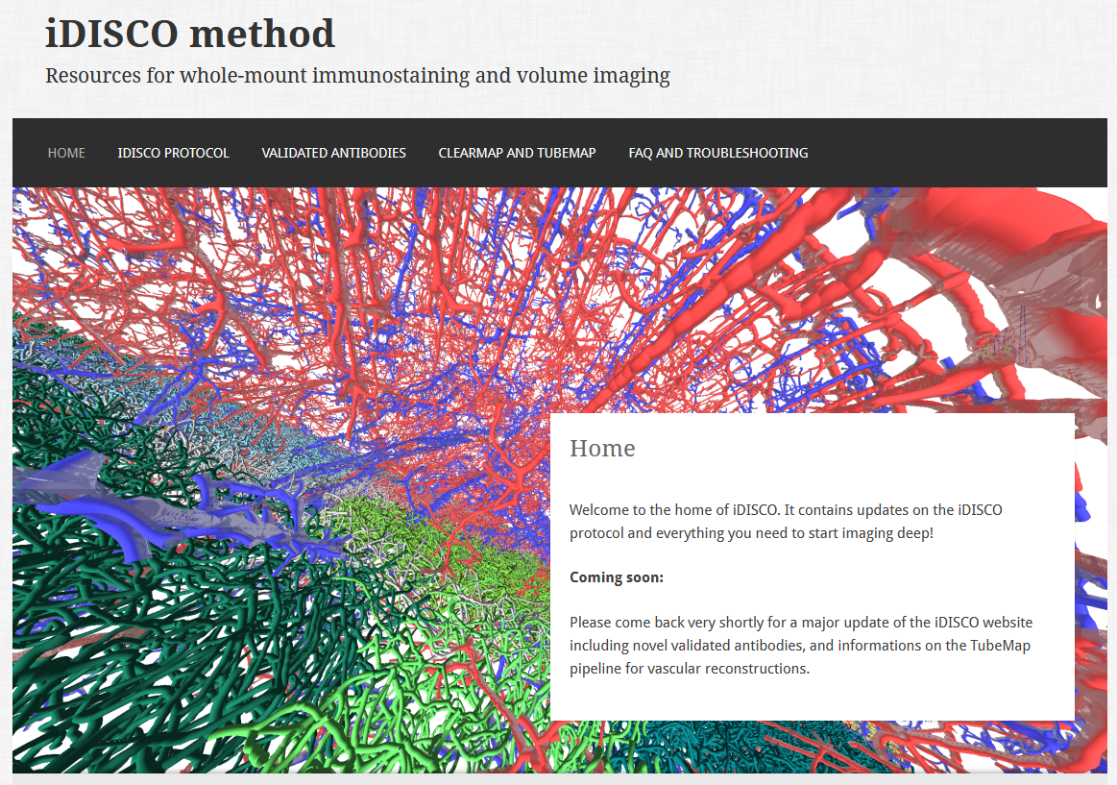
Which clearing method?
At MSL the best answer has usually been
iDISCO+
https://idisco.info/

Slide 25
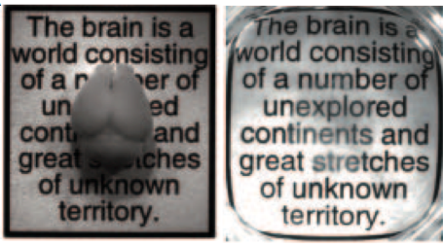
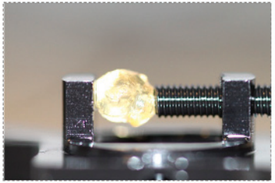
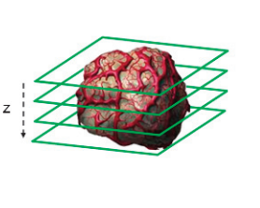
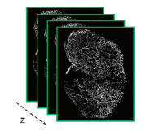
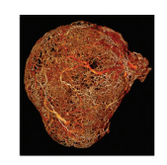
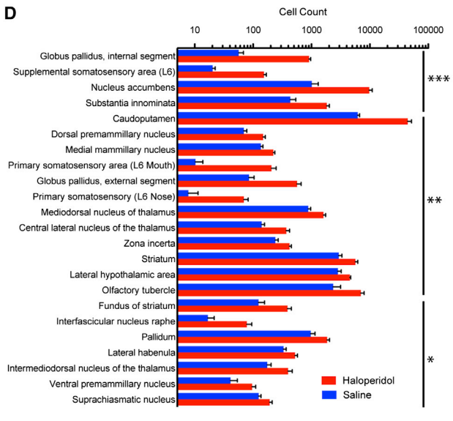
Workflow
Sample preparation
days - weeks
Sample mounting
minutes
Sample imaging
minutes - hours
Data visualization
minutes – tens of minutes
Data management
tens of GBs – thousands of GBs
Data analysis
hours - months
Chung et al, Nature 2013
Ertürk et al, 2012
Dobosz et al, Neoplasia 2014
Renier et al, Cell 2016

Slide 26
Before imaging
During imaging
After imaging

Slide 27
Trim based on your biology
Notes:
Typical: Studying circuits deep in brain; hemisphere as good as both sides
Smaller samples clear faster, use less antibody, faster staining, easier to image, can be cut to size

Slide 28
Trim based on your biology
Notes:
Typical: Studying circuits deep in brain; hemisphere as good as both sides
Smaller samples clear faster, use less antibody, faster staining, easier to image, can be cut to size

Slide 29
Trim based on your biology
Notes:
Typical: Studying circuits deep in brain; hemisphere as good as both sides
Smaller samples clear faster, use less antibody, faster staining, easier to image, can be cut to size

Slide 30
Trim based on your biology
Notes:
Typical: Studying circuits deep in brain; hemisphere as good as both sides
Smaller samples clear faster, use less antibody, faster staining, easier to image, can be cut to size

Slide 31
Trim based on your biology
Smaller samples:
stain faster
require less antibody
clear faster
are easier to image
Notes:
Typical: Studying circuits deep in brain; hemisphere as good as both sides
Smaller samples clear faster, use less antibody, faster staining, easier to image, can be cut to size

Slide 32
Clearing - Steal from the best
Use a clearing method that works
For a question similar to yours
Not just in the lab that created it
With minimal equipment and fuss (avoid $$$)
Good results with iDISCO+ on:
brains, kidneys, liver, heart, embryos, intestine…

Slide 33
Glial networks in pig intestine visualized with iDISCO+
GFAP immunostaining
Data courtesy of Amanda Ziegler (Blikslager lab, NCSU)
Notes:
GFAP: stains glial cell cytoskeleton
Illustrates segmentation based on morphology

Slide 34
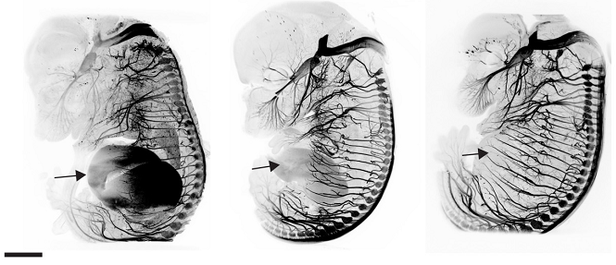
Labeling – (far) redder is better
AlexaFluor 488
Ex 488; Em 525/50
AlexaFluor 568
Ex 561; Em 595/40
AlexaFluor 647
Ex 640; Em 680/30
1 mm
Autofluorescence
Scattering
Absorbtion
Renier et al, Cell 2014

Slide 35
Optimize mounting
Narrower in X
Centered in XY
< WD in Z
Areas of interest at top
Notes:
Narrower: better propagation
Centered: better for tiling; possibly less shadowing,

Slide 36
Optimize mounting
If sample is:
Too small
Too big
Too soft
Too asymmetric
Possible solutions:
Embed in agarose
Custom holders; cut smaller
Glue down, embed in agarose
Cut differently; glue down; custom holders

Slide 37
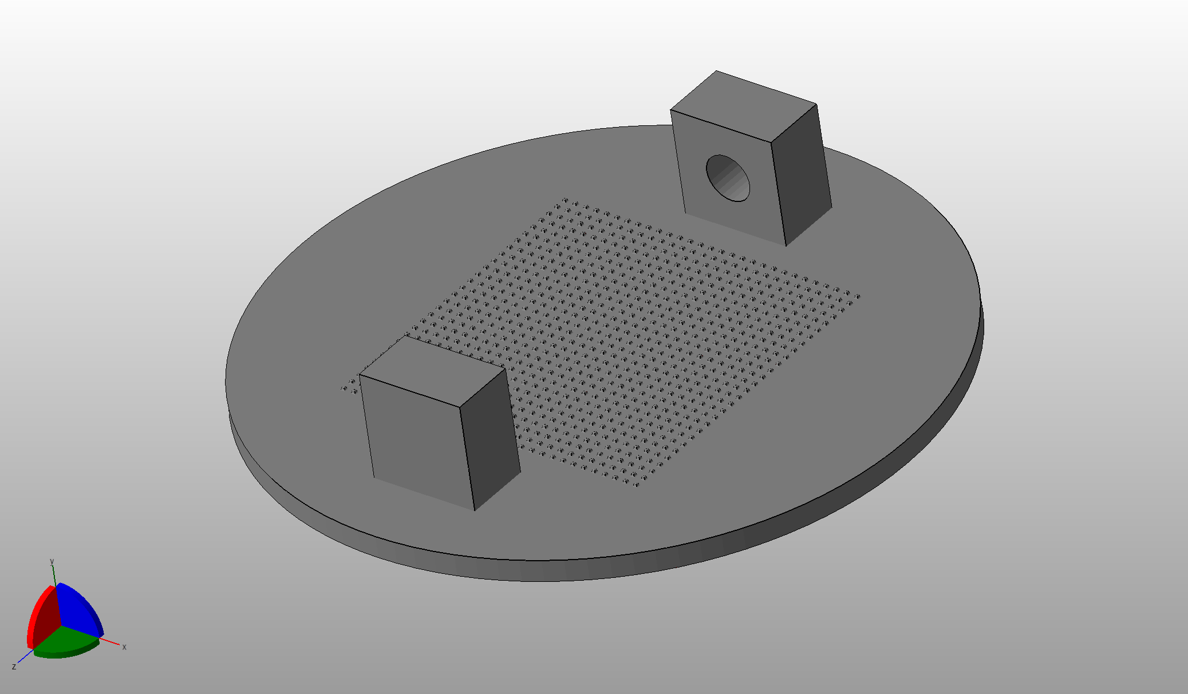
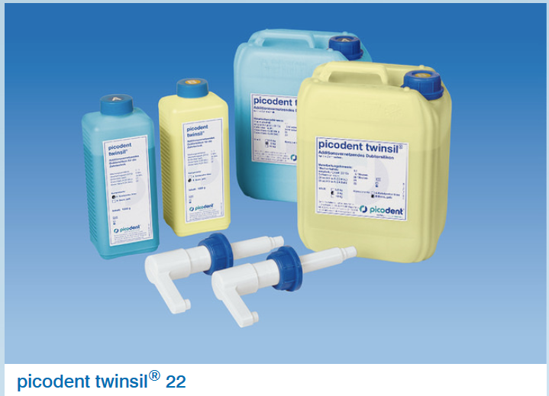
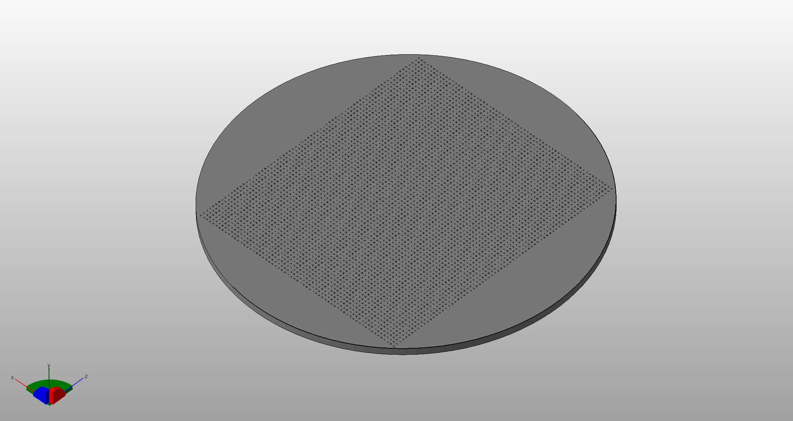
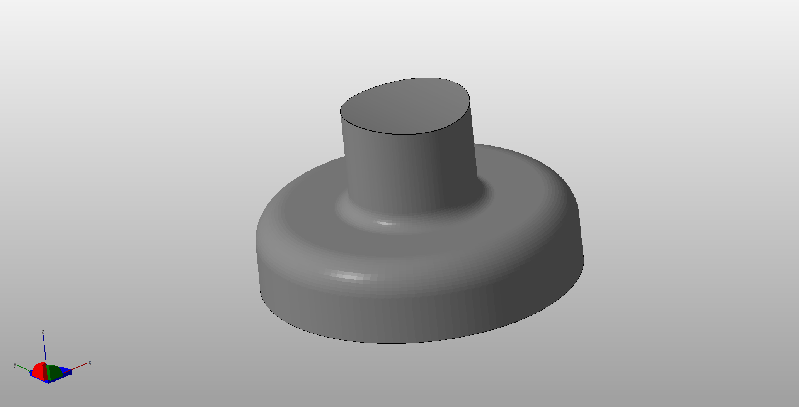
Optimize mounting
Custom holders and pedestals
Very useful glue
Notes:
Mention designs available

Slide 38
Before imaging
During imaging
After imaging

Slide 39
Know the key limitations
Radial aberrations
Better
Worse
Light propagation
Sheet shape
Notes:
Radial are zoom independent
Sheet shape also affects Z, dramatically. Is zoom dependent
Light propagation: also in Z, a little

Slide 40
Radial aberrations
Partly due to poor performance on edges of objective
Partly due to illumination with more than one sheet from each side
Options?

Slide 41
Radial aberrations
Partly due to poor performance on edges of objective
Partly due to illumination with more than one sheet from each side
Trade detail for eveness:
zoom out

Slide 42
Radial aberrations
Partly due to poor performance on edges of objective
Partly due to illumination with more than one sheet from each side
Trade detail for eveness:
zoom out
Trade FOV for eveness:
crop

Slide 43
Light propagation
Not a problem in good samples
(well cleared, clean staining, no bubbles)
Options?

Slide 44
Light propagation
Not a problem in good samples
(well cleared, clean staining, no bubbles)
Image with 2 sheets

Slide 45
Sheet shape
Major problem in Z
Bigger problem at low mag
Low mag FOV
10X higher mag FOV
y
x
z

Slide 46
Sheet shape and NA
Major problem in Z
z
x
High NA sheet
Tighter sheet waist
Uneven Z resolution across field of view
Brighter
Low NA sheet
Broader sheet waist
More even Z resolution across field of view
Dimmer

Slide 47
Sheet shape and NA
Major problem in Z
Bigger problem at low mag
z
x
Low magnification; no cropping
Large field of view
Uneven Z resolution across field of view
High magnification and/or cropping
Small field of view
More even Z resolution across field of view

Slide 48
Sheet shape
Major problem in Z
Options?
Bigger problem at low mag
Low mag FOV
10X higher mag FOV
y
x
z

Slide 49
Sheet shape
Trade Z resolution for eveness:
lower sheet NA
y
x
z

Slide 50
Sheet shape
Trade Z resolution for eveness:
lower sheet NA
y
x
z

Slide 51
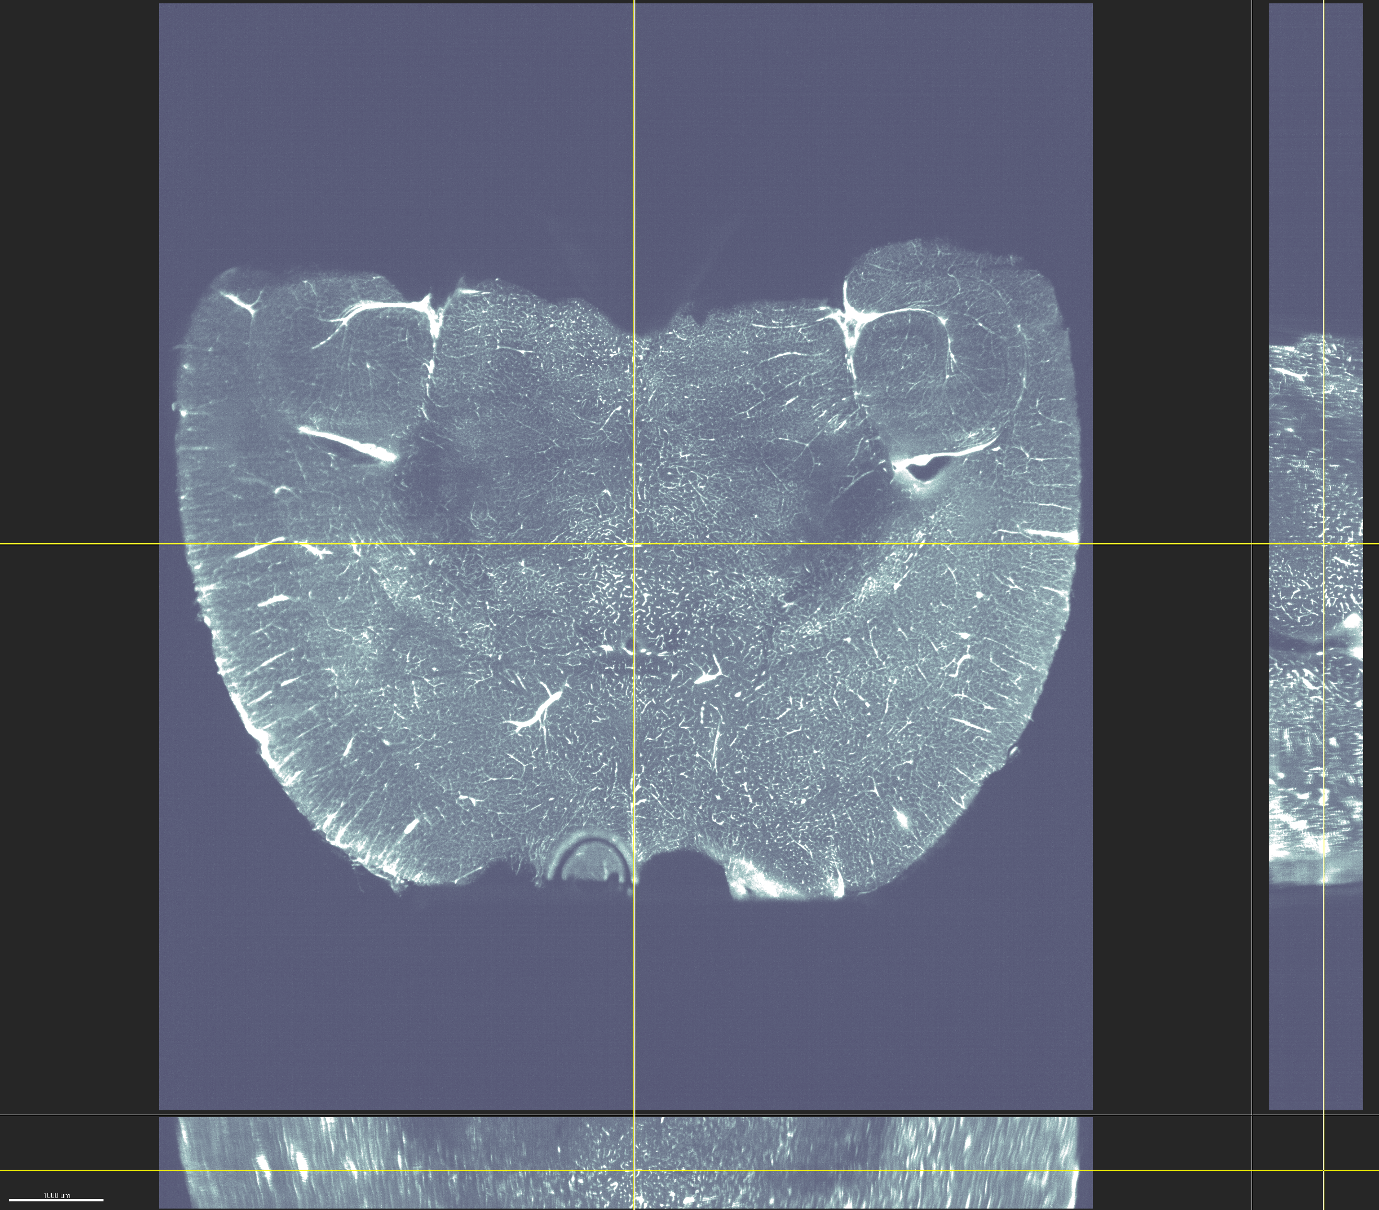
Mouse brain vasculature - high NA, R sheet
Sample courtesy of Nico Renier (ICM brain & spine, Paris)

Slide 52
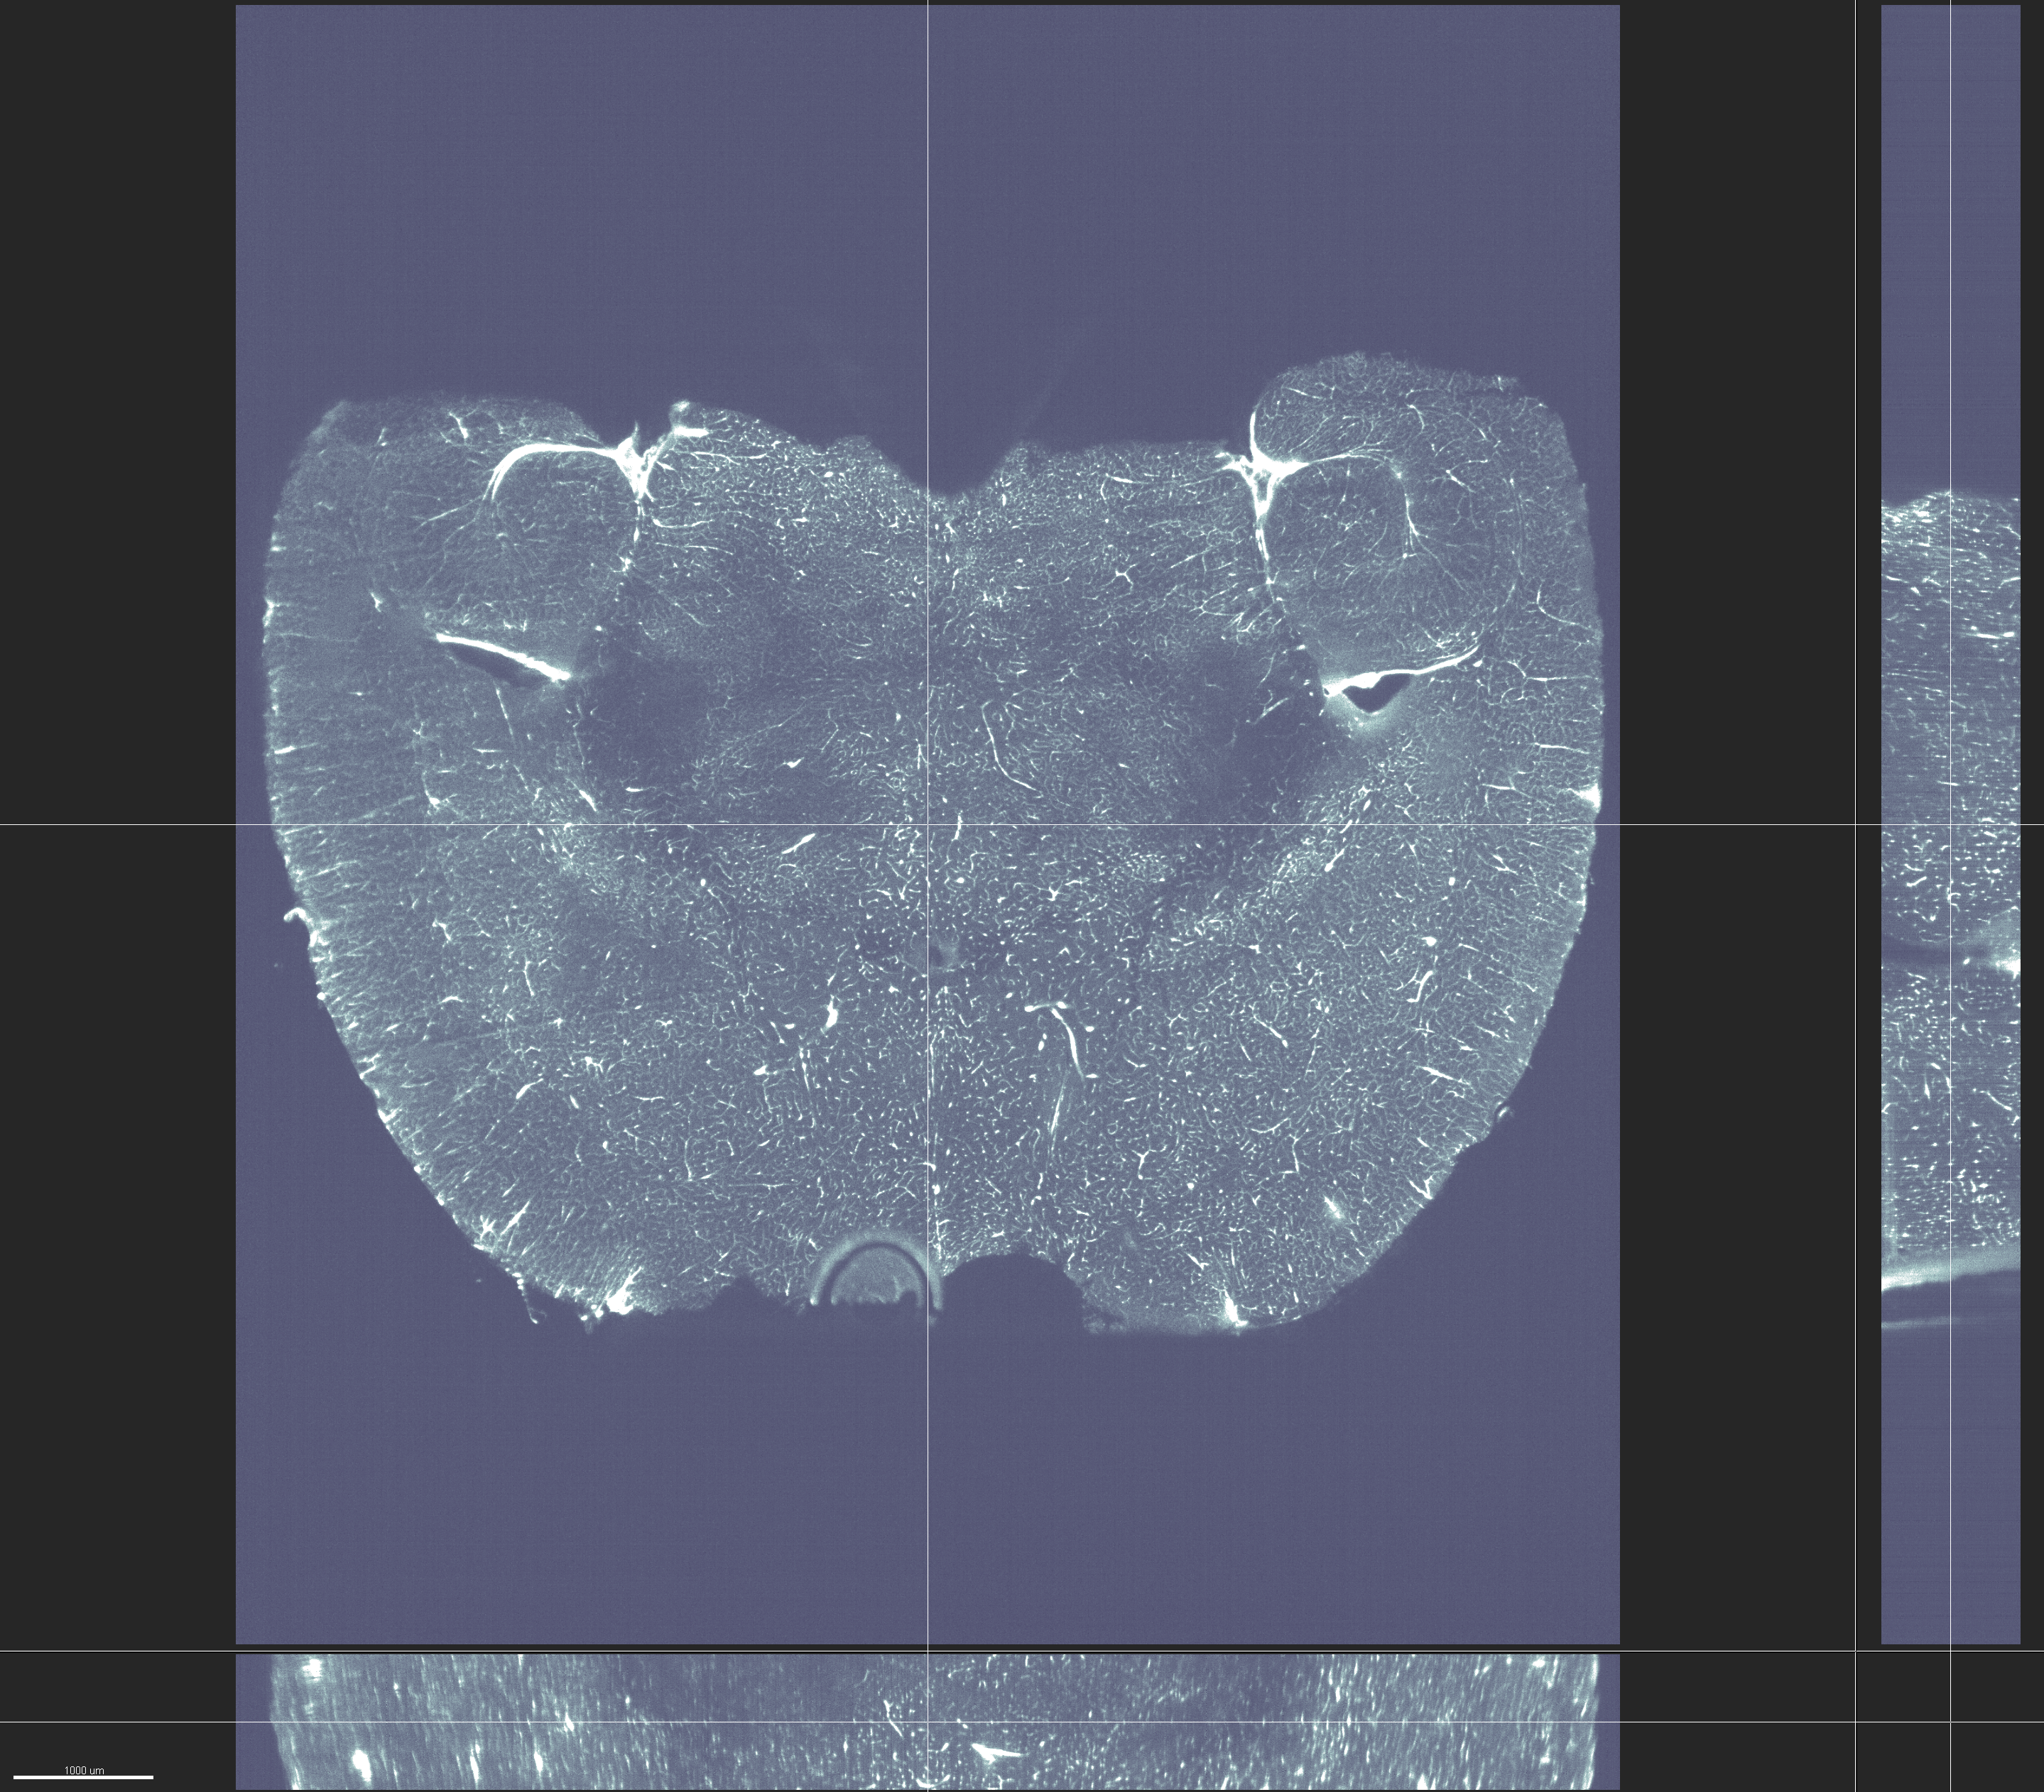
Mouse brain vasculature - low NA, R sheet
Sample courtesy of Nico Renier (ICM brain & spine, Paris)

Slide 53
Mouse brain vasculature - low NA, R+L sheets
Sample courtesy of Nico Renier (ICM brain & spine, Paris)

Slide 54
Sheet shape
Trade time for eveness:
crop + tile
y
x
z

Slide 55
Sheet shape
Trade time for eveness:
crop + tile
y
x
z

Slide 56
Sheet shape
Trade time for eveness:
crop + tile
y
x
z

Slide 57
Sheet shape
Trade time for eveness:
crop + tile
y
x
z

Slide 58
Sheet shape
Trade time for eveness:
crop + tile
y
x
z

Slide 59
Sheet shape
Trade time for eveness:
crop + tile
y
x
z

Slide 60
Sheet shape
Trade time for eveness:
crop + tile
y
x
z

Slide 61
Sheet shape
Trade time for eveness:
Dynamic focus
y
x
z

Slide 62
Sheet shape
Trade time for eveness:
Dynamic focus
y
x
z

Slide 63
Sheet shape
Trade time for eveness:
Dynamic focus
y
x
z

Slide 64
Sheet shape
Trade time for eveness:
Dynamic focus
y
x
z

Slide 65
Sheet shape
Trade time for eveness:
Dynamic focus
y
x
z

Slide 66
Sheet shape
Trade time for eveness:
Dynamic focus
Beware:
Documentation of DF algorithms is poor
y
x
z

Slide 67
Sheet shape
Major problem in Z
Bigger problem at low mag
Speed
Trade Z res for eveness:
lower sheet NA
Trade time for eveness:
Crop + Tile
Dynamic focus
Quality

Slide 68
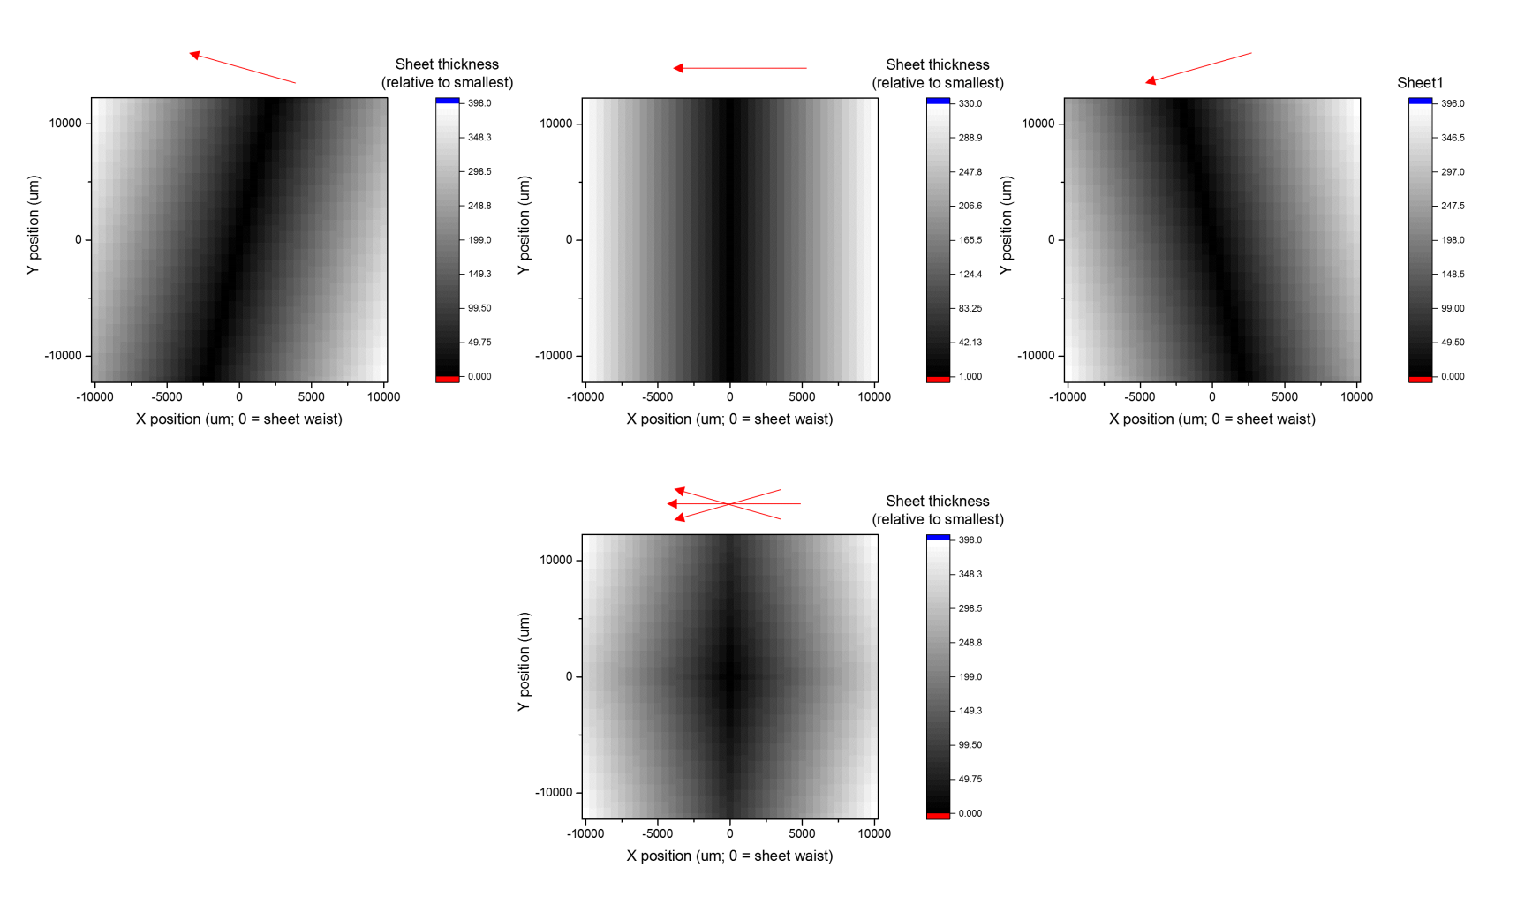
Sheet shape – more problems
Z resolution gets worse as we move away from middle in any direction

Slide 69
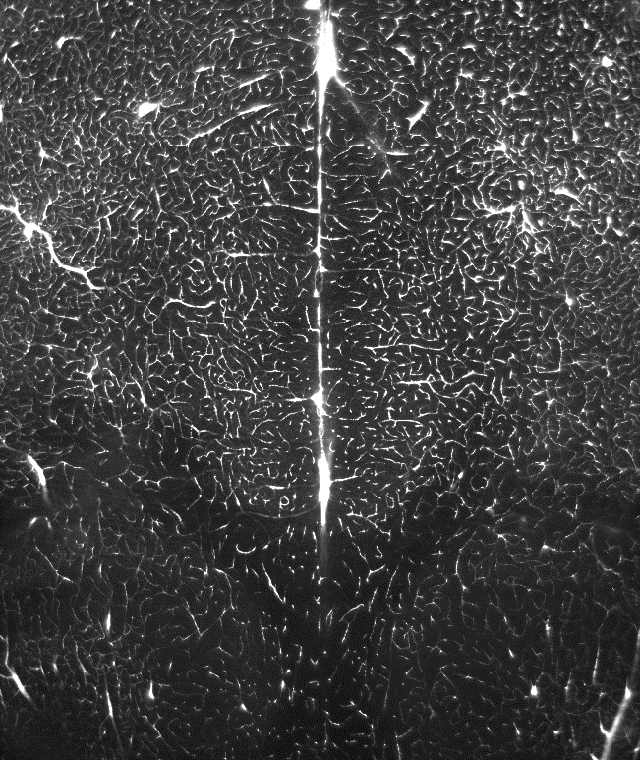
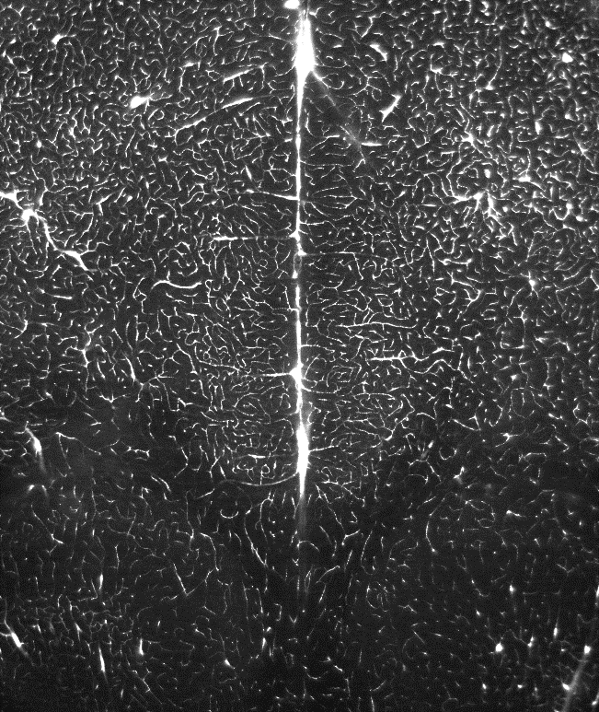
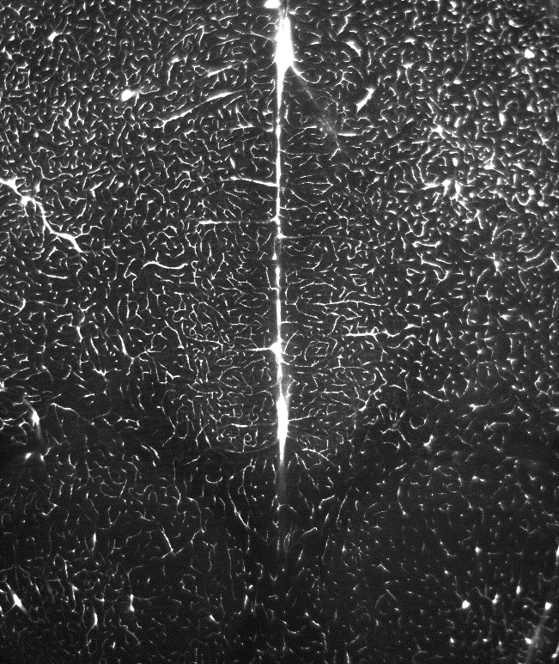
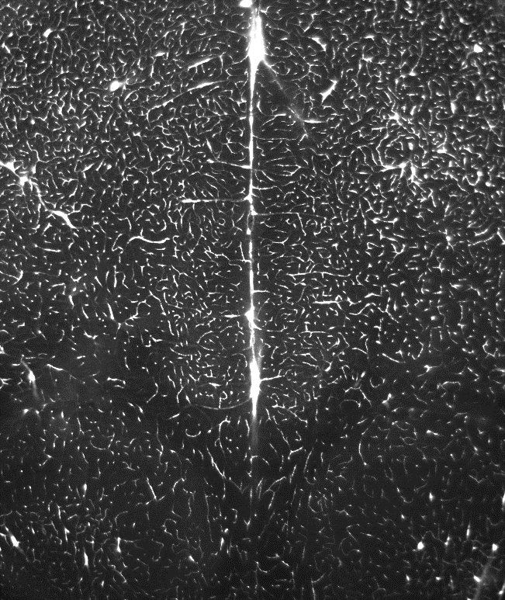
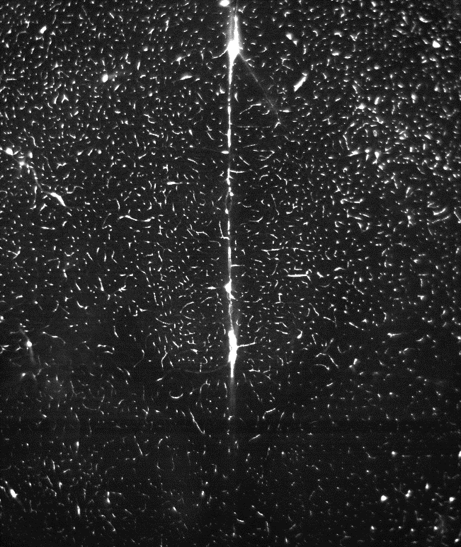
z
Single XY planes from center of Z stacks acquired with different settings
y
x
A
B
C
D
E
1 mm
3 R sheets
NA=0.154
Δt = 1x
3 R sheets
NA=0.017
Δt = 1x
3 R + 3 L sheets
NA=0.026
Δt = 2.2x
3 R sheets
NA=0.154
Dynamic focus (25 positions)
Δt = 12.8x
1 R sheet
NA=0.154
Dynamic focus (25 positions)
Δt = 12.8x
y
x
z
XZ views of Z stacks (max projected in Y)
y
x
max Y
A
B
C
D
E
D
E
z
0.25 mm
x

Slide 70
Key to good tiling
Crop!!!
Radial aberrations
Sheet shape
Notes:
Beware of edges when tiling

Slide 71
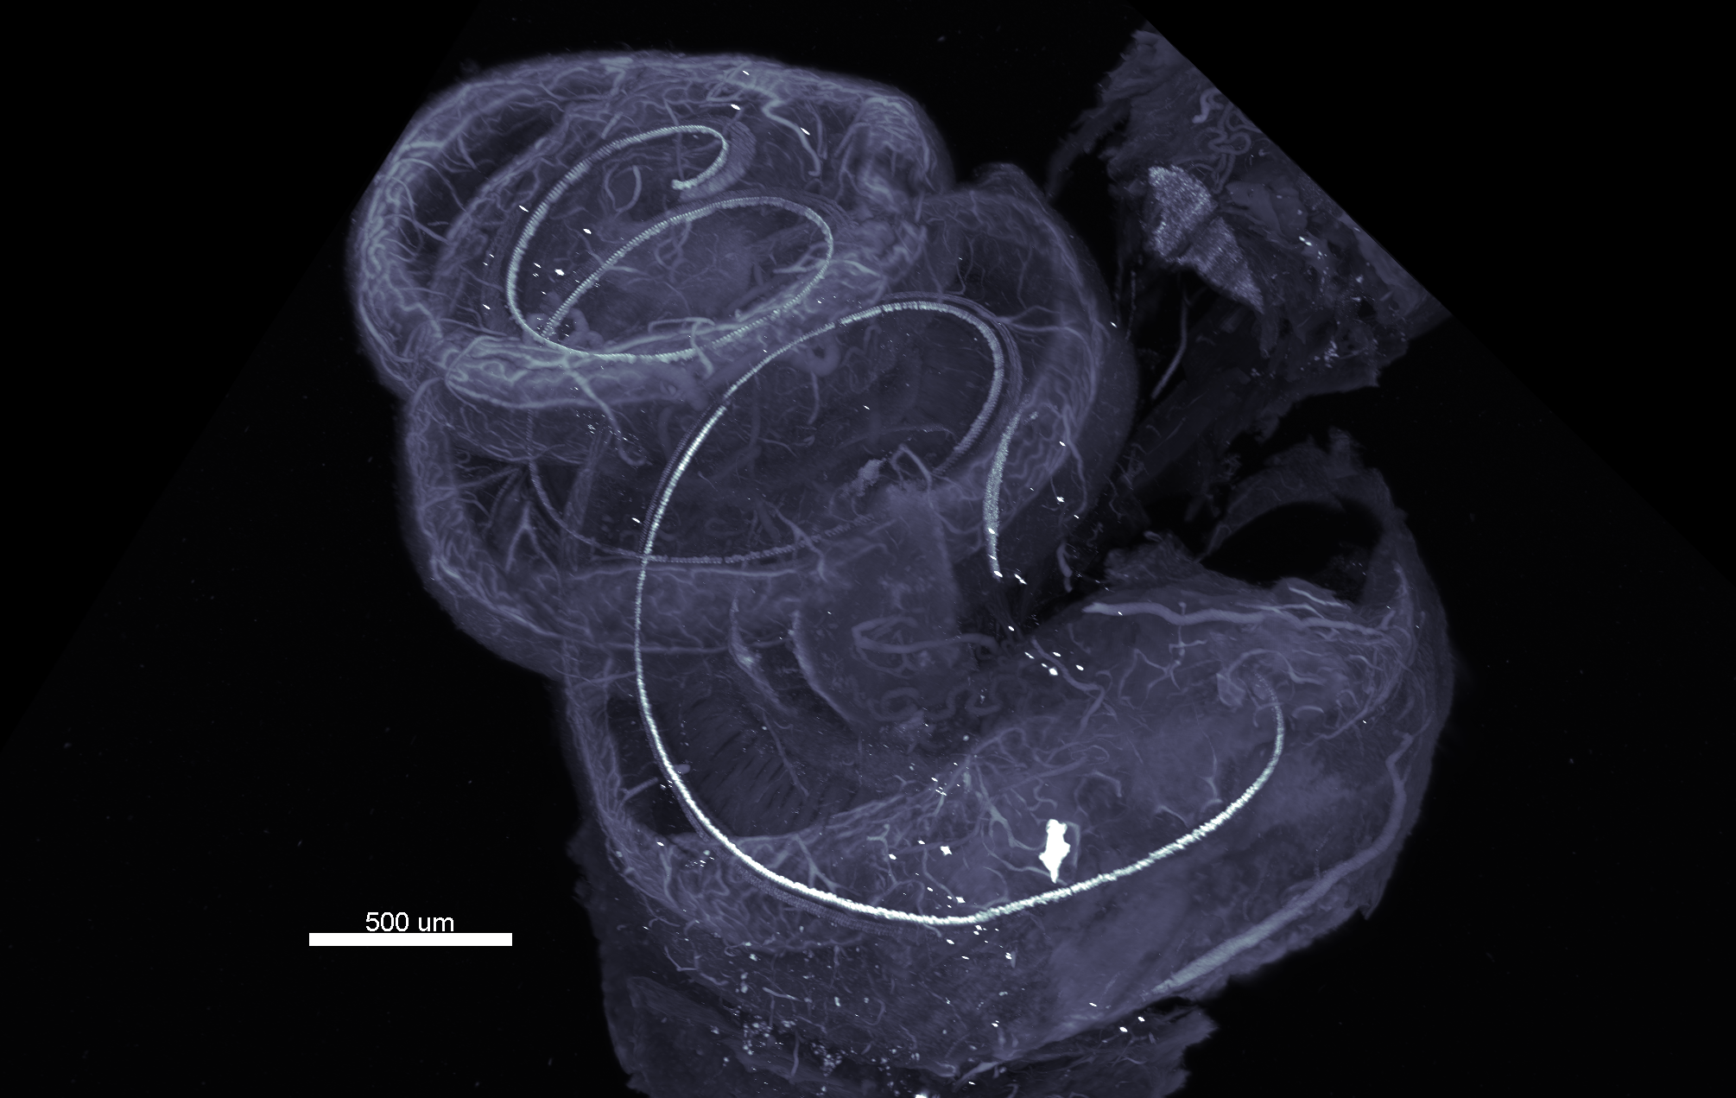
Gerbil cochlea – 12.6X mag, high NA, crop+tile
Sample courtesy of Ken Hutson (Fitzpatrick lab, UNC)

Slide 72
Laser power and exposure
To look at sample
To acquire data
Power level
Low
High
Exposure time
Long
Short
Low bleaching
High speed
Notes:
Mention light-sheet time macro available

Slide 73
Before imaging
During imaging
After imaging

Slide 74
Workflow
Sample preparation
days - weeks
Sample mounting
minutes
Sample imaging
minutes - hours
Data visualization
minutes – tens of minutes
Data management
tens of GBs – thousands of GBs
Data analysis
hours - months
Chung et al, Nature 2013
Ertürk et al, 2012
Dobosz et al, Neoplasia 2014
Renier et al, Cell 2016

Slide 75
Data management – Slow
Lab
500Mb/s:
10Gb Ethernet
SATA
“Network”
50-100 Mb/s:
1Gb Ethernet
USB3
Outside core
Scope
Acquisition PC
Workstation PC
Local HDD
SSDs
RAID 0
Datasets:
10-1000 GB
External USB3
Core

Slide 76
Data management – Faster ($)
Lab
500Mb/s:
10Gb Ethernet
SATA
“Network”
Hot swap SSD
5.6TB/s/m
(4TB SSD, 1.4m/s human)
50-100 Mb/s:
1Gb Ethernet
USB3
Hot swap SSD
Outside core
Scope
Acquisition PC
Workstation PC
Hot swap SSD
Hot swap SSD
Datasets:
10-1000 GB
Hot swap SSD
Core
Notes:
At 5km/hour, 1.4m/s. Assuming current consumer level max SSDs are 4TB, transporting 4TB over 14m takes 10s: 400Gb/s, or 4GB/s/m. Over 140m, it is 40Gb.s. Speed is same as SATA or 10Gb Ethernet if lab is 11.2km away (2 hours, 15 minute walk), assuming no motorized transport.
White paper available.

Slide 77
Data Visualization
Use Imaris on the MSL workstation

Slide 78
Data analysis
Conceptual issue:
What should you measure?
Execution issues:
Large datasets are very cumbersome
Algorithms are not always available
This is the bottleneck.
Notes:
Typically 5-25GB data sets

Slide 79
Contact MSL if you think this kind of microscopy would be useful for your research
msl@med.unc.edu
Notes:
Typically 5-25GB data sets

