Slide 1

The basics of imaging cleared tissue
Third iDISCO Workshop
April 25th, 2023
Rockefeller University and Kavli NSI, NYC
Pablo Ariel, Ph.D.
Microscopy Services Laboratory
Department of Pathology and Laboratory Medicine

Slide 2
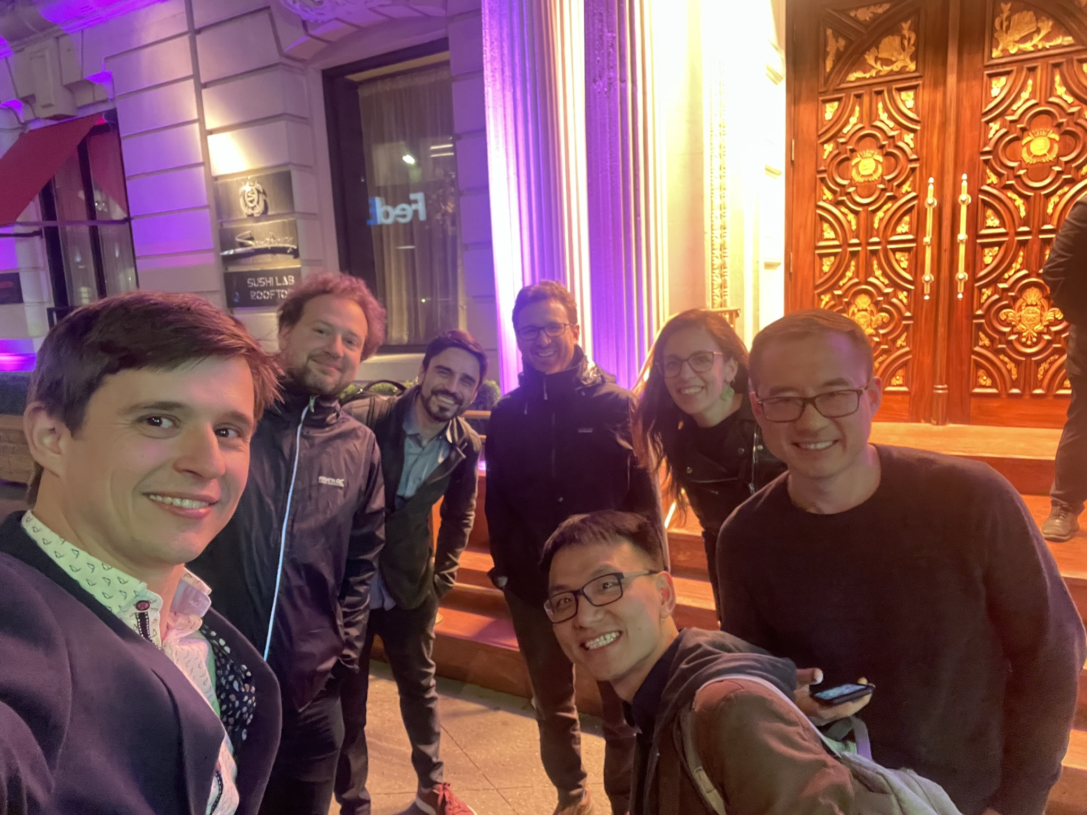
Huge thanks to
Organizing gurus
Marc Schneeberger Pane
Han Tan
iDISCO conversations
Nico Renier
Zhuhao Wu
Funding
Kavli Neural System Institute

Slide 3
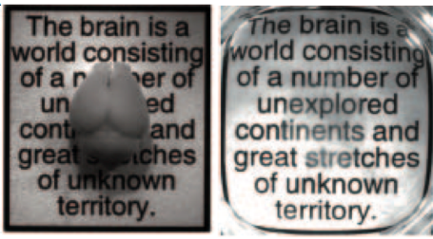
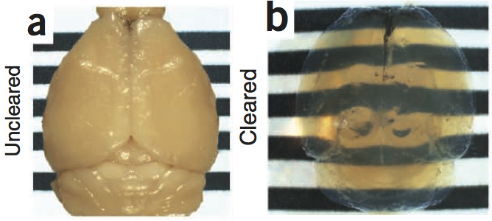
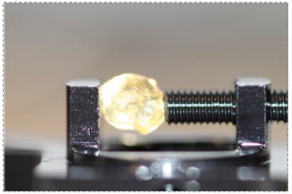
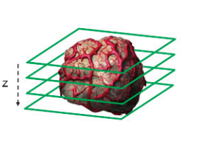
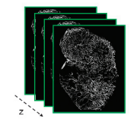
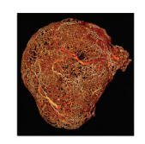
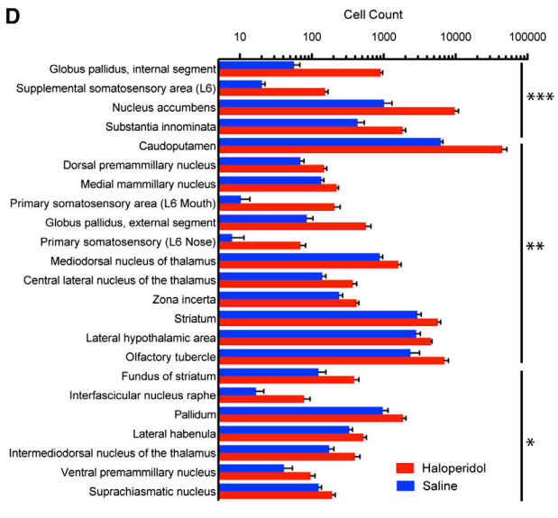
Workflow
Sample preparation
days - weeks
Sample mounting
minutes
Sample imaging
minutes - hours
Data visualization
minutes – tens of minutes
Data management
tens of GBs – thousands of GBs
Data analysis
hours - months
Chung et al 2013
Ertürk et al 2012
Dobosz et al 2014
Renier et al 2016

Slide 4
Workflow
Sample preparation
days - weeks
Sample mounting
minutes
Sample imaging
minutes - hours
Data visualization
minutes – tens of minutes
Data management
tens of GBs – thousands of GBs
Data analysis
hours - months
Chung et al 2013
Ertürk et al 2012
Dobosz et al 2014
Renier et al 2016

Slide 5
3 tips before imaging

Slide 6
Clearing and labeling
Use a method that works
For a question similar to yours
Not just in the lab that created it
With minimal equipment and fuss (avoid $$$)
iDISCO+ and AdipoClear perform well in many cases

Slide 7
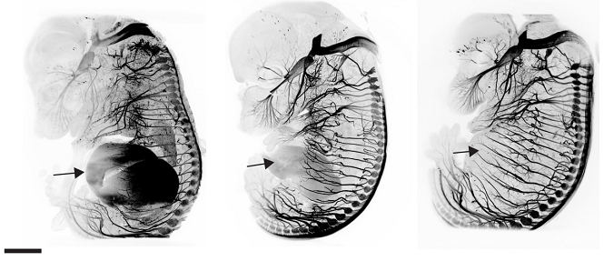
Labeling – (far) redder is better
AlexaFluor 488
Ex 488; Em 525/50
AlexaFluor 568
Ex 561; Em 595/40
AlexaFluor 647
Ex 640; Em 680/30
1 mm
Autofluorescence
Scattering
Absorbtion
Renier et al 2014

Slide 8
Trim based on your biology

Slide 9
Trim based on your biology

Slide 10
Trim based on your biology

Slide 11
Trim based on your biology

Slide 12
Trim based on your biology
Smaller samples:
  stain faster
  require less antibody
  clear faster
  are easier to image

Slide 13
On to imaging…

Slide 14
Assumptions:
BIG samples: >2mm diameter
DEEP imaging: >2mm deep
Clearing with organic solvents
Imaging with turnkey commercial systems

Slide 15
What level of detail do you need?

Slide 16
Spacing is more important than size

Slide 17
Example:
Labeled axons (0.2μm)

Slide 18
Example:
Labeled axons (0.2μm)
look bigger
without high res optics

Slide 19
Problem:
2 objects close together

Slide 20
Problem:
2 objects close together
?

Slide 21
Problem:
2 objects close together
?

Slide 22
Spacing more important than size

Slide 23
Spacing more important than size

Slide 24
Examples of biological questions
Subcellular scale
Dense labelling
High resolution
sub-um(ish)
Discerning subcellular details (spines, organelles)
Counting all cells in densely packed tissue
Tracing individual axons in densely labeled samples
Cellular scale
Sparse labelling
Medium resolution
um(ish)
Locate cells of interest in large pieces of tissue
Trace neural circuits
Trace sparsely labeled axons
Analysis of vasculature

Slide 25
Different microscopes for different questions
Subcellular scale
Dense labelling
High resolution
sub-um(ish)
Some laser scanning systems:
Slow, potential for high bleaching, even resolution across field of view
Cellular scale
Sparse labelling
Medium resolution
um(ish)
Some light-sheet systems:
Very fast, low bleaching, uneven resolution across field of view

Slide 26
Different microscopes for different questions
Subcellular scale
Dense labelling
High resolution
sub-um(ish)
Some laser scanning systems
Need very special objectives
Long working distance
High resolution (high NA)
Designed for RI of clearing solutions
Big (need special stands)
$$$

Slide 27
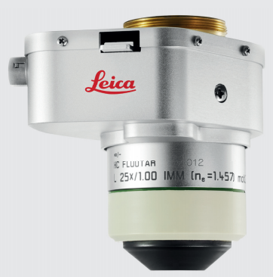
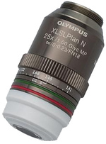
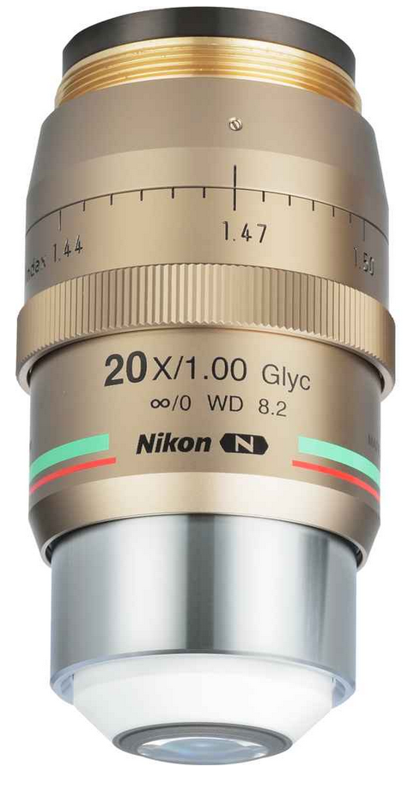
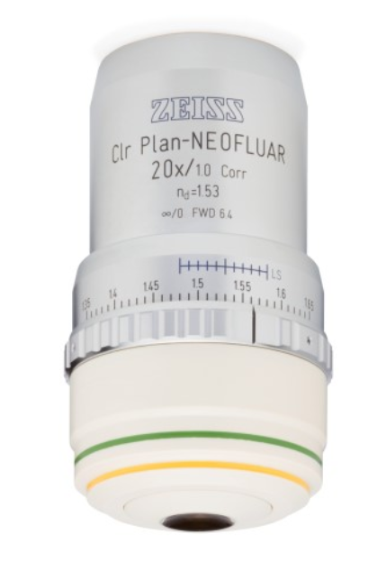
Objectives for high resolution volumetric imaging
$$$

Slide 28
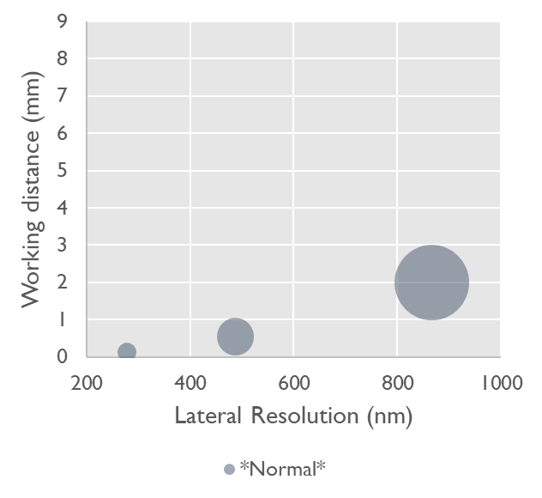
Objectives for high resolution volumetric imaging
FOV
more depth
more detail

Slide 29
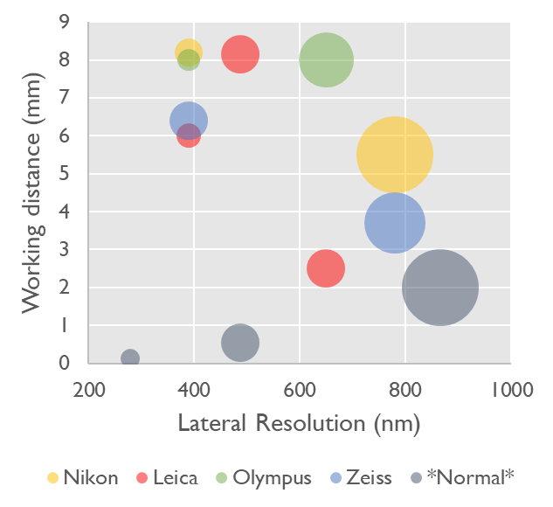
Objectives for high resolution volumetric imaging
FOV
more depth
more detail

Slide 30

Objectives for high resolution volumetric imaging
RI
RI DBE = 1.56
more depth
more detail

Slide 31
Objective details

Slide 32
Implementation challenges
Immersion fluid:
  $$
  corrosion
  evaporation
  RI
Custom sample holders:
  Keep sample still
  Minimize immersion fluid
  Allow space for huge objectives

Slide 33
Problems with laser scanning
Low Speed
High Bleaching

Slide 34
Scanning means imaging in series:
Low Speed
Y
X

Slide 35
Scanning means imaging in series:
Low Speed
Y
X

Slide 36
Illuminating areas outside the focal plane:
High Bleaching
Where we get information
Where we bleach

Slide 37
Illuminating areas outside the focal plane:
High Bleaching
Where we get information
Where we bleach

Slide 38
Illuminating areas outside the focal plane:
High Bleaching
Where we get information
Where we bleach

Slide 39
Problems with laser scanning
Low Speed
High Bleaching
Light-sheet is a great alternative

Slide 40
Features of light-sheet microscopy
Objective
z
x
Sample with fluorophores
Laser sheet
Detection orthogonal to sheet

Slide 41
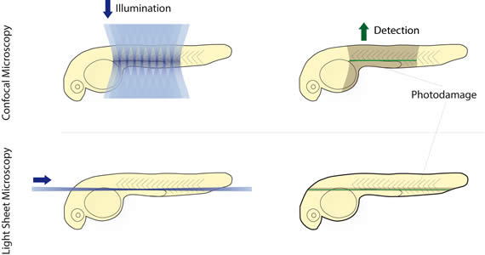
Compared to scanning, light-sheet is
Faster
Less damaging
Modified from Leica Microsystems

Slide 42
Light-sheet bleaching bonus # 1
Photons have more chances to interact with informative fluorophores
Laser scanning confocal
Light-sheet
Focal plane
Excitation
Informative fluorophores

Slide 43
Light-sheet bleaching bonus # 2
Light delivery is gentler
Laser scanning confocal
Light-sheet
Pixels in series:
brief pixel dwell time
high power
Pixels in parallel:
long pixel exposure
low power

Slide 44
Which light-sheet microscope ?
Remember assumptions:
BIG samples: >2mm diameter
DEEP imaging: >2mm deep
Clearing with organic solvents
Turnkey commercial systems

Slide 45
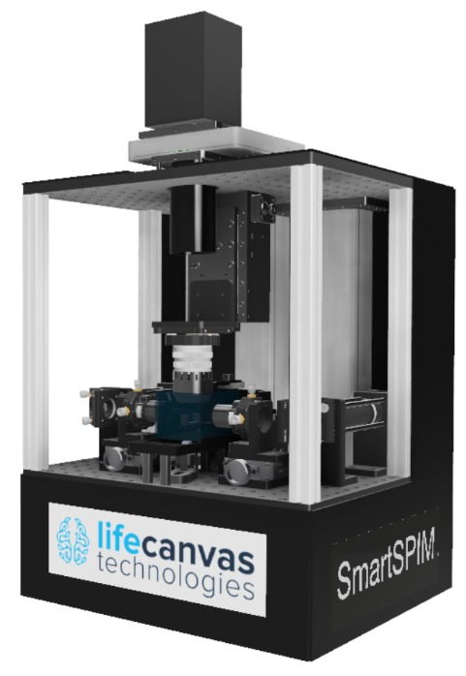
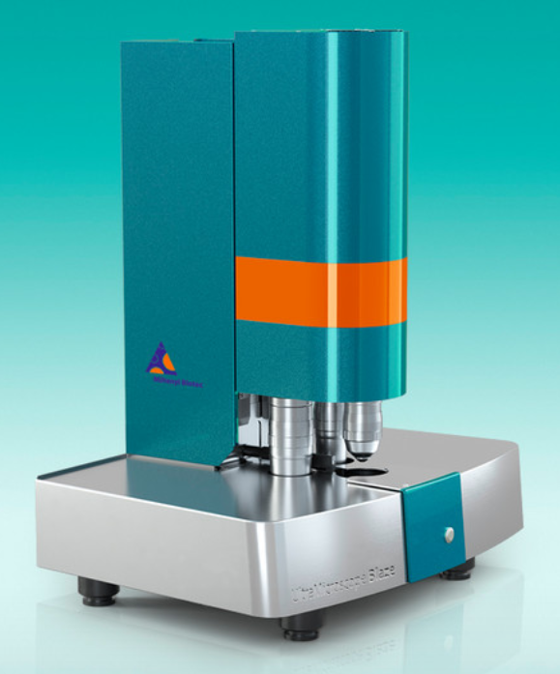
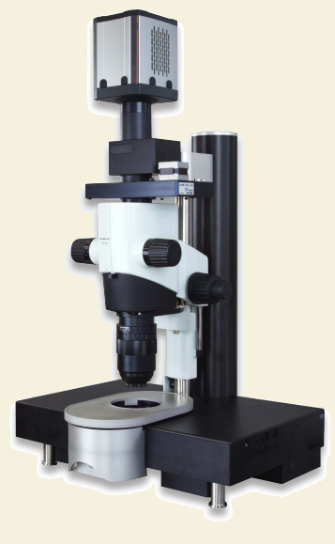
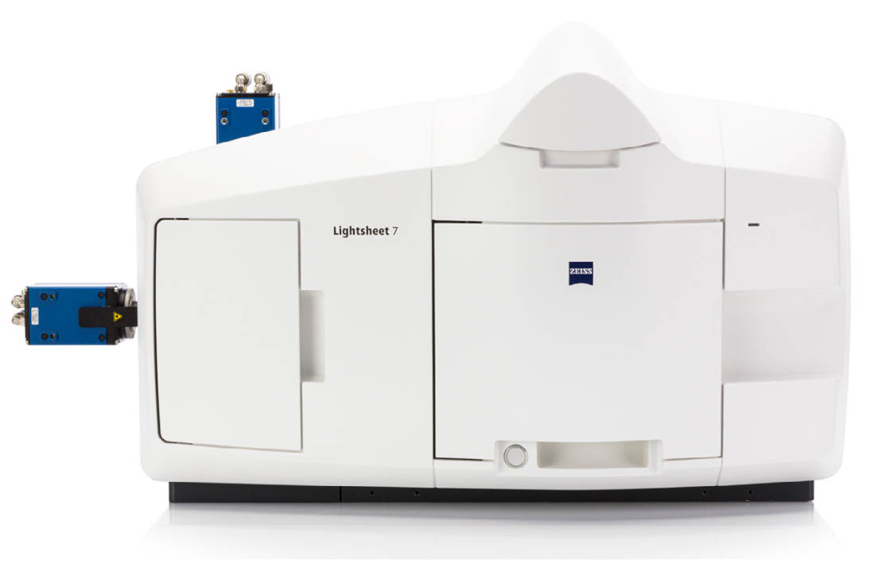
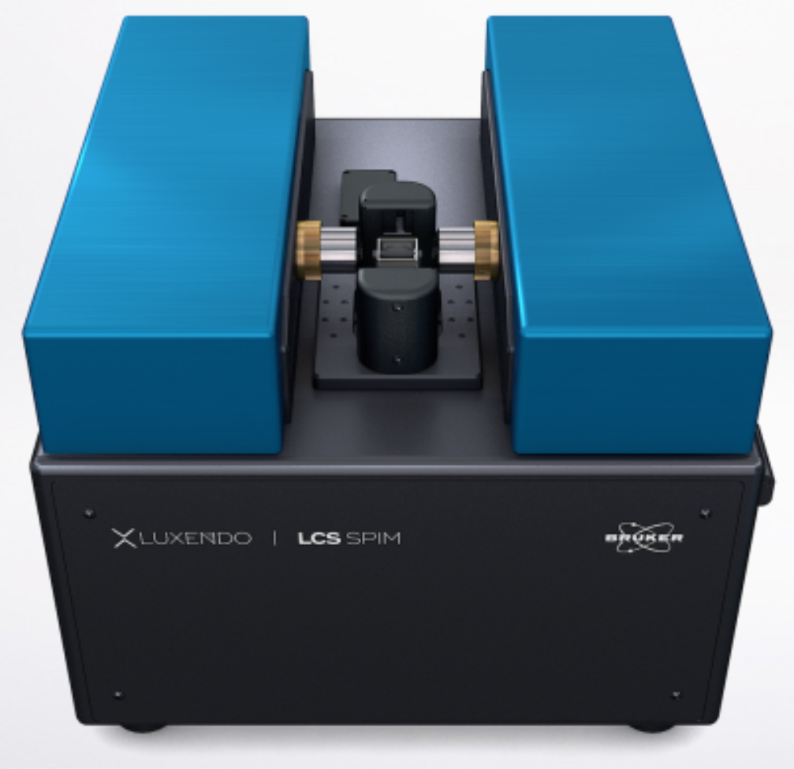
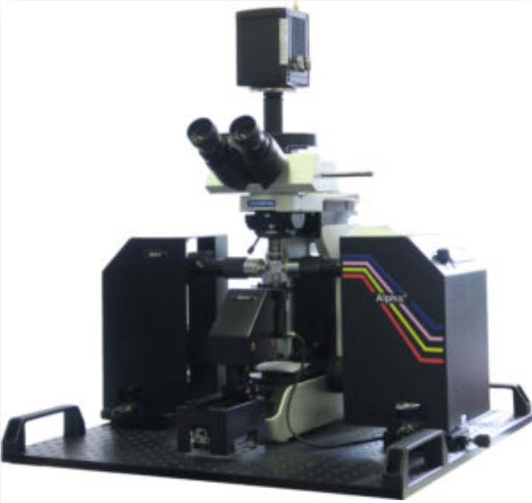
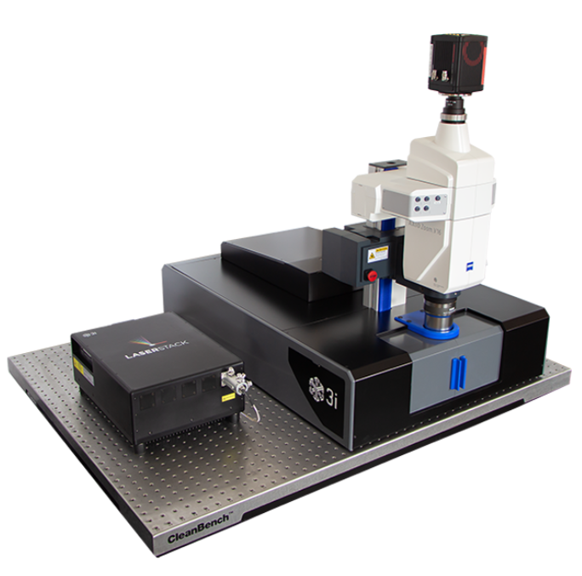
Many commercial options
LaVision/Miltenyi
UltraMicroscope II and Blaze
Zeiss – Lightsheet 7
LifeCanvas Technologies
SmartSPIM
Bruker Luxendo
LCS SPIM
Olympus Phaseview
Alpha3
3i
CTLS

Slide 46
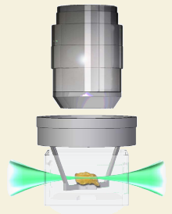
For this course we have an UltraMicroscope II
Objective
Sample
Lavision Biotec
UltraMicroscope II

Slide 47
To optimize, know the key limitation
Sheet shape
Better
Worse

Slide 48
Sheet shape
Major problem in Z
Bigger problem at low mag or uncropped
Low mag FOV
10X higher mag
or
cropped
field of view
z
y
x
x
z

Slide 49
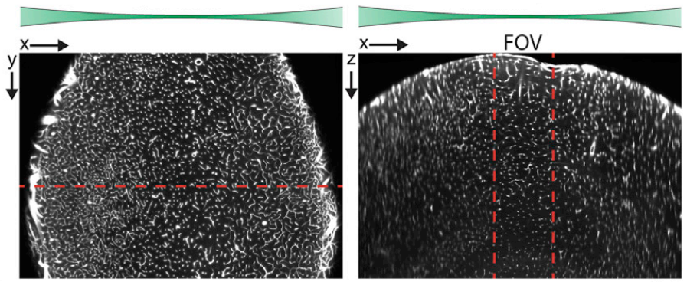
Sheet shape
Example with Brain Vasculature
modified from Kirst…Renier 2020

Slide 50
Sheet shape
Major problem in Z
Bigger problem at low mag or uncropped
Options?
y
x
z

Slide 51
Sheet shape
Major problem in Z
Bigger problem at low mag or uncropped
Trade Z resolution for evenness:
lower sheet NA
y
x
z

Slide 52
Sheet shape
Major problem in Z
Bigger problem at low mag or uncropped
Trade Z resolution for evenness:
lower sheet NA
y
x
z

Slide 53
Sheet shape
Major problem in Z
Bigger problem at low mag or uncropped
Trade time for evenness:
Crop + Tile
y
x
z

Slide 54
Sheet shape
Major problem in Z
Bigger problem at low mag or uncropped
Trade time for evenness:
Crop + Tile
y
x
z

Slide 55
Sheet shape
Major problem in Z
Bigger problem at low mag or uncropped
Trade time for evenness:
Crop + Tile
y
x
z

Slide 56
Sheet shape
Major problem in Z
Bigger problem at low mag or uncropped
Trade time for evenness:
Crop + Tile
y
x
z

Slide 57
Sheet shape
Major problem in Z
Bigger problem at low mag or uncropped
Trade time for evenness:
Crop + Tile
y
x
z

Slide 58
Sheet shape
Major problem in Z
Bigger problem at low mag or uncropped
Trade time for evenness:
Crop + Tile
y
x
z

Slide 59
Sheet shape
Major problem in Z
Bigger problem at low mag or uncropped
Trade time for evenness:
Crop + Tile
y
x
z

Slide 60
Sheet shape
Major problem in Z
Bigger problem at low mag or uncropped
Trade time for evenness:
Crop + Tile
y
x
z

Slide 61
Sheet shape
Major problem in Z
Bigger problem at low mag or uncropped
Trade time for evenness:
Crop + Tile
y
x
z

Slide 62
Sheet shape
Major problem in Z
Bigger problem at low mag or uncropped
Trade time for evenness:
Crop + Tile
y
x
z

Slide 63
Sheet shape
Major problem in Z
Bigger problem at low mag or uncropped
Trade time for evenness:
Crop + Tile
y
x
z

Slide 64
Sheet shape
Major problem in Z
Bigger problem at low mag or uncropped
Trade time for evenness:
Crop + Tile
y
x
z

Slide 65
Sheet shape
Major problem in Z
Bigger problem at low mag or uncropped
Trade time for evenness:
Crop + Tile
y
x
z

Slide 66
Sheet shape
Major problem in Z
Bigger problem at low mag or uncropped
Trade time for evenness:
Crop + Tile
Big stitching challenge
y
x
z

Slide 67
Sheet shape
Major problem in Z
Bigger problem at low mag or uncropped
Trade time for evenness:
Dynamic focus
y
x
z

Slide 68
Sheet shape
Major problem in Z
Bigger problem at low mag or uncropped
Trade time for evenness:
Dynamic focus
y
x
z

Slide 69
Sheet shape
Major problem in Z
Bigger problem at low mag or uncropped
Trade time for evenness:
Dynamic focus
y
x
z

Slide 70
Sheet shape
Major problem in Z
Bigger problem at low mag or uncropped
Trade time for evenness:
Dynamic focus
y
x
z

Slide 71
Sheet shape
Major problem in Z
Bigger problem at low mag or uncropped
Trade time for evenness:
Dynamic focus
y
x
z

Slide 72
Sheet shape
Major problem in Z
Bigger problem at low mag or uncropped
Trade time for evenness:
Dynamic focus
Blending algorithm challenge
y
x
z

Slide 73
Sheet shape
Major problem in Z
Bigger problem at low mag or uncropped
Speed
Trade Z res for evenness:
lower sheet NA
Trade time for evenness:
Crop + Tile
Dynamic focus
Quality

Slide 74
Optimization example

Slide 75
Brain vasculature - high NA
z
y
x

Slide 76
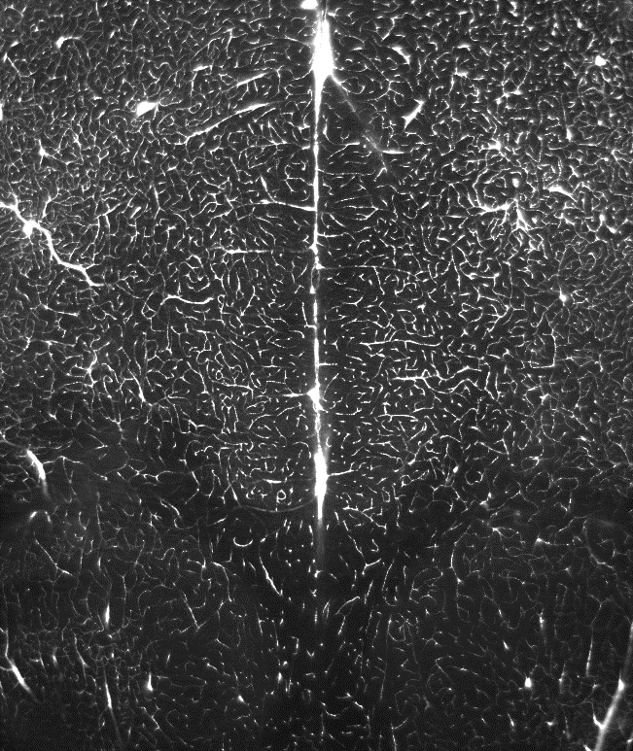
Brain vasculature - high NA
Δt = 1x
z
y
x
z
y
max Y
x
y
x
Sample courtesy of
Nico Renier
z
0.25 mm
x

Slide 77
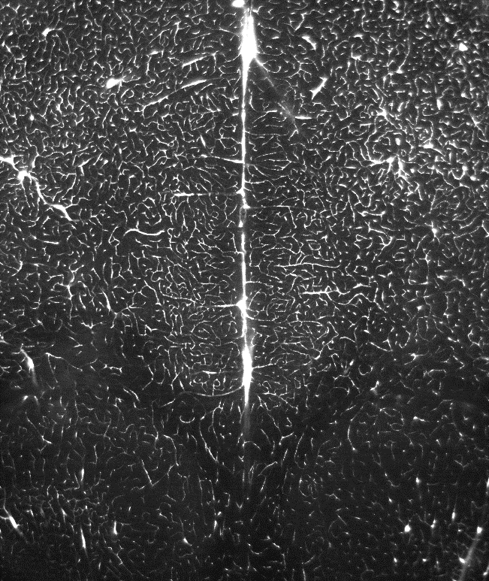
Brain vasculature - low NA
Δt = 1x
z
y
x
z
y
max Y
x
y
x
Sample courtesy of
Nico Renier
z
0.25 mm
x

Slide 78
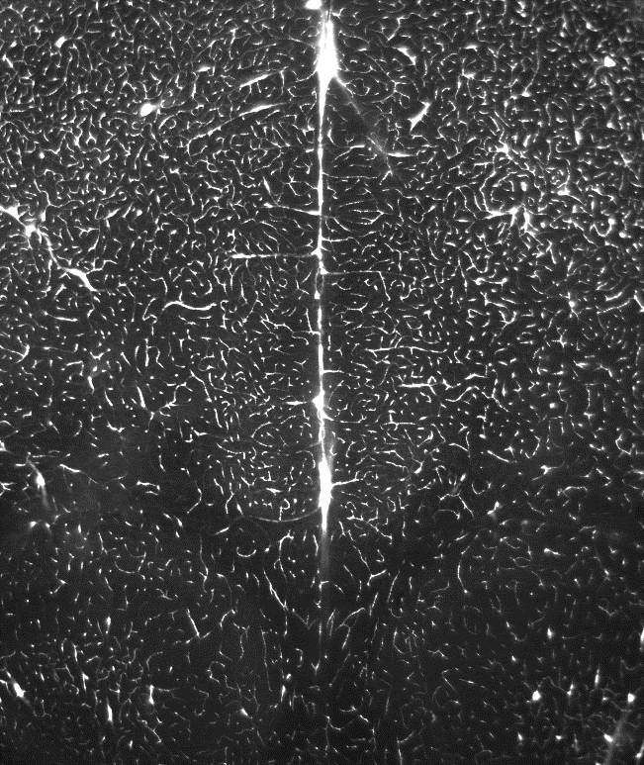
Brain vasculature - high NA, dynamic focus
Δt = 12.8x
z
y
x
z
y
max Y
x
y
x
Sample courtesy of
Nico Renier
z
0.25 mm
x

Slide 79
What if we need
high XYZ resolution
and
a large area ?
We have to tile and stitch images.

Slide 80
Problem
Low quality on stitching edges
Sheet shape
Lens performance worse away from middle
“Radial” aberrations
Notes:
Beware of edges when tiling

Slide 81
Solution
Crop high quality region for good stitching
Sheet shape
“Radial” aberrations
Notes:
Beware of edges when tiling

Slide 82
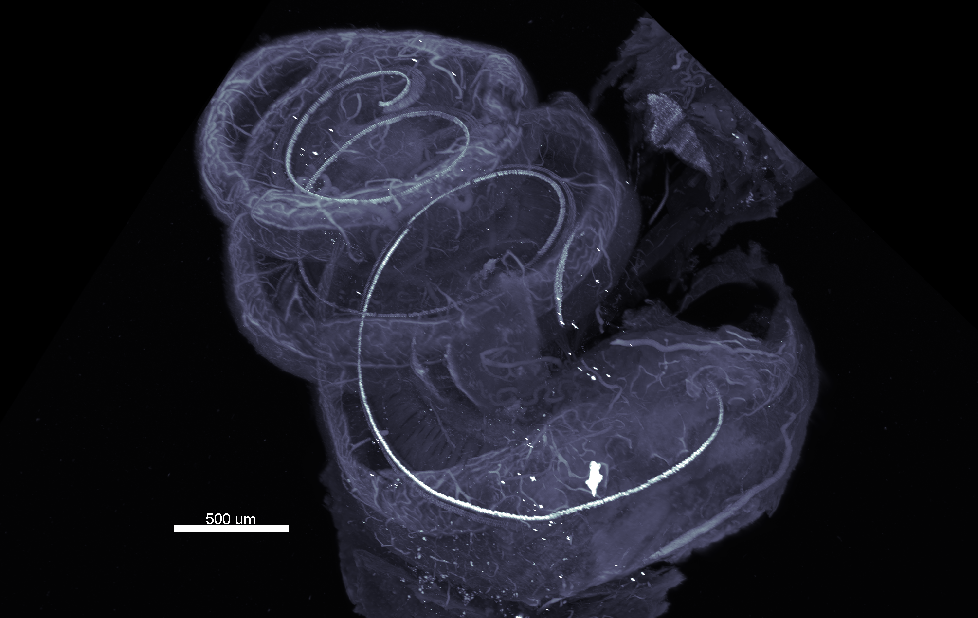
Gerbil cochlea – 12.6X mag, high NA, crop+tile
Sample courtesy of Ken Hutson (Fitzpatrick lab, UNC)

Slide 83
A few final tips and tricks

Slide 84
For your data:
Always look at XZ views with Imaris Viewer
Cannot miss:
Poor clearing
z
Better
x
Worse

Slide 85
For your data:
Always look at XZ views with Imaris Viewer
Cannot miss:
Poor clearing
Poor staining
Specific shell
Not enough Ab
z
x
Non-specific ring
Ab concentration
too high

Slide 86
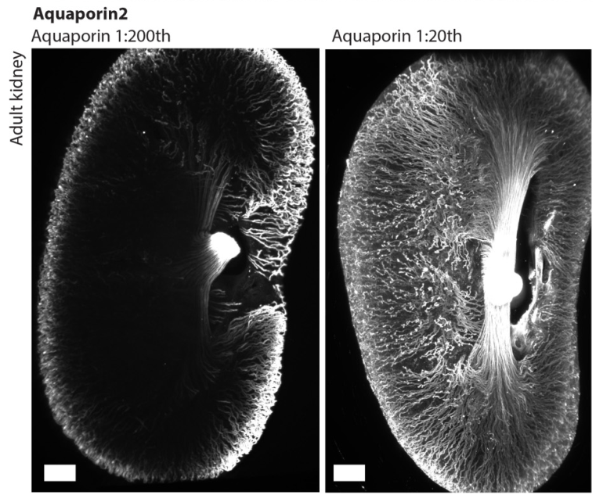
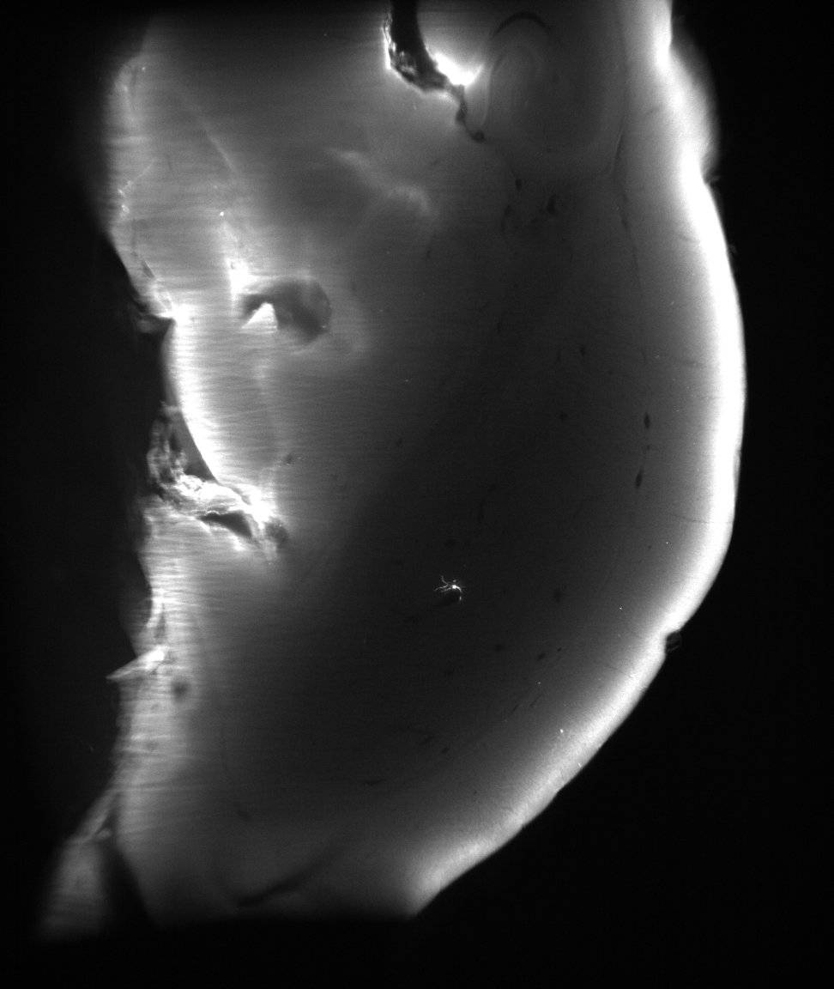
For your data:
Always look at XZ views with Imaris Viewer
Specific shell
Non-specific ring
Ab concentration
too high
Not enough Ab

Slide 87
For your data:
Always look at XZ views with Imaris Viewer
Cannot miss:
Poor clearing
Poor staining
Chromatic aberrations
z
x

Slide 88
For your data:
Always look at XZ views with Imaris Viewer
Cannot miss:
Poor clearing
Poor staining
Chromatic aberrations
For papers:
Be suspicious if there are no XZ views
Easy to hide issues in 3D views and animations

Slide 89
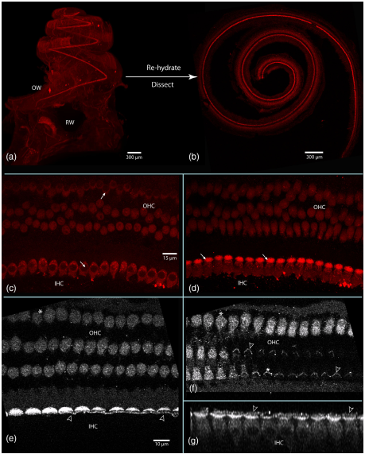
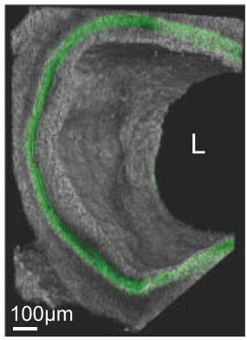
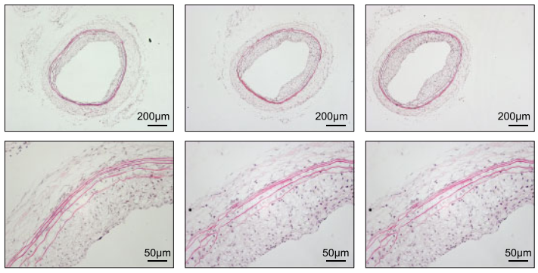
Rehydrate the sample after light-sheet for
Higher res confocal
H&E pathology
Gerbil cochlea
Rat carotid artery
Hutson et al, J Comp Neurol 2020
Buglak et al, J Cardiovasc Res 2021

Slide 90

Move big datasets with sneakernet
Lab
500Mb/s:
10Gb Ethernet
SATA
“Network”
Hot swap SSD
5.6TB/s/m
(4TB SSD, 1.4m/s human)
50-100 Mb/s:
1Gb Ethernet
USB3
Hot swap SSD
Everywhere else
Scope
Acquisition PC
Workstation PC
Fastest
Cheap(ish)
Low-tech
Hot swap SSD
Hot swap SSD
Datasets:
10-1000 GB
Hot swap SSD
Where you image and analyze
Notes:
At 5km/hour, 1.4m/s. Assuming current consumer level max SSDs are 4TB, transporting 4TB over 14m takes 10s: 400Gb/s, or 4GB/s/m. Over 140m, it is 40Gb.s. Speed is same as SATA or 10Gb Ethernet if lab is 11.2km away (2 hours, 15 minute walk), assuming no motorized transport.
White paper available.

Slide 91
Take home
Focus on what you need to answer your biological question
“Quality”
XYZ resolution
Evenness of Z resolution
Signal-to-noise
Nothing in microscopy
is free
Volume
Imaging time
Bleaching
Dataset size

Slide 92
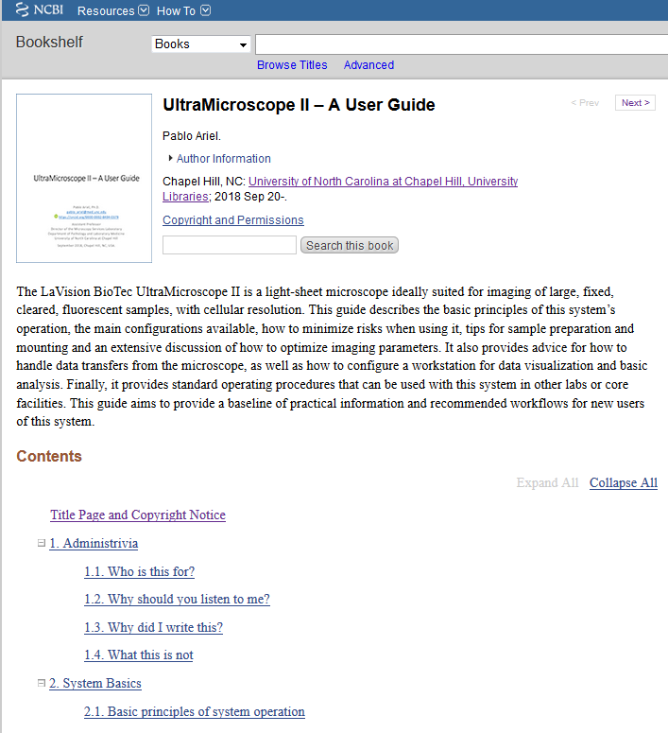
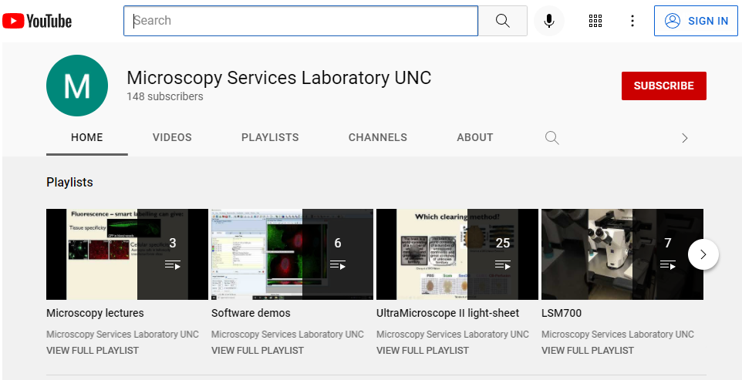
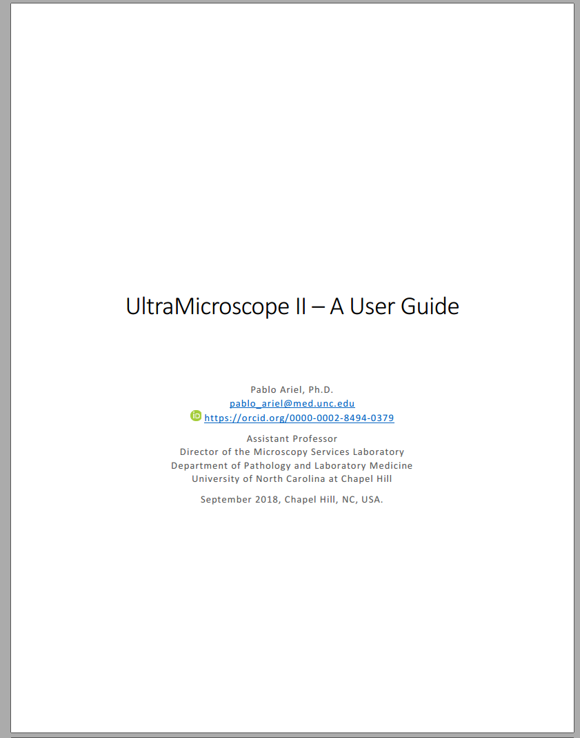
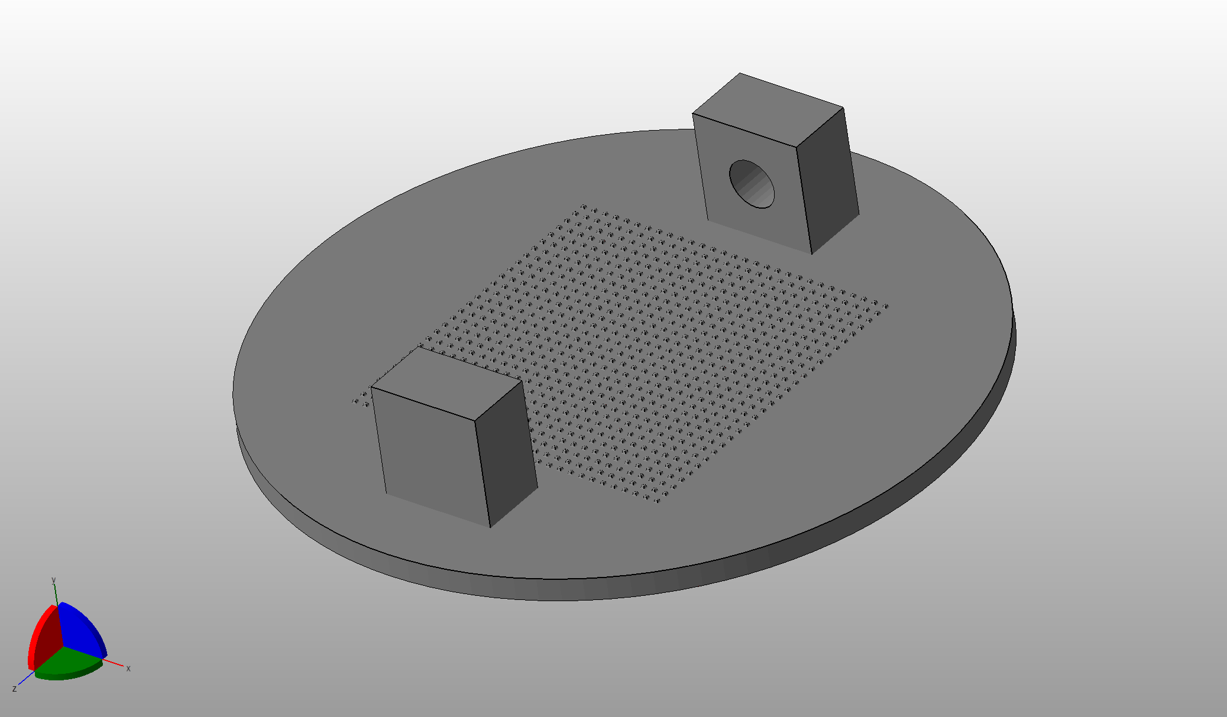
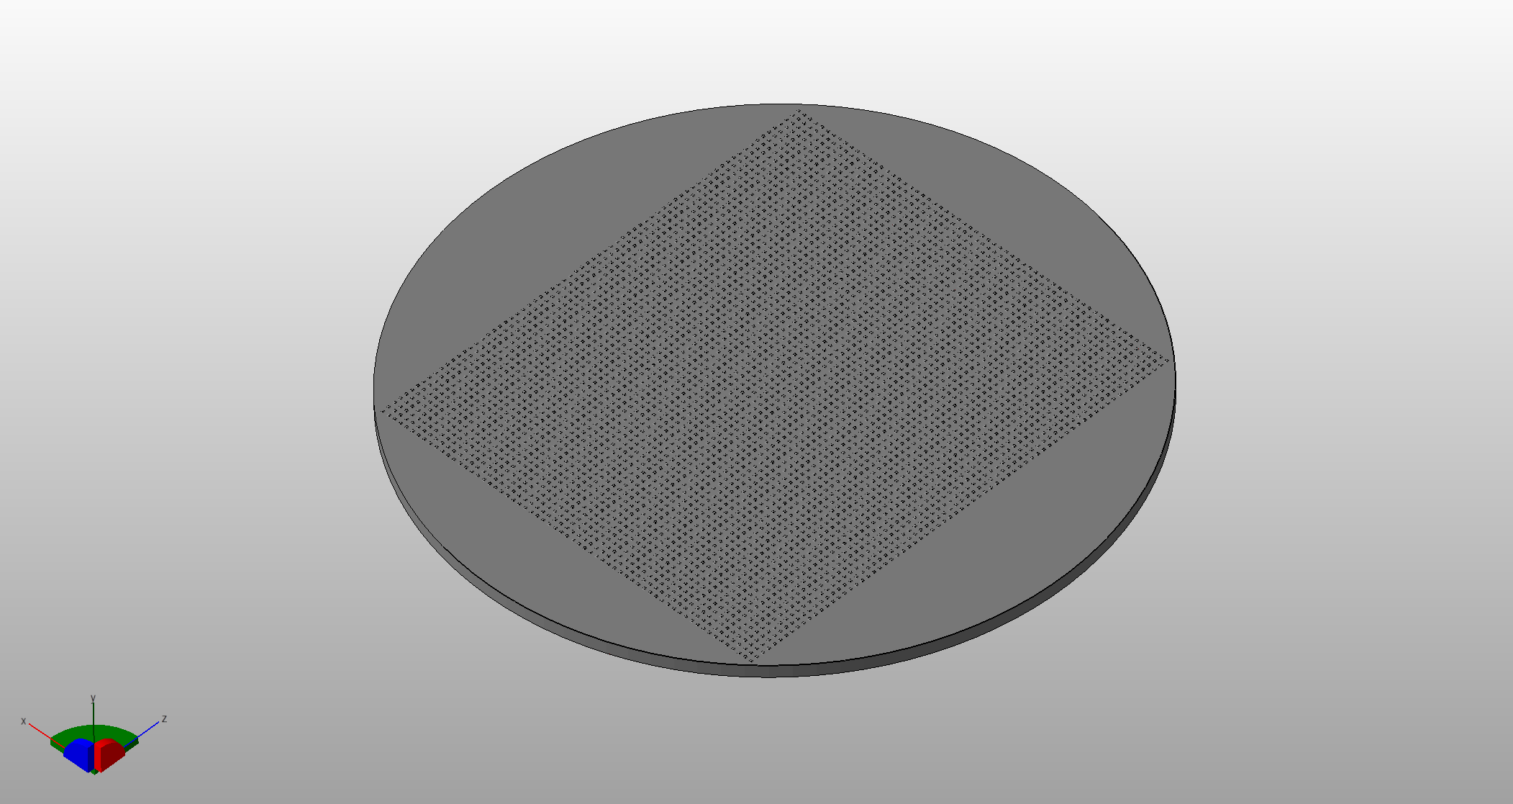
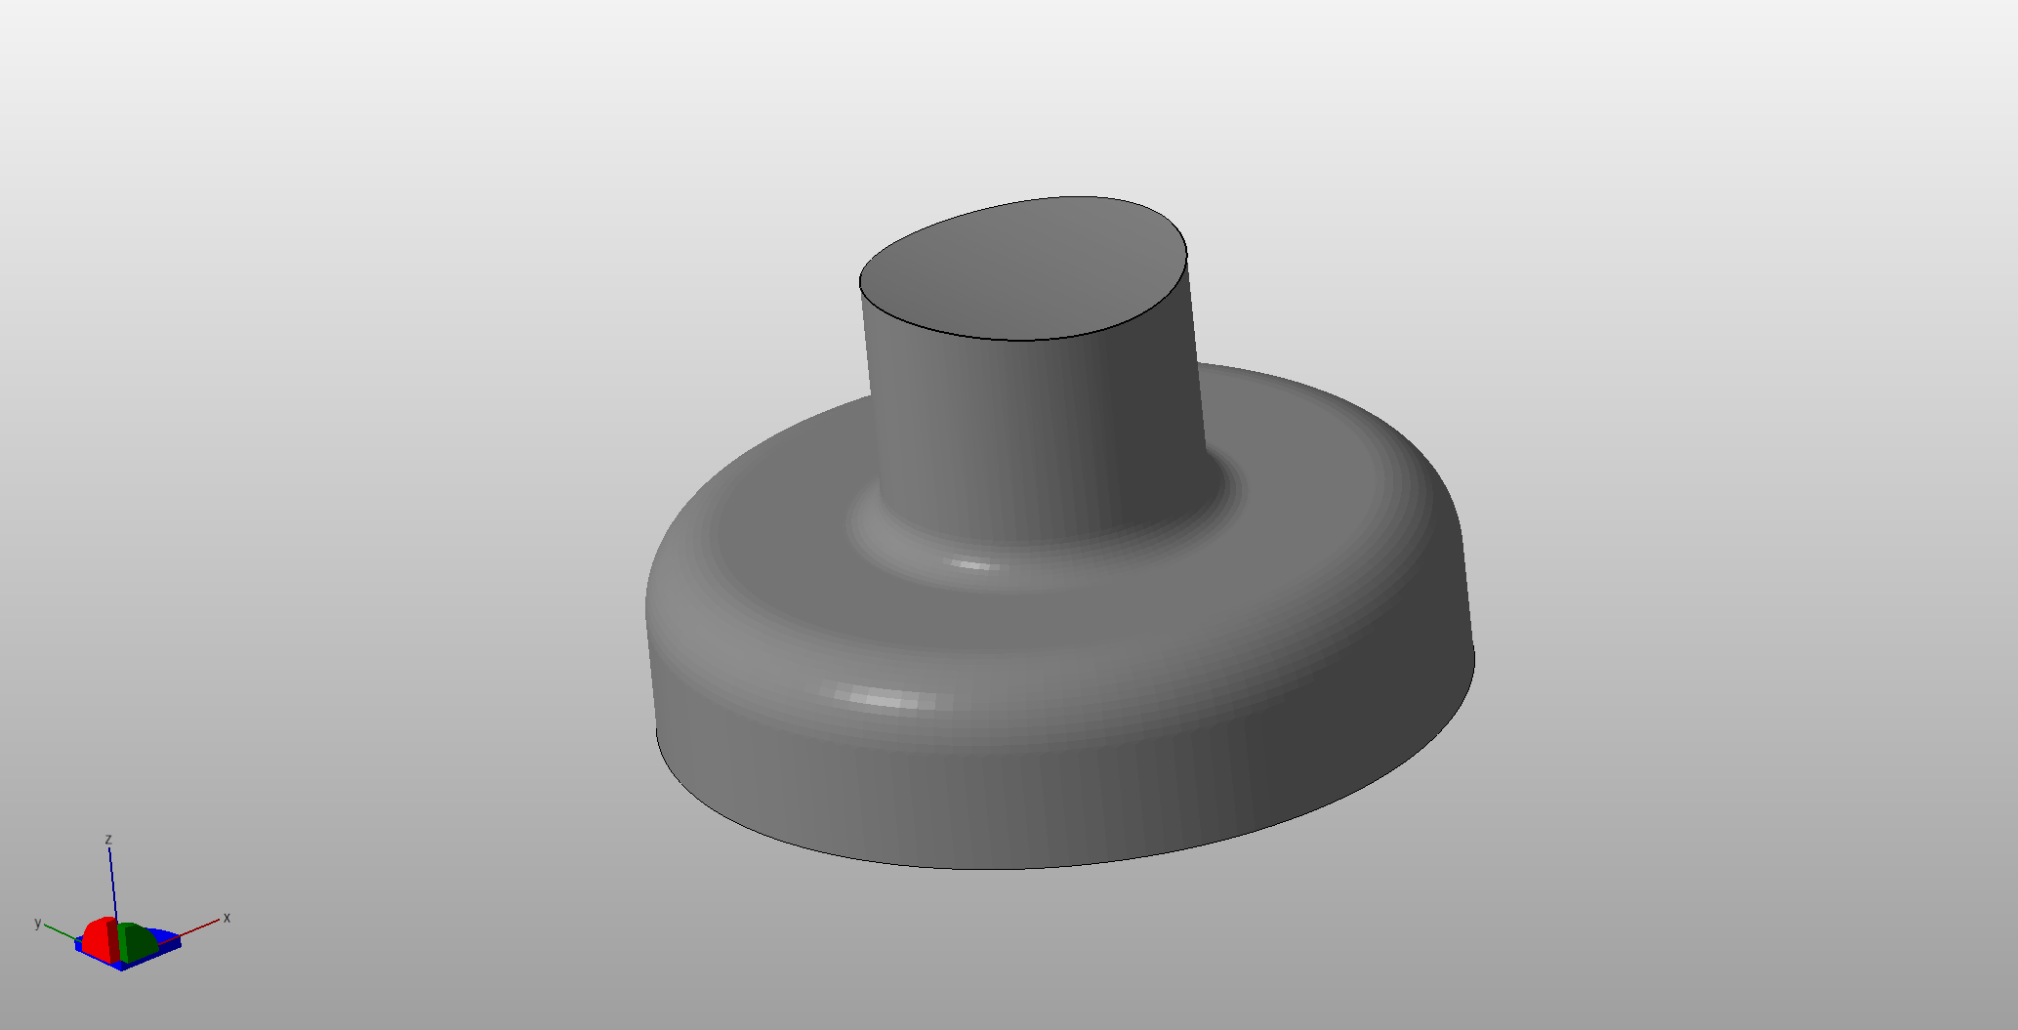
If you want more information
HTML and PDF user guides
Video tutorials: microscope use and maintenance
Video lectures
3D files for sample holders

Slide 94
Take home
Focus on what you need to answer your biological question
“Quality”
XYZ resolution
Evenness of Z resolution
Signal-to-noise
Volume
Imaging time
Bleaching
Dataset size

