Slide 1

Thyroid Disease
Mini Medical School
Loren Oh
February 23, 2021

Slide 2
Learning Objectives
To be familiar with the function of the thyroid and thyroid hormones
To understand what occurs in thyroid disease, specifically hypothyroidism and hyperthyroidism
To recognize the signs and symptoms of thyroid disease
To be familiar with the doctor’

Slide 3
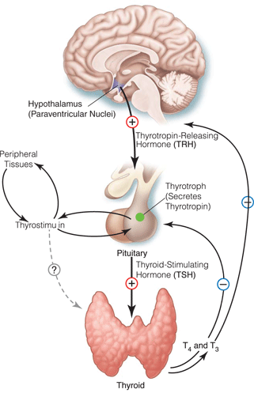
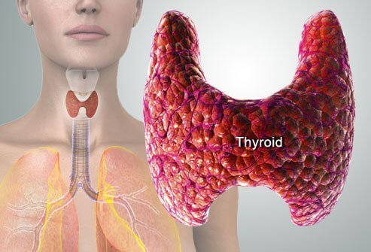
The Thyroid
https://www.medicinenet.com/thyroid_disorders/article.htm
Notes:
Thyroid is a gland, meaning that it secretes hormones into our bloodstream to act in other parts of our body.
Located in the front of our neck and wraps around the trachea/windpipe
Has two lobes with a middle known as the isthmus
Part of a larger pathway regulated by the brain (hypothalamus) that acts on the pituitary gland that stimulates the thyroid to secrete hormones

Slide 4
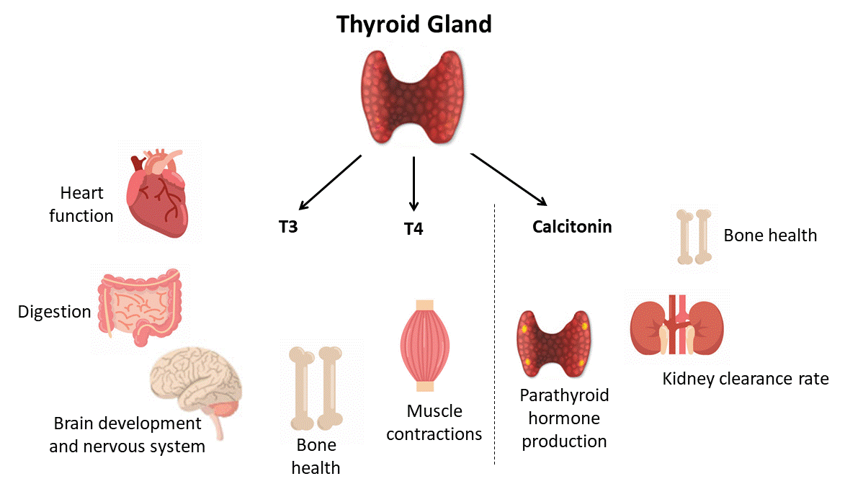

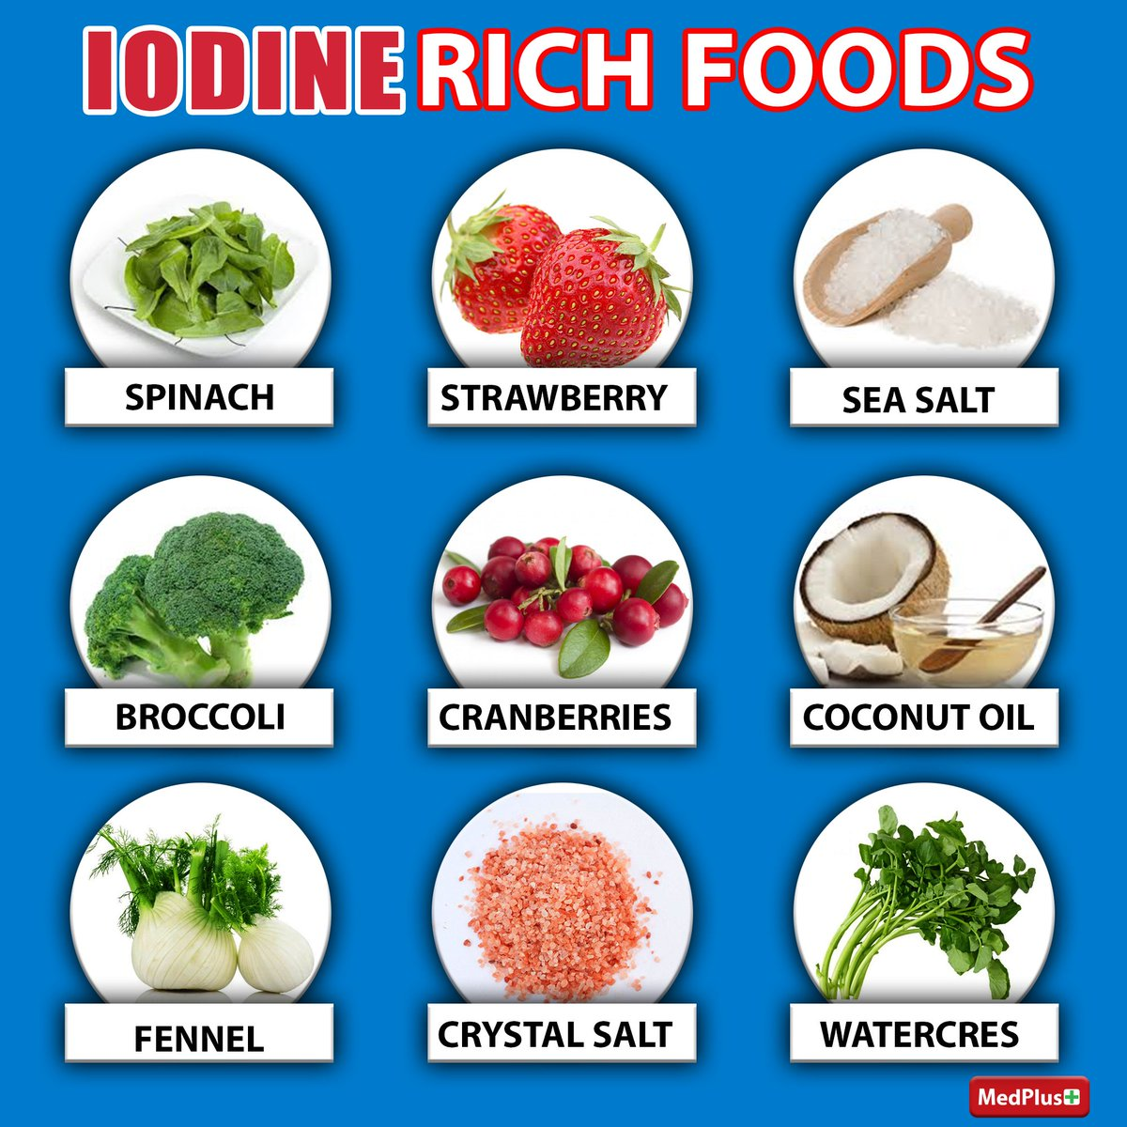
Thyroid Hormones
Notes:
Produces T3 and T4 hormones – which are considered active hormones in the bloodstream
You can think of the function of these hormones as the 7Bs
Brain maturation
Bone growth
Blood pressure & heartBeat
Basal metabolic rate
Blood sugar (to increase via making glucose from storage and making new glucose)
Break down lipids (fats)
Babies: Helps create surfactant synthesis (coating of the lungs to make breathing easier)

Slide 5
Thyroid Disease
Many different reasons for thyroid disease
  Brain disease that affects the hypothalamus
  Pituitary gland dysfunction
Typically, can present because too little thyroid hormones or too much thyroid hormones
  Hypothyroidism: Too little thyroid hormones
  Hyperthyroidism: Too much thyroid hormones

Slide 6
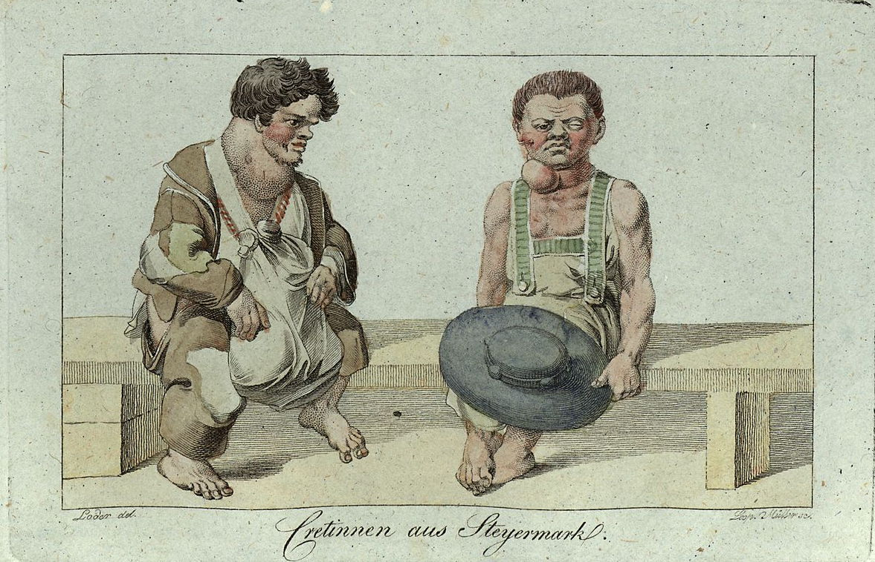
Congenital
Hypothyroidism
Notes:
Can results for many reasons:
Mother doesn’t make enough thyroid hormone for baby’s bloodstream
Iodine deficiency, so hormones are not made (congenital iodine deficiency syndrome)
Lack of a thyroid
Signs & symptoms include:
Stunted growth
Presence of a goiter (enlarged thyroid)
Lack of weight gain
Mental/intellectual disability
General puffy/swollen appearance
Screening in newborns for hypothyroidism

Slide 7
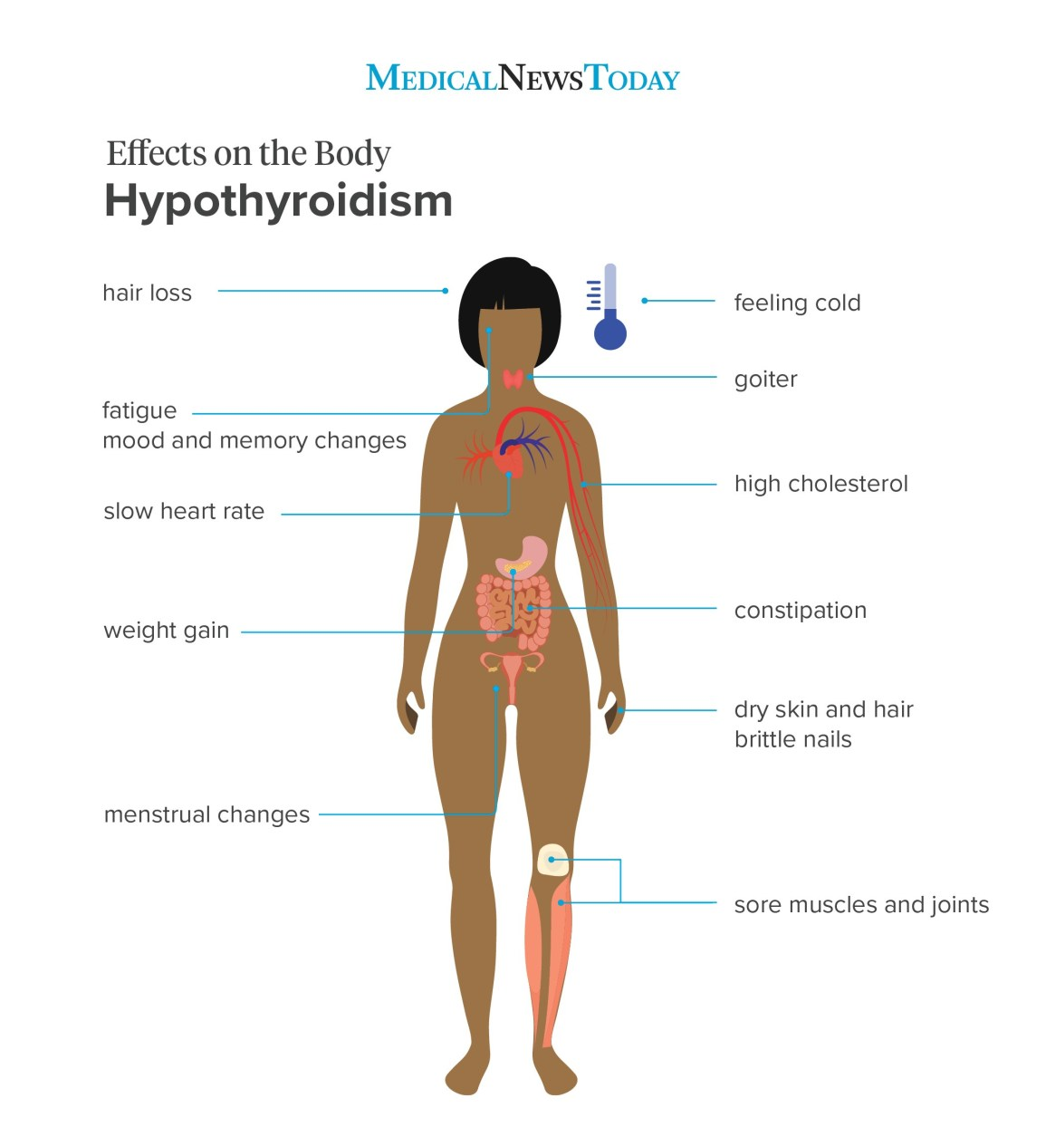
Hypothyroidism
Notes:
Can acquire hypothryoidism in later points in life
Can results for many reasons:
Most common being Hashimoto thyroiditis, autoimmune disorder
Iodine deficiency
Inflammation of the thyroid (pregnancy, flu-like illness)
Signs & symptoms include:
Fatigue
Hair loss
Cold intolerance (feeling cold)
Constipation
Weight gain
Hyporeflexia
Low sodium levels
High levels of cholesterol

Slide 8
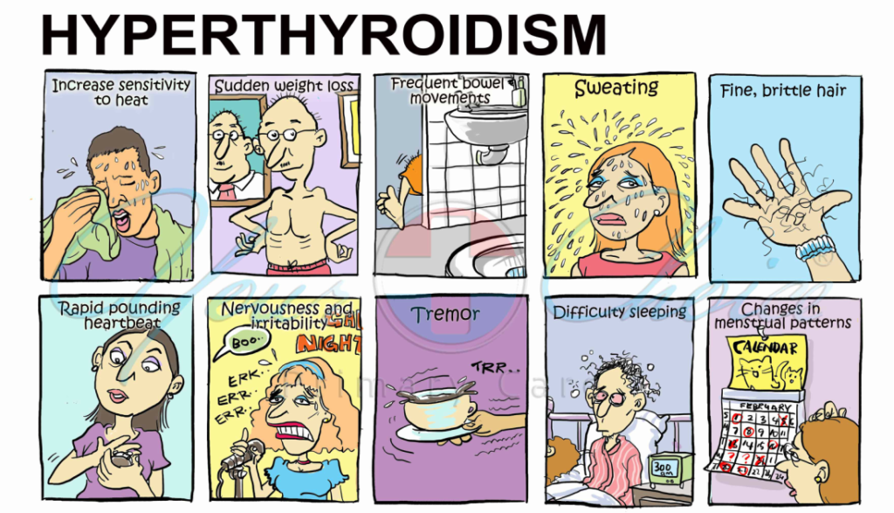
Notes:
Can acquire hyperthyroidism later in life
Can results for many reasons:
Most common being a disease called Grave Diseases that leads to hyperactivation of the thyroid
Taking too much thyroid hormone
Signs & symptoms include:
Heat intolerance
Weight loss
Diarrhea
Sweating
Palpitations (rapid heartbeats)

Slide 9
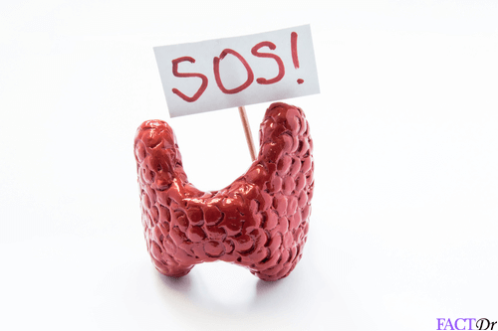
Thyroid Storm
Rare, severe complication of (untreated) hyperthyroidism, worsened in setting of any stress (infection, surgery)
Symptoms:
  Agitation
  Delirium
  Fever
  Tachyarrhythmias
Notes:
Tachyarrhythmias: Rapid heartbeats that mess with the rhythm of the heart

Slide 10
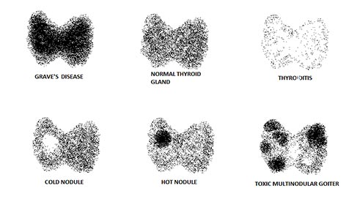
Doctor’s Toolkit for Thyroid Disease
TSH: Thyroid stimulating hormone
T3, T4: Thyroid hormones
RAIU: Radioactive iodine uptake test
Thyroid scan

