Slide 1


Stroke
Ana C. G. Felix, MBBCh, FAAN
Department of Internal Medicine
Department of Neurology
UNC Chapel Hill

Slide 2
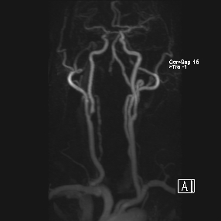
Ana C. G. Felix, MBBCh, FAAN
Department of Internal Medicine
Department of Neurology
UNC Chapel Hill

Slide 3
Learning Objectives
At the end of this session, you should be able to answer the following questions:
What is a Stroke?
What is different about stroke in North Carolina?
How do I know if someone may be having a stroke?
Which common drug(s) are used to treat and/or prevent stroke?
What are 5 things I can do today to lower my risk for stroke?

Slide 4
Please make a note of questions in the chat- we will try to answer them!

Slide 5


Stroke….

Slide 6
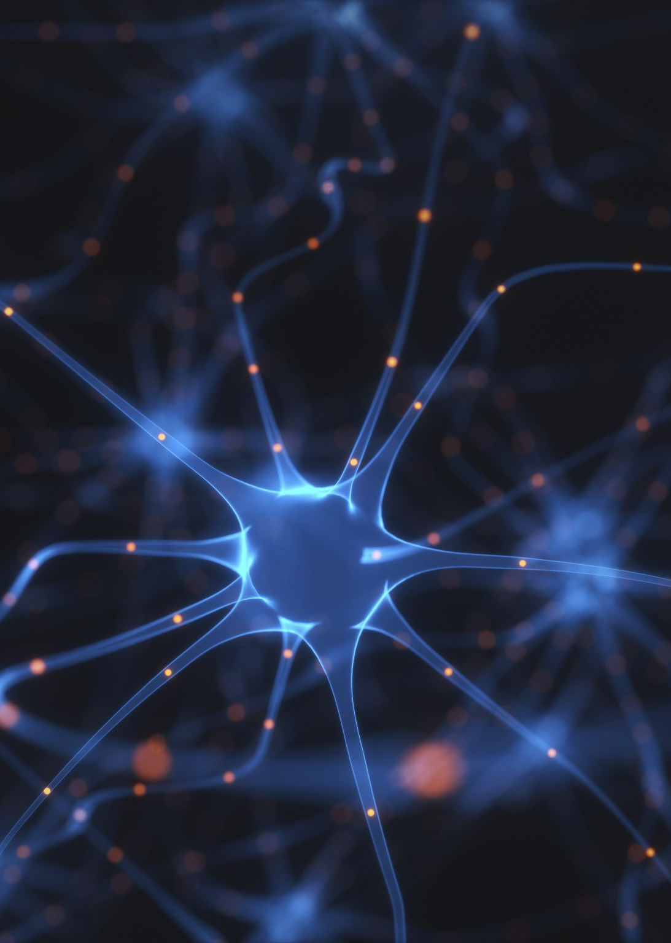
What is a stroke?

Slide 7
What is a Stroke?
Stroke is a loss of blood flow to the brain
Stroke = a Plumbing problem
  Blockage (“ischemic”)
  Blood vessel rupture (“hemorrhagic”)
Leads to symptoms in that part of the brain
  Different parts of the brain control different activities
  Not all stroke survivors will have the same symptoms

Slide 8
Stroke
Stroke is a
  SUDDEN ONSET
  focal neurological deficit*
  of (presumed) VASCULAR ORIGIN
  * EXCEPTION: Subarachnoid hemorrhage often does not produce a focal deficit. SAH is thought of a “special type” of stroke syndrome with unique pathological and clinical features.

Slide 9

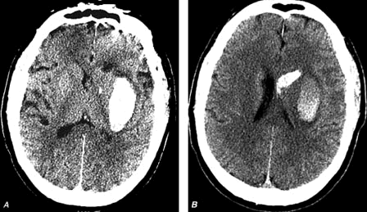
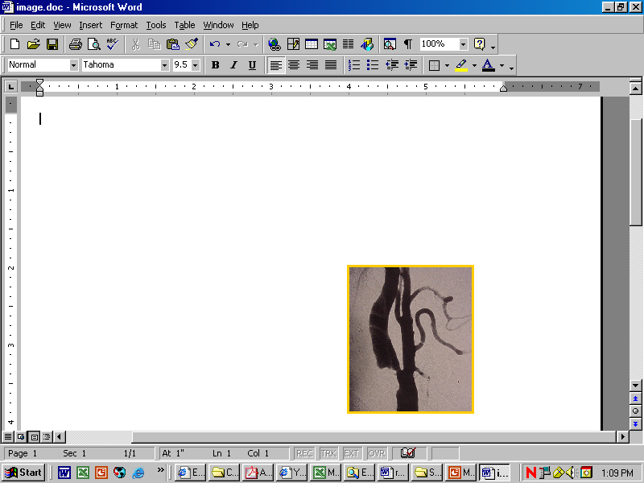
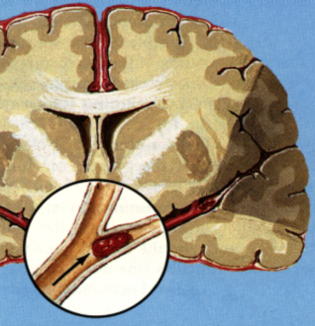
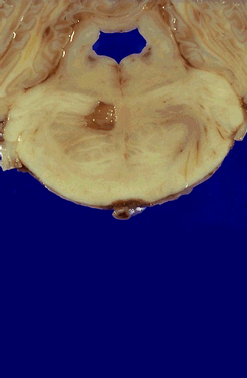
Types of Stroke
Ischemic Stroke (85%)
Hemorrhagic Stroke (15%)
Atherothrombotic
Cerebrovascular
Disease (20%)
Cardioembolic (20%)
Intracerebral Hemorrhage (70%)
Subarachnoid Hemorrhage (30%)
Lacunar (25%)
(small vessel)
Cryptogenic (30%)
Other (5%)
Albers GW et al. Chest. 1998;119:683S-698S.
Albers GW Personal communication. February 27, 2003.
Rosamond WD et al. Stroke. 1999;30:736-743.
Notes:
References:
1. American Stroke Association. Impact of Stroke. Available at: www.strokeassociation.org. Accessed June 21, 2002.
2. Albers GW, Easton JD, Sacco RL, Teal P. Antithrombotic and thrombolytic therapy for ischemic stroke. Chest. 1998;119(suppl):683S-698S.
Additional Reference:
Rosamond WD, Folsom AR, Chambless LE, et al. Stroke incidence and survival among middle-aged adults: 9-year follow-up at the Atherosclerosis Risk in Communities (ARIC) cohort. Stroke. 1999;30:736-743.

Slide 10

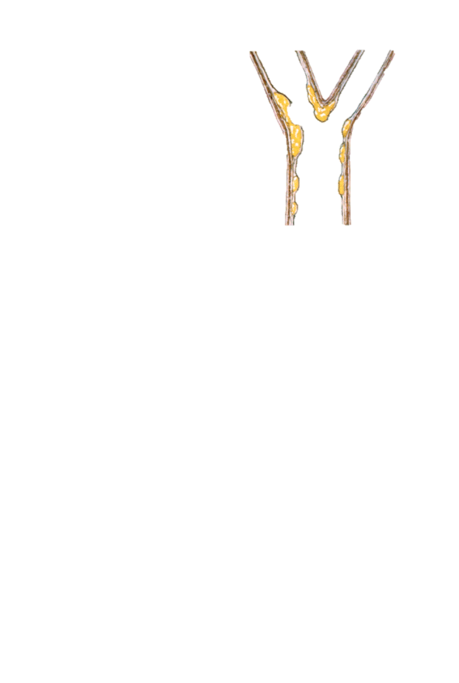
Mechanisms of Cerebral Ischemia: Atherosclerosis
Embolic
Hemodynamic

Slide 11
Clots (emboli) typically come from the heart….
Likely
  Atrial Fibrillation
  Prosthetic valves
  Acute Myocardial Infarction (“heart attack”)
  Cardiomyopathy
  Endocarditis (infection of heart valves)
  Ventricular aneurysm
Less Likely
  Intracardiac tumors
  Patent Foramen Ovale

Slide 12
Some Other Causes of Ischemic Strokes
Dissection (wall vessel tears)
Oral Contraceptives
Migraine
Sickle cell disease
Cocaine (and similar compounds)
Arteritis (inflammation of blood vessels)
Venous sinus thrombosis
Reversible vasoconstrictive syndrome
CADASIL (Cerebral Autosomal Dominant Ateriopathy with Subcortical Infarcts and Leucoencephalopathy)

Slide 13
What is a mini-stroke?

Slide 14
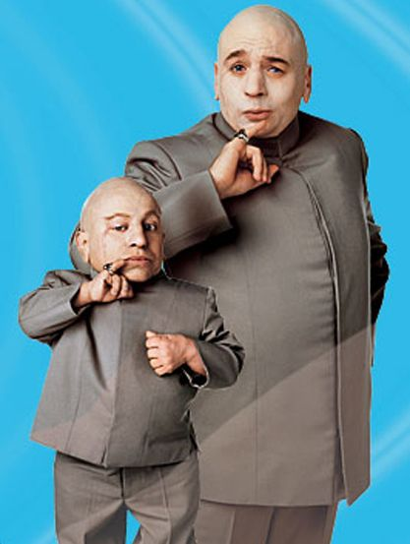
What is a mini-stroke?
Mini-stroke = TIA (Transient Ischemic Attack)
Neither stroke nor TIA are very useful terms in the current way we think about treatment
Difference is TIME

Slide 15
Transient Ischemic Attack
TIA is a
  Transient episode
  neurological dysfunction
  resulting from focal brain, spinal cord, or retinal ischemia,
  not associated with infarction* (if there IS infarction, then it is referred to as a “stroke”)
  Typically brief lasting 10 mins - 4 hours
  *if there IS infarction, then it is referred to as a “stroke” . 30% - 50% of classically defined TIAs (< 24 hours) show brain injury on diffusion-weighted MRI (DWI).
Notes:
(1) Approximately 25% of persons who have had a major stroke report a history of warning symptoms (TIA or minor stroke). Early identification of such persons is extremely important because of the availability of medical and surgical treatment of proven efficacy.
(2) A TIA identifies a patient at substantial risk of stroke, providing a warning that allows the physician to intervene before stroke occurs.
(3) A TIA is a transient episode of focal neurological or retinal dysfunction secondary to impaired blood supply to that region. While events that last as long as 24 hours are included in diagnosis of TIA, most lasts less than 1 hour. A TIA is a warning symptom of stroke, but it is also part of the continuum of ischemic disease. It should not be considered different from a stroke. Much of the evaluation and treatment of persons with TIA is similar to that recommended for persons with stroke.

Slide 16

Less than 4 hours = TIA
More than 4 hours = stroke
  Cell death on MRI scan
  Permanent symptoms

Slide 17
TIA patients are at high risk for stroke
Between 10-15% of patients with TIA, will have a stroke within 3 months
  50% occur within first 48 hours !
  7-day risk of a completed stroke among patients with TIA is 5%.
Highest risk in patients with:
  Symptoms for > 10 minutes
  Aphasia Symptoms
  Age > 60 years
  Co-morbid Diabetes Mellitus
  Weakness as one of the symptoms
  This can be calculated as the ABCD2 score

Slide 18

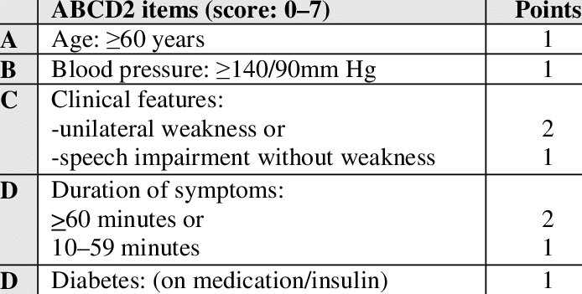

Slide 19
What about NC and stroke?

Slide 20
Stroke Statistics
Epidemiology
Every 40 seconds someone has a stroke in the US
Someone dies from stroke every 4 minutes in the US
Leading cause of disability in the US
  ~ 795,000 events every year
  25% are recurrent strokes
Stroke is the 5th leading cause of death in for Americans
Economic cost for stroke-related medical costs and disability
  $46 billion/year in the US

Slide 21
Stroke Statistics
Important disparities
Stroke death rates have declined for decades among all race/ethnicities
  Risk of having a first stroke is nearly twice as high for blacks as for whites
  Blacks have the highest rate of death due to stroke
  Hispanics have seen an increase in death rates since 2013
Stroke risk increases with age
  In 2009, 34% of people hospitalized for stroke were less than 65 years old
Notes:
https://www.cdc.gov/stroke/facts.htm

Slide 22
Stroke Hospitalization Rates

Slide 23
Stroke Mortality Rates

Slide 24
What are stroke symptoms?

Slide 25
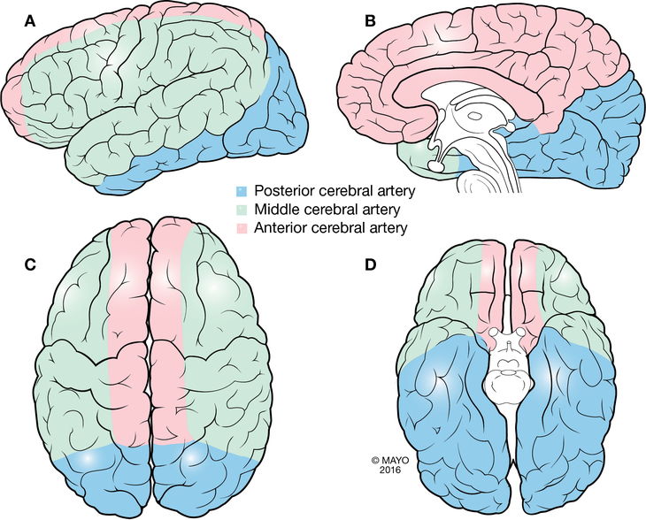
Figure 13.5 Distributions of the Anterior, Middle, and Posterior Cerebral Arteries. Lateral (A), medial (B), superior (C), and inferior (D) views are shown.
Chapter: Vascular System Author(s): Eduardo E. Benarroch, Jeremy K. Cutsforth-Gregory, and Kelly D. Flemming From: Mayo Clinic Medical Neurosciences: Organized by Neurologic System and Level
Downloaded from Oxford Medicine Online. © Oxford University Press

Slide 26
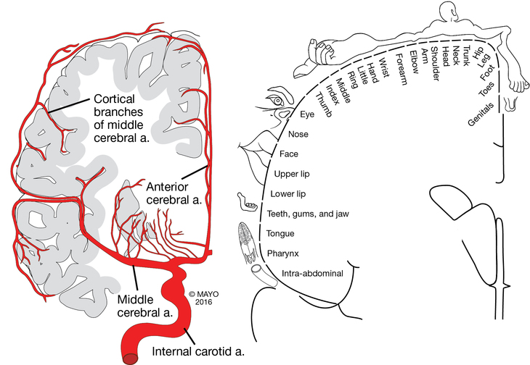
Blood Supply has redundancy!

Slide 27
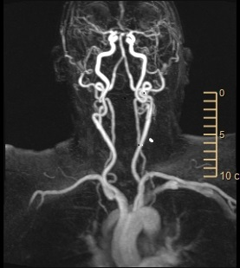

Slide 28
Symptoms of Carotid Ischemia
VISION:
  Transient Monocular Blindness
  = Carotid disease
  Ipsilateral
  Monocular graying, clouding, blurring/loss of vision
MOTOR:
  Contralateral weakness, clumsiness, or numbness of the hand, arm and face
Language disturbances (if dominant hemisphere)
Visual and neurological symptoms do not typically occur simultaneously
Notes:
Benarroch, E., Cutsforth-Gregory, J., Flemming, K., Benarroch, E., Cutsforth-Gregory, J., & Flemming, K. (2017-11). Vascular System. In Mayo Clinic Medical Neurosciences: Organized by Neurologic System and Level. Oxford, UK: Oxford University Press. Retrieved 25 Aug. 2019, from https://oxfordmedicine-com.libproxy.lib.unc.edu/view/10.1093/med/9780190209407.001.0001/med-9780190209407-chapter-13
(1) Symptoms of TIA depend on the vascular territory involved. The symptoms of TIA carotid circulation are: ipsilateral monocular graying, clouding, blurring, or loss of vision
(2) Contralateral weakness, clumsiness, or numbness of the hand, arm and face
(3) Language or articulatory disturbances
(4) Visual and neurological symptoms that do not usually occur simultaneously.
When the carotid artery territory is involved, the symptoms reflect ischemia to the ipsilateral eye or brain.

Slide 29
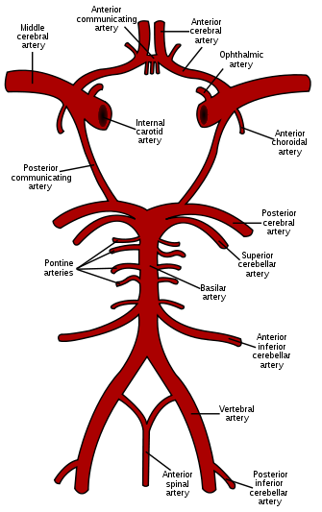
Symptoms of Vertebrobasilar Ischemia
VISION:
  Diplopia (Double vision)
  Binocular graying, clouding, blurring, loss of vision
MOTOR:
  Unilateral or bilateral weakness, clumsiness, or numbness in limbs
CR NN:
  Dysphagia (swallowing)
  Dysarthria (articulation)
BALANCE:
  Vertigo
  Lack of coordination or staggering
    “look drunk”
Notes:
(1) In the vertebrobasilar territory, symptoms include double vision, binocular graying, clouding, blurring or loss of vision.
(2) vertigo
(3) unilateral or bilateral weakness, clumsiness, or numbness in limbs. In addition, motor or sensory symptoms may alternate, switching sides in recurrent attacks.
(4) There may be articulatory or swallowing disturbances and
(5) a lack of coordination or staggered walking.
Occasionally, isolated vertigo, double vision, trouble swallowing, ataxia, or trouble talking are due to vertebrobasilar TIA, but this is rare.
Image: http://www.thefullwiki.org/Circle_of_Willis

Slide 30
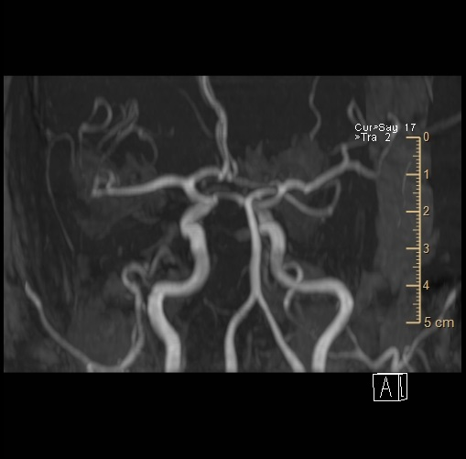

Slide 31
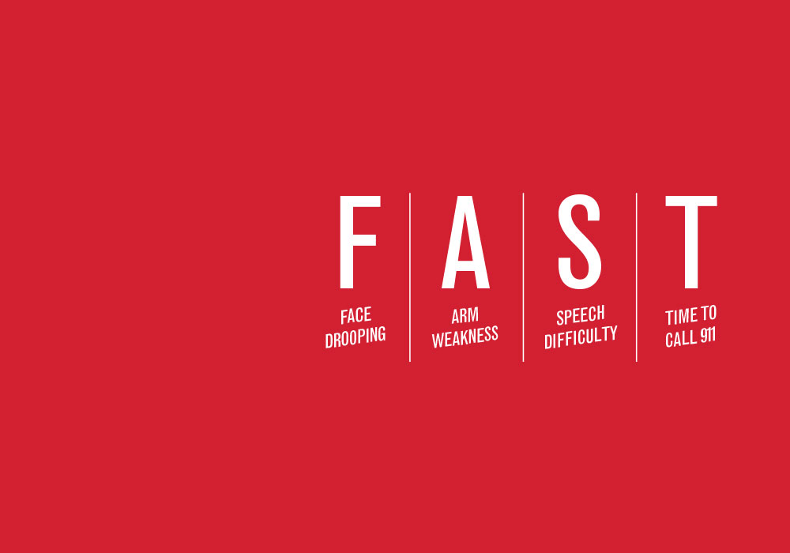


Slide 32
What else could this be?
Fixed Deficit
Transient Deficits
Tumor
Encephalitis
MS
Sz (Todds paralysis
Migraine
Glucose abnormality
Labyrinthine dysfunction
Syncope
Myasthenia (ptosis)
Amyloid angiopathy

Slide 33
Clinical Approach to patient with Stroke/TIA Symptoms
History
  Is it a Stroke/TIA?
Examination
  Stabilize the patient (ABC)
  Screening Neurological Exam (NIH Stroke Scale)
  Non contrast Head CT scan
Treatment
  Open up the clogged vessel
  Or …..Stop the bleeding
Look for the cause
  Prevent the next stroke/TIA
Rehabilitation

Slide 34
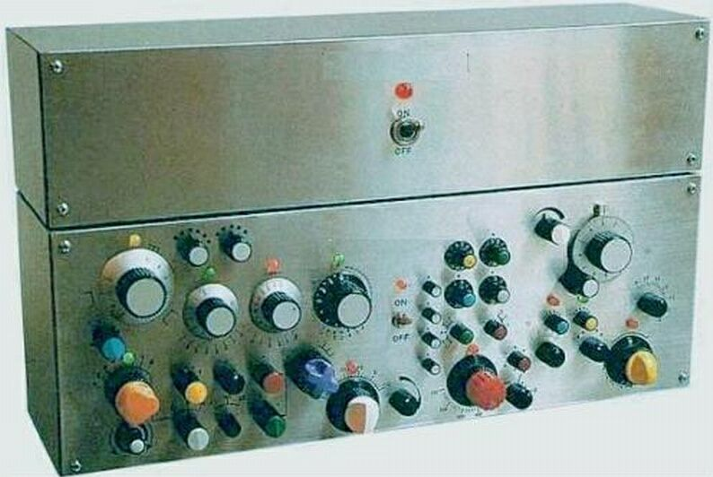
MRI vs. CT for Acute Stroke
CT
MRI

Slide 35
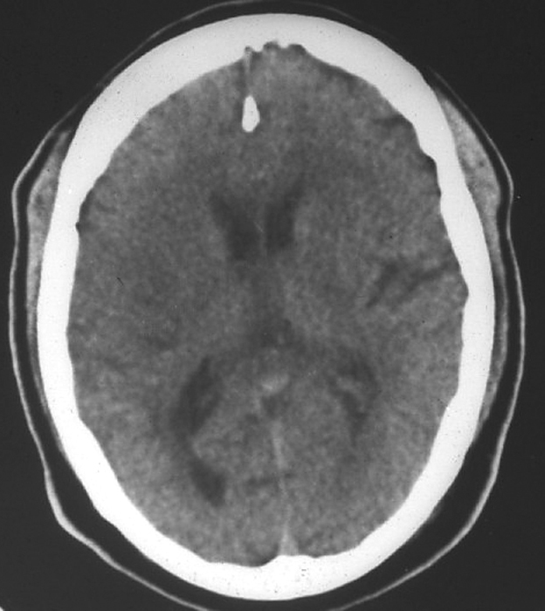
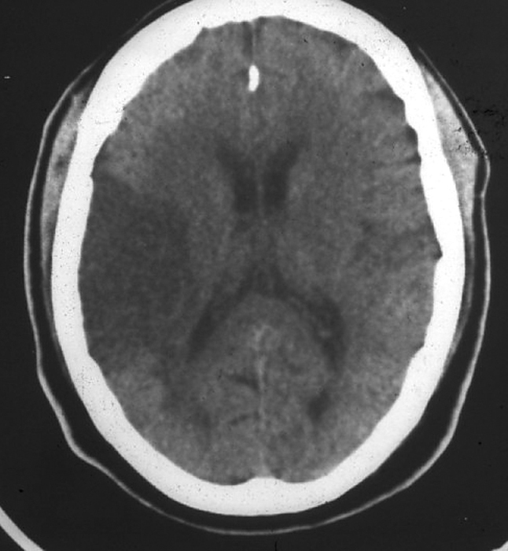
CT scan:
Infarction shows up after hours
Day 1
Day 2
Within Hours
2 days later

Slide 36
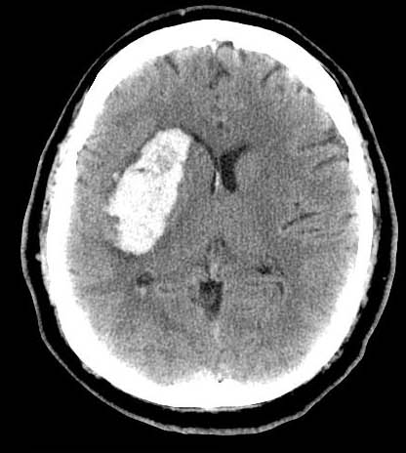
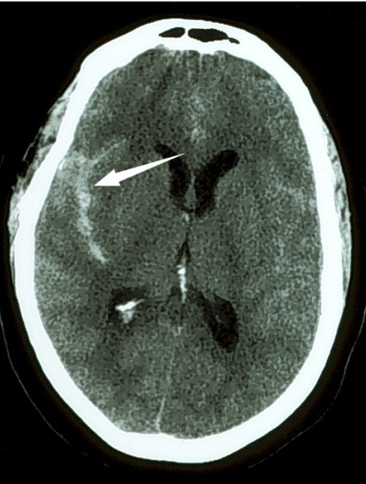
Non-Contrast CT scan:
Sensitive for HEMORRHAGE
Intracerebral
Hemorrhage
Subarachnoid
Hemorrhage
Cerebral
Infarction

Slide 37
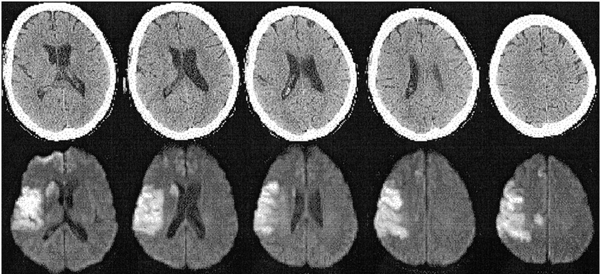
MRI Scan:
Sensitive for early detection of ischemic stroke
75-year-old woman with left hemiparesis
CT scans @ 1.5 hours
Acute Diffusion Weighted (DWI) @ 3.5 hours after stroke onset
Lansberg, M. G. et al. Neurology 2000;54:1557-1561

Slide 38
What drugs prevent stroke?

Slide 39
Common Drugs Used for Management of
Stroke/TIA
Acute Stroke
IV Alteplase breaks up the clot
Mechanical thrombectomy
Secondary Prevention
Antiplatelet Drugs
  Aspirin
  Clopidogrel
  Dipyridamole
Anticoagulant Drugs
  Warfarin
  Dabigitran
  Direct thrombin inhibitor
  Apixaban
  Factor Xa inhibitor
  Rivaroxaban
  Factor Xa inhibitor
  Edoxaban
  Factor Xa inhibitor
  None are reliably detected by basic coagulation tests (PTT, INR)
  Factor Xa inhibitor antidote is FDA-approved

Slide 40
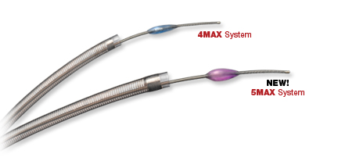
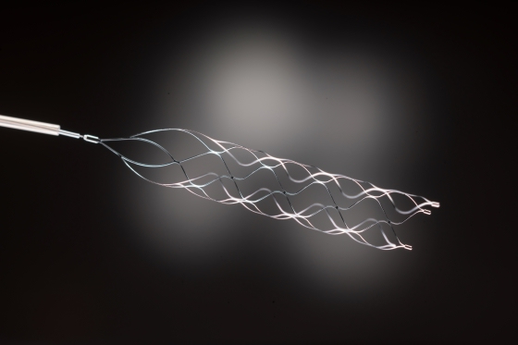
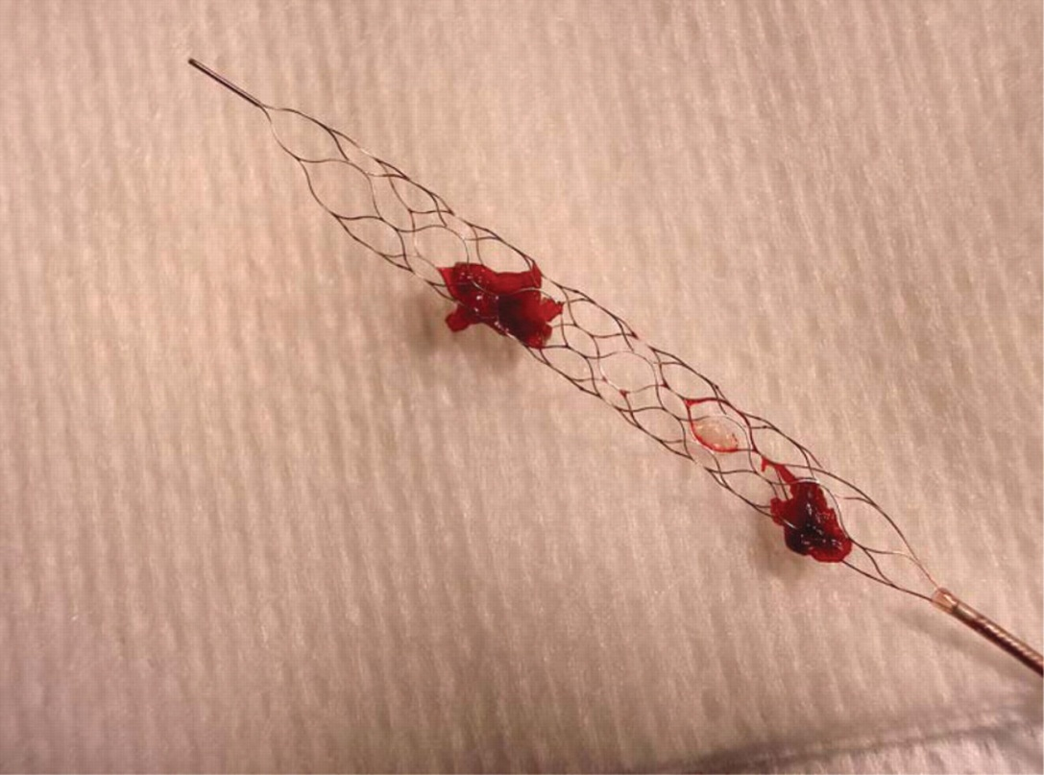
Medical Devices for Ischemic Stroke Therapy
MERCI
PENUMBRA
SOLITAIRE
TREVO

Slide 41
Indications for Intravenous Thrombolysis (rtPA) in Acute Ischemic Stroke
Normal Head CT Scan (No Blood!)
  i.e. ischemic stroke ONLY
Time of onset of stroke known and < 4.5 hrs.
No obvious increased risk for bleeding,
  i.e. low platelets, recent surgery, trauma
You have available expertise to treat complications
  bleeding
Notes:
To decrease the risk for intracerebral hemorrhage, the use of thrombolytics should be limited to patients who meet the inclusion/exclusion criteria of the NTNDS rtPA Stroke Trial or the ECASS III trial. rtPA is the only FDA approved treatment of acute ischemic stroke. The use of other thrombolytic agents should be limited to clinical trials and/or investigational settings, especially given the negative and potentially harmful results of the streptokinase trials for acute stroke.
✶ National Institute of Neurological Disorders and Stroke rtPA Stroke Study Group: Tissue plasminogen activator for acute ischemic stroke. New Engl. J Med 1995:333:1581-1587.

Slide 42
Risk Factors for Stroke/TIA
Modifiable
Hypertension
Diabetes
Cardiac disease
Atrial fibrillation
Prior TIA/stroke
Dyslipidemia
Cigarette smoking
Alcohol abuse
Obesity
Physical Inactivity
Carotid stenosis
Non-Modifiable
Age
Sex at birth
Genetic
Goldstein L et al. Circulation. 2001;103:163-182.
Broderick J et al. Stroke. 1998;29:415-421.
Notes:
References:
1. Goldstein LB, Adams R, Becker K, et al. Primary prevention of ischemic stroke. Circulation. 2001;103:163-182.
2. Broderick J, Brott T, Kothari R, et al. The Greater Cincinnati/Northern Kentucky Stroke Study: preliminary first-ever and total incidence rates of stroke among blacks. Stroke. 1998;29:415-421.
Several risk factors for stroke exist and can be reduced by lifestyle changes and medical or interventional treatment.^{1,2} Modifiable and nonmodifiable risk factors are listed.

Slide 43
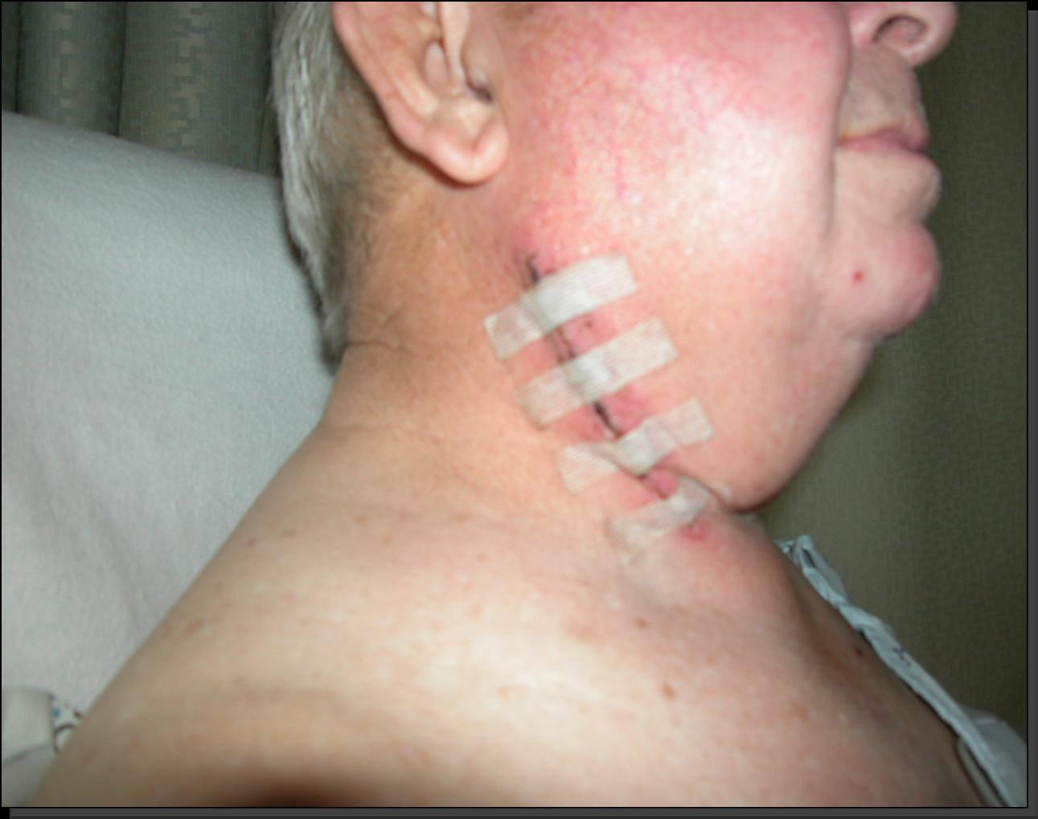
Carotid Revascularization: Endarterectomy
Symptomatic carotid stenosis
  Recent nondisabling carotid artery ischemia
  Ipsilateral 70% to 99% carotid stenosis
  Expected to live at least 5 years
  No prior endarterectomy
  ASA should start prior to surgery and cont. for 3 mo.
Asymptomatic carotid stenosis
  Based on degree of stenosis (at least 60%)
  Low Operative risk (<6%)
American Heart Association: http://circ.ahajournals.org/cgi/content/full/97/5/501

Slide 44
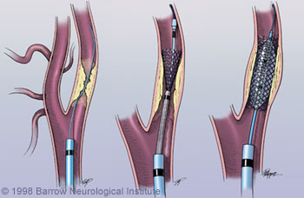
Carotid Revascularization:
Stenting
Indications:
  Symptomatic or asymptomatic high grade stenosis of the ICA (70-99%)
  Not suitable for surgical access/S/P XRT/ restenosis/high risk of anesthesia
  Contralateral occlusion
Contraindications:
  Visible thrombus in lesion
  Difficult vascular access
  Infection
  Age>80

Slide 45
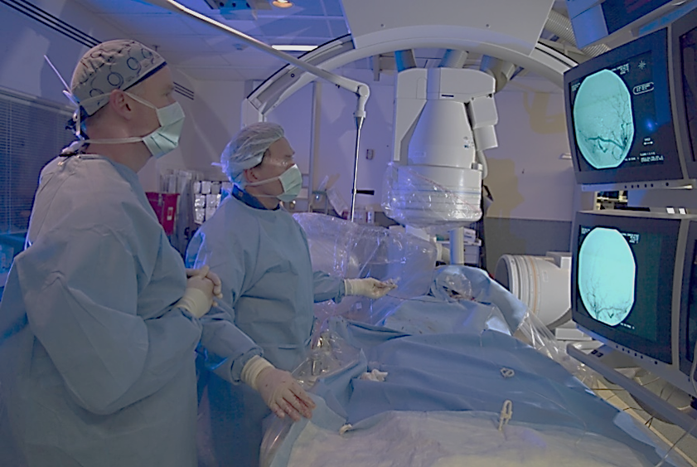
Look for other causes….
Cardiac Monitoring
Cardiac Echocardiogram
Extracranial Vasculature
  Carotid Doppler
  MRA or CTA
  Digital Subtraction 4-vessel Cerebral Angiography
Intracranial Circulation
  Transcranial Doppler
  MRA or CTA
  Digital Subtraction 4-vessel Cerebral Angiography

Slide 46
Supportive Management
Prevent Complications
  Blood Pressure Optimization
    DO NOT DROP THE BP early on!
  Swallowing Evaluation
  Venous Thromboembolism Prophylaxis
  Management of increased intracranial pressure
  Physical Therapy
  Occupational Therapy
  Speech/Cognitive Therapy
  Treatment of depression, spasticity

Slide 47
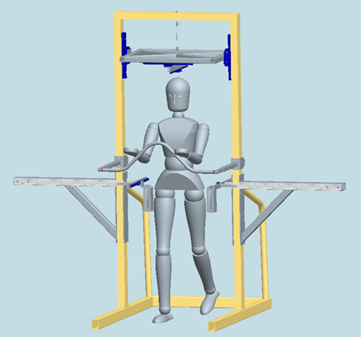
Rehabilitation
Immediate:
  Early rehabilitation is associated with improved long-term outcomes
Short-term:
  Physical Therapy: Gait/ambulation
  Occupational Therapy: Hand/arm function
  PM&R: Medication, alertness, depression, spasticity management
  Speech & Language: Swallowing/Cognition
Long-term:
  Ongoing treatment: Cost prohibitive
  Support Caregivers & Patients

Slide 48
What can I do to prevent stroke?

Slide 49
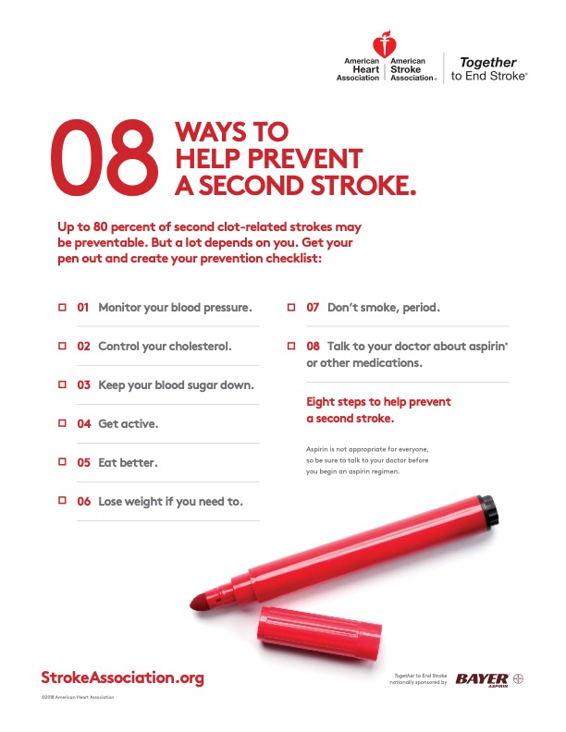
If you have one….

Slide 50
Future Directions
Primary Prevention: Policy e.g. tobacco cessation
Secondary Prevention: Cost of medications
Delivery of Care: Telemedicine for acute and rehab
Caregiver support: Burden is high

Slide 51

Questions
https://youtu.be/ygCll-tPBmg

