Slide 1
Mini Med School: Thyroid Diseases
Paul Guido, MD
Endocrinology Fellow
UNC Department of Endocrinology
2/23/2021

Slide 2
Five goals for today:
Understand how thyroid hormone is replaced with medicine.
Understand what Hashimoto’s disease is.
Understand how we evaluate thyroid nodules and goiters.
Understand how we treat thyroid cancer.
Ask questions about anything thyroid!

Slide 3

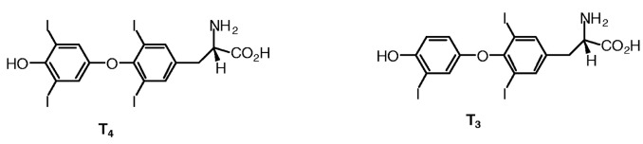

Thyroid hormone
The timekeeper of the body
Regulates metabolic speed in all cells of the body
Correct levels are vital for survival
Formed from amino acids and IODINE
One of the only places iodine is used in the body

Slide 4
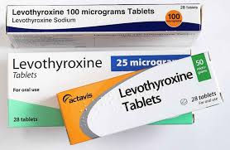
Hypothyroidism
Lots of causes:
Hashimoto’s disease
Surgical removal of the thyroid
Radiation to the neck for other conditions
Thyroiditis- viral infection, autoimmune conditions, postpartum
Medication side effects
Lots of symptoms:
Tiredness
Weight gain
Feeling cold all of the time
Dry skin and brittle hair
Constipation
Irregular menstrual periods for women
One common treatment:
Thyroid hormone replacement!

Slide 5
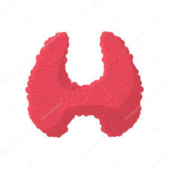
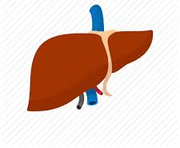
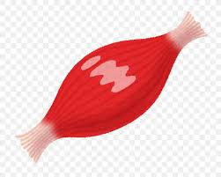
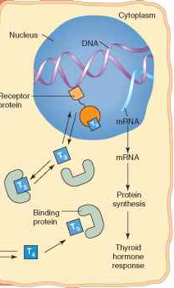

Thyroid hormone metabolism A journey from T4 to T3
Thyroid produces hormones.
Blood levels of T4 are fifteen times higher than T3
Liver, muscles, other tissues turn T4 into T3 so it can be used
T4
T3
T3 causes a change within all cells in the body!

Slide 6
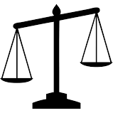

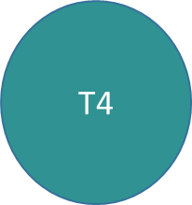

Thyroid hormone metabolism
T4 is our “storage form”. You can’t use it directly, but there is a lot more of it
T3 is our “active form”. It is what we run on, and there is less of it. You only use what you need.

Slide 7
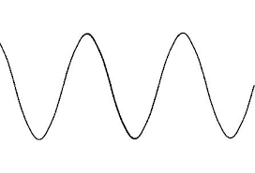
Thyroid hormone metabolism
T3 level
T4 level
Day 1 Day 2 Day 3 Day 4
Because T4 is a reserve hormone and lasts much longer, the levels are more stable when given in medicine form.
Your body converts what it needs to T3 when it needs it.
This is why we use T4 (levothyroxine, “Synthroid”) to treat people with hypothyroidism and not T3.

Slide 8
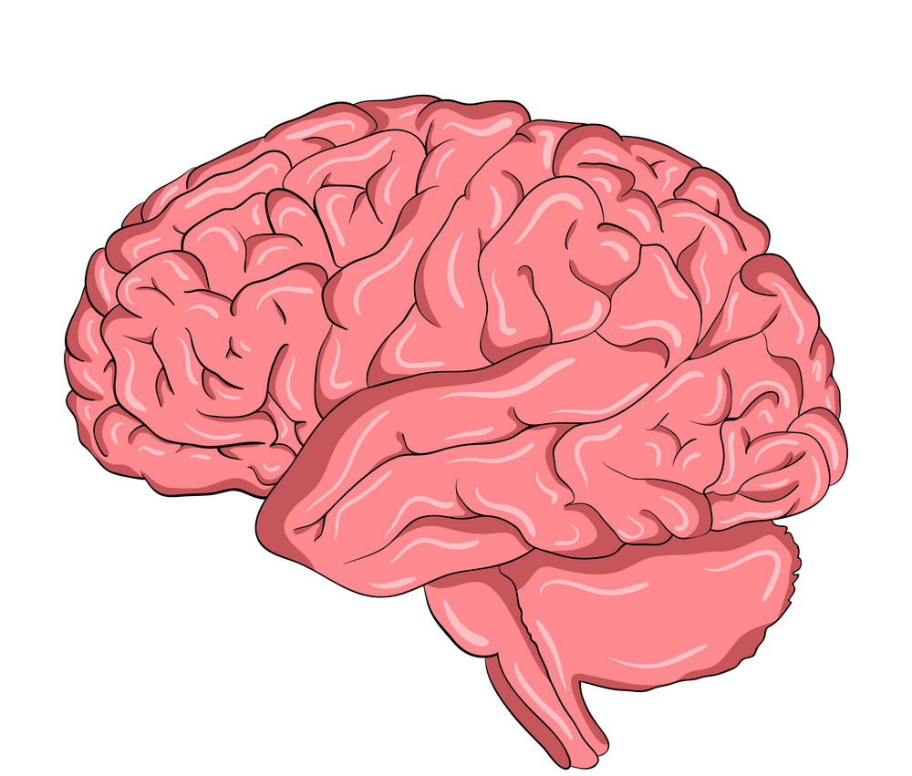
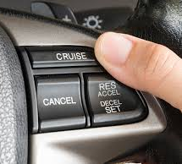


What are thyroid levels?
The thyroid hormone system is like cruise control in your car.
- Brain (pituitary gland) is the computer
TSH is equivalent to the gas pedal
Thyroid is the engine
TSH
T3 and T4 are the speed
Too slow- the cruise control gives the engine more gas (TSH goes up) and the speed increased (more T3/T4 hormone)
Too fast- the cruise control lets off the gas (TSH goes down) and the speed decreased (less T3/T4 hormone)
TSH levels are the opposite of how fast or slow the system is going!

Slide 9
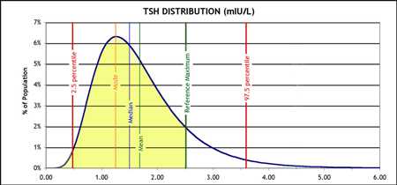
TSH measurement
TSH is the most reliable measurement of how the thyroid system is working
Results are reported within a range (often somewhere between 0.5 and 5.0)
The range is for the entire population- not for an individual
It’s the physician’s job to find out where in the range the patient belongs based on how they feel!

Slide 10
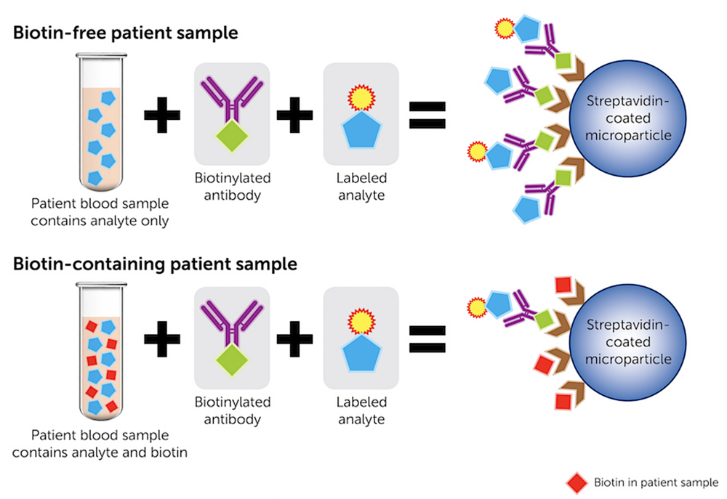
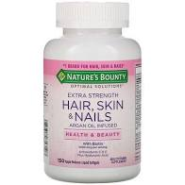
Biotin-a common problem with TSH!
The lab uses biotin as part of their chemical analysis
Supplemental Biotin “gets in the way” of the lab reaction and makes the TSH look too low.
Chemical containing biotin
TSH
Chemical containing biotin
TSH
Biotin in patient blood

Slide 11
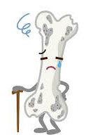
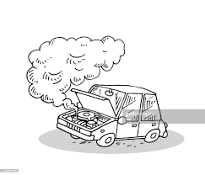
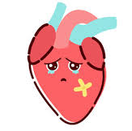
Complications of too much thyroid hormone
While it is fine to treat within the normal range of TSH, overtreatment can cause problems.
Too much hormone is like revving the engine for too long
Heart problems- atrial fibrillation, heart failure
Bone problems- osteoporosis

Slide 12
Common misconceptions about thyroid hormone replacement
Iodine supplements can fix hypothyroidism.
May actually make things worse due to a protective mechanism
US diets have more than enough iodine naturally
Armour thyroid is more natural and better for the patient.
Synthroid/Levothyroxine is the same molecule that your thyroid makes.
Armour thyroid is a dried/ground pig thyroid- the dose is inconsistent and has too much T3 in it so it is less stable. (Pig ratio is 4:1 instead of human 15:1)
You need to take a mix of T3 with the T4
Complicated subject- at this time the American Thyroid Association recommends against it.
Trial of a very low T3 dose daily with levothyroxine for patients with no thyroid left as a last resort if they do not feel well on many different levothyroxine doses.

Slide 13


Any questions on thyroid hormone?

Slide 14
Hashimoto’s Hypothyroidism
What is Hashimoto’s disease?
Who gets Hashimoto’s?
What else is associated with it?

Slide 15
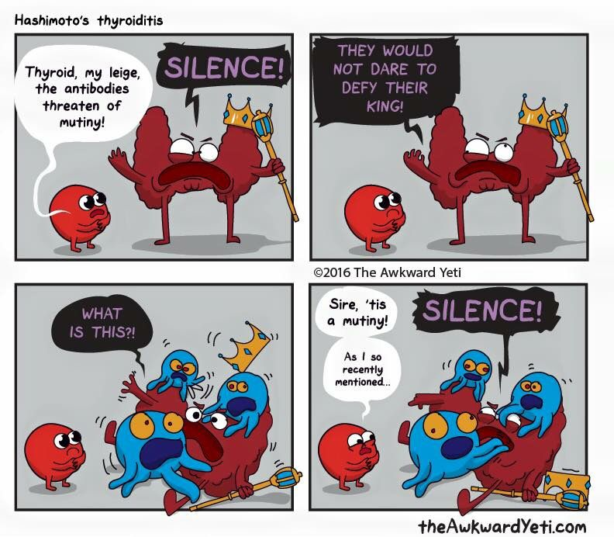
What is Hashimoto’s hypothyroidism
Cause: Autoimmune destruction of the thyroid gland
TPO antibodies are active against the thyroid cells
Symptoms: Often painless and does not cause any symptoms until the thyroid levels are low (hypothyroidism)
Some people experience tenderness or goiter
Treatment: There is no known treatment to stop the autoimmune process
Replace needed thyroid hormone!

Slide 16
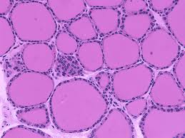
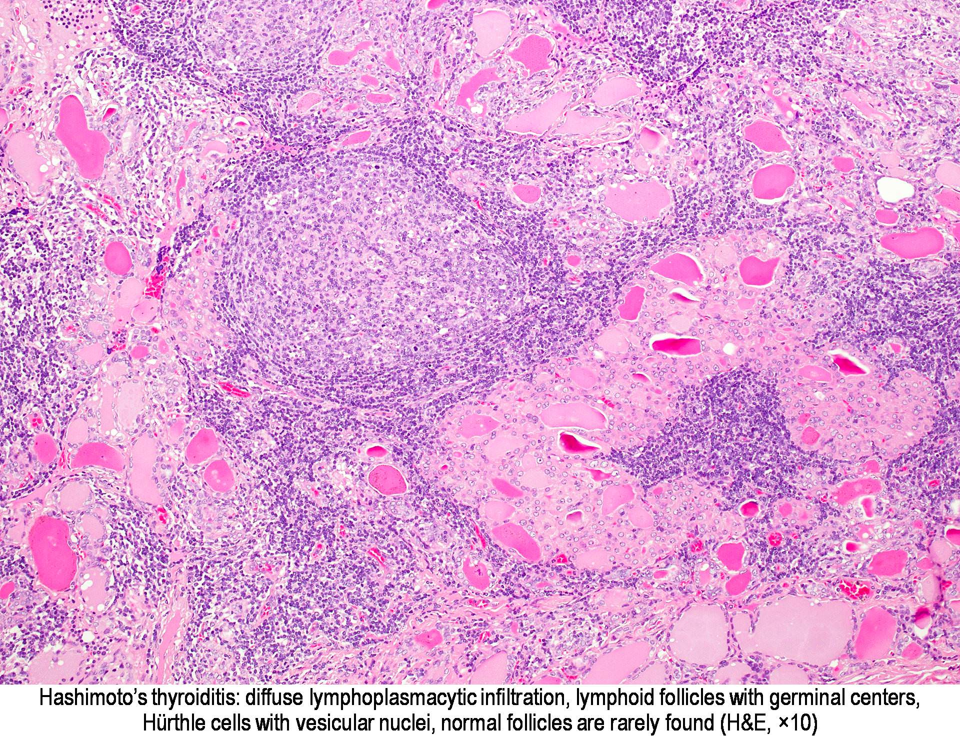
Thyroid up close
Normal thyroid under microscope
Hashimoto’s inflammation

Slide 17
Who gets Hashimoto’s hypothyroidism
Thyroid antibodies (TPO) are present in 10-20% of all people
About 5% of all people have hypothyroidism
Having TPO antibodies does not necessarily mean you will have hypothyroidism in the future- risk is about 5% per year
5 times more common in women
Risk increases with age- more common age 30-60

Slide 18
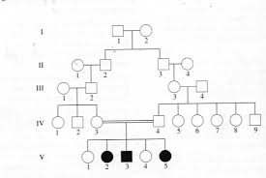
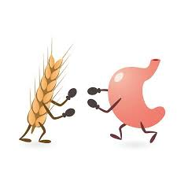
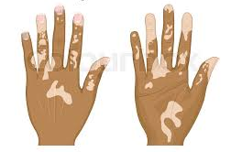
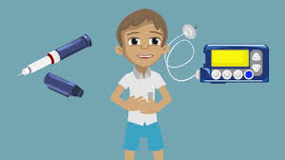
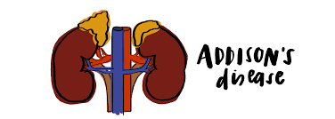
Who gets Hashimoto’s hypothyroidism
Genetically linked- families often have many members with hypothyroidism.
Most likely linked with HLA alleles
Can be brought on by stress, pregnancy, excess iodine, viral infections.
Associated with other autoimmune conditions
Celiac disease
Type 1 diabetes
Vitiligo
Addison’s disease

Slide 19
Any questions about Hashimoto’s?

Slide 20
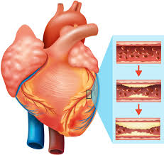
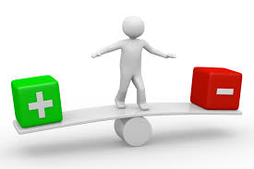
What is subclinical hypothyroidism?
TSH levels are slightly out of range
Between 5 and 10
Thyroid hormone (T4) levels are normal.
People typically do not have symptoms
We think that risk of heart disease and high cholesterol increases with subclinical hypothyroidism as we age.
There is also a risk to pregnancies in women.
TSH above 10: Treat everyone!
TSH 7-10: Treat patients above 65
TSH above normal: Treat women planning pregnancy

Slide 21
Thyroid nodules and goiter
What is a thyroid nodule?
What is a goiter?
What are some symptoms of thyroid nodules and goiters?
How do we diagnose thyroid nodules and goiter?

Slide 22
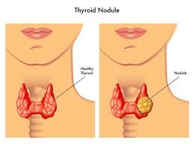
What is a thyroid nodule?
Thyroid nodules are benign or cancerous growths in the thyroid
They are very common as we age
Age 20-30: 3% of people
Age 30-40: 10% of people
Age 40-50: 15% of people
Age 50+: 20% of people
95% of thyroid nodules are benign (Not cancer)

Slide 23
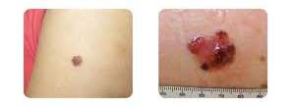
What causes thyroid nodules?
Cysts- fluid collections
Functioning nodules- make extra hormone
Solid nodules
Benign- cells grow and divide too fast but still follow the rules
Malignant- cells grow and divide too fast but break the rules and may spread
Think like a mole vs skin cancer

Slide 24
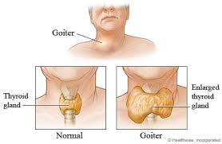
What is a goiter?
Goiter is simply an enlarged thyroid
There are many different causes
Iodine deficiency (not in the USA)
Multinodular goiter
Graves disease
Thyroiditis
Thyroid cancer

Slide 25
What are symptoms of a thyroid nodule or goiter?
Lump (s) in the neck
Trouble swallowing
Hoarse voice
Symptoms of hyper or hypo thyroidism
No symptoms at all

Slide 26
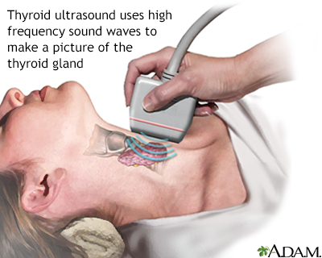
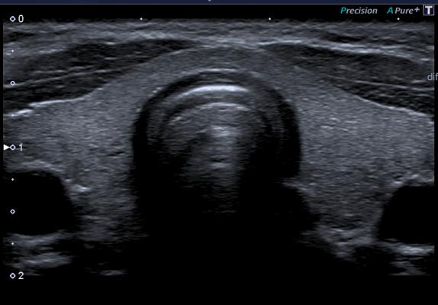
How do we diagnose thyroid nodules?
Thyroid ultrasound machine
Uses harmless sound waves to visualize the inside of the neck

Slide 27
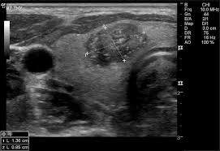
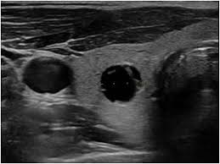
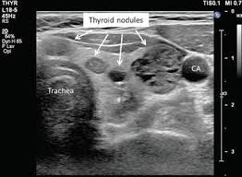
Thyroid ultrasound
Thyroid cyst
Thyroid cancer
Multiple nodules

Slide 28
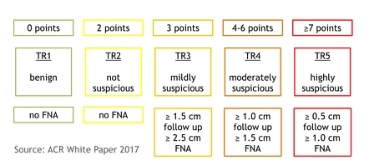
Following thyroid nodules
Radiologist or Endocrinologist uses standardized scales to “grade” how they look on ultrasound
This is called a Ti-RADS score and relays the risk for cancer
Based on this score, you may need ultrasounds annually, a biopsy, or nothing at all!

Slide 29
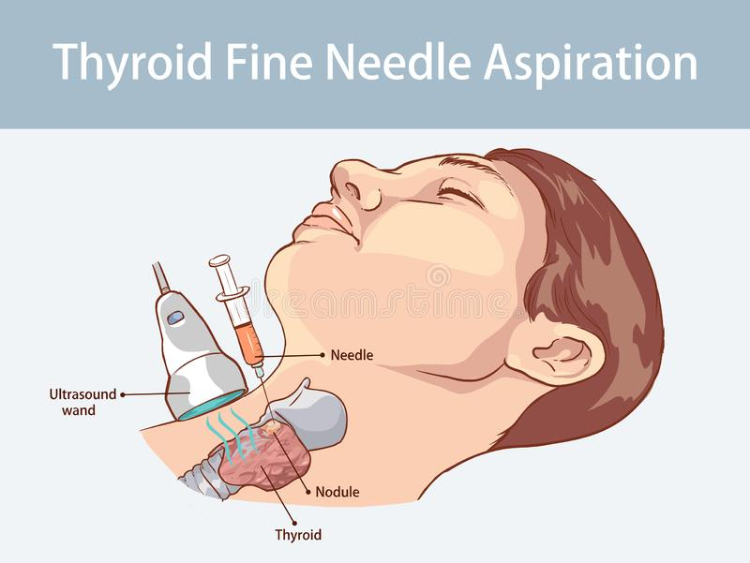
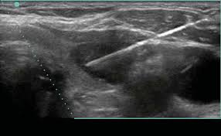
How do we biopsy thyroid nodules?
Needle on ultrasound image

Slide 30
Thyroid biopsies at UNC
Office procedure- no special preparation needed
Similar to a skin biopsy or a dental filling.
Neck is cleaned with alcohol swabs
Numbing spray is used to minimize discomfort
Very small needle (27 gauge) similar to an insulin syringe or flu shot is used.
Small samples of thyroid cells are sent to the pathologist
Takes about 30 minutes and you can go home right afterward

Slide 31
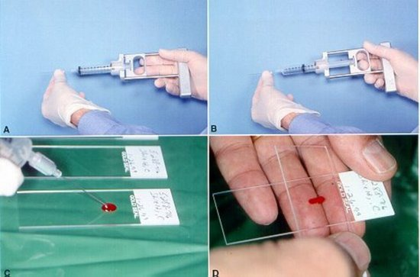
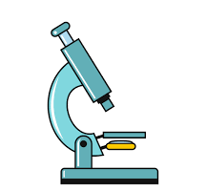
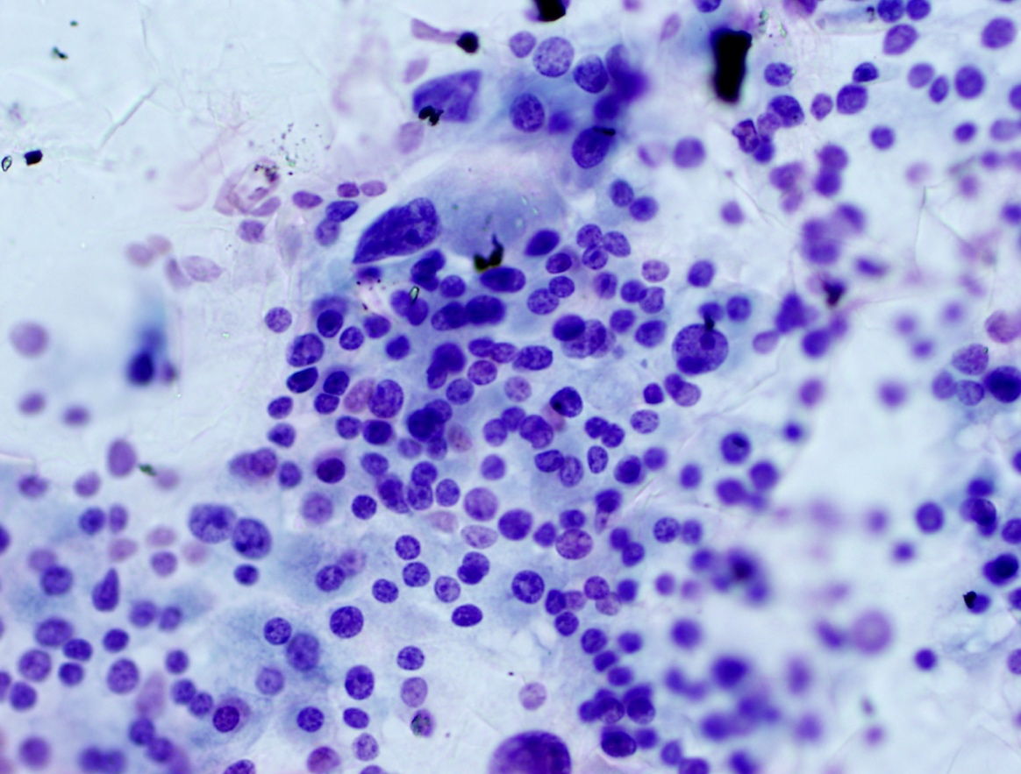
Thyroid cytopathology

Slide 32
Any questions about Thyroid Nodules?

Slide 33
Thyroid cancer
How common is thyroid cancer?
What causes thyroid cancer?
How does thyroid cancer get detected?
How is thyroid cancer treated?
What are some recent advances in thyroid cancer care?

Slide 34
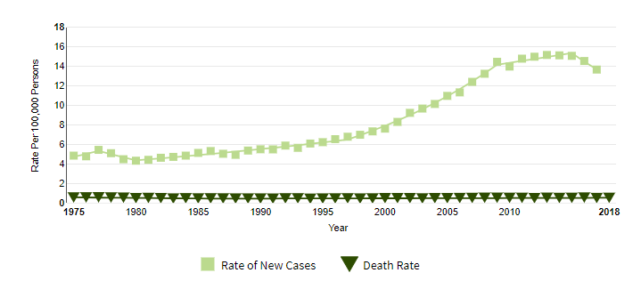
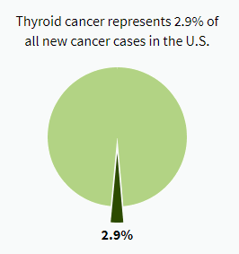
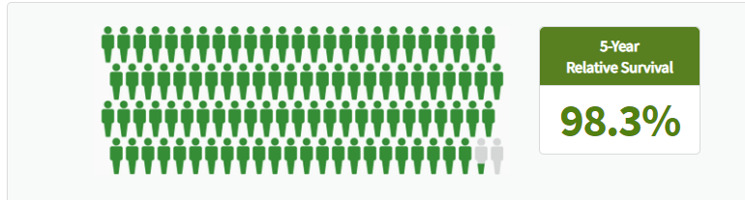
How common is thyroid cancer?
About 15 in every 100,000 people get thyroid cancer each year.
1.3% of people in their whole life
Almost everyone will survive their cancer though!

Slide 35
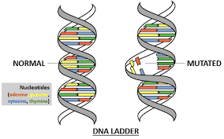
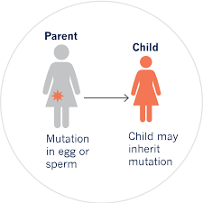
What causes thyroid cancer?
Gene mutations in the thyroid cells cause them to grow out of control.
Some mutations happen on their own.
Some are inherited in family trees
Radiation exposure is a risk factor especially at young age

Slide 36
How does thyroid cancer get detected?
Patients or doctors feel a lump in the neck
Found by chance on other imaging tests
like an MRI, CT, or ultrasound.
There is no standard screening regime in the United States
The United States Preventive Services Task Force has done an analysis and found more harm would come from screening everyone.
Unnecessary biopsies and surgeries.
Select people that SHOULD get thyroid cancer screening
Very strong family history of thyroid cancer or cancer syndromes
Multiple endocrine neoplasia
Familial adenomatous polyposis
Carney complex
Children that have had radiation therapy at a young age

Slide 37
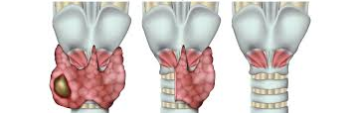
How is thyroid cancer treated?
95% of thyroid cancer is limited to the neck only.
Surgery
Remove half the thyroid- hemi-thyroidectomy
Remove the whole thyroid- total-thyroidectomy
Remove the whole thyroid and lymph nodes- total thyroidectomy with lymph node dissection

Slide 38
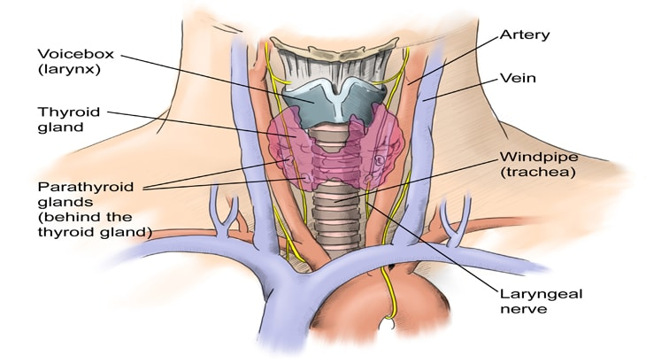
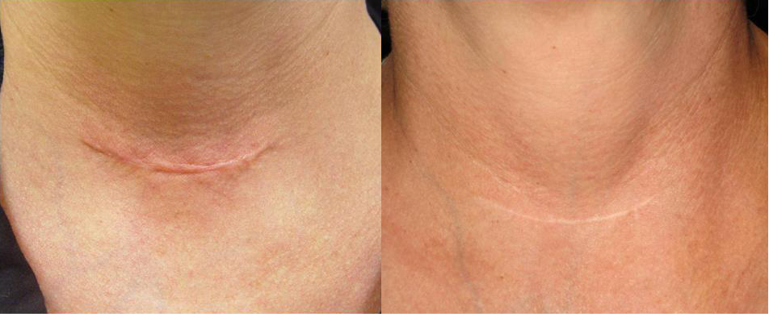
Thyroid surgery
General Anesthesia, day surgery or overnight hospitalization.
Usually leaves a very small scar in the neck.
Better outcomes when surgeons do many thyroid surgeries per year.
Must be careful of nerves, arteries, and parathyroid glands

Slide 39
Thyroid cancer monitoring after surgery
Annual ultrasound
Thyroglobulin tumor marker level every 6-12 months
Levothyroxine medication
Keeps you alive by replacing your thyroid hormone
Also keeps the body from growing back any remaining thyroid!
This is called TSH suppression

Slide 40

Treatment of advanced thyroid cancer
Radioactive iodine treatment (RAI) after surgery.
Since the body only uses iodine mainly in the thyroid, we can give a radioactive form of iodine to kill off any microscopic or spreading thyroid cancer.
Functions like chemotherapy or radiation therapy but:
has no traditional chemo or radiation side effects since we can take advantage of the unique properties of iodine!

Slide 41
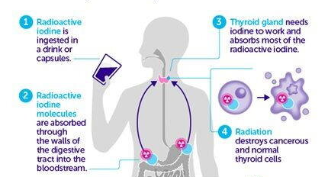
Radioactive iodine treatment
Step 1- lower the thyroid hormone levels in the body to prime the microscopic thyroid cells for treatment. One month prior to therapy
Step 2- low iodine diet to make the thyroid cells hungry for iodine. Two weeks prior to therapy
Step 3- administer iodine 131 isotope
Possible Side effects
Some people experience dry mouth, dry eyes
Have to stay away from people for 2-3 days afterwards
Step 4- radiation kills any remaining cancer with minimal symptoms to the patient

Slide 42

Recent Discoveries for Thyroid Nodules: Personalized Genetic Testing

Slide 43
Recent Discoveries for Thyroid Cancer: Targeted Chemotherapies
For patients with stage 4 (metastatic) disease in whom radioactive iodine has not worked.
New generation anti-cancer medications that target some specific mutations causing the cancer
May increase survival without traditional side effects of chemo.

Slide 44
Any questions about Thyroid Cancer?

Slide 45
What we learned tonight.
Thyroid hormone plays a very important role in our body and finding the right dose of levothyroxine is different for everyone.
Hashimoto’s disease is a common autoimmune problem that affects many people.
Thyroid nodules are almost always benign but still require thoughtful care.
Thyroid cancer can be cured in most people, and there are more options every day for patients with advanced disease.

Slide 46
THANK YOU!!

Slide 47
More information for the public
https://www.thyroid.org/thyroid-information/
https://www.cancer.org/cancer/thyroid-cancer.html

