Slide 1


UNC Mini Medical School: Stroke
Sarah Glier
Dr. Ana Felix
February 9, 2021

Slide 2
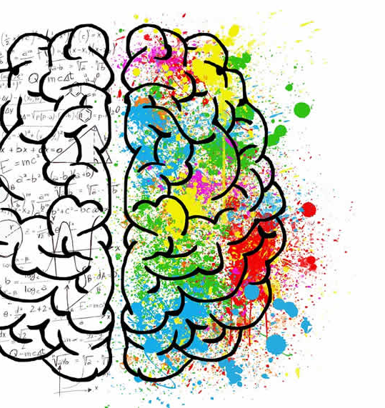
Breakdown for the evening:
15-20 minute introduction (Sarah)
What is a stroke?
Structure of the nervous system
Functional neuroanatomy (how does our brain work?)
Neurovascular supply
10 minute break
45 minute interactive talk (Dr. Felix)
15-20 minutes for questions

Slide 3
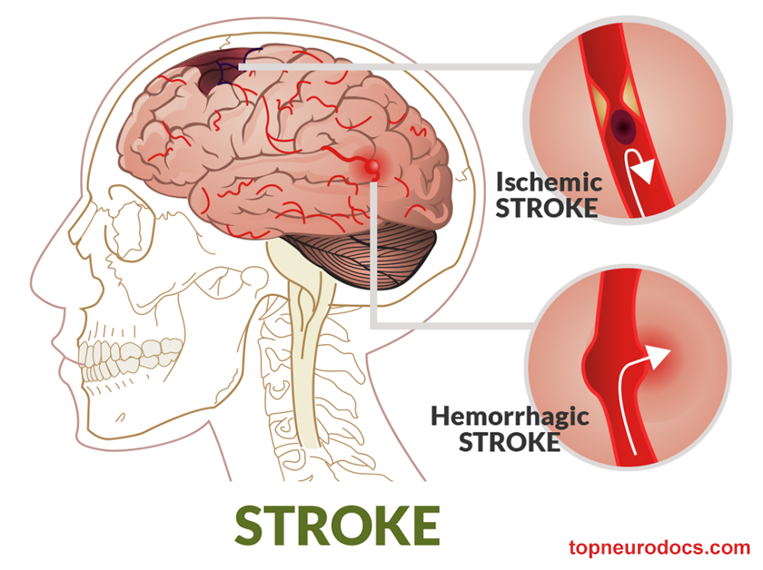
What is a stroke?
When a part of the brain is damaged because of a problem with blood flow
Clogging
Breaks open
Part of the brain goes without blood for too long
Bleeding into or around the brain
American Stroke Association

Slide 4
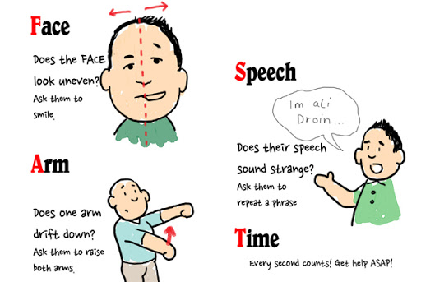
In order to understand the clinical presentation of a stroke, we must first understand normal neuroanatomy

Slide 5
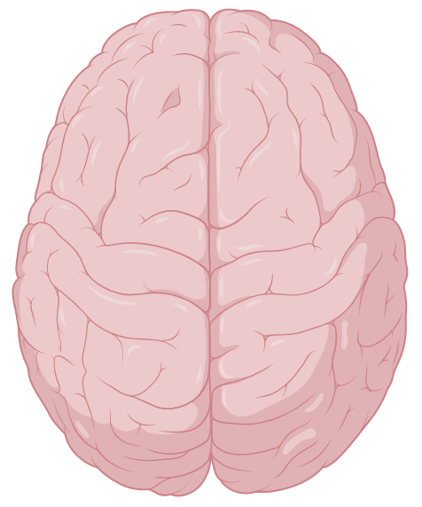
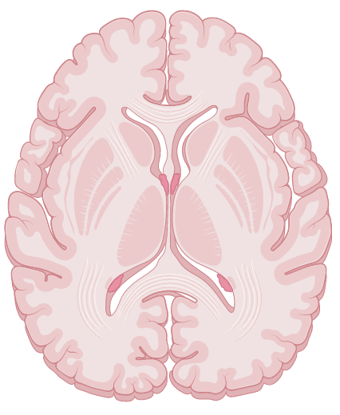
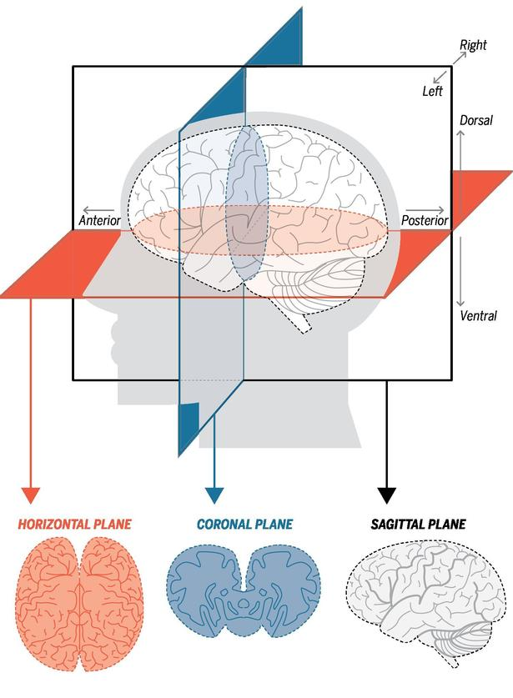
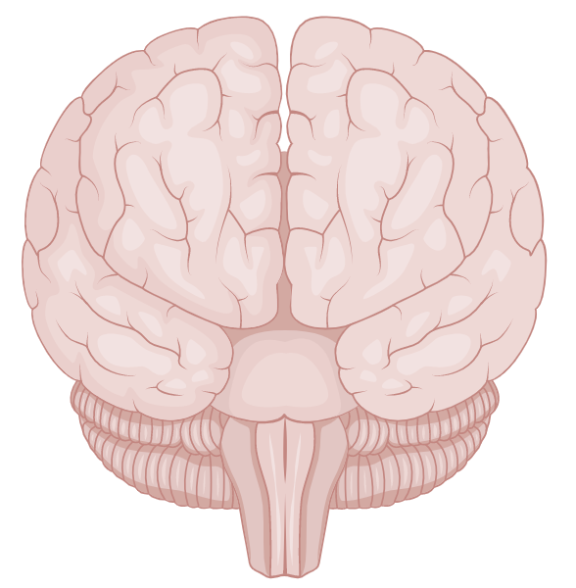
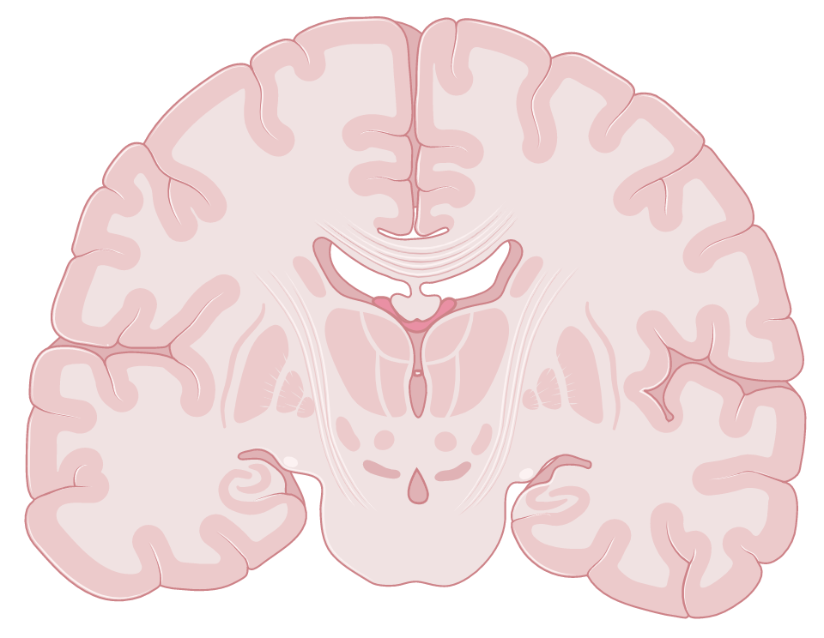
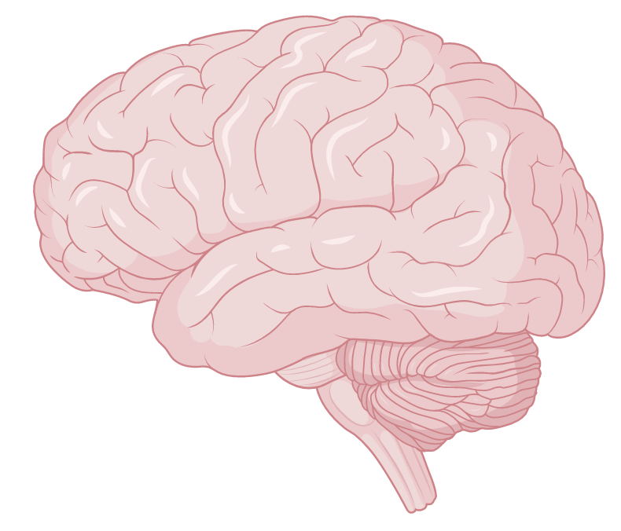
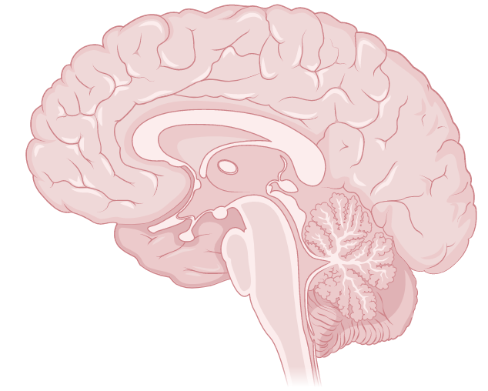
Viewing the brain:
Superior
Horizontal
Frontal
Coronal
2002 Sinauer Illustrations
Lateral
Sagittal
Notes:
You might hear of these different “cuts” or views of the brain, but it’s just different ways to visualize the same 3D structure to help us understand the complex layout of regions and vessels inside of the brain.
On the left you can see the whole brain from the view on the outside. And then on the right, pretend we are cutting right down the middle of the plane we are looking at. This would be the corresponding view of the inside of the brain (note for me: all images on right are at level of thalamus).
Horizontal sometimes called axial plane

Slide 6
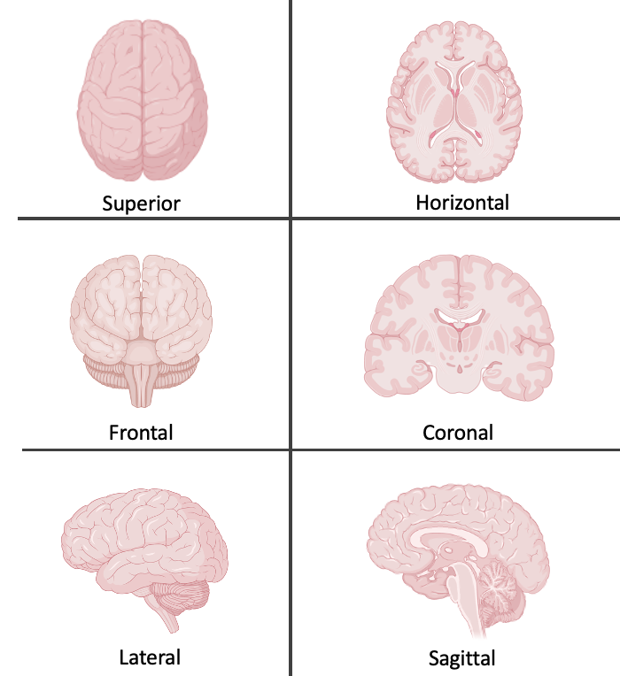
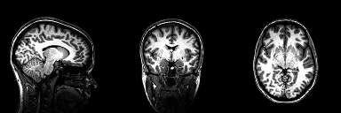
Neuroimaging in 3 planes:
Sagittal
Coronal
Horizontal
Radiopedia.org

Slide 7
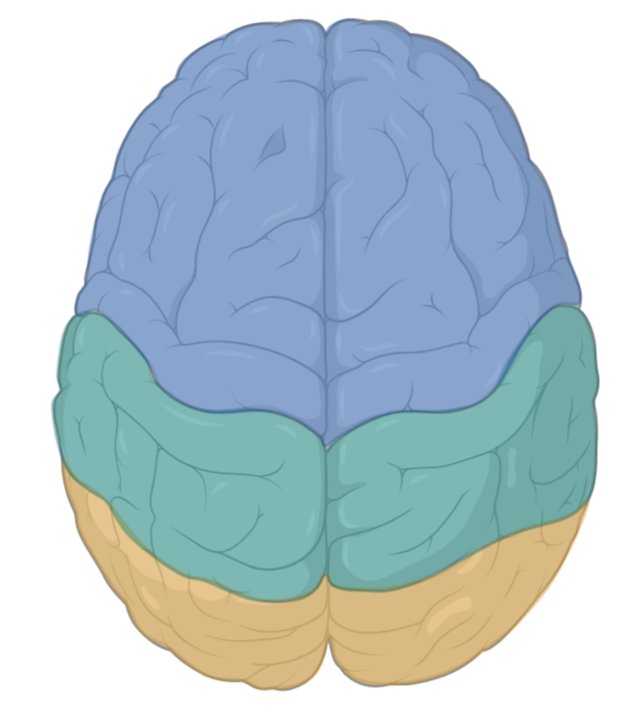
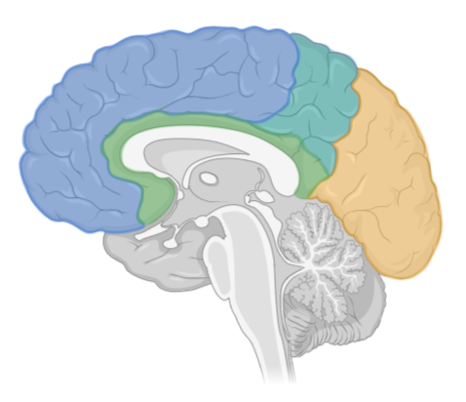
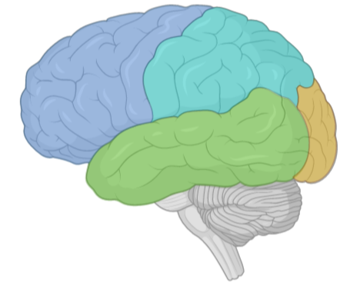
Cortical (brain) anatomy
Parietal lobe
Frontal lobe
Temporal lobe
Occipital lobe

Slide 8
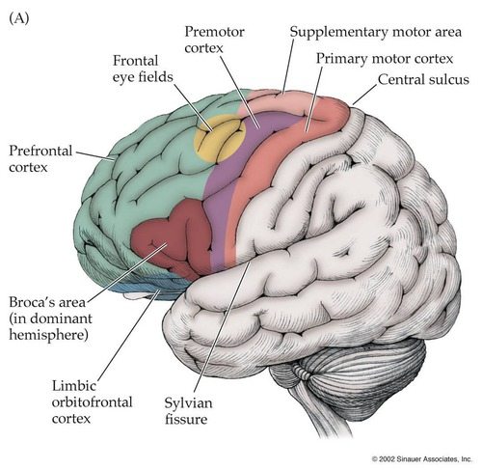
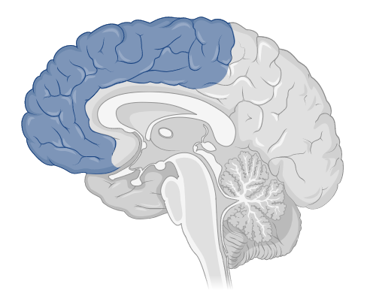
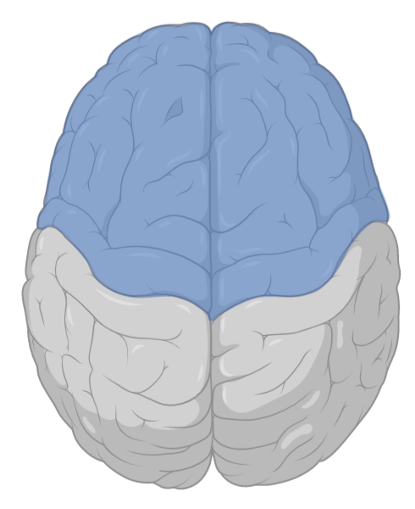
Functional frontal lobe anatomy
2002 Sinauer Illustrations
Notes:
Broca’s area = production of speech

Slide 9
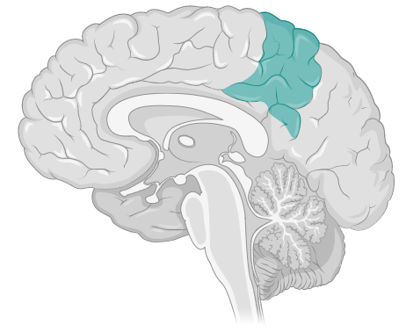
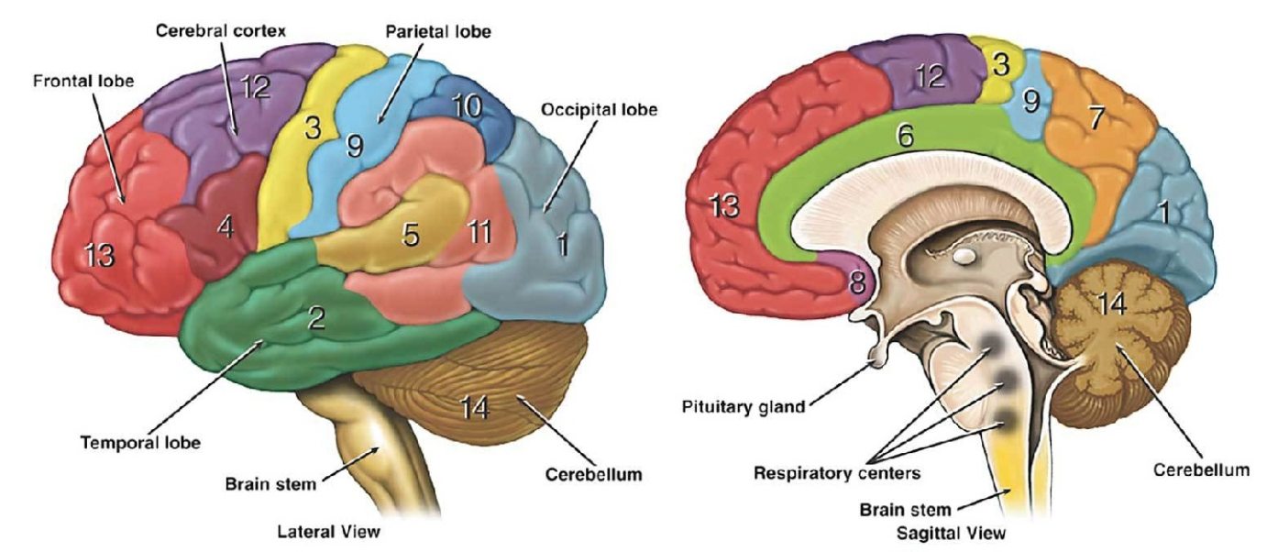
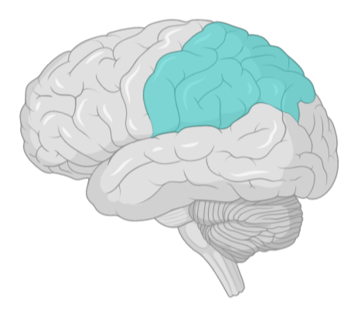
Functional parietal lobe anatomy
Somatosensory association areas
Primary sensory cortex
Waxman 2017
Notes:
Primary: receives “data” about sensations in skin, muscles, joints, and organs
Association areas: “data” received is analyzed, think about evaluation or qualification of weights, textures, temperatures, object recognition… and connect to other areas use memories, smells, sights, etc.

Slide 10
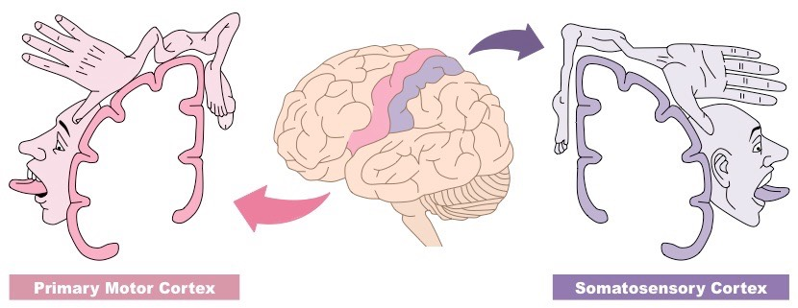
Representation of motor (frontal) and sensory (parietal) areas in cortex: the homunculus + lateralization
Waxman 2017
Notes:
Homunculus meaning human or humanoid creature – we have that exact representation in our brain!

Slide 11
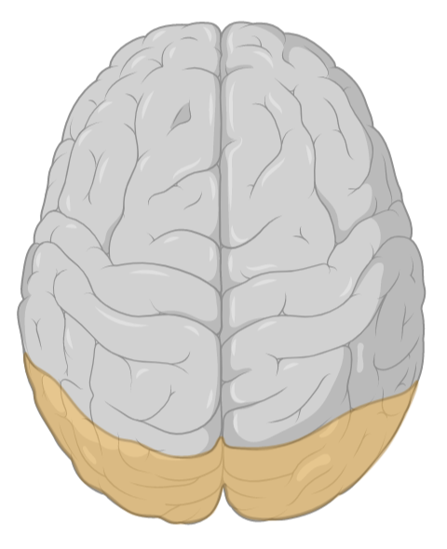
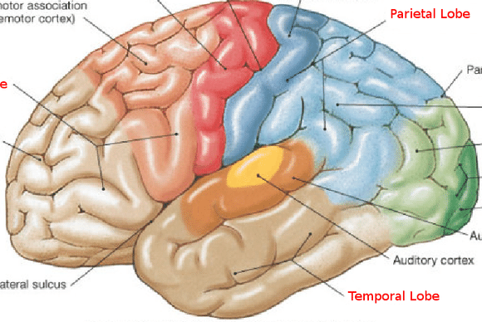
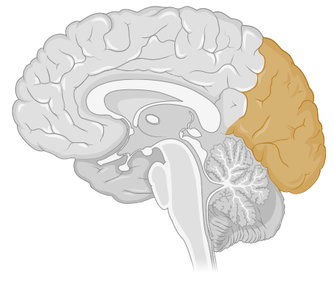
Functional occipital lobe anatomy
Visual association area
Primary visual cortex
Bussu 2015
Notes:
Same concept of primary vs association areas discussed in previous slide. Primary gets the “raw data” from our eyes. Visual association area helps to analyze this information – think about how you visually recognize someone’s face that you know well or have seen before. The “familiarity” – this area helps with this! It again, connects with other areas to integrate information. Think about reading facial expressions or body language.

Slide 12
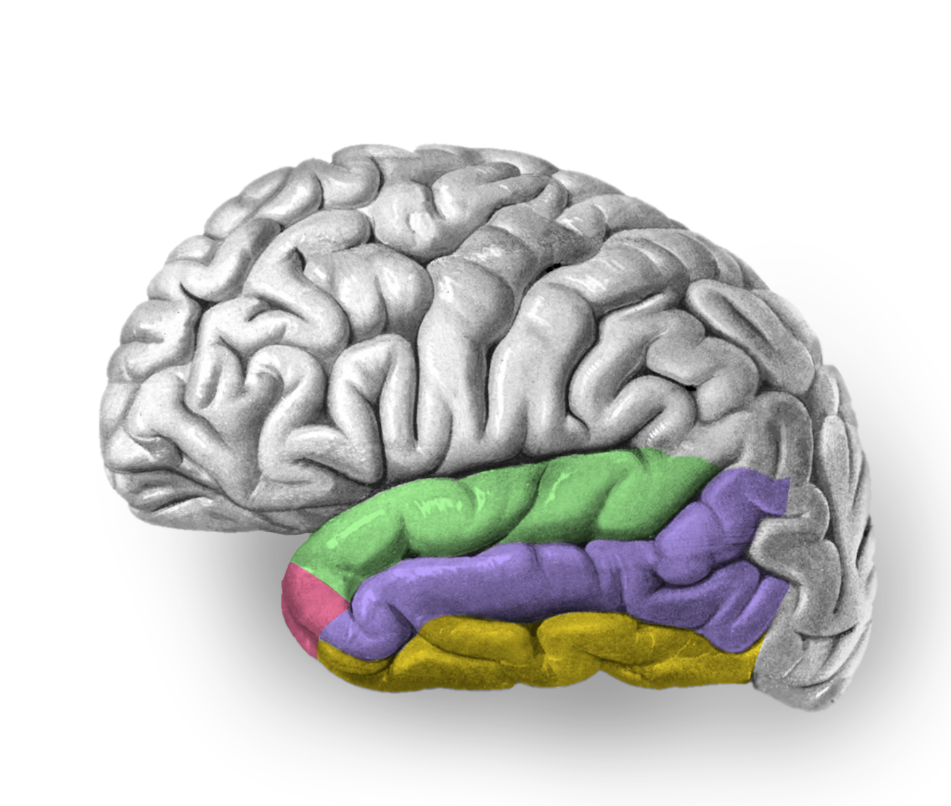
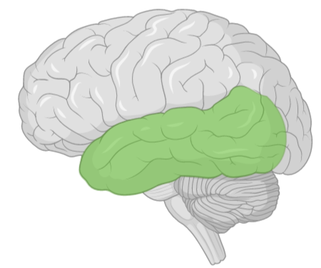
Functional temporal lobe anatomy
Wernicke’s area
Primary auditory cortex
Limbic association area
Radiopedia.org
Notes:
Wernicke’s area = comprehension of speech
Limbic association area = helps integrate information from deeper structures about memory (hippocampus), emotion (amygdala), and other regions – emotion processing
Temporal in general – rich language processing, variety of higher order sensory processing too (visual, spatial, auditory, olfactory)

Slide 13
How does our brain process, integrate and act on all this information?

Slide 14
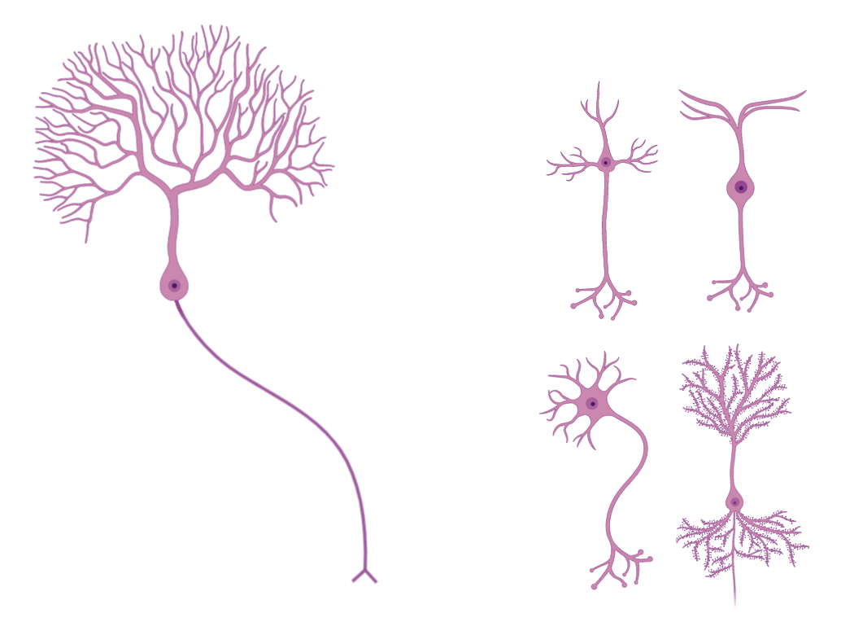

Neurons: the workhorse of our brain
All shapes and sizes:
Grey matter
White matter
Grey matter
White matter
Notes:
Neurons come in all shapes and sizes, and their shapes are often an indication of their specific functions. (I am showing purkinje here b/c they look really cool!)
These cell bodies are dense and located in the darker parts called grey matter
The long “tails”, called axons, contain a lot of fatty material, making them look white and spongier, and they look more white/lighter – all these axons travel in the white matter

Slide 15
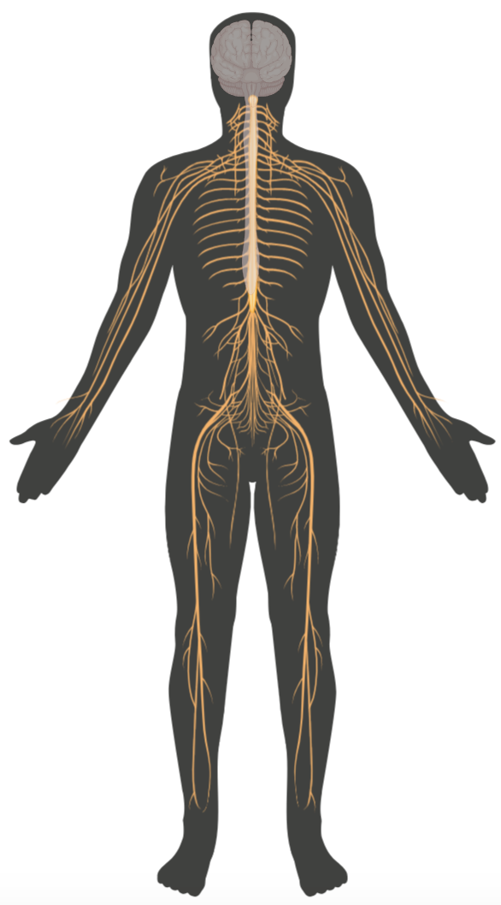
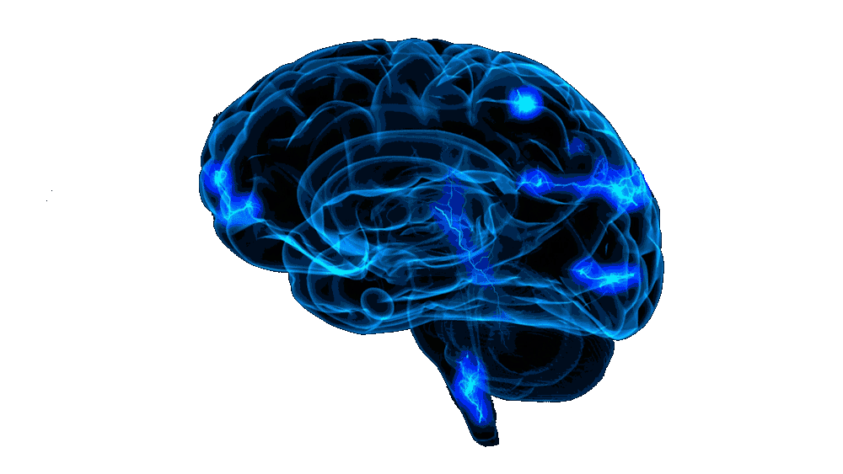

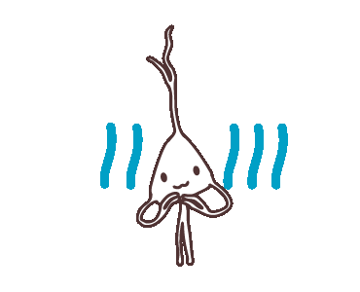


Neurons: coordinated control
Individual neuronal activity
Population neuronal activity
Nervous system control
Notes:
Individual neurons “fire” or respond to environmental (or internal) stimuli (data). It is in the population activity, neuronal connections or communication, that allow us to process information, interpret, analyze, make decisions. Interconnected. These neurons can then send information (via long axons traveling to their destination) to exert control on: organs, muscles, joints, eyes, etc.

Slide 16
Neurons need a lot of energy and oxygen to function – our blood supplies this and is crucial to maintaining normal function

Slide 17
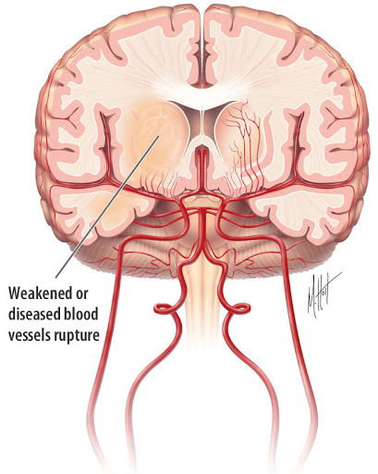
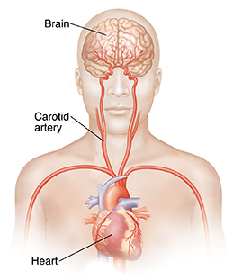
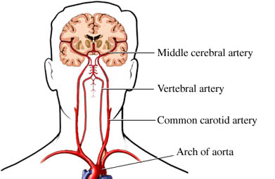
Blood flow from heart to brain

Slide 18
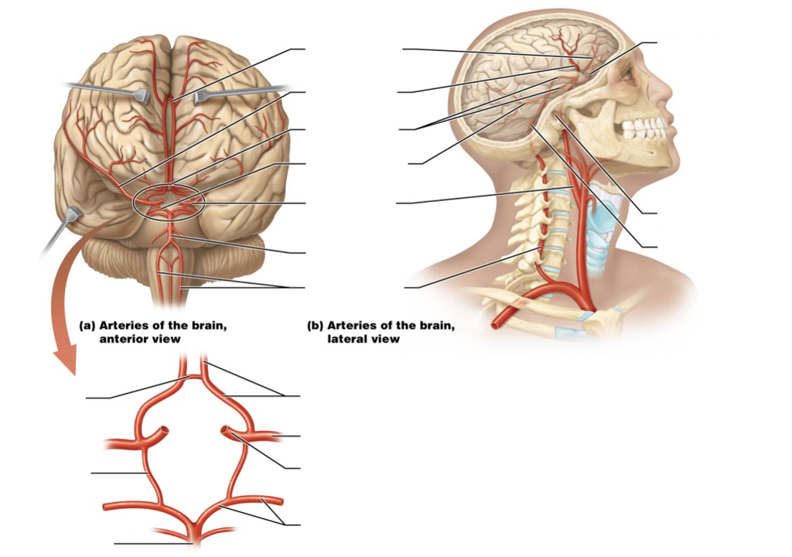
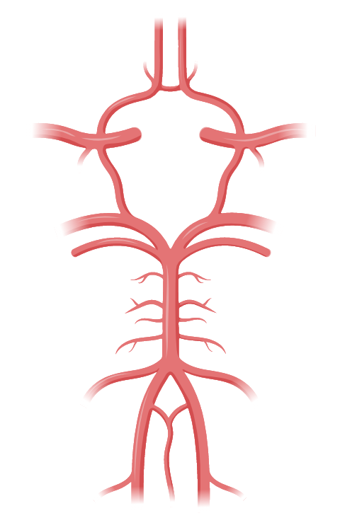
Arteries of the brain: Circle of Willis
Circle of Willis

Slide 19
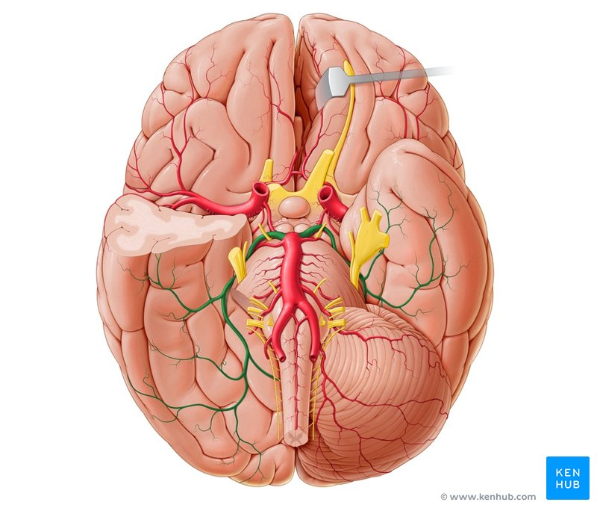
Circle of Willis
Anterior cerebral (ACA)
ACA
Internal Carotid
MCA
Middle cerebral (MCA)
PCA
Posterior cerebral (PCA)
Basilar artery
Vertebral artery
Kenhub anatomy
Notes:
Stress the focus on the ACA, MCA, PCA

Slide 20
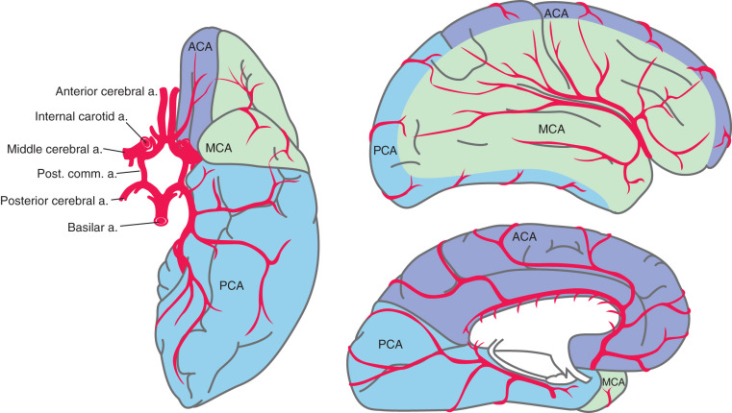
Supply to the cortex: ACA, MCA, and PCA
Occipital
Parietal
Frontal
Temporal
Gabay 2017
Notes:
Gabay 2017 Neurovascular diseases text - Elsevier

Slide 21
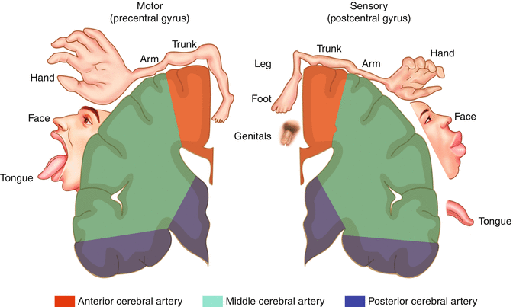

Supply to the cortex: ACA, MCA, and PCA
Gabay 2017
Notes:
Gabay 2017 Neurovascular diseases text - Elsevier

Slide 22
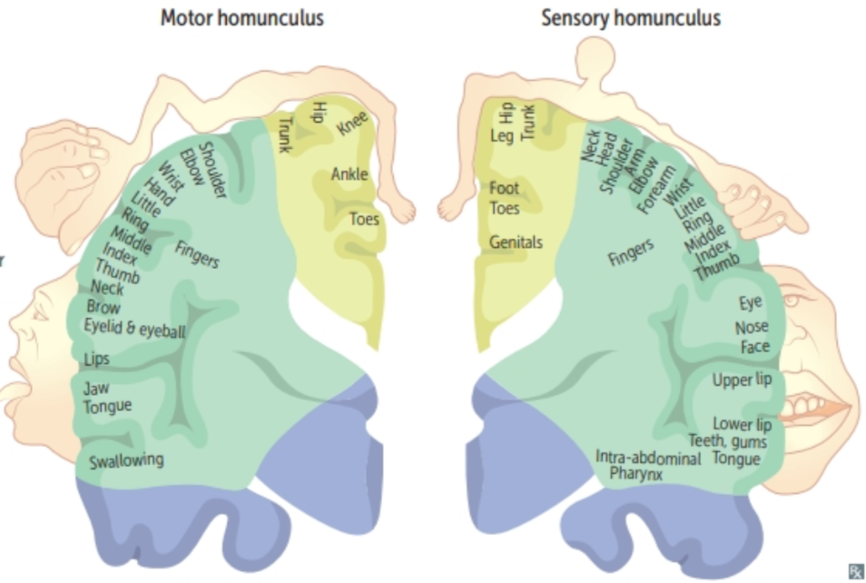
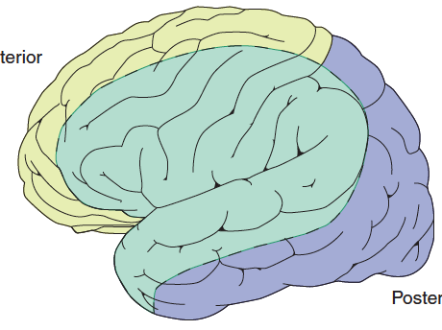
Supply to the cortex: recap
Vessel | Function of areas supplied
Anterior cerebral artery (ACA) yellow | Motor function of lower body (frontal: motor cortex) Sensations from lower body (parietal: somatosensory cortex)
Middle cerebral artery (MCA) green | Motor function of upper body (frontal: motor cortex) Sensations from upper body (parietal: somatosensory cortex) Production of speech (Frontal: Broca’s area) Comprehension of speech (Temporal: Wernicke’s area)
Posterior cerebral artery (PCA) blue | Vision (Occipital: primary visual cortex) Ability to read (Occipital: visual association areas)
Notes:
Gabay 2017 Neurovascular diseases text - Elsevier

Slide 23
How can we use our knowledge of neuroanatomy, function, and blood supply to understand stroke?

Slide 24
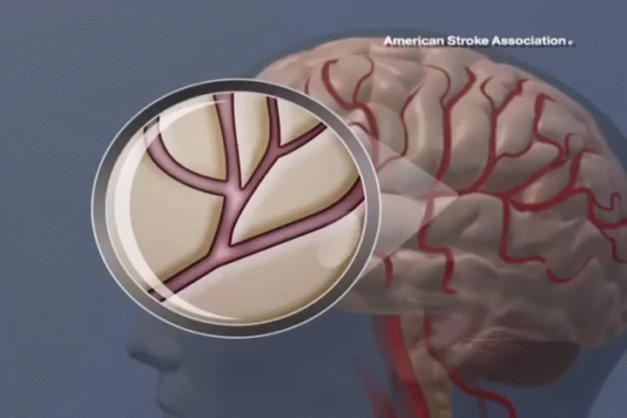
Depending on where the stroke occurs, we will see a corresponding loss of normal function in the regions without blood supply
American Stroke Association

Slide 25
What is a stroke?
When a part of the brain is damaged because of a problem with blood flow
Clogging
Breaks open
Part of the brain goes without blood for too long
Bleeding into or around the brain
American Stroke Association

Slide 26
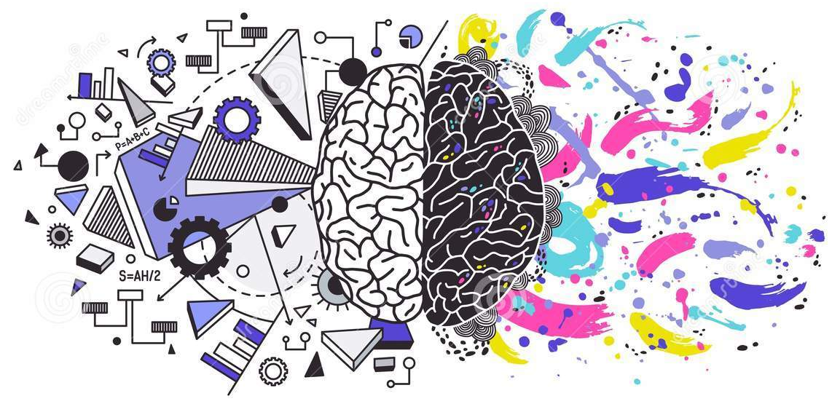
What we learned:
Stroke definition
Views of the brain (axes)
Functional neuroanatomy
Neurovascular supply
Coming up:
Clinical presentation of stroke
Pathophysiology
Risk factors
Treatment and outcomes

Slide 27
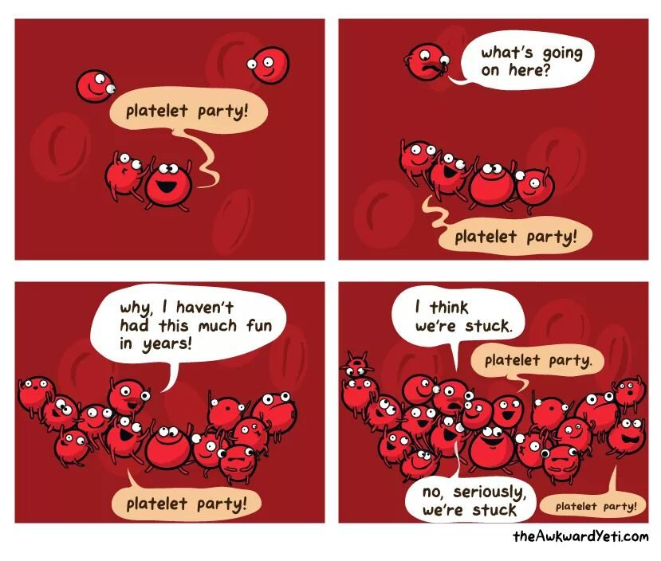
Thank you!

