Slide 1
Health Equity
UNC MD/PhD Mini Medical School Lecture
Dani Brathwaite
Tuesday, March 2, 2021

Slide 2
Learning Objectives
To define health equity and how it is measured.
To understand existing disparities in health and health care.
To define factors that influence health access and outcomes.
To consider how, we as a community, can work towards equity.

Slide 3
What is Health Equity?
Health equity is achieved when every person has the opportunity to “attain his or her full health potential” and no one is “disadvantaged from achieving this potential because of social position or other socially determined circumstances.”
Health inequities are reflected in differences in length of life; quality of life; rates of disease, disability, and death; severity of disease; and access to treatment.
Centers for Disease Control and Prevention (CDC)
Notes:
https://www.cdc.gov/chronicdisease/healthequity/index.htm
1.) Full health potential – is RELATIVE. This depends on the person. As much as we try to make universal standards, health needs vary from person to person.
2.) Socially determined – there are social factors (social determinants of health) that influence health outcomes.
3.) Outcomes – we generally measure inequity in terms of health outcomes and access.

Slide 4
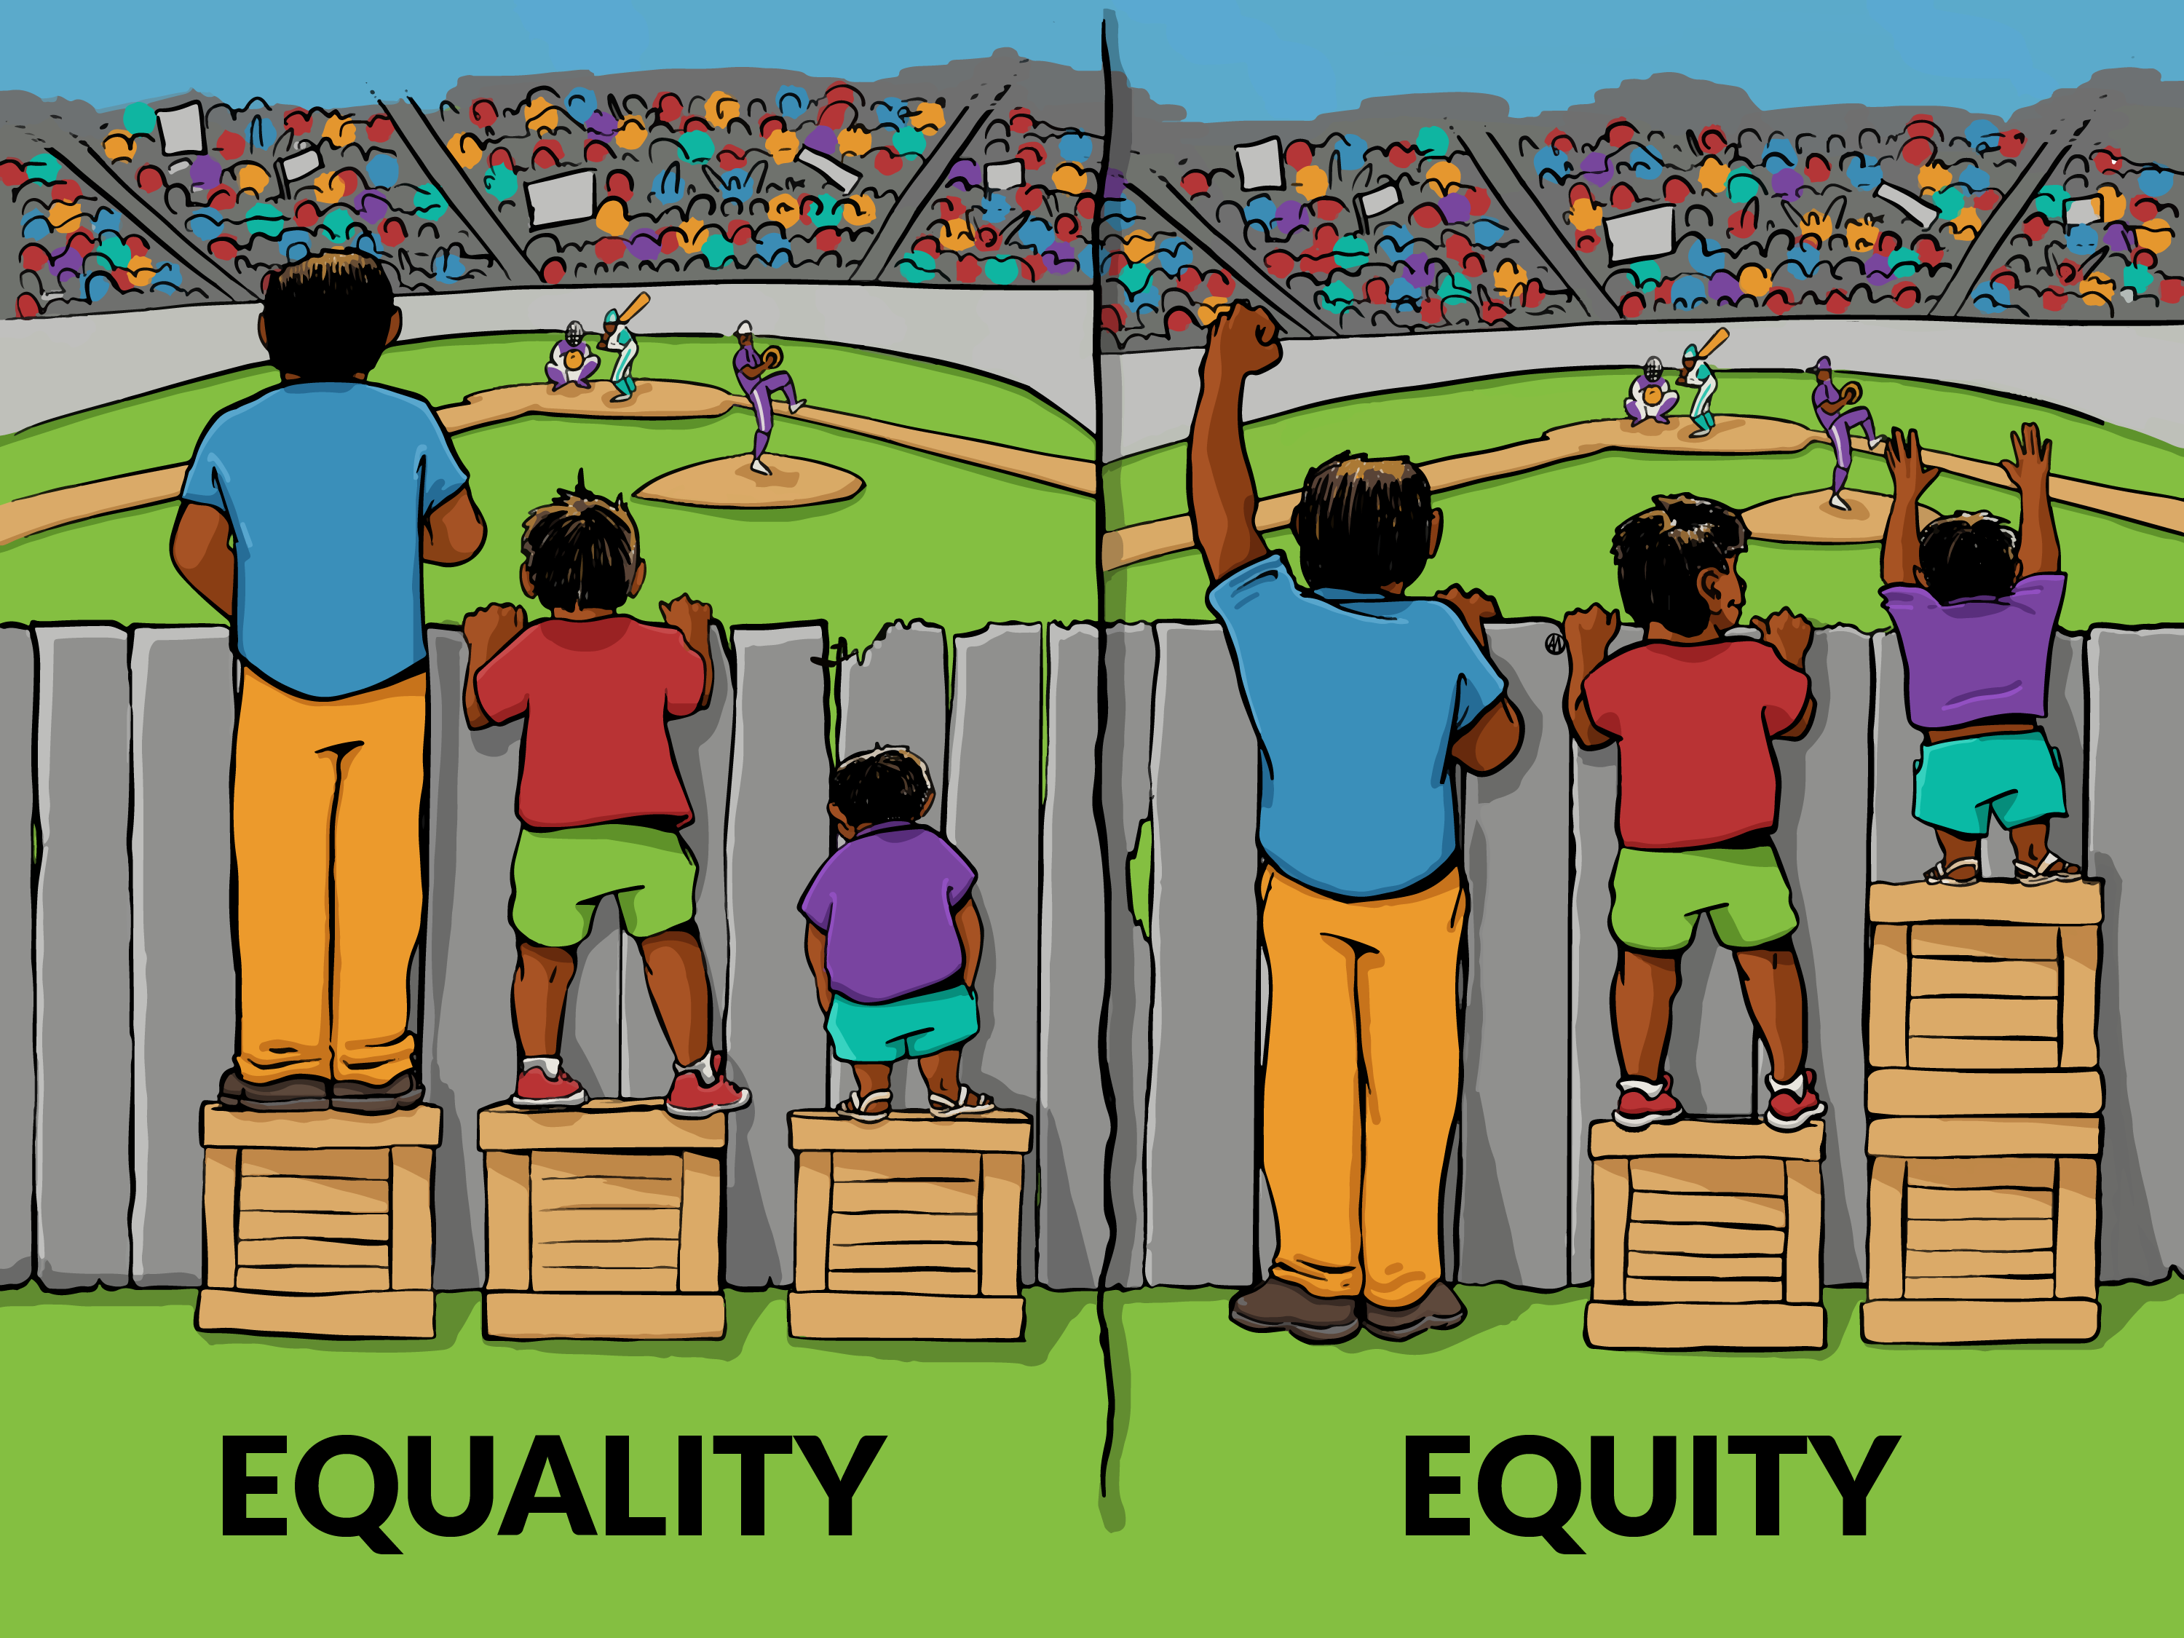
Health Equity

Slide 5
The Social Determinants of Health
Social determinants of health are the conditions in which people are born, grow, live, work and age. They include factors like socioeconomic status, education, neighborhood and physical environment, employment, and social support networks, as well as access to health care.
Kaiser Family Foundation (KFF)
Notes:
https://www.kff.org/racial-equity-and-health-policy/issue-brief/beyond-health-care-the-role-of-social-determinants-in-promoting-health-and-health-equity/

Slide 6
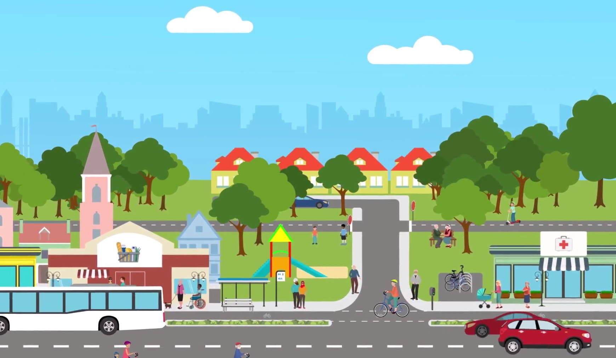

Slide 7
Notes:
https://www.kff.org/racial-equity-and-health-policy/issue-brief/beyond-health-care-the-role-of-social-determinants-in-promoting-health-and-health-equity/
Unfortunately, we cannot measure all of these! So instead, we measure the health outcomes that result.

Slide 8
Health Disparities
Health and health care disparities refer to differences in health and health care between groups that are closely linked with social, economic, and/or environmental disadvantage. Disparities occur across many dimensions, including race/ethnicity, socioeconomic status, age, location, gender, disability status, and sexual orientation.
Kaiser Family Foundation
Notes:
https://www.kff.org/racial-equity-and-health-policy/issue-brief/disparities-in-health-and-health-care-five-key-questions-and-answers/

Slide 9
Existing Disparities
Health Care Access
Maternal Mortality
Childhood Obesity
Cardiovascular Disease
COVID19

Slide 10
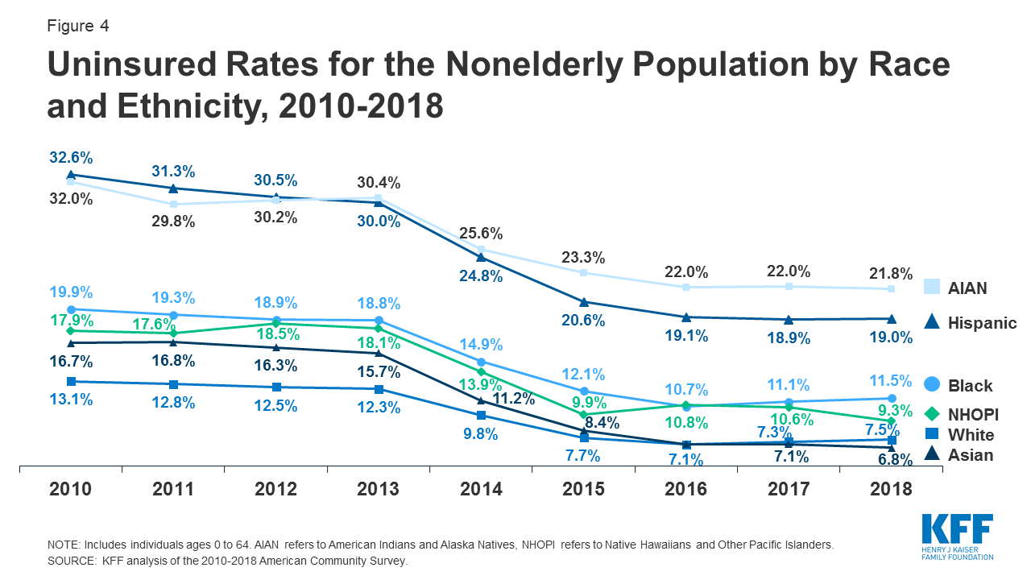
Insurance Coverage
Notes:
https://www.kff.org/racial-equity-and-health-policy/issue-brief/disparities-in-health-and-health-care-five-key-questions-and-answers/

Slide 11
Insurance Coverage
Notes:
https://www.kff.org/racial-equity-and-health-policy/issue-brief/disparities-in-health-and-health-care-five-key-questions-and-answers/

Slide 12
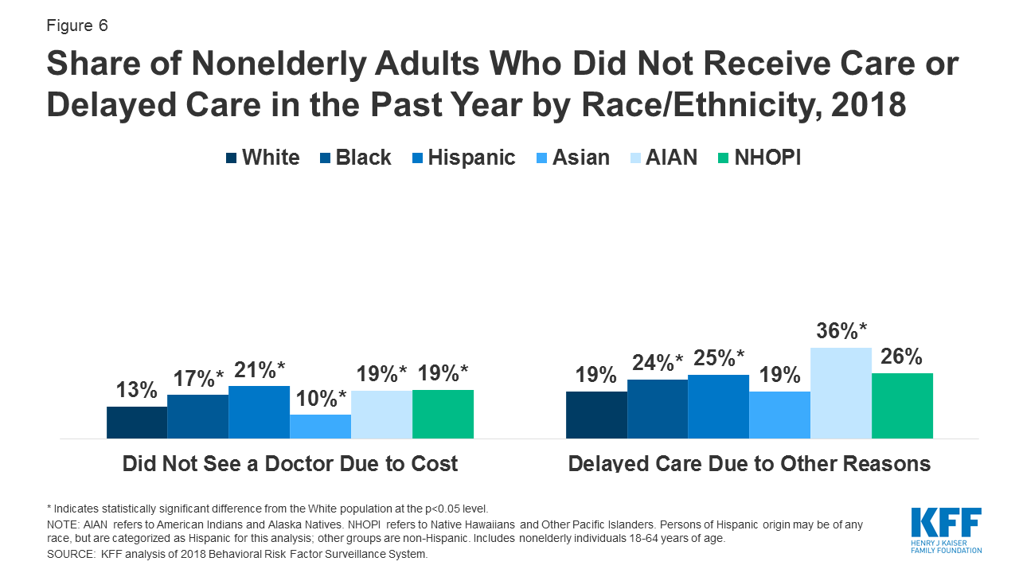
Notes:
https://www.kff.org/racial-equity-and-health-policy/issue-brief/disparities-in-health-and-health-care-five-key-questions-and-answers/
When care is received, there is evidence supporting that the care received is of lower quality.

Slide 13
Notes:
Source: https://www.cdc.gov/nchs/maternal-mortality/index.htm

Slide 14
Notes:
Source: https://www.cdc.gov/reproductivehealth/maternal-mortality/disparities-pregnancy-related-deaths/infographic.html

Slide 15
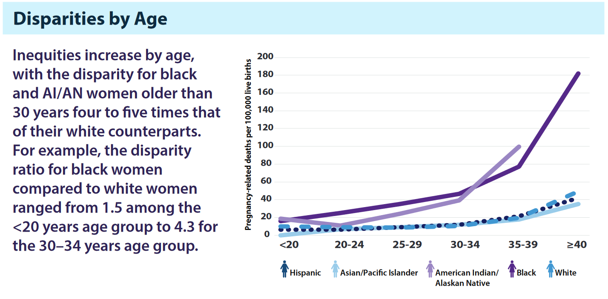
Notes:
Source: https://www.cdc.gov/reproductivehealth/maternal-mortality/disparities-pregnancy-related-deaths/infographic.html

Slide 16
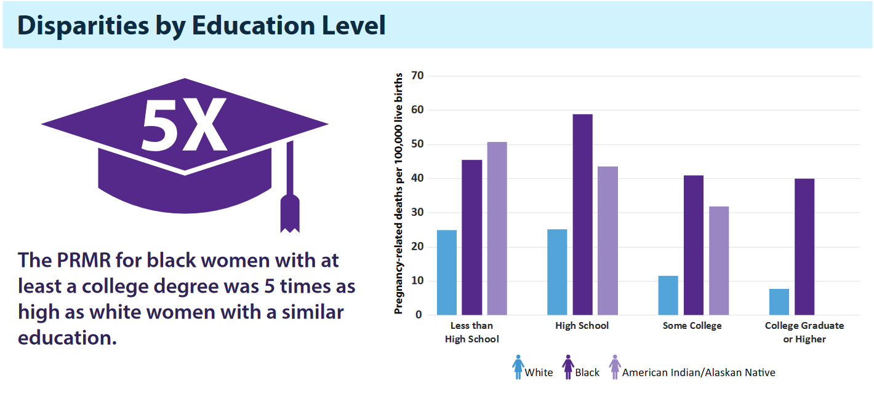
Notes:
Source: https://www.cdc.gov/reproductivehealth/maternal-mortality/disparities-pregnancy-related-deaths/infographic.html

Slide 17
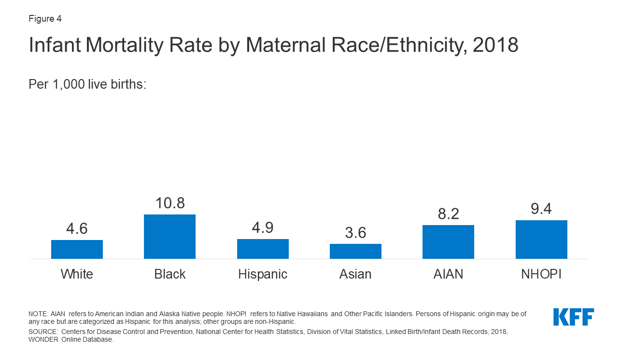
Notes:
https://www.kff.org/report-section/racial-disparities-in-maternal-and-infant-health-an-overview-issue-brief/

Slide 18
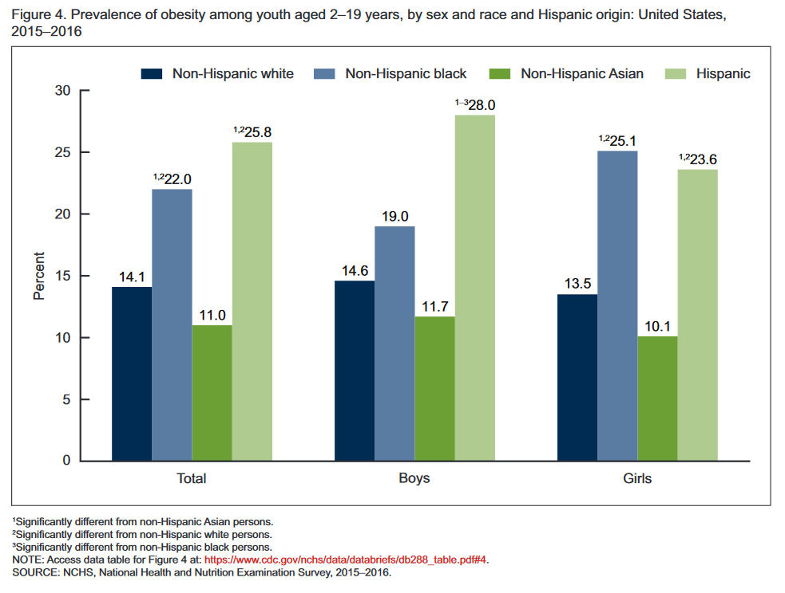
Notes:
https://www.cdc.gov/nchs/data/databriefs/db288.pdf
Native American/Tribal populations are left off of these measures

Slide 19
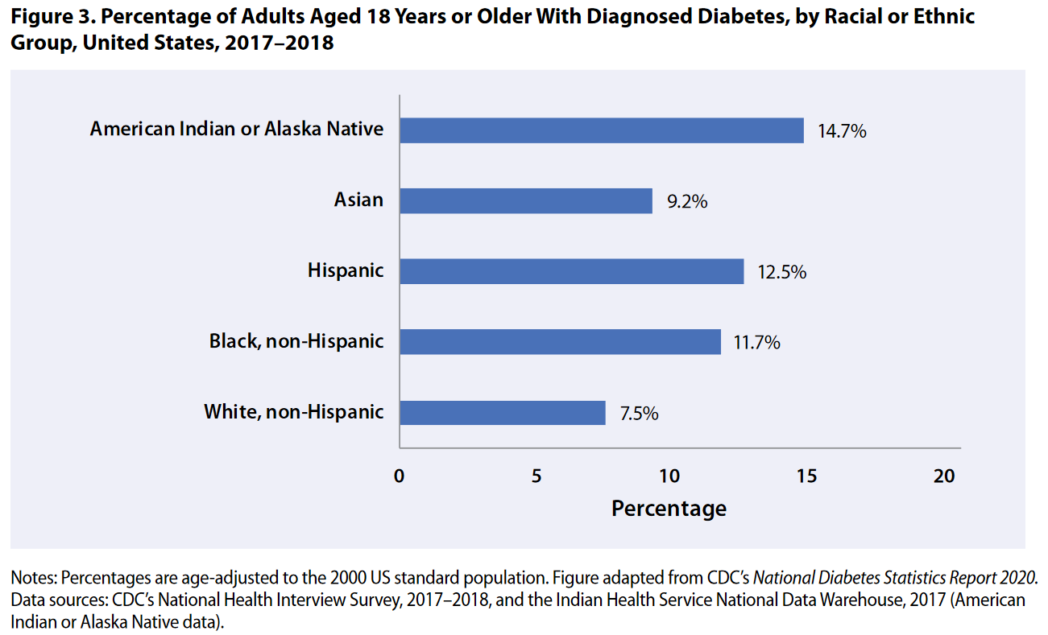
Notes:
https://www.cdc.gov/diabetes/library/reports/reportcard.html

Slide 20
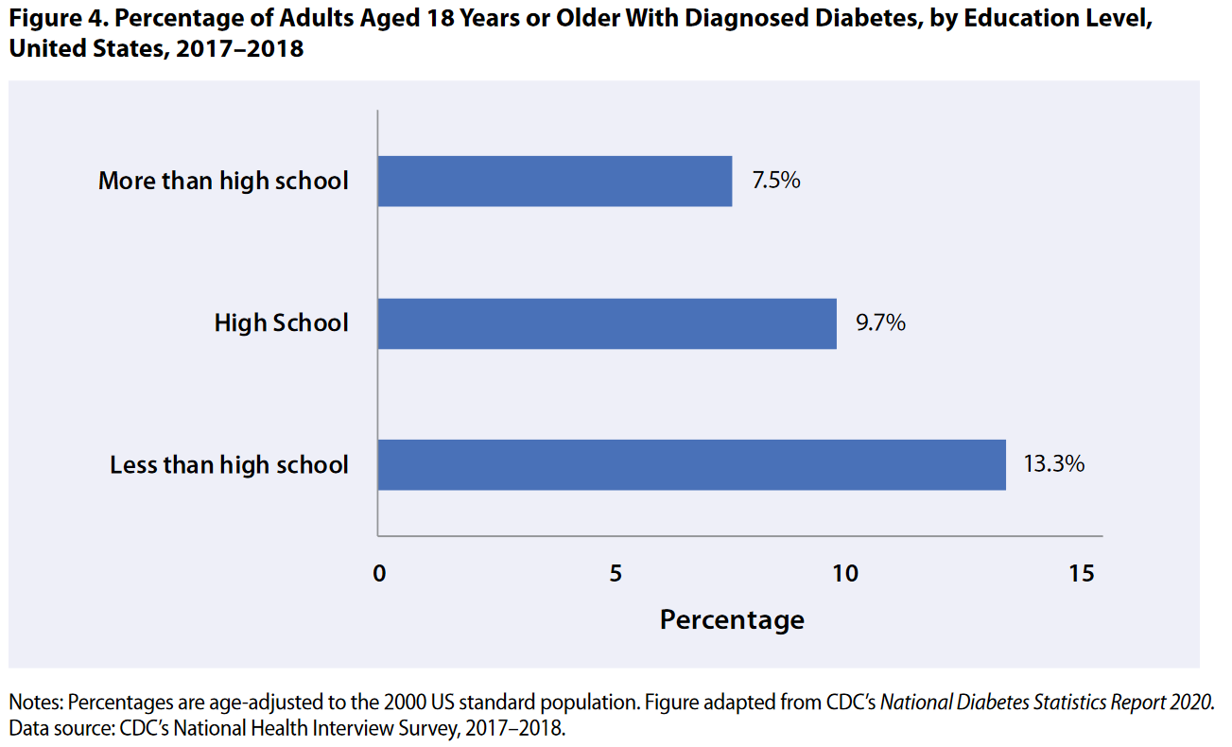
Notes:
https://www.cdc.gov/diabetes/library/reports/reportcard.html

Slide 21
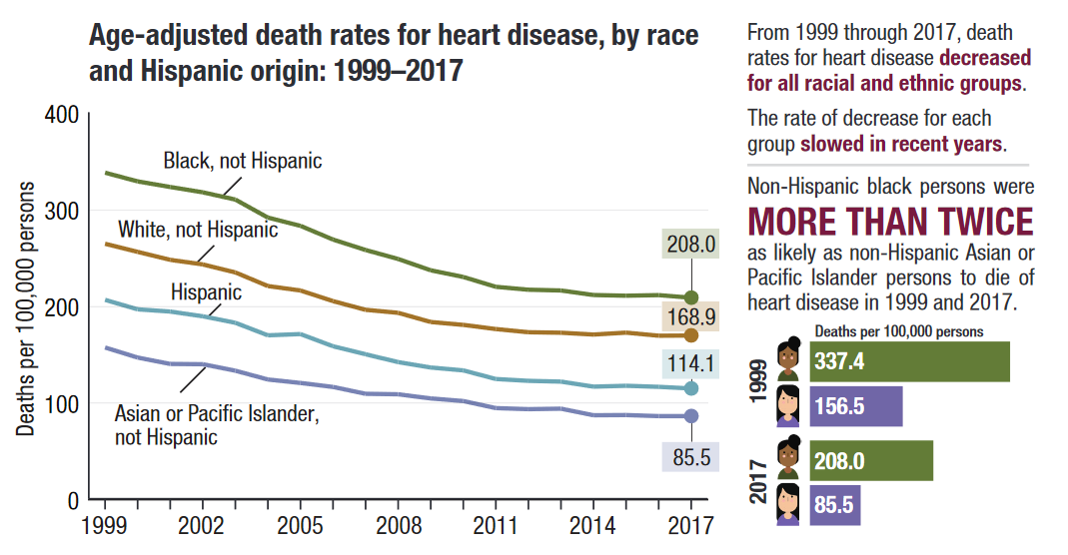
Notes:
https://www.cdc.gov/nchs/hus/spotlight/HeartDiseaseSpotlight_2019_0404.pdf

Slide 22
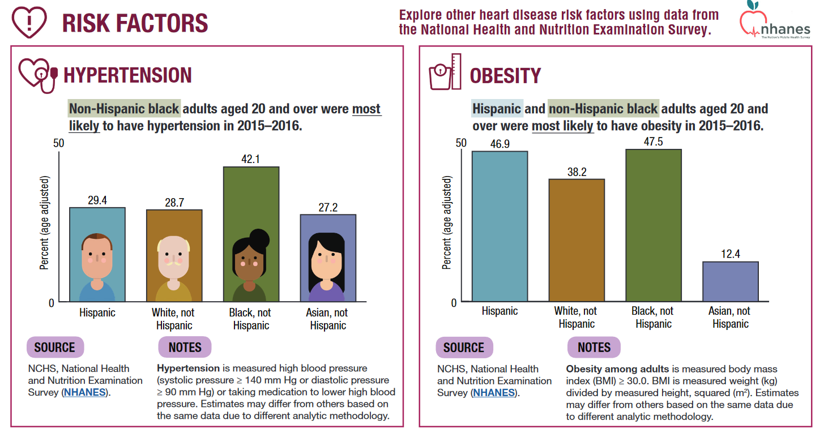
Notes:
https://www.cdc.gov/nchs/hus/spotlight/HeartDiseaseSpotlight_2019_0404.pdf

Slide 23
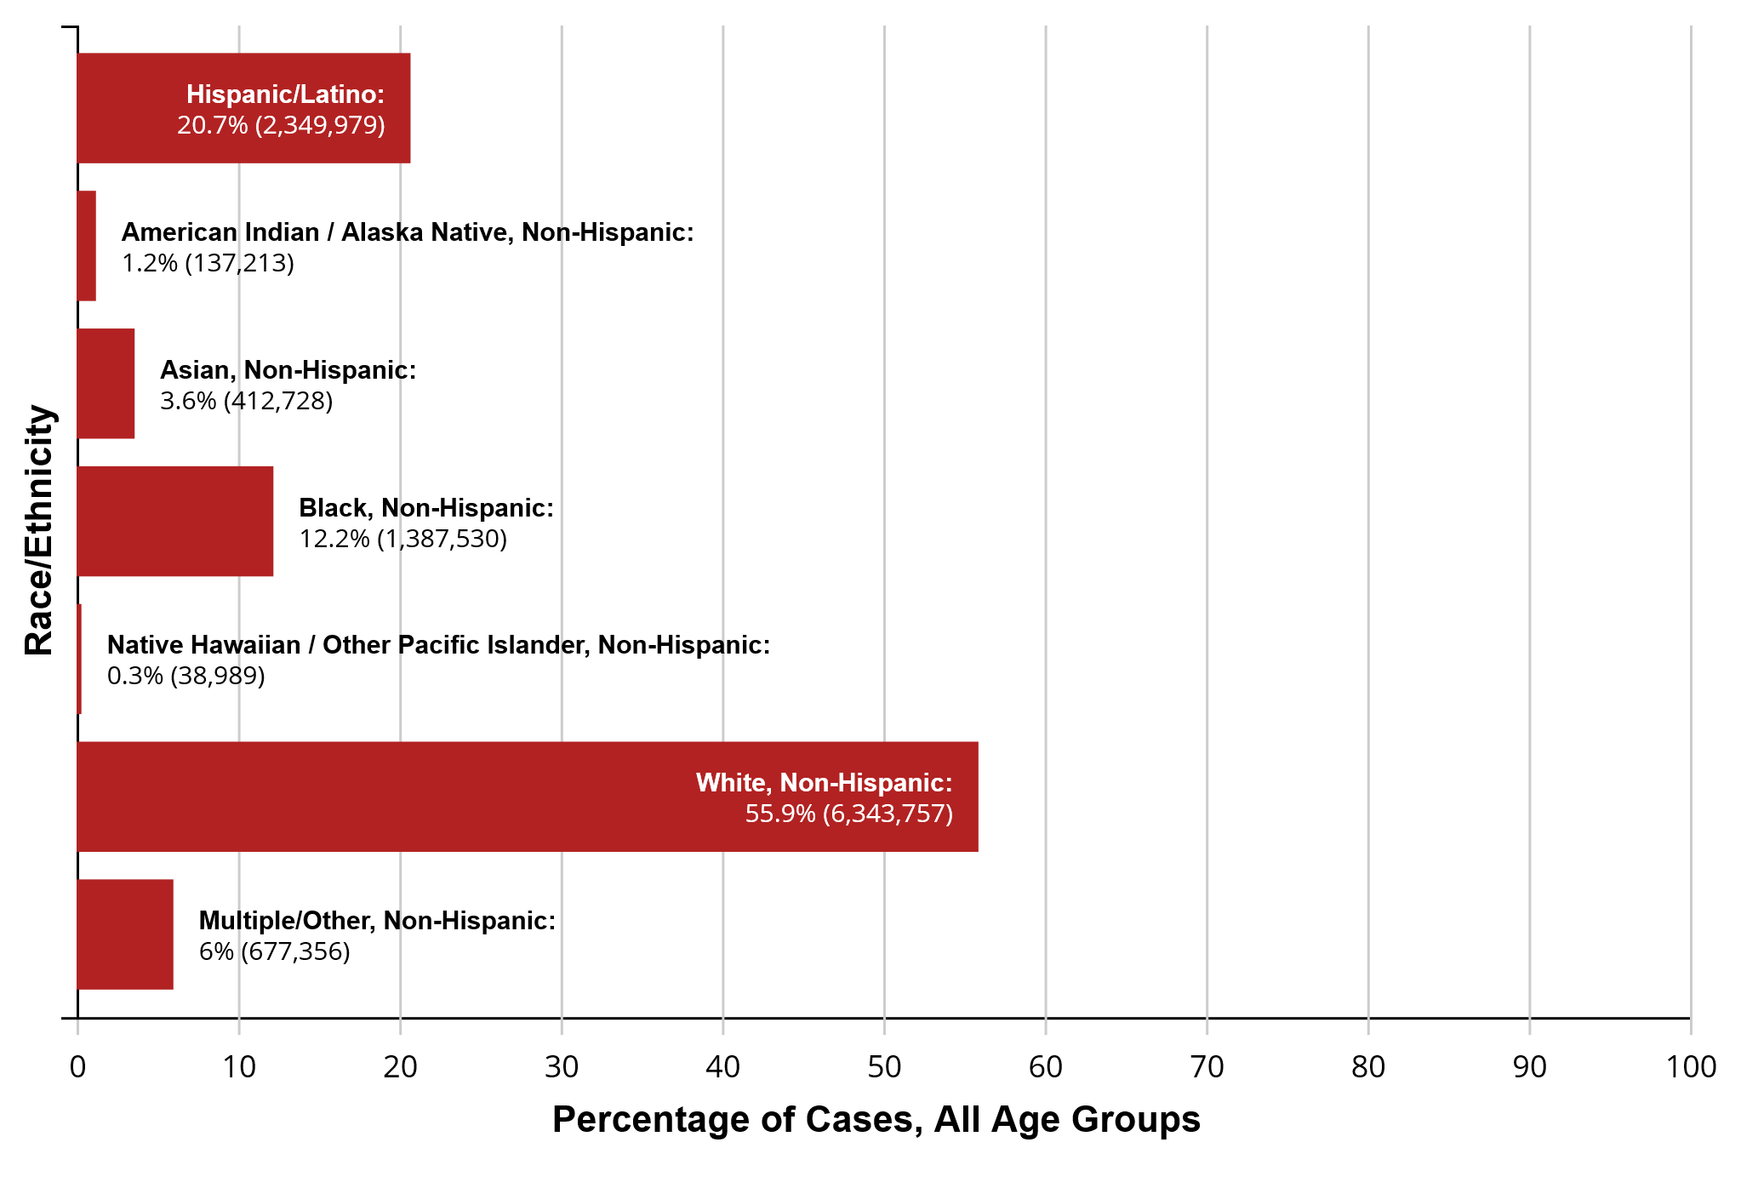
Notes:
https://www.cdc.gov/coronavirus/2019-ncov/community/health-equity/racial-ethnic-disparities/increased-risk-illness.html

Slide 24
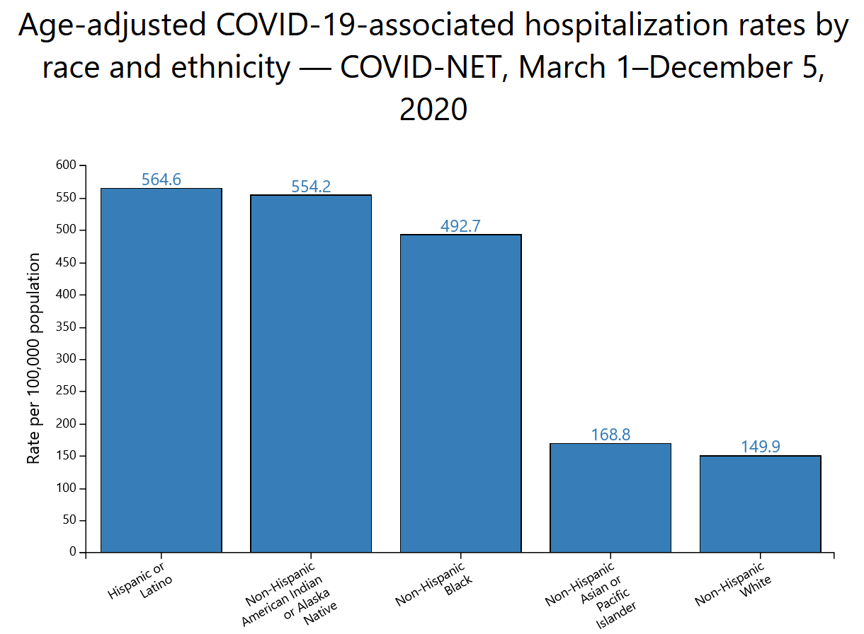
Notes:
https://www.cdc.gov/coronavirus/2019-ncov/community/health-equity/racial-ethnic-disparities/disparities-hospitalization.html

Slide 25
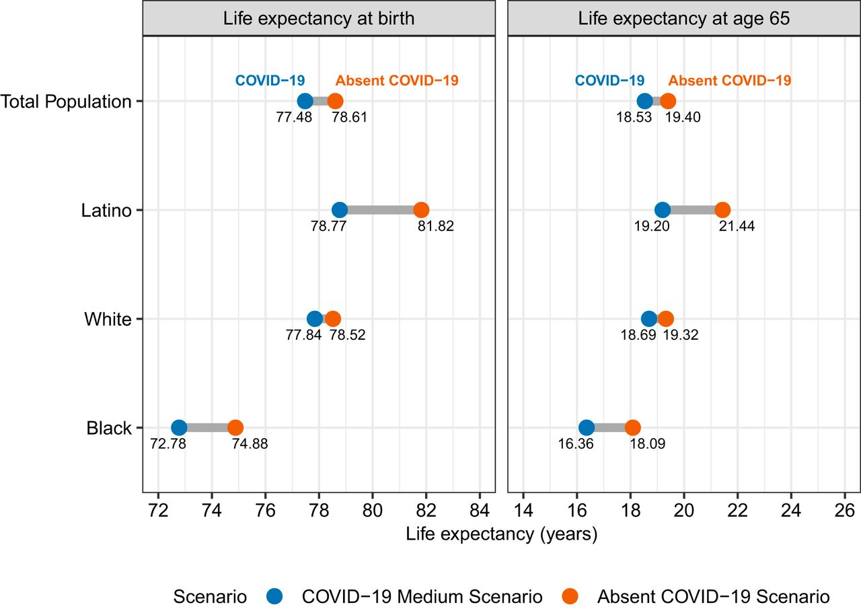
Notes:
Andrasfay, T., & Goldman, N. (2021). Reductions in 2020 US life expectancy due to COVID-19 and the disproportionate impact on the Black and Latino populations. Proceedings of the National Academy of Sciences, 118(5).

Slide 26
Take Home Points
Disparities exist across race/ethnicity, income, education, age, and other social strata.
Disparities exist across all types of diseases from infectious to chronic.
Disparities exist across the life course and compound over time.

Slide 27
Notes:
https://www.cdc.gov/minorityhealth/publications/health_equity/index.html

Slide 28
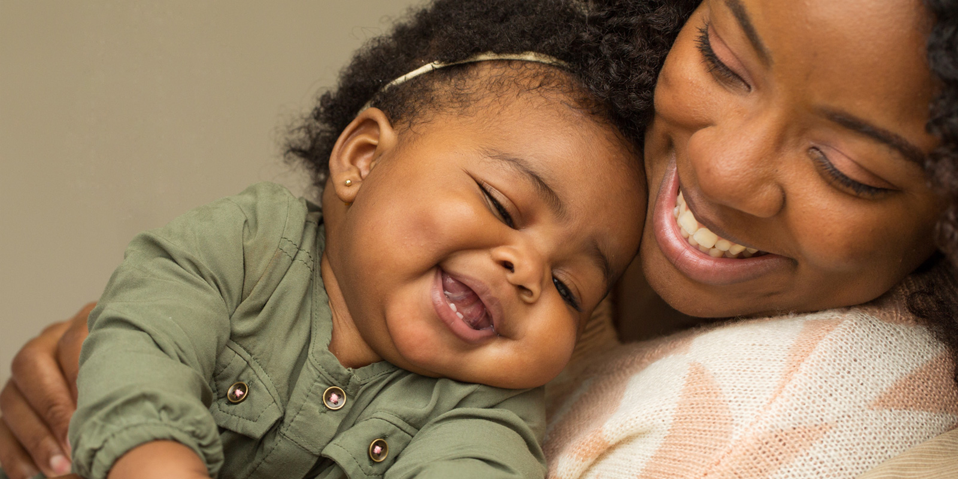
Community-Based Birth Centers
Mamatoto Village, Washington D.C.
Community-based non-profit
Perinatal Clinical Services (Pregnancy, Lactation)
Training – Community Health Workers
Home Visits & Care Coordination
Social Needs Assessment
Patient Education
Notes:
Serves approximately 400 women per year.
Built partnerships with Medicaid MCOs in the areas – patients can be referred here
Determinants: access to medical care, community support, provider trust, social support network
Outcomes: normal birth weight, breastfeeding, postnatal follow-up
https://www.nationalpartnership.org/our-work/resources/health-care/maternity/tackling-maternal-health-disparities-a-look-at-four-local-organizations-with-innovative-approaches.pdf
https://www.commonwealthfund.org/publications/newsletter-article/2018/sep/community-based-approach-reducing-disparities-maternal
https://www.mamatotovillage.org/

Slide 29
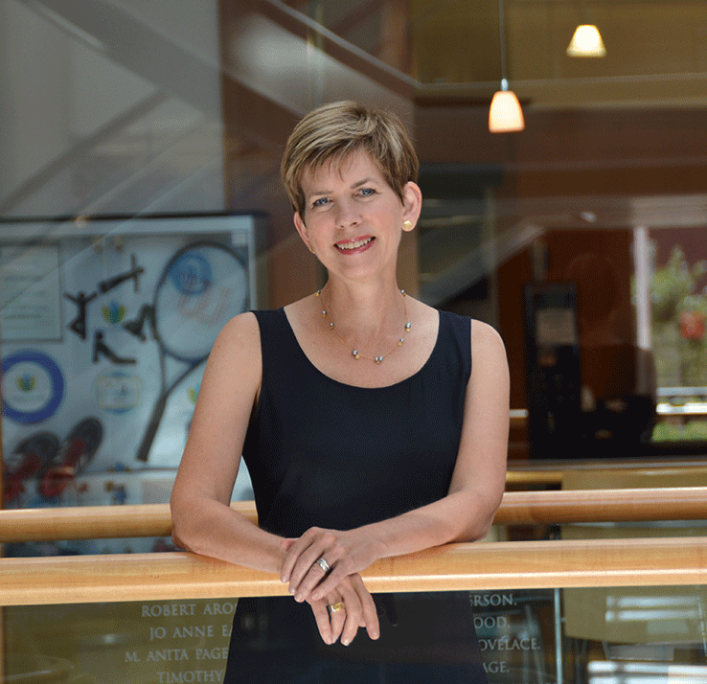
Tribal Turning Point
Primary school-aged youth
10-session group class
Physical activity
Group meal
“Wellness bucks”
Motivational interviewing session (Caregiver/Youth)
Resource Toolbox for coaches
Delivered by tribe-member coaches
Notes:
Source: Sauder KA, Dabelea D, Bailey-Callahan R, et al. Targeting risk factors for type 2 diabetes in American Indian youth: the Tribal Turning Point pilot study. Pediatr Obes. 2018;13(5):321-329. doi:10.1111/ijpo.12223
Dr. Beth Mayer-Davis (UNC Nutrition – Chair)
RCT, 8 mo. Pilot trial. Collaborative partnership between the Eastern Band of Cherokee Indians, Navajo Nation, the University of North Carolina at Chapel Hill (UNC), and the University of Colorado in Denver (UCD). Built off of existing federally funded Diabetes Prevention Program.
This program came together after YEARS of conducting focus groups and working with local stakeholders and CDC-funded programs to adapt existing interventions to youth needs.
MI – assess stages of change for parent and household.
Local health coaches were trained to administer the program.
What did they find? 62 participants, 52 families (29 exp/33 control)
BMI increased in control group but not treatment group
BMI decreased in treatment group
Treatment group was satisfied with the intervention.

Slide 30
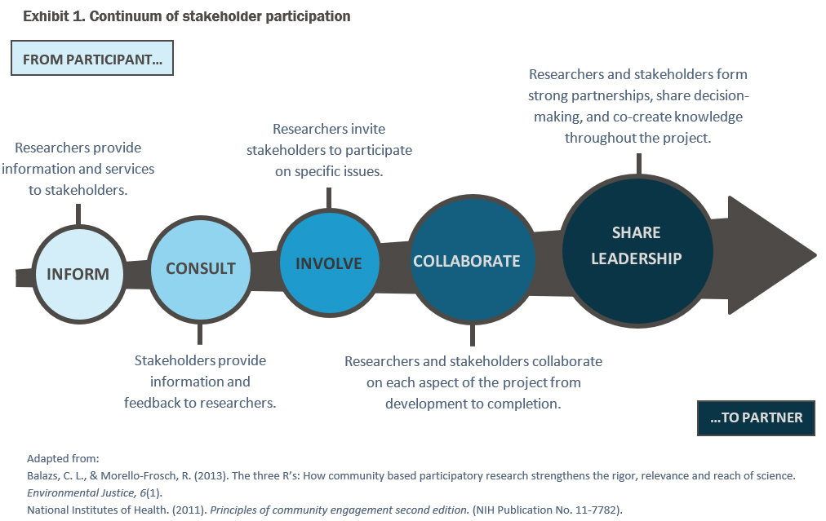
Community Based Participatory Research
Notes:
https://www.hvresearch.org/precision-home-visiting/participatory-approaches/

Slide 31
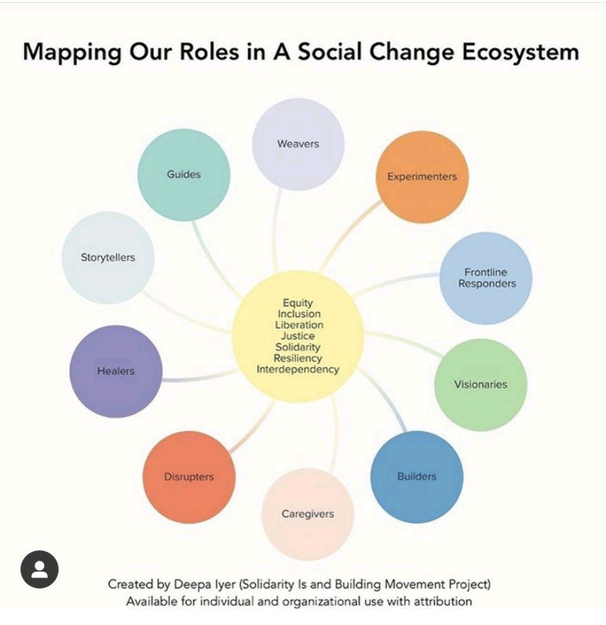
Next Steps
INFORM
INVOLVE
INFLUENCE
Notes:
https://medium.com/@dviyer/mapping-our-social-change-roles-in-times-of-crisis-8bbe71a8ab01

Slide 32
Questions?
danielle_brathwaite@med.unc.edu

