Slide 1
Introduction to Vaccines
Cameron Adams, PhD

Slide 2
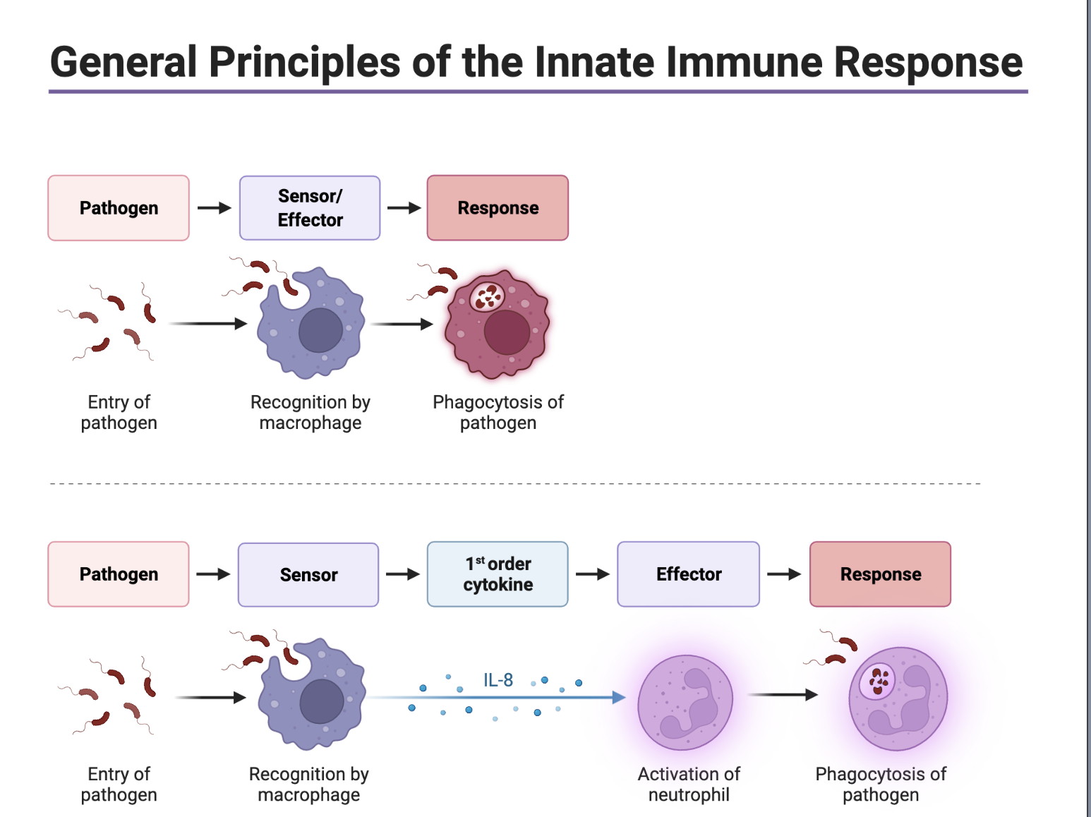


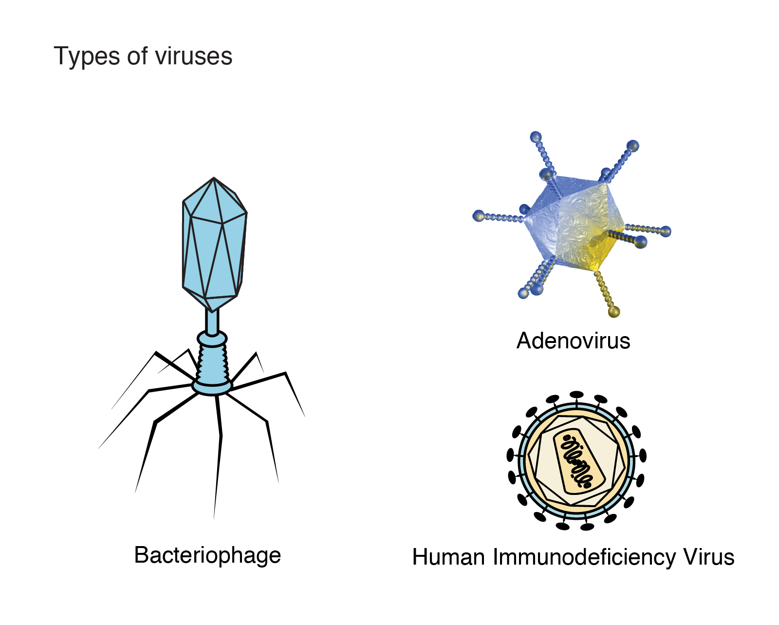

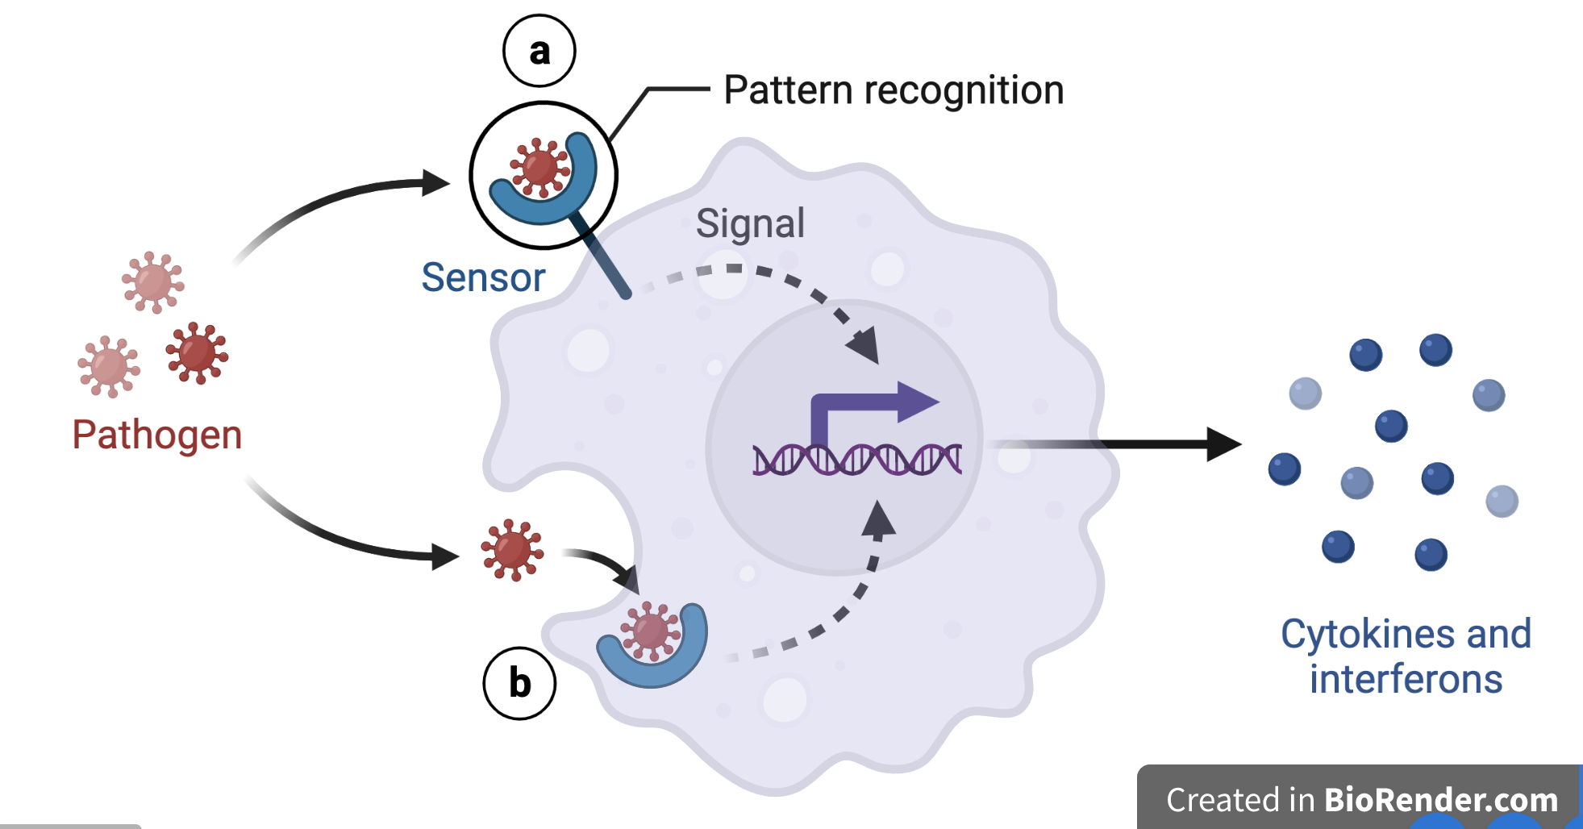
How do you normally respond to infection?
Innate response
Infection

Slide 3



Two branches of adaptive immune response
B-Cell
T-Cell
Infection
Adaptive immune response

Slide 4
B-cells produce antibodies
IgM
IgG
IgA
IgE
B-Cell
Infection
Adaptive immune response

Slide 5
T-cells fulfill two different functions
CD4+
“Helper T-cells”
CD8+
“Killer T-cells”
T-Cell
Infection
Adaptive immune response

Slide 6

What is a vaccine?
Goal of a vaccine: Elicit a protective immune response
Different formats:
  Live, attenuated (weakened) virus MMR
  Killed virus Flu
  Subunit (part of virus) HepB
  Toxoid Diphtheria
  mRNA COVID

Slide 7
How do we think vaccines work
B-Cell
T-Cell
Infection
Adaptive immune response

Slide 8
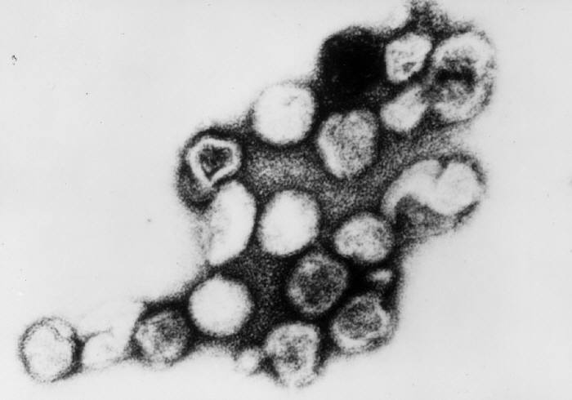
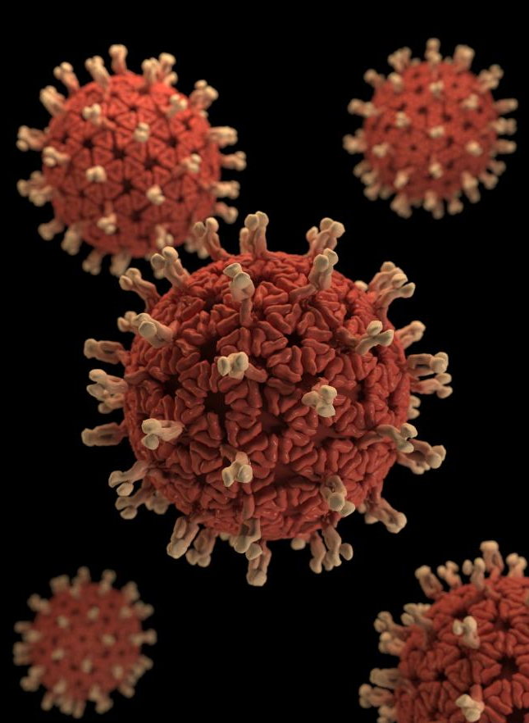
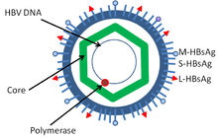
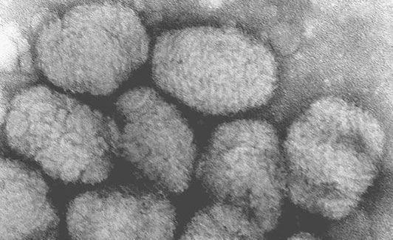
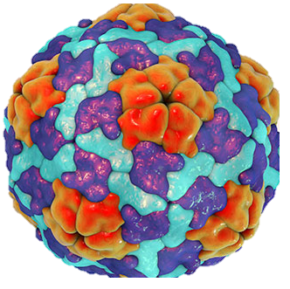
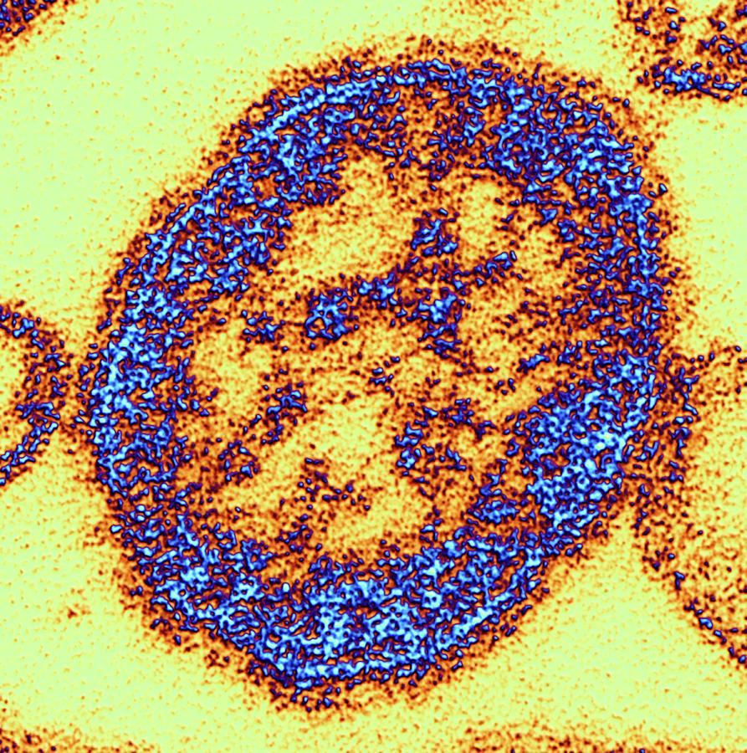
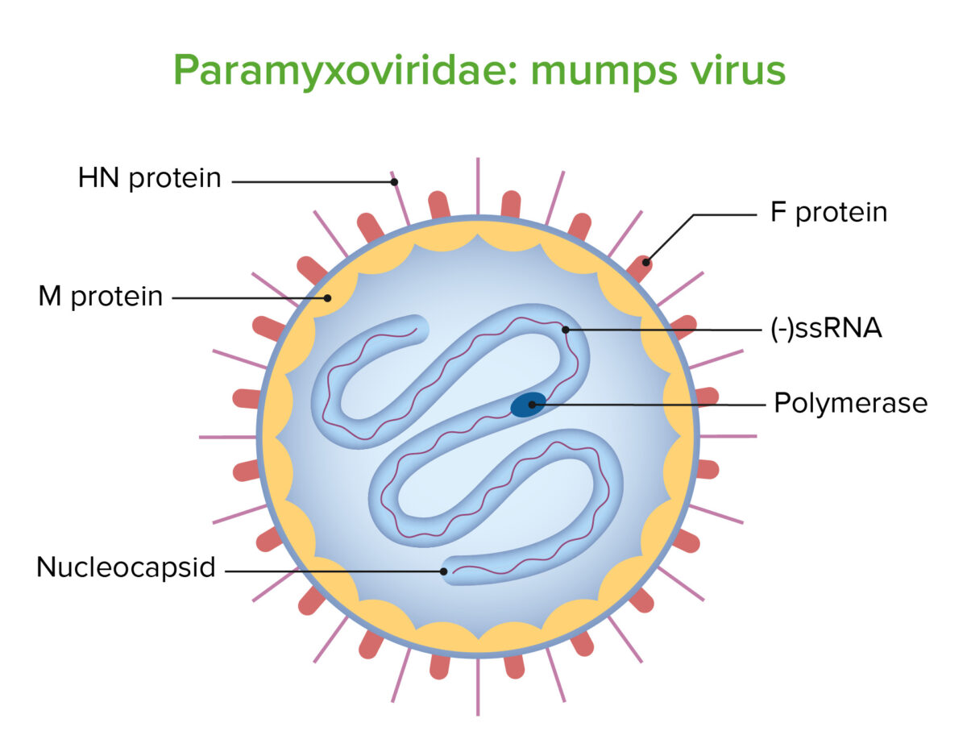
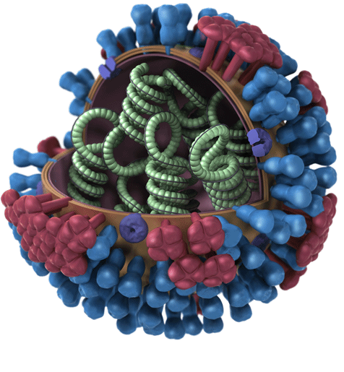
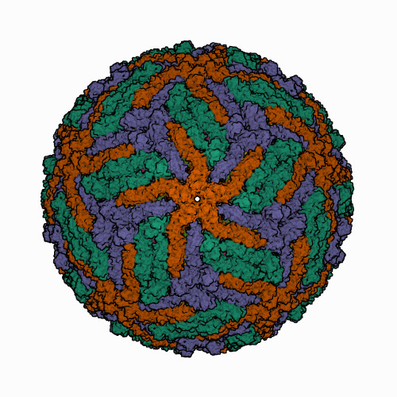
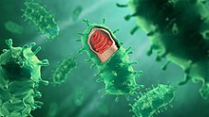
Antibodies are identified as protective macromolecules
Identified Ab as protective
Rubella
HepA
Smallpox
HepB
Rotavirus
Influenza
Measles
Rabies
Mumps
JEV

Slide 9
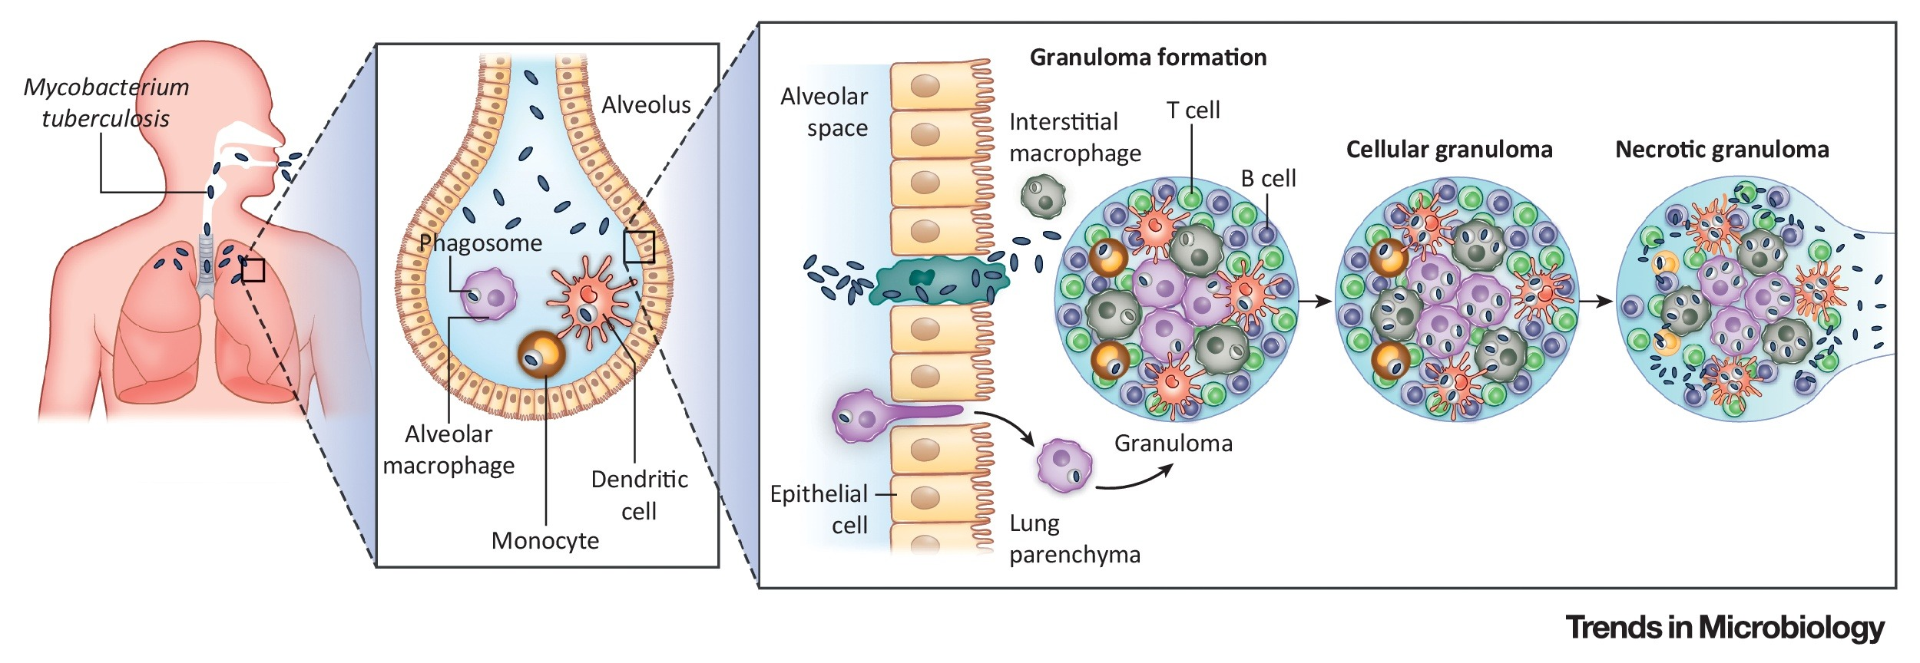
Some pathogens require a good T-cell response
Tuberculosis requires a good T-cell response as TB hides intracellularly
Koch/Mizrahi, Cell, 2018

Slide 10
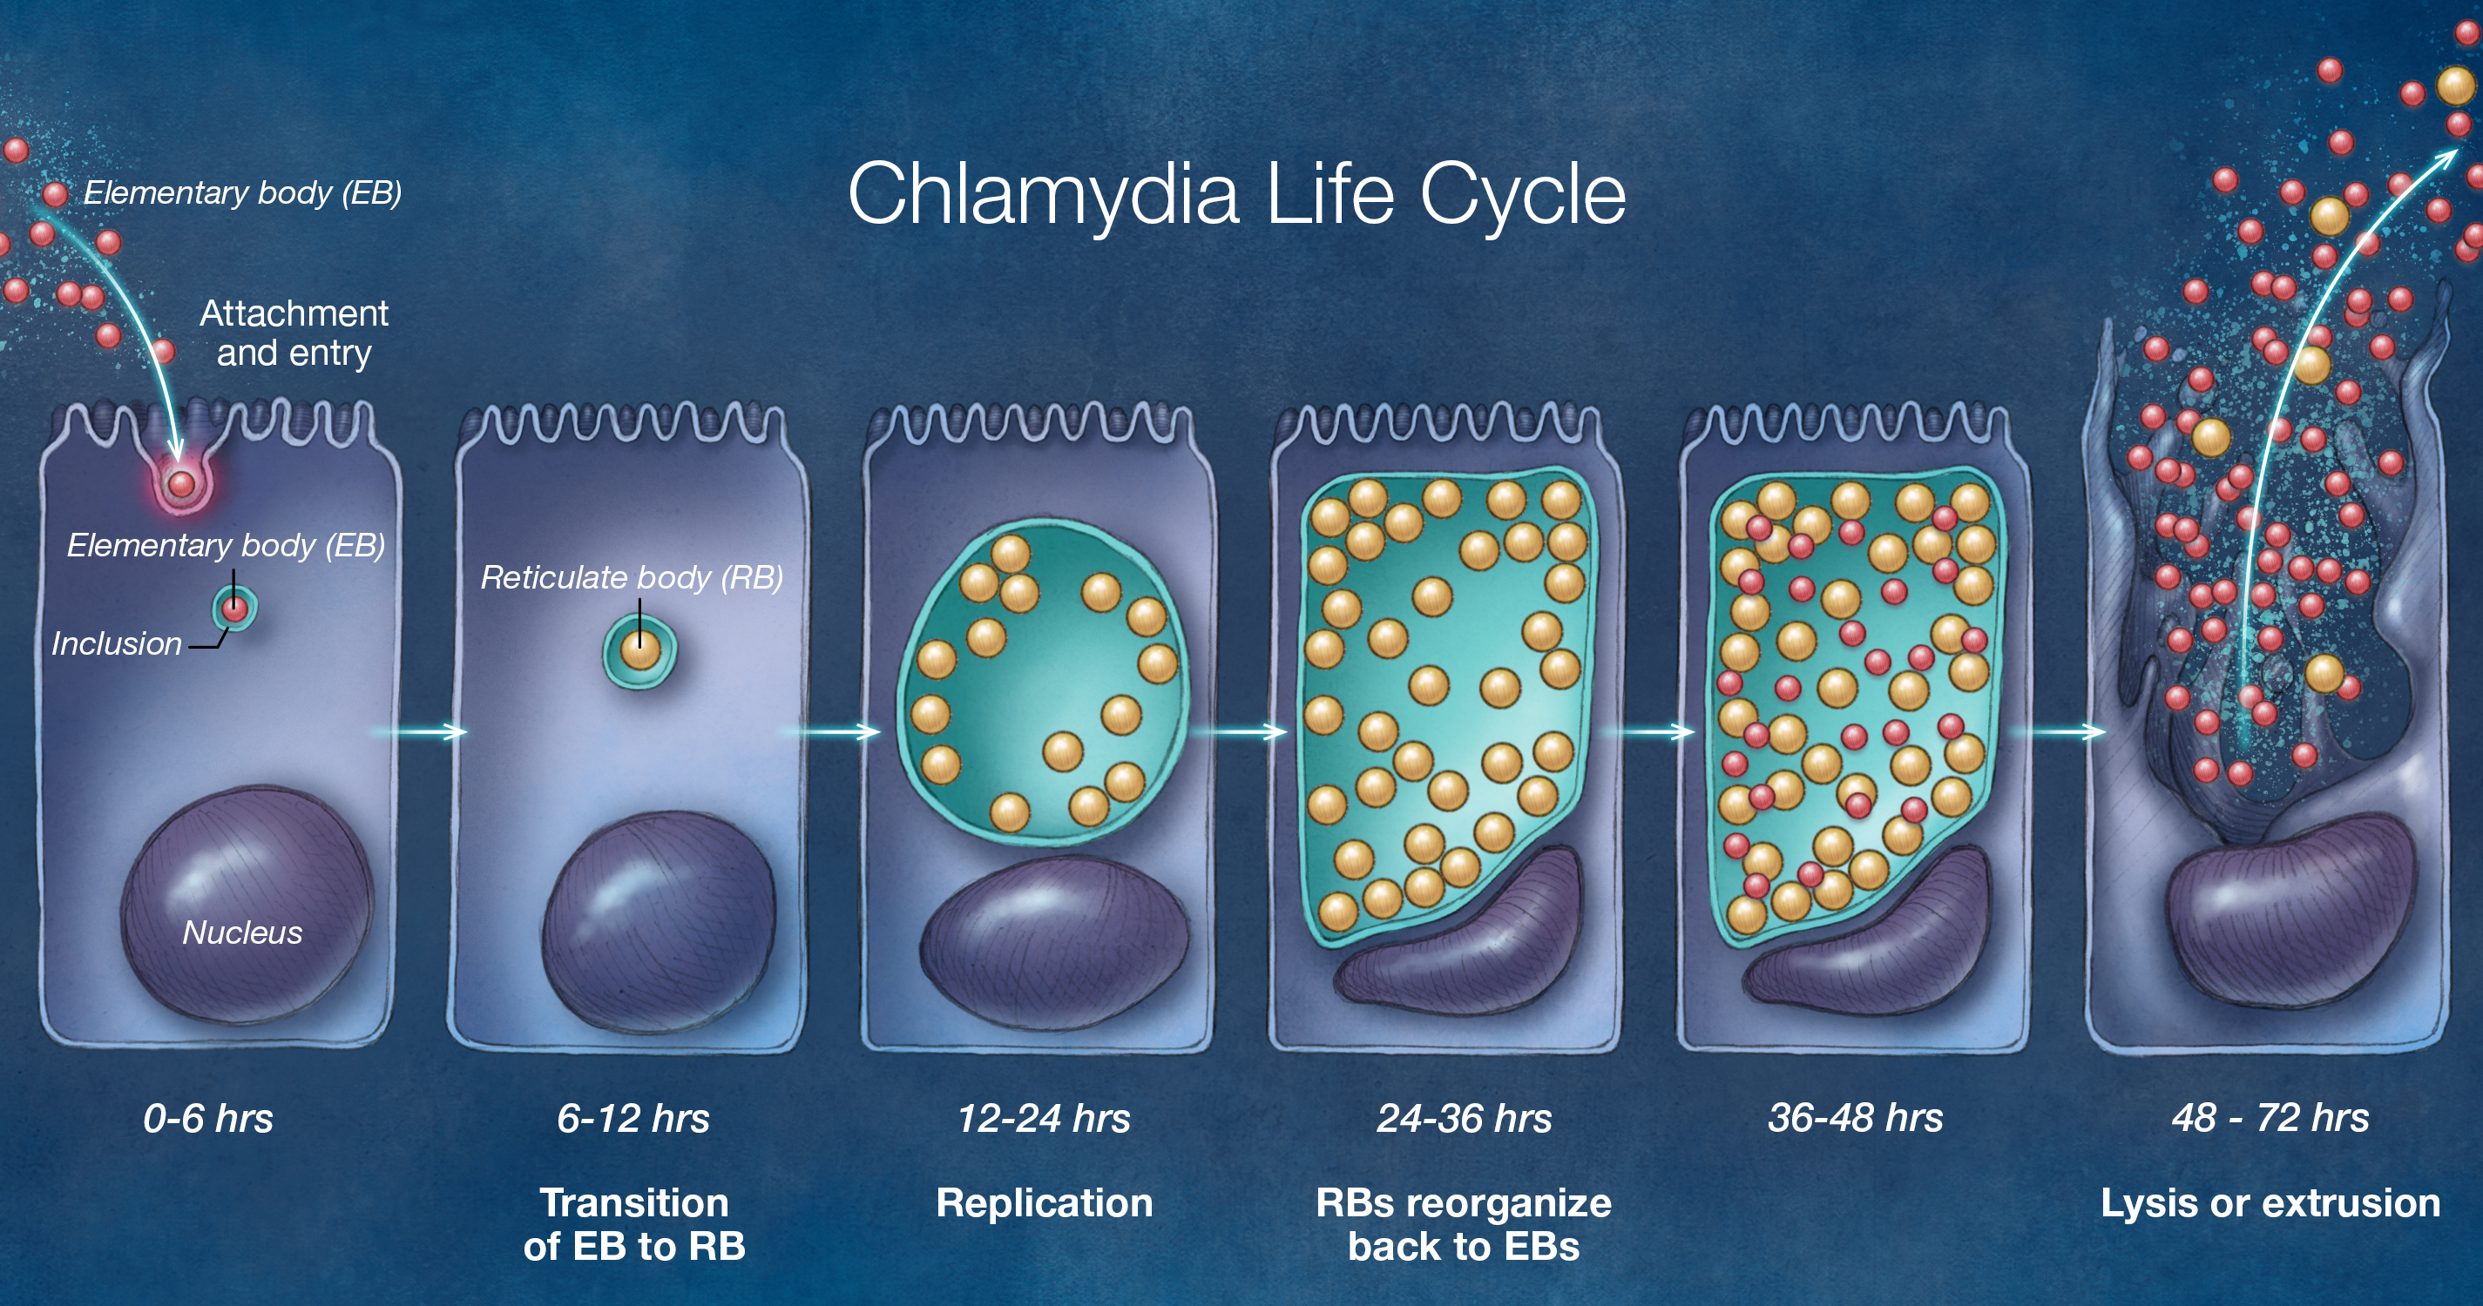
Majority of chlamydia lifespan is in the cell
University of Washington

Slide 11
Next Frontier: T-cell Vaccines
How do we make vaccines that produce a robust T-cell response to clear these intracellular organisms?

Slide 12
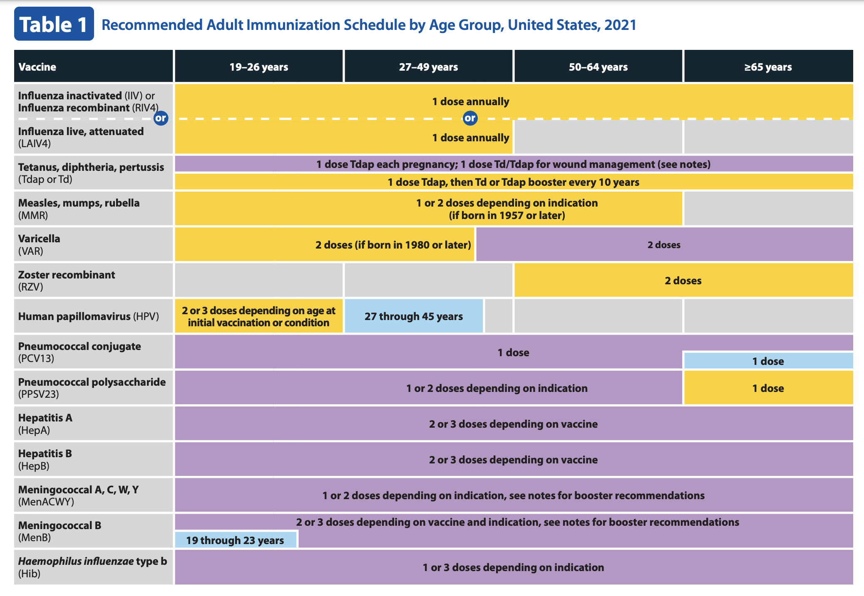
Next Frontier

