Slide 1
By the
Numbers
HCV and HIV Epidemiology in the US

Slide 2
Christopher B. Hurt, MD
Associate Professor of Medicine
Co-Director, North Carolina AIDS Training & Education Center
Director, HCV Treatment Services, UNC ID Clinic
Institute for Global Health & Infectious Diseases
University of North Carolina at Chapel Hill
School of Medicine
Dr. Hurt serves as UNC site PI for a study of PrEP funded by Gilead Sciences (DISCOVER) and previously oversaw a study of HCV therapy sponsored by AbbVie (EXPEDITION-2).
Dr. Hurt is supported by the Centers for Disease Control and Prevention (ELC-2017-J3), Health Resources and Services Administration (U1OHA30535), Eunice Kennedy Shriver National Institute of Child Health & Human Development (U19HD089881), the National Institute on Drug Abuse (UG3DA044823), and the National Institute of Allergy and Infectious Diseases (P30AI50410, UM1AI069423, UM1AI068619).
The views expressed are not necessarily those of CDC, HRSA, or the NIH.

Slide 3
Acknowledgments
This presentation is based on the first 3 core competencies of the Curriculum on HIV/HCV Coinfection, from the AETC National Coordinating Center: https://aidsetc.org/hivhcv/1/contents
Data have been updated where possible and augmented throughout. Please see individual modules for additional details about the content.

Slide 4
Objectives
Describe trends in HCV and HIV infection in the United States
Identify which populations are at greatest risk for HIV and HCV infection
Explain the natural history of HCV and how it impacts the wellness of people also living with HIV
Characterize some of the barriers facing people living with HCV, HIV, and coinfection in receiving care

Slide 5
Hepatitis C
Most common chronic blood-borne infection in the US
RNA-based flavivirus
Distant relative of yellow fever, Zika, and West Nile viruses
Remains separate from the host’s genetic material (unlike HIV)
Six different “genotypes”
Closely related, yet each has unique characteristics
Genotype 1 predominates in US →
No major differences in transmission or natural history
Germer JJ, et al. J Clin Microbiol. 2011 Aug;49(8):3040-3.

Slide 6
How many Americans have HCV?
US Population 309.3
million in 2010
Approximately 1.5%
ever infected (4.6 million)
Edlin BR, et al. Hepatology. Nov 2015;62(5):1353-1363.

Slide 7
How many Americans have HCV?
US Population 309.3
million in 2010
Approximately 1.5%
ever infected (4.6 million)
Approximately 1.1
million
cleared (Ab+ and RNA–)
At least 3.5
million
actively infected (Ab+ and RNA+)
Edlin BR, et al. Hepatology. Nov 2015;62(5):1353-1363.

Slide 8
Who are those persons living with HCV?
Among non-institutionalized civilians with active HCV:
64%
10%
25%
male
Hispanic
Black
48%
Who’s missing?
Incarcerated persons (~1 in 3 living with HCV)
Homeless persons
Hospitalized or in nursing homes
Active-duty military personnel
Native Americans living on reservations
aged 50 or older
National Health & Nutrition Examination 2003-2010 – Denniston MM, et al. Ann Intern Med. Mar 4 2014;160(5):293-300.
Who’s Missing – Edlin BR, et al. Hepatology. Nov 2015;62(5):1353-1363.
Prevalence in incarcerated population – MMWR 1998;47(No. RR-19):[i1-54]

Slide 9
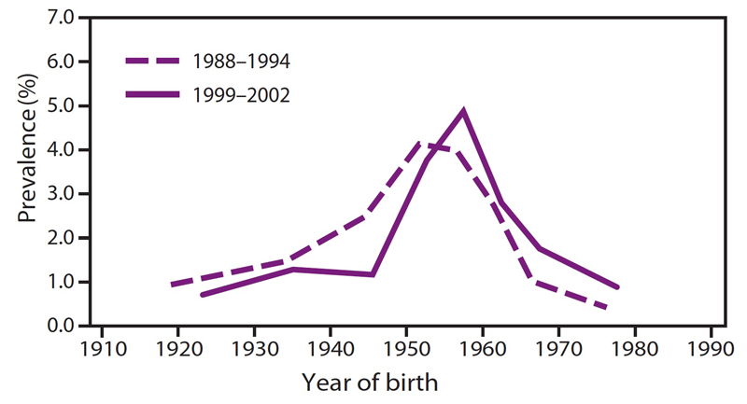
HCV seropositivity by birth year, NHANES
Why the Boomers?
Transfusions & IDU originally proposed
Increased medical procedures after World War II, with reusable glass & metal syringes
Joy JB, et al. Lancet Inf Dis 2016;16:698-702
MMWR Recomm Rep. 2012 Aug 17;61(RR-4):1-32.

Slide 10
Estimated HCV incidence in US, 1982-2014
Routine screening of blood supply
https://www.cdc.gov/hepatitis/statistics/2016surveillance/

Slide 11
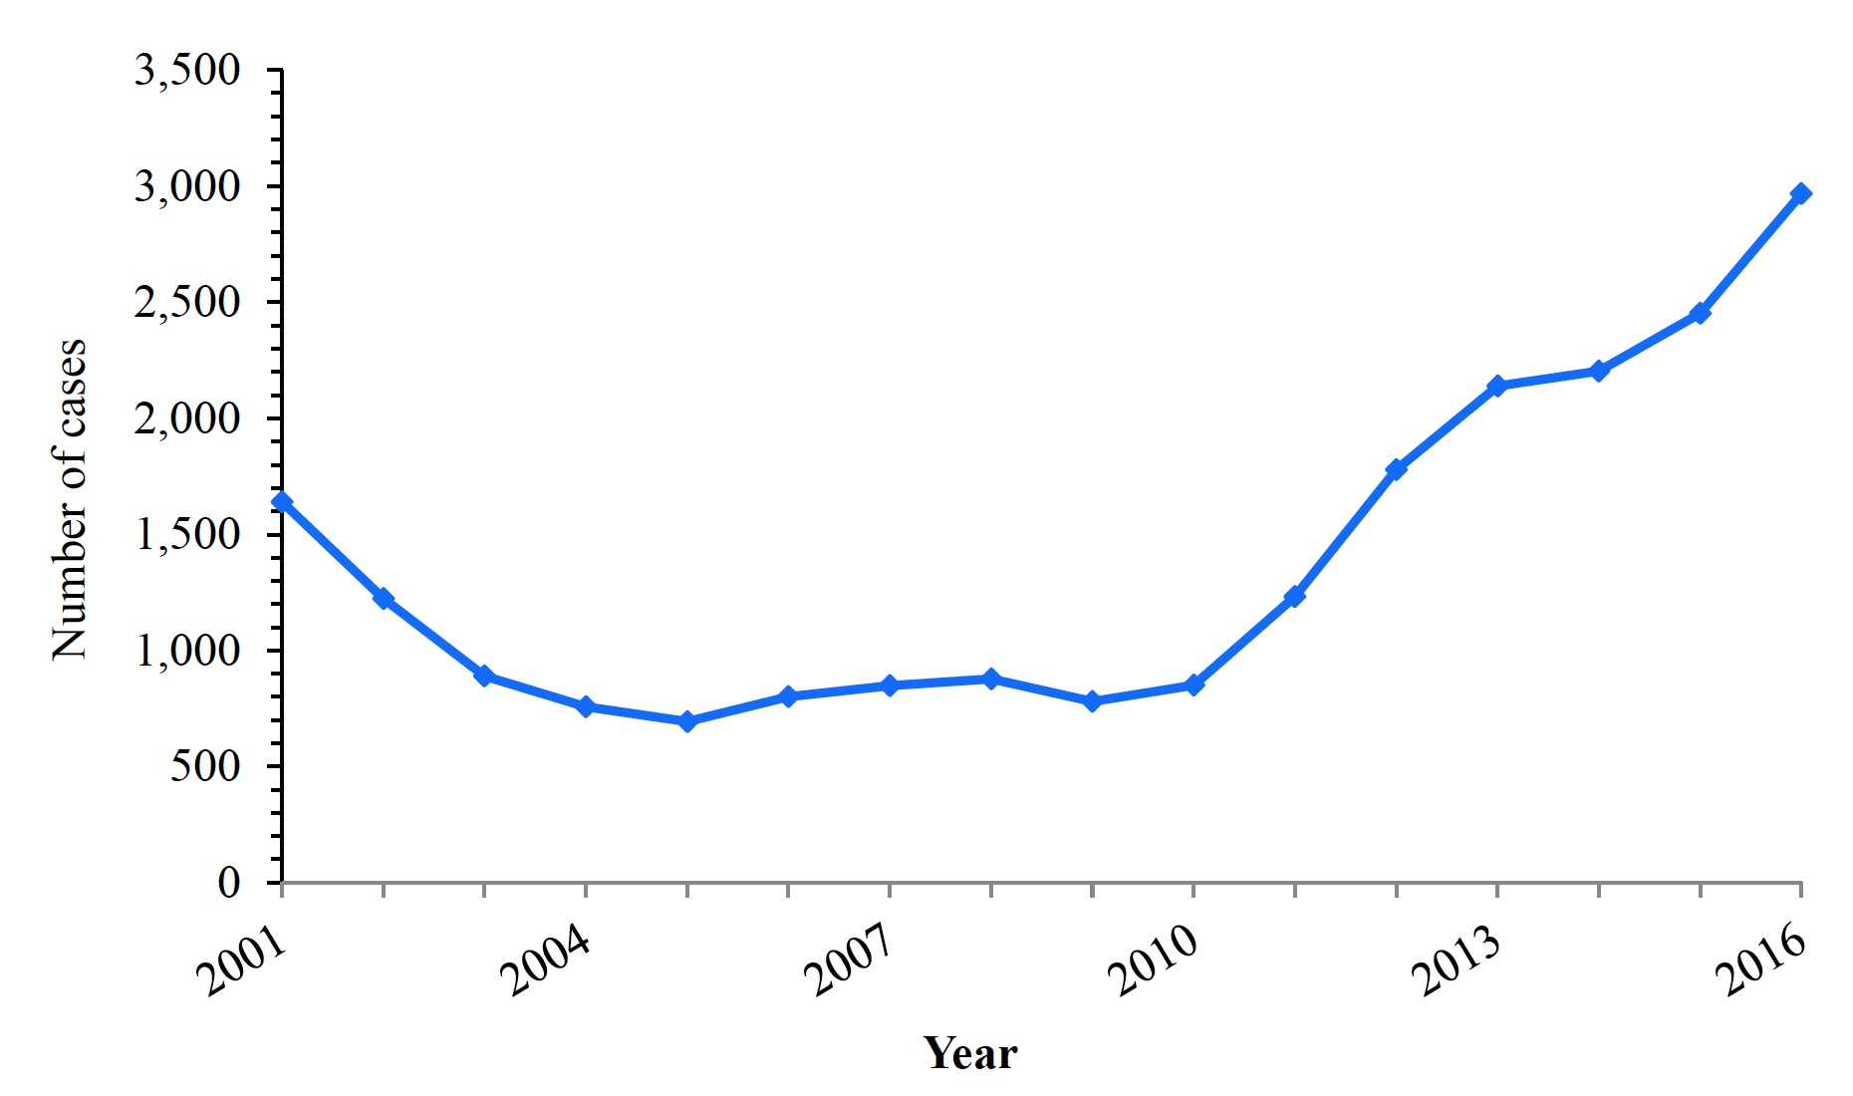
Incidence of acute HCV, 2001-2006
Number of cases
Year
https://www.cdc.gov/hepatitis/statistics/2016surveillance/

Slide 12
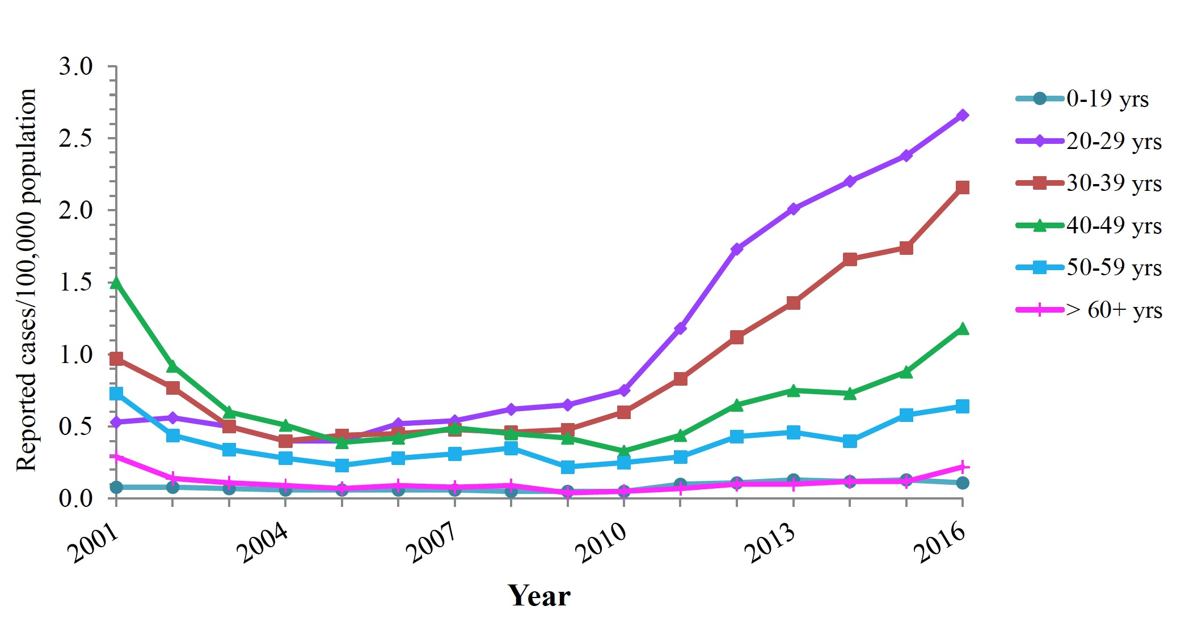
Incidence of acute HCV by age, 2001-2006
Reported cases per 100,000 population
Year
https://www.cdc.gov/hepatitis/statistics/2016surveillance/

Slide 13
Who is at risk for HCV infection?
Illicit drug users
(IDU, crack, snorting)
Blood before ~1990
(1987 clotting factors; 1992 blood or organs)
Long-term hemodialysis
https://www.cdc.gov/hepatitis/statistics/2016surveillance/

Slide 14
What about sexual transmission of HCV?
“Vanilla” sex (MSM and heterosexual)
Very inefficient at transmission
Condoms suggested (but not essential)
Sex that could cause bleeding
(MSM more than hetero)
Shared sex toys
Fisting
Group sex
Sex under influence
Tohme RA, Holmberg SD. Hepatology. 2010 Oct;52(4):1497-505.
Terrault NA, et al. Hepatology. 2013 Mar;57(3):881-9.
McFaul K, et al. J Viral Hepat. 2015 Jun;22(6):535-8.

Slide 15
Natural history of hepatitis C
Out of
100
people infected with hepatitis C
http://www.cdc.gov/hepatitis/hcv/hcvfaq.htm

Slide 16
Natural history of hepatitis C
80
will develop chronic infection
http://www.cdc.gov/hepatitis/hcv/hcvfaq.htm

Slide 17
Natural history of hepatitis C
20
will develop cirrhosis over a 20-30 year period
http://www.cdc.gov/hepatitis/hcv/hcvfaq.htm

Slide 18
Natural history of hepatitis C
8
persons with cirrhosis will have decompensated, after 10 years
http://www.cdc.gov/hepatitis/hcv/hcvfaq.htm

Slide 19
Natural history of hepatitis C
1-2
persons with cirrhosis will develop HCC, per year
http://www.cdc.gov/hepatitis/hcv/hcvfaq.htm

Slide 20
Natural history of hepatitis C
60
will die with HCV, not from HCV
http://www.cdc.gov/hepatitis/hcv/hcvfaq.htm

Slide 21
Projected outcomes without HCV treatment
Davis GL, et al. Gastroenterology. 2010 Feb;138(2):513-21, 521.e1-6
Notes:
HCC = Hepatocellular cancer
Without treatment, decompensated cirrhosis and HCC would rise into the 2020s.
Projected number of cases by year of decompensated cirrhosis (purple) and hepatocellular carcinoma (green). The model assumes a first year mortality of 80% to 85%, so in contrast to the decompensated cirrhosis projection, the number of cases of hepatocellular carcinoma the prevalence demonstrated here closely resembles annual incidence of liver cancer.
Without the advantage of effective new treatments, decompensated cirrhosis cases will continue to increase through 2020-2030.
Without the advantage of effective new treatments, hepatocellular carcinoma is expected to peak in 2019 at 14,000 cases.
This slide does not reflect the impact of direct-acting antivirals for HCV infection.
Morbidity and mortality due to HCV infection are projected to rise into the 2020s as illness and deaths from decompensated cirrhosis and HCC peak among baby boomers, the generation with the highest infection rates
The delayed effect of morbidity and mortality following initial HCV infection reflects the long time period that usually passes between initial infection and the onset of severe hepatic illness
Widespread treatment of HCV infection would diminish but not totally reverse this projected increase in mortality

Slide 22
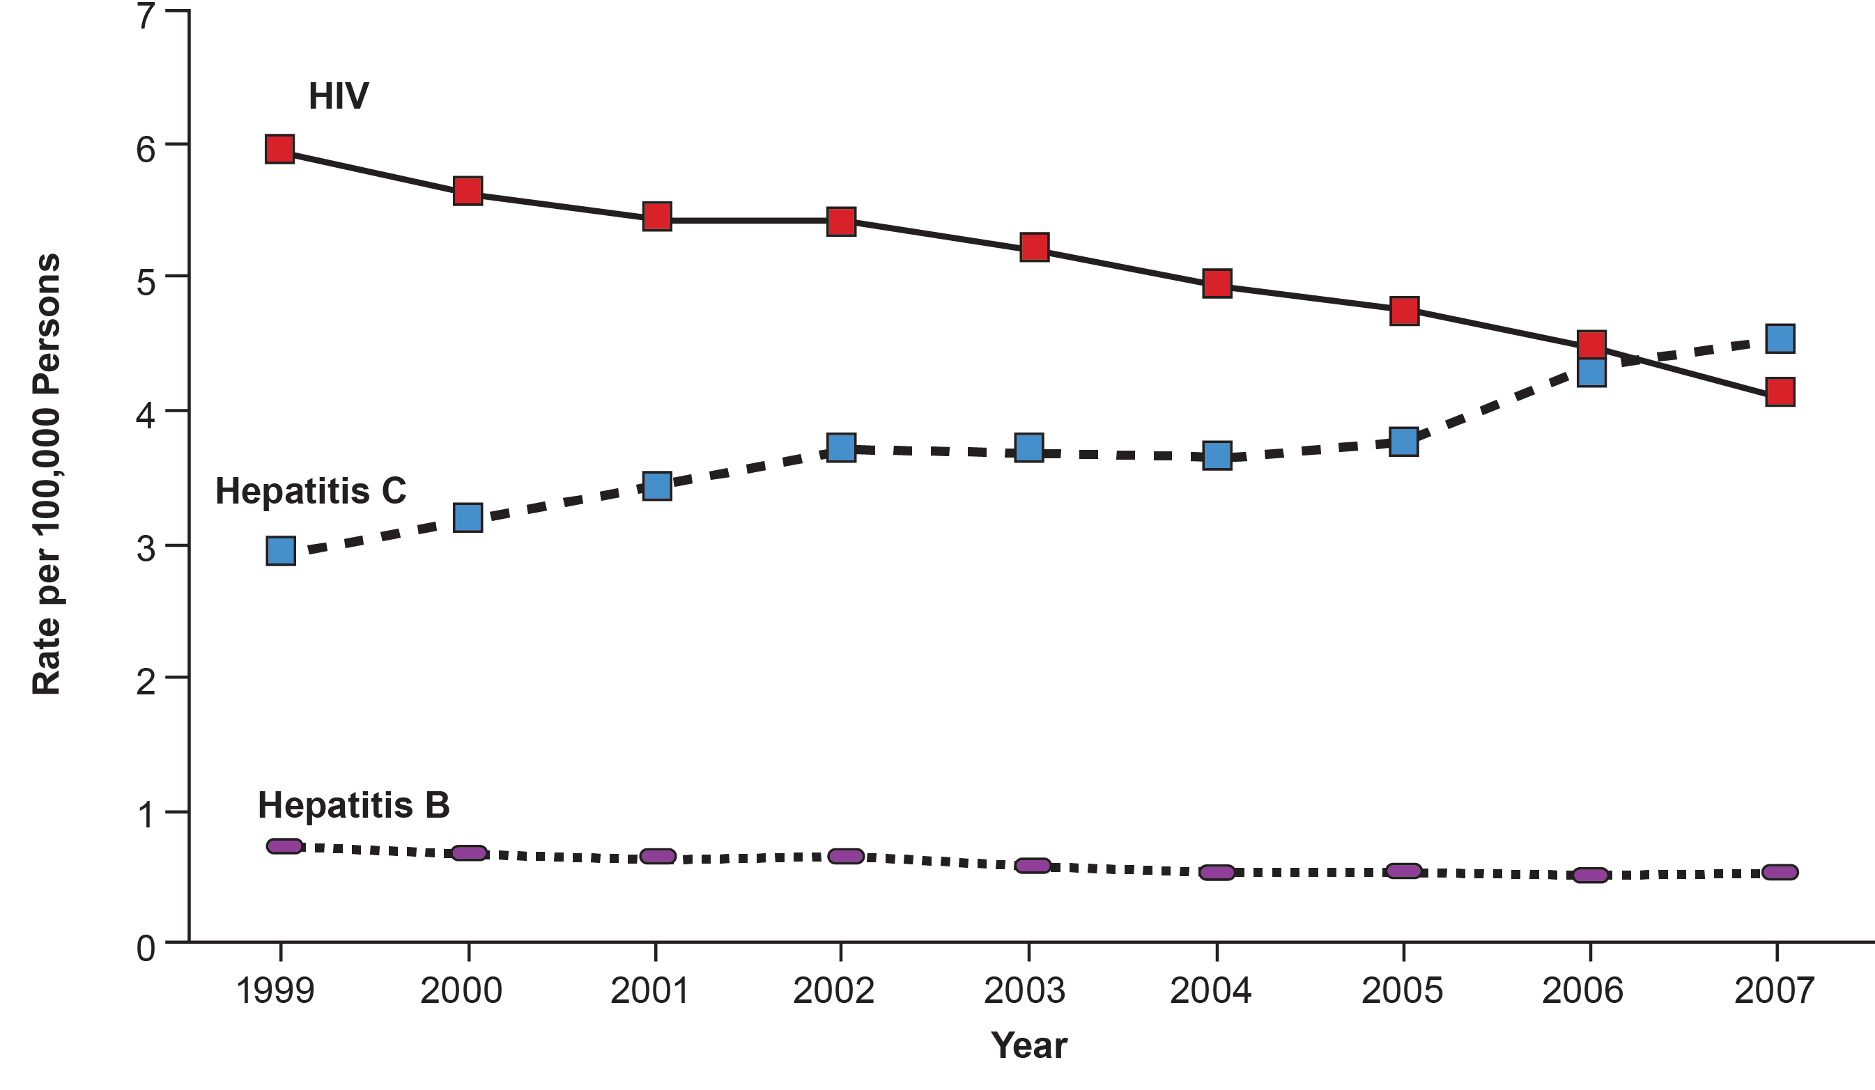
Deaths from HCV surpassed HIV in 2006-07
HIV
15,106
Rate per 100,000 Americans
12,734
HCV
HBV
Year
Ly KN, et al. Ann Intern Med. 2012; 156: 271-278.
Notes:
HCC = Hepatocellular cancer
Without treatment, decompensated cirrhosis and HCC would rise into the 2020s.
Projected number of cases by year of decompensated cirrhosis (purple) and hepatocellular carcinoma (green). The model assumes a first year mortality of 80% to 85%, so in contrast to the decompensated cirrhosis projection, the number of cases of hepatocellular carcinoma the prevalence demonstrated here closely resembles annual incidence of liver cancer.
Without the advantage of effective new treatments, decompensated cirrhosis cases will continue to increase through 2020-2030.
Without the advantage of effective new treatments, hepatocellular carcinoma is expected to peak in 2019 at 14,000 cases.
This slide does not reflect the impact of direct-acting antivirals for HCV infection.
Morbidity and mortality due to HCV infection are projected to rise into the 2020s as illness and deaths from decompensated cirrhosis and HCC peak among baby boomers, the generation with the highest infection rates
The delayed effect of morbidity and mortality following initial HCV infection reflects the long time period that usually passes between initial infection and the onset of severe hepatic illness
Widespread treatment of HCV infection would diminish but not totally reverse this projected increase in mortality

Slide 23
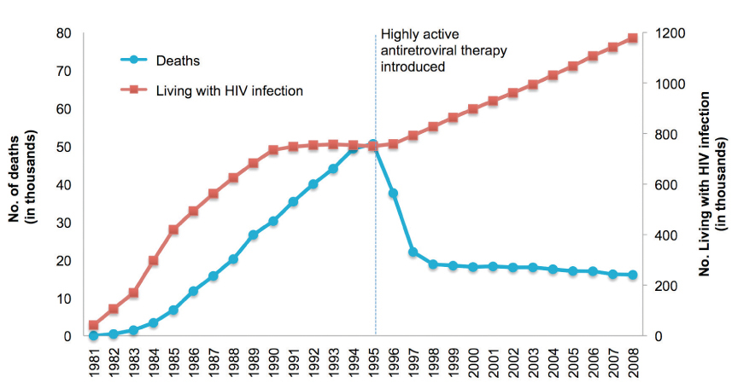
HIV is no longer a death sentence
http://www.drugabuse.gov/publications/research-reports/hivaids/how-does-drug-abuse-affect-hiv-epidemic

Slide 24
How many Americans have HIV?
US Population 309.3
million in 2010
Approximately 0.4%
infected (1.1 million in 2015)
https://www.cdc.gov/hiv/statistics/overview/ataglance.html. Accessed 16 Jan 2019.

Slide 25
How many Americans have HIV?
US Population 309.3
million in 2010
Approximately 0.4%
infected (1.1 million in 2015)
Approximately 162,500
unaware of their infection (in 2015)
937,500
diagnosed with HIV
(in 2015)
https://www.cdc.gov/hiv/statistics/overview/ataglance.html. Accessed 16 Jan 2019.

Slide 26
Who are those persons living with HIV?
23%
cisgender women (n=256,500)
77%
cisgender men (n=866,400)
CDC. HIV Surveillance Supplemental Report. Vol 23 (No. 1) 2018.

Slide 27
Who are those persons living with HIV?
23%
cisgender women (n=256,500)
77%
cisgender men (n=866,400)
21% 54,100 | IDU | 16%* 57,300 + 81,000
78% 201,000 | Het | 11% 93,600
– | MSM | 73% 632,300
* This chart is simplified from CDC data
MSM who also inject drugs = 6.6% of IDUs here; MSM-IDUs not included in this MSM figure
Who’s missing? Trans folks
CDC. HIV Surveillance Supplemental Report. Vol 23 (No. 1) 2018.

Slide 28
Who are those persons living with HIV?
CDC. HIV Surveillance Supplemental Report. Vol 23 (No. 1) 2018.

Slide 29
Who are those persons living with HIV?
CDC. HIV Surveillance Supplemental Report. Vol 23 (No. 1) 2018.

Slide 30
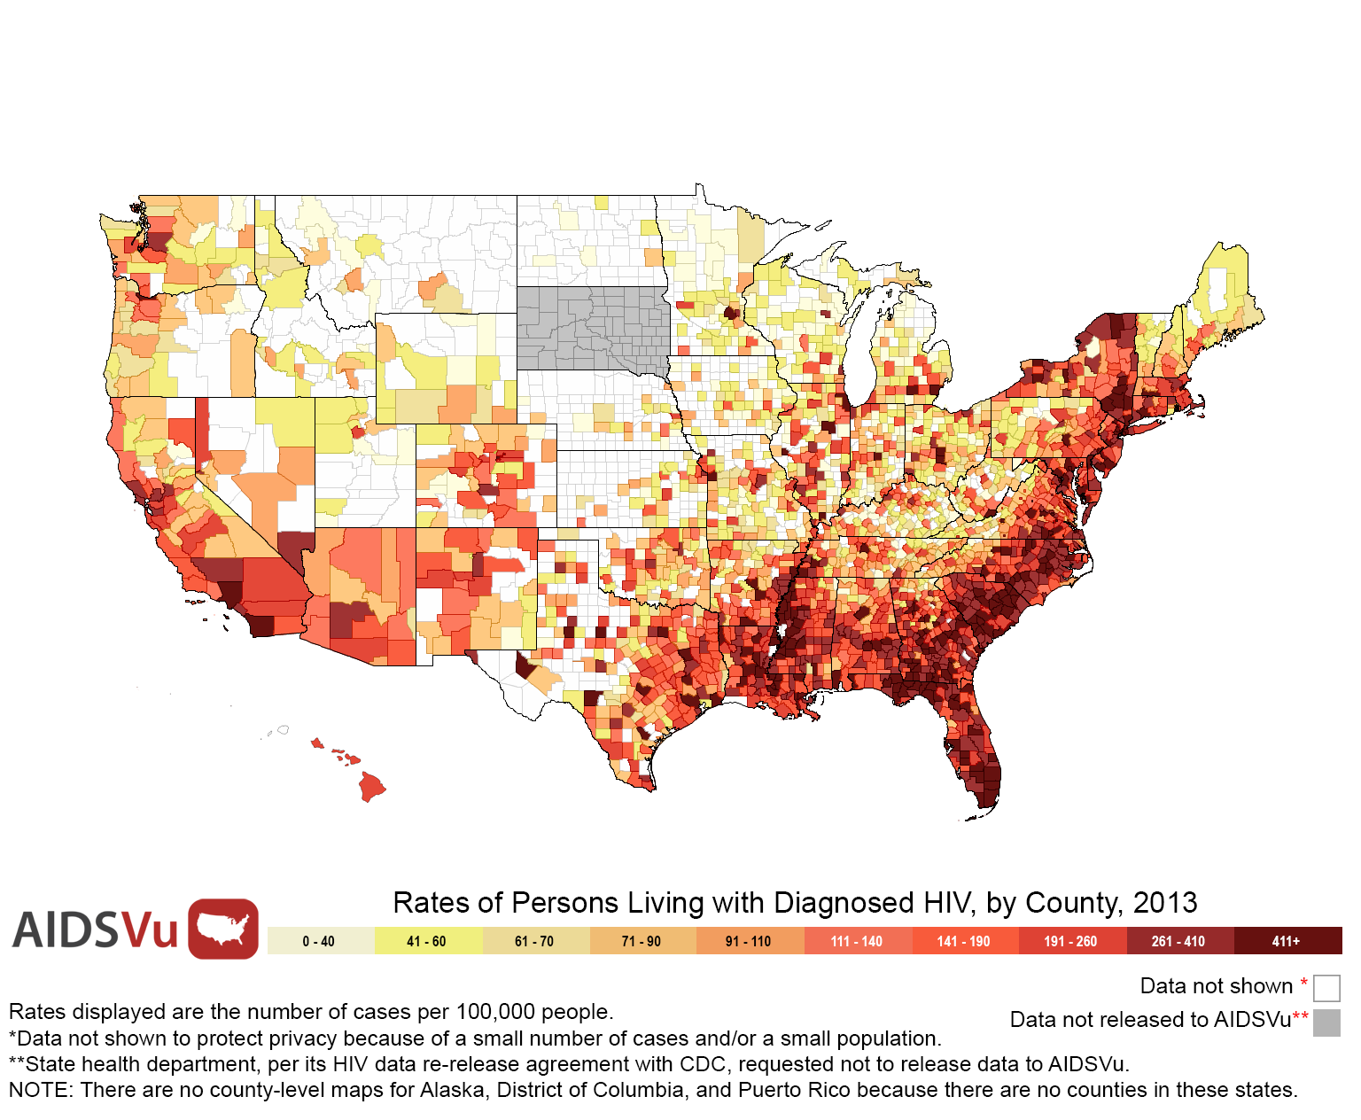
Where are those persons living with HIV?
382
of every 100,000
Americans
(1.2M HIV+ of 314.1M, in 2012)
2013
Notes:
1,148,200 HIV+ estimated in 2010 (living with HIV, not just diagnosed)
US pop in 2010 = 308,745,538 (according to Census)
Equates to 372 per 100,000 pop

Slide 31
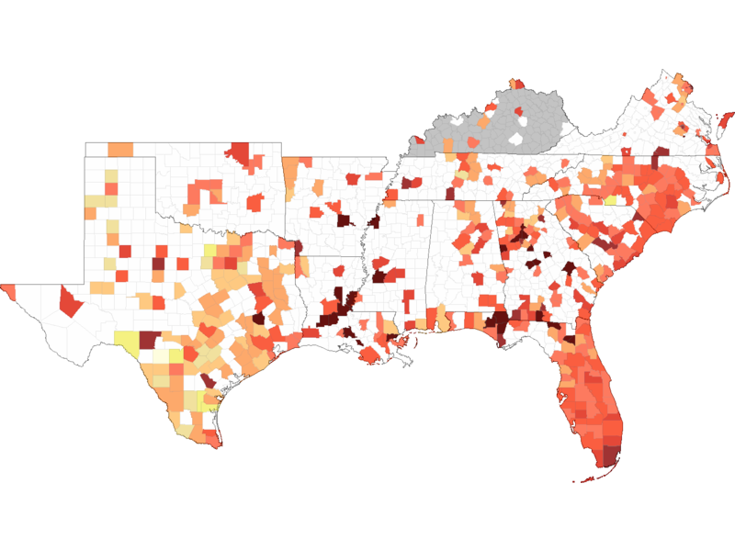
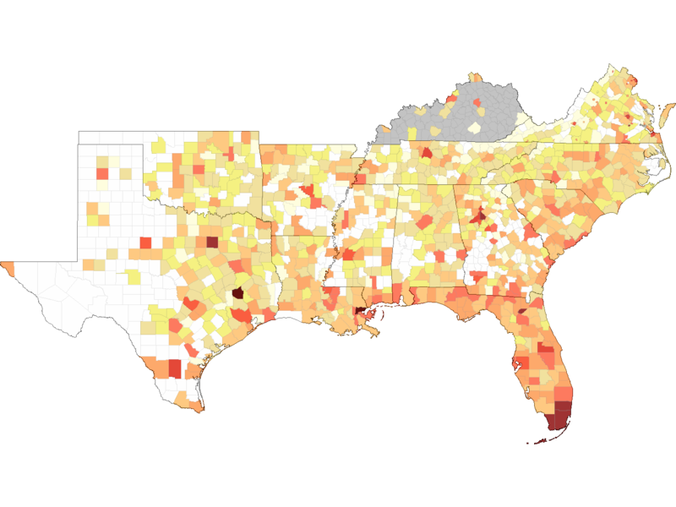
Where are those persons living with HIV?
Hispanic/Latino
White
2012

Slide 32
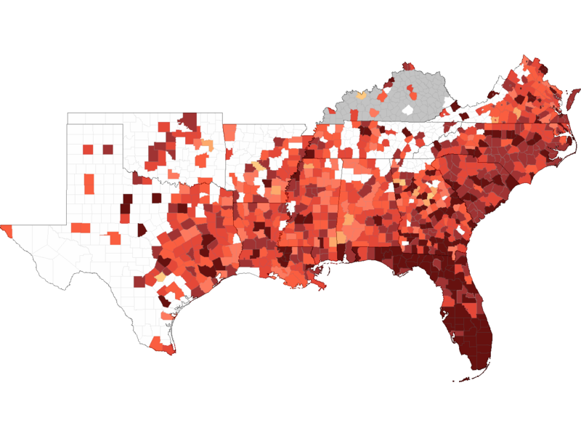
Where are those persons living with HIV?
Black
White
2012

Slide 33
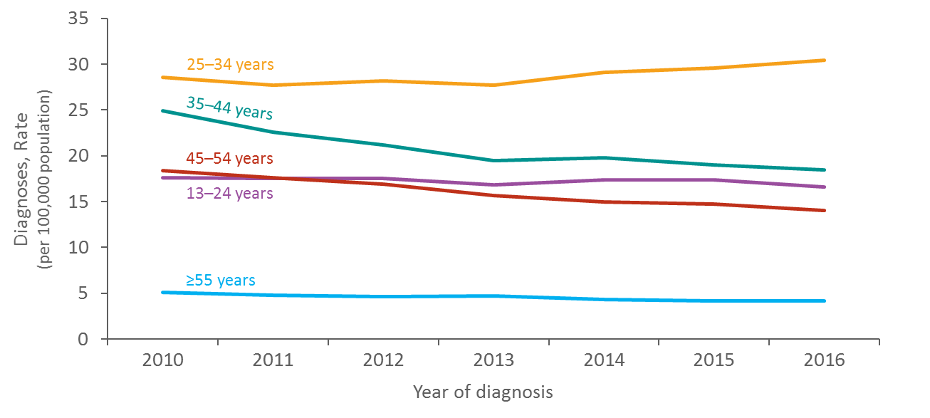
Who is acquiring HIV in the US?
Rates of HIV Diagnosis among Adolescents & Adults, 2010-2016
Rate per 100,000 Americans
Year of Diagnosis
https://www.cdc.gov/hiv/ppt/library/slidesets/cdc-hiv-surveillance-epidemiology-2017.pptx

Slide 34
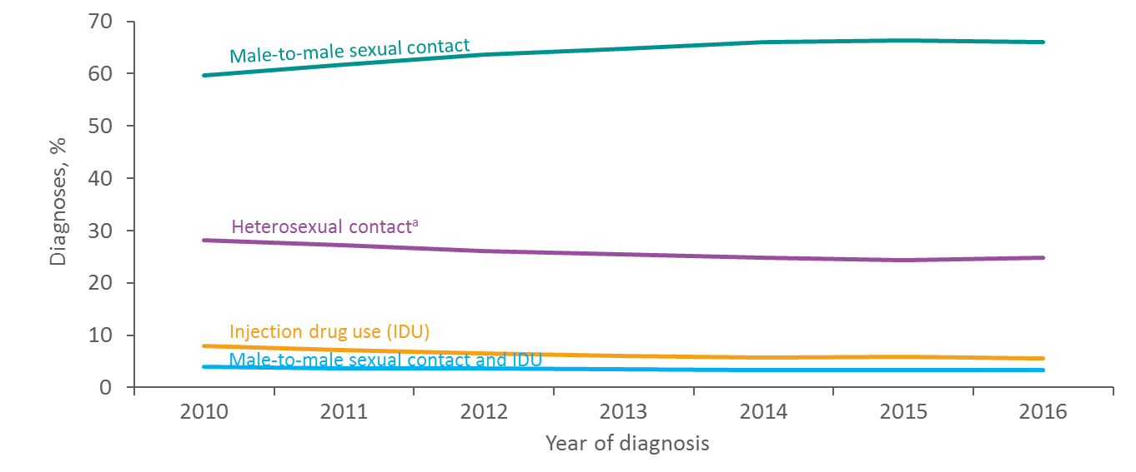
Who is acquiring HIV in the US?
HIV Diagnoses among Adolescents & Adults, 2010-2016
Percentage of Diagnoses
Year of Diagnosis
https://www.cdc.gov/hiv/ppt/library/slidesets/cdc-hiv-surveillance-epidemiology-2017.pptx

Slide 35
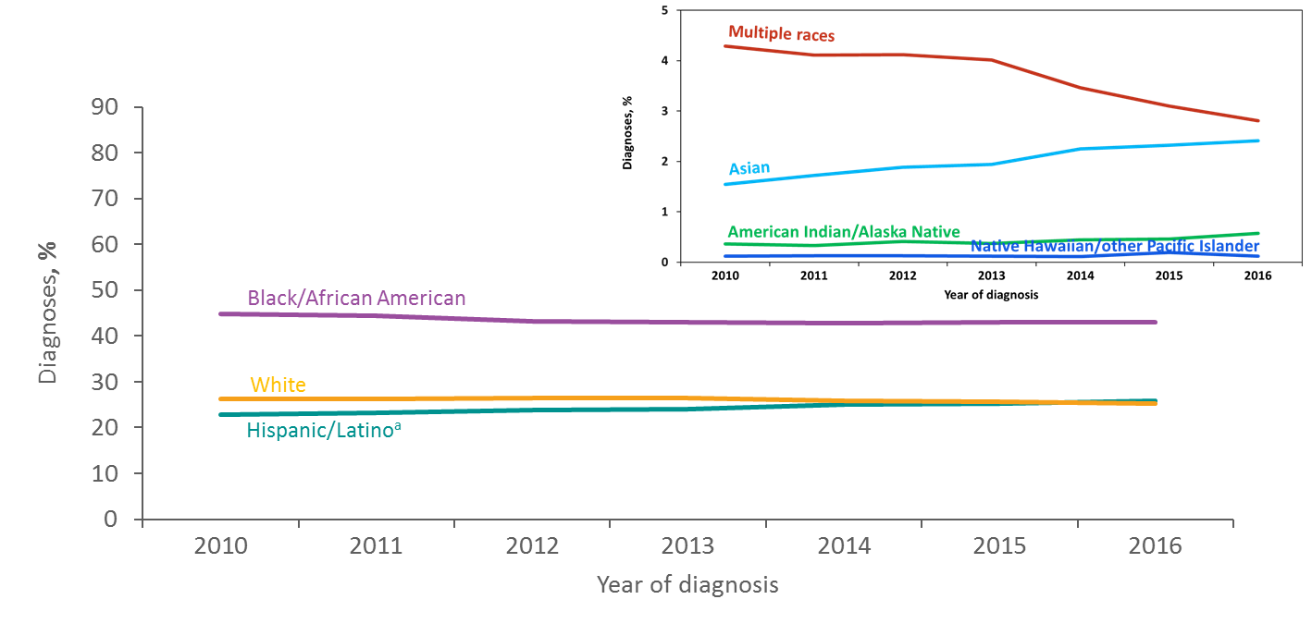
Who is acquiring HIV in the US?
HIV Diagnoses among Adolescents & Adults, 2010-2016
Percentage of Diagnoses
Year of Diagnosis
https://www.cdc.gov/hiv/ppt/library/slidesets/cdc-hiv-surveillance-epidemiology-2017.pptx

Slide 36
Who is acquiring HIV in the US?
HIV Diagnoses among Adolescents & Adults, 2010-2016
Percentage of Diagnoses
Year of Diagnosis
https://www.cdc.gov/hiv/ppt/library/slidesets/cdc-hiv-surveillance-epidemiology-2017.pptx

Slide 37
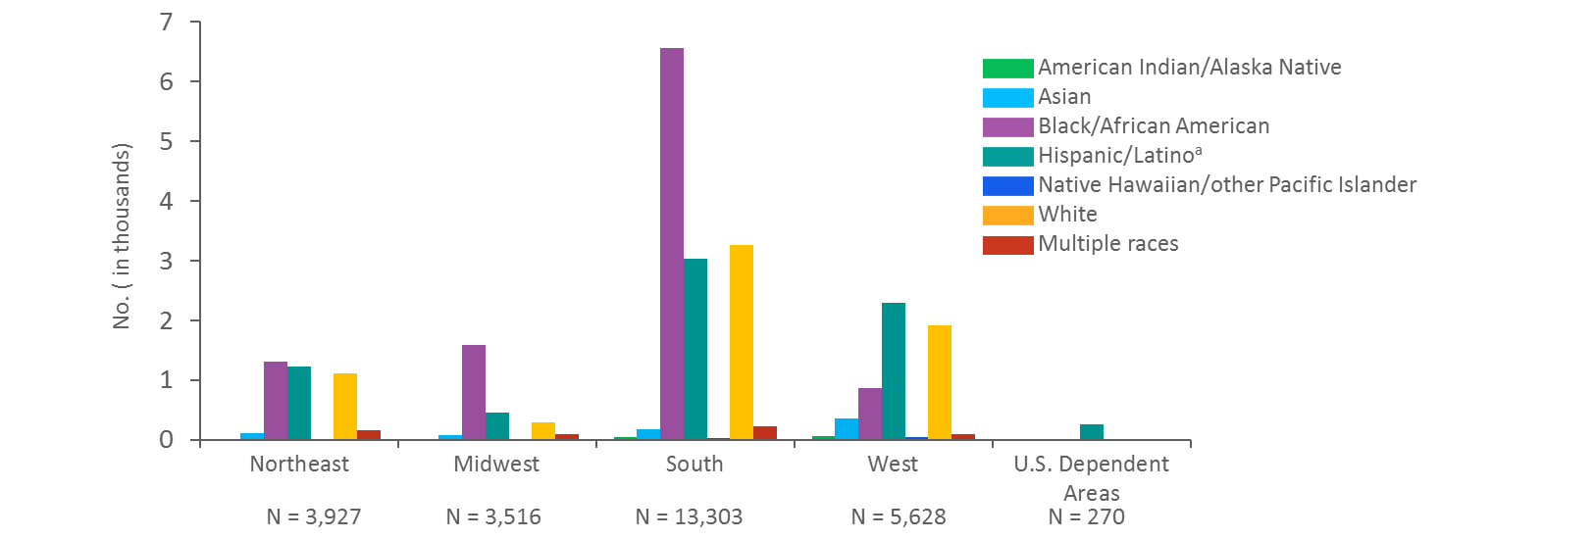
Who is acquiring HIV in the US?
Number of Diagnoses among Adolescents & Adults, 2010-2016
Number of Diagnoses (in Thousands)
https://www.cdc.gov/hiv/ppt/library/slidesets/cdc-hiv-surveillance-epidemiology-2017.pptx

Slide 38
Why are there such disparities in HIV by race?
“The Louisville Flood” by Margaret Bourke-White, 1937
https://rarehistoricalphotos.com/there-no-way-like-american-way-1937/

Slide 39
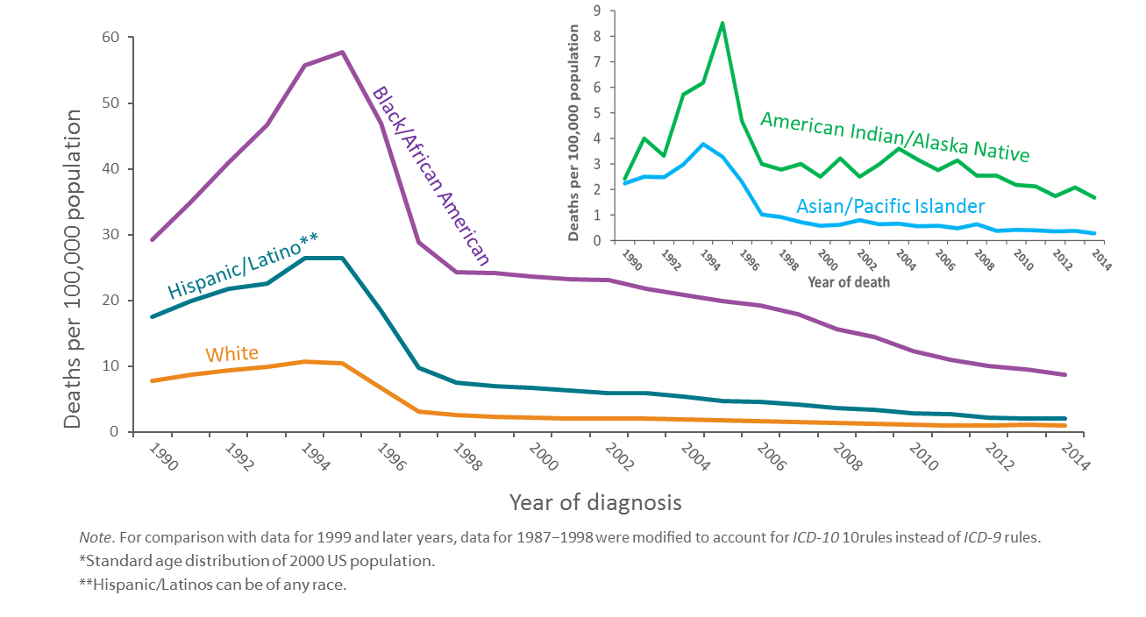
Who is dying from HIV in the US?
Deaths per 100,000 Americans
https://www.cdc.gov/hiv/ppt/library/slidesets/cdc-hiv-surveillance-epidemiology-2017.pptx

Slide 40
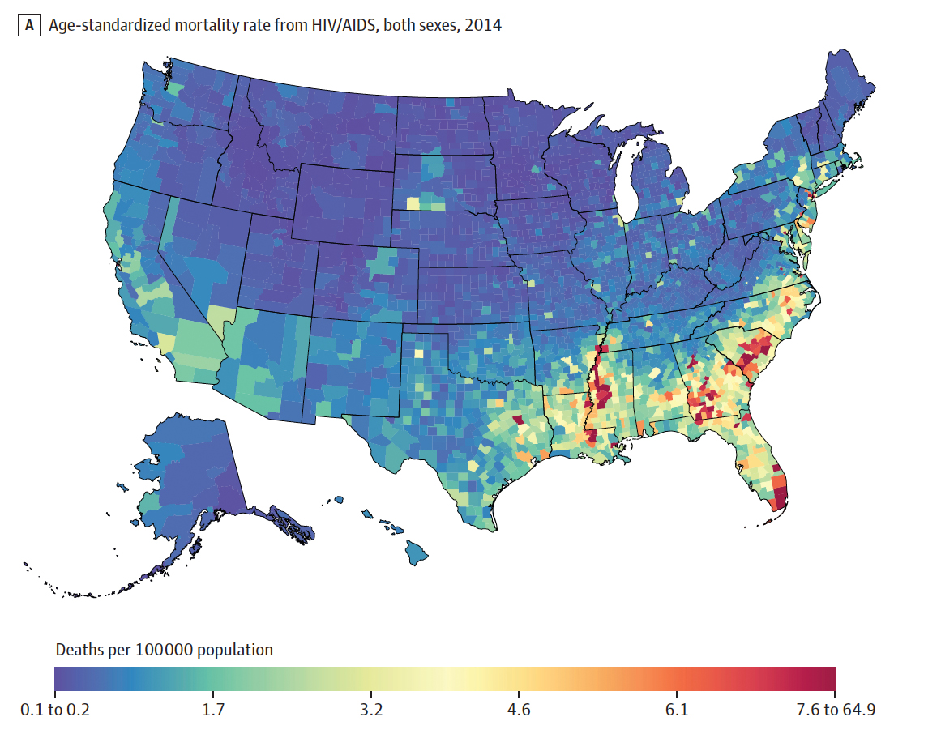
Where are people dying from HIV in the US?
Age-standardized HIV/AIDS mortality rate, men and women, 2014
El Bcheraoui, et al. JAMA 2018 Mar 27;319(12):1248-1260

Slide 41
How does HCV contribute to HIV morbidity?
Approximately 25%
of PLWH are also living with HCV
https://www.cdc.gov/hepatitis/hiv-hepatitis-coinfection.htm . Accessed 16 Jan 2019.

Slide 42
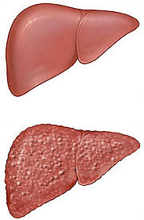
How does HCV contribute to HIV morbidity?
HIV and HCV are synergistically bad
HIV increases pace of HCV liver scarring (fibrosis)
Specific risks:
Lower nadir CD4 and higher HIV RNA
Alcohol use
Older age and higher BMI
Some PLWH who acquire new HCV progress rapidly
de Lédinghen V, et al. J Viral Hepat. 2008 Jun;15(6):427-33.
Kirk GD, et al. Ann Intern Med. 2013 May 7;158(9):658-66.
Fierer DS, et al. Clin Infect Dis. 2013 Apr;56(7):1038-43.

Slide 43
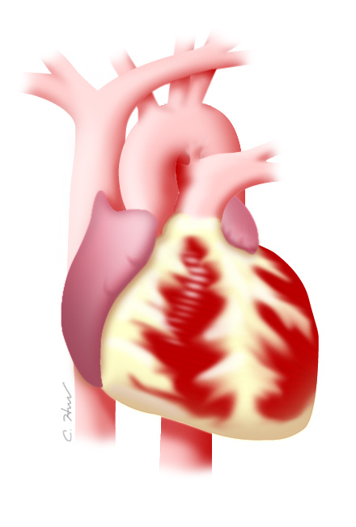
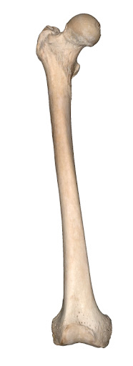
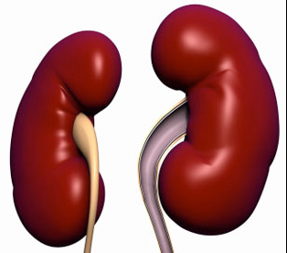
How does HCV contribute to HIV morbidity?
Extrahepatic complications are increased – at least as long as HCV is untreated
Cardiovascular risk
Stroke risk
Renal disease
Bone fractures
Adapted from slide – https://aidsetc.org/hivhcv/1/morbidity-mortality

Slide 44
Access to HCV treatment reduces mortality*…
* monoinfected patients
van der Meer AJ, et al. JAMA. 2012 Dec 26;308(24):2584-93

Slide 45
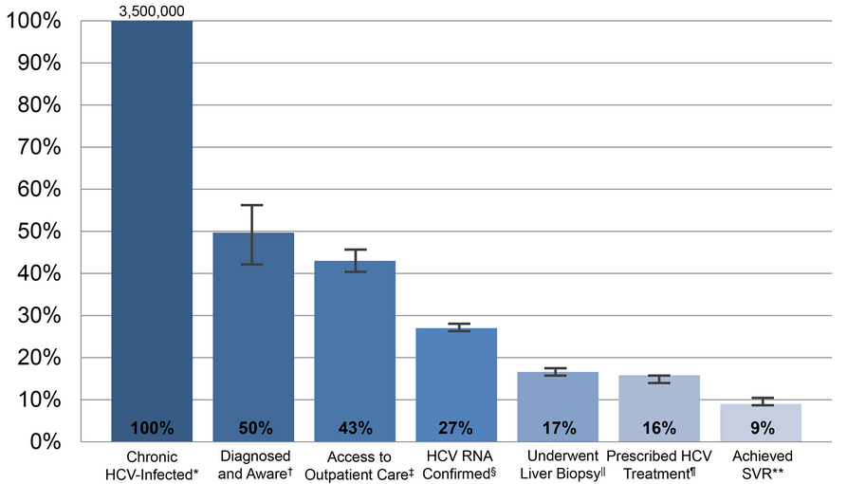
…but a care cascade exists for HCV, too
Yehia BR, et al. PLOS One. 2014 Jul 2;9(7):e101554.
Notes:
This review by, Yehia et al, identifies large gaps between current practice and treatment goals for people with mono infected chronic HCV infection. It also highlights multiple opportunities for improving engagement along the HCV treatment cascade, particularly in the diagnosis and awareness of infection, prescription of antiviral therapy, and achievement of SVR.

Slide 46
Take-home messages
HCV and HIV disproportionately impact marginalized groups within our society
Individually, each infection can be life-threatening – but treatment can dramatically improve outcomes
About ¼ of all PLWH also are living with HCV – so screening, diagnosis, and treatment are essential (stay tuned!)

Slide 47
Questions?
Please email me!
Christopher Hurt, MD
churt@med.unc.edu

