Slide 1
Hepatitis C in 30 minutes
Heidi Swygard, MD, MPH
NC DHHS – Viral hepatitis medical director
UNC – Medicine

Slide 2
Disclosures
None HCV related
Grant support Viiv and Gilead for HIV projects

Slide 3
Does my patient have Hep C?
Epidemiology
Clinical presentation
Screening
Testing and interpretation
Next steps….

Slide 4
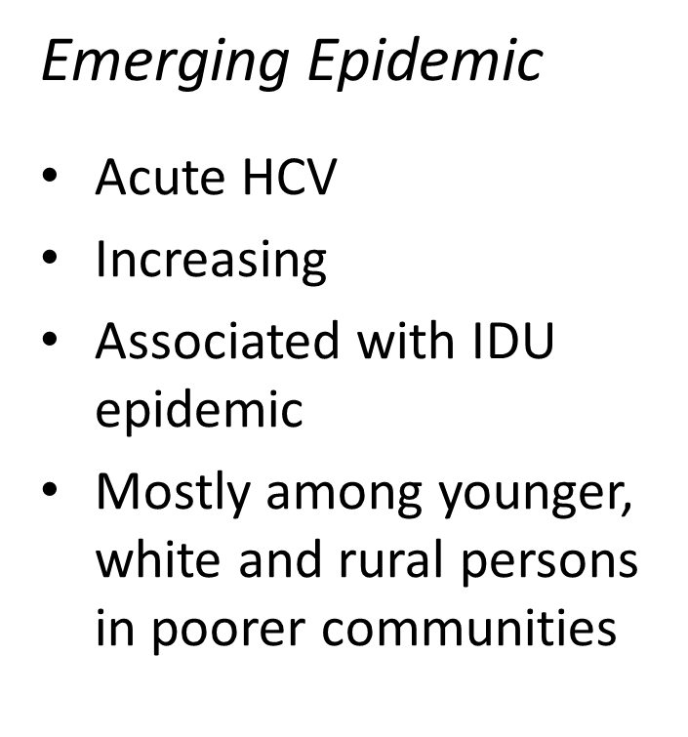
Two Epidemics
Historic Epidemic
Chronic HCV
150,000+
Baby boomers born b/w 1945 – 1965 are 5X more likely to have HCV
Doubling of liver cancer rates during past 10 years in NC

Slide 5
Acute HCV Rates in North Carolina and United States, 2000–2017
*HCV case definition changed in 2016
*Case definition for HCV changed in 2016.
Data Source: North Carolina Electronic Disease Surveillance System (NC EDSS) (data as of June 3, 2018) and Surveillance for Viral Hepatitis, United States, 2009-2015 CDC reports (https://www.cdc.gov/hepatitis/statistics/index.htm).

Slide 6
NC epidemiology
Newly Diagnosed Acute Hepatitis B, Acute Hepatitis C, and HIV by year of diagnosis, 2013-2017
Disease | 2013 | 2014 | 2015 | 2016 | 2017
Acute Hep B | 94 | 114 | 148 | 169 | 185
Chronic Hep B (newly diagnosed) | 906 | 966 | 1,101 | 1,381 | 1,147
Acute Hep C | 87 | 128 | 121 | 201 | 186
HIV | 1,306 | 1,319 | 1,333 | 1,392 | 1,310

Slide 7
Viral hepatitis
Case definition (public health)
  Fever, headache, myalgia, GI Sx (nausea, anorexia, V/D, abdominal pain) JAUNDICE
  And
  Labs (serology, transaminitis)

Slide 8
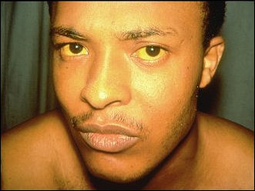
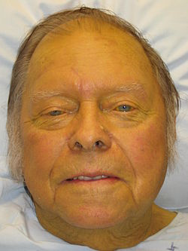
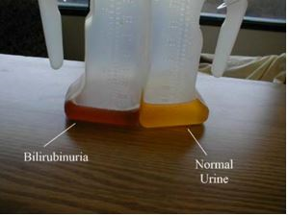

Slide 9
Acute Hep C
3-4 month incubation
Fatigue, anorexia, mild or moderate abdominal pain, low-grade fever, nausea, vomiting
<25% will develop jaundice (predicts clearance)
  Female sex, younger age
  Elevated ALT level, hepatitis B virus surface Ag (HBsAg) positivity
  HCV genotype 1

Slide 10
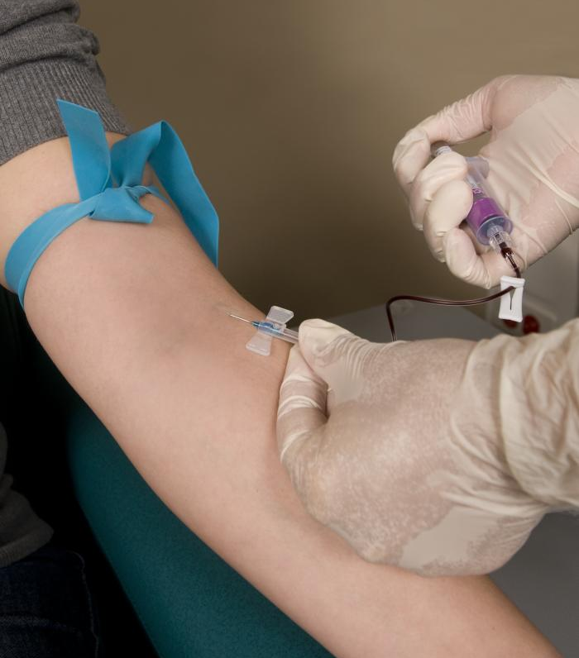
Who should be tested for HCV?
People who…
Were born 1945 – 1965
Have ever injected drugs
Have certain medical conditions
  HIV or AIDS
  Abnormal liver function tests
  Ever on long-term dialysis
Received
  Donated blood, blood components, or organs before 1992
  Clotting factor concentrated produced before 1987
Have exposure to blood of infected person
  Healthcare, public safety workers
  Infants born to infected mothers

Slide 11
Test interpretation
HCV antibody
  May be negative in the first 6 weeks after exposure
  May be delayed or absent when the individual is immunosuppressed
  Presence alone does not distinguish between acute and chronic infection
HCV RNA
  Viral fluctuations greater than 1 log10 IU/mL may indicate acute HCV infection
  May be transiently negative during acute HCV infection
  Presence alone does not distinguish between acute and chronic infection
Alanine aminotransferase (ALT)
  May fluctuate peaks during acute HCV infection
  May be normal during acute HCV infection
  May be elevated due to other liver insults such as alcohol consumption

Slide 12
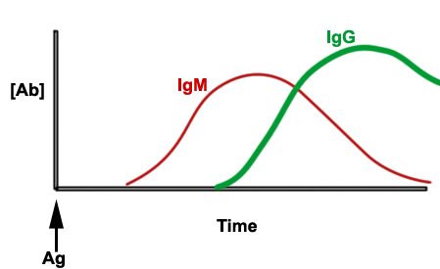
Testing available
 | RNA+ | RNA -
Ab + | Current infection (acute OR chronic) | Old infection, cleared; maybe acute?
Ab - | Acute infection | Susceptible, never infected
No commercially available IgM test for hep C

Slide 13
Monitoring acute HCV (q 2-4 weeks)
(Assuming infection at LAST exposure)
HCV infection clears spontaneously in 25-35% of patients
  In at least two-thirds of patients, clearance occurs within 6 months of the estimated time of infection (median, 16.5 weeks)
Almost 90% of those who remain viremic at 6 months will develop chronic Hep C
Detectable HCV RNA 6 months after the time of infection will identify most persons who need HCV therapy
A single undetectable HCV NA is NOT sufficient to declare clearance
  Monitor until ALT normalizes and HCV RNA repeatedly undetectable

Slide 14
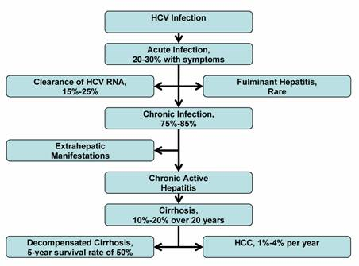
Hepatitis C
HCV progression accelerators:
- Alcohol
- Obesity
- Older age
- Male gender
- Race
- HIV or HBV co-infection
Renal disease, lymphoma, cardiovascular disease, DM
Time, 10-20 years

Slide 15
My patient has chronic HCV. Now what?
Counseling
  Hepatoprotection
  Infection control measures
Lab testing
Treatment
  Highly effective, available
  More next section

Slide 16
Hep C labs
Virus specific
  Confirmatory
    Ab AND RNA
  Genotype
    6
    (2 pangenotypic drugs)
  Quantitative
    Matters for insurers
    Genotype 1 exception
Patient specific
  LIVER
    Fibrosis score
    LFTs (AST/ALT/Tbili/ablumin), INR
    CBC with diff
  Kidney
  Pregnancy/potential
  Comorbid illness
    HIV, HBV, HAV
    DM
    <6 month life?

Slide 17
Hepatitis A Outbreaks, 2016–19

Slide 18
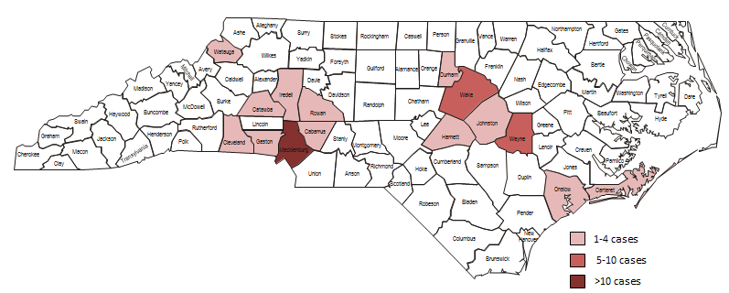
Hepatitis A Outbreak in North Carolina
As of April 26, 2019:
76 cases
55 hospitalizations (72%)
1 death, 1 transplant

Slide 19
Hepatitis B blackbox
Hep B s Ag negative, core Ab + and core Ab NEG
  Risk of HBV flare
  27 deaths
  Black box warning
  CHECK HBV DNA
    Negative→ vaccinate
    Positive→ monitor closely, ?treat HBV

Slide 20
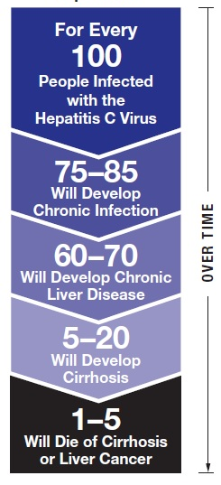
Progression of HCV infection
CDC, 2010

Slide 21
Does my patient have cirrhosis?
Treatment specific decision
  Check guidelines
  More later
Clinical care
Long term followup

Slide 22
Cirrhosis
Clinical signs/symptoms
Complications
  Liver cancer (imaging and aFP)
Portal hypertension
  Varices and EGD screening (plt <150K)
Compensated
  Childs Pugh score A
  Vaccinate, check HAV, HBV
Refer to GI
  Decompensated
  Liver cancer

Slide 23



Mortality and Morbidity Reduced with HCV Cure
530 adults in Europe prospectively followed for median 8.4 years after HCV treatment
192 (36%) achieved SVR
30
Adjusted HR of SVR:
0.07 (95%CI 0.03-0.20)
p < 0.001
30
Adjusted HR of SVR:
0.06 (95%CI 0.02-0.19)
p < 0.001
20
non-SVR
non-SVR
20
Liver Failure (%)
Liver Failure
LR-Mortality
p < 0.001
LR-Mortality (%)
p < 0.001
10
10
SVR
SVR
0
0
0
1
2
3
4
5
6
7
8
9
10
0
1
2
3
4
5
6
7
8
9
10
Time – in years
Time – in years
30
Adjusted HR of SVR:
0.19 (95%CI 0.08-0.44)
p < 0.001
Cumulative Mortality
20
HCC
non-SVR
HCC (%)
p < 0.001
10
SVR
0
0
1
2
3
4
5
6
7
8
9
10
Van der Meer JAMA 2012
Time – in years

Slide 24
Decreased Five-year Mortality Rates in Multiple Populations Associated with SVR (Meta-analysis)
General: 18 studies
n=29,269
Avg. FU = 4.6 years
Cirrhosis: 9 studies
n=2,734
Avg. FU = 6.6 years
HIV/HCV: 5 studies
n=2,560
Avg. FU = 5.1 years
Mortality %
General= Studies that include all stages of liver disease
Simmons B et al, 2015 (epub)

Slide 25
Rates of Cirrhosis Regression According to the METAVIR Scoring System
100
Metavir
80
F4
F3
60
15
F2
NUMBER OF PATIENTS (%)
F1
40
F0
20
14
Cirrhosis Regression in
23 (61%) Patients
7
0
38
2
PRE-TREATMENT
POST-TREATMENT
D’Ambrosio R et al Hepatology 2012, 56(2):532-43

Slide 26
Long-term care (compensated) cirrhosis
Regular HCCA screening
Pneumovax
EGD/colonoscopy
Hepatoprotective behaviors

Slide 27
Treatment
BOOKMARK these on lap top
  https://www.hcvguidelines.org/treatment-naive/gt1b/no-cirrhosis
  https://www.hep-druginteractions.org/

Slide 28
Hepatitis C Infection Can Be Cured
The main goal of therapy is sustained virological response (SVR)
SVR = Cure from HCV
  Defined as undetectable HCV RNA in sera at least
  3 months AFTER stopping antiviral therapy
  SVR is associated with:
    Normalization of ALT
    Improved hepatic histology
    Decreased disease progression
    Lower rates of liver cancer
    Lower rates of hepatic decompensation
    Improvement in all-cause mortality

Slide 29
Approved Direct-Acting Antiviral Agents from Multiple Classes: Combination Regimens for HCV
5’UTR
Core
E1
E2
p7
NS2
NS3
4A
NS4B
NS5A
NS5B
3’UTR
Protease
Polymerase
Ribavirin
NS3
Protease Inhibitors
NS5A
Replication Complex Inhibitors
NS5B
NUC Inhibitors
NS5B
Non-NUC Inhibitors (NNI)
Simeprevir
Paritaprevir
Grazoprevir
Voxilaprevir
Glecaprevir
Daclatasvir
Elbasvir
Ledipasvir
Ombitasvir
Velpatasvir
Pibrentasvir
Sofosbuvir
Dasabuvir
Note the common root name for each drug class.

Slide 30
Brand Names of Commonly Used DAA Combinations
Generic | Class of inhibitor | Brand Name
Ledipasvir + Sofosbuvir | NS5A + NS5B | HARVONI
Velpatasvir + Sofosbuvir** | NS5A + NS5B | EPCLUSA
Velpatasvir + Sofosbuvir + Voxilaprevir** | NS5A + NS5B + PI | VOSEVI
Elbasvir + Grazoprevir | PI + NS5A | ZEPATIER
Glecaprevir + Pibrentasvir** | PI + NS5A | MAVYRET
PI= Protease inhibitor
NS5A= NS5A inhibitor
NS5B= Nucleoside NS5B inhibitor
**Pangenotypic regimens

Slide 31
General Concepts About Selecting
HCV Regimens
Choice of regimen, treatment duration, and use of ribavirin depends on:
Genotype: Genotype 1a vs 1b or Genotypes 2-6
Prior treatment experience (Naïve vs Experienced)
  PEG-RBV failure
  Prior protease inhibitor failure
  Prior NS5A inhibitor failure
  Prior sofosbuvir failure
Presence of cirrhosis
  Compensated (CP-A) vs Decompensated (CP-B, CP-C)
Presence of baseline resistance-associated variants (NS5A)
Potential for drug-drug interactions
HCVguidelines.org
HCVguidelines.org.

Slide 32
New Therapies Are Very Well Tolerated:
Selected Side Effects of New Therapies*
Ledipasvir/sofosbuvir
  Nausea, fatigue, headache
  Side effects mild, rarely associated with treatment discontinuation
Elbasvir/grazoprevir
  Nausea, fatigue, headache
  ALT elevation in ~1% (>5x ULN at or after week 8)
  Side effects mild, rarely associated with treatment discontinuation
Sofosbuvir/velpatasvir
  Fatigue, headache
  Side effects mild, rarely associated with treatment discontinuation
Glecaprevir/Pibrentasvir
  Fatigue, headache
  Side effects mild, rarely associated with treatment discontinuation
Ribavirin-containing regimens
  Hemolytic anemia
Treatment with all DAAs carries some risk of HBV Reactivation
*See package Inserts for additional details.
RTV, ritonavir; RBV, ribavirin.
Adapted from package inserts of respective drug regimens.

Slide 33
Selected Drug Interactions with DAAs
Concurrent Med | Sofosbuvir | Ledipasvir | Velpatasvir | Elbasvir/ Grazoprevir
Acid reducers | - | X | X | -
Alfuzosin/tamsulosin | - | - | - | -
Amiodarone | X | X | X | -
Anticonvulsants | X | X | X | X
Buprenorphine | - | - | - | -
Calcineurin inhibitors | - | - | - | X
Calcium channel blockers | - | - | - | X
Ethinyl estradiol products | - | - | - | -
St. John’s Wort | X | X | X | X
Milk thistle | - | - | - | X
Statins | - | X | - | X
For interactions with antiretrovirals: See hcvguidelines.org
Additional resources to evaluate DDI: Hep-druginteractions.org
Adapted from hcvguidelines.org.

Slide 34
Monitoring during/after treatment
Hep B
  Hep BsAb -; core Ab +; sAg negative
Week 4 labs
SVR 12

Slide 35
Failure
Re-infection?
  Happens
  Referral for addiction help
Failure?
  Happens
  4 week labs helpful

Slide 36

Hepatitis C management resource
ESTABLISH DIAGNOSIS
Hep C Ab POSITIVE (reflex quant/qual HCV RNA [qRNA])*
Hep C Ab NEGATIVE
qRNA POSITIVE
qRNA NEGATIVE
If there is concern for acute Hep C, consider further testing and routine screening based on ongoing risk behaviors
Order HCV genotype (quant reflex to genotype)*
BEGIN EVALUATION
FIBROSIS ASSESSMENT
Order sCr, LFTs, PT/INR, CBC with diff, HIV, Hep B surf antigen, Hep B core antibody; NS5A resistance testing (if genotype 1a and elbasvir/grazeprevir under consideration†)
Order Fibrosure OR Fibroscan (check payor requirements)
OR
Calculate APRI (AST/Platelet ratio Index) and FIB 4 score**
Calculate Childs –Pugh score**
If cirrhosis diagnosed (Fibroscan, Fibrosure) or likely (APRI >1.0 & FIB-4 >3.25): schedule abdominal ultrasound to screen for hepatocellular carcinoma (HCCA) and to evaluate for ascites; if plt <150K, pt needs EGD to evaluate for variceal screen
All Hep C cirrhosis patients require HCCA evaluation every 6 months LIFELONG
REFER TO GI
Results suggest cirrhosis (F4)
Child-Pugh score is B or C**
Transplant (pre/post) for kidney/liver
History Hep C treatment
Kidney disease
Evidence current or past Hepatitis B infection
HIV+
 | FIB-4 < 1.45 | FIB-4 >3.25
APRI <0.5 | Significant fibrosis unlikely | Advanced fibrosis likely
APR >1.0 | Advanced fibrosis likely | Cirrhosis highly likely
* Check with your laboratory
**Calculator for Fib-4,APRI, Child-Pugh: www.hepatitis.uw.edu
†http://www.hcvguidelines.org/full-report-view
††http://hep-druginteractions.org/checker
Additional testing with fibrosure or fibroscan recommended for discordant APRI and FIB4
TREATMENT
COUNSELING
Determine treatment regimen based on clinical data and use of appropriate guidelines†; checking for drug-drug interactions is important††
-Strict avoidance of alcohol with referral to treatment, other services as available
-Update vaccinations (pneumonia, influenza, Hep A/B)
-Reinfection can occur; refer to substance abuse treatment centers where available
-Drink 1-2 cups of coffee daily
-If patient has cirrhosis, they must be screened for liver cancer every 6 months LIFELONG
Repeat qRNA 4 weeks into therapy, other labs as indicated†; repeat qRNA 12 weeks following END of treatment
Preventing transmission:
-Do not share drug use “works,” refer to syringe exchange program where available
-Use 1:10 bleach solution for cleaning surfaces contaminated with blood
Notes:
For uninsured patients, Drug Assistance Programs through the drug companies have not been requiring an F score; use the APRI and FIB-4 to determine significant fibrosis/cirrhosis in order to make a decision about WHICH treatment to use. In other words, goal will be to treat regardless of F score in uninsured patients.

Slide 37
Patient Assistance Programs
HCV Advocate: Patient Assistant Programs
  http://hcvadvocate.org/hepatitis/factsheets_pdf/Patient_Assistance.pdf
Abbvie
  http://abbviepaf.org/index.cfm
Bristol Meyers Squibb
  http://www.bms.com/products/Pages/programs.aspx
Gilead
  http://gilead.com/responsibility/us-patient-access
Merck
  http://www.merckhelps.com/

