Slide 1
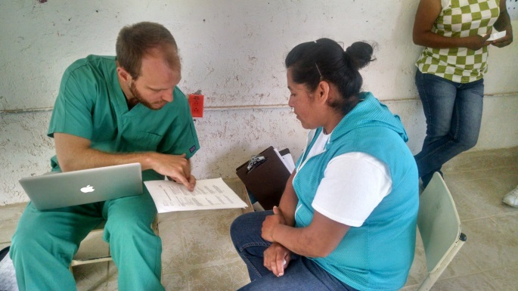
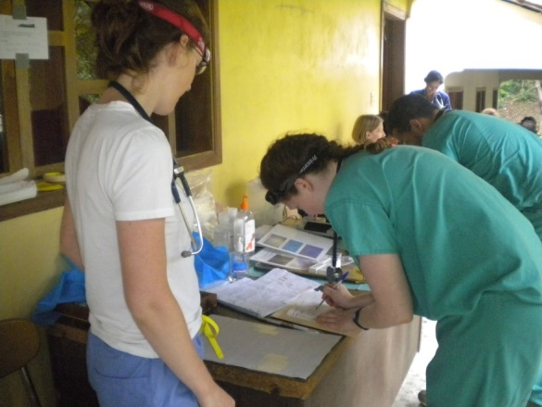
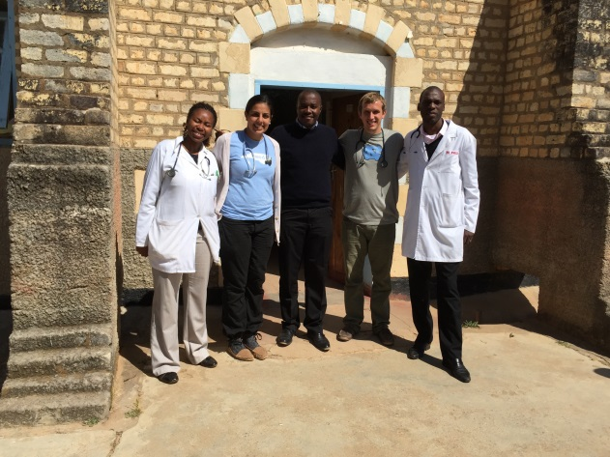
Getting the Most Out of Your Global Health Elective Office of International Activities
Research
Health Education
Clinical Observer
Notes:
Open with questions

Slide 2
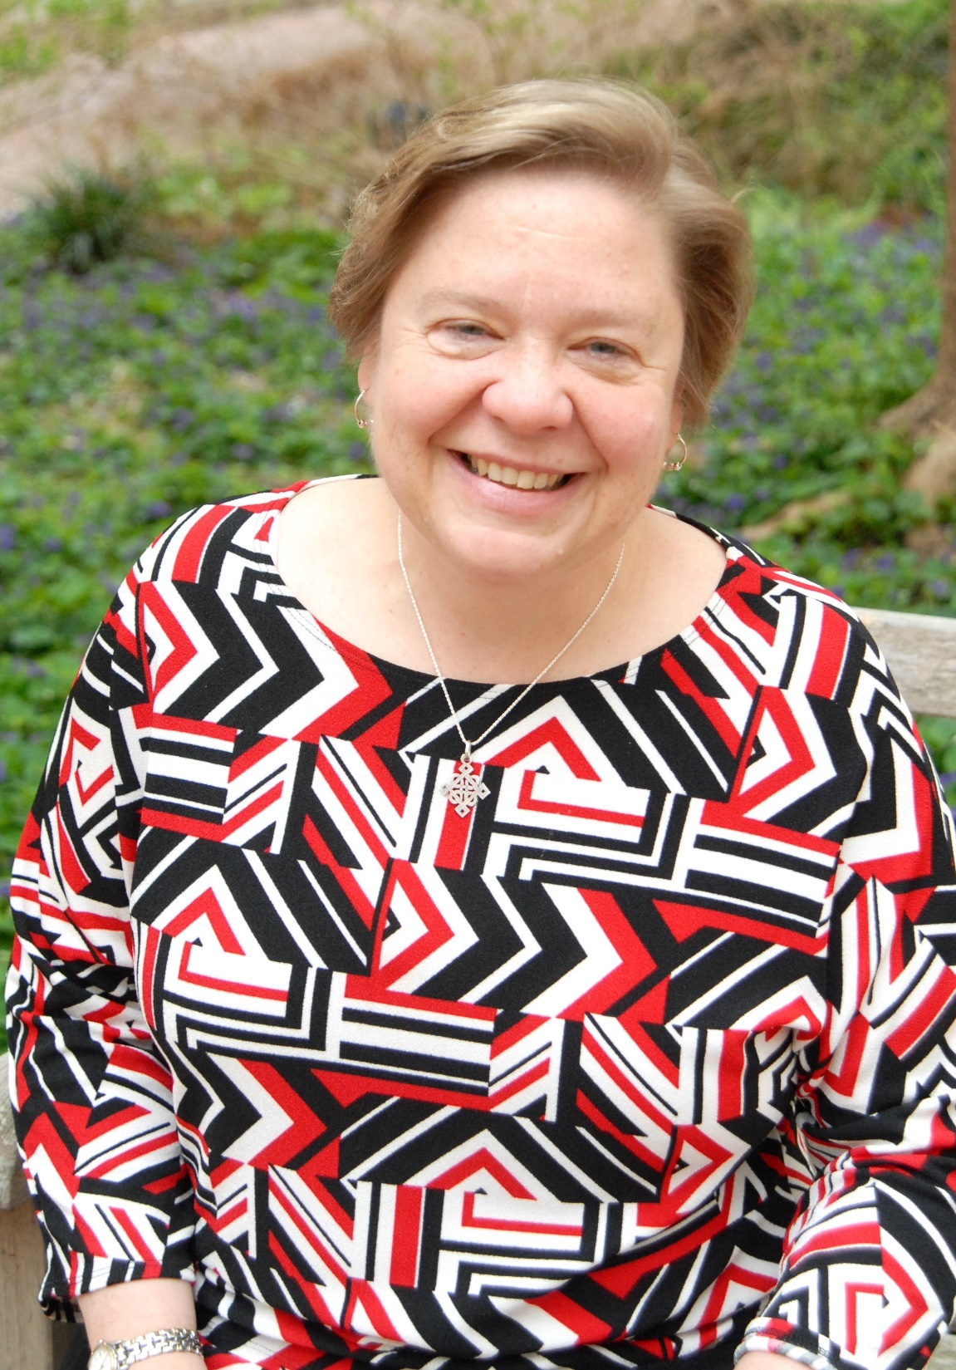
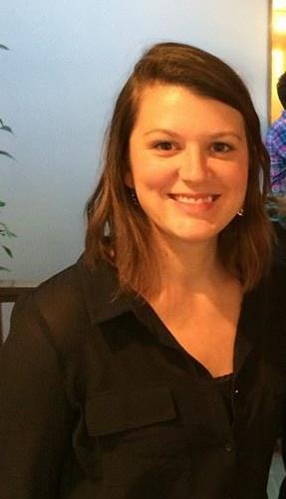
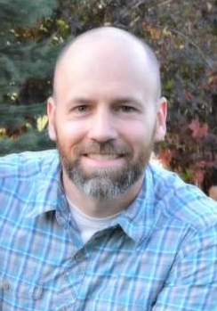
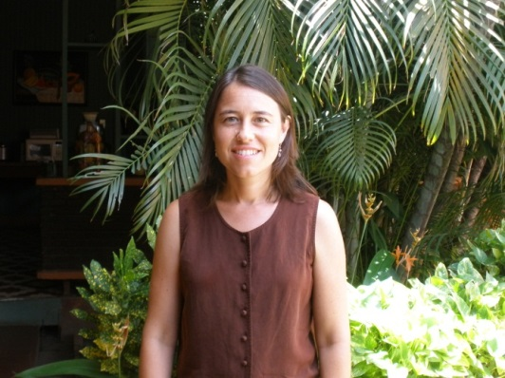
Office of International Activities (OIA) Leadership
Martha Carlough, MD, MPH - OIA Director
Shay Slifko, MA - OIA Program Manager
Justin Myers, DO, MPH - OIA Assoc. Director
Africa focus
ERMD 409; ERMD 414 (Tanzania)
Sylvia Becker-Dreps, MD, MPH - OIA Assoc. Director
Latin America focus
GLBE 204/404 (Nicaragua)

Slide 3
You will leave today knowing:
What is an “elective” and why you should know that
Possibilities for international student experiences
What type of experiences are supported (and some that are discouraged)
YOUR steps to be approved for academic credit
Expectations and Ethical Considerations
Institutional Review Board (IRB) tips for conducting research
Funding: How have students funded their experience?

Slide 4
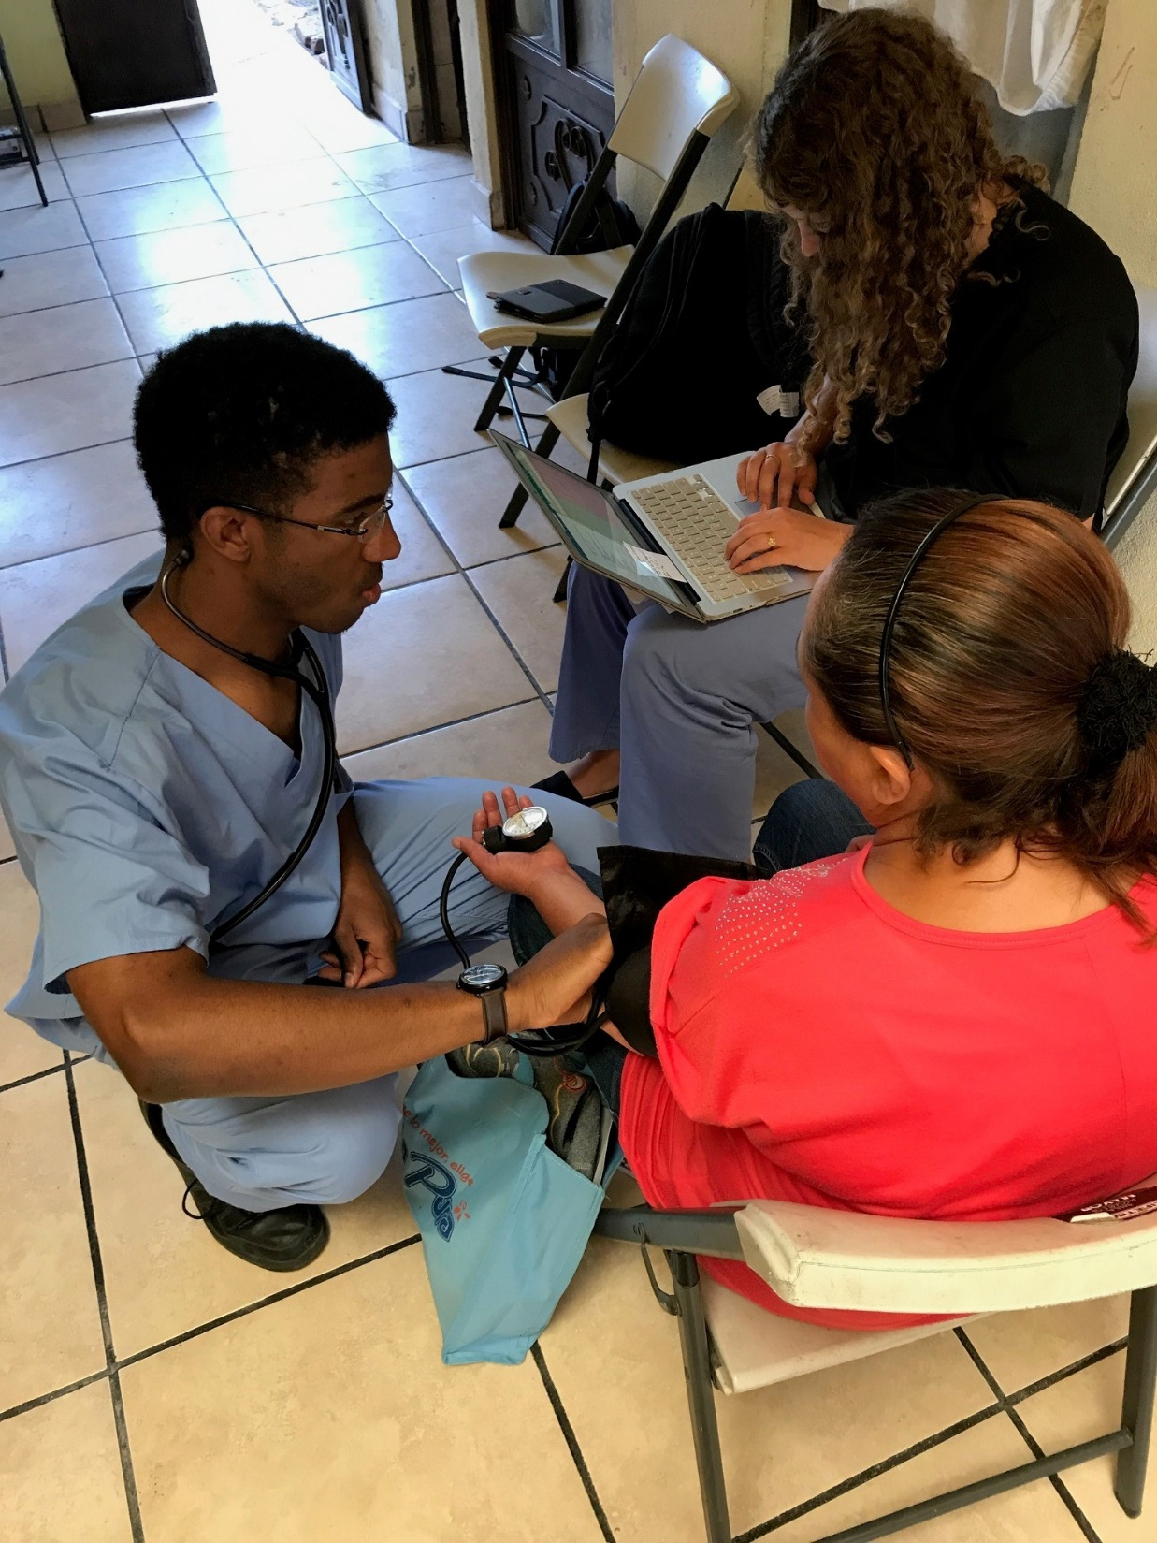
What is Global Health

Slide 5
How can a Global Health elective inform your competencies as a medical student?

Slide 6
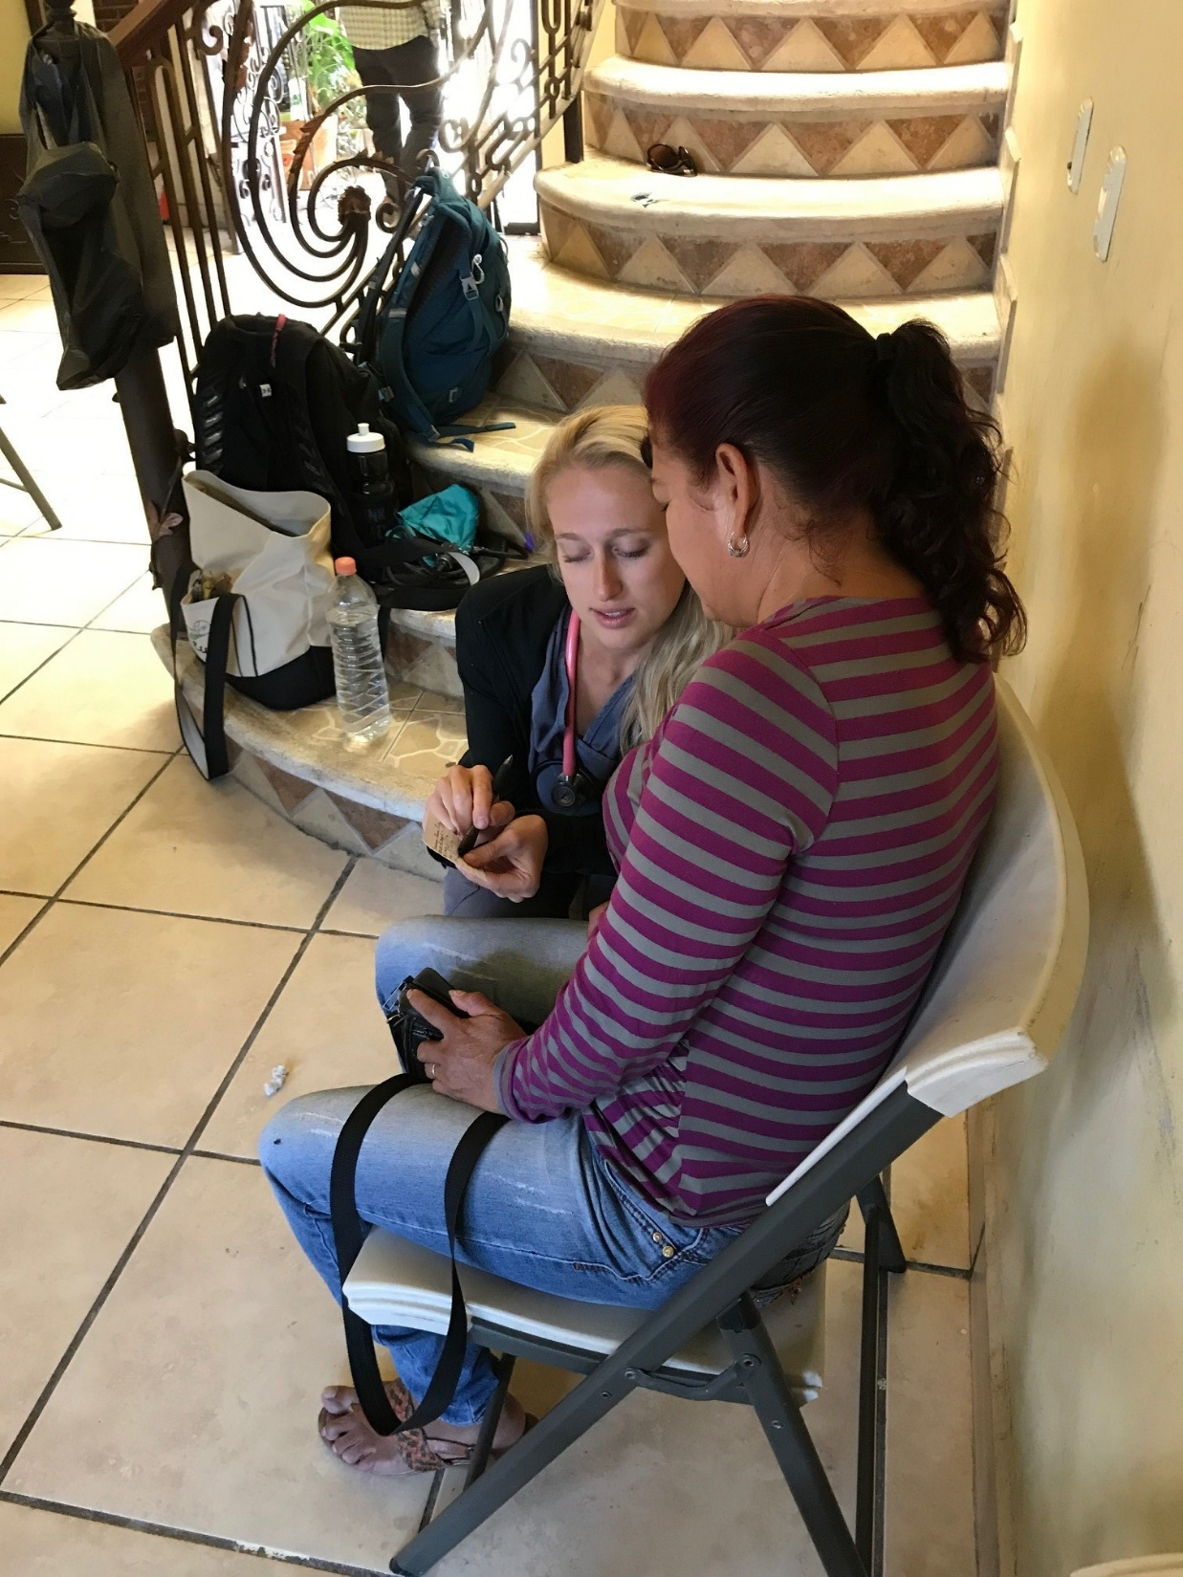
Types of Global Experiences
4-6 week pre-clinical community health oriented experience
A rotation in an established hospital/clinic functioning as a clinical observer
A research opportunity with UNC faculty or outside faculty
A combo – language study and medical learning
An extended experience – a year away from traditional medical school for a fellowship or MPH including an international practicum
Language Immersion: While not eligible for credit, this is still a useful way to spend your summer

Slide 7
Academic Credit
Pre-Clinical Elective Request Form This form is required for medical students who are completing a credit-bearing global health elective in addition to international global health work. After you have met with the OIA Program Manager and clarified the UNC Faculty Advisor for your international elective, submit the form to Leanne Shook in the Office of Student Affairs.
Scenario 1: UNC site with ecxisting course number and faculty advisor
Scenario 2: independing/unaffiliated site but I do want academic credit
You have done your research and preparation and determined you are going to go to apply to
Notes:
To get academic credit:
Steps:
Establish host-site
UNC course advisor
Contact Leanne Shook
OPTION 1: Independent elective? Pickup Elective Request Form
OPTION 2: UNC GH Elective Course: Elective request form
I’m doing ERMD415
I want academic credit and I need financial aid for the summer course =Then course elective form ends in July and they register with Leanne
I want aca credit and I want it to apply to 2nd year
I’m doing an independent elective
I don’t need financial aid or credit
End date on elective form on Aug 15
By what date do I need to submit the completed elective form and course description to Leanne Shook: by May 1st
160 hours= 6 elective credit hours

Slide 8
Global Health Experiences How do I begin the search?
Review OIA website: www.med.unc.edu/oia
Questions to consider
Why do you want to do a global health experience?
Are there types of experiences that are not supported (OIA award money)? YES.
Clinical, public-health related, or research?
For you? For those you serve? For your CV? For your faith? Because everyone else is?
Potential Outcomes
Skills in problem solving and clinical examination
Interest in primary care
Ignited interest in community service or rural health
Limitations:
Lack of clinical experience
Short duration
Varying levels of supervision
Once you’ve carefully reviewed the OIA website, and considered your options, schedule an appointment to meet with OIA Program Manager

Slide 9
Global Health Experiences When is the best time to go?
Summer after MS1/Foundation phase(4-8 weeks)
You can only apply 6 elective credits from MS1 & MS2 year towards the 18 elective credits necessary for graduation
During MS4/Individualization phase (4-8 weeks)
At least two clinical blocks of 4 weeks each (usually for two separate elective courses unless this is an ongoing research project)
Longer electives/fellowships if you are considering an MPH year or a break in your med school years

Slide 10
Global Health Experiences How do I begin the process?
October
Get a clear understanding of what your options are for electives during medical school at UNC (OIA website + meet with OIA Program Manager)
November–December
Find a UNC faculty preceptor and an international preceptor/mentor
To register for a global health elective and receive credit, you MUST have a UNC medical school faculty advisor who registers you for a specific elective course in their department.
January – February
Make a schedule of deadlines - for a project proposal (if needed), scholarship applications and applications to overseas placements, applications, letters of recommendation, and getting ready to go!
http://www.med.unc.edu/oia/medical-students/glocal-opportunities

Slide 11
International experiences fall into 3 categories
UNC Trips
Independent Organizations familiar with UNC
Independent Organizations
Notes:
International trips fall into three categories: UNC-related experiences, Independent Organizations that UNC is very familiar with or have standardized opportunities for medical students, and Independent Organizations or individual experiences that do not have any affiliation with the university. Associated fees are the responsibility of the students, however some funding is available through the OIA.

Slide 12
What have other MS1s done?
UNC Sites
MS18-week summer Infectious Disease research elective with UNC/Malawi, Vietnam, Zambia, South Africa, China research teams
Carolina for Kibera, Kenya (Peacock Fellowship funding)
Unaffiliated Independent Organizations
Still an option…requires student inititiave to organize and ask questions of the organization to plan approved experience:
Himalayan Health Exchange (India)
Child Family Health International (Global Sites)
AMOS (Nicaragua)

Slide 13
Language Immersion
If you’re looking for a longer experience with a greater focus on language skill development, consider applying for the Critical Language Scholarship (CLS) Program.
This program offers a summer language immersion experience for fourteen different languages in locations around the globe. CGI houses an on-campus CLS advisor for this federally managed immersion program, so please reach out if you’re interested in learning more or would like support with your application strategy.
Deadline: Nov 15, 2017
Eligibility: enrolled graduate students
Fully funded, intensive language study during the summer
Contact: Iyman Gaspard (919) 843-6842

Slide 14
Language Immersion
Celas Maya, Guatemala
One-on-one language classes learning conversational Spanish
Medical Spanish learning in clinical observership
No funding from OIA for language study only

Slide 15
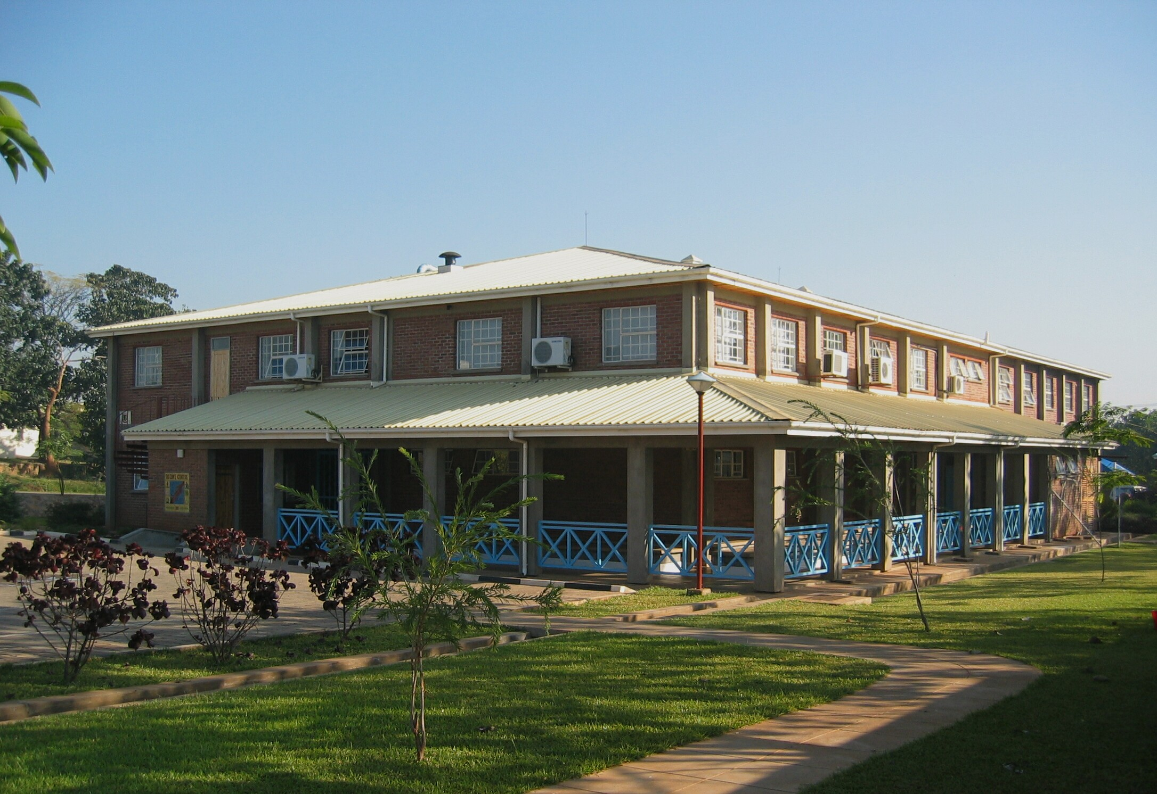
IGHID Global Research in Malawi, Zambia, Nicaragua, China and Vietnam: 8 week summer scholarship for MS1s
For the past 10+ years, the UNC Institute for Global Health & Infectious Diseases has sponsored 7 first-year UNC medical students to conduct summer research at the UNC Project in Lilongwe, Malawi or the University of Zambia, Lusaka, Zambia. We are now extending this program to include our research sites in Vietnam; Nicaragua; South Africa, and China. If chosen,
UNC faculty will mentor students to apply for scholarships and grants’, however students
must procure their own funding.
Students typically receive funding from OIA
Eligibility: ­First-year medical students who are available for eight weeks during the summer. They are looking for students with either a demonstrated or strong career interest in (global) research.

Slide 16
How much will this cost you?
Students spend an average of $2,000 on a 6 week international elective (likely more for travel to Africa and Asia)
Immunizations = Approximately $200-400
Roundtrip Airfare= $850-1600
Visas/Work permit = $300
Housing = $450
Food = $300
Required UNC-sanctioned emergency health insurance= $1.42/day
Notes:
Some organizations have program fees that cover everything – may be worth it

Slide 17
How will I pay for thi$?
SOM/OIA Scholarship- Feb. 15th deadline
Awards ranking from $1,000-$2,000
Applications found on OIA website “funding”
Carolina Global Initiative Internship Award
Funding to students $1,500-$6,000 for selected students with limited to no international travel
http://cgi.unc.edu/funding-opp/carolina-global
Other UNC-based scholarships- deadlines vary- see OIA website under “Other funding options”
Fundraising from family/friends/community organizations …church, rotary…

Slide 18
Expectations Developing ethical awareness
Rose is a first-year medical student at Chapel Hill Medical School in the USA. She hopes to spend a month during the summer in Africa as she has long had an interest in global health. She has never been to Africa, but Chapel Hill has a new relationship with Proye Hospital in Kenya and she would like to go there….
What did Rose expect to gain from her experience in Kenya? What did she not know about her host community when she planned her research project? What knowledge and preparation would have helped her to be more successful?
Notes:
She had hoped to work in the hospital where she could see the diseases that she never sees in the US and help patients, but because she needs funding she is willing to do some kind of study. Rose is referred to a Midatlantic faculty member, Dr. Steve Landers, who is responsible for the new partnership. Dr. Landers suggests she design a project involving local village health workers. Because Rose is interested in pediatrics, she proposes to investigate the village health workers’ care of pediatric patients and do a needs assessment of their deficiencies in this area. With Dr. Landers’ support, Rose gets a partial scholarship and raises an additional $1500 through family and friends to finance her trip.
Upon arriving in Kenya, Rose is immediately presented with several challenges. She learns that the village health workers speak two quite different languages and are scattered throughout a large geographic area only accessible by car. Moreover, most of them are subsistence farmers, busy planting this season’s crops and unavailable for interviews this time of year. Unsure of how to
proceed with her research, Rose spends her first week accompanying Dr. Landers in the hospital. She is very glad he is there, as even when they speak English she rarely understands what the local doctors and their patients are saying. Often she cannot hear them at all as they speak very quietly, she assumes in order to protect patient privacy in the large open wards. When there is
time, Rose asks Dr. Landers what is going on, but sometimes he doesn’t know either. During this week, Rose meets a nurse at the hospital from one of the outlying villages who speaks English and is willing to translate for her. The nurse helps Rose find a driver and borrows the ambulance van from the hospital for a day. The road to their chosen village is impassable due to flooding, so they go to a nearby village where the same language is spoken. There Rose meets two village health workers who seem rather shy. Rose tries to ask them questions about their pediatric patients but they prefer to talk about the weather, offer Rose tea, and make lunch for their extended family. She understands that they may be more willing to talk after lunch, but then they lead Rose to another house where she meets someone she is told is a ‘village elder.’ Rose isn’t sure what to do but introduces herself and her project and the elder seems satisfied. After her visit with the elder, Rose meets again with the two village health workers. They are still friendly and willing to talk to her, but it is hard for Rose to get clear answers to her questions. The village health workers say they don’t care for children, but visit families. Sometimes they only visit elder villagers. They sometimes talk to parents and caregivers about the children in the family, but they do not read or write and use water bottles to measure the height of children. Unsure of what she can do with this information, Rose decides to focus instead on their training. She asks them what kind of training they would like. The village health workers seem confused by this question, saying they would like to become a ‘cluster’ that is recognized by microfinance bank in the
nearby town. When Rose asks what a cluster is, they say that another group of women is a cluster which allows them to buy a cow and borrow money to start a small store. By now Rose is overwhelmed. She knows nothing about microfinance and only has three weeks left to do her research project. She begins to wonder if she should have just donated her $1500 to the community health workers rather than coming to Kenya herself. Rose heads back to the hospital to offer to help care for patients until she can figure out what to do next.
What did Rose expect to gain from her experience in Kenya? What did she not know about her host community when she planned her research project? What knowledge and preparation would have helped her to be more successful?

Slide 19
Expectations Developing ethical awareness
Nilly is a nursing student at Proye Hospital in Nkoli, Kenya. One day, one of her instructors told her she would need to leave her post in the consultation area in order to translate for a visiting American medical student, Rose…
Notes:
It seemed the student wanted to do some kind of research project out of town. Nilly was instructed to accompany the visiting American, Rose, to her home village to interview some village health workers there. Nilly had not been back to her village for several months and was excited at the opportunity to see her family. She also hoped that by doing this work she might be paid an
extra stipend or that the American could be a helpful contact in the future. At the same time, Nilly saw the lines of mothers, babies, and elders waiting to be seen
and felt badly about leaving all the work to one other nurse. Nilly’s first impression of Rose was that she was very nice but very young and anxious. She was clearly eager to
get started on her project and did not want to take time for tea with the driver, which Nilly felt was common courtesy before embarking on a journey. When they got
in the car, Rose also seemed stressed. She was upset that the seatbelts were not working and seemed uneasy when the driver picked up and dropped off other passengers along the way. Sadly, the road to Nilly’s village was blocked by flooding so Nilly would not get to see her mother and sisters, but when she saw the disappointment
on Rose’s face, she suggested they visit a neighboring village that used the same language. Within an hour, they arrived.
Rose’s research project included interviewing village health workers about their care of pediatric patients and the training they wished for. Nilly thought Rose asked good questions, but she wanted to know about children, not knowing that the village health workers were usually only concerned with the health of adults. Furthermore,
the village health workers measured children’s heights in lengths of water bottles, which seemed to bother Rose. Worst of all, it was planting time and the village health workers wanted to be working their fields, not answering strange questions from a young foreigner. But some did stay. Nilly tried her best to translate, but Rose seemed frustrated that her questions were not easily answered. In addition, it seemed that Rose and the village health workers had different ideas about what counted as training. When Rose asked them what training they wanted, they said they wanted to become a cluster that could be recognized by a microfinance bank. The village health workers thought this was why Rose had come, and was
why they gave up their time in the fields to meet with her. This misunderstanding was awkward for Nilly because it was clear to her that Rose could not provide this kind of
assistance. It was a long day and Nilly and Rose returned to town after dinner. Nilly did not get to eat because the student cafeteria was closed. Nor did she get the stipend that she hoped for, although Rose did ask her to help translate again the next day. This would again pull Nilly away from her clinical duties and study time, but she still hoped that Rose might give her something to compensate for her time.
How did Rose’s presence impact the clinical and support staff at Kenyan Hospital? How might western medical trainees minimize the disruption they impose on the under-resourced institutions and communities they visit?

Slide 20
Institutional Review Board (IRB) Tips for conducting research
Last year, over one million people took part in research studies at UNC CH.
IRB Guidance for Student Research
Federal regulations and university policies require Institutional Review Board (IRB) approval for research with human subjects. This applies whether the research is conducted by faculty or students, by individuals or a group.
Failure to obtain proper approval in advance may jeopardize your data, prevent you from publishing the results, and place you and the university in violation of federal regulations. At the same time, many class projects are conducted for educational purposes and not as research, and will
not require IRB approval.
Visit the UNC IRB and Office of Human Research Ethics

Slide 21
What is research?
A systematic investigation, designed to develop or contribute to generalizable knowledge (i.e. beyond the particular setting)
Examples of research often undertaken by students:
Informal and formal questionnaires
Data collection for local clinicians
Interviews with key personnel that include patient information
Notes:
So, quality improvement activities used only within a project are not “research” but if this information is printed/published more broadly it IS.

Slide 22
Timeline
November - December
(Step 3) Find a UNC faculty preceptor and an international preceptor/mentor
In order to register for global health elective or selective and receive credit, you MUST have a UNC faculty advisor who registers you
for a specific elective course in their department. Any UNC medical school faculty CAN be your faculty advisor if they are able to
sign off on your elective request, approve registration for you in an elective course in their department, and take responsibility for
working with you to plan an appropriate learning experience, completing your evaluation and grade submission.
January - February
(Step 4) Make a schedule of deadlines
It may be helpful to set deadlines for a project proposal (if needed), scholarship/grant applications and applications to overseas
placements, applications, letters of recommendation, and getting ready to go (immunizations, travel insurance, visa, etc).
(Step 5) Find and apply for funding
Funding generally comes from one of three sources: yourself, loans, or scholarships and grants. If you are getting credit for your
project abroad, you are eligible to receive financial aid. In order to receive financial aid before your trip, you need to apply for it at
least 6 weeks prior to departure (and your elective request/credit application MUST be submitted before you apply). March – April
(Step 6) Get ready to travel safely and be prepared for emergencies
Travel insurance including evacuation is required for all UNC students and faculty traveling outside of the US as part of school or
work experience. You MUST obtain insurance and complete two online modules: “Travel Health and Safety” and “Cross-cultural
Issues, Ethics and Professionalism for global health electives.” UNC Student Health Services has an International Travel Clinic which
can help to get all your immunizations and meds up to par for travel. Call for an appointment 3-6 months prior to travel. UNC SOM
students and faculty must abide by UNC travel policies and emergency procedures. See UNC SOM Emergency Plan for important
emergency planning information.
August
(Step 7) Remember to leave some time and energy to re-enter gently and wrap things up when you return
If you have applied for elective credit, you will need to submit an evaluation of your elective, a preceptor’s evaluation of your
performance and experience, and whatever project or paper is required by your faculty advisor for the specific class you registered for.
The elective evaluation and the preceptor evaluation should be submitted electronically to the Office of International Activities.

Slide 23
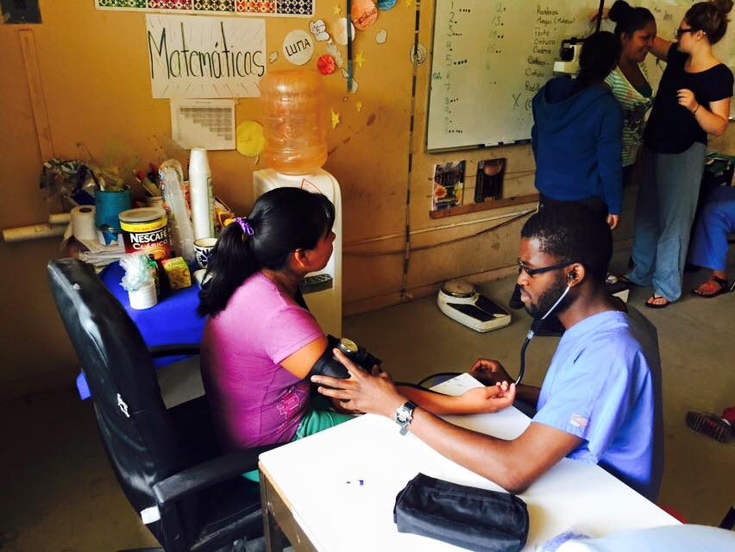
Questions?
Review today’s session on the OIA website

