Slide 1
The Challenges of Conducting Clinical Research in Low Resource Settings
Carl Bose, MD
Division of Neonatal-Perinatal Medicine
The University of North Carolina

Slide 2
Improving Neonatal Outcomes in Low Resource Settings Through Education and Research
Carl Bose, MD
Division of Neonatal-Perinatal Medicine
The University of North Carolina

Slide 3
I have no conflicts of interest to disclose.

Slide 4
Improving Neonatal Outcomes in Low Resource Settings
Define the setting
  What is a “low resource setting”? What is the quality of life there?
Define the problem
  What is the impact of poverty on neonatal health? On research?
Discovering solutions
  Are there effective and sustainable interventions? How do you overcome the challenges of discovery?

Slide 5
Improving Neonatal Outcomes in Low Resource Settings
Define the setting
Define the problem
Discovering solutions

Slide 6
What is a “low resource setting”?
Developing Countries
  US President Harry Truman, inaugural address 1949
Third World
  Alfred Sauvy, L’Observateur 1952, Three Worlds One Planet
Global South
  West German Chancellor Willy Brandt, North-South: A Programme for Survival 1980
Low- and lower-middle-income countries (LMICs)
  World Bank income categories established in 1989
Majority World
  Writer and photographer Shahidul Allam, early 90s

Slide 7
What is a developing country?
World Bank Country Classification
Classification GNI per capita ($)
Low < 1035
Low-Middle 1036 - 4085
Upper-Middle 4086 – 12,615
High > 12,616
Developing Countries
http://data.worldbank.org/about/country-classifications

Slide 8
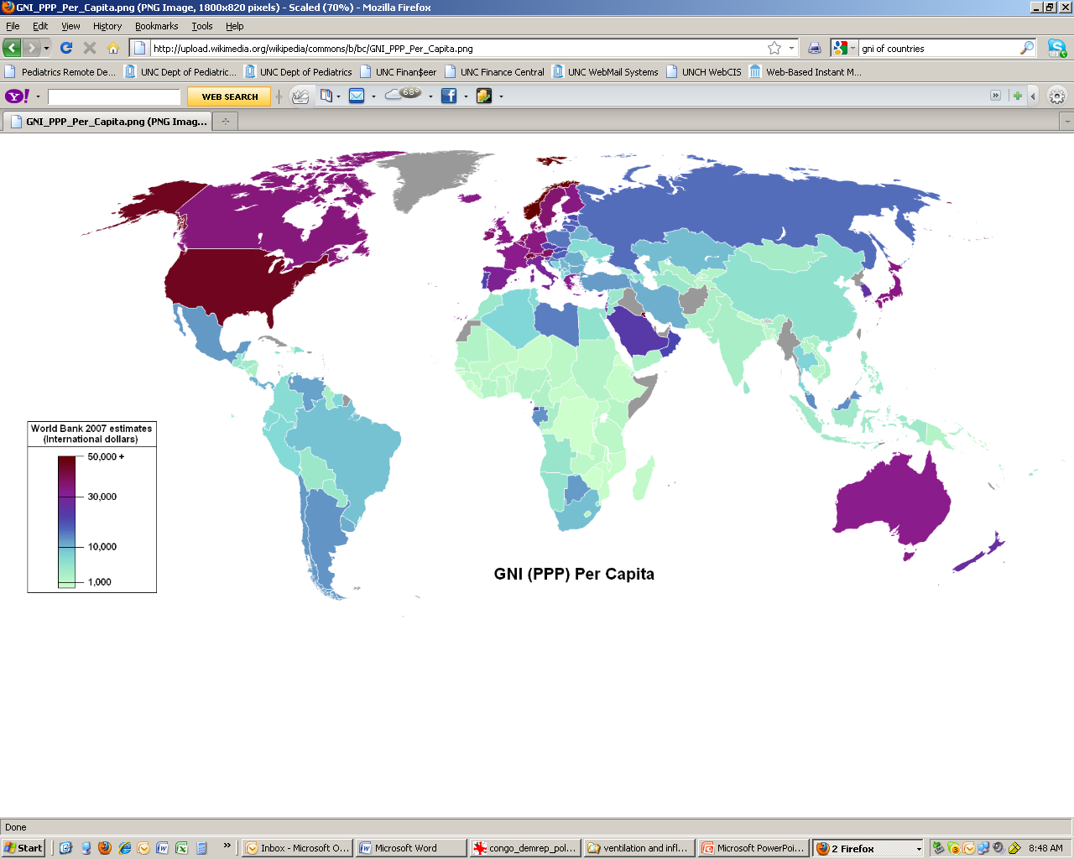
Gross National Income per Capita
Most developing countries in Sub-Saharan Africa and South Asia

Slide 9
Democratic Republic of Congo
Land area = 900,000 sq. mi. (US = 3.7 million)
Population ≈ 66 million
Classification = Low income
GNI per capita = $340
Poverty* ratio = 71% (higher in rural areas)
* poverty = < $ 2/day

Slide 10
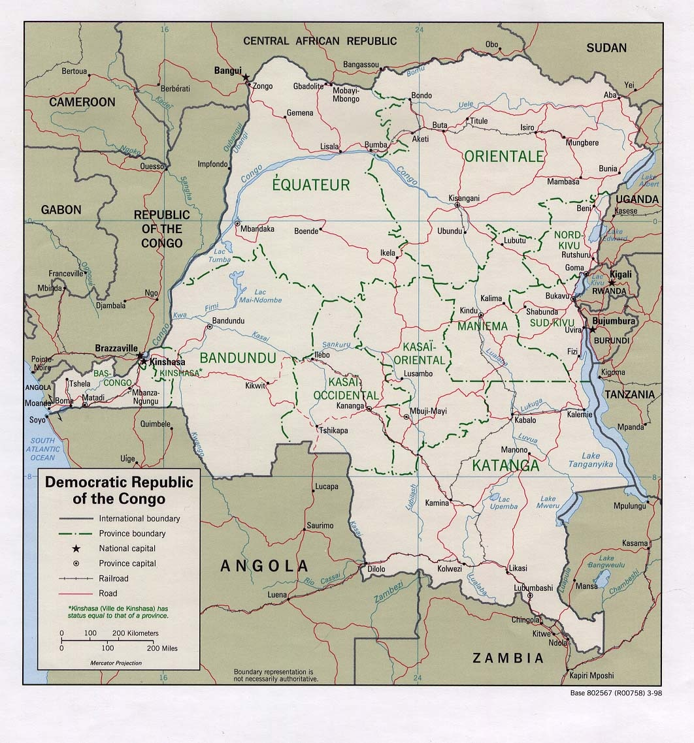

Slide 11

Landscape: sparsely populated forest and savannah

Slide 12
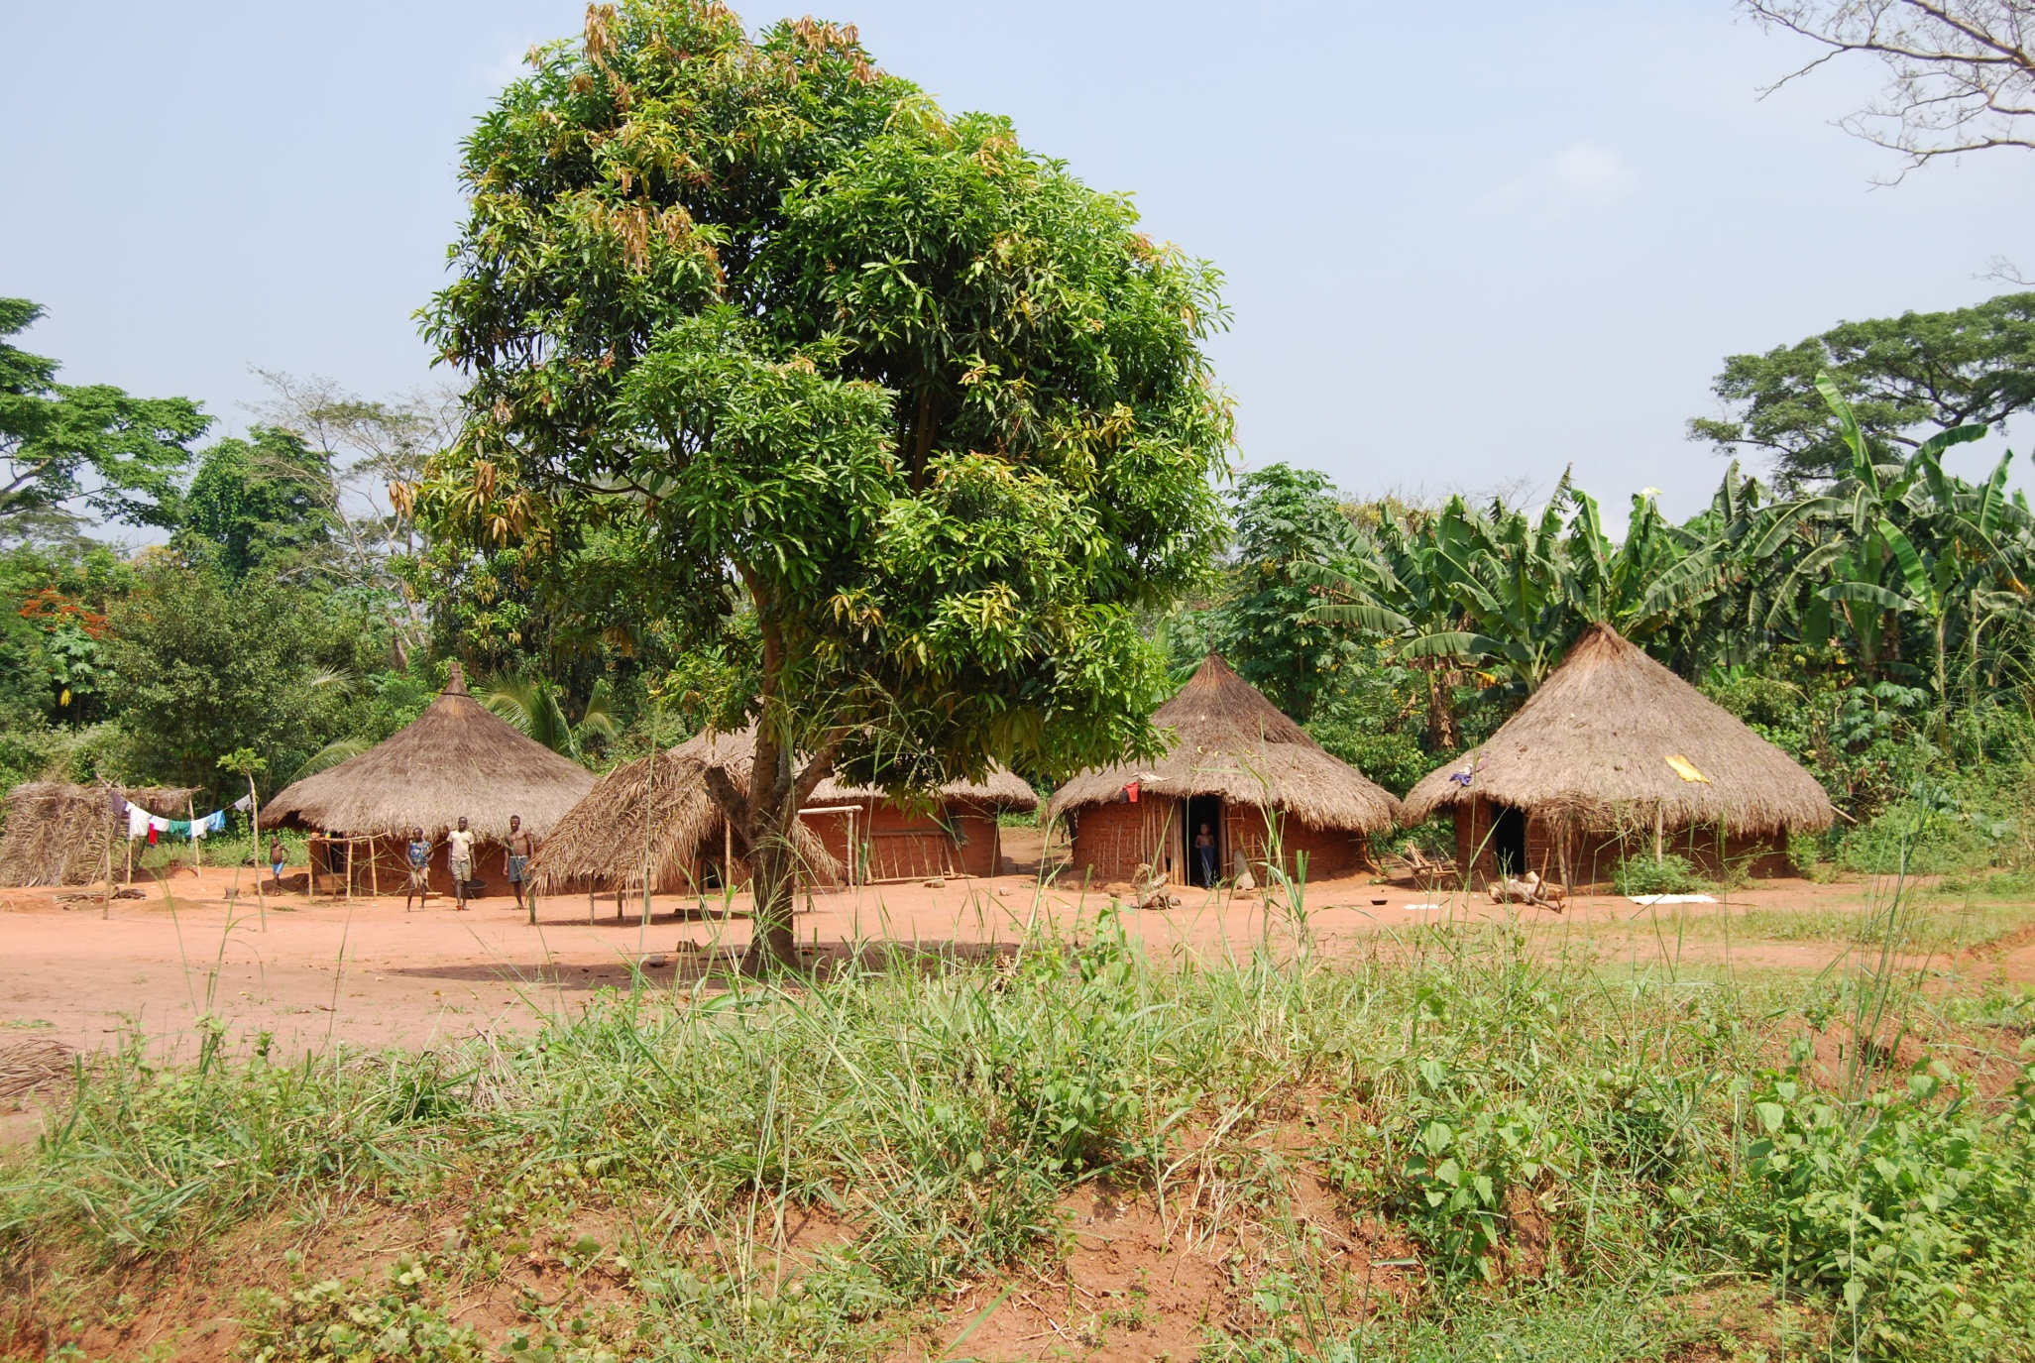
Small villages: single-family dwellings, no electricity or safe water

Slide 13
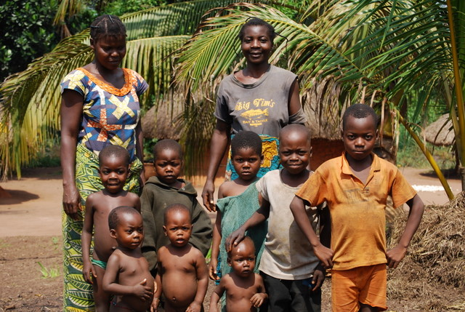
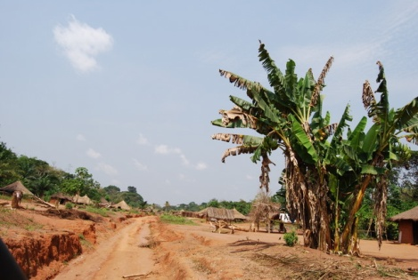
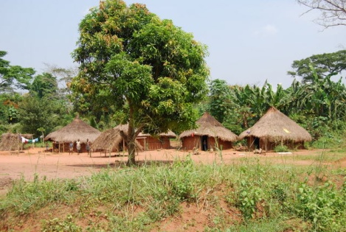
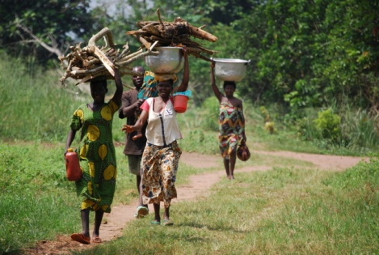
Large families: ∼6.0 pregnancies/woman

Slide 14

Transportation infrastructure: few paved roads, no public transportation

Slide 15
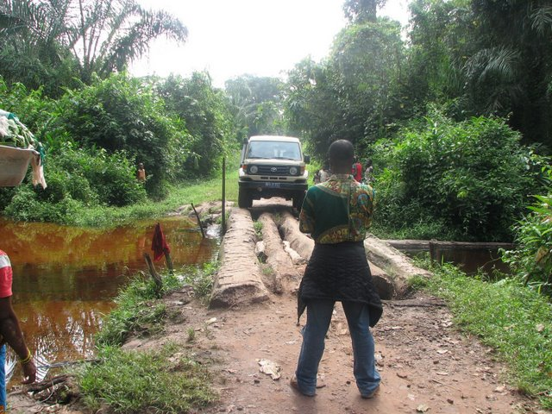
Transportation infrastructure: few bridges, many regions virtually inaccessible

Slide 16
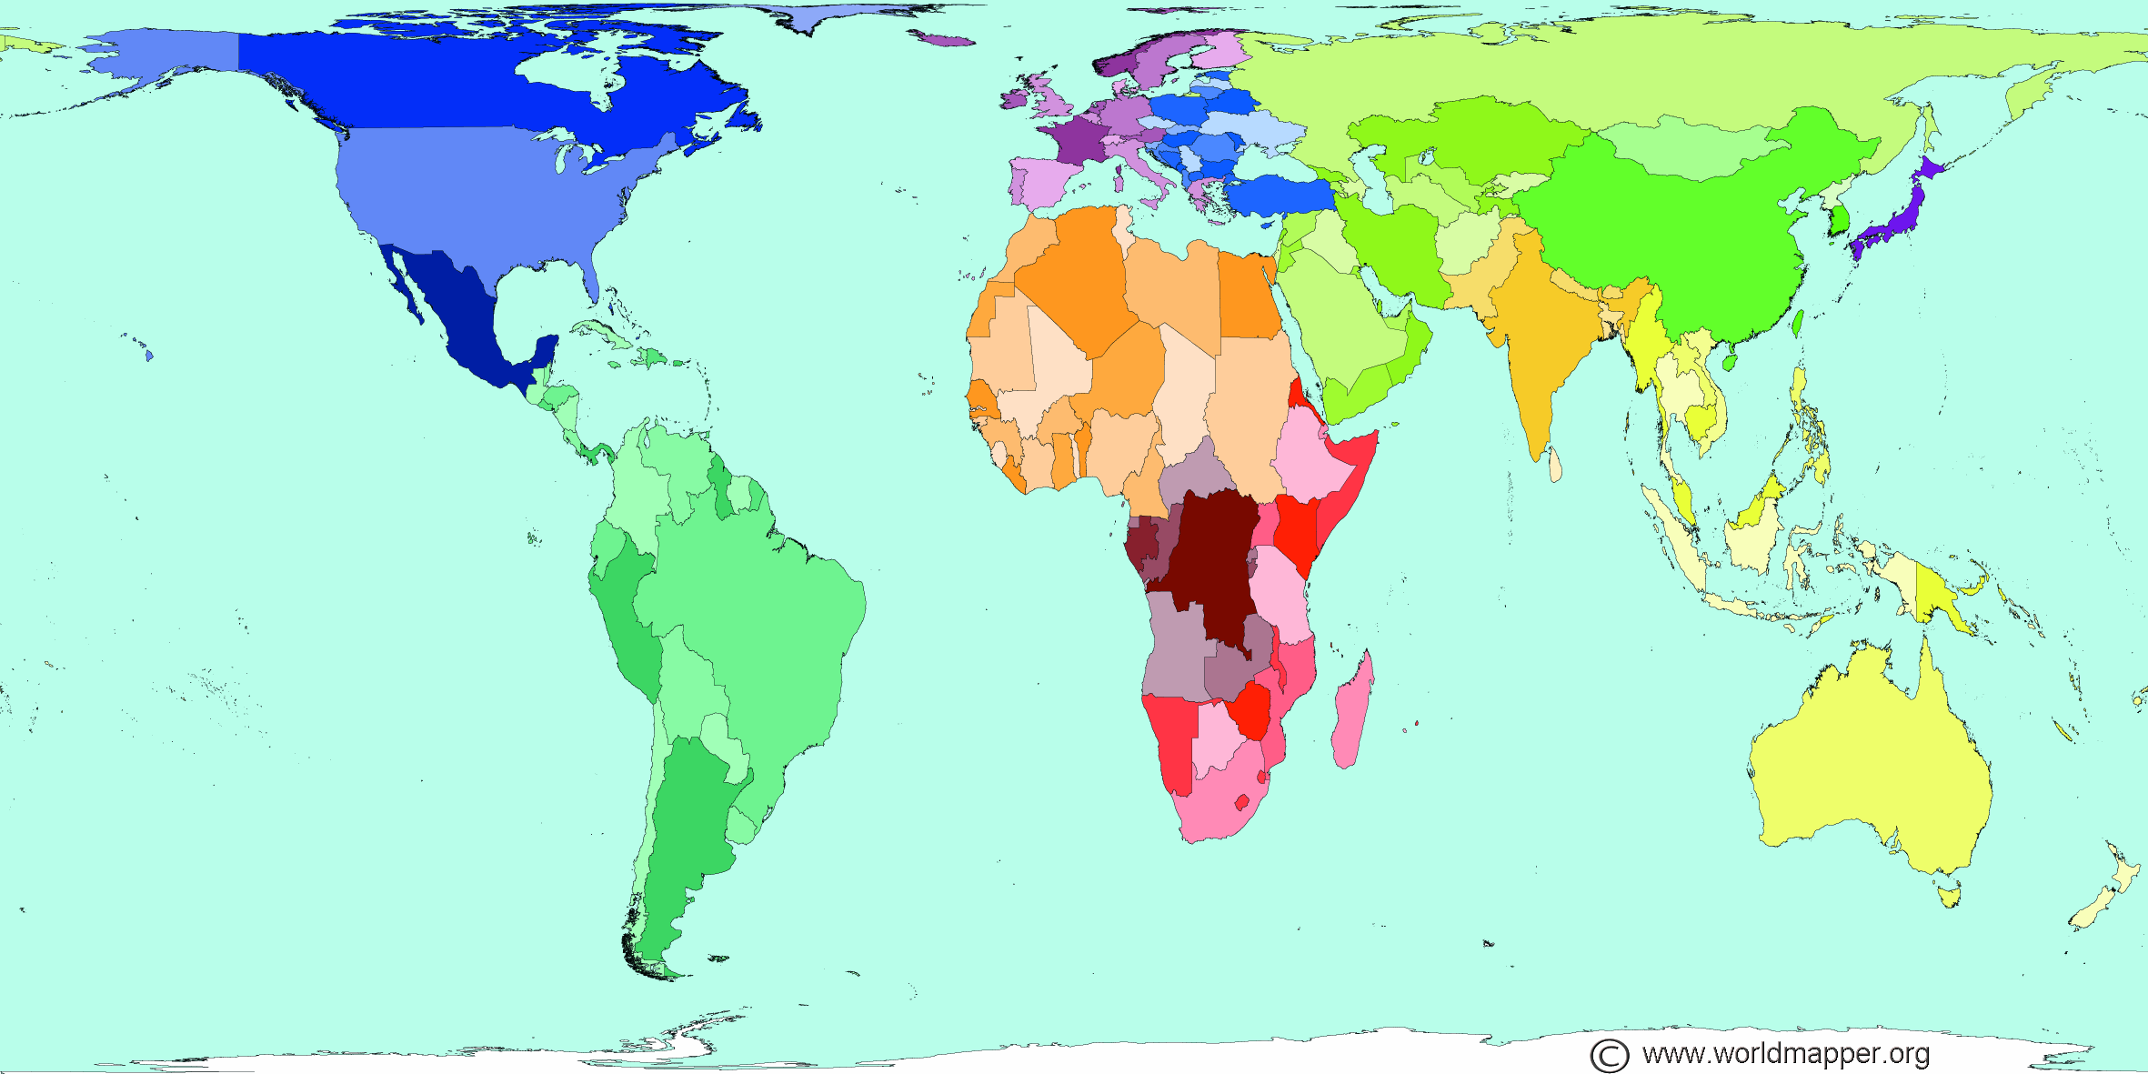
Land Area
Each territory's size on the map is drawn according to its land area.

Slide 17
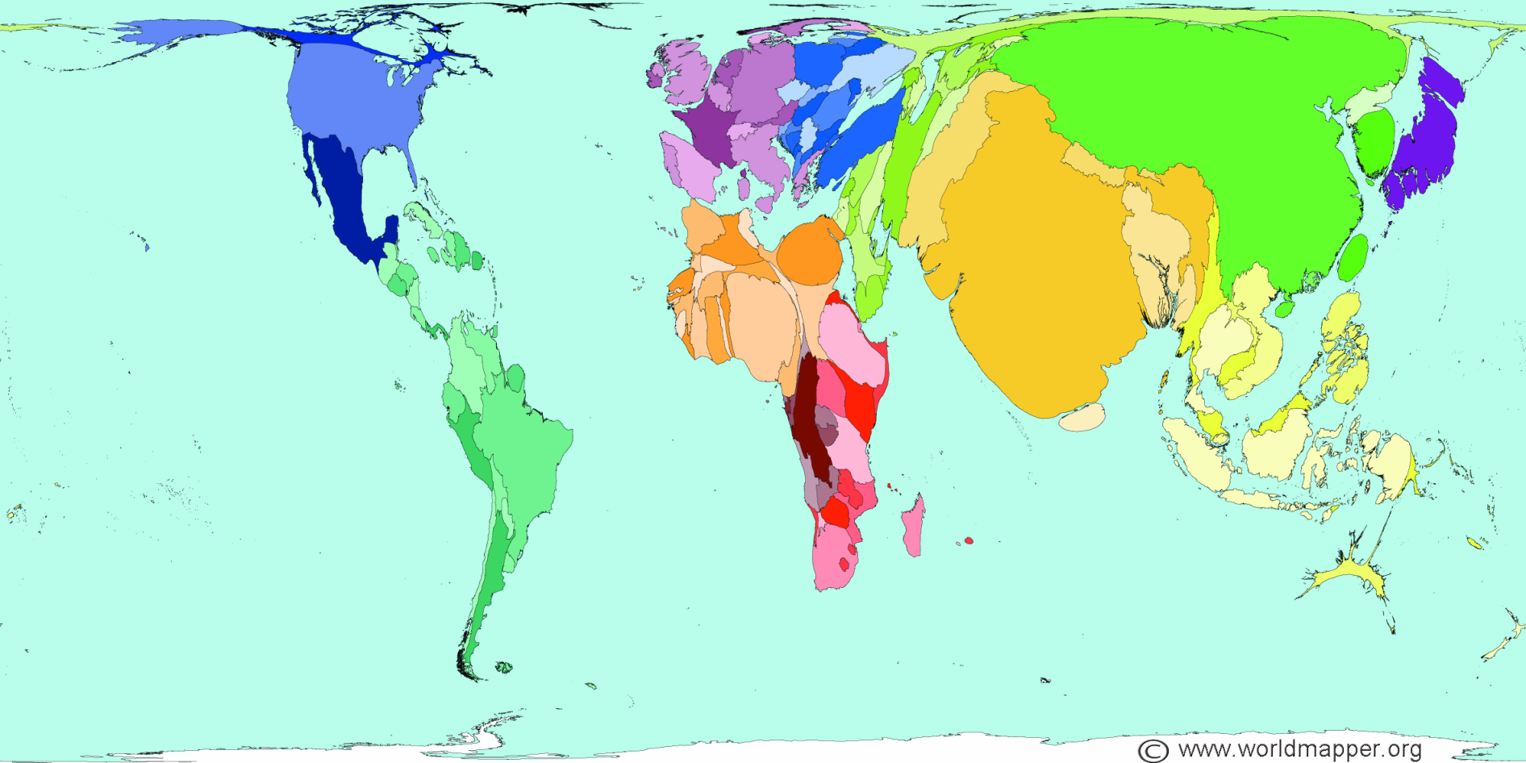
Population
The size of each territory shows the relative proportion of the world's population living there.

Slide 18
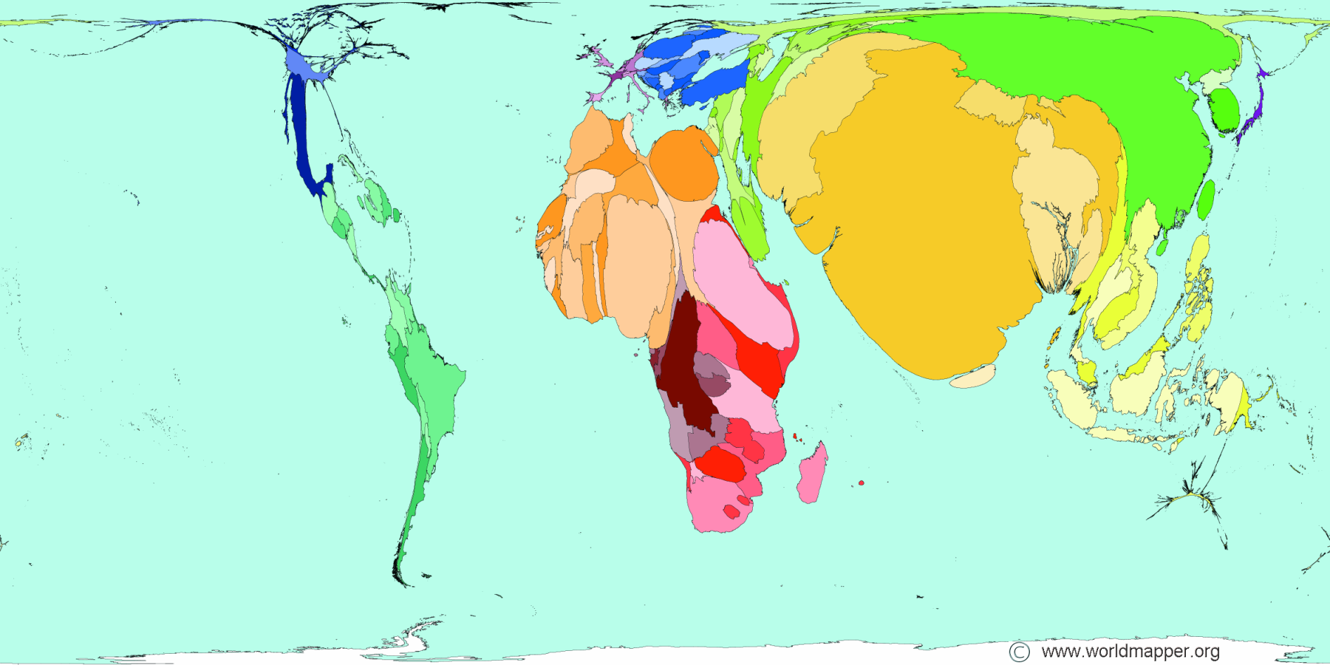
Poverty
Territory size shows the proportion of all people living on less than or equal to US$2 in purchasing power parity a day.

Slide 19
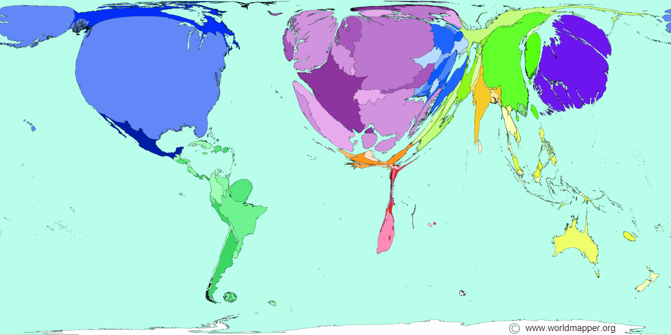
Public Health Spending
Territory size shows the proportion of worldwide spending on public health services that is spent there. This spending is measured in purchasing power parity.
Poverty

Slide 20
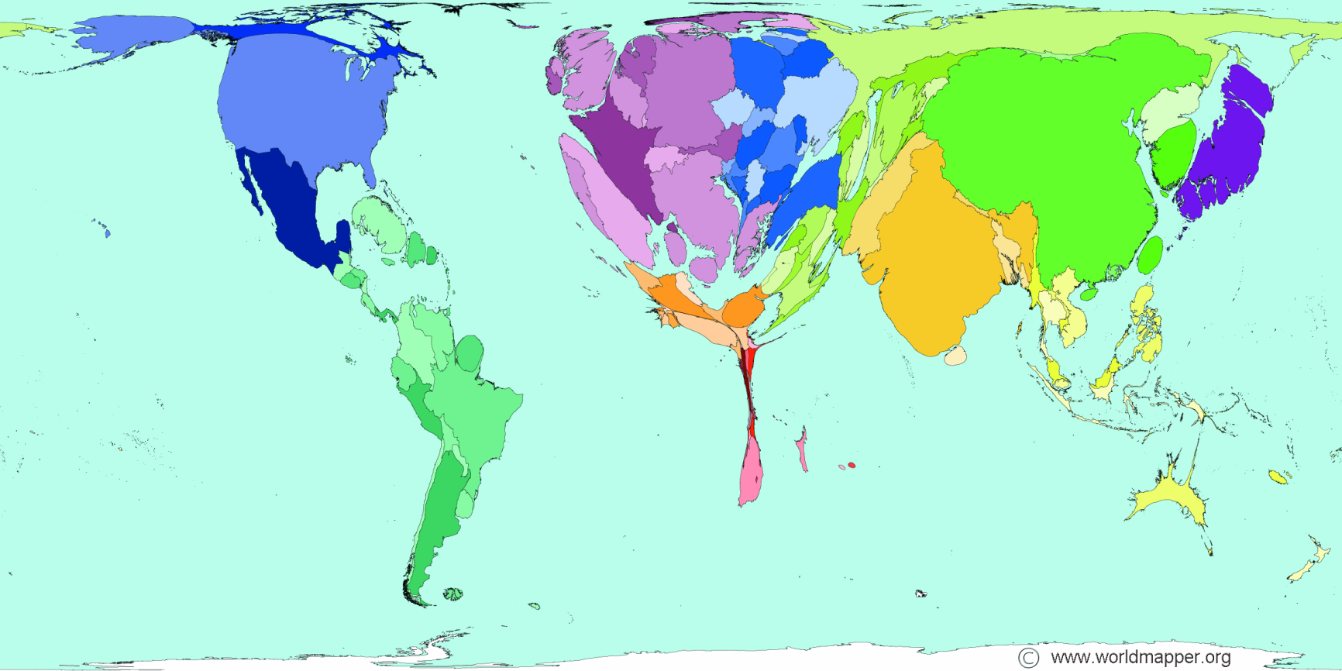
Physician Workforce
Territory size shows the proportion of all physicians (doctors) that work in that territory.
Public health spending

Slide 21
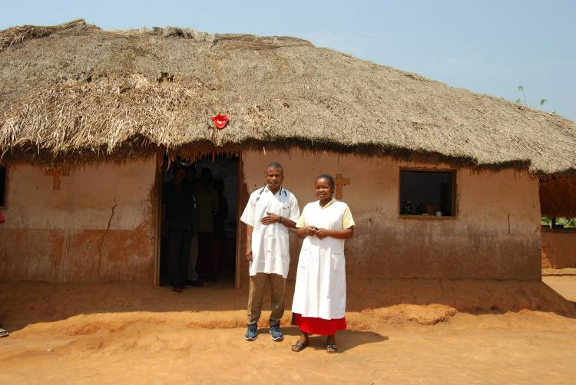
Health center: main site of care

Slide 22
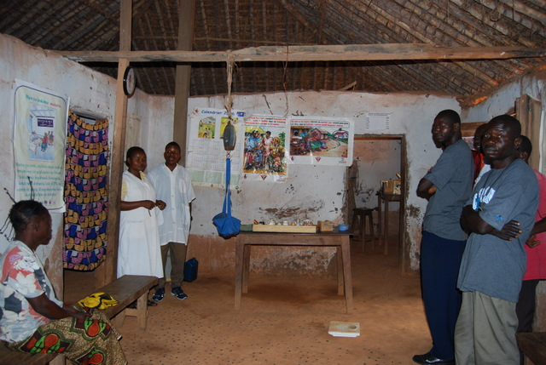
Health center: no water or electricity

Slide 23
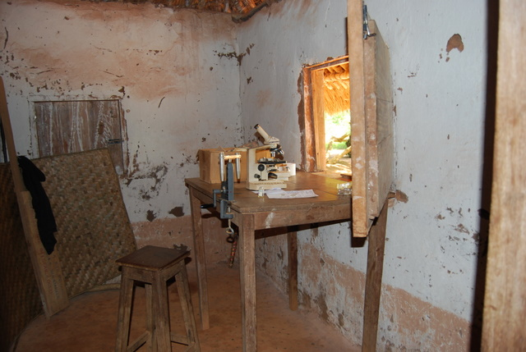
Health center: very limited laboratory services

Slide 24
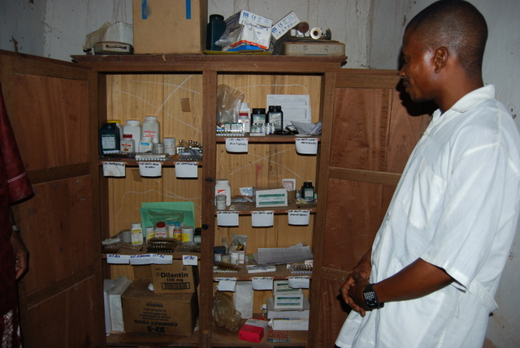
Health center: limited pharmaceuticals

Slide 25
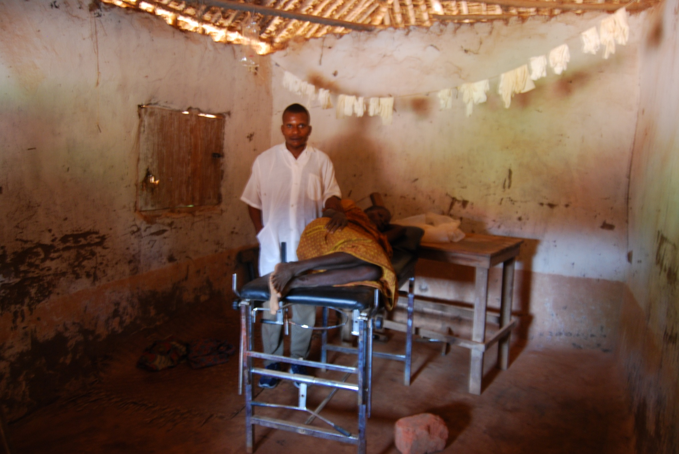
Health center: limited obstetrical care

Slide 26
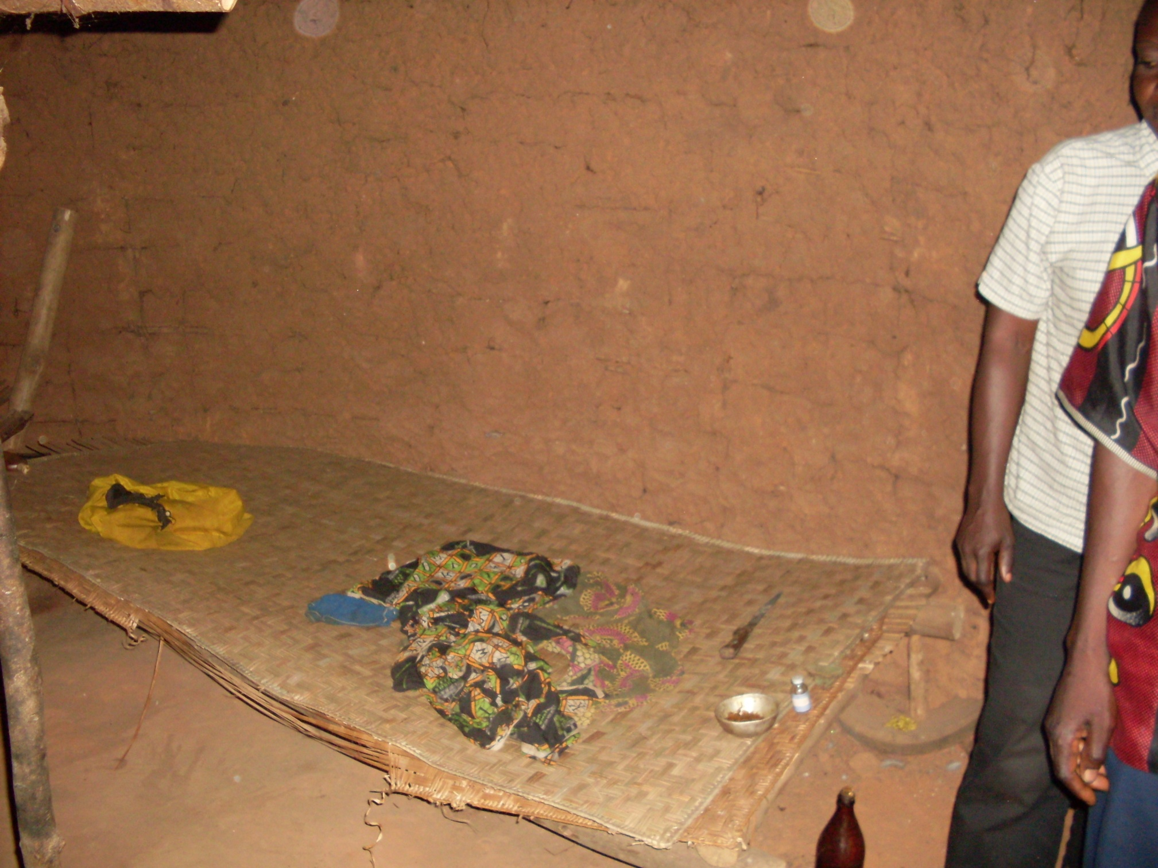
Many (most) deliveries at home

Slide 27
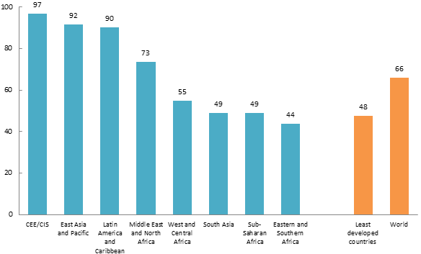
Percentage of births attended by skilled health personnel (doctor, nurse or midwife), 2007–2012
SOWC 2013, UNICEF global databases 2012, from Multiple Indicator Cluster Surveys (MICS), Demographic and Health Surveys (DHS), and other nationally representative sources.
Notes:
Daily risk of death during first month of life based on analysis of 47 DHS datasets (1995-2003) with 10,048 neonatal deaths. Lawn et al

Slide 28
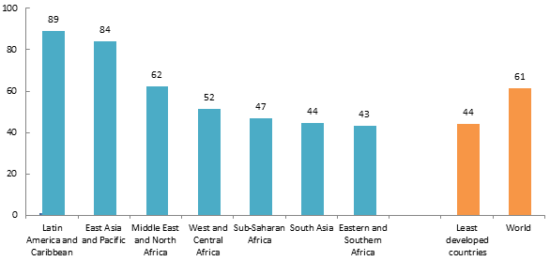
Percentage of births delivered in a health facility, 2007–2012
SOWC 2013, UNICEF global databases 2012, from MICS, DHS and other nationally representative sources. .
Notes:
Daily risk of death during first month of life based on analysis of 47 DHS datasets (1995-2003) with 10,048 neonatal deaths. Lawn et al

Slide 29
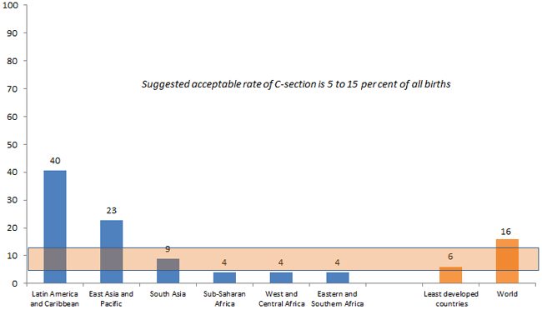
Percentage of births delivered via C-section, 2007-2012
Notes:
Daily risk of death during first month of life based on analysis of 47 DHS datasets (1995-2003) with 10,048 neonatal deaths. Lawn et al

Slide 30
Improving Neonatal Outcomes in Low Resource Settings
Define the setting
Define the problem
Discovering solutions

Slide 31
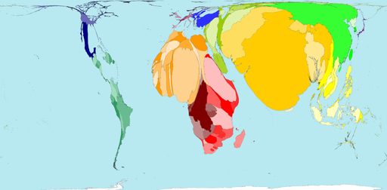
Health Outcome: Neonatal Mortality
Territory size shows the proportion of all neonatal deaths that occurred there in 2000.
Poverty

Slide 32
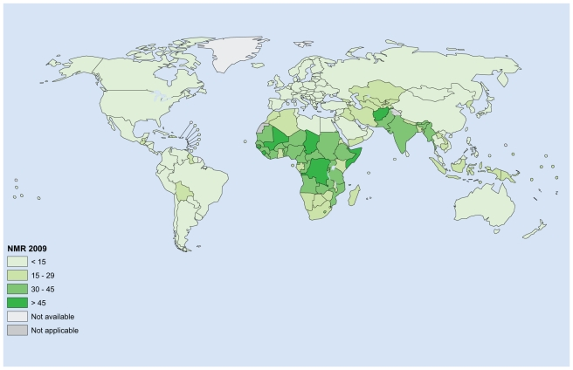
Where do most neonatal deaths occur?
Oestergaard et al. PLoS Med 2011

Slide 33
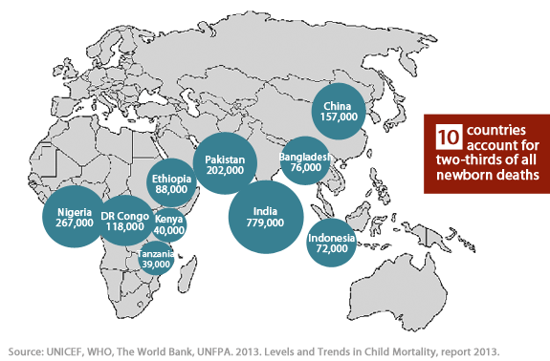
Where do most neonatal deaths occur?
3.8 neonatal deaths (3.2 million stillbirths)
~ 3x deaths due to HIV/AID’s and malaria combined
> 400 neonatal deaths each hour

Slide 34
Intra-country Disparities in Child Survival
From: State of Latin American and Caribbean Children, UNICEF 2008

Slide 35
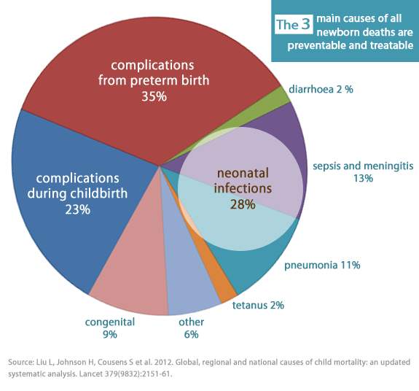
What causes neonatal death?
Notes:
Daily risk of death during first month of life based on analysis of 47 DHS datasets (1995-2003) with 10,048 neonatal deaths. Lawn et al

Slide 36
Congenital
malformations
Infection
Prematurity
Prematurity
Congenital
malformations
Asphyxia
Lawn J, et al. Lancet 384:196, 2014

Slide 37
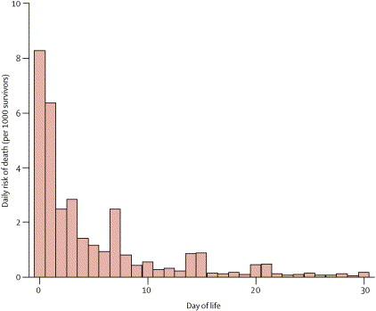
When do most neonatal deaths occur?
Daily risk of neonatal death based on 47 DHS datasets (1995-2003). Lawn et al, Lancet 2005
Notes:
Daily risk of death during first month of life based on analysis of 47 DHS datasets (1995-2003) with 10,048 neonatal deaths. Lawn et al

Slide 38
Lawn J, et al. Lancet 384:196, 2014

Slide 39
Improving Neonatal Outcomes in Low Resource Settings
Define the setting
Define the problem
Discovering solutions

Slide 40
Myths and Misconceptions
Myth: The problem is poverty; neonatal mortality will not decline until poverty is reduced.
Fact: Although there is a strong correlation between poverty and high neonatal mortality, some L-MIC achieve good outcomes

Slide 41
Myths and Misconceptions
Myth: Facility-based, high-tech interventions, such as neonatal intensive care units, are needed to reduce neonatal mortality.
Fact: Most countries with a low NMR achieved substantial reductions in neonatal mortality (to an NMR of 15 per 1000) before neonatal intensive care became widely available.
Lancet 2005; 365:1189, 2006

Slide 42
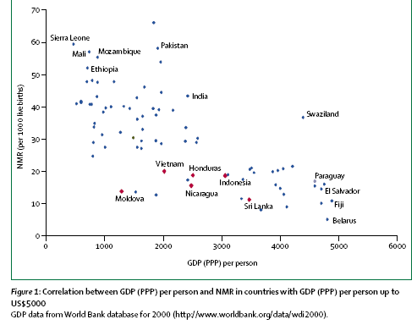
Neonatal Mortality Rates and Country Wealth
Notes:
Vietnam GDP $2700 Honduras GDP $2800 Nicaragua GDP$2300 Moldova GDP $1900 Ghana GDP 2300

Slide 43
Neonatal Mortality Rates and Country Wealth
Notes:
Vietnam GDP $2700 Honduras GDP $2800 Nicaragua GDP$2300 Moldova GDP $1900 Ghana GDP 2300

Slide 44
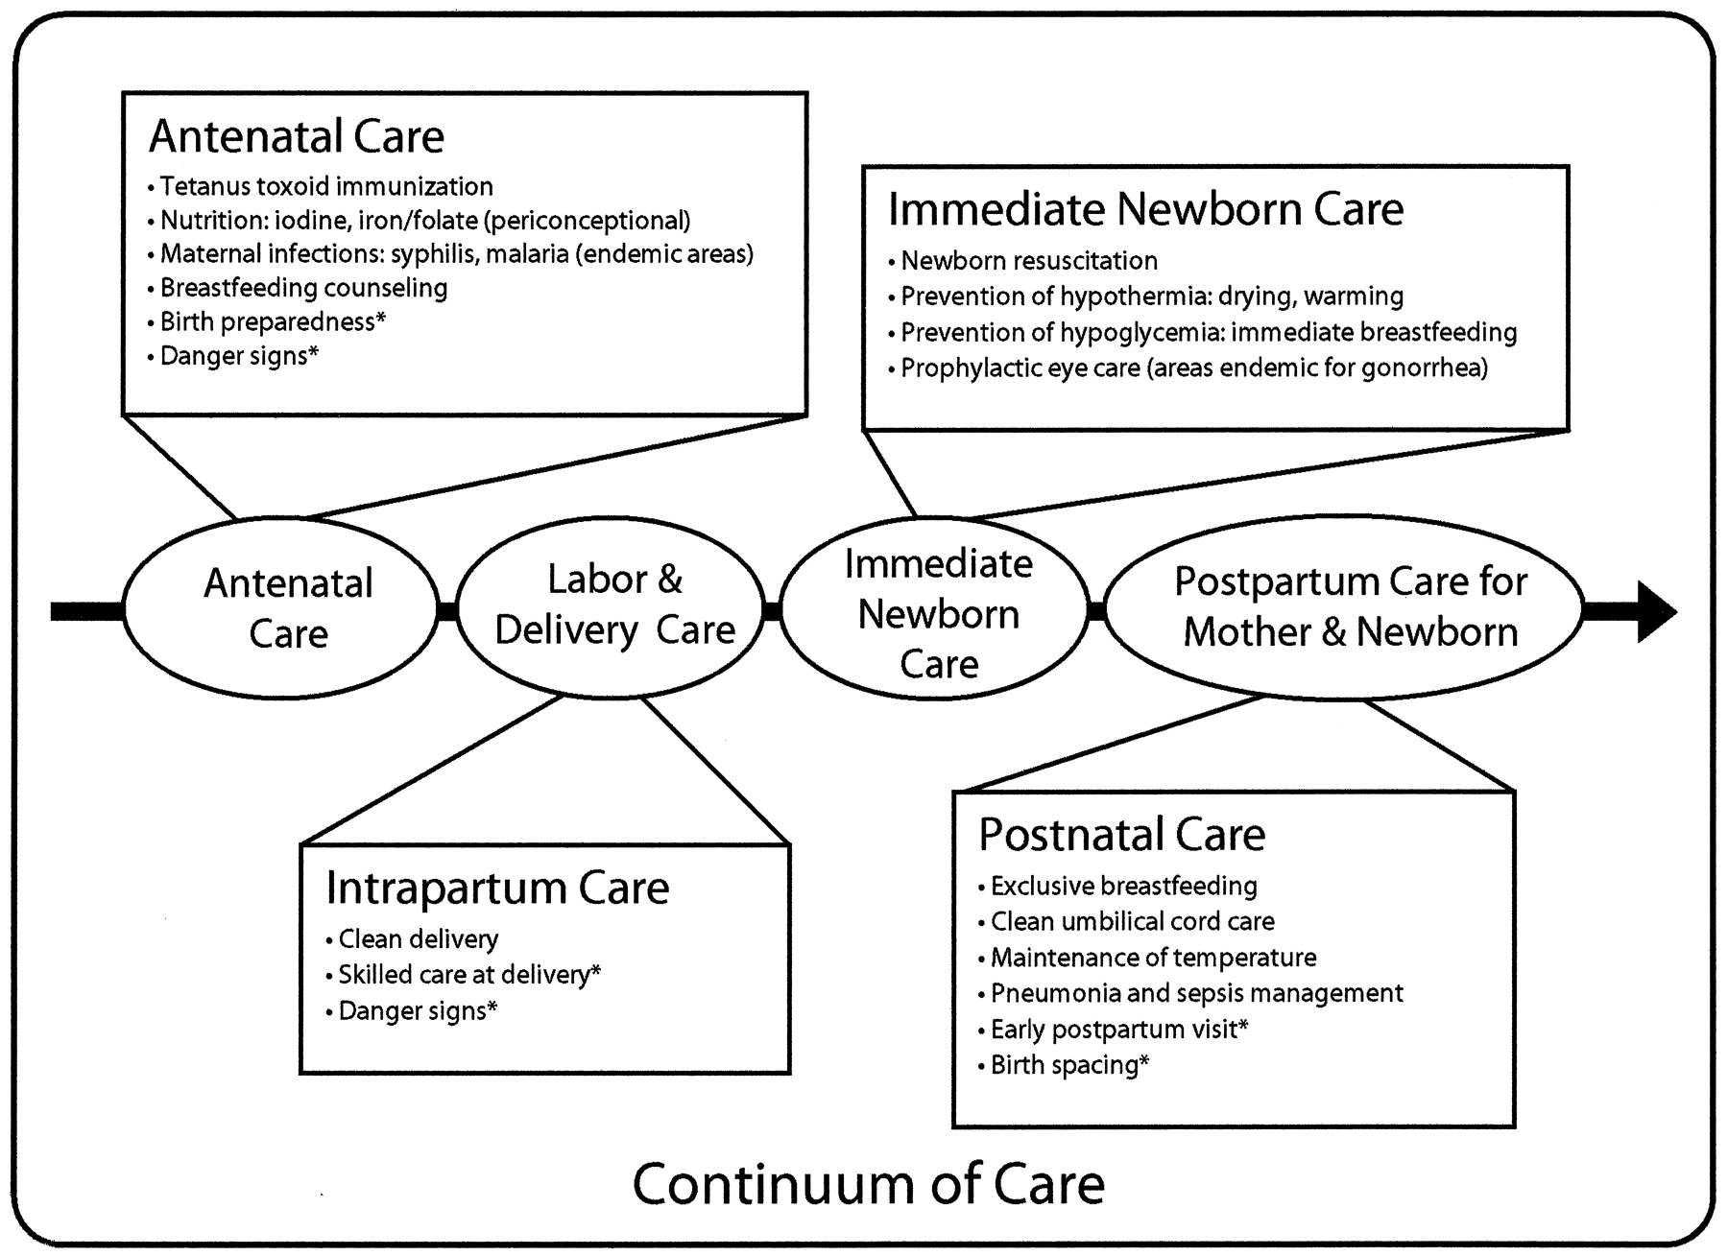
Priority interventions for programs of maternal and neonatal health care
* Indicates elements that were either not reviewed in this report or for which evidence is lacking
©2005 by American Academy of Pediatrics
Bhutta Z A et al. Pediatrics 2005;115:519-617
Notes:
Summary of priority antepartum, intrapartum, and postnatal interventions for inclusion in programs of maternal and neonatal health care, based on assessment of available evidence for impact on perinatal and neonatal health status. * indicates essential elements of the Saving Newborn Lives conceptual framework for advancing newborn health and survival, which either were not reviewed in this report or for which evidence is lacking (see “Methods”).

Slide 45

Priority interventions for programs of maternal and neonatal health care
* Indicates elements that were either not reviewed in this report or for which evidence is lacking
©2005 by American Academy of Pediatrics
Bhutta Z A et al. Pediatrics 2005;115:519-617
Notes:
Summary of priority antepartum, intrapartum, and postnatal interventions for inclusion in programs of maternal and neonatal health care, based on assessment of available evidence for impact on perinatal and neonatal health status. * indicates essential elements of the Saving Newborn Lives conceptual framework for advancing newborn health and survival, which either were not reviewed in this report or for which evidence is lacking (see “Methods”).

Slide 46

The AAP Helping Babies Survive Programs
Improved resuscitation
Cord care
Improved hygiene
Exclusive breastfeeding
Notes:
Daily risk of death during first month of life based on analysis of 47 DHS datasets (1995-2003) with 10,048 neonatal deaths. Lawn et al

Slide 47
How Can We Make a Difference?
The need:
Simple and effective training programs
Training for all types of birth attendants and neonatal providers (e.g. TBAs)
Supplies/equipment for sustenance
Supportive environment

Slide 48
Helping Babies Breathe
a global educational program in neonatal resuscitation for birth attendants
developed in collaboration with USAID, NICHD, Saving Newborn Lives/Save the Children, Laerdal Foundation, WHO

Slide 49
Need for Intervention at Birth
Assessment at birth and routine care
80-90%
Drying, warmth, clearing the airway, stimulation
8-10%
Potential population for impact of simple interventions
3-6%
Bag and mask ventilation
< 1%
Chest compressions, medications
Notes:
What can be done in the face of such a large burden of mortality and limitations of workforce? The answer lies in an understanding of the science of resuscitation. For 99% of babies simple interventions can be lifesaving. All babies need assessment and routine care at birth, and for most, such simple care is enough. For babies who do not breathe at birth, many will respond to the basic steps of drying and warmth, plus clearing the airway and specific stimulation to breathe. Only a small percentage of babies will require bag and mask ventilation, and less than 1% of babies require advanced methods of resuscitation, such as chest compressions and medications. By focusing on the timely delivery of the essential interventions of drying, warmth, clearing the airway, stimulation to breathe, and bag and mask ventilation, many babies can be saved.

Slide 50
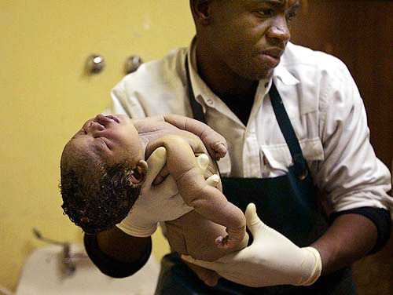
Helping Babies Breathe
Notes:
A baby’s first cry is one of the most anticipated and welcome sounds in all the world. But in much of the world, when there is no cry – hopes are dashed. Too many times there is no one with the knowledge or the skills or the equipment to help…and a baby dies. This baby in Lesotho was born in a such a center and did not survive.

Slide 51
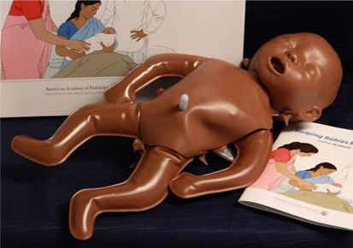
Flip Chart/Simulator/Learner Workbook
Notes:
A new neonatal simulator is purpose-built with crying, breathing, and heart rate (umbilical cord pulse). The mannequin ships flat, but when filled with 2 liters of warm water, it has the weight, the warmth, and the tone of baby who needs help to breathe.

Slide 52
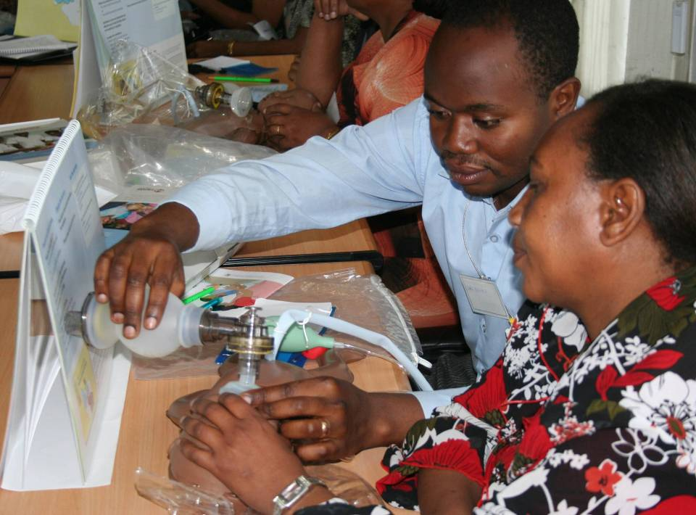
Pair Learning/Teaching
Notes:
The baby is the focus for learning in pairs, with an educational methodology that emphasizes facilitation of learning. Participants work together to help one another learn skills - recognizing that we all learn best when we are teaching.
These participants in a workshop in Tanzania are providing feedback to one another on techniques for bag and mask ventilation. As one learner is providing ventilation, the other learner not only offers suggestions, but provides the response of the baby by squeezing the pneumatic bulbs of the simulator to create a cry, spontaneous breathing, or umbilical pulse.

Slide 53
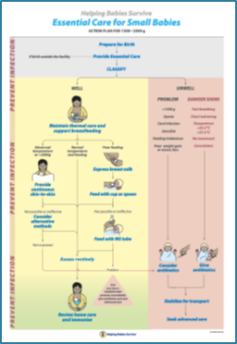
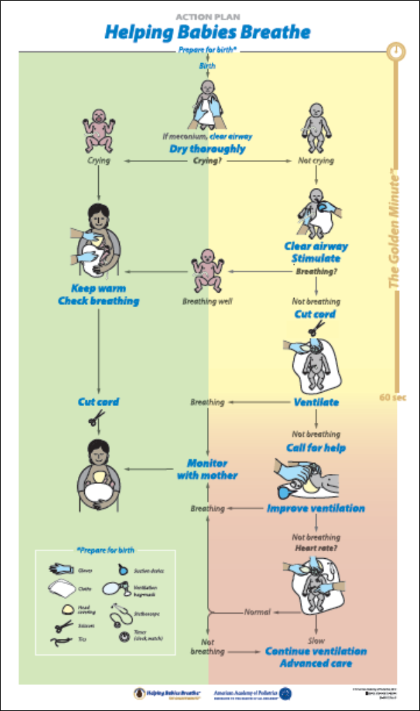
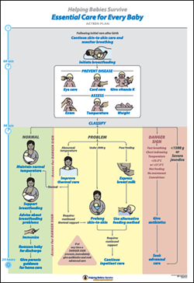
The AAP Helping Babies Survive Programs
Improved resuscitation
Cord care
Improved hygiene
Exclusive breastfeeding
Notes:
Daily risk of death during first month of life based on analysis of 47 DHS datasets (1995-2003) with 10,048 neonatal deaths. Lawn et al

Slide 54
Challenges of Research in
Low Resource Settings

Slide 56
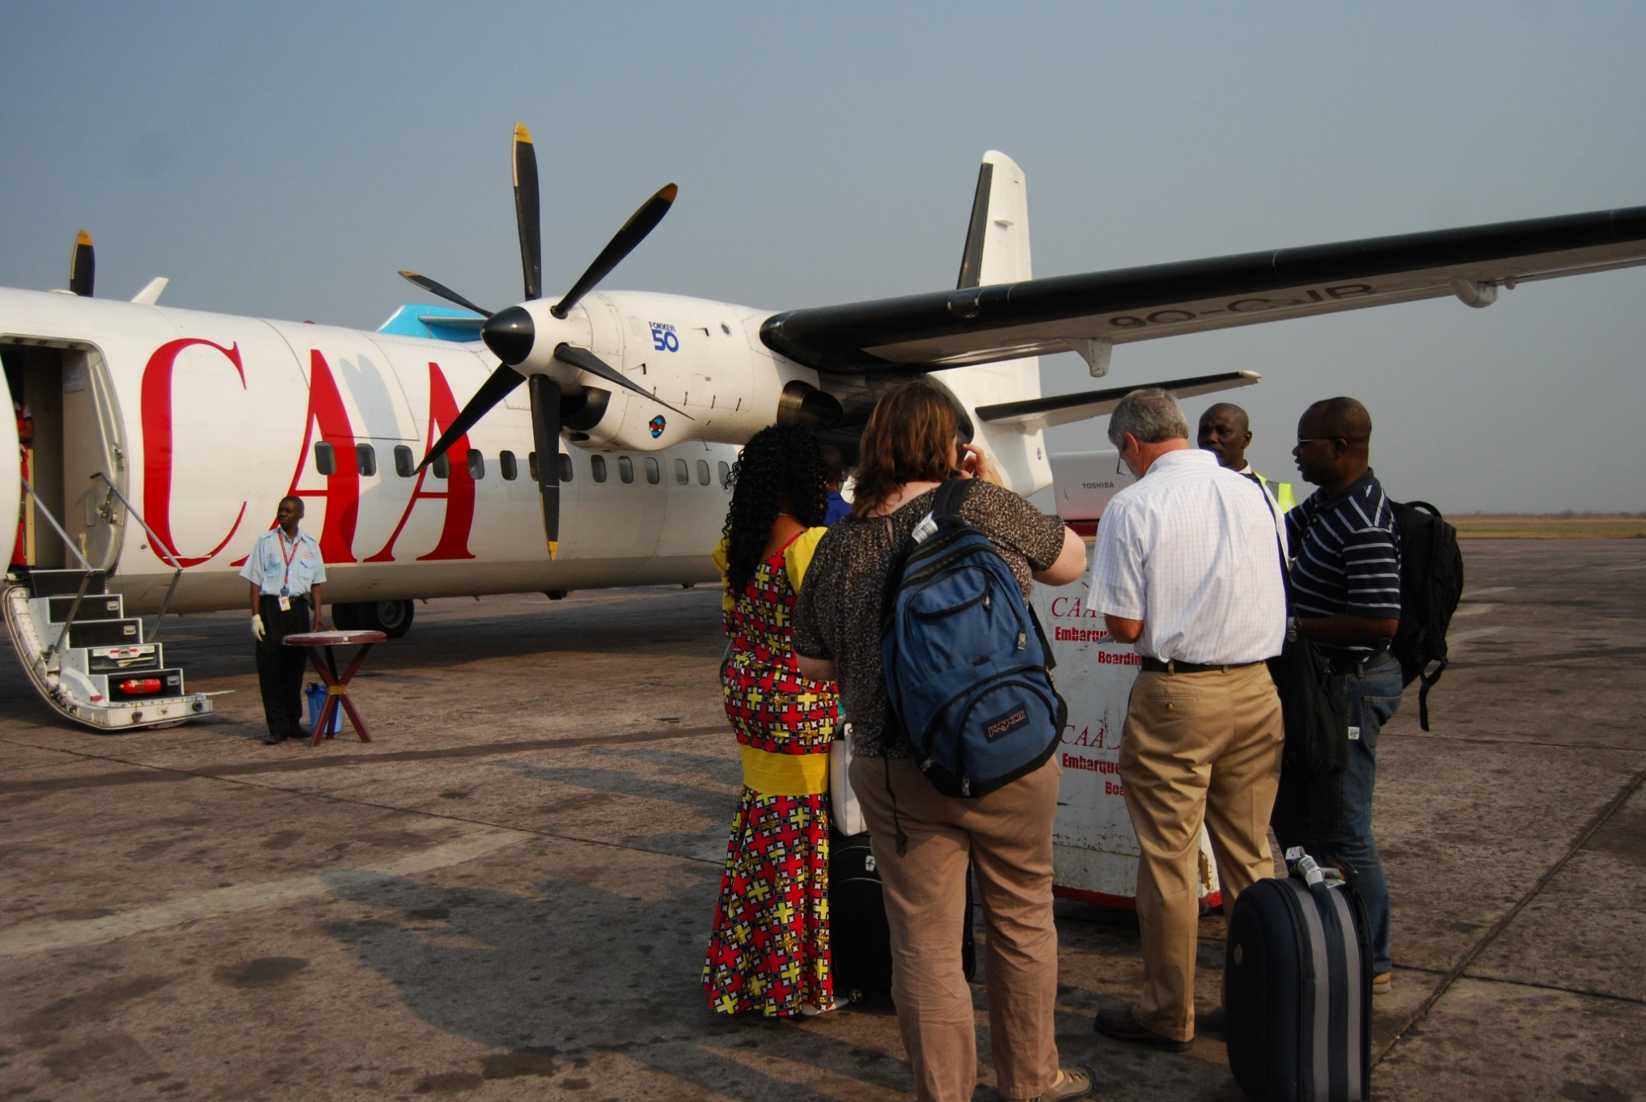
Getting there…………………

Slide 57
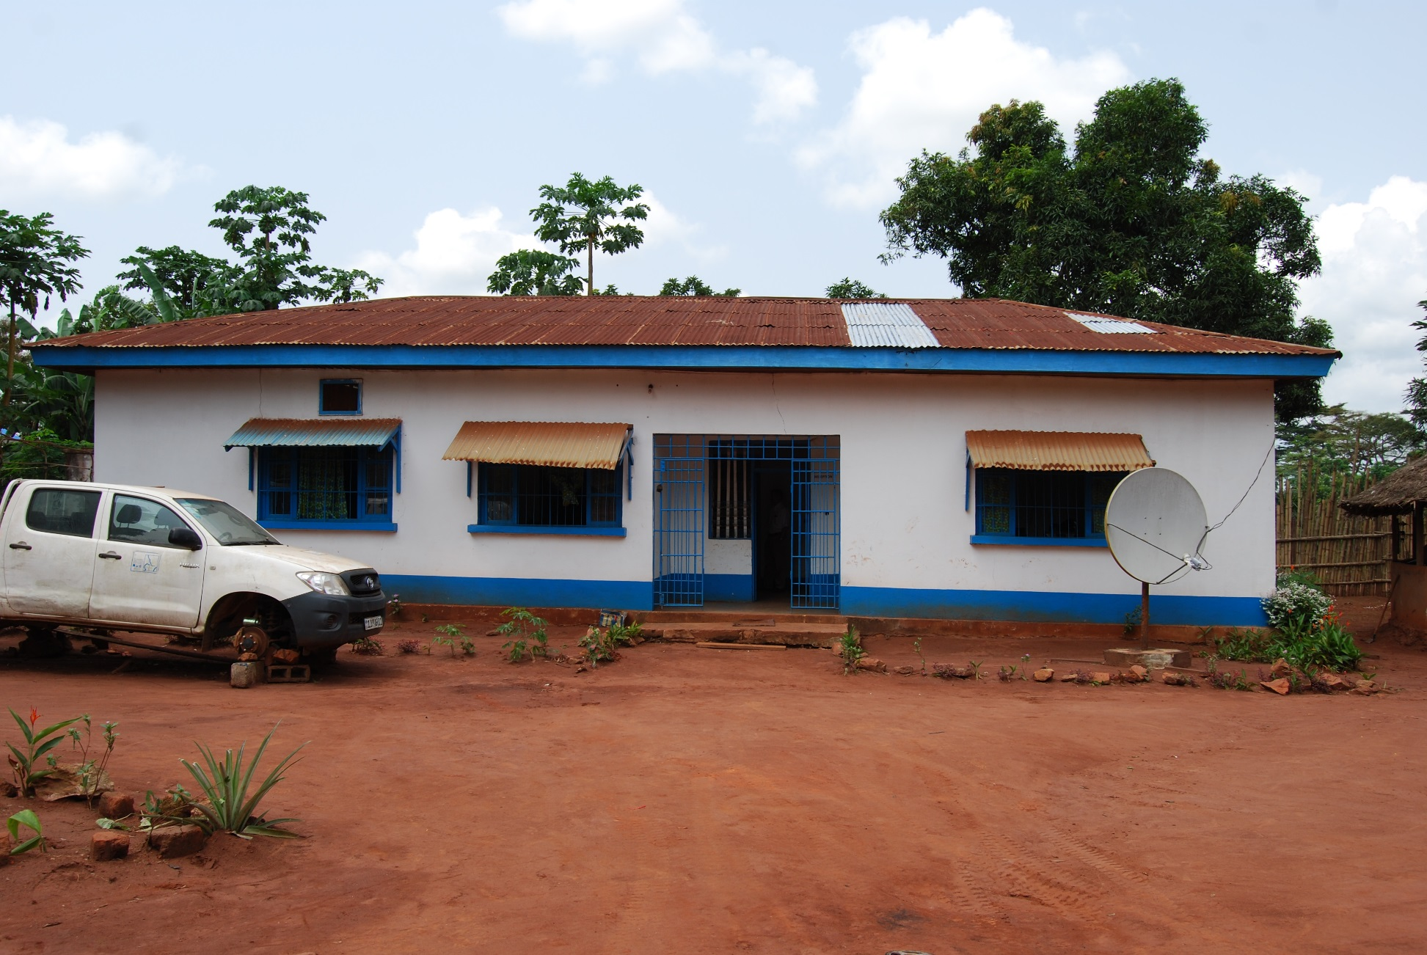
Infrastructure

Slide 58
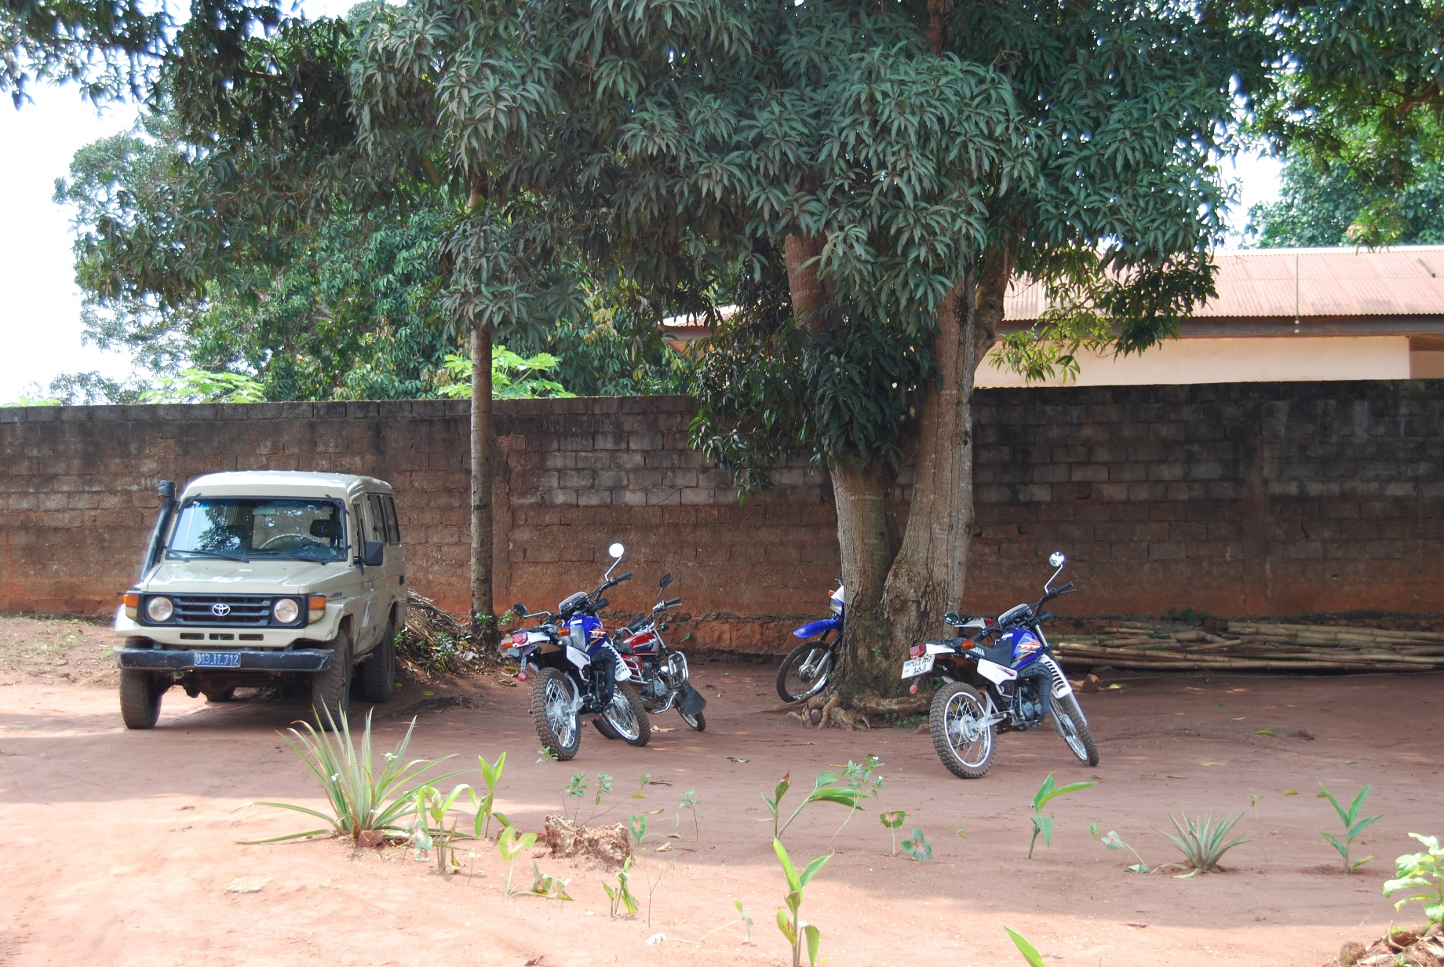
Data collection

Slide 59
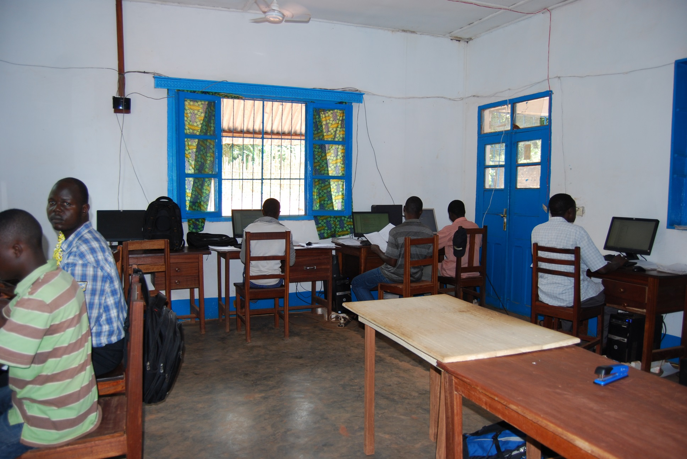
Data collection

Slide 60
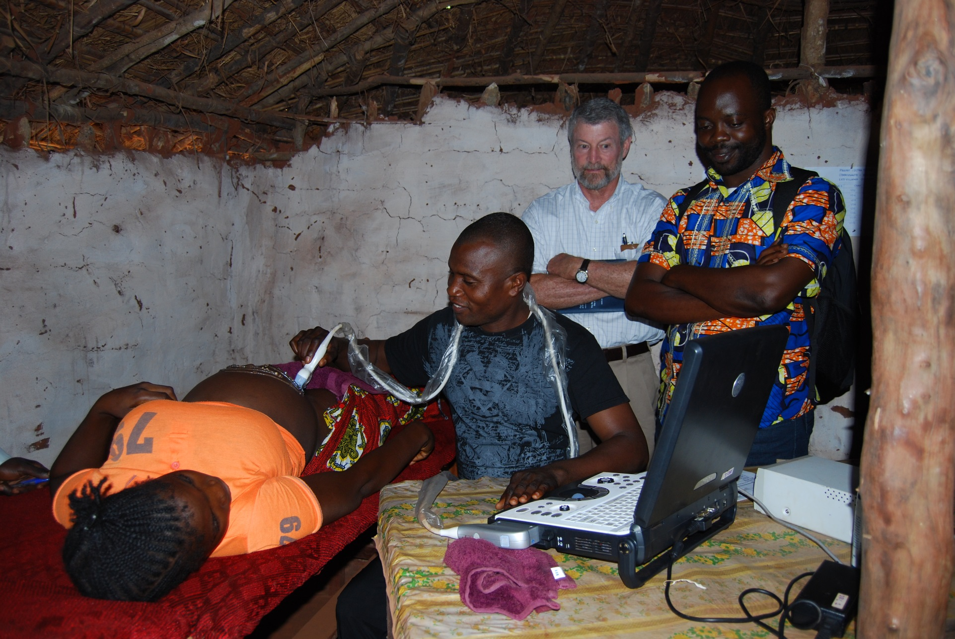
Diagnostics

Slide 61
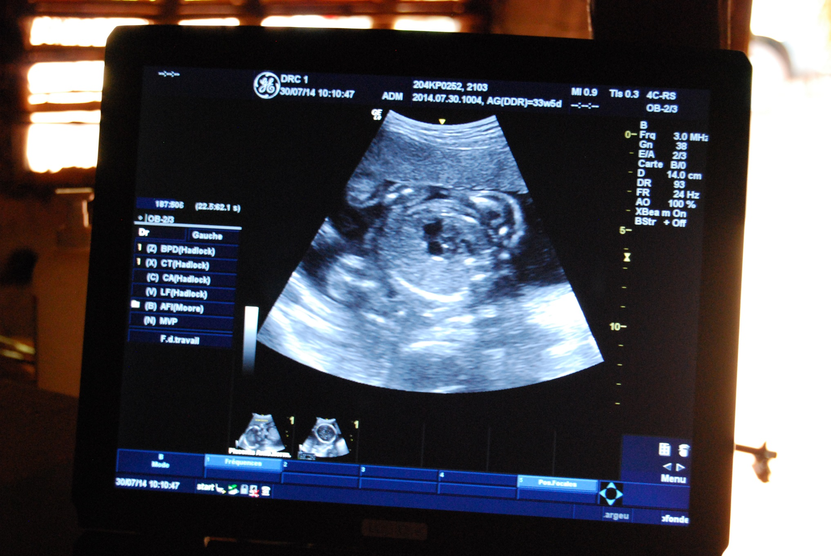
Diagnostics

Slide 62
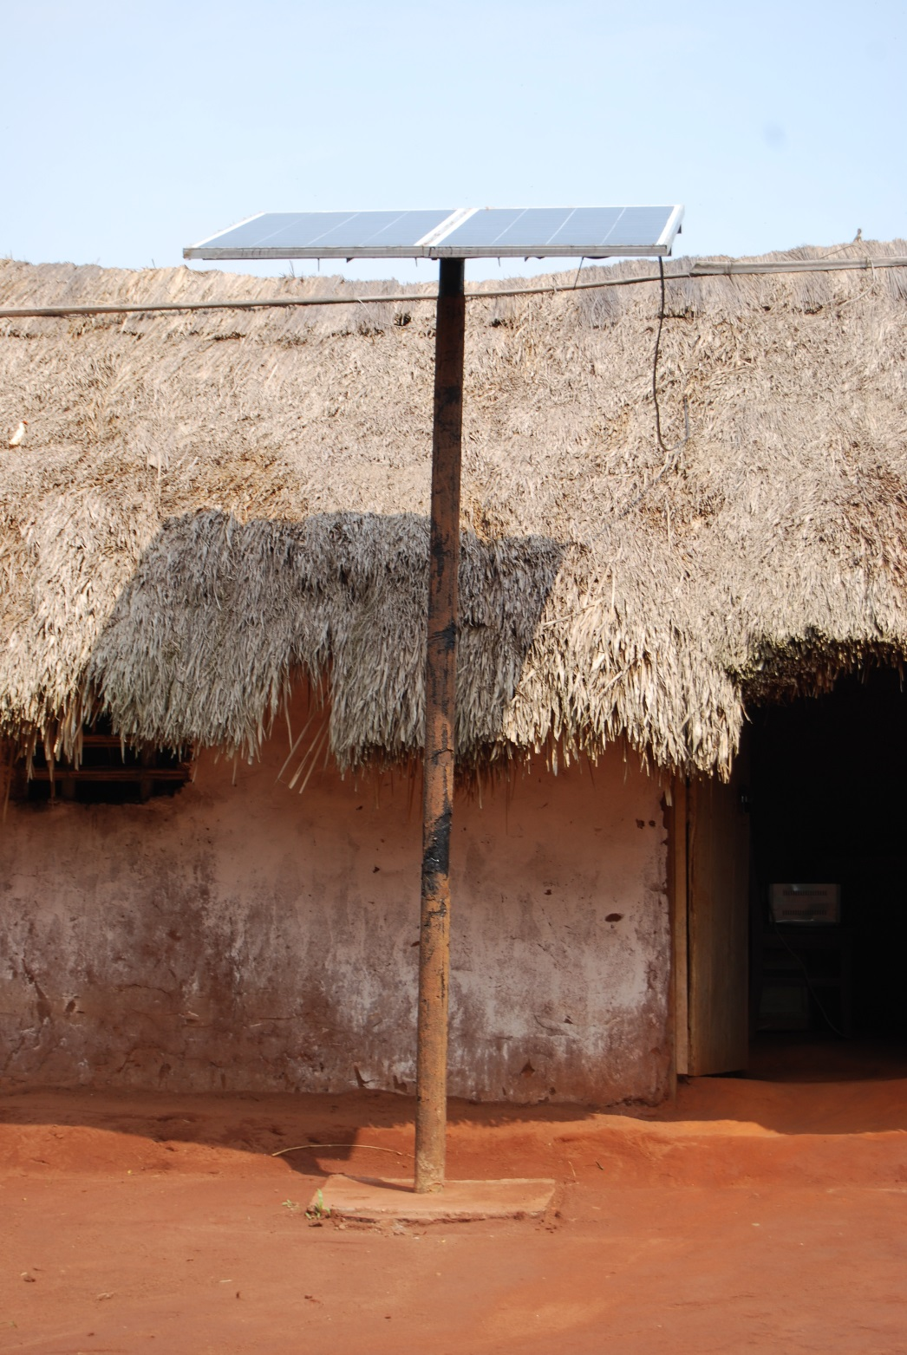

Slide 63
Asking the Right Questions
Testing effectiveness of therapies that are efficacious in HICs
Testing therapies for which there is adequate infrastructure for improvement of public health
Testing strategies that will change international guidelines
Testing implementation strategies of effective therapies

Slide 64
Asking the Right Questions
Testing effectiveness of therapies that are efficacious in HICs
Testing therapies for which there is adequate infrastructure for improvement of public health
Testing strategies that will change international guidelines
Testing implementation strategies of effective therapies

Slide 65

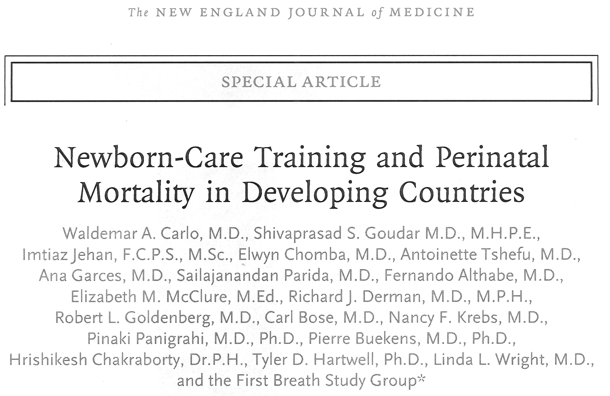

Slide 66
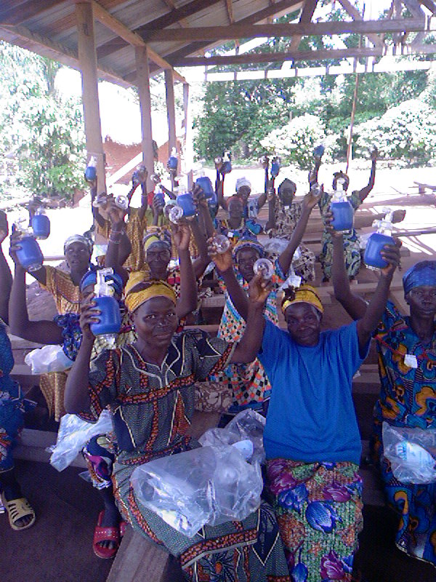
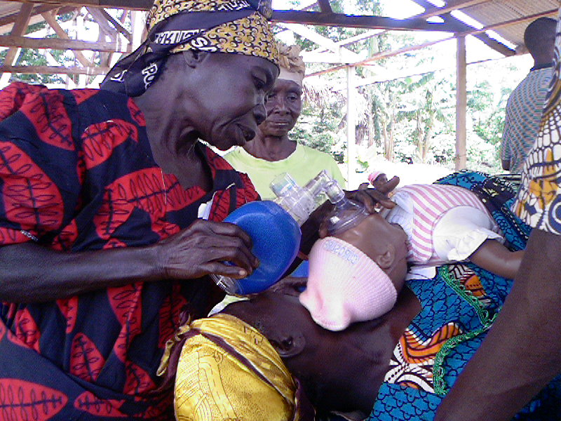
TBAs holding B&Ms
practices during the NRP training

Slide 67
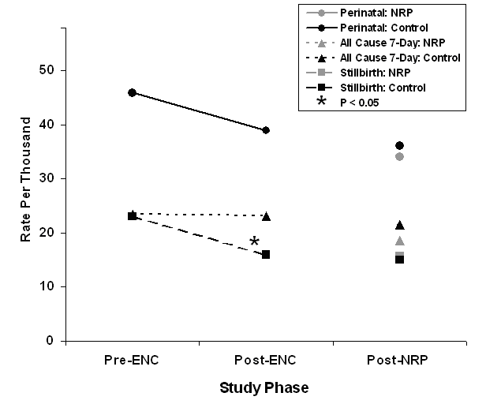
Results: Mortality following training
Carlo et al. N Engl J Med. 362:614-23, 2010.

Slide 68
The Global Network ACT Trial

Slide 69
Intervention group
<36 wk at high risk for preterm birth
one course of betamethasone
referral recommended
Control group
no additions to maternal care
Primary outcome:
neonatal mortality among infants < 5th % (LBW)
Secondary outcomes:
all neonatal mortality
maternal infections
Althabe F, et al. Lancet 385:629, 2015.

Slide 70
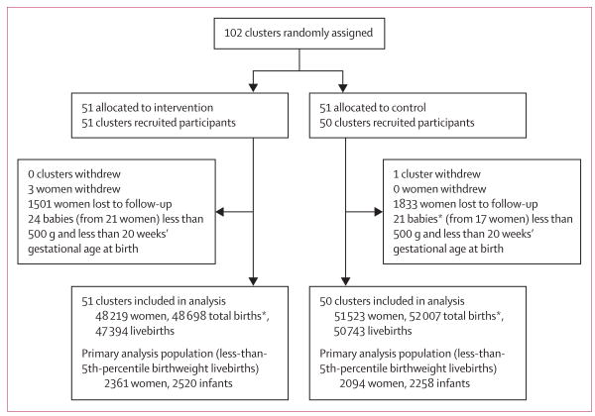
Althabe F, et al. Lancet 385:629, 2015.

Slide 71
Results
Intervention group
5% LBW
45% of LBW infants exposed to ANC
12% of all infants exposed to ANC
Control group
4% LBW
10% of LBW infants exposed to ANC
2% of all infants exposed to ANC
Althabe F, et al. Lancet 385:629, 2015.

Slide 72
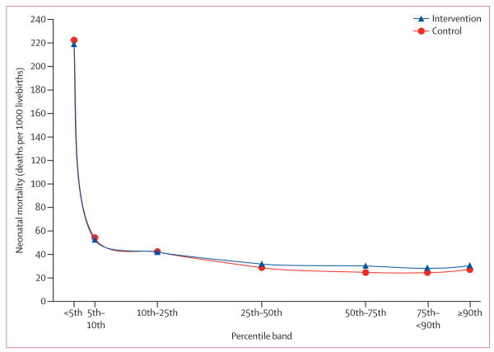
Althabe F, et al. Lancet 385:629, 2015.

Slide 73
Althabe F, et al. Lancet 385:629, 2015.

Slide 74
Asking the Right Questions
Testing effectiveness of therapies that are efficacious in HICs
Testing therapies for which there is adequate infrastructure for improvement of public health
Testing strategies that will change international guidelines
Testing implementation strategies of effective therapies

Slide 75
Other Issues
Ethics of research
Governmental support
Well-intentioned but nefarious influence of outsiders

Slide 76
Questions?
Comments

Slide 77
“Women (and children*) in some parts of the world are not dying because of diseases we cannot treat; they are dying because societies have yet to make decisions that their lives are worth saving.”
Professor Mahmoud Fathalla, recipient of the 2009 United Nations Population Award
* added by speaker

