Slide 1
Asthma in Latin America &
Community Health Worker Screening for Asthma in Nicaragua
Mary Crocker, MD, MPH
March 16, 2017

Slide 2
Disclosures
Conflicts of interest: None
Funding sources:
  NC Children’s Promise Research Grant
  OIA Global Health Scholars Program

Slide 3
Outline
Overview of Asthma in Latin America
  Is asthma really a global health problem?
  How important is asthma?
  What are risk factors for asthma in Latin America?
Asthma Screening Project in Managua, Nicaragua
  Project development and implementation
  Results

Slide 4
Part 1: Asthma in Latin America

Slide 5
Is asthma really a problem in global health?
Common perception that asthma is more prevalent in affluent nations
A result of the “hygiene hypothesis”
Notes:
I start out with this question because if you were anything like I was a few years ago, you may have the impression that asthma is much more common in more affluent, so-called “western” nations.
Probably where this comes from is the idea of the hygiene hypothesis, which even if you haven’t heard the name, you have likely come across the concept either in medical school or in the newspaper or on television.

Slide 6
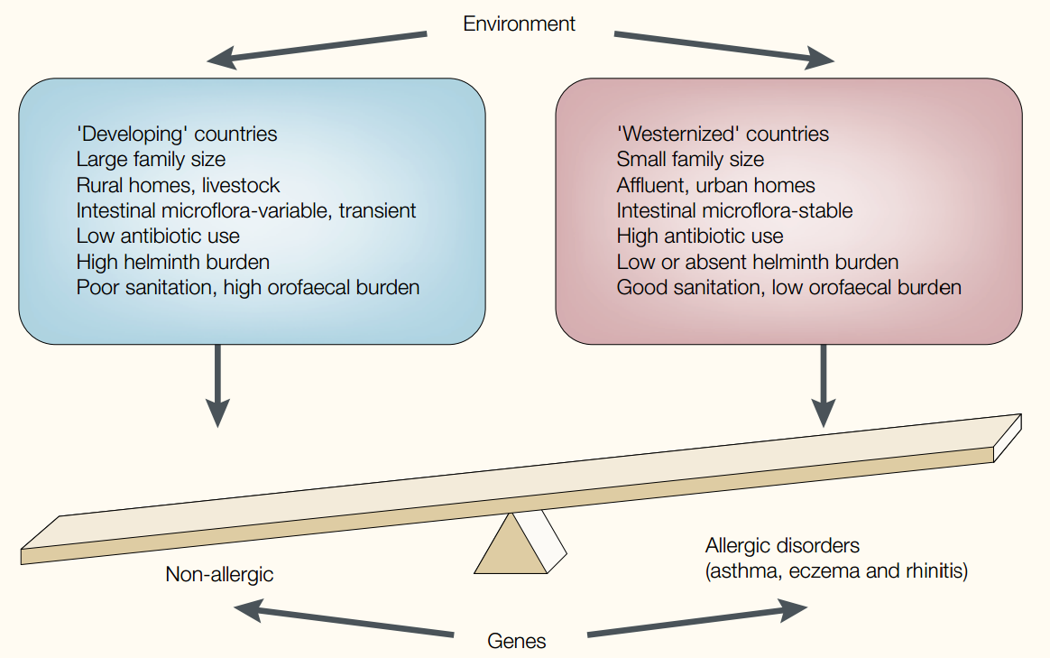
The Hygiene Hypothesis
Wills-Karp M, et al. Nat Rev Immunol. 2001;1(1):69-75.
Notes:
Here is a diagram that illustrates this concept. The hygiene hypothesis suggests that children who brought up in ultra-clean environments, whose immune systems are not challenged as young children, are more likely to go on to develop allergy and asthma than those who have more exposure to germs.
This idea dates back to 1989 and explains many of the differences we see in asthma prevalence in the United States. It has also been extrapolated to try and explain what appeared to be higher prevalence of asthma in more affluent, “Westernized” nations, and the apparent lower prevalence in developing countries.
However, in the late 1990s and early 2000s we started to get back the first solid data on the worldwide prevalence of asthma, and there were some pretty surprising results.

Slide 7
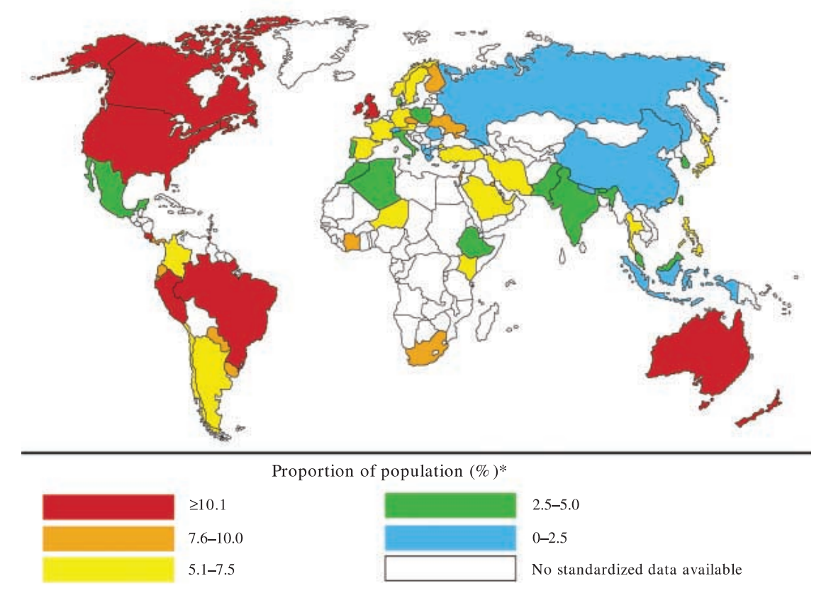
(Asthma Prevalence)
Masoli M, et al. Allergy. 2004;59:469-478.
Notes:
This map is based on the results of the ISAAC study, which stands for the International Study of Asthma and Allergies in Childhood. It was the largest worldwide effort to measure asthma prevalence in a standardized way.
The first phase of the ISAAC study was conducted from 1994 to 1995, with these results. As expected, there were high prevalence of asthma in the United States, Canada, the UK, and Australia/New Zealand. But surprisingly, several countries in Latin America also showed high prevalence.

Slide 8
Global Burden of Asthma
Estimated 334 million people have asthma
14% of the world’s children experience asthma symptoms
8.6% of young adults (aged 18-45) experience asthma symptoms
4.5% of young adults have been diagnosed with asthma and/or
are taking treatment for asthma
Asthma is the 14th most important disorder in the world in terms of the extent and duration of disability
Asthma contributes more to morbidity rather than mortality
The Global Asthma Report 2014. Auckland, New Zealand: Global Asthma Network; 2014.
Notes:
DALYs on a par with diabetes, cirrhosis of the liver, schizophrenia

Slide 9
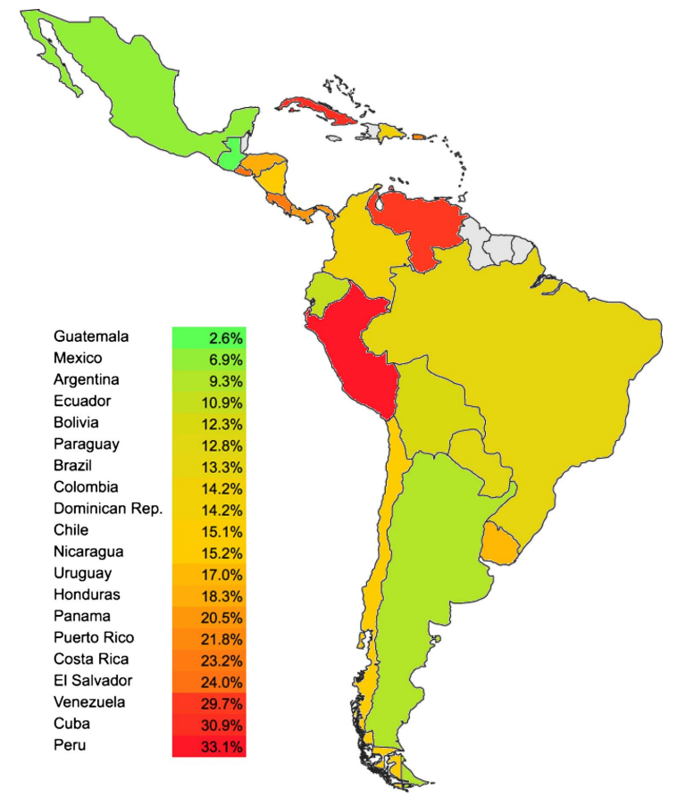
Prevalence of asthma in Latin America
Forno et al. Thorax. 2015;70(9):898-905.
Notes:
And the prevalence in Latin America is increasing. This data was updated during ISAAC phase 3 in 2001-2003. Notice here that the color scale is different. Some of these numbers are startling– for example the prevalence in Peru is about 33%. Also interesting is the wide variability in prevalence between nations that have fairly comparable standards of living. Also, what you don’t see on this map is there is also a considerable amount of variability within countries, with asthma concentrated in more urban areas, which again contrasts with the hygiene hypothesis.
This suggests that there are factors at play here beyond what is included in the Hygiene hypothesis.
So the next question is: what can explain all these differences?

Slide 10
More complicated than we thought…
The hygiene hypothesis took the simplistic view that all asthma is created equal (i.e. classic allergic asthma)
In fact there are multiple asthma phenotypes
  Different clinical patterns
  Different pathogenesis
  Different responses to treatment

Slide 11
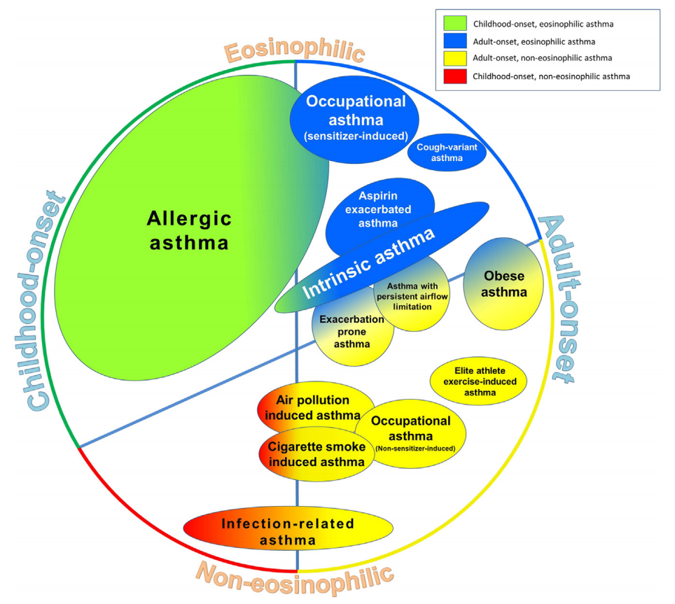
Asthma Phenotypes
Hekking PPW, Bel EH. J Allergy Clin Immunol Pract. 2014;2(6):671-680.
Notes:
This slide shows all the various phenotypes that have emerged as distinct, separate entities.

Slide 12
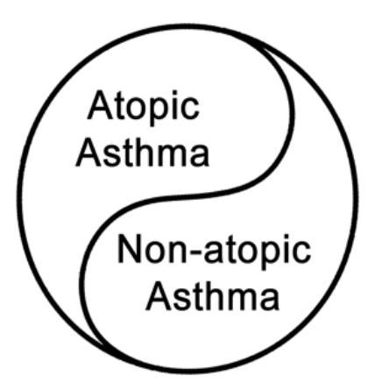
Atopic vs Non-atopic Asthma
The atopic (or allergic) asthma phenotype is more common in the “western world”
Asthma in developing countries tends to be non-atopic
Driving factors behind the high prevalence in these areas is different
Forno et al. Thorax. 2015;70(9):898-905.

Slide 13
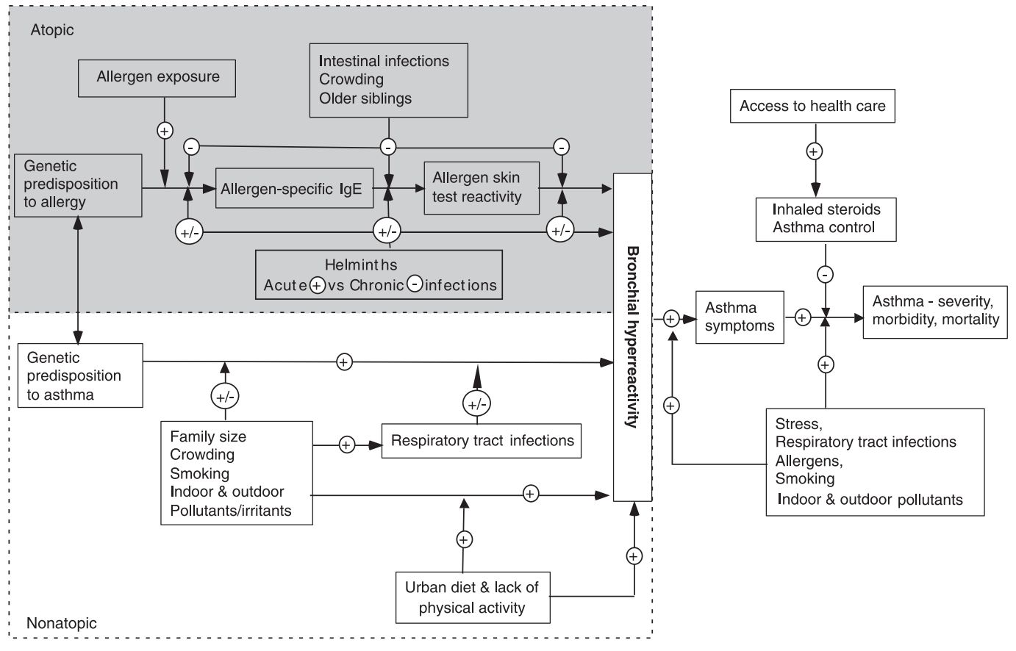
Cooper PJ, et al. Allergy Eur J Allergy Clin Immunol. 2009;64(1):5-17
Notes:
Conceptual framework for environmental and host factors affecting the development of atopic and nonatopic asthma in Latin America. The figure illustrates how different environmental exposures and genetic susceptibilities may lead to the development of bronchial hyper-reactivity and asthma symptoms that are associated with or not associated with atopy. The effects of intestinal infections (such as helminths), crowding, and older siblings may modify the development of asthma through effects on the development of allergic inflammation, while other distinct (environmental irritants and respiratory tract infections) or similar (crowding) exposures may effect the development of asthma through distinct biological mechanisms and genetic factors. Many social and environmental factors may be involved in determining asthma severity. Risk (+) and protective ()) effects are shown. Arrows pointing at arrows represent interactions. Urban residence would be expected to increase both atopic and nonatopic asthma through effects on important environmental exposures (e.g. decreasing helminth infection prevalence, increasing exposure to pollutants, urban diet and physical inactivity, increased allergen exposure, etc.).

Slide 14
Risk factors for asthma in Latin America
Changes in diet and exercise → obesity
Increased exposure to antibiotics and vaccines
Indoor irritants
Changes in exposure to allergens
Increased psychosocial stresses and violence
Relationship is unclear:
  Effect of poverty is NOT straightforward
  Helminth infection
  Outdoor air pollution – associated with exacerbations but not necessarily increased prevalence
  Indoor air pollution (e.g. wood stoves)
Notes:
Many of these factors are associated with ubanization
Not unique to Latin America
Early URI
Smoking/SHS
Maternal smoking during pregnancy

Slide 15
Key Points
Asthma is an important cause of morbidity in the developing world
High prevalence of asthma in urban communities is not adequately explained by the hygiene hypothesis
Risk factors for asthma in Latin America are different than those in more affluent countries, but many are still not well understood

Slide 16
Part 2: Community Health Worker Screening for Asthma in Managua, Nicaragua

Slide 17
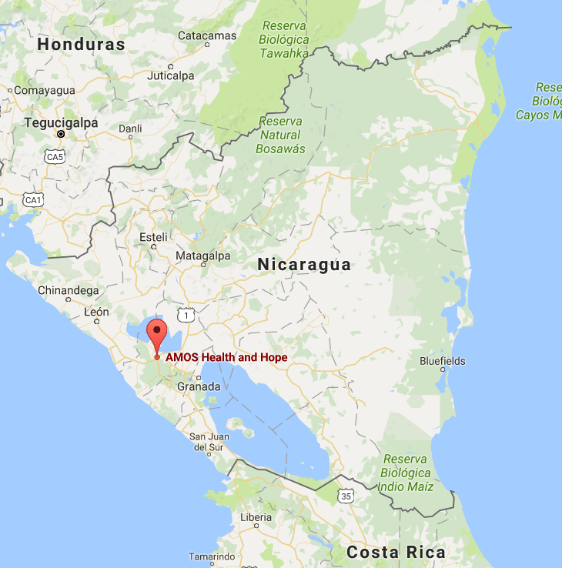
Partnership with AMOS Health & Hope
Non-profit organization in Managua, Nicaragua
Trains community health workers (CHWs) on basic health topics and community organization
Community-set priorities:
  Seemingly high number of children with wheezing, not being treated for it
  Community health workers wanted tools to help their community
Notes:
When I first started thinking about doing research in Nicaragua, I got connected with an organization called AMOS H&H, whose mission is to improve health in poor communities of Nicaragua, primarily by training lay community health workers. When I asked what they felt was a need that I could help with in their community, their health workers, who have no formal medical training, said that they were worried about asthma. They said there seemed to be a lot of kids in their community with wheezing that wasn’t being adequately treated. And they wanted to know what they, as health workers, could do to help those children. And that was how this project was born.

Slide 18
Project Goals
Develop a tool to help the community health workers (CHWs) identify children at risk for asthma
Evaluate the tool for its effectiveness
Ensure that children identified as having asthma receive appropriate care
Secondary objectives:
  Determine the actual prevalence of asthma
  Explore risk factors for asthma in this population
Notes:
So I partnered with AMOS and their community health workers to develop these goals. (read slide)

Slide 19
Tools to Screen for Asthma
There are many programs in the US that address a similar problem
  CHW-led case management programs
  School-based screening programs
In the developing world, lay CHWs are frequently utilized
  Integrated Management of Childhood Illness
Drawing from all these successful examples, we hypothesized:
  A screening questionnaire administered by community health workers would be effective in case-detection of asthma in our target community (semi-urban, poor Nicaraguan community).

Slide 20
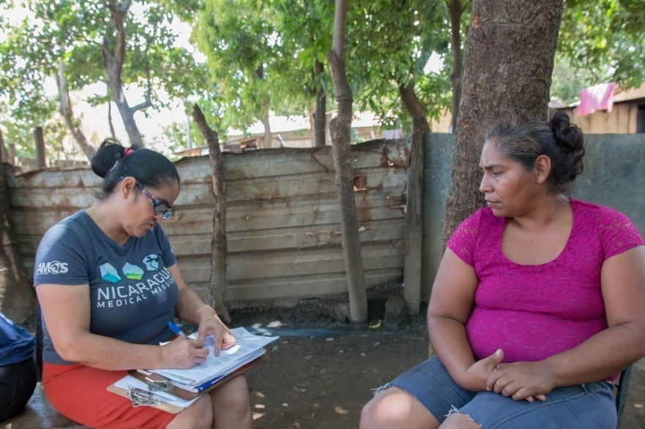
Choosing a Screening Tool
Selected a school-based, Spanish-language questionnaire developed in Argentina (Busi et al, 2012)
Met with CHWs to review language and cultural appropriateness
Designed a study to evaluate the questionnaire
Notes:
So the first objective was to develop a tool for the health workers to use to identify children at risk for asthma. Many tools exist to screen for asthma, but none of them are developed or validated for use in a developing country, or Latin America specifically. Because there was nothing exactly like what we needed, we decided to adapt another questionnaire to fit our purposes.
After a literature search, we selected a school-based questionnaire developed in Argentina, and then reviewed this with the CHWs to ensure that the language was correct and relevant.

Slide 21
Ask the parent: Does your child . . . |  | Circle the response:
1) | Have a cough that won’t go away? | No | Some-times | Frequently | Don’t know
2) | Wake up at night because he/she has trouble breathing? | Never | Some-times | Frequently | Don’t know
3) | Have trouble breathing deeply? | Never | Some-times | Frequently | Don’t know
4) | Make noise or have wheezing when he/she breathes? | Never | Some-times | Frequently | Don’t know
5) | Have chest tightness or pain after running, playing a lot, or playing sports? | Never | Some-times | Frequently | Don’t know
6) | Wake up at night coughing? | Never | Some-times | Frequently | Don’t know
7) | Cough when running, climbing stairs, or playing sports? | Never | Some-times | Frequently | Don’t know
8) | Miss days of school because of respiratory problems? | Never | Some-times | Frequently | Don’t know
9) | Has a doctor or nurse told you that your child has asthma, reactive airways, or allergic bronchitis? | No |  | Yes | Don’t know
10) | Has your child spent the night in the hospital for asthma or breathing problems in the last year? | No |  | Yes | Don’t know
11) | Does your child use medication or puffers for asthma or another respiratory illness? | No |  | Yes | Don’t know
Notes:
This is the questionnaire. It’s only 11 questions long, and as you can see, many of the questions resemble those that we’re very used to using when we as physicians evaluate a child for asthma. The CHW directs the questions to the parent, but the child is present and invited to provide input. Scoring: 0 for never or I don’t know, 1 for sometimes, and 2 for frequently. (The authors of the original study validating this questionnaire don’t recommend a particular cut off to be used to designate a positive test, so in our analysis we tested various cut-offs to see which was the most appropriate for this specific application.)

Slide 22
Study Design
Enroll all children ages 2-17 in Vladimir Hernandez, a small sector in Managua
Perform pediatric pulmonologist evaluation to assess for asthma
Separately, CHW administers screening questionnaire
Using results of physician evaluation as a gold standard, evaluate the effectiveness of the screening questionnaire (sensitivity, specificity, positive predictive value, and negative predictive value)

Slide 23
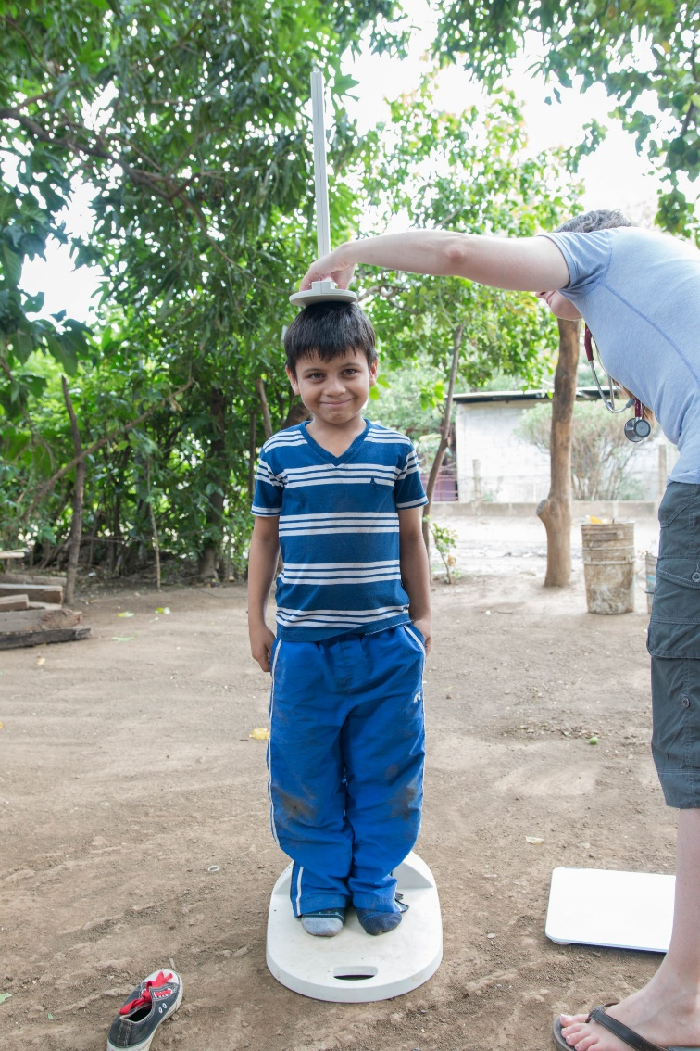
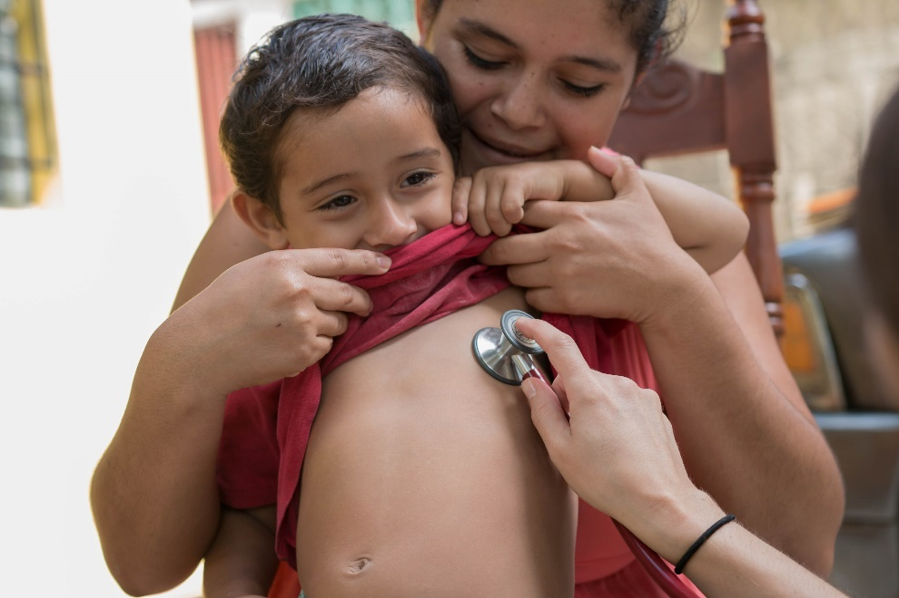
Physician Evaluation
Medical history
Height, weight, physical exam
Spirometry in children age 5 and older
  Repeat spirometry after bronchodilator in children with suspicion of asthma (based on history/physical exam or obstruction on initial spirometry)
Notes:
Just to give you an idea of what this looks like, the physician evaluation involved… read slide… Decision on diagnosis was made at the conclusion of the physician evaluation, BEFORE community health worker administered screening questionnaire, but was withheld from the family until the end of the visit

Slide 24
Diagnosis of asthma
Requirements for a diagnosis of asthma:
  Clinical history consistent with asthma
    Recurrent wheezing (>2 episodes) or shortness of breath that vary in intensity or over time
    Presence of triggers, such as URIs, exercise, allergens, smoke, odors
    Improvement with steroids or bronchodilator, if used
  Spirometry used as an aid to diagnosis, but obstruction or bronchodilator response not required for diagnosis
In children ages 2-4, term reactive airways disease (RAD) was used instead of asthma
Notes:
Based on NHLBI guidelines. The >2 episodes wheezing criterion was used to help exclude those who wheezed only once or twice during viral illnesses
Consideration of differential diagnosis: recurrent tonsillitis, chronic bronchitis, recurrent pneumonia, anemia, depression, cardiac

Slide 25
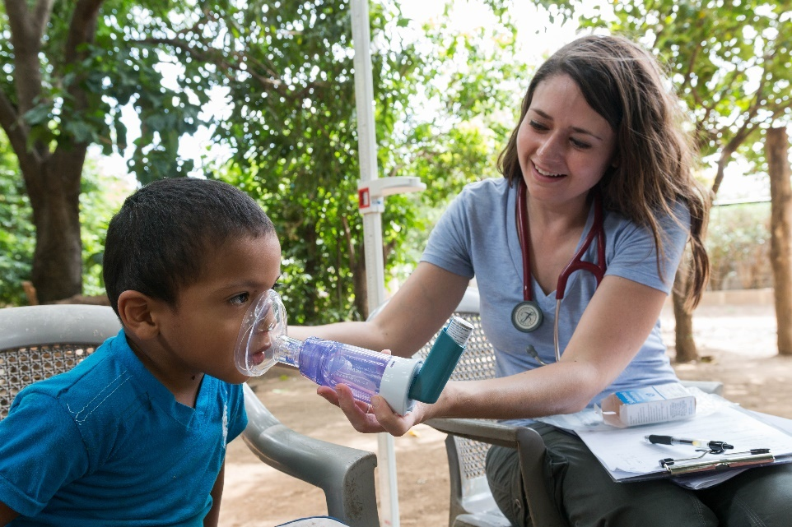
For children with asthma/RAD
Explanation of diagnosis
Spacer and teaching
Referral to clinic
Prescription for salbutamol and/or beclomethasone (donated by our project)

Slide 26
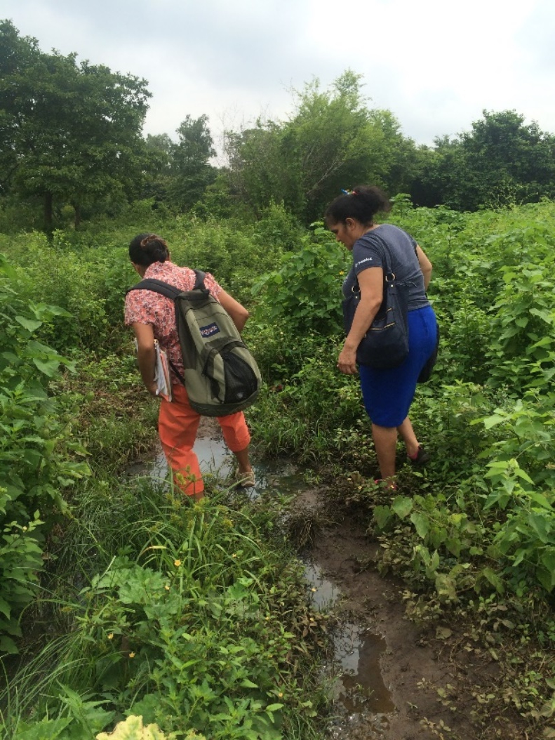
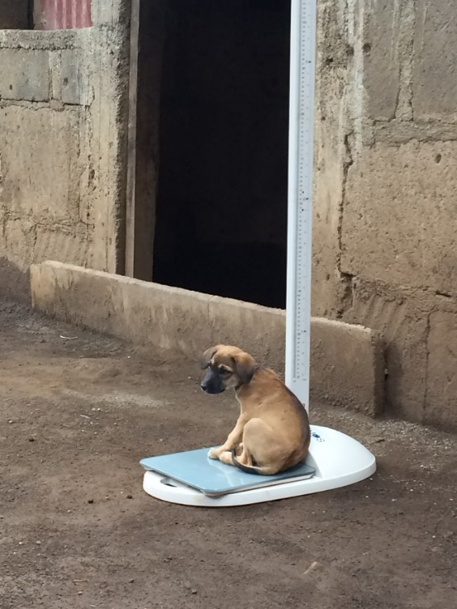
Challenges
Setting
  No table, no floor
  Sometimes outdoors
  Animals everywhere
  Lots of noise
  Wind, rain
  Political climate
  Performing spirometry
  in the elements
Language barriers
Poor health literacy
Notes:
Before moving on to our results, wanted to give you a sense of some of the challenges that we faced.

Slide 27
RESULTS

Slide 28
Study Population
Vladimir Hernandez
Total population (2014 census) | 733
Expected # children ages 2-17 | 218
Total enrolled | 199
Refusals | 4 individuals, 2 families
Study period: Aug 13 – Sept 10, 2016

Slide 29
Descriptive Statistics (n=199)
Age range | 2-17 years
Female | 102 | (51%)
Previous asthma diagnosis | 23 | (12%)
History of pneumonia | 50 | (25%)
Sick at time of evaluation | 66 | (33%)
Respiratory infection < 3 mo of age | 36 | (18%)
Preterm | 26 | (13%)
Vaccinations complete | 176 | (88%)
History of malnutrition | 26 | (13%)
Overcrowding (>5 in household) | 70 | (35%)
SHS exposure | 76 | (38%)
Maternal smoking in pregnancy | 5 | (3%)
Family uses woodstove | 91 | (46%)
Woodstove is indoors | 9 | (5%)
Mold in the home | 24 | (12%)

Slide 30
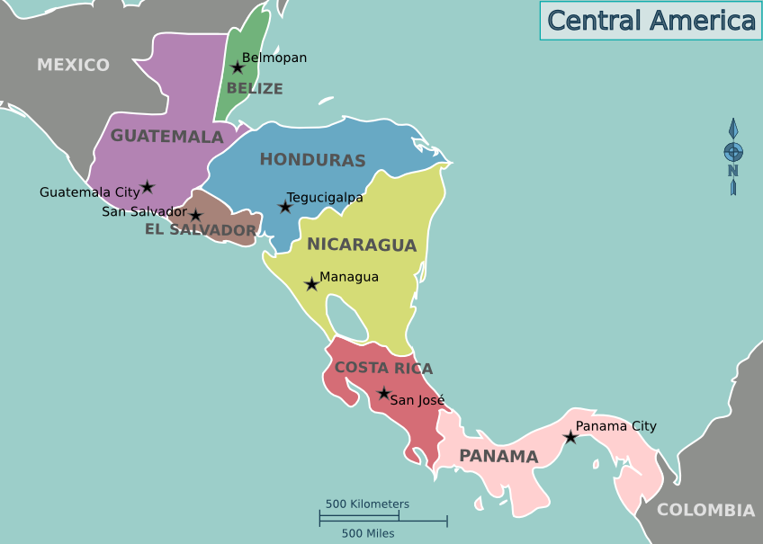
Prevalence of Asthma in Vladimir Hernandez
Prevalence = 30% (59 of 199 children)
For comparison, here are prevalence data from several other countries:
  Mexico 7 %
  Nicaragua 15 %
  Honduras 18 %
  Panama 21 %
  Costa Rica 23 %
  El Salvador 24 %
  Vladimir Hernandez 30 %
  Peru 33 %

Slide 31
Possible explanations for high prevalence
Strong family history of asthma (25%)
Early respiratory infections and pneumonia (18 and 25%)
Secondhand smoke exposure (38%)
Indoor and outdoor air pollution
  Biomass fuel stoves
  Burning trash
  Insecticide spraying

Slide 32
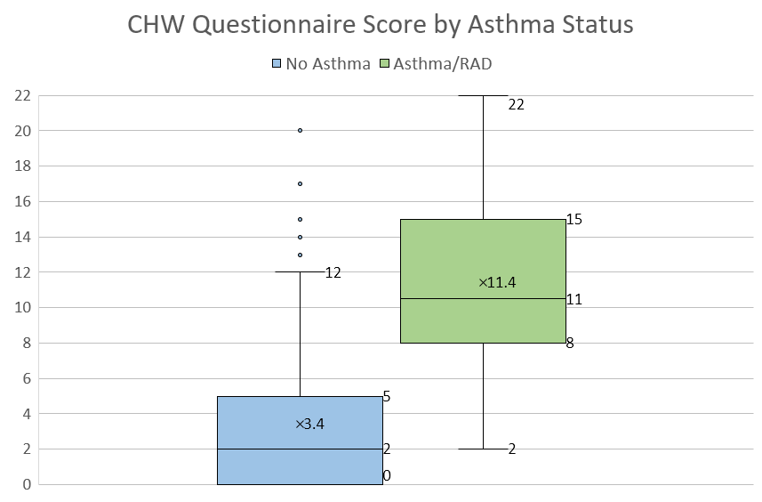
n = 133 59
p < 0.0001
Notes:
Next we looked at the results of the community health worker questionnaire. So remember, the scoring was from 0 to 22, with a higher score indicating more symptoms of asthma. Here I’ve plotted those scores in a box and whisker plot, categorized by whether or not the child was determined to have asthma. You can see there’s some overlap in terms of the ranges of scores, but the means here are significantly different, with p<0.0001. You’ll notice the total adds up to 192, this is because 7 were excluded due to inability to make a clear diagnosis at the time of the evaluation, for example if the child needed further workup to rule out another chronic respiratory illness
Outliers are > 1.5 the interquartile range. End of the whisker is the minimum/maximum excluding outliers. X shows the mean

Slide 33
Evaluating a Screening Test
Sensitivity
Specificity
Positive predictive value (PPV)
Negative predictive value (NPV)
Notes:
When evaluating a screening test, though, it’s more illustrative to look at these measures (sens, spec, PPV, NPV). These are the parameters that help you understand the usefulness of the test and what the test means, and are determined by comparing the results of the test to the results of some gold standard. As a reminder from epidemiology, I’m going to go through what each of these mean.

Slide 34
Sensitivity and Specificity: Characteristics of the test
Sensitivity – the likelihood that the test will pick up those who have the disease
  80% sensitivity means the test will detect 80% of those who have the disease
Specificity – the proportion of those who do not have the disease who have a negative test
  72% specificity means 72% of those without the disease will have a negative test

Slide 35
Predictive Value: What the test results mean to your patient
Positive predictive value (PPV) – Likelihood that a positive test means that the patient has the disease
  67% PPV means that a patient who tests positive has a 67% chance of having the disease
Negative predictive value (NPV) – Likelihood that a negative test means that the patient does not have the disease
  95% NPV means that a patient who tests negative has a 95% chance of not having the disease
These depend on the prevalence of the disease

Slide 36
Cutoff for Positive Test | Sensitivity | Specificity | PPV | NPV
≥6 | 92% | 79% | 66% | 95%
≥7 | 83% | 82% | 68% | 92%
≥8 | 80% | 83% | 69% | 90%
≥9 | 68% | 86% | 69% | 86%
≥10 | 55% | 89% | 70% | 81%
≥15 | 27% | 97% | 80% | 74%
Notes:
All of these characteristics depend on how you score the test (i.e. what you consider to be a test positive). For the screening questionnaire we chose, the authors did not recommend a specific cut off, so we tested various cutoff points to see what yielded the best results. You’ll notice that as you increase the cutoff for a positive test, your sensitivity goes down because you’re restricting your diagnosis to more and more stringent criteria. However, at the same time, your specificity goes up, and you are less likely to be picking up red herrings. Same is true for PPV and NPV. These are often a trade-off– as one improves, the other worsens. In light of that, we need to choose a cutoff that’s most appropriate for the values of the community and what we’re trying to accomplish. This is another point at which it becomes vital to involve the community in the decision-making process.

Slide 37
Determining a Cutoff for a Positive Test
Presented the community these scenarios about two families:
  False Positive: One family is told their child has asthma, and they are sent to the doctor only to find out it isn’t correct and their child is actually fine. They lose time and money in the process, and have been worrying needlessly.
  False Negative: The other family is incorrectly told by the health worker that their child does not have asthma, when in fact he/she actually does. They make no changes to their routine and the child continues to occasionally get sick. The family only finds out later that there were medications that could have helped him/her.
They unanimously chose the first scenario as the lesser of two evils
Notes:
They felt that being incorrectly told the child had asthma was forgivable, but they wanted at all cost to avoid missing an asthma diagnosis

Slide 38
Cutoff for Positive Test | Sensitivity | Specificity | PPV | NPV
≥6 | 92% | 79% | 66% | 95%
≥7 | 83% | 82% | 68% | 92%
≥8 | 80% | 83% | 69% | 90%
≥9 | 68% | 86% | 69% | 86%
≥10 | 55% | 89% | 70% | 81%
≥15 | 27% | 97% | 80% | 74%
Notes:
This led us to choose a cutoff with a highest sensitivity, at the cost of specificity, where 6 or higher indicates a positive test and need for further evaluation of asthma. As a bonus, the NPV here is quite high, which can also be a source of reassurance for the family– if the child scores negative, there is a 95% chance that they do not have asthma.

Slide 39
ROC Curve
Area under curve | Test accuracy
0.90 – 1.00 | Excellent
0.80 – 0.90 | Good
0.70 – 0.80 | Fair
0.60 – 0.70 | Poor
0.50 – 0.60 | Useless

Slide 40
Comparisons
Very good profile for a screening test
Test | Sensitivity | Specificity | PPV | NPV
Asthma screening | 92% | 79% | 66% | 95%
Mammography | 78% | 89% | 5% | 99%
Hgb A1c >6.5 | 42.8% | 99.6% | 87.2% | 96.5%

Slide 41
Sources of error
Misclassification of children with well-controlled asthma
False positives due to other chronic disease
False positives in children who are currently sick with respiratory illness
Less than ideal reference values for spirometry

Slide 42
Conclusions
Community health worker questionnaire has excellent potential for a screening test
  High sensitivity and NPV
  Easy to administer and score
  Does not require presence of a physician
  Highly likely to be useful to the community
  Could greatly increase the detection of asthma, allowing for education and referral for ongoing care

Slide 43
Conclusions
First validation of a Spanish-language asthma screening tool for use in a low to middle income country
May have applications in other countries in Latin America
Caveat: may not perform as well in a population with lower asthma prevalence
High asthma prevalence in Vladimir Hernandez

Slide 44
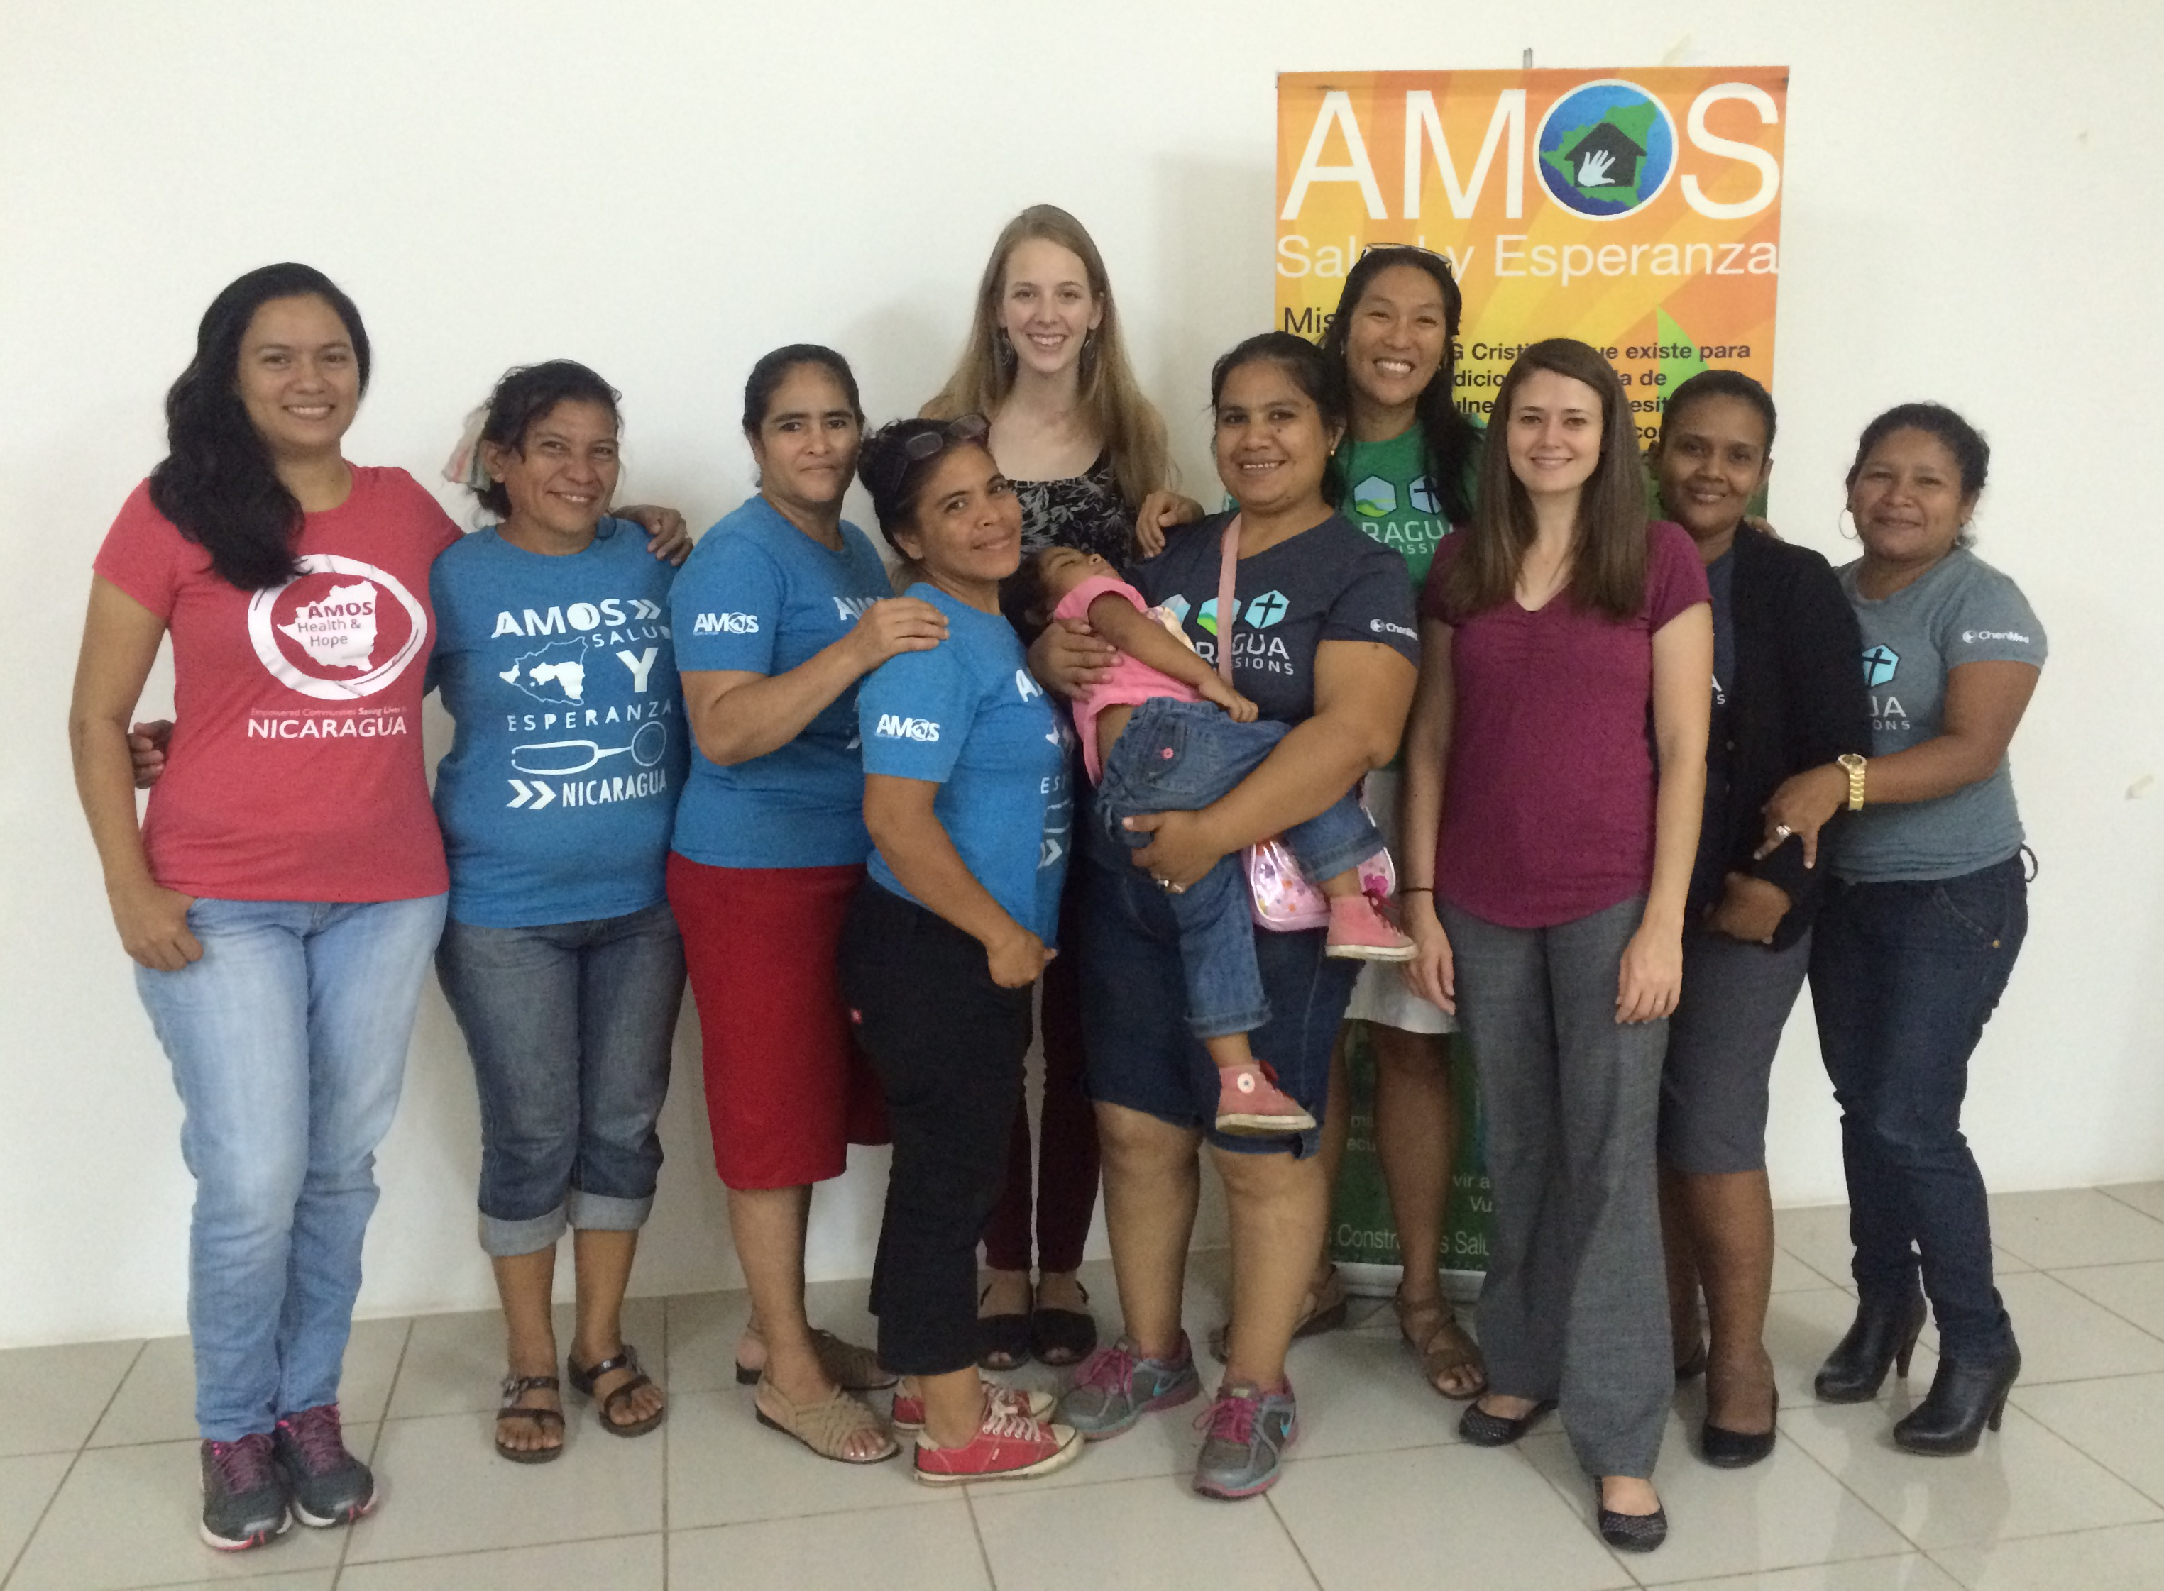
Special Thanks:
Ivania Flores, Maria Eveling Cabrera, Ligia Araica, Patricia Salazar
Dra. Laura Parajón
Dra. Gabriela Woo
Sylvia Becker-Dreps
Ceila Loughlin
Terry Noah
Charles Esther
Jim Ronk
Mike Wirt
Jonathan Crocker

Slide 45
References
Busi LE, Sly PD, Restuccia S, Llancamán L. Validation of a school-based written questionnaire for asthma case identification in Argentina. Pediatr Pulmonol. 2012;47(1):1-7.
Cooper PJ, Rodrigues LC, Cruz AA, Barreto ML. Asthma in Latin America: A public health challenge and research opportunity. Allergy Eur J Allergy Clin Immunol. 2009;64(1):5-17.
Fischer GB, Camargos PAM, Mocelin HT. The burden of asthma in children: a Latin American perspective. Paediatr Respir Rev. 2005;6(1):8-13.
Forno E, Gogna M, Cepeda A, et al. Asthma in Latin America. Thorax. 2015;70(9):898-905.
Global Initiative for Asthma. Global Strategy for Asthma Management and Prevention; 2015. Available at: www.ginasthma.org. Accessed Dec. 2, 2015.
Hekking PPW, Bel EH. Developing and emerging clinical asthma phenotypes. J Allergy Clin Immunol Pract. 2014;2(6):671-680.
The International Study of Asthma and Allergies in Childhood (ISAAC) Steering Committee. Worldwide variation in prevalence of symptoms of asthma, allergic rhinoconjunctivitis, and atopic eczema: ISAAC. Lancet. 1998;351(9111):1225-32.
Lemanske RF, Busse WW. Asthma. J Allergy Clin Immunol. 2003;111(2):S502-S519.
Liu L, Orza S, Hogan D, et al. Global, regional, and national causes of child mortality in 2000–13, with projections to inform post-2015 priorities: an updated systematic analysis. Lancet. 2015;385:430-440.
Mallol J, Crane J, von Mutius E, Odhiambo J, Keil U, Stewart a. The International Study of Asthma and Allergies in Childhood (ISAAC) Phase Three: A global synthesis. Allergol Immunopathol (Madr). 2012;41:73-85.
Masoli M, Fabian D, Holt S BR. The global burden of asthma: executive summary of the GINA Dissemination Committee report. Allergy. 2004;59:469-478.
National Asthma Education and Prevention Program. Expert Panel Report 3: Guidelines for the Diagnosis and Management of Asthma. Bethesda: National Heart, Lung, and Blood Institute; 2007.
Østergaard MS, Nantanda R, Tumwine JK, Aabenhus R. Childhood asthma in low income countries: an invisible killer? Prim Care Respir J. 2012;21(2):214-219.
Pitrez PM, Stein RT. Asthma in Latin America: the dawn of a new epidemic. Curr Opin Allergy Clin Immunol. 2008;8:378-383
Pellegrino R. Interpretative strategies for lung function tests. Eur Respir J. 2005;26(5):948-968.
Sheikh SI, Anp JP, Ryan-wenger NA, Mccoy S, Jr DH. Screening high-risk children for asthma through a community intervention. 2015;0903(October).
Wills-Karp M, Santeliz J, Karp CL. The germless theory of allergic disease: revisiting the hygiene hypothesis. Nat Rev Immunol. 2001;1(1):69-75.
World Health Organization. Handbook: IMCI Integrated management of childhood illness. 2005.

Slide 46
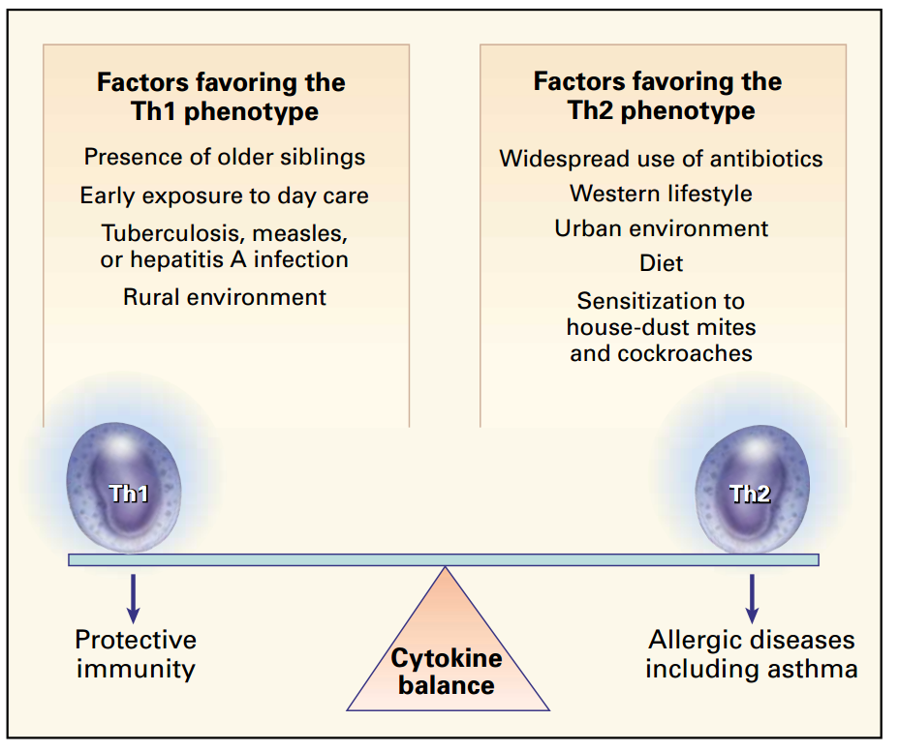
The Hygiene Hypothesis
Busse WW, Lemanske RF. J Allergy Clin Immunol. 2003;111(2):S502-S519.

Slide 47
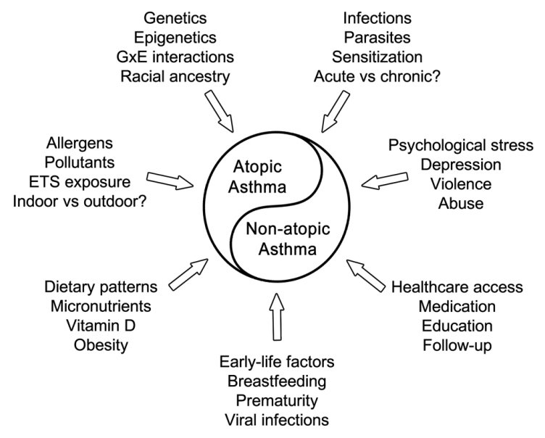
Atopic vs Non-atopic Asthma
Forno et al. Thorax. 2015;70(9):898-905.

Slide 48
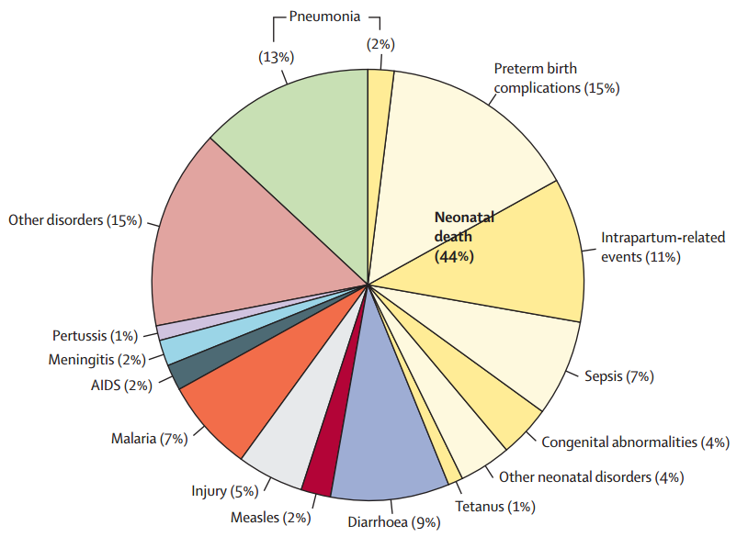
Is asthma really a problem in global health?
Liu L et al. Lancet. 2015;385:430-440.
Østergaard et al. Prim Care Respir J. 2012;21(2):214-219.

Slide 49
Asthma in Latin America
In DN, asthma more prevalent in urban cities
In DN urbanization associated more with poverty?
Contrasts to hygiene hypothesis– another factor at play?

