Slide 1
Update on
Global Child Malnutrition
UNC Global Health Forum
January 2017
Martha C Carlough MD MPH
Professor, Department of Family Medicine
Director, Office of International Activities
UNC/Chapel Hill

Slide 2
Objectives
To review the prevalence and consequences of childhood undernutrition and malnutrition globally
To discuss methods of nutritional surveillance and management of child malnutrition in emergencies
To consider the complex interplay of “development” and malnutrition – politics, climate and agriculture, shifting food preferences

Slide 3
What constitutes malnutrition?
UNDERNUTRITION
Intrauterine growth restriction resulting in low birth weight
Underweight: low body weight for age in children, and low Body Mass Index (BMI) and adults
Stunting (shortness): linear growth deficits
Wasting (thinness): reflecting low weight for height
Protein deficiency malnutrition
Micronutrient deficiencies – most importantly: Vitamin A, Vitamin D, zinc, iodine, iron and folate, calcium
MALNUTRITION = UNDERNUTRITION AND OVERNUTRITION

Slide 4
The Burden of Maternal and Child Undernutrition
“More than 3.1 million children under 5 die unnecessarily each year due to the underlying cause of undernutrition (2/3rds of deaths are in 1st year) and 165 million more are permanently disabled by the physical and mental effects of a poor dietary intake in the earliest months of life making yet another generation less productive than they otherwise would be”
The consequences of child undernutrition affect immediate as well as future health and well being
Source: Lancet Child Survival Series 2013

Slide 5
Rates of global stunting are slowly decreasing
Lancet series, 2013

Slide 6
Wasting is slower to improve
Lancet series, 2013

Slide 7
Adolescent nutrition
Lancet series, 2013

Slide 8
Intergenerational importance of poor maternal nutrition
Fetal nutritional sufficiency is a reflection of the mother’s preconceptional nutritional status (weight status, fat stores, micronutrient status) and her diet and nutritional status during pregnancy
In the short term, fetal nutritional sufficiency is reflected in growth and development in young childhood
Poor maternal nutrition plays out in the next generation with increased risk of infectious as well as chronic diseases (CVD and diabetes)

Slide 9
UN data – attributable child mortality
UNICEF, 2015

Slide 10
Determinants of malnutrition: The 6 “P’s”
Production - About half of people in developing countries do not have an adequate food supply - issues of food production and local availability of food
Preservation - 25% of grains are lost to bad post harvest handling, spoilage and pest infestation; up to 50% of easily perishable fruits and vegetables are not consumed
Population - density, distribution, urban migration
Pathology - nutrition-infection synergism
Poverty - root cause of malnutrition income inequality, household food distribution
Politics - government policies can foster malnutrition directly by how food is subsidized and distributed; indirectly civil unrest and natural disasters affect market availability and costs of foods

Slide 11
Synergy of nutrition and infection
*Malnutrition depresses immune
function and increases susceptibility to infection
*Anorexia (lack of appetite) results in decreased intake
and increased challenge with feeding
Nutrition
Infection
* Diarrhea & vomiting speed up
nutrient losses
*Fever increases metabolic needs
*Chronic infection increases protein needs – breaks down muscles, deplete fat stores
*Infection and fever result in anorexia

Slide 12
Nutritional anthropometry – WHY?
Identify children or groups of children at risk of morbidity and mortality
Survey a population
As a tool for individual monitoring and intervention
BUT, growth monitoring by itself is NOT an intervention…

Slide 13
Using growth charts
A standard suggests a norm or desirable target, and thus can be a value judgment (e.g. chubby bottle fed babies in Denver and Ohio were the basis for international growth standards for infants and toddlers in the 1970s and 80s)
A reference is a tool for grouping and analyzing data: it shows the normal distribution of sizes in a selected population. Should be based on a large sample of ethnically diverse, healthy, optimally fed children

Slide 14
Standard deviation

Slide 15
Z-score – based on standard deviation
Most frequently used reference ranges today in nutritional assessment – multiple computer programs use standard distribution curves (e.g. WHO Anthro – free software)
The basis of WHO and most standard national growth charts – “zones”
GREEN = median
YELLOW = Z score of -1 (15th%)
RED - Low = Z score of -2 (3rd%)
BLACK - Very low = Z score of -3 (<3rd%) or less

Slide 17
WHO Multi-center growth standards (0-5 yrs)
Pooled multi-country assessment – most children grow similarly when nutritional needs are met
Brazil, Ghana, India, Norway, Oman, USA
Breastfeeding was used as the “biologic norm” – breastfed babies are longer and leaner in the first few years
May play an important part in the early recognition of childhood obesity

Slide 18
For example: WHO Growth Chart Girl 0-2 years, W/A
In a well nourished population there should be virtually NO children at < 3rd percentile

Slide 19
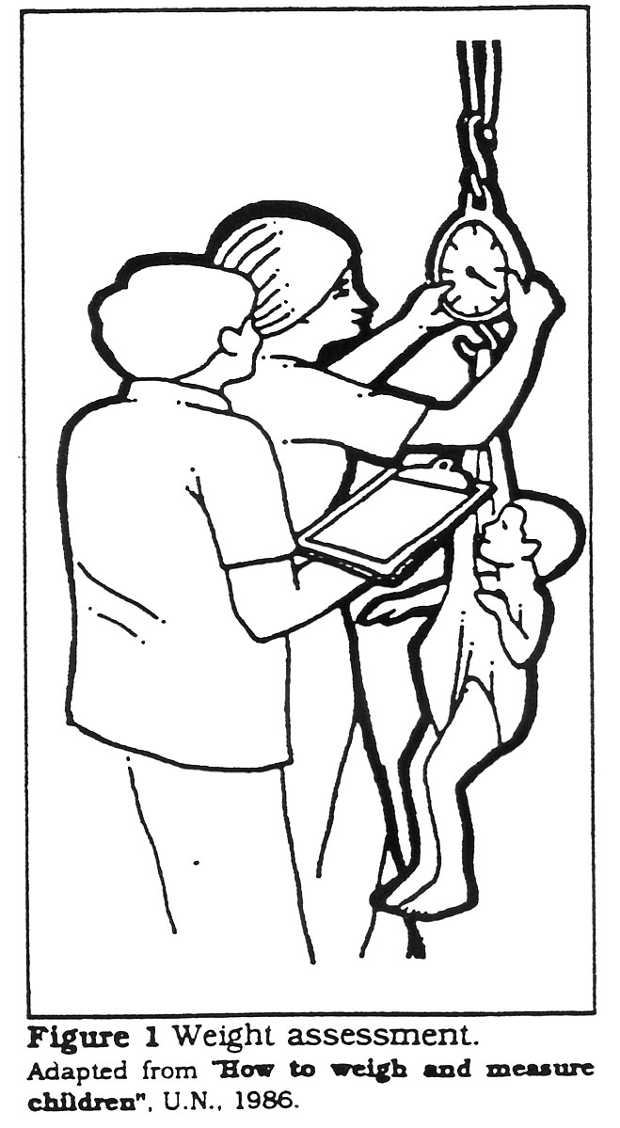
Anthropometric Measurements
Weight
Scale (hanging vs. standing)
Height
board for recumbent for sick or very young (<2 YOA) children or upright for others
Middle Upper Arm Circumference (MUAC): tape
Head Circumference: tape (<3 YOA)

Slide 20
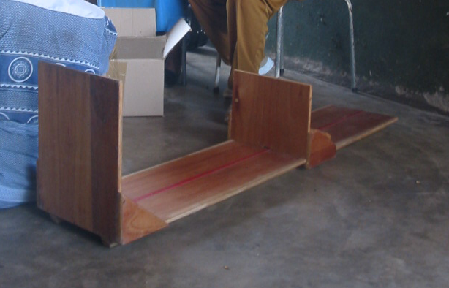
Length boards
Two people required to properly measure length
locally made resources

Slide 21
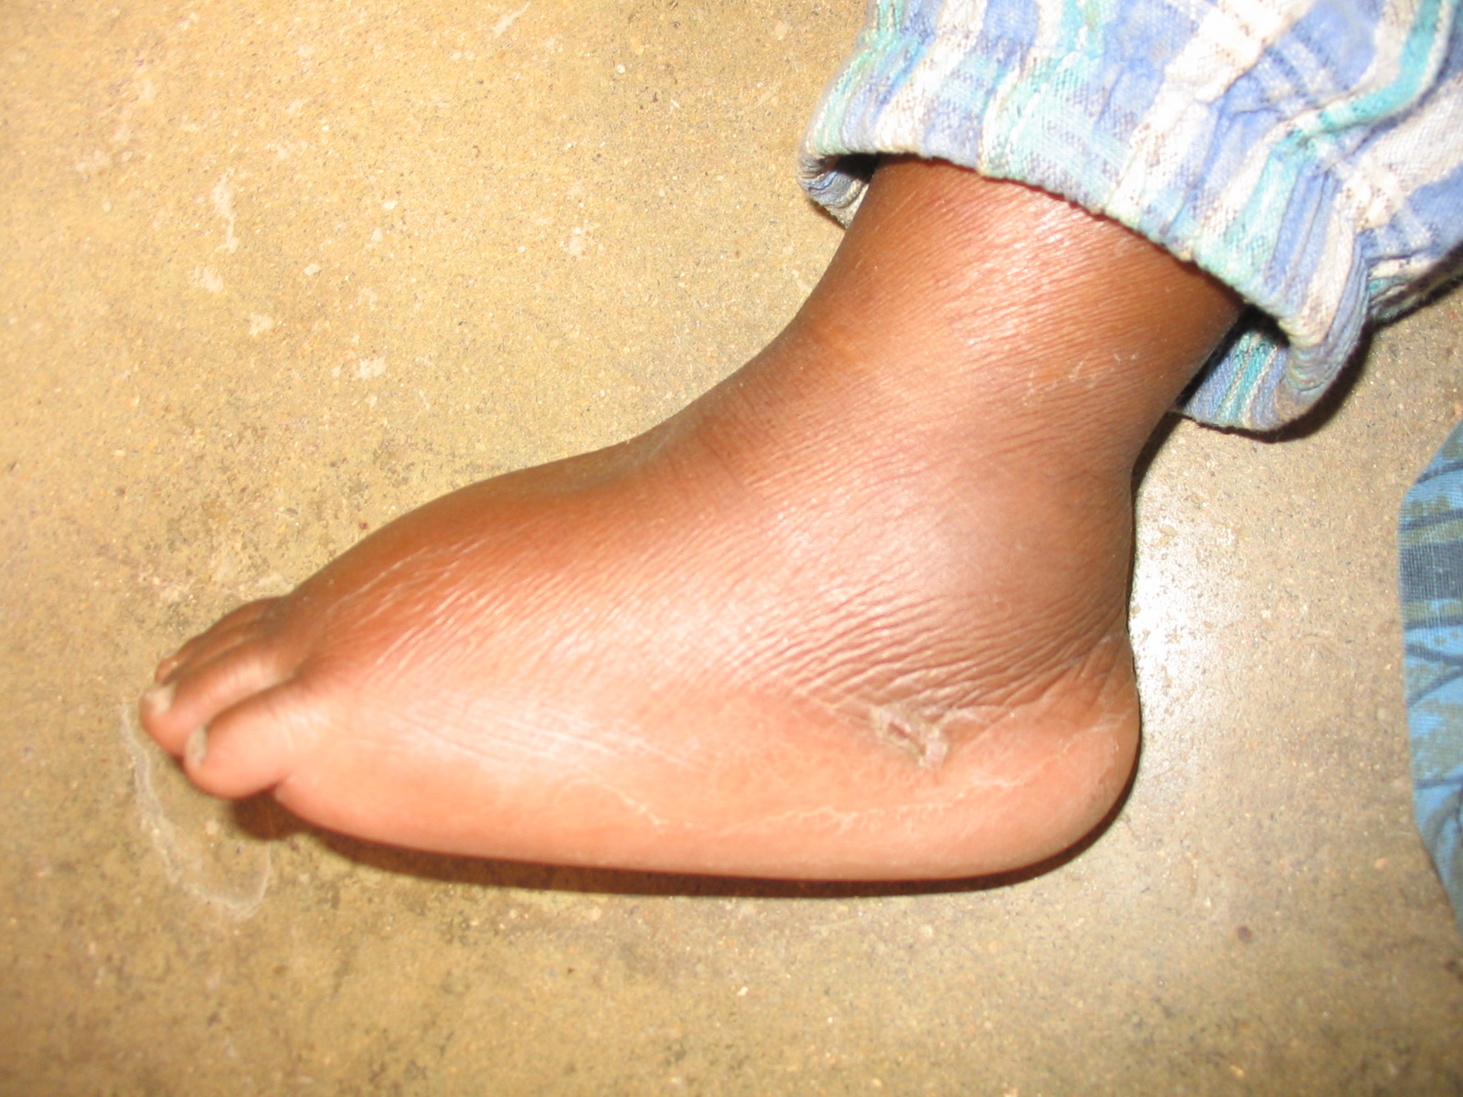
Visual Screening for Nutritional Assessment
Marasmus or severe wasting – shoulders, back, buttocks; ribs easily visible
Kwashiokor (protein energy malnutrition) pedal edema, thin/dry hair, very thin arms/legs
Edema – standard technique
5 sec pressure, wait 2 sec and measure depth of impression
Notes:
Edema measured with standard technique: 5 seconds of pressure with the thumb, wait 2 seconds, estimate depth of impression left
trace is <1/2cm
1+ is ½ cm
2+ is 1cm
3+ is >1cm

Slide 22
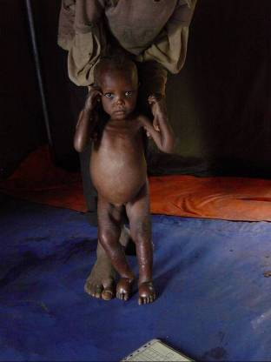
Severe Acute Malnutrition
Marasmus (wasting)
Kwashiorkor (edema)
Kwashiokor
Marasmic
Case Fatality:
20 to 30 Percent
Case Fatality: 50 to 60 Percent

Slide 23
Measuring other malnutrition states:
Iron Deficiency
Hgb/Hct measurements or subjective pallor of palm and nail beds, conjunctiva, mucous membranes
Intermediate indicator – % of pregnant women with Fe/folate
Vitamin A deficiency
keratomalacia, corneal ulcerations, conjunctival Bitot’s spots
Night blindness (particularly in young children and pregnant women)
Intermediate - % of children < 5 with Vitamin A supplementation at least annually
Iodine deficiency
Goiter and cretinism in population
Intermediate - % of households with iodinized salt
Overnutrition
BMI/Obesity measurements
Cases/1000 population of CV disease, diabetes
Notes:
ZINC!!!!!!

Slide 24
Weight for Height (W/H) "wasting"
Advantages:
age not required
useful for larger population surveillance and emergencies
Disadvantages:
Less sensitive for change over time
Inter-observer variability in height measurements more common

Slide 25
Height for Age (H/A) “stunting”
Advantages:
Assessment multiple SES-based causes, including LBW and genetic differences
More genetic differences globally (though we know from immigrated populations that this DOES change)
Disadvantages:
Variability in height measurement
Need to know age (might be hard in emergencies; especially if separated from parents)

Slide 26
Weight for Age (W/A) -“growth faltering”
Advantages:
Composite of W/H and H/A
good for following individual children over time (old “Road to Health” charts…)
Picks up faltering, due to inadequate weight gain (wasting) or concomitant illness
If slow faltering, directed to get more info - H/A and W/H
Disadvantages:
does not indicate whether child is short and normal weight or tall and underweight

Slide 27
Recurrent illness episodes:

Slide 28
Median Upper Arm Circumference (MUAC)
Advantages
easy to perform
does not require age (reference applies to children 6 -60 months of age, MUAC for pregnant women with separate values)
May be the "best" predictor of mortality in children at risk (MUAC of < 115 mm)
Disadvantages:
measurement error if not trained
Doesn’t correlate with stunting
WHO, 2009
Notes:
Pregnant women – in 2nd and 3rd trimester

Slide 29
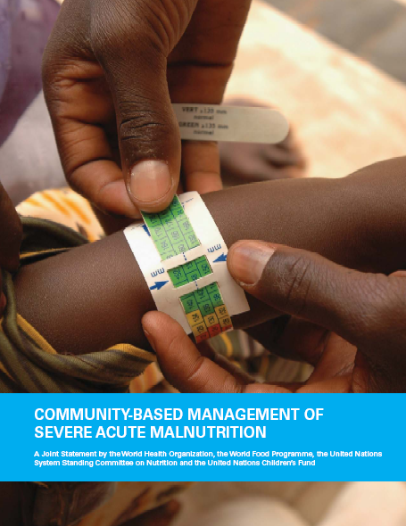
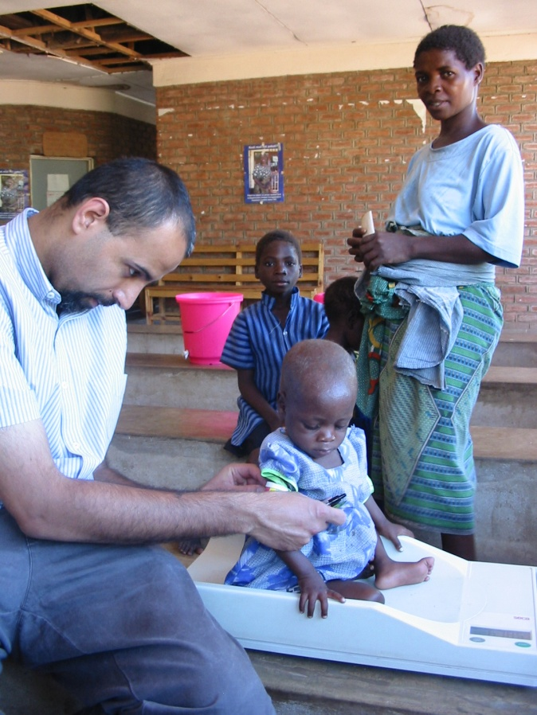

Slide 30
Most important, evidence based nutrition interventions for populations at risk
Maternal micronutrient supplementation with calcium and balanced protein supplements
Exclusive breastfeeding for 6 mo, continued with appropriate complementary foods until at least 2 YOA
Vit A supplementation for postpartum women and children U5
Fe/folate for anemia (though HARD to reliably take tabs)
Zinc for diarrhea and measles episodes, and burns in children12-60 months of age
Universal salt iodinization
Supplementary home and/or community based feeding for moderate malnutrition
Recognition and management of acute malnutrition
Notes:
Vitamin A – stimulates immune function reducing risk of death during illness, building block for mucous membranes – eyes, respiratory tract, alimentary tract – so directly related to risk of blindness (most common cause of childhood blindness), death from measles (reduces risk by 50%) , ARI and diarrhea (reduces risk of death by 40%). Age appropriate supplementation with illness and routine supplementation of children 6-60 mo of age every 6 months. Breastfeeding through the 2nd year of life reduces this risk There is also evidence that it adequate Vit A reduces risk of maternal mortality, although high dose Vit A during pregnancy can be teratogenic. 200,000 IU immediately postpartum, or 8000 IU per day, 25,000 IU per week. Night blindness in pregnancy is a marker for VAD in a population, and children whose siblings have night blindness are 10x as likely to be VAD themselves. Its actually relatively hard to get enough Vit A from foods – seasonal variation. Almost all children are born relatively Vit A deficient; breastmilk is rich in Vit A. Continued breastfeeding through year 2 of life provides 50% of Vit A needs.
Iron – necessary for hemoglobin production, important during periods of rapid growth and expansion of blood volume – pregnancy, 0-2 in particular. Important for early mental development, less fatigue, better immune function. Folic acid also needed (increased need during pregnancy – 400 mcg, and linked to neural tube defects). IDA affects up to 1/3 of the world’s population making it the most common micronutrient deficiency. Exacerbated by parasites, infections (malaria and HIV). Iron is HARD to absorb from foods, made worse by phytates (whole grains) and tannins (e.g. coffee,tea) but can be improved with Vit C. Best sources are actually animal based. Dietary supplementation – cereals, etc. Fe/folate (60 mg/400 mcg folic acid) supplementation for at least 6 mo of pregnancy and 2 months postpartum (or 6 mo postpartum if prevalence of anemia in population > 40%)
Iodine – globally the single preventable cause of mental retardation (“cretinism), also linked with pregnancy loss, stillbirth and neonatal death. Infants who are not exclusively breastfed are at increased risk of IDD. Occurs where iodine is insufficient in soil (particularly regions not bordering oceans). Iodinized salt (with potassium iodide) is perhaps the most important nutritional intervention of the last 40 years.

Slide 31
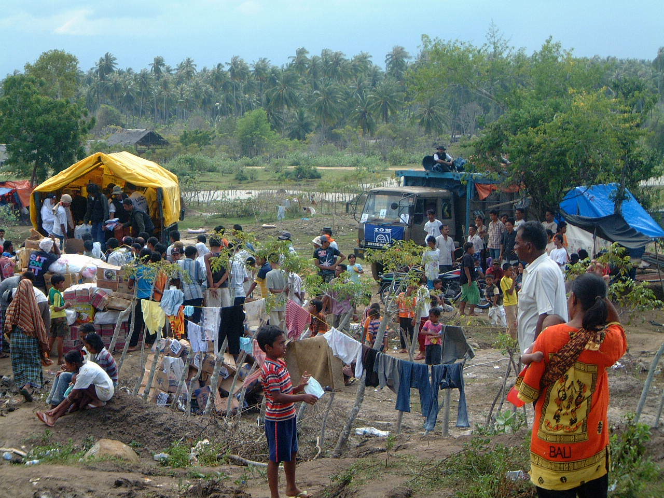
Undernutrition in Emergencies

Slide 32
Major risks for infants and young children in complex humanitarian crisis
Separation from family
Hypo or hyperthermia
Dehydration
Starvation
PTSD/depression
Abrupt weaning
Illness – gastroenteritis, respiratory infection, skin infections, measles and malaria

Slide 33
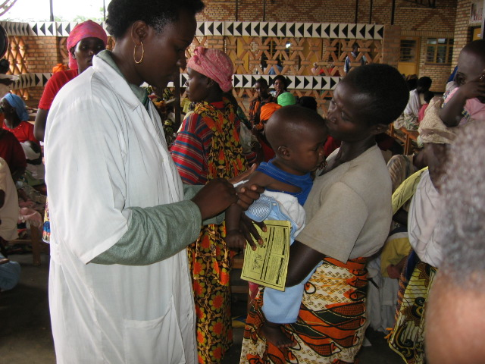
Triage
Weight for Height
MUAC
Signs of micronutrient or kwashiokor deficiency
Assess for OTHER complications

Slide 34
Assess for complications → REFER:
Signs of shock or sepsis
Concomitant infections (malaria, HIV, ARI, TB)
Uncontrolled diarrhea
Dehydration
Anorexia
Edema or Kwashiokor

Slide 35
Emergency contexts Definitions of global acute malnutrition
 | Stunting (Chronic) | Underweight (Both) | Wasting (Acute)
Index | H/A | W/A | W/H or MUAC
Moderate GAM | < -2 SD | < -2 SD | < -2 SD or MUAC 10-11.5 cm
Severe GAM | < - 3 SD | < - 3SD | < - 3SD or MUAC <11.5 cm, edema or other complications

Slide 36
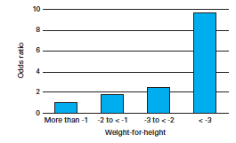
Odds Ratio of Mortality by W/H
WHO, 2009

Slide 37
Population Benchmarks
Severity | Prevalence of GAM (Global Acute Malnutrition)
Acceptable | < 5 %
Poor | 5 - 9 %
Serious | 10 – 14 %
Critical | > = 15 %
GAM: children aged 6-59 months on the basis of WHZ <-2

Slide 38
Food - local
Supplement local food resources
Seasonal alterations
Integrate cultural issues
Functionality of markets and shops
Consider: fuel, soap, water availability, fair distribution and cost

Slide 39
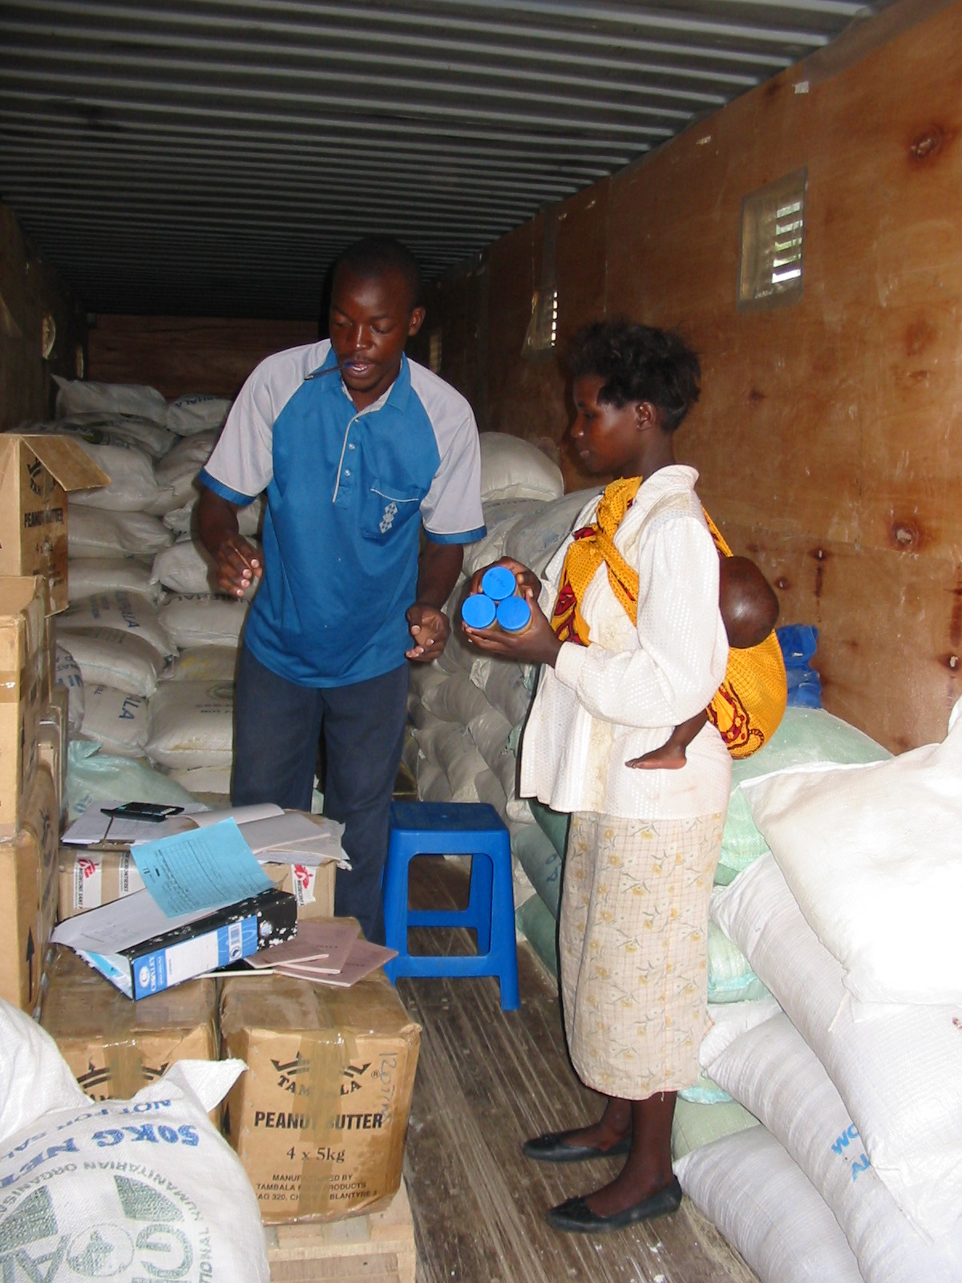
Food - imported
Cost and potential to NOT be culturally acceptable
Bulk nutritive value may be higher
Increased resources spent on logistics, staff, storage transportation, set up of distribution
Issues of safety and storage (and politics)

Slide 40
Response
Prevention
General Food
Distribution
Support
Vulnerable
Populations
Supplementary
Feeding
Treat
Severe
Malnutrition
Therapeutic
Feeding
Cost/Benefit
Notes:
General food distribution – if average in community is <2100kcal/per per person per day – market supplementation and increases

Slide 41
Supplementary Nutrition Options
Wet or dry rations (should be taken home unless there is clear rationale for on-site feeding) of at least 1000 kcal and 40 g protein per child per day
Ration types:
Fortified blended foods
Grain + oil, sugar, salt
High energy biscuits
Lipid-Based Nutrient Supplements
Point of Care supplements (usually liquid, HIGHER micronutrient contents, 20-40g protein “dose” )
Ready to use therapeutic food (RUTF)
Notes:
– supplement with fortified blend of at least 1000kcal/day and 40g protein per person – dry rations vs. energy biscuits vs. local food

Slide 42
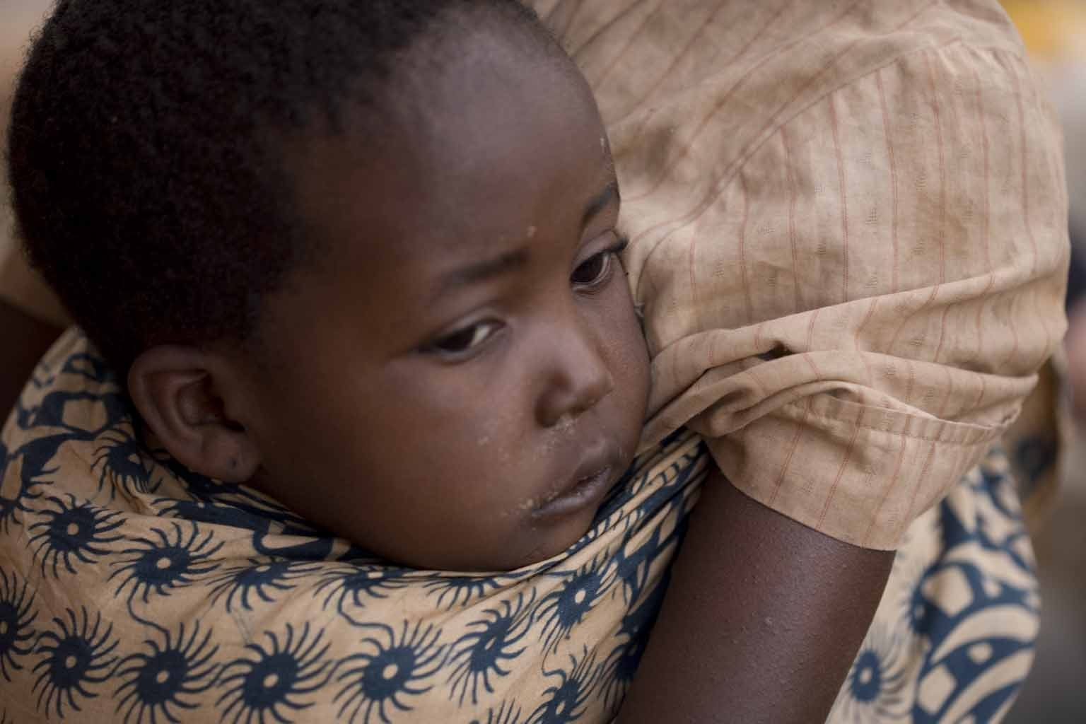
Misconceptions about breastfeeding in emergencies:
Women under stress lose supply
Malnourished women have reduced production and poor quality milk
Women who have stopped nursing cannot start again
A weaned infant will not nurse again
BREASTFEEDING, AND RELACTATION ARE LIFE SAVING OPTIONS

Slide 43
Breastfeeding
Infants who do not breastfeed are 14x more likely to die in the first year of life than those exclusively breastfed
Globally approximately 38% of infants are exclusively breastfed
Up to 220,000 infant lives could be saved annually with optimal breastfeeding practices

Slide 44
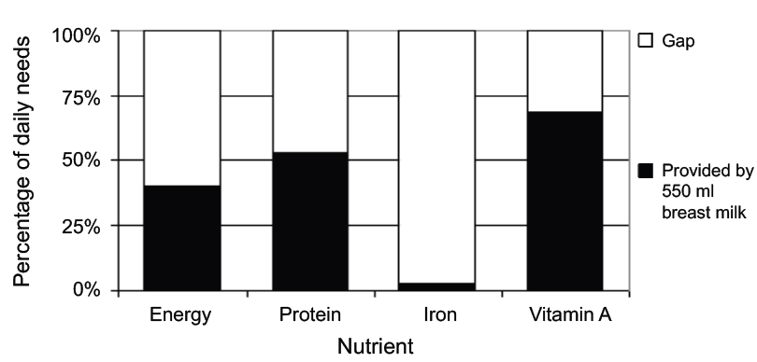
Breast milk in the second year of life
Lancet, 2013

Slide 45
Generalized Acute Malnutrition
Severe Malnutrition
WHZ < -3, MUAC < 11.5 or edema
Moderate Malnutrition
WHZ < -2
COMPLICATED
UNCOMPLICATED
Facility based care
Community based therapeutic Food
Discharge based on resolution of edema, 10-15% weight gain, improved appetite and ability to take RUTF
Supplementary Feeding

Slide 46
Inpatient stabilization
Dehydration – rehydration formula, IV fluids or blood
Hypoglycemia – frequent feedings
Hypothermia – appropriate protection from environmental factors
Micronutrient Deficiencies – supplementation of Vitamin A, Zinc, iron/folate
Anorexia – slow feeding, spoon feeding, naso-gastric feeding
Treatment for infections, parasitic infestation, malaria
EXPENSIVE and DISRUPTIVE, sometimes INCREASES risk of infections

Slide 47
Facility based care – liquid nutrients
Stabilization phase
Low protein milk based formula F-75 (75 kcal/100 cc) for 4-7 days
Restore electrolyte balance (additional ORS as needed w zinc)
Treat complications, watch for resolution of edema and improved appetite
Rehabilitation phase
Higher protein, high energy formula F-100 (100kcal/100 cc)
Add iron, other micronutrients
Start porridge feeds or RUTF as an inpatient and transition

Slide 48
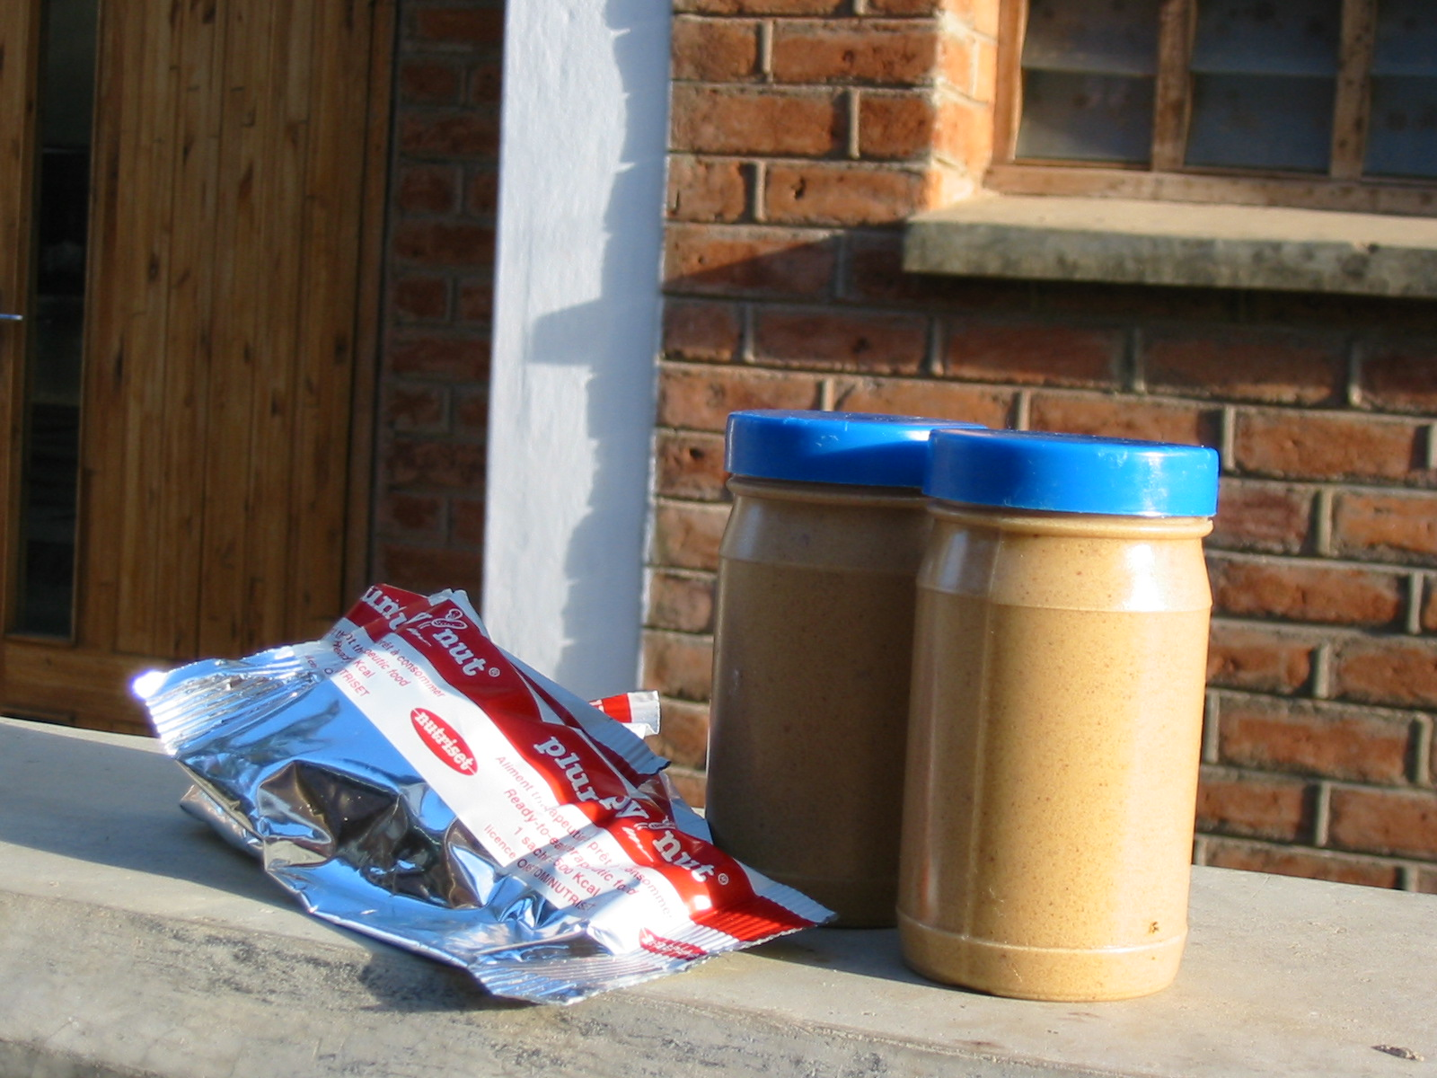
Ready to Use Therapeutic Food (RUTF)
Home-based therapy for the treatment of moderate to severe malnutrition
Notes:
RUTF: Ready to Use Therapeutic Food
--on the left, commercially produced as “plumpy’nut” by Nutriset (France)
--on the right, locally produced as “Chiponde” or “Plumpy’nut Chiponde” (Malawi)
Ingredients
Milk powder
Peanut Paste
Oil (palm oil w Vit A)
Sugar
Vitamin Mineral Mix

Slide 49
RUTF
First produced as “Plumpynut” by Nutriset (France)
Now numerous local production processes (Malawi, Haiti, Kenya)
Ingredients
Milk powder
Peanut Paste
Oil (palm oil with added Vit A)
Sugar
Vitamin Mineral Mix

Slide 50
Easy to feed a child RUTF
Few spoons at a time, multiple times a day
Continue to breastfeed (or give clean water)
No cooking required
No special storage – doesn’t spoil easily
Continue nursing

Slide 51
For any child with moderate malnutrition oil base with low osmolality

Slide 52
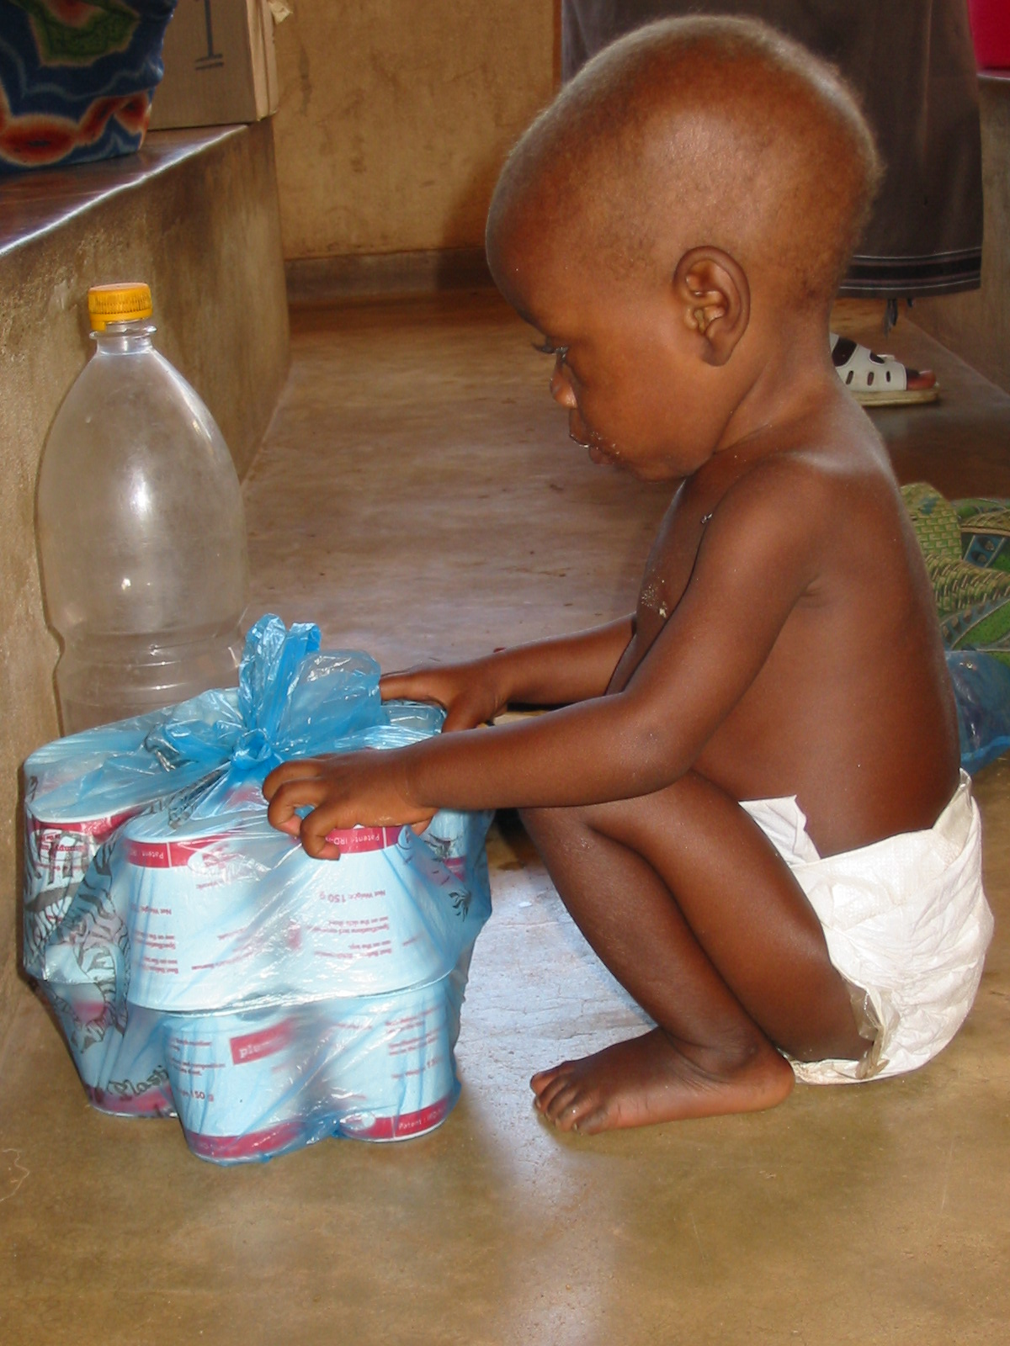
Ready to use therapeutic food
Child can go home with supply
Follows up in 1 to 2 weeks
All recovery done at home
No family separation
No social isolation
Can be followed up in outpatient clinic/feeding center
Notes:
RUTF distribution:
Child goes home with supply
Follow up in 2 weeks, or 1 week depending on feeding center protocols or plans
All recovery is done at home, without family separation or social isolation
Family is given careful directions about routine follow up and reasons to seek treatment earlier (signs of untreated infections)

Slide 53
Nutrition doesn’t improve in a vacuum…
Water and sanitation
Maternal mental health, child development, family structure
Access to health care, family planning
Education, pro-family social services
Civil society, food security, famine
NUTRITION TRANSITION

Slide 54
Nutrition transition -“Progress” in biology and technology…
Shift to less physical economic work, urban migration trends globally and increased taste preferences for sweet and fatty foods
Edible oil revolution (easier to extract oil)
Corn/fructose and soy excess dumping by developed countries into processed foods
Unlike undernutrition, overnutrition will not be solved by economic growth and development
Need innovative approaches – integrated interventions to different “types” of malnutrition, linkages between climate/agriculture and food/development

Slide 55
References:
Black, R and C Victoria, et.al. Maternal and Child Undernutrition in LIC and MIC. The Lancet Series on Maternal and Child Nutrition. June 2013
Chaparro, C and K Dewey. Use of Lipid Based Nutrient Supplements to Improve Nutrition Adequacy of General Food Distribution Rations for Vulnerable Subgroups in Emergency Settings. 2010. MCH Nutrition. 6(1): 1-69
Medicines San Frontieres. Refugee health: An approach to emergency situations. MSF. MacMillan Press. 2008
Save the Children. Emergency Health and Nutrition Toolkit (2014)
Save the Children. Nutrition in the first 1000 days – State of the World’s Mothers. 2012. New York, NY
UNHCR. Guidelines for Effective Feeding Programs in Emergencies 2014. UNHCR/WFP. Rome
World Food Programme. State of Food Insecurity in the World. 2013. Rome.
World Health Organization. Rapid Health Assessment Protocols for Emergencies and WHO Management of Nutrition (1999) in Emergencies (2003)
World Health Organization. WHO Child Growth Standards and the Identification of severe acute malnutrition in infants and children. Joint Statement by WHO and UNICEF. 2009. Geneva
Software – WHO Anthro 2005, Epi Info Emergency Nutritional Assessment (ENA)

Slide 56
Questions and comments?

