Slide 1
Radiology in Global Health
Melissa Culp, MEd, RT(R)(MR)
Chief Operating Officer Assistant Professor of Allied Health Sciences
RAD-AID International UNC School of Medicine

Slide 2
What is Global Health?
•Issues that transcend national boundaries
•Emphasis on solutions that require global cooperation
•Individuals and population
•Health equity
•Multidisciplinary
Koplan JP, Bond TC, Merson MH, et al. Towards a common definition of global health. Lancet 2009; 373:1993-5.

Slide 3
THE NEED FOR GLOBAL RADIOLOGY
World Health Organization:
Over half of the world has no access to radiology…
3-4 billion people

Slide 4
THE NEED for RADIOLOGY
Babies and mothers need ultrasound for safe delivery.
Women need mammography for breast cancer screening.
Cancer patients need CT/MRI/PET for staging & treatment
Trauma & Infection victims need x-ray, ultrasound & CT to address injuries and outbreaks
Heart & stroke victims need CT, angiography, and ultrasound for diagnosis and treatment

Slide 5
NEED FOR GLOBAL RADIOLOGY: DATA
Tanzania: 58 radiologists for 56 million people
US/Canada/Europe: ~25 CT Scanners per 1 million people
Africa: Less than 1 CT scanner per 1 million people
Breast Cancer 5-yr survival: US – 89%, S. Africa 53%, Gambia 15%

Slide 6
RAD-AID’S MISSION
Increase and improve radiology in underserved, poor, and developing regions of the world
Founded 2008

Slide 7
RAD-AID Affiliation with UNITED NATIONS
Worked with WHO since 2012, Designated official relations
UN Members Voted to approve RAD-AID as UN-affiliated NGO in 2015, renewed in January 2018

Slide 8
Cornerstone of our Strategy: RADIOLOGY-READINESS
Systematic framework for analyzing radiology
Existing Resources at Site?
Clinical Goals?
Fill Gaps to match resources with goals
Optimize donated resources to maximize program’s impact

Slide 9
Radiology Readiness Survey Sections
General and Background Information
Community Involvement and Patient Satisfaction
Clinical Specialties and Disease Epidemiology
Patient Demographics, Capacity and Referral Patterns
Clinical Tests
Pharmaceutical Agents and other Clinical Consumables
Human Resources
Training and Continuing Medical Education
Structural, Electrical, Climate Control, and Transportation Infrastructure
Communications
Information Technology
Medical Imaging Capabilities and Limitations
Medical Imaging Device Maintenance
Patient Financial Issues
Financial Infrastructure
Funding of Medical Imaging Services

Slide 10
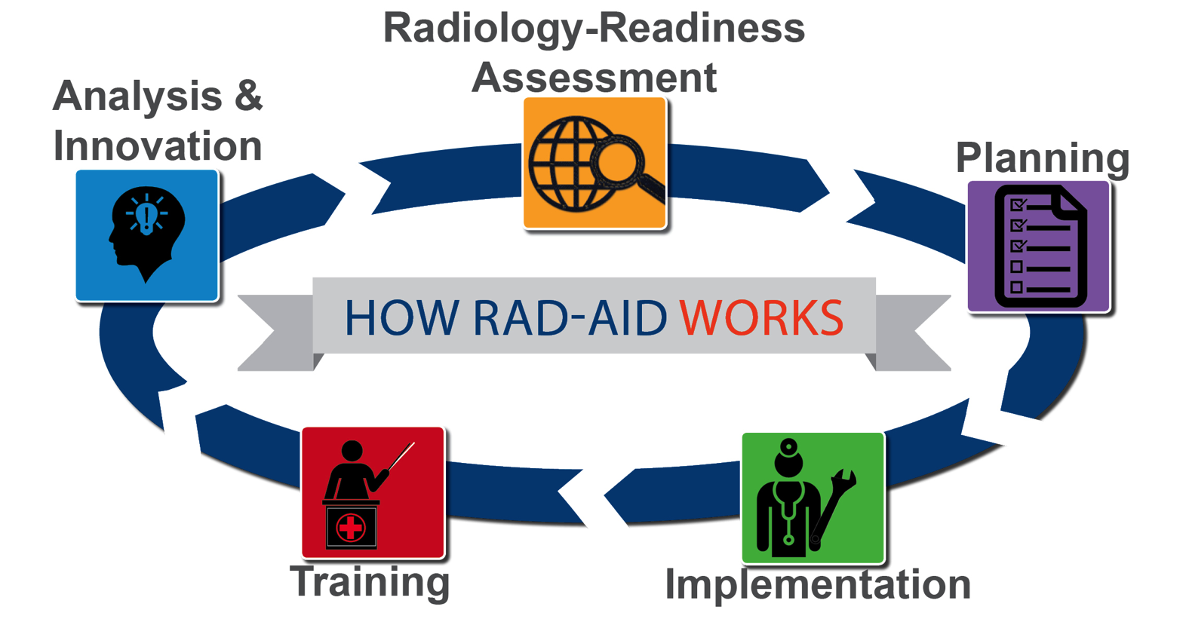

Slide 11
RAD-AID in 31 Countries & 53 Hospitals
Dan Mollura, MD

Slide 12
RAD-AID Volunteers & Supporters

Slide 13
RAD-AID VOLUNTEERS FROM 114 Countries
53% USA
8.3% Canada
8.3% UK
6.2% Continental Europe +Australia
24.2% Africa/Latin America/Asia
U. Zuwasti Curran, 2018 RAD-AID Assistant Director of Operations, Quantitative Analysis
Notes:
Principles of “good donation”
Health care equipment donations should benefit the recipient to the maximum extent possible
Donations should be given with due respect for the wishes and authority of the recipient, and in conformity with government policies and administrative arrangements of the recipient country.
There should be no double standard in quality. If the quality of an item is unacceptable in the donor country, it is also unacceptable as a donation.
There should be effective communication between the donor and the recipient, with all donations made according to a plan formulated by both parties.

Slide 14
RAD-AID CHAPTERS NETWORK
Project development & relationships with overseas radiology facilities
Legal liability management
Grants to chapter members
Health and safety of travelers (vaccines, insurance, etc.)
Education & Webinars for project development
Inter-chapter collaboration for greater sustainability
National
per capita: USD3,678

Slide 15
72 RAD-AID CHAPTERS

Slide 16
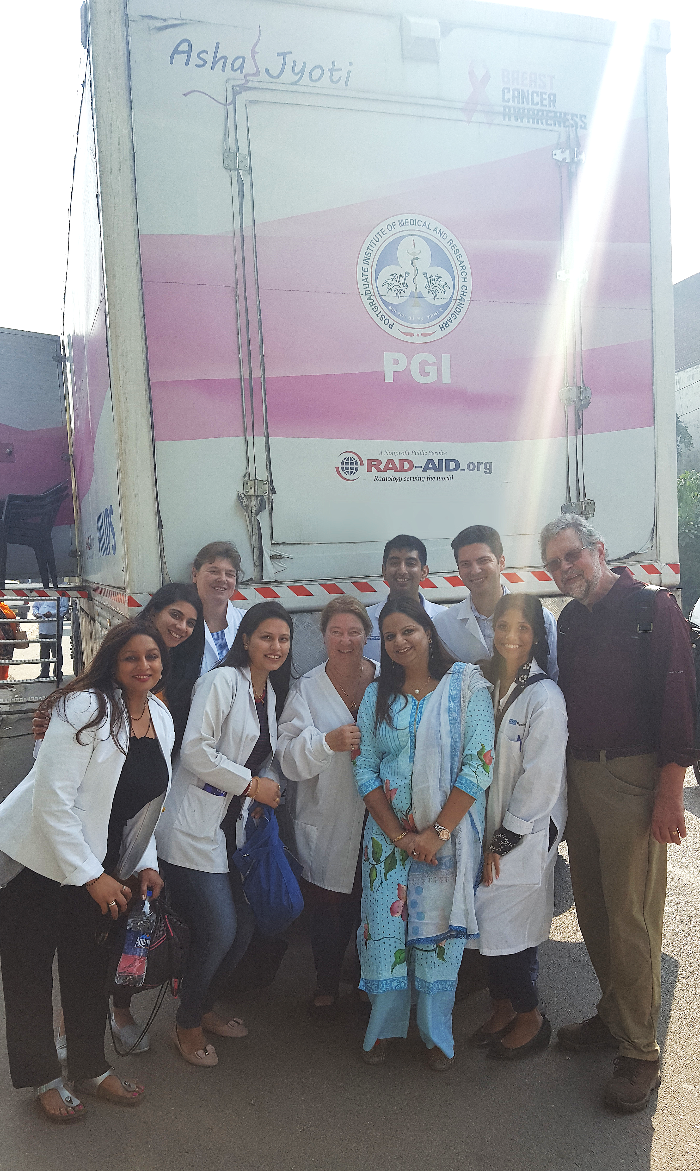
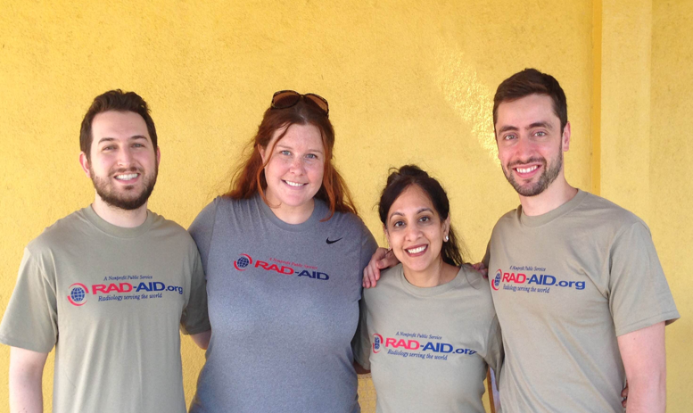
RAD-AID Chapters
Dalhousie & UNC RAD-AID: Malawi
Montefiore & SUNY Downstate Chapters: Ghana
CHOP, Cornell, Emory: Ethiopia
Columbia (NY) RAD-AID: Haiti, Liberia, & India
U Wisconsin, Ford, & U Iowa RAD-AID: Nicaragua
NYU & Yale RAD-AID: Tanzania
RAD-AID India:
Georgetown, Cornell, & UCLA Chapters, 2018
RAD-AID Nicaragua:
Ford, UW, UI chapters
Notes:
Principles of “good donation”
Health care equipment donations should benefit the recipient to the maximum extent possible
Donations should be given with due respect for the wishes and authority of the recipient, and in conformity with government policies and administrative arrangements of the recipient country.
There should be no double standard in quality. If the quality of an item is unacceptable in the donor country, it is also unacceptable as a donation.
There should be effective communication between the donor and the recipient, with all donations made according to a plan formulated by both parties.

Slide 17
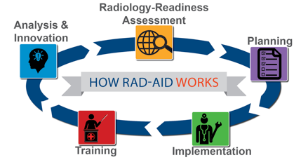
RAD-AID FLYWHEEL
OPERATIONAL LEADERS
REGIONAL LEADERS
Synthesize regional and operational expertise to form program strategies

Slide 18
Examples of How We Work…
Notes:
Principles of “good donation”
Health care equipment donations should benefit the recipient to the maximum extent possible
Donations should be given with due respect for the wishes and authority of the recipient, and in conformity with government policies and administrative arrangements of the recipient country.
There should be no double standard in quality. If the quality of an item is unacceptable in the donor country, it is also unacceptable as a donation.
There should be effective communication between the donor and the recipient, with all donations made according to a plan formulated by both parties.

Slide 19
RAD-AID Jordan
Malik Mossa-Basha, MD
Program Manager, RAD-AID Middle East

Slide 20
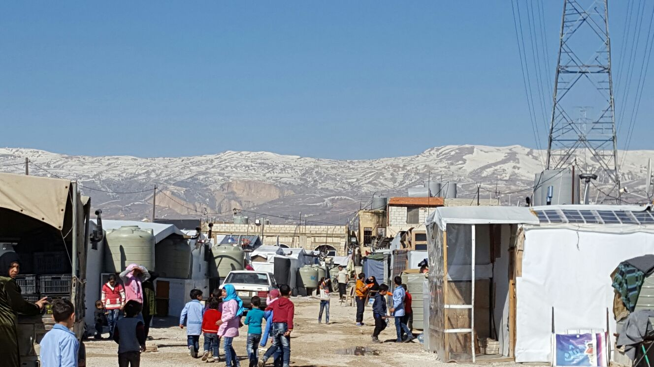
Syrian refugee crisis
Syrian Civil War starts in 2011
Over 500,000 dead
Over 5 million Syrians externally displaced
Additional 6.6 million internally displaced

Slide 21
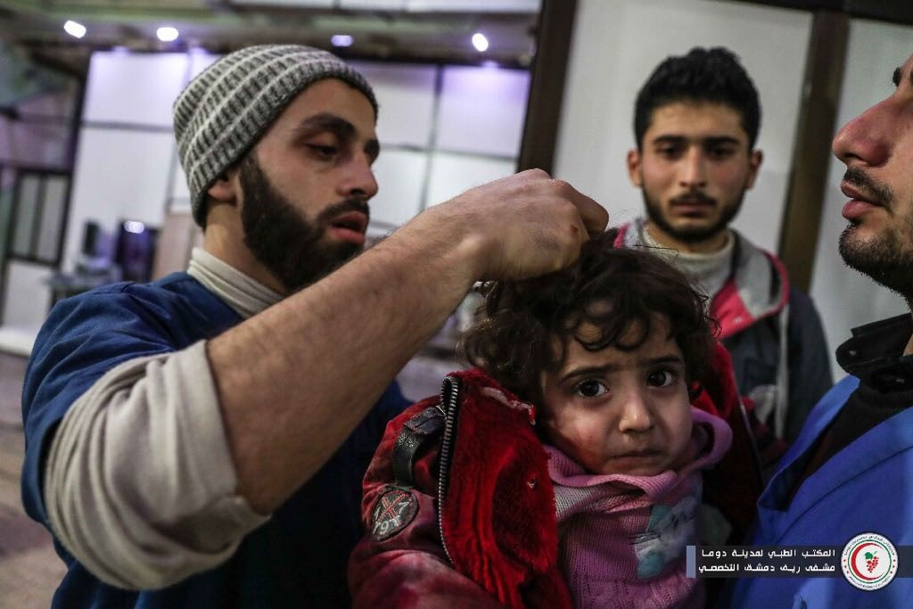
JOrdan
Over 600,000 refugees in a country of 10 million
2nd highest per capita
Za’atari Refugee Camp
Northern Jordan near Daraa
Approximately 80,000 inhabitants
4th largest city in the country

Slide 22
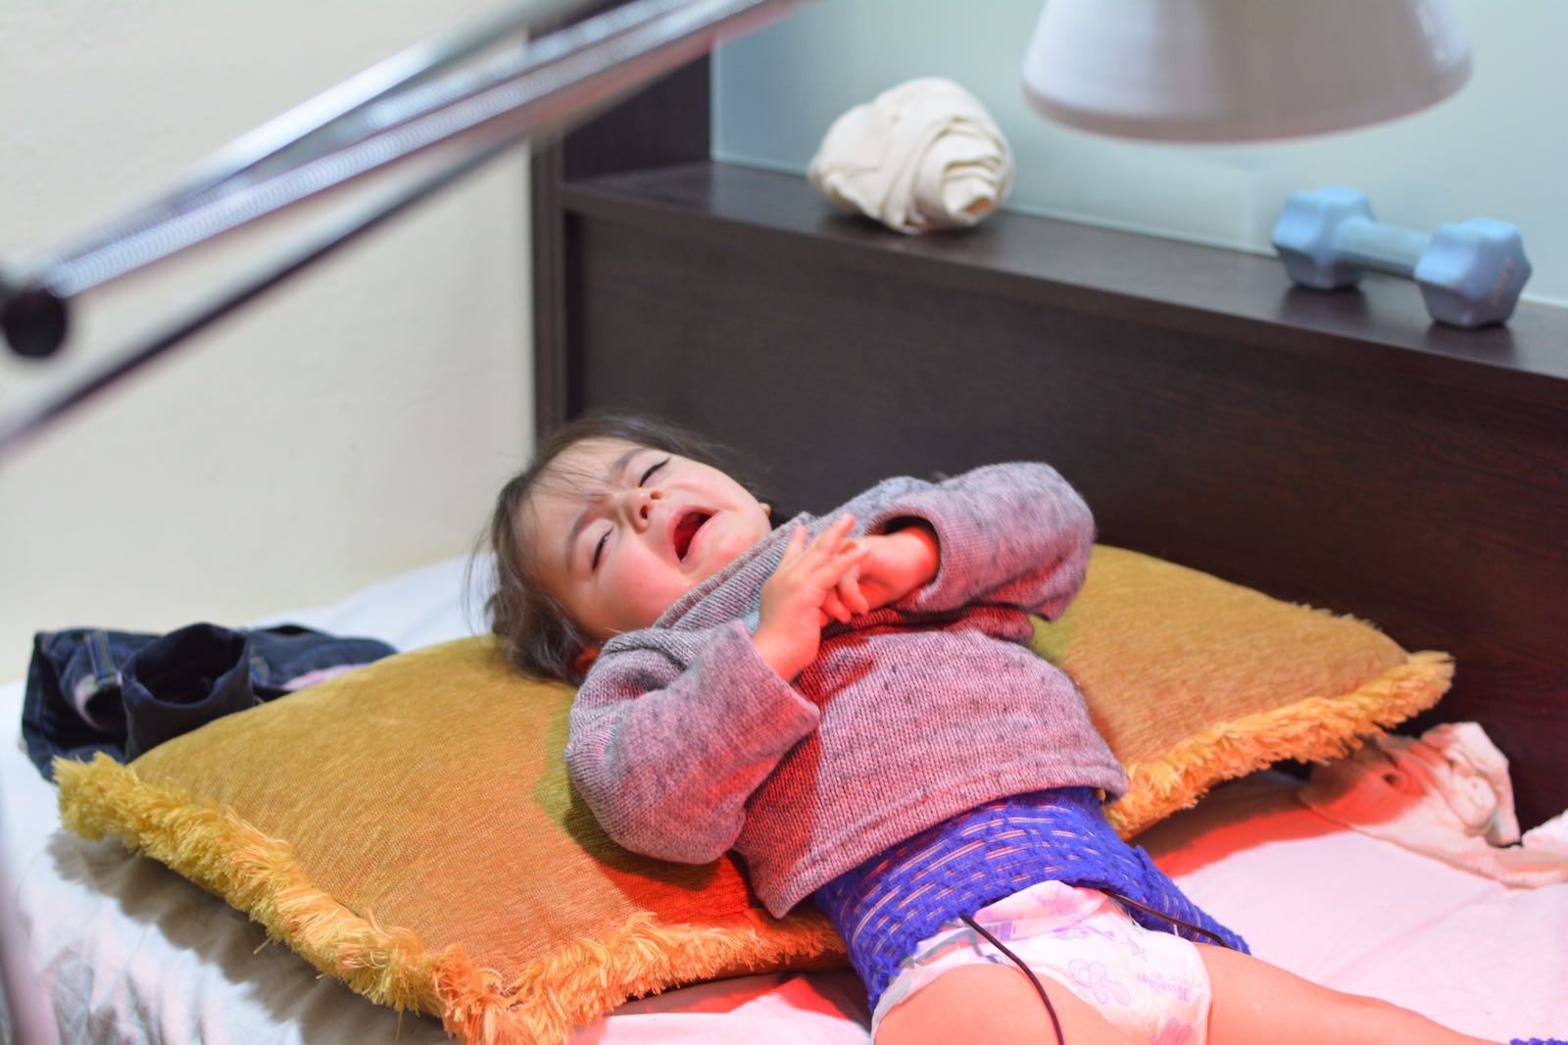
Radiology and access
Majority of radiologists work in private hospitals
Non-citizens face restrictions to access
1 UNWRA facility in Jordan
Almost half closed in Syria

Slide 23
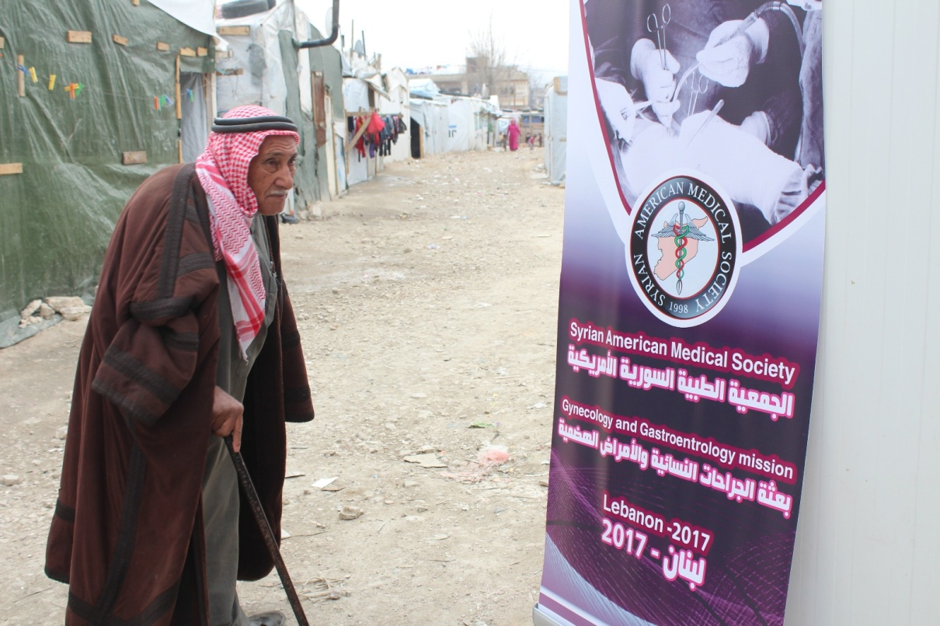
Syrian American Medical society (SAMS)
Multidisciplinary services
Operate medical missions in Jordan, Turkey, Lebanon, Greece, and Syria
Radiology services

Slide 24
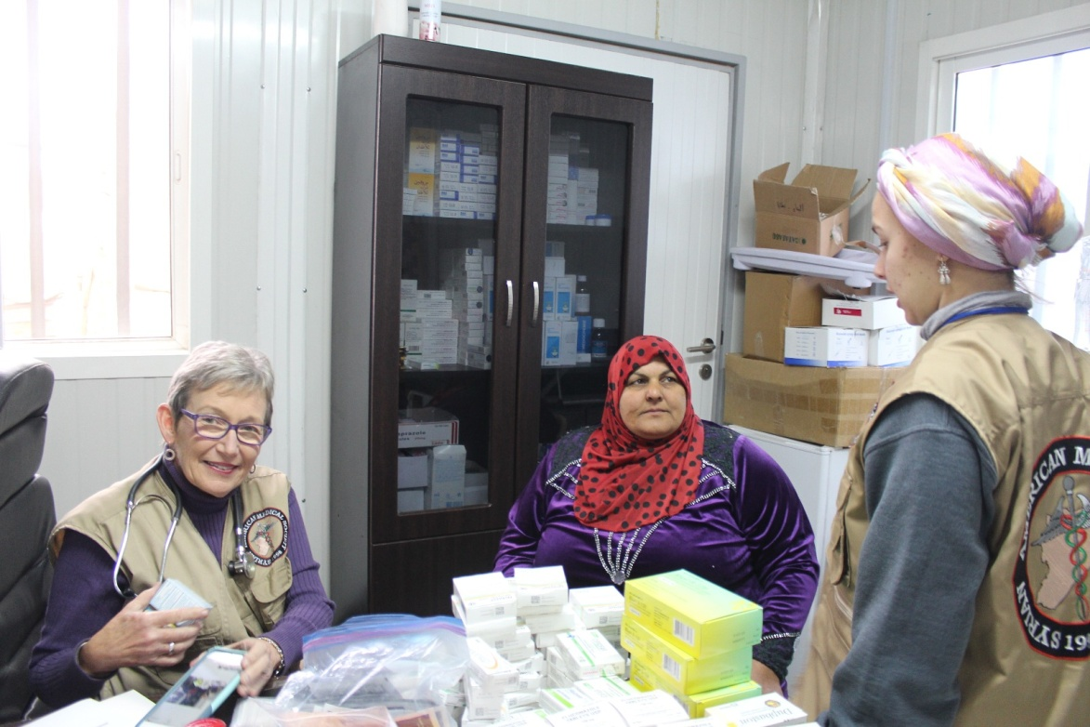
SAMS Za’atari clinic
Opened November 2017
Permanent staff
Limited radiology capability
Training

Slide 25
2019 mission
Targeting Fall 2019
Overlap with SAMS mission
Radiology Readiness Assessment
Ultrasound and radiography
US unit donation
Education
Clinic staff
Visiting Syrian physicians

Slide 26
References
1. UNHCR. Zaatari Refugee Camp Factsheet. August 2017. UNHCR, August 2017.
2. Esmadi, Mohammad. Jordan Country Profile- Rad-Aid, August 2009.
3. Duchesne, Nathalie. United Nations Relief and Works Agency for Palestine Refugees. UNRWA. November 4, 2017.
4. Doocy, S. "Syrian Refugee Health Access Survey in Jordan. 2014, Johns Hopkins University Bloomberg School of Public Health." World Health Organization, Jordan University for Science and Technology, United Nations High Commissioner for Refugees, Ministry of Health of the Hashemite Kingdom of Jordan.

Slide 27
RAD-AID Malawi
UNC RAD-AID Chapter
John Campbell, MD

Slide 28
Goals from Malawi Radiology Readiness 2013
1. Physician support for radiology integration
Strengthening radiology services
Private / public partnerships
Scholarship for Malawian physician to complete radiology training in South Africa
Education to clinicians for appropriate use of radiology in other specialties
2. Radiographer education and professional development
Guest lectures at Malawi College of Health Sciences for radiography students
Hands on training for topics requested by sonographers at Kamuzu Central Hospital (KCH), including cardiac echo, vascular, and pediatric imaging
Continuing education for KCH radiographers
3. Education for Sustainable Equipment Use
RAD-AID Radiology Business Administration Curriculum including topics of procurement and supply chain
Mentorship of Malawian biomedical technicians

Slide 29
Background: Country
-- Southeastern Africa
-- Population ~19 Million (2017)
-- ½ population lives below national poverty line: ~16,000 Kwacha/$145 pp/py
-- Subtropical climate: Dry (May - Nov), Rainy (Nov - May)
-- Agriculture based economy (~40% GDP, 85% labor force)
-- High prevalence of communicable disease (HIV, malaria, TB), maternal and child health problems, neglected tropical diseases

Slide 30
Background: Country
-- Nationalized health care system with four Central Hospitals (tertiary care, referral): Queen Elizabeth (south, 1250), Zomba (south, 450), Mzuzu (north, 300), Lilongwe (central, 1200)
-- 2 Radiologists
-- No radiology residency in Malawi, go abroad
-- Malawi College of Health Sciences train medical imaging professionals in diploma level, MoH assigns 2 years, free

Slide 31
Background: Kamuzu Central Hospital, Lilongwe
-- Public/government hospital in Central region
-- Inpatient beds occupied 100%, 1000 patients seen per day
-- Specialties available: Breast Surgery, Cardiology, Dermatology, General Internal Medicine, General Surgery, Gynecology, Hematology, Maxillofacial Surgery, Neonatology, Neurological Surgery, Obstetrics, Medical Oncology, Ophthalmology, Orthopedic Surgery, Otorhinolaryngology, Pathology, Pediatrics, Physical Medicine and Rehabilitation, Radiology and Urology.
-- Frequent conditions: Cardiac disease, Stroke, Diabetes, Cancer, Trauma and Musculoskeletal Injury, Pregnancy, Peripartum hemorrhage, Diarrheal Illness, HIV/AIDS, Tuberculosis, Viral Hepatitis, Malaria, and Schistosomiasis.

Slide 32
Background: Kamuzu Central Hospital, Lilongwe
-- 1 radiologist, 2 sonographers, 17 radiographers, 1 radiology nurse, 2 registration desk attendants and 1 registrar in the Radiology Department
-- Radiography: 150, K 1366 (1 view), up to 2-3 days, interpreted by non-radiologist physicians
-- Ultrasound: 50, K 3000 (abdominal), up to 2-3 days, interpreted by radiographers
-- CT: 64 slice installed 2013, 30, K 9000 (CT chest non-contrast), up to one month, interpreted by radiologist
-- No MRI → Queen Elizabeth

Slide 33
Tour

Slide 34
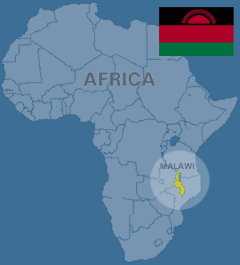
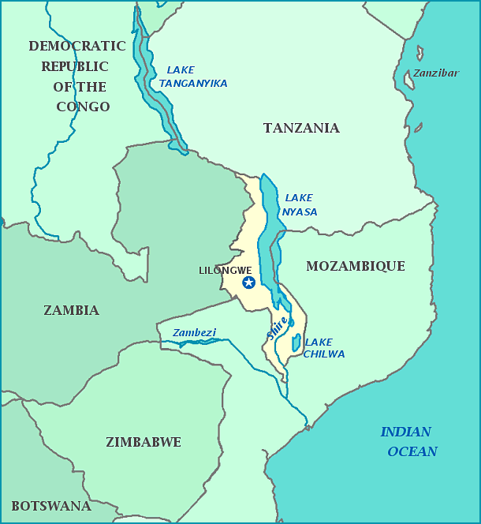
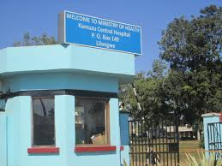
Kamuzu Central Hospital
Lilongwe, Malawi

Slide 35
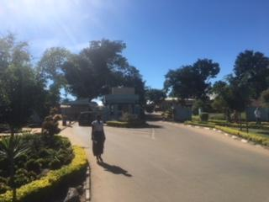
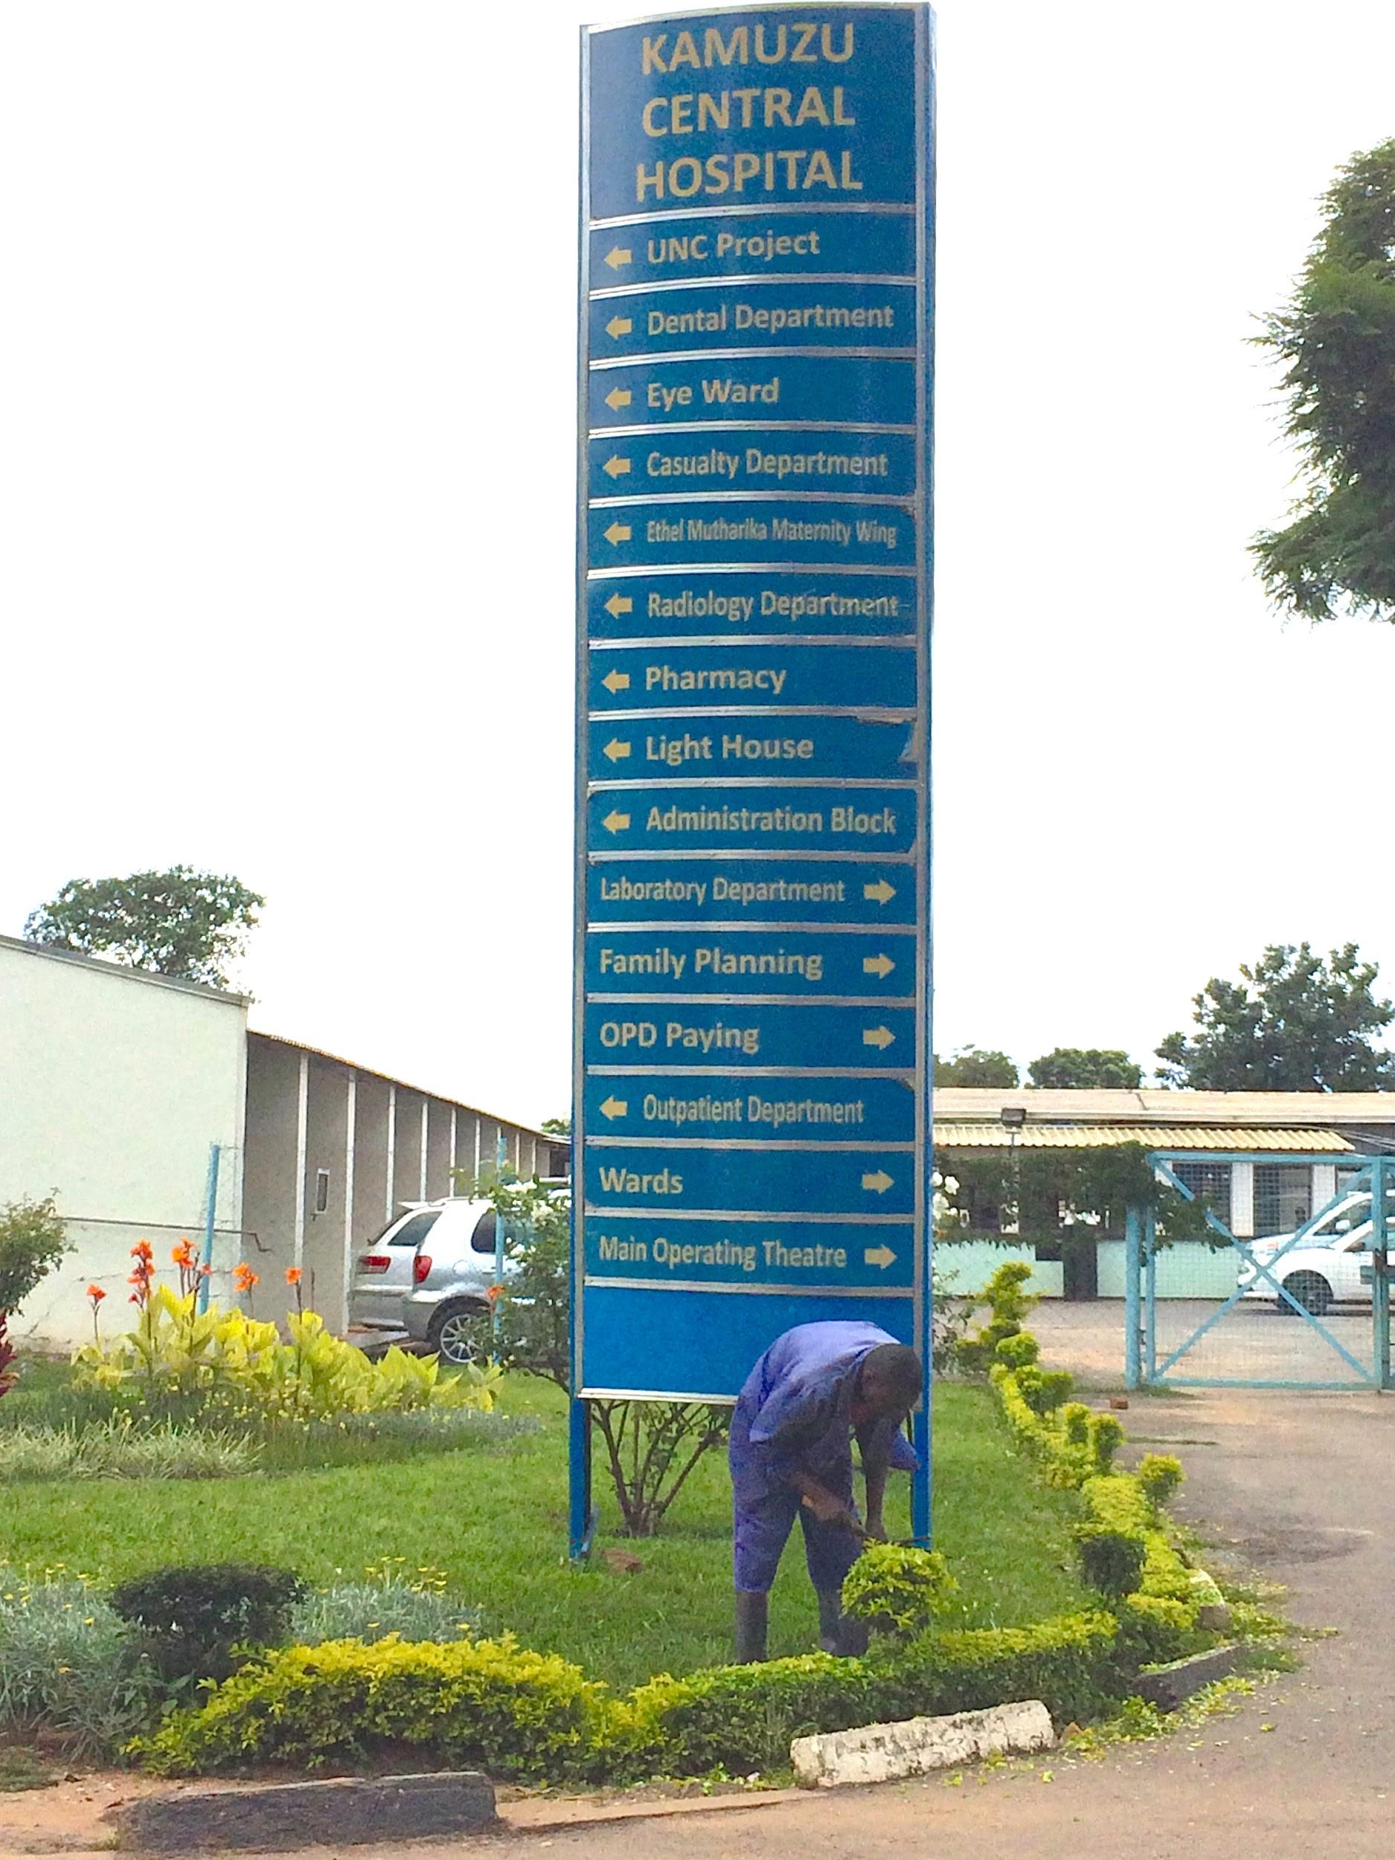
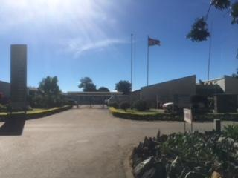
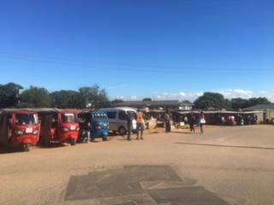
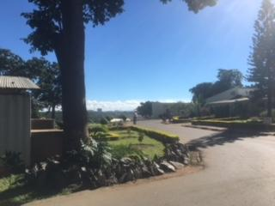

Slide 36
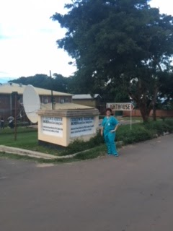
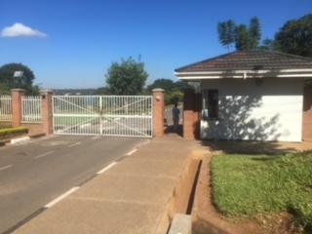
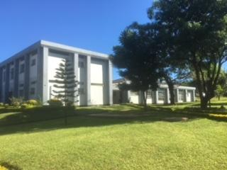
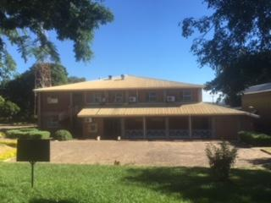
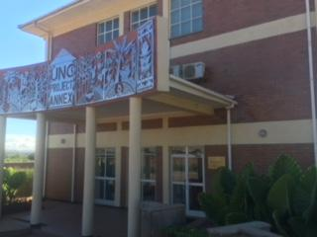
Notes:
UNC/KCH Tidziwe Research Care and Training Centre (project based), UNC project Annex (path), Surgery Grand Rounds (casualty, new admissions, surgeries from the day prior, M&M)

Slide 37
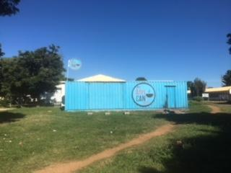
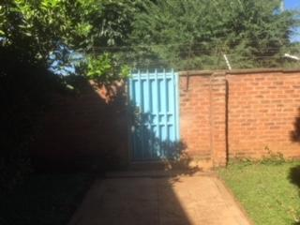
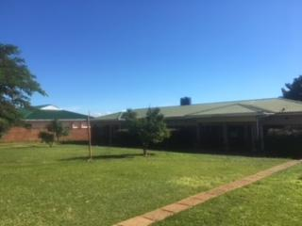
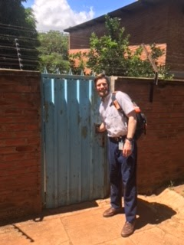
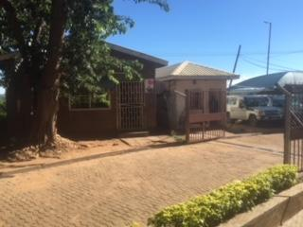

Slide 38
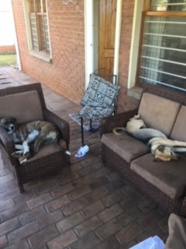
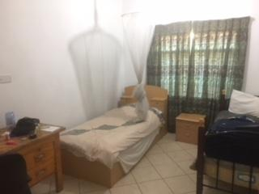
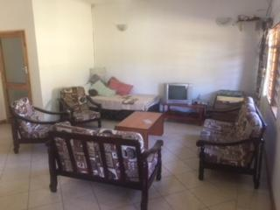
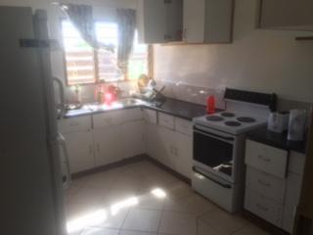

Slide 39
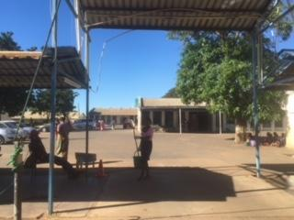
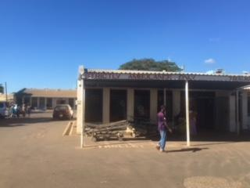
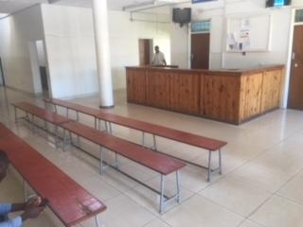
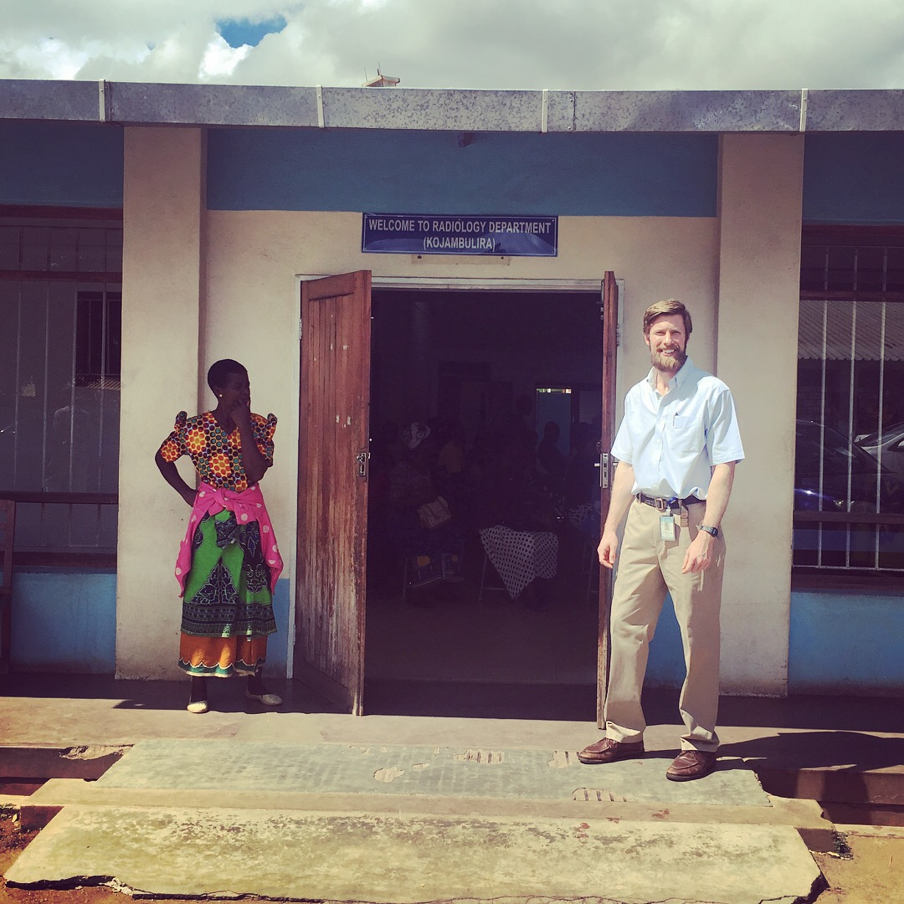
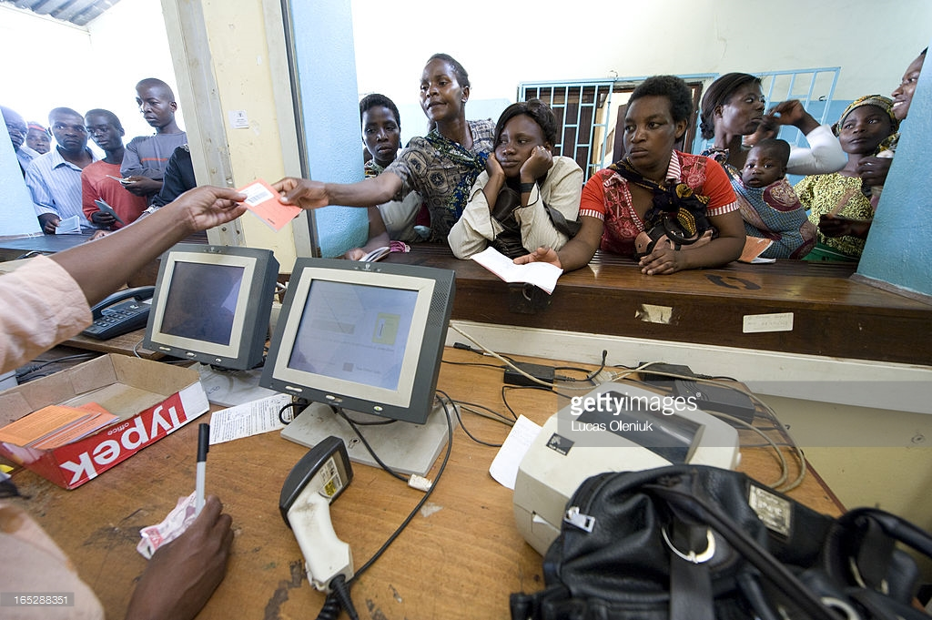

Slide 40
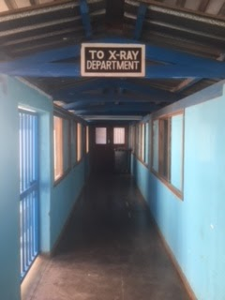
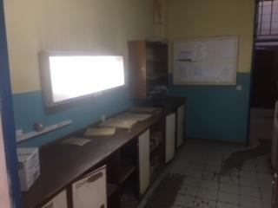
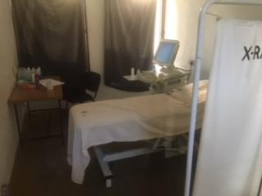
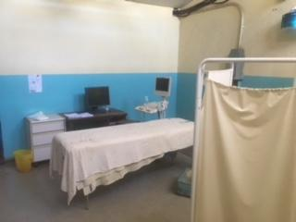
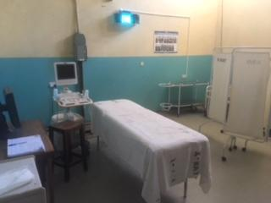

Slide 41
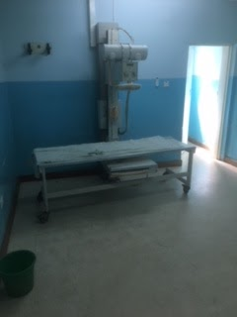
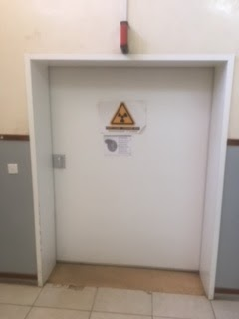
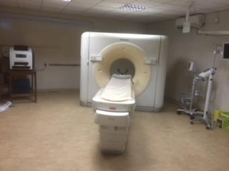
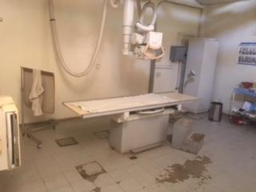
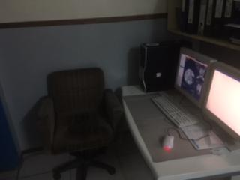

Slide 42
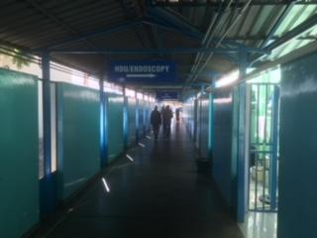
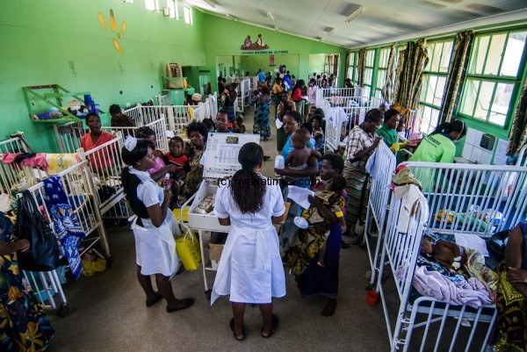

Slide 43
Clinical

Slide 44
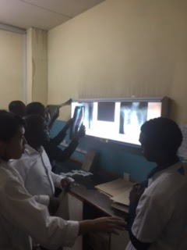
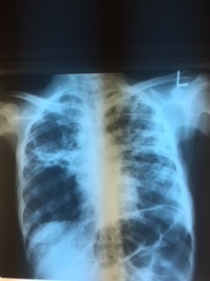
Notes:
Grand Rounds (surgery and radiology), lectures, interpreting radiographs (including devised system), routine ultrasounds with sonographers, consultations

Slide 45
Notes:
Outside MRI, Ultrasound on wards, Dr. Kuvas

Slide 47
*2 yr old F, intermittent vomiting since birth

Slide 50
Debriefing
Moving Forward
-- Grand Rounds: surgery, radiology, pediatrics
-- Lectures
-- Hands on teaching (primarily ultrasound, casualty)
-- CT/MRI
-- Consultations
-- Imaging education
-- Clinician
-- Radiographers
-- Curriculum development
-- Communication
-- Internal, Interdepartmental
-- Pretravel, in country
-- Whatsapp?

Slide 51
Communication
-- Streamline communication by creating Whatsapp group between UNC/KCH radiology departments and Malawian clinicians
-- Pretravel: Introductions and informing of resident timeline, topics for lectures/didactics, targeted hands-on workshops, wards/rounds preparation, scheduling
-- In country: Facilitate consultations and intradepartmental communication, scheduling
-- 18 current members of the group

Slide 52
Proposal:
Dan Mollura, MD

