Slide 1
Characteristics and Outcomes in Pediatric Patients Presenting with Congenital Colorectal Diseases in Sub-Saharan Africa
Laura N. Purcell, MD
OIA Global Health Forum
April 18, 2019

Slide 2
Disclosure
Laura N. Purcell, MD
I do not have any relevant financial relationships with any commercial interest that pertains to the content of my presentation.

Slide 3
Notes:
I feel like we can't talk about global surgery without the obligatory lancet commission on global surgery slide...
Investing in surgery is affordable, saves lives, promotes economic growth and is an indispensable part a global health plan.
Now that we have that out of the way,

Slide 4
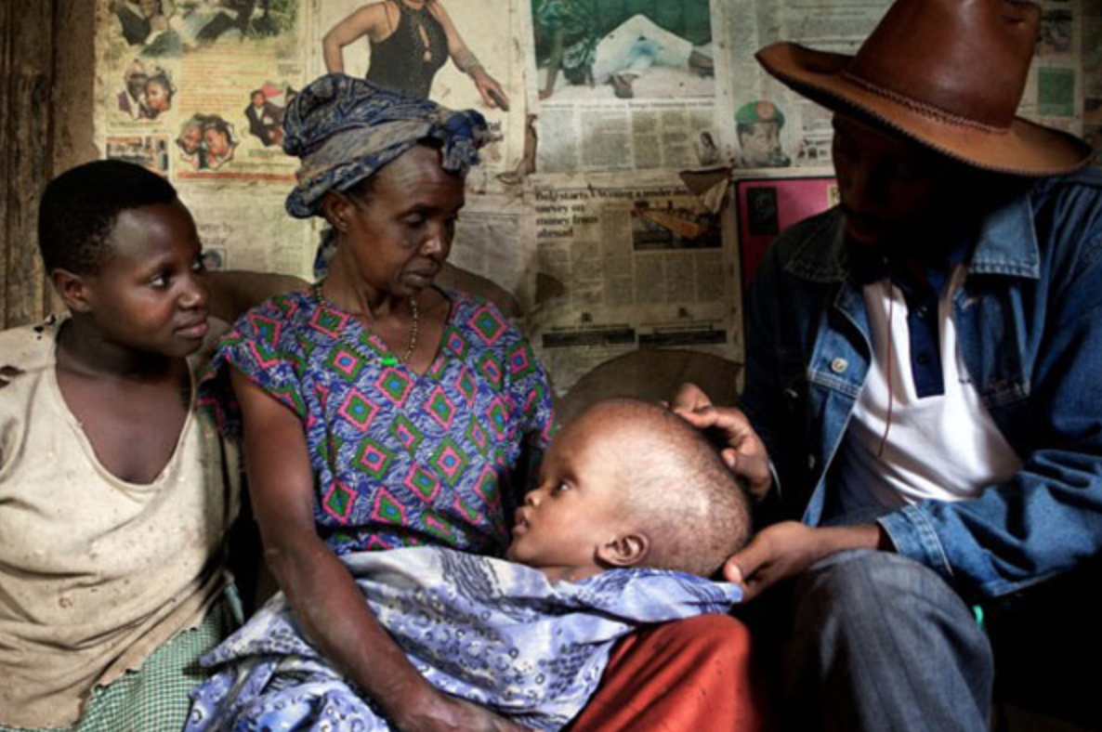
History of Pediatric Surgery In Africa
1920 – 1950s
    Pediatricians and part-time surgeons
    High morbidity and mortality
    Treating:
      Sepsis
      TB of bone/joints
      Bone fractures
      Bowel obstruction
      Empyemas
    Congenital disease
      Rarely reported
      high morbidity/mortality

Slide 5
History of Pediatric Surgery In Africa
  1950s – 1960s
    Improved post operative survival rates
      New surgical techniques
    Increasing interest of general surgeons
    Increasing global interest in basic science, clinical, and experimental research
      Cape Town, South Africa
        Louw and Barnard – intestinal atresia

Slide 6

History of Pediatric Surgery In Africa
  1960s – 2005
    Substantial and rapid advances
    Increase focus in neonatal disease and congenital anomalies
    Pediatric Surgery recognized as a subspecialty
      South Africa, Egypt, Nigeria, Algeria
    Pediatric Surgery professional associations
Notes:
were made in diagnosis, investigations, management, prognosis, and understanding of pathophys

Slide 7

History of Pediatric Surgery In Africa
  2005 – Present
    Accredited training programs with formal certification
    Establishment of PICU/NICUs

Slide 8
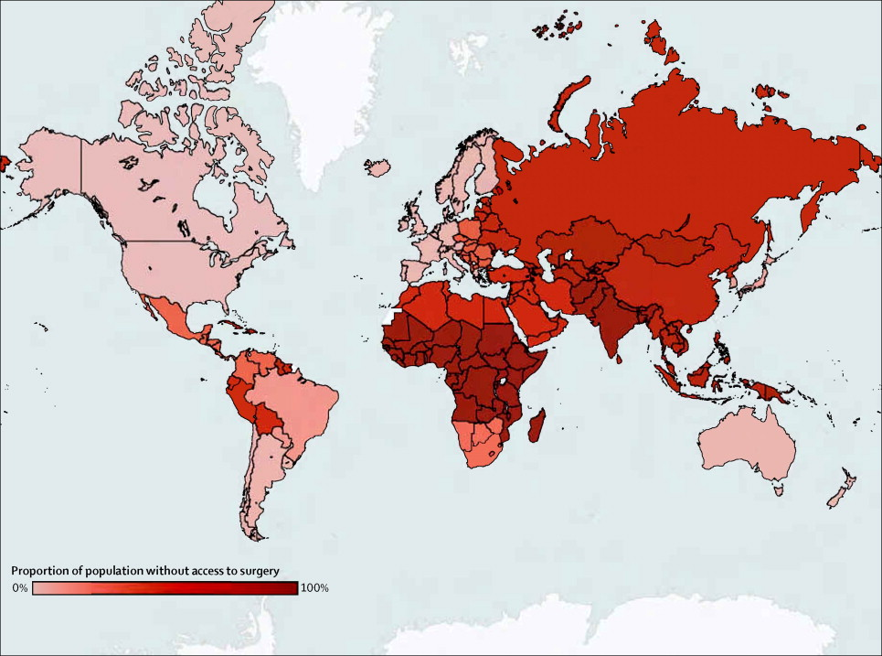
Challenges to Pediatric Surgical Care in Africa
Workforce Limitations
  Paucity of trained, qualified surgeons
  Mauritania and Rwanda
    0 Pediatric Surgeons
  Gabon
    2.07 Pediatric Surgeons per million
Notes:
As can be deduced from the Lancet commission on global surgery findings, there are still continued challenges to pediatric surgery in Africa even though there has been significant advancements since the 1920s.
Paucity of trained general surgeons … and even less peds surgeons

Slide 9
Notes:
Medical migration contributes signficiantly to the physician shortage in Africa, as nearly 15% of trained physicians leave sub-Saharan Africa for the US, UK, Canada and Australia due to challenging working conditions

Slide 10
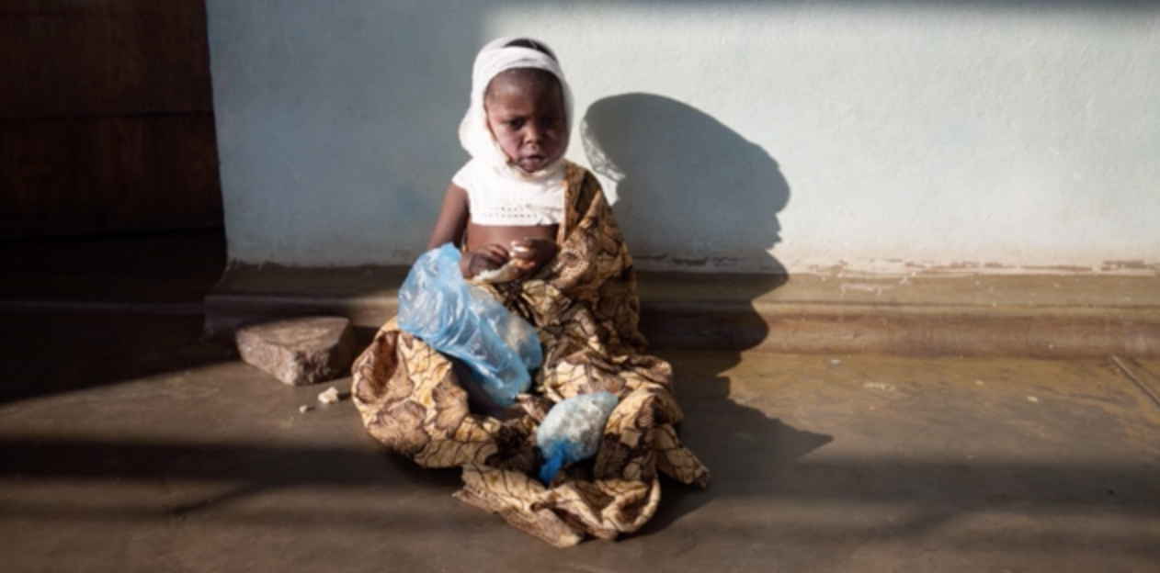
Challenges to Pediatric Surgical Care in Africa
Enormous Workload
  ~ 85% of African children by 15 years will need surgery
Notes:
in addition to a paucity of qualified pediatric surgeons, there is an enormous workload as an estimated 85% of African children by 15

Slide 11
Challenges to Pediatric Surgical Care in Africa
Resource Limitations
  Lack of facilities (ICU/OR)
  Parenteral nutrition
  Imaging Modalities
  Research Funding
Notes:
– specifically operation research to improve and advance the surgical care on the continent

Slide 12
Challenges to Pediatric Surgical Care in Africa
Financial Limitations
  11% of the world’s population
  25% of the global burden of disease
  < 1% of the global health expenditure

Slide 13
Congenital Anomalies in LMIC
Estimated incidence of 12 per 1000 live births globally
90% occurring in LMIC countries
Likely underestimation due to paucity of data
Notes:
Congenital anomalies are a major cause of pediatric and neonatal mortality worldwide with an estimated incidence of 12 per 1000 live births globally. Low- and middle-income countries (LMIC) bear the burden of congenital anomalies and resultant mortality, with an estimated 90% occurring in these countries. Unfortunately, the 90% LMIC burden is a gross underestimation due to the paucity of quality data on congenital anomalies.

Slide 14
Congenital Colorectal Disease
Anorectal Malformation and Hirschsprung Disease
Incidence: 1:4000 – 1:5000
Notes:
Congenital colorectal diseases, including anorectal malformations and Hirschsprung disease, are two of the most common congenital anomalies managed by pediatric surgeons. Global incidence of ARM and HD are estimated to affect 1 in 4000 to 5000 live births

Slide 15
Geographic Variations in Incidence
US, lower incidence of ARM in African Americans
No association between ethnicity and ARM incidence in sub-Saharan Africa
  No studies

Slide 16
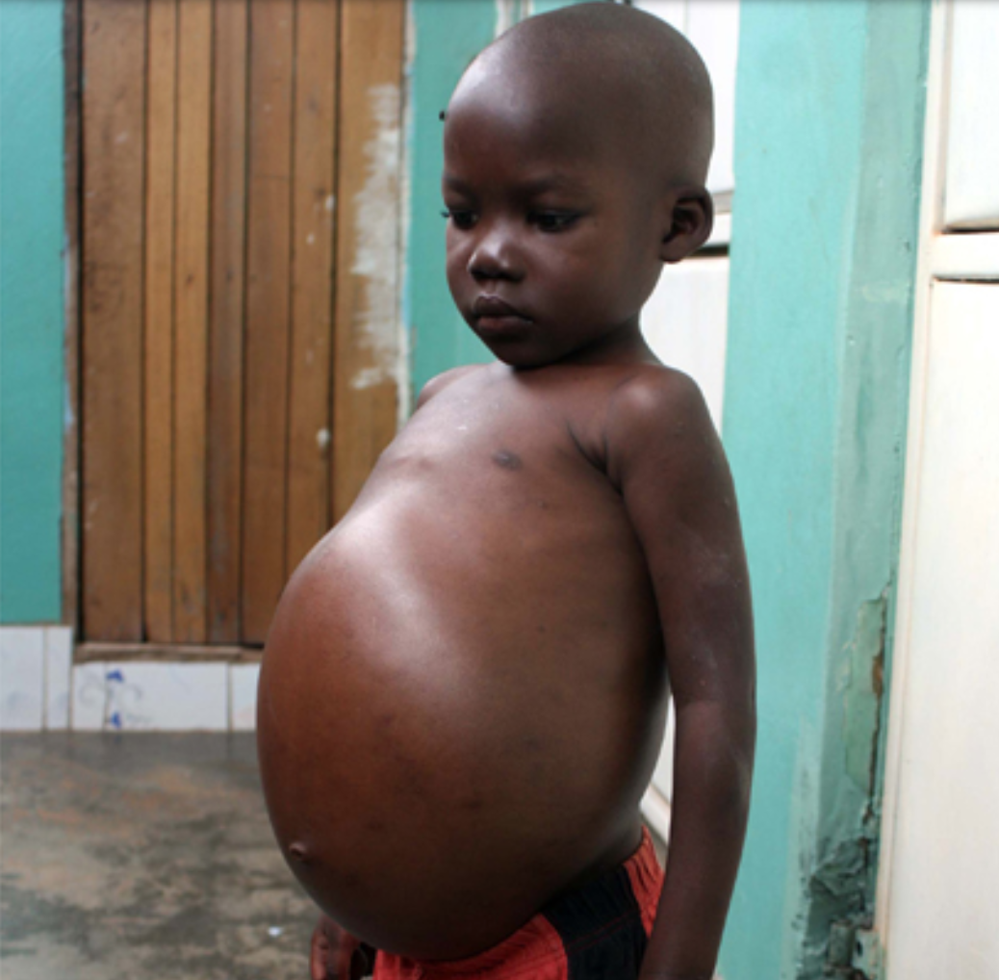
Congenital Colorectal Disease in LMIC
Delayed Diagnosis
Delayed Presentation
  50% of Intestinal Obstruction in Malawi
Definitive management requires pediatric surgeons
Notes:
Congenital Colorectal disease highlights the challenges of pediatric surgery care in LMIC is characterized by Delayed diagnosis, delayed presentation, and definitive management requires surgery from pediatric surgeons.

Slide 17
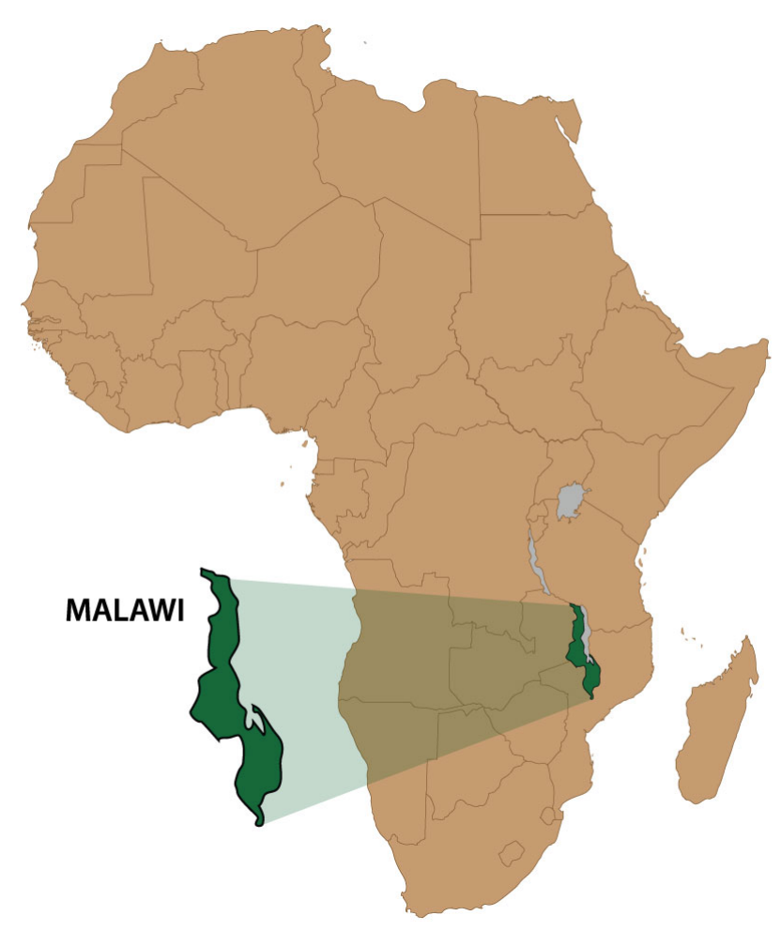
Malawi
1 Pediatric Surgeon for 6 Million Children
Notes:
Malawi, a small landlocked country in southeast sub-Saharan Africa has approximately 17 million people. 1 pediatric surgeon for 6 million children.
HIV Prevalence 12%

Slide 18
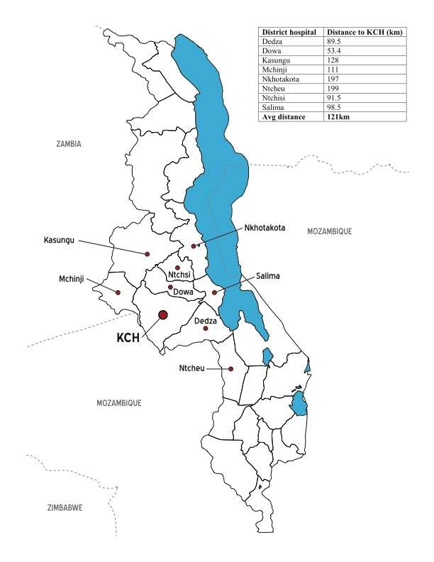
Malawi
Notes:
Its heath care system is stratified into three tiers – the primary healthcare centers at the local level, district hospitals located in each of the 28 districts, and 4 centrals hospitals which provide surgical care to the country, one of which is Kamuzu Central Hospital, which is a 900-bed tertiary hospital and referral center for the approximately 6 million people who reside in the central region of Malawi.
During the time of the study, surgical care was provided by 4 general surgeons, 6 surgical clinical officers, and 11 residents in 4 ORs with one anesthesiologist and 6 clinical officer anesthetists. NO PEDS surgeon

Slide 19
Study Aim
Characterize congenital colorectal anomalies in a Malawi tertiary care center, as well as describe both operative management and patient outcomes.
Notes:
With all these challenegs

Slide 20
Methods
Kamuzu Central Hospital
Pediatric Surgery Consults
Pediatric Surgical Admissions
Emergency Department
Anorectal Malformation (n=51)
Surgery
51% (n=26)
Non-operative
49% (n=25)
Hirschsprung Disease (n=82)
Non-operative
50% (n=41)
Surgery
50% (n=41)
Notes:
To better characterize congenital colorectal disease in Malawi, we performed a retrospective, descriptive analysis utilizing the pediatric surgery database at KCH. The pediatric surgery database was composed of surgical patients less than 18 yrs evaluated as direct admissions, emergency room admissions, or surgical consults.
There were 51 patients with anorectal malformations and 82 with Hirshsprung disease were identified.

Slide 21
Anorectal Malformation Results
 | Anorectal Malformation (n = 51)
 | All Patients (n = 51) | Surgical Management (n = 26) | Non-surgical Management (n = 25)
Patient Age: (years) Mean ± SD | 1.8 ± 2.4 | 1.5 ± 2.5 | 1.9 ± 2.4
Gender: n (%)
Male | 21 (41.2) | 11 (42.3) | 10 (40.0)
Female | 30 (58.8) | 15 (57.7) | 15 (60.0)
Missing | 0 (0.0) | 0 (0.0) | 0 (0.0)
Disposition: n (%)
Discharged | 47 (92.2) | 24 (92.3) | 23 (92.0)
Death | 2 (3.9) | 2 (7.7) | 0 (0.0)
Abscond | 1 (2.0) | 0 (0.0) | 1 (4.0)
Missing | 1 (2.0) | 0 (0.0) | 1 (4.0)
Notes:
2 died in hospital s/p OR
ARM – better in girls – usually lower

Slide 22
Anorectal Malformation Results
Notes:
51% of ARM underwent surgery

Slide 23
Anorectal Malformation Results
Only 11.8% of the ARM cohort had
definitive management
Notes:
Nearly 60% had exploratory laparotomy with colostomy, approximately 25% had PSARP, 11% were managed with dilation

Slide 24
Hirschsprung Disease Results
 | Hirschsprung Disease (n = 82)
 | All Patients (n = 82) | Surgical Management (n = 41) | Non-surgical management (n = 41)
Patient Age: (years) Mean ± SD | 4.2 ± 4.3 | 2.7 ± 3.1 | 2.2 ± 2.3
Gender: n (%)
Male | 58 (70.7) | 31 (75.6) | 27 (65.9)
Female | 24 (29.2) | 10 (24.4) | 14 (34.1)
Missing | 0 (0.0) | 0 (0.0) | 0 (0.0)
Disposition: n (%)
Discharged | 76 (92.7) | 40 (97.6) | 36 (87.8)
Death | 1 (1.2) | 1 (2.4) | 0 (0.0)
Abscond | 4 (4.8) | 0 (0.0) | 4 (9.8)
Missing | 1 (1.2) | 0 (0.0) | 1 (2.4)

Slide 25
Hirschsprung Disease Results
Notes:
50% of HD patient went to the operating room
Mortality was 2.4% in the surgical cohort

Slide 26
Hirschsprung Disease Results
Only 10.0% of Hirschsprung Disease patients
underwent a definitive operation
Notes:
Of those who underwent surgery, the majority had an exploratory laparotomy, 34% only had a diagnostic biopsy, and approximately 20% had a biopsy and pull-through
Pull through the end of the staged procedure or the initial procedure depending on the critical illness

Slide 27
Congenital Colorectal Malformation in Malawi
50% are managed without operative interventions
The majority of operative intervention is staged, not definitive
  Definitive:
    HD 9.8%
    ARM 13.7%
Notes:
We showed approximately 50% of all children presenting with congenital colorectal malformation are managed without any operative interventions, let alone diagnostic or therapeutic intervention.

Slide 28
Diagnostic Challenges in Malawi
Majority of children born outside the healthcare system
Only use failure to pass meconium in the first 24 hours of life
South African Study, only 18% of patients with HD presented as neonate
Notes:
Most children are born outside a structured health care system and in the absence of a physician or a trained nurse or midwife, there is failure of early recognition of ARM leading to delayed presentation or mortality prior to receiving any medical care. For failure to pass meconium in the first 24 hours of life to be used as a screening method for congenital colorectal disease is only helpful if the mother and neonate are admitted for 24 hours.

Slide 29
Access to Care Challenges in Malawi
Significant travel distance to medical provider
Cost and safety of travel
Poor health literacy
Notes:
Access to care challenges in malawi are due to Significant travel distances
- Cost and safetly
- Poor population health literacy

Slide 30
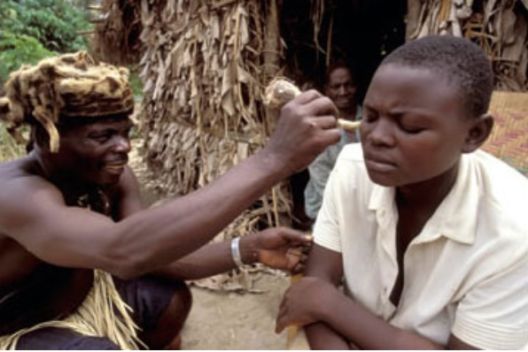
Clinical Challenge in Malawi
Traditional Healers
  Integral part of healthcare in Malawi
  Patients have local, easy access
  Common Practice
    43% sought advice before hospital admission
Notes:
As a result of challenges with access in Malawi, may parents and patients seek advice of Traditional healers.
Which can contribute to delayed diagnosis…
The causes of these diseases or symptom complexes were: (i) natural diseases inflicted upon the patient by God or by bad luck (35%); (ii) bewitchment (30%); (iii) diseases caused by spirits such as ancestral spirits which have not been honoured or demonic spirits (18%); and (iv) breaking sexual taboos (17%).

Slide 31
Therapeutic Challenges in Malawi
Delayed Diagnosis:
  In distress: perforation, megarectum, and dilated colon
  Stoma formation
Lack of Surgeon Training
Malnutrition
Anemia
Notes:
As a result of delayed presentation, there is an increased incidence of perforation, megarectum, and dilated colon which requires stoma formation and negates a single-staged definitive procedure.
A lack of pediatric surgeons or trained general surgeon result in non-optimal surgical care. As ostomies performed by non-pediatric trained general surgeons increase the risk of downstream complications. Patients with ARM should have an end ostomy and mucus fistula placed at the junction between the descending and sigmoid colon to provide complete diversion, decrease risk of genitourinary infections, as well as improve results definitive operations.
Malnutrition and anemia due to malaria and HIV also contribute to delayed surgical operations and poor outcomes.

Slide 32
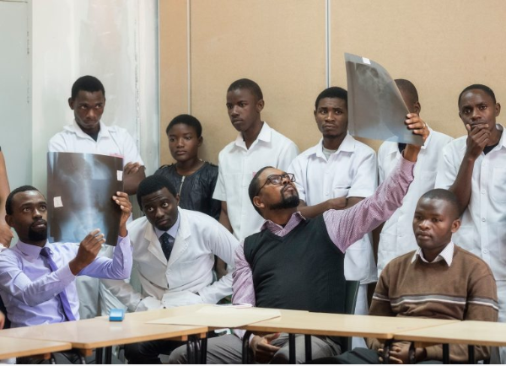
Therapeutic Challenges in Malawi
Dearth of Diagnostic Adjuncts:
  Anesthesia
  Radiology
  Imaging – Ultrasound
  Pathology
13% of Ugandan Anesthesiologist believed had capacity to take care of children <5 years
Notes:
There is a dearth of diagnostic adjuncts available in our setting, including pediatric anesthesiology, radiology, ultrasonography, and pathology services. The association between colorectal anomalies and other associated congenital diseases is well established making surgical intervention in a child a high-risk activity. In a survey performed in 2007, only 13% of Ugandan anesthetists believed they had the appropriate tools to take care of pediatric patients < 5 years old. For HD, the presence of pathology is essential for diagnosis and appropriate surgical management to identify the level of aganglionosis

Slide 33
Clinical Challenges in Malawi
Poor Follow Up
  None
  360 km journey to Blantyre, Malawi
  Majority discharged home
    Persistence of partial obstructive symptoms
    Fatal intestinal obstruction
Notes:
None in our study returned during the study period
A small minority of these patients may have made the 360 km journey to Blantyre, which at the time of the study was the location of the closest pediatric surgeon
Majority of these patients went home and may have continued with persistence of partial obstructive symptoms or suffered fatal intestinal obstruction

Slide 34
Future Directions
Future Directions:
  Focused educational curriculum
  Local general surgical training programs in pediatric surgical conditions
  Improved follow up and referral networks
  Maturation of adjunct specialties
Notes:
Focused pediatric surgery educational curriculum

Slide 35
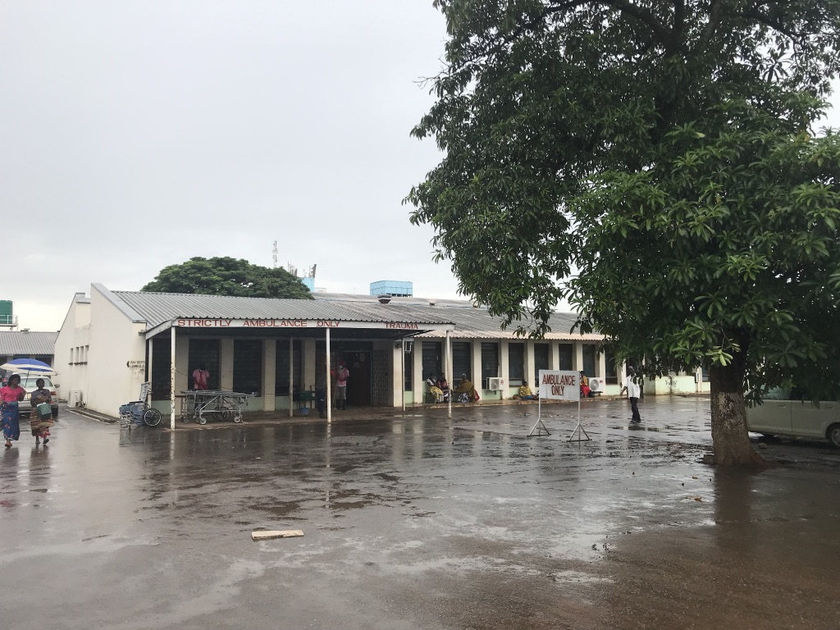
Thank you!

