Slide 1
Maternal HIV, antiretroviral timing, and spontaneous preterm birth in an urban Zambian cohort
Katelyn J. Rittenhouse
OGHE Global Health Forum
June 27, 2022

Slide 2
Background
Objectives
Methods
Results
Conclusions
Ongoing Research

Slide 3
Background

Slide 4
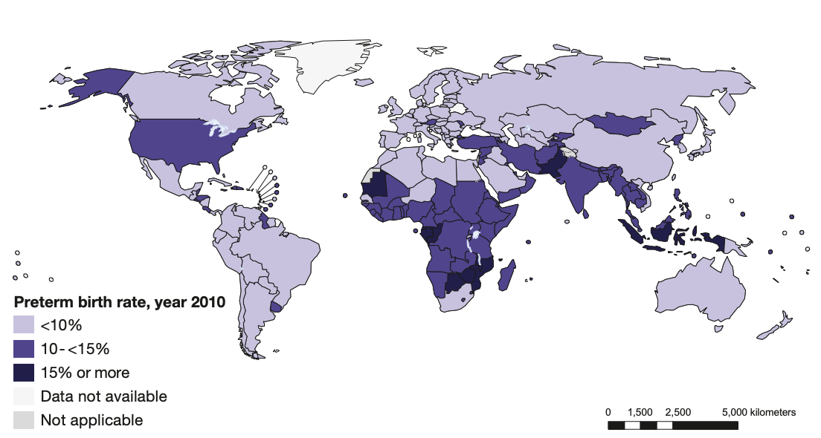
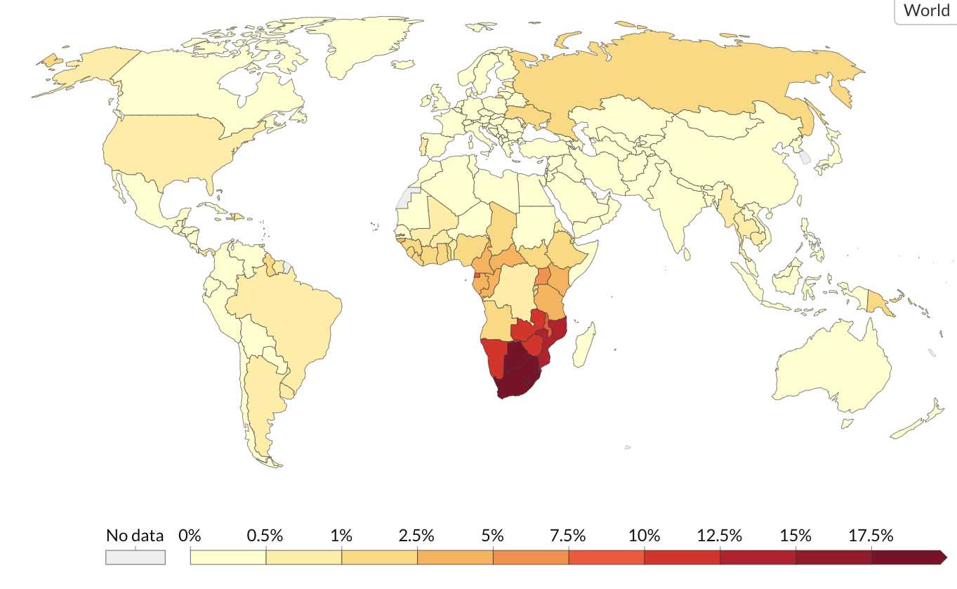
Preterm Birth (PTB)
4
PTB
PTB is the leading cause of neonatal death
15 million PTB occur each year
>60% of PTBs occur in south Asia & sub-Saharan Africa
HIV & ART have been associated with PTB
HIV
Zambia: PTB 13%; HIV 11.5%
Blencowe, et al. Lancet. 2012.
Roser & Ritchie (2018) - "HIV / AIDS". Published online at OurWorldInData.org.

Slide 5
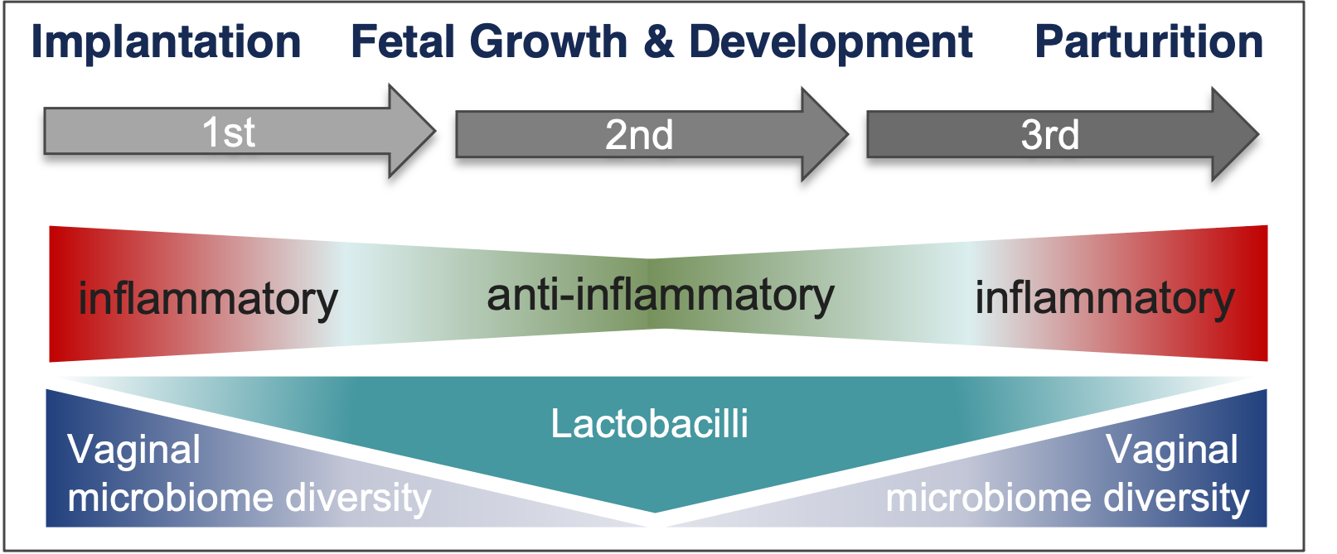
Cause(s) of PTB
Normal Pregnancy:
Immune System
Microbiome
Majority of PTBs occur spontaneously, without a known cause
Inflammation, infection, and vaginal dysbiosis associated with PTB

Slide 6
Objectives

Slide 7
Objectives:
7
In an ongoing Zambian antenatal cohort:
Assess alterations associated with HIV and ART
Assess association with spontaneous PTB
Characterize local and systemic inflammation
Characterize the vaginal microbiota
Hypothesis:
Acute Immune Activation
Persistent Immune Activation
Immune
Reconstitution
HIV
ART initiation
ART continuation
Spontaneous
PTB
Metabolic
Changes
Altered Microbiome
Persistent Microbiome Changes

Slide 8
Methods

Slide 9
ZAPPS:
The Zambian Prematurity Prevention Study
Women and Newborn Hospital of the University Teaching Hospital
Lusaka, Zambia
Prospective Cohort
Phase 1:
Aug 2015-Sept 2017
n = 1450
First PNC
Visit
ZAPPS Study Period
Enrollment
Delivery
HIV-
uninfected
n = 1097
HIV⁺
preconceptional ART
n = 205
HIV⁺
postconceptional ART
n = 99
HIV-
Pre-
Pregnancy
Pregnancy
Postpartum
HIV+
pre-ART
ART
Exposure
HIV pre-ART
HIV+
post-ART
HIV post-ART
ClinicalTrials.gov: NCT02738892
Castillo et al. Gates Open Research 2019
Study approval granted by The University of Zambia Biomedical Research Ethics Committee and the University of North Carolina Institutional Review Board

Slide 10
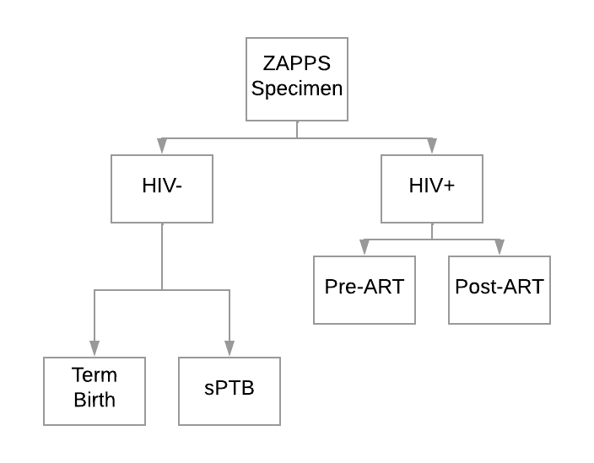
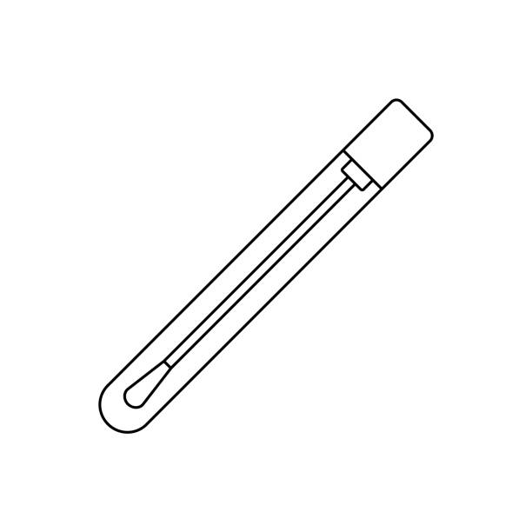

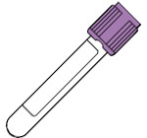
Methods: Double Sampling Technique
10
Specimens evaluated:
ZAPPS Initial Biorepository Shipment:
n = 452
Vaginal swabs
Plasma samples
Excluded:
provider-
initiated PTB
HIV-
Primary Exposure Groups
HIV+
pre-ART
HIV+
post-ART
sampled at
random
100% sampled
All analyses were performed using inverse probability sampling weights

Slide 11
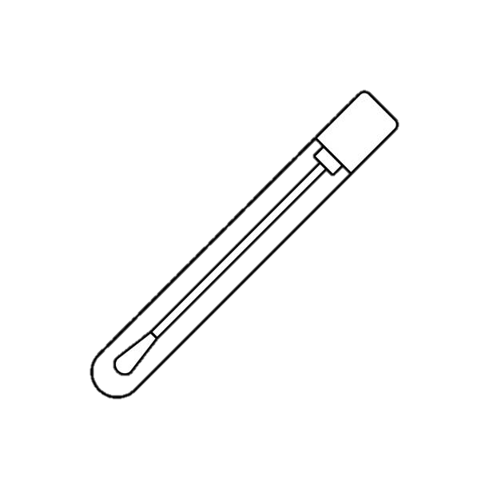
11
Methods: Cytokines
Multiparameter bead array and ELISA performed on plasma and vaginal swab specimen to quantify immune mediators
Confirmatory factor analyses to assign inflammatory scores
  Factor Analysis: Multivariate statistical technique that reduces a large number of intercorrelated variables into a smaller set of independent clusters underlying physiological relationships
Analysis of paired plasma and vaginal swab specimen from enrollment (16-20wk) and repeat (24-34wk) visits
Pro-inflammatory
immune mediators:
IL-1β, IL-2, IL-6, IL-8, IL-12p70, IFN-γ,
CXCL-10, TNF-α,
MIP-1α/β, sCD14
Anti-inflammatory
immune mediators:
IL-10, TGF-β
Staff performing laboratory analyses were blinded to baseline characteristics & clinical outcomes

Slide 12
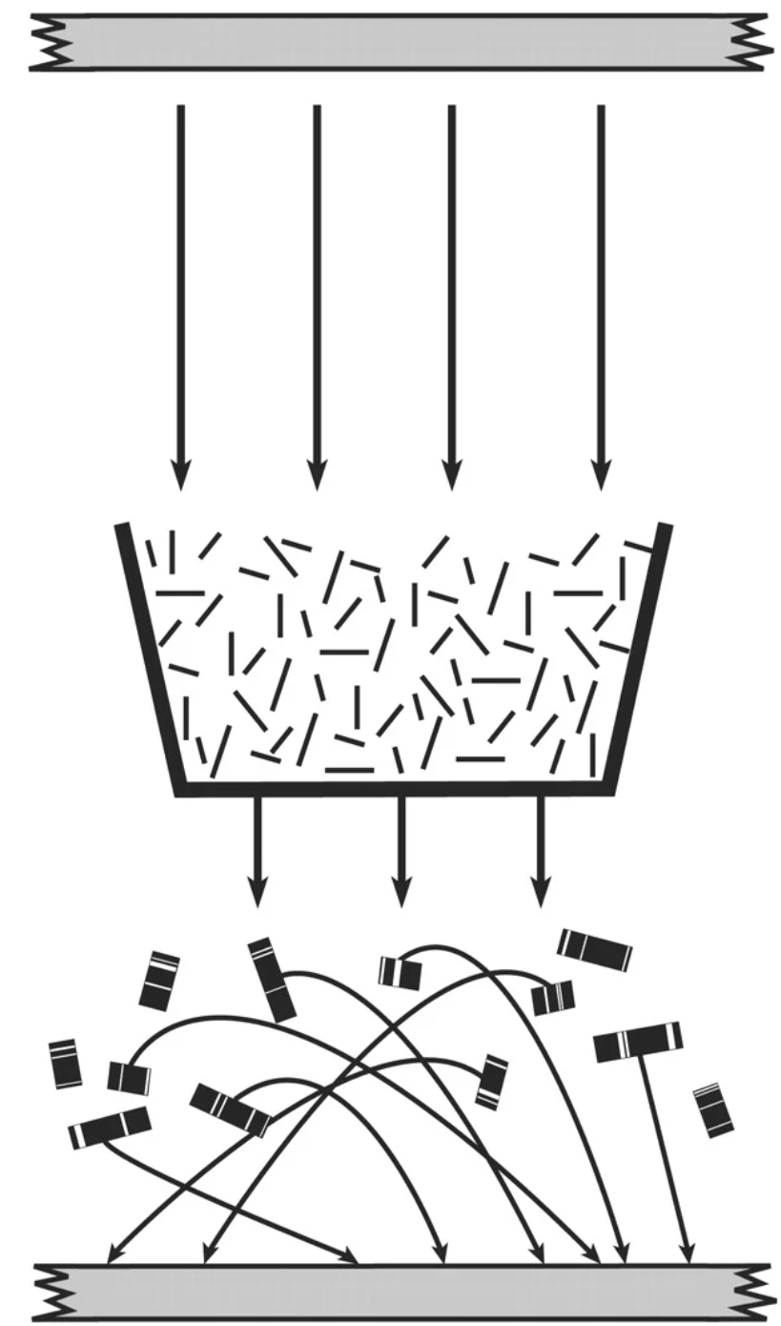
12
Methods: Vaginal Microbiome
Whole genome shotgun sequencing of
bacterial DNA extracted from vaginal swabs
Hierarchical clustering to identify Community
State Types (CSTs)
  CSTs: General groupings with similar microbial composition
  and abundance established in the literature
Shannon Diversity Index (SDI)
  SDI: Estimation of species diversity accounting for
  number of species living in a habitat (richness) and
  their relative abundance (evenness)
Analysis of vaginal swab specimen from enrollment
(16-20wk) and repeat (24-34wk) visits on same women as Cytokine Analyses
Genome
Random Reads
Anchoring
Genome Assembly
Staff performing laboratory analyses were blinded to baseline characteristics & clinical outcomes

Slide 13
Results

Slide 14
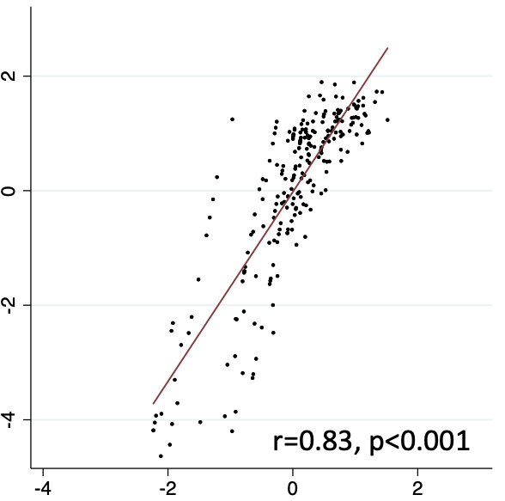
Vaginal Inflammation at Baseline
14
(16-20 wks)
Cross-sectional analysis
Pro-inflammatory Score
5.0
5.0
Anti-inflammatory Score
p = 0.016
p = 0.004
2.5
2.5
Pro-inflammatory Score
Anti-inflammatory Score
0.0
0.0
-2.5
-2.5
-5.0
n=151
n=50
n=39
-5.0
n=151
n=50
n=39
HIV-
HIV+
pre-ART
HIV+
post-ART
HIV-
HIV+
pre-ART
HIV+
post-ART
HIV+ post-ART have higher local inflammatory scores than HIV- women
No difference was observed with HIV+ pre-ART.
Rittenhouse KJ et al. AIDS. 2021.

Slide 15
Vaginal Inflammation at Baseline
15
(16-20 wks)
Cross-sectional analysis
5.0
p = 0.016
2.5
HIV+ post-ART
Pro-inflammatory Score
Implantation
Fetal Growth & Development
Parturition
0.0
1st
2nd
3rd
-2.5
inflammatory
anti-inflammatory
inflammatory
inflammatory
-5.0
n=151
n=50
n=39
HIV-
HIV+
pre-ART
HIV+
post-ART
HIV+ post-ART have higher pro-inflammatory scores than HIV- women
No difference was observed with HIV+ pre-ART.
Rittenhouse KJ et al. AIDS. 2021.

Slide 16
Increased Vaginal Inflammation post- ART Initiation
16
Longitudinal analysis
Vaginal Fluid
6
p = 0.04
4
2
Delta Proinflammatory Score
(24-34wk - 16-20wk)
0
-2
-4
n=30
n=21
HIV+
pre-ART
HIV+
post-ART
HIV+ post-ART had an increase in vaginal inflammation between the baseline and repeat visits compared to HIV+ pre-ART
Rittenhouse KJ et al. AIDS. 2021.

Slide 17
Increased Vaginal Inflammation post- ART Initiation
17
Longitudinal analysis
Vaginal Fluid
6
p = 0.04
4
HIV+ post-ART
2
Implantation
Fetal Growth & Development
Parturition
Delta Proinflammatory Score
(24-34wk - 16-20wk)
1st
2nd
3rd
0
local inflammation
-2
inflammatory
-4
n=30
n=21
HIV+
pre-ART
HIV+
post-ART
HIV+ post-ART had an increase in vaginal inflammation between the baseline and repeat visits compared to HIV+ pre-ART
Rittenhouse KJ et al. AIDS. 2021.

Slide 18
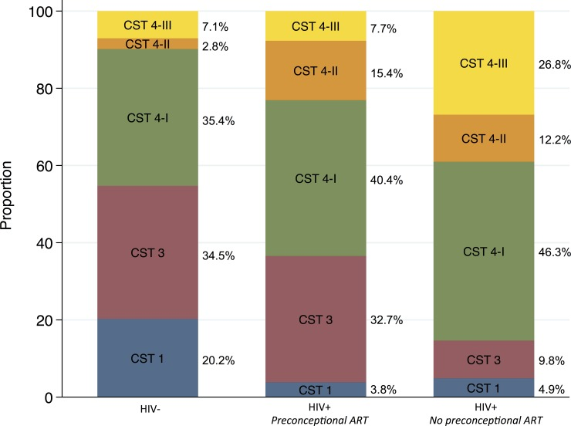
Anaerobe-rich microbiota in HIV+ women
18
CST 4-III
CST 4-III
Anaerobes
G vaginalis
CST 4-II
CST 4-II
CST 4-III
CST 4-I
CST 4-II
Proportion
CST 4-I
CST 3
CST 4-I
In HIV+ pre-ART & HIV+ post-ART women, anaerobe-dominant CSTs are more prevalent & Lactobacillus species are less prevalent than their HIV- counterparts.
CST 3
CST 1
CST 3
CST 1
CST 1
HIV-
HIV+
pre-ART
HIV+
post-ART
Community State Type (CST): General groupings with similar microbial composition and abundance established in the literature
n=158
n=55
n=41
CST 1: L crispatus
CST 3: L iners
Dominated by:
CST 4-I: G vaginalis
CST 4-II: G vaginalis & Atopobium vaginae
Anaerobe-
dominant
CST 4-III: Other mixed anaerobes
Price JT et al. PLoS One. 2019.

Slide 19
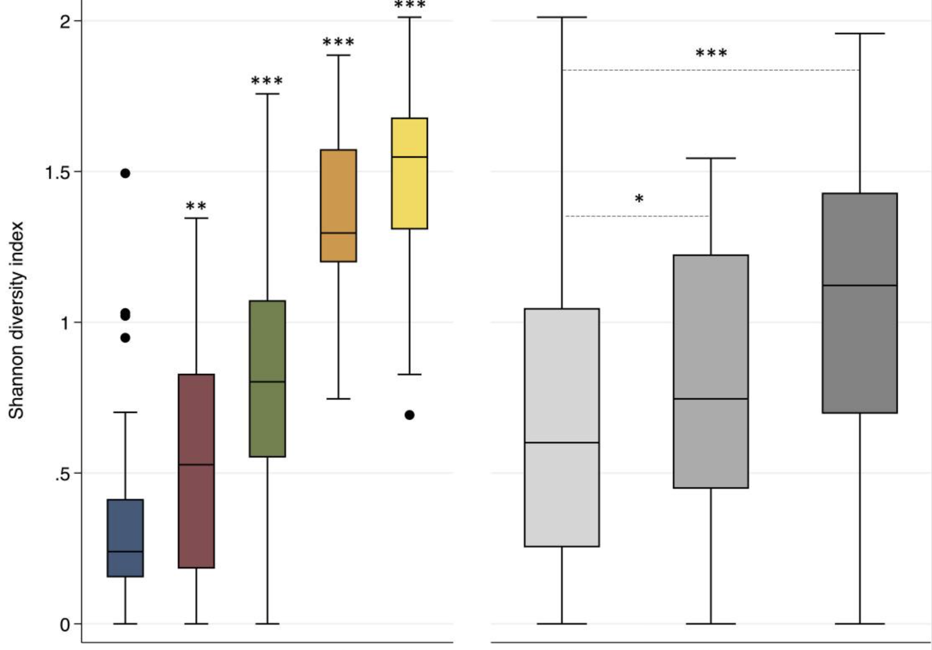
Vaginal Microbiome more diverse in HIV+ women
19
Anaerobe-
dominant
*p = .04
**p < 0.01
***p < .001
• Anaerobe-rich CSTs have more diverse vaginal microbiota than lactobacillus-rich CSTs
• HIV+ pre-ART and
HIV+ post-ART have more diverse vaginal microbiota than HIV- women
Shannon Diversity Index
Shannon Diversity Index: Estimation of species diversity accounting for number of species living in a habitat (richness) and their relative abundance (evenness)
1 2 4-I 4-II 4-III
HIV-
HIV+
pre-ART
HIV+
post-ART
Community State Type
Price JT et al. PLoS One. 2019.

Slide 20
Vaginal Microbiome more diverse in HIV+ women
20
Anaerobe-
dominant
*p = .04
**p < 0.01
***p < .001
• Anaerobe-rich CSTs have more diverse vaginal microbiota than lactobacillus-rich CSTs
• HIV+ pre-ART and
HIV+ post-ART have more diverse vaginal microbiota than HIV- women
Shannon Diversity Index
Shannon Diversity Index: Estimation of species diversity accounting for number of species living in a habitat (richness) and their relative abundance (evenness)
1 2 4-I 4-II 4-III
HIV-
HIV+
pre-ART
HIV+
post-ART
Community State Type
Price JT et al. PLoS One. 2019.

Slide 21
Vaginal Microbiome in HIV+ women
21
Implantation
Fetal Growth & Development
Parturition
1st
2nd
3rd
HIV-
Vaginal
microbiome diversity
Lactobacilli
Vaginal
microbiome diversity
Implantation
Fetal Growth & Development
Parturition
1st
2nd
3rd
HIV+
pre-ART
Vaginal
microbiome diversity
Lactobacilli
Vaginal
microbiome diversity
Implantation
Fetal Growth & Development
Parturition
1st
2nd
3rd
HIV+
post-ART
Lactobacilli
Vaginal
microbiome diversity
Vaginal
microbiome diversity

Slide 22
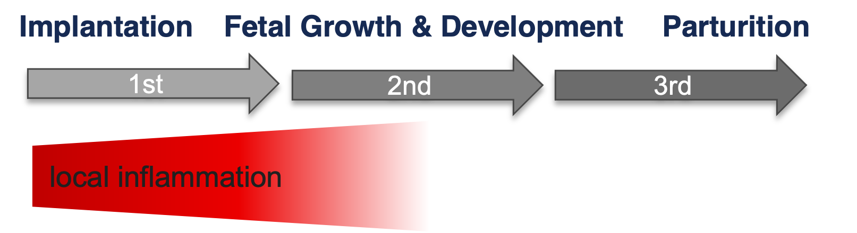
Vaginal Inflammation Predicts Spontaneous PTB
Pro-Inflammatory Factor Score | Spontaneous PTB (<37wk)
Pro-Inflammatory Factor Score | OR (95%CI) | p-value | AOR* (95%CI) | p-value
Vaginal Fluid | 1.4 (1.0-1.9) | 0.05 | 1.6 (1.1-2.3) | 0.02
Plasma | 1.4 (0.6-3.0) | 0.39 | 1.3 (0.6-3.1) | 0.53
Increasing vaginal inflammation at 16-20 weeks predicts spontaneous PTB
Plasma inflammation did not differ by HIV or ART exposure and was not associated with spontaneous PTB
Spontaneous
PTB
*Logistic regression adjusted for HIV serostatus, ART exposure, prior PTB, maternal age, BMI
Models exclude women with twin pregnancies (n=8) and short cervix (n=6)
Rittenhouse KJ et al. AIDS. 2021.

Slide 23
Vaginal Microbiome Diversity Associated with Spontaneous PTB
23
 | Term median (IQR) | sPTB median (IQR) | PR (95% CI) | APR* (95% CI) | p-value
Repeat analysis among participants with HIV
Δ Shannon diversity index | 0.11 (-0.54, 0.37) | 0.18 (0.11, 0.21) | 2.1 (1.1, 3.8) | 2.5 (1.1, 5.6) | 0.03 | 0.03
In women who had a spontaneous PTB, shannon diversity index increased between baseline and repeat collection timepoints.
Implantation
Fetal Growth & Development
Parturition
1st
2nd
3rd
Spontaneous
PTB
Vaginal
microbiome diversity
*Calculated by weighted Poisson regression with robust error variance and adjusted for HIV serostatus, maternal age, body mass index, parity, and prior PTB

Slide 24
Vaginal Microbiome Diversity Associated with Vaginal Inflammation
24
Vaginal diversity (Shannon Diversity Index) is positively correlated with vaginal inflammation
coeff: +0.66, 95%CI 0.28-1.03; p=0.001
Vaginal
microbiome diversity

Slide 25
Conclusions

Slide 26
Summary & Conclusions
26
At 16-20 wks, HIV+ exhibit the following lower genital tract changes:
  Higher inflammation
  Higher mean relative abundance of anaerobic species and lower mean abundance of lactobacilli
  Increased diversity of microbiota
Inflammatory local milieu are associated with vaginal dysbiosis
Vaginal inflammation in the early mid-trimester and increasing Shannon Diversity Index during pregnancy are associated with spontaneous PTB
Implantation
Fetal Growth & Development
Parturition
1st
2nd
3rd
inflammatory
anti-inflammatory
inflammatory
local inflammation
Lactobacilli
Vaginal
microbiome diversity
Lactobacilli
Vaginal
microbiome diversity
Vaginal
microbiome diversity
Vaginal
microbiome diversity
Spontaneous
PTB
Vaginal
microbiome diversity

Slide 27
Working Hypothesis
27
Acute Immune Activation
Persistent Immune Activation
Immune
Reconstitution
HIV
ART initiation
ART continuation
Spontaneous
PTB
Metabolic
Changes
Altered Microbiome
Persistent Microbiome Changes
Additional research is needed:
To identify women who would benefit from intervention
To define how risk is modified by other host factors
To tailor interventions to population and individual risk profiles

Slide 28
Ongoing Research

Slide 29
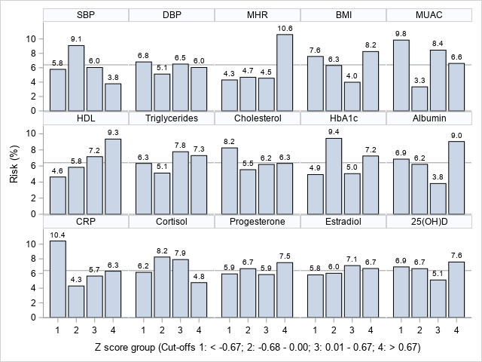
Allostatic Load
29
Allostatic Load is part of a theoretical framework that attempts to capture multisystem detrimental effects of accumulating stress and has been proposed as a useful concept for understanding the pathophysiology and prediction of PTB.
Study: Case Cohort
Hypothesis: Spontaneous PTB and HIV infection are associated with a higher midtrimester allostatic load

Slide 30
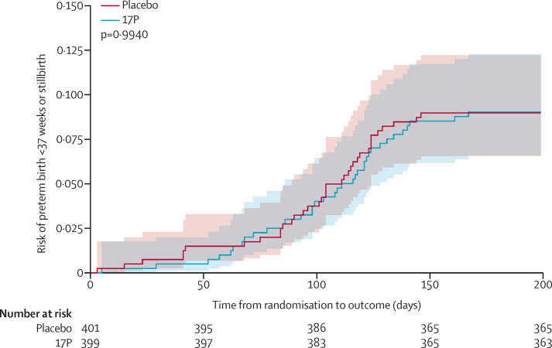
Improving Pregnancy Outcomes with Progesterone (IPOP)
30
17 alpha-hydroxyprogesterone caproate (17P) has been shown in some trials to reduce early delivery among women with a history of spontaneous preterm birth.
Study: Double-blind, placebo-controlled, Phase III trial, randomized to weekly 17P vs placebo
Population: 800 HIV+ pregnant women (19P n=399, placebo n=401)
Findings:
  No difference in PTB risk
  No serious adverse events
  Acceptable intervention
ClinicalTrials.gov: NCT03297216
Price et al. Lancet HIV. 2021.

Slide 31
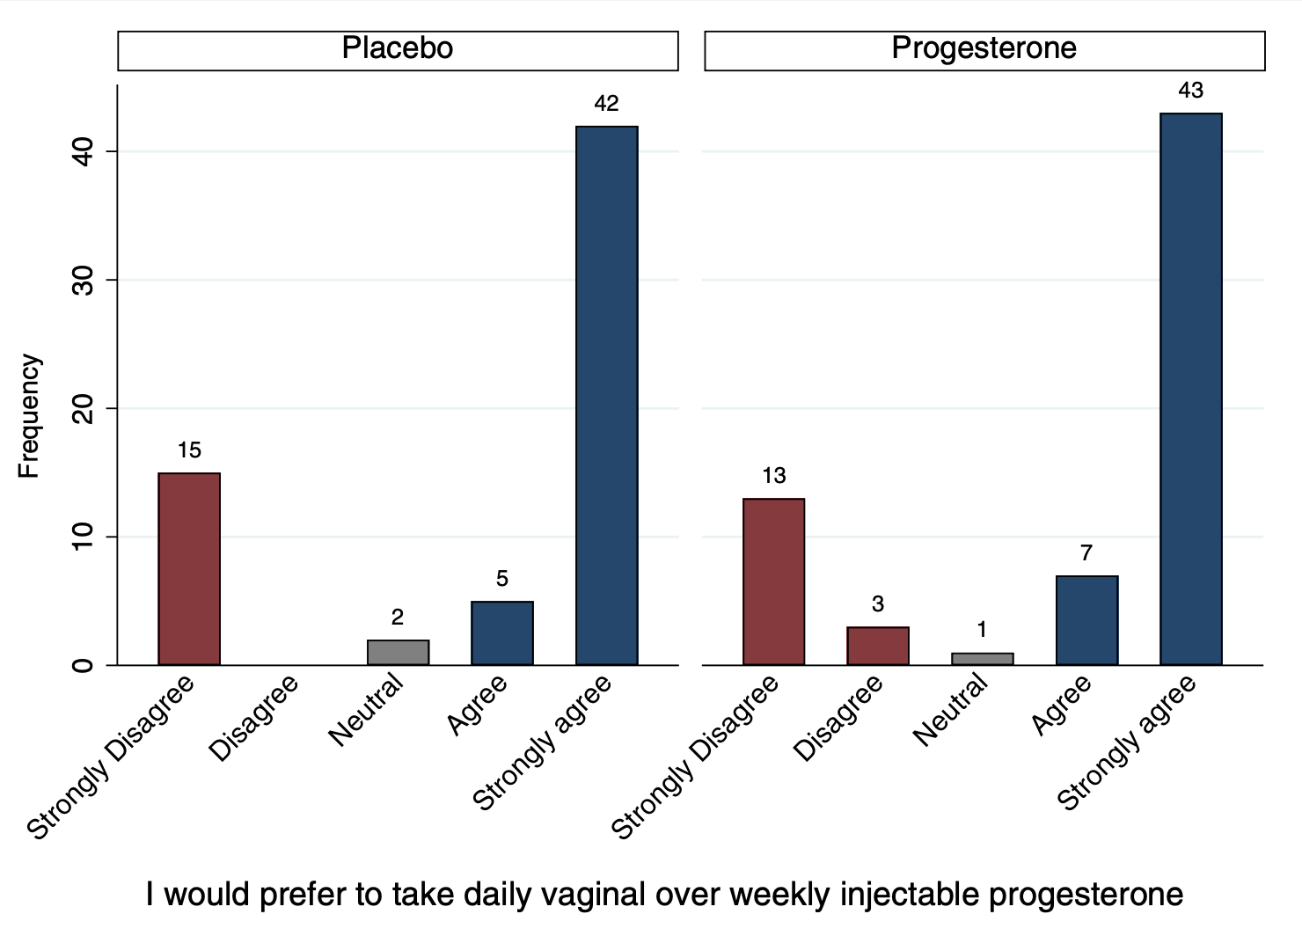
Vaginal Progesterone (VP) Trial
31
Antenatal vaginal progesterone supplementation has been demonstrated to reduce the risk of PTB in women with short cervix. However, VP has not been tested for the indication of maternal HIV to date.
Study: Double-masked, placebo-controlled, randomized trial of daily self-administered VP or placebo
Population: 140 HIV+ pregnant women
Findings: VP is an acceptable intervention
I would prefer to take daily vaginal over
weekly injectable progesterone
Price et al. Plos One. 2020.

Slide 32
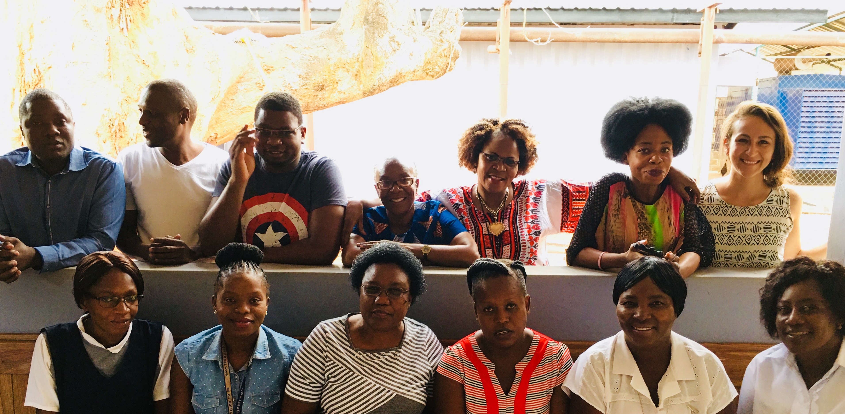
Acknowledgements
32
UNC Chapel Hill
UNC Project Zambia
Jeffrey S. A. Stringer
Joan T. Price
Kristina De Paris
Julie A.E. Nelson
Elizabeth M. Stringer
Bellington Vwalika
Margaret Kasaro
Humphrey Mwape
ZAPPS Study Staff
OGHE Global Health
Scholarship
References:
Rittenhouse KJ, Mwape H, Nelson JA, Mwale J, Chipili G, Price JP, Hudgens M, Stringer EM, De Paris K, Vwalika B, Stringer, JSA. Maternal HIV, timing of antiretroviral therapy, and spontaneous preterm birth in an urban Zambian cohort: the role of local and systemic inflammation. AIDS. 2021, 35(4):555-565.
Price JT, Vwalika B, Hobbs M, Nelson J, Stringer EM, Zou F, Rittenhouse KJ, Azcarate-Peril A, Kasaro MP, Stringer JSA. Highly diverse anaerobe-predominant vaginal microbiota among HIV-infected pregnant women in Zambia. PLoS One 2019, 14(10):e0223128.
Castillo M, Vwalika B, Rittenhouse KJ, Price J, Freeman B, Mwape H, Winston J, Sindano N, Fuseini N, Chi B, Baruch-Gravett C, Kasaro M, Stringer J. Cohort Profile: the Zambian Prematurity Prevention Study (ZAPPS). Gates Open Res. 2018, 2:25.

Slide 33
Questions?
33

Slide 34
Confirmatory Factor Analysis
34
Multivariate statistical technique that reduces a large number of intercorrelated variables into a smaller set of independent clusters underlying physiological relationships
IL-1β
IL-2
Independent clusters
IL-6
IL-8
Pro-inflammatory Activity
IL-12p70
IFN-γ
Intercorrelated variables
CXCL-10
TNF-α
sPTB
MIP-1α
MIP-1β
Anti-inflammatory Activity
sCD14
IL-10
TGF-β
Structural equation model on relationship between inflammatory activity and sPTB

Slide 35
Microbiome
35
Genome Sequencing:
A laboratory technique for determining the DNA sequence of an organism’s genome.
The genome is randomly broken up into small DNA fragments that are sequenced individually.
A computer program looks for overlaps in the DNA sequences, using them to reassemble the fragments in their correct order to reconstitute the genome.
Genome
Random Reads
Anchoring
Genome Assembly

