Slide 1
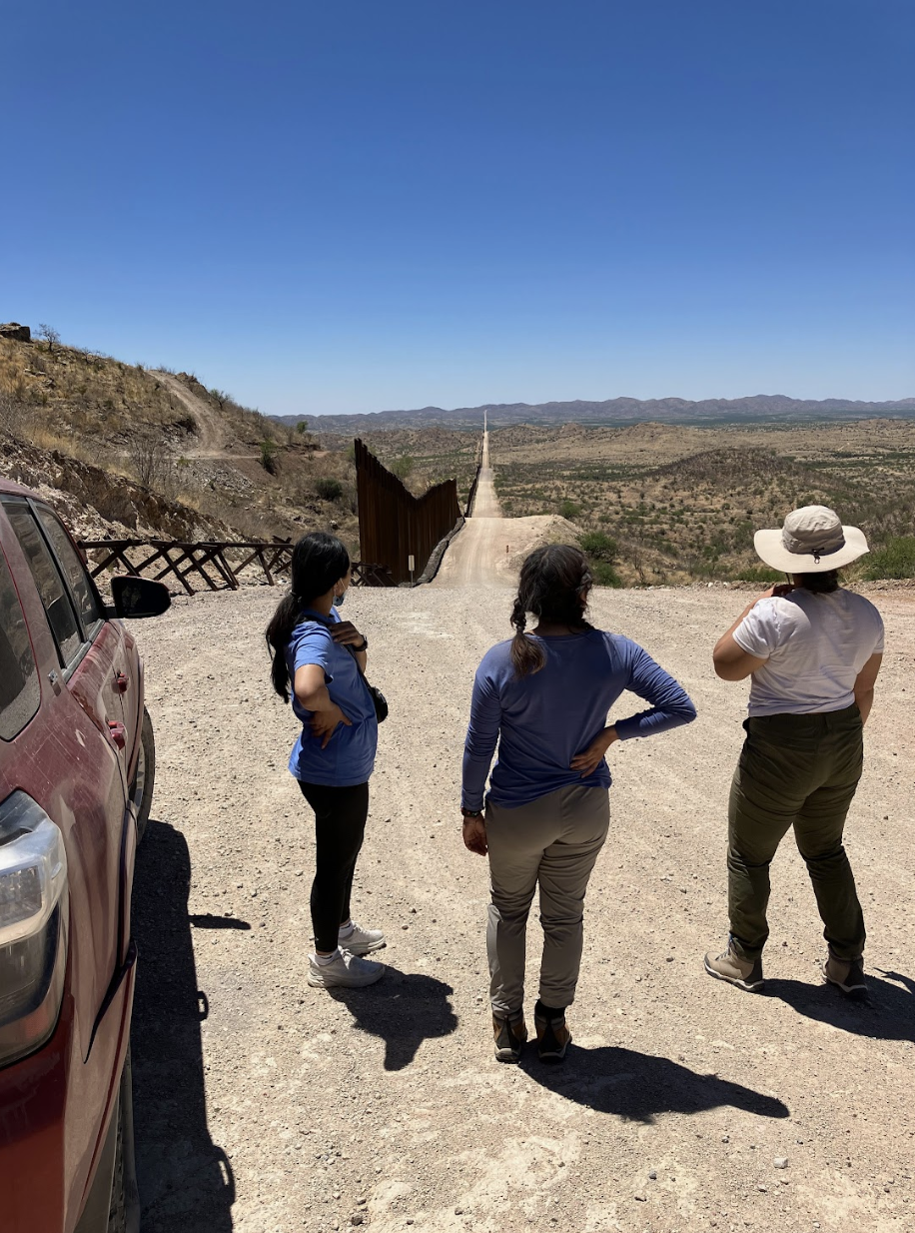
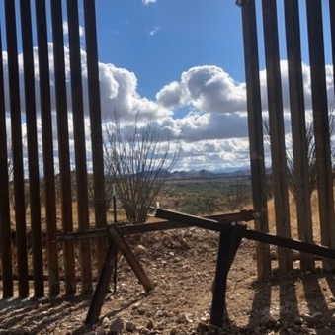
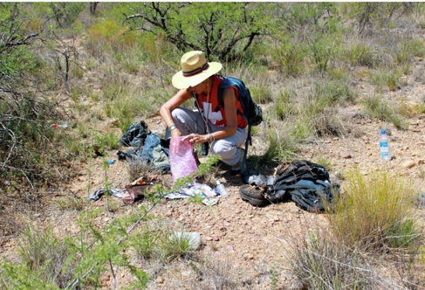
Migrant Health Service-Learning Pilot
Tucson, Arizona
May 28-June 6, 2022
Notes:
Moira, Anne, and Isabella introduce ourselves on this slide

Slide 2
PARTICIPANT Testimonies

Slide 5
Notes:
Video of Adie, Vividiana, Diana

Slide 6
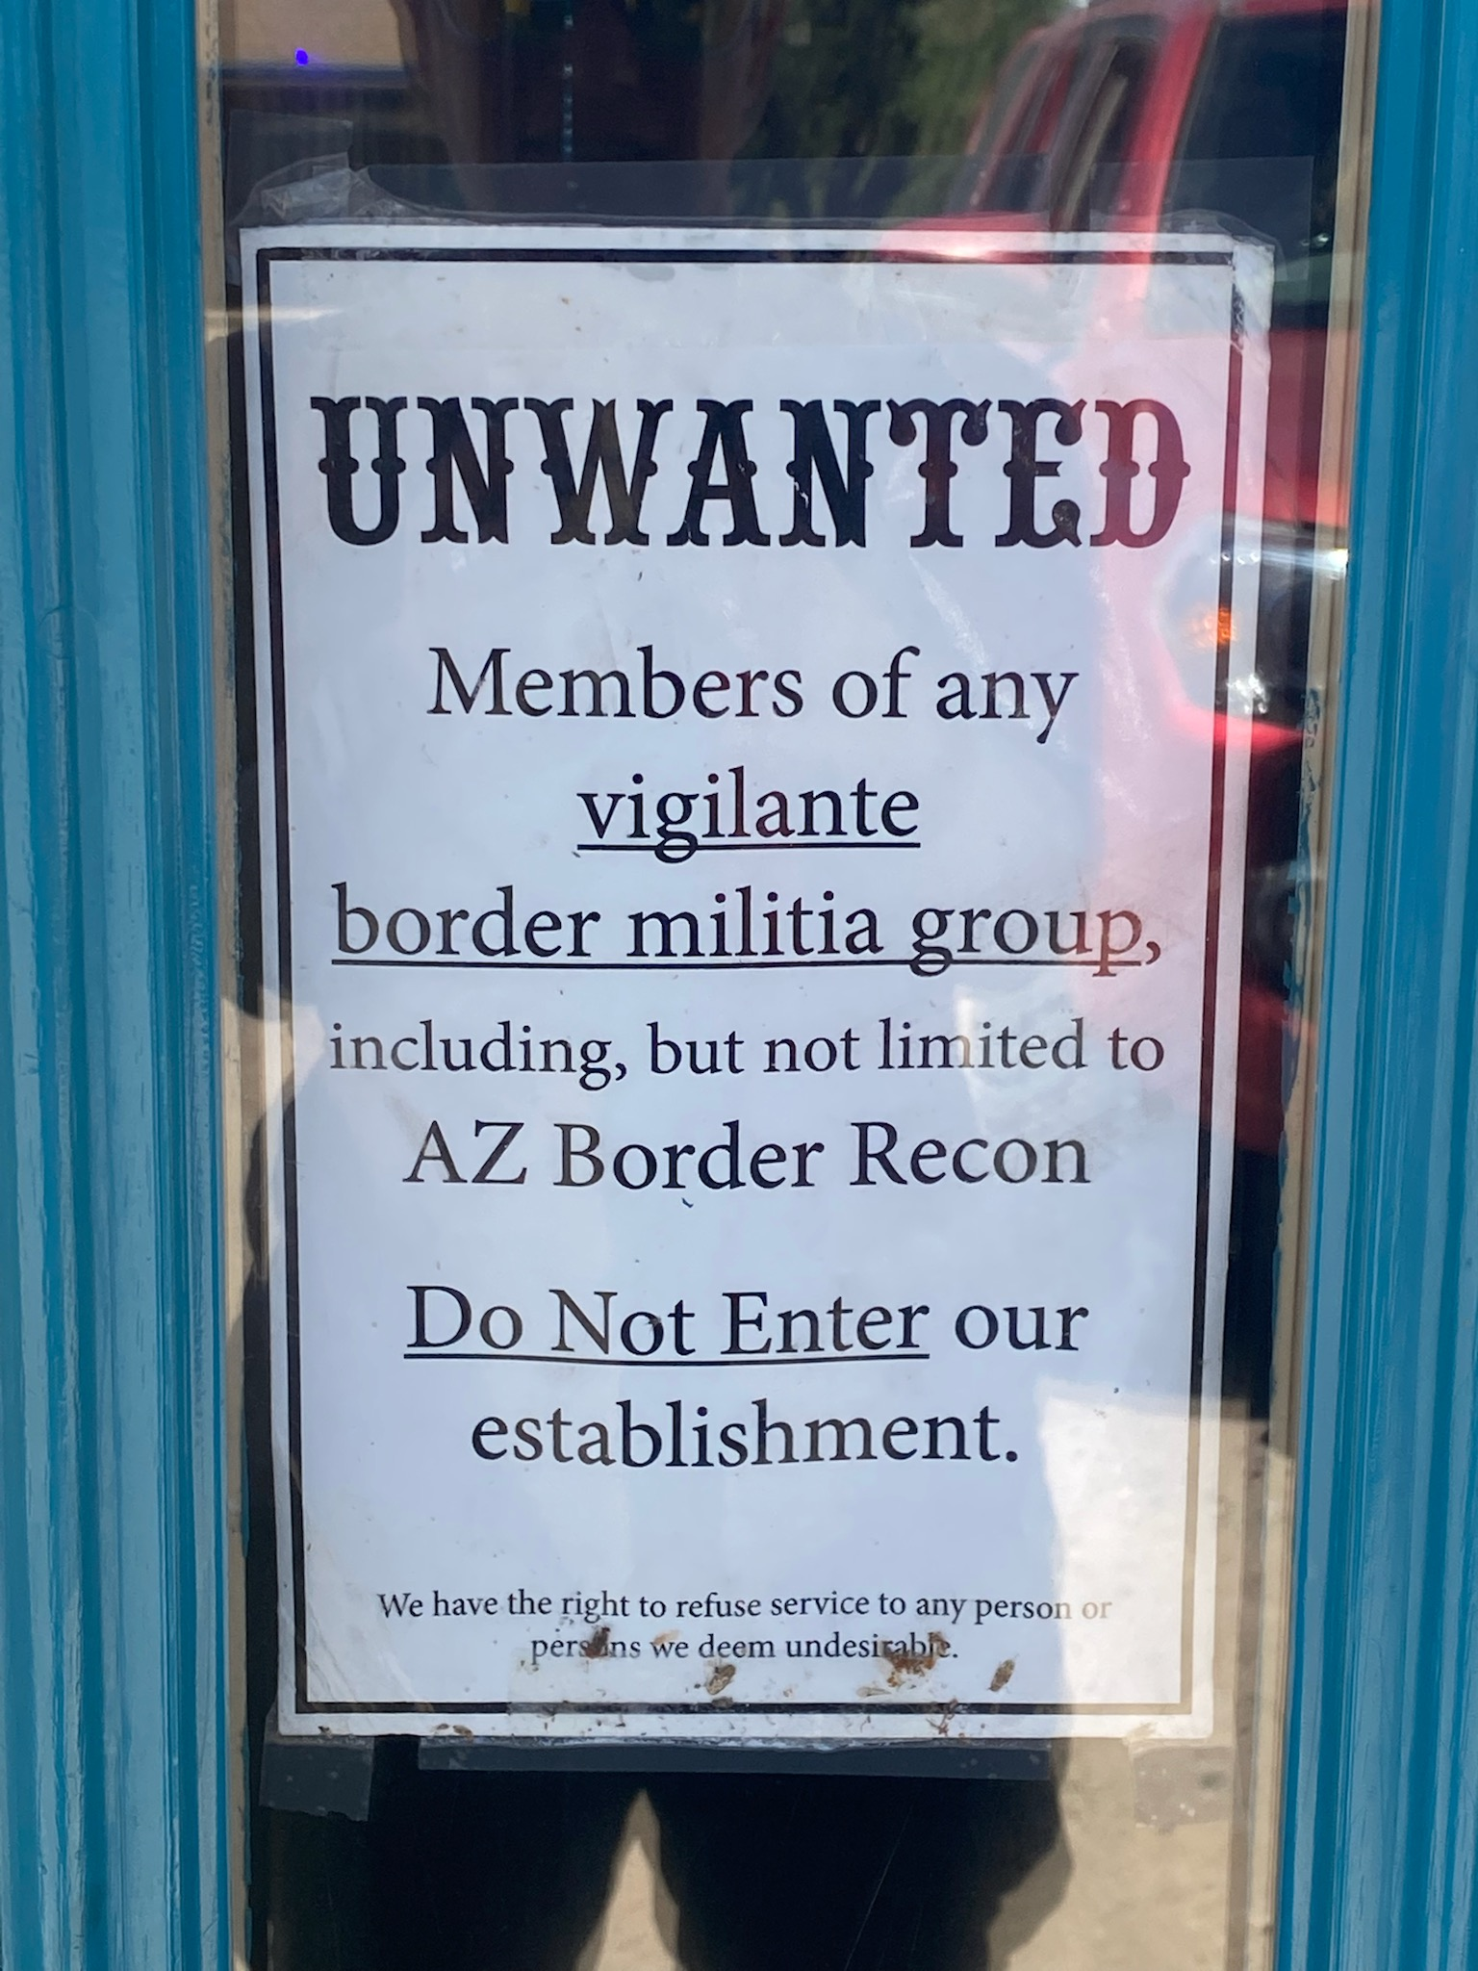
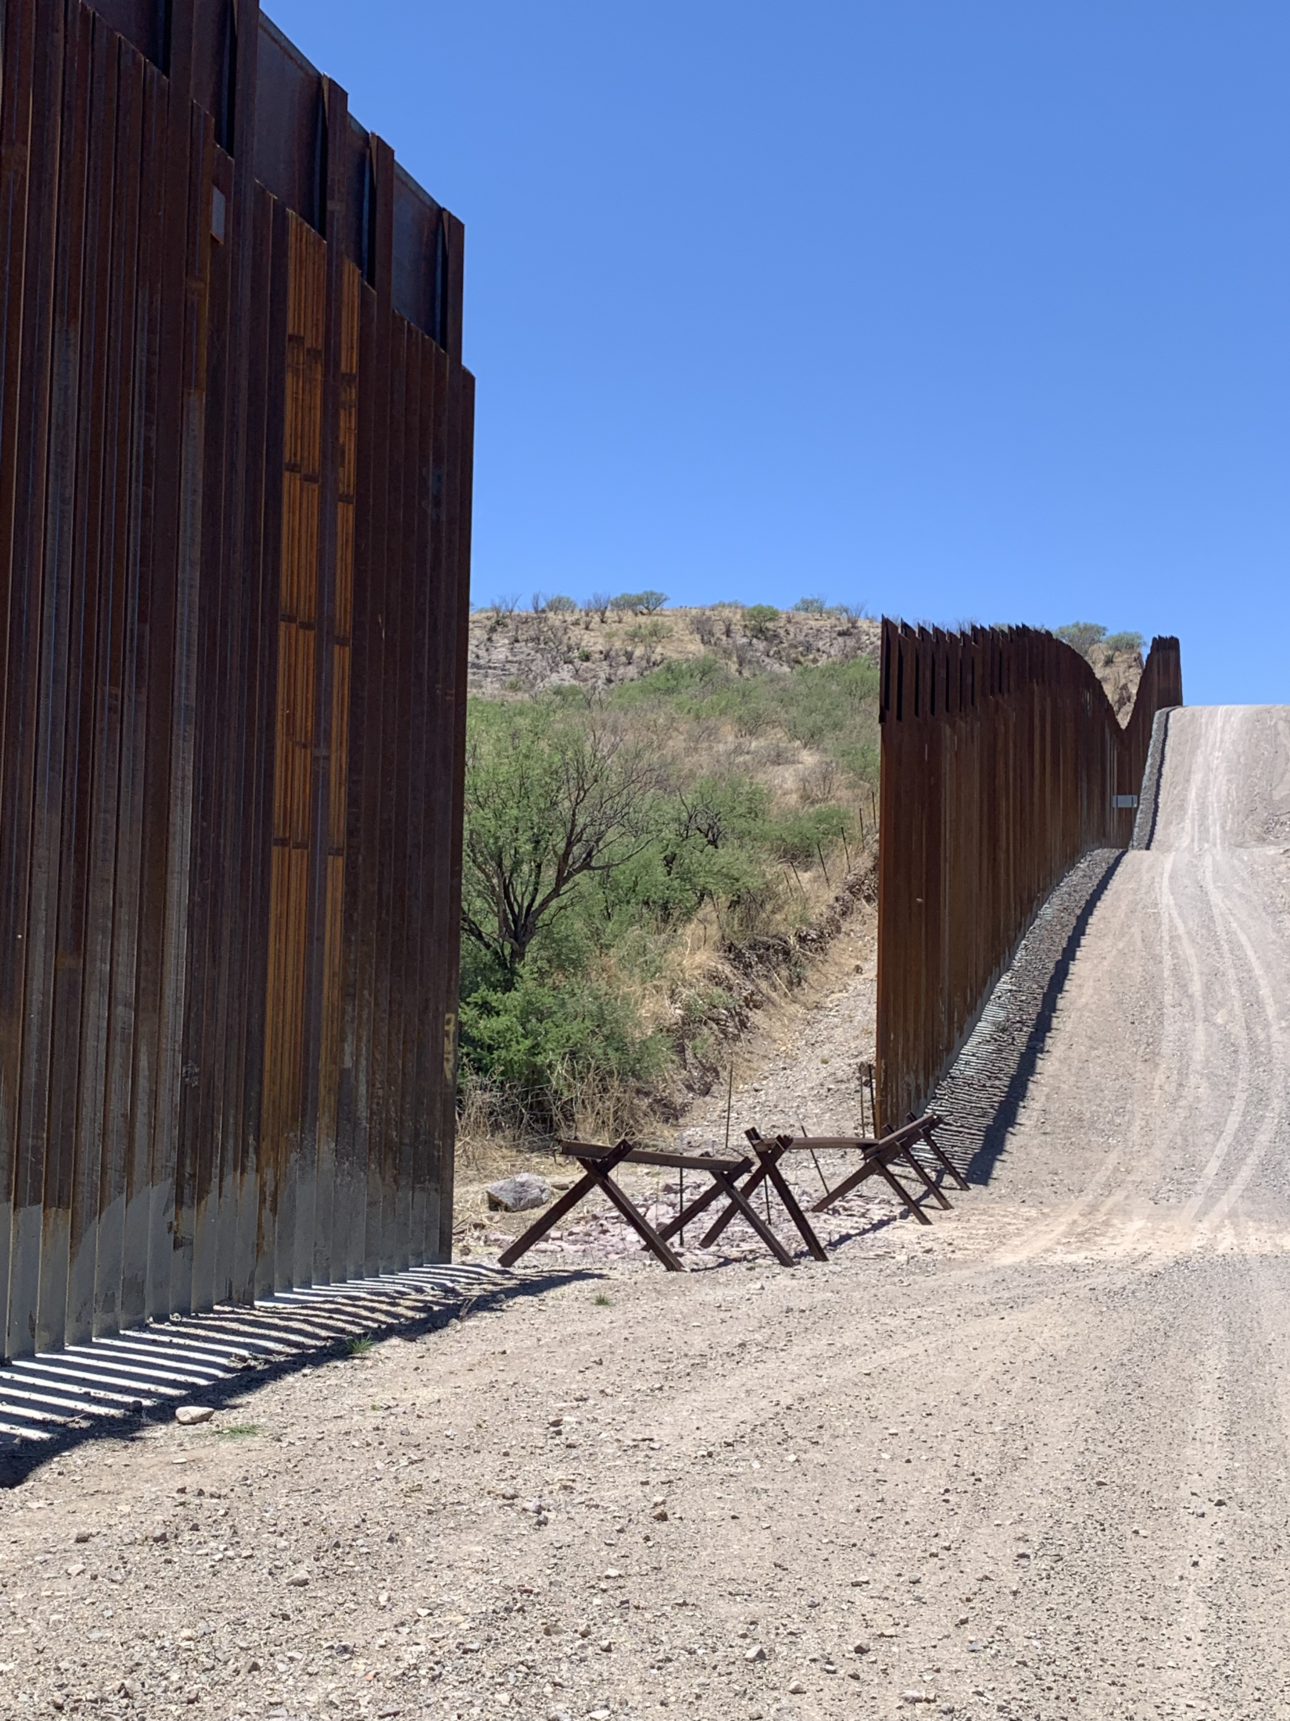
Connect with Isabella Higgins, PHD program, Isabella ihiggins@email.unc.edu
Notes:
Isabella’s slide to talk about her experience

Slide 7
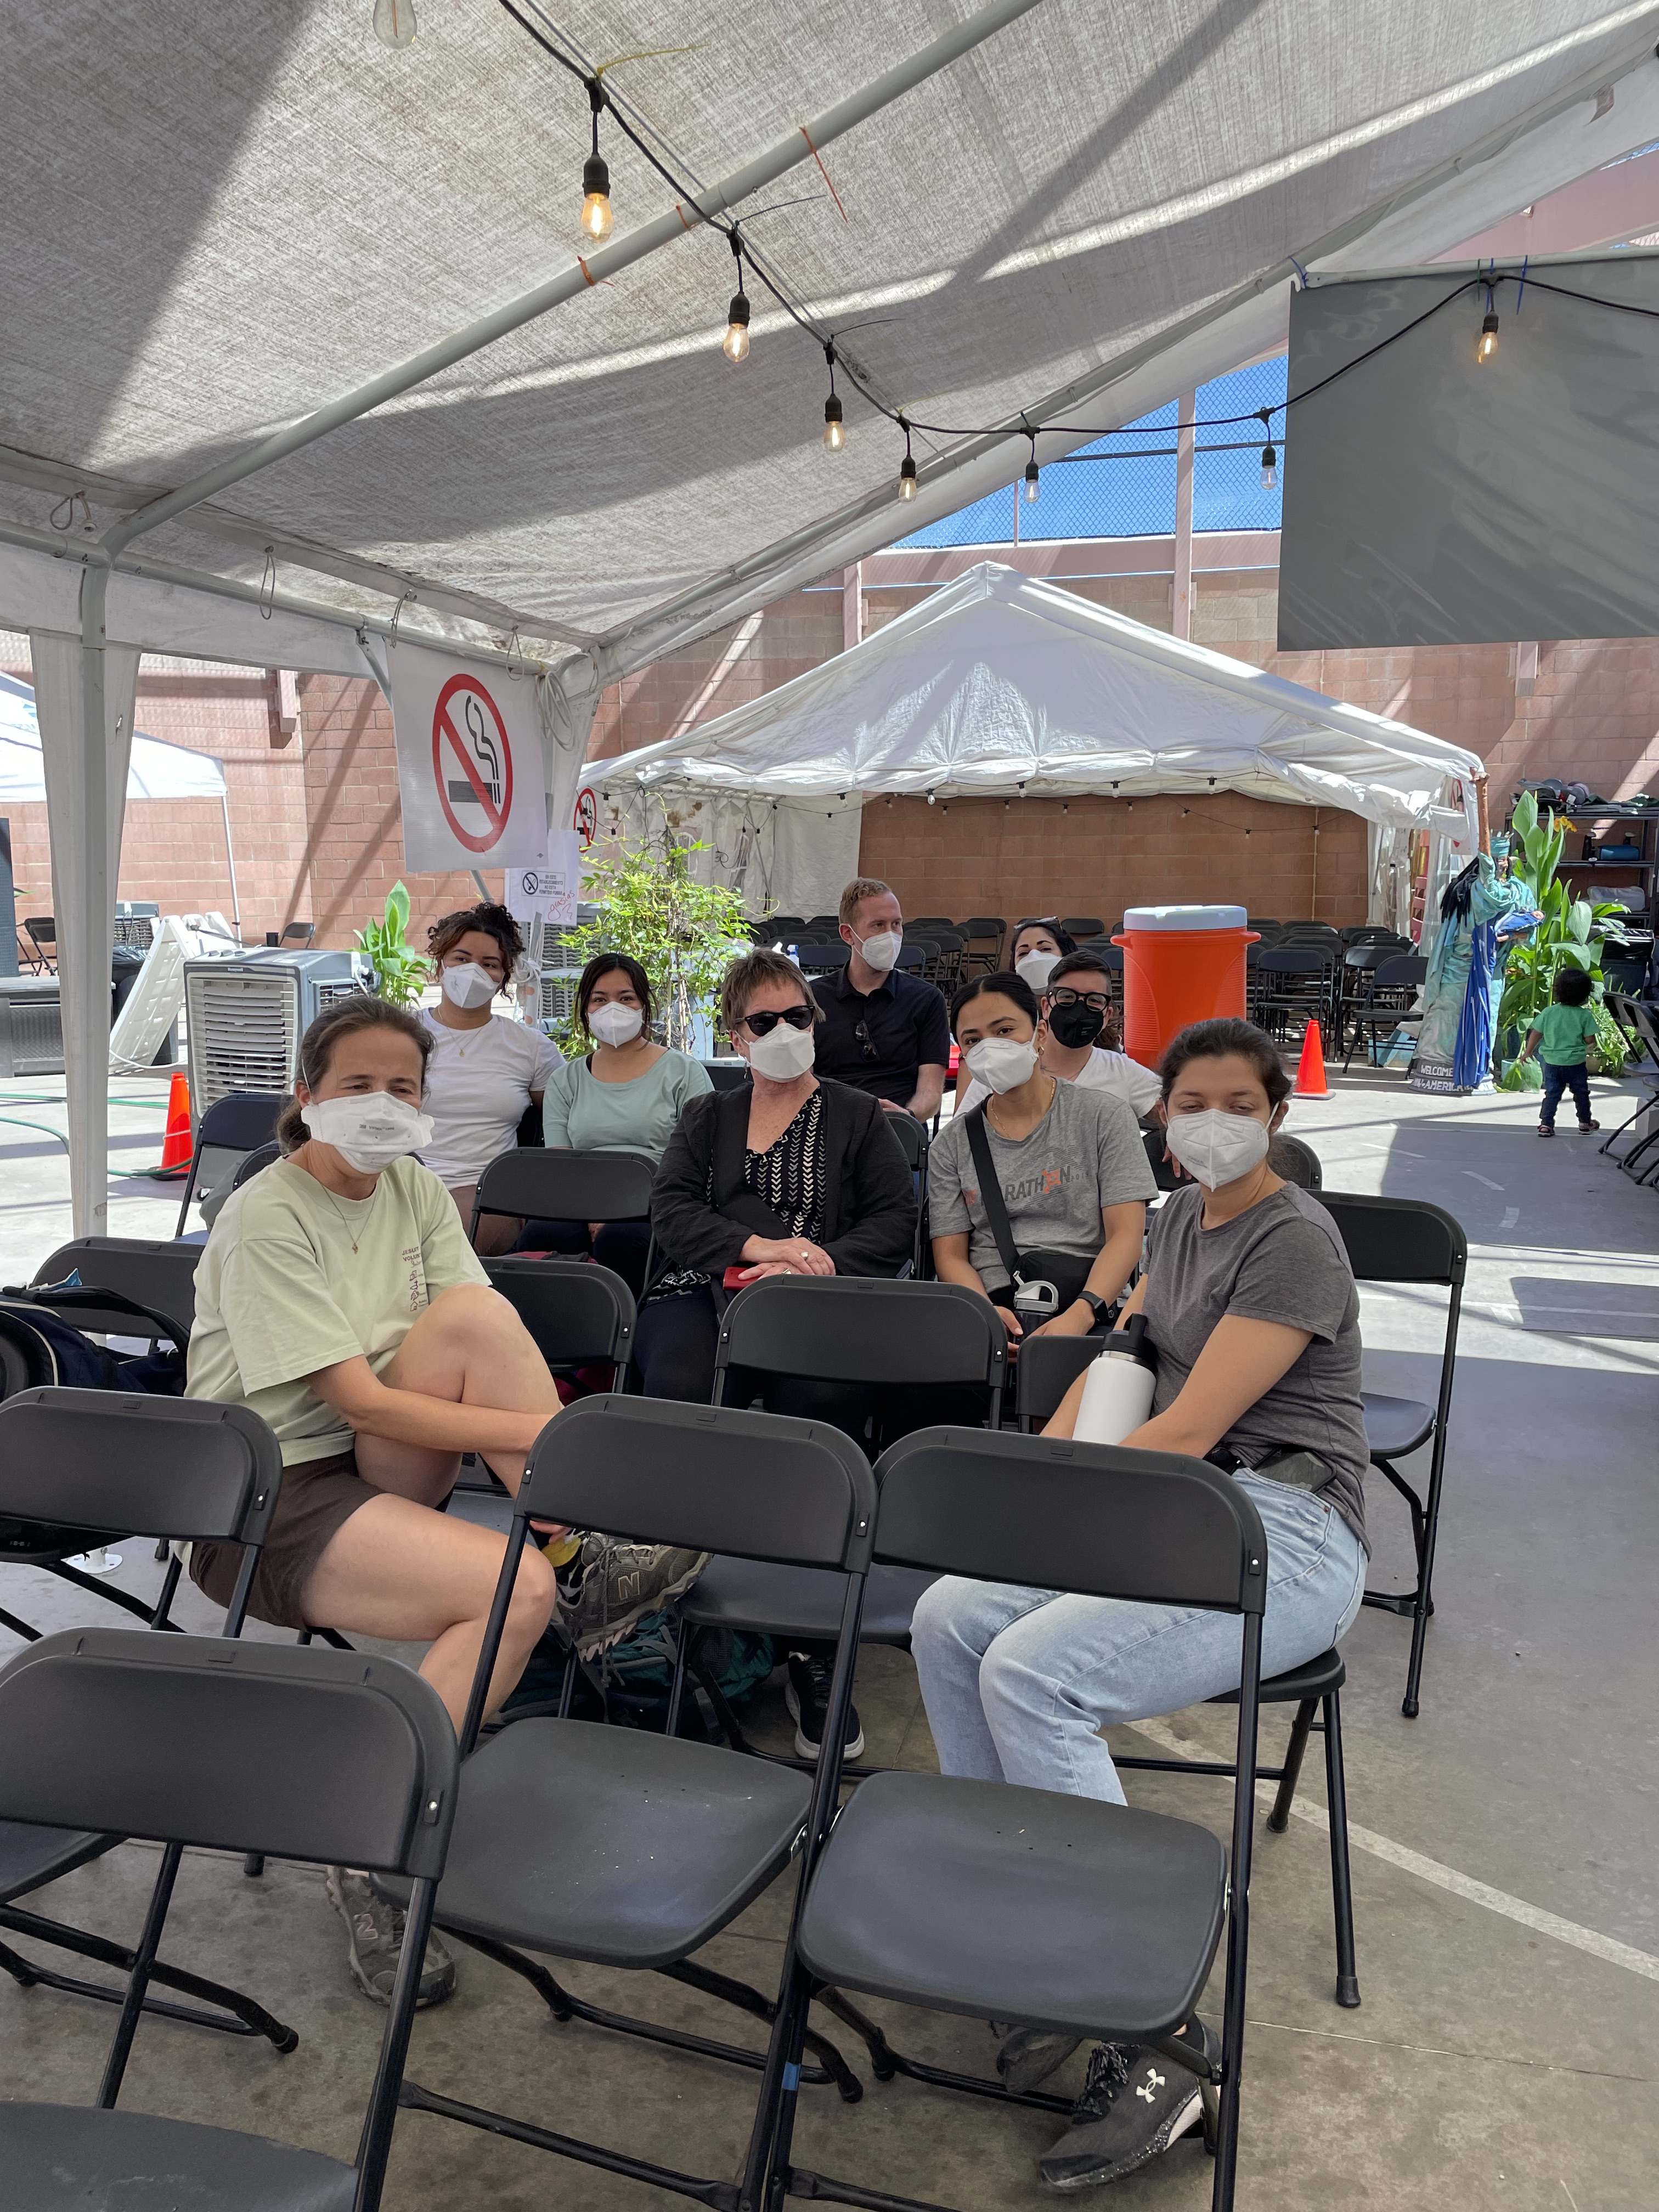
Connect with Dr. Anne Berry, Resident on the pilot
Anne_berry@med.unc.edu

Slide 8
Questions?
Thank you!
Come see us! 1002 Bondurant
Moira_rogers@med.unc.edu

