Slide 1
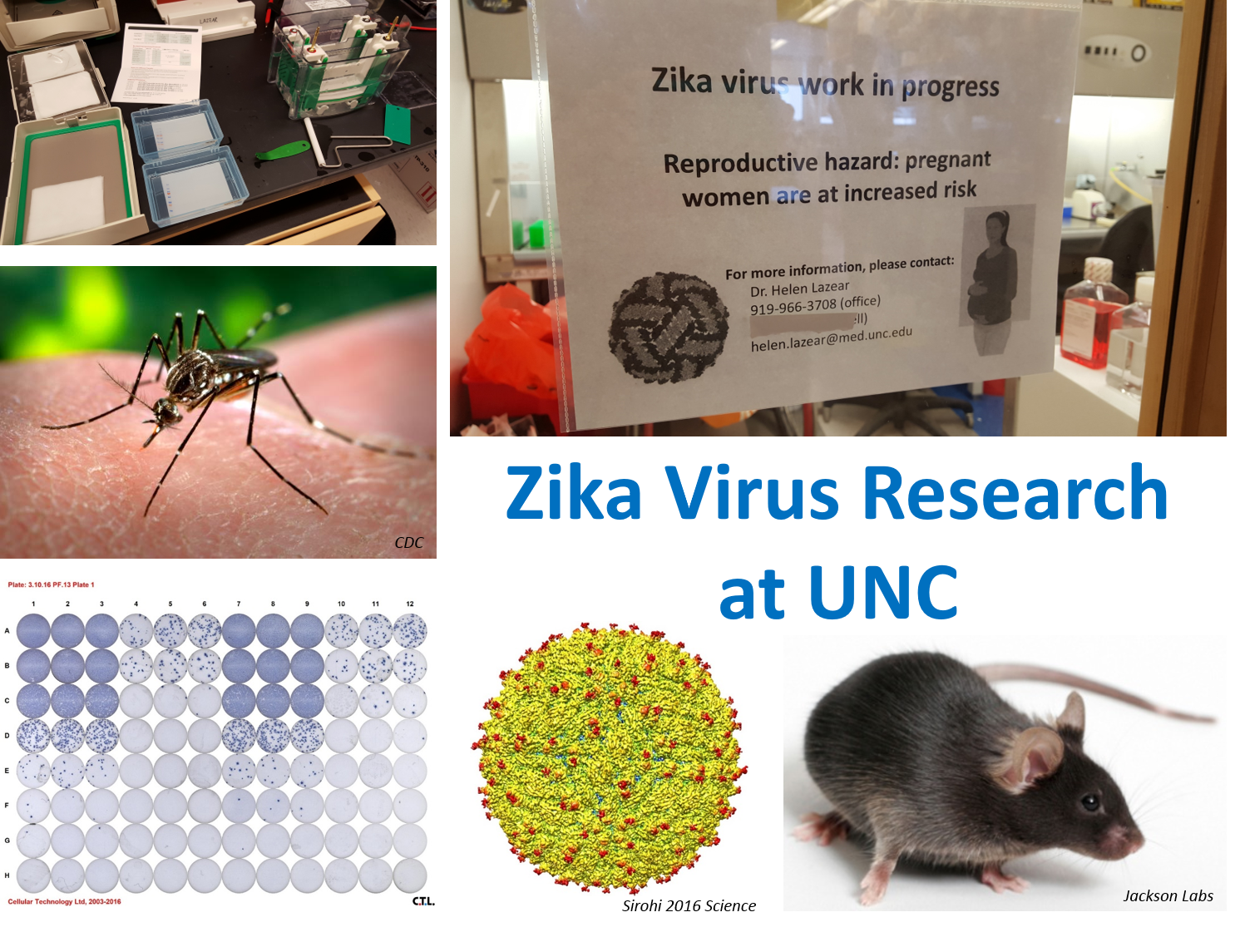
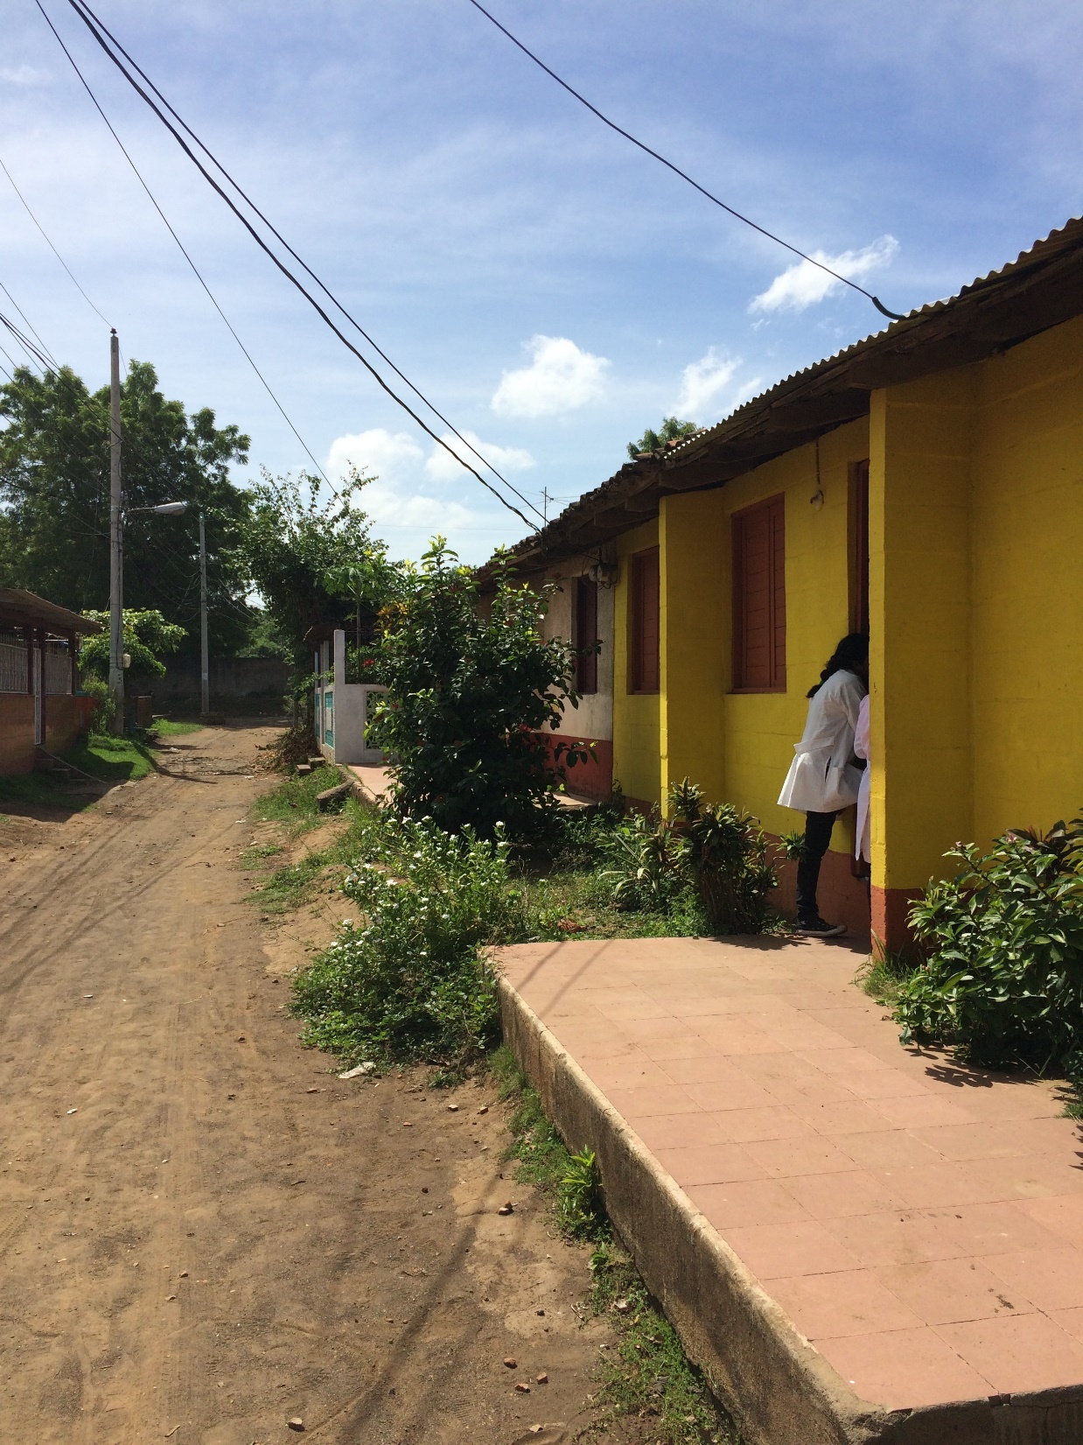
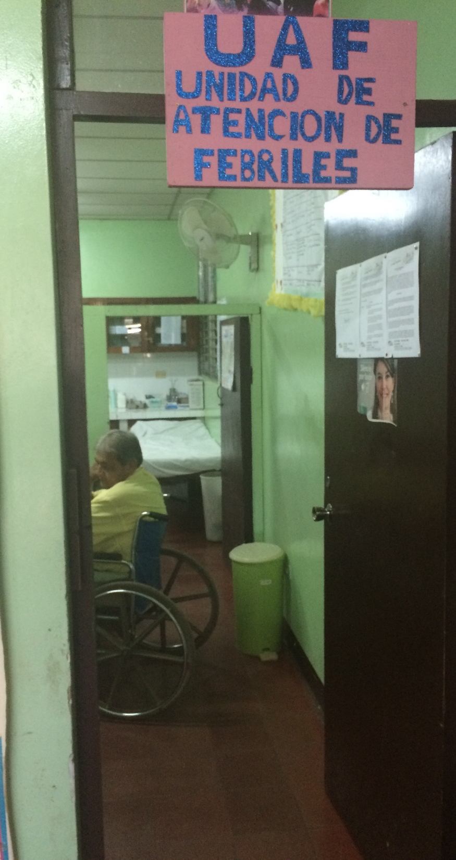
OIA GLOBAL HEALTH FORUM
Banco a campo

Slide 2

Baric Lab
Ralph Baric
Doug Widman
Emily Gallichotte
Kara Jensen
Boyd Yount
Ellen Young
Jesica Swanstrom
Jessica Plante
de Silva Lab
Aravinda de Silva
Prem Lakshmanane
Sandra Henein
Laura White
Eileen McGowan
Ramesh Jadi
Usha Nivarthi
Alice Liou
Stefan Metz
Rajendra Raut
Ashlie Ransom
Mark Stoops
Cameron Adams
Stephen Graham
Marc Corten
Matt Delacruz
Toni Baric
Lazear Lab
Helen Lazear
Melissa Mattocks
Cesar Lopez
Derek Carbaugh
Rebecca Casazza
UNAN-León
Filemon Bucardo
Yahoska Reyes
Samuel Vilchez
Armando Matute
UNC ID, OB, OAI, IGHID
Shay Slifko
Martha Carlough
Kathy James
Kathryn Salisbury
Jessie Hardison
Mike Cohen
Elizabeth Stringer
Natalie Bowman
Irving Hoffman
Sylvia Becker-Dreps
Jeff Stringer
Collaborators
Eva Harris, UC Berkeley
Sean Diehl, UVM
Megan Reller, Duke
Alex Sette, LJI
Funding
T32 Viral Pathogenesis
OIA GHSP
ECBR
EGH
TraCS
Study Participants!!

Slide 3
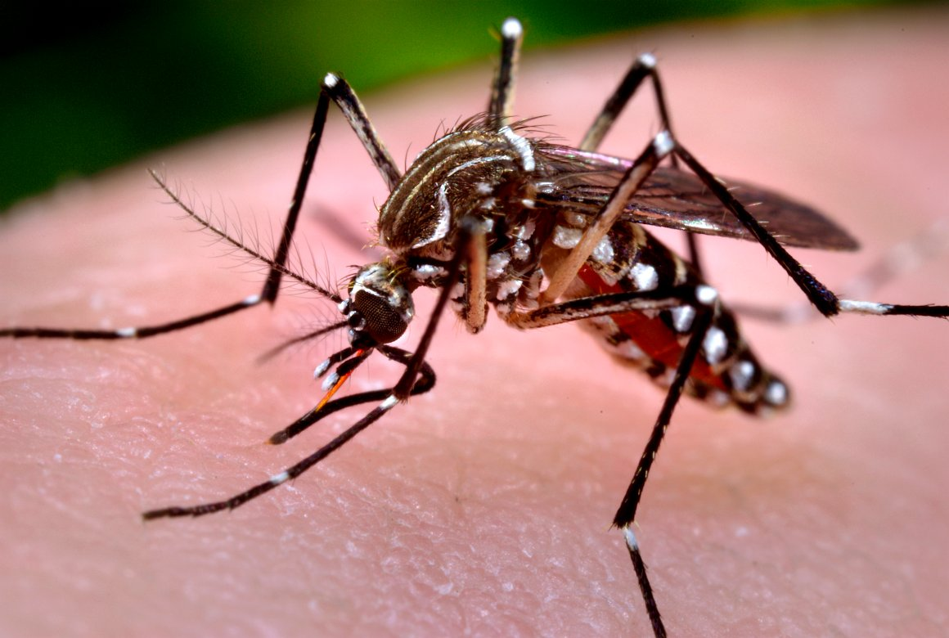

Banco a campo
Discovery science to field-ready serodiagnostics for Zika
Matthew Collins, MD, PhD
OIA Global Health Scholar
Fellow, Infectious Diseases
University of North Carolina
matthew.collins@unchealth.unc.edu
Notes:
Grateful to be here, and even a little “star struck” to be in a room with such a high-density of accomplished researchers
I’m fairly new to the flavivirus field, so by way of introduction, hello field
I did do a PhD in a mouse T cell lab about 6-7 yr ago and most my time since has been dedicated to clinical training in IM and ID
I joined Aravinda de Silva’s group and that’s been a great opportunity to develop my career in ways that allow me to exercise my interest in immunology as well as medical management of tropical and emerging global infections.
I’m really the representative, our group is very collaborative and we work closely with other PIs such as Helen and Prem – who is also here and looks fwd to taking the more difficult questions during the coffee break
So,

Slide 4
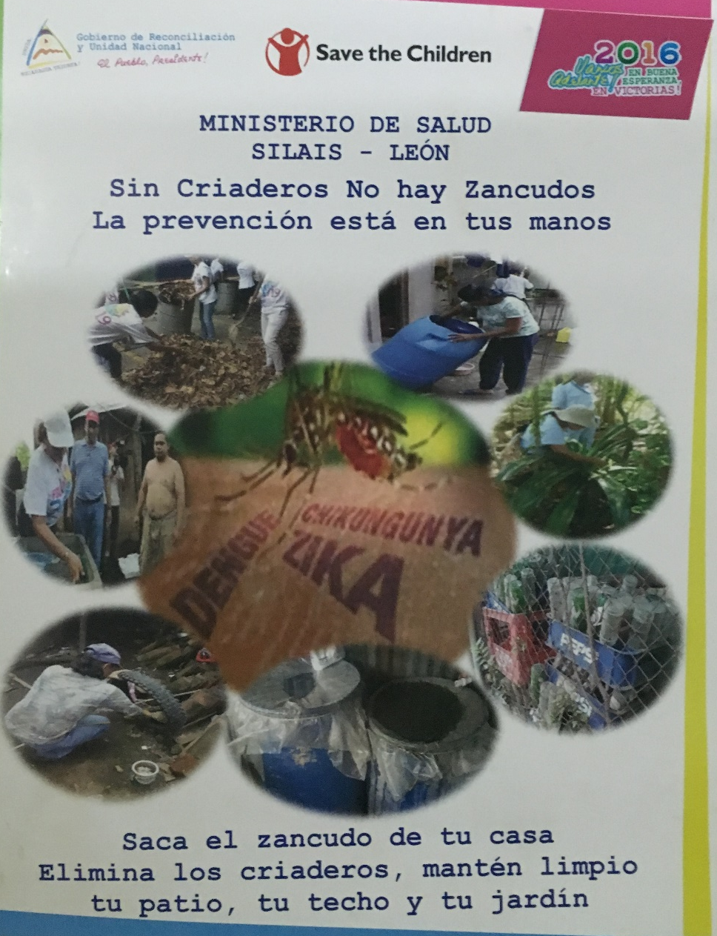
OUTLINE
No COI
This can be a discussion – interrupt me
Zika and the flaviviruses
A diagnostic dilemma
Banco → campo

Slide 5
Zika is an emerging Flavivirus
5’ Cap
C
prM
E
NS1
NS3
NS5
NS2a
NS2b
NS4a
NS4b
Flaviviridae → Flavivirus
Single ORF
Incubation < 2 weeks
(+) ssRNA genome (~10.7kb)
Enveloped virus
Viremia 1 wk
Lazear and Diamond 2016 J Virol

Slide 6
Global Spread of the Zika Virus
Mosquito-transmitted
Notes:
A third area of interest is in emerging flaviviruses. One of the interesting things about working on arboviruses is that there are always new and interesting viruses coming on to the scene.
As I just discussed, one potential source of emerging viruses is when there is a host range shift, but this is probably a very rare event.
A more common source is when there is a geographic shift and a virus is introduced into a new area. An example of this is WNV being introduced into North America in 1999.
There are 2 flaviviruses in particular that I’ve had my eye on for a couple of years now that had been causing simmering outbreaks and have the potential for wider emergence.
The first of these is USUV, which is related to WNV. This virus was originally isolated in Africa, but was detected in Eastern Europe in the early 2000s, and has since been moving westward. USUV has mostly been associated with bird die-offs and there have only been just a few cases of encephalitis in humans, so I think it remains to be seen how big of a public health problem this is going to be.
The second of these viruses is ZIKV. This virus is related to DENV; it was originally isolated in Uganda and caused sporadic outbreaks in Africa. But since 2007 this virus has been causing outbreaks in micronesia and the South Pacific. Then earlier this year the virus was detected in Brazil.

Slide 7
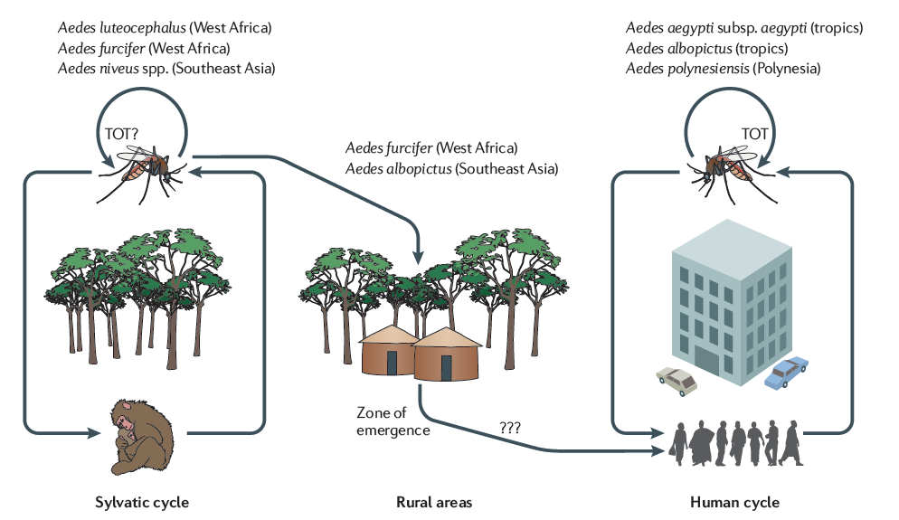
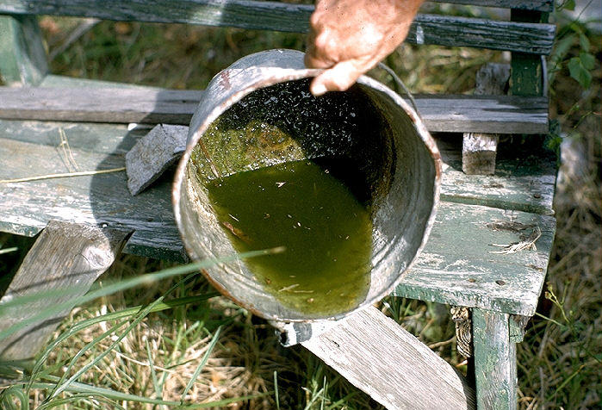
Transmission ecology – Aedes aegypti
Arboviruses are “spreading explosively” by “the most murderous animal on the planet.”
- Drs Chan and Fauci
Aedes aegypti
Aggressive, day-time biters
Prefer human blood meals (female)
Domestic lifestyle (enter homes to feed)
Breed in small water receptacles
Vasilakis 2011 Nat Rev Microbiol
Microbes Infect. 2010 Apr;12(4):272-9
Mem Inst Oswaldo Cruz. 2013;108 Suppl 1:11-7

Slide 8
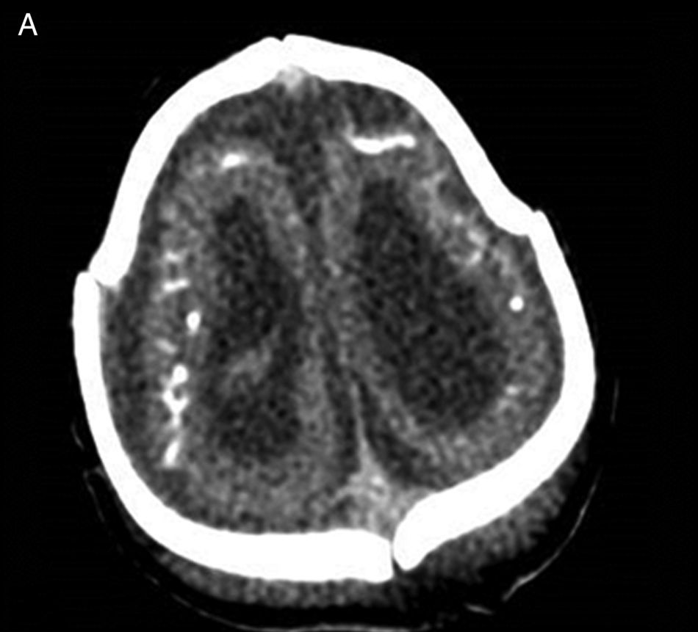
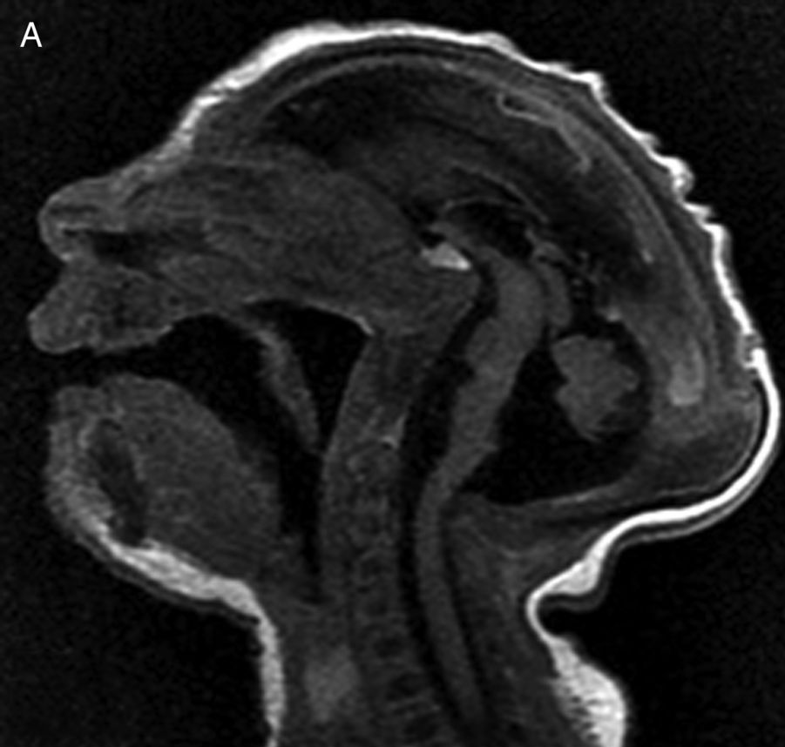
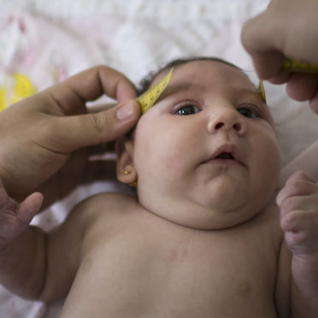
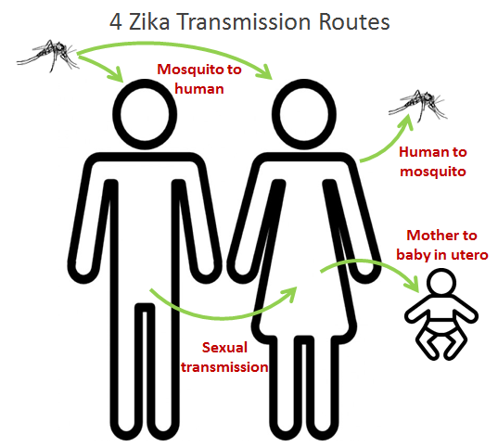
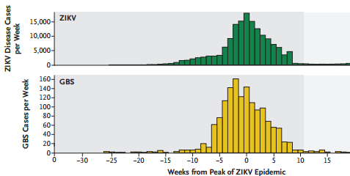

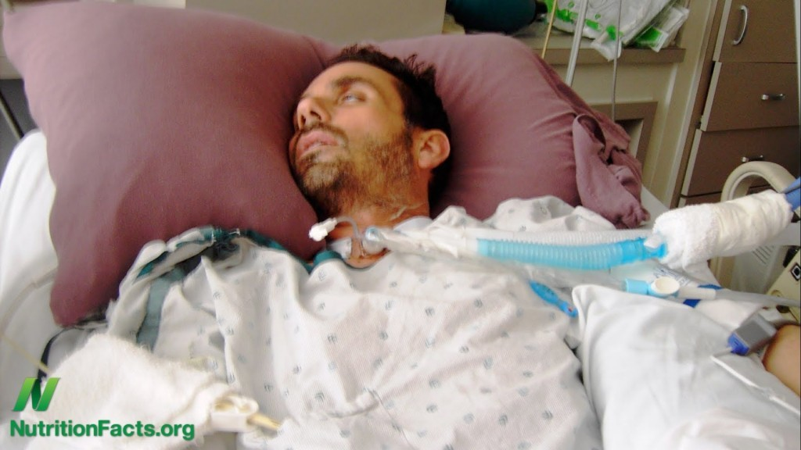
Zika - novel phenotypes
Microcephaly Pregnancy Complications
Sexual Transmission
Guillain-Barré Syndrome

Slide 9
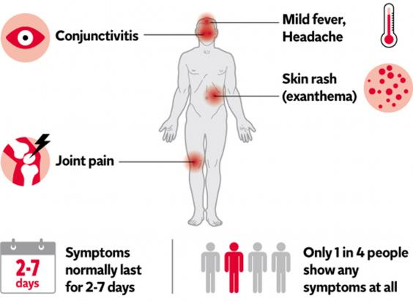
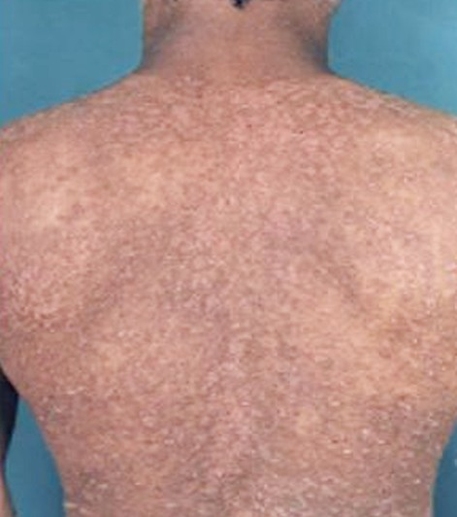
Zika – clinical manifestations

Slide 10
Clinical Manifestations of DENV, CHIKV, ZIKV, MAYV and OROV Infections
 | DENV | CHIKV | ZIKV | MAYV | OROV
Fever | + | + | + | + | +
Rash | + | + | + | + | rare
Arthralgia | + | + | + | + | +
Myalgia | + | + | + | + | +
Headache | + | + | + | + | +
Photophobia | + | + | 0 | + | +
Vomiting | + | + | + | + | +
Hemorrhagic manifest. | + | + | + | 0 | 0
Retro orbital pain | + | + | + | + | +
Conjunctivitis | + | + | + | + | +

Slide 11
Clinical Manifestations of DENV, CHIKV, ZIKV, MAYV and OROV Infections
 | DENV | CHIKV | ZIKV | MAYV | OROV
Fever | + | + | + | + | +
Rash | + | + | + | + | rare
Arthralgia | + | + | + | + | +
Myalgia | + | + | + | + | +
Headache | + | + | + | + | +
Photophobia | + | + | 0 | + | +
Vomiting | + | + | + | + | +
Hemorrhagic manifest. | + | + | + | 0 | 0
Retro orbital pain | + | + | + | + | +
Conjunctivitis | + | + | + | + | +
Not a clinical diagnosis!

Slide 12
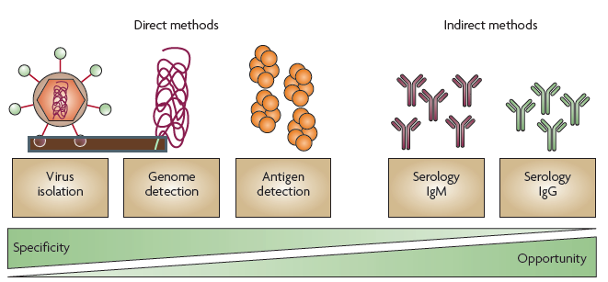
Diagnosis of arbovirus infection
Emerg Infect Dis. 2008 Aug;14(8):1232-9
N Engl J Med. 2015 Jul 2;373(1):94-5
PLoS Negl Trop Dis. 2014 Oct 16;8(10):e3171

Slide 13
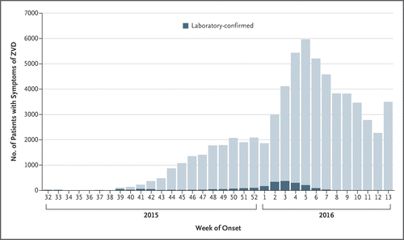
Zika Laboratory Diagnosis: Advantages and Challenges
PCR is the most reliable assay
  Viremia is short lived
  Other body fluids not yet standardized
  Majority of cases asymptomatic
Serology
  IgM present after 4 dpi
  IgG present for years → life
  Improved specificity with neut testing
  Less reliable in secondary flavivirus infection
  Paired specimens can be helpful (acute and convalescent)
  Lab capacity for advanced testing may be limited

Slide 14
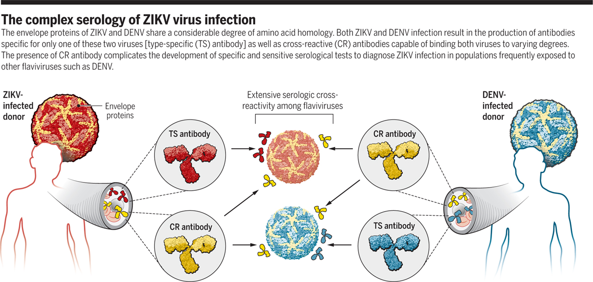

Zika – A diagnostic dilemma
Scott D. Speer, and Theodore C. Pierson Science 2016;353:750-751
Notes:
The complex serology of ZIKV virus infection The envelope proteins of ZIKV and DENV share a considerable degree of amino acid homology. Both ZIKV and DENV infection result in the production of antibodies specific for only one of these two viruses [type-specific (TS) antibody] as well as cross-reactive (CR) antibodies capable of binding both viruses to varying degrees. The presence of CR antibody complicates the development of specific and sensitive serological tests to diagnose ZIKV infection in populations frequently exposed to other flaviviruses such as DENV.

Slide 15
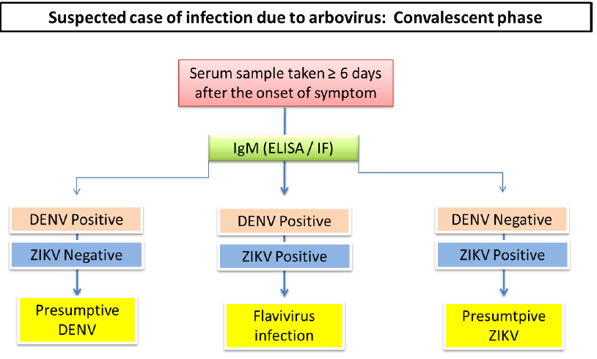
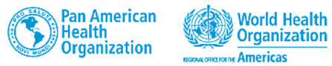

Zika diagnostic challenges

Slide 16
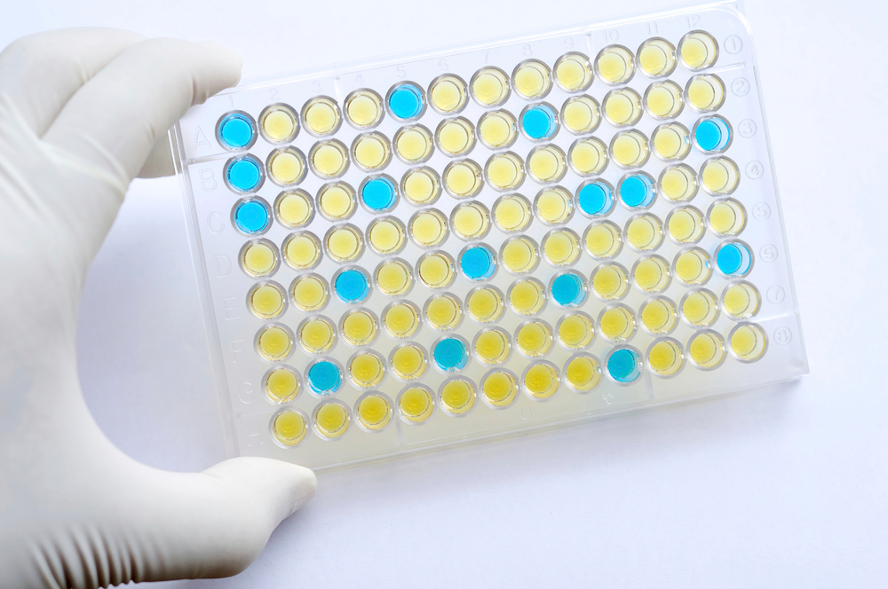
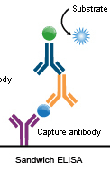
Developing Improved Zika Diagnosis
Ideal serodiagnostic test
  Sensitive and Specific
    - distinguish between flaviviruses
  Field deployable
  Cheap
  Fast
Approaches for Zika
  NS1
  Optimizing Envelope as a diagnostic antigen

Slide 17
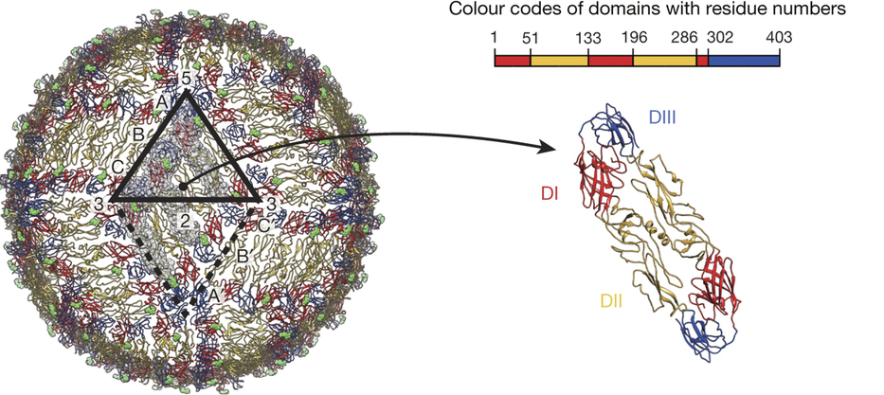
Basic Virology – Crystal Structure
Nature. 2016 Apr 19;533(7603):425-8

Slide 18
Current Goals
Diminish global disease burden due to flaviviruses
Define and understand flavivirus Ab cross reactivity
Provide knowledge and tools to enhance public health measures

Slide 19
Current Goals
Diminish global disease burden due to flaviviruses
Define and understand flavivirus Ab cross reactivity
Provide knowledge and tools to enhance public health measures
Hypothesis
Type-specific binding and neutralizing Ab are attractive diagnostic targets
Protein engineering allows rational antigen design for serodiagnostics
  Identify and predict antigenic regions of interest
  Alter cross-reactive epitopes while preserving type-specific epitopes

Slide 20
Methods Overview
Sera Source Characterization Application
Screening of novel recombinant Ag
Traveler cohort
IgG ZIKV + DENV1-4
IgM ZIKV + DENV1-4
Epitope mapping
Banked Dengue exposed sera
(vax trials, prospective cohorts)
Neutralization profiling ZIKV + DENV1-4
Reagent development (human mAb)
Ab depletion studies
Zika endemic areas
In vitro and in vivo pathogenesis studies

Slide 21
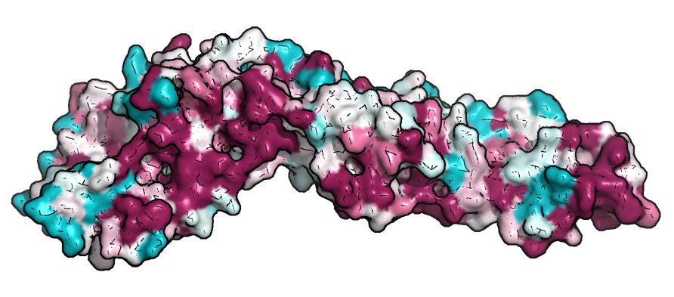
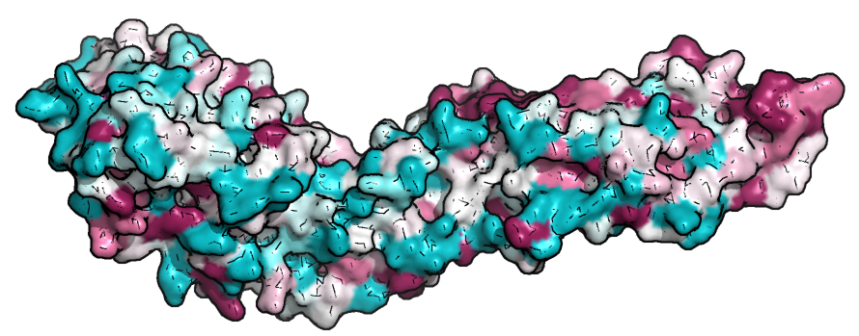
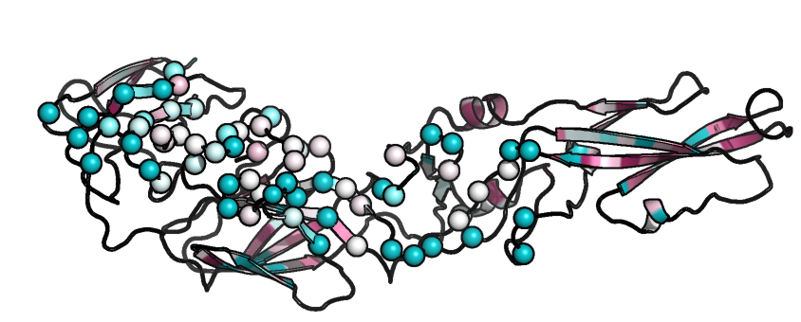
Variability of Envelope: Zika vs dengue
Estimation of degree of conservation of amino-acid positions among close sequence homologues
EDIII
EDII
EDI
180°
Variable
Conserved
EDIII
Fusion loop
EDI
domain I/II hinge region
Putative type-specific Ab binding regions
Dr. Prem Lakshmanane, UNC Microbiology and Immunology
Notes:
Homology model

Slide 22
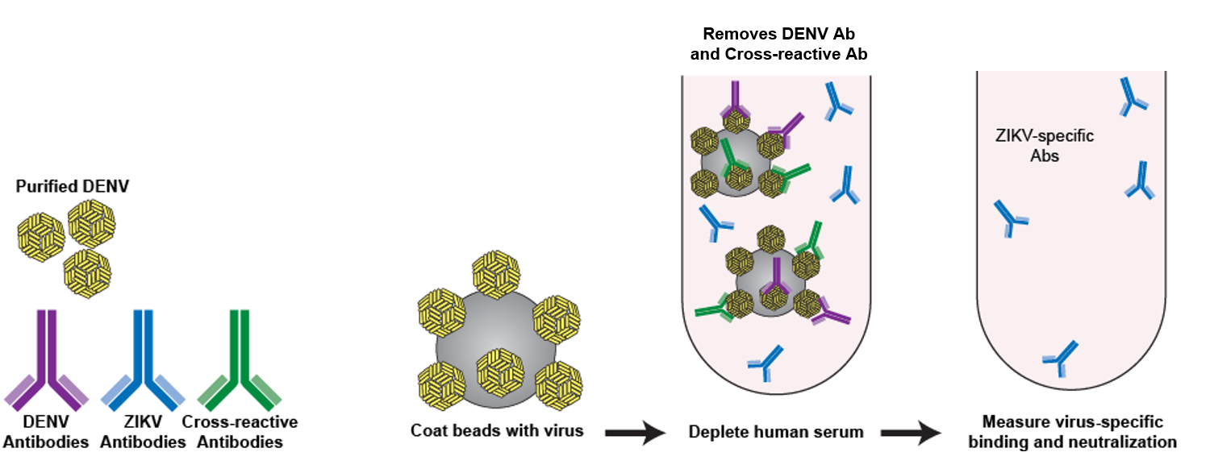
Resolving cross-reactive and type-specific Ab
Notes:
Figure 5. Depletion with DENV antigen does not reduce ZIKV neutralization. A) Relative infection in the presence of sera depleted with DENV1 and DENV2 (open circles) and with BSA control (closed circles). The infecting virus is indicated on top of each column and the flavivirus infection history is indicated at the left of each row. B) Table summarizes neutralization IC50 against indicated viruses for each sera with control or DENV1 and DENV2 depletion.

Slide 23
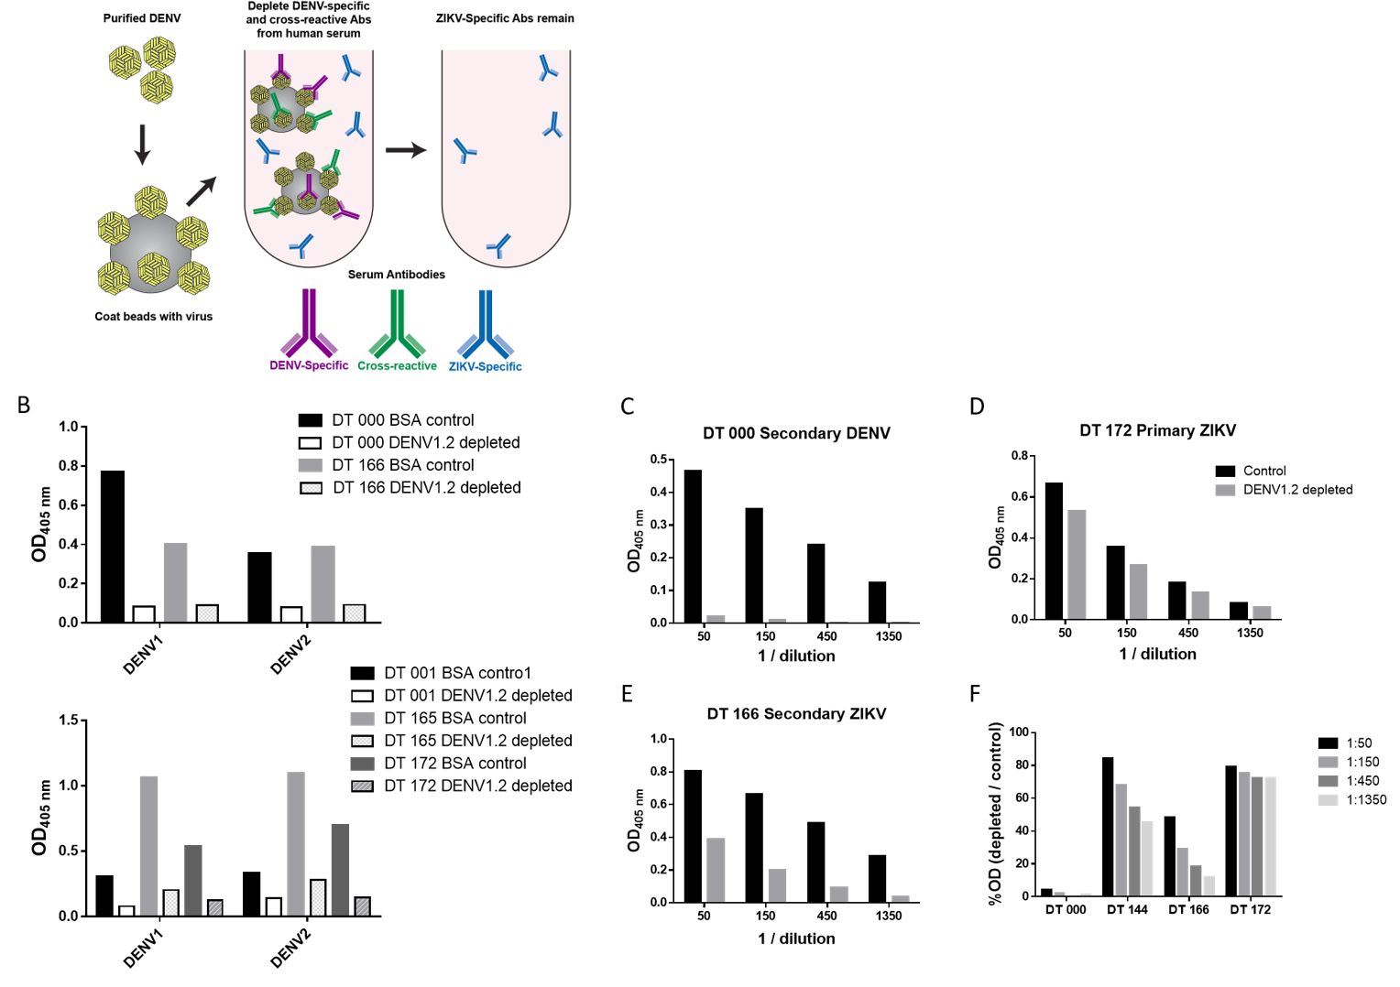
  xrAb depletion reveals type-sp Zika binding
huIgG
Capture ELISA
Capture: 4G2
Ag: Zika HPF2013
2ry Ab: GaHuIgG-APP

Slide 24
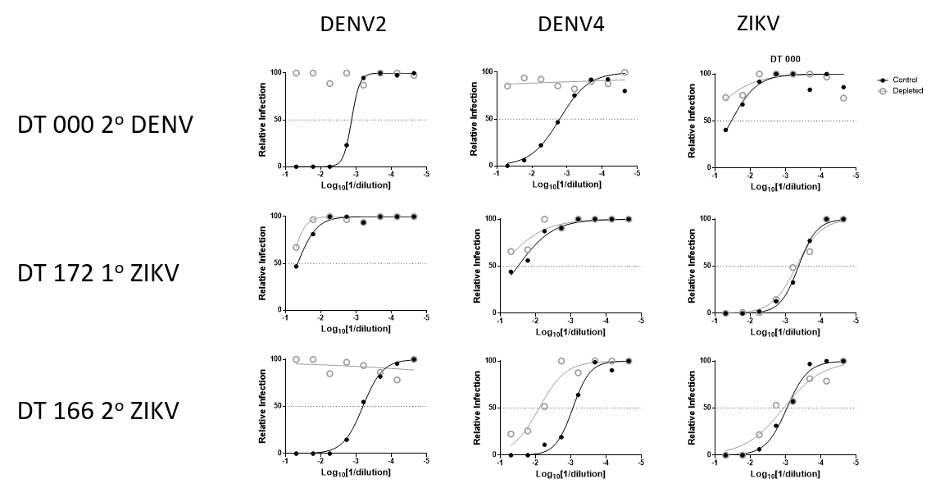
  xrAb depletion reveals type-sp neutralization

Slide 25
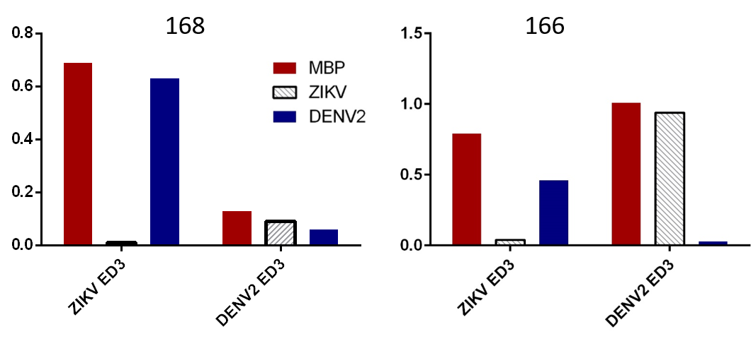
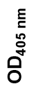
Flavivirus type-specific Ab to E domain 3
Primary ZIKV
Secondary ZIKV
Coating Ag:

Slide 26
Current Goals
Diminish global disease burden due to flaviviruses
Define and understand flavivirus Ab cross reactivity
Provide knowledge and tools to enhance public health measures
Hypothesis
Type-specific binding and neutralizing mAb are useful reagents
Zika and dengue exhibit different determinants of neutralization
The MBC repertoire is and is not shaped by flavivirus exposure history

Slide 27
Zika mAb
Therapeutic potential
  Blocking MTCT
Valuable diagnostic reagents
Key tools for research
  Vaccine development
  Immunology
  Virology and pathogenesis
Sean Diehl and Huy Tu, UVM
Notes:
Figure 2 | Memory B cell responses ZIKV exposure. Memory B cells (MBC) from two subject exposed ZIKV either as a (A) primary or (B) exposure were transduced and cultured at 50 cells/well and screened by ELISA for production of IgG that can bind to ZIKV HPF/2013 and with a mix of DENV1-4. We observed over 80% concordance between UVM and UNC with regard to ZIKV-hit identification, demonstrating the harmonization of our assays and robustness of this collaborative approach.

Slide 28
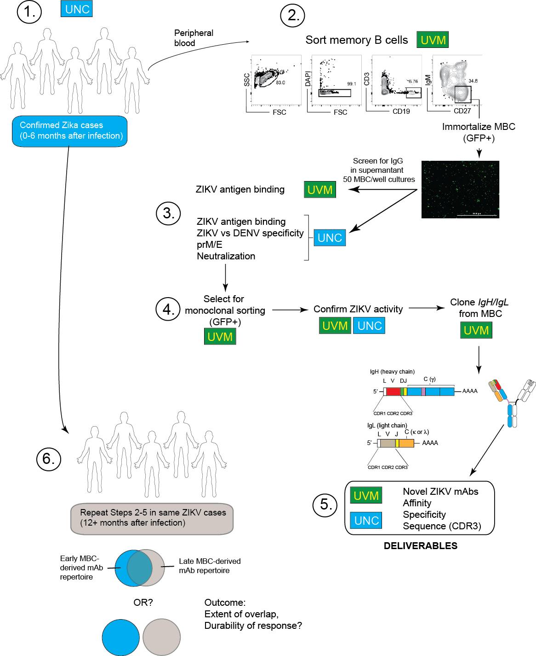
Zika mAb
Therapeutic potential
  Blocking MTCT
Valuable diagnostic reagents
Key tools for research
  Vaccine development
  Immunology
  Virology and pathogenesis
Sean Diehl and Huy Tu, UVM
Notes:
Figure 2 | Memory B cell responses ZIKV exposure. Memory B cells (MBC) from two subject exposed ZIKV either as a (A) primary or (B) exposure were transduced and cultured at 50 cells/well and screened by ELISA for production of IgG that can bind to ZIKV HPF/2013 and with a mix of DENV1-4. We observed over 80% concordance between UVM and UNC with regard to ZIKV-hit identification, demonstrating the harmonization of our assays and robustness of this collaborative approach.

Slide 29
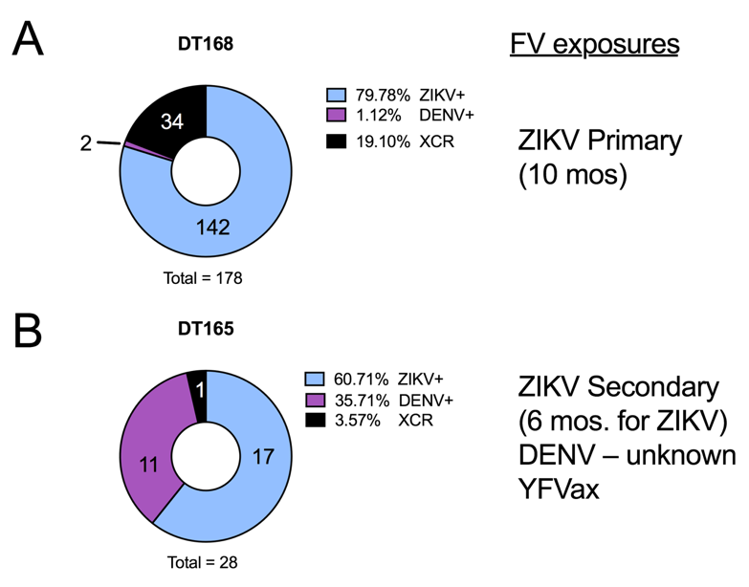
Zika mAb
Sean Diehl and Huy Tu, UVM
Notes:
Figure 2 | Memory B cell responses ZIKV exposure. Memory B cells (MBC) from two subject exposed ZIKV either as a (A) primary or (B) exposure were transduced and cultured at 50 cells/well and screened by ELISA for production of IgG that can bind to ZIKV HPF/2013 and with a mix of DENV1-4. We observed over 80% concordance between UVM and UNC with regard to ZIKV-hit identification, demonstrating the harmonization of our assays and robustness of this collaborative approach.

Slide 30
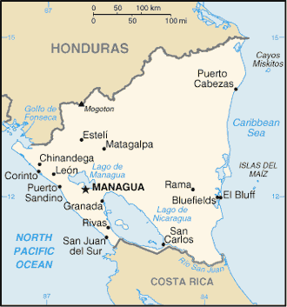
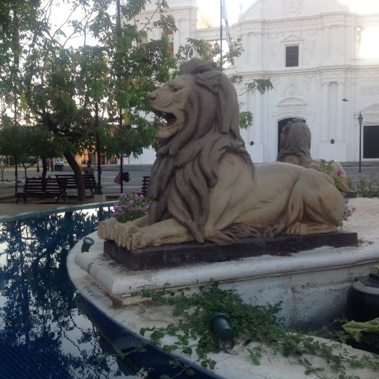

UNC lab work UNAN field work
Cohort studies in León, Nicaragua
  Clin-Epi of AFI/AEI
  MTCT and pregnancy outcomes
  Sexual / non-vector transmission
  Host susceptibility factors
Lab studies with León, Nicaragua
  Antibody responses to flaviviruses
  SeroDx devo and implementation
  Zika field isolates
  Vaccine Trials

Slide 31
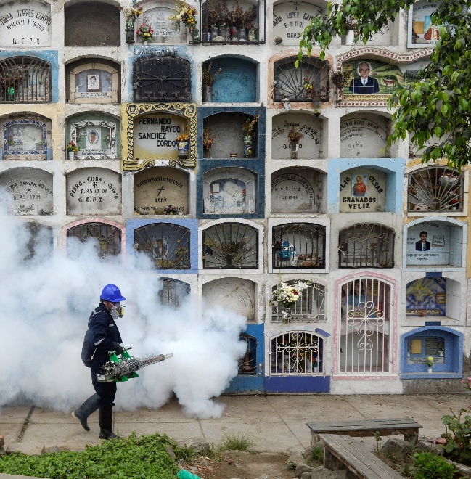
Conclusions
Banco a campo
Zika SeroDx are a critical and urgent need
determining flavivirus exposure in clinic
epidemiology and surveillance
vaccine trials
SeroDx for Zika is a solvable problem
Partnerships → effective and relevant
science with meaning
implementation

Slide 32
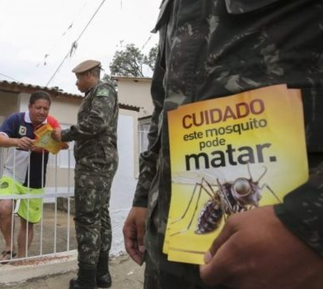

Slide 33
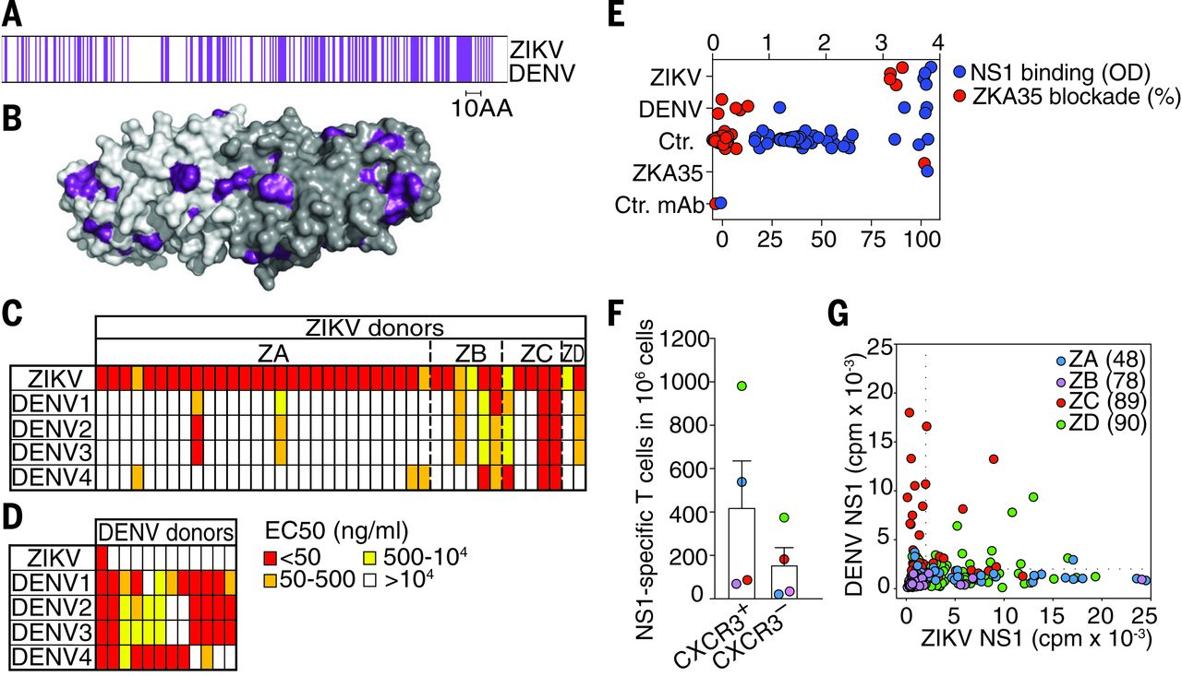
Fig. 1 Specificity and cross-reactivity of NS1-reactive mAbs and T cells derived from ZIKV- and DENV-infected donors.
Karin Stettler et al. Science 2016;353:823-826
Published by AAAS
Notes:
Specificity and cross-reactivity of NS1-reactive mAbs and T cells derived from ZIKV- and DENV-infected donors. (A) Sequence conservation of NS1 proteins as determined by the alignments shown in fig. S2. Conserved residues in NS1 are in purple. (B) Structure of the ZIKV NS1 dimer [Protein Data Bank (PDB) 5IY3]. The two monomers are shown with different shades of gray. The surface residues of each protomer that are conserved between ZIKV and DENV are colored as in (A). (C and D) Heat map of the reactivity of (C) 41 mAbs derived from four ZIKV-infected donors (ZA-ZD) and (D) 12 mAbs derived from two DENV-infected donors. The mAbs were tested for binding to NS1 proteins of ZIKV and DENV1-4 [median effective concentration (EC₅₀), nanograms per milliliter]. A description of the immune status of the donors and the mAbs codes is provided in table S1. The binding curves of NS1-reactive mAbs are shown in figs. S3 and S5, and EC₅₀ values are reported in tables S3 and S4. Data are representative of at least two independent experiments. (E) Plasma from ZIKV-infected (n = 4 donors), DENV-infected (n = 5 donors), and control donors (n = 48 donors) (1/10 dilution) were tested for their capacity to bind NS1 (blue dots) and to inhibit the binding of the biotinylated mAb ZKA35 to NS1 (red dots). (F and G) T cell libraries were generated from CXCR3⁺ and CXCR3– memory CD4⁺ T cells of the four ZIKV-infected donors and screened for reactivity against ZIKV or DENV1-4 NS1 proteins by use of ³H-thymidine incorporation. Shown is the estimated number of ZIKV NS1–specific T cells per 10⁶ cells [mean + SEM and color-coded values for individual donors (F)]. Shown is also the proliferation [counts per minute (cpm)] of individual cultures to either ZIKV or DENV1-4 NS1 proteins (G). The cultures from different donors are color-coded, and their numbers are shown in parentheses. Dotted lines represent the cut-off value.

Slide 34
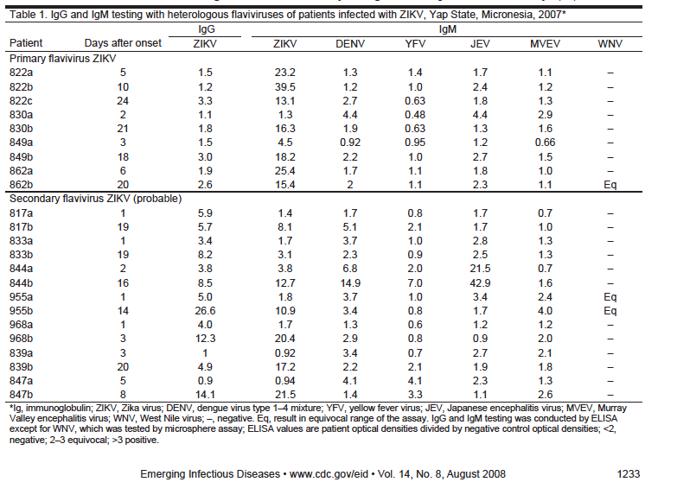
ZIKA IgM assay is accurate in primary but not secondary flavivirus infections

Slide 35
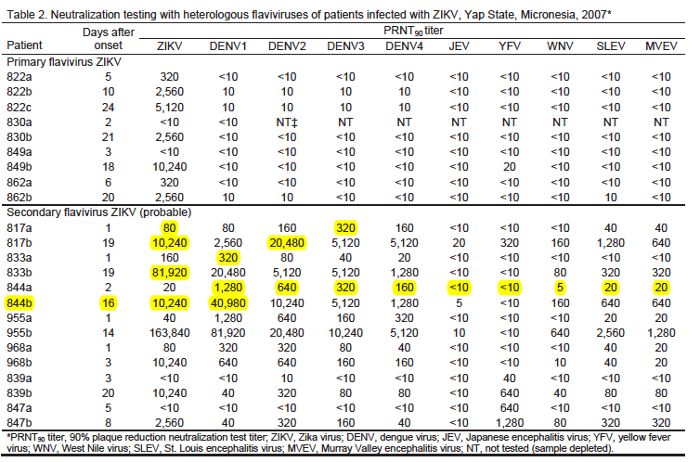
Current ZIKA neutralization assays are accurate in primary but not secondary flavivirus infections

