Slide 1
Primary Care in
Displaced Persons __________________________________________________________________________
Experiences in Greece
UNC OIA Global Health Forum
17 November 2016
Sonya V. Patel-Nguyen, MD
Departments of Internal Medicine & Pediatrics

Slide 2
The Crisis

Slide 3
Refugees
1948 Universal Declaration of Human Rights
1951 Refugee Convention
Defines refugees
UN High Commissioner for Refugees
Notes:
1948 arose from WW2; 30 articles total
Committee lead by Eleanor Roosevelt (not legally binding, but adjusted and followed by International Bill of Human Rights which in 1976 became international law)
Article 14 -- Persons have a right to seek asylum from persecution from other countries
Article 15 - right to a nationality
Article 25 - right to a standard of living adequate for the health and well-being of himself and of his family, including food,clothing, housing, and medical care and necessary social services, and the right to security in the event of unemployment, sickness, disability, widowhood, old age, or lack of livelihood in circumstances beyond his control
1951 - UN treaty builds on article 14. Set up post WW2, initially protect Europeans only but later extended to all (1967 protocol - same year as second palestinian exodus)
Defines refugee
War criminals do NOT qualify
Defines rights of individuals who are granted asylum
Defines responsibilities of nations that grant asylum
Non-refoulement = refugee should not be returned to a country where they face serious threats to their life or freedom. This is now considered a rule of customary international law.
UNHCR = UN high commissioner for Refugees (or UN Refugee Agency)
An asylum-seeker is someone whose request for sanctuary has yet to be processed. Every year, around one million people seek asylum.
Refugees are specifically defined and protected in international law. Refugees are people outside their country of origin because of feared persecution, conflict, violence, or other circumstances that have seriously disturbed public order, and who, as a result, require ‘international protection’. Their situation is often so perilous and intolerable, that they cross national borders to seek safety in nearby countries, and thus become internationally recognized as ‘refugees’ with access to assistance from states, UNHCR, and relevant organizations. They are so recognized precisely because it is too dangerous for them to return home, and they therefore need sanctuary elsewhere. These are people for whom denial of asylum has potentially deadly consequences.

Slide 4
http://www.unhcr.org/en-us/figures-at-a-glance.html
Notes:
65.3 million forcibly displaced persons
34000 people forcibly displaced daily
21.3 million refugees (½ under age 18) ==== definition ***
10 million stateless == denied nationality and access to basic rights (education, healthcare, employment, freedom of movement)

Slide 5
http://www.unhcr.org/en-us/figures-at-a-glance.html
Notes:
More than 1-mllion people arrived in the EU in 2015 alone

Slide 6
Greece

Slide 7
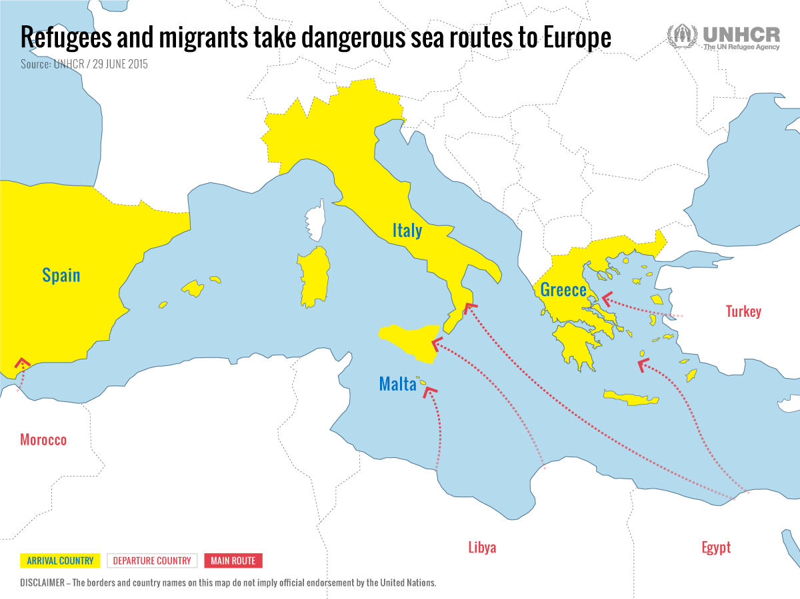
http://tracks.unhcr.org/2015/07/the-sea-route-to-europe/

Slide 8
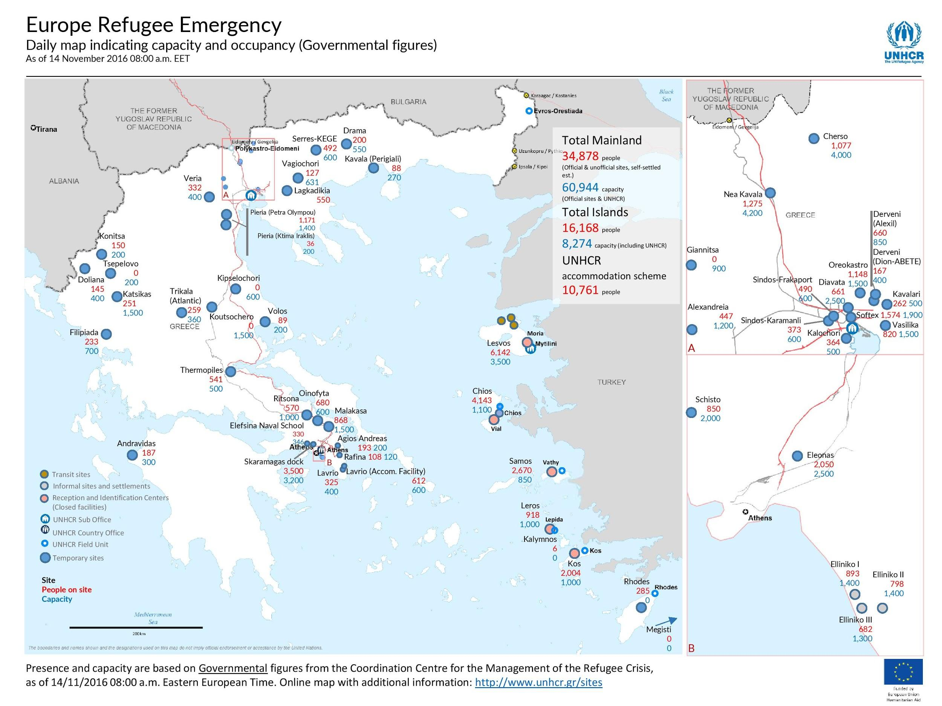
http://www.refworld.org/country,,UNHCR,,GRC,,58060cfe4,0.html
Notes:
Red: how many are there. Blue: capacity
Top corner shows Sindos
Mid/top
MAINLAND
>36K refugees (official and unofficial)
>57K capacity to house
ISLANDS
>15K refugees
8K capacity

Slide 9
Notes:
https://www.theguardian.com/world/2015/jul/09/greek-debt-crisis-damage-healthcare-hospital-austerity
http://pulitzercenter.org/reporting/refugees-and-health-care-crisis-greece
http://www.huffingtonpost.com/entry/greece-refugee-crisis-economy_us_56b12f1de4b04f9b57d7b7d4
https://www.foreignaffairs.com/articles/greece/2016-07-28/refugees-and-greeces-health-crisis
http://www.euronews.com/2016/10/20/greece-gets-economic-boost-from-refugee-aid

Slide 10
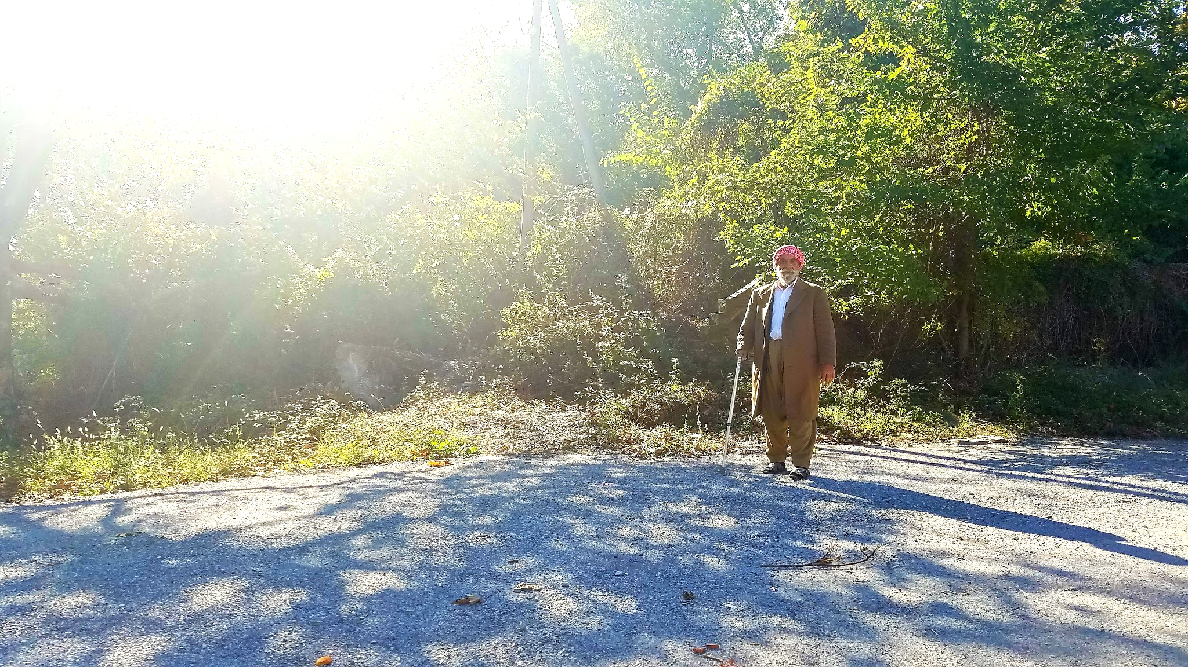
Yezidis
Ethnic Kurds
Religiously separate
Religious persecution for centuries
Genocide by ISIS in 2014
Notes:
Isis genocide 2014
Conversion campaign by ISIS - convert to sunni islam, or die
Abduction of women
Over 5000 killed
Escaped up side of mountain; some killed when returning to “white flag”
Directly led to american strikes in Iraq
US, UK, Australia made emergency drops to moountain; provided guns to peshmerga
Result - 500,000 refugees

Slide 11
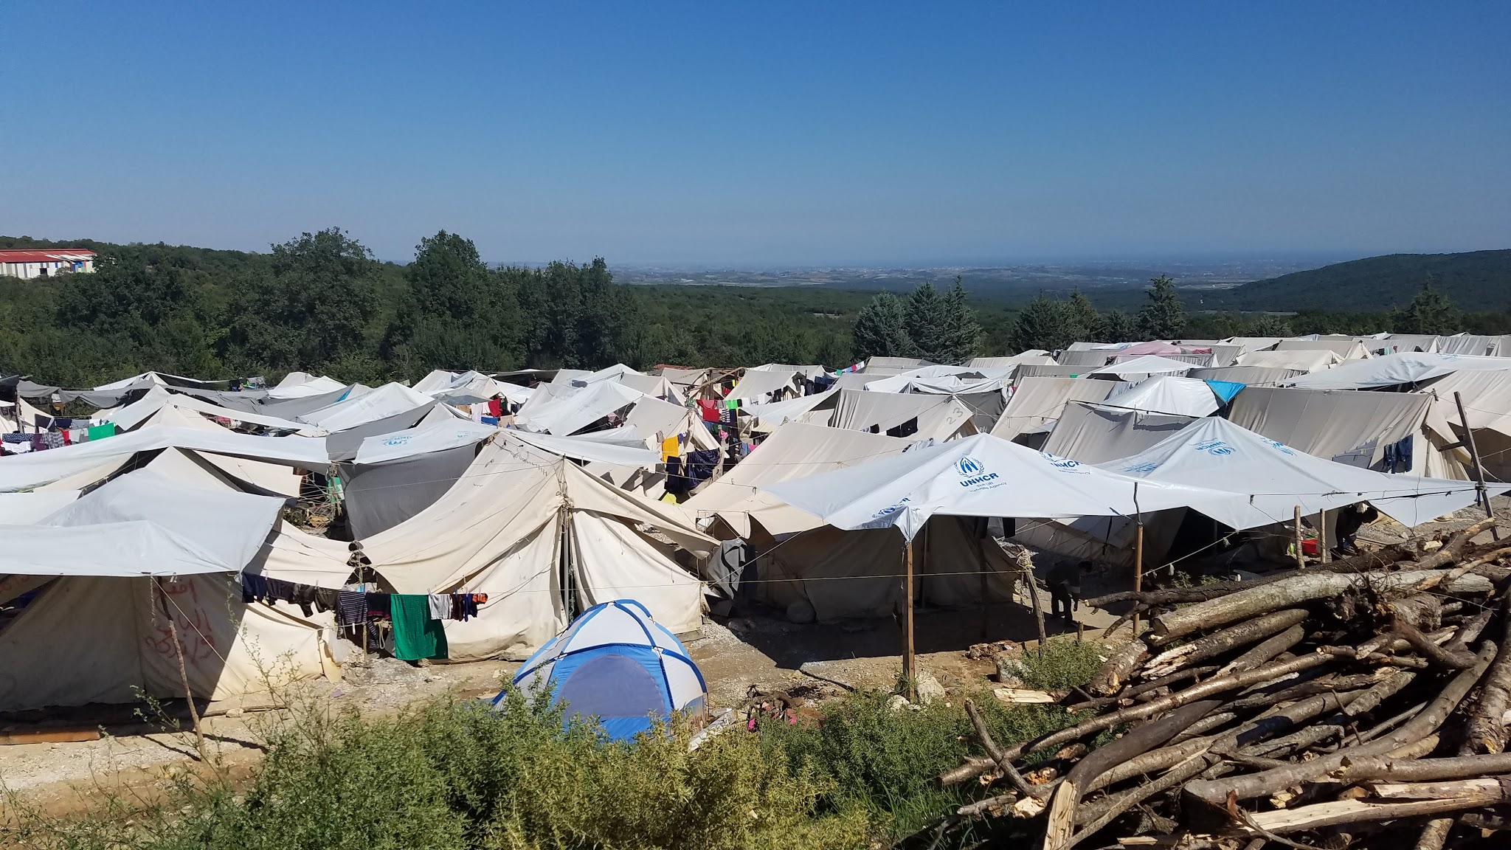
Yezidis
Migration to Turkey, Greece
Initially in Idomeni camp
UNHCR official camps established
Yezidis placed in a separate camp

Slide 12
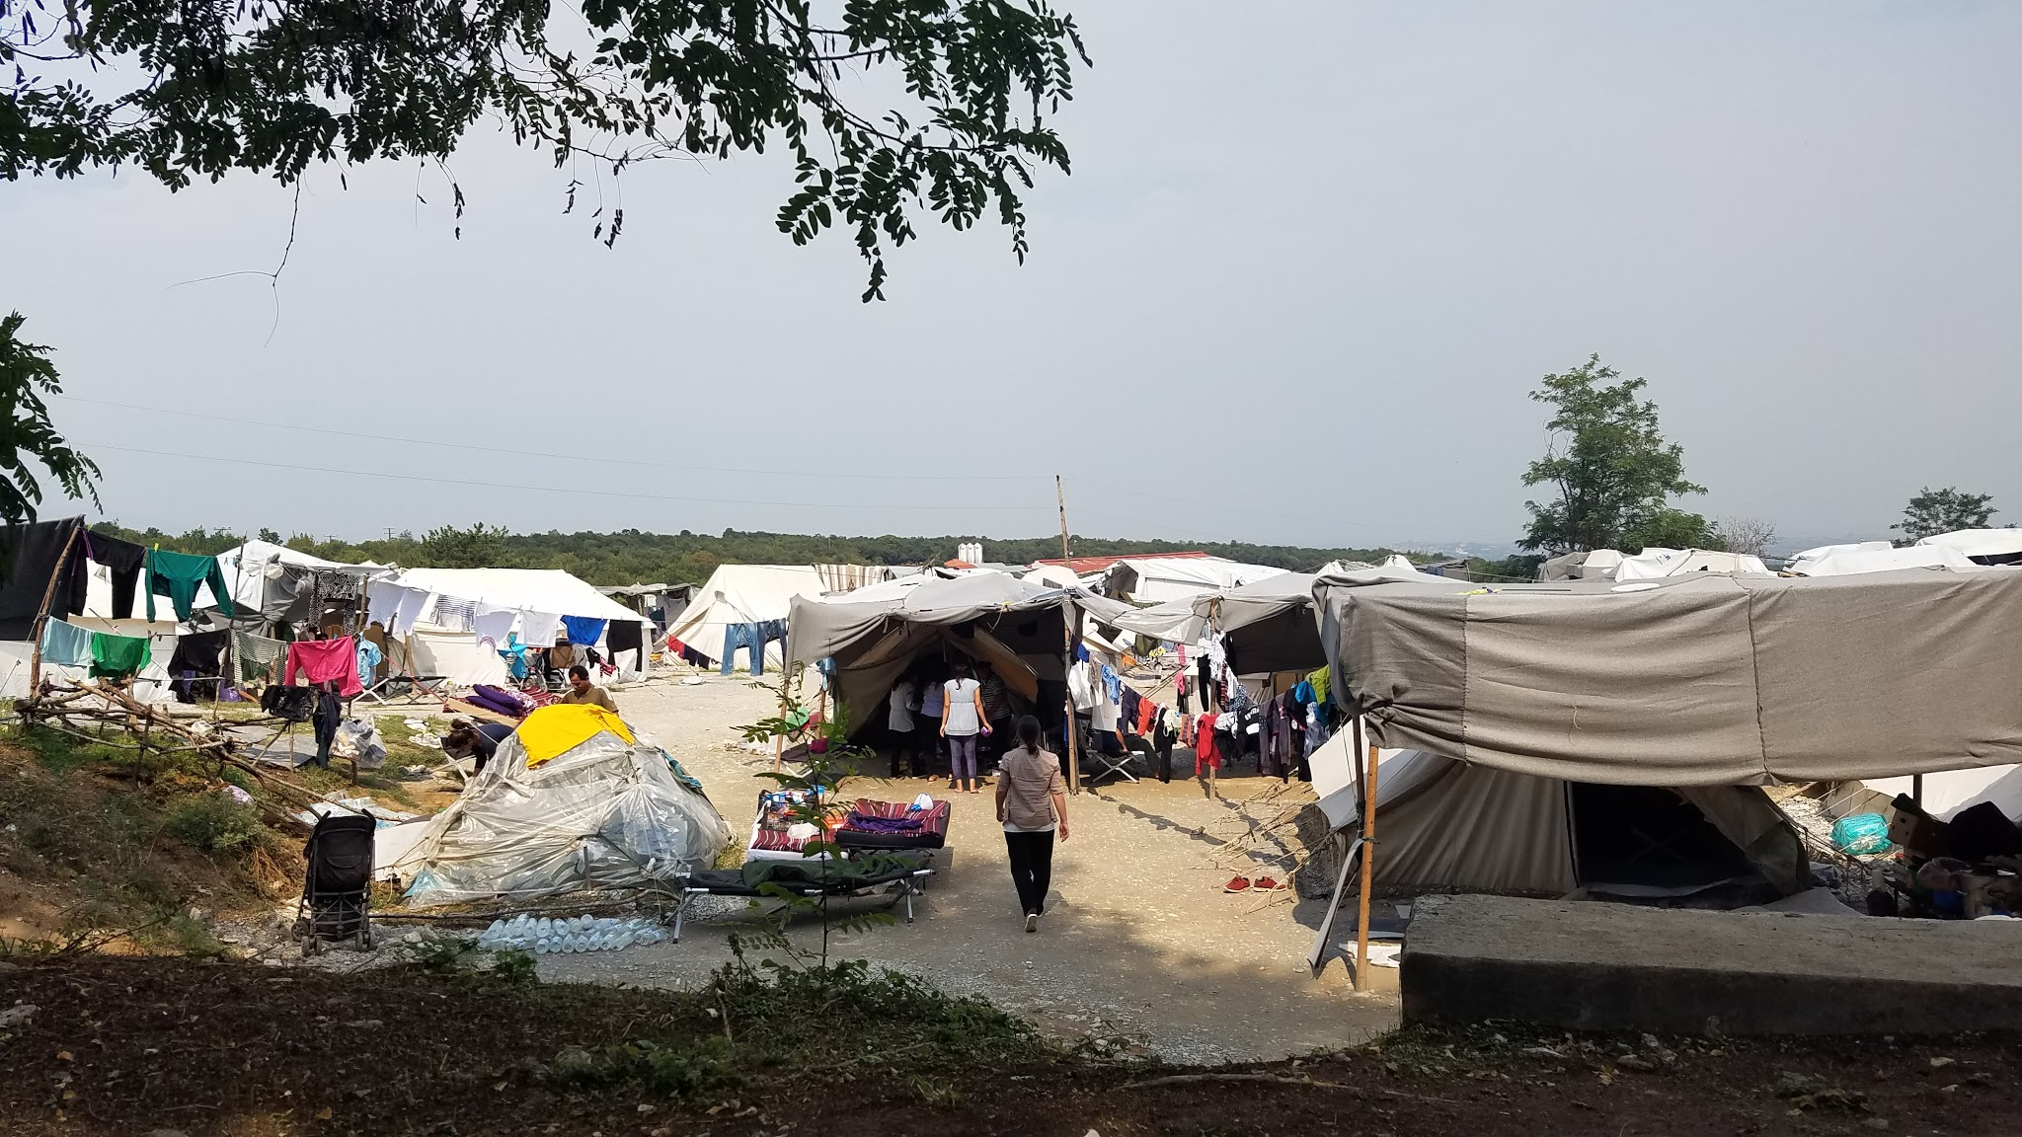
Petra Camp
Psych hospital
1200 people
95% Iraqi, 54% children
48 water taps, 31 toilets, 26 showers
Food and clothing distribution

Slide 13
Providing Primary Care

Slide 14
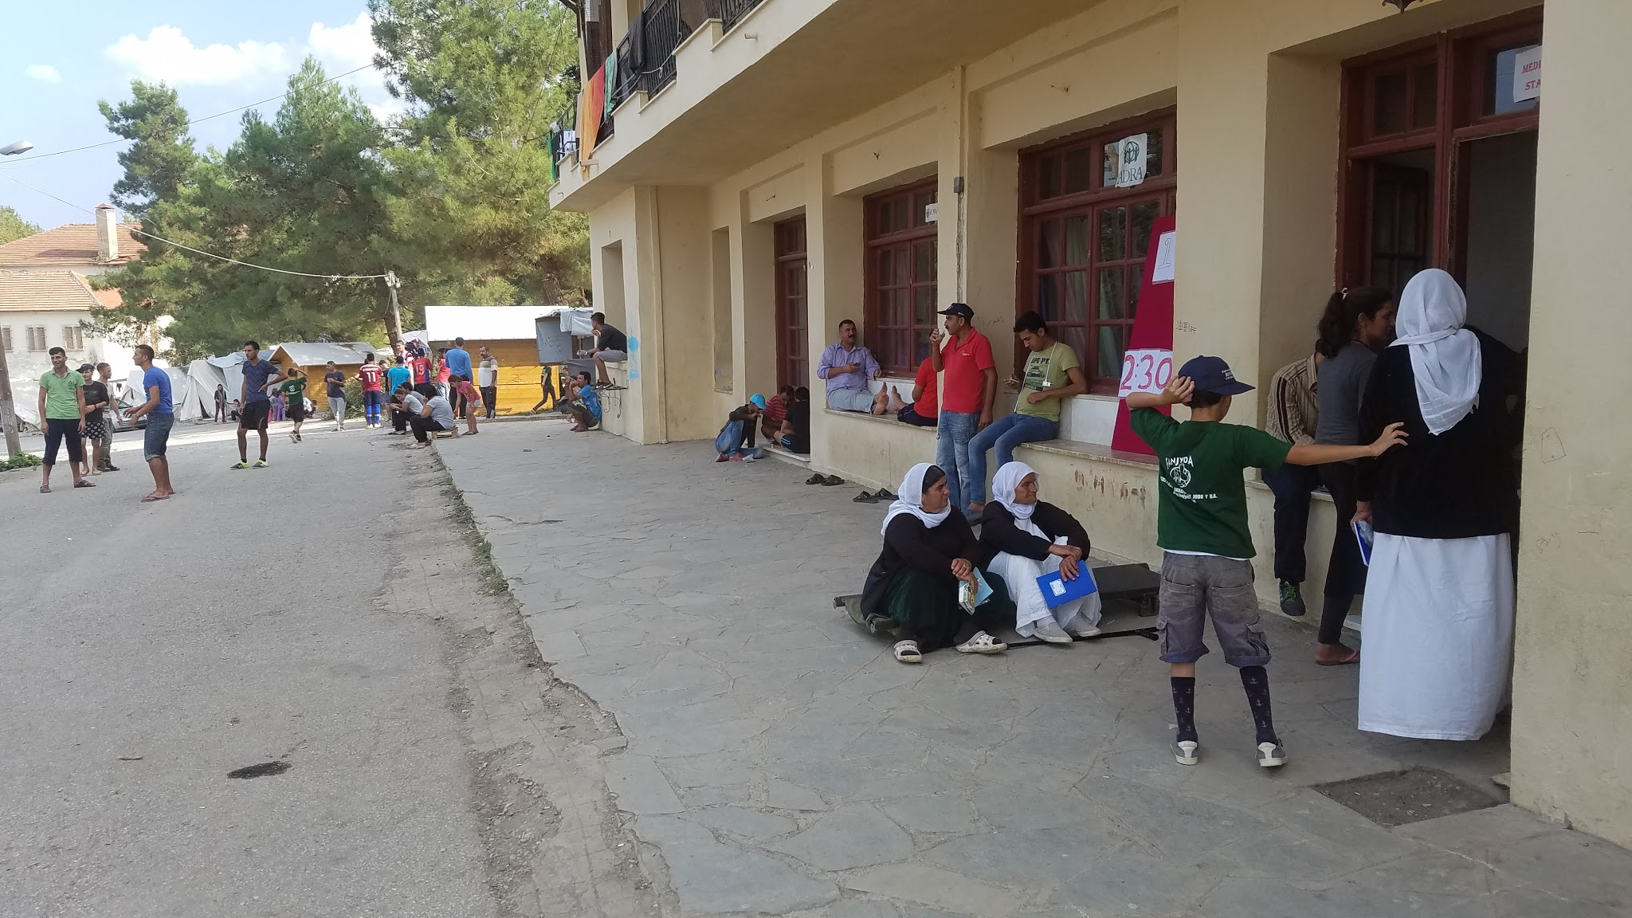
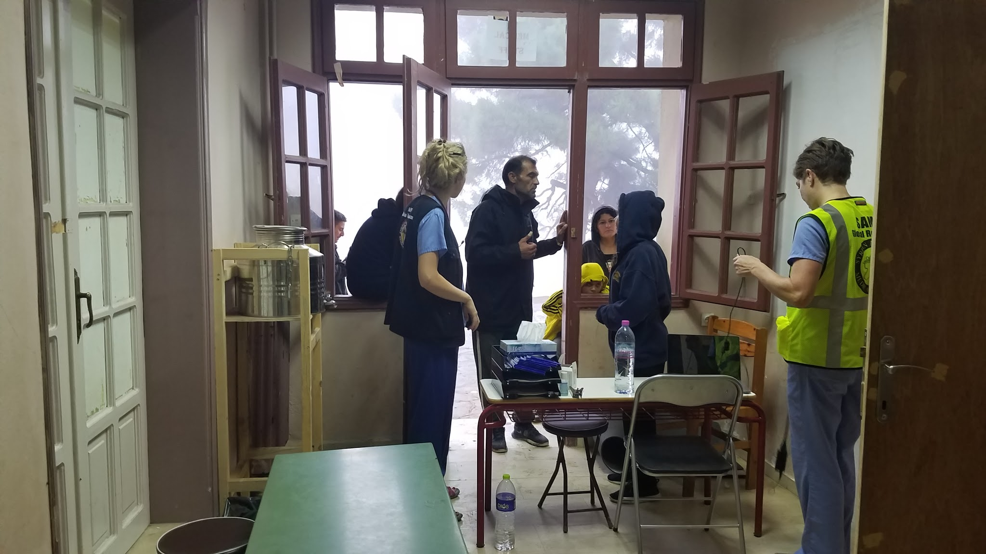
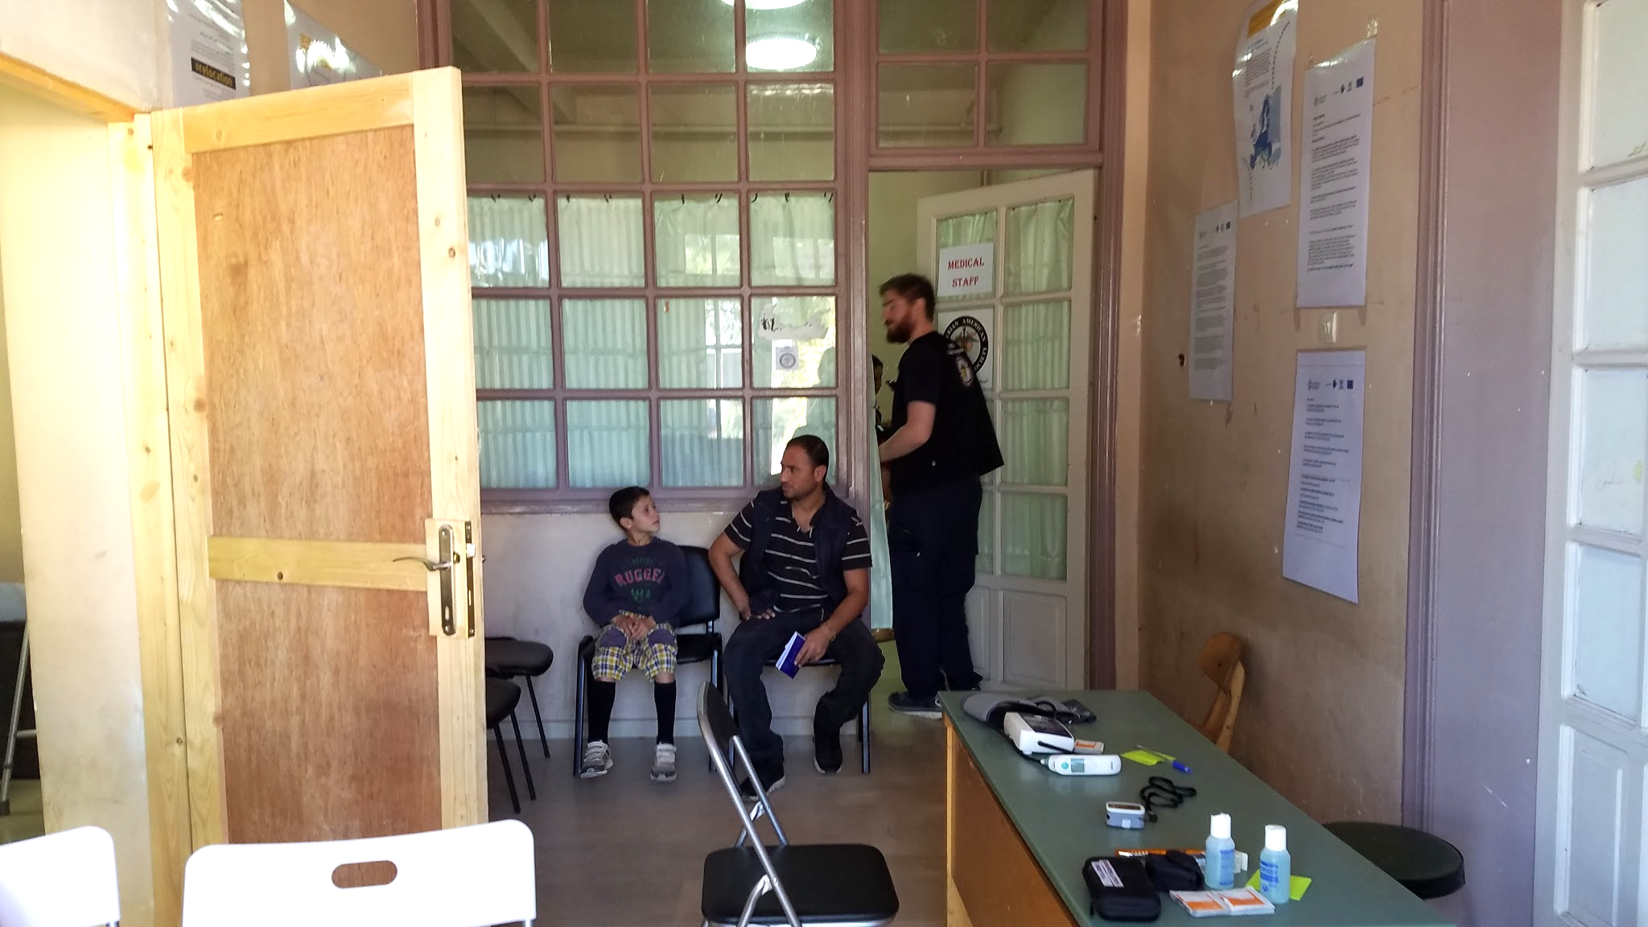
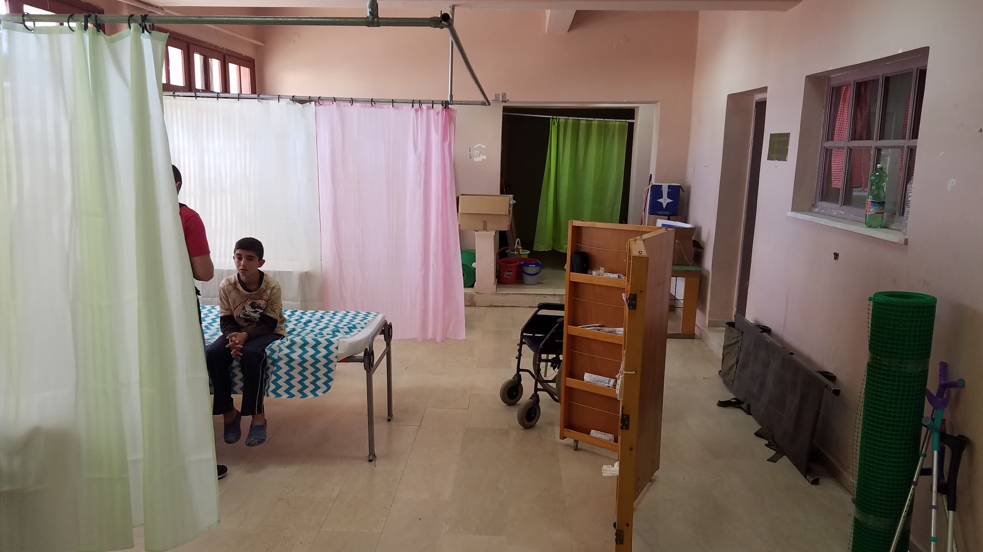

Slide 15
Communication

Slide 16
Use of Translators
Documents in Greek
Providers speak English
Camp tenants translating in Arabic and Kurmanji

Slide 17
“I remember when I started 3 weeks ago, I only knew “stomach” and “pain” in English.”
- Khawla
18 year old Yezidi girl in Petra, Greece. September 2016.

Slide 18
Treatment Options

Slide 19
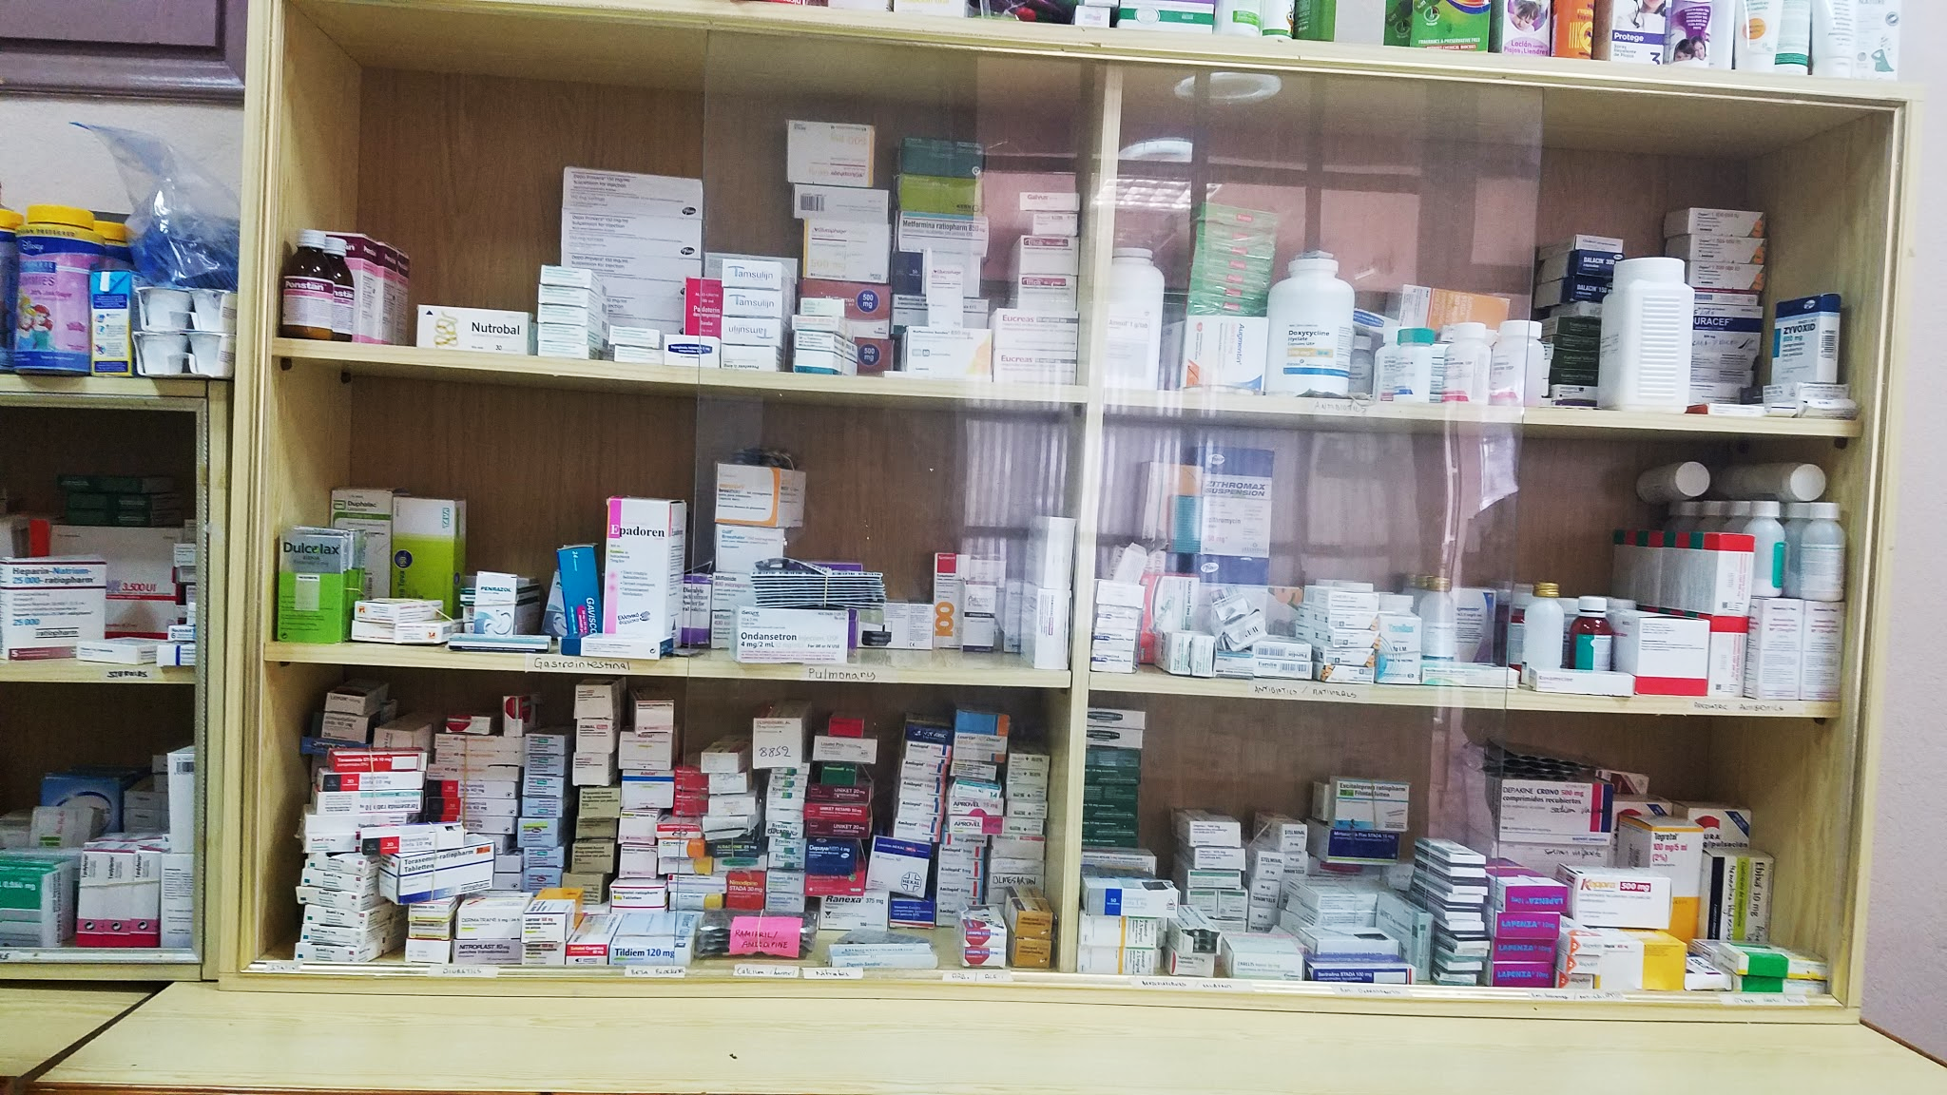
Available
Formulary
Illegal to import meds
Purchased from Greek formulary
Special orders
Differences in continental guidelines
Notes:
POC testing limited = urine dipstick basically. Glucometers. Have general other things like thermometers, BP cuffs.
Plenty of paracetamol, ibuprofen
Plenty of amoxicillin (reconstituting our own meds), augmentin, ciproflox, azithro
Interesting differences
Brits never use triple abx cream
Doxy first line for abx
Used BNF a lot

Slide 20
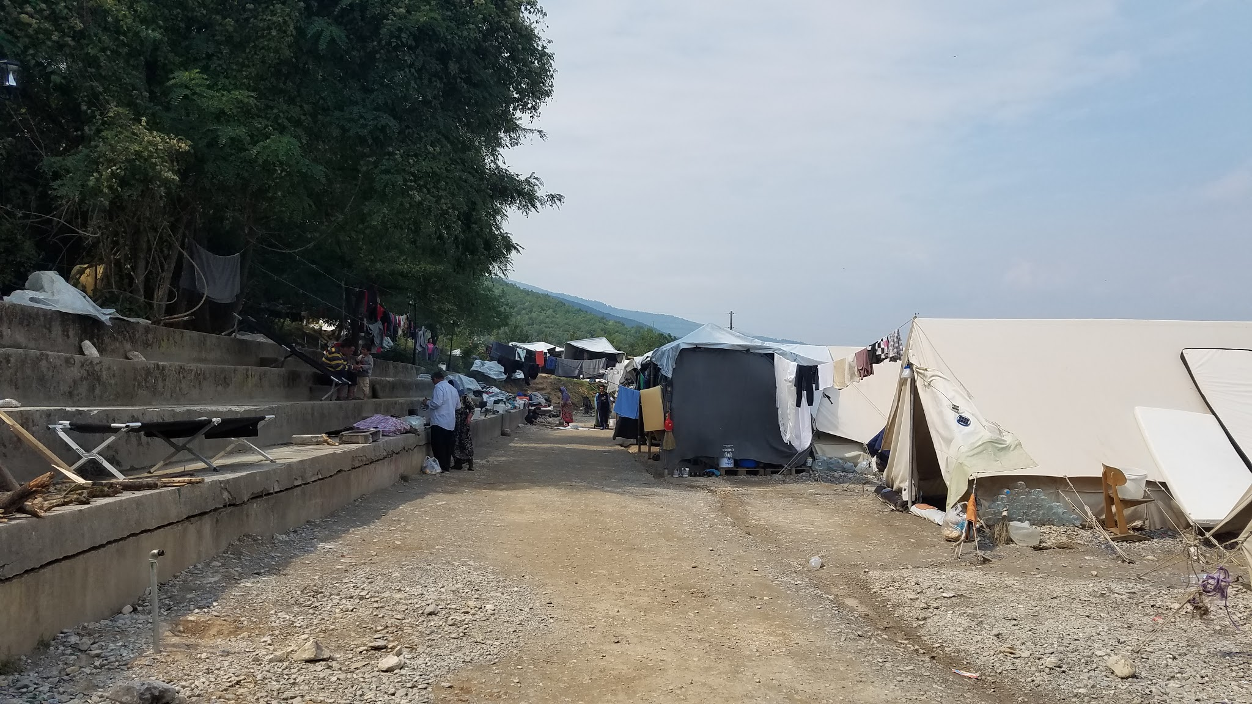
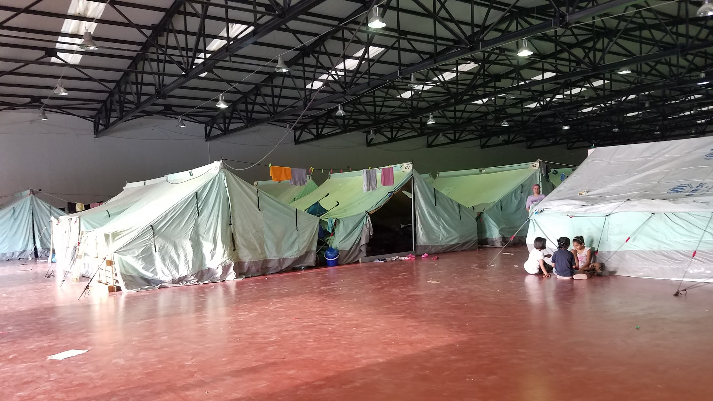
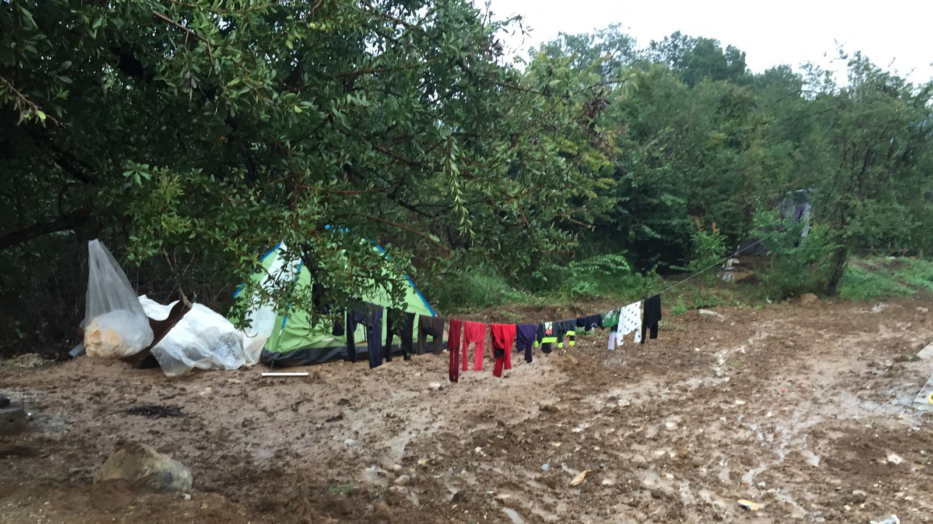
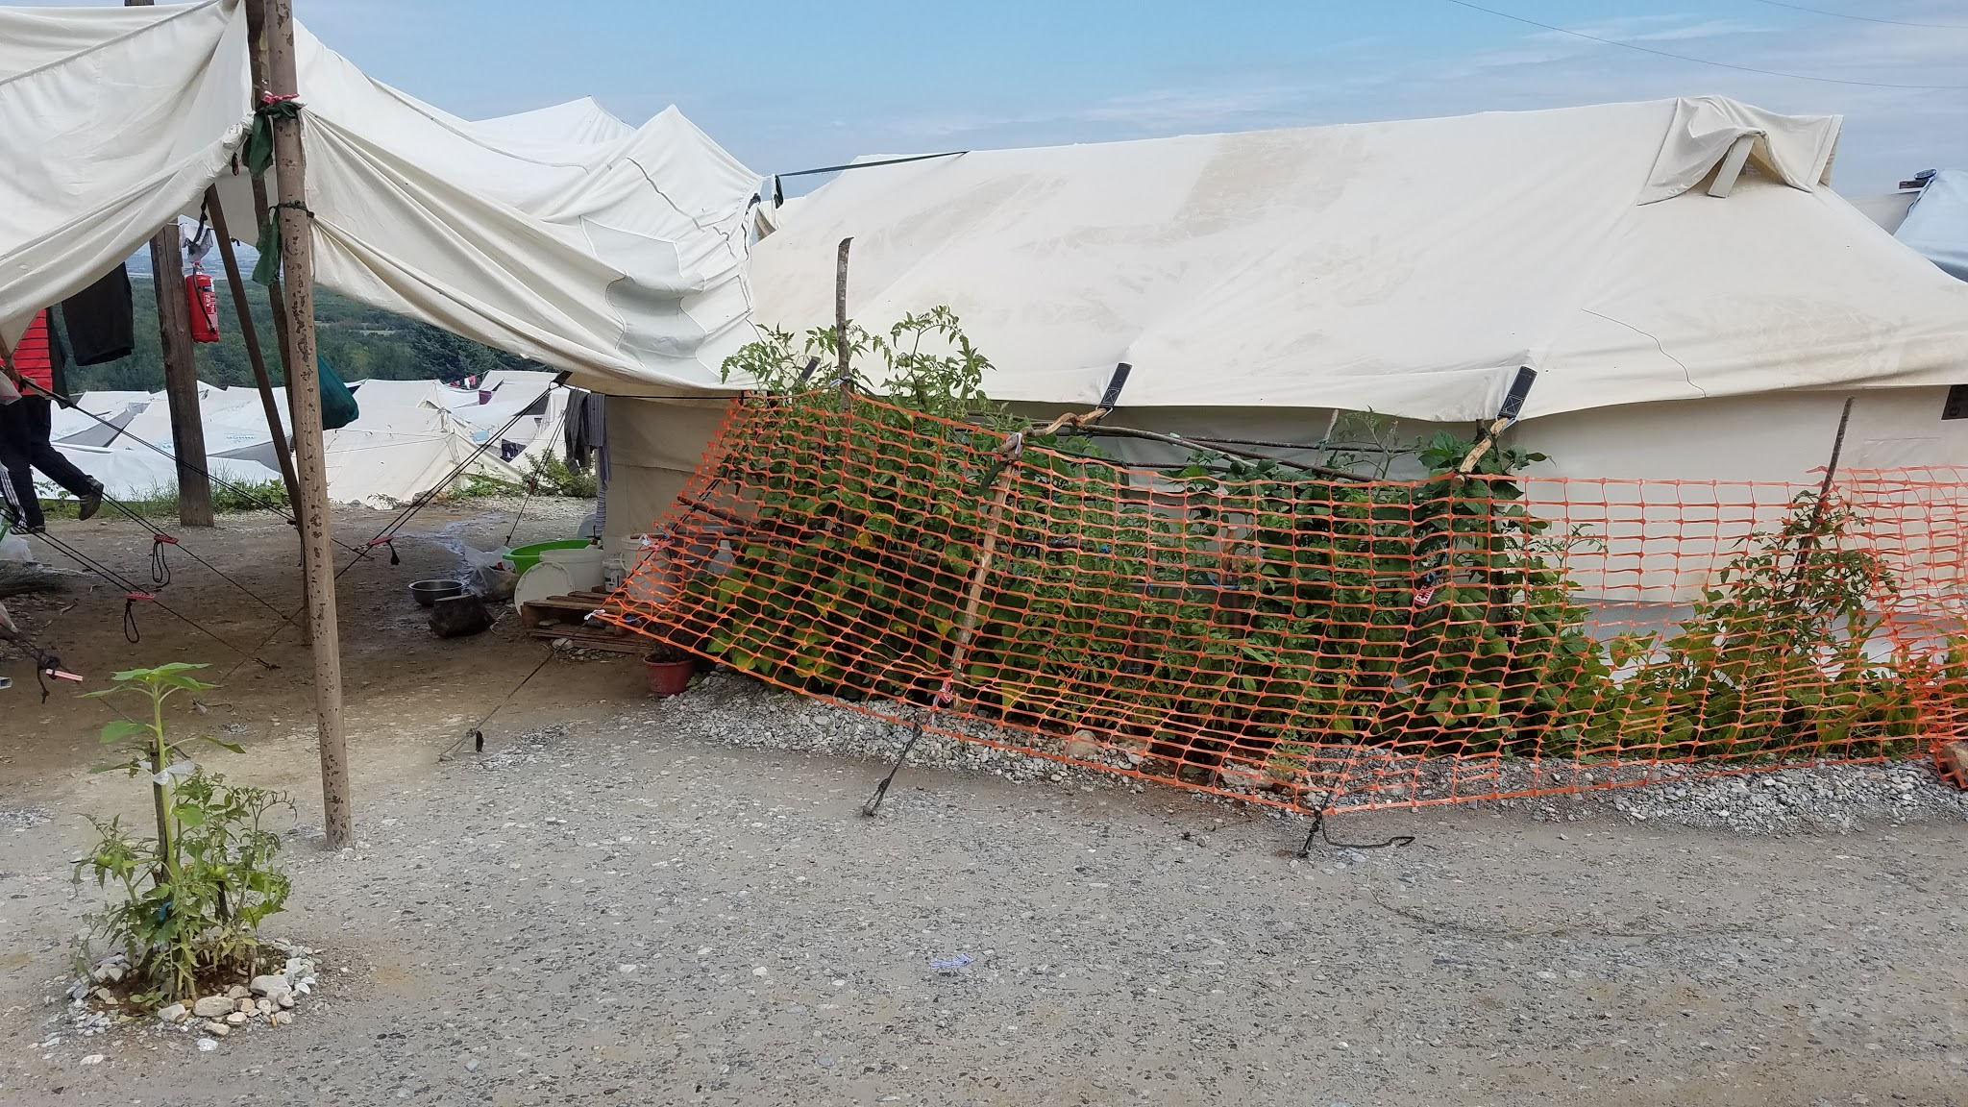
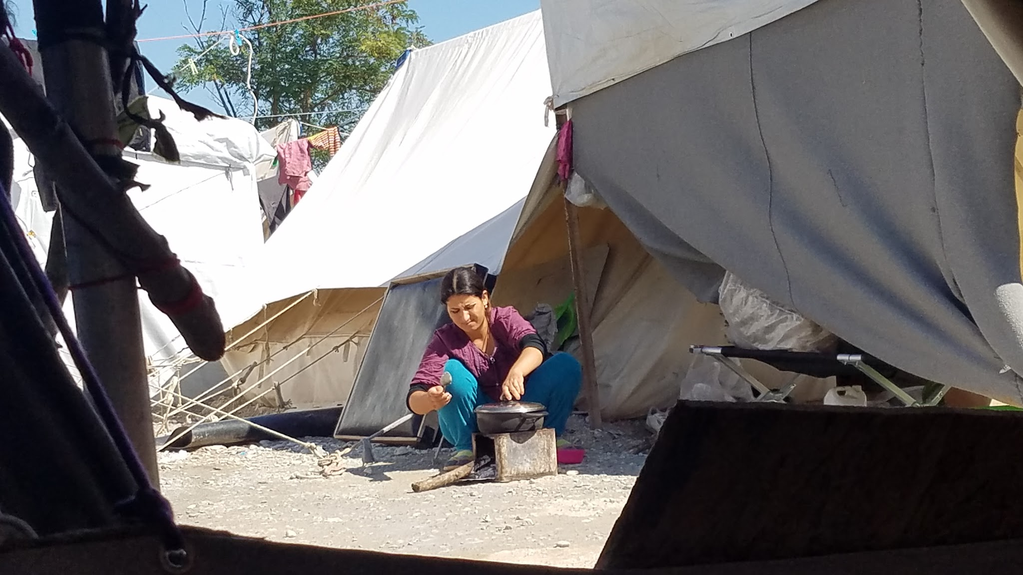
Lifestyle changes
Weather elements hard to combat
Fixed diet
Hand hygiene
Close living quarters
Supportive management
Notes:
Limited

Slide 21
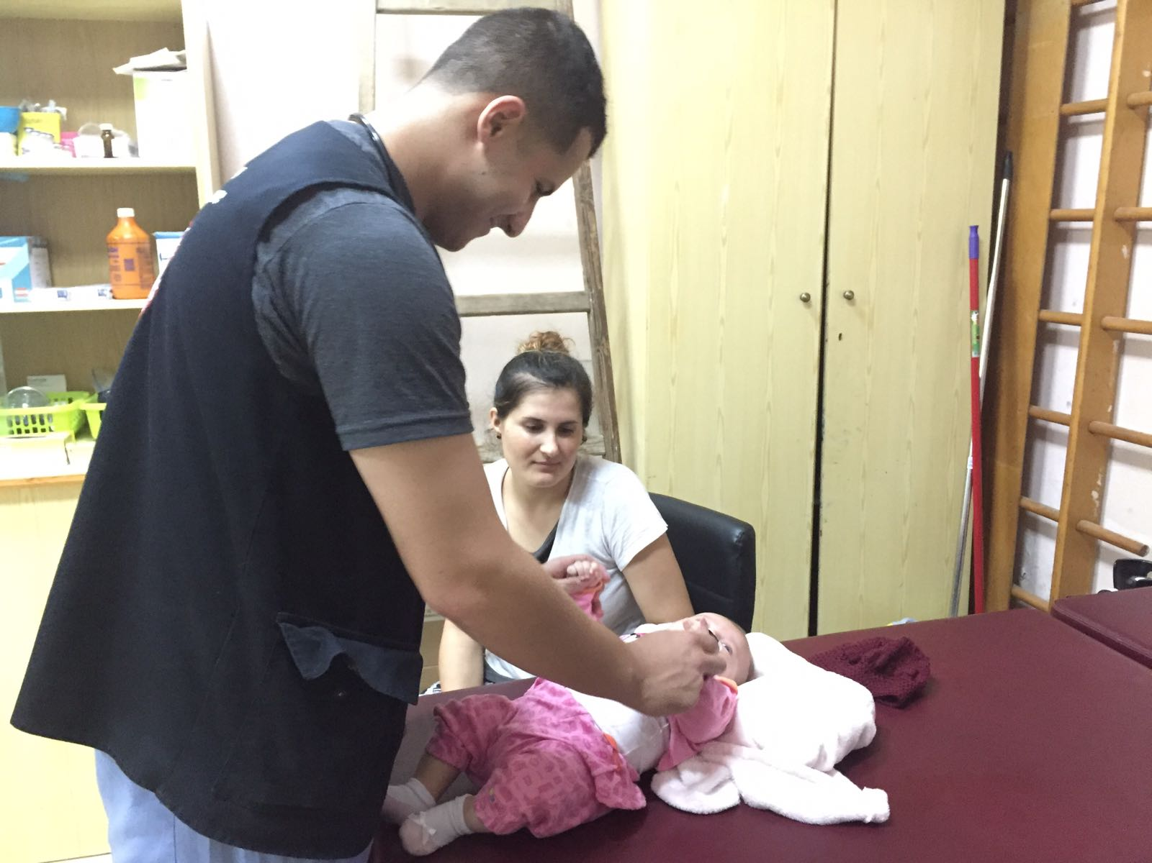
Access to specialists
Public sector
Limited with long wait times
Private consults are costly (e.g., abortion)
Volunteer physicians for short visits
Notes:
Limited

Slide 22
“In Iraq, they would give us an injection for pain. I want that.”
- Sami
37 year old Yezidi man in Petra, Greece. September 2016.

Slide 23
Minor Procedures

Slide 24
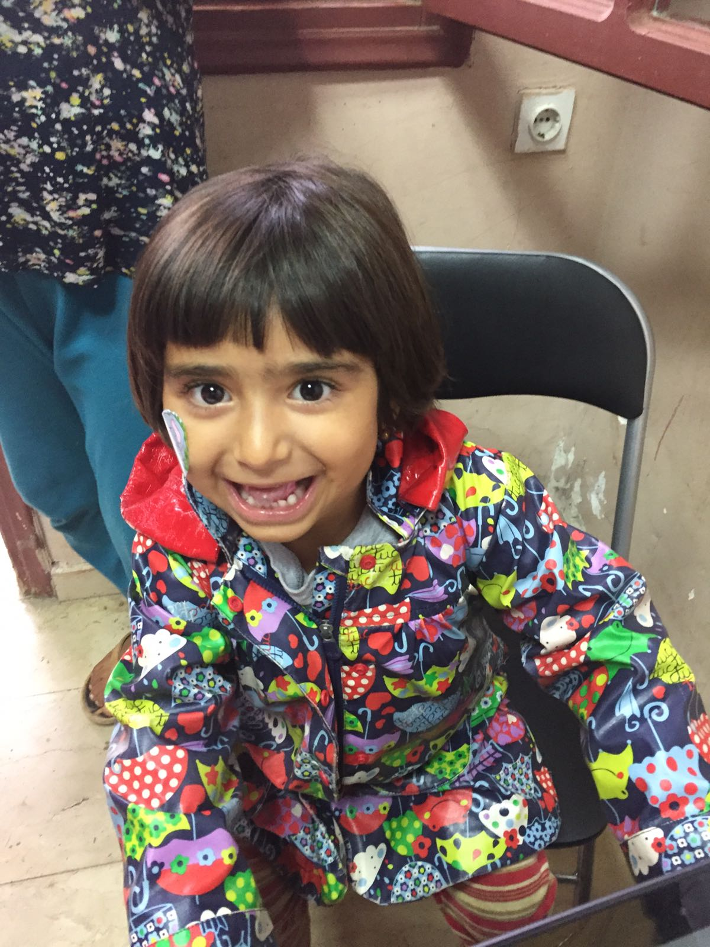
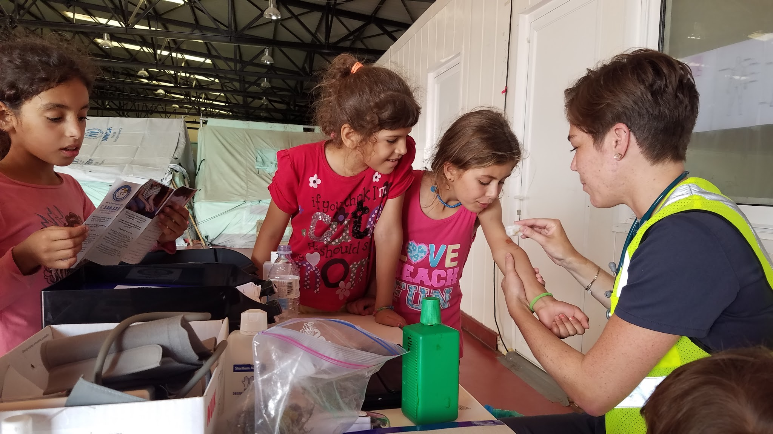
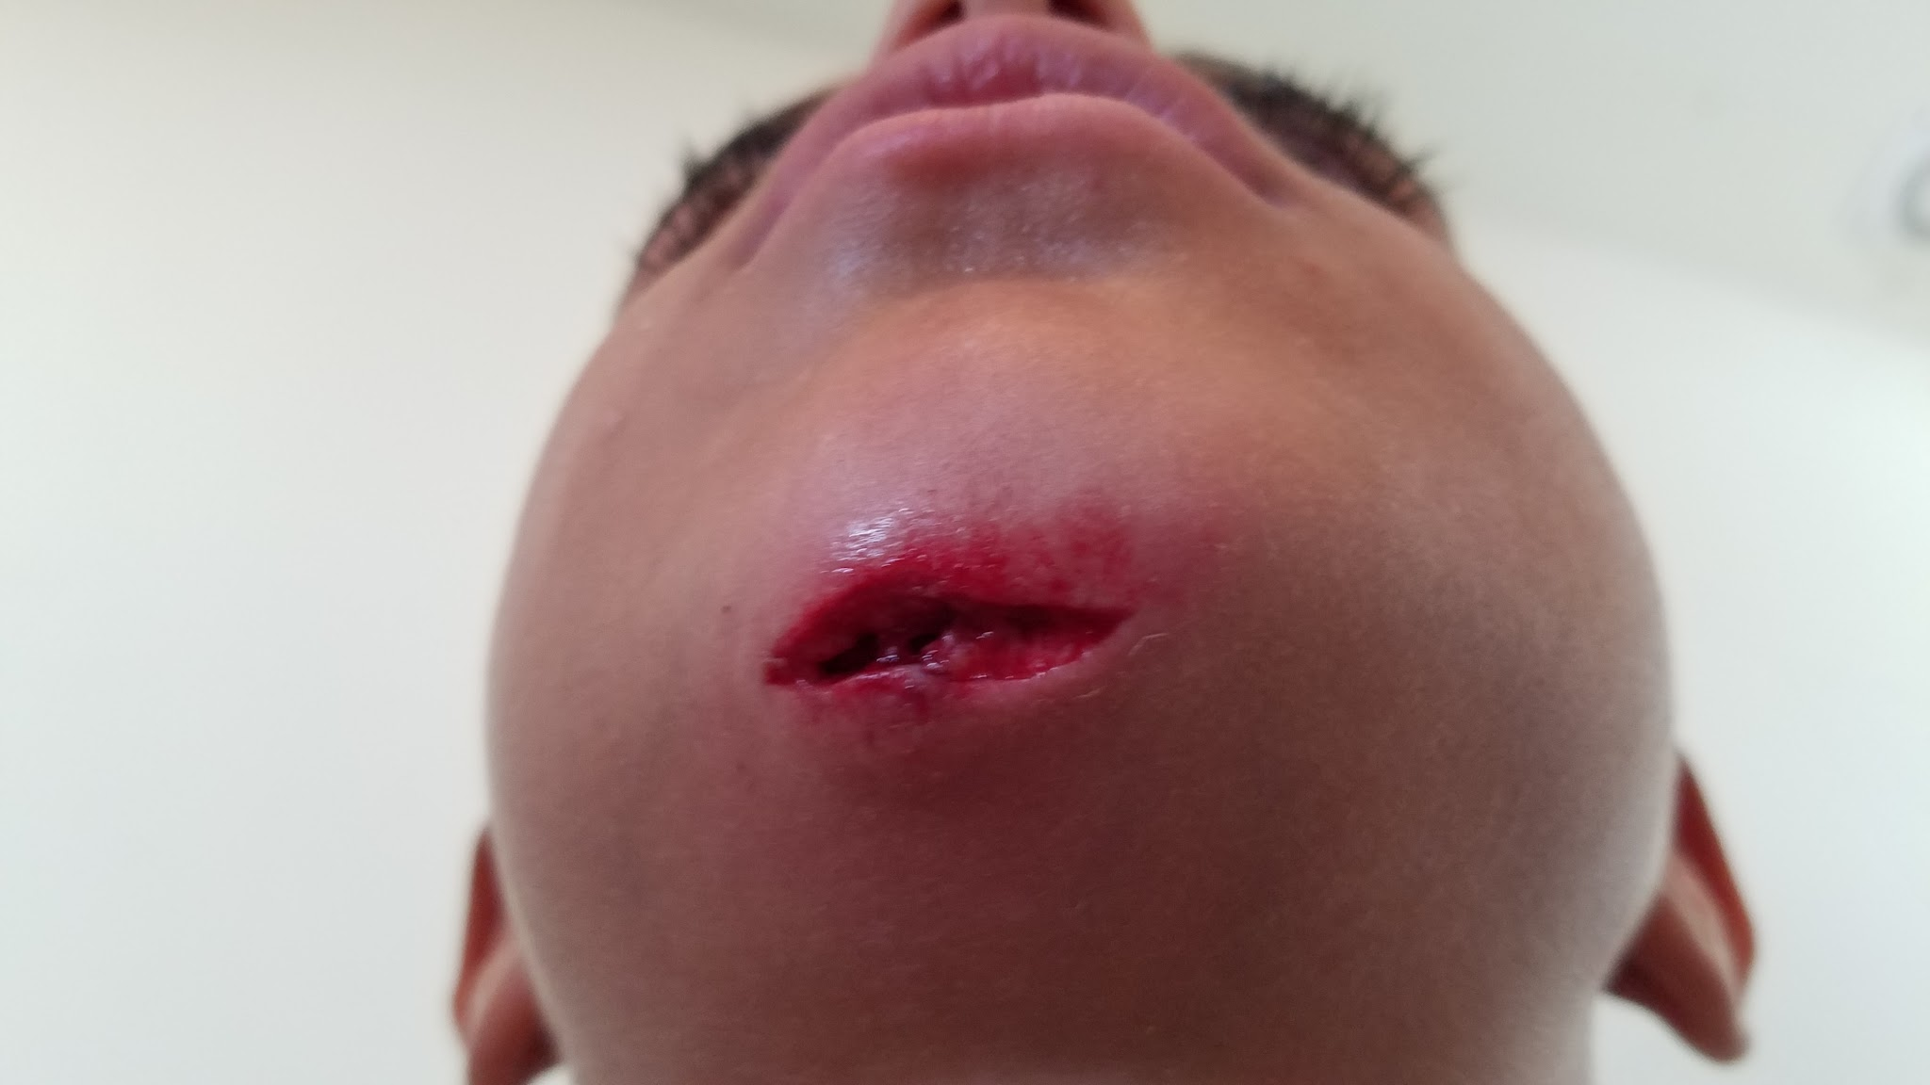
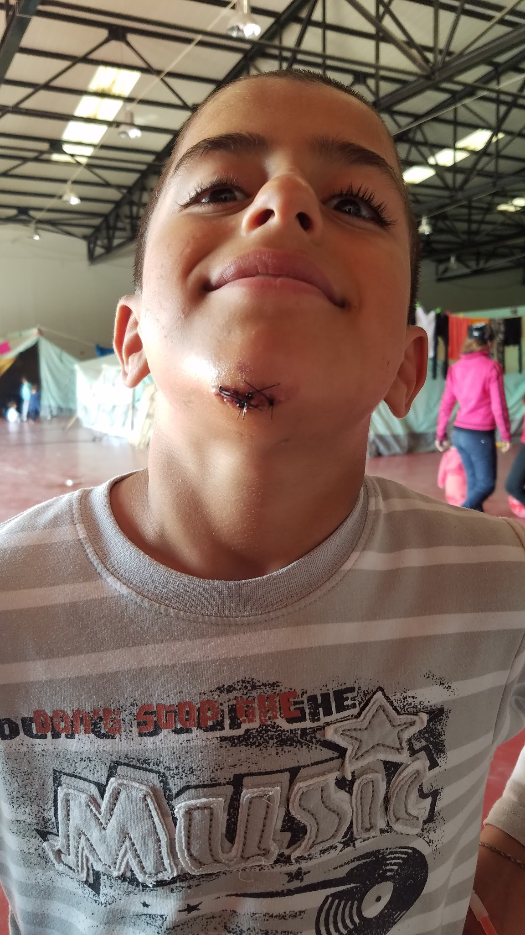
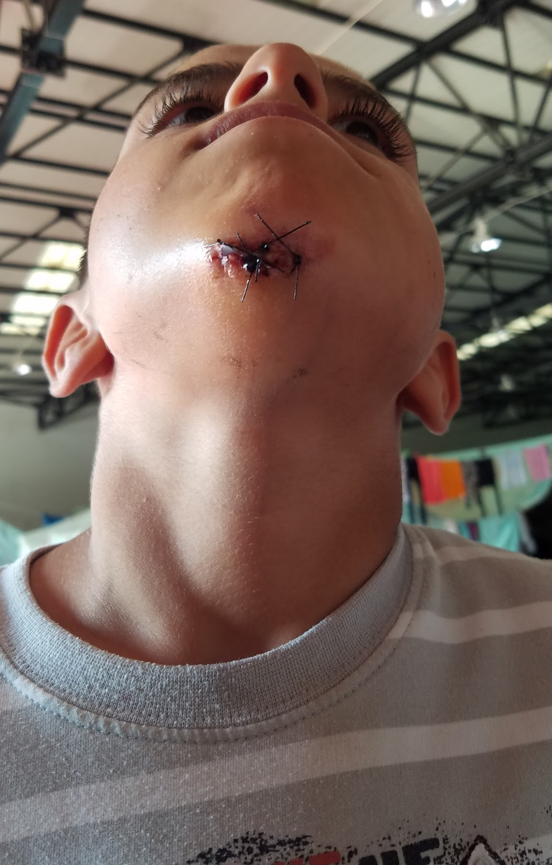
Wound &
Infection Care
Mosquito bites
Bed bugs
Scabies
Lice
Lacerations
Abscesses
Notes:
Lacerations (chin, lip, lots of forehead)

Slide 25
“She is Iraqi. She has seen more blood than this. She has suffered pain much worse than this.”
- Father
of 5 year old girl who suffered a forehead laceration after a fall.

Slide 26
Mental Health

Slide 27
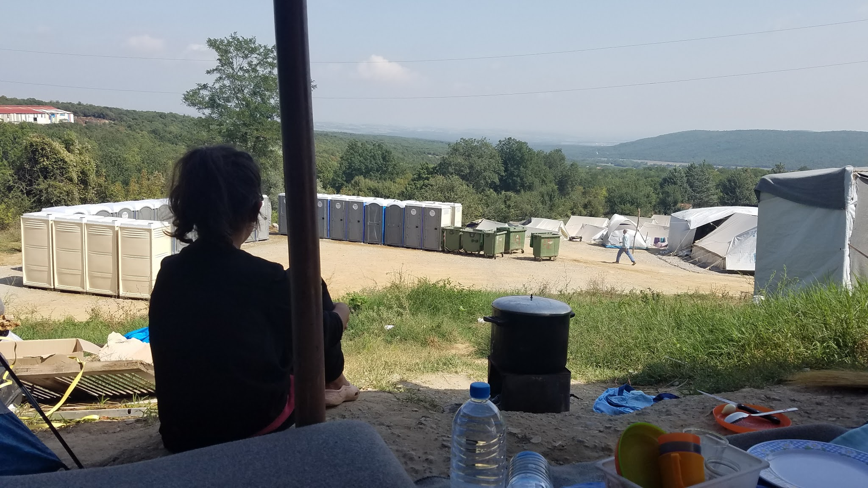
Mental Health
Depression
Panic disorders
Conversion disorder
Anger
Enuresis
Behavioral concerns
Poor feeding
Notes:
Lots of depression - guy who came in with vague pain, flat flat affect, unwell.
Treatment options = meds (citalopram or sertraline) and SOME therapy (isra-aid)
Sometimes leads to spousal abuse (1 story of woman with a sister-wife; husband abused her)
Conversion disorder - lady fell out in front of me.

Slide 28
“Please do not be mad at him. He is only that way because of what he has suffered. If you are upset, you can take it out on me.”
- Aishan
20 year old Yezidi woman in Petra, Greece. September 2016.

Slide 29
Substance Abuse

Slide 30
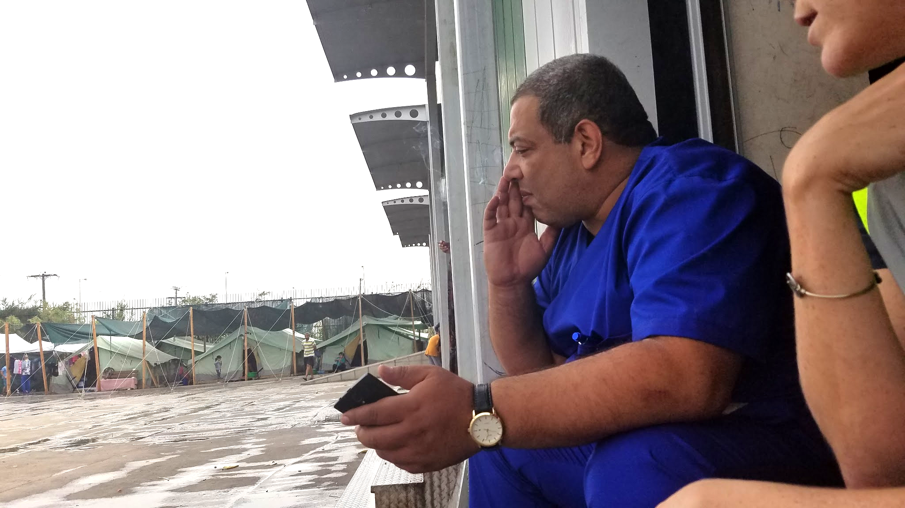
Substance abuse
Alcohol use
Tobacco use
Paracetamol overdose
Notes:
Alcohol use (as described in case)
Tobacco use - lots of nicotine patches (like candy).

Slide 31
“If I wasn’t sad all the time, I wouldn’t smoke… I will stop when I’m out of this camp. I have a pregnant wife, a small child, and winter is coming.”
- Mohsen
30 year old Yezidi refugee in Petra, Greece. September 2016.

Slide 32
Women & Children’s Health

Slide 33
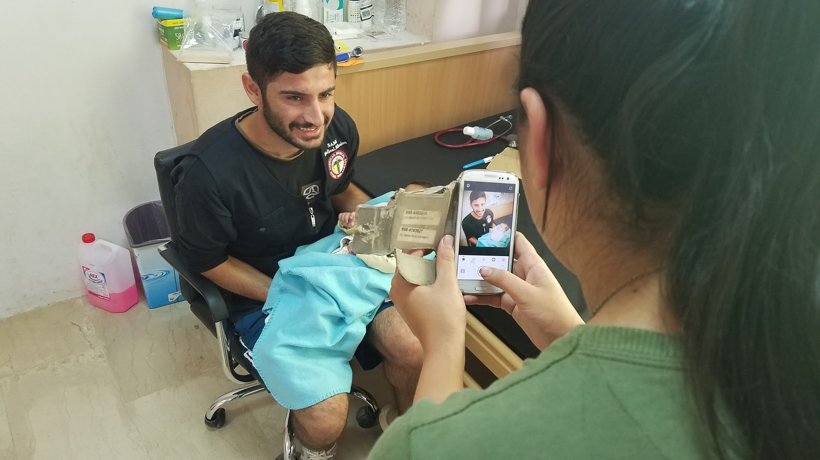
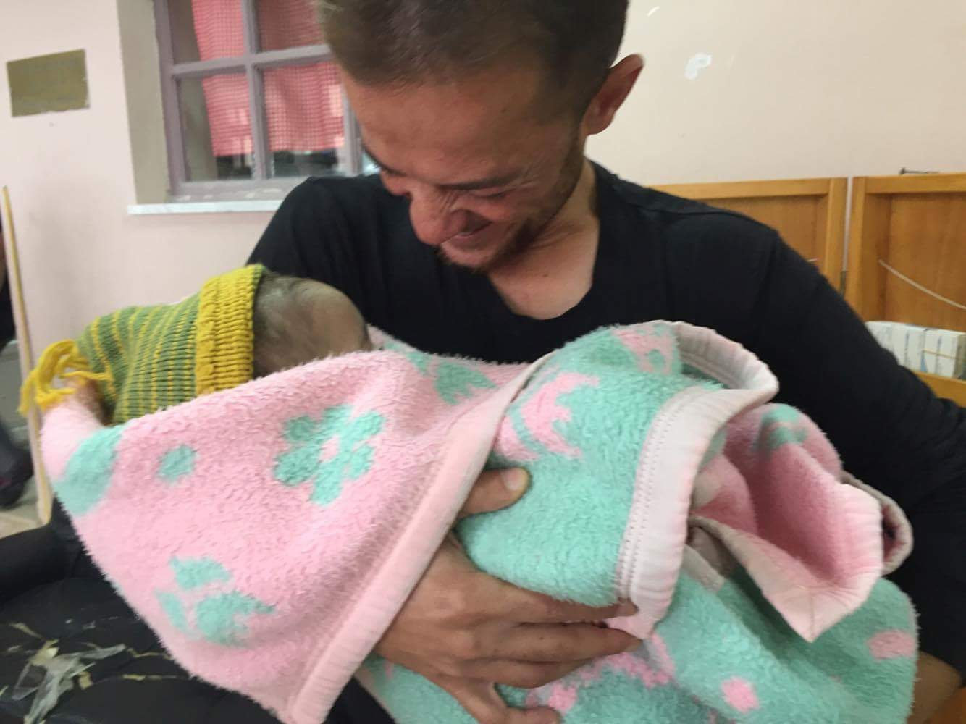
Pregnancy & Newborn Care
NGOs and local hospitals
Discharge “home”
Newborn checks difficult
False belief about locally born children
Notes:
Alcohol use (as described in case)
Tobacco use - lots of nicotine patches (like candy).

Slide 34
“What can you give me so that I don’t have babies anymore? I really don’t want another baby.”
- Hebda
31 year old Yezidi refugee in Petra, Greece. September 2016.

Slide 35
Emergencies

Slide 36
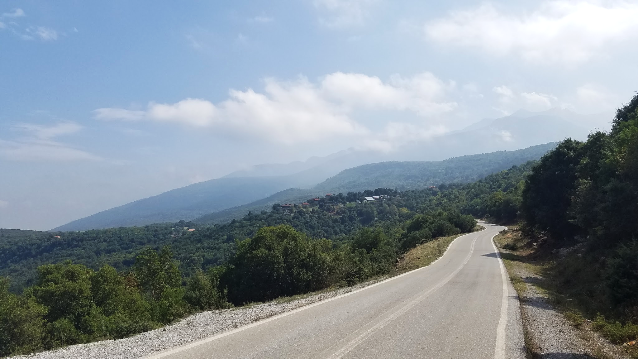
Emergency Care
2 ambulances in Katerini
Often refuse to come to Petra (45 minute drive from town)
Meeting half way

Slide 37
“They let her die. The ambulance would not come for her. They don’t care about us. They will leave us here forever.”
- Khawla
18 year old Yezidi refugee in Petra, Greece. September 2016.

Slide 38
Lessons Learned

Slide 39
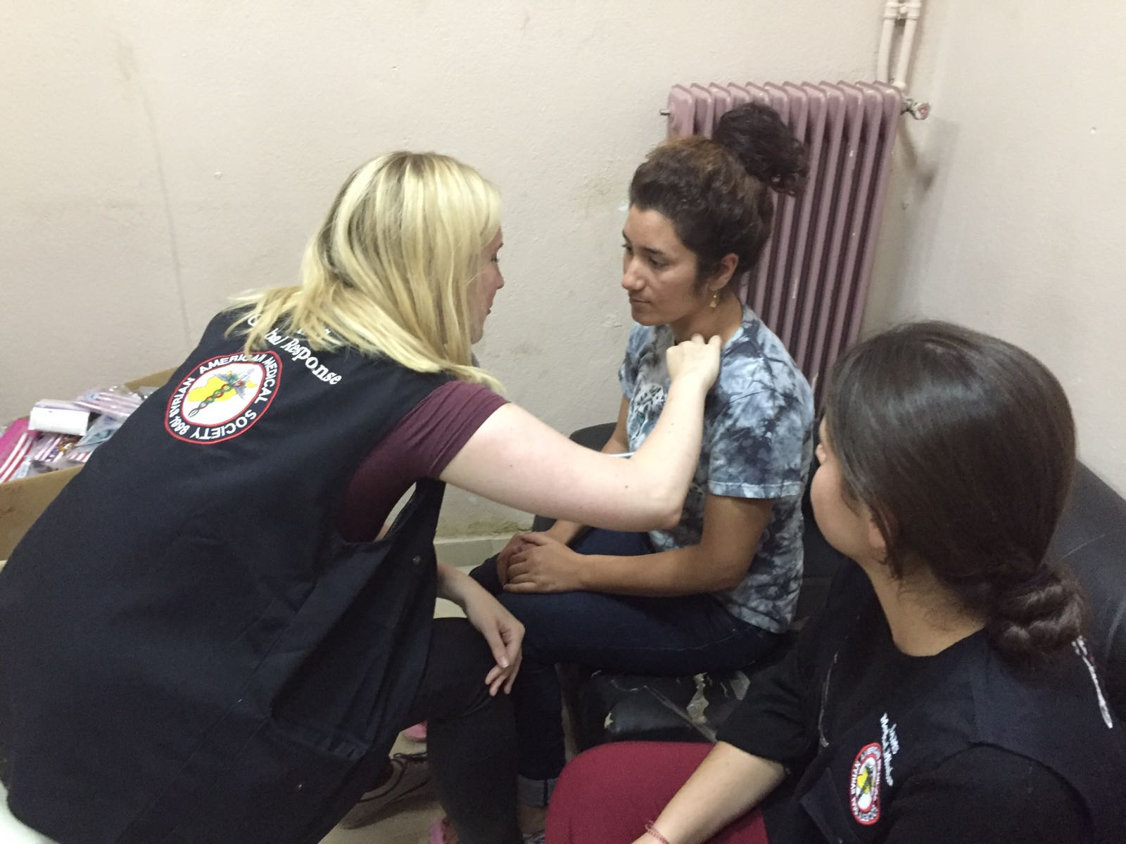
Notes:
Love medicine all over again

Slide 40
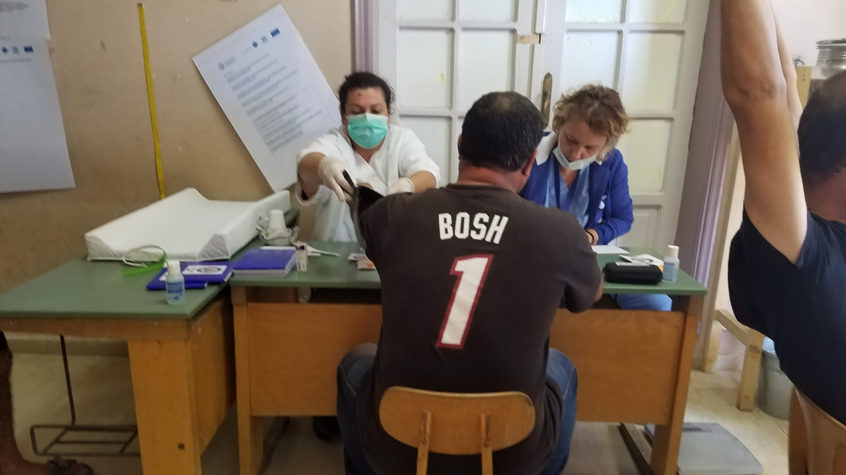
Notes:
Humans are amazing and resilient

Slide 41
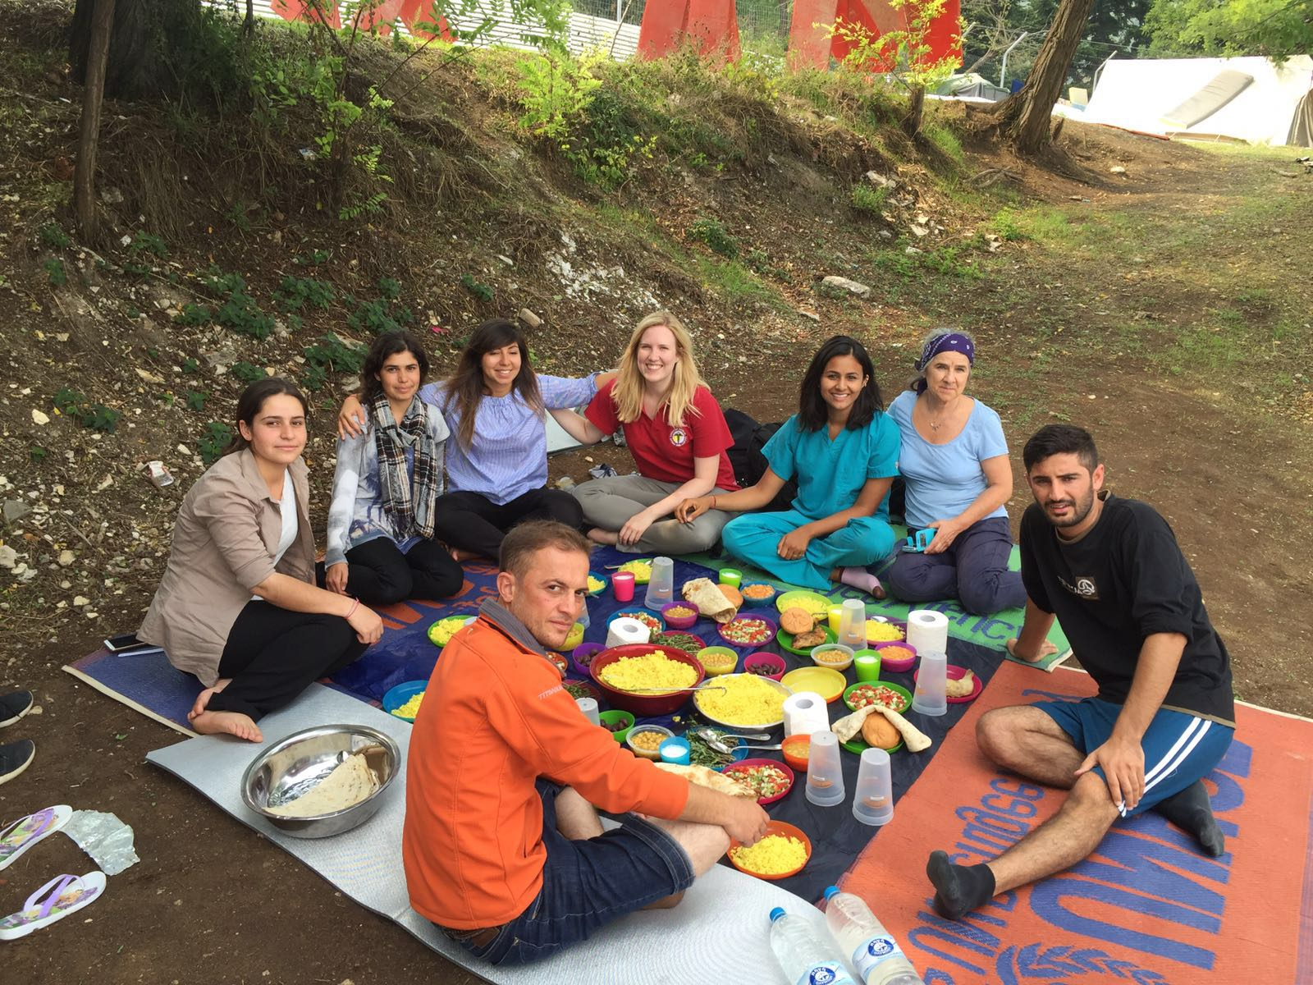
Notes:
Humans are amazing and resilient

Slide 42
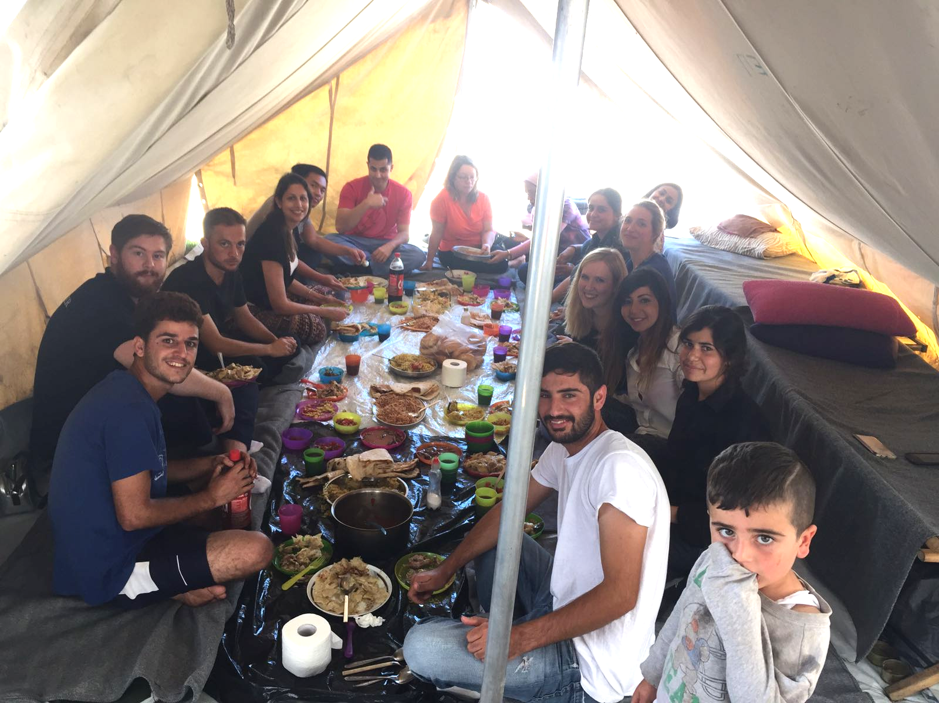
Notes:
Generosity

Slide 43
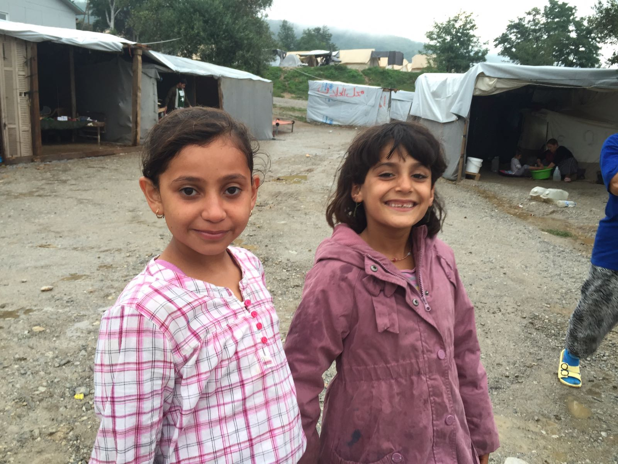
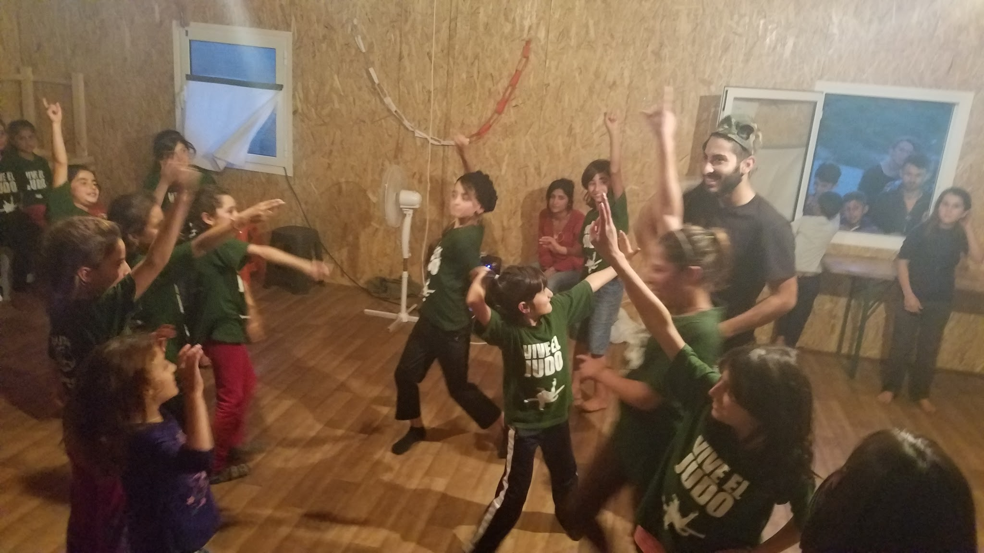
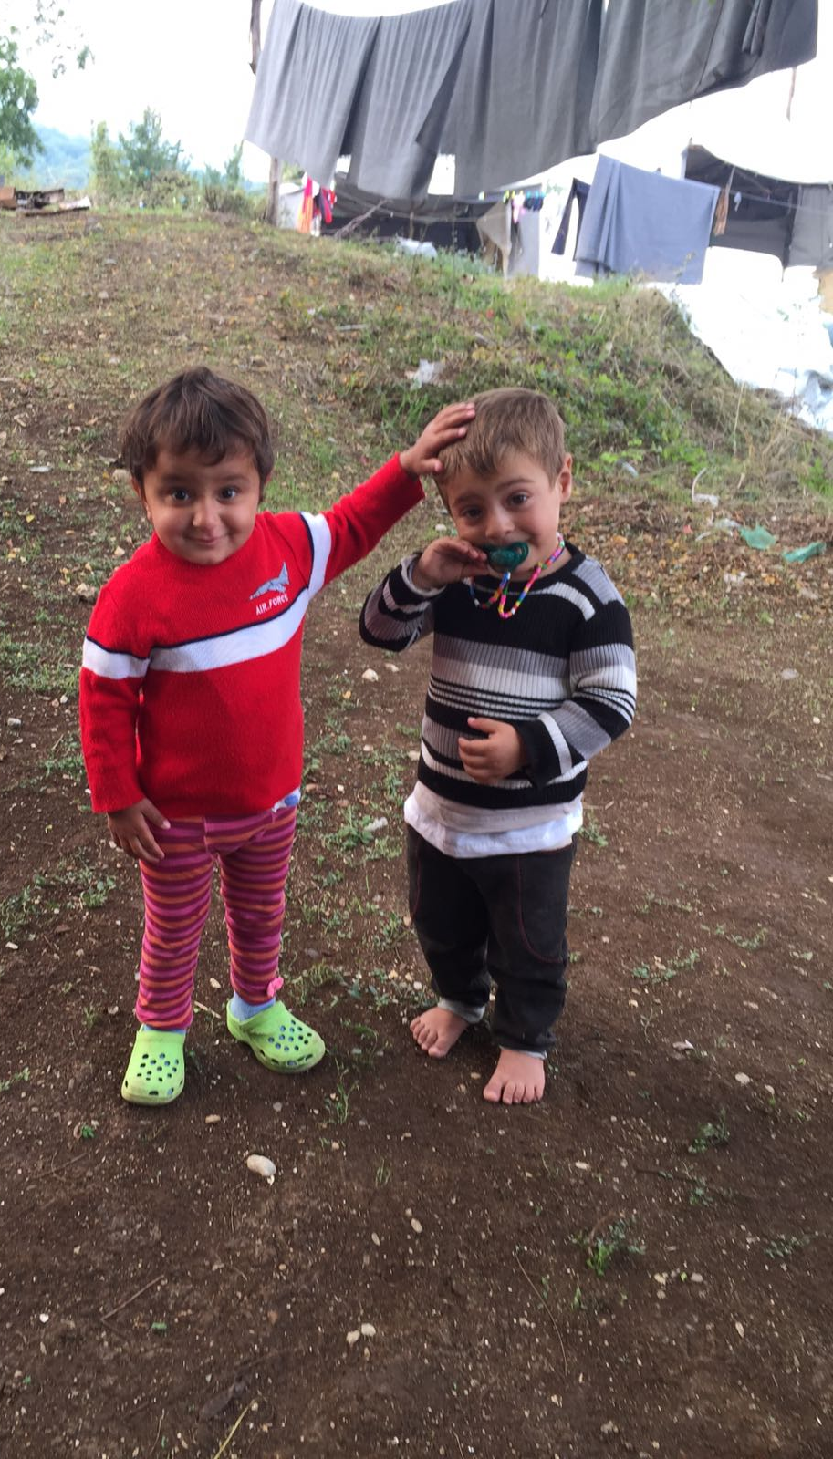
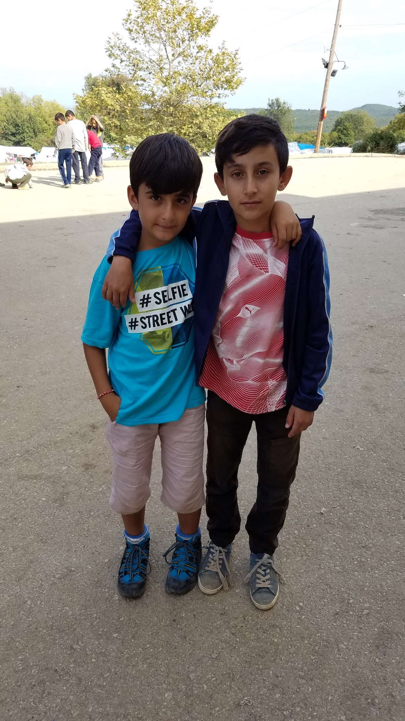

Slide 44
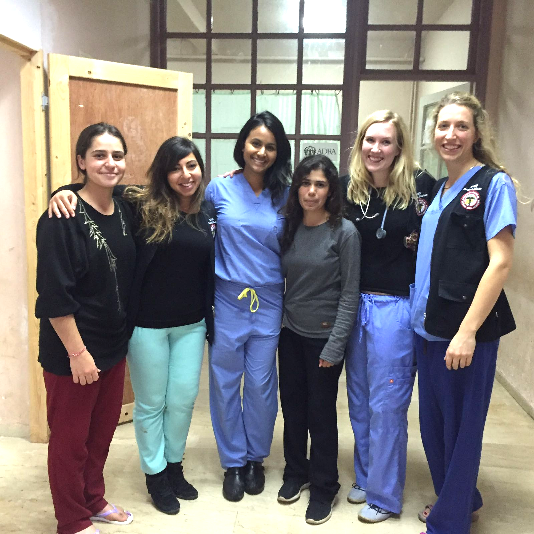
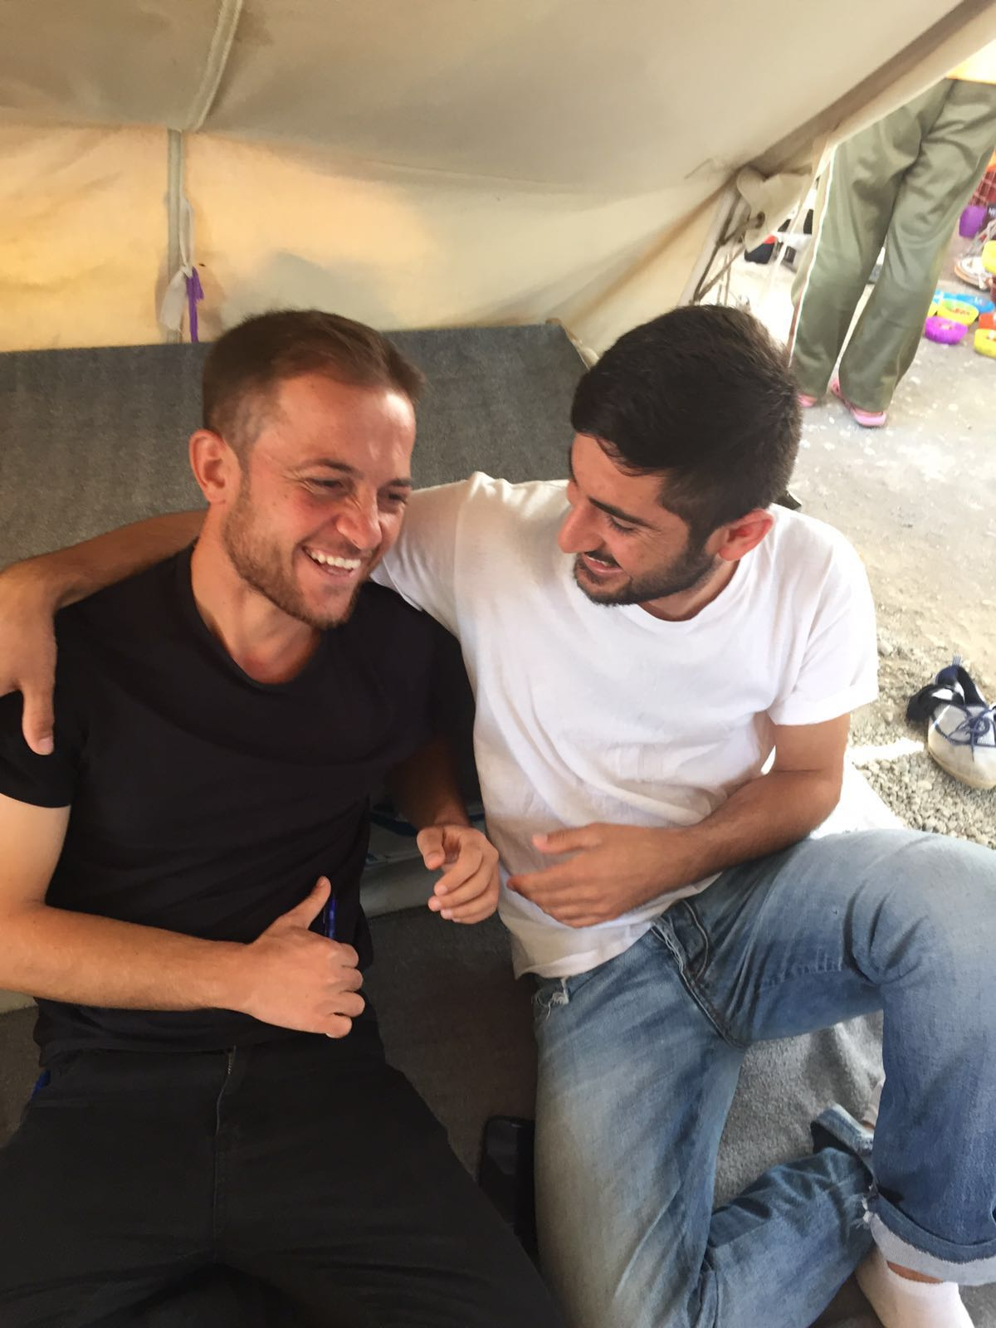
Notes:
Not easy, but helps to have a good crew

Slide 45
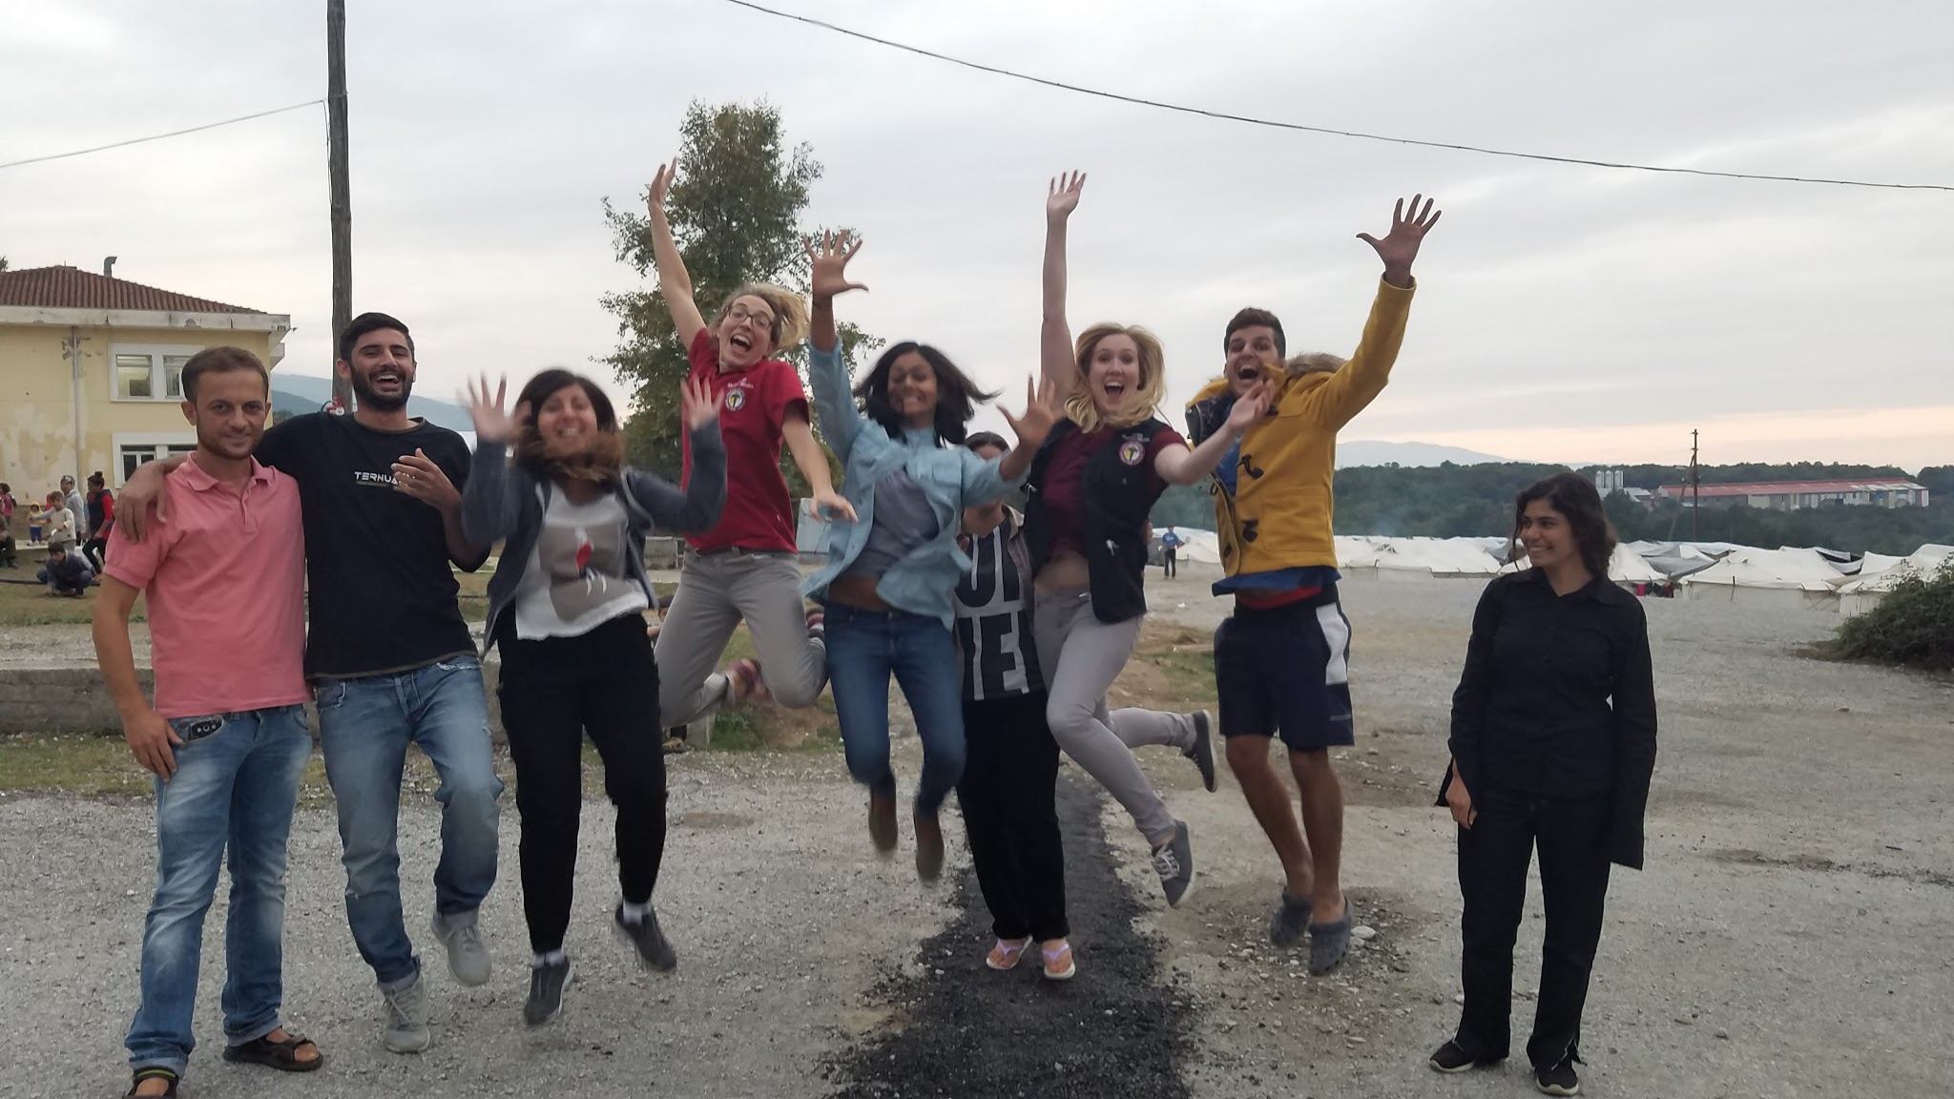

Slide 46
sonya.patel-nguyen@unchealth.unc.edu

Slide 47
“If you are never proud of anything you do in your life - you should be proud of this. That you left your country to come here and help. Thank you, from our country to yours.”
- Kamiran
22 year old Yezidi refugee in Petra, Greece. September 2016.

Slide 48
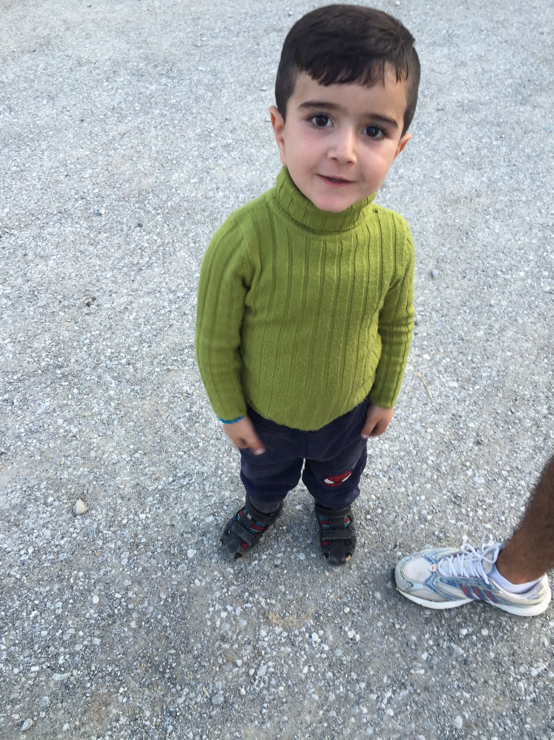
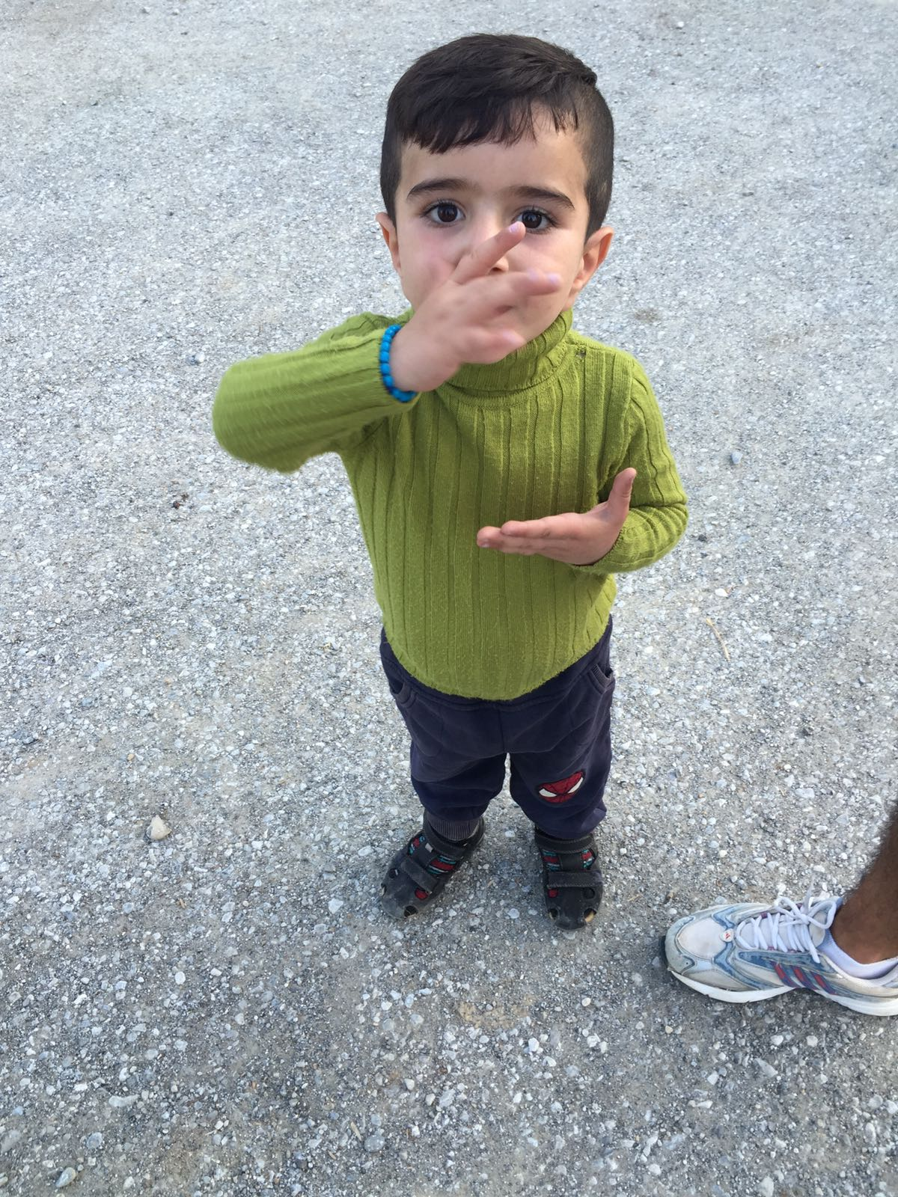
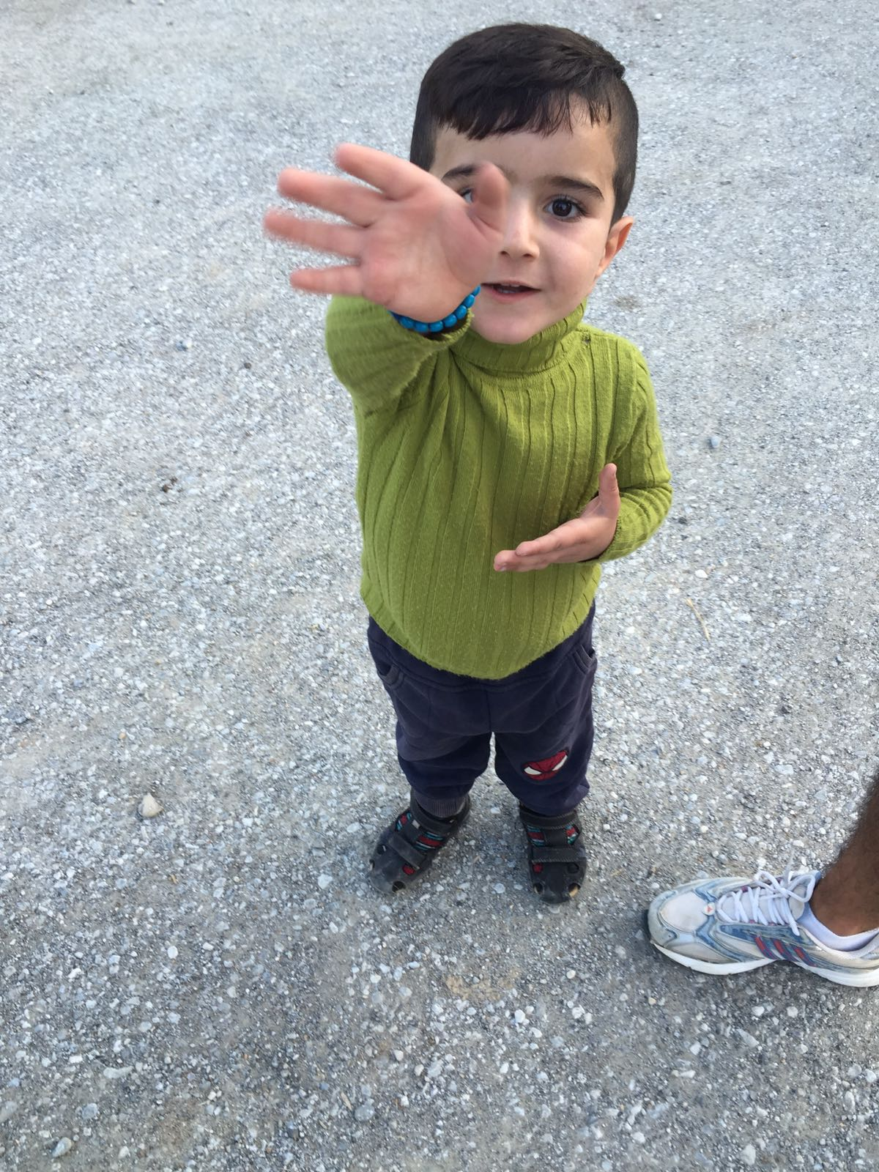

Slide 49
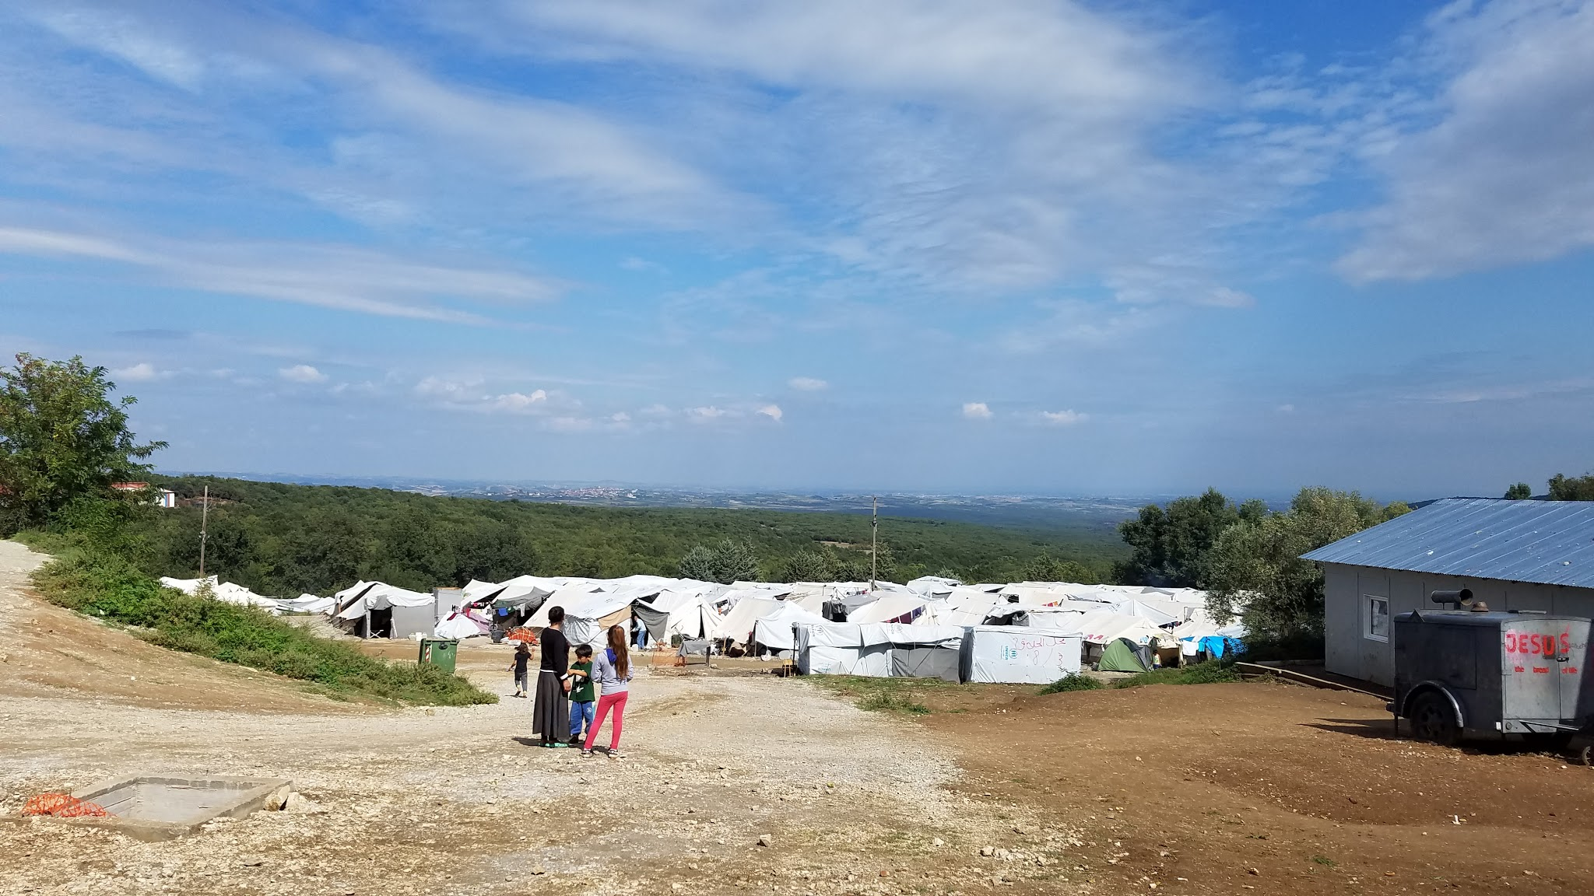

Slide 50
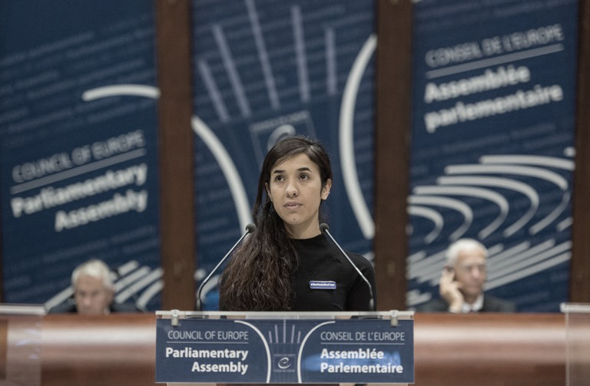
Nadida Murad
Capture by ISIS
Escaped
UN Goodwill Ambassador

Slide 51
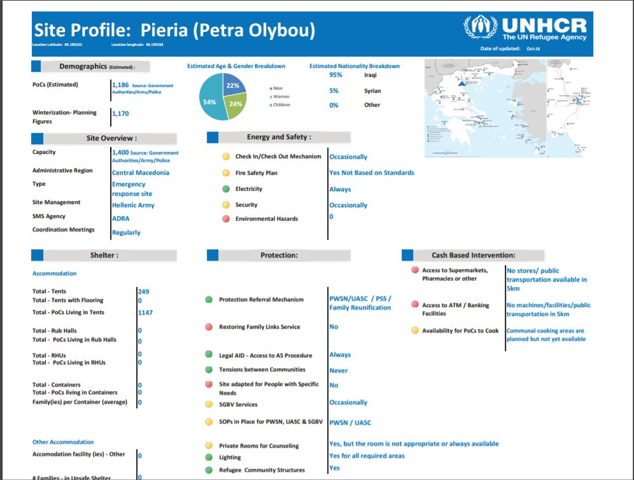

Slide 52
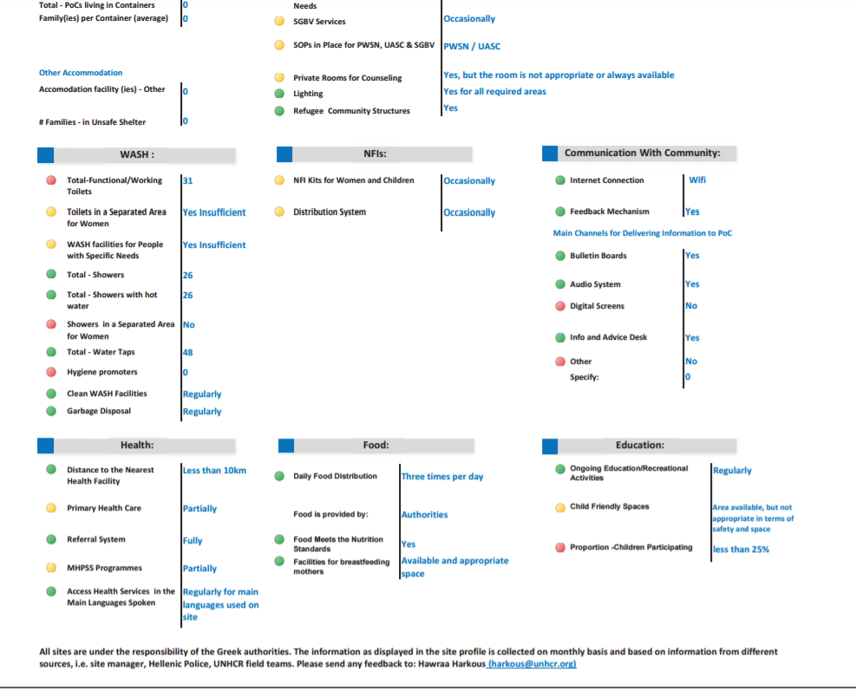

Slide 53
Universal Declaration of Human Rights
The right to a standard of living adequate for the health and well-being of himself and of his family, including food, clothing, housing, and medical care and necessary social services, and the right to security in the event of unemployment, sickness, disability, widowhood, old age, or lack of livelihood in circumstances beyond his control.
Article 25
Notes:
THis is what motivates me.
THis motivates many of us - abroad, domestic, et.

