Slide 1
AWAY ROTATIONS TO NIH GRANTS: Building BLOCKS FOR a career in globAL HEALTH
Ross M. Boyce, MD, MSc
Fellow, Infectious Diseases
University of North Carolina at Chapel Hill
ross.boyce@unchealth.unc.edu

Slide 2
Purpose
Provide an overview of global health opportunities and resources for medical students and residents with a focus on developing an academic, research career
Highlight “lessons learned” from my own experiences

Slide 3
Overview
Brief Introduction
Career Tracks in GH
Opportunities & Resources
Medical School
MPH
Residency
Fellowship & Beyond
Publishing

Slide 4
My Path to Global Health
Winston-Salem
Davidson College
US Army
UNC SOM
LSHTM
Massachusetts General
UNC Infectious Diseases
Notes:
Tell story of research
End with where I am now Fellow → Faculty transition

Slide 5
Partnerships
Mbarara University of Science & Technology
Epicentre
Bugoye Health Centre

Slide 6
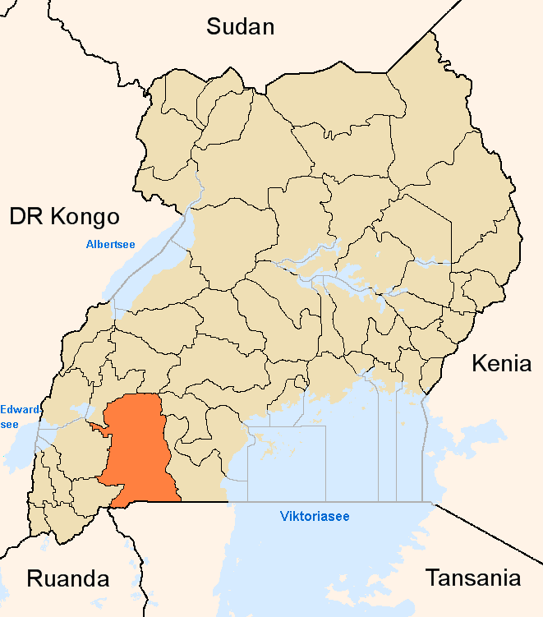
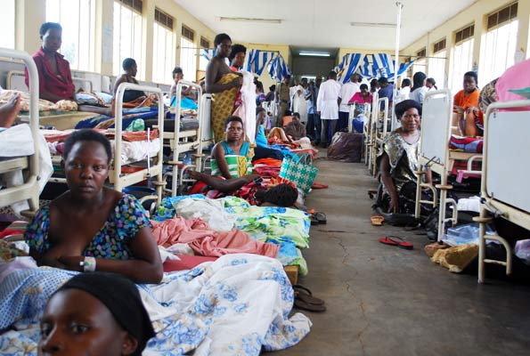
Mbarara University of Science & Technology
Notes:
Regional Referral Hospital
Faculty of Medicine
Department of Community Health

Slide 7
Research Division of MSF
Research “Base” in Mbarara
Advanced laboratory
Highly trained personnel
Strong logistical network

Slide 8
Bugoye Level III Health Centre
Nuwaha et al. BMC Public Health, 2011

Slide 9
Global health tracks

Slide 10
Global Health is…
Academic / Research
Programmatic – Government & NGO
Policy
Military
Volunteerism / Service / Mission / Tourism
Notes:
All can blur together
I initially wanted more programmatic work
Important to define earlier if possible; can go back and forth between some, but not others

Slide 11
Opportunities & Resources
Medical School
Residency
Fellowship & Beyond

Slide 12
Medical School
Windows of Opportunity:
Summer after MS1
Away electives in MS4
Limitations:
Lack of clinical experience
Short duration
Varying levels of supervision
Goals:
Do I like this? What did I like? Does it inform specialty choice?

Slide 13
Medical School
Global Health Research
Difficult to complete project in short time of travel
Lack of methodological skills
Are you bringing something new?
Difficult to do good job unless you understand environment
Other Options
Small part of existing research project
Need committed mentor
US-based, transferrable research
HIV/TB, smoking, trauma care
Systematic Reviews
Annual Meetings

Slide 14
Fogarty International Center
Notes:
Year long; funded
Research mentor
Looks great on a CV

Slide 15
Doris Duke

Slide 16
Specialty Societies

Slide 17
Specialty Societies
Notes:
Topical Medicine is broad and can include injury, MFM, etc
UNC has had one for the past 5 years

Slide 18
Medical School
Internal (UNC) Awards
School of Medicine & OIA
UNC Global
School of Public Health
Researchers / Departmental Funds
Notes:
Internal is ALWAYS best because competition is generally less

Slide 19
Masters of Public Health
Why do it?
Exposure to issues of population health
Develop new, research-relevant skillsets
Mentorship, collaboration, & networking
Looks good for that residency application
Time away from medical school

Slide 20
Masters of Public Health
Medical School
Fellowship
Still in student mode
Don’t have clinical experience
Uncertainty about career choice
Might not use skills for a couple years
You pay tuition
I haven’t written a paper in four years!
Plenty of clinical experience
More defined career choice
Can put new skills to immediate use
Fellowship pays tuition
Notes:
Is UNC the right choice?

Slide 21
Masters of Public Health
From a research perspective
Don’t just take “interesting” courses
Need hard skills:
Epidemiology
Statistics & Statistical Programs
Qualitative Methods
Policy Analysis
Systematic Reviews & Reference Managers
Notes:
Unsolicited advice

Slide 22
Global Health Residencies
Integrated Programs
Often extends duration of training
May incorporate (funded) MPH
Research focus with expectation of scholarly output
May be normal or separate match process
Specialty Tracks
Normal duration of training
May substitute 1-2 elective blocks for away rotations
Longitudinal GH activities such as journal clubs
Normal match

Slide 23
Integrated Residencies

Slide 24
Integrated Residencies

Slide 25
Specialty Tracks
Notes:
6 weeks in PGY2
12 weeks in PGY3

Slide 26
Specialty Tracks
Notes:
1 month in PGY2 – Leadership course (Path, Gates); 1 month research/abroad
2 months in PGY3

Slide 27
Specialty Tracks
Notes:
1 month in PGY2 & PGY3

Slide 28
Specialty Tracks
Notes:
Bimonthly meetings
One away month

Slide 29
Residency
Windows of Opportunity:
Away electives, generally after internship
Limitations:
Lack of available time; program needs you
Short duration of travel
Varying levels of supervision
Goals:
Apply clinical skills
Preliminary research
Small grants
Publication?

Slide 30
Residency
Global Health Research
Difficult to complete project in short time of travel
Use vacation time?
Can bring to bear clinical knowledge
Small projects, especially retrospective studies are possible
Reasonable to propose own research plan within mentored relationship
Appropriate to apply for small, research specific grants
Can continue US-based, transferrable research
Present at Annual Meetings

Slide 31
Residency

Slide 32
Residency

Slide 33
Residency
Other Options:
Internal (UNC) Awards
Specialty Societies
Research is research – An MI in Tanzania is an MI
Pharmaceutical Companies
Wealthy benefactors!
Notes:
Internal is ALWAYS best because competition is generally less

Slide 34
Fellowship
Sub-specialty & Global Health Opportunities
Specific to research topics & mentorship
Malaria:
UCSF
Johns Hopkins
UNC
Most are highly academic:
Research focus
Building towards independent investigator
Lead to junior faculty position

Slide 35
NIH Pathway

Slide 36
NIH Pathway

Slide 37
Publishing

Slide 38
Publishing
Opportunities for Medical Students & Residents
Case reports & Clinical Images
Severe Malaria in Martha’s Vineyard
Malaria in Pregnancy on ECMO
Literature Reviews & Meta-Analyses
Always faculty looking for help
HSL librarians can assist with methods
Retrospective Studies & Chart Reviews
Opinion & Editorials

Slide 39
Good “Starter” Journals for GH
American Journal of Tropical Medicine & Hygiene
Global Health Action
BMJ Global Health
PLOS NTD & PLOS One
International Health
Pathogens and Global Health
Malaria Journal

Slide 40
Publishing
General Tips
Important to get preliminary work published, even if not in NEJM
Establish your credentials
Citable for funding applications
Don’t be dissuaded by publication fees
Rejections, if reviewed, will improve your manuscript
If not in a hurry, aim (a little) high
Be persistent

Slide 41
Closing Thoughts
Find your passion
Be aggressive & persistent
Find diverse mentors
Get the skills you need

Slide 42
Questions
Ross M. Boyce, MD, MSc
Fellow, Infectious Diseases
University of North Carolina at Chapel Hill
ross.boyce@unchealth.unc.edu

