Slide 1
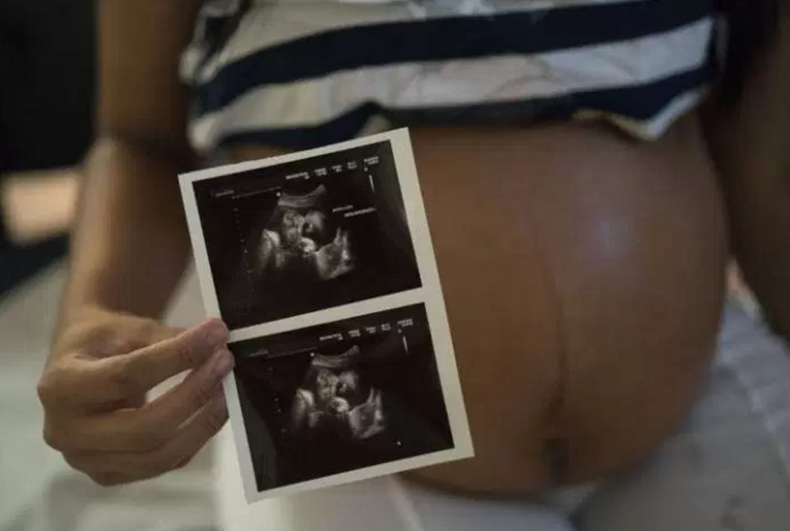
Uncovering the rules of Zika
Sylvia Becker-Dreps, MD, MPH
September 21, 2017
OIA Global Health Forum
Photo Credit: GlobalNews

Slide 2

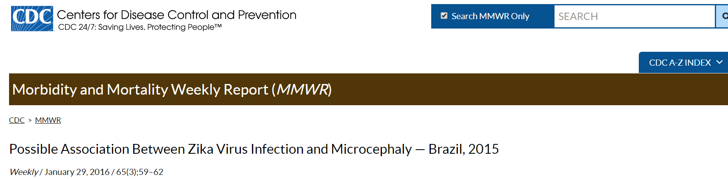
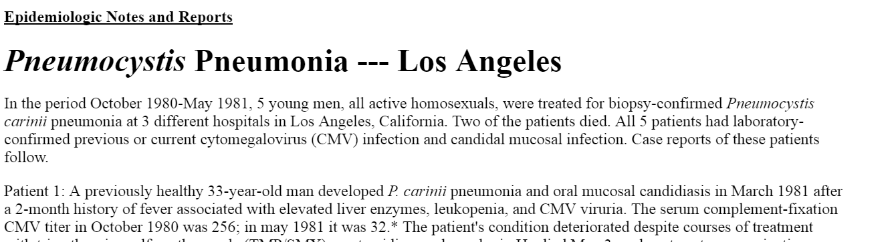
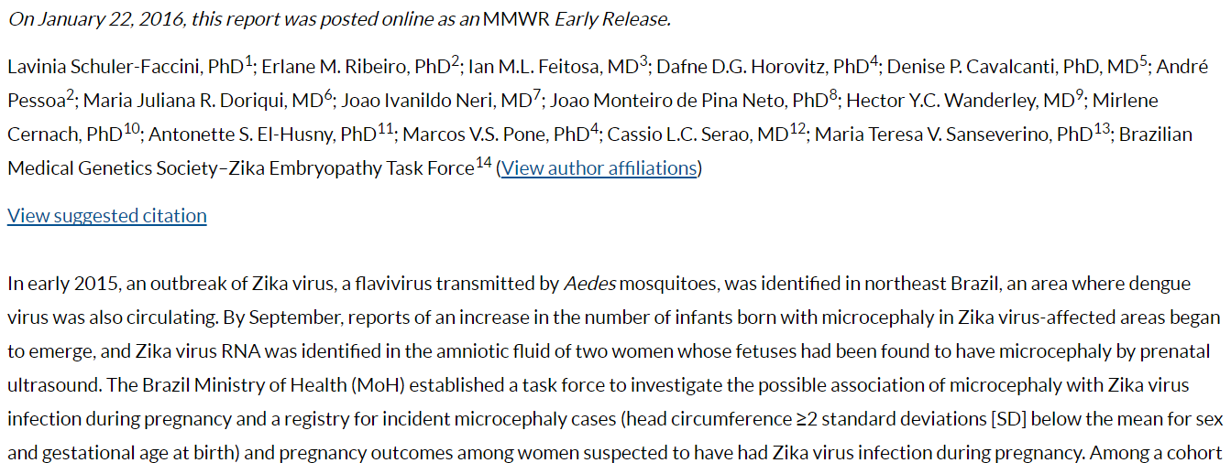
1981: HIV 2016: Zika

Slide 3

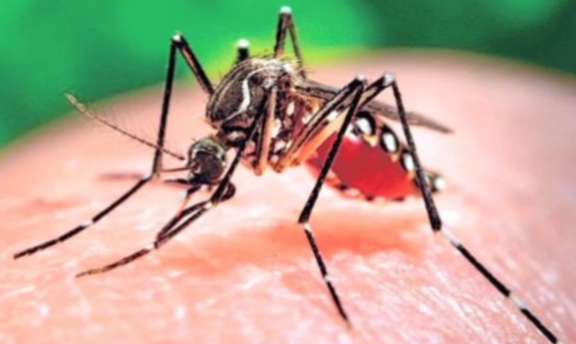
Uncovering the rules of Zika
Background
Q & A
Our UNC Studies

Slide 4
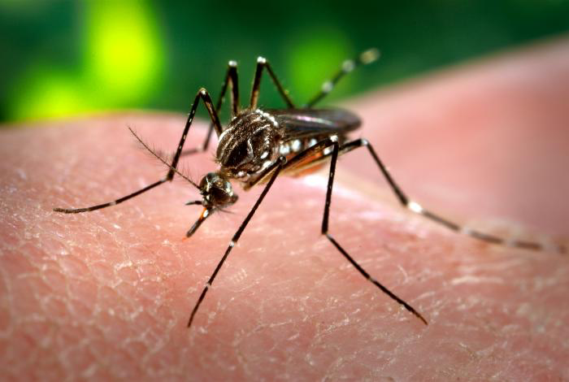
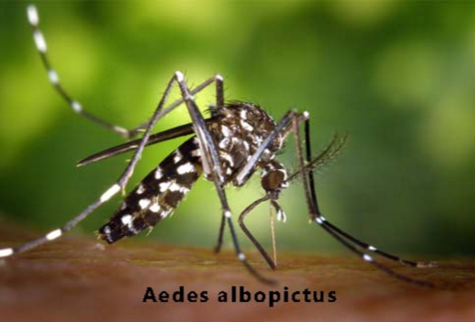
Zika Virus
Flavivirus (related to dengue, West Nile)
Primary vector: Aedes aegypti mosquito
Lazear and Diamond 2016 J Virol
Notes:
-Zika is a flavivirus, related to other human pathogens such as DENV, WNV, and YFV
-generally causes a self-limited febrile illness, but in the current epidemic we have seen more severe presentations as well
-ZIKV is a mosquito-borne virus and we think Ae aegypti mosquitoes are the key vector driving the current ZIKV epidemic
-this is significant because this is the same mosquito species that transmits DENV, YFV as well as CHIKV so we can make pretty good predictions about ZIKV spread based on what we have seen previously with these other viruses
-being mosquito-borne distinguishes ZIKV from other recent emerging infectious diseases (EBOV, SARS), because ZIKV is not generally a communicable disease. So there is less of a need to worry about person-to-person transmission and more of an emphasis on vector control
-Ae aegypti poses a particular challenge in combatting vector-borne diseases as these mosquitoes have evolved to feed preferentially on humans and to live around human settlements; they are very aggressive biters; and they are “sip feeders”, meaning that rather than taking a single large blood meal, a mosquito will take many small meals from several hosts, enabling 1 infected mosquito to transmit an infection to many people
-unlike some mosquito-borne viruses (e.g. WNV) that require an animal reservoir for transmission, ZIKV can be transmitted directly between humans and mosquitoes, which enables large urban outbreaks

Slide 5
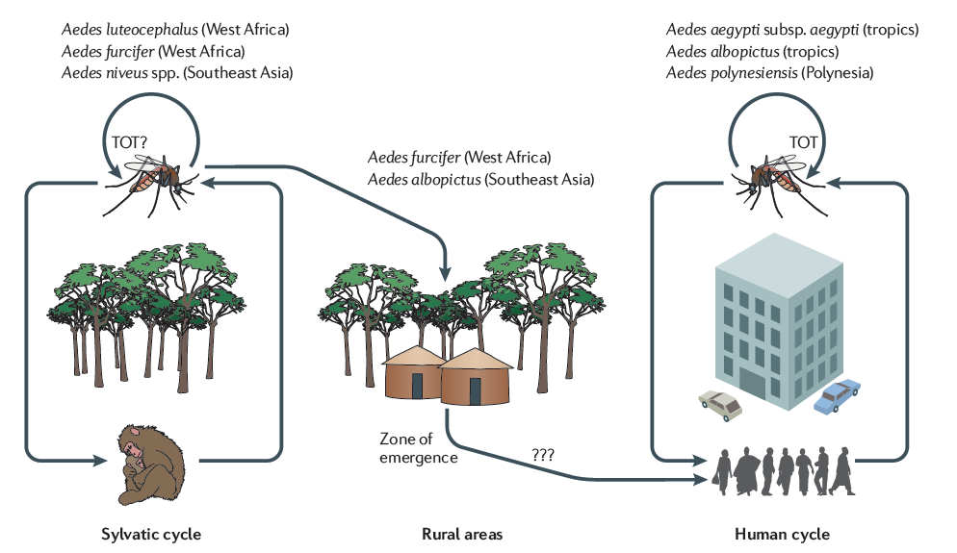
Emergence
Vasilakis 2011 Nat Rev Microbiol

Slide 6
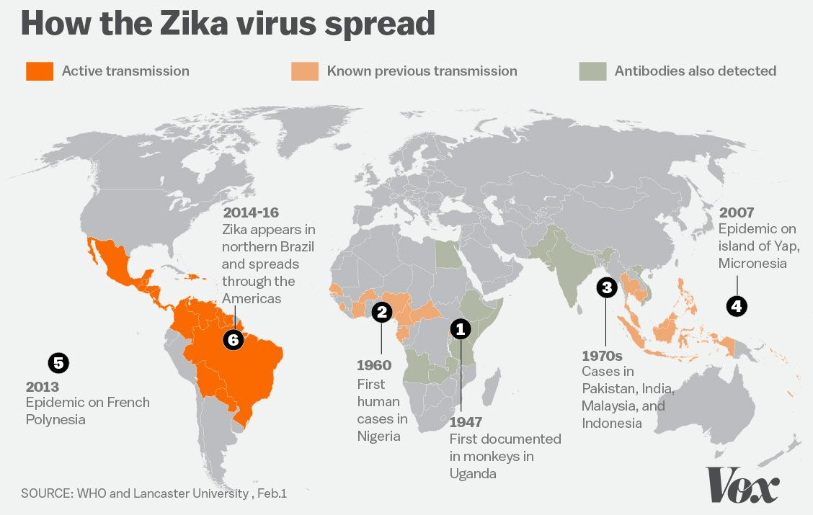
Zika Emergence in the Americas
Notes:
-although ZIKV is only just recently getting a lot of attention, this is not a new virus – it has been known to science for some 70 years since it was first isolated in Uganda
-although ZIKV transmission was detected periodically in Africa and Southeast Asia, there was no significant human disease associated with the virus until outbreaks in Micronesia in 2007 and French Polynesia in 2013
-ZIKV was first detected in Brazil in early 2015 and since then has spread throughout Latin America and the Caribbean
-the current ZIKV epidemic is an order of magnitude larger than any previous outbreak, so while there are many aspects of the current epidemic that we could predict based on previous outbreaks of ZIKV as well as DENV and CHIKV, such a large outbreak has revealed unexpected aspects of ZIKV pathogenesis as well

Slide 7
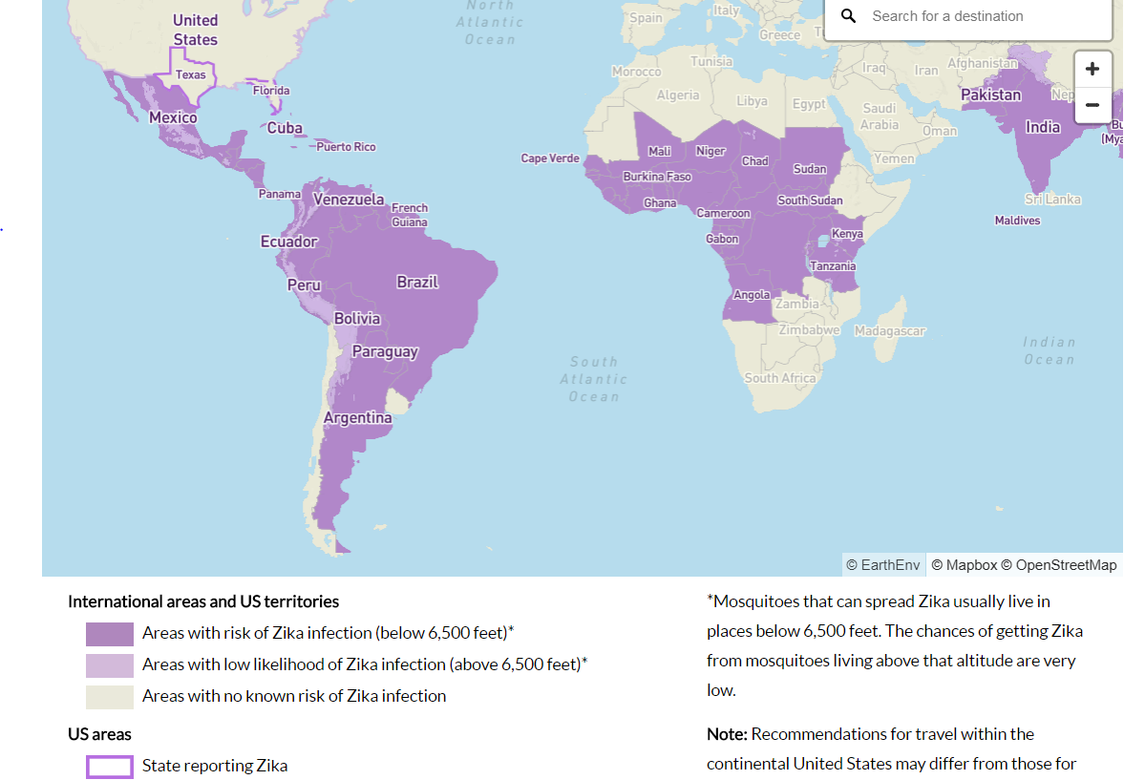
Map of countries with local mosquito-borne transmission
CDC, 9/2017

Slide 8
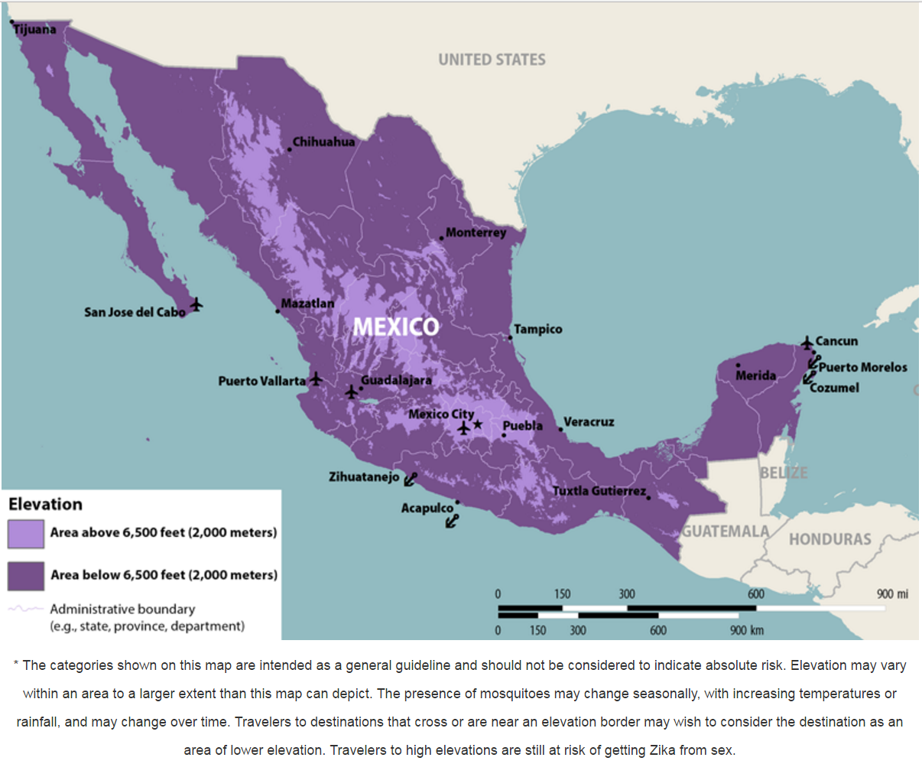
CDC, 2016

Slide 9
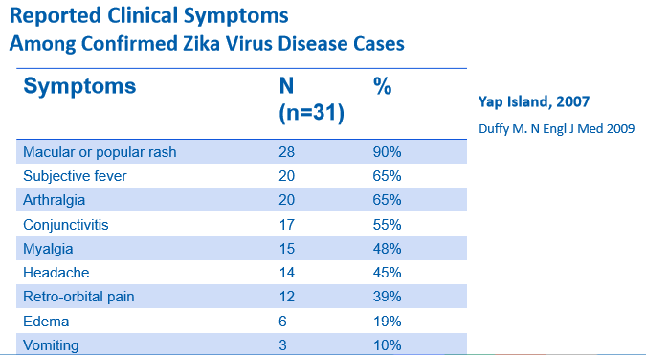
Clinical Manifestations
Majority of cases asymptomatic (~80%)

Slide 10
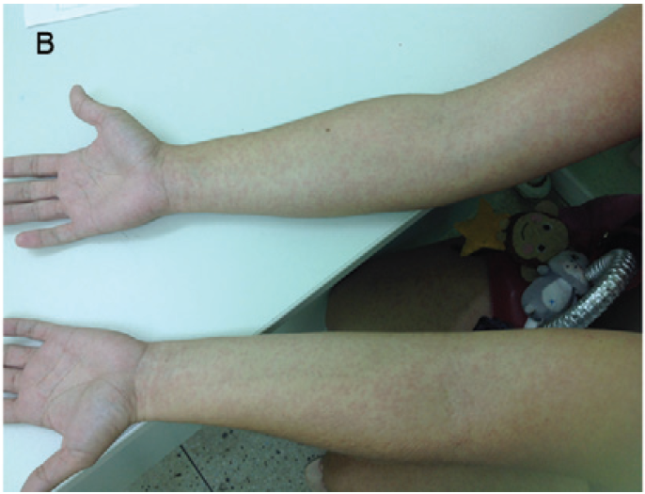
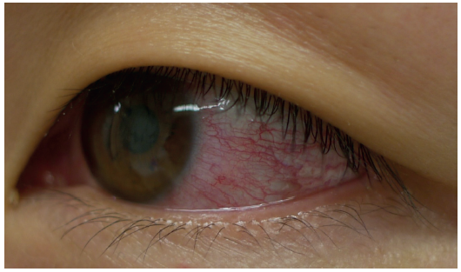
Timeline of Illness
Incubation
Convalescence
3-7 days ~1 week
?
Infection
Symptoms
Kutsuna 2014 Eurosurveillance
Zanluca 2014 Mem Inst Oswaldo Cruz

Slide 11
Complications: Guillain-Barré Syndrome
Associations with C. jejuni, CMV, EBV
Two-thirds GBS cases report preceding URI or diarrhea
GBS reported with ZIKV outbreaks French Polynesia, also in Americas
Euro Surveill. 2014 Mar 6;19(9)
N Engl J Med. 2012 Jun 14;366(24):2294-304
Lancet. 2016 Advance Online

Slide 12
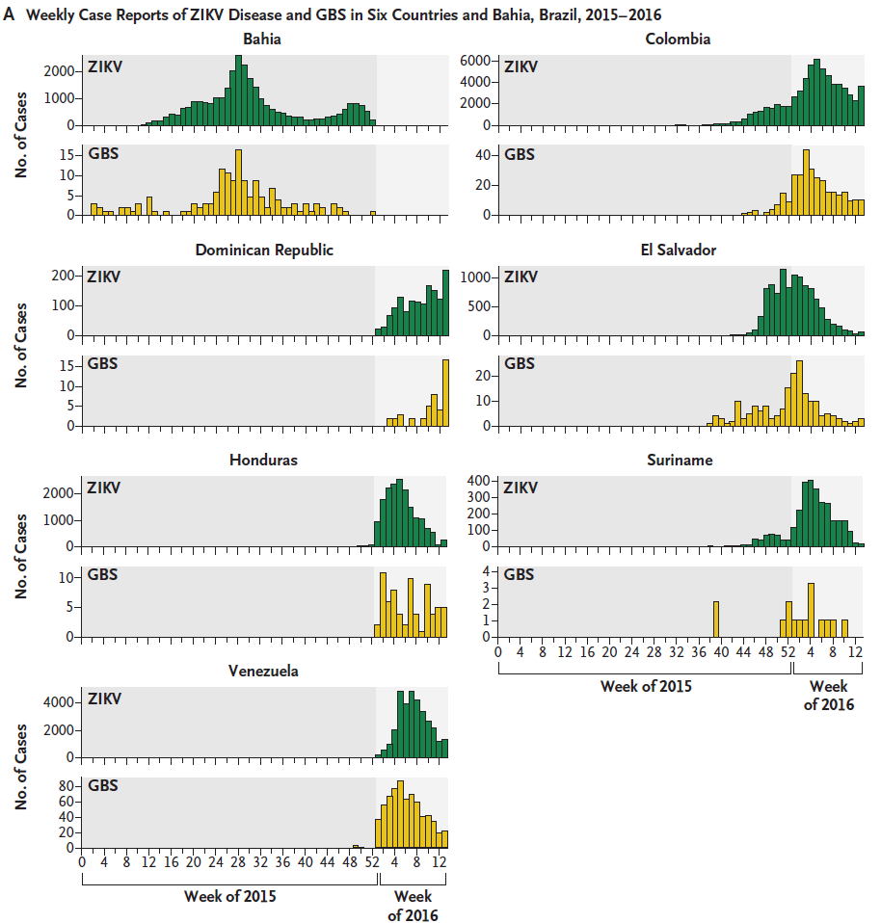
Dos Santos, et al. N Engl J Med. 2016

Slide 13
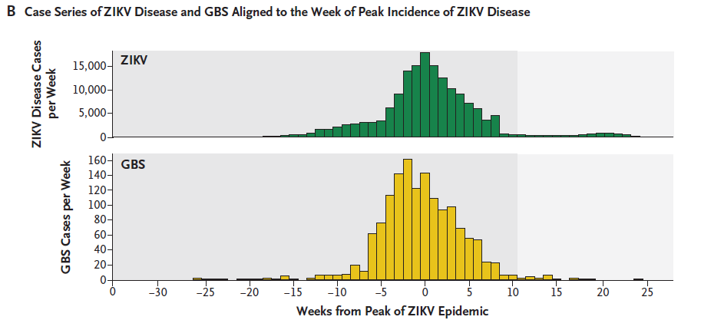

Slide 14
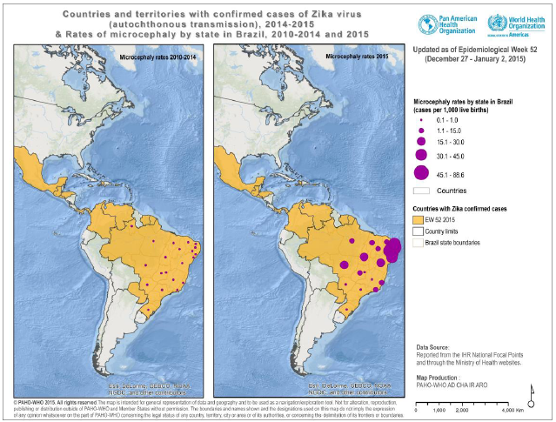
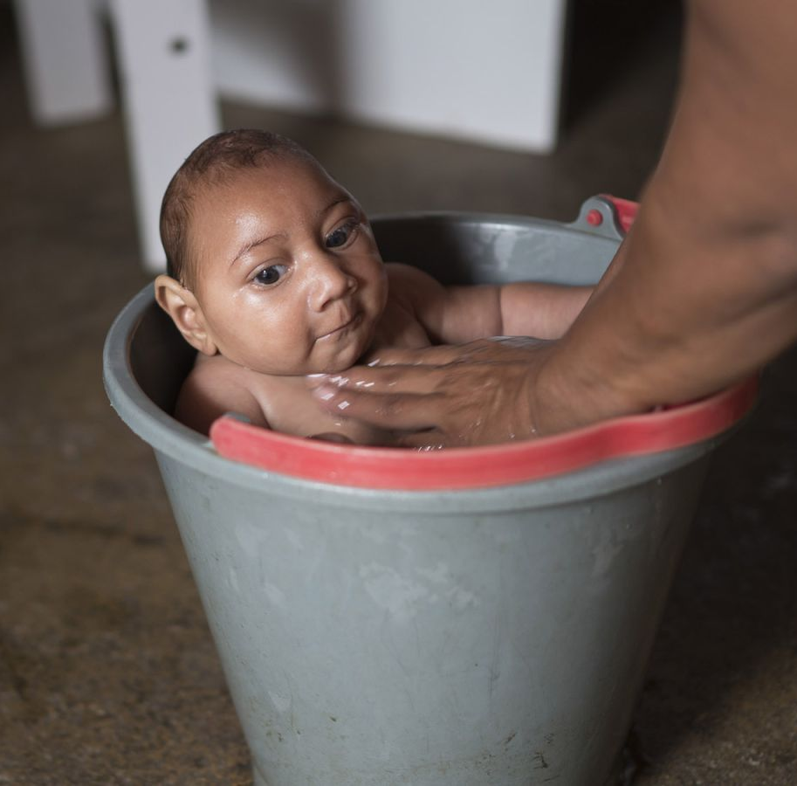
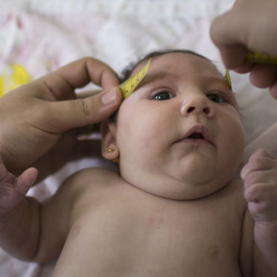
Zika Virus and Microcephaly
20-fold increase in microcephaly with ZIKV Emergence in Brazil

Slide 15
Evidence of ZIKV Congenital Infection
In microcephalic infants/fetuses of mothers with presumed ZIKV infection:
  PCR test positive of amniotic fluid, placenta, fetal brain tissue
  ZIKV antigen in fetal brain by immunohistochemistry
  Flavivirus-like particles in fetal brain by EM
  ZIKV IgM in amniotic fluid (Calvet, 2016; Mlakar, 2016; Martines, 2016)
→ supports causal role for ZIKV and microcephaly
Mlakar 2016 NEJM

Slide 16
Mechanisms of destruction
ZIKV targets forebrain-specific neural progenitor cells (as shown in cell culture and using brain “organoids”)
  Less efficient in infecting differentiated cortical neurons
  This really screws up neural development (Tang, 2016; Cugola, 2016)
ZIKV in the CNS may evade the immune system
ZIKV is able to cross the placental barrier, which has not been observed for other flaviviruses (Pardigon, 2017)

Slide 17
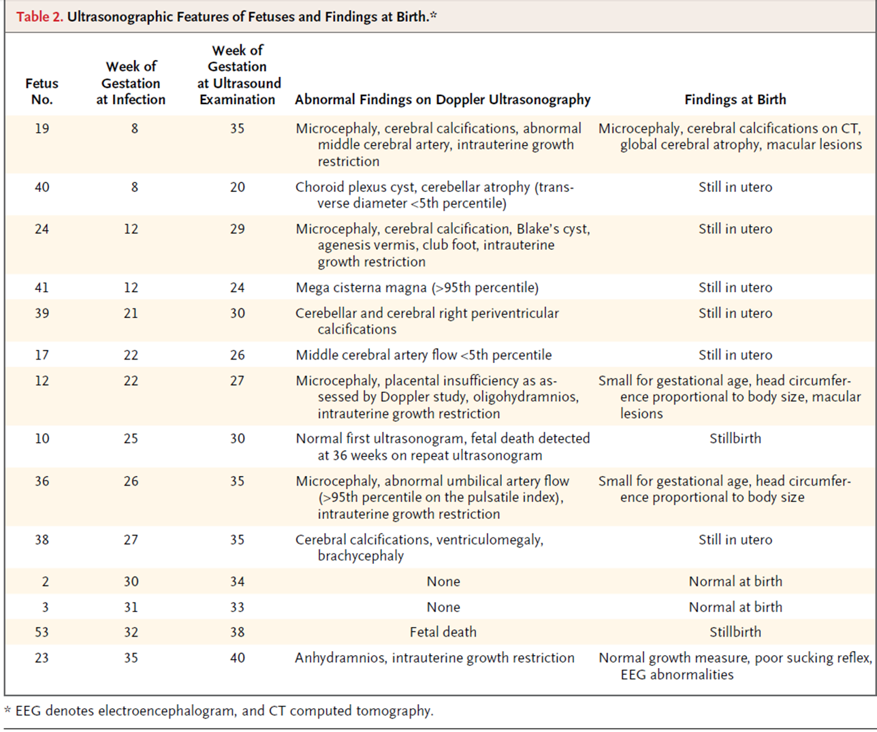
Microcephaly is tip of the iceberg
Brasil, NEJM, 2016
30% of women with symptomatic Zika infections had abnormal ultrasound findings or fetal anomalies
  Decreased brain volume/cerebral calcifications
Seizures
Macular scarring and retinal mottling
Hearing loss
Contractures of joints (arthrogryposis)
Even infections late in pregnancy can cause cerebral calcifications, IUGR, decreased fluid, and stillbirth!

Slide 18
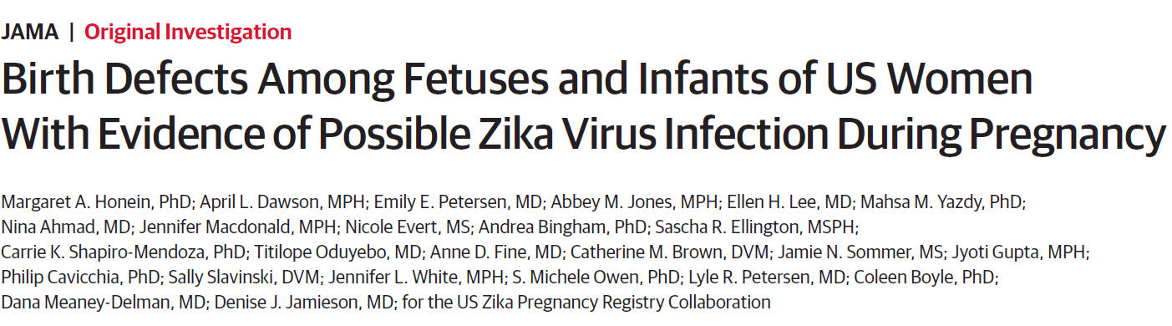
Latest on risk of congenital infection
Jan 3, 2017

Slide 19
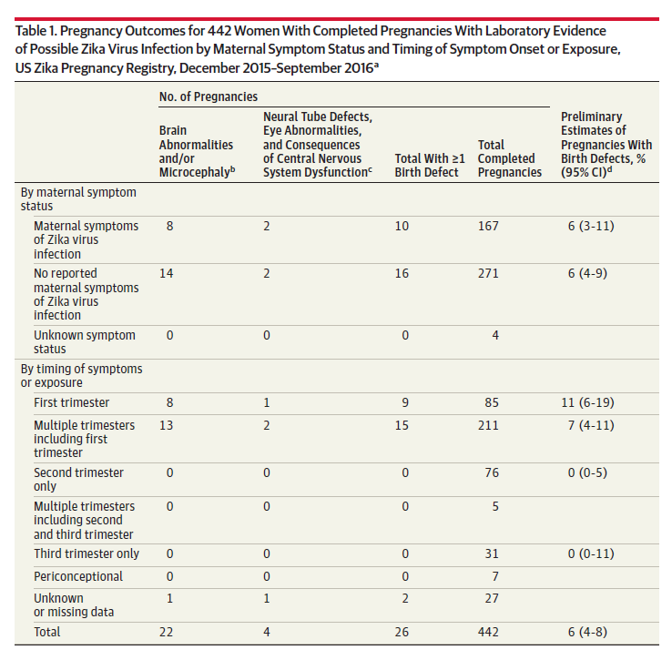

Slide 20
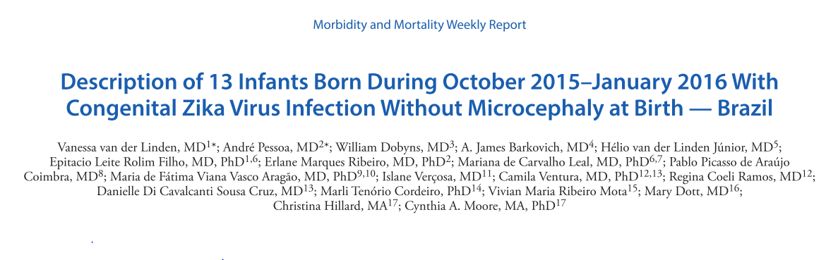
Manifestions of Zika can present later in infancy
11/13 infants with neurological findings on U/S, but WITHOUT microcephaly at birth, developed microcephaly in the first year of life

Slide 21
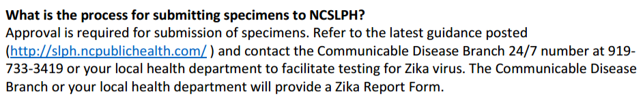
Diagnostics
Virus detected in serum by PCR on average for about 7-14 days in serum (22 days in whole blood), 7 days in urine, and 3 months in semen.
IgM antibody assays for past infection, but often false positive if prior dengue (~90% of adults in Nicaragua). Need confirmation with neutralization assays.
In NC: WHO TO TEST?
  Suspect symptomatic Zika in anyone returning from area with local transmission
  Any pregnant woman who has traveled to an area with local transmission
  They do not want to test those planning pregnancy but not currently pregnant

Slide 22
Prevention of Zika & complications
Avoidance of mosquitoes
  Insecticide spraying (“adulticiding”)– aerial, neighborhood, indoor
  Larvacides
  Insecticide-treated bednets, curtains, and screens
  Long sleeves/long pants
  DEET spray
  Removal of standing water
Condom use, as Zika is present in semen for up to 6 months after infection
(In endemic areas, condom use recommended DURING pregnancy)
Delay pregnancy
Avoid travel

Slide 23
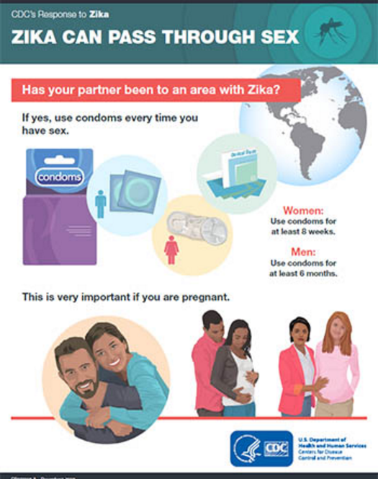
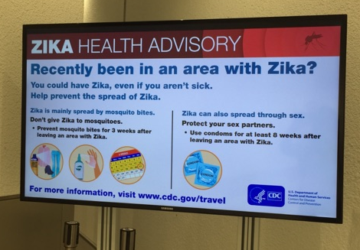

Slide 24
What rules we still need to understand:
Modes of transmission and their relative importance- mosquito, sexual, blood-borne, casual contact
Length of shedding in various body fluids; is all shed virus infectious?
For congenital Zika syndrome:
  Timing of infection
  Factors which predispose to bad outcomes (prior dengue infection?)
  Spectrum of sequelae
  Reliable diagnostics
Sequelae in children, older adults
Ways to prevent transmission
Advice for travelers and those in areas with local transmission
Which vaccine candidate and whom/when to give it to?

Slide 25
Uncovering the “rules” of Zika
Background
Brief Q & A
Our UNC Studies

Slide 26
Uncovering the “rules” of Zika
Background
Brief Q & A
Our UNC Studies

Slide 27
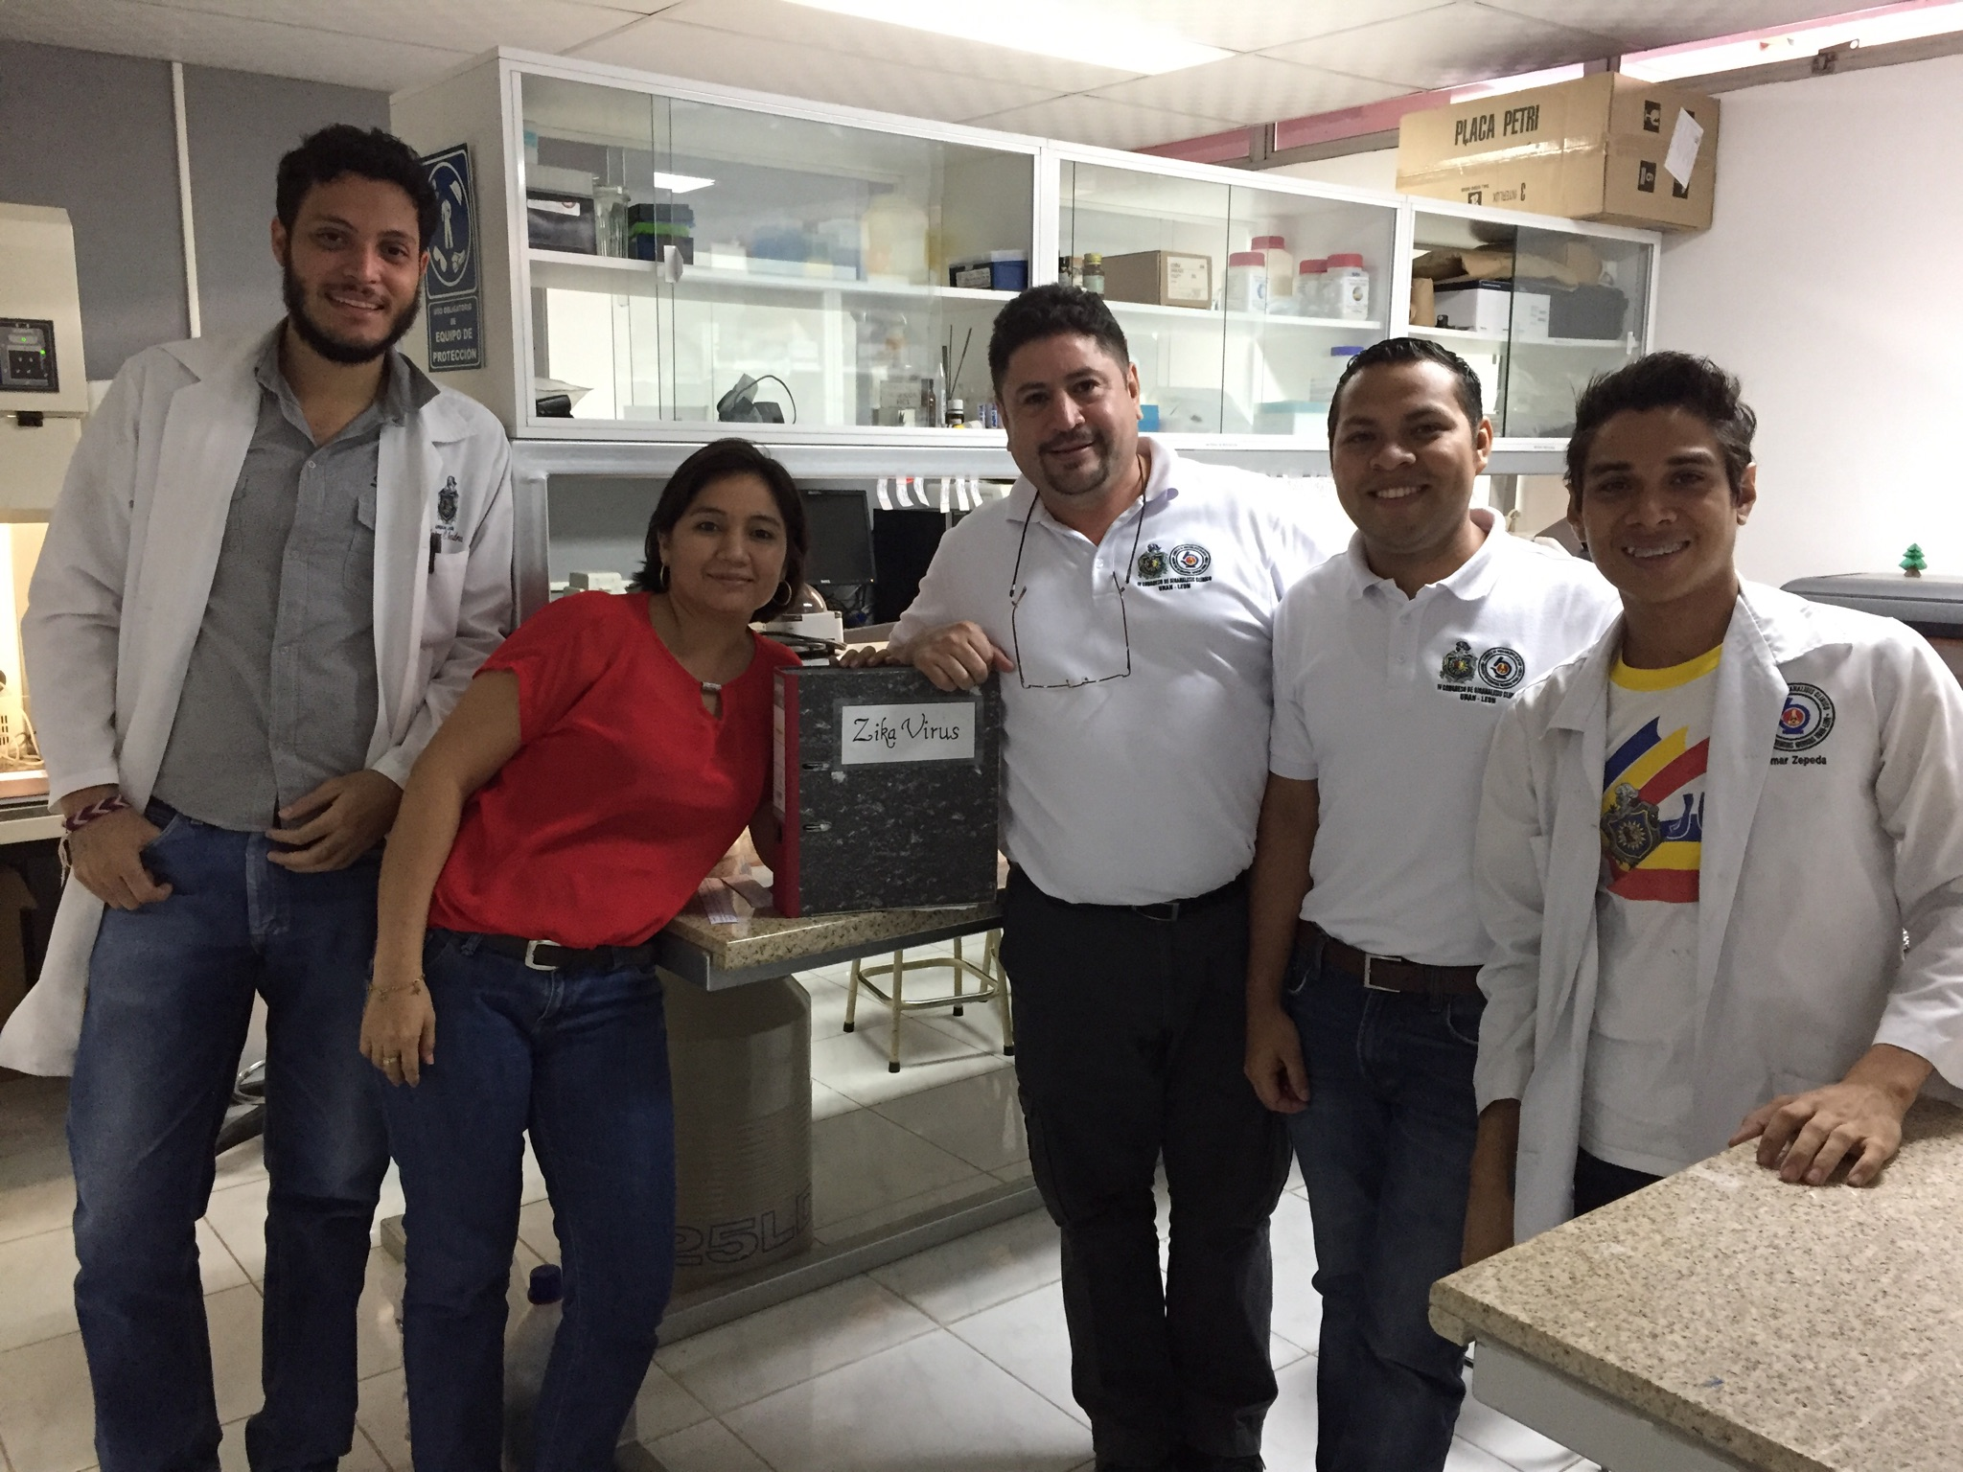
Thank you! Gracias!

