Slide 1
A Model for Community Mental Health Care in Latin America The Austral Institute in Neuquén, Argentina
Shannon Herndon; Lauren Ellis; Bradley Gaynes, MD MPH
University of North Carolina, Chapel Hill, NC
8/16/2018
OIA Global Health Forum

Slide 2
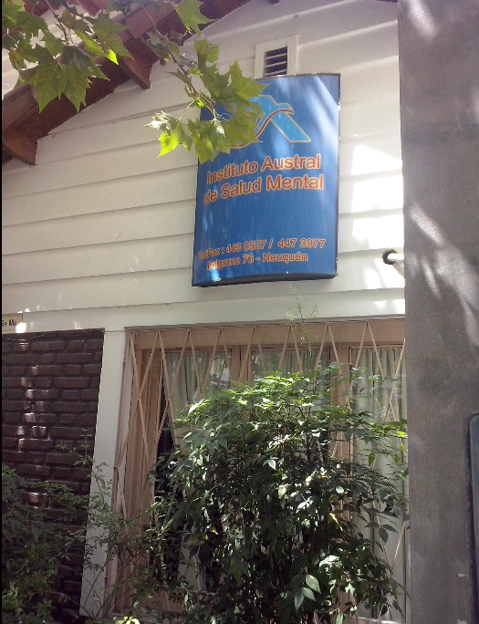
Project Conception
Mental health in Latin America
Rede Americas, Dr. Ezra Susser (Columbia University)
Austral Institute (Neuquén, Argentina) and Dr. Jose Lumerman
Notes:
Talk about effort that went into project building and making connections → google/lit search, many emails, skyping and communication between myself and eventually Director and assistants at clinics who helped me with logistics

Slide 3
Neuquén, Argentina
The city: 224,685 people (2010)
Petroleum
The province: 551,266 people (2010)
Patagonia Region, Andes Mountains
Argentina
Mainly a public health system
Influence from the “Dirty War” (1974-1983)
Children of Militants, Los Desaparecidos (The Disappearances)
https://en.wikipedia.org/wiki/List_of_cities_in_Argentina_by_population

Slide 4
Clinic Background
1987: 9 psychiatric beds for a population of 400,000 people
Patients sent to Buenos Aires
1993: Lumerman forms team
1994: Austral Institute Opens
ISSN
Different clinic modalities (Day, Half-day, Ambulatory, Social Rehabilitation)
Diverse team of professionals
Notes:
Design to maximize psychiatric care despite limited # of psychiatrists in the area
Importance of GP
Utilization of local resources (arts and crafts, theater, etc.)
Partnership with local obra social and investment of co-founders
Longevity of clinic – how was this possible? The question

Slide 5
Research Gap
Mental health care in resource-deplete settings
Day hospitals/partial hospitalization research
Little known about the Austral Institute and it’s model of care

Slide 6
Project Design
Goals
Primary characteristics of the Austral Institute
Population
Services
Implementation
Interactions
Key aspects to success
In-person semi-structured interviews
Patients, employees, community affiliates
Notes:
Can talk about process of interviewing patients – how I decided who to interview, etc.
set of interview questions
23 patients, 21 employees, 3 community affiliates
can discuss in more detail details about interviews
patients of varying pathologies and lengths of stay
employees of varying positions - interviewed nearly all employees
affiliates - local hospital, Obra social, Rede Americas

Slide 7
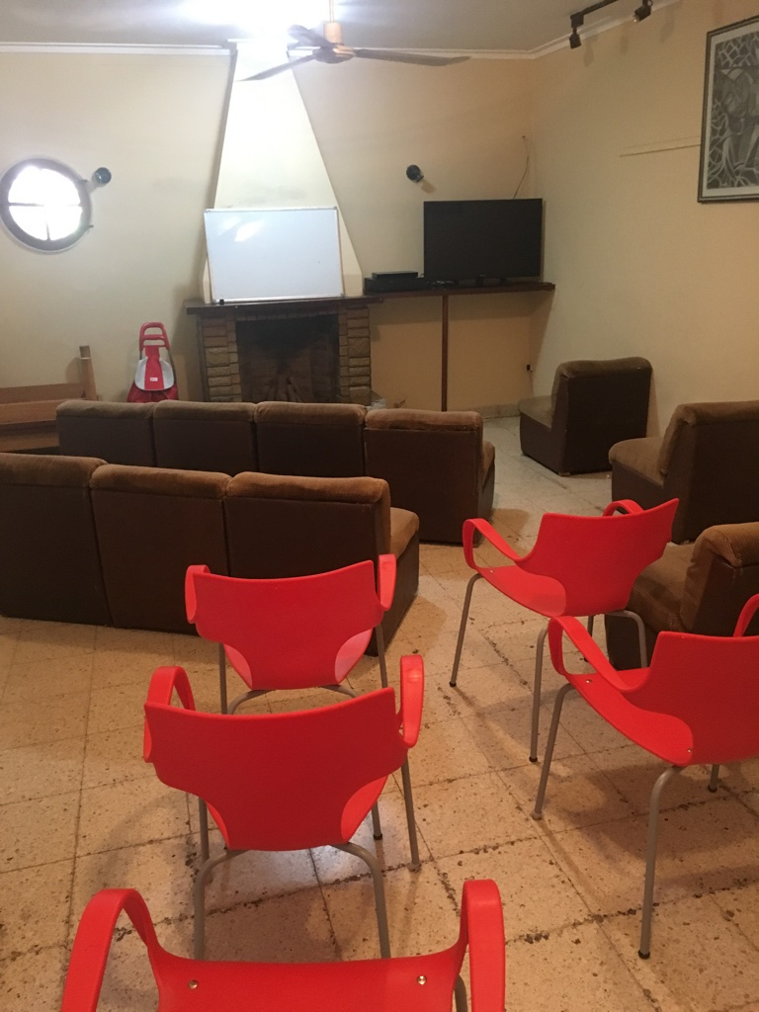
Team Meeting Area/Classroom
Notes:
When I got there this is what I saw…

Slide 8
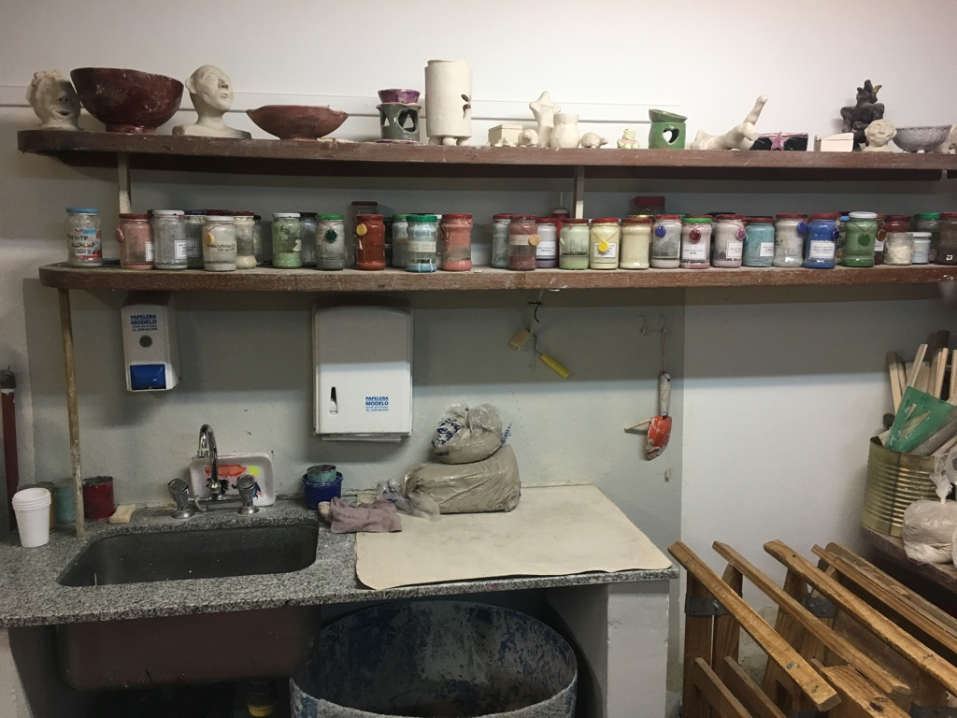
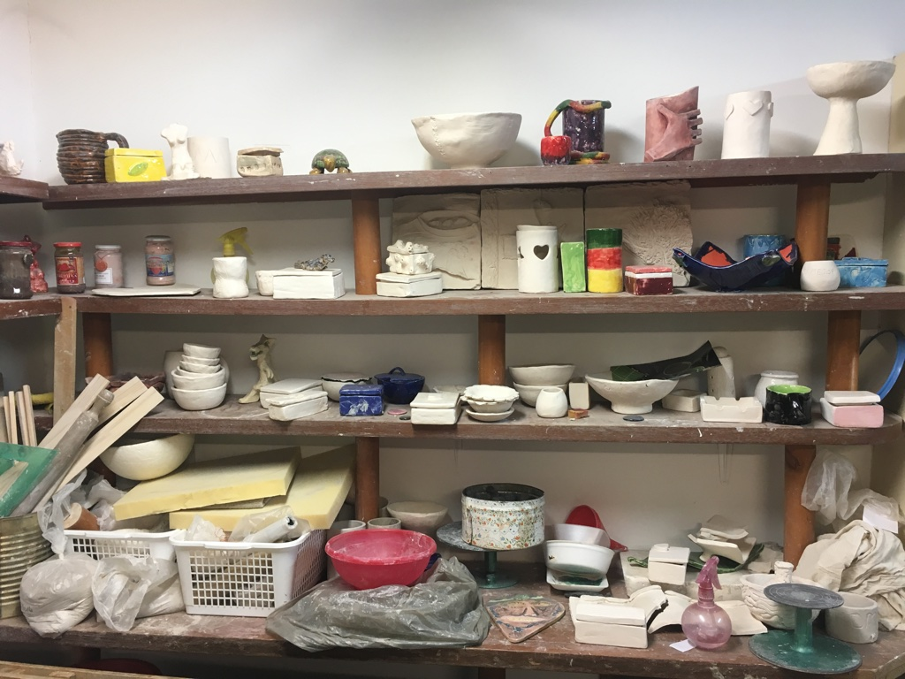
Classroom/Ceramics Workshop Area

Slide 9
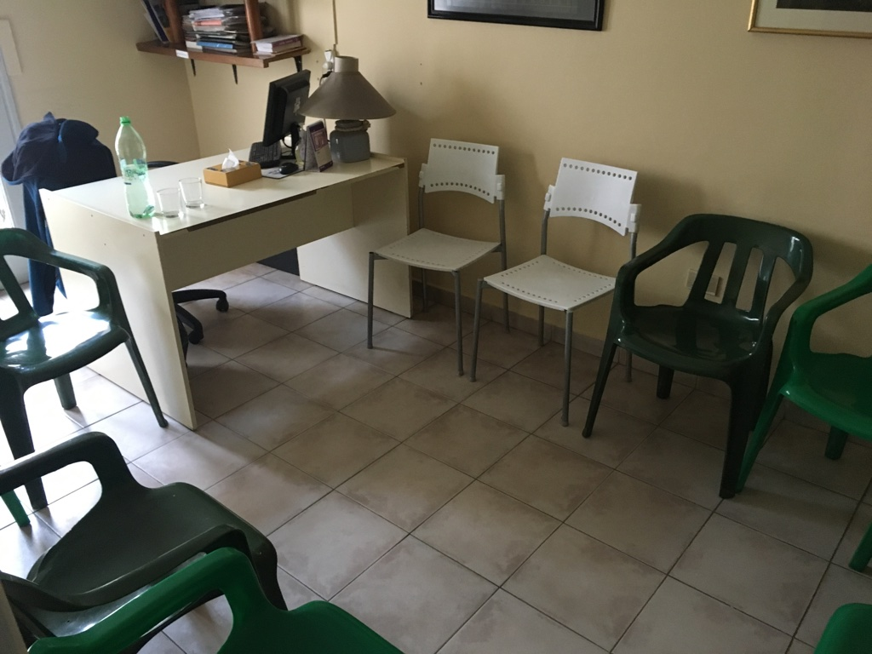
Group therapy session

Slide 10
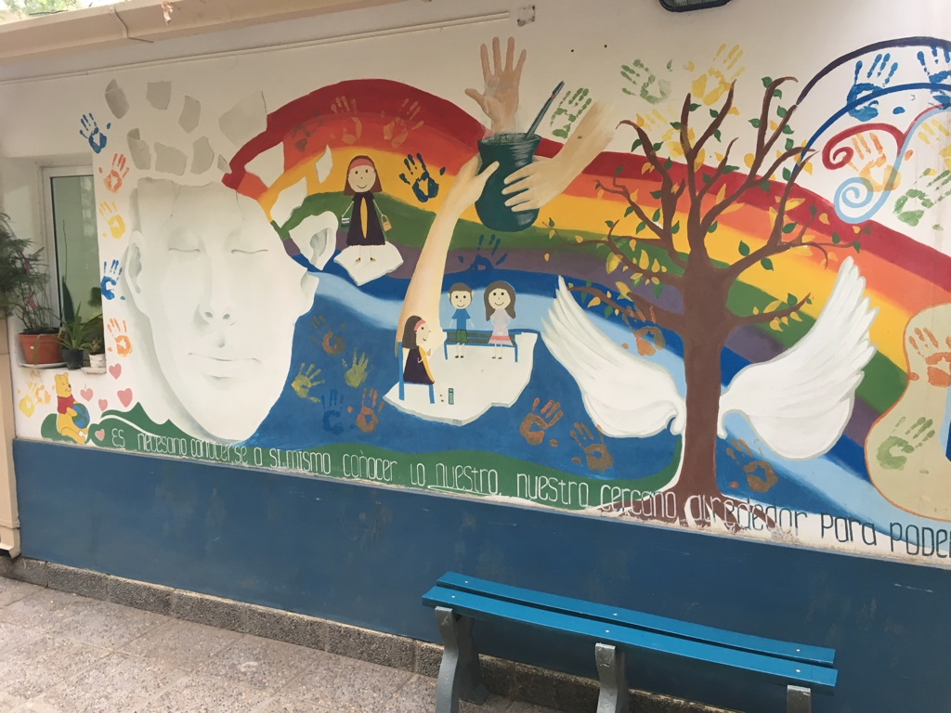
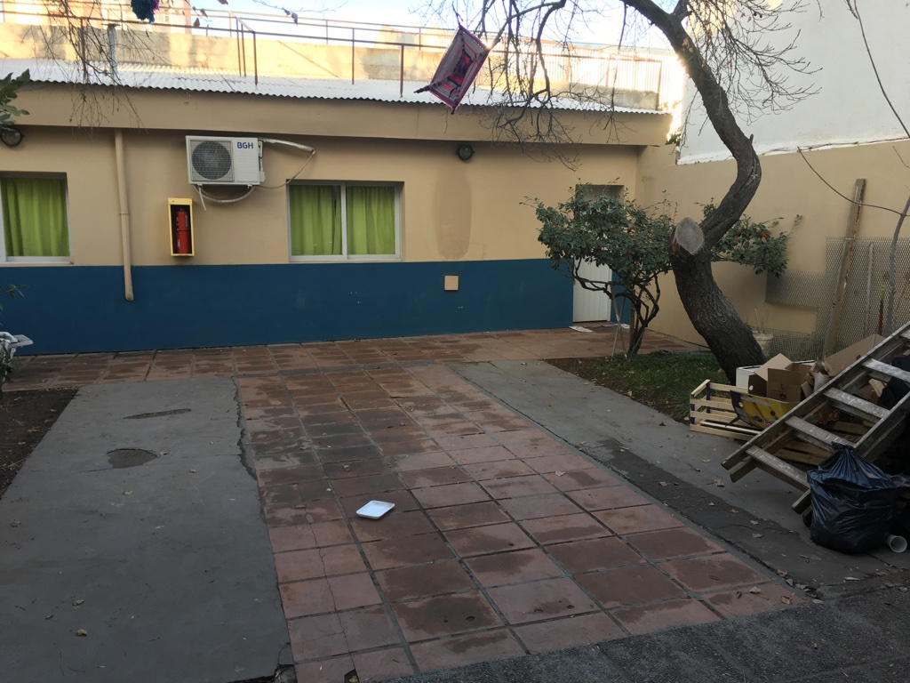
Outdoor Patio

Slide 11
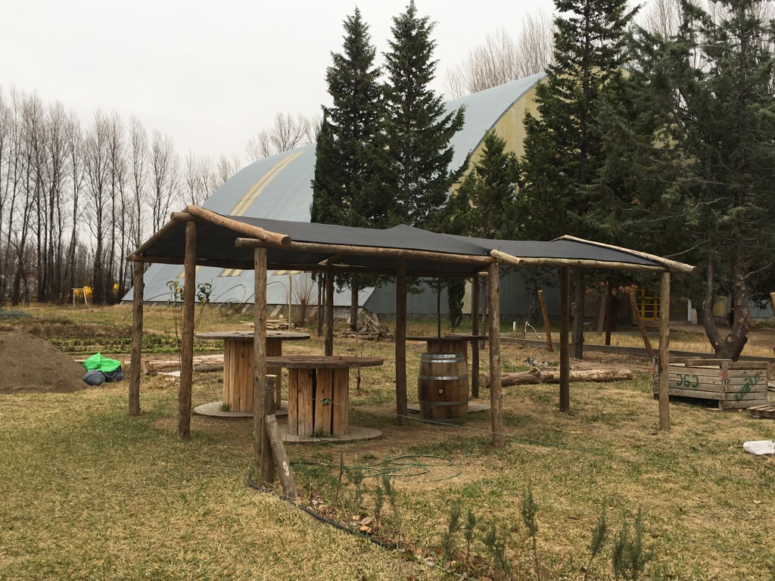
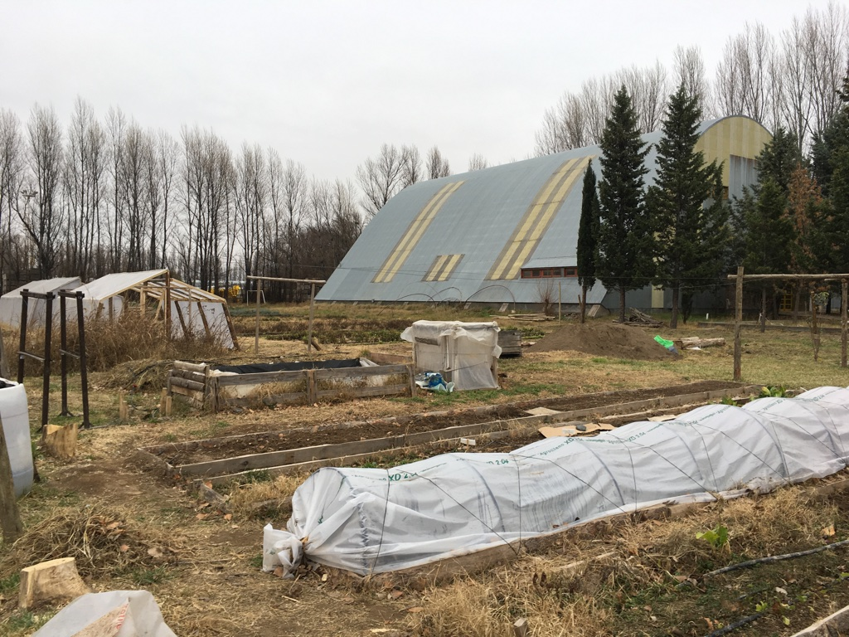
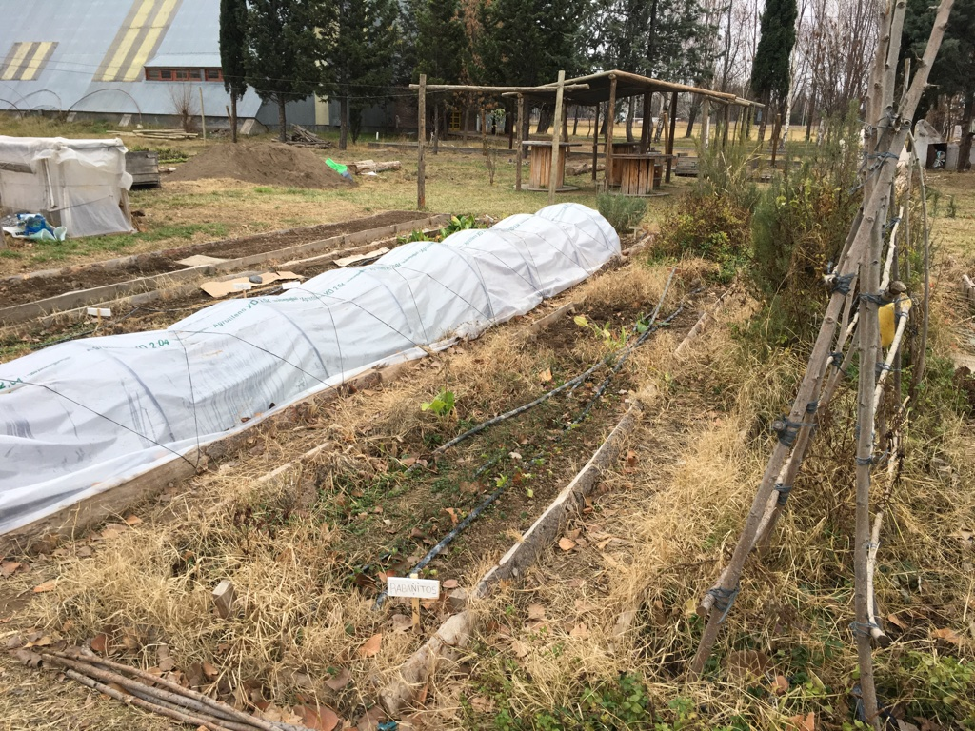
The garden (in winter)

Slide 12
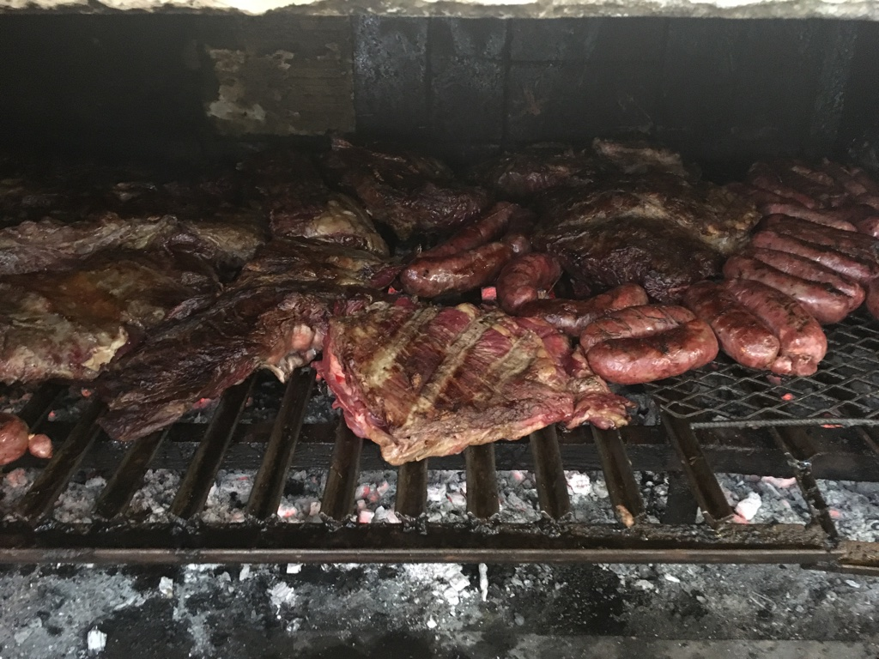
Friday Asado (Grill out)

Slide 13
Qualitative Analysis of Interview Data
Transcription of interviews
Developing a set of meaningful codes
Clinic structure and environment
Interpersonal relationships within the community
Mainstays of therapy
Analysis using Atlas.ti software
Notes:
importance of clinic structure in the success of individual treatment and clinic sustainability/success
therapeutic value of the community - patients from diverse backgrounds able to interact and participate in each others healing

Slide 14
Primary Clinic Characteristics
Team of multi-dimensional professionals
Psychiatrists, psychologists, general physicians, therapeutic assistants, workshop professors (art, theater, mindfulness, literature)
Diverse patient population
Depression, Bipolar, Substance Abuse, Panic Disorder, Post-Traumatic Stress Disorder, Schizophrenia, Personality Disorders, Dementia
Targeted modalities for patient needs
Day Hospital as focus
Notes:
Our research focuses on the day hospital since it is the most unique modality and the one built upon the community foundation pillars

Slide 15
Identifying Key Themes
Across all interviews
Therapeutic community
Clinic structure
Measures of patient improvement and recovery
Patient interviews
Feeling of intimacy
Employees
Equality in teamwork
Notes:
therapeutic value of the community - patients from diverse backgrounds able to interact and participate in each others healing

Slide 16
Results
Differences between patient and employee perspectives
Measuring therapeutic success
Personal growth vs. functional rehabilitation
Value of unstructured time
“dead time” vs. “free time”
Notes:
personal growth - comments specific to changes within a person that they note in themselves, i.e. how they feel, painting nails, etc.
functional rehab - big picture in society, with focus on skills acquired and social interactions

Slide 17
Unstructured Time: Employee
The free time is a space that contributes to health so to be able to generate these free times where patients can learn to do activities that have to do with enjoyment, leisure, rest…it is a space to be creative, to be able to look for something, and not like the workshops…they tell you what to do…here no, you have to search for it and enjoy yourself.
(Female, Therapeutic Assistant, 7 months of employment)

Slide 18
Unstructured Time: Patients
I don’t like the dead times. After lunch we have many hours here to play ping pong, which yes I like but…I think it would be better to use this time for something more productive, let’s say the workshops.
(Male, Depression, 1 year at clinic)
Additionally, because I’m learning to plan my weekends, we have a planning group so that now I’m no longer in my house without anything to do, lying down if I don’t go out.
(Female, Panic Disorder, 2 months at clinic)
Notes:
Second quote shows one patient who was able to find meaning in unstructured time – but this was a rare perspective from patient

Slide 19
Results
Keys to clinic success
Alta Simplicidad or “High Simplicity”
Local resources, workshops, unstructured time, community
External support vital to sustainability - “Obra Social”
Teamwork to gain comprehensive understanding of patient status

Slide 20
High Simplicity and Teamwork
Here the novelty is the general physician, not the psychiatric physician. The general physician can take care of patients with mental illnesses and inter-consults with the psychiatrist…because if the physician works with the psychologist, the psychiatrist, the nurse, the therapeutic assistant, what makes up the therapeutic community…all of this forms part of the treatment that has provided much, much success.
(Male, Accountant, 24 years of employment)

Slide 21
Limitations/Considerations
Clinic
Dependent on Obra Social
Study
One clinic director for 25 years
What will happen with a successor?
Would findings be different if there had been a few directors?
Potential bias
Selection, Social desirability, Confirmation
Notes:
Bias
selection - perhaps I interviewed patients who were more approachable/had more trust with the clinic and staff? however, somewhat negated since I interviewed 22 patients & interviewed nearly all employees
social desirability - idea that respondents answer in a way that will seem pleasing, being accepted, liked
confirmation - idea that researcher goes in with a preformed hypothesis and will remember points better that reflect that and forget other points that might contradict it
Also idea of validity of study – is this population/location generalizable to broader global health contexts? Reproducible?

Slide 22
Future Directions
Therapeutic value of unstructured time
Other settings where this method is used
Skills acquired
Feasibility of clinic model in other Latin American communities
Notes:
Skills acquired – meaning are patients more effective at coping with free time in the external environment when they have been exposed to it on the inside? Does it make a difference?

Slide 23
Acknowledgements
Vivian Go, PhD
Paul Mihas, MA
Kenan Penaskovic, MD
Roberto Blanco, MD
Ezra Susser, MD DrPH
Jose Lumerman, MD
The Austral Institute Community
The Office of International Activities at UNC

Slide 24
Questions?
Thank you!

