Slide 1
Creating Value: Global Innovations That Will Transform Medicine
Alan Rosenbaum, MD
Fellow, Global Women’s Health
Department of Ob/Gyn
Alan_rosenbaum@med.unc.edu
September 20, 2018

Slide 2
Conflicts of Interest
I have no conflicts of interest to report

Slide 3
Outline
WHO Global Initiative on Health Technologies
Global Innovations that Will Transform Medicine
Telemedicine/Mobile Apps (Health Care Service Optimization)
Smart Technology / Machine Learning
Introduction to FAMLI Project
Innovation Resources at UNC
Bonus: Impactful Global Health Innovators

Slide 4
Outline
WHO Global Initiative on Health Technologies
Global Innovations that Will Transform Medicine
Telemedicine / Mobile Apps
Smart Technology / Machine Learning
Introduction to FAMLI Project
Innovation Resources at UNC

Slide 5
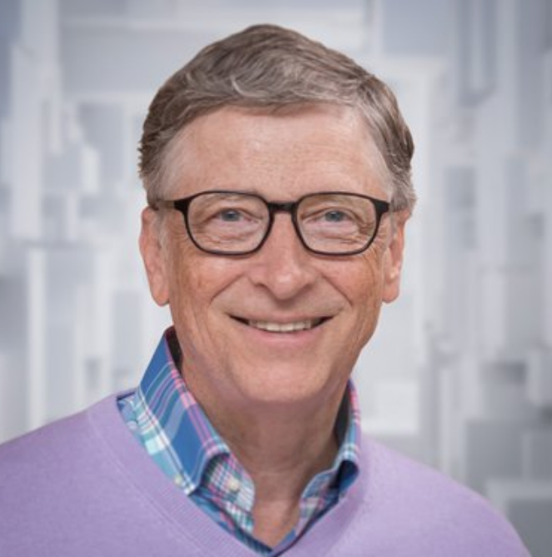
Medical Innovators: William Gates, III
Cofounder, Former CEO, Microsoft
Dropped out of Harvard to form company with Paul Allen
Worked on coding, product strategy, business management
Philanthropist, Bill and Melinda Gates Foundation
Aims to donate 99.96% of his wealth

Slide 6
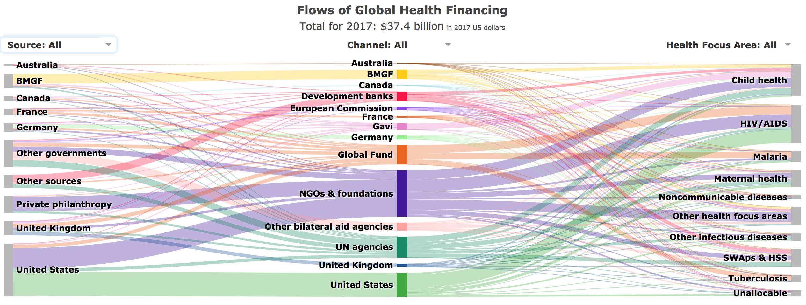
Medical Innovators: William Gates, III
Cofounder, Former CEO, Microsoft
Dropped out of Harvard to form company with Paul Allen
Worked on coding, product strategy, business management
Philanthropist, Bill and Melinda Gates Foundation

Slide 7
Medical Innovators: William Gates, III
Innovator in Global Health Funding
Developed Grand Challenges in Global Health
Based upon Hilbert’s Problems in mathematics– “Bottlenecks”
Identified specific ‘Bottlenecks’ in Global Health
After overcoming a ‘Bottleneck’, a potential pathway to solving significant health problems could be solved
Initial Challenges Proposed (14 total)
Develop needle-free delivery systems for vaccines
Develop immunological methods to cure chronic infections
Develop technologies to assess for multiple conditions or pathogens at point-of-care

Slide 8
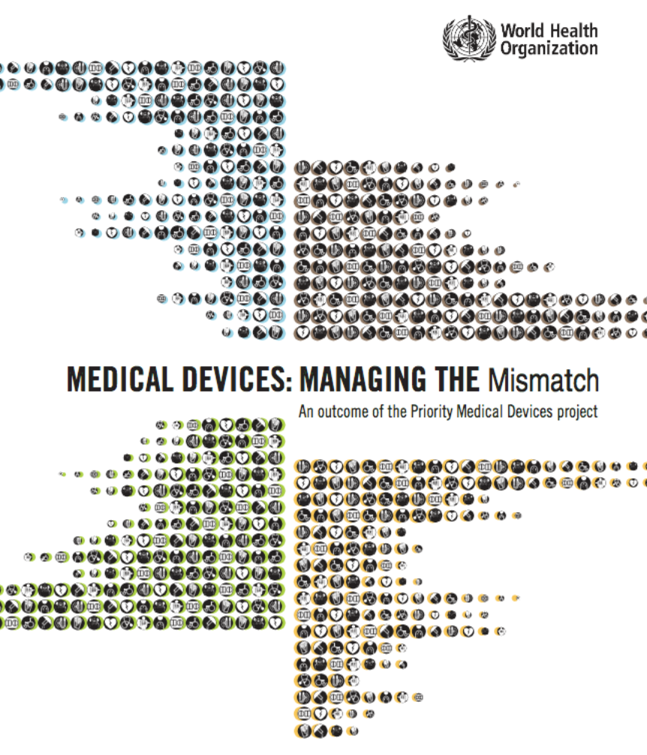
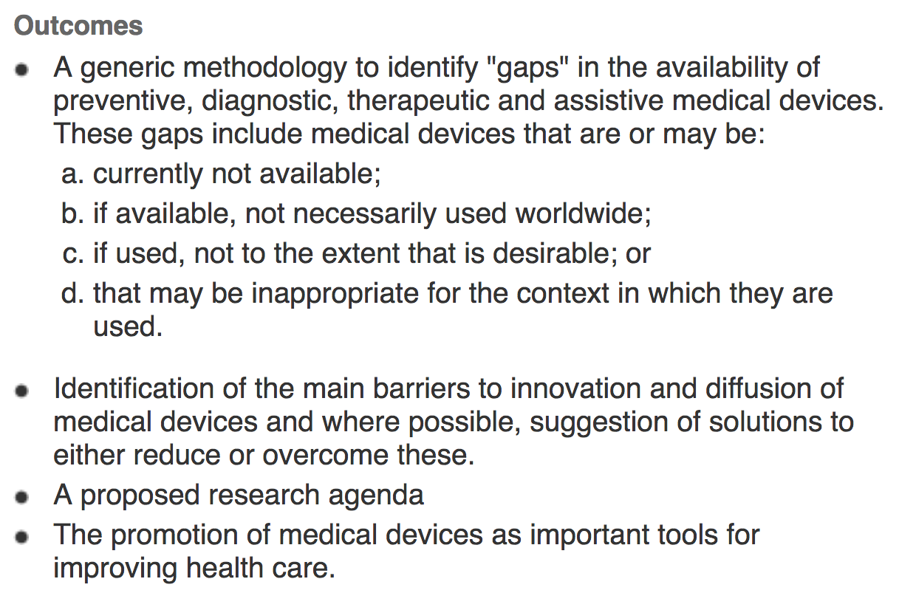
WHO Priority Medical Devices

Slide 9
WHO Global Initiative on Health Technologies
Funded by BMGF

Slide 10
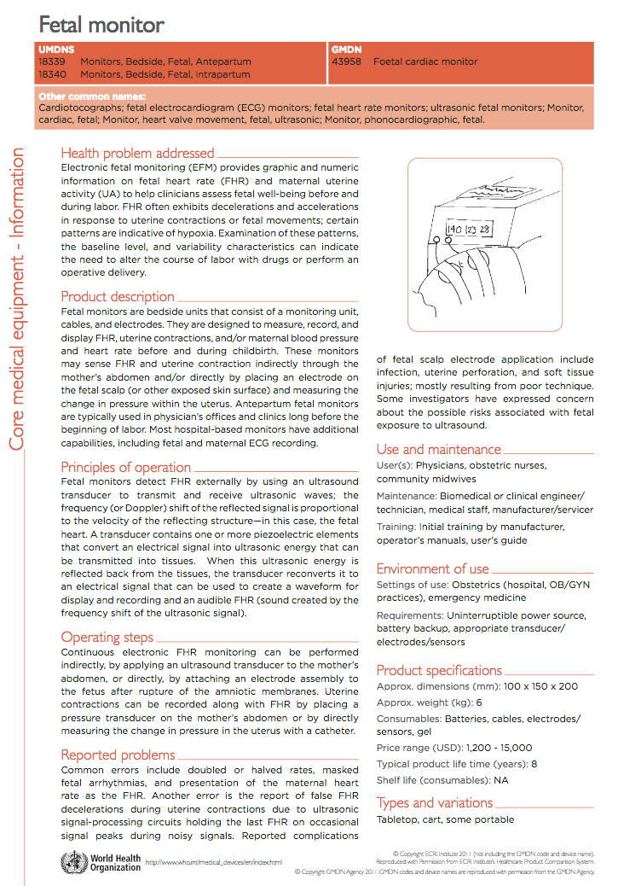
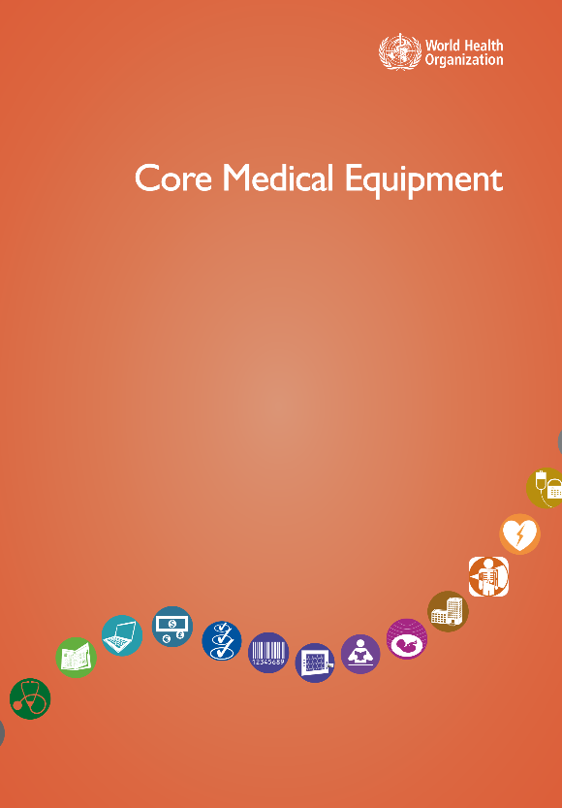
WHO Global Initiative on Health Technologies
Objective 1

Slide 11
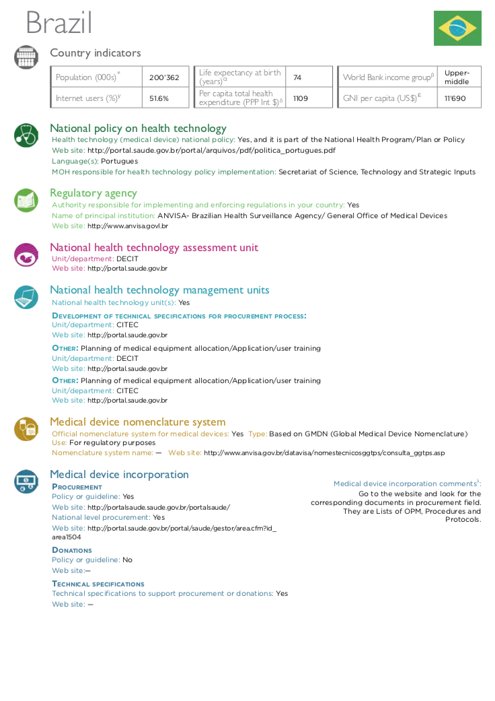
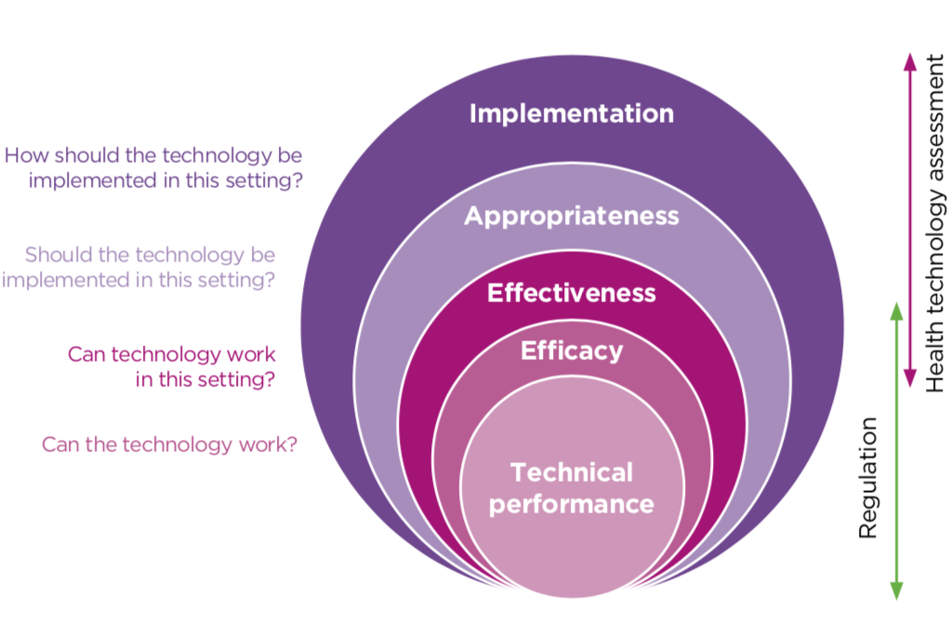
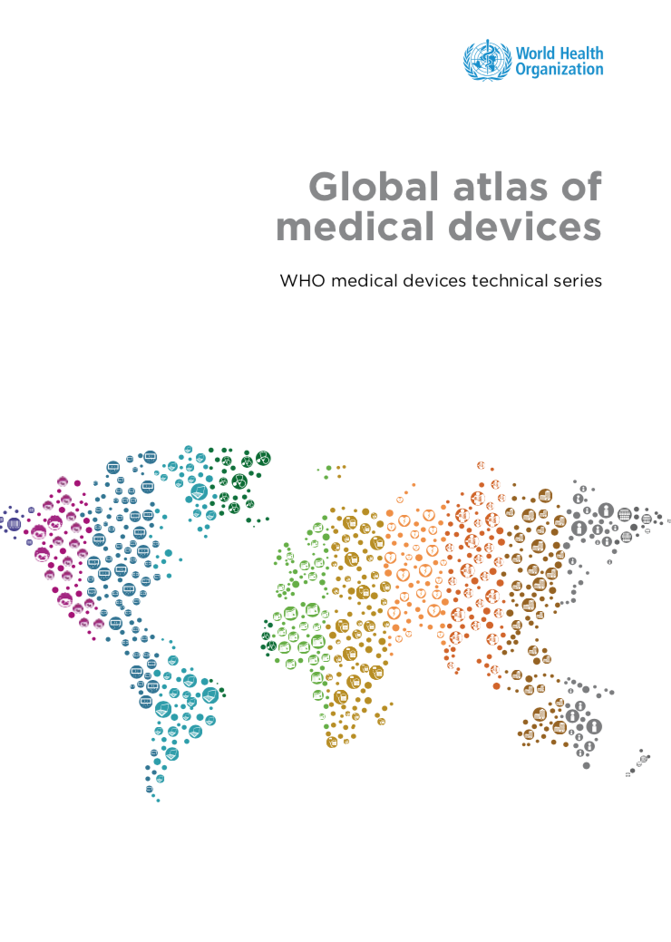
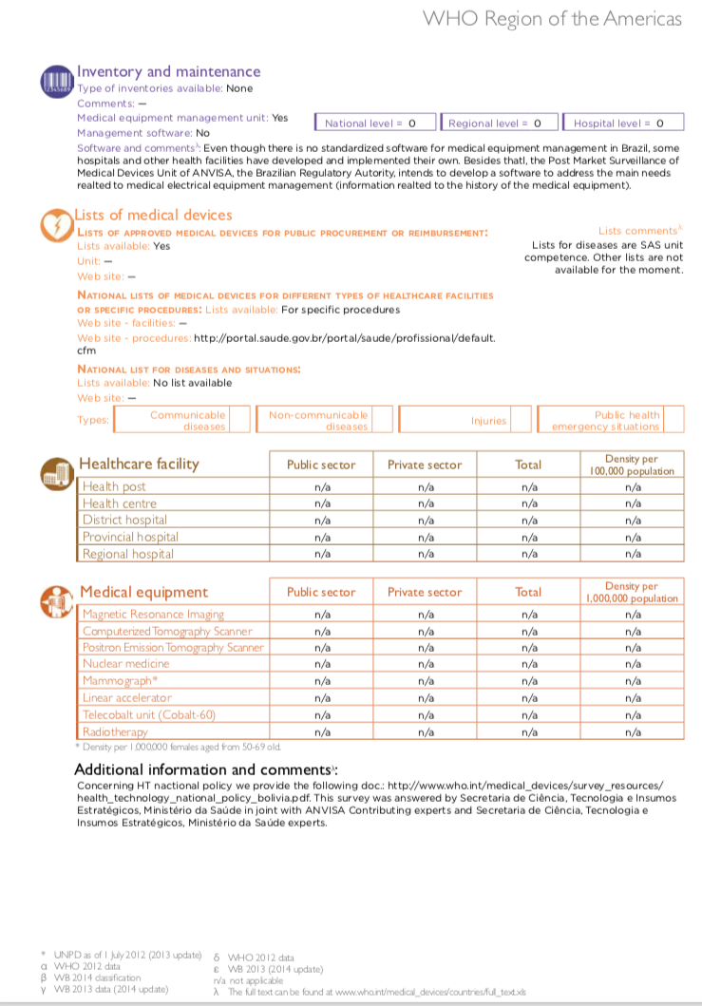
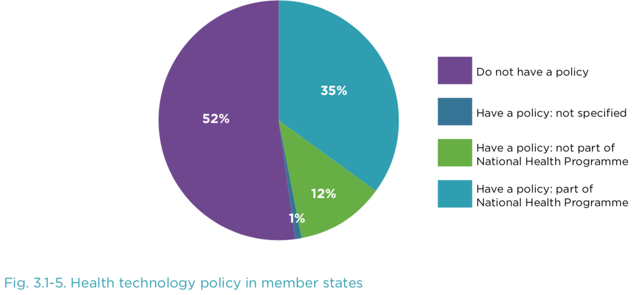
WHO Global Initiative on Health Technologies
Objective 1

Slide 12
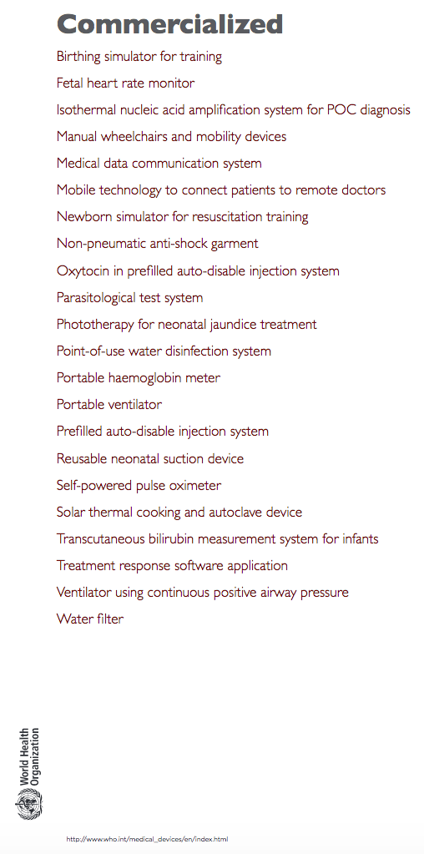
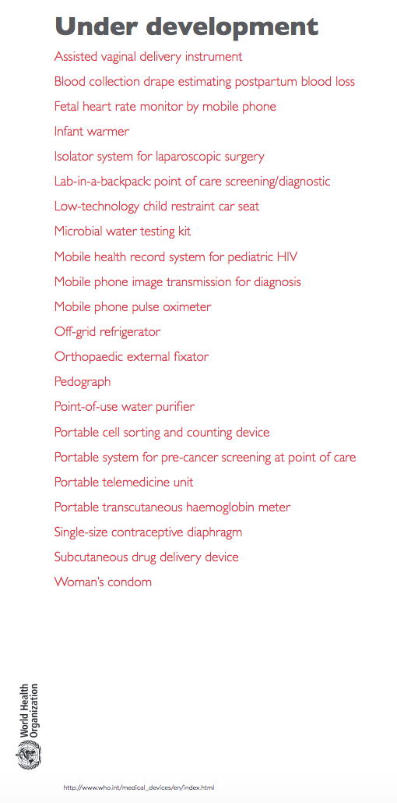
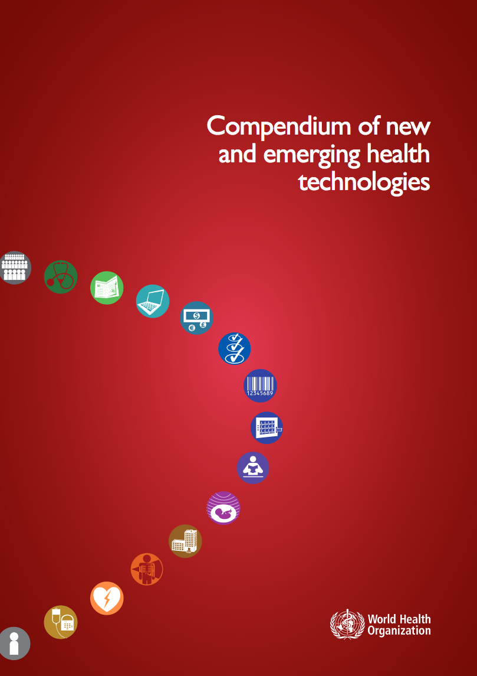
WHO Global Initiative on Health Technologies
Objective 2

Slide 13
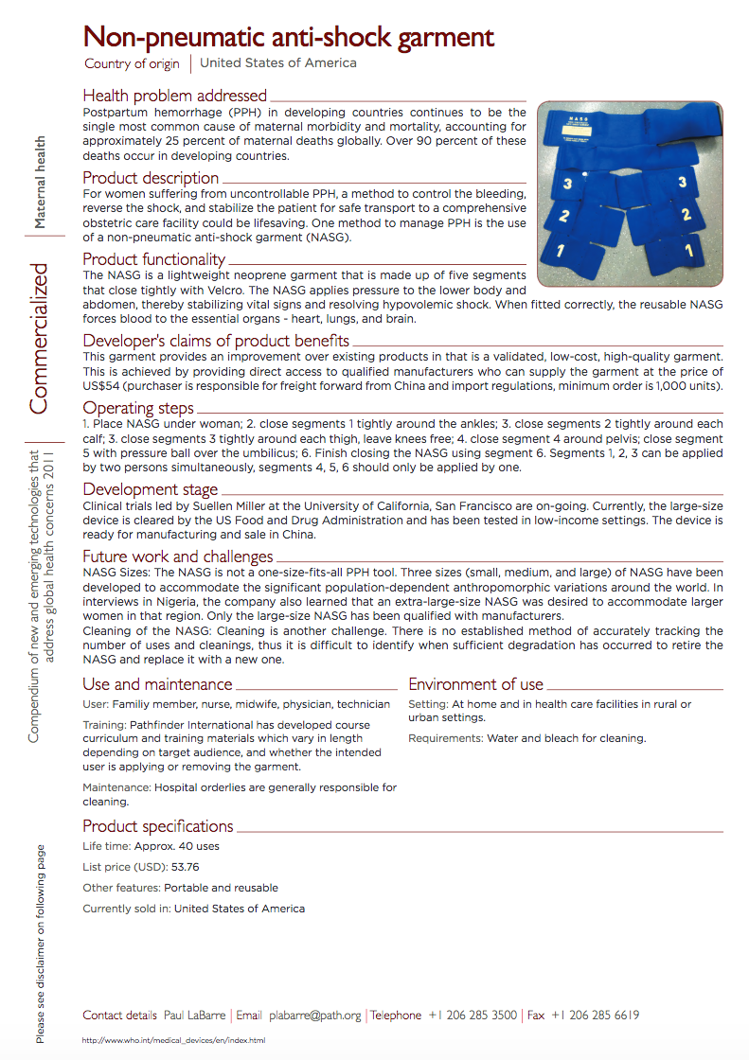
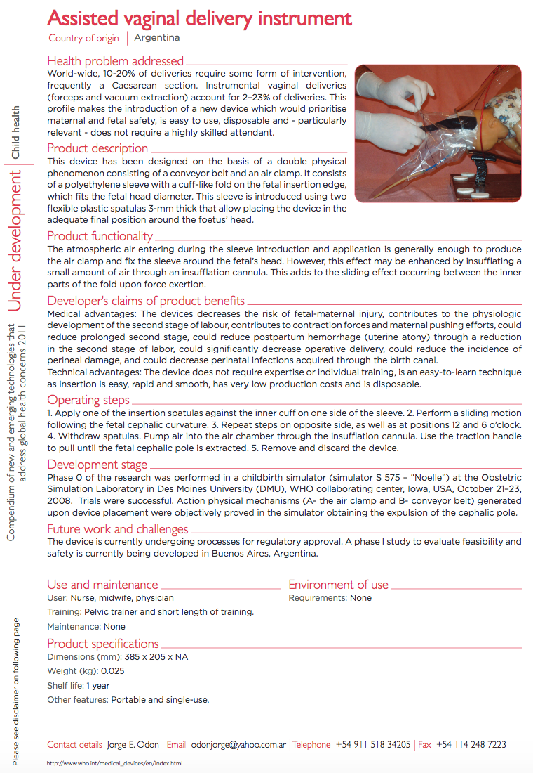
WHO Global Initiative on Health Technologies

Slide 14
Outline
WHO Global Initiative on Health Technologies
Global Innovations that Will Transform Medicine
Telemedicine / Mobile Apps
Smart Technology / Machine Learning
Introduction to FAMLI Project
Innovation Resources at UNC

Slide 15
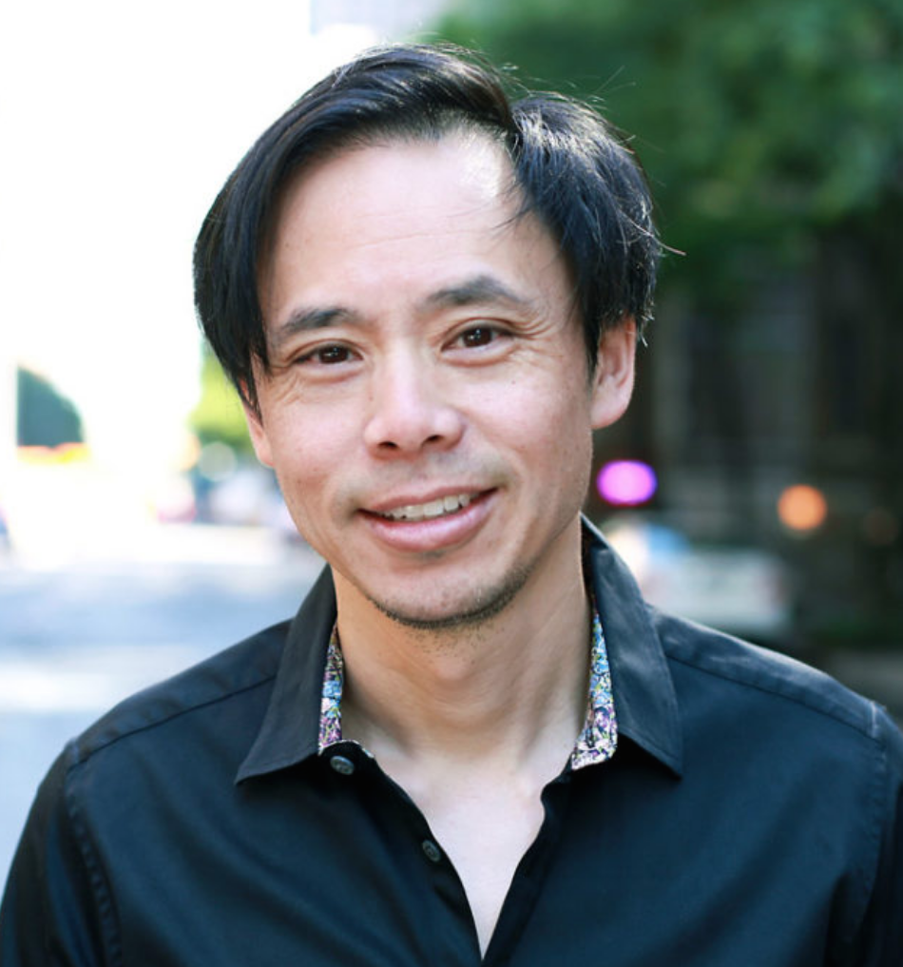
Medical Innovators: Dr. Tom Lee
Founder and CEO, One Medical
T-Shaped
Residency, Internal Medicine, Brigham & Women’s
MBA, Stanford
Past CMO, Editor-in-Chief, and lead designer of Epocrates®
Utilized those skills to found One Medical®
Concierge Platform-Based Primary Care
Delivers cheaper rates to insurers by
decreasing primary care visits through
seamless utilization of their app

Slide 16
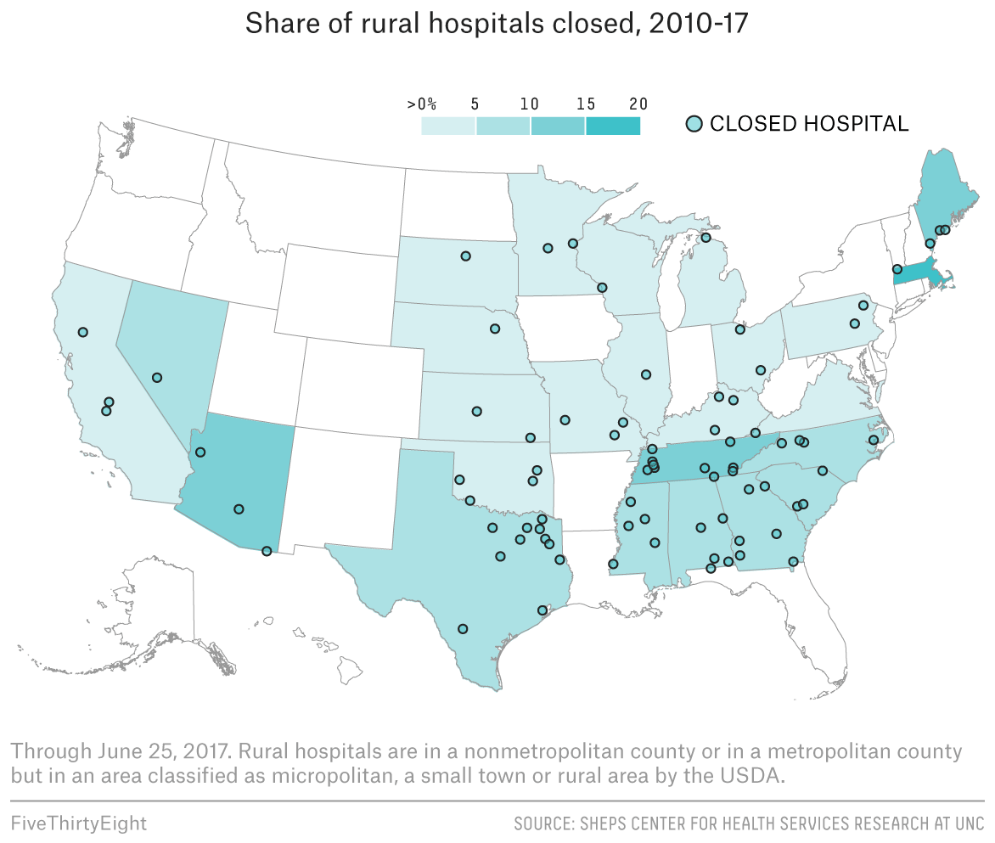
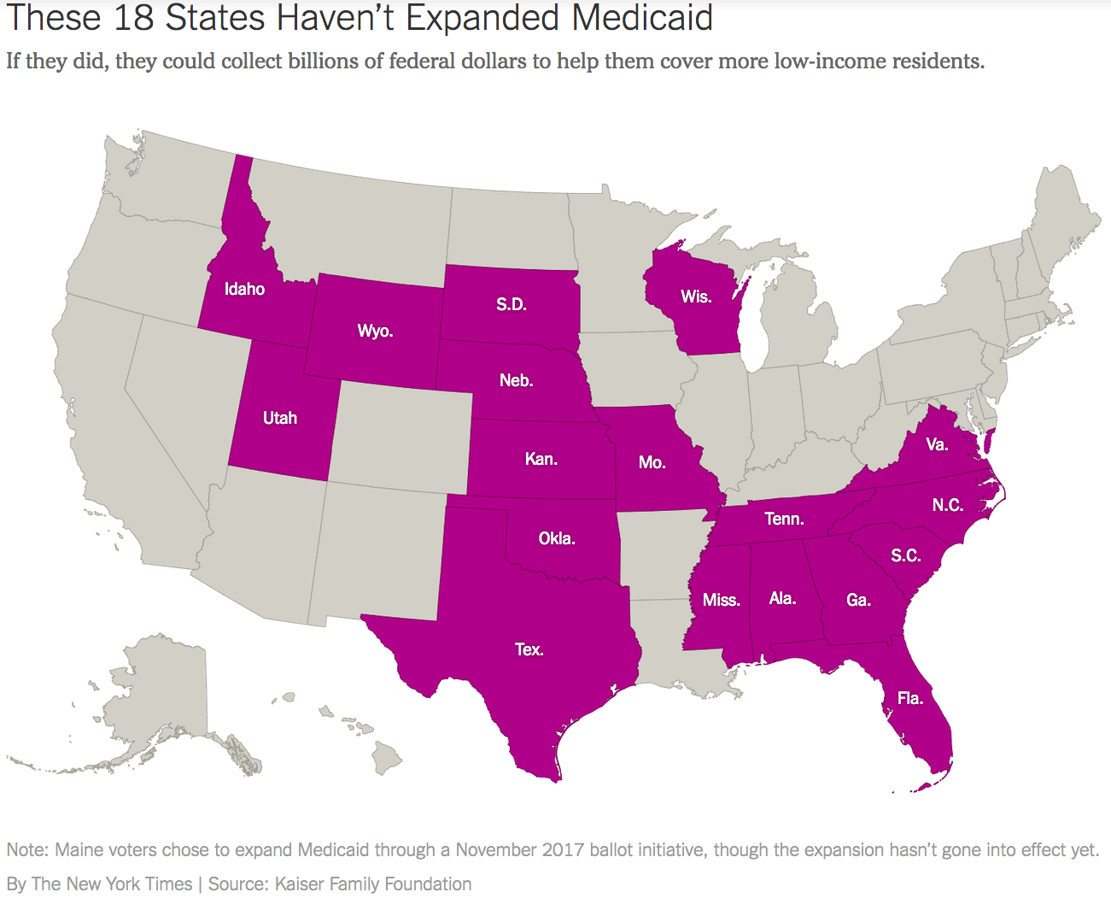
Telemedicine
Mobile-Based Telemedicine Services
The Problem:

Slide 17
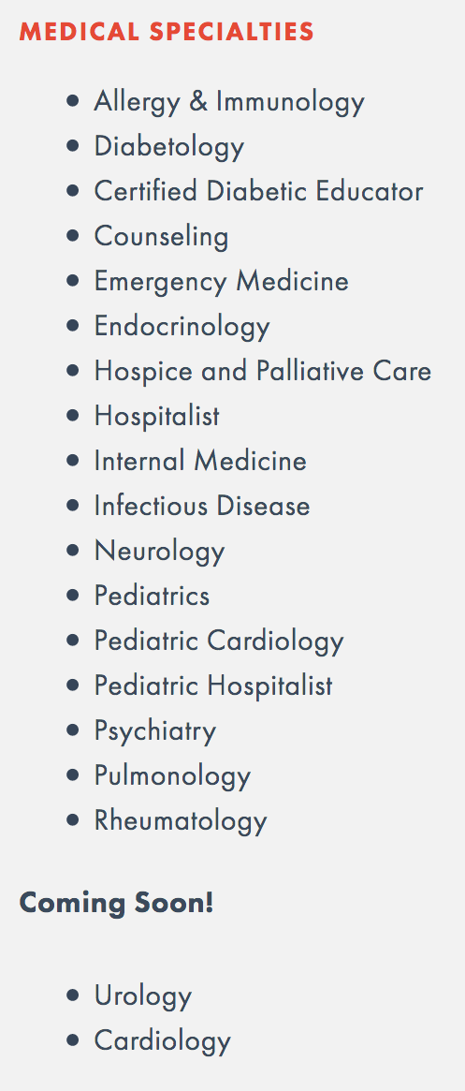
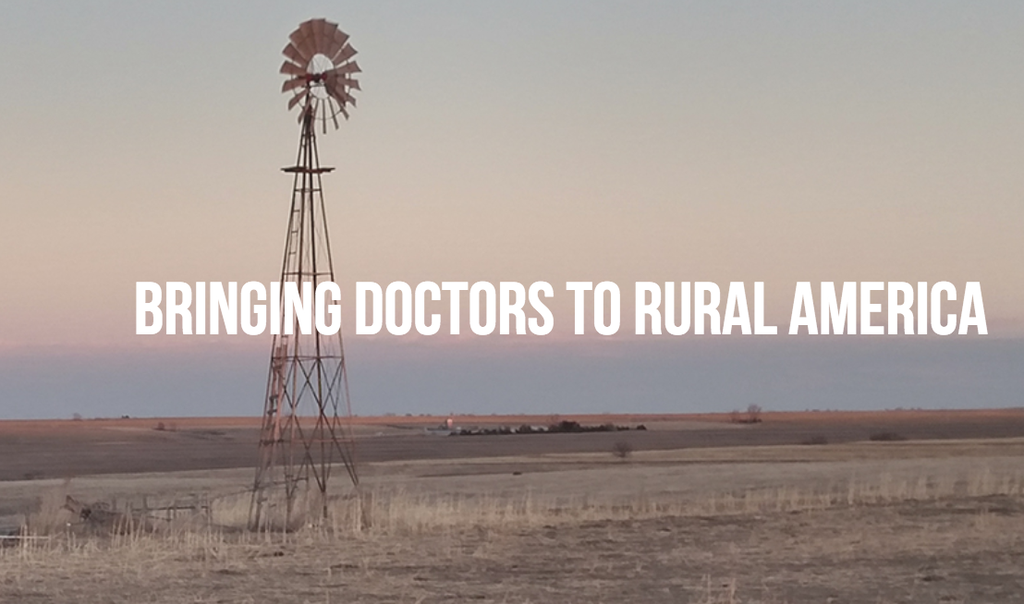
Telemedicine
Mobile-Based Telemedicine Services
Freestate Connect™

Slide 18
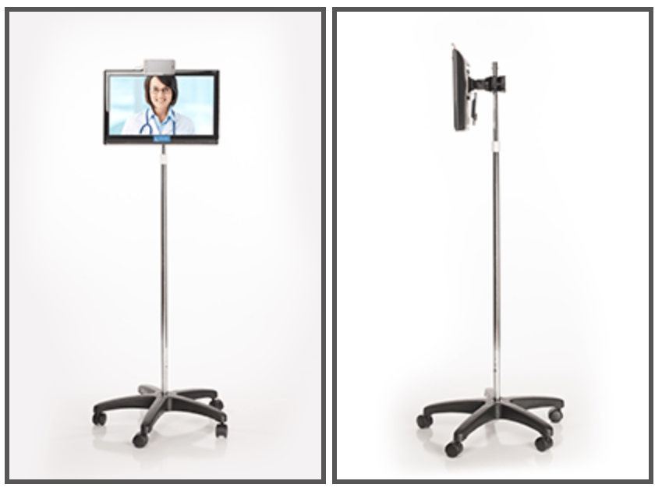
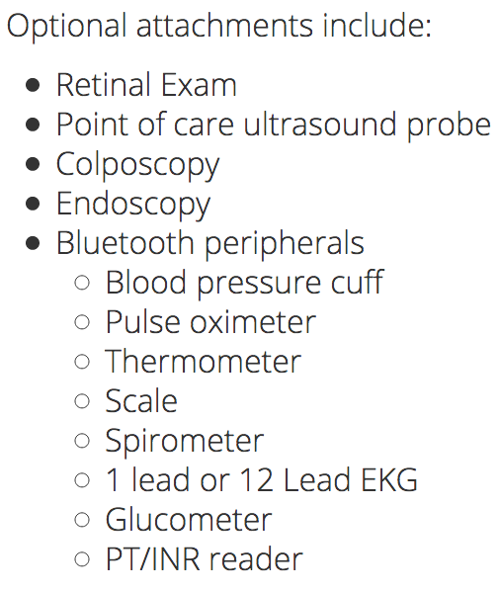
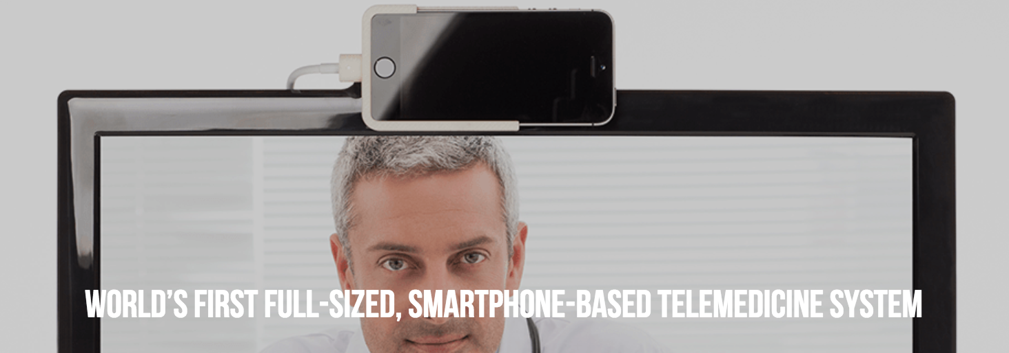
Telemedicine
Mobile-Based Telemedicine Services
Freestate Connect™
Ability to perform full exam
of heart, lungs, ears, eyes, nose,
throat and skin

Slide 19
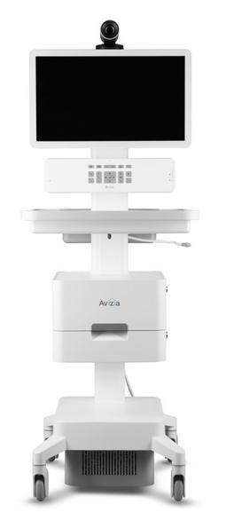
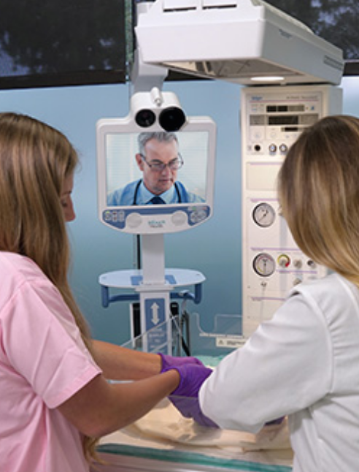
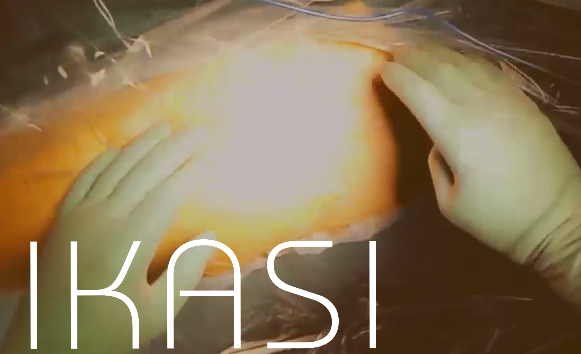
Telemedicine
Mobile-Based Telemedicine Services
Avizia®
InTouch Health®
Hodei Technology®

Slide 20
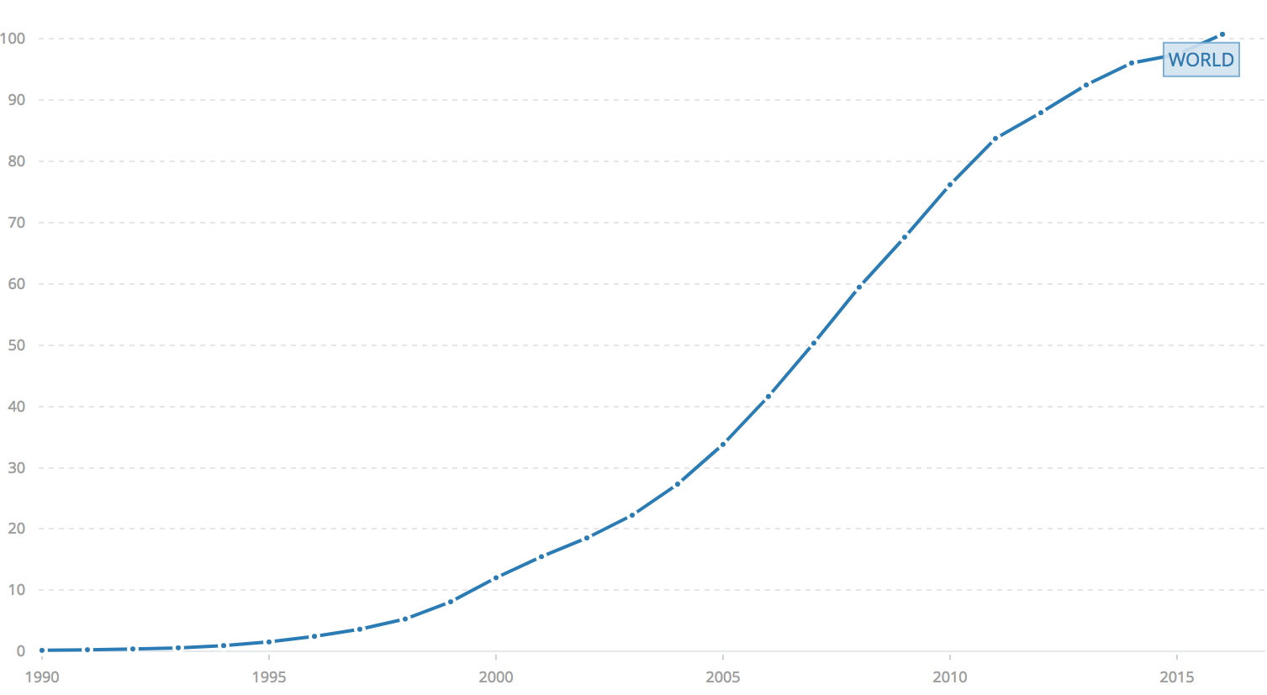
World Bank Mobile Phone Subscriptions
Subscriptions per 100 people

Slide 21
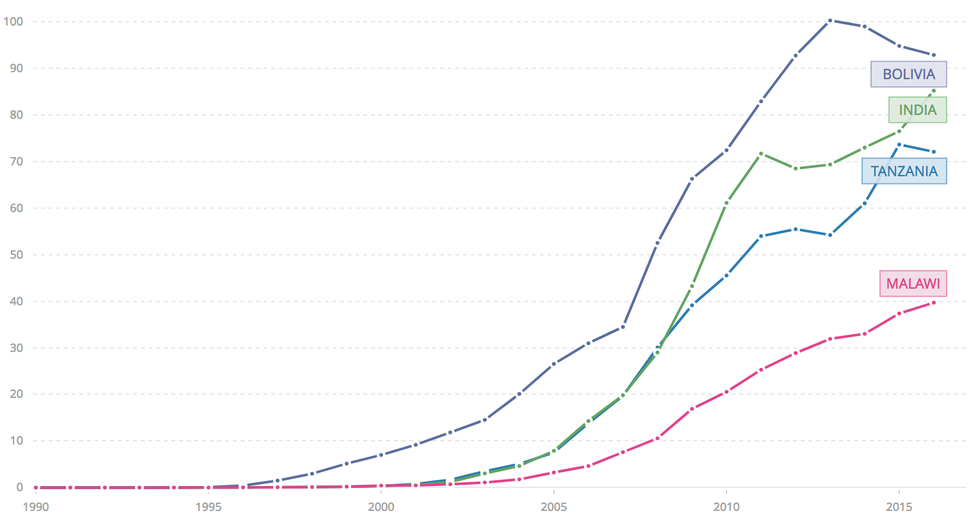
World Bank Mobile Phone Subscriptions
Subscriptions per 100 people

Slide 22
Outline
WHO Global Initiative on Health Technologies
Global Innovations that Will Transform Medicine
Telemedicine / Mobile Apps
Smart Technology / Machine Learning
Introduction to FAMLI Project
Innovation Resources at UNC

Slide 23
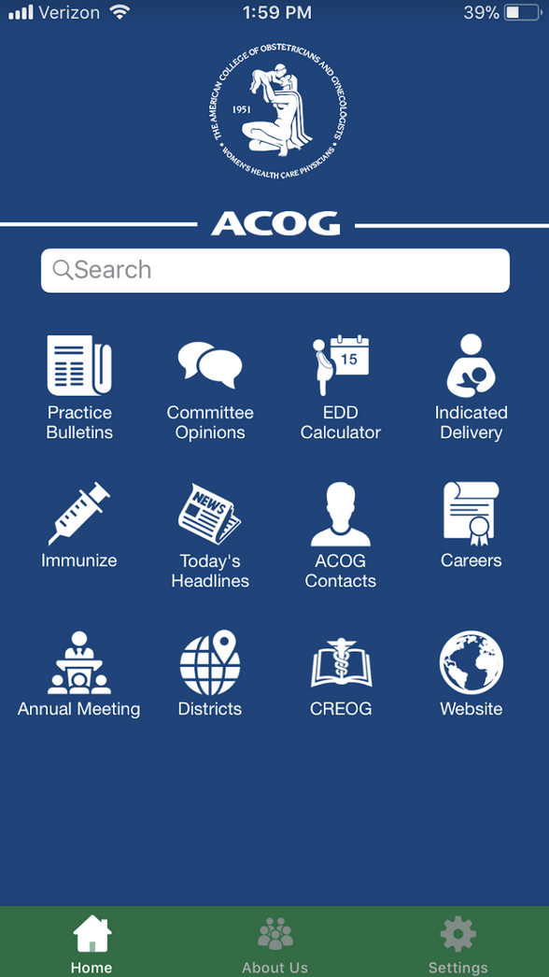
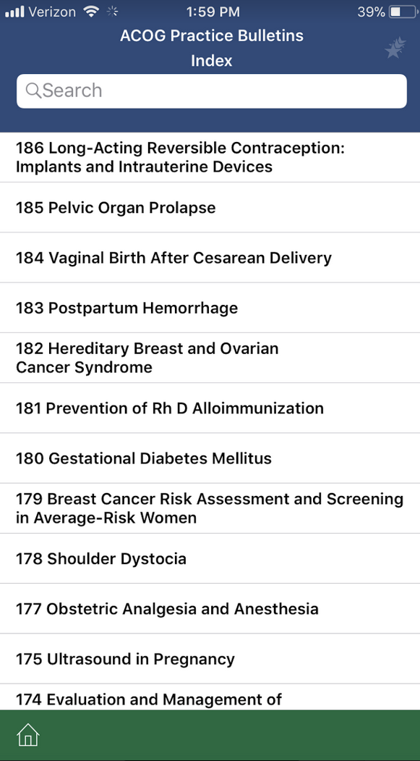
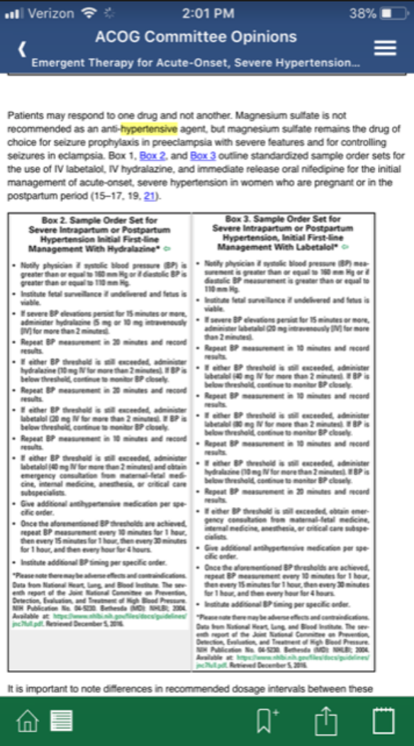
Mobile Apps
Education, Clinical Recommendations

Slide 24
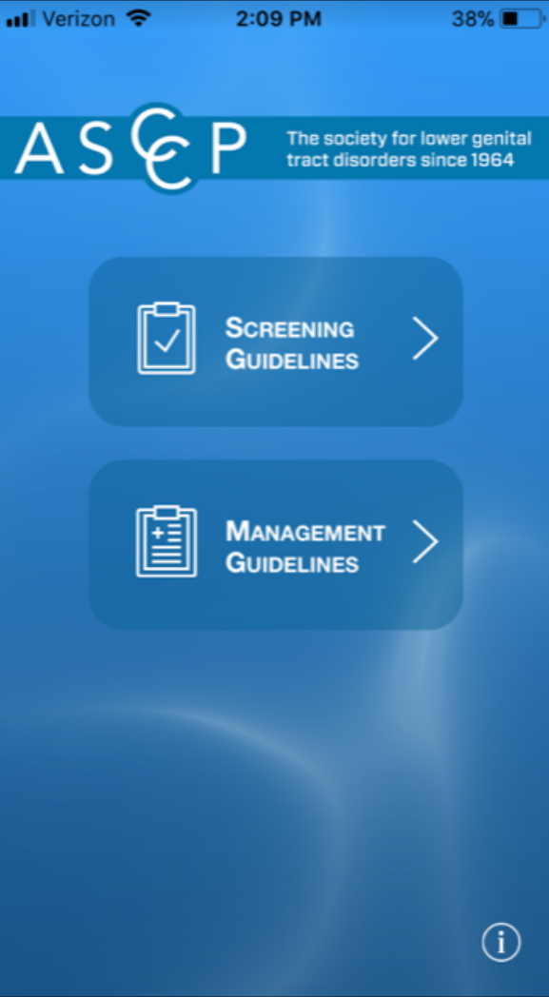
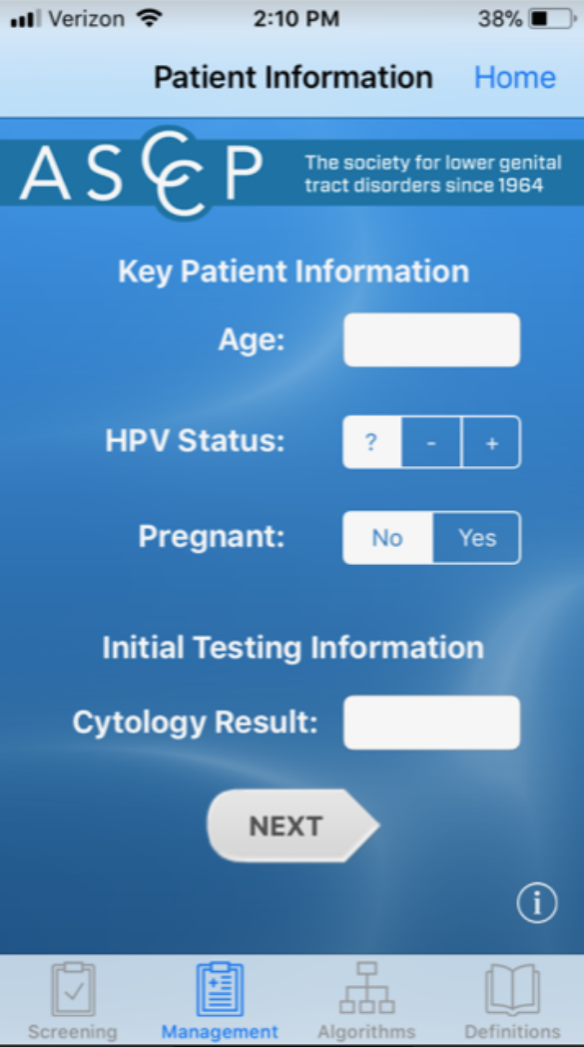
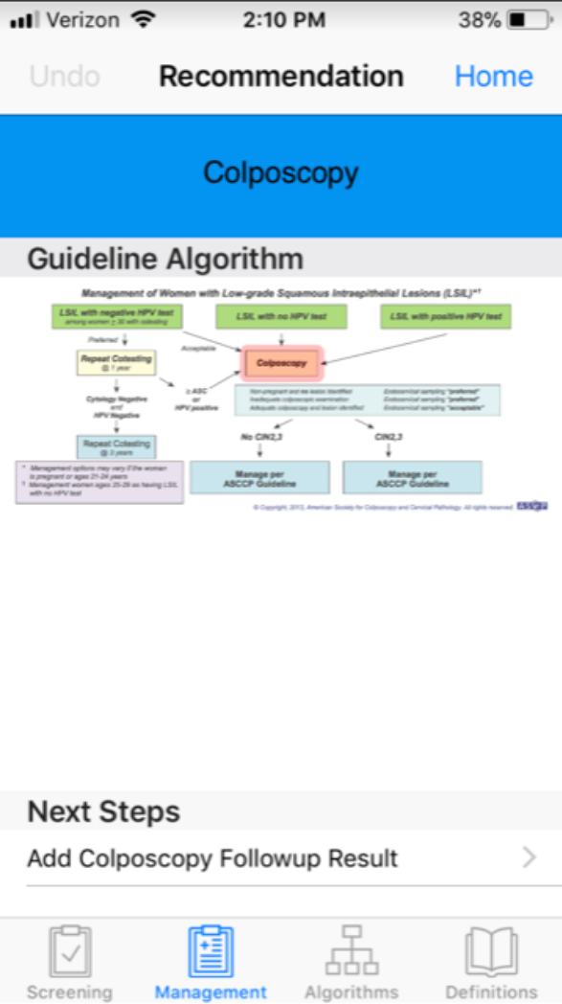
Mobile Apps
Education, Clinical Recommendations

Slide 25
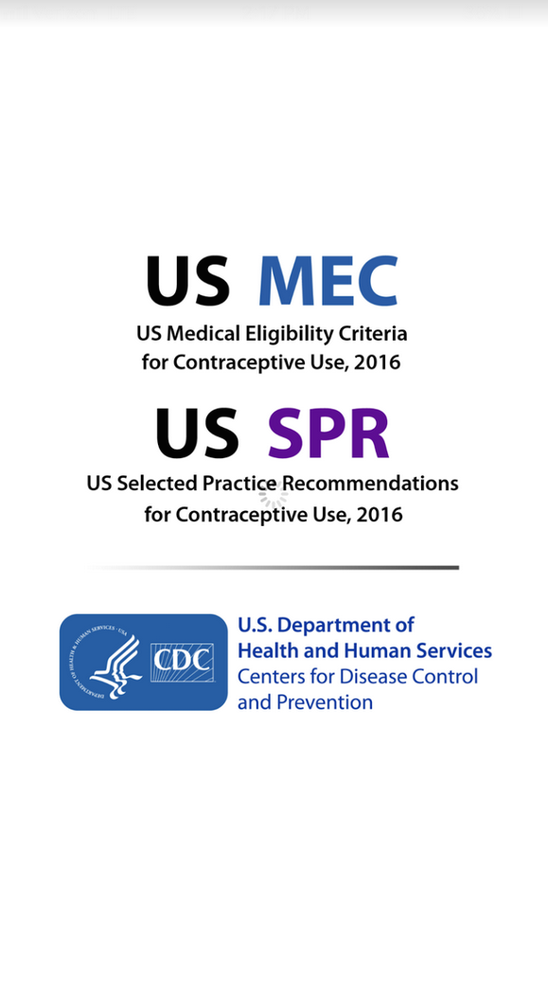
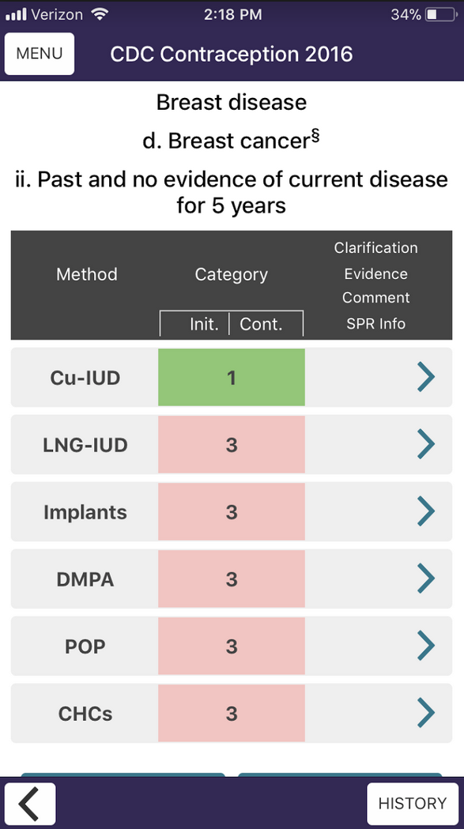
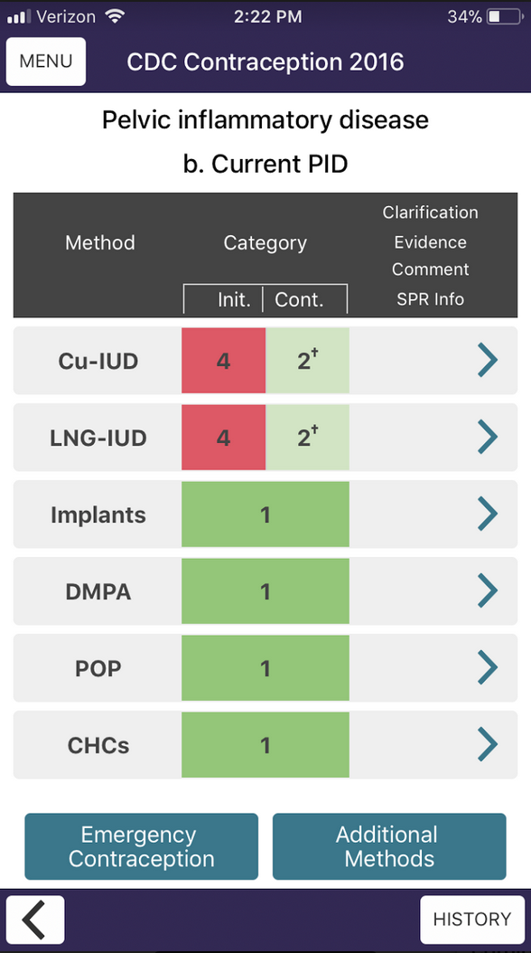
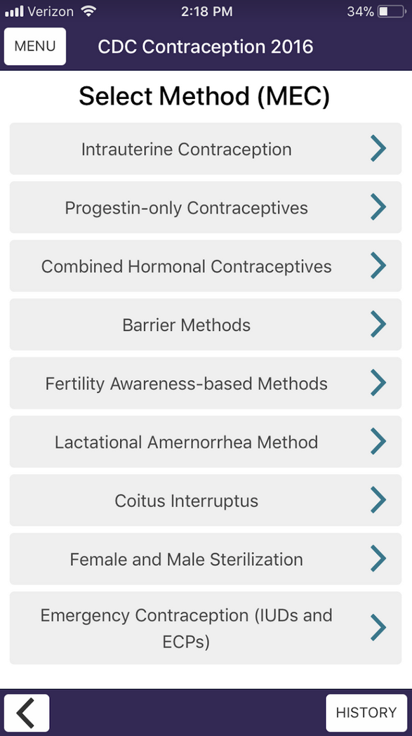
Mobile Apps
Clinician Education, Clinical Recommendations

Slide 26
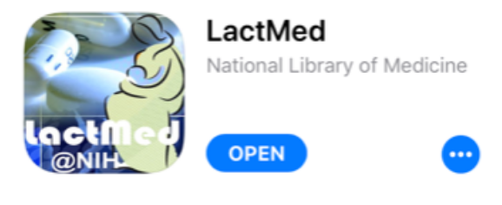
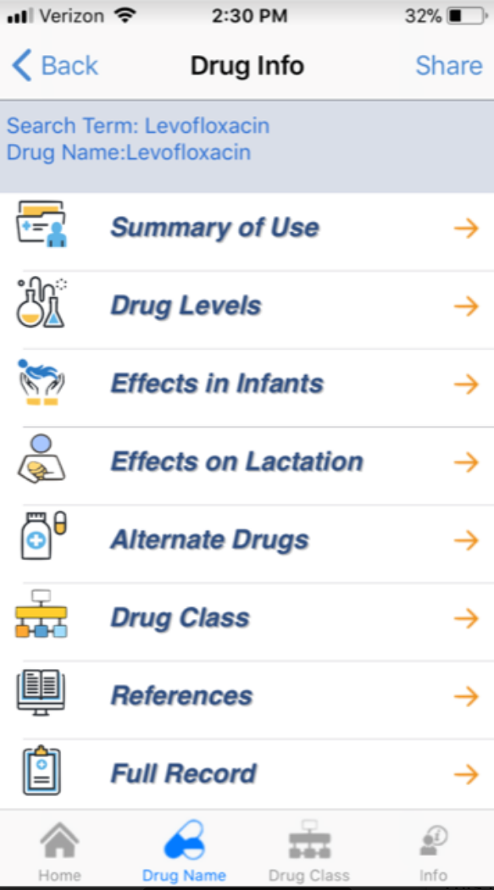
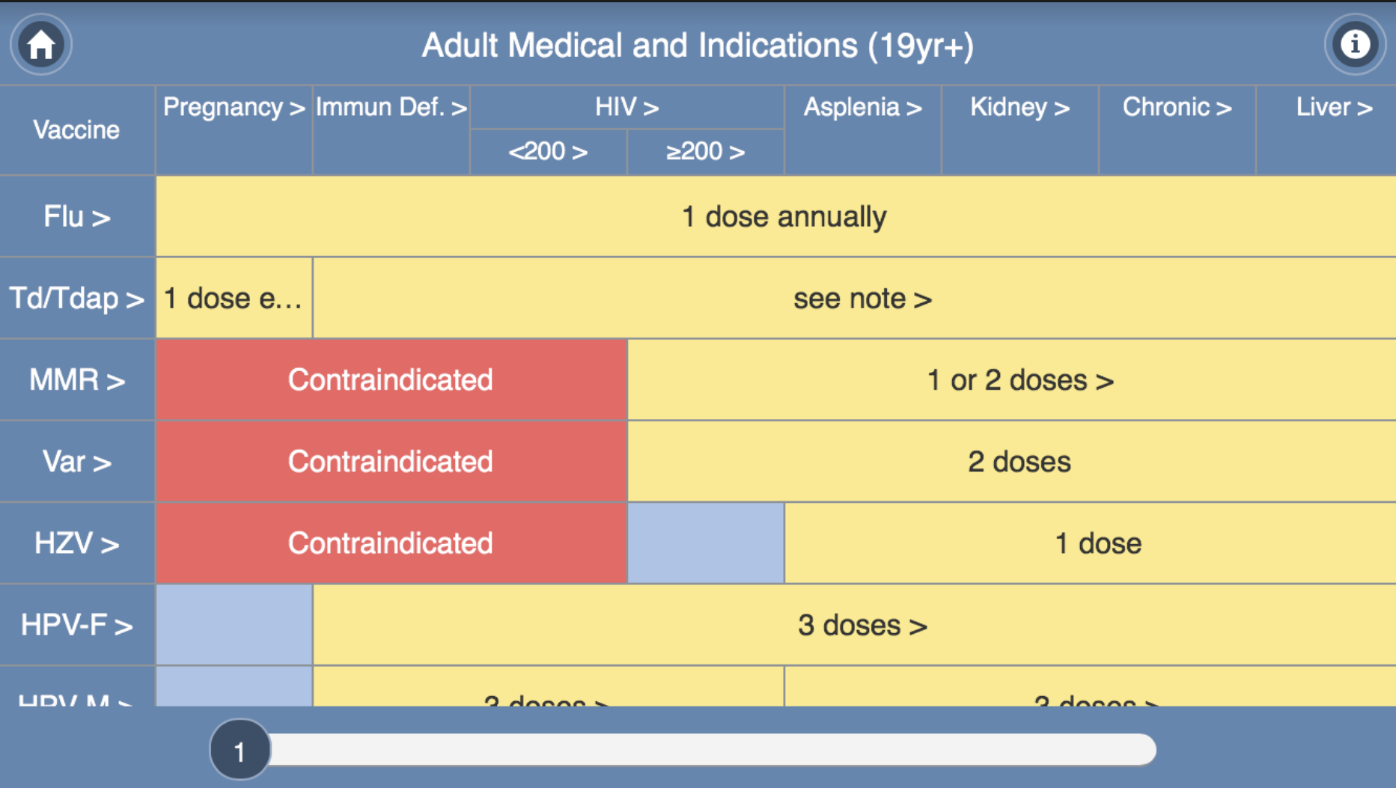
Mobile Apps
Clinician Education, Clinical Recommendations

Slide 27
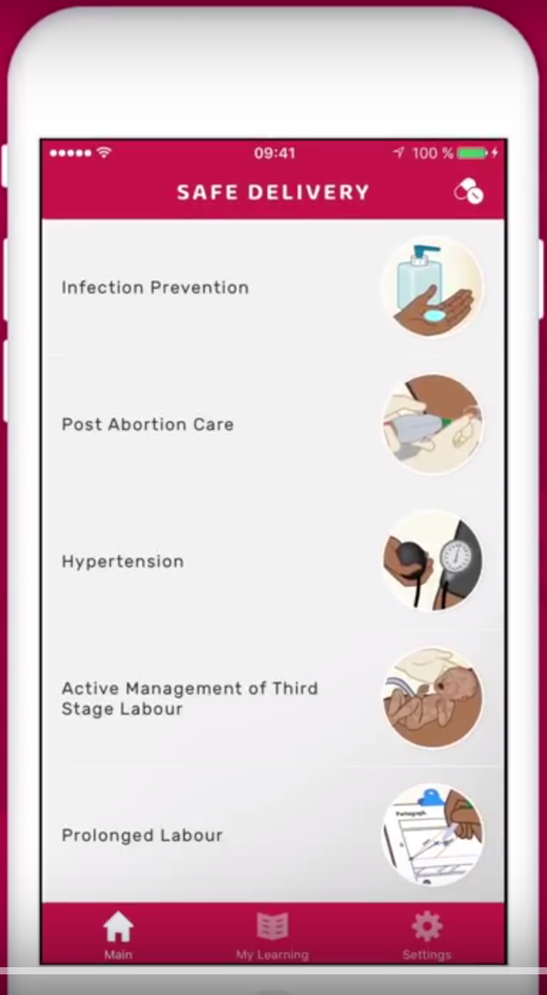
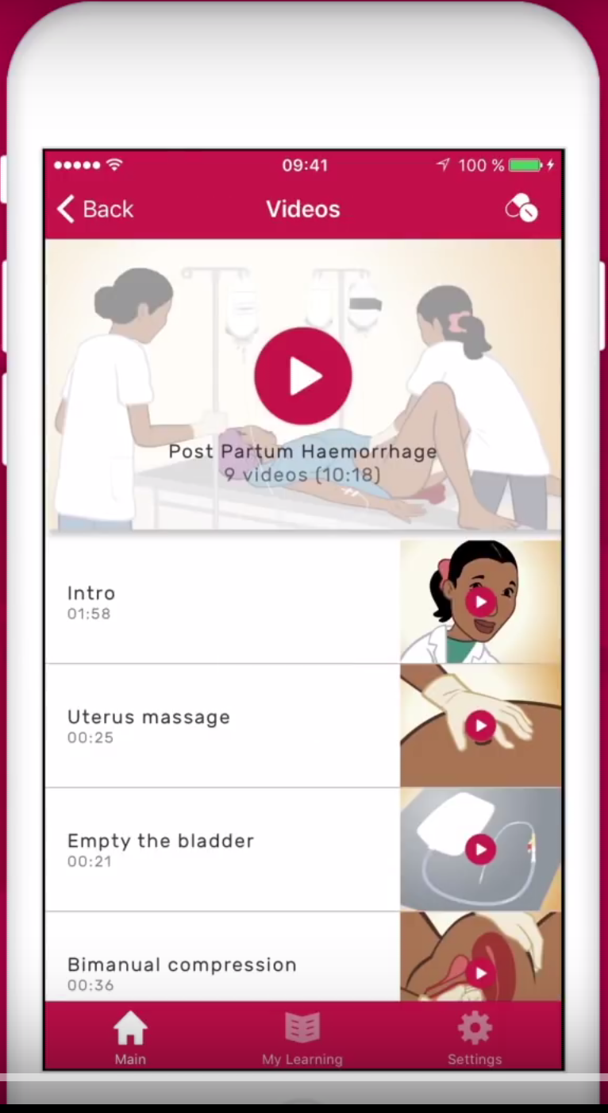
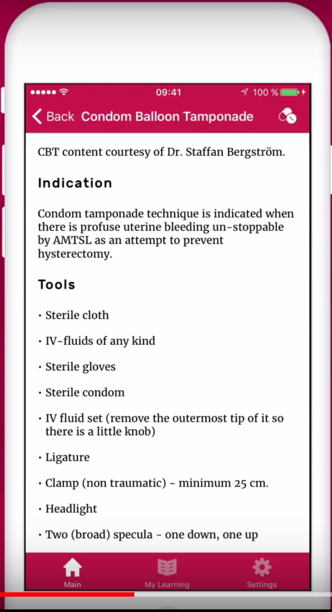
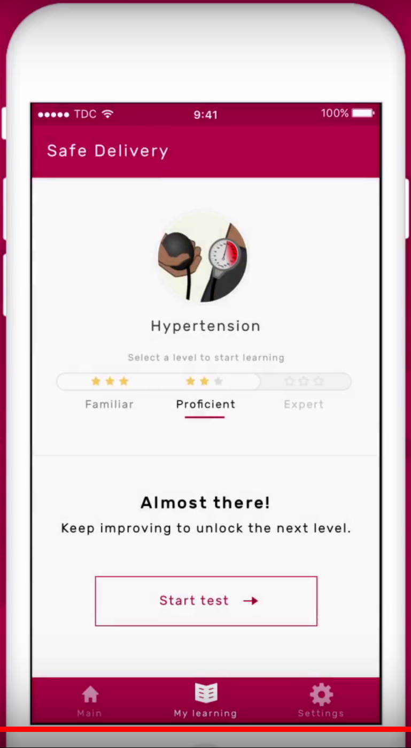
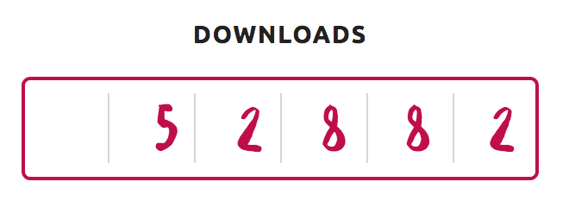
Mobile Apps
Clinician Education, Clinical Recommendations

Slide 28
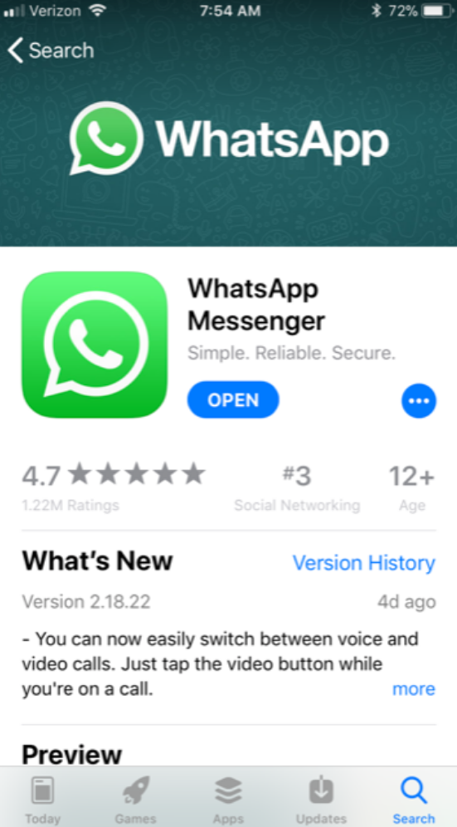
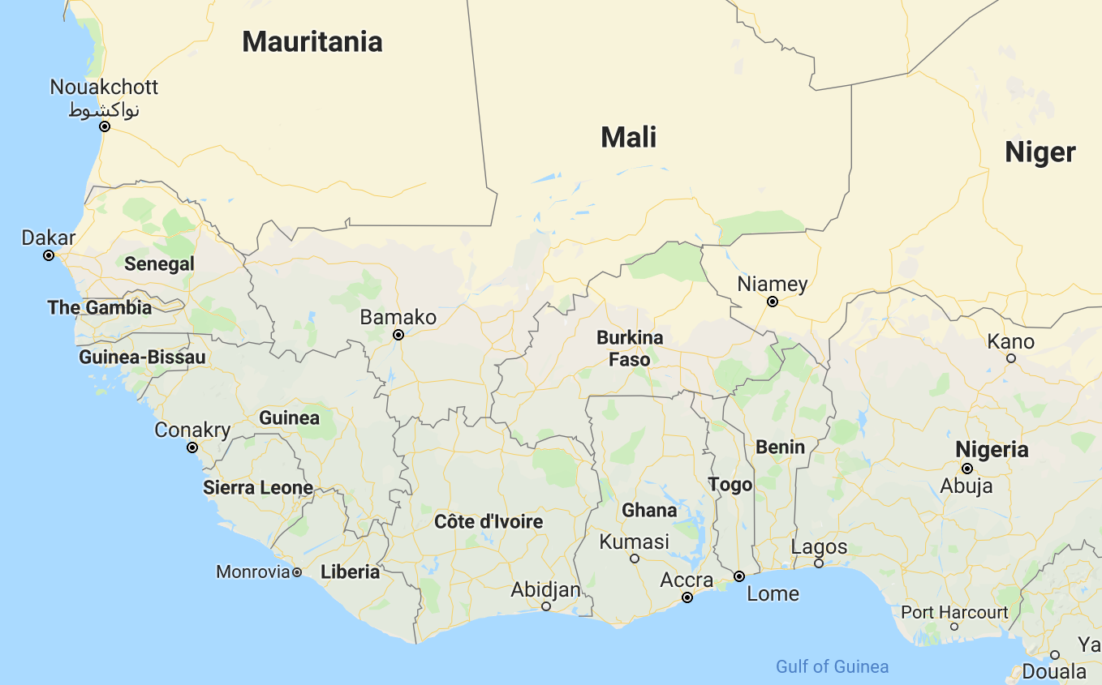
Mobile Apps
Communications, Logistics, Care Coordination

Slide 29
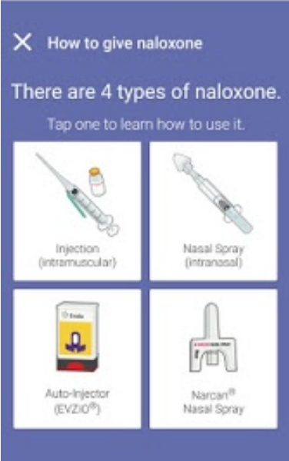
Mobile Apps
Community Education

Slide 30
Mobile Apps
Caution: Many disjointed endeavors can be overwhelming, confusing, misleading, or incorrect

Slide 31
Outline
WHO Global Initiative on Health Technologies
Global Innovations that Will Transform Medicine
Telemedicine / Mobile Apps
Smart Technology / Machine Learning
Introduction to FAMLI Project
Innovation Resources at UNC

Slide 32
Medical Innovators: Dr. Eyal Ephrat
Founder, PeriGen and MedCPU
T-Shaped
Chief Designer and Developer at Advanced Communications and Logical Systems
Ob/Gyn Residency Sha’are Zedek Medical Center, Jerusalem
Founded PeriGen, which communicated with EMRs, reduced duplicative documentation
Includes analytics, estimates, and
recommendations with respect to shoulder
dystocia risk, Cat II EFM tracings, and labor
curves
Founded MedCPU
Data Analytics for EMRs

Slide 33
Smart Technology
Adherence Trackers
Propeller Health™
Inhaler attachment allows tracking inhaler use or spirometry function via mobile app
Partners with healthcare systems, health plans, or employers
FDA Clearance Nov 2016

Slide 34
Smart Technology
Adherence Trackers
Abilify MyCite®
Schizophrenia management
Pill with sensor is ingested, and upon contact with gastric contents sensor is activated, which sends a signal to patch on the patient’s body
Signal is sent to mobile device
FDA Approval Nov 2017

Slide 35
Smart Technology
Integrated Sensor Devices
Monitoring Devices
AliceCor™ KardiaBand®
Watch wristband that monitors heart rate and assesses arrhythmia
Patient prompted to take an EKG (rhythm strip) by placing thumb on sensor for 30 seconds
Patients can be mailed monthly reports

Slide 36
Smart Technology
Integrated Sensor Devices
Nanorobots
Mice models with melanoma, breast cancer, ovarian cancer
Safety evaluated in miniature pig model
Notes:
Robot: A machine capable of carrying out a complex series of actions automatically
Nucleolin: Tumor endothelial cell marker.

Slide 37
Machine Learning
Machine Learning is a branch of artificial intelligence

Slide 38
Machine Learning
Supervised Learning uses historical inputs and labeled outcomes to predict future

Slide 39
Machine Learning
Unsupervised Learning data is not labeled and thus the machine creates inferences; there are no correct answers

Slide 40
Machine Learning
Reinforcement Learning involves an agent in an environment who makes decisions and receives feedback

Slide 41
Machine Learning
Autonomous Robots
Veebot™: Autonomous Phlebotomy
Uses combination of infrared and ultrasound
imaging to identify vessel

Slide 42
Machine Learning
Butterfly
Portable, inexpensive ultrasound probe
Plugs in to smartphone, costs $2,000
Initially used for echocardiogram, but now FDA approved for 13 clinical applications
Provides feedback on images

Slide 43
Machine Learning
Cervical Colposcopy
CT scan
Ophthalmology
Psychiatry
Radiation Oncology
EMRs
Epidemiologic Models
Clinical Trials
Obstetrics

Slide 44
Outline
WHO Global Initiative on Health Technologies
Global Innovations that Will Transform Medicine
Telemedicine / Mobile Apps
Smart Technology / Machine Learning
Introduction to FAMLI Project
Innovation Resources at UNC

Slide 45
FAMLI: Fetal Age Machine Learning Initiative
BMGF funded ($1.4M) collaboration between UNC, NCSU, Google, Butterfly
P.I.: Dr. Jeffrey Stringer
Aim: To use machine learning to develop
an improved obstetric ultrasound for use in
low-resource locations using machine learning
Low-cost, portable, reliable

Slide 46
FAMLI: Fetal Age Machine Learning Initiative
What do we use obstetric ultrasound for?

Slide 47
FAMLI: Fetal Age Machine Learning Initiative
What do we use obstetric ultrasound for?

Slide 48
FAMLI: Fetal Age Machine Learning Initiative
Machine Learning – Dr. Juan Carlos Prieto, UNC
Identification of fetal structures
Sensor Input – Prof. Xiaoning Jiang, NCSU
Position and angle of probe in space

Slide 49
FAMLI: Fetal Age Machine Learning Initiative
But one of the most important roles of obstetric ultrasound is to determine an accurate gestational age.
FAMLI tasks are to train machine learners to:
Identify and measure fetal structures from ideal images
Estimate gestational age from those measurements
Identify ideal images of fetal structures from a series of images
Recreate structures and measurements from non-ideal images
Aims are to:
Reduce need for
skilled
ultrasonographers
Reduce costs
Improve access

Slide 50
Outline
Challenges and Limitations in Global Health
WHO Global Initiative on Health Technologies
Global Innovations that Will Transform Medicine
Telemedicine / Mobile Apps
Smart Technology / Machine Learning
Introduction to FAMLI Project
Innovation Resources at UNC

Slide 51
Medical Innovators: Dr. Andreas Gruentzig
Pioneer of balloon angioplasty and founder of Interventional Cardiology
Learned of angioplasty during a lecture from American Charles Dotter in Frankfurt, Germany, utilizing a guidewire and sequential dilators
Created prototypes in his kitchen, using
various designs and materials, deciding to use a
double-lumen catheter and balloon
Initially operated on animals, then on a
human during a bypass surgery, then on an
awake human
Case Study on Regulatory Strategy

Slide 52
Innovation Resources at UNC: Who can?
Everyone!
U.S. Patent No. 6,459; May 22, 1849
“Be it known that I, Abraham Lincoln, of Springfield in the County of Sangamon, in the State of Illinois, have invented a new and improved manner of combining adjustable buoyant air chambers with a steamboat or other vessel for the purpose of enabling their draught of water to be readily lessened to pass over bars, or through shallow water without discharging their cargoes…”
Original
model now in
The Smithsonian

Slide 53
Innovation Resources at UNC: Device Development

Slide 54
Innovation Resources at UNC: OTC
Office of Technology Commercialization
Invention Disclosures, Patents, Licensing
https://otc.unc.edu

Slide 55
Innovation Resources at UNC: NC TraCS
North Carolina Transitional and Clinical Sciences Institute
https://tracs.unc.edu/
Funding Opportunities
Industry Contacts in the Triangle
FastTraCS engineers focused on rapid
technology innovation
Partner with clinicians
Identify/evaluate needs, prototype solutions
Guidance to be competitive from regulatory
and market perspective

Slide 56
Innovation Resources at UNC: Licensing

Slide 57
Innovation Resources at UNC: Cont. Education
UNC Graduate Certificate in Global Health
https://sph.unc.edu/global-health/residential-graduate-certificate-in-global-health/
UNC/NCSU Joint Graduate Certificate in Medical Devices
https://www.bme.unc.edu/md-certificate/
UNC Graduate Certificate in Technology Commercialization and Entrepreneurship
http://tcgraduatecertificate.unc.edu/
MBA Health Care Concentration
https://www.kenan-flagler.unc.edu/~/media/files/bohc/mba_healthcare_concentration.pdf?la=en

Slide 58
Innovation Resources at UNC: E(I) Lab
6 month experiential program
Graduate, professional, and postdoc students
Teams of 4-6 people with cross-discipline approach
Training & mentoring by entrepreneurship educators & successful entrepreneurs
Funds for prototype development
Graduate school participants from schools of business, law, public health, arts & sciences, pharmacy, info & library sciences, nursing, medical
https://eilab.unc.edu
Applications due Sept 23

Slide 59
Innovation Resources at UNC: Center for the Business of Health
https://www.kenan-flagler.unc.edu/businessofhealth
Program is brand new
Focus areas:
Value Delivery, Transformative Innovation, Pricing and Costing, Individual Decision Making, Digital Health

Slide 60
Outline
WHO Global Initiative on Health Technologies
Global Innovations that Will Transform Medicine
Telemedicine / Mobile Apps
Smart Technology / Machine Learning
Introduction to FAMLI Project
Innovation Resources at UNC

Slide 61
Conclusions
Innovation is continually changing medicine and global health!
Innovation is everyone’s job!
There are many ways to innovate!
There are resources to help you innovate at UNC!

Slide 62
References: Medical Innovators
https://www.gatesfoundation.org/
https://vizhub.healthdata.org/fgh/
https://gcgh.grandchallenges.org/grand-challenges-global-health-science-magazine
https://www.onemedical.com/
http://perigen.com/
http://medcpu.com/
http://medcpu.com/how-it-works/
https://www.pcronline.com/About-PCR/40-years-angioplasty/Spotlight-on/Experiencing-the-history-of-angioplasty
https://en.wikipedia.org/wiki Abraham_Lincoln%27s_patent
https://www.biography.com/people/abraham-lincoln-9382540

Slide 63
References: WHO
http://www.who.int/medical_devices/appropriate_use/en/
http://apps.who.int/iris/bitstream/handle/10665/95786/WHO_HSS_EHT_DIM_11.02_eng.pdf;jsessionid=84DEFAFE4E1623B08AE276E21DC64C5E?sequence=1
http://apps.who.int/iris/bitstream/handle/10665/44407/9789241564045_eng.pdf?sequence=1
http://apps.who.int/iris/bitstream/handle/10665/95788/WHO_HSS_EHT_DIM_11.03_eng.pdf?sequence=1
http://www.who.int/medical_devices/priority/en/
http://www.who.int/medical_devices/publications/global_atlas_meddev2017/en/

Slide 64
References: Telemedicine
https://fivethirtyeight.com/features/the-health-care-system-is-leaving-the-southern-black-belt-behind/
https://www.nytimes.com/2017/11/13/upshot/what-red-states-are-passing-up-as-blue-states-get-billions.html
http://www.vigilias.com/mitee
http://www.vigilias.com/what-we-do?utm_source=front-page&amp;utm_medium=front-page&amp;utm_content=expansion-of-offerings&amp;utm_campaign=front-page#technology
https://www.freestateconnect.com/
http://www.hodeitech.com/#ikasiAnchor
https://www.intouchhealth.com/products-and-services.html#medicaldevices
https://www.avizia.com/telehealth-solutions/virtual-care-devices
https://data.worldbank.org/indicator/it.cel.sets.p2?end=2016&start=1990&view=chart

Slide 65
References: Mobile Apps
https://www.acog.org/About-ACOG/News-Room/ACOG-App
http://www.asccp.org/store-detail2/asccp-mobile-app
https://www.cdc.gov/reproductivehealth/contraception/mmwr/mec/summary.html
http://www.stfm.org/Resources/Shots
https://toxnet.nlm.nih.gov/help/lactmedapp.htm
https://www.maternity.dk/safe-delivery-app/
https://www.ghanabusinessnews.com/2018/02/12/whatsapp-platform-helps-to-reduce-maternal-mortality/
https://www.whatsapp.com/
https://www1.nyc.gov/site/doh/services/mobile-apps.page
http://hesperian.org/books-and-resources/safe-pregnancy-and-birth-mobile-app/
Aceng, JR. Uganda Ministry of Health. 2012. Re: Coordination and harmonisation of ehealth initiatives.

Slide 66
References: Smart Technology
https://www.propellerhealth.com/2016/11/07/propeller-health-receives-fda-clearance-for-the-propeller-platform-in-association-with-gsks-ellipta-inhaler/
https://www.propellerhealth.com/how-it-works/
https://www.fda.gov/NewsEvents/Newsroom/PressAnnouncements/ucm584933.htm
https://www.abilifymycite.com/
https://www.alivecor.com/clinicians/
https://www.prnewswire.com/news-releases/fda-clears-first-medical-device-accessory-for-apple-watch-300564129.html
Nat Biotechnol. 2018 Feb 12. doi:10.1038/nbt.4071. [Epub ahead of print] A DNA nanorobot function as a cancer therapeutic in response to a molecular trigger in vivo. Li S, Jiang Q, Liu S, Zhang Y, Tian Y, Song C, Wang J, Zou Y, Anderson GJ, Hang JY, Chang Y, Liu Y, Zhang C, Chen L, Zhou G, Nie G, Yan H, Ding B, Zhao Y.

Slide 67
Reference: Machine Learning
https://towardsdatascience.com/coding-deep-learning-for-beginners-types-of-machine-learning-b9e651e1ed9d
http://www.cognub.com/index.php/cognitive-platform/
http://www.veebot.com/
https://www.butterflynetwork.com/press-releases/first-ultrasound-on-a-chip-receives-broadest-fda-510-k-clearance
M. Traversi, M. Falagario and C. Guaragnella, "CADdy — Colposcopy learning machine for computer aided diagnosis," 2013 IEEE Third International Conference on Consumer Electronics ¿ Berlin (ICCE-Berlin), Berlin, 2013, pp. 1-4.
Deep Learning in Neuroradiology. G. Zaharchuk, E. Gong, M. Wintermark, D. Rubin, C.P. Langlotz. American Journal of Neuroradiology Feb 2018, DOI: 10.3174/ajnr.A5543
https://medium.com/health-ai/deep-learning-in-ophthalmology-using-128-175-retinal-images-59814e8a3f68
Bzdok, Danilo and Andreas Meyer-Lindenberg. 2017. “ Machine learning for precision psychiatry ”. arXiv preprint arXiv:1705.10553.
https://www.springer.com/gp/book/9783319183046
https://ai.googleblog.com/2018/05/deep-learning-for-electronic-health.html
Yuexin Wu, Yiming Yang, Hiroshi Nishiura, and Masaya Saitoh. 2018. Deep Learning for Epidemiological Predictions. In SIGIR ’18: The 41st International ACM SIGIR Conference on Research and Development in Information Retrieval, July 8–12, 2018, Ann Arbor, MI, USA. ACM, New York, NY, USA, 4 pages. https://doi.org/10.1145/3209978.3210077
http://www.clinicaltrialsummit.com/clinical-trial-data/

Slide 68
References: FAMLI
https://www.gatesfoundation.org/
https://www.google.com/
The University of North Carolina
North Carolina State University
https://www.med.unc.edu/obgyn/gwh
https://en.wikipedia.org/wiki/Adolphe_Pinard
https://en.wikipedia.org/wiki/Christian_Gerhard_Leopold
https://en.wikipedia.org/wiki/Leopold%27s_maneuvers
American Institute of Ultrasound in Medicine. Consensus Report on the Detailed Fetal Anatomic Ultrasound Examination. J Ultrasound Med 2014; 33:189-195.

Slide 69
References: Innovation at UNC
https://otc.unc.edu/
https://tracs.unc.edu/
https://sph.unc.edu/global-health/residential-graduate-certificate-in-global-health/
https://www.bme.unc.edu/md-certificate/
http://tcgraduatecertificate.unc.edu/
https://www.kenan-flagler.unc.edu/~/media/files/bohc/mba_healthcare_concentration.pdf?la=en
https://www.kenan-flagler.unc.edu/businessofhealth
http://fiercebiotech.com/

