Slide 1
Exploring Global Emergency Medicine
Dr. Sarah Ashley
25 October 2021
UNC OGHE Global Health Forum
Notes:
My name is Sarah Ashley. I am an emergency medicine physician and I was invited here to give a short talk about some of the different types of experiences available out there in global emergency medicine. I went to medical school at UC Davis in California, did my residency at ECU, and then completed a global health fellowship and MPH here at UNC.

Slide 2
Disclosures
Currently working as a contractor for NYCMedics, Global Medical Staffing, and AB Staffing (IHS) but no financial compensation or conflicts of interests regarding this talk
Opinions and thoughts are my own, and do not represent UNC or the US Government or military.
Notes:
I’m currently an adjunct faculty at UNC and work as a private contractor for a humanitarian organization called NYC Medics in Yemen. I also work as a locum tenens contractor for two companies, with contracts in the Indian Health Service and the US Virgin Islands, and I serve as a Major in US Army Reserves Civil Affairs, which is a branch of the military specializing in civil-military interactions.

Slide 3
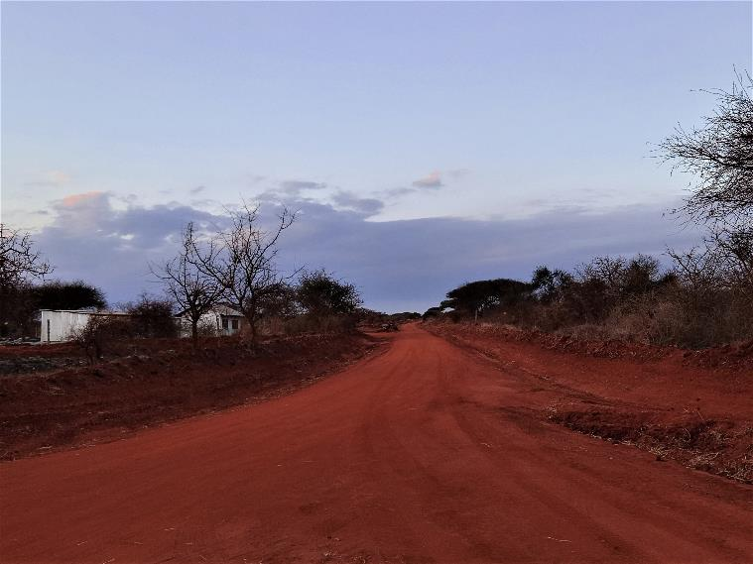
Overview
Introduction to global emergency medicine
Brief tour of different kinds of global emergency medicine work
Lessons learned
Notes:
I’ve had an opportunity to practice emergency medicine and global health in many different settings and contexts. I’d like this talk to be an opportunity to explore some of the career options in global health that you might not have thought about before, and to share some of the lessons learned along the way.

Slide 4
Introduction
What do we mean when we say…
Global Health?
International Emergency Medicine?
Tropical Medicine?
Notes:
Global Health – This is the broadest of all terms, which refers to all health related activities in all places, particularly for underserved populations. Global health can happen in your own country and town, in another country, or can encompass topics which affect all places. It includes everything from clinical care, to public health and determinants of health beyond medicine alone.
International Emergency Medicine – This refers to the community of emergency medicine practitioners in countries around the world tackling the same issues in our specialty as they happen in many different settings. This is really about professional exchange across borders, and sharing our expertise and learning from the experience of our colleagues, including other EM specialists, doctors who are not EM specialists or those who work in emergency care in countries where the EM specialty does not exist, non-physician practitioners such as PAs and Clinical Officers, emergency nurses, paramedics and EMTs. This includes all countries, not just developing countries.
Tropical Medicine – This refers to specialized care focused mostly on infectious in tropical settings, but is often used to refer to clinical care of diseases that are unrelated to the tropics, such as diseases of poverty and inequality we associate with developing countries. We often think of this as seeing the things we’ve only read about on USMLE test questions. But overall, I would like to think of this more as recognizing that when traveling to a new place, we should always stay humble and recognize how much we don’t know, and take an effort to prepare ourselves.

Slide 5
Who definition of health
“Health is a state of complete physical, mental and social well-being and not merely the absence of disease or infirmity. The enjoyment of the highest attainable standard of health is one of the fundamental rights of every human being without distinction of race, religion, political belief, economic or social condition.”
Notes:
This is the WHO definition of health. For me personally, this is a bit too broad. Yes, health is more than the absence of disease. But does the world really need to be a state of complete physical, mental and social well-being for us to say we have succeeded in Global Health? How far does our scope go when we talk about the determinants of health and well-being? People need more than medicine to be this kind of healthy – they need effective governments, economies, security, education and so many other things. As medical providers considering our career paths in global health, we can’t really take responsibility for tackling all those things at once. I think the point of this quote is just to remind us that our role in health and the well-being of society falls into a much bigger picture shaped by many different forces. If we focus too much on our own expertise, we will lose sight of all the other important things out there that make it possible for people to be healthy.

Slide 6
Dr. Ashley Defines the universe
Global Health: Recognizing and fighting health disparities and serving the underserved in all places, including clinical care, public health and determinants of health
International Emergency Medicine: Professional community of emergency care practitioners in different countries, sharing ideas and tackling the same problems in different contexts
Tropical Medicine: Expertise focused on diseases associated with tropical climates (such as malaria or dengue) and often poverty in low resource, underdeveloped settings (such as diarrhea or complications of tuberculosis)
Notes:
Global Health – This is the broadest of all terms, which refers to all health related activities in all places, particularly for underserved populations. Global health can happen in your own country and town, in another country, or can encompass topics which affect all places. It includes everything from clinical care, to public health and determinants of health beyond medicine alone.
International Emergency Medicine – This refers to the community of emergency medicine practitioners in countries around the world tackling the same issues in our specialty as they happen in many different settings. This is really about professional exchange across borders, and sharing our expertise and learning from the experience of our colleagues, including other EM specialists, doctors who are not EM specialists or those who work in emergency care in countries where the EM specialty does not exist, non-physician practitioners such as PAs and Clinical Officers, emergency nurses, paramedics and EMTs. This includes all countries, not just developing countries.
Tropical Medicine – This refers to specialized care focused mostly on infectious in tropical settings, but is often used to refer to clinical care of diseases that are unrelated to the tropics, such as diseases of poverty and inequality we associate with developing countries. We often think of this as seeing the things we’ve only read about on USMLE test questions. But overall, I would like to think of this more as recognizing that when traveling to a new place, we should always stay humble and recognize how much we don’t know, and take an effort to prepare ourselves.

Slide 7
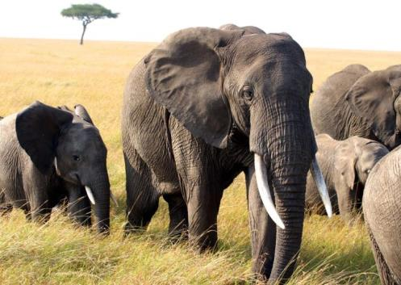
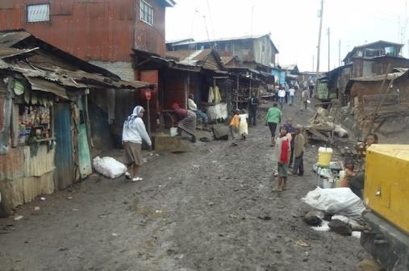
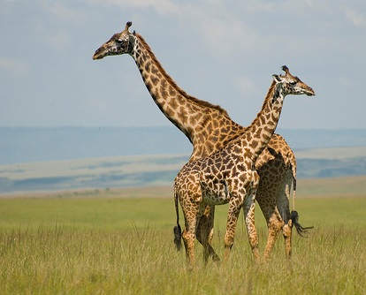
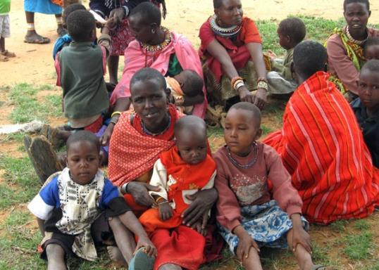
Notes:
When we talk about global health experiences, such as global health in Africa, we might picture something like this. All of these pictures are from Kenya – of course there are slums there, wild animal parks, and traditional tribal cultures. It feels like a different world altogether. If these are the only pictures you’ve ever seen of a country, you might assume that they don’t have healthcare there at all.

Slide 8
“Something is better than nothing”
What problems can I anticipate? What do I need to be prepared?
Do I have the appropriate training and experience for this?
What resources are available? How can my patient access them?
Who can I ask for help? Who will supervise me?
Notes:
This is a phrase you might often here when we are talking about ethical dilemmas in providing care in low resource or disaster settings
What do you think about:
Donating expired medications
Performing surgery without anesthesia after a major disaster
Someone with little or no medical training practicing medical care outside of their scope
Deciding to withdraw care or pursue palliative care because resources are not available in your facility or medical camp
Reading: https://www.pri.org/stories/2012-10-12/medical-volunteers-learn-mistakes-made-rush-haiti

Slide 9
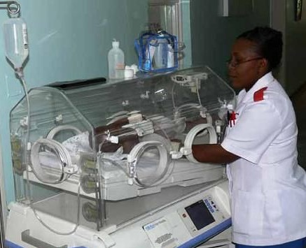
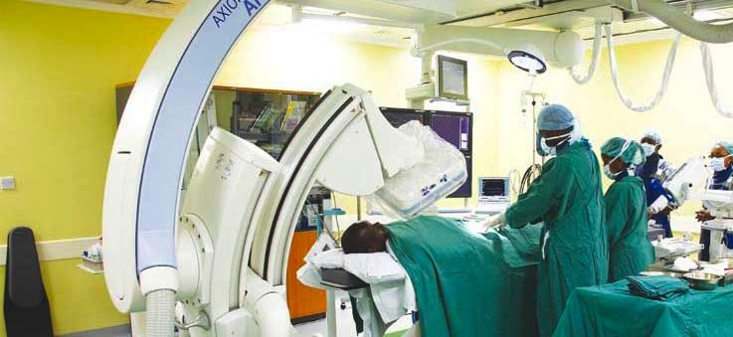
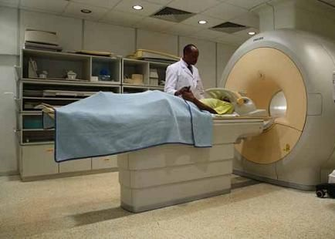
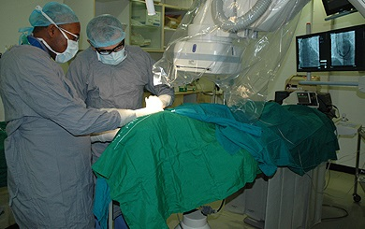
Notes:
Working in a developing country is not “wilderness medicine”. Don’t underestimate the local medical community! Use it and integrate with it.
Nairobi Hospital – Private hospital with a highly functioning staff of ICU nurses and other emergency providers, full imaging capabilities
Aga Khan University – Site of Kenya’s first cardiac cath lab and a center for cardiac care excellence

Slide 10
Key points
Global health is not “wilderness medicine”
Take advantage of civilization and tap into local resources as much as possible
Don’t make assumptions about what is available. Check first before drastically changing your standards of care. Work with local providers who know the system
You must go through local licensing, credentialling and registration
Do NOT act outside your scope of practice without appropriate supervision
In almost all cases it is illegal to donate or distribute expired drugs

Slide 11
The range of options
Volunteer service trips (mission trips and short-term service)
Academic exchange (teaching and research partnerships)
Working for a humanitarian aid NGO (directly or as a contractor)
Working for a government health agency (USAID, CDC, DMAT, SMAT)
Military global health and diplomacy
Living overseas as an expat and working in the local healthcare system
Contracting (locum tenens, travel medicine, expedition medicine, etc)

Slide 12
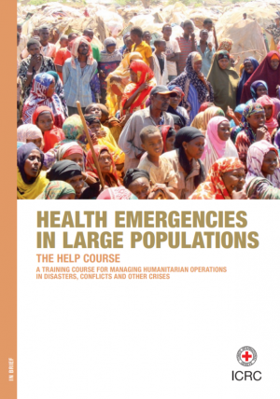
courses
Notes:
If you are planning a trip to an equatorial country, I would highly recommend getting some practical training in tropical medicine for that region. The UMN Tropical Medicine Course was very useful for understanding the types of testing and treatment available in East African settings, which is very different from what we have available in the US.
If you want to know more about working in a refugee camp or planning a humanitarian disaster response, I recommend the HELP course held by the ICRC. It was great information about the considerations that go into a refugee camp or response, and the humanitarian principles.
For anyone interested in military global health, I recommend the Fundamentals of Global Health Engagement as a basic introduction to global health considerations for military providers

Slide 13
Key point
The more I learn, the less I know!
Challenge your assumptions and explore your blind spots as often as you can
The best source of knowledge is talking to the local experts
Notes:
Ask the lab technicians and pharmacists to give you a tour.
Visit different facilities to find out what the standard of care is – you may find very different standards in different parts of the same city
Find people you can call and ask for advice.
Work alongside local providers so you can share knowledge and discuss cases
Read the local medical literature if available, attend grand rounds and lectures in the host country, and find out about local guidelines

Slide 14
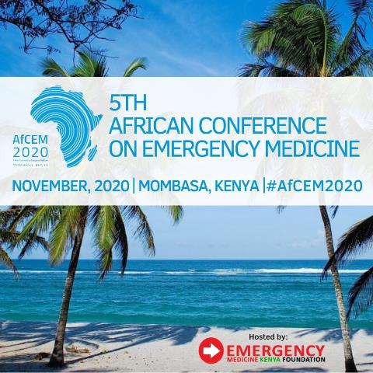
Academic partnerships
Notes:
Opportunity to teach and conduct research in different settings
Can balance clinical and academic career in the US with a few weeks or months per year overseas
Supports the career path of health professionals in the other country
Can contribute to the body of knowledge and perhaps reduce bias in our science by including African and other unheard voices and experiences
Downside is that it is hard to understand complexities from a distance, and hard to keep projects on track when you’re in the US

Slide 15
Key points
Providers in low-income countries work really hard and rarely get credit
There is a shortage of literature from low-income countries, despite a wealth of experience and practices worth sharing
Highlight the professionalism of others, elevate their voices, and help build their careers
Notes:
My personal belief:
We can’t travel all over the world and then judge our colleagues overseas for wanting to do the same. Don’t ever hold back your colleagues from career opportunities. Brain drain is real, but keeping things the way they are is not the answer to that. The people you work with have already done more for their communities than you ever will as a visiting foreigner. Every physician should have the opportunity to explore different systems and contribute to the profession.

Slide 16
Notes:
Working directly for a local hospital
Long term, sustainable
Professional and cultural humility
Opportunity to really understand how things work
Opportunity to learn the language and culture well
Bedside teaching and involvement in department management just like in the US
Opportunity to learn skills for low resource settings
See cases of things you might not normally see (HIV complications, TB, pellagra)

Slide 17
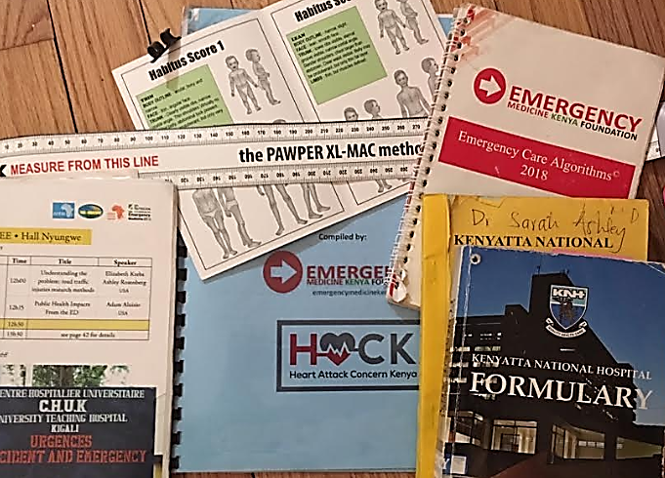
Notes:
Good to know that the EM practices in Kenya are not lower quality than US standards –if you try to apply US practices directly in practice, you will find they don’t work. Need to really focus on adapting your expertise and knowing what medications and resources are available, realistic time limitations, etc.
Key lesson: Don’t assume that US practices equate to high quality care in low resource settings. Don’t make doctors working in these settings feel like the care they deliver is worthless because it doesn’t match the US textbooks! Impossible care is NOT high quality care.
Knowing the local formulary and availability of drugs (chloramphenicol versus diphenhydramine for example)
Antibiotic resistance patterns (ceftriaxone especially)
Pediatric weight estimation by body habitus
Outpatient management of inpatient diseases
Considering diagnosis, you might not normally think of (TB for hematuria for example)
Understanding the tests available for typhoid, malaria, TB, etc
Realistic access to radiology (working without a CT scan and no portable XR, limited portable US) – ATLS doesn’t work!
Realistic access to ICU care and ventilators
Lack of EMTALA or healthcare funding and universal access policies

Slide 18
Key points
Don’t assume that you know best!
Walk a mile in a stranger’s shoes before you assume that you know their problems better than they do
Don’t deliver a low quality version of care back home, deliver a high quality version of appropriate care for where you are.
Impossible care is not high-quality care. Make sure the protocols you are teaching actually work in the local setting.

Slide 19
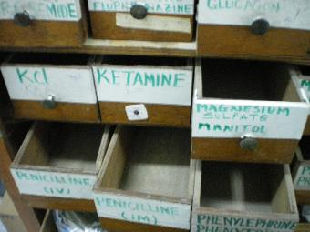
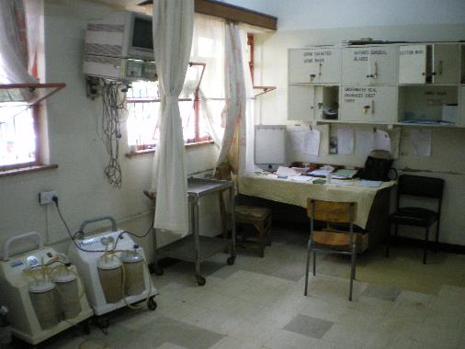
Challenges
Notes:
Clinical Care (Working for a Hospital)
Real world experience with all the challenges that come with it
Requires licensing, credentialling and a work permit
Shortages of medications and supplies
Difficulty moving patients
Worker strikes and lack of pay
Risks: Malpractice, risk of infection, Violence from patients, political turmoil and corruption
Language barriers
Lessons learned: You can do all the education and research you want, but you can’t take care of a patient without any medications or tools, and doctors and nurses can’t work if they can’t survive. It sucks to be a doctor who can’t feel good about the quality of care they are delivering. We all deserve to be proud of our profession and have purpose in our work

Slide 20
Key poinT
The responsibility you take on as a doctor is not proportional to your control over the situation or the resources available
All patients deserve the best care.
All providers deserve a work environment that allows them to deliver it
Appreciate the personal and emotional sacrifices of your international colleagues!
They are the real heroes and carry the scars of that service.
Notes:
Being a global health provider, free to travel around the world, free to turn around and head back to the US at any time, is a privilege.
Most of the providers in the settings you go to have served their communities more than any foreign visitor ever will
Support their careers!
You can’t deliver good care if you don’t have the tools you need, money to eat and pay rent, safety and security.

Slide 21
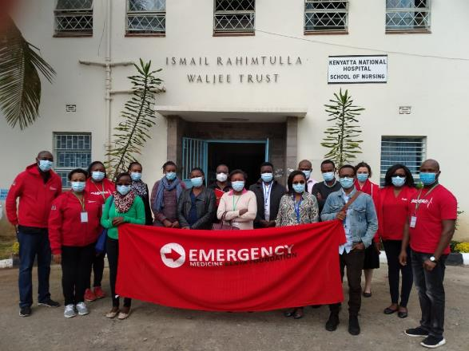
EMKF
Notes:
Working for EMKF was a great experience – teaching locally developed best standard protocols and focusing on team communication similar to ACLS/ATLS

Slide 22
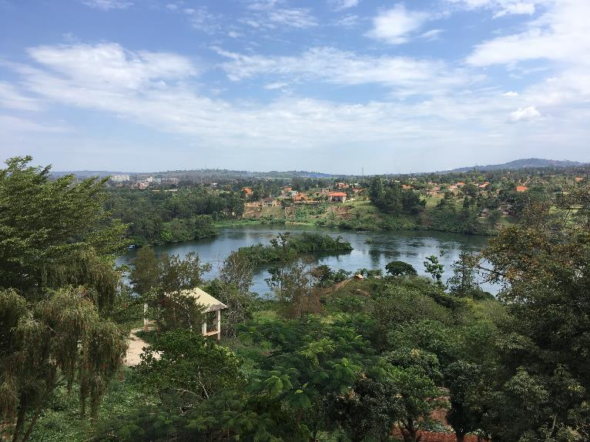
Jinja, Uganda
Notes:
Health Diplomacy is a term that refers to how states conduct global health activities to support their strategic objectives
Includes positions with the DoD, DoS, USAID, CDC
Opportunity to do global health activities in a variety of places as part of a larger strategy
Does not follow humanitarian principles of neutrality and independence, but can still do good in the world!
The US military has a branch called Civil Affairs, mostly reservists, where you can serve on a Functional Specialty Cell as a technical advisor for civilian health issues. This can include acting as a liaison to civilian ministries of health and similar positions.
Military medical units deploy to support military operations but also engage in mil-mil or civ-mil workshops and sometimes disaster aid. Most military support for disaster response is about logistics rather than direct medical care. PACOM is the most active in this type of engagement.
There are opportunities to work as a doctor for the Department of State if you are looking for non-military opportunities to work with the USG and travel
USAID typically hires people in a public health and management focused role, rather than direct care or emergency medicine exactly

Slide 23
Key points
Embrace interests and influences. The world is moved by more than good intentions alone - understand the forces of politics, economies, media, influence, technology, and culture around you
Avoid silos. Learn to speak the language of non-health stakeholders! Don’t expect them to adopt your priorities as their priorities. Understand what their goals are and how you fit into their operating picture.

Slide 24
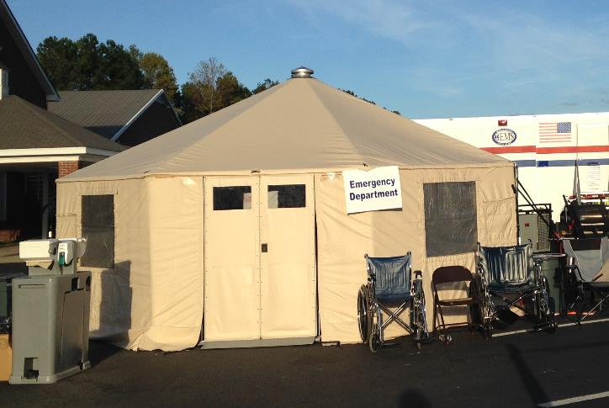
SMAT
Notes:
Really, the best disaster response is the one that doesn’t happen, because the local system was already prepared
Be cautious about losing perspective or practicing out of scope in unfamiliar settings
Always reassess your resources and check your assumptions! Stay above the chaos.
Start local – SMAT, DMAT, National Guard, Red Cross, local EMS
Volunteer with an organization before the disaster happens!

Slide 25
Key points
The best disaster response is the one that doesn’t need you. The best way to help is to support local responders and build robust emergency systems before the disaster happens.
The day of the disaster is not the time to volunteer. Get your name and credentials on the roster early.

Slide 26
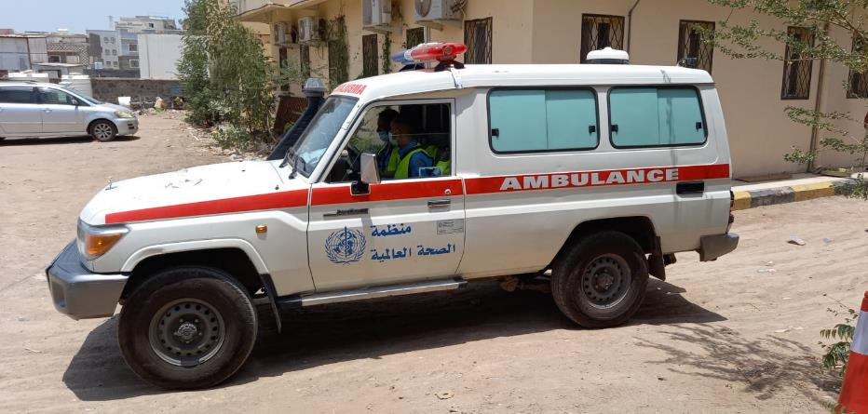
Aden, Yemen
Notes:
EMS development in Yemen
Acting more like an EMS medical director, with administrative and teaching roles, rather than clinical care
Limited movement and security concerns
Donor/funder based, difficult to plan ahead
Lots and lots of NGOs working within the WHO health cluster
Blurring of the lines between HA, development

Slide 27
Key points
The best laid plans of mice and men will ALWAYS go awry. Stick to your ethics and your humanity and trust that the local community has been through worse than your well-intentioned mistakes.
If you can’t be sustainable, be effective. Be realistic about the goals of your mission and what you can achieve, and focus on doing that well.
Don’t get comfortable. Keep pushing yourself into unfamiliar environments. The more you challenge yourself, the stronger and more capable you will become

Slide 28
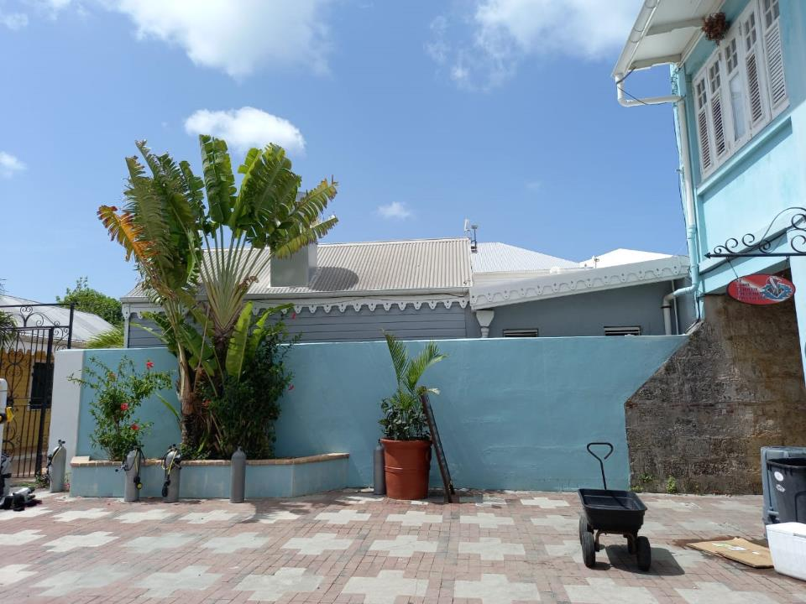
St Croix USVi
Notes:
Locums in USVI. Poor, underserved population several hours by plane from the nearest major hospital in Miami.
Some tropical diseases – dengue, chikungunya, marine envenomation
Environmental health – oil refinery accident
Not exactly a paid vacation but pretty close

Slide 29
KEY POINTS
Pay attention to the social determinants of health wherever you are
Be an advocate! You may be the first person to recognize a problem or a trend.

Slide 30
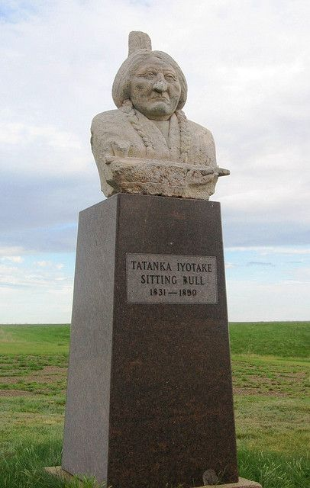
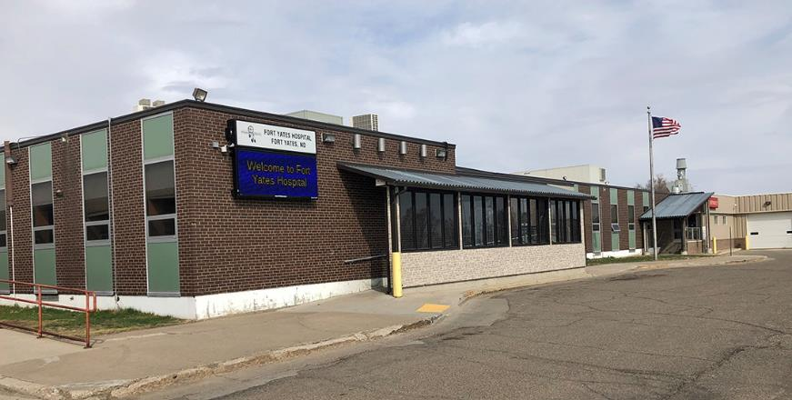
Indian health service
Notes:
Indian Health Service
There are full time positions and locums
Locums companies compete for contracts to provide physicians
Typically pays about $150-$250 an hour and includes malpractice coverage, sometimes includes housing
Opportunity to work in remote, underserved communities
Relatively well resourced, patients have access to free meds and outpatient services

Slide 31
Conclusion
“Don’t ask what the world needs. Ask what makes you come alive, and go do it. Because what the world needs is people who have come alive.” ― Howard Thurman
Notes:
Global health is about service, but just as importantly, it’s about learning, curiosity, adaptability, humility, and connecting with all different kinds of people

Slide 32
Dr. Sarah Ashley
Email: Seashley.uc@gmail.com

