Slide 1
TRANSLATION AND VALIDATION OF THE CHICHEWA Pediatric PRO-CTCAE TOOL TO MEASURE TREATMENT-RELATED ADVERSE EVENTS AMONG ADOLESCENT AND YOUNG ADULT LYMPHOMA PATIENTS IN MALAWI
Authors: April Evans, MD, MPH, Alyssa E. Tilly, MD, Yolanda Gondwe MPH, Maria Chikasema, DPT, Agness Manda, Bryce B. Reeve, PhD, Katherine D. Westmoreland, MD
Affiliations: ​​UNC Project-Malawi, Lilongwe, Malawi, University of North Carolina at Chapel Hill, North Carolina, USA, Duke University School of Medicine, Durham, North Carolina, USA
Notes:
Good Afternoon everyone. My name is APril Evans, I am a UJMT Fogarty Aulumn and a 3 rd year peds heme onc fellow at the University of North Carolina. I am elated to be here today to share with you all the results of my Fogarty project that focused on the ............
Authors to note are
Alyssa Tilly Pediatric & Internal Medicone Palliative care faculty at the UNC
Yolande Gondwe MPH student UNC project Malawi
Maria and Agness Data Corrdinators UNC project Malawi
Bryce Reeve Psychometrician faculty of Duke Universtity Scohol of medicine
Kate Westmoreland Peds Heme ONc Faculty UNC project Malawi

Slide 2
Conflict of Interest
I have no conflicts of interest to disclose
This study was funded in part by :
NIH UJMT Fogarty
NIH K01 Fogarty Career Development Award (Westmoreland)
UNC Office of Global Health and Education
Lineberger Comprehensive Cancer Center
Notes:
Safety and tolerability are fundamental to conclusions about the effectiveness of cancer therapies

Slide 3
Background
Improving childhood cancer outcomes, particularly in resource-limited settings, is a major global health priority set by the World Health Organization.
In high-income countries, more than 80% of children with cancer are cured, but in many LMICs less than 30% are cured.
In resource-rich settings, patient-reported outcome (PRO) measures have emerged as a critical method to holistically understand the effects of disease and treatment on patients' mental, physical, and social HRQoL.
Notes:
Cancer is a leading cause of death for children and adolescents. And unfortunaltey the likelihood of surviving a diagnosis of childhood cancer depends on the country in which the child lives: in high-income countries, more than 80% of children with cancer are cured, but in many LMICs less than 30% are cured.
The goal is to achieve at least 60% survival for all children with cancer by 2030.
Not all children with cancer can be cured, but relief of suffering is possible for everyone. Paediatric palliative care is considered a core component of comprehensive care

Slide 4
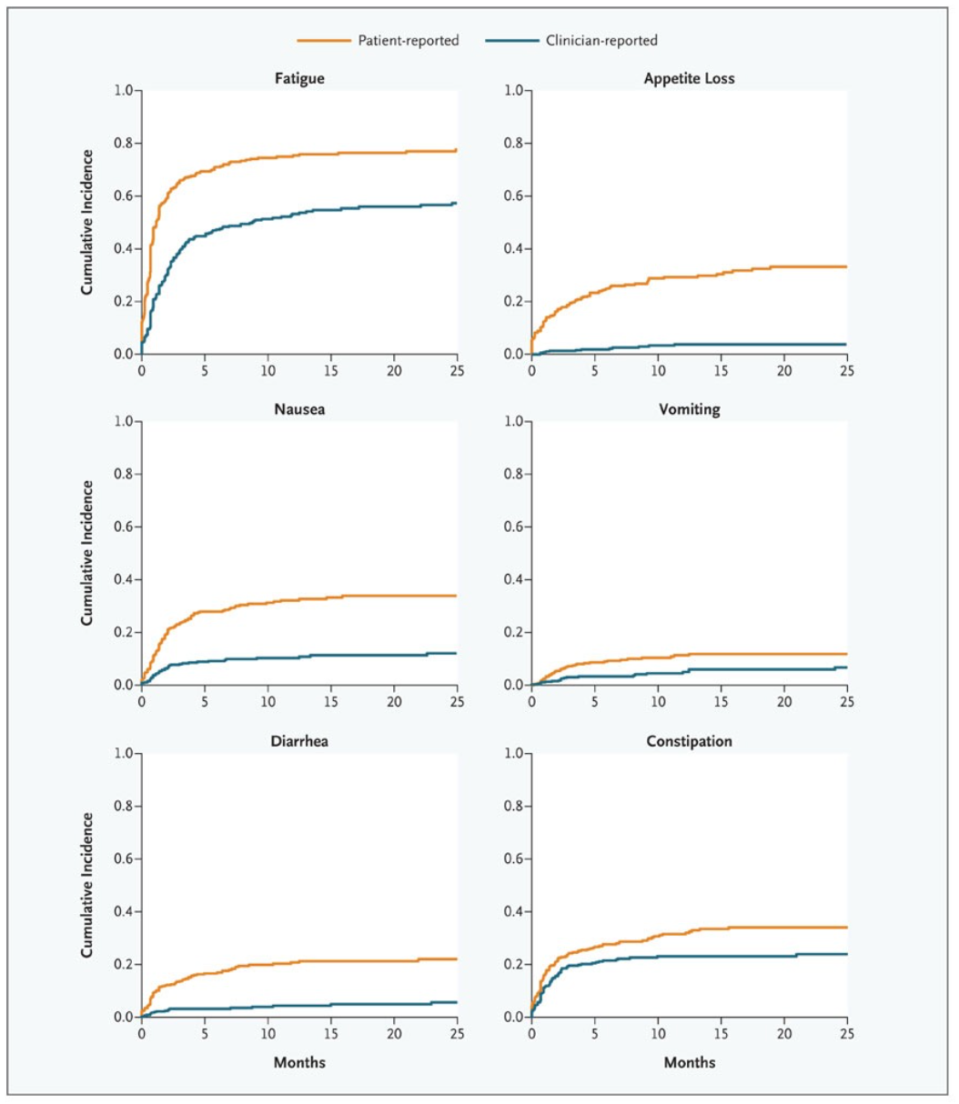
Background
2010
2017
Notes:
Ethan Bash is here at UNC (one of my mentors)
These are critical things to discuss the importance of PROs
Physician's under report patient symptoms
Measuring PROs alone showed decreased ER visits and improved survival!!!!!

Slide 5
PEDS PRO-CTCAE
The Ped-PRO-CTCAE measurement system includes a library of 130 items that can assess up to 62 symptom adverse events.
The Pediatric PRO-CTCAE Core Items Questionnaire assesses 15 core symptomatic domains including: abdominal pain, constipation, diarrhea, oral mucositis, nausea, vomiting, fatigue, pain, anorexia, headache, peripheral sensory neuropathy, anxiety, depression, insomnia, and cough.
Each domain has 2-3 question items, a 4-point Likert scale, and a 7-day recall period.
Additional information: https://healthcaredelivery.cancer.gov/pro-ctcae/
Notes:
Evidence from multiple studies in pediatric cancer populations has demonstrated that clinicians and caregivers underreport the number and severity of symptoms.^{21–24} In response to this need, Dr. Reeve led the development of the pediatric version of PRO-CTCAE and recently published the validation for its use among a US cohort of cancer patients. ^{25–28} This is the first pediatric self-reporting symptom AE measure designed for pediatric oncology trials.

Slide 6
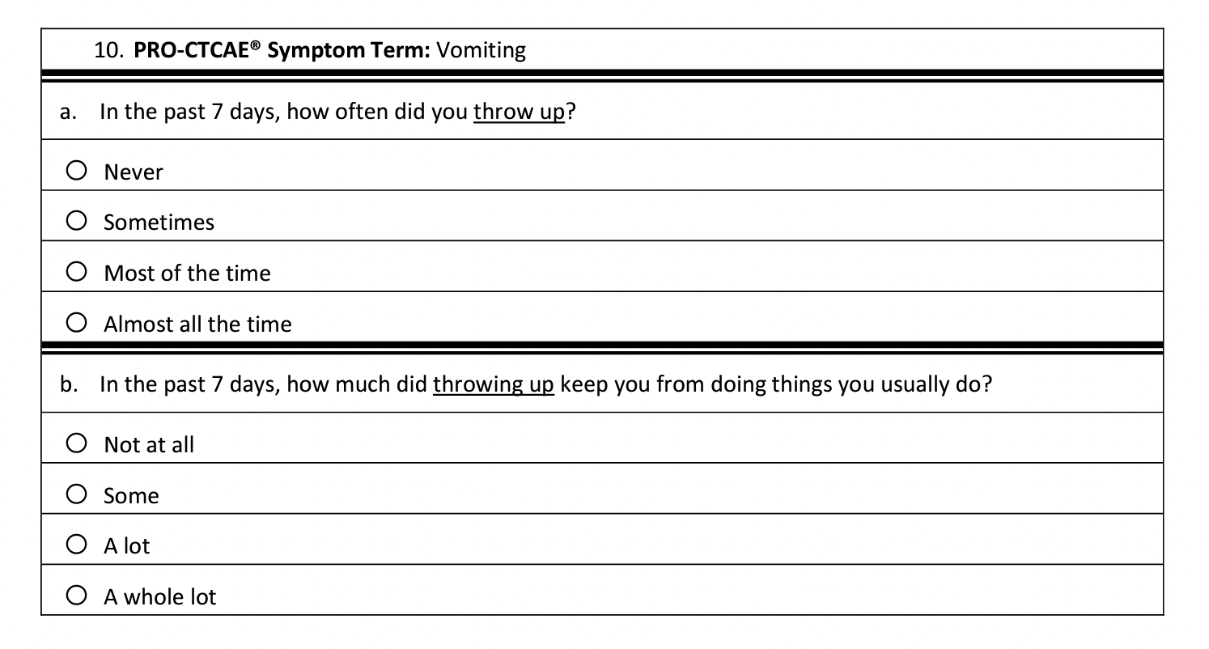
Sample Question
Notes:
This demonstrates the PRO-CTCAE Symtom Vomiting
Never
Sometimes
Most of the time
Almost all of the time
And are graded 0, 1, 2 and 3
If the patient exhibits NO/NEVER then the subsequent question will be automatically scored as a zero
.,kl

Slide 7
PROMIS-25
The PROMIS-25 is a validated short form composed of 25 questions that assess mental, physical, and social health components of HRQoL.
PROMIS-25 evaluates six HRQoL domains: mobility, anxiety, depressive symptoms, fatigue, peer relationships and pain interference
Four questions per domain, using a five-point Likert scale.
Additionally, a single-item pain intensity measurement was scored from 0 to 10.
All items have a 7-day recall period.
*Lower PROMIS scores for Mobility and Peer Relationships indicated worse functioning and higher scores for other domains equal poorer symptoms
Notes:
Validated Dr Westmoreland 2018

Slide 8
PROMIS-25

Slide 9
Symptom Toolkit
The symptom toolkit is equipped with medications that are used to symptomatically manage some of the most common symptoms experienced by patients with cancer:
nausea/vomiting (ondansetron, promethazine)
constipation (bisacodyl, lactulose)
oral mucositis (mouthwash/honey)
pain (oral morphine, paracetamol)
insomnia (diphenhydramine)
gastritis (antacid)
Notes:
Pictorial medication labels that aid the patients and their families in understanding which medication to use for which symptom. Patients are given a pictorial booklet with cartoon explanations and also diary to record when the toolkit medications were taken, for the providers to review at the next clinic visit.

Slide 10
AIMS
Aim 1: To translate and culturally validate Peds PRO-CTCAE for use amongst adolescent and young adult patients with lymphoma in Malawi.
Aim 2: To validate the Pediatric PRO-CTCAE for use among adolescent and young adult patients with patients with lymphoma in Malawi.

Slide 11
METHODOLOGY
The Ped-PRO-CTCAE was translated into Chichewa and culturally validated for use in Malawi using the Functional Assessment of Chronic Illness Therapy (FACIT) method.
Translated and validated survey was administered to 50 participants. Psychometric validation was assessed using Spearman’s correlation for responsiveness/convergent and discriminant validity and Wilcoxon rank-sum for known group validity.

Slide 12
TRANSLATION CULTURAL & QUALITATIVE VALIDATION

Slide 13
TRANSLATION: FACIT METHODOLOGY
Principles of Good Translation and Cultural Adaptation Practice Recommended by the International Society of Pharmacoeconomic and Outcomes Research (ISPOR)
Currently available in English, Simplified Chinese and Italian
Notes:
This method is recommended by the International Society of Pharmacoeconomic and Outcomes Research (ISPOR) to assure cross cultural equivalence and relevance to the target population.
There are more than 2000 languages spoken across Africa…… Although there is Development activlet occurring in 8 additional languages none of these are SSA
2.3.1 Step 1: Forward Translation
The English version of the Ped-PRO-CTCAE core items questionnaire was forward translated into Chichewa, local language of Malawi, by two independent bilingual native speakers.
2.3.2 Step 2: Reconciliation
A third bilingual independent translator reconciled the two forward translations by either selecting one forward translation or providing a new version of the translated items to resolve discrepancies.
2.3.3 Step 3: Back Translation
The reconciled Chichewa version was blindly back-translated into English by a fourth bilingual independent translator.
The finalized and harmonized version of the Peds PRO-CTCAE was created by compiling the feedback and recommendations of the bilingual translation coordinator (O.M.) and Peds PRO-CTCAE staff comments

Slide 14
PSYCHOMETRIC VALIDATION

Slide 15
Kamuzu Central Hospital (KCH)
Notes:
is a national teaching hospital in the capital of Malawi, Lilongwe

Slide 16
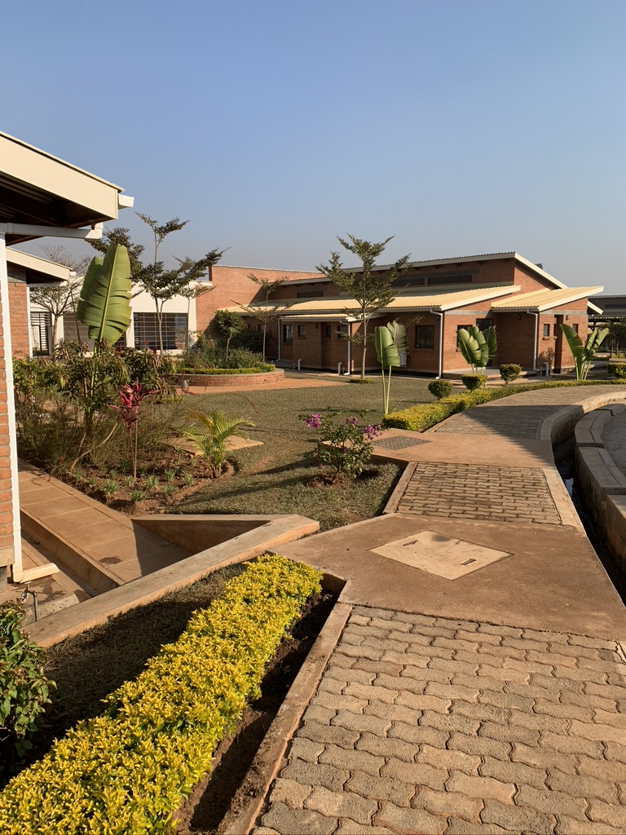
UNC Project Malawi
UNC Project Malawi was established in 1999 as a collaboration between UNC and the Malawi Ministry of Health (MOH)
Notes:
UNC Project Malawi was established in 1999 as a collaboration between UNC and the Malawi Ministry of Health (MOH)

Slide 17
SETTING & DEMOGRAPHICS
This study was conducted at Kamuzu Central Hospital (KCH) in Lilongwe, Malawi.
A total of 79 Adolescent and Young Adult patients participated in the study.
The diagnoses included Burkitt's Lymphoma, Diffuse Large B Cell Lymphoma, Hodgkin’s Lymphoma and Lymphoma NOS.
The median age was 28
46 of which were Male

Slide 18
KNOWN GROUP VALIDITY
HRQoL Domains |  |  | Wilcoxon Rank Sum
 | Anemia Hgb < 9.0 g/dl | Not Anemic Hgb ≥ 9.0 g/dl
Fatigue Severity | N = 29 | N = 95 | p < 0.001
 | Poor Performance ECOG ≥ 2 | Good Performance ECOG < 2
Pain Frequency | N = 18 | N = 19 | p < 0.001
Pain Severity | N = 16 | N = 12 | p = 0.01
Patients with poor performance status (ECOG≥2) had higher pain frequency (p<0.001) and pain prevalence (p=0.005)
Patients with anemia (hgb<9g/dL) had worse fatigue severity
Notes:
One additional tool that we use to assess HRQol in Malawi was created by our palliative care faculty Dr Tilly. This is referred to as the symptom tool kit. It assesses these core demains including Nausea, insomnia, constipation, mucositis, stomach pain, and pain.
Ped-PRO-CTCAE when compared to home symptom diary (ie nausea, constipation, pain, mucositis, insomnia and abdominal pain) were correlated across all matching PRO-CTCAE domains (p<0.001).

Slide 19
KNOWN GROUP VALIDITY
PRO-CTCAE symptom AE items | Corresponding Symptom Toolkit AE NOT PRESENT | Corresponding Symptom Toolkit AE PRESENT
 | Mean (95% CI) | Mean (95% CI) | p
PRO-CTCAE Nausea | 1.17 (1.08 to 1.26) | 1.78 (1.49 to 2.05) | p < 0.001
PRO-CTCAE Insomnia | 1.04 (1.01 to 1.08) | 2.30 (1.68 to 2.93) | p < 0.001
PRO-CTCAE Constipation | 1.04 (1.00 to 1.07) | 2.04 (1.74 to 2.34) | p < 0.001
PRO-CTCAE Mucositis | 1.13 (1.05 to 1.21) | 2.07 (1.74 to 2.40) | p < 0.001
PRO-CTCAE Stomach Pain | 1.11 (1.04 to 1.17) | 1.64 (1.25 to 2.03) | p < 0.001
PRO-CTCAE Pain | 1.12 (1.03 to 1.21) | 2.00 (1.79 to 2.28) | p < 0.001
Notes:
Ped-PRO-CTCAE when compared to home symptom diary (ie nausea, constipation, pain, mucositis, insomnia and abdominal pain) were correlated across all matching PRO-CTCAE domains (p<0.001).

Slide 20
CONVERGENT & DISCRIMINANT VALIDITY
 | Spearman’s Correlation with Fisher Transformation, r (95% CI)
PROMIS Physical Functioning/Mobility Score
PRO-CTCAE pain F | -0.53 (-0.62 to -0.42)
PRO-CTCAE neuropathy S | -0.35 (-0.47 to -0.22)
PRO-CTCAE fatigue S | -0.54 (-0.63 to -0.43)
PROMIS Pain Interference Score
PRO-CTCAE pain S | 0.56 (0.41 to 0.68)
PRO-CTCAE pain I | 0.63 (0.49 to 0.74)
PROMIS Fatigue Score
PRO-CTCAE fatigue S | 0.68 (0.60 to 0.75)
PRO-CTCAE fatigue I | 0.67 (0.56 to 0.77)
PRO-CTCAE Depression S | 0.45 (0.33 to 0.56)
PRO-CTCAE Anxiety F | 0.42 (0.29 to 0.53)
PROMIS Depression Score
PRO-CTCAE Depression I | 0.49 (0.31 to 0.64)
PRO-CTCAE Anxiety F | 0.46 (0.33 to 0.56)
PRO-CTCAE fatigue I | 0.50 (0.35 to 0.63)
PROMIS Anxiety Score
PRO-CTCAE Depression I | 0.65 (0.50 to 0.76)
PRO-CTCAE Anxiety S | 0.71 (0.59 to 0.80)
PRO-CTCAE fatigue I | 0.41 (0.24 to 0.56)
When compared to the translated and validated Patient-Reported Outcomes Measurement Information System (PROMIS) Pediatric tool, there were stronger correlations when symptoms matched
Magnitudes of correlation are classified as small (0.10–0.29), moderate (0.30–0.49), strong (0.50–0.69), and very strong (>0.70).
Notes:
Convergent and discriminant validity of the Ped-PRO-CTCAE was examined by its association with the translated and validated PROMIS Pediatric tool. Spearman’s correlation showed there were stronger correlations when symptoms matched between the two instruments (i.e. pain intensity r=0.63, fatigue severity r=0.68, depression r=0.49, and anxiety severity r=0.71). Magnitudes of correlation estimates are classified as small (0.10-0.29), moderate (0.30-0.49), strong (0.50-0.69), and very strong. (>0.70), per Cohens’s recommended effect sizes .
Bryces paper
Magnitudes of correlation are classified as small (0.10–0.29), moderate (0.30–0.49), strong (0.50–0.69), and very strong (>0.70).

Slide 21
CONCLUSION
This study found supporting evidence for the validity of the Chichewa-translated version of the Ped-PRO-CTCAE for Malawi.
This emphasizes an urgent need to address symptomatic AEs experienced by children and AYA undergoing cancer treatment in SSA using PRO instruments validated within the local context.
Notes:
The FACIT translation process was established to ensure that PRO measures reflect cultural and conceptual equivalence of meaning and measurement between different countries . This is a critical step in Africa where there are known to be more then 1000-2000 local languages and dialects https://pubmed.ncbi.nlm.nih.gov/15851774/

Slide 22
DISCUSSION
The Chichewa version of the Pediatric PROMIS-25 and Ped-PRO-CTCAE measures are the first-ever translated and culturally validated PROs instruments for use in a resource-limited setting and in SSA.
This study allowed the implementation of cutting-edge PRO measures in Malawi to holistically and comprehensively assess symptomatic adverse events and HRQoL similar to ongoing efforts in resource-rich countries.
As hematology-oncology care expands, we are hopeful that this work will facilitate the translation, validation, and implementation of PROMIS and PRO-CTCAE across SSA.
The Chichewa version of the PROMIS-25 pediatric short form and the Peds PRO-CTCAE have an exceptionally broad scope for implementation and literature supports the use of PROs measures in both clinical trials and in clinical practice.
Notes:
The translation of the Chichewa version of the Ped-PRO-CTCAE followed the FACIT translation methodology that is recommended by the ISPOR. The FACIT translation process was established to ensure that PRO measures reflect cultural and conceptual equivalence of meaning and measurement between different countries . This is a critical step in Africa where there are known to be more then 1000-2000 local languages and dialects. The Chichewa version of the Pediatric PROMIS-25 and Ped-PRO-CTCAE measures are the first-ever translated and culturally validated PROs instruments for use in a resource-limited setting and in SSA.
https://pubmed.ncbi.nlm.nih.gov/15851774/

Slide 23
WHAT’S NEXT
We believe that direct reporting of Pediatric PRO-CTCAE to measure symptomatic adverse events will lead to more complete and accurate toxicity assessments allowing us to better care for our patients and monitor clinical trial safety.
For this study, our survey was administered by a trained research assistant and although this was a necessary step due to low literacy among our patients this could have created social desirability bias.
With the UNC PRO-CORE team we have developed an interactive Chichewa voice enabled tablet as a new mode of delivery for low literacy patient population. We are now validating of this new platform in Malawi.
Notes:
Awaiting local IRB approval with anticipated enrollment date of April 2023!
I am so honored to be invited to speak to you all during this palliative conference. Incorporating these PRO measures into SSA will address a gap; in a country where healthcare delivery is historically patriarchal and shared decision making between patients and providers is not the norm. We are so excited about the potential to harness the voice of vulnerable and often silenced patients across the globe.
I do understand barriers in LMICs, I have dedicated my work to ensuring that children receive the best care REGARDLESS of where they are born.
I encourage you all to look into utilizing PROs methodology to assess HRQol. The World Healths Organizations commitment to global oncology has set the precedent, now we just need to get onboard!
Thanks everyone

Slide 24
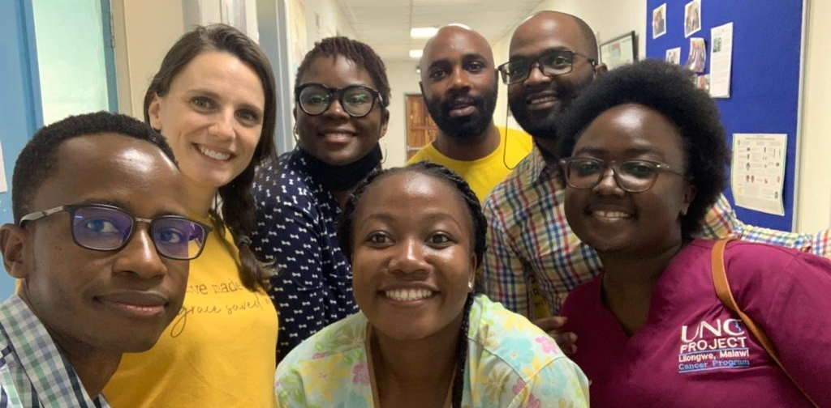

Slide 25
Zikomo !

