Slide 1
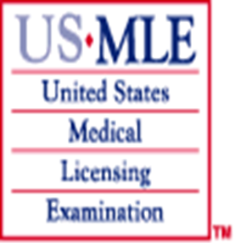
Step 1 Overview Drs. Hadler, Ingersoll, & Dent
Office of Student Affairs
University of NC School of Medicine

Slide 2
The Basics
When do I sign up?
How do I sign up?
What is the SOM policy?
What products should you use to prepare?
How much time should you study?
When should you take the exam?
What does it all mean?

Slide 3
The Basics
When should you sign up?
September 2016
How do I sign up
Online sign up
Student Affairs will certify your application & provide picture
Certified application should be ready by October 1st
What is the SOM policy?
Must take exam before starting Application Phase
Must pass before November 1st of Application Phase
In the unlikely event of a fail, finish current clerkship and plan on delaying your second clerkship so you can retake Step 1
Can do electives if you do not need 16 weeks to prepare

Slide 4
Application Process
Apply online – NBME Licensing Examination Services
Certification/Proof of Enrollment
Must download and fill out USMLE form
Bring form to Tiffany Pitt (Assistant Registrar) in 1001 Bondurant Hall, CB# 9535, 919-962-8337
Testing accommodations available
Contact Deborah Ingersoll (Educational Resources Coordinator) in1050 Bondurant Hall, 843-6171
Computerized exam offered at testing centers worldwide including 10 centers in NC
Asheville, Charlotte, Greensboro, Greenville, Raleigh, Wilmington

Slide 5
Basics
What products should I use to prepare
First Aid
Question bank
USMLE World is probably best
Everyone should have a schedule or plan
Be wary of sales pushes using fear to encourage you to spend $100s on products that do not fit your life or study style and that you are not going to use

Slide 6
A Few Best Practices
Start preparing for Step 1 by reading the appropriate sections of First Aid with each course as it is in session, if possible.
Use First Aid and a question bank (e.g. Kaplan, USMLE World) electronic question banks as core Step 1 study materials during the December-February study period following Foundation Phase.
Develop a feasible plan of study that includes reading/studying, doing questions in question banks, and ongoing review of topics already studied.
Do not wait until you have studied all content before using question bank or taking practice test.
Identify weak areas and use subject-specific review materials (e.g. Board Review Series, Lippincott for pharmacology or pathology).
Do random questions in 50 minute blocks.
Review correct and incorrect answers and understand why the correct answer is correct and why others are wrong.
Keep a running list of topics that will require additional study.

Slide 7
Basics
When should I take the exam?
February will be the best time for most students
USMLE Step exams not offered the first 2 weeks of January
Take at least a week completely off before start studying
Should plan on spending 5 to 8 weeks preparing for the exam

Slide 8
Step 1 and the Match Ratio of Positions to US Seniors Median Step 1 Scores for Matched Students
Ratio* Step 1
Family Medicine 2.3 218
Internal Medicine 2.0 231
Neurology 1.8 230
Pathology 2.1 231
PM & R 1.6 220
Psychiatry 1.7 220
*Ratio of spots to US Seniors applying
Match Outcomes Data, August 2014

Slide 9
Competitive Specialties: Ratio of Positions to US Seniors Median Step 1 Scores for Matched Students
Ratio Step 1
Anesthesiology 1.4 230
Emergency Medicine 1.3 230
General Surgery 1.3 232
Med/Peds 1.2 233
Obstetrics/Gynecology 1.3 226
Pediatrics 1.4 226
Radiology 1.7 241
Match Outcomes Data, August 2014

Slide 10
Highly Competitive Specialties: Ratio of Positions to US Seniors Median Step 1 Scores for Matched Students
Ratio Step 1
Dermatology 1.1 247
Orthopedic Surgery 1.0 245
Otolaryngology 1.1 248
Plastic Surgery 1.0 245
Radiation Oncology 1.1 241
Match Outcomes Data, August 2014

Slide 12
Best Practices
It is gratifying to study what you like, but…you must resist the temptation to study what you already know!!!
A key to success is efficiently figuring out what you do not know and learning as much of it as possible before the exam!

Slide 13
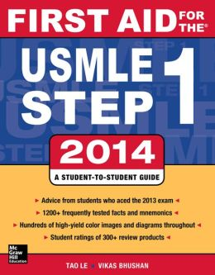
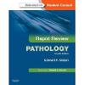
Popular Step 1 Preparation Materials

Slide 14
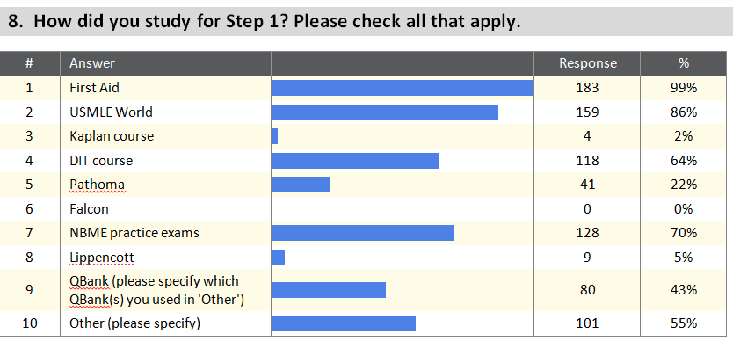
Step 1 Review Aids and Question Banks cont.
Results from the 2012-13 UNC SOM Step 1 Study Analysis – March 2013

Slide 15
Step 1 Review Aids and Question Banks
Resource | % who purchased | % who used | Recommendation Ranking (1=best, 5=worst) | % who ranked as a Top 3 resource | Aug | Nov/Dec | Jan/Feb | Mar | May
Pathoma | 87.9 | 77.3 | 1.64 | 48.5 | 34 | 5 | 5 | 2 | 12
First Aid | 100 | 98.5 | 1.12 | 90.9 | 26 | 5 | 8 | 7 | 19
Firecracker | 43.9 | 12.2 | 3.33 | 0.0 | 9 | 4 | 4 | 1 | 0
Kaplan Qbank | 18.2 | 10.6 | 3 | 1.5 | 2 | 2 | 1 | 2 | 3
Practice Exams | 69.7 | 68.2 | 1.47 | 25.8 | 0 | 0 | 0 | 0 | 45
USMLE World | 98.5 | 95.5 | 1.05 | 90.9 | 1 | 2 | 8 | 15 | 35
Clinical Microbiology Made Ridiculously Easy | 39.4 | 19.7 | 2.62 | 0.0 | 5 | 1 | 0 | 3 | 12
BRS Books | 31.8 | 16.7 | 3 | 0.0 | 1 | 0 | 0 | 0 | 10
Pharmacology flashcards | 34.9 | 15.2 | 3.04 | 0.0 | 1 | 0 | 0 | 0 | 15
Lippincott's Illustrated Reviews: Pharmacology | 0 | 0 | 3.33 | 0.0 | 0 | 0 | 0 | 0 | 0
High-Yield Immunology | 4.5 | 3 | 3.5 | 0.0 | 1 | 0 | 0 | 0 | 1
High-Yield Gross Anatomy | 3 | 3 | 3.5 | 0.0 | 0 | 0 | 0 | 1 | 0
High-Yield Neuroanatomy | 19.7 | 9.1 | 3.1 | 0.0 | 2 | 0 | 2 | 0 | 1
DIT | 45.5 | 43.9 | 2.19 | 27.3 | 0 | 0 | 0 | 2 | 28
USMLE Rx Qbank | 7.6 | 6.1 | 2 | 1.5 | 0 | 0 | 2 | 1 | 3
Microbiology flashcards | 3 | 3 | 2 | 1.5 | 0 | 0 | 2 | 1 | 3
Preliminary data from Class of 2016
Approximately 1/3 class responding

Slide 16
Pros
Comprehensive material, detail orientated
Organized
Covers many topics
Great memorization techniques
Multiple formats to keep you interested
Good if you’re someone who thrives with rigid structure and schedule imposed by someone else (e.g., you just follow along with the recorded lectures)
Quizzes reinforce materials and help with memorization
Well structured review plan
Cons
A lot to cover in short amount of time
Expensive
Time consuming to watch all the videos
Workbook (and lectures) lacked SO many of the important, truly high yield topics for Step 1
No explanations – more or less restates the book
Boring at times to watch for 10hrs/day
Recite Step 1 at times
http://www.doctorsintraining.com

Slide 17
Pros
Excellent review
Satisfying explanations for a lot of the tough pathologies
Clever mnemonics for remembering some of the key features
Can speed up the recordings to at least 1.5x.
Great to use in parallel with the clinical parts of FirstAid (in fact, I found that NOT using the pathology section of First Aid, but relying on the corresponding section of Pathoma instead was a more efficient use of my time.
Good pictures and diagramming by the speaker.
Cheaper than DIT
Cons
Doesn’t cover ALL the pathologies you’re responsible for
Recorded lectures are largely a verbatim recapitulation of the text
http://www.pathoma.com/

Slide 18
Pros
Same format as real thing
Great companion to First Aid!
Lengthy explanations to each question that provides lots of important learning points
Great learning!
Has Iphone and Android apps so you can do questions from anywhere
Supplements First Aid very well
Questions that were probably a little harder than the actual Step 1, but they had good explanations for the answers and it highlighted important facts that need to be memorized for Step 1
MUST have for Step 1 (and Step 2, for that matter)
Cons
Expensive, though worth it!
http://www.usmleworld.com/

Slide 19
Pros
Questions help teach you how to really read every word of question stems and answer choices
Cons
Little more esoteric and unrealistic
Seemed to focus on trying to trick you instead of increase your Step 1 knowledge
http://www.kaptest.com/

Slide 20
Pros
Cheapest qbank
Biggest qbank
Cons
Many questions slightly easier than UWorld counterparts—stems have more of the obvious keywords you’re trained to look for
https://www.usmle-rx.com/

Slide 21
Pros
Good way to gauge how well your studying is preparing you for realistic questions very similar to those on real USMLE Step 1
Provides a score that is very predictive of your actual step 1 score
Cons
Somewhat expensive ($60 each)
Keep in mind that scores are not an exact predictor and could be a little higher or lower
http://www.nbme.org/

Slide 22
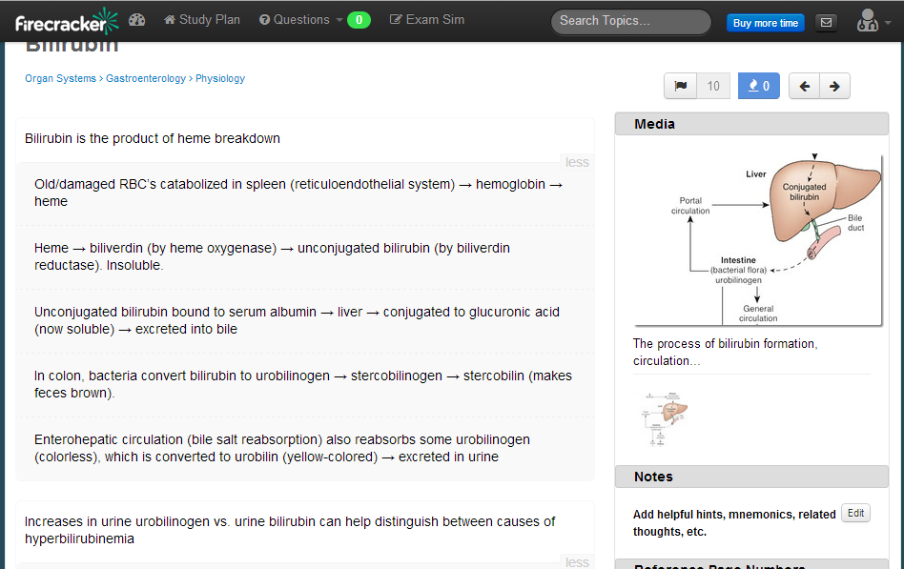
Spaced repetition flashcards: flashcards that you rate how well you remember it, then computer figures out when to show it to you next

Slide 23
Take home message
Have a plan
Be true to your study style
Do not feel compelled to spend a lot of money on materials that you do not have either the time or inclination to use
Everyone should get First Aid and a question bank
Usefulness of other resources depends on your individual learning style
More info at upcoming PDX Session!

Slide 24
Resources and Contacts
USMLE Web Site
http://www.usmle.org/
National Board of Medical Examiners
The National Board of Medical Examiners®
Prometric web site
http://www.prometric.com
AAMC Careers in Medicine
https://www.aamc.org/cim/‎

Slide 25
STEP 1 Prep at UNC 2016 Susan Hadler, MD, MS
Office of Student Affairs
University of NC School of Medicine

Slide 26
STEP 1 PREP AT UNC
STEP 1 content: Blocks are working to align course content with First Aid for USMLE content. An ongoing project.
Experience with USMLE question format: Blocks use USMLE question formats as often as possible on in-course exams. An ongoing project.
Experience with practice STEP 1 exams: Curriculum provides multiple opportunities for class to take practice STEP 1 exams.

Slide 27
STEP 1 PREP AT UNC

Slide 28
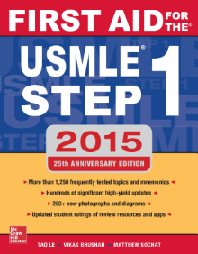
ON-LINE UNC-CREATED STEP 1 PREP REVIEW LECTURES
Review Lecture Series based on First Aid for USMLE Step 1 content
This lecture series was designed by UNC medical students.
Each lecture covers high yield info identified by MS 3 students.
20 lectures: 1 or 2 lectures for almost all of the chapters in First Aid
Most lectures are 2 hours, a few are 1 hour in length.
Lectures were lecture captured in 2015.
Lecturers are UNC faculty chosen by previous MS 3 students and are mostly block directors.
Dr. Hadler is the lecture series director. Contact her with all questions and concerns. susan_hadler@med.unc.edu

Slide 29
ON-LINE UNC-CREATED STEP 1 PREP REVIEW LECTURES
Possible ways to use:
Try one out and see if it is helpful.
If it is helpful, during 3rd semester, review 1 lecture and it’s First Aid chapter per week.
If it is helpful, incorporate into dedicated study time.
WHY :
Previous classes wanted an in-house review the semester before the exam to review content, help encourage studying, provide a study structure, and diminish anxiety.

Slide 30
ON-LINE UNC-CREATED STEP 1 PREP QUIZZES
Based on First Aid for USMLE Step 1
content
Designed to cover and reinforce very high
yield info.
16 different quizzes, almost one for each
chapter of First Aid.
Factoid-type questions (NOT USMLE
format)
These quizzes were written by UNC MS
3 medical students soon after
completing STEP 1.
Dr. Hadler is responsible for these
quizzes. Contact her with all questions
and concerns. susan_hadler@med.unc.edu
Possible ways to use:
Try 1 out and see if it is helpful.
If it is helpful, during 3rd semester, work through one each week.
If it is helpful, during 3rd semester align the quiz with the First Aid chapter you are reviewing.
If it is helpful, use during dedicated study time.

Slide 31
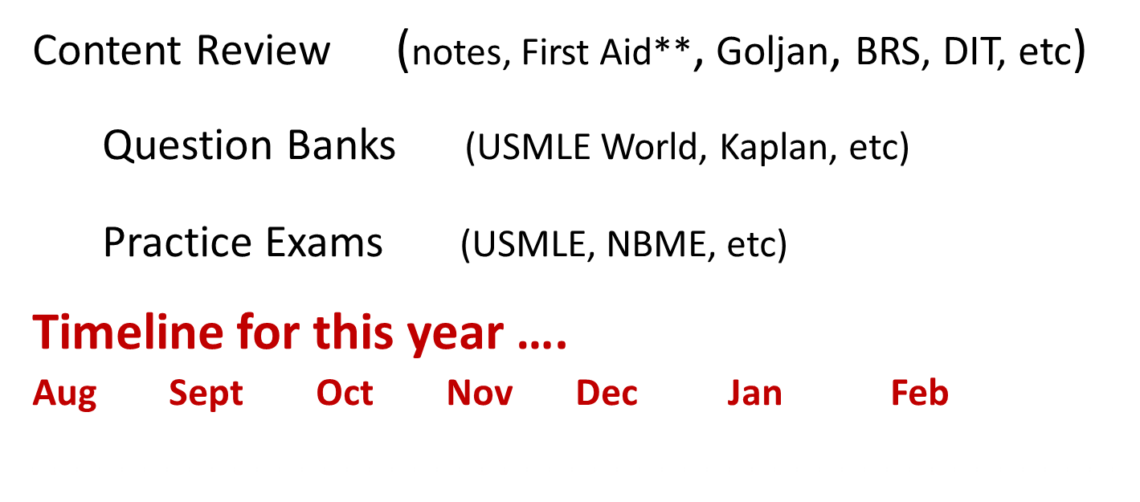
The Big Picture
Learning requires repetition
3 types of study materials
If possible go over material at least once
Intensive study : put content in short term memory … develop ease with question format …. pick up speed, endurance

Slide 32
Step 1 Prep Deborah Ingersoll deborah_ingersoll@med.unc.edu
Office of Student Affairs
University of NC School of Medicine

Slide 33
A Word about Advice
Collect information
There will be conflicting advice.
“Everyone is already studying for Step 1.”
“Everyone is using [First Aid, DIT, Pathoma…].”
“ You should study no more than X number of weeks.”
Scheduling a trip on the day after you take Step 1 is not the best plan for everyone.

Slide 34
What materials will you use?
Choose materials that you will want to use to study and learn from, not what someone says you should use.
Many resources are listed in the back of First Aid.
Browse and sample materials to find what works for you.
It’s better to selective then overwhelmed with resources.

Slide 35
What are the components of your plan?
Reading/listening – learning content
ID your IDKs
How will you manage IDKs? Electronic? Hard copy?
What will your study aids be? Annotations? Flash cards? Notes? Tabs in FA?
Review
Re-review
Work your question bank
Practice Exams

Slide 36
When will you schedule the components of your plan?
 | SUNDAY | MONDAY | TUESDAY | WEDNESDAY | THURSDAY | FRIDAY | SATURDAY
6:00
7:00
8:00
9:00
10:00
11:00
12:00
1:00
2:00
3:00
4:00
5:00
6:00
7:00
8:00
9:00
10:00
11:00
12:00

Slide 37
Where will you study?
At home in Chapel Hill area
At home elsewhere
HSL
Davis study room
Bondurant, Berryhill, SPH, other
Coffee shop
Public library

Slide 38
Study Solo or With Other(s)
Study solo
Interactive study group/study partner
Mostly not interactive study group/partner – mutual accountability
Study group/partner to talk through missed questions
Combination?

Slide 39
How will you use your materials?
Customize your plan
First Aid
You can study from First Aid
You can refer to First Aid as a curriculum guide
U World
Use timed option
Sorted questions 0-49% of the time
Mixed content questions
Use tutorial mode after timed session
Triage your IDKs

Slide 40
Practice Exams
NBME Practice Exams or 4 UWorld Blocks
Use regularly
Analyze results
Why did you miss the question?
Content
Test taking – (misread, assumption, misinterpreted
Other reason
How did you choose your answer?
Guess, thought it was a trick, over-thought, too easy, “they” would never…, etc.

Slide 41
Practice Exams (con’t.)
What do results tell you about your study approach?
Are you showing improvement in the areas you have studied?
Do you need to modify your approach?
Are you re-reviewing?
Is your approach working?

Slide 42
Putting in Time vs. Learning
Quantity – number of hours/questions/chapters/videos
Quality of your learning
The effect of putting in long hours, diminishing focus, feeling like information isn’t “sticking”, increased anxiety, fatigue, feeling frustrated, depleted reserves, questioning ability, becoming depressed, feeling like you need to work harder and longer…..emotional and physical drain

Slide 43
This Semester, Leading Up to Step 1, Exam Day
Draining effects of fatigue, doubt, worry and anxiety
Burn out prevention
Monitor internal dialogue
Know how YOU can
Reset
Refocus
Re-energize
Re-motivate

Slide 44
This Semester, Leading Up to Step 1, Exam Day
Worry, Anxiety, Doubt, Exhaustion
vs.
Calm, Clear Thinking, Confidence
Give yourself the advantage of the latter.

Slide 45
Balance – Burn Out Prevention
Breathe
One or two or ten slow deep breaths in and out
Positive, meaningful message
Manage distractions and distracting thoughts
Protected time for studying AND
Protected time for family, friends, fun, working out, sleep, eating healthily, attending to spiritual needs

Slide 46
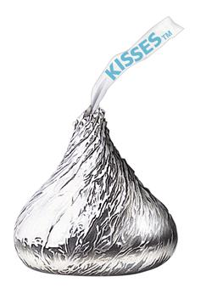
Hershey Kiss Model for Balance

Slide 47
Hershey Kiss Model for Balance
Spiritual
Physical
Eat
Sleep
Exercise
Emo/Soc
Friends
Family
Fun
Academics

Slide 48
Preparing for Step 1 is a lot of work covering a vast amount of material.
To do your best, you will want to study smart, have adequate rest, and feel well physically and emotionally
Schedule time each day to replenish your reserves.

Slide 49
Best of Luck!
Please contact me with questions or if you would like to meet.
deborah_ingersoll@med.unc.edu
1050 Bondurant Hall

