Slide 1

Scheduling 4th Year &
Introduction to Residency
Application Process
The University of North Carolina School of Medicine
December 16, 2016

Slide 2
Agenda
FOURTH-YEAR SCHEDULING &
INTRO TO RESIDENCY APPLICATION PROCESS
MS3 CLASS MEETING
AGENDA
Dr. Dent Welcome
9:00 am to 9:05 am
Dr. Steiner and Kimmy Vuong Legacy Teacher Program
9:05 am to 9:10 am
Drs. Felix & Noone Individualization Phase & Scholarly Concentration
9:10 am to 9: 30 am
Johanna Foster Scheduling Individualization Phase
9:30 am to 10:00 am
10:00 am to 10:10 am Break
Dr. Dent Step 2 & Introduction to the Match
10:10 am to 10:35 am
Sheila Graham McDonald Financial Aid and Debt Management
10:35 am to 11:00 am
MS4 Student Panel Scheduling and the Match
11:00 am to 11:50 am

Slide 3

Legacy Teacher Program
Dr. Beat Steiner and Kimmy Vuong

Slide 4

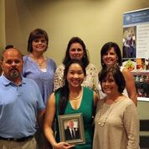
Legacy
Teachers
Honoring Our Patients as Teachers
Reflect on a patient who has had a lasting impact on you.
Write a short description, poem, or something that describes the patient’s impact on you.
Submit to Zach Moore by the end of Application Phase (zach_moore@med.unc.edu)
Come celebrate with that patient during a banquet on May 15, 2017!!!

Slide 5
Thoughts from last year’s students
Try to keep the Legacy Teachers program in the back of your mind while on rotations.
When you have a memorable experience…
  Let the patient(s)/families know how meaningful your interactions with them have been
  Store their names on your Epic profile
  Reach out earlier with the banquet date (5/15/17) so they can coordinate transportation/work to attend!
Families really appreciate it, and you will too!
  It’s a great way to end your Application Phase!
SUPER helpful during interview season
  When asked about a memorable patient experience it helps to have this experience to reflect on and share
  Many interviewers loved my experience in the Legacy Teachers program!

Slide 6

Individualization Phase &
Scholarly Concentration
Drs. Anna Felix and Peadar Noone

Slide 7
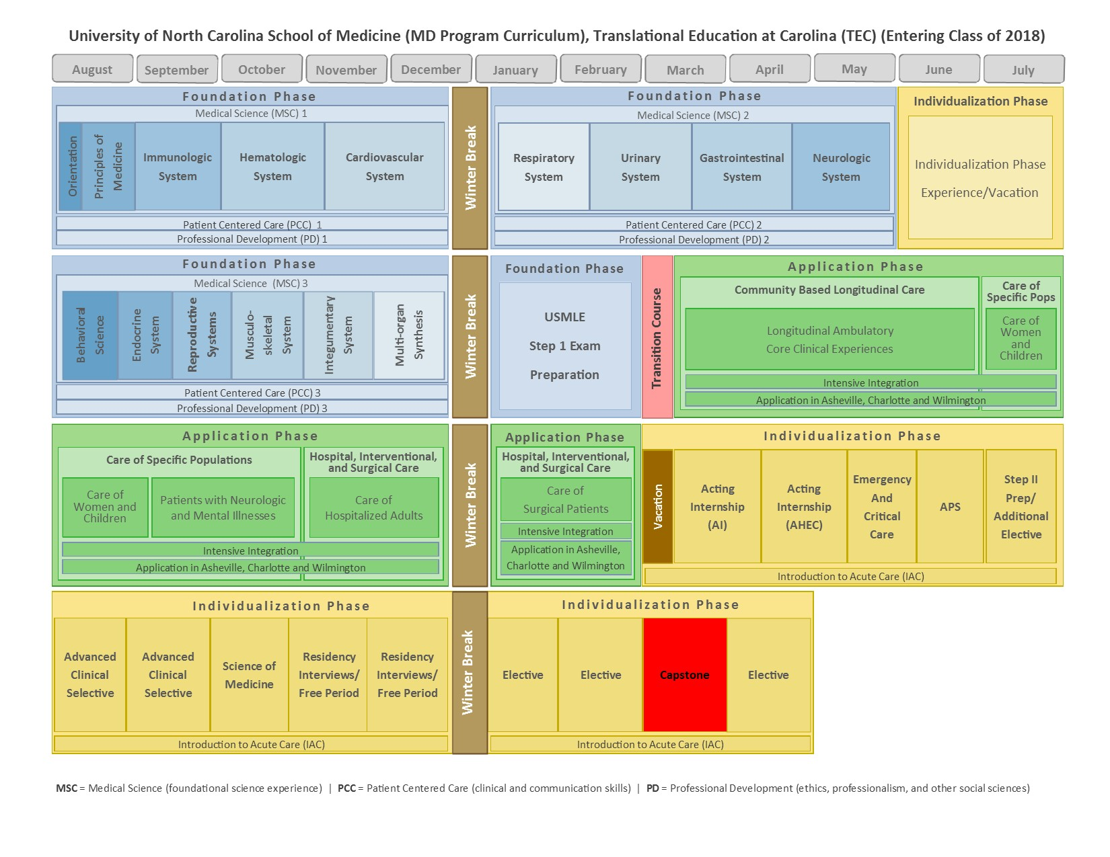
Individualization Phase
AGENDA
https://www.med.unc.edu/md/curriculum/tec-curriculum-information/tec-graphics/TECCalendarOutline03.03.2016.jpg

Slide 8

AGENDA
Scholarly Concentration Program
Allows an opportunity to work closely with a mentor expert in your chosen discipline
Scholarly Concentration Programs Offered
Medical Education
Leadership
Physician Leadership in Quality and Safety
Care of Older Patient
Humanities and Social Sciences
Technology in Medical Education (TiME)
Application Process & Deadline
Select the “ONLINE APPLICATIONS” hyperlink from the SCP website to complete and submit your application by 5pm on January 23, 2017
https://www.med.unc.edu/md/curriculum/tec-curriculum-information/primary-care-programs-and-scholarly-tracks/scholarly-concentration-programs

Slide 9

AGENDA
Learn more about the program
and meet the Scholarly Concentration Leaders
Stop by information tables
today between 2:00-3:00pm, Room 2020 Bondurant Hall

Slide 10

Scheduling
Individualization Phase
Johanna Foster

Slide 11
Round 2
Individualization Phase Scheduling
December 16, 2016
Johanna_foster@med.unc.edu

Slide 12
What we will cover today
Managing expectations because capacity is always tight.
Planning Round 2.
Entering your schedule in the revamped online platform.
Receiving approval from Dr. Dent, College Advisor or Campus Director.
Drop/Add dates and parameters.

Slide 13
Planning Round 2
  The worksheet that Anna Fleischman sent you is intended to help map out Round 2 of scheduling. It is optional.
  This worksheet helps you:
      Understand the graduation requirements.
      Figure out what elective credit you can bring forward.
      Determine what graduation requirements that you are fulfilling in Round 1.
      Plan which graduation requirements you want to fulfill in specific blocks of Round 2.
      Review overall progress toward graduation.

Slide 14
Planning Round 2
Here are the resources your need when developing your Round 2 plan
One45
Review your Round 1 courses.
Use Worksheet
Develop your Plan
For Round 2
Course Catalog
Go to UNC MD Website.
Search for
Individualization Phase
Click on
Course Descriptions
Enter Scheduling Platform
https://woodland.med.unc.edu/4thYearPackage/
Complete the sections
correctly.
Email College Advisor.
Request Approval
well before
Jan. 20
May be helpful to email your worksheet.

Slide 15
The Revamped Scheduling Platform
Using your ONYEN and password, log into: https://woodland.med.unc.edu/4thYearPackage/
One page. It is contained on just one page.
Focus on graduation requirements. Identify the grad req that you want to complete in blocks 5-14 according to two ideal schedules. This Informs the sections for course selections, which is logic-based.
Logic-based course selection. In other words, the drop downs for courses are based on the grad requirement and block you selected in a previous section. If a course is not in a drop down, then it may not be available in that block or may not fulfill a specific grad requirement.
Notes to Staff: There are sections for notes that you can send to the scheduling staff; they will read these notes.
Email confirmation. When College Advisors, Campus Directors, or Dr. Dent approve the schedule, both of you will receive email confirmations.

Slide 16
Approval of Round 2 Schedules
Please seek approval from your college advisor, Campus Director or Dr. Dent. There is no mechanism for Career Goal advisors to approve your schedule, but please consult them as you develop your Round 2 plan.
The deadline for advisor approval is January 20 by 5 pm. Please contact Dr. Dent, your college advisor or Campus Director well before this deadline. They will approve by Feb 1.
Consider emailing your them your worksheet. It is not required, but it shows them they you are working to fulfill graduation requirements.
Once your cdirector/advisor has approved Round 2, then you both receive an email confirmation. Please save this email.

Slide 17
Prelim Schedules and Drop/Add Process
Capacity is tight. We do our best to meet students’ requests.
Mindy McKinney is conducting preliminary Round 2 scheduling (mindy_mckinney@med.unc.edu) from February 1 – March 17.
Preliminary Round 2 Schedules will be released via one45 on March 22.
Internal swapping among students, March 22-26.
Drop/add on March 27-31. There are parameters for drop/add that require your help. Changes will be made in the order that the requests are received.
Mid-April: Mindy McKinney and Dustin Norris will work on changes. You will receive email confirmation of changes.

Slide 18
Drop/Add Parameters
Submit swaps and requests for drop/add to: https://unc.az1.qualtrics.com/SE/?SID=SV_6ngm3FKkNVDqAG9
You will first indicate swaps. Both you and your peer must submit separate swap requests to make it official.
Next, indicate what you what to drop and add. Please be accurate.
Bulk swap/drop/add actions will conclude mid April.

Slide 19
Continual Drop/Add during Indiv Phase
Continuing to drop and add courses throughout Individualization Phase is minimized. Special exceptions:
  Personal/medical reasons,
  Away electives falling through, or
  Requests from College Advisor.
  If you want to drop/add throughout Indiv Phase, then do so 4 weeks prior to the start of the course because:
  Constantly and last-minute changes to schedules can be challenging for campuses and coordinators.
  It is respectful to your peers who may have wanted that course.
  Capacity is even less at this point because visiting students have been scheduled.

Slide 20
Important Contacts and Resources
People
Mindy McKinney (mindy_mckinney@med.unc.edu)
Dustin Norris (dustin_norris@med.unc.edu)
Johanna Foster (Johanna_foster@med.unc.edu)
Websites
Individualization Phase: https://www.med.unc.edu/md/curriculum/tec-curriculum-information/individualization-phase
Course Catalog: https://www.med.unc.edu/md/curriculum/tec-curriculum-information/individualization-phase/course-descriptions
Round 2 Online Scheduling Platform: https://woodland.med.unc.edu/4thYearPackage/
Swap/Drop/Add online form: https://unc.az1.qualtrics.com/SE/?SID=SV_6ngm3FKkNVDqAG9

Slide 21

IT’S TIME FOR A
BREAK!
AGENDA

Slide 22

Step 2 & Introduction
to the Match
Dr. Georgette Dent

Slide 23

Step 2 CK
AGENDA
Step 2 CK
  Must have passing score posted by November 1, 2017
  Ideally take in March or April
  Score typically takes 4 weeks to return
  Multiple choice exam, similar to Step 1
  Covers clinical content
  Registration done online
  Office of SA will verify enrollment (typically on Mondays)
  After verification is complete you will receive scheduling permit and may select test date
  Can get administrative excuse from electives/selectives to take exam

Slide 24
Step 2 CS
Step 2 CS
  Must have passing score posted by November 1, 2017
  Standardized Patient Assessment
  Testing appointments are typically filled 3-5 months in advance
  Registration done online
  Enrollment verified by SA
  Can get administrative excuse from electives/selectives to take exam
  It may take 3 months for you to receive your score
  Need to review First Aid for Step 2 CS
  Reporting Schedule
  Testing Period Reporting Start Date Reporting End Date
January 1-January 28 March 8 March 30
  January 29 – March 26 April 26 May 24
  March 27-May 20* June 28 July 26
  May 21-July 15 August 16 September 13
  July 16 – September 9 October 11 November 8
  September 10-November 4 December 13 January 10, 2018
  November 5 – December 31 January 31, 2018 February 21, 2018
  *No Step CS exams will be delivered March 27 through April 1
AGENDA

Slide 25
Step 2 CS Testing Sites
AGENDA
5 Test Centers
  Atlanta
  Chicago
  Houston (least busy)
  Los Angeles
  Philadelphia (most busy)

Slide 26
When do you need to decide on a specialty?
AGENDA
Can take electives/selectives in March to August
Need to decide on specialty by August 15th (early
match specialty) or September 15th
Ideally, you want your ERAS application submitted by September 15th

Slide 27
Introduction to Residency Application Process
    Medical Student Performance Evaluation (MSPE)
    Faculty help & support (career goal and college advisors)
    Electronic Residency Application Service (ERAS)
    Letters of recommendation (LORs)
    National Residency Matching Program (NRMP)
    Humanism Society

Slide 28
Medical Student Performance Evaluation Packet
AGENDA
Transcript uploaded September 15
MSPE, including comments from Foundation and Application phases (and from Individualization phase as applicable), and Foundation Phase and Application phase grade distributions, uploaded October 1
Answers to AAMC questions and SOM information available online and linked within letter

Slide 29
How are evaluations compiled together in the Dean’s Letter?

Slide 30
Dean’s Letter/
Medical Student Performance Evaluation (MSPE)
AGENDA
Identifying Information
Noteworthy Characteristics
Academic History
  Dual/Combined degrees
  Remedial work
  Leave of Absence (research, personal, medical, etc.)
  Adverse actions, if applicable
Academic Progress
  Preclinical record (grades and comments)
  Clinical clerkships (grades and comments)
Summary paragraph/”designation”/academic standing
Appendices (answers to AAMC questions)

Slide 31
MSPE Appointment
AGENDA
Update curriculum vitae, submit to staff writer at staffwriter@med.unc.edu by January 5th!
Meet with Staff Writer to review MSPE
Appointments available January – June
    If you are returning from a LOA and have completed third year, you must schedule your MSPE appointment from January to March!
Pay attention to emails from Staff Writer about scheduling your MSPE appointment
Final MSPE review in late August/early September

Slide 32
4th Year Advising Meeting
AGENDA
Required meeting with College Faculty Advisor from January to August to discuss
  Specialty choice
  Plan for selecting a specialty if undecided
  Competitiveness for specialty choice (s)
  Individualization Phase
  Away electives
  Plan for letters of recommendation (LoRs)
  Number of programs applying to
  Career goal advisor
  Personal statement

Slide 33
Career Goal Advisors
AGENDA
Provide CGA with CV, personal statement, transcript
Review your permanent record in 1001 Bondurant
Encourage CGA to review your permanent record
May meet CGA today
Stay in touch with CGA to discuss:
  choices of programs & priorities
  activities to strengthen application
  number of applications/interviews
  electives here & away
  interview etiquette
  ranking strategies
List of CGAs can be found at http://www.med.unc.edu/ome/studentaffairs/academic-assistance-and-advising/career-counseling-and-careers-in-medicine-1/career-goal-advisors

Slide 34
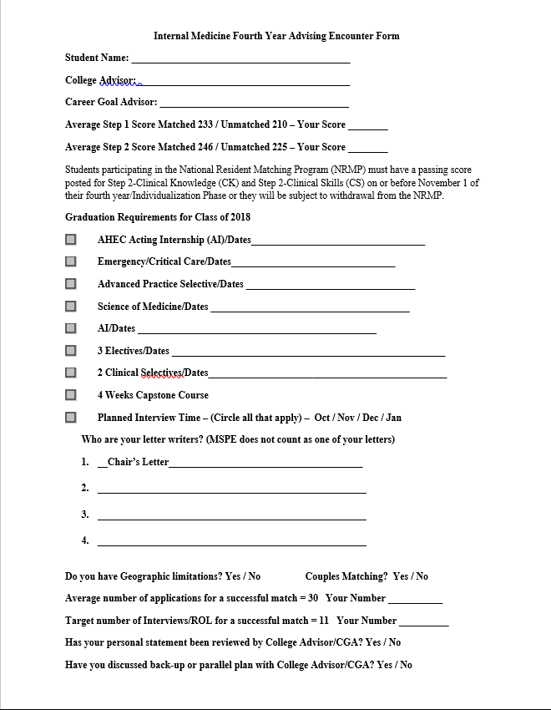
AGENDA
http://www.med.unc.edu/ome/studentaffairs/academic-assistance-and-advising/career-counseling-and-careers-in-medicine-1/specialty-encounter-forms

Slide 35

Electronic Residency Application Service (ERAS)
Web-based for:
  Application
  Personal statement
  Photograph
  Assignment of LoRs
  MSPE/Dean’s letter
  Transcript
  Selection of programs
Estimated fee of $99
Opens to applicants – Spring 2017
Opens to programs – September 15, 2017

Slide 36
When and how should we start asking for LoRs?

Slide 37
ERAS Web Portal for Letters of Recommendation
You need to inform your letter writers the following:
  All LoRs must be uploaded to the ERAS system using the ERAS Letter of Recommendation Portal (LoRP)
  LoRs must be uploaded by either the LoR Author or his/her designee.
    Designees may be anyone the author chooses as long as they are not a member of the hospital (in an advising role) or medical school staff supporting students in the application process.
  Specifically, the Office of Student Affairs is no longer able to upload LoRs on your behalf.
Ideally LoRs should be submitted by September 15 or October 1 (at latest)
ERAS allows for a maximum of 4 letters

Slide 38
Photographs
  For the USMLE exam and the ERAS application, you will need photographs
  Turn in a 2x2 black and white (for transcript) to 1001 Bondurant Hall. You will need to upload a 3x4 color photo to ERAS
  But why do I need a new photograph?

Slide 39


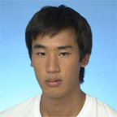

Photographs
  First Year

Slide 40
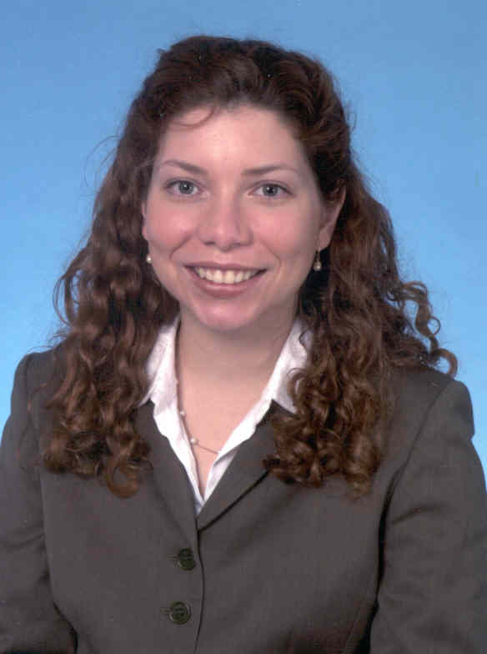
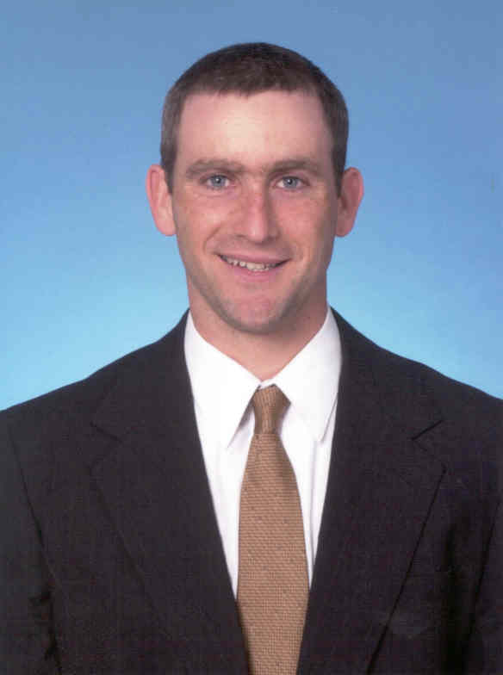
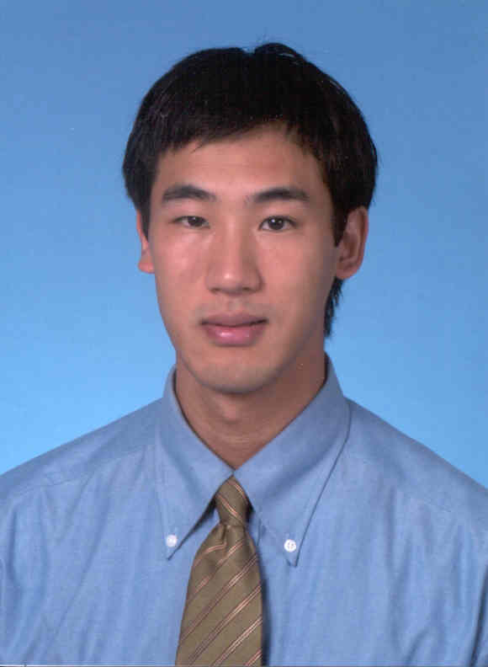
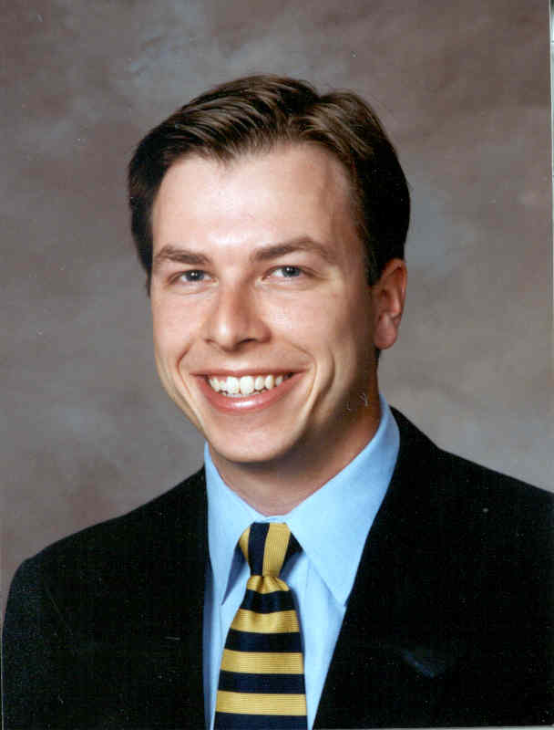
Photographs
  Before
  After

Slide 41

The National Resident Matching Program (NRMP)
All students enroll regardless of specialty!
Estimated Fee of: $75
Matches applicants with programs based on preferences
Not an application service
Uniform dates nationally
Eliminates pressure to make a decision before all of your options are known

Slide 42
UNC SOM Match Statistics Overview
AGENDA
 | 2011 | 2012 | 2013 | 2014 | 2015 | 2016
UNC Match rate | 96% | 98% | 93% | 97% | 97% | 97%
National Match rate (US Seniors) | 94.1% | 95.1% | 93.7% | 94.4% | 93.9% | 93.8%
Number of unmatched students | 6 | 3 | 9* | 7** | 6 | 6

Slide 43
Class of 2016 Placements (168)
AGENDA
UNC School of Medicine - Match 2016

Slide 44
Selection Criteria for Interviews: Results of a National Program Director’s Survey
AGENDA
1. Grades in required clerkships
2. USMLE step 1 score
3. Grades in senior electives in specialty
4. Number of honors grades in clerkships
5. USMLE Step 2 score
6. USMLE Step 2 CS pass
7. Class rank*
*UNC does not put student rank on Dean’s Letter

Slide 45
Selection Criteria for Residency: continued
8. Membership in Alpha Omega Alpha (AOA)
9. Medical school reputation
10. Medical school academic awards
11. Grades in other senior electives
12. Grades in pre-clinical courses
13. Published medical school research
14. Research experience while in medical school
*Importance of items differs by specialty

Slide 46
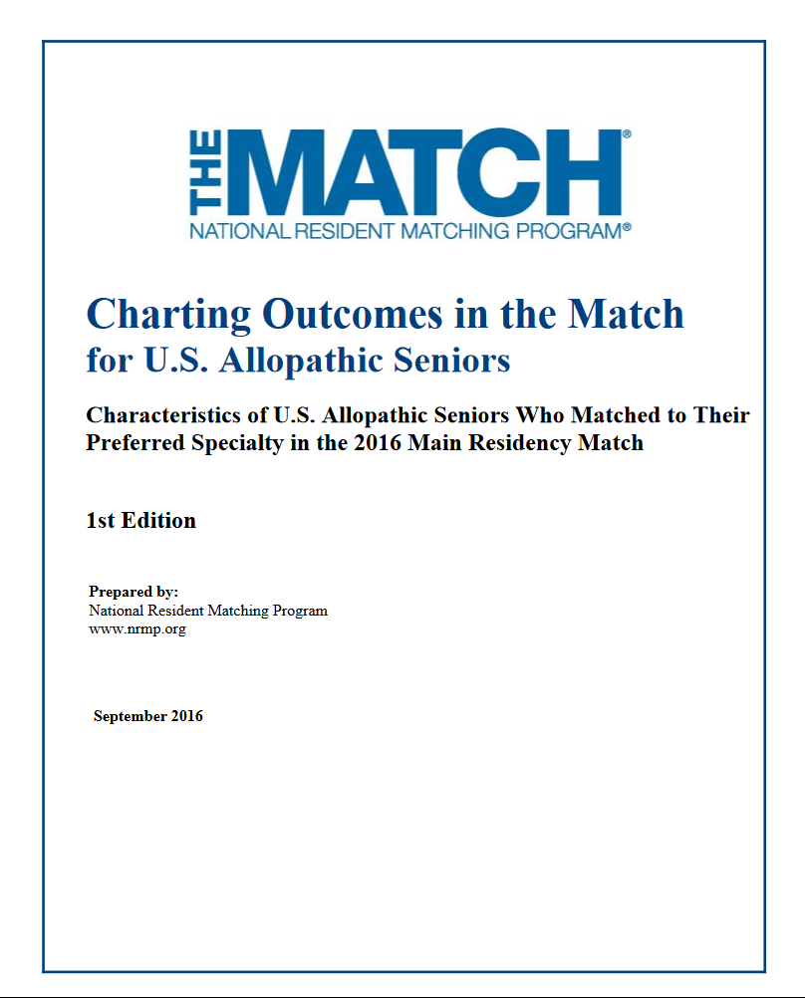
AGENDA
http://www.nrmp.org/wp-content/uploads/2016/09/Charting-Outcomes-US-Allopathic-Seniors-2016.pdf

Slide 47
Median Step 1 Scores for Matched Students in Selected Popular Specialties
AGENDA
Step 1M Step 1U
Family Medicine 221 208
Internal Medicine 233 210
Neurology 231 216
Pathology 233 210
PM & R 226 210
Psychiatry 224 214
Charting Outcomes of the Match, 2016
M=matched students
U=unmatched students

Slide 48
Median Step 1 Scores for Matched Students in Selected Popular Specialties
AGENDA
Step 1 M Step 1 U
Anesthesiology 232 209
Emergency Medicine 233 220
General Surgery 235 218
Med/Peds 236 227
Obstetrics/Gynecology 229 214
Pediatrics 230 207
Charting Outcomes of the Match, 2016

Slide 49
Median Step 1 Scores for Matched Students in Highly Competitive Specialties
AGENDA
Step 1M Step 1U
Dermatology 249 239
Neurosurgery 249 238
Orthopedic Surgery 247 238
Otolaryngology 248 240
Plastic Surgery 250 240
Radiation Oncology 247 238
Radiology 240 221
Charting Outcomes of the Match, 2016

Slide 50
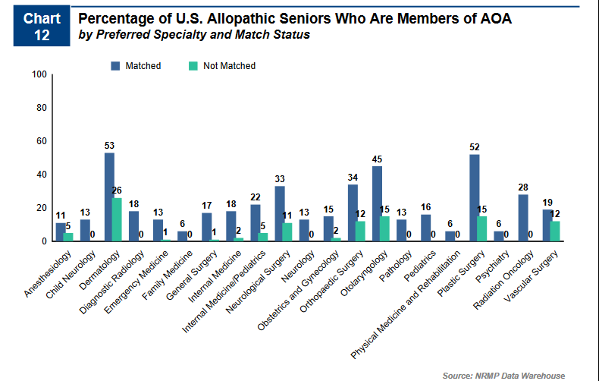

Slide 51
UNC SOM Mean Step Scores by Specialty (2013-2015)
(469 students)
AGENDA
Specialty | N | Step 1 Mean | Range |  | Step 2K Mean | Range
Anesthesiology | 29 | 234.72 | 198 | 259 | 250 | 214 | 276
Dermatology | 12 | 247.92 | 231 | 263 | 260 | 246 | 279
Emergency Medicine | 43 | 233.47 | 188 | 259 | 246 | 206 | 269
Family Medicine | 55 | 222.05 | 192 | 263 | 243 | 199 | 281
General Surgery | 24 | 232.5 | 211 | 261 | 247 | 226 | 270
Med Peds | 22 | 245.14 | 209 | 266 | 261 | 229 | 283
Medicine | 93 | 234.58 | 190 | 276 | 249 | 207 | 281
Neurology | 8 | 239.88 | 225 | 248 | 240 | 219 | 262
ObGyn | 46 | 228.57 | 200 | 256 | 246 | 200 | 270
Opthalmology | 10 | 236.7 | 218 | 259 | 246 | 230 | 271
Orthopaedics | 11 | 239.45 | 231 | 256 | 253 | 237 | 266
Otolaryngology | 11 | 243.55 | 222 | 268 | 251 | 223 | 275
Pathology | 6 | 237.83 | 197 | 251 | 245 | 198 | 266
Pediatrics | 47 | 225.57 | 190 | 258 | 248 | 203 | 272
Paychiatry | 16 | 217.44 | 190 | 239 | 234 | 205 | 262
Radiology Diag | 11 | 245.27 | 228 | 258 | 254 | 234 | 271
Radiology Onc | 9 | 241.44 | 210 | 260 | 249 | 234 | 266
Surgery Prelim | 12 | 223.2 | 191 | 254 | 236 | 213 | 264

Slide 52
Can your credentials be enhanced?
Step 2
Research
Audition electives
Joint degree
If your credentials cannot be enhanced, you may need
a back up plan if you are applying to a highly
competitive specialty.

Slide 53
What is the Supplemental
Offer and Acceptance Program (SOAP, formerly known as the Scramble)?

Slide 54

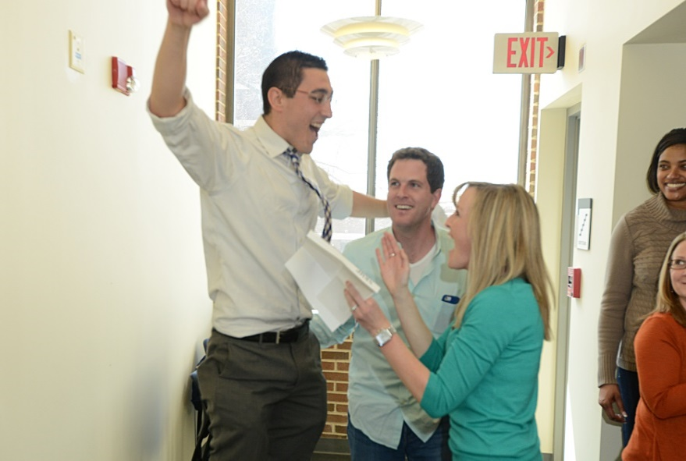
The National Resident Matching Program (NRMP)
ERAS Opens
Spring 2017
ERAS Application Submission
September 15, 2017
NRMP Registration November 30, 2017
(price increases on 12/1)
Rank Order List opens January 2018
Rank Order List closes February 2018
SOAP & Match March 2018

Slide 55
Central Application Service (CAS) Specialties & the San Francisco Match
Specialties:
  Ophthalmology
www.sfmatch.org
Dates:
Rank order lists due and results usually released in January
https://www.sfmatch.org/MatchCalendar.aspx

Slide 56
Review of Residency Application Process
Spring - Update CV, meet with College Advisor/Career Goal Advisor, review MSPE with staff writer, take Step 2 CK and Step 2 CS
Spring/Summer - Write personal statement, request LoRs, work on ERAS application, have photo taken, attend or watch summer ERAS workshop
Summer/ Fall – Research programs, submit ERAS application, attend interview preparation sessions, sign up with NRMP
Fall/Winter - Interview
Winter – Submit rank order list

Slide 57


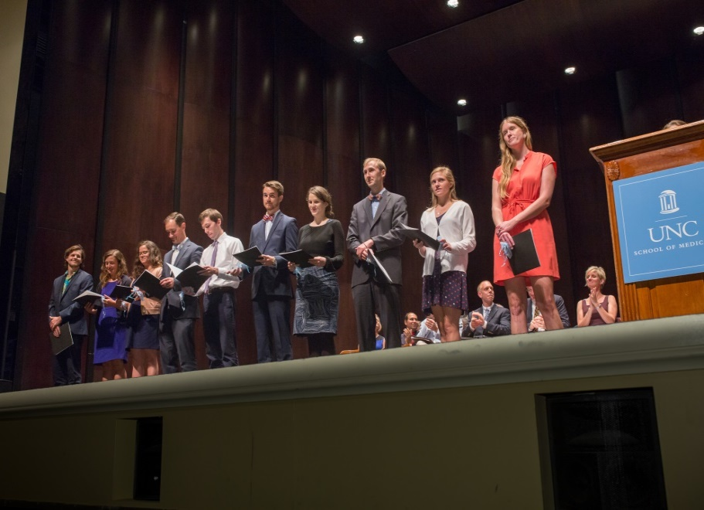
UNC SOM Gold Humanism Society
Humanism Survey Link
https://unc.az1.qualtrics.com/SE/?SID=SV_6sZtxoOLcBkYBMh

Slide 58
On-line Resources
Careers in Medicine: https://www.aamc.org/cim/
Personal Career Assessment
  Medical Specialties ApitudeTest
    http://www.med-ed.virginia.edu/specialties/
  Temperament Sorter
    http://www.advisorteam.com/temperament_sorter/register.asp?partid=1
Match
  Charting outcomes of the match: http://www.nrmp.org/wp-content/uploads/2016/09/Charting-Outcomes-US-Allopathic-Seniors-2016.pdf
  ERAS: https://students-residents.aamc.org/attending-medical-school/how-apply-residency-positions/applying-residencies-eras/
  VSAS: https://www.aamc.org/students/medstudents/vsas/
  NRMP: http://www.nrmp.org/
  Selection Criteria for Residency: Results of a National Program Director’s Survey: http://www.nrmp.org/wp-content/uploads/2016/09/NRMP-2016-Program-Director-Survey.pdf
  FREIDA: https://www.ama-assn.org/life-career/search-ama-residency-fellowship-database
  AAMC Roadmap to Residency: From Application to the Match and Beyond

Slide 59




Match Day!

Slide 60

QUESTIONS
AGENDA

Slide 61

Financial Aid and
Debt Management
Sheila Graham McDonald

Slide 62
Financial Aid
Making Sense of Your Dollars

Slide 63
Spring 2017
  Clear all HOLDS for disbursement
  Pay all Past Due Balances
  https://connectcarolina.unc.edu/
  Loans Disbursing from Direct Loans on January 5, 2017 (does not mean refund available)
  Refunds Disbursed the week of Jan 12, 2017
  If you are not a financial aid recipient and you have not been registered you must pre-pay before you can be registered.

Slide 64
Summer Session I Fees (2017)
End of Third Year (March) however for financial aid purposes the term doesn’t end till June
  $325 Summer Session I fees billed with Spring Tuition/Fees
In-state Tuition | 12418.50
Fees | 972.58
Summer Session I fees | 325.00
Health Insurance | 1111.00
Total | 14,827.08
Total w/o Hlth ins. | 13,716.08
Out-of-State tuition:
25,858

Slide 65
Applying for Financial Aid
2017-18
Must complete FAFSA (opened 10/1/16)
Must complete any additional items and return to 1001 Bondurant Hall
Visit ConnectCarolina at www.connectcarolina.edu to check the status of financial aid and view your bill

Slide 66
Start of Fourth Year
  Individualization phase starts March 2017
  Financial aid awarded July 2017
  Summer Session II fees (awarded 2017-18 aid) billed with Fall 2017 tuition/fees
  Financial Aid will be disbursed in July
  Tuition billing is two tier
    Full tuition if enrolled for 14 or more hours
    Reduced tuition if enrolled for 13 or less hours
  Be mindful of when away rotations are added

Slide 67
USMLE
USMLE Step II Clinical Knowledge ($590) is included in Application Phase cost of education and review expenses ($1088)
USMLE Step II Clinical Skills ($1250) is included in Individualization Phase cost of education and travel cost ($1328)

Slide 68
Returning from a
Leave Of Absence (LOA)
Complete FAFSA by March 1st
If enrolling in SPH or Med School in June (SSI) –complete a summer aid application
If enrolling in SPH in July - start of the fourth year - notify Financial Aid Office to make sure billing is correct.

Slide 69
Going on a
Leave of Absence (LOA)
School of Public Health (SPH) Leave
Complete FAFSA by 3/1
Set up a LOA meeting with Receptionist in Student Affairs
Financial Aid will be completed by med school financial aid office
If enrolling in SPH in Summer Session II term – complete a summer aid application
Fall enrollment for SPH begins mid-August. This is also when financial aid will be disbursed.
Financial Aid for SPH is less than med school because you’ll only be enrolled in a nine month term and the tuition/fees are not as much as they are at med school.

Slide 70
Going on a
Leave of Absence (LOA)
Research for credit or no credit
No CREDIT
No credit may exhaust six month grace period
Not eligible for financial aid
Not an enrolled student; therefore not eligible for amenities on campus; ie…gym, campus health
For CREDIT
Enroll for at least 6 hours; pay the reduced tuition rate
Considered a full-time student
Eligible for financial aid and other amenities on campus

Slide 71
Medical Expenses Not included in the Cost of Education (COE)
Transportation and living expenses for electives done away
Photographs for residency applications
Electronic Residency Application Service (ERAS) fee
Travel Expenses for residency interviews
Match Agreement Contract (NRMP) fee
Graduation Expenses

Slide 72
How to Pay for Expenses not included in the COE
Residency and Relocation Loan
-credit based application
Used for residency interview travel and expenses incurred for a relocation to a residency program.
  FIRST for Medical Education-AAMC Fact Sheet –
  Residency & Relocation Loans – To Borrow or Not to Borrow
  https://www.aamc.org/services/first/
  Sallie Mae…..
  https://www.salliemae.com/student-loans/medical-residency-loan/
  Discover…..
  https://www.discover.com/student-loans/residency-loans.html

Slide 73
Debt Management Responsibilities
Communication is your responsibility
  Contact your lender when you graduate or leave school
  Contact your lender when you begin or complete an authorized deferral period
  Contact your lender when you change your name or address
  Contact your lender if you find yourself in any situation which prevents you from fully meeting your repayment obligations according to your repayment schedule

Slide 74
Debt Management Responsibilities
Information
  The loan application includes a student copy for your records.
  A promissory note, your legal promise to repay the loan and abide by its terms.
  The amount and terms of each loan are spelled out in the disclosure statement, which you will receive shortly before receiving your funds.
  Shortly before you begin repayment, your lender will send you a repayment schedule, explaining the number and amount of monthly payments required to fulfill your obligation.

Slide 75
Debt Management Responsibilities
Key Concepts you will need to understand
  Rights and responsibilities
  Interest
  Grace Period
  Deferment
    Internship Residency
    Economic Hardship will be harder to qualify for after July 1, 2009; May have to apply for income based repayment program.
    Graduate Fellowship
  Forbearance
  Capitalization
  Repayment Options http://www.aamc.org/programs/first/facts/loanrepay.pdf
    Standard
    Graduated
    Income Based
    Extended
    Income-Based (IBR)
  Know how much you’ve borrowed
    National Student Loan Database NSLDS
      http://www.nslds.ed.gov/nslds_SA/

Slide 76
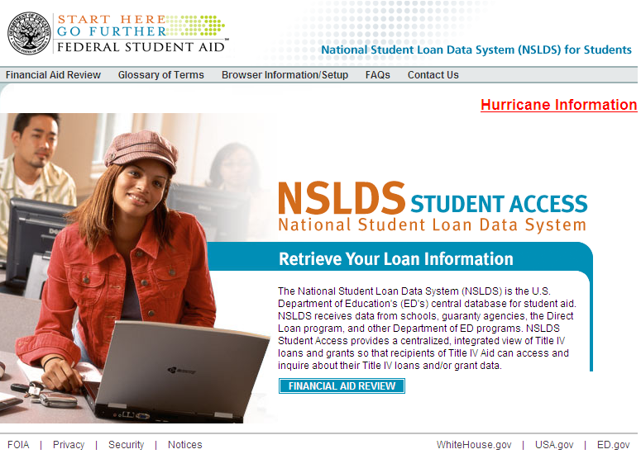
Finding Federal
Student Loans
www.nslds.ed.gov
  To access provide your:
  Social Security #
  Date of Birth
  First 2 letters (last name)
  PIN # (www.pin.ed.gov)
  Private loans are listed on your credit report: www.annualcreditreport.com
Notes:
To identify your lender(s) of federal loans, from undergrad and medical school, you can access NSLDS, a central database for federal loans, at this website: www.nslds.ed.gov.
This site is a repository of information about all of your federal loans, but only your federal loans, and will list the original lender and the outstanding principal balance (OPB) of the loan.
In order to review your personal information, you will need to provide the following: your social security number, your date of birth, the first two letters of your last name and the pin number that you use each year to complete your online FAFSA. If you do not know your pin #, you can request it by going to www.pin.ed.gov.

Slide 77
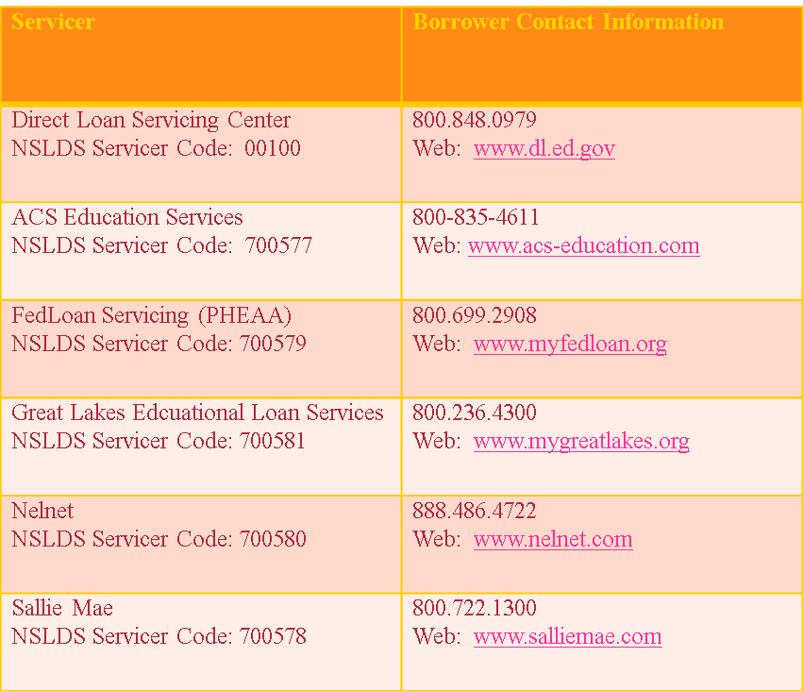
Loan Servicers just a few

Slide 78
Mandatory Loan Exit Interview
  Mandatory federal requirement before leaving school
  Online exit interview –FAO will meet with you one-on-one after completion of online exit interview

Slide 79
FIRST Fact Sheet from AAMC
Income-Based Repayment –
Loan Forgiveness for Public Service
https://www.aamc.org/services/first/

Slide 80
What’s happening in Spring 2017
Financial Literacy Sessions:
Dealing with Finances in Residency
Navigating the Different Types of Insurance
Public Service Loan Forgiveness
Home Buying Tips
Dealing with Taxes as a Doctor
Rules of the Road – Fundamentals of investing
Financial Planning
Details to follow…

Slide 81
Financial Aid Office contact information:
1001 Bondurant Hall
(919) 962-6118
somfinaid@listserv.med.unc.edu

Slide 82

MS4 Student Panel

