Slide 1
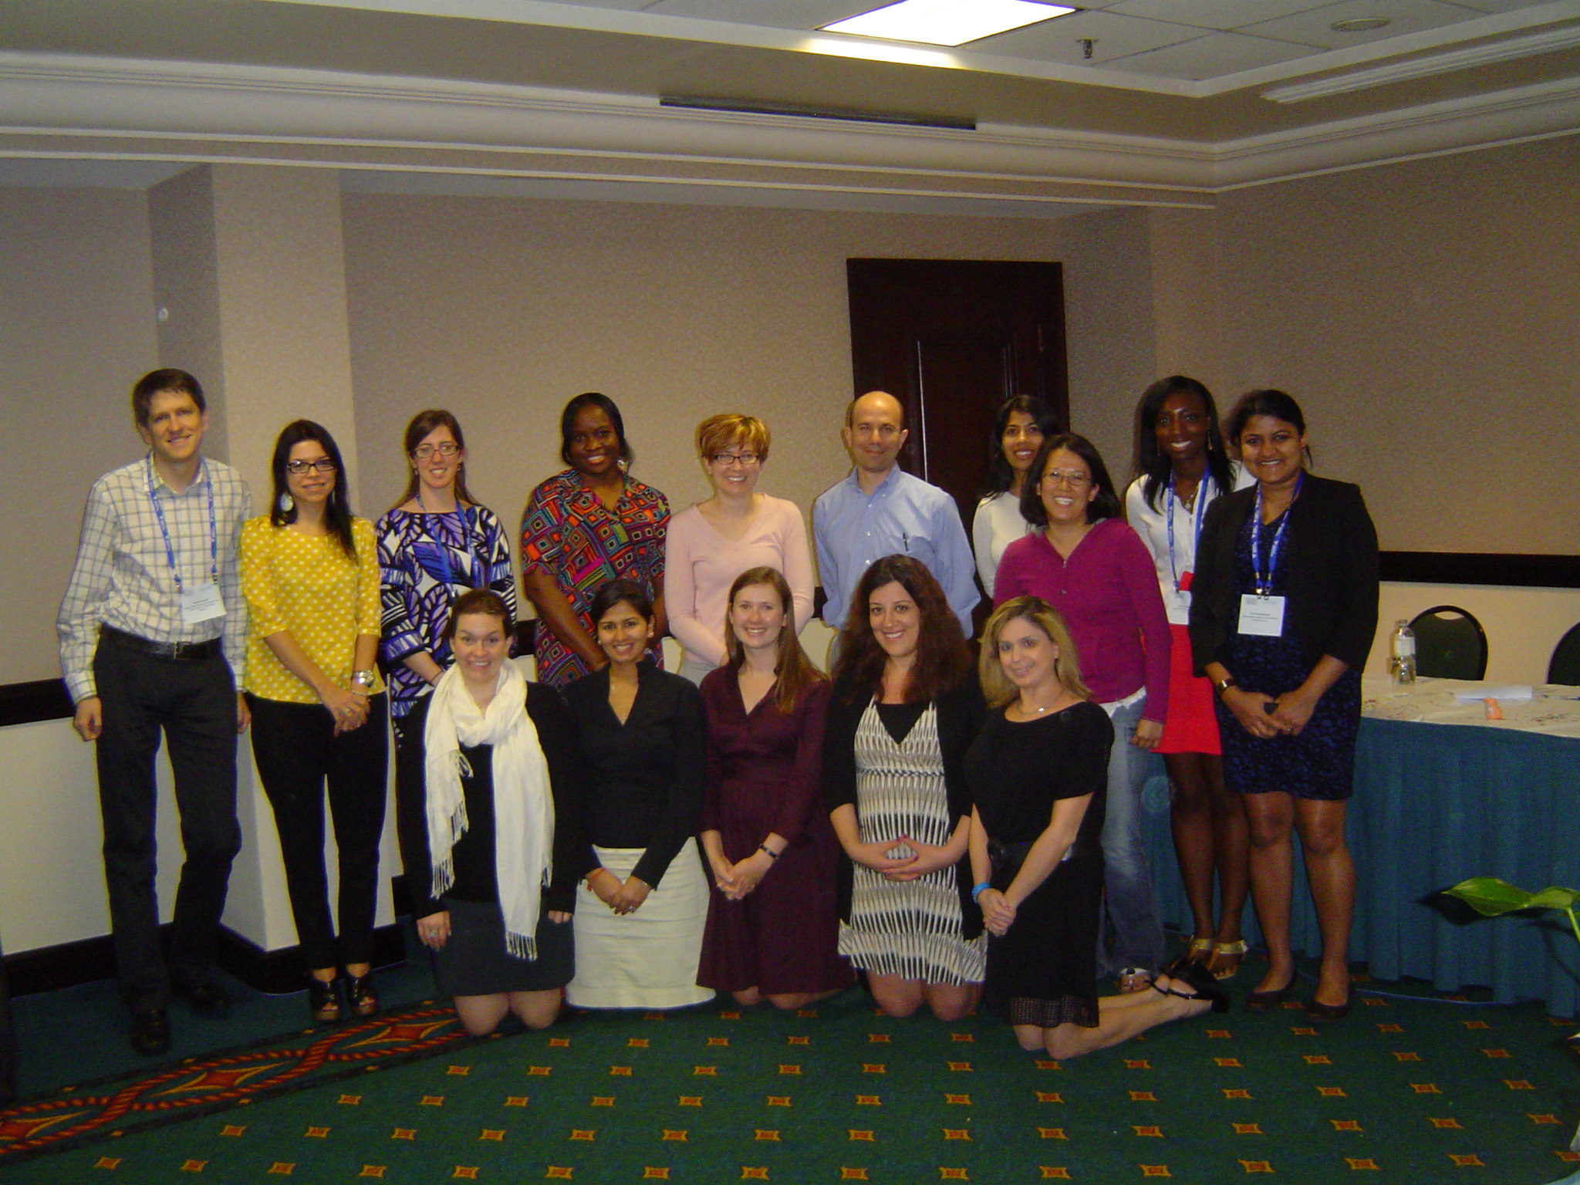
The 2013 Pediatric Nephrology Fellows Conference
San Juan de Puerto Rico
January 22nd 2012

