Slide 1


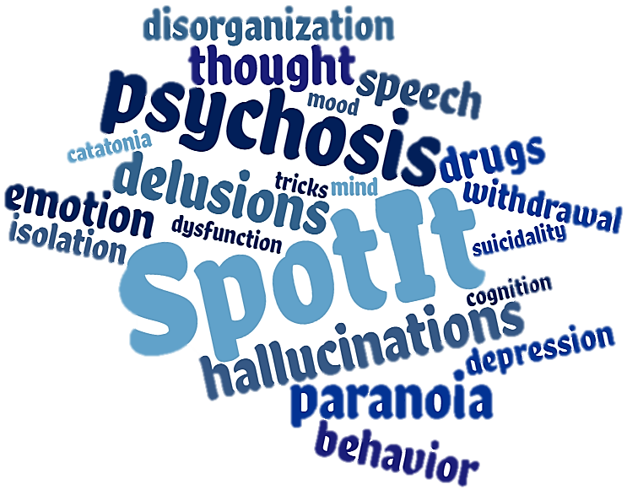


Psychosis: Can You Spot It?
Diana O. Perkins, MD MPH
Professor, Department of Psychiatry, University of North Carolina at Chapel Hill
Director, Early Psychosis Interventions in North Carolina (EPI-NC ) Advisors
Notes:
Welcome. I am Chad Jones, your host for today’s webinar. The webinar series “Psychosis, Can You Spot It?” was developed by Dr. Diana Perkins and her team. Dr. Perkins is the Director of EPI-NC, a program supporting the development of early psychosis treatment programs in North Carolina. This webinar series is supported by EPI-NC, funded by a federal Community Mental Health Services Block Grant as a project of the NC Division of Mental Health, Developmental Disabilities & Substance Abuse Services. Dr. Perkins is a Professor in the Department of Psychiatry at the University of North Carolina at Chapel Hill and is the Director and one of the psychiatrists of the UNC OASIS program, a coordinated specialty care program for persons in the early stages of a psychotic disorder. Her research focuses on discovering what causes schizophrenia, in the hope of developing better treatments and eventually a cure.

Slide 2
Psychosis: Can You Spot It?
An educational series:
Signs and symptoms of first episode psychosis
Barriers to recognition
Notes:
Thanks Chad.
I want to welcome you to Psychosis: Can you spot it?, an educational series that addresses the common signs and symptoms of first episode psychosis, as well as the barriers to recognition by health care providers.

Slide 3
Disclosures
In the past two years Dr. Perkins received
funding from Boehringer-Ingleheim to conduct a clinical trial at UNC,
consulting fees from Alkermes,
royalties from APA publishing.
Notes:
Before we begin, I have the following to disclose. In the past two years I received funding from Boehringer-Ingelheim to conduct a clinical trial at UNC, consulting fees from Alkermes and royalties from APA publishing.

Slide 4
Psychosis: Can You Spot It?
Module 1 – Psychosis: Can You Spot It?
Module 2 – Differentiating Between Types of Symptoms
Module 3 – Oversight and Misdiagnosis of Psychosis
Module 4 – Confounds and Overlaps in Clinical Features
A look at the national prevalence of psychotic disorders, common signs and symptoms, and barriers to diagnosis and treatment.
Distinguishing key features of fully psychotic, attenuated psychotic, and non-psychotic symptoms and the differences therein.
How cognitive heuristics influence clinical decision-making and strategies for decreasing biases and improving the likelihood of a correct diagnosis.
Identifying the range of disorders that feature psychosis as a symptom and factors like trauma and substance use that increase clinical risk.
Notes:
There are four one-hour modules in this series. Module 1 examines the prevalence of psychosis in comparison to other mental disorders, describes psychosis syndromes and discusses barriers to recognition. Module 2 is an in-depth look at the spectrum of psychosis, ranging from full psychosis to “prodromal-severity” to “unusual” experiences. Module 3 explores why clinicians make diagnostic errors, in general and in relation to psychosis. Module 4 explores the variety of disorders that include psychosis as a feature.
This is Module 1….
This is Module 1….

Slide 5

Module 1: An Introduction to Psychosis
Diana O. Perkins, MD MPH
Professor, Department of Psychiatry
Director, UNC Outreach and Support Intervention Services (UNC OASIS)
Director, Early Psychosis Interventions in North Carolina Resources (EPI-NC Resources)
Notes:
…an “Introduction to Psychosis”.
To start, I’d like to tell you about our motivation for this series. I am an academic psychiatrist with a clinical and a research focus on the earliest stages of psychotic disorders. At the beginning of my career, I assumed schizophrenia was inevitably disabling,

Slide 6
…a different story
Notes:
but two decades of research and my clinical experiences tell a different story:

Slide 7
…most persons recover from an initial psychotic episode
Notes:
most persons recover from a first episode of psychosis. The earlier psychosis is recognized and treated the better the outcomes

Slide 8
…misperceptions lead to misdiagnosis
Notes:
Misperceptions about psychotic disorders can result in misdiagnosis, contributing to longer durations of untreated psychosis, chronic symptoms and functional disability.

Slide 9
Learning Objectives
At the end of this module the clinician will better understand:
The risk of a psychotic disorder across a person’s life
The signs and symptoms of emerging psychosis
Factors contributing to delays in diagnosis of a psychotic disorder
The negative impact of treatment delays on important clinical outcomes
Notes:
The purpose of Module 1 is to help you better recognize psychosis in the early stages.
In this module we will cover psychosis risk at different ages,
the signs and symptoms of emerging psychosis,
factors that contribute to delays in diagnosis of a psychotic disorder,
and the negative impact of treatment delays.

Slide 10
Jessica tells us about what she’s doing these days.
Notes:
Next I would like to introduce Jessica who, like many remarkable people I have met, show through their lived experiences that recovery from a psychotic disorder is possible. We have anonymized her image and name, but the stories she tells are real.

Slide 11
Risk of Psychosis Across the Lifespan
Notes:
Jessica tells us she was recently diagnosed with schizophrenia. We know that about 1 in every 50 persons develops a psychotic disorder, like schizophrenia, schizoaffective disorder, or a mood disorder with psychotic features. How likely is it that clinicians will encounter a person with first episode psychosis in their clinical practice?

Slide 12
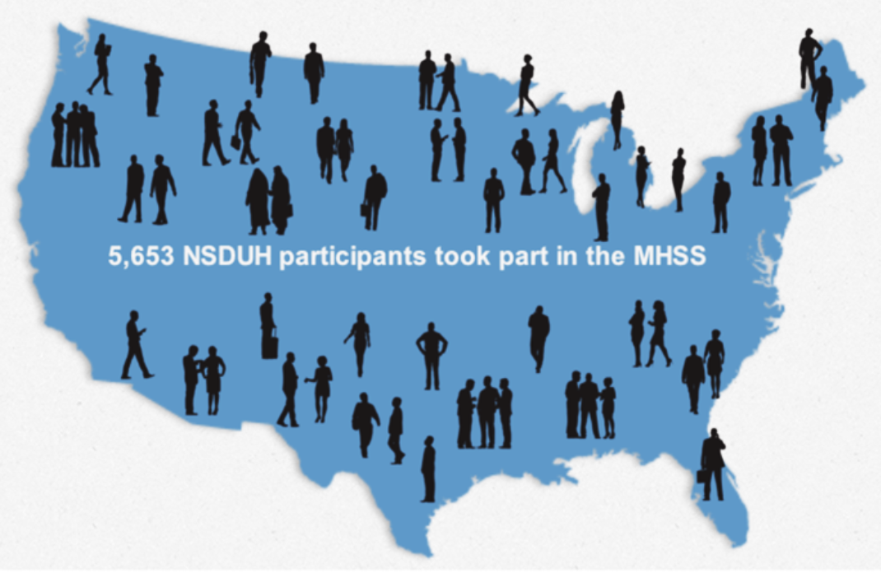
How common is mental illness?
Mental Health Surveillance Study (MHSS)
Center for Behavioral Health Statistics and Quality, (2015). Behavioral health trends in the United States: Results from the 2014 National Survey on Drug Use and Health (HHS Publication No. SMA 15-4927, NSDUH Series H-50). Retrieved from http://www.samhsa.gov/data
Notes:
To determine the prevalence of various mental disorder diagnoses, including psychotic disorders, the US conducted the Mental Health Surveillance study, interviewing 5653 randomly selected participants of the National Survey on Drug Use and Mental Health.

Slide 13
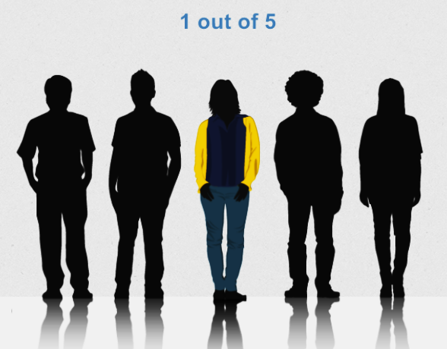
How common is mental illness?
Mental Health Surveillance Study (MHSS)
Mental Illness Prevalence, Ages 18-30
Center for Behavioral Health Statistics and Quality, (2015). Behavioral health trends in the United States: Results from the 2014 National Survey on Drug Use and Health (HHS Publication No. SMA 15-4927, NSDUH Series H-50). Retrieved from http://www.samhsa.gov/data
Notes:
The Mental Health Surveillance study found that about 1 in every 5 persons between the ages of 18 & 30 experienced a diagnosable mental illness in the past year.

Slide 14

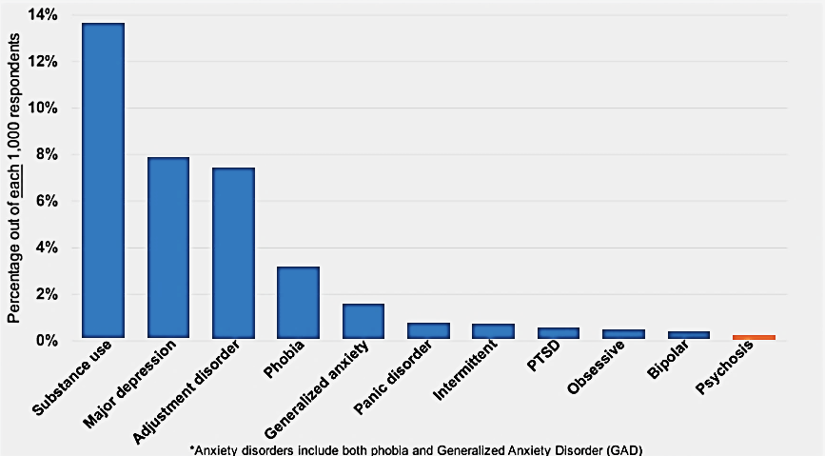
How common is mental illness?
Mental Health Surveillance Study (MHSS)
Mental Illness Prevalence, Ages 18-30
Center for Behavioral Health Statistics and Quality, (2015). Behavioral health trends in the United States: Results from the 2014 National Survey on Drug Use and Health (HHS Publication No. SMA 15-4927, NSDUH Series H-50). Retrieved from http://www.samhsa.gov/data
Notes:
The most commonly reported disorders involved substance use, major depression and adjustment disorders. Psychotic disorders were rarely reported, only by 1 in every 500 adolescent and young adults.

Slide 15
Kirkbride et al. PLoS One2012;7(3):e31660. doi: 10.1371/journal.pone.0031660. Epub 2012 Mar 22
Notes:
This graph is from a meta-analysis, and shows the incidence of psychotic disorders per 100,000 persons per year for different age groups. The highest incidence of psychosis was between the ages of 20 to 24, (click) at 20 persons per 100,000. The risk of a psychotic disorder gradually declined with age. Pooling all age groups, the annual incidence was 32 per 100,000 persons for any psychotic disorder, with about two-thirds developing schizophrenia and related non-affective psychotic disorders, and one third developing psychosis as part of a mood disorder.

Slide 16
Kirkbride et al. PLoS One2012;7(3):e31660. doi: 10.1371/journal.pone.0031660. Epub 2012 Mar 22
Notes:
Males had a higher risk of psychosis than females in late adolescence and early adulthood. By middle age the incidence of psychosis is similar for males and females, but older females have a slightly higher risk of psychosis than males.

Slide 17
Kirkbride et al. PLoS One 2012;7(3):e31660. doi: 10.1371/journal.pone.0031660. Epub 2012 Mar 22
Notes:
Most psychotic illnesses are persistent, so the number of people in the population who have a psychotic disorder accumulates with age. Extrapolating from the psychosis incidence meta-analyses gives us an idea and the risk of developing a psychotic disorder was greater for males than females. By age 65 about 2% of males compared to 1.5% of females would be expected to be diagnosed with a psychotic disorder.
Extrapolating the AESOPs study results, we expect that by age 20, about 30 out of every 10,000 persons have a psychotic disorder. The number with psychosis per 10,000 persons increases to 60 by age 25 and to 100 by age 35. By age 65, about 180 out of 10,000, or 1.8 percent, of people have a psychotic disorder.

Slide 18
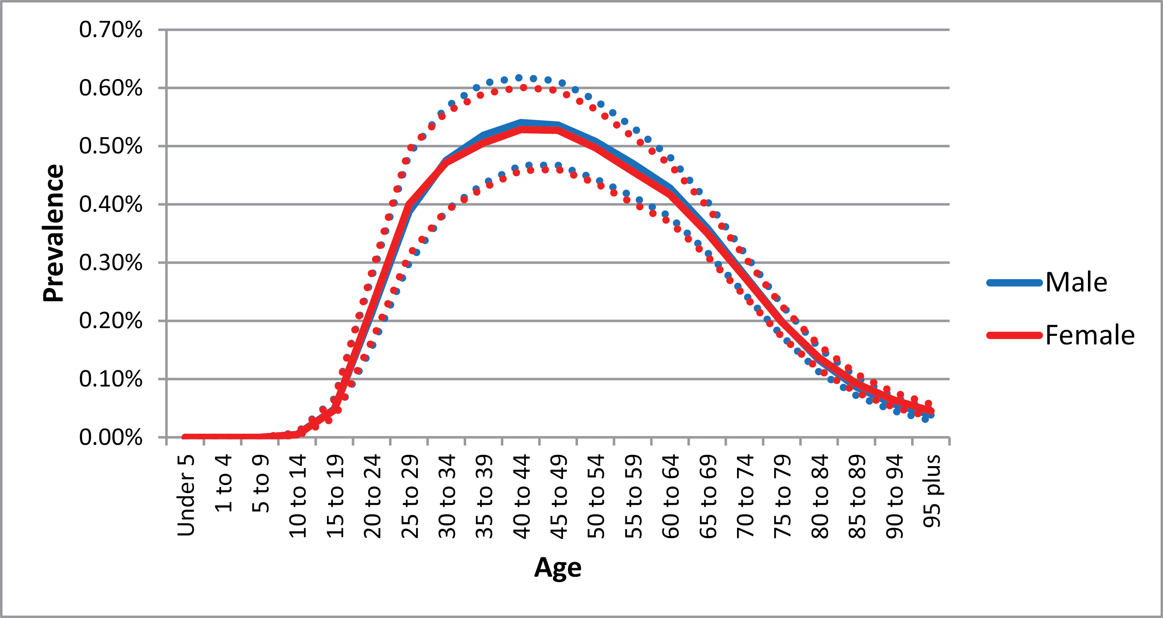

Fig. 2. Global mean prevalence rates (with 95% uncertainty interval) by age and sex, 2016.
Notes:
Global mean prevalence rates (with 95% uncertainty interval) by age and sex, 2016.

Slide 19
About what percent of your
clients have a psychotic disorder?
0%
1-5%
6-10%
11-20%
20-50%
>50%)
Notes:
How does the results of these studies fit with your clinical world? About what percent of your clients have a psychotic disorder?
Let’s see how this compares to the prevalence of psychotic disorders across the US….

Slide 20
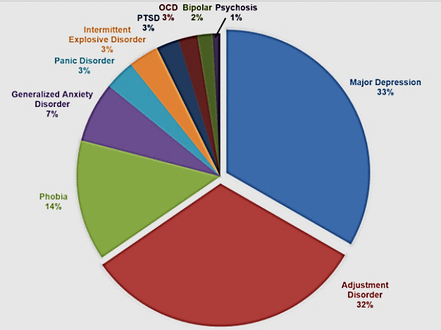
How common is psychosis?
Mental Health Surveillance Study (MHSS): Prevalence of Psychosis & Other Mental Disorders, Ages 18-30
Center for Behavioral Health Statistics and Quality, (2015). Behavioral health trends in the United States: Results from the 2014 National Survey on Drug Use and Health (HHS Publication No. SMA 15-4927, NSDUH Series H-50). Retrieved from http://www.samhsa.gov/data
Notes:
The results of the Mental Health Surveillance Study found that most community mental health care providers rarely treat clients with psychotic disorders, while major depression and adjustment disorders are common. Persons with chronic schizophrenia and related psychotic disorders are typically treated in speciality programs rather than by general practicioners. However, most persons experiencing a first psychotic episode initially turn to a community provider for help. Because the annual incidence of psychosis is low, it is easy for mental health clinicians to miss the diagnosis, since it is not on the clinician’s radar. Knowing the red flags that suggest psychosis can help clinicians to SPOT IT.

Slide 21
The Signs and Symptoms of Emerging Psychosis
Notes:
Next we review the signs and symptoms of emerge psychosis.

Slide 22
Psychosis includes:
Delusions
Hallucinations
Disorganized Speech & Behavior
Notes:
Most of you are probably aware that “psychosis” includes delusions, hallucinations, and disorganized speech and behaviors.

Slide 23





Delusions
I stole a car and drove across the country, thinking I was on a mission from god.
I know that people on TV are talking directly to me.
Somebody is poisoning my food.
Notes:
Delusions involve misinterpretation and misattribution of events. An individual may have delusions of reference, for example (click). Other common delusions involve paranoid thoughts, for example (click) or are religious in nature, for example (click).

Slide 24


Hallucinations
I saw the demon in front of me and then it disappeared
I had a funny smell, like something bad, no matter how many times I took a shower.
I heard voices coming from the walls that were telling me to stay in my room
Notes:
Hallucinations are misperceptions, and can involve any sense. Auditory hallucinations can be command in nature, or may be described as a running commentary, for example (click). Visual hallucinations involve seeing something that isn’t really there. Other less common hallucinations include olfactory, tactile and gustatory hallucinations. Here are a few examples.

Slide 25




Disorganized
Speech & Behavior
The store manager asked me to leave because he said I was acting strange.
My friends tell me that can’t follow what I am saying anymore.
My mind goes blank mid-sentence.
Notes:
Psychosis symptoms also include disorganization of speech and behavior. The individual may struggle in conversations , for example (click), experience thought blocking (click), or act in a way that appears strange to others, for example (click).

Slide 26
Defining Prodromal Level Psychosis
Phases of Psychosis
Premorbid
Stage
Prodromal
Stage
Active
Stage
Symptoms
Begin
Disease Onset
Ninety percent of the time, psychosis is heralded by a prodromal phase.
Notes:
Ninety percent of the time psychosis is heralded by what is called a prodromal phase, or a high-risk stage. This includes attenuated changes in thought content and perception, where the person retains insight that the experiences are “not real”.

Slide 27


Attenuated Psychotic Symptoms
I know my thoughts are going off track, and my friends tell me they can’t follow what I’m saying anymore.
I see a shadow beside me, but when I I turn, no one is there.
I get confused about whether something really happened or was my imagination.
Notes:
During the prodromal stage persons experience altered thought content, altered thought process, and perceptual abnormalities. Attenuated psychotic symptoms resemble delusions (click), disorganization (click), and hallucinations (click) in that the symptoms are compelling, captivating, and impact function. They are distinguished from full-psychosis by the retention of insight that the experiences are “not real”. With attenuated psychosis persons retain insight that the experiences are a product of their mind, that their “mind is playing tricks” on them.

Slide 28
Attenuated Psychotic Symptoms
I kept skipping class because I was so uncomfortable, and my grades dropped.
I felt uncomfortable about going to classes.
I kept thinking that everyone in class was talking about me, although I knew this wasn’t happening.
This happens several times a week whenever I am in class.
Notes:
A person is at elevated risk for psychosis if the attenuated psychotic symptoms are compelling or captivating, impact function, and occur frequently. Attenuated psychotic symptoms are similar to fully psychotic symptoms in that the experience is unusual or illogical, however the person maintains doubt about veracity, for example (click). Both full and attenuated psychosis are compelling or captivating, for example (click), bothersome or interfere with function, for example (click), and occur frequently (click).

Slide 29

Non-Psychotic Symptoms
I thought I heard my phone ring when I was in the shower, but I was wrong.
He’s not answering my email because he doesn’t like me.
I could have sworn you told me the meeting was today.
Notes:
Most people experience their “mind playing tricks” on them once in a while. These experiences are infrequent and usually easy to dismiss, for example…

Slide 30
Defining the Continuum
Notes:
So there is a continuum from occasional mind-tricks to full psychosis. However, there are specific features that determine where a person’s symptoms are along this continuum.

Slide 31
Defining the Continuum
Full vs. Attenuated Psychosis
Quality: Unusual or illogical, not culturally held, and compelling
“It seems I control the weather, I wish for rain or shine and that’s what happens.”
Frequency: several times a month to every day
“It happens whenever I weather-wish, a couple of times a week.”
Notes:
To summarize, both fully psychotic and attenuated psychotic symptoms share the quality of being unusual or illogical, not culturally held, and compelling. For example, “It seems I control the weather, I wish for rain or shine and that’s what happens.” Full and attenuated psychosis also both occur frequently, ranging from several times a month to every day. For example, “It happens whenever I weather-wish, a couple of times a week.”

Slide 32
Defining the Continuum
Conviction
Full Psychosis: No doubt that experiences are real
“I decide the weather – no doubt about it.”
Attenuated Psychosis: While compelling, doubt is maintained
“It seems like more than a coincidence, but how could that be possible? I know I can’t be controlling the weather”
Notes:
The difference between full- and attenuated psychosis is in the person’s conviction about the reality of the events or experiences. With full psychosis the person has no doubt that the experiences are real, for example “I decide the weather, no doubt about it.” With attenuated psychosis, even though the experiences are compelling or captivating, the persons retains a sense that the experiences are product of their own mind, for example “It seems like more than a coincidence, but how could that be possible? I know I can’t be controlling the weather.” The person still has a grip on reality.

Slide 33
Would you diagnose this symptom as:
I have to eat in the cafeteria but I sit far away from everyone so that they can’t hear what I am thinking. I know this is happening but I don’t know why.”
Fully Psychotic
Attenuated-Psychotic
Non-Psychotic
Notes:
Given the definition of full versus attenuated psychosis, would you diagnosis this symptom as fully psychotic, attenuated psychotic, or non-psychotic?

Slide 34
Would you diagnose this symptom as:
I have to eat in the cafeteria but I sit far away from everyone so that they can’t hear what I am thinking. I know this is happening but I don’t know why.”
Fully Psychotic
Attenuated-Psychotic
Non-Psychotic
Notes:
This symptom is fully psychotic, because the experience is unusual, illogical, impacts function, and he is also convinced it is happening. He is sure they can hear his thoughts, even though he is perplexed about why it is happening.

Slide 35
Would you diagnose this symptom as:
“Every time I turn on the radio or open a magazine I see one of my family members’ names. I keep getting the sense they are in danger, like this is a message for me. I want to warn them, but I know they would think I was crazy because it can’t be true.”
Fully Psychotic
Attenuated-Psychotic
Non-Psychotic
Notes:
How about this symptom? (read)

Slide 36
Would you diagnose this symptom as:
“Every time I turn on the radio or open a magazine I see one of my family members’ names. I keep getting the sense they are in danger, like this is a message for me. I want to warn them, but I know they would think I was crazy because it can’t be true.”
Fully Psychotic
Attenuated-Psychotic
Non-Psychotic
Notes:
This is an attenuated psychotic symptom because while unusual, illogical, compelling and frequent, she retains insight that the experience isn’t real.

Slide 37
Case Study: Katie

Slide 38
“Katie”
Katie’s mother sought help for her daughter because her daughter related “dark thoughts” (e.g. fleeting suicidal thoughts and fears of being watched).
Katie is a 20-year old college junior who lives with friends off campus.
Diagnosed with ADHD at 7, for which she takes methylphenidate with good results.
Maintained a 3.4 GPA since a freshman; active in community theater
For the past two years, she has consistently volunteered weekly at the food bank with two of her close friends.

Slide 39
“Katie”
Over past three months Katie has had trouble concentrating, forgetting assignments, missing practices, and finding excuses not to go to the food bank.
She feels anxious much of the time, especially around other people.
In addition to fleeting suicidal thoughts, she reports low energy, reduced motivation, and that she “doesn’t care much anymore”, but denies depressed mood.
She has seen shadows moving in her dorm room most evenings, then turning and realizing there no one was there
Irrational thoughts (e.g. Most days feels like she is being watched, looks around room for cameras but knows this “is silly”)

Slide 40
Clinical Challenges
Relatively complex “differential diagnosis”
Does she have fully psychotic or attenuated psychotic symptoms?
Are drugs involved (amphetamine abuse, marijuana)?
Are low motivation, low energy, “not caring”
Symptoms of a depressive disorder?
Emerging negative symptoms?
Are anxiety and suicidal thoughts
Symptoms of a major depression?
Symptoms of an anxiety disorder?
Secondary to disturbing attenuated psychosis/psychosis?
What factors are contributing to her functional impairments?
What is Katie’s risk of progressing to full psychosis?

Slide 41
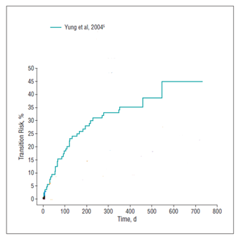
Risk of Transition to Psychosis in Persons Meeting Clinical High Risk Criteria
Fusar-Poli 2012, Perkins et al. 2016
Notes:
The research definition of a psychosis clinical high risk syndrome involves the presence of attenuated psychosis symptoms that impact function and occur at least several times a month. This graph shows the results of the very first study that depicted the risk of psychosis in persons meeting criteria for a psychosis high risk syndrome, with follow-up time on the x-axis, and psychosis risk on the y-axis. By one year about 35% developed full psychosis, and by 2 years almost half developed full psychosis.

Slide 42
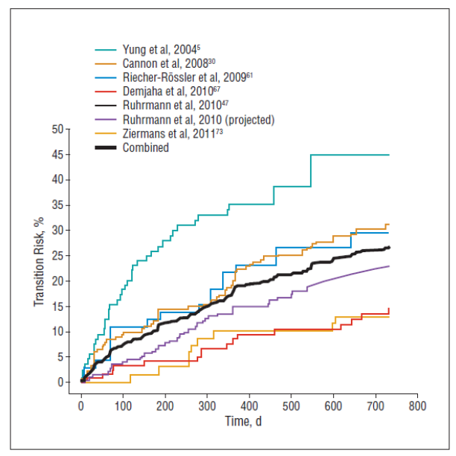
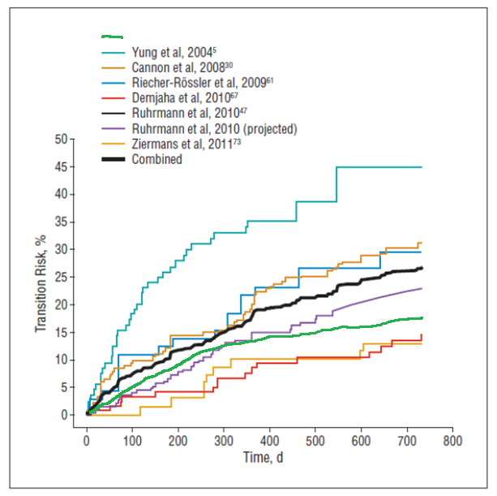
Risk of Transition to Psychosis in Persons Meeting Clinical High Risk Criteria
Perkins et al. 2016 (NAPLS2)
Yung et al. 2004
Cannon et al. 2008 (NAPLS1)
Riecher-Rossler et al. 2009
Demjaha et al. 2010
Ruhrmann et al. 2010
Ruhrmann et al. 2010 (est.)
Ziermans et al., 2011
Combined
Fusar-Poli 2012, Perkins et al. 2016
Notes:
As often happens in research, subsequent studies found the risk of psychosis in persons meeting research criteria for a clinical high risk syndrome to be much lower. The black line shows the average rate of conversion to psychosis. By one year the average risk of conversion to psychosis was about 15%, and by two years 20%. If we ignore the first study, that likely over-estimates psychosis risk, we can see that Katie has between a 10-25% risk of developing a full psychotic disorder within 2 years.

Slide 43
Addington J et al (2018). Psychological Medicine 1–8. https://doi.org/10.1017/S0033291718002258
Notes:
Outcomes for the 75-90% of person who don’t develop a psychotic disorder include continued or worsening attenuated psychosis in about 60%. Attenuated psychotic symptoms remit in about 40%. However, about half of persons with remission of attenuated psychosis continue to experience depression, anxiety, substance use, or others disorders that benefit from treatment.

Slide 44
Delays in Recognition and Treatment of Psychosis
Notes:
Even after a fully psychotic disorder has emerged there are often delays in recognition.

Slide 45
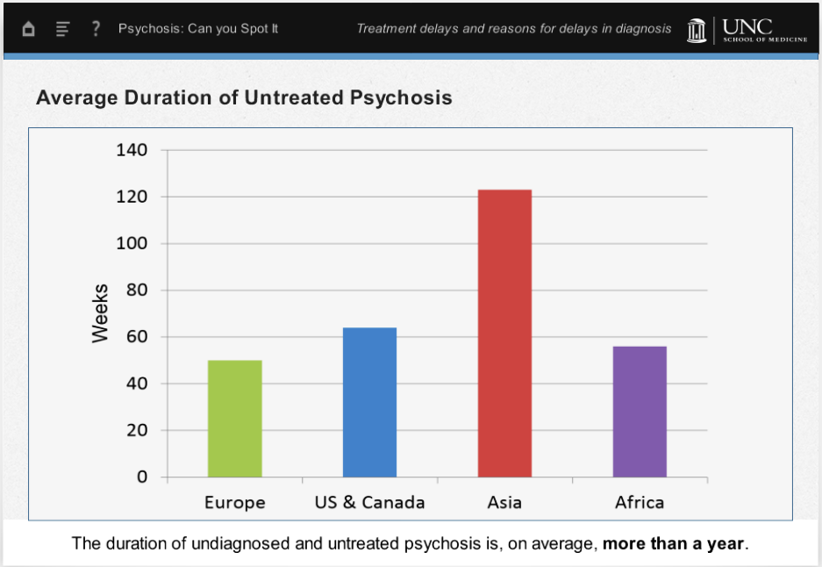
Average Duration of Untreated Psychosis
The duration of undiagnosed and untreated psychosis is, on average, more than a year.
Notes:
The duration of undiagnosed and untreated psychosis varies in different parts of the world In the US the average treatment delay is over a year.

Slide 46
Factors contributing to treatment delay
The person fails to disclose symptoms.
Notes:
Several factors contribute to delays in diagnosis and treatment of a psychotic disorder. The person with psychosis may keep the symptoms to themselves.

Slide 47

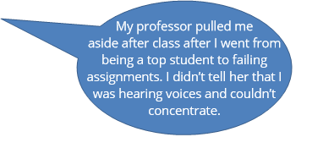
Keeping Symptoms Private
Notes:
The person may choose to keep the psychotic symptoms private, even when asked for an explanation of the behavioral consequences.
For example, “

Slide 48

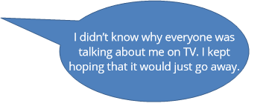
Keeping Symptoms Private
Notes:
By definition persons experiencing psychosis believe their experiences are real. The person may think of the problem as outside of anyone’s control, and so may not seek help.

Slide 49
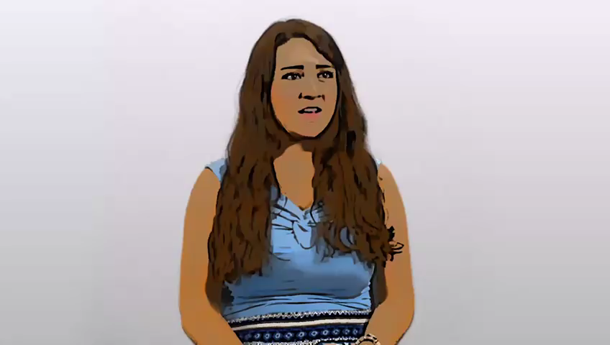
Jessica
Notes:
Here Jessica tells us about how her psychosis started.

Slide 50
Factors contributing to treatment delay
The person fails to disclose symptoms.
Friends, family, teachers, etc. misattribute symptoms.
Notes:
Family members, friends, and others may notice unusual behaviors or a change in function, but attribute the changes to something other than psychosis.

Slide 51

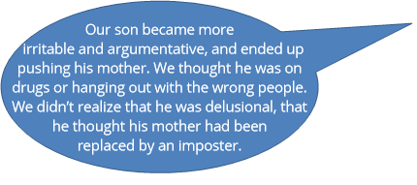
Misattribution
Notes:
Behaviors that are “out of character” for a family member may be attributed to drugs, or “bad influences”. For example…

Slide 52

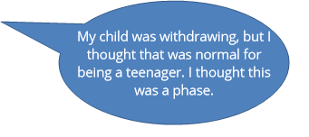
Misattribution
Notes:
Or the behavioral and functional problems may be attributed to a developmental phase…

Slide 53
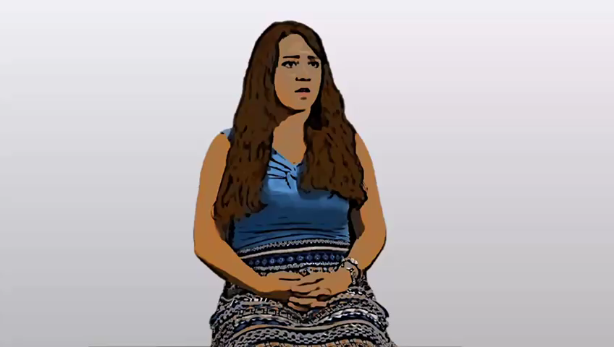
Jessica
Notes:
Here Jessica tells us about what other people noticed when she became ill…

Slide 54
Factors contributing to treatment delay
The person fails to disclose symptoms.
Friends, family, teachers, etc. misattribute symptoms.
Clinician’s preconceptions
Notes:
Clinicians may have preconceptions about schizophrenia that don’t match the reality of early psychosis.

Slide 55
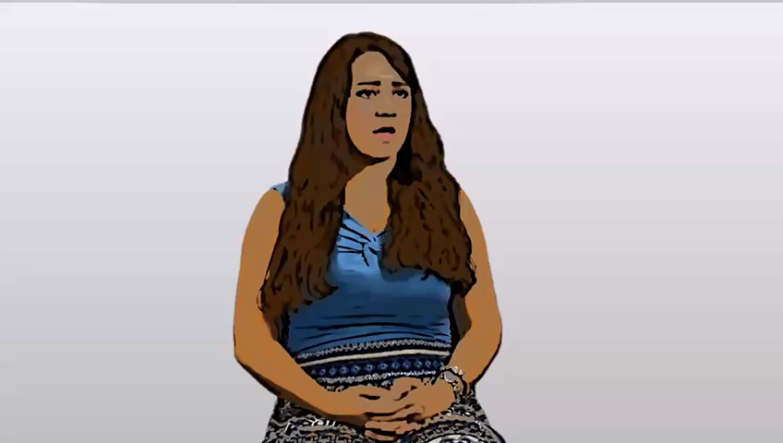
Jessica
Notes:
Let’s hear from Jessica what happened when she first went to get help.
As Jessica tells us, several clinicians missed the early warning signs of psychosis. This is not uncommon. It may be helpful to better understand why this happens.

Slide 56

Notes:
We are all exposed to stigmatizing characterizations of persons with schizophrenia, schizoaffective, and other psychotic disorders. These are real headlines from various newspapers. The public portrayal of psychotic disorders often involves obvious signs of the illness, such as a person ranting on the street. Persons with schizophrenia may be portrayed as homeless, bizarre, and potentially dangerous.

Slide 57
Severe Psychosis
The voices told me someone was trying to hurt me and so I walked around my house in circles holding a knife. My brother called 911 and I was taken to the ER.
I got in my car and drove onto a farm, thinking that it was part of my mission from God. The cops came and arrested me.
My son wore sunglasses indoors and began to sleep in the closet.
Notes:
A consequence of delays in recognition and treatment is that psychosis worsens. A severe psychosis is obvious to most people, because behavior is impacted dramatically. When psychotic symptoms become severe the behavioral disturbances typically lead to rapid recognition, diagnosis and treatment. For example…

Slide 58
Early Psychosis
With early psychosis, the presenting problem may include the consequences of the psychosis such as:
Social withdrawal
Decline in function
Notes:
contrast, at the earliest stages of a psychotic disorder the presenting problems may be nonspecific, such as withdrawal from others or a decline in function. The person may not volunteer their unusual thoughts or perceptual experiences. It is easy for clinicians to latch on to anxiety, depression, or substance use since these disorders are much more common, and not consider psychosis.

Slide 59

Delays in Diagnosis: Role of the Clinician
It didn’t occur to me that the client was psychotic because he was so well-dressed.
Notes:
Clinicians may not consider a psychotic disorder because the client doesn’t meet their preconceptions, for example -
When talking to a clinician patient’s may work hard to appear “fine”. Family members’ concerns about unusual behaviors are a red flag that the patient may be experiencing symptoms that they are reluctant to discuss.

Slide 60
Delays in Diagnosis: Role of the Clinician
I wasn’t sure the client was psychotic, I didn’t want to scare him off.
Notes:
Stigma about severe mental illness may also cause the clinician to be reluctant to consider the diagnosis of a psychotic illness such as schizophrenia.

Slide 61
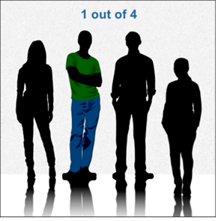
Suicidal Ideation
Notes:
Clinicians may focus on the behavioral responses to psychosis. Psychotic experiences can be distressing, anxiety-provoking. A person experiencing psychosis may feel overwhelmed yet unable to escape their frightening experiences. Suicidal thoughts are not unusual, in fact, about one in four persons with first episode psychosis attempt suicide prior to their first hospitalization. Psychosis should be considered in any person with suicidal thoughts or behaviors.

Slide 62
Psychosis & History of Substance Use Disorders
Nearly half of the people diagnosed with schizophrenia also present with a lifetime history of substance use disorders.
Given the high correlation between psychosis and drug use, psychotic symptoms can be misattributed to the substances.
Notes:
Nearly half of the people diagnosed with schizophrenia also present with a lifetime history of substance use disorders. In this case, psychotic symptoms can be misattributed to the substances.

Slide 63
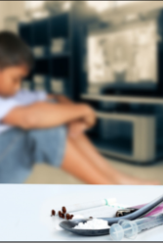
Use of Drugs
The use of drugs complicates the clinical picture. Drugs can:
Cause psychotic symptoms
Increase the risk of developing a psychotic disorder
Drug use disorders are co-morbid with psychotic disorders

Slide 64
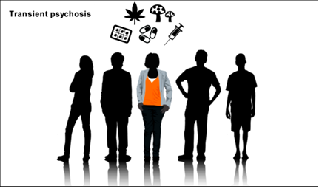
Substance-Induced Psychosis
Notes:
Intoxication with marijuana, stimulants, and hallucinogens may cause a short lived psychotic episode. Typically the psychosis resolves as the substance is cleared by the body.
The effects of synthetic cannabinoids and stimulants may last longer, sometimes several weeks.

Slide 65

Substances May Trigger a Chronic Psychotic Disorder
Notes:
Chronic, heavy use of marijuana, stimulants, and hallucinogens may be an environmental trigger for a persistent psychotic disorder for a person with a predisposition due to genetic or other biological factors

Slide 66
Psychotic Experiences: Suicidal Thoughts
Ventriglio, A. Suicide in the Early Stage of Schizophrenia. Front. Psychiatry 2016 http://dx.doi.org/10.3389/fpsyt.2016.00116
Notes:
Psychotic experiences can be distressing, anxiety-provoking, and associated with social withdrawal. In fact, about one in four persons with first episode psychosis attempt suicide prior to their first hospitalization.

Slide 67
Mask of Psychosis
Mood Symptoms
Behavioral Change
Drug Use
Social Withdrawal
Suicidality
Emotional Problems
Psychosis
Notes:
To summarize, persons experiencing psychosis may be reluctant to reveal their symptoms or unsure of how to explain what is going on. The family and the clinician may focus on the more obvious mood symptoms, suicidality, functional problems, and drugs, and the underlying psychosis missed.

Slide 68
Consequences of Treatment Delay
Derails normal development
Social consequences
Notes:
The consequences of unrecognized untreated psychosis can be dire. Psychosis derails normal psychosocial development. Social withdrawal is extremely common, and can persist for years. Psychosocial maturation in adolescents and young adults depends on interactions with peers and persons in the community. With untreated psychosis the person misses these opportunities.

Slide 69
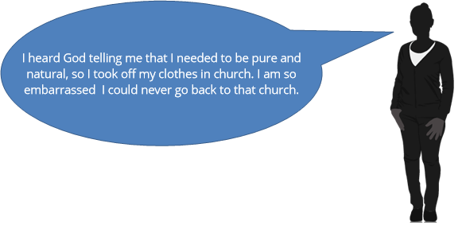
Social Consequences of Unrecognized Psychosis

Slide 70
Consequences of Treatment Delay
Derails normal development
Social consequences
Vocational costs
Notes:
The consequences of unrecognized untreated psychosis can be dire. Psychosis derails normal psychosocial development, and inteferes with function at work and school. Social withdrawal is extremely common, and can persist for years. Psychosocial maturation in adolescents and young adults depends on interactions with peers and persons in the community. With untreated psychosis the person misses these opportunities , so normal psychosocial development may be derailed.
Untreated psychosis is associated with dangerous and embarrassing behaviors, and may have legal consequences. Longer duration of untreated psychosis is associated with worse outcomes and treatment resistance.

Slide 71
Lost Opportunities
Psychosis results in:
Decline in school or work performance
Increased risk for dropping out of school or losing a job
Notes:
Psychosis results in a decline in school or work performance leaving the person at risk for dropping out of school or losing their job. An employer may become frustrated because of a decline job performance.

Slide 72
Consequences of Treatment Delay
Derails normal development
Social consequences
Vocational costs
Potential for dangerous behavior to self, others, property
Legal consequences
Notes:
The consequences of unrecognized untreated psychosis can be dire. Psychosis derails normal psychosocial development, and inteferes with function at work and school. Social withdrawal is extremely common, and can persist for years. Psychosocial maturation in adolescents and young adults depends on interactions with peers and persons in the community. With untreated psychosis the person misses these opportunities , so normal psychosocial development may be derailed.
Untreated psychosis is associated with dangerous and embarrassing behaviors, and may have legal consequences. Longer duration of untreated psychosis is associated with worse outcomes and treatment resistance.

Slide 73
Untreated Psychosis and Violence
About 1/3 of persons who develop a psychotic illness commit a violent act prior to first treatment contact.
Substance abuse increases risk of violence.
Once in treatment, people with psychosis are not any more dangerous than the general population.
Notes:
Longer duration of untreated psychosis is associated with greater risk of violence. In fact, about a third of persons with schizophrenia commit a violent act prior to first treatment contact. The consequences of violence may be longstanding. Violence is most often directed towards a family member, permanently impacting the relationship. The person may face legal charges as a result of violence. In recovery the person with psychosis may suffer from guilt and remorse about aggressive acts.
Once in treatment, persons with psychotic disorders are no more likely than their peers to commit a violent act. Catching psychosis early lessens the risk and so the devastating consequences of violent behaviors.

Slide 74
Consequences of Treatment Delay
Derails normal development
Social consequences
Vocational costs
Potential for dangerous behavior to self, others, property
Legal consequences
Treatment resistance
Notes:
The consequences of unrecognized untreated psychosis can be dire. Psychosis derails normal psychosocial development, and inteferes with function at work and school. Social withdrawal is extremely common, and can persist for years. Psychosocial maturation in adolescents and young adults depends on interactions with peers and persons in the community. With untreated psychosis the person misses these opportunities , so normal psychosocial development may be derailed.
Untreated psychosis is associated with dangerous and embarrassing behaviors, and may have legal consequences. Longer duration of untreated psychosis is associated with worse outcomes and treatment resistance.

Slide 75
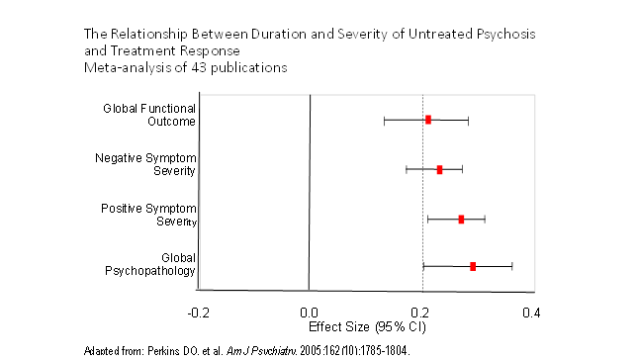
Notes:
Meta-analyses like this one find that the longer the delay in diagnosis and treatment, the worse the symptomatic outcomes.

Slide 76
Benefits of Early Intervention
With early and aggressive treatments, most persons recover.
Effective treatment, especially early in the course of illness, increases the chance of a good recovery.
Community clinicians, educators, family members, and others who work with adolescents and young adults can help avoid treatment delays by understanding the signs and symptoms of psychotic disorders.
Notes:
We now understand that sooner treatment is started, the better the clinical outcomes. We don’t have a cure for psychotic disorders, but effective treatment, especially if initiated early in the course of illness, increases the chance of a good recovery. If community clinicians, educators, family members, and others who work with adolescents and young adults are aware of the signs and symptoms of psychotic disorders, treatment delays may be avoided and the potential for full recovery optimized.

Slide 77
Summary
Psychotic disorders are uncommon.
Attenuated psychosis is found in 5-10% of adolescents and young adults in mental health treatment.
Missed psychosis
Happens because: clients don’t disclose symptoms, clinicians don’t suspect psychosis.
Results in: derailed development, lost opportunities, risk of violence, treatment resistance.
Notes:
Psychotic disorders are uncommon.
Attenuated psychosis is found in 5-10% of adolescents and young adults in mental health treatment.
Missed psychosis
results in: derailed development, lost opportunities, treatment resistance.
happens because: clients don’t disclose symptoms, clinicians don’t suspect psychosis.

Slide 78
Credits
This webinar series was funded by a grant from the National Institute of Mental Health (R34MH103834), a federal Community Mental Health Services Block Grant (CFDA #93.958) as a project of the NC Division of Mental Health, Developmental Disabilities & Substance Abuse Services and a grant from the NC AHEC Innovation fund.
We would like to thank all of those who were involved in creating these webinars:
Jennifer Nieri, LCSW
Nina Fiero, LCSW
Jenna Roller
Katie Bucrek
Notes:
We would like to thank the NC Division of Mental Health and all of those who helped with creating this webinar.

