Slide 1
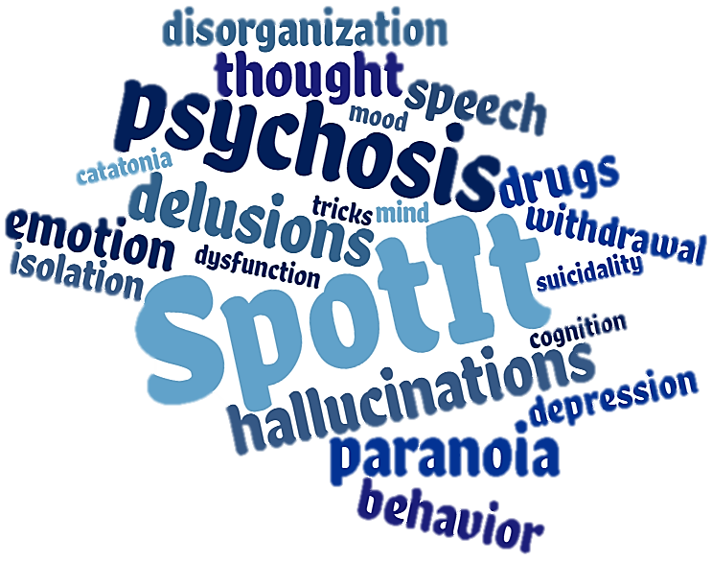
Psychosis: Can You Spot It?
Diana O. Perkins, MD MPH
Professor, Department of Psychiatry
Director, UNC Outreach and Support Intervention Services (UNC OASIS)
Director, Early Psychosis Interventions in North Carolina Resources (EPI-NC Resources)
Notes:
Welcome. I am Chad Jones, your host for today’s webinar. The webinar series “Psychosis, Can You Spot It?” was developed by Dr. Diana Perkins and her team. Dr. Perkins is the Director of EPI-NC, a program supporting the development of early psychosis treatment programs in North Carolina. This webinar series is supported by EPI-NC, funded by a federal Community Mental Health Services Block Grant as a project of the NC Division of Mental Health, Developmental Disabilities & Substance Abuse Services. Dr. Perkins is a Professor in the Department of Psychiatry at the University of North Carolina at Chapel Hill and is the Director and one of the psychiatrists of the UNC OASIS program, a coordinated specialty care program for persons in the early stages of a psychotic disorder. Her research focuses on discovering what causes schizophrenia, in the hope of developing better treatments and eventually a cure.

Slide 2
To connect your audio:
Click the phone icon at the bottom of your screen.
Notes:
To connect your audio, click the phone icon at the bottom of your screen.

Slide 3
To connect your audio:
Then, click the “Connect Audio” button in the display window. This should allow you to hear the presentation.
Notes:
Then, click the “Connect Audio” button in the display window.

Slide 4
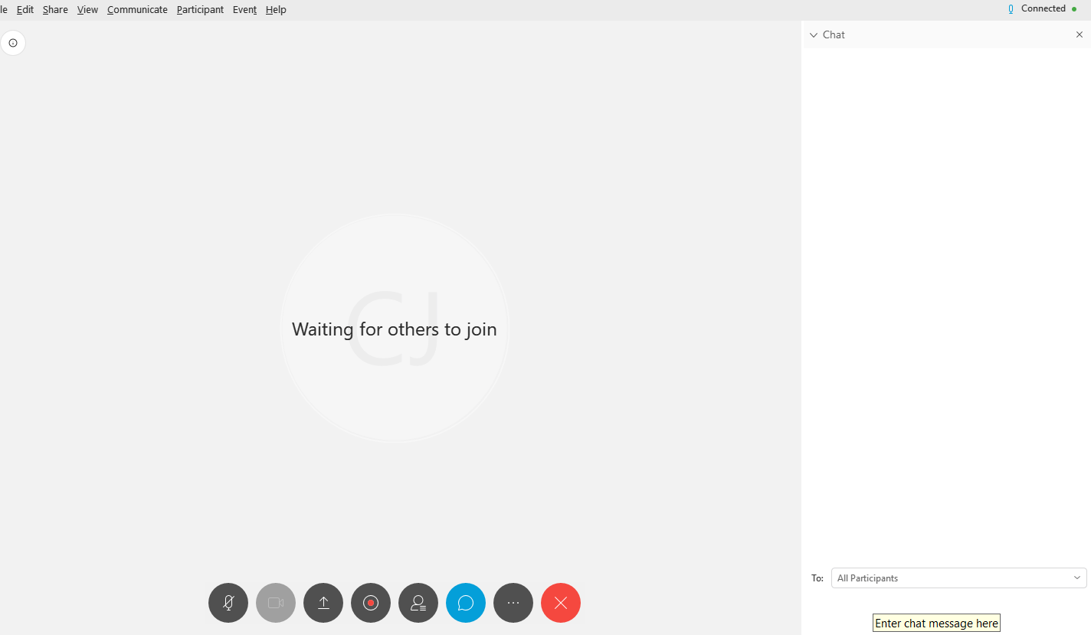
To ask a question:
Click the Chat bubble icon at the bottom of your screen.
Notes:
(click) The chat box opens at the bottom of the screen.

Slide 5
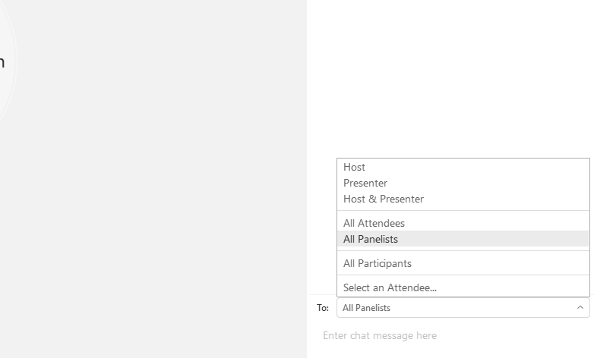
To ask a question:
Then, on the bottom right hand of your screen, select “All Panelists” from the drop down menu, and type your question into the window below:
Notes:
Select “All Panelists” from the drop down menu. You can type in questions or comments at any time during the presentation. Dr. Perkins will address these at the end of the presentation.

Slide 6
Instructions
Program evaluation
Continuing education credits
Notes:
All attendees are encouraged to complete an evaluation of this program. Attendees who are requesting continuing education credits or a certificate of attendance for this presentation are required to complete the evaluation. At the end of this presentation you will receive a link to complete the evaluation online.
Dr. Perkins, please begin.

Slide 7
Psychosis: Can You Spot It?
An educational series:
Signs and symptoms of first episode psychosis
Barriers to recognition
Notes:
Thanks Chad.
I want to welcome you to Psychosis: Can you spot it?, an educational series that addresses the common signs and symptoms of first episode psychosis, as well as the barriers to recognition by health care providers.

Slide 8
Disclosures
In the past two years Dr. Perkins received
funding from Boehringer-Ingleheim to conduct a clinical trial at UNC,
consulting fees from Alkermes,
royalties from APA publishing.
Notes:
Before we begin, I have the following to disclose. In the past two years I received funding from Boehringer-Ingelheim to conduct a clinical trial at UNC, consulting fees from Alkermes and royalties from APA publishing.

Slide 9
Psychosis: Can You Spot It?
Module 1 – An Introduction to Psychosis
Module 2 – “Mind Tricks,” Attenuated-Psychosis, and Full Psychosis
Module 3 – Why Clinicians Miss Diagnosis and What You Can Do About It
Module 4 – Unmasking Psychosis
A look at the national prevalence of psychotic disorders, common signs and symptoms, and barriers to diagnosis and treatment.
Distinguishing key features of fully psychotic, attenuated psychotic, and non-psychotic symptoms and the differences therein.
How cognitive heuristics influence clinical decision-making and strategies for decreasing biases and improving the likelihood of a correct diagnosis.
Identifying the range of disorders that feature psychosis as a symptom and factors like trauma and substance use that increase clinical risk.
Notes:
There are four one hour modules in this series. Module 1 examines the prevalence of psychosis in comparison to other mental disorders, describes psychosis syndromes, and discusses barriers to recognition. Module 2 is an in depth look at the spectrum of psychosis, ranging from full psychosis to prodromal severity to unusual experiences. Module 3 explores why clinicians make diagnostic errors, in general and in relation to psychosis. Module 4 explores the variety of disorders that include psychosis as a feature. This is Module 2.

Slide 10
Module 2: Mind Tricks, Attenuated-Psychosis, and Full-Psychosis: What’s the Difference and Why You Should Care
Diana O. Perkins, MD MPH
Professor, Department of Psychiatry
Director, UNC Outreach and Support Intervention Services (UNC OASIS)
Director, Early Psychosis Interventions in North Carolina Resources (EPI-NC Resources)
Notes:
The spectrum of psychosis. At one end of the continuum, our occasional misinterpretations or misperceptions of events, and disorganization experienced by most people. For example when tired, or under a great deal of stress. At the other end are fully psychotic delusions, hallucinations, and disorganization.

Slide 11
Learning Objectives
Understand the key features that distinguish fully-psychotic, attenuated-psychotic and non-psychotic symptoms.
Demonstrate your ability to distinguish fully-psychotic, attenuated-psychotic, and non-psychotic symptoms in clinical scenarios.
Know the long-term outcomes of persons with attenuated-psychosis.
Understand the rationale for current treatment recommendations for fully-psychotic, attenuated-psychotic, and non-psychotic symptoms.
Notes:
Determining where a client lies on this continuum is not straightforward. In this module we review the key features that distinguish fully-psychotic, attenuated-psychotic, and non-psychotic symptoms.
We provide you an opportunity to apply these principles to clinical examples. This module ends with information about outcomes and treatment recommendations across the continuum of occasional “mind tricks” to full psychosis.

Slide 12
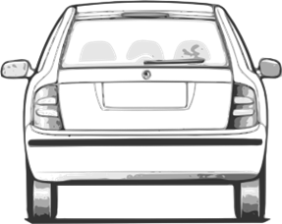
Notes:
Our brains are tasked with perceiving and interpreting what’s going on around us and orchestrating our responses. Brains function along a continuum of accuracy, making occasional mistakes in

Slide 13
Notes:
Perception (CLICK)

Slide 14
Was that my phone ringing? Guess not…
Notes:
“Was that my phone ringing? Guess not…”
Meaning (CLICK)

Slide 15
Everyone thinks my clothes don’t match.
Was that my phone ringing? Guess not…
Notes:
“Everyone thinks my clothes don’t match.”
…and behavior (CLICK)

Slide 16
Everyone thinks my clothes don’t match.
Was that my phone ringing? Guess not…
Alright, who took my glasses?
Notes:
“Alright, who took my glasses?”

Slide 17
Psychosis
Delusions
Hallucinations
Disorganization
Notes:
At the extreme of this accuracy-continuum is full-psychosis that includes
delusions, hallucinations, and disorganization.

Slide 18
Notes:
Citation: DSM5

Slide 19
“…delusions are fixed beliefs that are not amenable to change in light of conflicting evidence.” Diagnostic and Statistical Manual Fifth Edition
Notes:
Conspiracy theorists aside, actual delusions “are fixed beliefs that are not amenable to change in light of conflicting evidence.”
The definition of delusions was revised in the most recent edition of the Diagnostic and Statistical Manual, DSM5.
Citation: DSM5

Slide 20
Vignette
Notes:
.

Slide 21
Meet the clinician, Gloria.
Meet Sam.
Notes:
Meet our therapist Gloria and her client, Sam. Here Gloria, uncovers delusional thoughts in the following examples.

Slide 22
I can’t watch TV anymore!
Notes:
The patient reveals that he “can’t watch TV anymore”

Slide 23
???.
I can’t watch TV anymore!
Notes:
Gloria is confused by her client’s somewhat unusual complaint.

Slide 24
Why is that?
Notes:
Gloria inquires further…

Slide 25
Because the people on TV keep talking about me, it’s creepy.
Why is that?
Notes:
And the patient give his explanation..

Slide 26
For example?
Notes:
So she asks for a specific example.

Slide 27
Last night I watched “Game of Thrones”, when someone was slayed, they looked at me, and it meant “you’re next”.
For example?
Notes:
And he describes a typical delusion of reference, (CLICK THROUGH AND READ)

Slide 28
Notes:
Her client goes on to tell her about another problem.

Slide 29
I just can’t go to class!!
Notes:
“I just can’t go to class!”

Slide 30
???.
I just can’t go to class!!
Notes:
Again, Gloria is puzzled, and asks for more detail.

Slide 31
Why is that?
Notes:
“Why is that?”

Slide 32
I’m uncomfortable and have to leave.
Why is that?
Notes:
“I’m uncomfortable and have to leave”

Slide 33
What’s making you feel so uncomfortable?
Notes:
“What’s making you feel so uncomfortable?”

Slide 34
My thoughts are so loud everyone can hear them. When I look at a really cute girl, I am embarrassed for her to hear what I am thinking.
What’s making you feel so uncomfortable?
Notes:
Her questioning reveals that her client is also experiencing delusions of thought broadcasting,

Slide 35
Notes:
Her client goes on to describe other unusual experiences.

Slide 36
I have thoughts that aren’t my own.
Notes:
The patient reveals “I have thoughts that aren’t my own.”

Slide 37
???.
I have thoughts that aren’t my own.
Notes:
Here again Gloria is confused

Slide 38
What’s an example?
Notes:
So she asks, “What’s an example?”

Slide 39
Last night there was this thought in my head “We are watching you”. It wasn’t my thought, I don’t know where it came from.
What’s an example?
Notes:
Here he gives an example of thought insertion. “Last night there was this thought in my head, ‘We are watching you.’ It wasn’t my thought, I don’t know where it came from.

Slide 40
The voices talked to each other about what I was wearing and what I was doing.
Notes:
Hallucinations are perceptions that occur without external stimulation. Hallucinations can occur in any sensory modality, but auditory and visual are the most common. (CLICK THROUGH AND READ)

Slide 41
I heard voices coming from the walls that were telling me to stay in my room.
The voices talked to each other about what I was wearing and what I was doing.
Notes:
Hallucinations are perceptions that occur without external stimulation. Hallucinations can occur in any sensory modality, but auditory and visual are the most common. (CLICK THROUGH AND READ)

Slide 42
I heard voices coming from the walls that were telling me to stay in my room.
I saw the demon in front of me, and then it disappeared.
The voices talked to each other about what I was wearing and what I was doing.
Notes:
Hallucinations are perceptions that occur without external stimulation. Hallucinations can occur in any sensory modality, but auditory and visual are the most common. (CLICK THROUGH AND READ)

Slide 43
Notes:
Psychosis includes disorganization of speech or behavior.

Slide 44
I am aware of creatures, creation is amazing, mazes are where you run, I don’t think you should crush bugs.
Notes:
One example is loose associations.

Slide 45
I am aware of creatures, creation is amazing, mazes are where you run, I don’t think you should crush bugs.
???.
Notes:
When you find yourself working very hard to understand what a client saying suspect disorganization.

Slide 46
Notes:
Other examples include thought blocking

Slide 47
All of sudden my mind goes blank.
Notes:
“All of a sudden my mind goes blank.”

Slide 48
I just sat there, I couldn’t decide whether to eat breakfast first or get dressed first.
All of sudden my mind goes blank.
Notes:
And difficulty making simple decisions. “I just sat there, I couldn’t decide whether to eat breakfast first or get dressed first.”

Slide 49
Jessica talks about difficulty making decisions
Notes:
We first met Jessica, a college student, in Module 1. Jessica tells us she was diagnosed with schizophrenia about a year ago. Here Jessica recalls the disorganization symptoms she experienced.
[play video]
It is not unusual for disorganization symptoms to manifest as social withdrawal. As was true for Jessica, clinicians may jump to depression, or an anxiety disorder, and not consider the possibility of emerging psychosis.

Slide 50
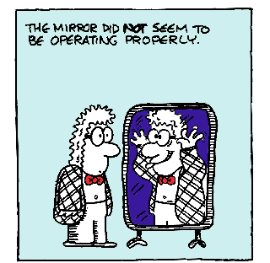
Notes:
In between “occasional mistakes” and full-psychosis is attenuated-psychosis. Illusions are an example, where there is an actual stimulus, but it is misperceived.

Slide 51
Jessica tells us about her initial attenuated-psychosis symptoms
Notes:
About 80 to 90 percent of people with a psychotic disorder have a prodromal stage, characterized by attenuated psychosis. Here, Jessica reflects on some of the symptoms she experienced during her prodrome.
[play video]

Slide 52
Vignette
Notes:
The next vignette explores the difference between attenuated and fully psychotic experiences.

Slide 53
Meet Fred.
Meet the clinician, Tyler.
Notes:
Let’s begin with Fred, the client, and Tyler, a Masters level clinician at a community mental health clinic. This is their first appointment.

Slide 54
Notes:
Fred is seeking help for “problems at work”. After introductions, Tyler asks about the reason for the visit. (CLICK)

Slide 55
How about if we begin by you telling me about why you are here.
Notes:
“How about if we begin by you telling me about why you are here.”
Fred responds that he is upset because people at work are saying bad things about him.

Slide 56
I’m upset because people at work have been saying bad things about me.
How about if we begin by you telling me about why you are here.
Notes:
“I’m upset because people at work have been saying bad things about me.”

Slide 57
Notes:
Tyler finds Fred’s assertion unusual, and decides to explore the quality of Fred’s complaint, Tyler asks Fred to elaborate.

Slide 58
What makes you think people at work are saying bad things about you?
Notes:
So “What makes you think people at work are saying bad things about you?”

Slide 59
Question: Pick the bubble with the more unusual quality:
Response A: At a staff meeting people kept looking at their phones then at me. I thought the company was texting about me that I was a loser.
Response B: A friend at work told me that a new guy is spreading rumors about me.
Notes:
Here are two alternative responses for Fred. Pick which response has the more unusual quality. The first response describes an unusual experience raising concerns of attenuated- or full-psychosis. A red flag, something the clinician might want to explore further! As for the second response - work gossip is not all that unusual, so Fred’s second response doesn’t really raise a flag.

Slide 60
???
Notes:
Whether Fred is reporting a fully-psychotic, attenuated-psychotic, or non-psychotic experience hinges on three aspects of his narrative:

Slide 61
Quality?
Conviction?
Frequency?
Notes:
The clinician needs to determine the Quality, Conviction, and Frequency.

Slide 62
Fully- and attenuated-psychotic quality:
Unusual or Illogical
Notes:
Both fully- and attenuated- psychotic symptoms have the quality of being unusual or illogical.

Slide 63
Fully- and attenuated-psychotic quality:
Unusual or Illogical
Not held by others in their culture or community
Notes:
Both fully- and attenuated- psychotic symptoms have the quality of being unusual or illogical, not held by others in their culture or community.

Slide 64
Full-psychosis
=
Notes:
An unusual experience is fully-psychotic if the impact on function is severe, (CLICK)

Slide 65
dangerous or incapacitating
Full-psychosis
=
Notes:
An unusual experience is fully-psychotic if the impact on function is severe, (CLICK) for example dangerous or incapacitating.

Slide 66
Non-psychotic
=
easily dismissed
Notes:
Even unusual or illogical experiences are non-psychotic if easily dismissed.

Slide 67
Full- or Attenuated-psychosis = captivating, compelling, distracting, impact function
Notes:
The experiences of fully or attenuated psychosis are not easily dismissed, but have an intensity that may be described as captivating, compelling, distracting, or by how the experience impacts function. Both fully and attenuated psychotic symptoms occur frequently, at least monthly to several times a day. In this case the difference between attenuated- and full-psychosis rests on whether the person is or is not convinced the experience is real.

Slide 68
Full- or Attenuated-psychosis = captivating, compelling, distracting, impact function
Full-psychosis = No Doubt Attenuated-psychosis = Doubt
Notes:
The distinguishing feature is that with attenuated psychotic symptoms, the person maintains doubt about the veracity of the experiences that, while intense, it is most likely their mind playing tricks. With full psychosis, the person has no doubt that the experiences are real, and does not see a possibility of mind tricks. So, the difference between attenuated- and full-psychosis rests on whether the person is or is not convinced the experience is real.

Slide 69
Anything else happen at work?
Notes:
Next, Tyler decides to explore the quality of Fred’s concerns about people at work. (CLICK)

Slide 70
Anything else happen at work?
They use secret hand-signals to make fun of me too. I avoid co-workers if I can.
Notes:
Fred gives several examples that seem unusual to Tyler, such as “co-workers exchanging coded-messages using hand-signals”. The unusual experiences have impacted Fred’s function, as he has been avoiding co-workers because of feeling singled-out.

Slide 71
Notes:
So Tyler next explores Fred’s conviction.

Slide 72
Are you sure that your co-workers are reacting to you?
Notes:
“Are you sure that your co-workers are reacting to you?”

Slide 73
Are you sure that your co-workers are reacting to you?
Absolutely. I don’t think I can put up with this kind of harassment, I’m going to quit.
Notes:
“Absolutely. I don’t think I can put up with this kind of harassment, I’m going to quit.”

Slide 74
Do you think Fred’s level of conviction is consistent with
a) Full-psychosis
b) Attenuated-psychosis
c) No psychosis
Notes:
In this example, do you think Fred’s level of conviction is consistent with fully psychotic, attenuated-psychotic or non-psychotic experiences?

Slide 75
Do you think Fred’s level of conviction is consistent with
a) Full-psychosis
b) Attenuated-psychosis
c) No psychosis
Fred’s response suggests fully-psychotic symptoms, as he was sure the events are real.
Notes:
Fred’s response suggests fully-psychotic conviction, as he has no doubt about the veracity of these experiences.

Slide 76
Are you sure that your co-workers are reacting to you?
Notes:
How about if Fred gave this response?

Slide 77
Are you sure that your co-workers are reacting to you?
… It’s weird… I’m probably making too much of it.
Notes:
“It’s weird…I’m probably making too much of it.”

Slide 78
Do you think Fred’s level of conviction is consistent with
a) Full-psychosis
b) Attenuated-psychosis
c) No psychosis
Notes:
Is Fred’s response most consistent with a fully-psychotic, attenuated-psychotic, or non-psychotic level of conviction?

Slide 79
Do you think Fred’s level of conviction is consistent with
a) Full-psychosis
b) Attenuated-psychosis
c) No psychosis
Notes:
Here Fred expresses doubt about whether he is correctly interpreting events, so his level of conviction is consistent with attenuated-psychosis.

Slide 80
Notes:
Now for Frequency.

Slide 81
How often has this happened?
Notes:
Now for Frequency.

Slide 82
How often has this happened?
Over the past couple of months something like that has happened almost every day.
Notes:
“Over the past couple of months something like that has happened almost every day.” Full-or attenuated-psychosis lasts minutes to hours and occurs frequently, ranging from a couple of times a month to daily. Full-psychotic symptoms tend to occur more often than attenuated-psychotic symptoms, but there is no clear dividing line.

Slide 83
Notes:
Attenuated-psychosis is when the quality is illogical, not culturally held, and compelling (CLICK)

Slide 84
It seems like the government is tracking me, because facebook ads keeping popping up about what I just ate
Notes:
“It seems I control the weather, I wish for rain or shine and that’s what happens.”
the conviction involves a sense of reality but doubt is maintained (CLICK)

Slide 85
It seems like more than a coincidence, but how could that be possible.
It seems like the government is tracking me, because facebook ads keeping popping up about what I just ate
.
Notes:
“It seems like more than a coincidence, but how could that be possible?”
And the experience occurs frequently. (CLICK)

Slide 86
It seems like more than a coincidence, but how could that be possible.
It happens most times I go facebook, so nearly every day.
It seems like the government is tracking me, because facebook ads keeping popping up about what I just ate
Notes:
“I’ve been noticing a connection between what I wish for and the weather at least once a week.”

Slide 87
Vignette
Notes:
The following three scenarios are of different clients presenting with possible psychosis. We’ll evaluate whether the symptoms are non-psychotic, attenuated psychotic, or fully psychotic.

Slide 88
Meet Sean.
Notes:
Sean is a 20 year old client, referred to Tyler’s community clinic from the student health clinic at a local college. The referral states that Sean has a diagnosis of schizophrenia due to delusional thoughts that he can predict the future and hallucinations that aren’t specified.

Slide 89
What did your school counselor tell you about why she referred you to our program?
Notes:
After welcoming Sean, Tyler begins by asking what Sean knows about the reason for referral.

Slide 90
What did your school counselor tell you about why she referred you to our program?
She thought I was nuts…
Notes:
Sean appears anxious and defensive, and states that the school counselor thought he “was nuts.”

Slide 91
Why do you think she thought you were nuts?
Notes:
Tyler elicits more details about the experiences and
(CLICK ONCE)

Slide 92
Why do you think she thought you were nuts?
Well, so … I told her about these weird dreams…
Notes:
Sean appears uncomfortable as he reveals he has vivid dreams that predict the future.

Slide 93
What should Tyler consider in determining whether the quality is consistent with attenuated- or full-psychosis?
a) Is the belief consistent with his family/cultural beliefs?
b) Sean’s conviction level?
c) If the experiences are impacting his function?
d) All of the above.
Notes:
Tyler wants to determine if the quality is consistent with attenuated- or full-psychosis. What should Tyler consider?

Slide 94
What should Tyler consider in determining whether the quality is consistent with attenuated- or full-psychosis?
a) Is the belief consistent with his family/cultural beliefs?
b) Sean’s conviction level?
c) If the experiences are impacting his function?
d) All of the above.
Notes:
Conviction and frequency are important considerations only if the symptom is illogical and outside of cultural norms. Belief in predictive dreams are accepted by some cultures, so it is important to determine whether Sean’s beliefs are consistent with his cultural and family beliefs.

Slide 95
When did the dreams start?
Notes:
Tyler asks …

Slide 96
When did the dreams start?
… two months ago
Notes:
Tyler finds out that this is a new experience for Sean.

Slide 97
What do your family and friends think?
Notes:
Tyler explores whether this belief might be culturally held…

Slide 98
What do your family and friends think?
I haven’t told them, they would think it was weird.
Notes:
…and finds out that this belief is not shared by others in his culture.

Slide 99
Do these weird dreams bother you?
Notes:
Tyler knows that in order to be full- or attenuated psychosis these experiences need to be compelling, captivating, and/or interfere with function.
(CLICK ONCE)

Slide 100
Yeah… I keep thinking about them… even when I should be paying attention in class.
Do these weird dreams bother you?
Notes:
They are.

Slide 101
How often do you have these dreams?
Notes:
Since the symptom quality is illogical, not consistent with his culture, and bothersome
Tyler goes on to explore frequency and finds out
(CLICK ONCE)

Slide 102
How often do you have these dreams?
A couple times a week?
Notes:
…they happen several times a week.

Slide 103
Are you sure these dreams really predict the future?
Notes:
Tyler next explores conviction and
(CLICK ONCE)

Slide 104
Are you sure these dreams really predict the future?
It kinda seems real at the time, but I know it can’t be true.
Notes:
…readily elicits doubt.

Slide 105
Considering the quality, conviction and frequency, how would you rate the severity of Sean’s experience of predictive dreams? Would you rate it as fully, attenuated or non-psychotic?
a) fully-psychotic
b) attenuated-psychotic
c) non-psychotic symptoms
Notes:
Considering the quality, conviction and frequency, how would you rate the severity of Sean’s experience of predictive dreams? Would you rate it as fully, attenuated or non-psychotic?

Slide 106
Considering the quality, conviction and frequency, how would you rate the severity of Sean’s experience of predictive dreams? Would you rate it as fully, attenuated or non-psychotic?
A) fully-psychotic
B) attenuated-psychotic
C) non-psychotic symptoms
Notes:
Sean maintains doubt into his experience, making it an attenuated-psychotic level symptom.

Slide 107
Vignette

Slide 108
Meet Angela.
Notes:
Next meet Angela, a 22-year old female, who has been seeing Tyler twice monthly for help with anxiety and depression that worsened when her father died about a year ago. Therapy has focused on Angela’s unresolved feelings about her father, who was abusive towards her until she was 12, related to alcoholism. The abuse ceased after her father’s sobriety that continued until his death. The depression and anxiety at first improved, but over the past few months appears to have worsened.

Slide 109
Hi Angela. It’s nice to see you again. How have you been?
Notes:
Tyler greets Angela. (CLICK ONCE)

Slide 110
Hi Angela. It’s nice to see you again. How have you been?
Uh… not so good… problems at work.
Notes:
Angela appears distressed, and reveals she is having problems at work.

Slide 111
What’s wrong at work?
Notes:
Tyler asks for more information (CLICK ONCE)

Slide 112
New customers are watching me… like they are trying to catch me doing something wrong.
What’s wrong at work?
Notes:
…and learns that for the past couple of months Angela has had a sense that new customers are watching her in order to catch her making mistakes.

Slide 113
Wow, it’s hard when your work-environment seems hostile.
Notes:
Tyler makes an effort to be empathetic but Angela looks more distressed. (CLICK ONCE)

Slide 114
It’s not just work anymore, they are watching me at home now.
Wow, it’s hard when your work-environment seems hostile.
Notes:
…She responds by clarifying that her sense of being watched has expanded to include home as well.

Slide 115
Odd… what does she mean “they are watching me at home” …. Did she just misspeak? … Does she think her customers are really watching her?
Notes:
Tyler pauses, unsure of what Angela means by her last remark, and concerned about her distress. He decides to gently inquire.

Slide 116
I see you are upset. This is a hard situation. How do you know you are being watched?
Notes:
Tyler acknowledges her distress, and asks for further details. (CLICK ONCE)

Slide 117
It’s obvious how they look at me. And I hear them say bad things about me… even at home! They’ve put cameras in my house and car to track me… Of course I’m upset… can’t sleep…
I see you are upset. This is a hard situation. How do you know you are being watched?
Notes:
…Angela’s explanations are illogical, and appear to include referential thinking, auditory hallucinations, and paranoia. She relates distress and impact on function.

Slide 118
How does a clinician determine level of conviction?
Notes:
When a client discloses unusual or illogical experiences, with an intensity that makes them compelling, distracting, and impactful, the clinician needs to determine the level of conviction in order to distinguish full from attenuated psychotic symptoms.
Let’s review some tools that help a clinician determine a client’s level of conviction.
(CLICK) Ask about the client’s conviction level in the moment of the experience. While the client may have insight after the event occurred, he or she may have believed the experience to be real while it was happening.
(CLICK) Try offering alternative explanations… If the client agrees that there may be another explanation, the experience may be at an attenuated level of psychosis.
(CLICK) A percentage scale may help.
(CLICK) If a client is defensive when a clinician is trying to illicit doubt, that may be a sign that they fully believe what they experienced to be real.

Slide 119
How does a clinician determine level of conviction?
Ask about the client’s conviction level in the moment of the experience:
“When you are at home, are you completely convinced cameras are in your house?”
Notes:
Let’s review some tools that help a clinician determine a client’s level of conviction.
Ask about the client’s conviction level in the moment of the experience. While the client may have insight after the event occurred, he or she may have believed the experience to be real while it was happening.

Slide 120
How does a clinician determine level of conviction?
Ask about the client’s conviction level in the moment of the experience:
“When you are at home, are you completely convinced cameras are in your house?”
Try offering alternative explanations:
“When you feel this way, did you consider that you are just very stressed and your mind might just be playing tricks on you?”
Notes:
Try offering alternative explanations… If the client agrees that there may be another explanation, the experience may be at an attenuated level of psychosis.
(CLICK)

Slide 121
How does a clinician determine level of conviction?
Ask about the client’s conviction level in the moment of the experience:
“When you are at home, are you completely convinced cameras are in your house?”
Try offering alternative explanations:
“When you feel this way, did you consider that you are just very stressed and your mind might just be playing tricks on you?”
Try asking with percentages:
“On a percentage scale of 1-100, 100% being fully convinced without question, how would you rate your level of conviction that the customers are watching you and placed cameras in your house?”
Notes:
A percentage scale may help.

Slide 122
How does a clinician determine level of conviction?
Ask about the client’s conviction level in the moment of the experience:
“When you are at home, are you completely convinced cameras are in your house?”
Try offering alternative explanations:
“When you feel this way, did you consider that you are just very stressed and your mind might just be playing tricks on you?”
Try asking with percentages:
“On a percentage scale of 1-100, 100% being fully convinced without question, how would you rate your level of conviction that the customers are watching you and placed cameras in your house?”
Is the client defensive when their experience is questioned?
Notes:
If a client is defensive when a clinician is trying to illicit doubt, that may be a sign that they fully believe what they experienced to be real.

Slide 123
How certain are you on a scale of 1%-100% that they are watching you and have cameras in your house?
Notes:
The therapist asks for level of conviction …

Slide 124
How certain are you on a scale of 1%-100% that they are watching you and have cameras in your house?
I’d say I’m about 100% sure I’m right about this.
Notes:
…and learns that Angela is fully convinced her experience is real.

Slide 125
Considering conviction, frequency and quality, how would you rate Angela’s experience of being watched?
a) Attenuated
b) Fully psychotic
c) Non-psychotic

Slide 126
Considering conviction, frequency and quality, how would you rate Angela’s experience of being watched?
a) Attenuated
b) Fully psychotic
c) Non-psychotic
Notes:
Angela’s explanations are fully psychotic, as they are illogical, including delusions of reference, auditory hallucinations, and paranoid delusions. She relates distress and impact on function. She is fully convinced of their veracity.

Slide 127
Vignette

Slide 128
Meet Will.
Notes:
Will is a 15 year old male brought in by his mother over concerns of how he reacted to an incident of being bullied at school. She tells Tyler that Will has been acting paranoid, putting tape over his computer camera saying that other kids are spying on him. Tyler is concerned about psychosis.

Slide 129
What’s been happening?
Notes:
Tyler meets with Will and asks about his perspective. Will appears annoyed as he states…

Slide 130
What’s been happening?
Mom thinks I’m crazy…like my uncle…she’s overreacting…
Notes:
…that his mom brought him in because she is worried that he is crazy. He adds that his Uncle had schizophrenia and that his mom is over-reacting. (CLICK)

Slide 131
Some kids are picking on me…Making fun of me online…Delete posts before I can show my mom…Don’t want my mom to make it worse…
What’s been happening?
Mom thinks I’m crazy…like my uncle…she’s overreacting…
Notes:
Tyler tries to get more of Will’s story. Will explains that while his mother thinks the bullying was a one-time thing the reality is that it has been occurring continually for weeks including physical aggression at school and cyberbullying on social media. Will states that he tried to show his mom, but the kids had already deleted the comments. Will explains that he doesn’t want to tell his mother who is doing the bullying, fearing that the bullying will get worse. Some kids are picking on me… Making fun of me online… Delete posts before I can show my mom… Don’t want my mom to make it worse.

Slide 132
What about the tape on the camera?
Notes:
Tyler asks about the tape on the camera, thinking this was unusual behavior (CLICK).

Slide 133
The bullies could be spying on me… How else could they know? Plus a couple of kids hacked my friends’ computers. Everyone is putting tape on their computer cameras.
What about the tape on the camera?
Notes:
Will responds that he was worried that the kids who were bullying him might also be spying on him, since some of the things they posted were about personal things he did in his room, so how else could they know? Will continues that all of the kids are putting tape on their cameras, because a couple of kids had recently hacked into other students’ computers.

Slide 134
What information does he need to determine if they are of attenuated- or fully-psychotic severity?
a) Will’s explanation is plausible, seek external evidence.
b) Determine Will’s conviction.
c) Determine impact on Will’s function.
Notes:
Tyler thinks the quality of Will’s experiences is unusual. What information does he need to determine if they are of attenuated- or fully-psychotic severity?

Slide 135
What information does he need to determine if they are of attenuated- or fully-psychotic severity?
a) Will’s explanation is plausible, seek external evidence.
b) Determine Will’s conviction.
c) Determine impact on Will’s function.
Notes:
Will is giving a plausible scenario, including that his mother is over-reacting due to her brother’s psychosis and her worries that Will could have the same problem. Tyler should also explore whether Will is having other unusual experiences, such as ideas of reference, perceptual abnormalities, delusional thoughts, etc. If the unusual experiences are isolated to just one plausible scenario, they are less likely to be attenuated- or fully-psychotic. Conviction and impact on function can be high in real scenarios as in psychosis, so first Tyler needs to know what is really going on.

Slide 136
Will, could you tell your mom more about what happened?
Notes:
By the end of the evaluation Tyler, mom, and Will agree that Will is actually being bullied. The intervention focuses on strategies for Will to get support and help to stop the bullying.

Slide 137
I know what happened… Will is not acting right…
Will, could you tell your mom more about what happened?
Notes:
By the end of the evaluation Tyler, mom, and Will agree that Will is actually being bullied. The intervention focuses on strategies for Will to get support and help to stop the bullying.

Slide 138
I know what happened… Will is not acting right…
Will, could you tell your mom more about what happened?
Bullied a lot… Some kids hacked a few computers… All my friends are… The kids posted mean things… The last time I took a screen shot, see…
Notes:
By the end of the evaluation Tyler, mom, and Will agree that Will is actually being bullied. The intervention focuses on strategies for Will to get support and help to stop the bullying.

Slide 139
Sean
Angela
Will
Notes:
An important reason why clinicians need to accurately evaluate clients on the psychosis continuum is because of the impact that the evaluation has on the best intervention choices. The treatment approaches will be very different for Sean, Angela, and Will.

Slide 140
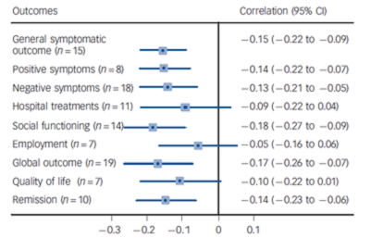
Evidence-based Treatment for Psychotic Disorders
Notes:
Once psychosis emerges, the sooner anti-psychotic medications are started, the better the outcomes. Duration of untreated psychosis refers to the time from when psychotic symptoms start to when anti-psychotic treatment is initiated. This graph summarizes the results of 33 published studies that examine the correlation between of untreated psychosis and clinical outcomes two years after anti-psychotic treatment was initiated. The x-axis shows the correlations with longer durations of untreated psychosis associated with more severe symptoms, worse social function, and decreased likelihood of remission.

Slide 141
Why does early intervention improve outcomes?
Halt a progressive pathology
Longer psychosis = Longer time to psychosis remission
Longer psychosis = Less likelihood of psychosis remission
Longer psychosis = Greater loss of brain tissue
Notes:
There are several reasons why duration of untreated psychosis impacts clinical outcomes. For some people, psychosis is symptomatic of a progressive, pathologic process. Studies find that longer duration of untreated psychosis is associated with longer time and less likelihood of psychosis remission and loss of brain tissue. Anti-psychotic medications may interrupt a neuro-progressive process.

Slide 142
Why does early intervention improve outcomes?
Halt a progressive pathology
Longer psychosis = Longer time to psychosis remission
Longer psychosis = Less likelihood of psychosis remission
Longer psychosis = Greater loss of brain tissue
Minimize psychosocial damage associated with untreated psychosis.
Longer psychosis = Greater risk of aggression and violence
Longer psychosis = Greater risk of legal system involvement
Longer psychosis = Greater risk of embarrassing acts
Longer psychosis = Loss of resources
Longer psychosis = Social and role function derailment
Notes:
There are several reasons why duration of untreated psychosis impacts clinical outcomes. For some people, psychosis is symptomatic of a progressive, pathologic process. Studies find that longer duration of untreated psychosis is associated with longer time and less likelihood of psychosis remission and loss of brain tissue. Anti-psychotic medications may interrupt a neuro-progressive process. CLICK
In fact, much of the benefit of early intervention may be in preventing the consequences of untreated psychosis. To a large extent these consequences are social and psychological. Longer duration of psychosis is associated with greater risk of aggressive and violent acts, often because the person is responding as if their delusions are real or to command hallucinations. The legal system may become involved because of aggression or because the person breaks the law because of disorganization and confusion. Unusual behaviors observed by others can later be a source of embarrassment. A person may drop out of school, be fired from a job, and lose friendships. All of these can be difficult to rebuild once psychosis is treated.

Slide 143
Why does early intervention improve outcomes?
Michael
DUP: 3 months
Remission of psychosis
Psychosocial consequences
Medical withdrawal from University but able to return
Only family and his best friend “knows what happened”
Ryan
DUP: 36 months
Partial response to antipsychotics
Psychosocial consequences:
Expelled from University
Legal charges for destroying public property
No longer “fits in” as his friends have “moved on” with their lives
Notes:
Here again, Michael and Ryan are fairly typical examples. Michael has a medical withdrawal from university, but will be able to return. Ryan was expelled from university, and faces legal charges because while psychotic he spray-painted symbols on the sidewalk in front of the police station, an act that led to his diagnosis and treatment. Ryan has withdrawn from friends while psychotic. As his symptoms improved, he sought to reconnect with old friends without much success, as his friends were in a different phase of life.

Slide 144
Evidence-based Treatment for Psychotic Disorders
Coordinated Specialty Care Services
Low-dose antipsychotics
Psychotherapy
Support for Employment and Education
Peer support
http://navigateconsultants.org/manuals
Notes:
Both Michael and Ryan need more than just anti-psychotic medication in order to move on with their lives. Clinical trials find that persons recovering from a first episode of psychosis benefit from a variety of interventions, typically delivered by a multi-disciplinary team. The types include individual and family psychotherapies, supported employment and education, and peer support services. One resource to learn more about coordinated specialty care services can be found at the website of a National Institute for Mental Health funded clinical trial called Navigate.

Slide 145
Mild attenuated psychosis symptoms are not that unusual, especially in persons seeking mental health treatment.
Notes:
A few facts are key when considering treatment options for attenuated psychosis. Attenuated psychotic symptoms that occur infrequently and with mild intensity are relatively common.

Slide 146
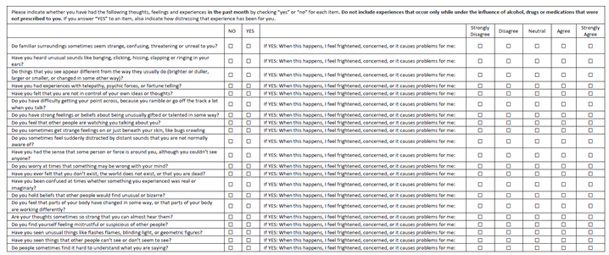
Prodromal Questionnaire Brief
Notes:
Numerous studies have used self-report questionnaires to screen for attenuated and full psychosis in mental health clinics and in community settings. Here is an example of one of the most widely used questionnaires, the Prodromal Questionnaire Brief version. It contains 21 items that describe unusual experiences. Examples of questions include: Do familiar surroundings seems strange, confusing, threatening or unreal to you? Have you heard unusual sounds like banging, clicking, hissing, clapping, or ringing in your ears? Do things that you see appear different than they usually do? Brighter or duller? Larger or smaller? Or changed in some other way? Have you had experience with telepathy, psychic forces, or fortune telling? Have you felt that you were not in control of your own ideas or thoughts? Do you have difficulty getting your point across because you ramble or go off track a lot when you talk? Do you have strong feelings or beliefs about being unusually gifted or talented in some way? Do you feel that other people are watching you or talking about you? And so on. So, if “yes” the person is asked whether they agree with the statement, “When this happens I feel frightened, concerned, or it causes problems for me.”

Slide 147
Mild attenuated psychosis symptoms are not that unusual, especially in persons seeking mental health treatment.
Reference: Kline E and Schiffman J. Psychosis risk screening: A systematic review. Schizophrenia Research 158: 11-18.
Notes:
Over half of adolescents and young adults in mental health treatment settings endorse having several such symptoms that are either only mildly or not at all distressing. The presence of mild attenuated symptoms does not indicate increased risk for future psychosis.

Slide 148
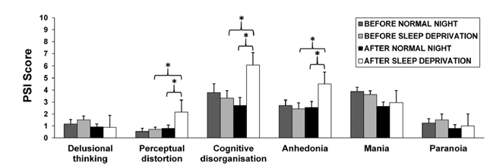
Most people experience “mind tricks” and their thinking becomes disorganized when............. sleep deprived.
Notes:
Mild, transient, attenuated psychosis symptoms can occur with various stressors. For example, most people experience mild perceptual abnormalities and cognitive disorganization with sleep deprivation.

Slide 149
Reference: Kline E and Schiffman J. Psychosis risk screening: A systematic review. Schizophrenia Research 158: 11-18.
Notes:
Screening questionnaires are not diagnostic of attenuated psychosis, as false positives are common. Screening questionnaires are intended to be used as part of a comprehensive, clinical evaluation, and followed up with a clinical interview. Based on the clinical interview, several studies find that about 4-5 percent of adolescents and young adults in mental health treatment settings report experiencing attenuated psychotic symptoms meeting research criteria for a clinical high risk state. With routine screening you are likely to find that about 1 in every 20 help seeking adolescents and young adults are experiencing attenuated psychosis. Less often, you will uncover an occult psychosis.

Slide 150
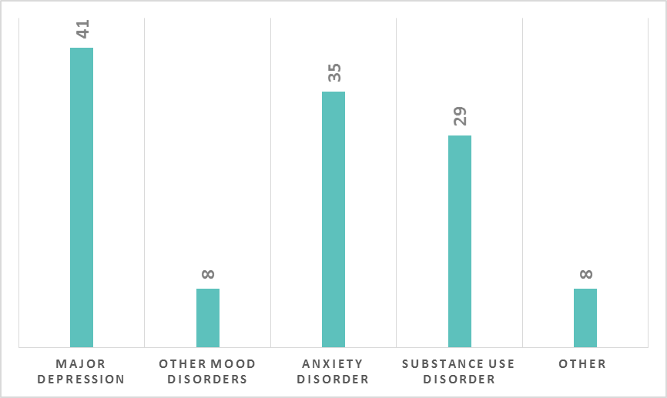
Two-Year Follow-up Diagnoses in Persons with Attenuated Psychosis (n=311) who Did Not Progress to Psychosis (n=226)
Lin A et al. Outcomes of non-transitioned cases in a sample at ultra-high risk for psychosis Am J Psychiatry 2015:249-258
Notes:
The 75-85% of persons with attenuated-psychotic symptoms who do not progress to psychosis typically meet criteria for other Axis 1 disorders.
Most have mood (show % for major depression and other mood disorders)
Anxiety (show % for anxiety disorder),
or substance use disorders (show % for anxiety disorders).
Other disorders are less common. (show % for other)
Attenuated-psychosis persists in about 28%.
Reference: Lin A et al. Outcomes of nontransitioned cases in a sample at ultra-high risk for psychosis Am J Psychiatry 2015:249-258

Slide 151
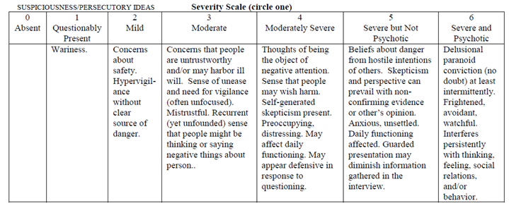
P.2 Description: Suspiciousness/Persecutory Ideas
Persecutory ideas of reference.
Suspiciousness or paranoid thinking
Presents a guarded or even openly distrustful attitude that may reflect delusional conviction and intrude on the interview and/or behavior
From: McGlashan 2014 “Structured Interview for Psychosis-Risk Syndromes
Notes:
At this point, perhaps we should talk about research criteria for a clinical high risk state. This includes the presence of disordered thought content, process, and perception. Here is one example symptom: persecutory ideas of reference, suspiciousness, paranoid thinking, or guarded behavior. A score of 3 to 5 defines attenuated severity with higher ratings given to experiences with greater intensity, indicated by being more difficult to ignore, more compelling, and having a greater impact on function. Note that in this rating scale, psychotic intensity requires conviction that the experience is real.

Slide 152
From: McGlashan 2014 “Structured Interview for Psychosis-Risk Syndromes
Notes:
Research criteria for psychosis clinical high risk includes 5 positive symptoms: Unusual thought content, suspiciousness or persecutory ideas, grandiosity, perceptual abnormalities, and disorganized communication. Research criteria for clinical high risk based on attenuated psychosis requires the presence of one or more of these positive symptoms. In addition the symptom should not be better explained by another disorder. For example, persons with PTSD may experience flashbacks, dissociation, and hyper-arousal. In a person with PTSD, if the unusual experiences are consistent with the trauma experience, then these would not be considered attenuated psychosis. Finally, the symptoms should occur frequently, at least once per week for at least a month.

Slide 153
What is the 2-year risk of a psychotic disorder for persons with attenuated-psychosis?
a) 2%
b) 20%
c) 50%
d) 90%
Notes:
Not everyone progresses from attenuated- to full-psychosis. What do you think is the 2-year risk of a psychotic disorder for persons with attenuated-psychotic symptoms?

Slide 154
What is the 2-year risk of a psychotic disorder for persons with attenuated-psychosis?
a) 2%
b) 20%
c) 50%
d) 90%
Notes:
In the general population the lifetime risk for psychosis is about 2%. In contrast, about 15-25% of adolescents and young adults that meet research criteria for a clinical high risk syndrome which is characterized by attenuated psychosis develop a psychotic disorder within 2 years.

Slide 155
Attenuated-Psychosis Clinical Trials
Antipsychotic medications
Psychotherapy
Omega-3 fatty acids
d-Serine
Notes:
Treatments that have been shown to be effective with schizophrenia symptoms have been evaluated in attenuated psychosis clinical trials. These include trials with antipsychotics, psychotherapies, and over-the-counter supplements including fish oil and d-Serine

Slide 156
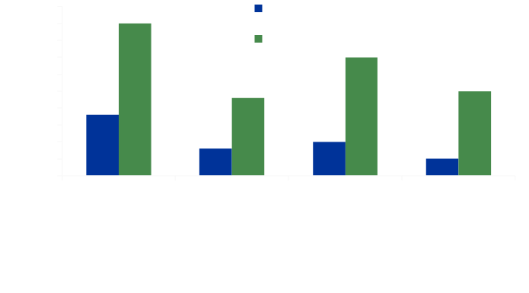
Attenuated-Psychosis Clinical Trials
McGlashan et al. 2006 AJP 163:790-799; McGorry et al. Arch Gen Psychiatry 59:921-928; van der Gaag et al. 2012 Schizophr Bull 38:1180-88;Morrison et al. 2007 Schizophr Bull 33:682-687
Notes:
Each of these interventions was associated with decreasing the risk of developing a psychotic disorder by more than 50 percent within one year follow-up. Note that cognitive behavioral psychotherapy reduced risk of psychosis about as much as antipsychotics. So all of these interventions seem to be effective at reducing risk of a psychotic disorder in persons with attenuated psychosis.

Slide 157
Given the psychosis risk and the clinical trial results, what would you consider to be the first-line treatment for persons with attenuated psychosis?
psychotherapy
antipsychotic medication
fish oil
all of the above
Notes:
Given that 80% of adolescents and young adults with attenuated psychosis do not progress to psychosis, and given the clinical trial results, what would you consider to be the first-line treatment for persons with attenuated psychosis?

Slide 158
Given the psychosis risk and the clinical trial results, what would you consider to be the first-line treatment for persons with attenuated psychosis?
psychotherapy
antipsychotic medication
fish oil
all of the above
Notes:
Practice guidelines recommend psychotherapy as the first-line treatment for attenuated psychosis symptoms. There have been over a dozen psychotherapy trials, most using cognitive behavioral strategies, with meta-analyses suggesting reduction of psychosis risk by more than 50 percent. Several of the psychotherapy studies find sustained benefits, with psychosis risk reduced by 30 percent in persons who receive CPT compared to usual care after 4 year follow-up.

Slide 159
Why would you avoid antipsychotics in persons with attenuated-psychotic symptoms?
a) Most people with attenuated-psychotic symptoms are not in the prodromal stage of a psychotic disorder, and so do not develop a psychotic disorder.
b)Antipsychotics have known side effects and unknown risks for adolescents and young adults who do not have a psychotic disorder.
c)Psychotherapy is as effective as antipsychotics in reducing risk of a psychotic disorder.
d)All of the above.

Slide 160
Why would you avoid antipsychotics in persons with attenuated-psychotic symptoms?
a) Most people with attenuated-psychotic symptoms are not in the prodromal stage of a psychotic disorder, and so do not develop a psychotic disorder.
b)Antipsychotics have known side effects and unknown risks for adolescents and young adults who do not have a psychotic disorder.
c)Psychotherapy is as effective as antipsychotics in reducing risk of a psychotic disorder.
d)All of the above

Slide 161
 | Quality | Conviction | Frequency
Full-psychosis | Illogical Not culturally held Compelling/ Impacts function | Certain is true | Couple of times a month to daily
Attenuated-psychosis | Illogical and Not culturally held and Compelling/Impacts function | Doubts about veracity | Couple of times a month to daily
Non-psychotic | Illogical and culturally held or Logical | Not applicable | Not applicable
 | Illogical and not culturally held but easy to dismiss | Not applicable | Very rare
Notes:
Let’s review the main take-home messages from this presentation. First, both full and attenuated psychotic symptoms may have the same quality. The symptoms are illogical, and not culturally held, and are intense, experienced as compelling, captivating, and may impact function. The symptoms occur frequently, ranging from a couple of times a month to daily. The difference between attenuated and full psychosis is whether the person is certain the experience is real, or doubts veracity. Now, a person experiencing a real threat that isn’t acknowledged by others may be labeled as paranoid. Or a person may hold beliefs of their subculture that aren’t shared by the larger community. These are clearly not psychotic symptoms. Finally, occasional mind tricks that are easily dismissed relatively common and typically not concerning.

Slide 162
Treatment Guidelines
Notes:
A key reason to differentiate full psychosis, attenuated psychosis, and non-psychotic mind tricks, is that the recommended treatment approaches are different, especially regarding medication.

Slide 163
Treatment Guidelines
Psychotic Disorders Comprehensive Approach
low-dose antipsychotic medication
psychotherapy
supported education and employment
peer support services
Notes:
Low dose antipsychotic medications are the cornerstone of treatments for psychotic disorders. Individual, family, and group psychotherapies address the consequences of untreated psychosis, may help with residual symptoms, and may help a client learn to effectively manage their illness. Supported education and employment, and peer support services may help with functional recovery.

Slide 164
Treatment Guidelines
Psychotic Disorders Comprehensive Approach
Attenuated Psychosis Stepped Approach
low-dose antipsychotic medication
psychotherapy
supported education and employment
peer support services
symptom monitoring
psychotherapy
risk factors (e.g. marijuana use)
other symptoms
omega-three fatty acids
Notes:
Persons with attenuated psychosis benefit from a stepped approach. At a minimum, clients with attenuated psychosis and their family members need education about attenuated psychosis, including the relatively low risk of a full psychotic disorder emerging. Psychotherapy reinforces insight, addresses factors that may increase the risk of subsequent psychosis, such as substance use, stress resiliency, and sleep disturbances, and addresses other active symptoms such as anxiety and depression.

Slide 165
Treatment Guidelines
Psychotic Disorders Comprehensive Approach
Attenuated Psychosis Stepped Approach
“Mind-Tricks”
low-dose antipsychotic medication
psychotherapy
supported education and employment
peer support services
symptom monitoring
psychotherapy
Address risk factors (e.g. marijuana use)
other symptoms
omega-three fatty acids
reassurance
monitoring
Notes:
Clients experiencing infrequent and mild intensity mind tricks may just need reassurance, or may benefit from counseling or psychotherapy linking the mind tricks to lifestyle, such as poor sleep habits, or overwhelming stress.

Slide 166
Credits
We would like thank the AHEC Innovation Fund and NIH (DUP Grant #R34MH103834) for the funding for this webinar series.
We would also like to thank all who were involved in creating these webinars:
Diana Perkins, MD, MPH Katie Bucrek Nina Fierro, LCSW
Emily Goldman, BS Jennifer Nieri, LCSW Jenna Roller

