Slide 1
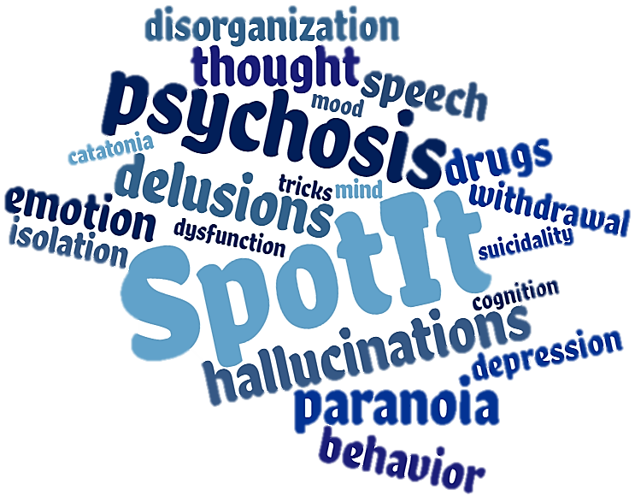
Psychosis: Can You Spot It?
An educational series on first episode psychosis, common signs and symptoms, and barriers to diagnosis and treatment.
Notes:
Welcome. I am Chad Jones, your host for today’s webinar. The webinar series “Psychosis, Can You Spot It?” was developed by Dr. Diana Perkins and her team.

Slide 2
Psychosis: Can You Spot It?
Diana O. Perkins, MD MPH
Professor, Department of Psychiatry
Director, UNC Outreach and Support Intervention Services (UNC OASIS)
Director, Early Psychosis Interventions in North Carolina Resources (EPI-NC Resources)
Notes:
Dr. Perkins is the Director of EPI-NC, a program supporting the development of early psychosis treatment programs in North Carolina. This webinar series is supported by EPI-NC, funded by a federal Community Mental Health Services Block Grant as a project of the NC Division of Mental Health, Developmental Disabilities & Substance Abuse Services. Dr. Perkins is a Professor in the Department of Psychiatry at the University of North Carolina at Chapel Hill and is the Director and one of the psychiatrists of the UNC OASIS program, a coordinated specialty care program for persons in the early stages of a psychotic disorder. Her research focuses on discovering what causes schizophrenia, in the hope of developing better treatments and eventually a cure.

Slide 3
Psychosis: Can You Spot It?
An educational series on first episode psychosis, common signs and symptoms, and barriers to diagnosis and treatment.
Notes:
Thanks Chad.
I want to welcome you to Psychosis: Can you spot it?, an educational series that addresses the common signs and symptoms of first episode psychosis, as well as the barriers to recognition by health care providers.

Slide 4
Disclosures
In the past two years Dr. Perkins received
funding from Boehringer-Ingleheim to conduct a clinical trial at UNC,
consulting fees from Alkermes,
royalties from APA publishing.
Notes:
Before we begin, I have the following to disclose. In the past two years I received funding from Boehringer-Ingelheim to conduct a clinical trial at UNC, consulting fees from Alkermes and royalties from APA publishing.

Slide 5
Psychosis: Can You Spot It?
Module 1 – An Introduction to Psychosis
Module 2 – Differentiating Between Types of Symptoms
Module 3 – Oversight and Misdiagnosis of Psychosis
Module 4 – Confounds and Overlaps in Clinical Features
A look at the national prevalence of psychotic disorders, common signs and symptoms, and barriers to diagnosis and treatment.
Distinguishing key features of fully psychotic, attenuated psychotic, and non-psychotic symptoms and the differences therein.
How cognitive heuristics influence clinical decision-making and strategies for decreasing biases and improving the likelihood of a correct diagnosis.
Identifying the range of disorders that feature psychosis as a symptom and factors like trauma and substance use that increase clinical risk.
Notes:
There are four one-hour modules in this series. Module 1 examines the prevalence of psychosis in comparison to other mental disorders, describes psychosis syndromes and discusses barriers to recognition. Module 2 is an in-depth look at the spectrum of psychosis, ranging from full psychosis to “prodromal-severity” to “unusual” experiences. Module 3 explores why clinicians make diagnostic errors, in general and in relation to psychosis. Module 4 explores the variety of disorders that include psychosis as a feature.

Slide 6
Module 3: Oversight and Misdiagnosis of Psychosis
Diana O. Perkins, MD MPH
Professor, Department of Psychiatry
Director, UNC Outreach and Support Intervention Services (UNC OASIS)
Director, Early Psychosis Interventions in North Carolina Resources (EPI-NC Resources)
Notes:
This is module 3, Why clinician’s miss diagnoses and what you can do about it.

Slide 7
Learning Objectives
At the end of the module the clinician will better understand:
The problem of diagnostic errors
Cognitive Heuristics
The short-cuts
Notes:
In this module we discuss the problem of diagnostic errors.

Slide 8
Learning Objectives
At the end of the module the clinician will better understand:
The problem of diagnostic errors
How cognitive heuristics contribute to diagnostic errors
Cognitive Heuristics
The short-cuts
Contribute to Misdiagnosis
Notes:
We will focus on the clinical decision-making process, especially related to “cognitive heuristics”. Cognitive heuristics are simple, efficient strategies used by all of us to integrate information and make judgements. Often helpful, use of cognitive heuristics can also contribute to misdiagnosis, and…

Slide 9
Learning Objectives
At the end of the module the clinician will better understand:
The problem of diagnostic errors
How cognitive heuristics contribute to diagnostic errors
Cognitive Heuristics
The short-cuts
Contribute to Misdiagnosis
&
“Missed” Diagnosis
Notes:
“Missed” diagnosis.

Slide 10
Learning Objectives
At the end of the module the clinician will better understand:
The problem of diagnostic errors
How cognitive heuristics contribute to diagnostic errors
Strategies to minimize missed diagnosis and misdiagnosis
Cognitive Heuristics
The short-cuts
Contribute to Misdiagnosis
&
“Missed” Diagnosis
Notes:
We will review strategies to avoid missed diagnosis and misdiagnosis, in general and with a special focus with less common disorders, especially psychotic disorders.

Slide 11
Misdiagnosis Estimates
Rietdijk et al. Soc Psychiatry Psychiatr Epidemiol 2014: 49: 349-358
Notes:
Clinicians make mistakes in diagnosis in all medical fields. Estimates are that misdiagnosis occurs in 2-7% of hospitalized patient, 5-10% of persons treated in an emergency room, and 0.2% of persons in primary care settings. In one study in a large outpatient mental health clinic 2% of patients had undiagnosed psychotic disorders.

Slide 12
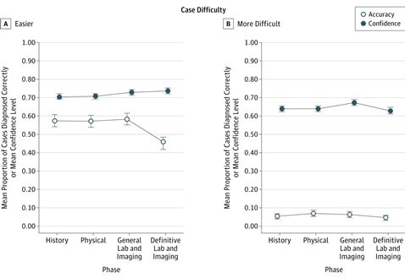
Physicians’ Diagnostic Accuracy and Confidence
Meyer et al. JAMA Intern Med. 2013 173:1952-1959
Notes:
Clinicians typically over-estimate their diagnostic skills. For example, this study compared practicing general medicine clinicians’ ability to diagnosis easier and more difficult clinical cases, based on vignettes where first the clinicians were given the medical history, then the physical exam findings, and then the laboratory and imaging results. The clinicians were given enough information needed to make the true diagnosis. The line with the solid squares shows that the clinicians’ were equally confident that they were on the right track for both the easier and more difficult cases, at about 70%. However, as shown by the line with circles, the actual accuracy was better for the easier cases, but still at 50% correct. For the more difficult cases the actual diagnostic accuracy was only 5%. The study investigators suggest that improvement in diagnostic accuracy hinges on training exercises that provide feedback to clinicians about diagnostic accuracy and on making clinicians more aware of the cognitive heuristics that lead to diagnostic errors.

Slide 13
Diagnostic Errors in Mental Health Care Settings
Missed diagnoses:
Anxiety disorders: missed ~50%
Substance use disorders: missed ~20%
Psychotic and somatoform disorders: almost always
Over-diagnosed
Bipolar Disorder ~50%
Adjustment Disorder ~50%
Zimmerman. A Review of 20 years of research on overdiagnosis and underdiagnosis in the Rhode Island Methods to Improve Diagnotic Assessment and Services (MIDAS) Project. The Canadian Journal of Psychiatry 2016 61:71-79Zimemerman
Notes:
Mental health clinicians are also prone to diagnostic errors. Several studies have compared diagnoses based on routine clinical exam to those made by a structured diagnostic interview. These studies find that a routine clinical evaluation frequently misses clinically important diagnoses, for example anxiety disorders were missed about 50% of the time, alcohol and other substance use disorders about 20% of the time, and uncommon disorders, such as somatoform and psychotic disorders were almost always missed. Furthermore, about half of the people given a diagnosis of Bipolar and adjustment disorders did not meet criteria.

Slide 14
Diagnostic Errors in Mental Health Care Settings
Strategies to avoid missed diagnoses:
Symptom checklists (e.g. DSM-5 self-rated screen)
Structured interview (e.g. SCID clinician version)
Zimmerman. A Review of 20 years of research on overdiagnosis and underdiagnosis in the Rhode Island Methods to Improve Diagnotic Assessment and Services (MIDAS) Project. The Canadian Journal of Psychiatry 2016 61:71-79Zimemerman
Notes:
If the diagnostic error involves mislabeling, where the clinician correctly identifies and addresses the symptoms but uses the technically “wrong” diagnosis, then the diagnostic error is relatively unimportant. However, diagnostic errors often lead to less-than-optimal treatment recommendations. Often diagnoses are missed because the clinician did not ask about the symptoms in that domain, and the client didn’t volunteer the symptoms. So, one simple strategy to address this issue is to make sure your initial screening evaluation includes a relatively complete review of major symptom domains. There are tools available to help clinicians. For example, the authors of the DSM-5 created a self-report symptom screener that is in the public domain, and the SCID clinician version provides a semi-structured interview and is free for use in clinical settings. Having learned the SCID as part of my research, I can say that my routine clinical evaluations were substantially improved as I incorporated the SCID screening and diagnostic strategies.

Slide 15
Let’s hear from Jessica
Notes:
Let’s here again from Jessica. As she told us in module 1, she had her first psychotic episode while in college. In her experience, her family and several health care professionals at the student health clinic and in the emergency room were involved and yet no one suspected psychosis. Here is her account of many of the people who were involved after she became symptomatic.

Slide 16
H
E
U
R
I
S
T
I
C
S
Notes:
We all use various heuristics for most routine decisions. (CLICK)

Slide 17
Fast
H
E
U
R
I
S
T
I
C
S
Notes:
These cognitive short-cuts are fast, (Click)

Slide 18
Fast
H
E
U
R
I
S
T
I
C
S
Automatic
Notes:
automatic (Click)

Slide 19
Fast
H
E
U
R
I
S
T
I
C
S
Automatic
Little Effort Required
Notes:
and require little effort. Without these heuristics we can easily become overwhelmed or bogged down with irrelevant details. Use of cognitive heuristics is our default mode, the way we approach every day problems.

Slide 20
A
N
A
L
Y
T
I
C
Notes:
An alternative cognitive strategy is “Analytic thinking”.

Slide 21
Slow
A
N
A
L
Y
T
I
C
Notes:
In contrast to cognitive heuristics, analytic thinking is a slower process…(CLICK)

Slide 22
Slow
A
N
A
L
Y
T
I
C
Effortful
Notes:
…it requires more effort, (CLICK)

Slide 23
Slow
A
N
A
L
Y
T
I
C
Effortful
Active
Notes:
…and is a strategy we actively engage when we are trying to consider alternative interpretations or “think outside of the box”.

Slide 24
Notes:
Clinical decision-making requires the integration of a large amount of information over a relatively short time-frame.

Slide 25
I’ve been experiencing anxiety and problems sleeping…
Notes:
The patient’s report of symptoms such as “anxiety” and “problems sleeping” guides the evaluation process.

Slide 26
Hmmm. She looks sad and her clothes are unkept. She is quite thin and doesn’t look healthy. …
Hmmm. She looks sad and her clothes are unkept. She is quite thin and doesn’t look healthy. …
I’ve been experiencing anxiety and problems sleeping…
Notes:
As the client is talking our therapist, Gloria, is not only listening to what the client says, but what is being communicated with gestures, facial expressions, and other non-verbals. In addition Gloria considers the client’s appearance.

Slide 27
How do you approach a new client who reports problems with anxiety and sleep? What sort of information do you seek?
Notes:
Thinking about your routine practice, how do you approach a new client who reports problems with anxiety and sleep? What sort of information do you seek?

Slide 28
Education
Training
Experience
Notes:
The clinical assessment process requires us to recognize patterns. How we approach this process is based on our education, training and experiences. Often our default is to use various cognitive heuristics to decide what is important and what is not important, after all these are fast and require less effort on the part of the clinician. However, the consensus from experts seeking to minimize diagnostic errors is that use of cognitive heuristics leads to diagnostic errors. Critical thinking skills, while slower and more effortful, better help the clinician determine what information is relevant, leading to a correct diagnosis. An important step is for clinicians to become more aware of how their use of cognitive heuristics influences their clinical assessment process.

Slide 29
Cognitive heuristics and diagnostic errors
Notes:
To that end we will review anchoring, availability, and confirmatory bias, three of the most common cognitive heuristics that can derail the diagnostic process and contribute to errors.

Slide 30
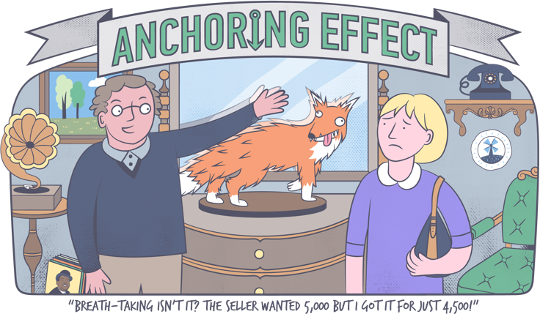
Anchoring Effect [Cartoon]. (n. d. ). Retrieved from https://www.towergateinsurance.co.uk/liability-insurance/cognitive-biases
Notes:
Anchoring is when information obtained early in the evaluation process determines next steps. We adjust our assessment process based on the anchor. The anchoring cognitive heuristic is frequently exploited by persons experienced in negotiations, as we see in this cartoon.

Slide 31
Vignette: Anchoring
Notes:
Anchoring can lead to premature closure, where an early conclusion is assumed to be right, and alternative explanations aren’t fully explored. In this vignette we look an example of anchoring.

Slide 32
Notes:
Our therapist, Gloria, is meeting with Kevin for an initial evaluation. Kevin is a 19 year old college student from a well-to-do family. The reason for the evaluation was a decline in his grades second semester of his freshman year.

Slide 33
So Kevin, what is the reason for your visit?
Notes:
After introductions Gloria asks him about why he is here…“So Kevin, what is the reason for your visit?”
…and Kevin gives an unexpected answer…

Slide 34
So Kevin, what is the reason for your visit?
I’m having this weird sense that I’m being followed.
Notes:
“I’m having this weird sense that I’m being followed.”

Slide 35
Hmm, I see that the client checked off marijuana use on his intake form. He’s wearing his fraternity t-shirt, he sure looks the frat boy “type)..
Notes:
Gloria had reviewed Kevin’s intake form, where he disclosed marijuana and other drug use. She notices that the patient’s dress, and sizes him up as a “typical frat boy”. Drug use is at the top of her list as the reason for his decline in school grades.

Slide 36
I see here that you mentioned that you use substances.
Notes:
So Gloria decides to pursue substance use… “I see here that you mentioned that you use substances.”

Slide 37
I see here that you mentioned that you use substances.
Yeah, sometimes I smoke pot with friends on the weekends. But, I’m having the feeling of being watched all of the time.
Notes:
…and Kevin acknowledges marijuana use.
“Yeah, sometimes I smoke pot with friends on the weekends. But, I’m having the feeling of being watched all of the time.”
Gloria knows that THC in marijuana can cause paranoia and decides she is on to something.

Slide 38
Did you know that paranoia is associated with marijuana use?
Notes:
Gloria follows up with providing the client with information “Did you know that paranoia is associated with marijuana use?”

Slide 39
Did you know that paranoia is associated with marijuana use?
Yeah, I heard that. I haven’t smoked in a while now. I’m pretty sure that a car followed me home last night. I wondered if it was the FBI.
Notes:
“Yeah, I heard that. I haven’t smoked in a while now. I’m pretty sure that a car followed me home last night. I wondered if it was the FBI.”
At this point Gloria decides that marijuana use is most likely Kevin’s key problem, and that he is minimizing his substance use.

Slide 40
Do you agree with Gloria’s diagnosis of substance use disorder?
Yes
No
Notes:
Use the response box to answer the following polling question: Do you agree with Gloria’s diagnosis of substance use disorder? Yes or No?

Slide 41
Do you agree with Gloria’s diagnosis of substance use disorder?
Yes
No
Notes:
Based on the intake form Gloria went in to the session already focused on substance use as an explanation for Kevin’s troubles. At some point a clinician needs to anchor their evaluation to the most likely possibilities, and intake forms are meant to provide tentative anchors for the clinical evaluation. However, most clinical evaluations benefit from an initial open-ended exploration of the client’s narrative, where the clinician is creating a short list of possibilities. Gloria didn’t explore other explanations for Kevin’s issues because she anchored too early, even before she met him.

Slide 42
How did the cognitive heuristic “anchoring” contribute to Gloria possibly misdiagnosing Kevin?
a) She selectively explored her initial impression.
b) She selectively pursued information that first came to mind.
c) She ignored information that went against her diagnostic formulation.
d) All of the above.
Notes:
Next, use the response box again to indicate how the cognitive heuristic “anchoring” contributed to Gloria possibly misdiagnosing Kevin. A) She selectively explored her initial impression. B) She selectively pursued information that first came to mind. C) She ignored information that went against her diagnostic formulation. Or D) All of the above.

Slide 43
How did the cognitive heuristic “anchoring” contribute to Gloria possibly misdiagnosing Kevin?
a) She selectively explored her initial impression.
b) She selectively pursued information that first came to mind.
c) She ignored information that went against her diagnostic formulation.
d) All of the above.
Notes:
Anchoring involves relying on information obtained early in the course of the clinical evaluation to guide the rest of the evaluation. Gloria did also used “c”, an example of confirmatory bias. It is important for all of us to remember that anchoring is a common strategy used by busy health care providers.
The common use of anchoring by health care providers might influence how we give information to our own health care providers. Most of us want to tell our own health care provider about our problem in chronological order, however the most important information may come later in the story. Perhaps next time you seek health care, consider that your provider may use the cognitive heuristic anchoring, and so provide what you think is the most important information early in your narrative.

Slide 44
Anxiety and depressive disorders are highly common, chances are you see many patients that actually do have anxiety and depressive disorders. Could the high prevalence of mood disorders impact the clinical assessment process, and contribute to missing less common disorders?
a) Yes, but mainly for inexperienced clinicians.
b) Yes, but mainly for experienced clinicians.
c) Yes, it happens with new and experienced clinicians.
d) Yes, for many clinicians, but not for me.
Notes:
One final question.

Slide 45
Anxiety and depressive disorders are highly common, chances are you see many patients that actually do have anxiety and depressive disorders. Could the high prevalence of mood disorders impact the clinical assessment process, and contribute to missing less common disorders?
a) Yes, but mainly for inexperienced clinicians.
b) Yes, but mainly for experienced clinicians.
c) Yes, it happens with new and experienced clinicians.
d) Yes, for many clinicians, but not for me.
Notes:
Anxiety and depressive disorders are common, when a patient leads with complaints of mood symptoms both new and experienced clinicians may use this information as an “anchor” for the rest of the evaluation.

Slide 46
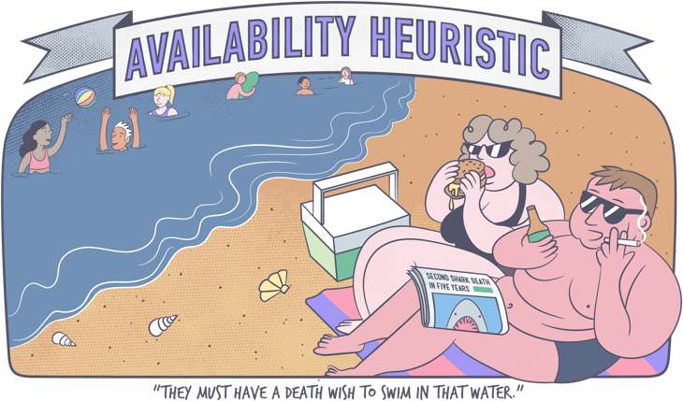
Availability Heuristic [Cartoon]. (n. d. ). Retrieved from https://www.towergateinsurance.co.uk/liability-insuranc/cognitive-biasese
Notes:
Availability is relying on what comes to mind most easily. In particular, scenarios that we have recently encountered come to mind more easily. Humans tend to assume that what comes to mind most readily is the most important consideration. This is the availability heuristic. What comes to mind most readily is, however, often shaped by a host of factors unrelated to importance or actual probability.

Slide 47
Vignette: Availability
Notes:
In the following vignette we explore an example of the availability heuristic.

Slide 48
Notes:
Gloria is meeting Susan, a new client, for the first time. Susan was referred by her primary care provider because of recent weight loss unexplained by any medical cause. Susan’s primary care provider is wondering if psychological factors may be contributing to her weight loss. Gloria asks Susan about her reason for being here, and Susan replies…

Slide 49
I’ve been feeling down. I recently lost weight and am not sleeping well. I exercise daily, but I still feel unhappy.”
Notes:
“I’ve been feeling down. I recently lost weight and am not sleeping well. I exercise daily, but I still feel unhappy.”
While Susan tells her narrative, Gloria is struck by her physical appearance. What comes first to Susan’s mind is influenced by her most recent experiences.

Slide 50
This woman is very thin. I just read that the number of eating disorders in middle-aged women is increasing. A similarly aged client last week has anorexia….hmm.
I’ve been feeling down. I recently lost weight and am not sleeping well. I exercise daily, but I still feel unhappy.”
Notes:
Gloria has been reading about eating disorders, and recently saw a women with an eating disorder. So, given the availability heuristic that we all use, it makes sense that what first pops into Gloria’s mind is that maybe this woman has an eating disorder. Gloria focuses her questioning on Susan’s recent weight loss.

Slide 51
How much weight have you lost?
Notes:
“How much weight have you lost?” she asks.

Slide 52
How much weight have you lost?
I’ve lost about 8-10lbs this month.
Notes:
Susan says she has lost 8-10 pounds this month. Gloria knows that a key diagnostic feature of anorexia nervosa is body image distortion.

Slide 53
Are you concerned about your body weight?
Notes:
She asks if the client is concerned about her body weight.

Slide 54
Are you concerned about your body weight?
Yes, I’m not happy with how much I weigh.
Notes:
Susan says, “Yes, I’m not happy with how much I weigh.”

Slide 55
Notes:
Gloria interprets Susan’s unhappiness to mean that Susan has a distortion in her body image.

Slide 56
She’s unhappy with her weight despite losing 8-10 lbs this month and she is exercising daily. I think she’s struggling with an eating disorder.
Notes:
Gloria focuses on the evidence that supports the diagnosis of an eating disorder. “She’s unhappy with her weight despite losing 8-10 lbs this month and she is exercising daily. I think she’s struggling with an eating disorder.”
…Susan is thinking along other lines…

Slide 57
She’s unhappy with her weight despite losing 8-10 lbs this month and she is exercising daily. I think she’s struggling with an eating disorder.
I don’t like that I’ve lost weight. I wish that I could get my appetite back.
Notes:
She’s thinking, “I don’t like that I’ve lost weight. I wish that I could get my appetite back.”

Slide 58
Do you agree with Gloria’s diagnosis of an eating disorder?
a) Yes
b) No
Notes:
Use the response box to answer the following polling question: Do you agree with Gloria’s diagnosis of an eating disorder? Yes or No?

Slide 59
Do you agree with Gloria’s diagnosis of an eating disorder?
a) Yes
b) No
Notes:
Gloria gave too high an importance to her first diagnosis, and neglected to explore other, more likely possibilities.

Slide 60
How did the cognitive heuristic “availability” contribute to Gloria possibly misdiagnosing Susan?
a) She selectively explored her initial impression.
b) She selectively pursued information that first came to mind.
c) She ignored information that went against her diagnostic formulation.
d) All of the above.
Notes:
Use the response box to answer the following polling question: How did the cognitive heuristic “availability” contribute to Gloria possibly misdiagnosing Susan? a) She selectively explored her initial impression. b) She selectively pursued information that first came to mind. c) She ignored information that went against her diagnostic formulation.
d) All of the above.

Slide 61
How did the cognitive heuristic “availability” contribute to Gloria possibly misdiagnosing Susan?
a) She selectively explored her initial impression.
b) She selectively pursued information that first came to mind.
c) She ignored information that went against her diagnostic formulation.
d) All of the above.
Notes:
Our brains are wired so that what first comes to mind is influenced by what we have been thinking about lately, as well as the strength of the emotions we experienced during the event. Gloria had been reading about late onset eating disorders, and recent clinical interaction with an eating disordered client made an impression on her. So it is reasonable to expect that Gloria would be thinking “eating disorder” with this client. Her diagnostic error was to overvalue her first idea, and not fully consider other possibilities. This led her to misinterpreting the client’s unhappiness with her weight loss, and failure to explore other more likely possibilities such as major depression.

Slide 62
Guess My Rule
Notes:
Dylan, Shannon, and Anthony play a game that illustrates the next cognitive heuristic. Try playing along.
[play video]

Slide 63
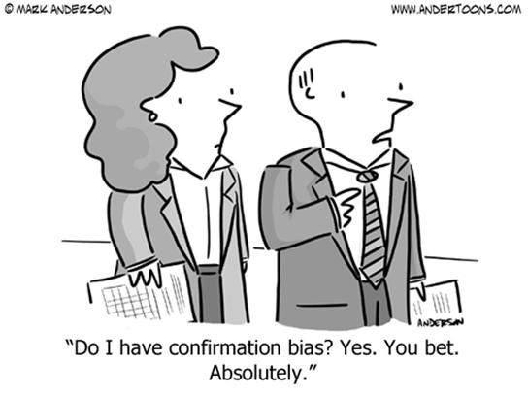
Notes:
What most people do when faced with this problem is come up with a rule very early on, and then only propose numbers that follow this rule, using the cognitive tactic, “Let me see if I am right”. This tactic is great for routine problems, we want to quickly “build a case” for what is happening and then move on to the next issue. Our brains are very good at pattern matching! Searching for confirmatory evidence is highly efficient. Finding disconfirmatory evidence takes more effort, we have to pause, “switch gears”. This game is not a test of intelligence. No matter what the person’s IQ, most people initially approach the number game by forming an hypothesis about the pattern, and then seeking out information to confirm, rather than to refute their hypothesis. It’s only when you switch to a ”disconfirmatory” approach that you finally guessed the rule.

Slide 64
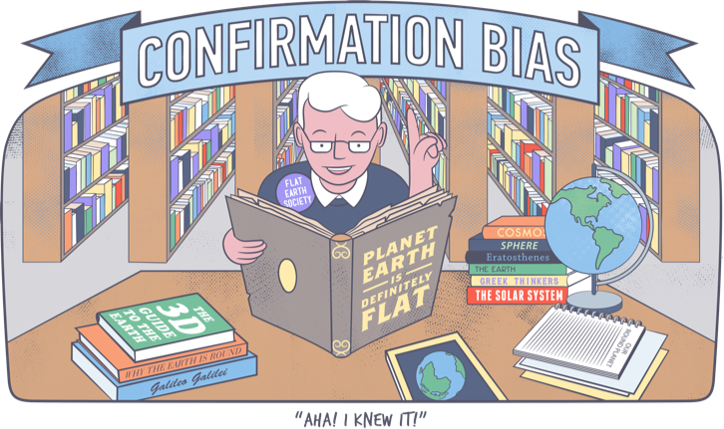
Confirmation Bias [Cartoon]. (n. d. ). Retrieved from https://www.towergateinsurance.co.uk/liability-insurance/cognitive-biases
Notes:
The human brain has an amazing ability to match patterns. Our training and experience are the basis of our clinical expertise, when doing a clinical assessment we attempt to match the client’s scenario to our previous experiences. Naturally clinicians take a confirmatory approach in this pattern-matching process. For this reason clinicians have a tendency to overemphasize information that supports and tend to ignore information that refutes our diagnostic conclusions.

Slide 65
Vignette: Confirmation Bias
Notes:
In our previous vignettes, in addition to her over-reliance on “recency” and “availability” heuristics, Gloria also tended to ignore information provided by her clients that might refute her diagnostic formulation, examples of confirmation bias. Here is another example…

Slide 66
Notes:
Joel is 9 years old, and up until the second quarter of third grade had been an excellent student with no behavioral issues. Joel’s mom describes his problems in school.

Slide 67
He’s having a hard time concentrating in school and his grades dropped. He is even distracted during basketball, which he loves…well, loves it outside of the time he hit his head during a game, which is when this all started. He is struggling to stay focused and his teachers complain that he is acting out in class.
Notes:
“He’s having a hard time concentrating in school and his grades dropped. He is even distracted during basketball, which he loves…well, loves it outside of the time he hit his head during a game, which is when this all started. He is struggling to stay focused and his teachers complain that he is acting out in class.”

Slide 68
He’s having a hard time concentrating in school and his grades dropped. He is even distracted during basketball, which he loves…well, loves it outside of the time he hit his head during a game, which is when this all started. He is struggling to stay focused and his teachers complain that he is acting out in class.
Hmmmm. Classic ADD.
Notes:
Gloria suspects ADD, and yes, problems concentrating, staying focused, and distractability are consistent with ADD. Is there anything else Gloria should consider in her evaluation? What detail is she ignoring?

Slide 69
Is he forgetful about daily activities? Fidgeting and needing to be in motion?
Notes:
Gloria explores other symptoms of attention deficit disorder…
She asks, “Is he forgetful about daily activities? Fidgeting and needing to be in motion?”

Slide 70
Is he forgetful about daily activities? Fidgeting and needing to be in motion?
Yes, he’s always been forgetful. Hmm, I wouldn’t say that he fidgets. He actually appears more lethargic to me recently.
Notes:
Mom replies… So Gloria gets a positive response to being forgetful, but what about mom’s response to fidgeting and needing to be in motion?

Slide 71
Does he not follow through on instructions? Does he lose things?
Notes:
Gloria continues to explore other symptoms of ADD, for example…“Does he not follow through on instructions? Does he lose things?”

Slide 72
Does he not follow through on instructions? Does he lose things?
He doesn’t always follow instructions, sometimes he loses things….
Notes:
The mother’s response is, “He doesn’t always follow instructions, sometimes he loses things…”

Slide 73
This sounds like ADHD!
Notes:
“This sounds like ADHD!” In the end Gloria went with her first impression. She used a confirmatory approach to questioning, so she didn’t pick up on the recent head trauma that occurred right before his problems began, and discounted symptoms that didn’t really fit a diagnosis of ADD, such as lethargy. A key to avoiding confirmatory bias is to routinely focus on eliciting information that could disconfirm, rather than confirm your working diagnoses.

Slide 74
Clinicians typically use a confirmatory approach…arriving at a diagnosis within the first 5 minutes.
Mendel et al. Confirmation bias: why psychiatrists stick to wrong preliminary diagnoses.Psychol Med 2011 41:2651-9
Notes:
Gloria is not unusual. Studies show that clinicians typically use a confirmatory approach an assessment, arriving at a diagnosis within the first 5 minutes.
(Mendel 2011 Confirmation bias)

Slide 75
Common “Cognitive Dispositions to Respond” that Derail Clinical Judgement
Anchoring: placing the greatest emphasis on early information
Availability: assume most readily recalled possibilities are most likely
Confirmatory Approach: seek evidence to confirm hypothesis, (disregard contradictory evidence)
Blumenthal-Barby and Krieger. Cognitive biases and heuristics in medical decision makes: a critical review using a systematic search strategy. Med. Decis. Making 2015. 35:539-57
Croskerry 2003 The importance of cognitive errors in diagnosis and strategies to minimize them. Acad Med 2003 78:775-80
Notes:
So to summarize, we have reviewed three common “cognitive dispositions to respond” that may derail clinical judgement. These include anchoring, placing too much emphasis on early information, availability, assuming that our most readily recalled possibilities are the most likely, and taking a confirmatory approach, seeking evidence to confirm our hypothesis, and disregarding contradictory evidence. This list is not exhaustive, as studies of normal cognition have identified many other cognitive heuristics that guide our decision-making.

Slide 76
Strategies
Example
Notes:
There are several strategies that clinicians can use to take advantage of cognitive heuristics when appropriate, and minimize the risk that cognitive heuristics interfere with clinical decision-making. The general principle relates to “meta-cognition”, taking a step back and thinking about our thinking process.

Slide 77
Use Analytic Thinking Strategies
Anchoring:
Avoid quick diagnostic decisions
Be aware of natural tendency to over-emphasize early information
Reformulate when you have new information:
Clinical conditions change over time.
Clients reveal new information as they develop trust in you.
Informants provide a different perspective.
Notes:
Anchoring, the tendency to emphasize early information, can be minimized if you first make a conscious effort to avoid coming to a “firm” diagnosis quickly. For example, clients may tell their stories in chronological order, with early events and symptoms leading you down the wrong track, and later details more telling in terms of diagnosis. Most importantly, be prepared to reformulate your diagnostic impression over time. After all, clinical conditions change over time, clients may reveal new information as they develop trust in you, and informants provide a different perspective. Actually, for yourself, when you visit a health provider as a patient, awareness of the impact of “anchoring” on your health care providers decision-making can make a difference! Tell your health care provider what you consider to be the most important information first!

Slide 78
Use Analytic Thinking Strategies
Anchoring:
Avoid quick diagnostic decisions
Be aware of natural tendency to over-emphasize early information
Reformulate when you have new information:
Clinical conditions change over time.
Clients reveal new information as they develop trust in you.
Informants provide a different perspective.
Availability:
Consciously think about the possibilities, rank in order of probability
Consider checklists, routinely use “Up-To-Date” or other tools
on diagnosis; allow multiple meetings/sessions
Notes:
Availability, the tendency to over value potential diagnosis that first come to mind, can be avoided if you make a habit of asking yourself “What else could this be?” Then rank the possibilities in order of probability. Consider using checklists or other tools. Remember that depression, anxiety, and concentration difficulties are highly non-specific, and may be a feature of almost any disorder. Clients with complex histories may require more than one meeting, or informant information to arrive at a diagnosis with full confidence.

Slide 79
Use Analytic Thinking Strategies
Confirmatory Approach:
Routinely seek disconfirmatory evidence.
Avoid quick decisions on diagnosis; allow multiple meetings/sessions.
Notes:
The confirmatory approach involves the tendency to seek out evidence that confirms our beliefs rather than to seek out evidence that might disprove our beliefs. As was the case with Gloria, we often disregard disconfirmatory evidence even when provided. Make a conscious effort to seek out disconfirmatory evidence. Look for discrepancies, and be curious.

Slide 80
Notes:
Here’s an example of a clinician avoiding ”anchoring” and also paying close attention to information that contradicting her initial diagnostic impression.

Slide 81
Hmm, he sounds really depressed, but he mentioned occasional racing thoughts. We’re out of time today. Next session I’m going to screen for Bipolar, OCD and psychotic symptoms…I’m not going to decide diagnosis today.
Notes:
“Hmm, he sounds really depressed, but he mentioned occasional racing thoughts. We’re out of time today. Next session I’m going to screen for Bipolar, OCD and psychotic symptoms…I’m not going to decide diagnosis today.”
Even though her initial impression was depression, she noted potential contradictory information, “racing thoughts.” She focused on establishing a therapeutic alliance at this first meeting, but decided that not all the clinical pieces fit together and that her client deserved a more detailed review of symptoms before she would be confident abut her diagnostic assessment.

Slide 82
Notes:
Gloria has been seeing Justin for about three months. She gave him a diagnosis of social anxiety disorder, based on intense anxiety in social situations due to fears that others will think he ”is stupid”. He avoids social situations because he is worried that others will notice how anxious he is, especially because he blushes so easily. He becomes so anxious when required to do a class presentation that he becomes nauseous and vomits. Today Justin mentions a new experience, and Gloria reflects on what the experience might represent…

Slide 83
I keep getting the feeling I am being followed…
Notes:
Today Justin mentions a new experience,

Slide 84
He’s having thoughts about being followed…sounds kinda paranoid.
Notes:
and Gloria reflects on what the experience might represent… “He’s having thoughts about being followed…sounds kinda paranoid”. Gloria notices the discrepancy of this new complaint with her formulation of Justin as having Social Anxiety Disorder, and so reconsiders what may be going on with Justin,

Slide 85
Can these thoughts about being followed just be in your imagination?
Notes:
She decides to better understand what he is experiencing, “Can these thought about being followed just be in your imagination?” she asks.

Slide 86
Can these thoughts about being followed just be in your imagination?
Probably. I do only have them after watching a TV show in which a character is followed.
Notes:
Justin says, “Probably. I do only have them after watching a TV show in which a character is followed.”

Slide 87
Do you feel followed any other times other than after you watch this show?
Notes:
Gloria continues to seek disconfirmatory evidence, and so follows up, asking, “Do you feel followed any other times other than after you watch this show?”

Slide 88
Do you feel followed any other times other than after you watch this show?
No, it’s only happened twice after watching the show.
Notes:
Justin says, “No, it’s only happened twice after watching the show.” Gloria decides that while unusual, this experience isn’t happening often enough to raise a concern for psychosis.

Slide 89
MHSS Findings: Prevalence of Mental Disorders, persons ages 18-29
Notes:
Now, let’s recall a graph we reviewed in the first module showing the results of the Mental Health Surveillance Survey on the prevalence of mental disorders in persons ages 18-29. As you can see, adjustment and mood disorders make up the majority of diagnoses seen in outpatient mental health care settings. Psychotic disorders are uncommon, and based on incidence data we expect new onset psychotic disorders to be relatively rare.

Slide 90
When and How to Inquire about Psychosis
New Clients
Always screen for Psychosis
Notes:
New clients should always be screened for psychotic symptoms, because even though rare these are not symptoms you want to miss. Routine use of symptom checklists, such as the DSM-5 self-rated checklist, helps to ensure that you haven’t missed anything that the client will share. Familiarity with semi-structured clinical interviews, such as the Structured Clinical Interview for DSM-5, Clinician version, may be helpful in fine-tuning your routine clinical evaluation process.

Slide 91
When and How to Inquire about Psychosis
New Clients
Always screen for Psychosis
Established Clients
Attend to disconfirmatory evidence
Re-evaluate if clients aren’t improving as expected
Notes:
Most important is to attend to disconfirmatory evidence, whether the client is new or established. This includes re-evaluating clients, especially if that aren’t improving as expected. Afterall, a failure to respond to treatment is discomfirmatory evidence regarding the initial diagnosis.

Slide 92
Notes:
Here is one last vignette. Joe is 16 years old, and he presents with school failure. His parents were recently divorced. It turns out he has been absent from school frequently. Joe tells Gloria more about what is going on…

Slide 93
I feel tired a lot, like I don’t have any energy, but then at night I have trouble sleeping. Then I don’t feel like going to school so I just skip.
Notes:
Joe says, ““I feel tired a lot, like I don’t have any energy, but then at night I have trouble sleeping. Then I don’t feel like going to school so I just skip.” The first thought that comes to Gloria’s mind is…

Slide 94
I feel tired a lot, like I don’t have any energy, but then at night I have trouble sleeping. Then I don’t feel like going to school so I just skip.
This might be depression.
Notes:
“This might be depression.” Gloria knows that she is prone to anchoring, but mood disorders are common…

Slide 95
What is your mood like most days?
Notes:
So she asks “What is your mood like most days?”

Slide 96
My mood is up and down, but mostly I feel bad.
What is your mood like most days?
Notes:
Joe says his mood is up and down, but mostly he feels bad. Gloria then explores other symptoms of depression…

Slide 97
What things do you enjoy doing?
Notes:
She asks what things he enjoys doing.

Slide 98
There really isn’t anything I enjoy anymore.
What things do you enjoy doing?
Notes:
“There really isn’t anything I enjoy anymore,” Joe says.

Slide 99
Did feeling bad and not enjoying things come out of the blue, or is there a reason for it?
Notes:
“Did feeling bad and not enjoying things come out of the blue, or is there a reason for it?”

Slide 100
Did feeling bad and not enjoying things come out of the blue, or is there a reason for it?
I don’t like to talk about it, but it started when I heard the demons taunting me and telling me to do bad things.
Notes:
Joe reveals that his mood changed when demons started taunting him and telling him to do bad things.

Slide 101
Whoa….I wasn’t expecting that.
Notes:
Even though Gloria was initially thinking that Joe’s problems were likely related to a depressive disorder, Gloria pays attention to the disconfirmatory evidence that Joe provides. She adds psychosis to her list of possible diagnoses.

Slide 102
Mask of Psychosis
Psychosis
Depressed Mood
Behavioral Change
Drug Use
Social Withdrawal
Suicidality
Anxiety
Notes:
The best clinicians understand their vulnerability to cognitive heuristics such as anchoring, availability, and confirmatory biases. Patients experiencing a first episode psychotic disorder often present to clinicians with depressed mood, anxiety, and suicidal thoughts. Behavioral changes such as a drop in school performance and frequent school absences and social withdrawal are common. Drug use, especially marijuana use, is common in persons with a first psychotic episode, and marijuana is also an environmental trigger for development of schizophrenia in some persons. Actively engaging an analytic thinking approach, especially seeking discomfirmatory evidence, is critical to getting the diagnosis right.

Slide 103
Summary
Notes:
As a summary let’s consider how cognitive heuristics may have impacted my evaluation of an admission to psychiatry inpatient service that occurred on a weekend that I was covering. He was admitted Friday night because he shot off his rifle in the woods after a fight with his wife. His admission diagnosis was depression, with dangerousness due to suicidal risk. He is from rural North Carolina (where, as I recently have learned from multiple different sources, the opioid epidemic is rampant). He revealed depressed mood, irritability, poor sleep, that he wasn’t having fun anymore, and hopelessness, but denied low energy, weight loss, or change in appetite and suicidal thoughts. He said he shot off the gun because he was angry at his wife, that losing his temper was his biggest problem, and that he had been depressed for the past 7 or 8 years, but that antidepressants hadn’t been much help. He admitted to a history of opioid use but said that he had been clean for 5 years. He also admitted to benzodiapine use a couple of times a week. He appeared anxious and guarded. My thought was that this patient most likely had antisocial personality disorder and a substance use disorder, with associated problems with impulse control, and that he was minimizing his substance use and was likely high on something the night he shot off the gun, probably opiates.
What happened the next day changed my thinking, when the patient sought me out, “Doc, can I tell you something I haven’t told anyone else?” Given the working diagnosis I was, of course, immediately suspicious about this patient’s motives. However what he told me next made it clear that I had missed the underlying issues. He revealed a 7-8 year history of worsening referential thinking. Over the last year he was certain people at work were talking about him and plotting against him. He knew because could hear them talking about him from a distance, saying all sorts of derogatory comments, many of a sexual nature. He thought a person from his job was sending coded text messages to his wife as part of the plot, and he knew because he had deciphered the code. In fact, the argument with his wife that precipitated his admission was about the plot, and he fired the gun in the woods because he was angry with the co-worker, not because he was thinking of harming himself. He told me the other patients on the unit were making fun of him. He pointed to a patient at the end of the hall and said, “see, he just said I was ‘the biggest looser God ever made’”, and that if it didn’t stop he was afraid he might start throwing things. He knew that would be wrong so he was just trying to stay away from everyone.
We added schizophrenia to the list of possible diagnoses, and information that we later obtained from his wife as well as further clinical monitoring led to the diagnosis of schizophrenia, and proved our initial formulation wrong.

Slide 104
What cognitive heuristic(s) may have influenced my initial diagnostic assessment?
Anchoring
Availability
Confirmatory bias
All of the above
Notes:
Using the polling box to indicate whether you think that any of the following cognitive heuristics influenced my initial diagnostic assessment?
Anchoring, availability, confirmatory bias, or all of the above?

Slide 105
What cognitive heuristic(s) may have influenced my initial diagnostic assessment?
Anchoring
Availability
Confirmatory bias
All of the above
Notes:
My answer is “all of the above”. Due to recent news reports I was particularly attuned to the opiod epidemic in North Carolina, and hence one of the first possibilities that I considered, that is the availability heuristic. I used anchoring, as the information about his opiod addiction history colored the rest of my evaluation. I didn’t pursue evidence that might have provided disconfirmatory evidence, for example his urine tox screen, that was negative for opiates, or that he was so guarded, or what the fight with his wife was about. Fortunately, I had a second chance the next day to re-evaluate his diagnosis.

Slide 106
Summary
Re-evaluate your approach to clinical assessments
Notes:
I hope this presentation encourages you to think about your approach to clinical assessment!

Slide 107
Summary
Re-evaluate your approach to clinical assessments
Does your initial clinical assessment include a complete review of major symptom domains?
Notes:
Does your initial clinical assessment include a complete review of major symptom domains?

Slide 108
Summary
Re-evaluate your approach to clinical assessments
Does your initial clinical assessment include a complete review of major symptom domains?
What cognitive heuristics do you tend to use, especially when you are “in a hurry?”
Notes:
What cognitive heuristics do you tend to use, especially when you are “in a hurry” or “tired”?

Slide 109
Summary
Re-evaluate your approach to clinical assessments
Does your initial clinical assessment include a complete review of major symptom domains?
What cognitive heuristics do you tend to use, especially when you are “in a hurry?”
How do you integrate disconfirmatory evidence into your clinical evaluation?
Notes:
How do you integrate discomfirmatory evidence into your clinical evaluation?

Slide 110
Credits
We would like thank the AHEC Innovation Fund and NIH (DUP Grant #R34MH103834) for the funding for this webinar series.
We would also like to thank all who were involved in creating these webinars:
Diana Perkins, MD, MPH Katie Bucrek Nina Fierro, LCSW
Emily Goldman, BS Jennifer Nieri, LCSW Jenna Roller
Notes:
This webinar series was funded by grants from the National Institute of Mental Health,, the federal Community Mental Health Services Block Grant Fund (CFDA #93.958) as a project of the NC Division of Mental Health, Developmental Disabilities & Substance Abuse Services and a grant from NC AHEC Innovation fund.

Slide 111
To ask a question:
Then, on the bottom right hand of your screen, select “All Panelists” from the drop down menu, and type your question into the window below:
Notes:
Thank you, Dr. Perkins.
Next is a discussion based on your comments and questions. If you haven’t already done so, please enter your comments and questions in the chat box at the bottom of the screen, sending to ”All Panelists”.

Slide 112
For More Information
Please visit our website: https://www.med.unc.edu/psych/epi-nc
Resources can be found on the “For Providers” tab.

