Slide 1

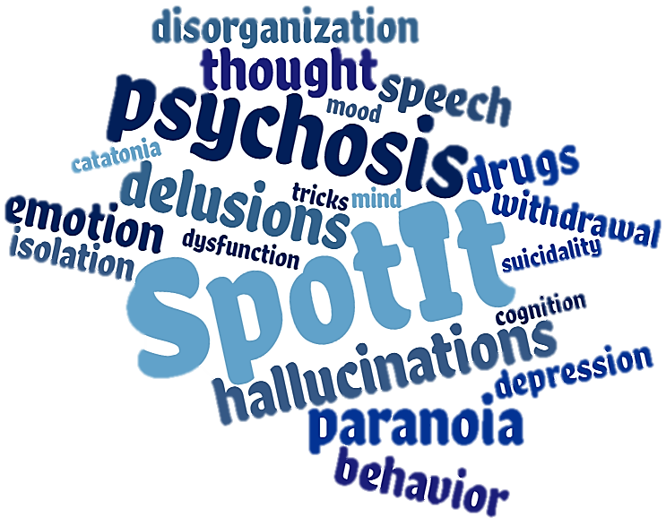


Psychosis:
Can You Spot It?
An educational series on first episode psychosis, common signs and symptoms, and barriers to diagnosis and treatment.
Notes:
Welcome. I am Chad Jones, your host for today’s webinar. The webinar series “Psychosis, Can You Spot It?” was developed by Dr. Diana Perkins and her team.

Slide 2

Psychosis:
Can You Spot It?
Diana O. Perkins, MD MPH
Professor, Department of Psychiatry
Director, UNC Outreach and Support Intervention Services (UNC OASIS)
Director, Early Psychosis Interventions in North Carolina Resources (EPI-NC Resources)
Notes:
Dr. Perkins is the Director of EPI-NC, a program supporting the development of early psychosis treatment programs in North Carolina. This webinar series is supported by EPI-NC, funded by a federal Community Mental Health Services Block Grant as a project of the NC Division of Mental Health, Developmental Disabilities & Substance Abuse Services. Dr. Perkins is a Professor in the Department of Psychiatry at the University of North Carolina at Chapel Hill and is the Director and one of the psychiatrists of the UNC OASIS program, a coordinated specialty care program for persons in the early stages of a psychotic disorder. Her research focuses on discovering what causes schizophrenia, in the hope of developing better treatments and eventually a cure.

Slide 3
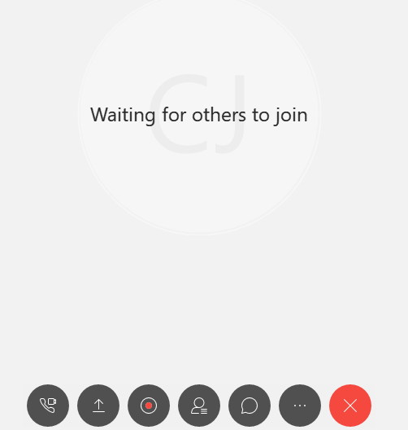
To connect your audio:
Click the phone icon at the bottom of your screen.
Notes:
To connect your audio, click the phone icon at the bottom of your screen.

Slide 4
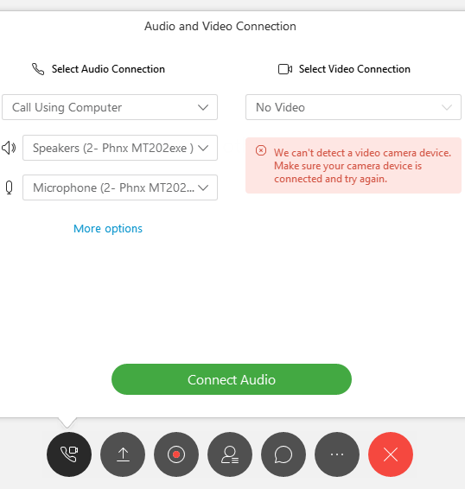
To connect your audio:
Then, click the “Connect Audio” button in the display window. This should allow you to hear the presentation.
Notes:
Then, click the “Connect Audio” button in the display window.

Slide 5
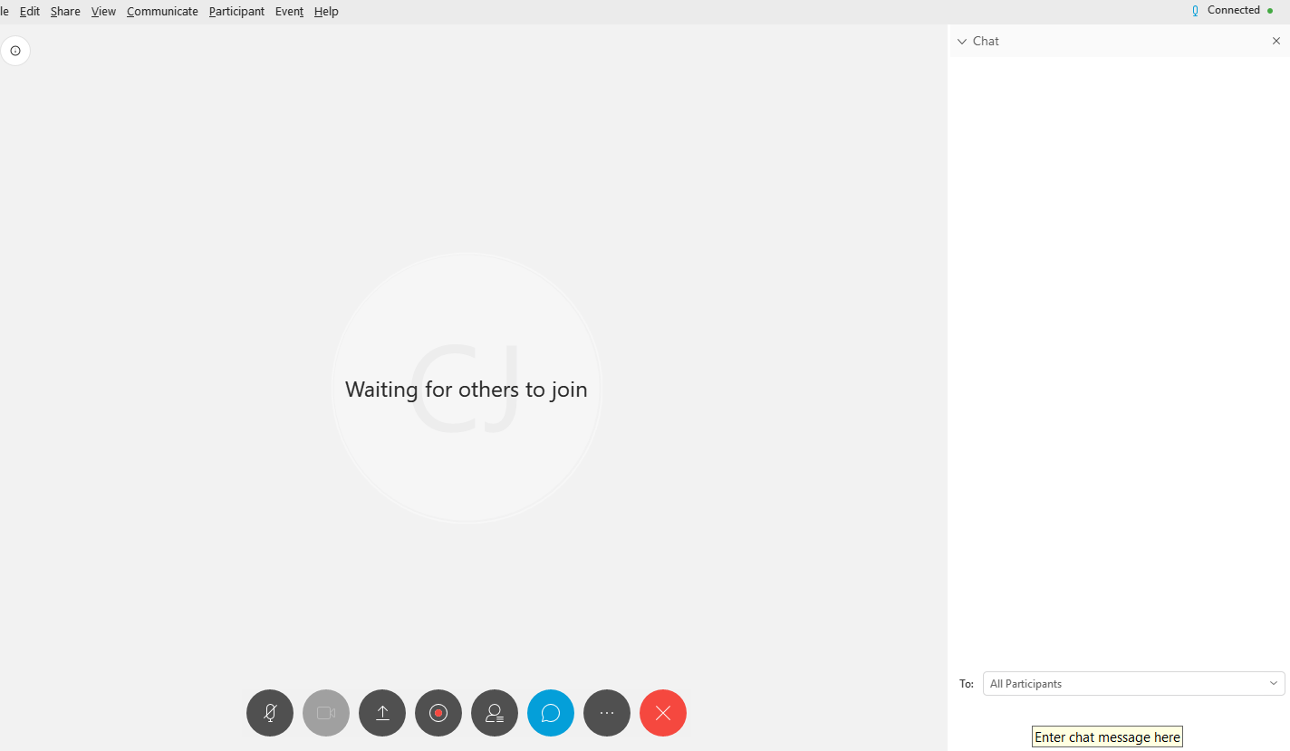
To ask a question:
Click the Chat bubble icon at the bottom of your screen.
Notes:
(click) The chat box opens at the bottom of the screen.

Slide 6
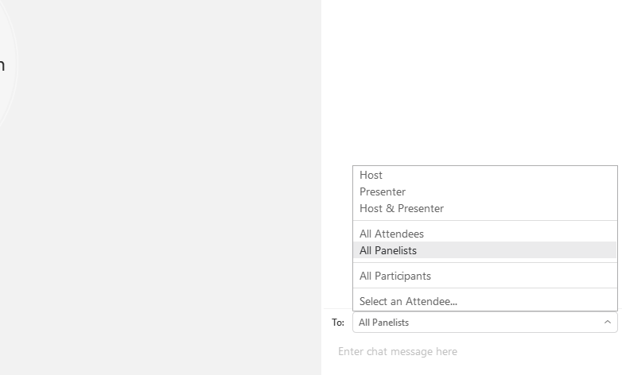
To ask a question:
Then, on the bottom right hand of your screen, select “All Panelists” from the drop down menu, and type your question into the window below:
Notes:
Select “All Panelists” from the drop down menu. You can type in questions or comments at any time during the presentation. Dr. Perkins will address these at the end of the presentation.

Slide 7
Instructions
Program evaluation
Continuing education credits
  The School of Medicine of The University of North Carolina at Chapel Hill is accredited by the Accreditation Council for Continuing Medical Education (ACCME) to provide continuing medical education for physicians.
  The School of Medicine of The University of North Carolina at Chapel Hill designates this live activity for a maximum of 1.0 AMA PRA Category 1 Credit(s)™. Physicians should claim only credit commensurate with the extent of their participation in the activity.
  Planner Disclosure: This activity is planned and implemented under the sole supervision of the above-named course director, in association with the Office of Continuing Professional Development (UNC CPD). The course director and CPD staff have no financial relationships with commercial interests as defined by the ACCME.
  Speaker Disclosure: The speaker has no relevant financial relationships with commercial interests as defined by the ACCME.
Notes:
All attendees are encouraged to complete an evaluation of this program. Attendees who are requesting continuing education credits or a certificate of attendance for this presentation are required to complete the evaluation. At the end of this presentation you will receive a link to complete the evaluation online.
Dr. Perkins, please begin.

Slide 8
Psychosis:
Can You Spot It?
An educational series on first episode psychosis, common signs and symptoms, and barriers to diagnosis and treatment.
Notes:
Thanks Chad.
I want to welcome you to Psychosis: Can you spot it?, an educational series that addresses the common signs and symptoms of first episode psychosis, as well as the barriers to recognition by health care providers.

Slide 9
Disclosures
In the past two years Dr. Perkins received
  funding from Boehringer-Ingleheim to conduct a clinical trial at UNC,
  consulting fees from Alkermes,
  royalties from APA publishing.
Notes:
Before we begin, I have the following to disclose. In the past two years I received funding from Boehringer-Ingelheim to conduct a clinical trial at UNC, consulting fees from Alkermes and royalties from APA publishing.

Slide 10
Psychosis: Can You Spot It?
Module 1 – An Introduction to Psychosis
Module 2 – Differentiating Between Types of Symptoms
Module 3 – Oversight and Misdiagnosis of Psychosis
Module 4 – Confounds and Overlaps in Clinical Features
A look at the national prevalence of psychotic disorders, common signs and symptoms, and barriers to diagnosis and treatment.
Distinguishing key features of fully psychotic, attenuated psychotic, and non-psychotic symptoms and the differences therein.
How cognitive heuristics influence clinical decision-making and strategies for decreasing biases and improving the likelihood of a correct diagnosis.
Identifying the range of disorders that feature psychosis as a symptom and factors like trauma and substance use that increase clinical risk.
Notes:
There are four one-hour modules in this series. Module 1 examines the prevalence of psychosis in comparison to other mental disorders, describes psychosis syndromes and discusses barriers to recognition. Module 2 is an in-depth look at the spectrum of psychosis, ranging from full psychosis to “prodromal-severity” to “unusual” experiences. Module 3 explores why clinicians make diagnostic errors, in general and in relation to psychosis. Module 4 explores the variety of disorders that include psychosis as a feature.

Slide 11
Module 4:
Unmasking
Psychosis
Diana O. Perkins, MD MPH
Professor, Department of Psychiatry
Director, UNC Outreach and Support Intervention Services (UNC OASIS)
Director, Early Psychosis Interventions in North Carolina Resources (EPI-NC Resources)
Notes:
This is Module 4: Unmasking Psychosis.

Slide 12
Learning Objectives
At the end of the module, the clinician will be able to:
Recognize the range of disorders that have psychosis as a clinical feature.
Differentiate between drug-induced psychosis and drugs as a risk factor for functional psychotic disorders
Understand how various medical problems may cause psychosis, and what factors raise concerns that a medical work-up is needed.
Notes:
The focus of today’s webinar is psychosis as symptom of most, if not all disorders that impact brain function.
Intoxication or withdrawal from a substance is a common cause of psychosis symptoms, so we will discuss the difference between a drug-induced psychosis and drugs as a risk factor for primary psychotic disorders. Today we will also review the characteristics of primary versus secondary psychotic disorders.

Slide 13
Psychotic Disorders
Psychotic disorder not due to a
substance or known physiological condition.
Mood disorders with psychotic features
Major Depression with psychosis
Mania with psychosis
Primary psychotic disorders
Schizophrenia
Schizoaffective disorder
Schizophreniform disorder
Delusional disorder
Brief psychotic disorder
Notes:
Psychotic disorders that are not due to a substance or known physiological condition are considered primary, or functional, psychotic disorders. We classify primary psychotic disorders and mood disorders with psychotic features based on the duration of psychosis and the overlap of psychotic symptoms with mood symptoms. When psychosis only occurs with mood symptoms, then the disorder is considered a mood disorder with psychotic features. Whether or not there is a mood syndrome present, if psychosis occurs independent of major depression or mania then the person has a primary psychotic disorder. Persons who only have well-organized delusions are diagnosed with delusional disorder. It is clear that there is not just one, but many different causes of primary psychotic disorders and mood disorders with psychotic features. Our diagnostic systems are likely to change as we learn more about the pathophysiology of psychosis.

Slide 14
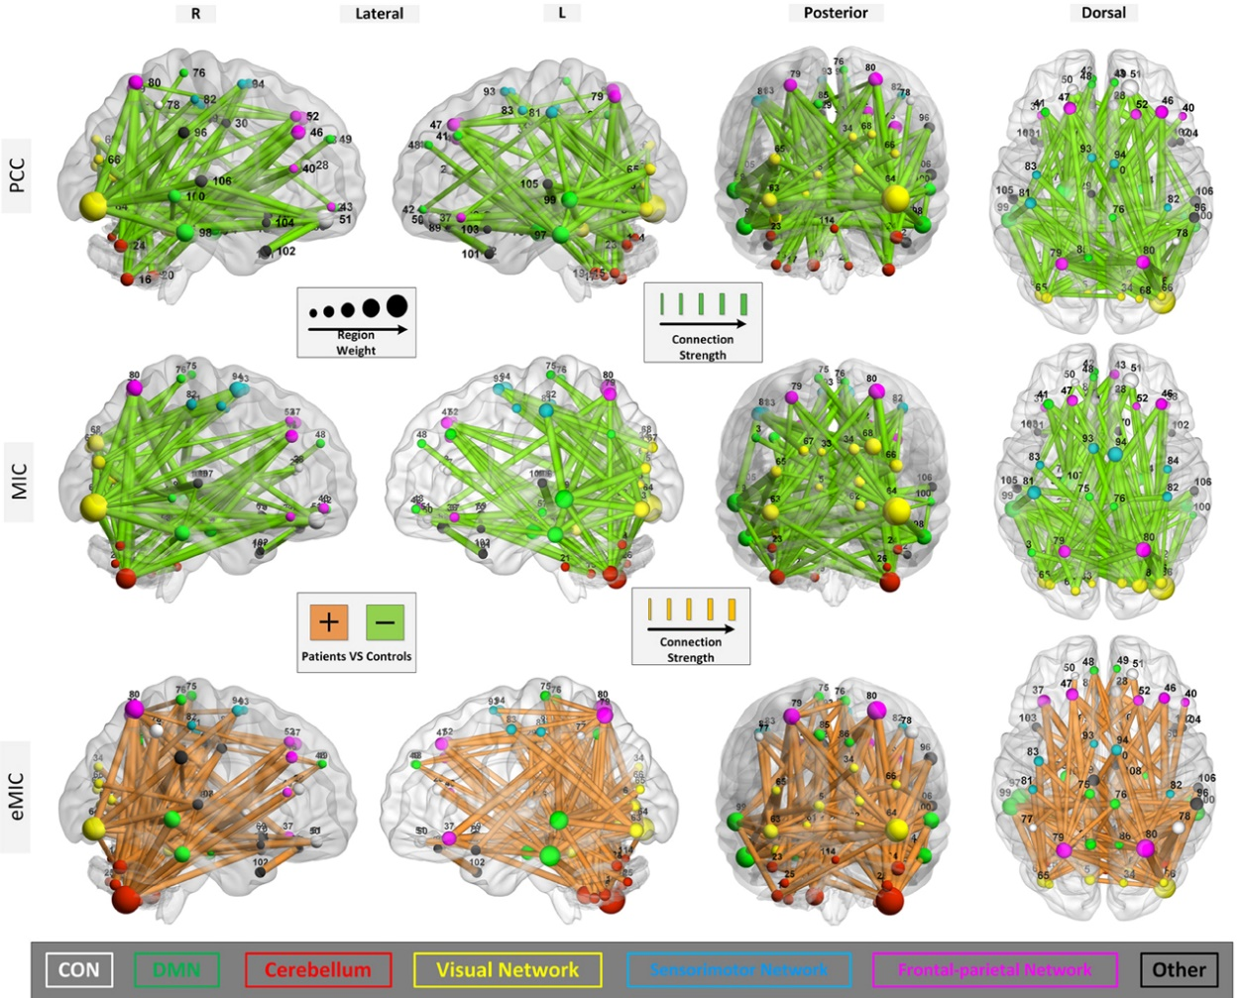
What is psychosis?
Hallucinations
Delusions
Disorganization speech/behavior
Notes:
Healthy brain function depends on connectivity between different brain regions, as shown in this picture. The connections involve both excitatory and inhibitory inputs. Persons with psychotic disorders have a change in the strength of normal brain connections, with connectivity between some regions stronger, and other regions weaker. In fact, in some countries the name schizophrenia has been changed to disconnectivity syndrome.

Slide 15
Biological Vulnerability
Genes
Environment
10
8
6
4
2
0
Notes:
Persons vary in their biologic vulnerability to psychosis.

Slide 16
Biological Vulnerability
x-fold increase in risk as compared to general population risk of 1%
Environment
Genes
10
8
6
4
2
0
Notes:
We know that both genes and environment contribute to psychosis risk and that about 1% of the general population will develop a psychotic disorder over the course of a lifetime. The impact of various genetic and environmental factors varies from a small impact on risk, to a large increase in risk. Having a 2-fold increase in risk means a doubling a risk, from 1 per 100 to 2 per 100 people. Having a 10-fold increase in risk means increasing risk from 1 per 100 to 10 per 100 persons.

Slide 17
Biological Vulnerability
x-Fold Increase in Risk as compared to general population risk of 1%
Environment
Genes
10
8
6
4
2
0
Hundreds of common genetic variants with small effect
Notes:
Studies involving tens of thousands participants have identified over 100 genetic regions that contribute to schizophrenia risk, and anticipate finding many more with even larger studies. The reason why the genetic risk studies have to involve so many subjects is that the impact of each gene variant on schizophrenia risk is very small. In addition, the genetic risk variants are common, meaning that between 10-90% of people in the general population have the risk variant. This means that each of us has many schizophrenia risk gene variants.

Slide 18
Biological Vulnerability
x-Fold Increase in Risk as compared to general population risk of 1%
Environment
Genes
10
8
6
4
2
0
Hundreds of common genetic variants with small effect
Polygenic Risk Score
Notes:
We can add up the number of genetic variants and create a polygenic risk score.

Slide 19
Biological Vulnerability
x-Fold Increase in Risk as compared to general population risk of 1%
Environment
Genes
10
8
6
4
2
0
Hundreds of common genetic variants with small effect
High
Polygenic Risk Score
Notes:
The greater the number of risk variants the greater the risk of schizophrenia. A person who has a large number of the psychosis risk variants will have a high polygenic risk score, and may have up to a ten-fold increase in risk for schizophrenia.

Slide 20
Biological Vulnerability
x-Fold Increase in Risk as compared to general population risk of 1%
Environment
Genes
10
8
6
4
2
0
Hundreds of common genetic variants with small effect
High
Polygenic Risk Score
Medium
Low
Notes:
Persons with a low polygenic risk score will have a risk comparable to the general population. So remember even persons with a low polygenic risk score will have some of the risk genes – we all do.

Slide 21
Biological Vulnerability
x-Fold Increase in Risk as compared to general population risk of 1%
Environment
Genes
10
8
6
4
2
0
Drugs
Hundreds of common genetic variants with small effect
High
Polygenic Risk Score
Medium
Low
Notes:
There are a variety of environmental factors that also influence biologic vulnerability to psychosis. The use of certain drugs increases risk 3-4 fold, and we’ll discuss the role of drugs more in a few minutes.

Slide 22
Biological Vulnerability
x-Fold Increase in Risk as compared to general population risk of 1%
Environment
Genes
10
8
6
4
2
0
Drugs
Stressors -
Trauma
Urban Environment
Immigrant
Hundreds of common genetic variants with small effect
High
Polygenic Risk Score
Medium
Low
Notes:
In addition, a variety of stressors are associated with about a 2-3 fold increased risk of developing a psychotic disorder like schizophrenia. These include emotional trauma, being raised in an urban environment, and being a 1st or 2nd generation immigrant.

Slide 23
Biological Vulnerability
x-Fold Increase in Risk as compared to general population risk of 1%
Environment
Genes
10
8
6
4
2
0
Drugs
Stressors -
Trauma
Urban Environment
Immigrant
Hundreds of common genetic variants with small effect
High
Polygenic Risk Score
Medium
Childhood Infections -
Encephalitis
Toxoplasmosis
Low
Notes:
Certain childhood infections are associated with increased risk of psychotic disorders, increasing risk 3-4 fold, in particular infections that affect the brain – encephalitis can increase risk 4-5 fold, and exposure to toxoplasmosis, which is transmitted to human via cats, is associated with about a doubling of risk of psychosis.

Slide 24
Biological Vulnerability
x-Fold Increase in Risk as compared to general population risk of 1%
Environment
Genes
10
8
6
4
2
0
Drugs
Stressors -
Trauma
Urban Environment
Immigrant
Hundreds of common genetic variants with small effect
High
Polygenic Risk Score
Medium
Childhood Infections -
Encephalitis
Toxoplasmosis
Low
Perinatal Factors
Infections
Trauma
Diabetes
Low folate
Low iron
Low vitamin D
Low oxygen at birth
Notes:
Perinatal factors are associated with a 50% to doubling of schizophrenia risk. Such factors include maternal infection i.e. influenza or other viruses, the mother being exposed to a traumatic event, having diabetes, or having low levels of certain micronutrients, or the baby having low oxygen at birth. All increase risk of later developing a psychotic illness. I think it is intriguing that many of the genetic and environmental vulnerability factors identified thus far point to immune system dysregulation as a possible cause of some types of psychotic disorders.

Slide 25
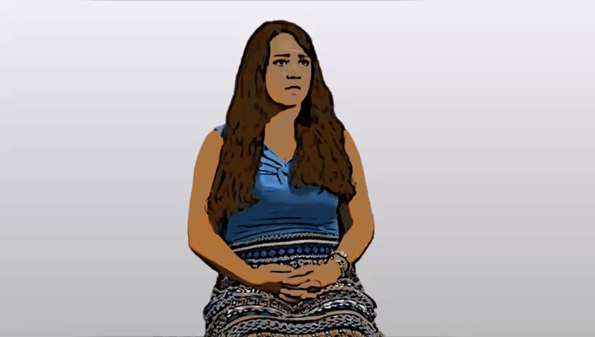
Let’s hear from Jessica
Notes:
We have met Jessica, a college student, who was recently diagnosed with schizophrenia, in previous modules. Jessica is a second generation immigrant who was living in an urban environment when she had her first episode. Here she talks about her first episode and what she made of her early symptoms.
[play video]
[After the video plays]…As you heard, Jessica was under a great deal of stress and was sleeping very little. That she was a second generation immigrant increased her risk of schizophrenia 3-4 fold, and living in a urban environmental further increased her risk. High levels of stress are also an environmental risk factors for psychosis. A few studies suggest that lack of sleep may also contribute to development of psychosis.

Slide 26
Drugs and Psychosis
Notes:
Let’s go into a little bit more detail about drugs and psychosis.

Slide 27
Biological Vulnerability
Environment:
Substances
Brain Disorder
High
Marijuana
Stimulants
Hallucinogens
Designer drugs Steroids
Antibiotics
Alcohol
Transient Psychosis
Intoxication
Low
Notes:
Intoxication with certain substances such as ketamine, PCP, and hallucinogens causes a transient psychosis in most persons. In fact, ketamine and PCP cause both psychosis and negative symptoms and are used to model schizophrenia in animal and human studies. So we know that marijuana, stimulants, hallucinogens, designer drugs, steroids, and even antibiotics can contribute to psychosis, as can alcohol.

Slide 28
Biological Vulnerability
Environment:
Substances
Brain Disorder
High
Marijuana
Stimulants
Hallucinogens
Designer Steroids
Antibiotics
Alcohol
Transient Psychosis
Intoxication
Withdrawal
Brain Damage / Chronic Psychosis
Low
Notes:
Heavy use of these drugs can cause brain damage, and result in chronic psychosis, and other problems such as cognitive impairments.
Withdrawal from alcohol and benzodiazepines is associated with psychosis as well as other withdrawal symptoms. Heavy use of alcohol is also associated with brain damage, impairments in cognitive function, and chronic psychosis. Various designer drugs, especially those that are analogs of THC and stimulants, are associated with high risk of a transient psychosis, and rarely chronic psychosis. It doesn’t matter the biologic vulnerability. These drugs can cause psychosis in everyone.

Slide 29
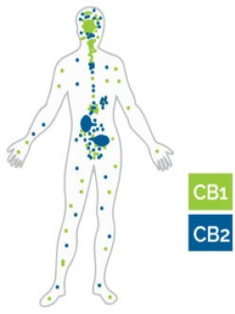
Endocannbinoid System
CB1 & CB2 receptors
Respond to endogenous molecules
  Anandamide
  2-AG
Best understood receptors
Distributed throughout the body
Marijuana
THC
CBD
Notes:
Marijuana and psychosis risk is a complicated issue. Marijuana contains more than 100 active compounds. Two of the most well-studied are THC and canabidiol, or CBD. THC activates CB1 receptors, shown here by the green dots, are mostly distributed on neurons. THC causes “a high”, as it binds more robustly than the molecules our body makes to bind to CB receptors, anadamide and 2-AG. CB2 receptors, here in blue, are located on glia, cells that regulate and support neurons, as well as on immune system cells. CBD binds to CB2 receptors, likely explaining CBD’s anti inflammatory effects.

Slide 30
Marijuana and Psychosis: THC
High dose THC causes a transient psychosis and cognitive deficits in healthy subjects
Dabs: street drug equivalent of high dose THC
Daily use, especially if begun at an early age, more than doubles the risk of schizophrenia
Notes:
THC has been administered to healthy humans in escalating doses. At high doses THC causes a short-lived psychosis, negative symptoms, and cognitive deficits similar to those seen in schizophrenia. Thus, it is not surprising that DABS, a high-concentration THC used recreationally, also may cause a brief psychosis that lasts days to weeks. Occasional use of marijuana is not associated with increased risk of psychosis. However, daily use of marijuana, especially if begun prior to late adolescence or early adulthood, more than doubles the risk of schizophrenia, with THC the likely culprit.

Slide 31
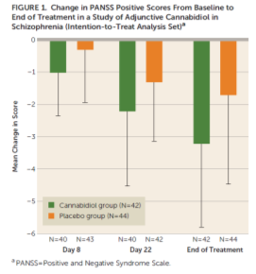
Marijuana and Psychosis: CBD
CBD protects against the effects of THC
A recent double-blind, placebo controlled clinical trial in schizophrenia showed CBD improves symptoms
Notes:
In contrast, CBD appears to protect against the effects of THC. In fact, a recent double-blind, placebo controlled clinical trial where CBD was added to schizophrenia patient’s treatment regimen found that CBD significantly improved psychotic symptoms as compared to placebo. I mentioned at the beginning of this webinar that the latest genetic and epidemiological studies were pointing to immune system dysregulation in schizophrenia. One of CBD’s prominent effects is immune system regulation!

Slide 32
What would you tell a client that wants to try CBD to help with anxiety, sleep, or attenuated or full psychosis?
The doses of CBD used in clinical trials make it very expensive.
The evidence base about CBD and other compounds in marijuana is just emerging, I don’t know enough to say.
It is legal to use CBD in North Carolina.
Ask about the effects, since likely the client has already tried CBD if they are asking.
Notes:
What would you tell a client that wants to try CBD to help with anxiety, sleep, or attenuated or full psychosis? Use the response box to indicate your answer.

Slide 33
What would you tell a client that wants to try CBD to help with anxiety, sleep, or attenuated or full psychosis?
The doses of CBD used in clinical trials make it very expensive.
The evidence base about CBD and other compounds in marijuana is just emerging, I don’t know enough to say.
It is legal to use CBD in North Carolina.
Ask about the effects, since likely the client has already tried CBD if they are asking.
Notes:
All of the above are true, but a prudent clinician would want to wait until the evidence base is stronger before actually recommending CBD to clients.

Slide 34
Case Vignette
Notes:
Here is a clinical example of a substance related psychosis.

Slide 35



Notes:
In this scenario we meet Natalie, who is self-referred to a community clinic. She had and intake evaluation by a clinical social worker intern, Maria. During the intake Maria learned that Natalie is 20 years old and lives with her parents and younger brother on their family farm. She works on the farm and also has a part-time job as a waitress. Natalie was encouraged to come to the clinic by her mother, who was concerned about her drug use. During the intake Natalie said she smoked marijuana daily to help with sleep and anxiety, but otherwise denied any problems. Now we join Maria and Natalie about one month later…

Slide 36
Thank you for coming in today. Tell me more about what brings you here.
Notes:
At this follow-up visit Maria seeks further details about Natalie’s abnormal perceptual experiences. She begins by saying “Thank you for coming in today. Tell me more about what brings you here.”

Slide 37
Thank you for coming in today. Tell me more about what brings you here.
Over the past month, I’ve been seeing things that are not there and it’s really freaking me out.
Notes:
Natalie talks about seeing things that aren’t there, and says these experiences are “freaking me out”.

Slide 38
Tell me more about this. What are you seeing and how often is this occurring?
Notes:
Marie asks what she is seeing and how often the hallucinations occur.

Slide 39
Tell me more about this. What are you seeing and how often is this occurring?
Almost every night I see these weird shadows out of the corner of my eye that look like people, but when I turn my head, no one is there. It’s making me very paranoid.
Notes:
Natalie says, “Almost every night I see these weird shadows out of the corner of my eye that look like people, but when I turn my head, no one is there. It’s making me very paranoid.” Maria inquires further…

Slide 40
Are you seeing anything else that may not be there or do you have other experiences that make you think that your mind is playing tricks on you?
Notes:
Marie follows up by asking about other possible psychotic experiences, for example if Natalie is seeing anything else that may not be there, or having other experiences that make her think her mind is playing tricks on her.

Slide 41
Are you seeing anything else that may not be there or do you have other experiences that make you think that your mind is playing tricks on you?
No, it’s just this, but it’s been occurring most nights for the last month.
Notes:
Natalie says, “No, it’s just this, but it’s been occurring most nights for the last month.”

Slide 42
Hear things other people can’t? Odd thoughts? TV/radio sending you a message? Convinced others are trying to hurt you?
Notes:
Maria goes through a few more questions to screen for common psychotic experiences. She asks if Natalie is hearing things other people can’t, if the TV or radio is sending her messages, and if she is convinced others are trying to hurt her.

Slide 43
Hear things other people can’t? Odd thoughts? TV/radio sending you a message? Convinced others are trying to hurt you?
Nope.
Notes:
Natalie says, “No.”

Slide 44
How about the paranoia? How often is that occurring?
Notes:
Maria then decides to delve into the paranoia that Natalie mentioned.

Slide 45
How about the paranoia? How often is that occurring?
It only happens when I see the shadows. It makes me paranoid that someone else is there or that I’m going crazy.
Notes:
Natalie says, “It only happens when I see the shadows. It makes me paranoid that someone else is there or that I’m going crazy.”

Slide 46
You mentioned marijuana use on intake. Can I ask if these experiences are occurring while smoking or are they also occurring outside of marijuana use?
Notes:
Maria knows marijuana intoxication can cause a transient psychosis, and that heavy use is a risk factor for a persistent psychotic disorder. So she asks….
“You mentioned marijuana use on intake. Can I ask if these experiences are occurring while smoking or are they also occurring outside of marijuana use?”

Slide 47
You mentioned marijuana use on intake. Can I ask if these experiences are occurring while smoking or are they also occurring outside of marijuana use?
You know, that’s a good point. These experiences have occurred almost every night, but I do usually smoke just about every night after work. It’s hard to say. I think that they may have occurred on nights that I wasn’t smoking.
Notes:
Natalie says, “You know, that’s a good point. These experiences have occurred almost every night, but I do usually smoke just about every night after work. It’s hard to say. I think that they may have occurred on nights that I wasn’t smoking.”

Slide 48
Hmmm, this may just be an effect of marijuana use. I need to figure out if Natalie is experiencing full or attenuated psychosis
Notes:
Maria considers whether daily marijuana use may be a factor, and also that she needs to determine the severity of her symptoms.

Slide 49
Distinguishing fully-psychotic, attenuated-psychotic, and non-psychotic symptoms
Notes:
We’re going to pause the vignette and review the distinction between full psychosis, attenuated psychosis and non-psychosis symptoms.

Slide 50
What is the main difference between attenuated-psychosis and fully psychotic symptoms?
How unusual or illogical the symptom seems
Whether the person has the insight that the experience is “not real”
How often the symptom occurs
All of the above
Notes:
What is the main difference between attenuated-psychosis and fully psychotic symptoms?

Slide 51
What is the main difference between attenuated-psychosis and fully psychotic symptoms?
How unusual or illogical the symptom seems
Whether the person has the insight that the experience is “not real”
How often the symptom occurs
All of the above
Notes:
The answer is b, whether the person has insight that the experience is “not real”.

Slide 52
 | Quality | Conviction | Frequency
Full-psychosis | Illogical Not culturally held Compelling/ Impacts function | Certain is true | Couple of times a month to daily
Attenuated-psychosis | Illogical and Not culturally held and Compelling/Impacts function | Doubts about veracity | Couple of times a month to daily
Non-psychotic | Illogical and culturally held or Logical | Not applicable | Not applicable
 | Illogical and not culturally held but easy to dismiss | Not applicable | Very rare
Notes:
With both full psychosis and attenuated psychosis, the quality of the experience is illogical, not culturally help, is compelling and impacts a person’s function. The frequency is relatively often, and this is true for both full and attenuated psychosis. Although with full psychosis the symptoms tend to occur more often there is no real dividing line. The difference between full psychosis and attenuated psychosis is the conviction. How certain is the person that this experience is true? If they have doubts about the truthfulness of the experience then it’s still in the category of attenuated psychosis. Attenuated psychosis symptoms can occur during the early prodromal stages of a psychotic illness, it can also just occur and get better by itself, and after someone has developed a full psychotic disorder they can have relapses that involve attenuated symptoms. But when we’re talking about the distinction between attenuated and full psychosis we’re really focusing on the time prior to developing a psychotic illness or if they’re in a first episode of psychosis. People also just have strange ideas, that can be illogical and culturally held, or logical or we can all have fleeting strange ideas that are easily dismissed. So those are not psychotic even though they’re unusual ideas.

Slide 53
Notes:
So let’s go back to our vignette where Maria talks to Natalie about substances and psychosis.

Slide 54
Did you know that marijuana can cause these experiences that you are having?
Notes:
Maria asks if Natalie knows that marijuana can cause these experiences she is having.

Slide 55
Did you know that marijuana can cause these experiences that you are having?
Well, I knew that marijuana can cause paranoia, but I didn’t know about the hallucinations thing.
Notes:
Natalie knows that marijuana can cause paranoia, but didn’t know that it could also cause hallucinations.

Slide 56
The shadows you are seeing are called perceptual abnormalities, which can occur with marijuana and other drugs.
Notes:
Maria tells her that the shadows she is seeing are called perceptual abnormalities, and that they can occur with marijuana use.

Slide 57
The shadows you are seeing are called perceptual abnormalities, which can occur with marijuana and other drugs.
Oh, wow, that’s scary.
Notes:
“Oh wow, that’s scary.”

Slide 58
Do you take any medications or use other substances?
Notes:
Natalie denies any of these except…

Slide 59
Do you take any medications or use other substances?
Hmm, I didn’t say this in intake, but I did use LSD about a month ago at a party and saw some weird things that night, but it’s been a month now. That should be out of my system!
Notes:
Maria continues her evaluation, exploring whether Natalie might have depression, mania, or anxiety symptoms, whether she has a history of trauma, her general physical health, and whether she is prescribed medications, takes over the counter supplements, or uses other substances. Natalie denies any of these except …she tells Maria about an experience with LSD she had a month before.

Slide 60
How likely is it that Natalie’s attenuated psychosis symptoms are related to use of marijuana or other drugs?
25% likely
50% likely
Close to 100% likely
Can’t say
Notes:
How likely is it that Natalie’s attenuated psychosis symptoms are related to use of marijuana or other drugs?
25% likely
50% likely
Close to 100% likely
Can’t say

Slide 61
How likely is it that Natalie’s attenuated psychosis symptoms are related to use of marijuana or other drugs?
25% likely
50% likely
Close to 100% likely
Can’t say
Notes:
It is certainly possible that Natalie’s attenuated psychosis symptoms are related to marijuana or LSD, but it is important that we keep an open mind and use analytic thinking strategies, rather than rely on cognitive heuristics such as confirmatory bias, which is seeking out information to confirm, rather than discomfirm, our hypotheses.

Slide 62
The impact of LSD and marijuana can linger longer. And using marijuana daily can cause psychosis in some persons, where the mind tricks won’t go away without medication.
Notes:
Maria is uncertain about the relationship of drugs to Natalie’s symptoms, and so tries to engage Natalie in a plan to figure it out…
Maria describes the impact of LSD and marijuana.

Slide 63
The impact of LSD and marijuana can linger longer. And using marijuana daily can cause psychosis in some persons, where the mind tricks won’t go away without medication.
Wow, I had no idea!
Notes:
Marie is surprised by this information.

Slide 64
What would you think about stopping drugs for a few weeks, to see what would happen?
Notes:
Maria suggests that Natalie stop using marijuana and other drugs so that she can monitor her symptoms without substances.

Slide 65
What would you think about stopping drugs for a few weeks, to see what would happen?
That’s going to be hard…
Notes:
Natalie says that would be difficult for her.

Slide 66
I understand. Let’s talk about more about the substance use...
Notes:
In a person who uses marijuana or other substances frequently, especially daily, it is often not possible to be certain whether attenuated or full psychosis symptoms are related to intoxication with the substances, are the beginning of a primary psychotic disorder that is triggered by the substance, or is entirely unrelated to the substance use. Often a period of sobriety is the only way to be sure. Maria and Natalie begin their work together…

Slide 67
Case Vignette
Notes:
Here is a clinical example of a substance related psychosis.

Slide 68



Notes:
Sam is a 17 years old high school junior . Sam is brought in by his parents to be evaluated by Tyler, a community mental health care provider. Sam’s parents tell Tyler that their son has not been himself lately, for example his grades have fallen and he quit the school band. A couple of weeks ago they found Sam talking to the TV, and Sam wouldn’t provide an explanation, prompting them to schedule the appointment. Sam’s mother attributes the changes in Sam to him using multiple substances over the last year. Tyler begins ….
and Sam responds….

Slide 69
Can you tell me more about why you are here today?
Notes:
José beings by asking Lamar to tell him why he is here.

Slide 70
Can you tell me more about why you are here today?
My mom thinks that I use too many drugs.
Notes:
Lamar responds, “My mom thinks that I use too many drugs.” José inquires about substance use…

Slide 71
What substances are you using?
Notes:
“What substances are you using?”

Slide 72
I smoke marijuana about every day with my friends. But, my mom’s more freaked out that I did cocaine and shrooms a few times. All my friends do that…who cares?
What substances are you using?
Notes:
Lamar relates using marijuana daily and, less frequently, cocaine, and “shrooms”, hallucinogenic mushrooms. Next José explores the unusual behaviors raised by his parents….

Slide 73
Ok, she mentioned some behaviors that worried her. Tell me more about that…
Notes:
He asks Lamar to tell him more about the worrying behaviors…

Slide 74
Well, you’re not going to believe me either, so why bother.
Ok, she mentioned some behaviors that worried her. Tell me more about that…
Notes:
…and Lamar responds, “Well, you’re not going to believe me either, so why bother.”

Slide 75
Well, try me. What we talk about stays here.
Notes:
Though he is initially hesitant, with support Lamar reveals…

Slide 76
…Ok, so, I am on a mission for the CIA...
Well, try me. What we talk about stays here.
Notes:
…that he is “on a mission for the CIA…” Lamar goes on to tell José that he is receiving telepathic messages from the CIA and that he believes that he has been chosen to fight a war in another dimension. José explores Lamar’s conviction.

Slide 77
Hmmm. To be fully-psychotic Lamar needs to be 100% sure that these experiences are real.
Notes:
José determines that these experiences are unusual, and not culturally held. Jose needs to evaluate conviction.

Slide 78
Do you ever doubt the CIA is communicating with you telepathically?
Notes:
“Do you ever doubt the CIA is communicating with you telepathically?”

Slide 79
This is real. I’m sure of it…
Do you ever doubt the CIA is communicating with you telepathically?
Notes:
Lamar is sure that it is real. This response validates José’s concerns that Lamar is experiencing fully psychotic symptoms.

Slide 80
Can it be the drugs??
Notes:
Now that José believes Lamar is having fully psychotic symptoms, he wonders what role the drugs play in Lamar’s psychosis.

Slide 81
What information might help Tyler determine whether Lamar’s psychotic symptoms are directly caused by substances, or are a primary psychotic disorder?
Determine if Lamar had psychotic symptoms prior to heavy substance use
Determine if Lamar has psychotic symptoms when not using drugs
Both a & b
None of the above, it is impossible to know
Notes:
What information might help Tyler determine whether Lamar’s psychotic symptoms are directly caused by substances, or are a primary psychotic disorder?
Determine if Lamar had psychotic symptoms prior to heavy substance use
Determine if Lamar has psychotic symptoms when not using drugs
Both a & b
None of the above, it is impossible to know

Slide 82
What information might help Tyler determine whether Lamar’s psychotic symptoms are directly caused by substances, or are a primary psychotic disorder?
Determine if Lamar had psychotic symptoms prior to heavy substance use
Determine if Lamar has psychotic symptoms when not using drugs
Both a & b
None of the above, it is impossible to know
Notes:
The answer is both a & b. The time course of symptoms and substance use is often our best clue to the relationship between the two. Knowing that the client has been using marijuana and cocaine, what can the clinician ask to try to distinguish his symptoms from substance use? Feel free to put in your answers in the chat box. What would you ask next?

Slide 83
Notes:
José explores the timing of the onset of psychosis and heavy substance use.

Slide 84
When did you first start receiving messages from the CIA?
Notes:
He starts by asking, “When did you first start receiving messages from the CIA?”

Slide 85
When did you first start receiving messages from the CIA?
A few months ago in the summer.
Notes:
“A few months ago in the summer.”

Slide 86
At that point, were you convinced that it was real?
Notes:
José goes on to ask if Lamar was convinced that it was real at that point.

Slide 87
At that point, were you convinced that it was real?
Yes, I knew from the beginning this was real, but I didn’t tell anyone. I knew that no one would believe me.
Notes:
Lamar says yes, that he knew it was real from the beginning, but didn’t tell any one because he didn’t think anyone would believe him.

Slide 88
Were you using a lot of drugs during the summer?
Notes:
José asks if he was using drugs during the summer.

Slide 89
No, I wasn’t using any, as I stayed with my grandma for the summer and she lives far from my friends. Well, I think that I got away one weekend to see my friends and we smoked some pot, but that’s it.
Were you using a lot of drugs during the summer?
Notes:
Lamar indicates that he did not use many drugs at that point because he was staying with his grandma, far away from his friends.

Slide 90
Do you recall when you last used shrooms prior to going to your grandma’s house?
Notes:
José asks about Lamar’s use of shrooms.

Slide 91
Nah, the shrooms are a recent thing. I did cocaine maybe a month before going to my grandmother’s house.
Do you recall when you last used shrooms prior to going to your grandma’s house?
Notes:
José finds out that Lamar developed fully psychotic symptoms prior to heavy drug use. While Lamar’s drug use is of clear concern, the new onset psychosis becomes the primary focus. As discussed in earlier modules, untreated psychosis is associated with dangerous behaviors and derailment of psychosocial development. The sooner psychosis is recognized and treated, the better the outcomes.

Slide 92
Transient/attenuated psychosis occurs in many disorders
Notes:
We know that transient and attenuated psychosis actually occurs in many psychiatric disorders. In this last section we will review other disorders that have transient or attenuated psychosis as a feature.

Slide 93
Transient psychosis/ attenuated psychosis occurs in many disorders
Kelleher British Journal Psychiatry, March 2017
Notes:
Transient and attenuated psychosis is reported in roughly 10-40% of persons diagnosed with anxiety disorders, depression, or borderline personality disorder. As reviewed in module 3, initial evaluations should routinely include screening for the full range of possible mental disorders, including psychosis symptoms, either by self-report questionnaires or by interview. Psychosis should also be considered and explored for established clients that report unusual experiences or ideas. Studies such as the one shown here suggest that if you routinely follow these screening recommendations you will pick up transient and attenuated psychosis in many of your clients.
I think this study is an important lesson because if you ask you will find that many of your clients with anxiety, depression, and other Axis II disorders especially BPD will also experience episodes of their mind playing tricks on them. (Go through %’s on table). So transient attenuated psychosis symptoms are actually a common feature of a variety of disorders and it’s important if you are exploring these symptoms with your client that you realize that they really are just part of the disorder and that in fact there is no specific treatment for transient attenuated symptoms within the disorder than there is for the rest of the disorder, so psychotherapy is still the most appropriate treatment intervention.
The evidenced based treatment for attenuated psychosis is monitoring for progression to full psychosis and psychotherapy. Antipsychotic medications are not first line treatment for attenuated psychosis, since psychotherapy appears to be about as effective as antipsychotic medications, and antipsychotics have uncertain risks in persons who do not have fully psychotic symptoms.

Slide 94
Mental Disorders with Symptoms Resembling Psychosis
Post-Traumatic Stress Disorder
Flashbacks
Frightening thoughts
Over-arousal
Obsessive Compulsive Disorder
Rumination
Notes:
Post traumatic stress disorder and obsessive compulsive disorder have features that sometimes are difficult to distinguish from psychotic symptoms. With PTSD, flashbacks may be similar to hallucinations, and frightening thoughts and over-arousal may be similar to paranoia. With PTSD the symptoms relate directly to the trauma. Traumatic life events also increase the risk of developing a primary psychotic disorder, so psychosis should be considered even in established clients with PTSD who develop new problems.
Ruminative thinking and intrusive thoughts that occur with obsessive compulsive disorder may be difficult to distinguish from the psychotic symptom thought insertion. A feature that may distinguish the two is that thought insertion is experienced as an outside force, and the thoughts do not seem to be the client’s own thoughts. With OCD, the thoughts may be ego dystonic, as so not be “the kind of thing” the client would normally think, but the client still recognizes the thoughts as coming from their own mind.

Slide 95
Biological Vulnerability
x-Fold Increase in Risk as compared to general population risk of 1%
Environment
Genes
10
8
6
4
2
0
Drugs
Stressors -
Trauma
Urban Environment
Immigrant
Thousands of genetic regions each with small effect
High
Polygenic Risk Score
Medium
Childhood Infections -
Encephalitis
Toxoplasmosis
Low
Perinatal Factors
Infections
Trauma
Diabetes
Low folate
Low iron
Low vitamin D
Low oxygen at birth
Notes:
So how can we make sense of these findings? We know from large scale genetic studies that there is a polygenic vulnerability to all common disorders including depression and anxiety disorders, and some very recent studies indicate that there is some overlap of risk genes for psychosis, anxiety and depression. Also these environmental risk factors for psychosis are associated with an increased risk for depression and anxiety disorders, so you won’t be surprised if I tell you that trauma especially in childhood is associated with increased risk of BPD, of depression, of anxiety disorders, and even these perinatal factors are associated with increased risk of depression or anxiety disorders later in life.

Slide 96
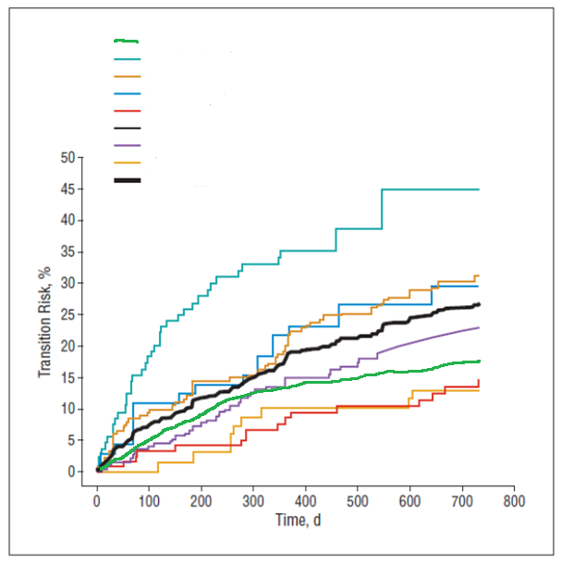
Risk of transition to psychosis in persons meeting attenuated psychosis research criteria
Perkins et al. 2016 (NAPLS2)
Yung et al. 2004
Cannon et al. 2008 (NAPLS1)
Riecher-Rossler et al. 2009
Demjaha et al. 2010
Ruhrmann et al. 2010
Ruhrmann et al. 2010 (est.)
Ziermans et al., 2011
Combined
Fusar-Poli 2012, Perkins et al. 2016
Notes:
And on the flipside even if a person is experiencing persistent attenuated psychosis that meets research criteria for attenuated psychosis syndrome the risk of transition to psychosis is about 20-25% over 2 years. So what this picture shows is the risk of transition to a psychotic disorder in persons with attenuated psychosis in a variety of different studies. On the bottom axis is time in days, and on the y axis is the transition risk. So everyone has these high risk symptoms and if you look at about 365 days (about a year), you’ll see there’s one study where there was a very high risk. And that was actually the first study that looked at risk of transition to psychosis in people with attenuated symptoms, and all the rest of the studies that are more clustered together are I think more realistic. We call that first study the ‘winner’s effect’, that the first study shows something much more dramatic than what subsequent studies have shown. So what you see is that after 2 years, about 1 out of 5, about 20% of people who have these symptoms have gone on to develop a full blown psychotic illness, but most don’t. And in fact most of those individuals have a co-morbid disorder of anxiety, depression, or other mental disorders, and so it appears that these attenuated symptoms may actually be part of the anxiety and mood disorders generally.

Slide 97
Psychotherapy, antipsychotics: similar benefits
Notes:
What’s really important about treating these attenuated symptoms is that psychotherapy seems to work just as well as an antipsychotic. So these are 4 studies, randomized control studies that looked at the percent of people who had clinical high risk symptoms who later went on to develop a psychotic disorder. And the treatment group is in darker blue and the placebo or the control group is in light blue. And you see that the clinical trial with olanzapine, about 45% of the olanzapine group compared to 18% of the placebo treated patients developed a psychotic disorder within a year. Similarly, a study of CBT (and there have been numerous studies with cognitive behavioral approaches) found that 6% of the patients who participated in CBT developed psychosis compared with 25% of the patients who received TAU. An earlier study that compared low dose risperidone and CBT to TAU found 10% of treatment compared to 35% of the TAU patients developed a psychotic disorder. A recent somewhat controversial study of omega 3 fatty acids in fish oil found 5% of the fish oil compared to 25% of the placebo treated patients developed a psychotic disorder within a year although a subsequent trial has not verified this finding. So it’s kind of a complicated picture in terms of the omega 3 fatty acids that’s going to be the subject of another talk. So, all of these interventions seem to be effective at reducing risk of psychosis in persons who are having sub-psychotic, prodromal level symptoms.

Slide 98
Psychotherapy, antipsychotics: Different Risks
Antipsychotics
  Weight gain/metabolic effects
  Sedation
  Unknown risks for 65% of patients who were not really prodromal for psychosis
Psychotherapies
  Time intensive
Omega 3 fatty acids
  Fishy burp
Notes:
The risks and costs of these treatments is very different. Antipsychotics, even at low dose, had side effects including weight gain, metabolic side effects, and sedation. Also, at most 35% of persons who experience sub-clinical psychotic-like symptoms actually develop a psychotic disorder. We don’t really know the risks associated with giving an antipsychotic to an adolescent or young adult with attenuated symptoms who is not really prodromal for psychosis. CBT, on the other hand, doesn’t have any “side-effects”, but does require the patient’s active participation. Fish oil, especially the cheap stuff, can cause an unpleasant, fishy burp. This can be avoided by either freezing the fish oil pills, or using the most expensive refined fish oils. The downside of psychotherapy is that it’s time intensive but it’s also quite effective.

Slide 99
Systemic and Brain Disorders that Cause Psychosis-Like Symptoms
Notes:
We’re going to move on to talk a little bit about how systemic disease and brain disorders can also cause psychosis-like symptoms.

Slide 100
Anything that impacts these circuits can cause psychosis
Drugs
Toxins (“mad as a hatter”)
Sleep deprivation
Brain pathology
  infections/tumors
  Multiple sclerosis
  Epilepsy
  Dementias
  Stroke
Hormonal disorders
Autoimmune Disorders
  Lupus
  Anti-NMDA-receptor encephalitis
Concussion
Notes:
Anything that can impact brain circuits can cause psychosis.
So we’ve talked about drugs that certainly can impact the connectivity between critical brain regions, so both intoxication and withdrawal of drugs can cause psychosis. And in an emergency room setting, intoxication or withdrawal from substances is the most common cause of new-onset psychosis.
A variety of toxins for example heavy metals like mercury can cause a permanent psychotic disorder, so the phrase ‘mad as a hatter’ came from the fact that hatters used mercury in the preparation of top hats and that led to a syndrome that included psychotic illness.
Extreme sleep deprivation can cause psychosis in anyone and I worry sometimes about our adolescents who are up all night gaming who really can become quite sleep deprived, what impact that might be having on brain function and it’s not unusual to have your mind play tricks on you if you’ve been sleep deprived. Many of us have experienced that.
And anything that can really impact the brain, brain pathology, brain infection, brain tumor, MS, epilepsy, dementia, strokes, can all cause psychotic illness. 1 patient who presented with delusions and hallucinations and when evaluating her also detected dysarthria or difficulty speaking and she also was dropping things and having transient weakness on one side of her body. It turned out her MS lesions where affecting her ability to speak, causing her transient weakness, and were also located in brain region that was causing psychosis.
Hormonal disorders can cause psychosis. So we know that disorders that affect cortisol in particular can cause psychosis. Also thyroid disorder, either too much or too little, is associated with psychotic symptoms. In fact, probably any of these psychotic disorders can be related to profound hormonal ________. Post-partum psychosis, while we are unsure what causes it, has been linked to very low estrogen levels for example.
Autoimmune disorders such as lupus or anti-NMDA-receptor encephalitis, which is when your body makes an antibody against one of the regulator neurotransmitter systems, the glutamate system, can cause a psychotic illness.
And finally, head trauma is associated with a 2-fold increased risk of developing a psychotic disorder.

Slide 101
When to worry about a medical cause
First episode
Person looks medically ill
Highly disorganized/delirious presentation
Notes:
So we’ve got this long list of medical conditions. When do you worry about a medical cause? Well, first, when it’s a first episode. We should always be suspicious when someone has a new onset of full-blown psychosis. Attenuated is just too common to be worried about a medical disorder. But frank psychosis, first episode, especially if there is something unusual about the presentation, and with that young woman there was. She was also having neurologic signs and symptoms, and whether I had actually missed it at the first evaluation, I didn’t pick up on her MS symptoms, but eventually it declared itself. Over the next few weeks as I was getting to know her it became clear that there was more than just psychosis going on. So there’s often a disorganized or delirious presentation to the picture. Often it just won’t look right. Even though they are having hallucinations, or being paranoid, or having delusions there is usually a strong disorganization and often the person really looks medically ill. It’s unusual for a person to present with a brain infection that doesn’t look medically ill or to present with an autoimmune disease that doesn’t have other signs and symptoms. And it turns out that while drugs are a common cause of psychosis these other medical causes are relatively uncommon and that functional psychotic disorders are generally what’s going on. And if a person has had episodes of psychosis, and remission, and relapse, that’s very characteristic of a psychotic disorder and a full medical work-up isn’t needed once the illness has established itself.

Slide 102

Synesthesia
Non-psychotic syndromes characterized by perceptual abnormalities include synesthesia, where stimulation of one sensory pathway co-stimulates another, for example tastes are perceived as having a color.
Notes:
There are also a couple of non-psychotic syndromes that are characterized by perceptual abnormalities, and I wanted to end by bringing these up, for example synesthesia where stimulation of one sensory pathway co-stimulates another. So there are people who experience taste as having color. My step-daughter experiences numbers as having colors, and so on. So the two senses get mixed up and it’s an odd neurologic condition. It’s just something about that person, about how their wires get crossed. It doesn’t happen very often but just be aware it isn’t progressive. It doesn’t appear to increase risk of developing a full-blown psychotic disorder to any significant amount.

Slide 103

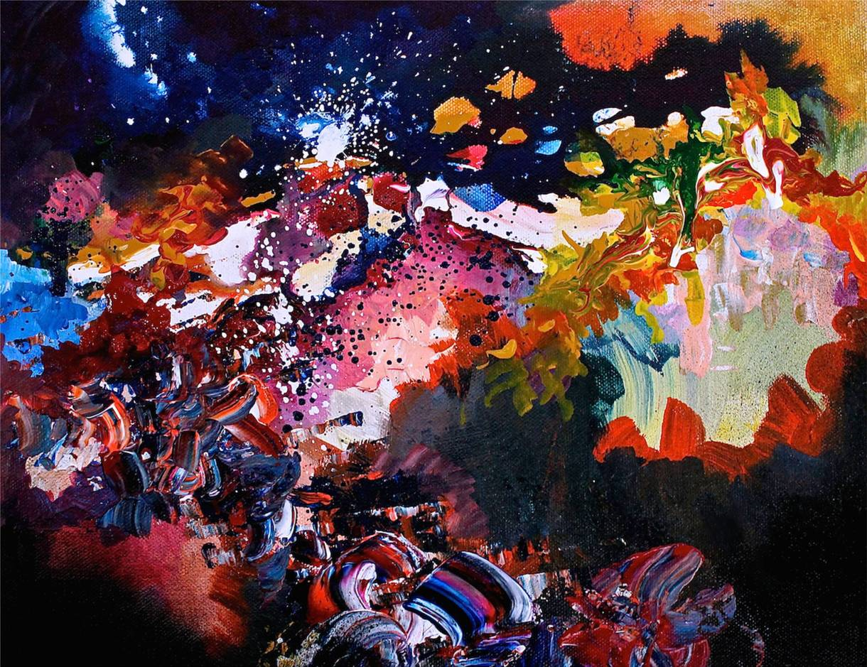
Synesthesia
David Bowie’s Life on Mars by Melissa McCracken
Radiohead’s Karma Police by Melissa McCracken
This artist with synesthesia spontaneously sees colors when listening to music and paints songs.
Full article at - https://broadly.vice.com/en_us/article/melissa-mccracken-synesthesia-painter-interview
Notes:
Synesthesia typically doesn’t interfere with function, isn’t progressive and is not associated with risk of any mental disorder including psychosis.

Slide 104


Benign Hallucinations
Brief hallucinations
Non-progressive
Do not interfere with function
No other psychosis symptoms
https://mobile.nytimes.com/2012/11/04/opinion/sunday/seeing-things-hearing-things-many-of-us-do.html
Notes:
Benign hallucinations describe a syndrome where the person experiences auditory or visual hallucinations, that are not progressive and do not interfere with function.

Slide 105
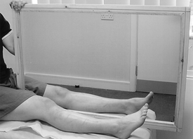
Hallucinations Related to Sensory Deprivation
Blindness
Visual Hallucinations
Loss of Limb
Phantom Sensations
Image: A controlled pilot study of the utility of mirror visual feedback in the treatment of complex regional pain syndrome (type 1) McCabe, et. al. Rheumatology (Oxford). 2003;42(1):97-101.doi:10.1093/rheumatology/keg041Rheumatology (Oxford) | © British Society for Rheumatology
N Engl J Med 2007; 357:2206-2207
Notes:
A person that develops blindness may experience visual hallucinations. A person who has lost a limb may experience phantom limb syndrome, where they experience pain or other sensations as coming from the limb that is no longer there. These syndromes develop due to spontaneous activity of parts of the brain that had been dedicated to perception for that part of the body. A successful treatment for phantom limb syndrome involves reprogramming the brain connections using a mirror!

Slide 106
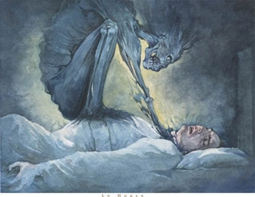
Hypnagogic and Hypnopompic Hallucinations
Hallucinations are associated with a sleep disorder, including hypnagogic hallucinations, that occur when a person is falling asleep, and hypnopompic hallucinations, that occur when a person is waking up.
Notes:
Another example, and this is quite common, is hypnagogic and hypnopompic hallucinations. So you’ve probably had the experience of waking up and thinking your dream might have been really happening, it can last a second or two. People who have sleeping disorders can actually have hallucinations that occur when a person’s falling asleep. Those are called hypnogogic and have hypnopompic hallucinations when a person is waking up. They can be experienced as a heavy weight or a person on your chest. That’s a common perceptual abnormality. These are not very unusual, not pathologic, except they may indicate that a person is having some problems with regular sleep that may need to be investigated.

Slide 107
Summary
Psychosis occurs in various brain disorders
  Schizophrenia, schizophreniform, schizoaffective, brief psychotic, delusional, not-otherwise-specified, bipolar with psychosis, major depression with psychosis
  Transient psychosis/attenuated-psychosis can occur with several disorders
  Any disorder that can impact the brain can cause psychosis
Substances can cause psychosis
  Intoxication/withdrawal
  Substance-induced brain damage
  Environmental risk factor for schizophrenia
Notes:
As we discover the medical cause, these will move to becoming medical conditions with names like the NMDA-receptor encephalitis used to be called schizophrenia. Treatment approach for transient, attenuated psychosis should be the same as how you are treating the anxiety or depressive disorder in general so addressing concerns and fears with a cognitive approach. One therapist at OASIS has been using trauma-based therapy and is pleased with the results.

Slide 108
Summary
Psychotic symptoms are a required feature of primary psychotic disorders.
Major Depression and Bipolar disorder may have psychotic features.
Any disorder that impacts brain function can cause psychosis.
Substances can cause psychosis –
  Intoxication/withdrawal
  Substance-induced brain damage
  Environmental risk factor for schizophrenia
Transient psychosis/attenuated-psychosis co- occur with anxiety, depression, and borderline personality disorder.
Notes:
Psychosis can be a symptom of most disorders that impact brain function. Primary psychotic disorders, such as schizophrenia and schizoaffective disorder, as well as mood disorders with psychotic features are diagnoses of exclusion, meaning that other medical conditions that can cause psychosis need to be ruled out. Any disorder that impacts brain function can cause psychosis. Intoxication or withdrawal from various substances, especially marijuana, stimulants, and hallucinogens are common causes of brief psychosis, but typically resolve soon after the substance is cleared from the body. Heavy drug use can damage the brain and results in chronic psychotic symptoms and cognitive impairments. THC from marijuana, when used daily or at a young age increases risk of a future psychotic disorder about 10-fold. Transient or attenuated psychosis frequently co-occurs with anxiety, depression, and borderline personality disorders.

Slide 109

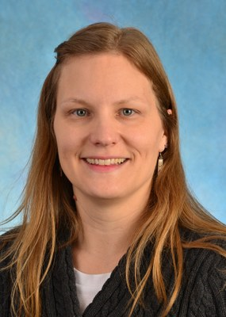




Credits
We would like thank the AHEC Innovation Fund and NIH (DUP Grant #R34MH103834) for the funding for this webinar series.
We would also like to thank all who were involved in creating these webinars:
Diana Perkins, MD, MPH Katie Bucrek Nina Fierro, LCSW
Emily Goldman, BS Jennifer Nieri, LCSW Jenna Roller
Notes:
This webinar series was funded by grants from the National Institute of Mental Health,, the federal Community Mental Health Services Block Grant Fund (CFDA #93.958) as a project of the NC Division of Mental Health, Developmental Disabilities & Substance Abuse Services and a grant from NC AHEC Innovation fund.

Slide 110
To ask a question:
Then, on the bottom right hand of your screen, select “All Panelists” from the drop down menu, and type your question into the window below:
Notes:
Thank you, Dr. Perkins.
Next is a discussion based on your comments and questions. If you haven’t already done so, please enter your comments and questions in the chat box at the bottom of the screen, sending to ”All Panelists”.

Slide 111
For More Information
Please visit our website: https://www.med.unc.edu/psych/epi-nc
Resources can be found on the “For Providers” tab.

