Slide 1
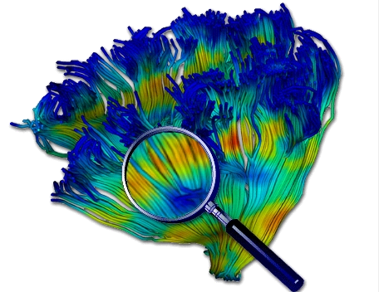
Diffusion MRI - Lesson 3 DWI/DTI QC
Martin Styner UNC
Thanks to Guido Gerig, NYU
And many, many folks

Slide 2
Content
Today’s topic: Diffusion MRI QC
Still under-appreciated
Artifact correction with FSL:
Motion & eddy current
Susceptibility artifacts
NRRD – NIFTI conversion
Remove bad DWI data with DTIPrep
Investigative tractography in Slicer

Slide 3
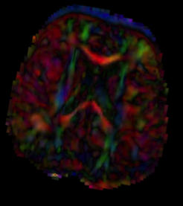
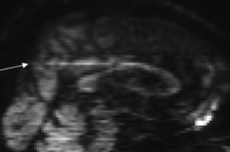
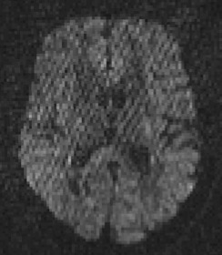
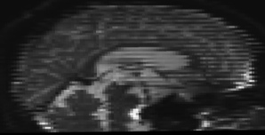
DWI Artifacts
Diffusion images are sensitive to a number of artifacts
Eddy-current distortions
Susceptibility artifacts
Noise/SNR issues
Vibrational artifacts
Motion
Venetian blind artifacts
“unknown”…
DTIPrep: Remove bad DWI’s

Slide 4
Bad DWI: Slicewise Artifact
Bad DWI detection => 3 choices
Remove bad DWI data (DTIPrep)
Simple and clean, but removes partially ok data
DWI model correction
RESTORE: DTI model, during estimation
HARDIPrep (NYU/Gerig): Correction of corrupt slices (identified by DTIPrep) via spherical harmonic model
FSL: Correction of corrupt drop-out slices (different identification) via Gaussian process model
Both: Need motion & eddy current correction done
Don’t care…
Estimated data significantly biased => incorrect results
Berl et al (2015). Investigation of vibration-induced artifact in clinical diffusion-weighted imaging of pediatric subjects. Hum Brain Mapp, 36(12), 4745–57.

Slide 5
Within DWI Motion Artifact
Venetian blind artifacts
DTIPrep: Detects and removes DWI with motion
Differences between interleaved volumes
FSL: Detects motion between slices and correct them (only new version 5.12 or 6.1, not 6.0)
Slice motion model as part of eddy current/motion correction, performs slice to volume registration
Very slow
High error setting for registration
I would not use (at this time)

Slide 6
Modern dMRI QC Workflow
DICOM conversion
(better) Remove bad DWIs via DTIPrep
Susceptibility artifact computation FSL
Concatenation of corrected AP & PA
Brainmask
Motion & Eddy current correction
Also applies susceptibility un-deformation
Alternatively correct bad DWIs
(simpler) Remove bad DWIs via DTIPrep
DTI estimation – tractography QC

Slide 7
DICOM convertion
Diffusion tags in DICOM are a mess!
No field permeating standard yet
No single great converter tool
Currently Best: DWIConvert (Slicer)
Captures many vendors and special cases well
Can write both NRRD and NIFTI images
Can convert to/from NRRD vs NIFTI
Uses B-matrix for actual gradient and b-value (option)
Alternative: dcm2nix
Converts to NIFTI, uses prescribed information

Slide 8
NIFTI vs NRRD DWI
NIFTI
4D – Image without diffusion information
Gradients (b-vectors) & b-values in separate text files
Confusing: often bvec & bval files not name linked
No measurement frame
b-vectors need to be specified in image coordinate space
Vendors use different spaces (patient vs scanner coordinate space) => Adaption of bvecs needed

Slide 9
NIFTI vs NRRD DWI
NRRD
Single file format (.nrrd) or raw+header (.raw +.nhdr)
All image information in header including diffusion data
No confusions
Measurement frame info
Inconvenient: b-vector and b-value info combined into single value

Slide 10
Susceptibility Correction
AP
PA
Corr
Correction of susceptibility artifacts
Geometric distortion due to air/tissue interface or other sources (e.g. metal plates)
Anatomy/Object induced distortion
At first approximation: constant for all DWI
Alternative: twice refocused sequence approach

Slide 11
Susceptibility Correction
Needs two acquisitions with opposing polarities of the phase-encode direction
AP vs PA, or LR vs RL
Alternatively use structural T2w image or field map
FSL Topup
Computes geometric un-distortion field
Works for both opposing polarity or with structural T2w
Time-consuming
Application best with joint motion corr (only new FSL)
Not crucial for “Quick” QC
Only used for minimal processing, not at QC
”Quick” QC separate for AP and PA

Slide 12
Topup
Best: only use b=0 images (high SNR)
topup --imain=<B0s> --out=<fieldcoef> --fout=<field> --iout=<B0corr> --datain=<topupParam> --config=<fslregParam>
Needs 2 parameter files
fslregParam: describes registration settings, defaults from FSL work well for most data
topupParam: lists phase encoding & readout time
Readout time is commonly consistent => bogus value ok
Absolute sign irrelevant, relative sign is important
E.g. 2 B0 AP & PA (orientation RAS) :
0 1 0 0.1
0 1 0 0.1
0 -1 0 0.1
0 -1 0 0.1

Slide 13
Topup
Topup computes the un-deformation field
Incorporate b0 image motion correction
applytopup (old style) to apply to non b0
Does NOT correct for motion, assumes no motion
Avoid
Use eddy_openmp (new style)
Jointly estimates motion & eddy currents, as well as applies the susceptibility correction
Compute on full concatenated data
Very slow (use longleaf)

Slide 14
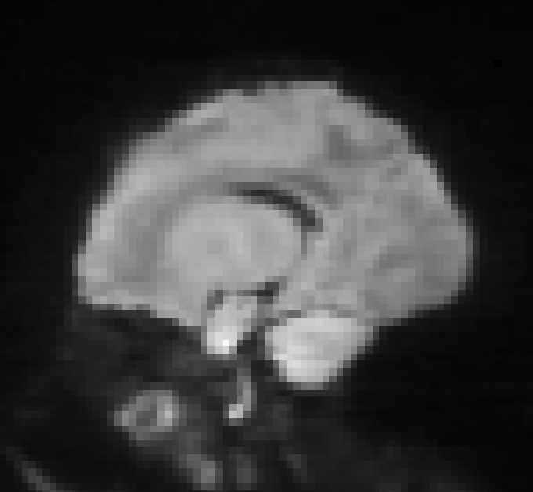
Brain Masking in DWI
Options depending on availability
Propagating sMRI brain mask to geometry corrected average b0 (affine reg)
FSL bet to IDWI image
Geometric average of non-b0 images
Contains little non-brain tissue
Most will need manual correction
Quick
Check on FA for non-inclusion of skull
I suggest to use ITK-Snap

Slide 15
DWI Motion Correction
Quantifies and corrects motion between DWIs
Both DTIPrep and FSL
Reporting of detected/corrected motion
Analysis of motion presence wrt clinical variables necessary nowadays
Old FSL (pre 5.12 and 6.0)
Registration to first b0
DTIPrep
Registration to unbiased b0 average
Estimate motion better for later acquired DWIs
Better than old FSL (Kreilkamp 2015 JMRI)

Slide 16
Eddy Current Artifacts
Different for every DWI
Shearing geometric distortion
No/little artifacts for b0 images
First order approximation
Correct via affine registration
Incorporates motion correction
Nearly all tools do it this way

Slide 17
New FSL Eddy
Only in 5.12/5.13 and 6.1 (and higher)
eddy_openmp does everything
Eddy current correction
Motion correction
Susceptibility field application
Within DWI motion correction (do not use)
Within DWI drop out correction (prefer removal)
Needs brain mask

Slide 18
New FSL Eddy
eddy_openmp
Very slow (> 1 day on single core)
Can use multiple cores (do so)
Environment variable: OMP_NUM_THREADS 4
bvals, bvecs, topup para, “--data_is_shelled”
Needs new configuration file identifying registration target per DWI by index (base 1)
Simple: all 1 => old FSL, register to first b0
Better: index of last acquired b0
Example: 5 b0, equally spaced, 35 total
1 1 1 1 1 1 1 2 2 2 2 2 2 2 3 3 3 3 3 3 3 4 4 4 4 4 4 4 5 5 5 5 5 5 5

Slide 19
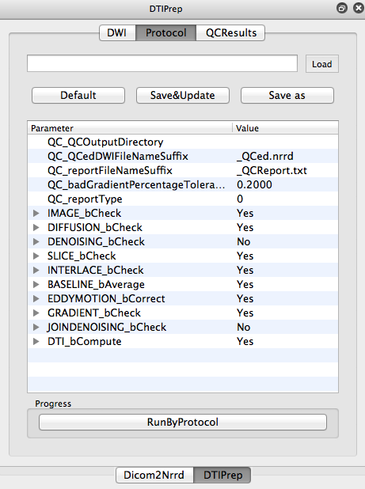
DTIPrep
DTIPrep – automatic diffusion QC tool
Protocol based QC and correction
Image dimensions check
Gradients directions check
Intensity changes across slices
Excessive motion across slices
Motion and eddy current correction
Residual motion detection
Vibration/direction DTI artifact detection
GUI and command line
Summary reporting, including motion

Slide 20
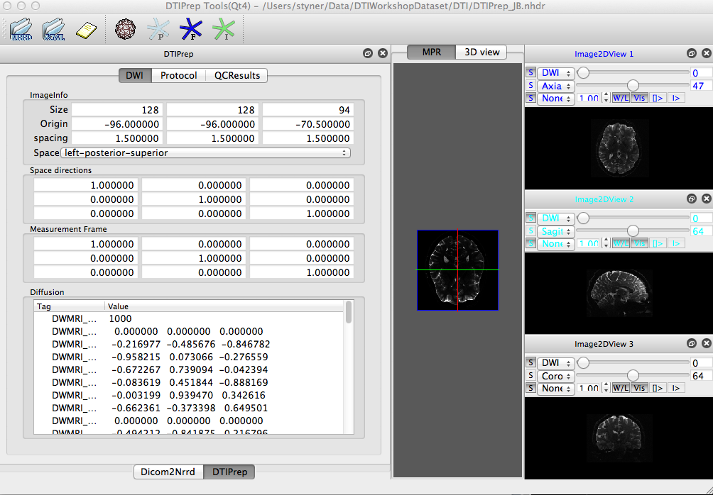
DWI info
Detailed
DWI
Info

Slide 21
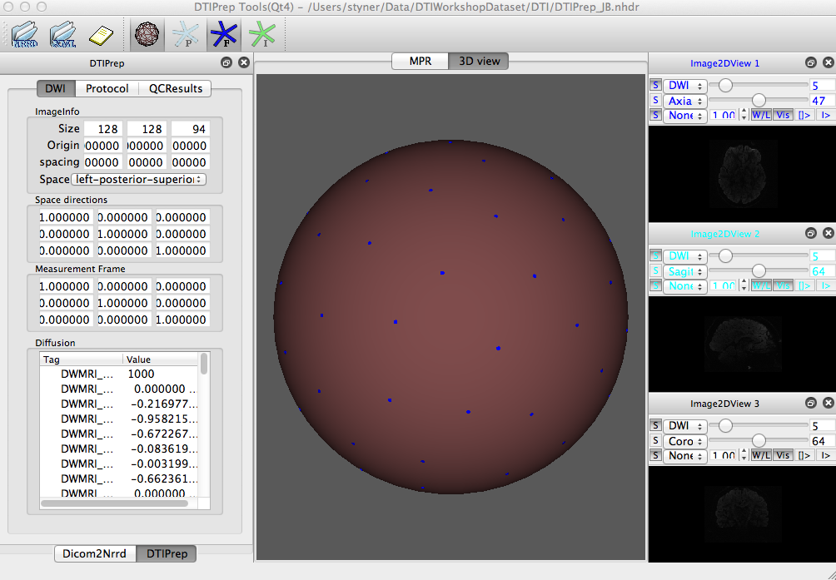
Gradient info in 3D
Displays gradient scheme on unit sphere
(F = File)
Check for uniformity

Slide 22
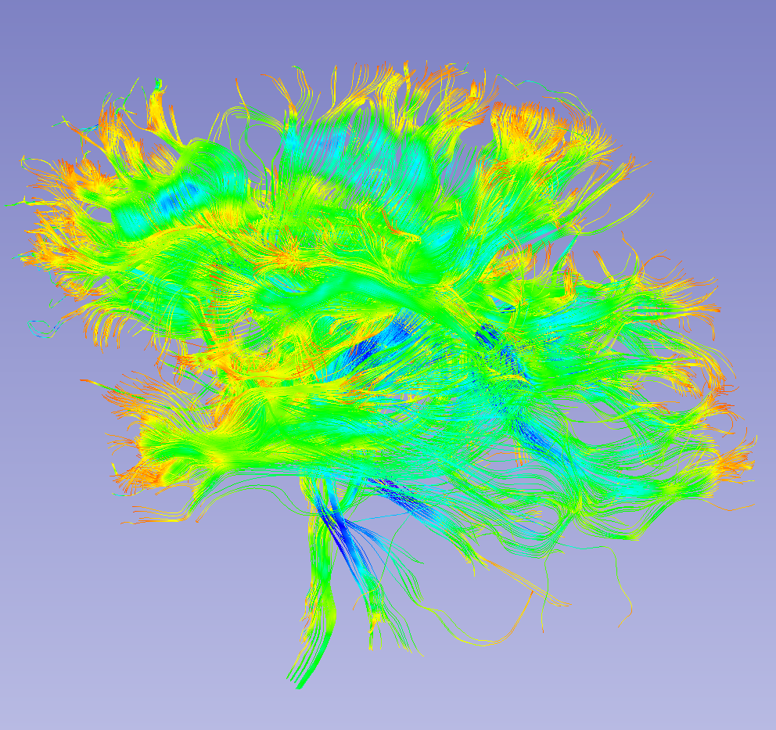
Visual DTI QC
Visual in 3D Slicer:
Remove DWI’s manually with significant residual motion
Happens rarely
Reconstruct tensor and perform investigative tractography
Ensure appropriate tractography
Major tracts, spatially diverse
CC genu, CC splenium, CC tapetum, uncinate, fornix, inferior longitudinal, cerebro-spinal, anterior cingulate, (arcuate)

Slide 23
Conclusion
Diffusion QC is a must
Otherwise you get crap data
FSL finally has detection of bad DWI!
Hurray!
FSL does not remove, but correct bad DWI and within-DWI motion
Ehhh, that’s not what I wanted…
Best: Combo of FSL/HARDIPrep and DTIPrep
DWI QC is now very very time consuming

Slide 24
Slicer Demo

